Slide 1
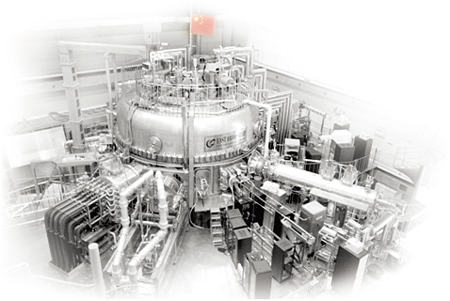

Artificial Intelligence Application for DEMO Plasma Control
B.J. Xiao^{1,2,}*
W.Y. Rui^{1,2}, B.H.Guo^{1.3}, Z.J. Liu^{1,3}, C.G. Wan¹, W.H. Hu¹, C. Rea⁴, J. X. Zhu⁴, G. De Tommasi^{5,6}, Y.H. Wang¹, Y. Huang¹, D.L. Chen¹, Q.P. Yuan¹, and EAST Team
¹Institute of Plasma Physics, Chinese Academy of Sciences, Hefei, China
²School of Nuclear Science & Technology, University of Science & Technology of China
³Shenzhen University, Shenzhen, China
⁴Massachusetts Institute of Technology, Plasma Science and Fusion Center
⁵Università degli Studi di Napoli Federico II
⁶Consorzio CREATE
*E-mail: bjxiao@ipp.ac.cn
Presented at 4th Technical Exchange Meeting
EU — China collaboration on CFETR and EU-DEMO Reactor Design

Slide 2
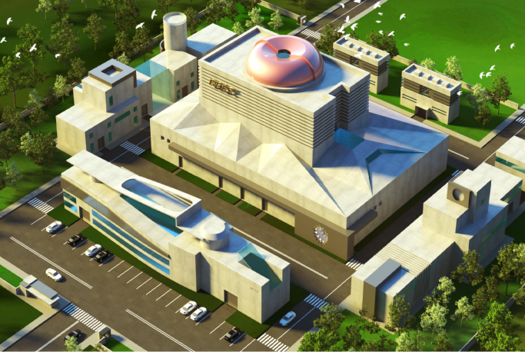
01
Specific requirements for DEMO plasma control
02
Demonstration of AI solution in EAST
Outline
Plasma parameter/state estimation
Disruption prediction
Controller optimization
03
Conclusion and Discussion

Slide 3
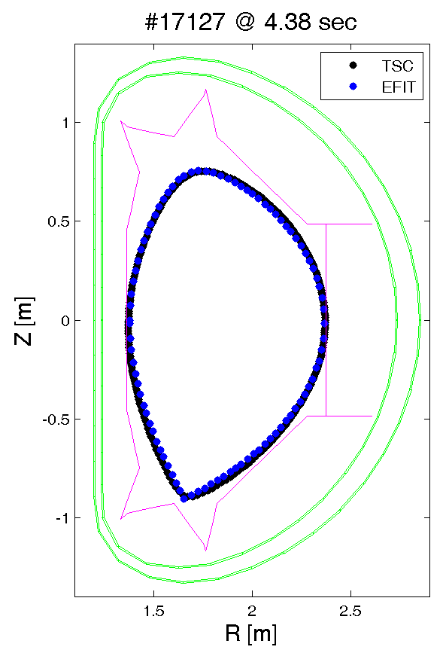
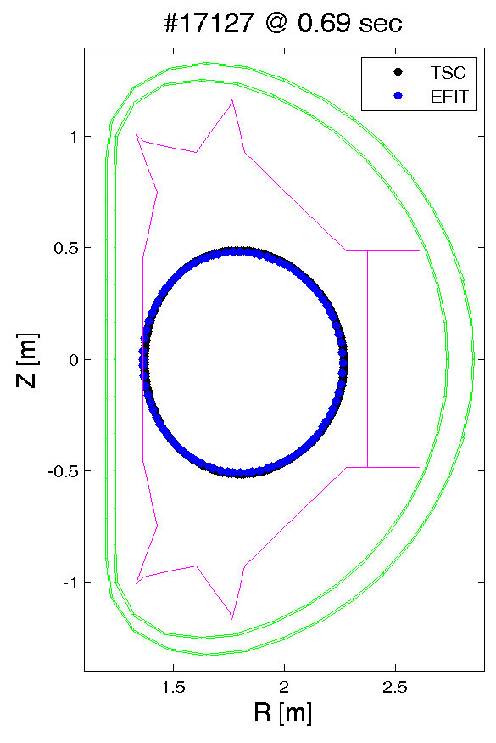
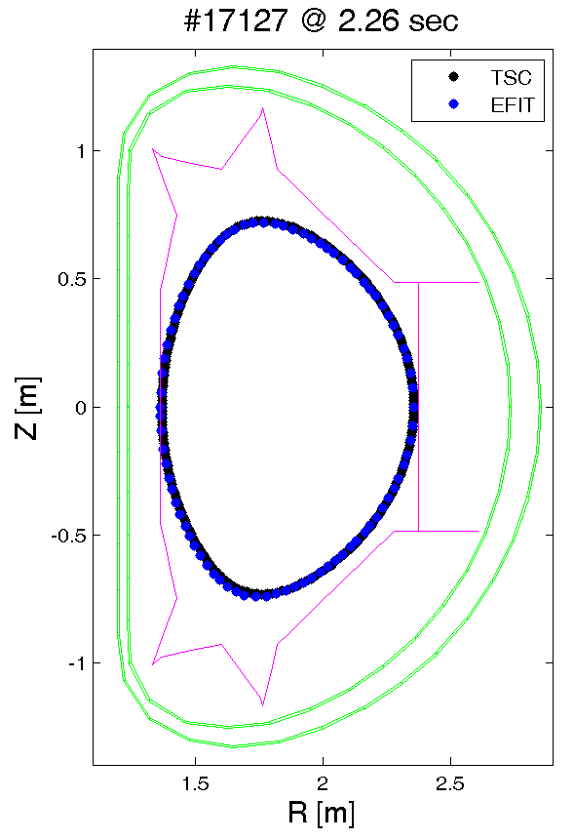
Specific requirements for DEMO Plasma Operation Control
For DEMO:
Events must be avoided
Controllers must be robust enough with limited experiment time
Diagnostic may not as many as today or may be degraded
Control Solutions:
1. Events must be predicted, prevented, or soft-landing
2. Sufficient modeling to have good controllers before being tested in actual experiment
3. Reconstruction must be accurate enough in real-time under any cases.
Shaping
Ip
I_{Pf}
Rampup shaping
Heating, CD and Flattop, fueling
Magnetization
BD
Termination
Event handling: Disruption prediction & mitigation, Stability control, Actuator/Diag. degradation

Slide 4
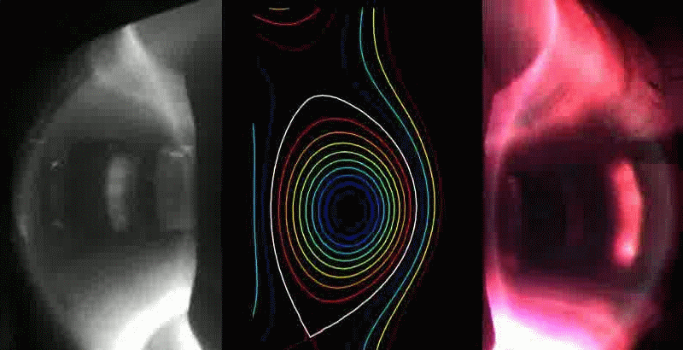
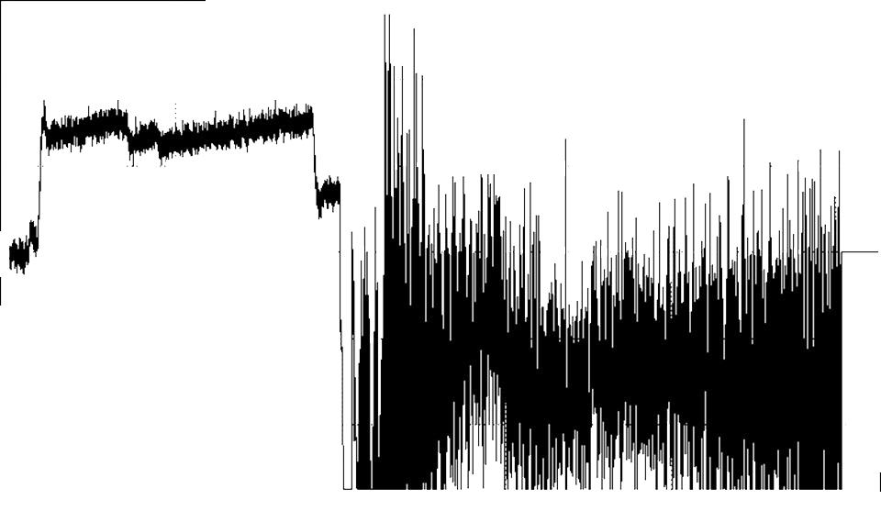
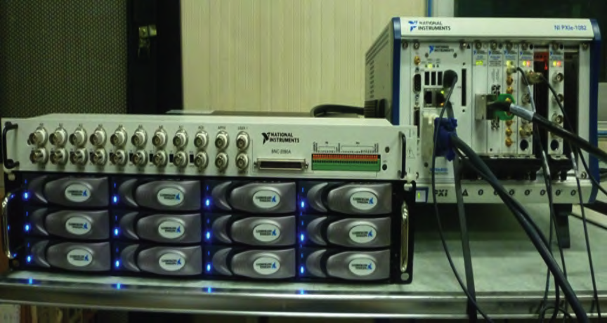



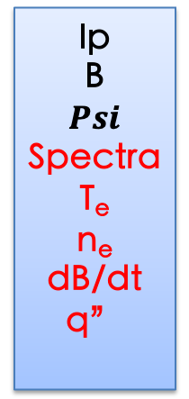
研究方案
Challenges in plasma control
3D structure,
non-linear,
MHD
Limited, sharing
OUTPUT
INPUT/Target
Ip
B
$$Psi$$
Spectra
T_{e}
n_{e}
dB/dt
q”
IP
RZ
Shape
profile
P
q”
MHD
010101110101
Actuator
Controller
Object
CD
Heating
PS
Fueling…
Indirect
limited
Reconstruction
DAQ
SCALER
mm, sub-ms
coupling
Event handling, branching

Slide 5
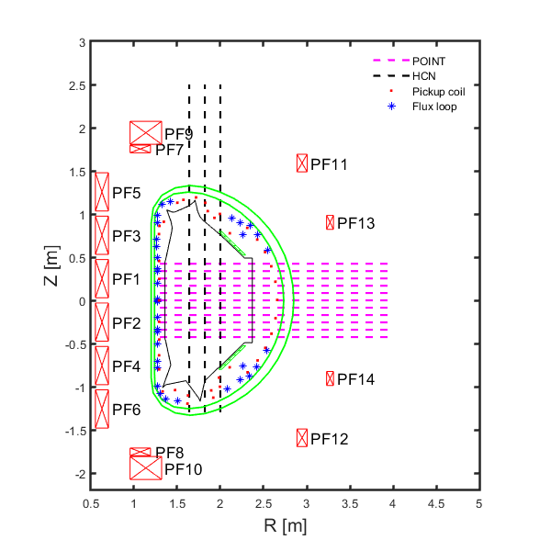
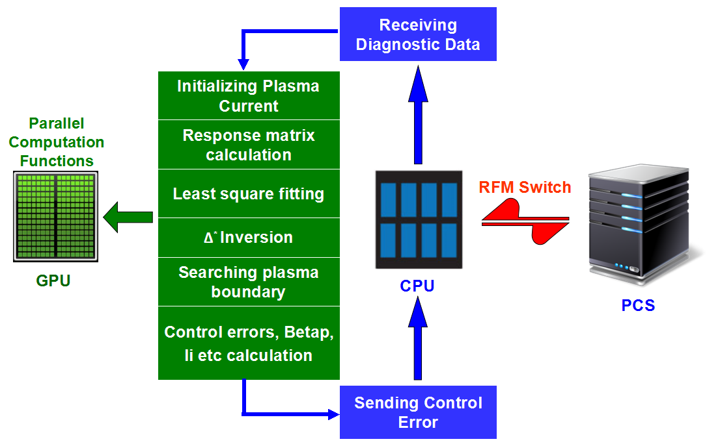
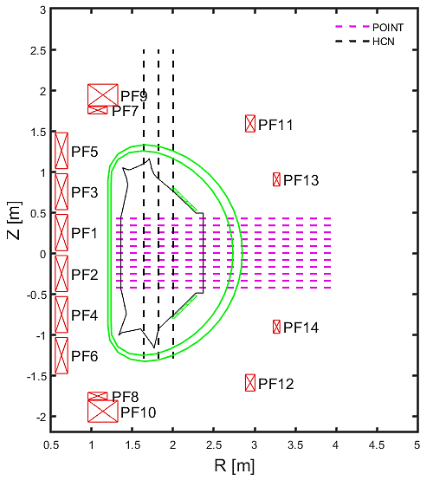
How to get physics quantities? An Example, eQ reconstruction
Diagnostics: Bps+ Fls + Ne.
G-S Solver by using GPU
1 full iteration: 300 us for 129*129 grids
Limitations: under limited or degraded diags? Consistency with more other diags? RT behavior?

Slide 6

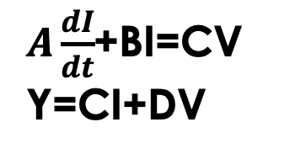
Controllers need complicated modeling
Controllers design: FF + Feedback
An Example：Complexity of 3D passive structures
Simplified
$A\frac{dI}{dt}$+BI=CV
Y=CI+DV
Maxwell + N+S
or F-P Eqs
$$V=Mδy$$
For EM control,
I: Plasma current and its distribution
Coil currents (12 and more?)
Vessel currents and distribution
V: Commands to the coil power supply
Still gaps between the state space and the real world, controllers always need to be adjusted by experiments

Slide 7

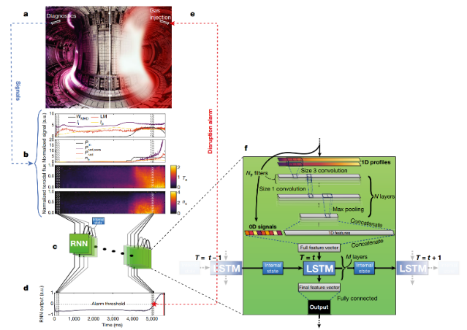
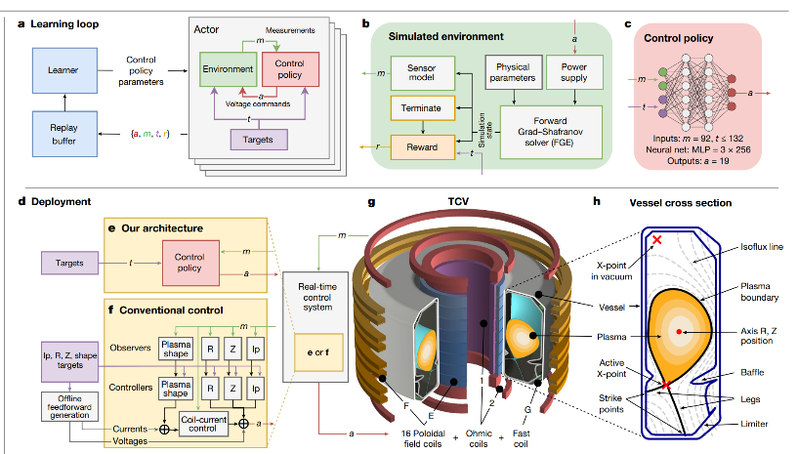
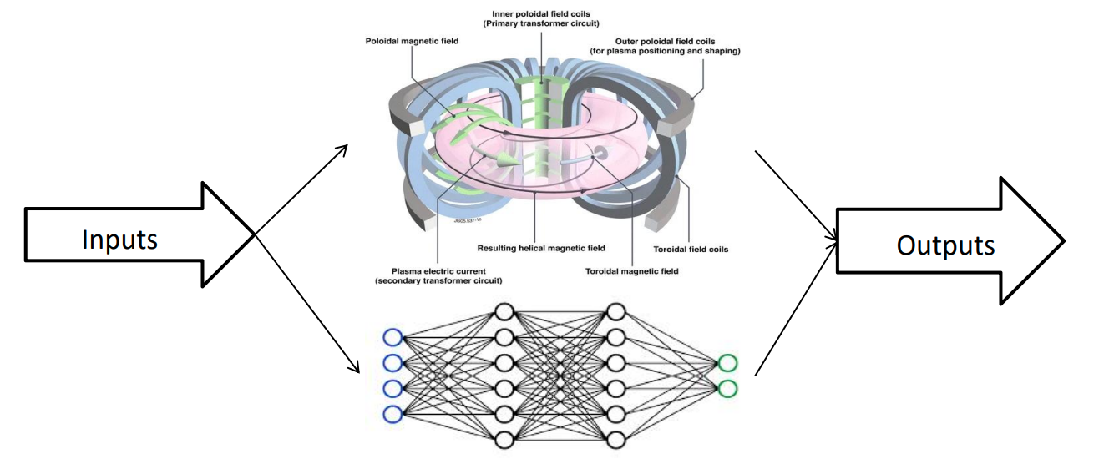
AI – a new way for tokamak control
Cross machine disruption predication, AL plasma shape control, plasma surrogate model
Plasma state/parameter estimation
Disruption prediction
MHD mode recognition
Advanced control algorithms
Reinforcement learning models
Self-adaptive control
Data-driven plasma modelling
Surrogate model of simulator, control response, PDE solver

Slide 8
研究方案
Ideal AI/ML for plasma control
OUTPUT
INPUT/Target
Ip
B
$$Psi$$
Spectra
T_{e}
n_{e}
dB/dt
q”
IP
RZ
Shape
profile
P
q”
MHD
010101110101
Actuator
Controller
Controller
Object
CD
Heating
PS
Fueling…
Reconstruction
DAQ

Slide 9
01
Specific requirements for DEMO plasma control
02
Demonstration of AI solution on EAST
Outline
Plasma parameter/state estimation
Disruption prediction
Controller optimization
03
Conclusion and Discussion

Slide 10
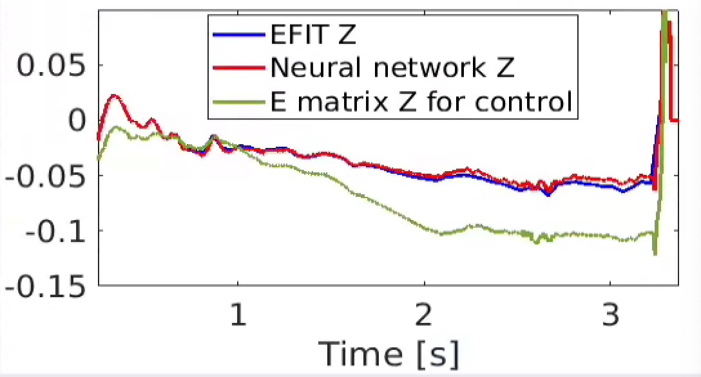
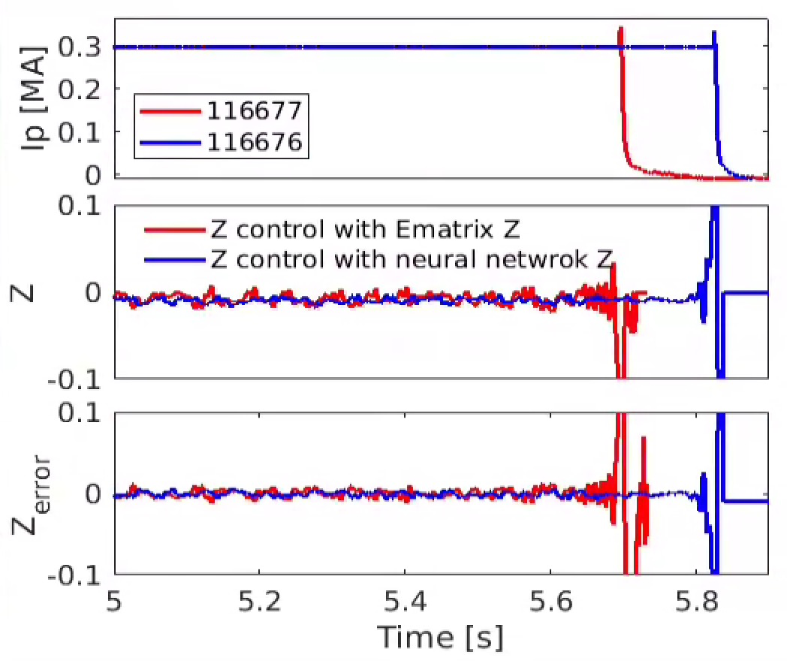
Surrogate NN Z model do well in REAL time
Motivation: Fast and accurate Z estimation for Z control
Method: BP neural network model was trained using magnetic probe measurement, offline EFIT calculated Z and TOK-SYS calculated Z growth rate
Vertical displacement
Vertical instability growth rate
Equilibrium parameters
Magnetic measurement
Surrogate models provide more reliable results than simplified linear physics model.
The surrogate models are deployed in the plasma control system to meet real-time computing demands.
The validation is obtained in EAST experiments.
Song H H, et al. [J]. Journal of Plasma Physics, 2023, 89(1): 895890104.
Liu B. N. et al., [J]. IEEE Transactions on Plasma Science, 2023.
10

Slide 11
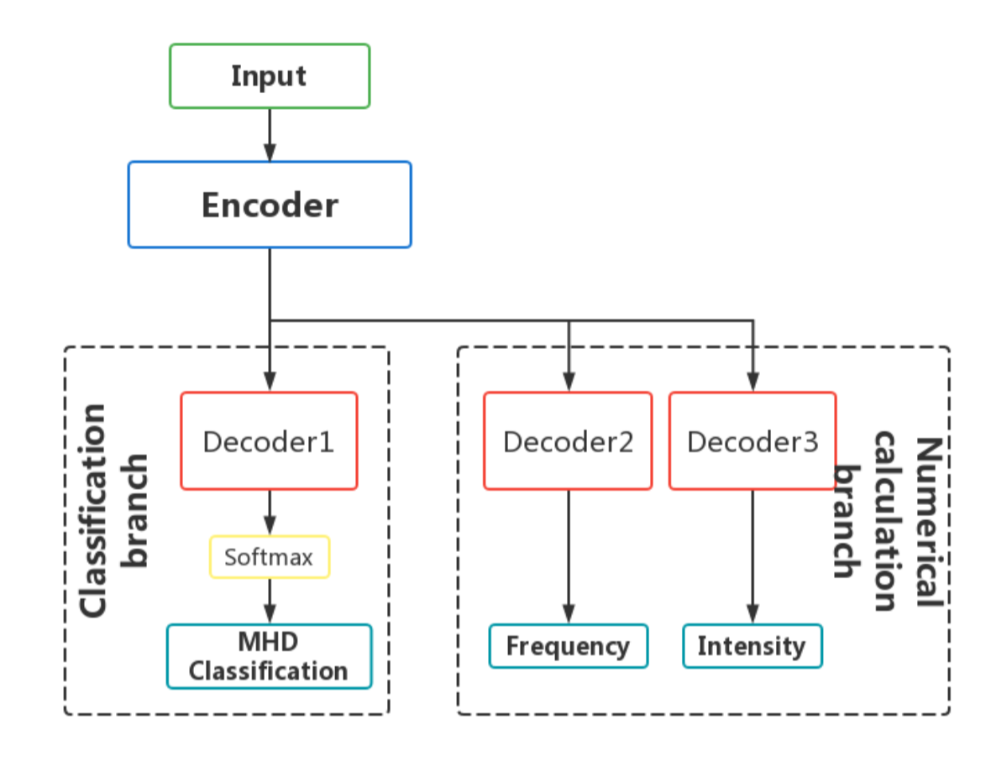
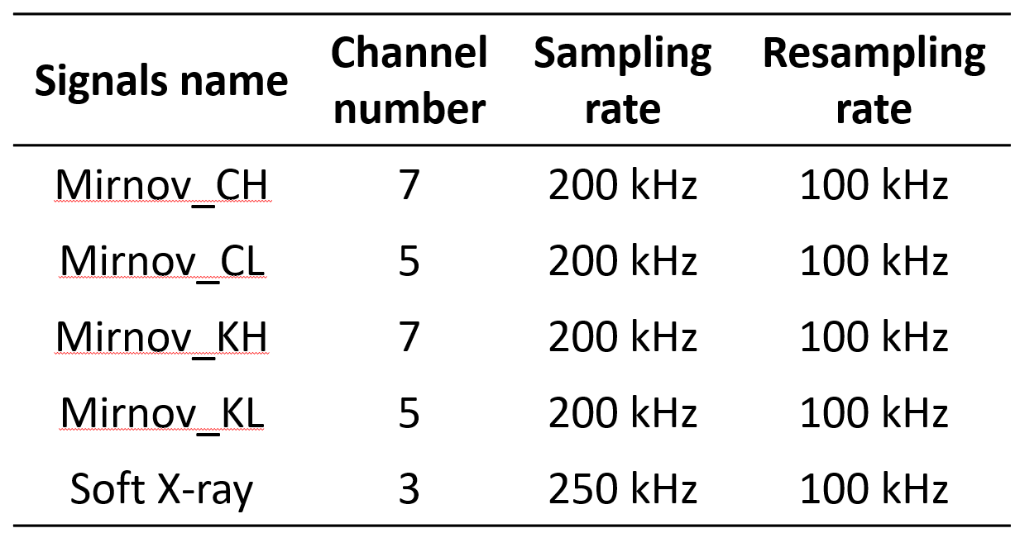
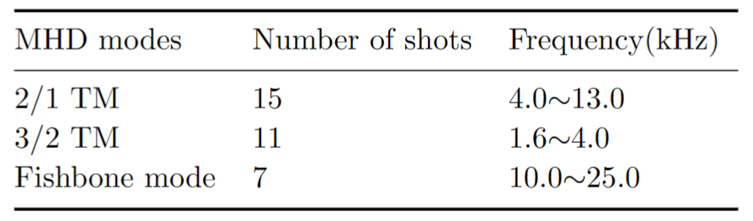
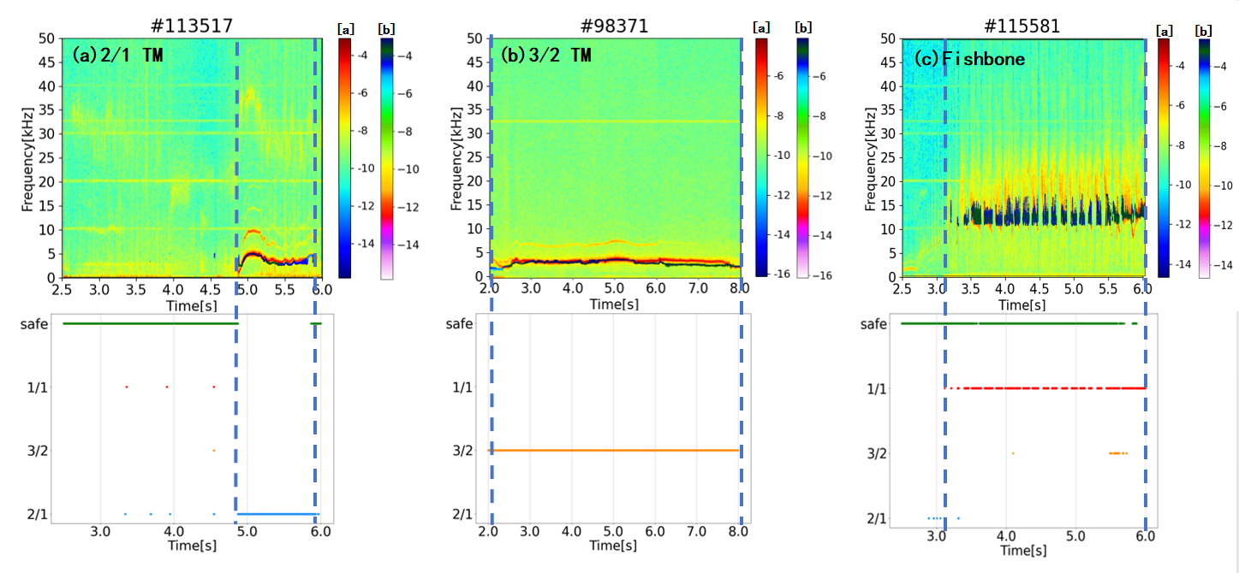
Integrated MHD modes recognizer using deep learning
The integrated MHD modes recognizer has been developed using deep learning on EAST
Recognizer Input
Dataset
Accuracy rate > 98%
Identify MHD information：time, frequency & intensity

Slide 12
01
Specific requirements for DEMO plasma control
02
Demonstration of AI solution on EAST
Outline
Plasma parameter/state estimation
Disruption prediction
Controller optimization
03
Conclusion and Discussion

Slide 13
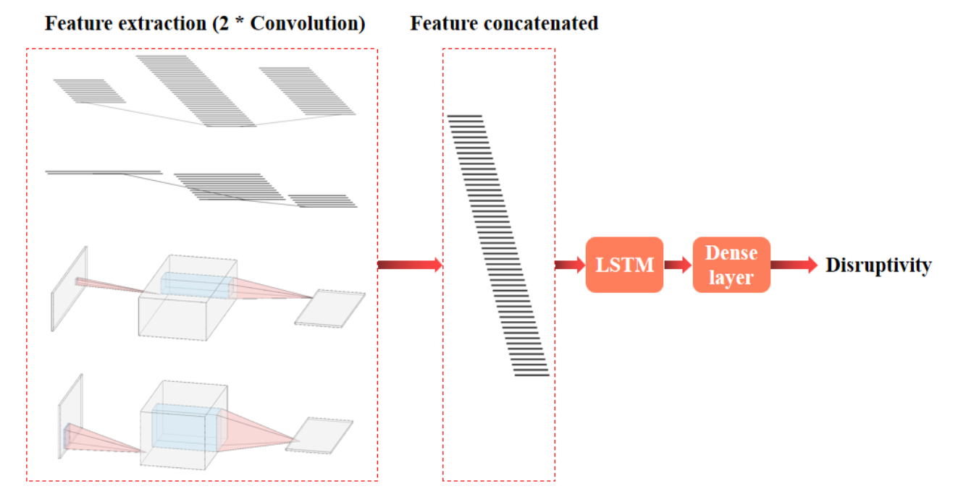
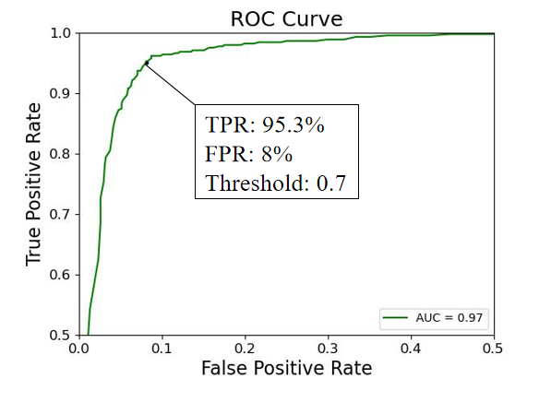
CNN+LSTM predicted EAST disruption w/ TPR 95%
Feature extraction module(CNN) + Characteristic time learning module(LSTM)
1-D convolution: 1-D diagnostic features
2-D convolution: array diagnostic features (2-D features)
LSTM：time evolution information
The performance better than single algorithm (CNN，LSTM)
Testing Result: TPR (95.3%), FPR (8%)

Slide 14
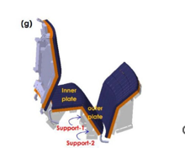
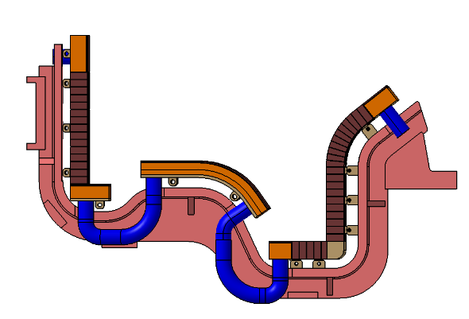
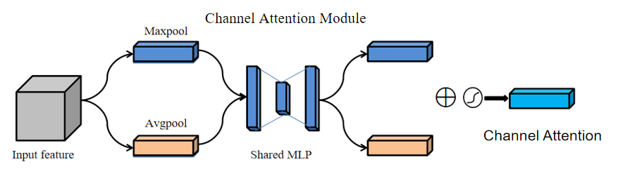
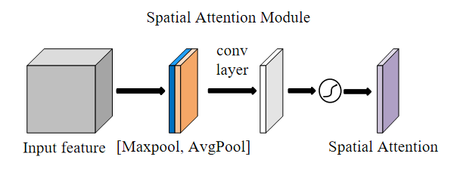
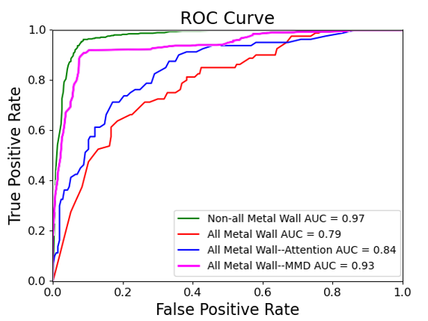
EAST plasma disruption prediction: transfer learning improves model extensibility
The lower C divertor has been replaced by W since 2021, some diagnostics have also been changed.
Previous model performance decreases (AUC~0.79)
2019
2021
Convolution attention module: channel attention module & spatial attention module
Transfer learning with a small amount of new data
The performance of all-metal wall is improved（AUC~0.93）
B.H. Guo, et al. Nucl. Fusion 63 (2023) 094001 (12pp)

Slide 15
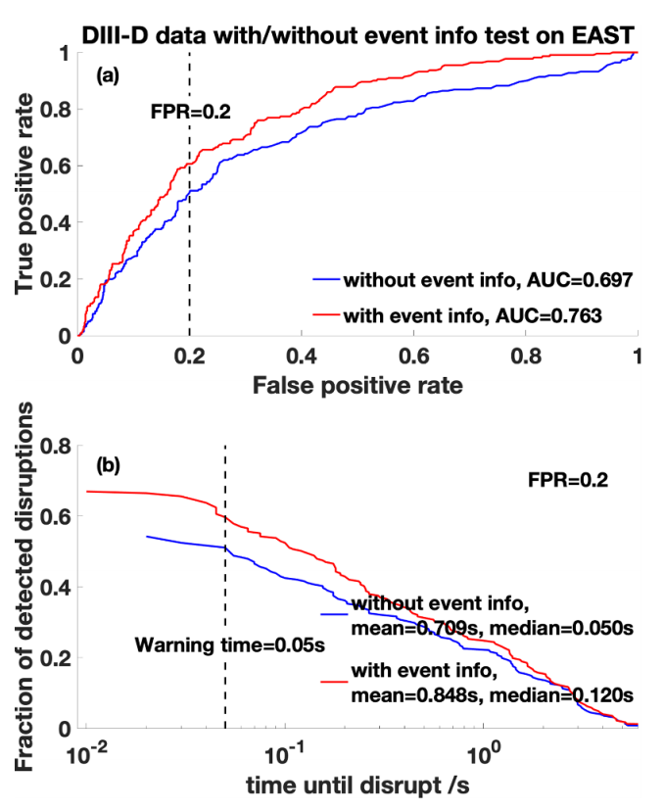
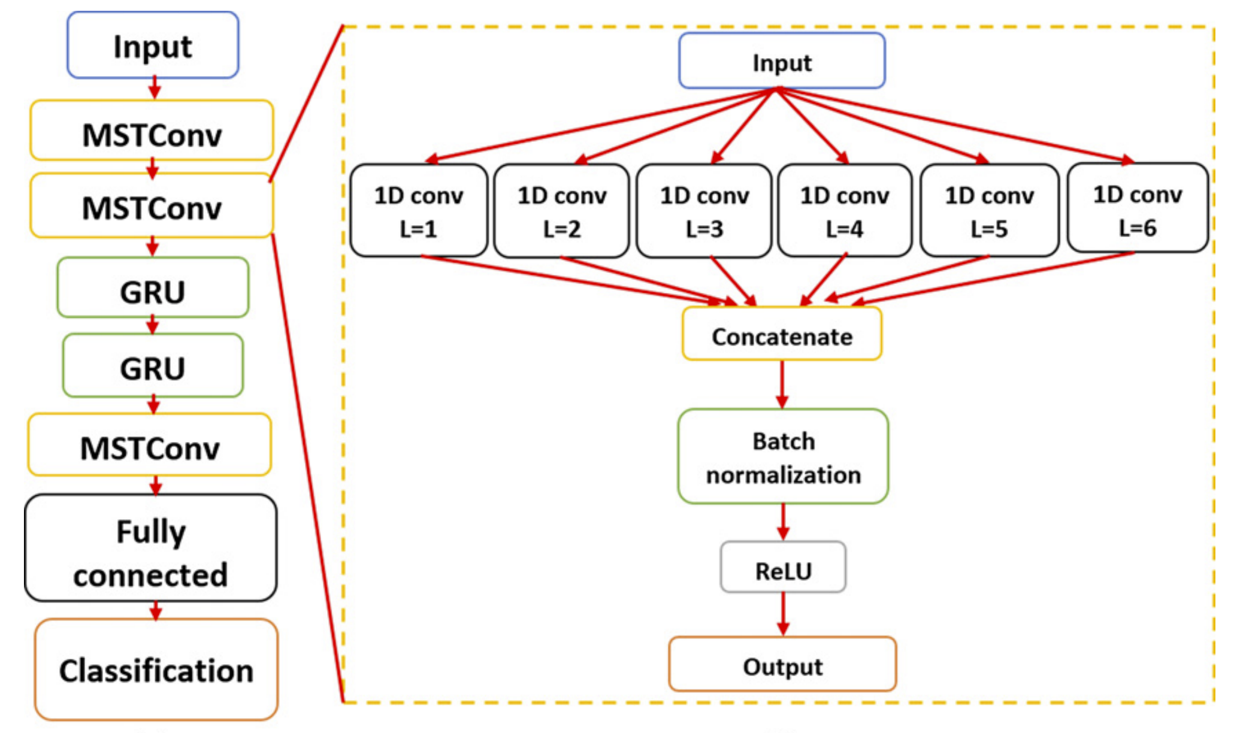
Cross-device plasma disruption prediction (EAST、DIII-D、C-Mod) (China-U.S. collaboration)
hybrid deep-learning (HDL) disruption warning model developed based on convolutional and recurrent neural networks
Transfer learning：
Database of existing devices + new device L-mode --> New device H-mode discharges
Abnormal event detection
J.X. Zhu et al 2021 Nucl. Fusion 61 026007

Slide 16
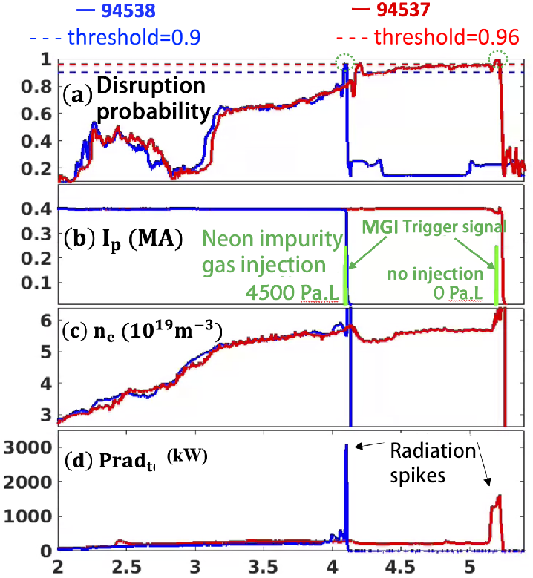
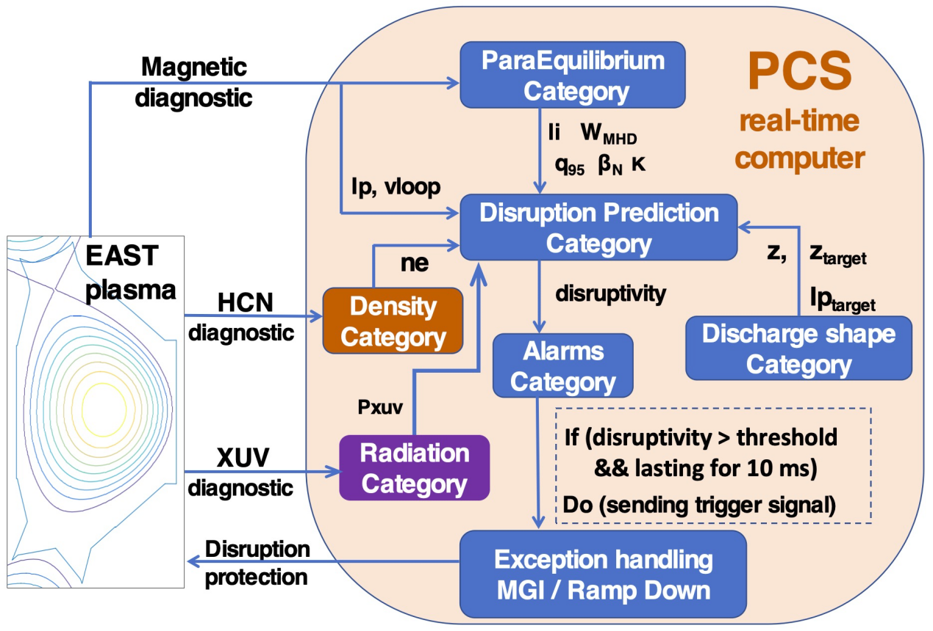
EAST Density Limit Disruption Prediction and Experimental Validation based on Random Forest (China-U.S. collaboration)
Random Forest Disruption Predictor (DPRF)
Calculation time of DPRF is 200~300μs and satisfy the real-time disruption prediction.
Real-time disruption warning triggers the MGI system, effectively reduces the damage caused by disruptions.
W.H. Hu et al 2021 Nucl. Fusion 61 066034

Slide 17
01
Specific requirements for DEMO plasma control
02
Demonstration of AI solution on EAST
Outline
Plasma parameter/state estimation
Disruption prediction
Controller optimization
03
Conclusion and Discussion

Slide 18
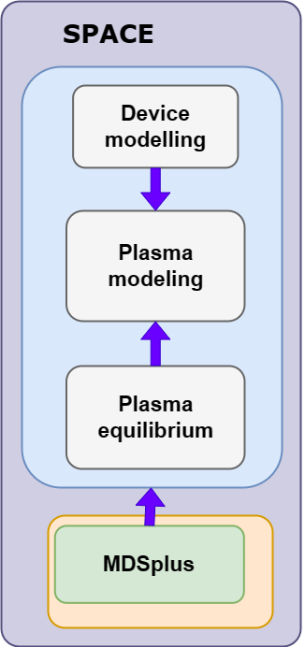
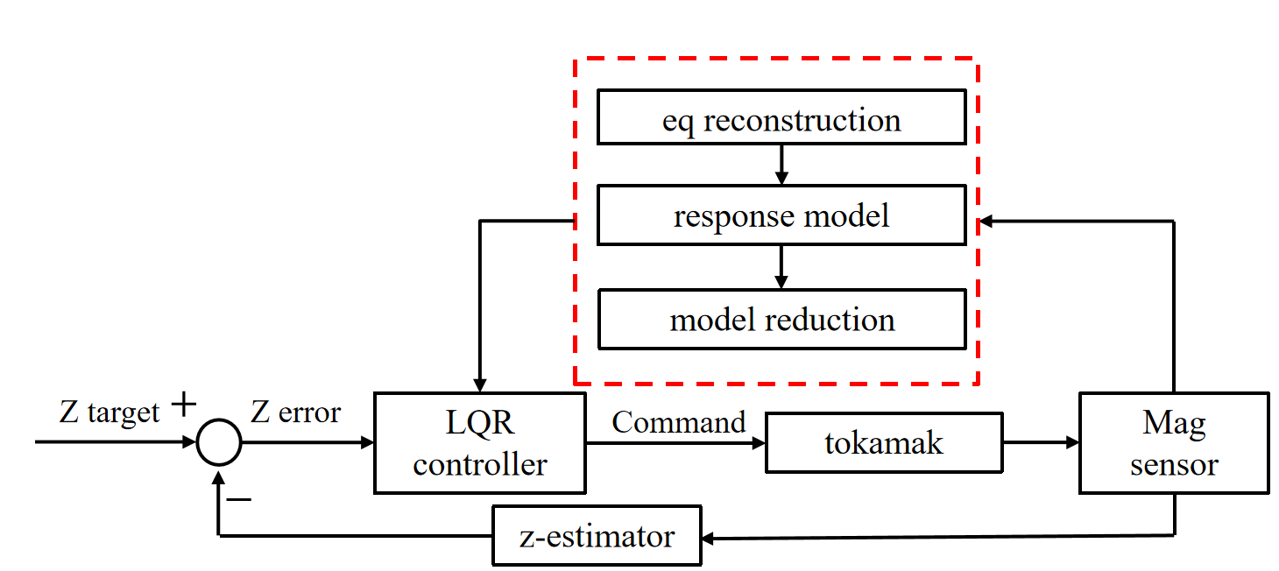
Z self-adaptive control with NN enhanced controllability
Plasma Z instability characteristic may change during a shot => AI Z self-adaptive control
  Adaptive-LQR optimal controller for alternative plasma configuration (LSN/USN/DN/Limiter)
  State-space model calculation by using neural network surrogate model（1s->0.1ms）trained by rigid model calculation datasets
      Real-time self-adaptive control verified in EAST experiment with half in-vessel coil turns.
        Maximum κ~1.87 (#126611)
        Maximum γ~750/s (#126625)

Slide 19
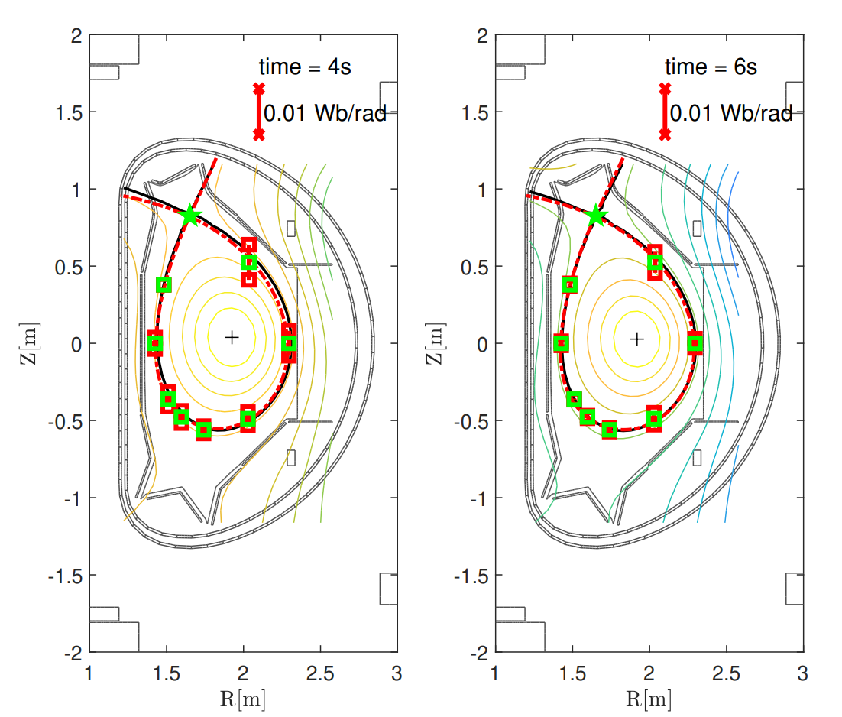
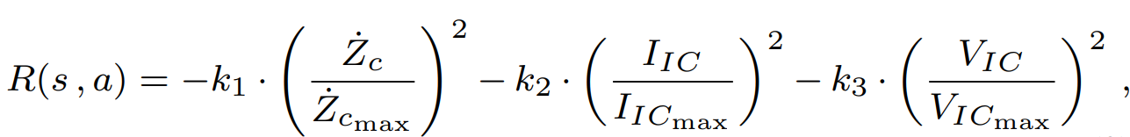
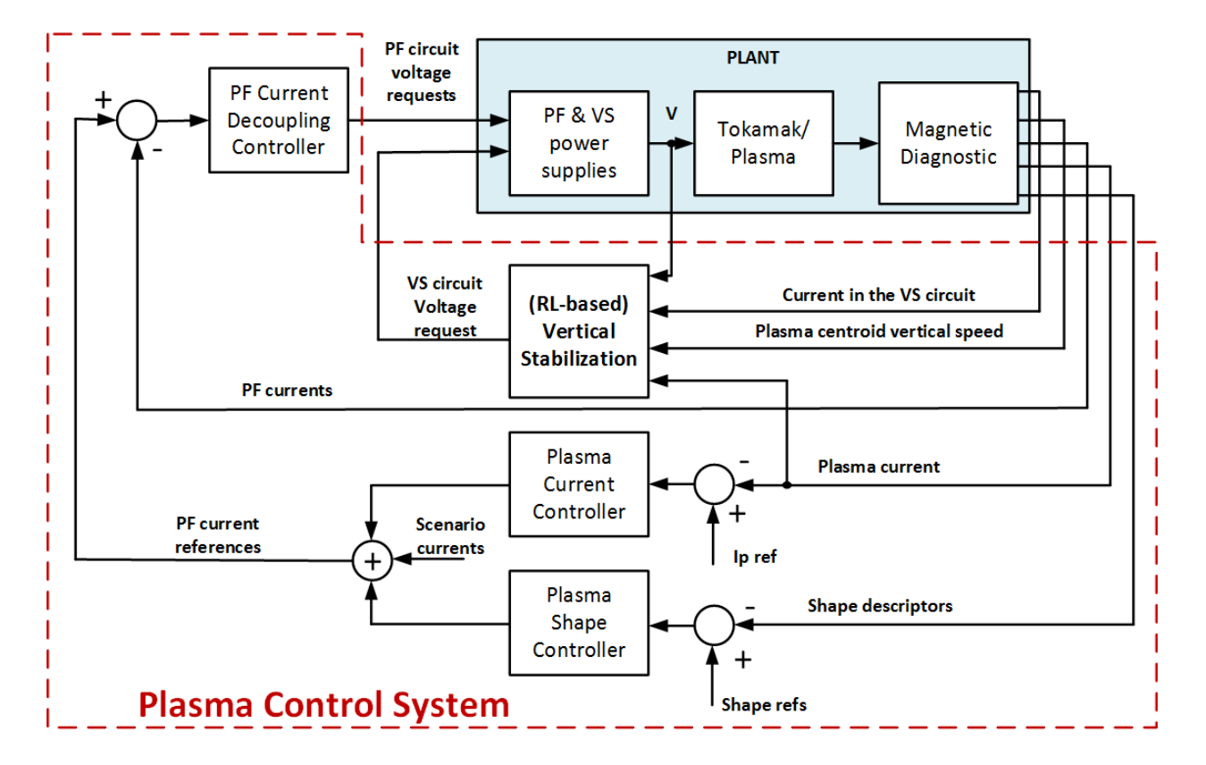
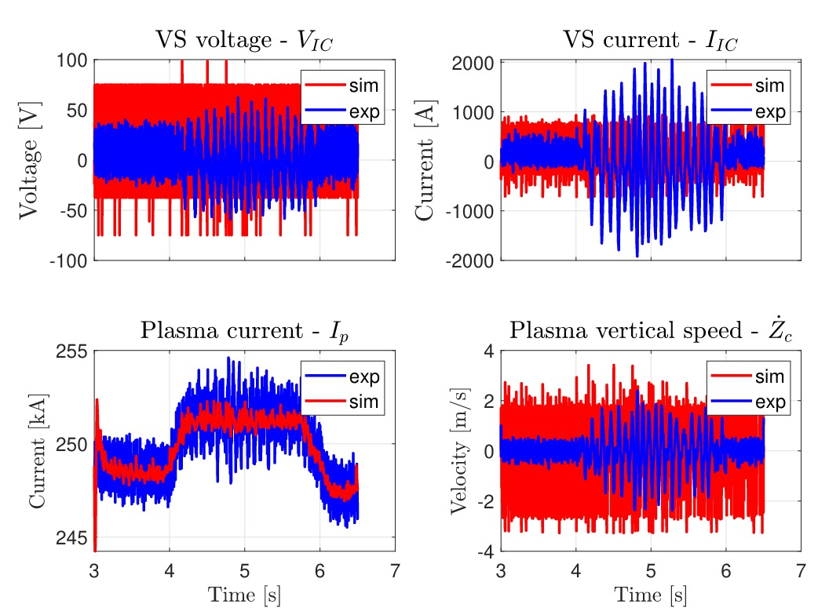
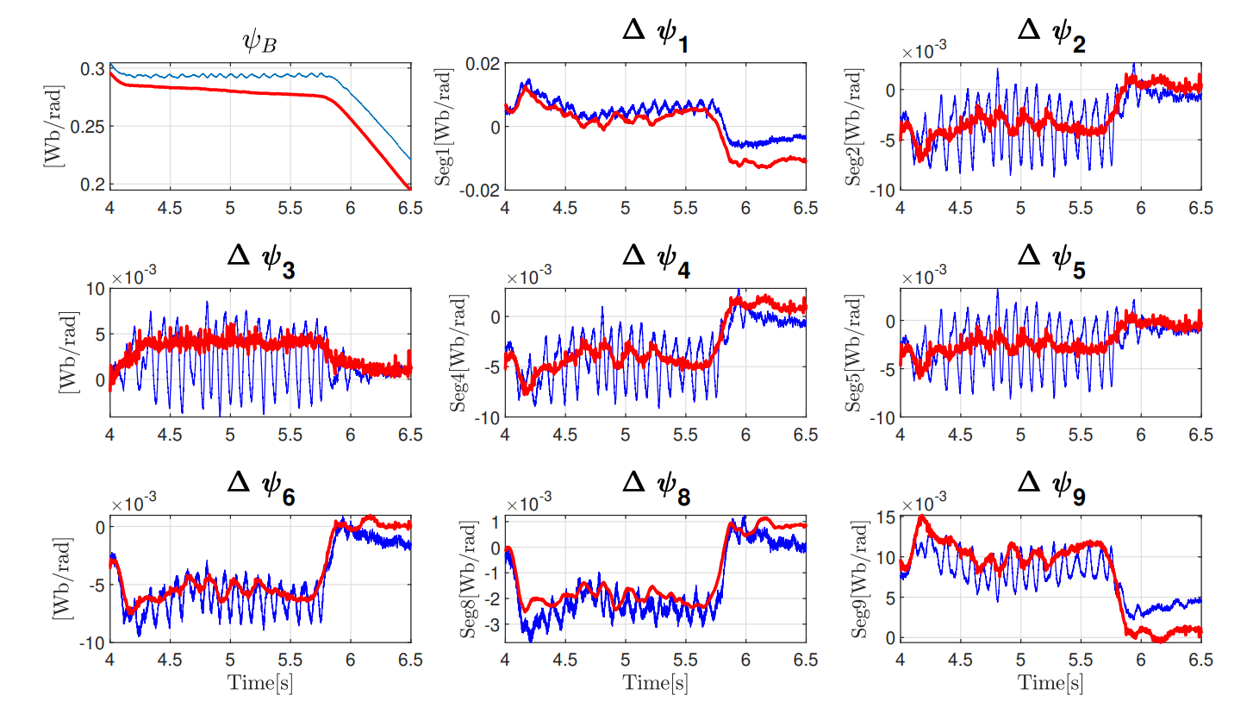
A RL-based Vertical Stabilization System for the EAST tokamak (China-Italy cooperation): better decoupling with shape
A model-free agent trained with the Q-learning algorithm and interact with a state-space linearized model of the plasma and the surrounding coils dynamics
Reward：
Blue： Exp. #92141 Red: RL model
Data-driven approach proved robust in scenarios simulation
RL vertical position controller decoupled with plasma shape control
G. De Tommasi, American Control Conference, 2022

Slide 20
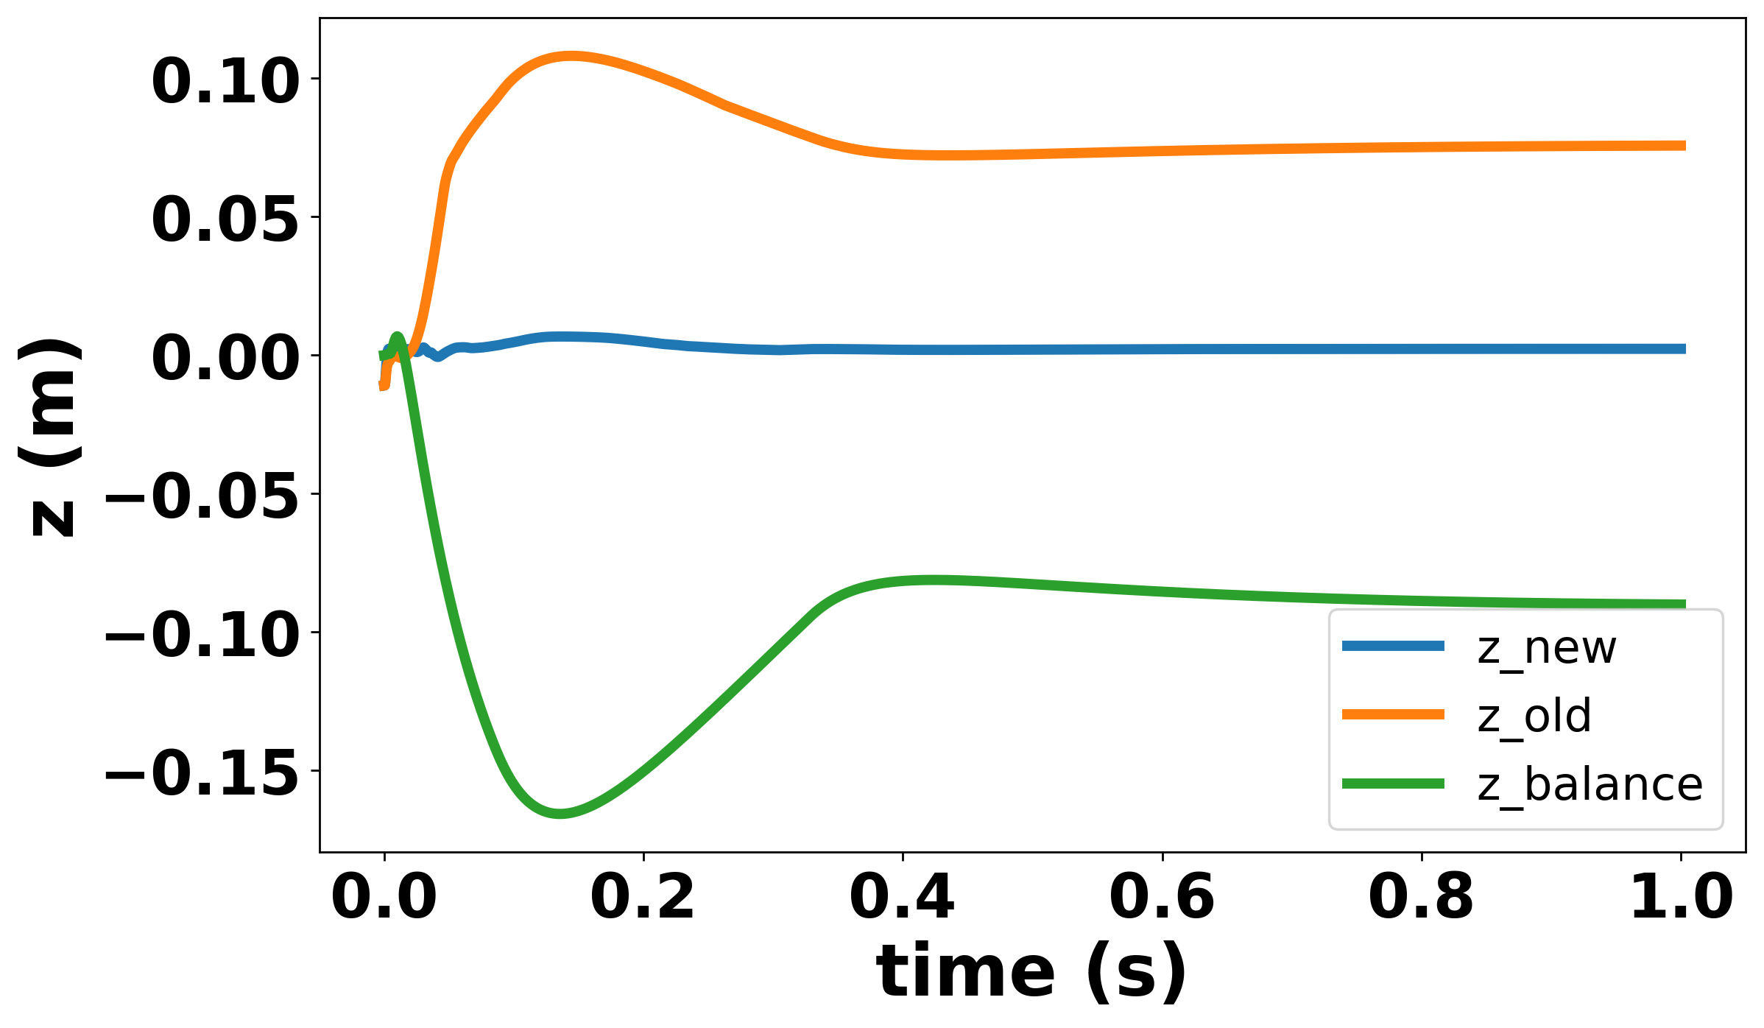
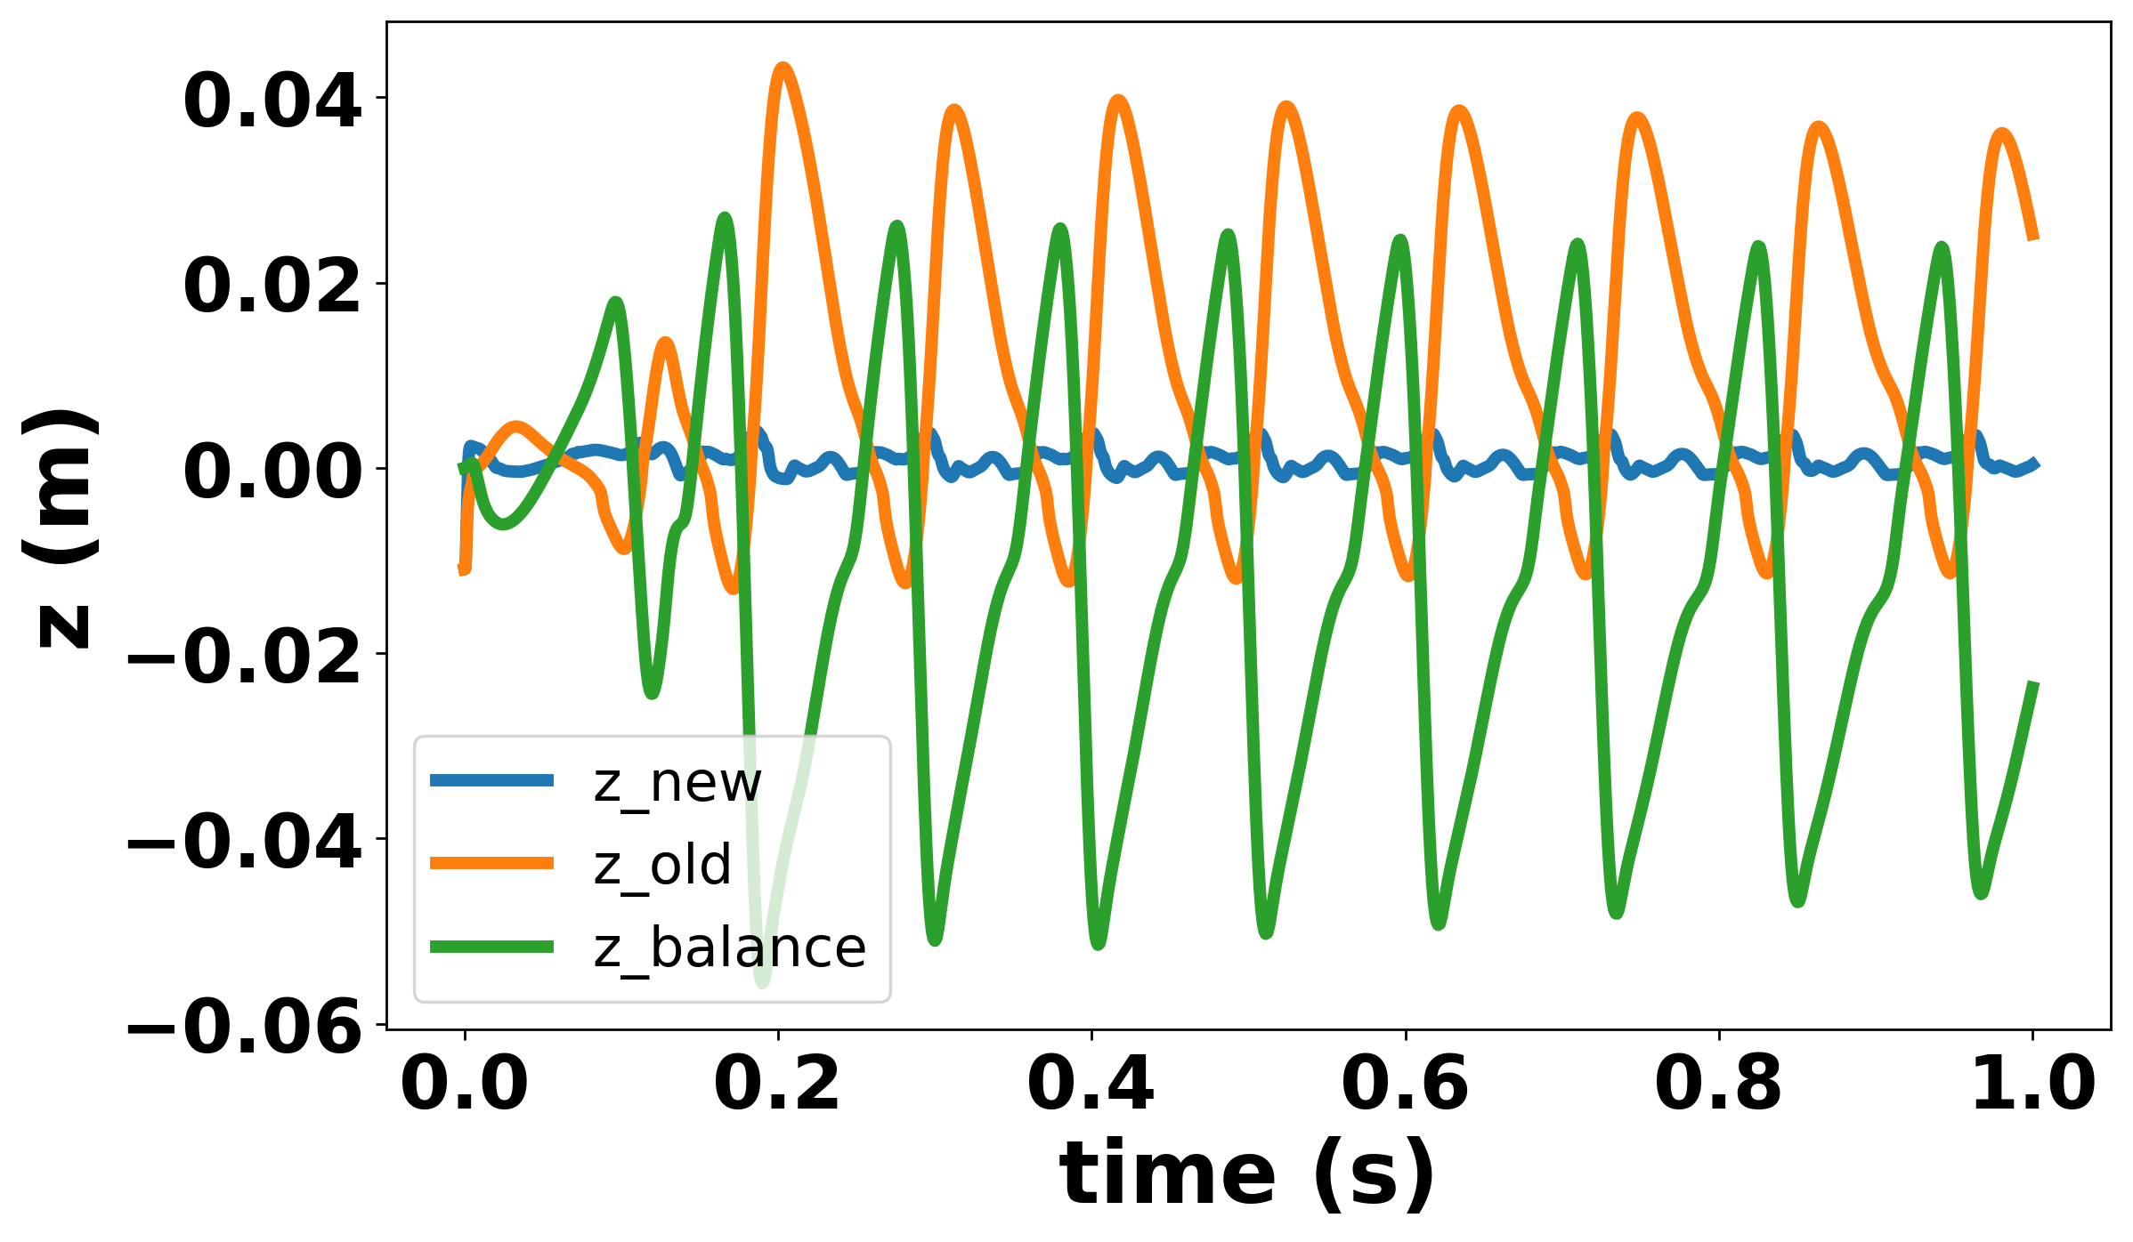
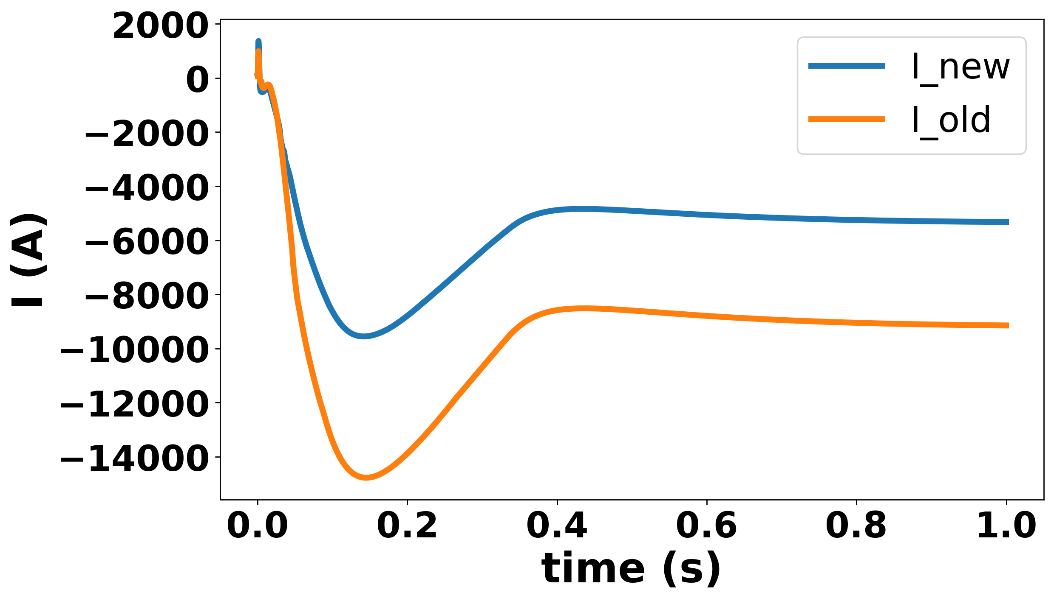
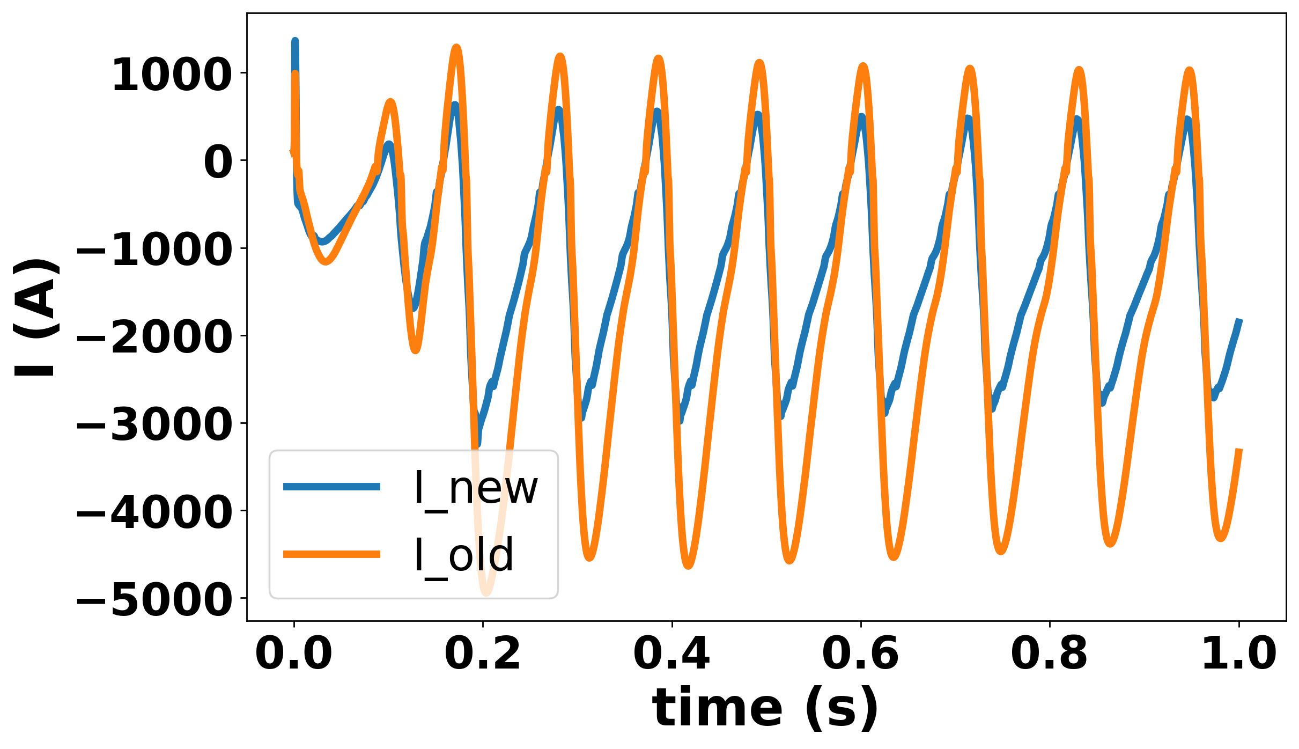
VS with Robust Adversarial Reinforcement Learning（RARL）
Vertical stabilization controller must avoid overcurrent with PF perturbations
12 PF coils with different amplitudes and frequencies: Impossible to exhaust
Adding adversarial during training to enhance the robustness
  RL-based adversarial ($R_{adv}=−R_{agent}$): Automatic Attempts to Attack Weaknesses
Environment Configuration
Env
$$I_{PF}$$
Adversarial
$$V_{PF}$$
EAST
High freq. turb.
disturbance source
PF controller
High amp. turb.
$$V_{IC}$$
Adv. try different types of attacks during training
VS controller
Agent
observation

Slide 21
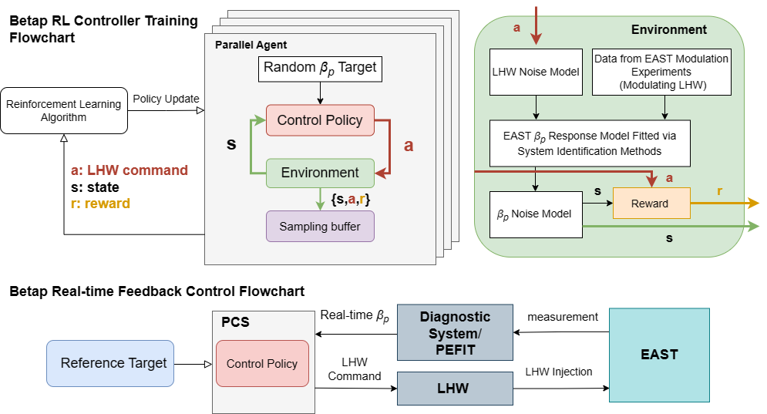
RL-based βp controlled well on EAST tokamak
RL-based feedback control of βp traces the target accurately in EAST experiment
  Profile response model by system identification
  Error integral and error model are included in reward function and training procedure
#128847
#128849

Slide 22
01
How AI Benefits Plasma Control
02
AI Application in EAST Plasma Control
Outline
Plasma parameter/state estimation
Disruption prediction
Controller optimization
03
Conclusion and Discussion

Slide 23
Conclusion and Discussion
AI/ML approaches have been applied on EAST for establishing plasma simulation, estimation, control response models and optimizing controllers,
  Plasma parameter recognition surrogate model: equilibrium/MHD mode
  Implications to DEMO: more reliable and RT state/parameters recognition.
  Advanced control algorithms: RL/self-adaptive based vertical instability and profile control
  Implications to DEMO: Simplified/Sys identification model can train RL AI model to have better controllability with less requirements to actuators
  Event handling: Cross-device disruption prediction and mitigation
  Implications to DEMO: more confidence for disruption predication and thus avoidance/mitigations
More physics-oriented modeling database/codes to train AI model for control
More cross machine AI train for disruption avoidance and robust plasma control

