Slide 1

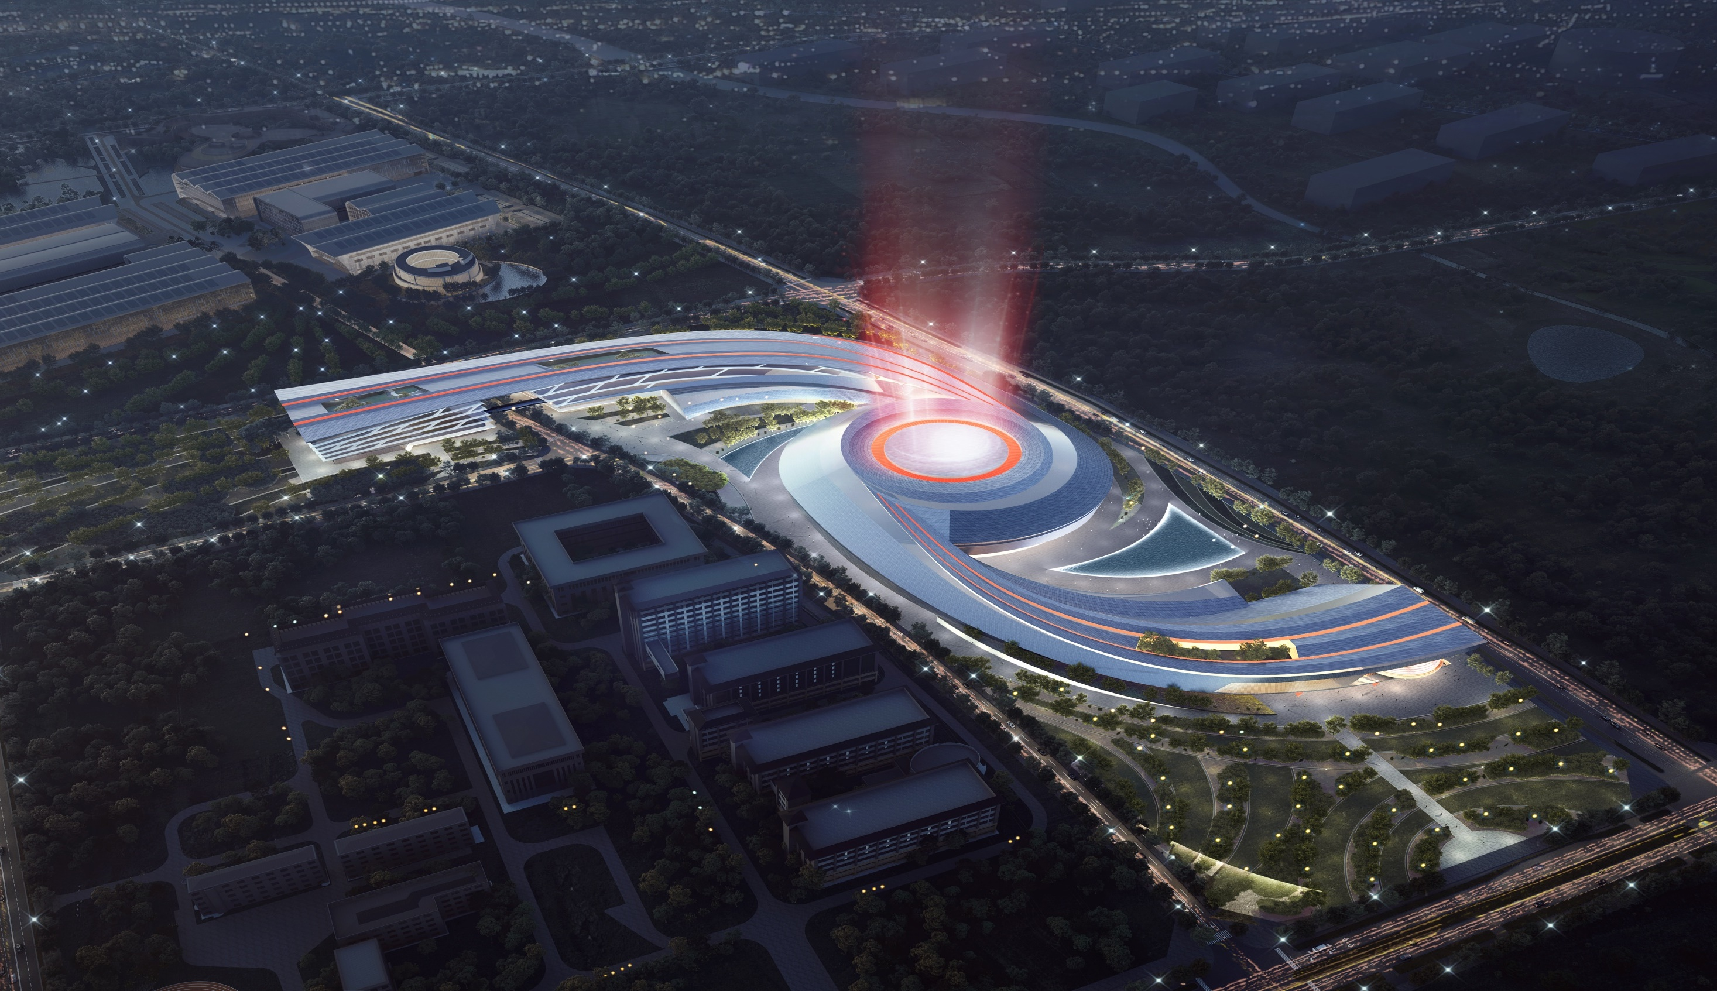
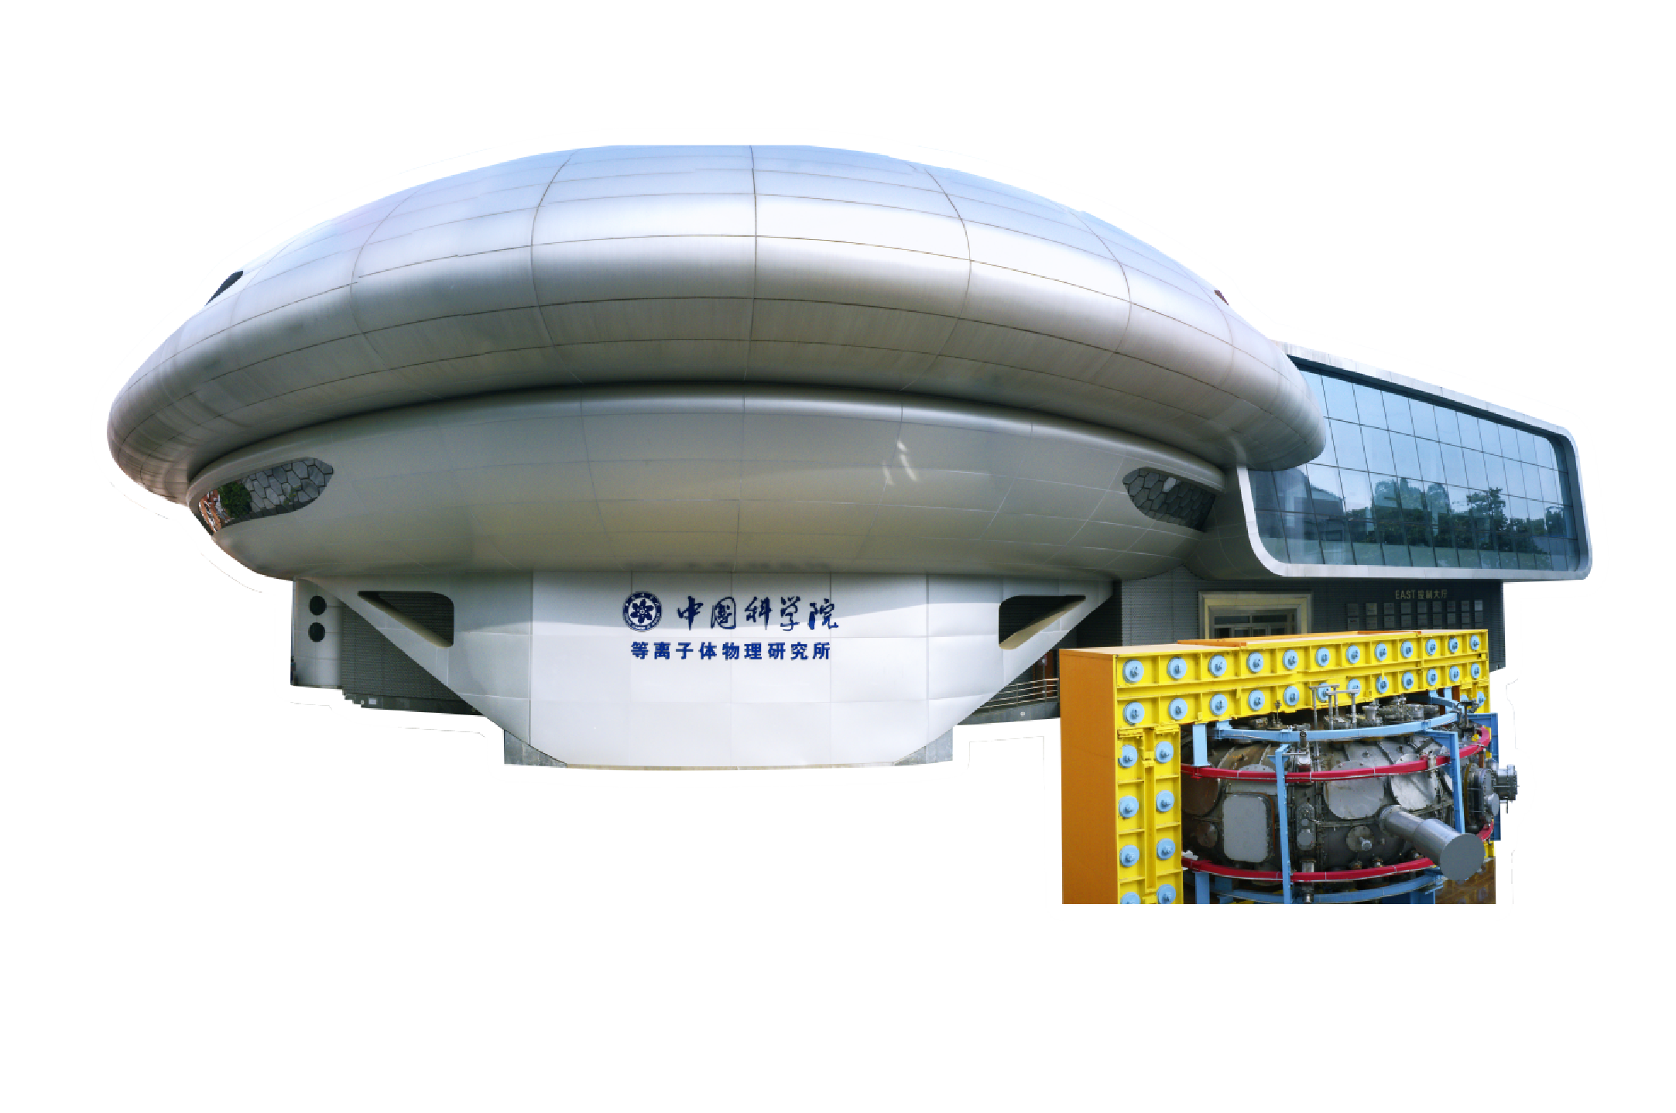

  New Plasma Control System
  for Fusion Reactor
  Qiping Yuan, on behalf of the plasma control team
  qpyuan@ipp.ac.cn
  2024.03.20
  EU – China 4th Technical Exchange Meeting, 19-22, March, 2024

Slide 2

Outline
Overview
System infrastructure design
System prototype and EAST application
Summary
Notes:
Mainly composed of three parts, system infrastructure development, simulation for control, and advanced control algorithms applied on EAST.

Slide 3

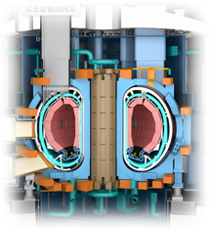
What needs to be done for future reactor control
For present tokamaks and future fusion reactors, the control of plasma initiation, shaping, heating, current drive, stabilization, and safe termination of discharges are required.
Infrastructure development to support steady state operation
Hardware and software infrastructure
Assistant platforms for algorithm development and verification
Development of control algorithms
- Magnetic control
Kinetic control
radiation control, profile control…
Nuclear operation
burning control, fusion power control…
Event handling
Simulation for control
Controller design and verification
Optimization of control parameters and scenarios
Notes:
For future reactor control, the plasma control system must have sufficient security, stability, and reliability to support steady state operation. Simulation tools need to be developed for controller design and scenarios optimization. And the advanced control algorithms need to be integrated for plasma initiation, maintenance and safe termination.

Slide 4
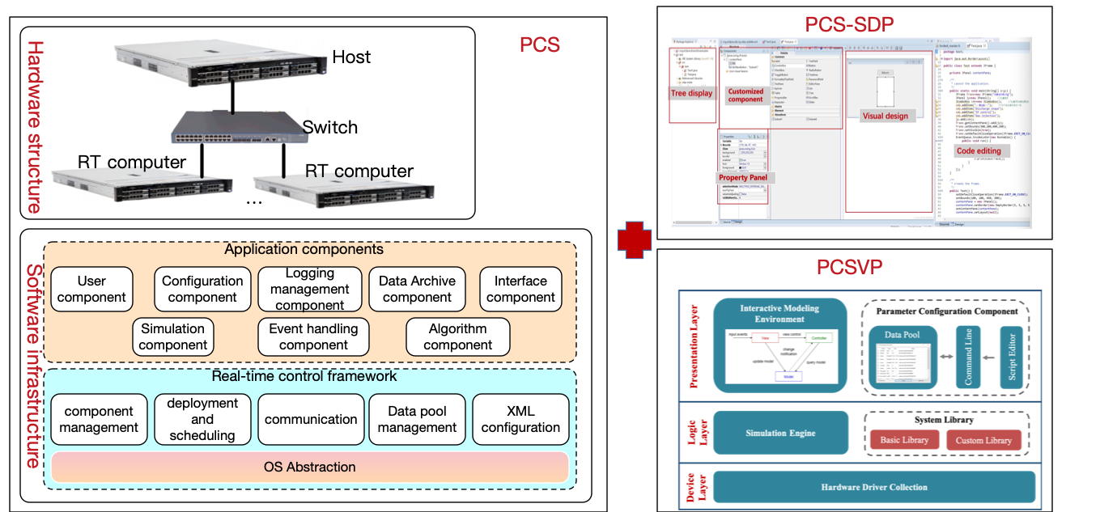
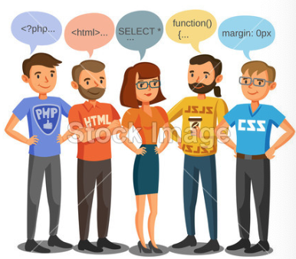
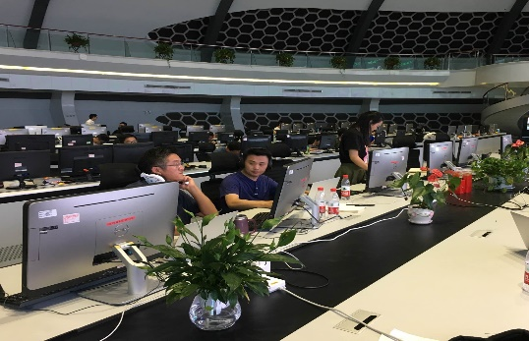
System Infrastructure Requirement
User cases
Friendly development environment
Module development support
Integrate control functions
Data communication and access
Algorithm test tool
programmer
Code management
Discharge parameter configuration
  Scalable H/S infrastructure + two assistant platforms
  Algorithm development platform (PCS-SDP) shall provide a visual and convenient programming environment
  PCS simulation environment (PCSVP) which can be used to develop controllers and architecture, as well as to validate pulses before execution
Workflow management
Control schedule
Plasma control
Real-time control execution
Event handling
Experiment operators
Data archiving
Log management
Reliability assurance

Slide 5
Outline
Overview
System infrastructure design
System prototype and EAST application
Summary
Notes:
To support steady-state operation of future reactor, a new plasma control system infrastructure is designed and developed.

Slide 6
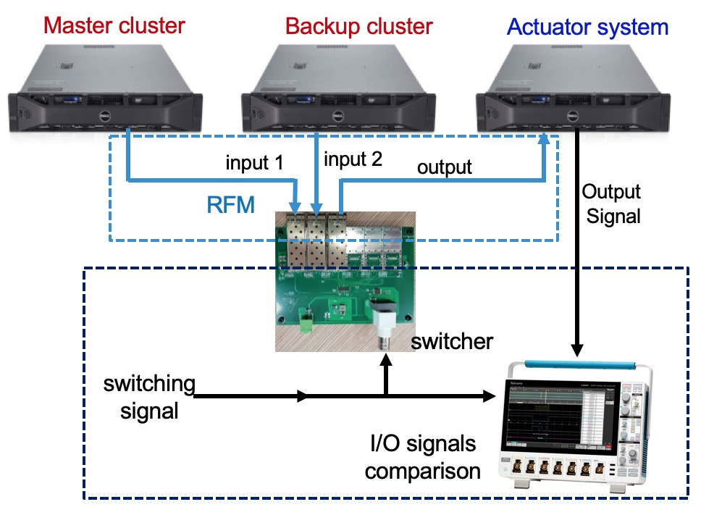
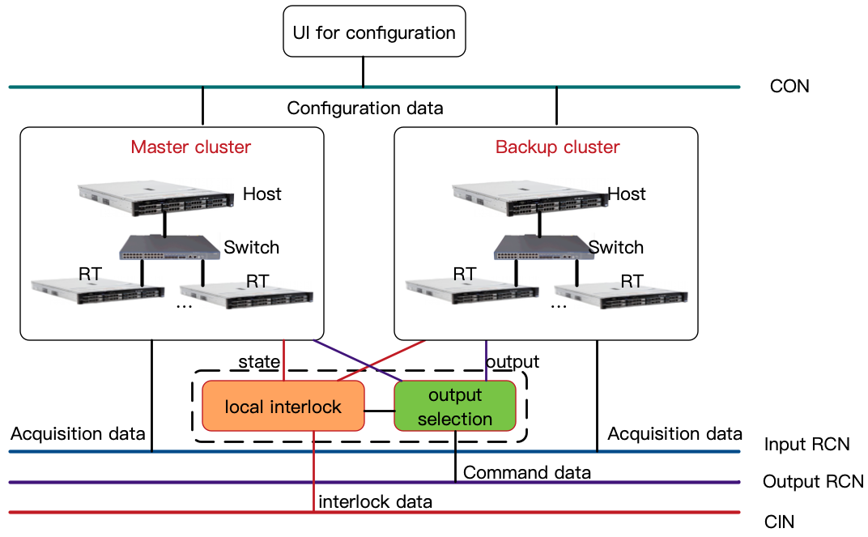
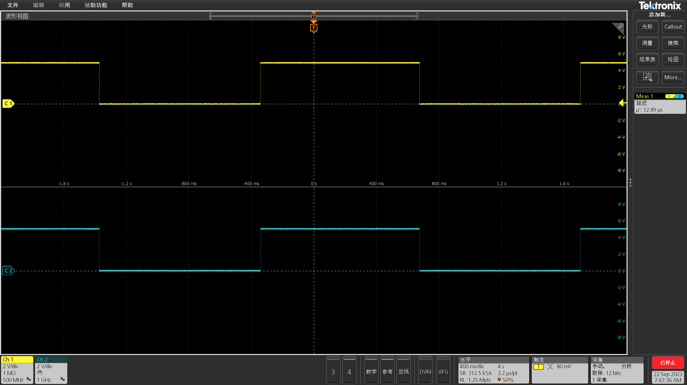
Hardware infrastructure design
Redundant cluster system
Non real time applications and real-time control calculation will be deployed on HOST and RT computers.
Master and backup cluster run synchronously and can be real-time switched in one control cycle.
Transparent hardware access ensures the portability and scalability of the system.
switch：
1: mater
0: backup
Output :
1: master
0: backup
switch and output delay：12.89 μs
Hardware switch + RFM read + I/O output
Notes:
The overall framework is composed of scalable hardware and software infrastructure, two assistant platforms for visual algorithm development and validation.

Slide 7
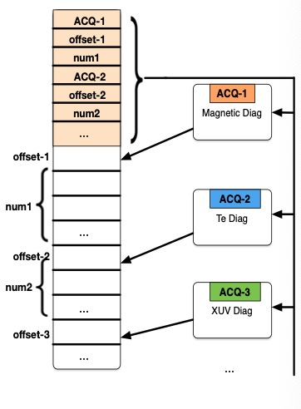
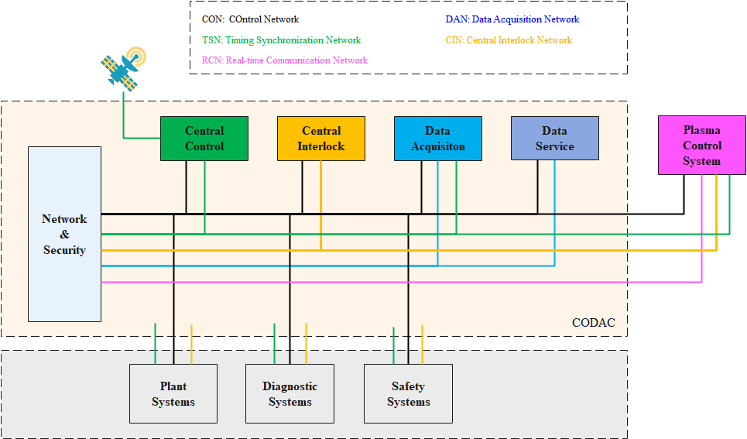
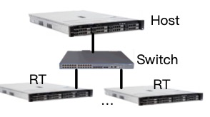
Interface design
External systems related to plasma control include central control system, central interlocking system, distributed real-time acquisition systems, actuator plants.
Interface to CODAC and CIS through CON, RCN, CIN
Communication Head information is designed for easy extension of I/O distributed systems.
CON
TSN
RCN
RCN

Slide 8
Software infrastructure design
Component-based distributed real-time control framework
User login
Parameter configuration
Deploy and workflow
Data archiving
Log and healthy
…
The core framework provides communication, XML configuration, data management, etc.
Various application components can be expanded like Lego blocks building.
Component model: I/O port, property and operation interface
Communication： ZeroMQ (non real-time), Shared memory (real-time)

Slide 9
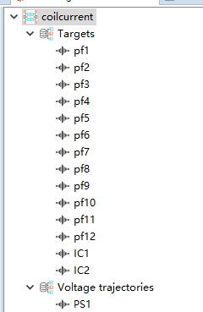
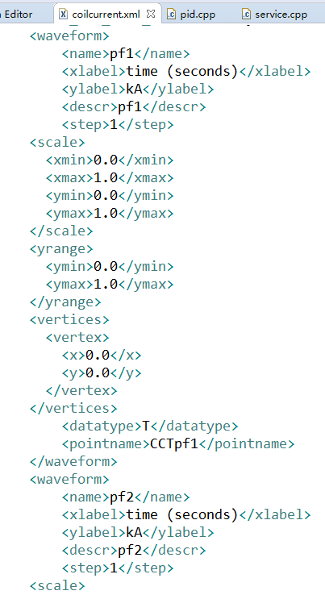
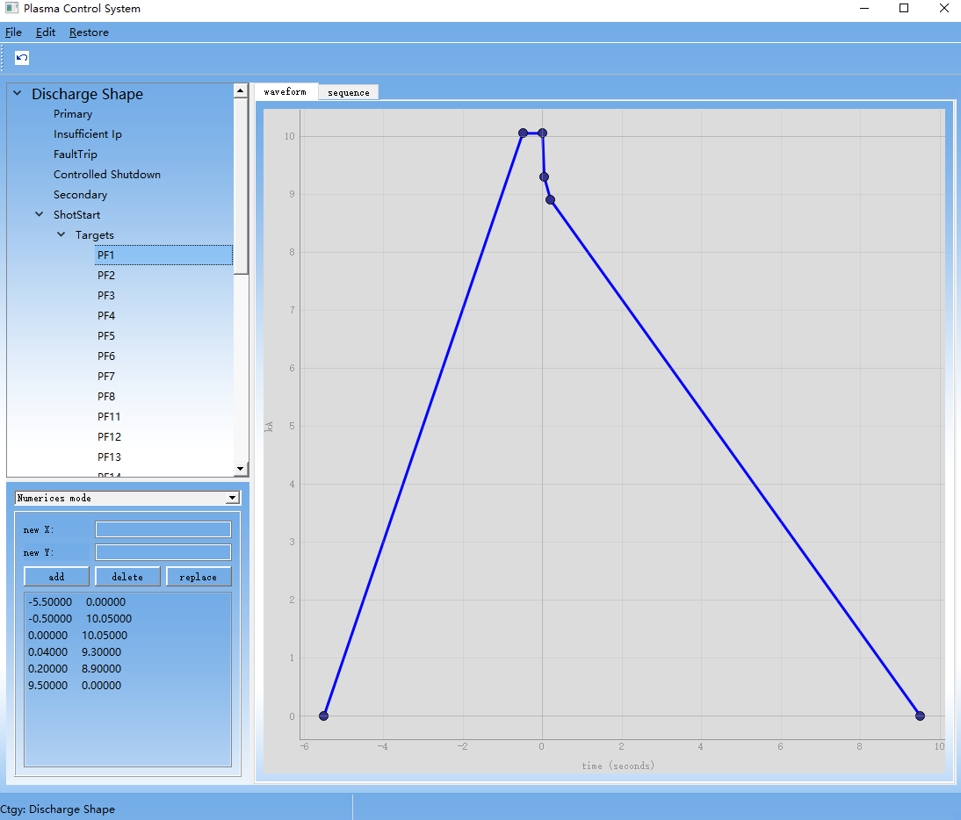
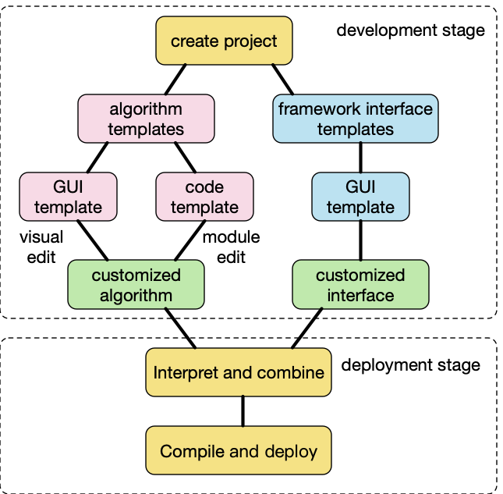
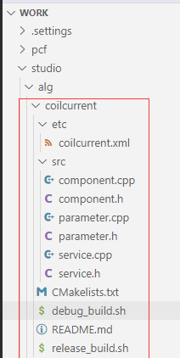
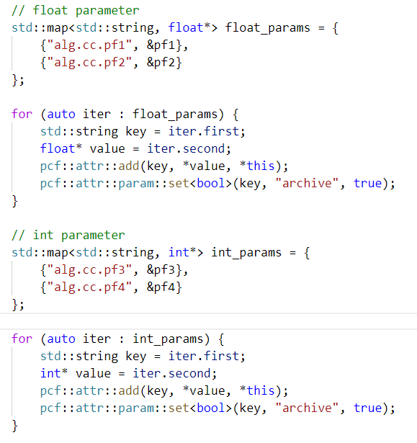
Design for algorithm development and integration
User case 1
Visual algorithm development based on PCS-SDP
Shield the difference of control framework
Visual interface development
Algorithm template compatible with real-time framework
algorithm develop
integrate and deploy
algorithm validate
Drag and drop
XML files
Embed in UI
template
Automatic code generation

Slide 10
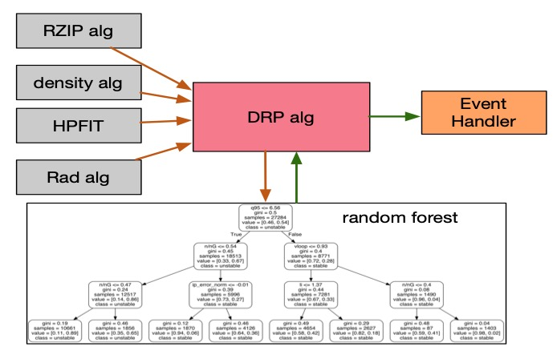
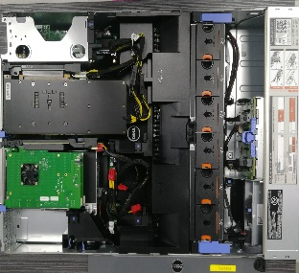
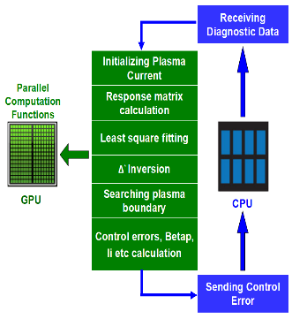
Design for algorithm development and integration
User case 1
Flexible deployment based on XML configuration
The framework support modular development, compilation and loading.
Support rapid integration of third-party algorithm library.
Flexible deployment can be realized according to the XML configuration.
Real time processes are deployed and bound on physical CPU cores.
algorithm develop
integrate and deploy
algorithm validate
HPFIT integration

Slide 11
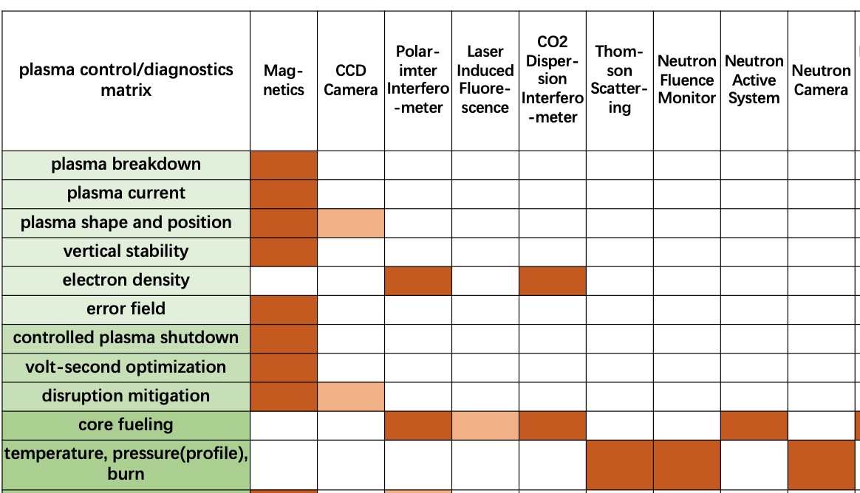
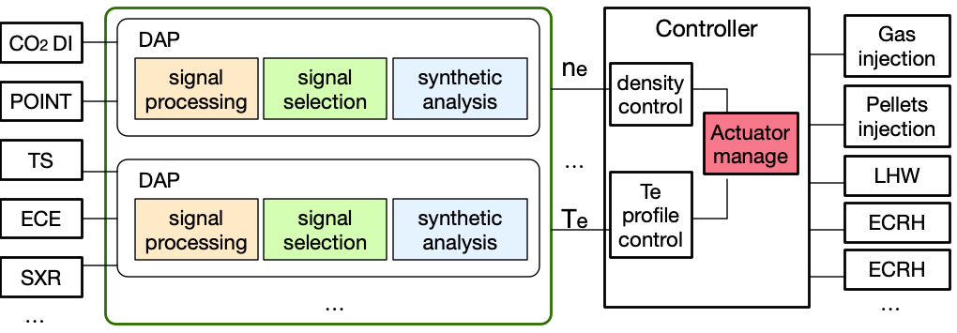
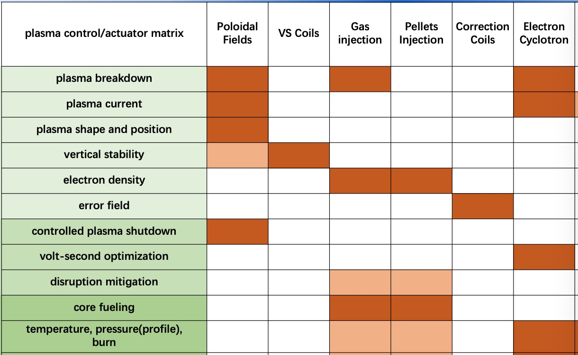
Design for algorithm development and integration
Control functions integration
Control matrix with actuators and diagnostics are designed.
Diagnostic data and command are transmitted through RCN.
Diagnostic signals will be preprocessed, and one or more signals will be analyzed to give plasma parameters.
The sharing actuator conflict will be solved by actuator management.

Slide 12
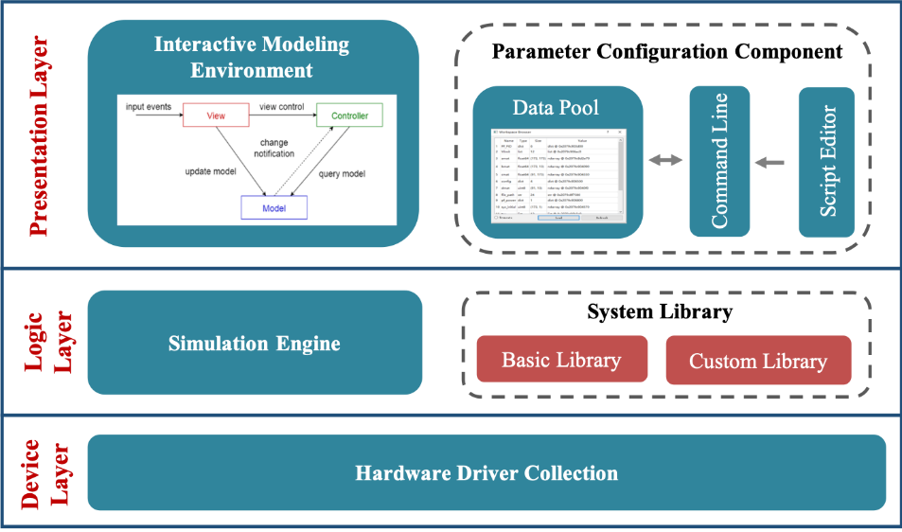
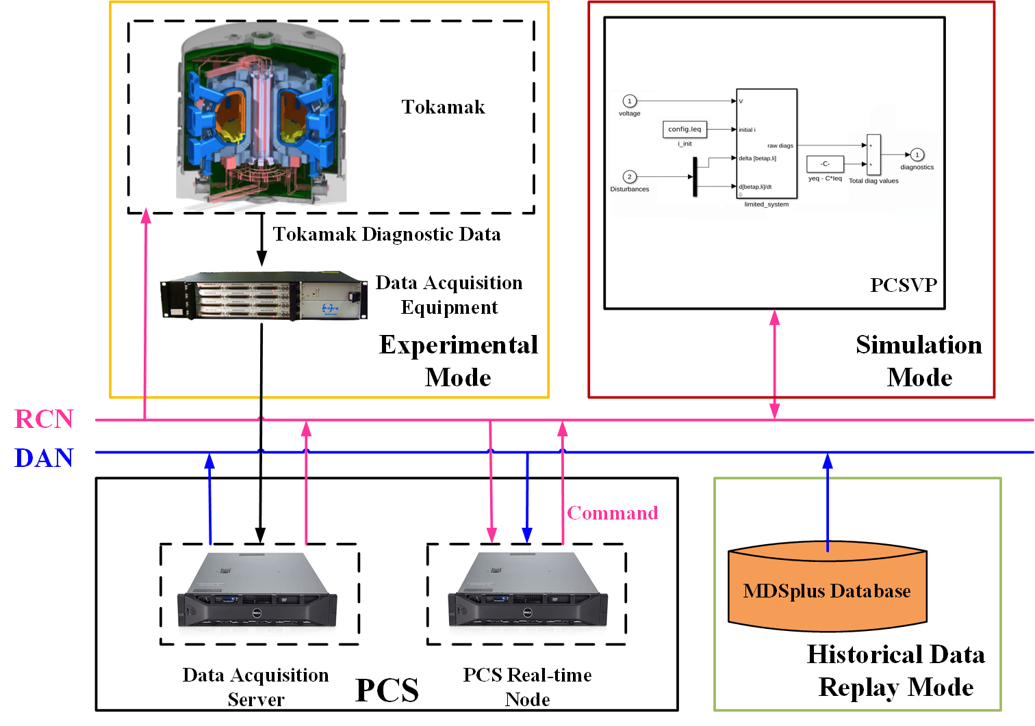
Design for algorithm development and integration
User case 1
Support multiple operation modes
The algorithm needs to be fully validated by simulation test.
PCS supports multiple operation modes including normal experimental mode and simulation test mode.
Python based verification platform PCSVP supports visual modelling and similar functions as Simulink.
algorithm develop
integrate and deploy
algorithm validate
Mode | Data source | Command to go
Normal | Real-time data acquisition | Actuators
Simulation based on data | Historical data | /
Simulation based on model | Model calculation | Model

Slide 13
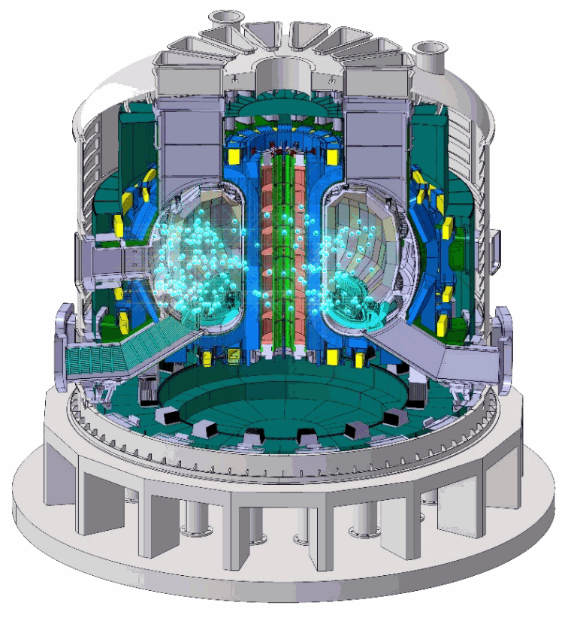
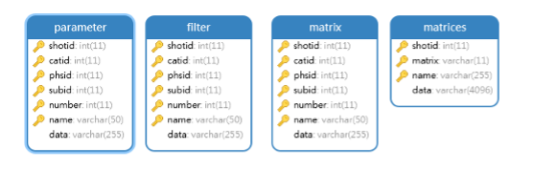
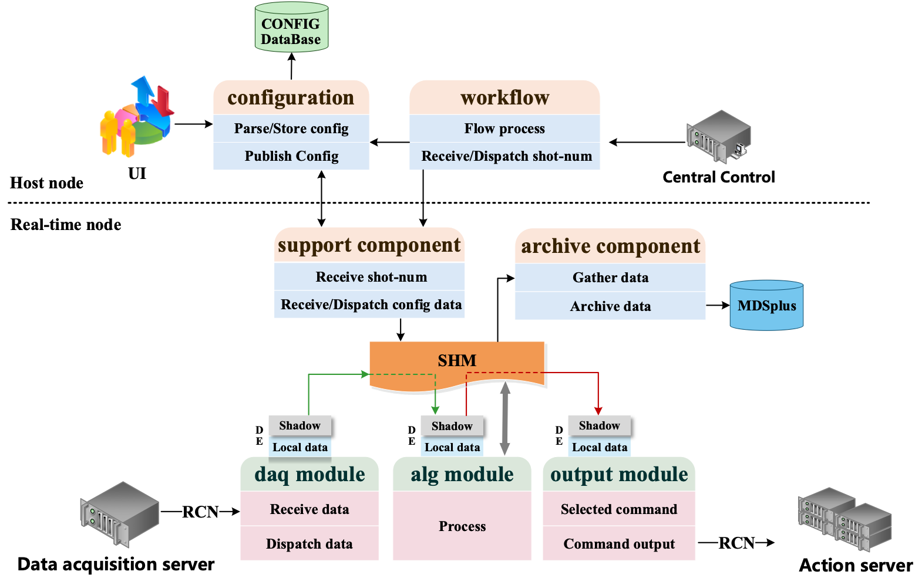
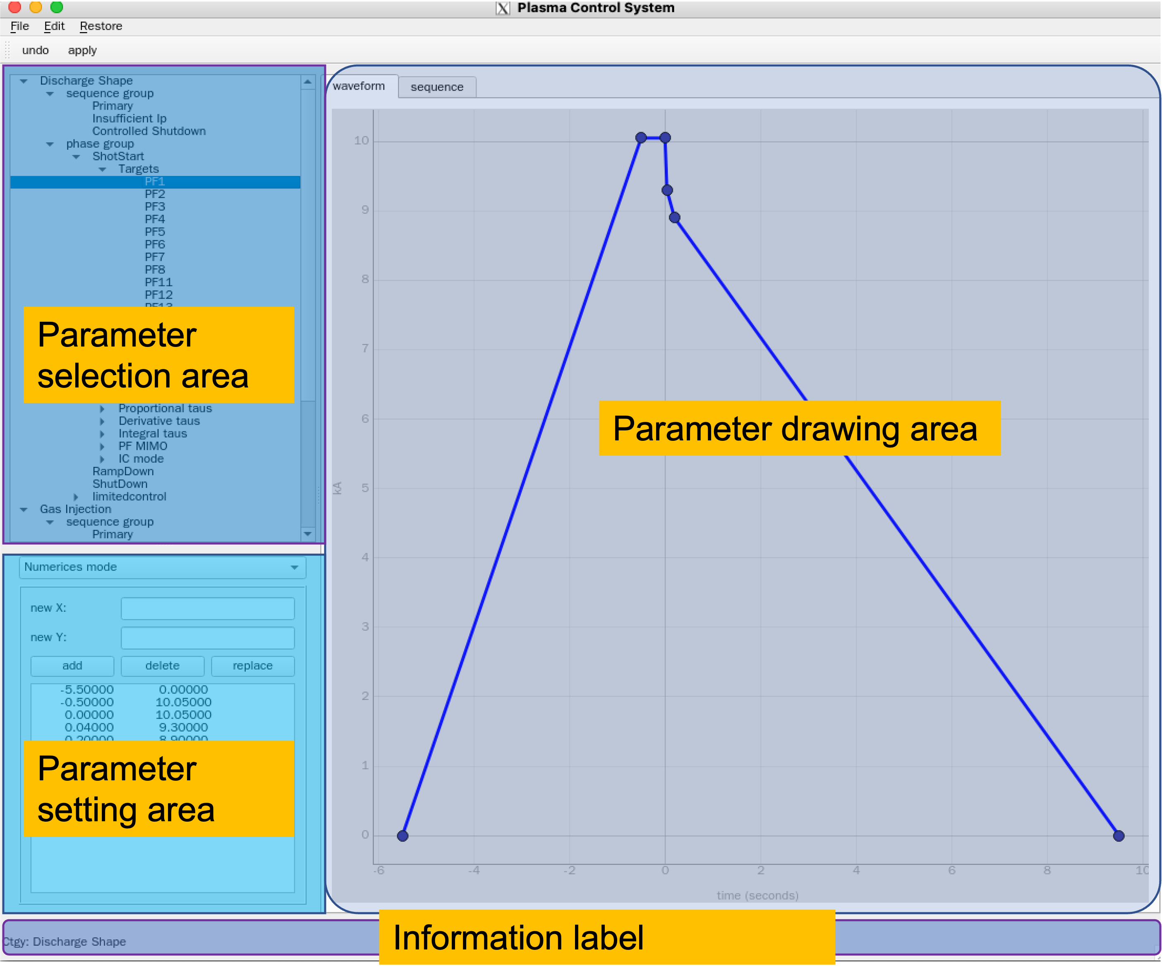
Design for control operation
User case 2
User and parameter configuration management
Login component
The user's identity and authority will be verified, the data will be checked and encrypted.
Parameters are configured with XML, subscription publishing mechanism is applied between UI and CS component.
Data is described through IDL to shield differences of programming languages.
CS component
User management and parameter configuration
schedule and control execution
data archiving
discharge workflow management

Slide 14
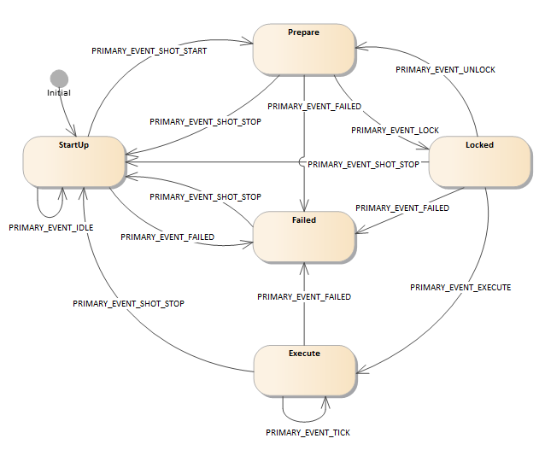
Design for control operation
User case 2
Discharge workflow management
Workflow component
The whole plasma control workflow is controlled by workflow component which is a state machine.
Each real-time process is managed by the local state machine.
Key information during operation will be recorded in the log.
User management and parameter configuration
schedule and control execution
data archiving
discharge workflow management
Local state machine

Slide 15
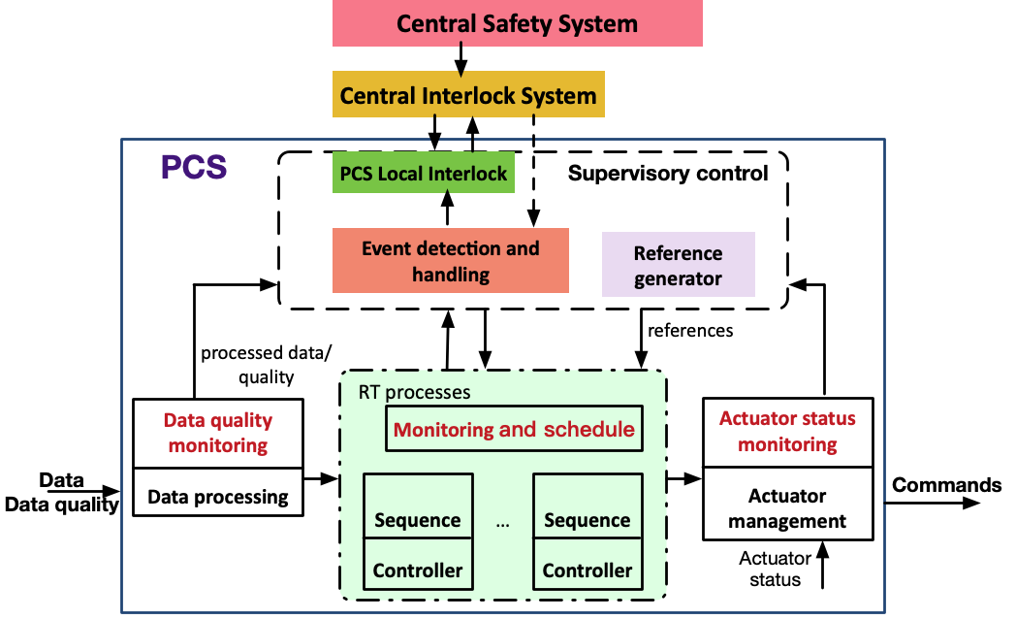
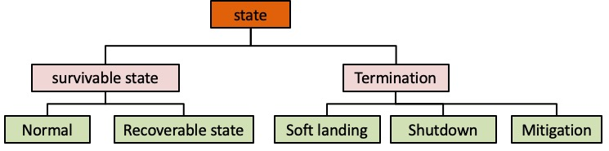
Design for control operation
User case 2
Schedule and event handling
PCS supports event detection and forecasting.
The plasma discharge process is described by several limited states, and event triggers state migration.
The execution sequence is determined according to the priority if multiple parallel states are triggered.
Status classification
User management and parameter configuration
schedule and control execution
data archiving
discharge workflow management
Event handling decision

Slide 16
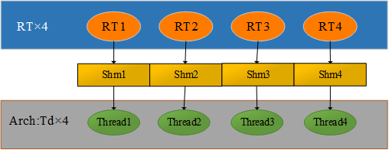
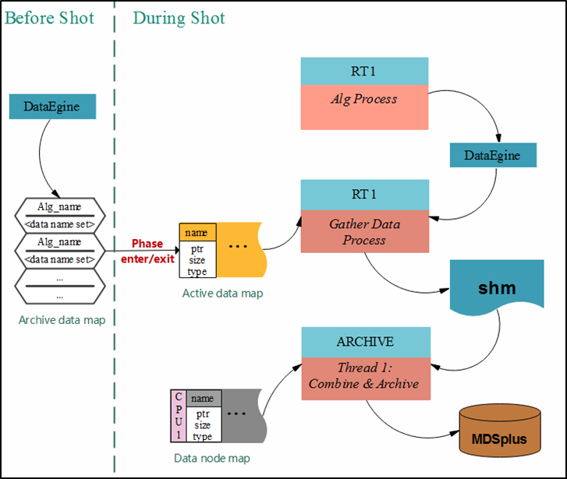
Design for control operation
User case 2
Real time data archiving
Archiving component
There are archiving processes corresponding to each real time process.
All data are stored and accessible in real-time.
The stored procedure is independent from the storage medium.
User management and parameter configuration
schedule and control execution
data archiving
discharge workflow management
Real time parameter parsing
Real-time archiving

Slide 17
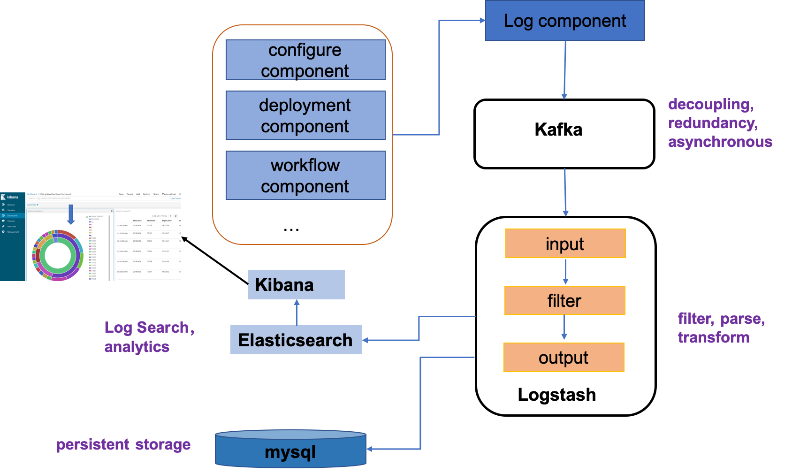
Design for system reliability
Log component
User parameter configuration before shot and key information during plasma operation will be recorded in the log
Log component communicates with other components through subscription publishing mechanism
multi-­producer and single-­consumer mode is designed for log collection.
Kafka acts as the message middleware between log collection and log management.

Slide 18
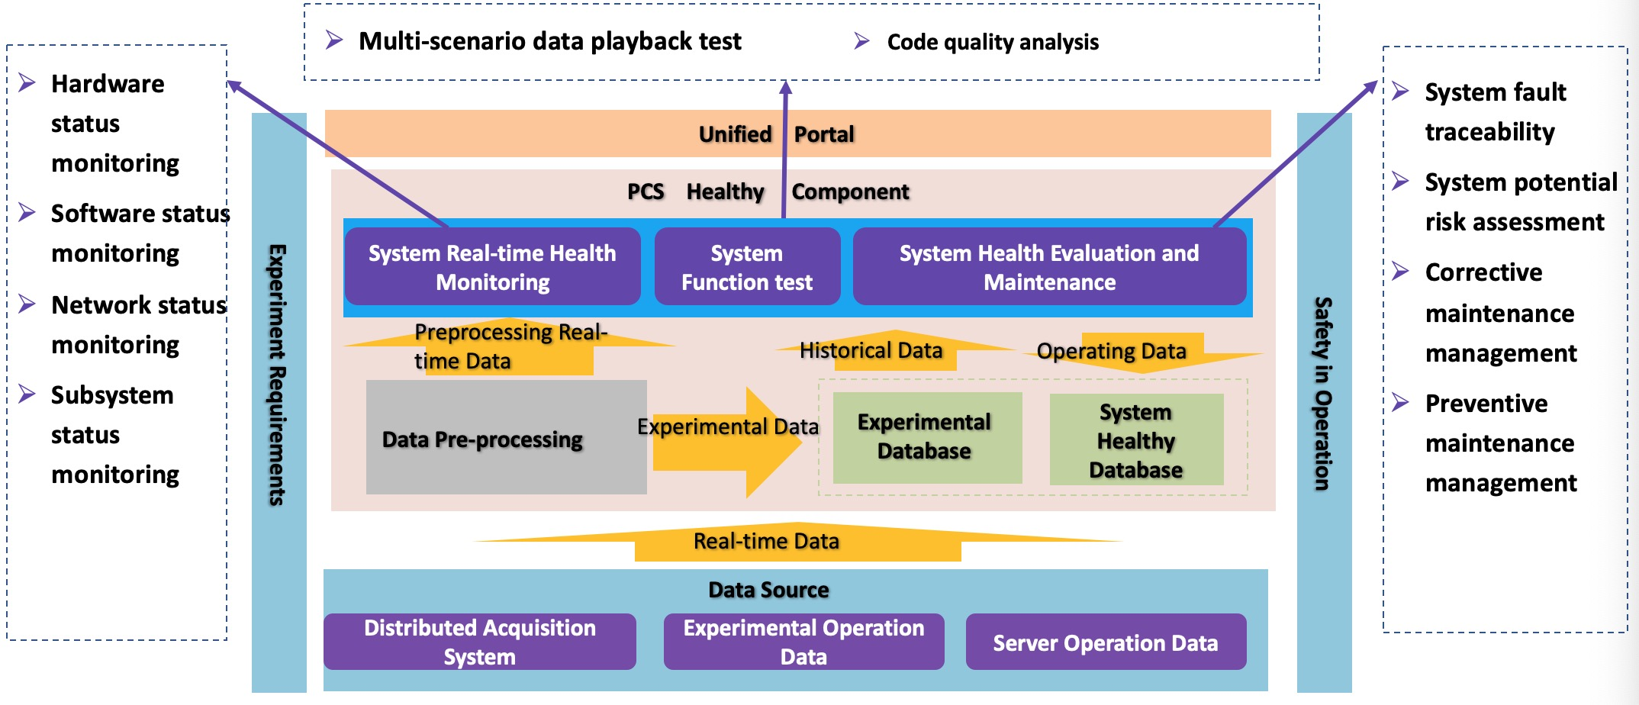
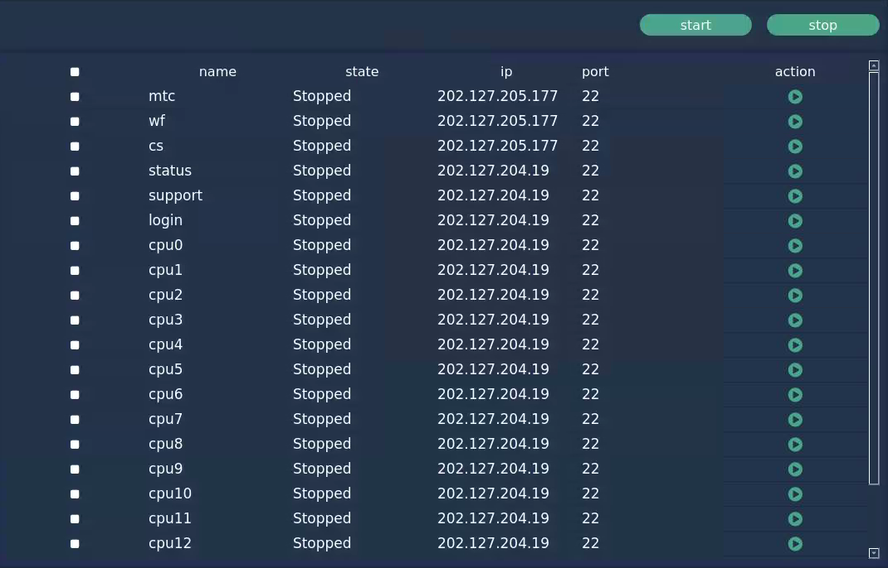
Design for system reliability
Healthy monitoring and management
Real-time monitor the hardware status and processors’ heartbeat.
Test the system function and evaluate healthy status.
The processes are monitored and managed on the web-based platform.

Slide 19
Outline
Overview
System infrastructure design
System prototype and EAST application
Summary
Notes:
Next, I will talk about the control simulation progress.

Slide 20
nt
Deployment of new PCS prototype on EAST
Infrastructure deployment
Algorithms integration
Two sets of clusters are deployed. One for operation and the other for testing and backup.
The real-time communication is through RFM.
10 categories and almost 20 algorithms have been integrated in the prototype system for EAST.
Category | Algorithms | Description
Discharge Shape | Coil Current | Coil current control
 | Limited control | Plasma position control
IP control | Ip current | Plasma current control
Density | Density | Plasma density control
Gas Injection | Gas | Open loop gas puffing
HPFIT | pequil | Parallel equilibrium code
ISOFLUX | isoelong | Limited shape control
 | isodnull | Double null shape
 | isosnull | Single null shape
DAQ | Acq | Data acquisition
System | sysmain | actuator management
Event Detection | edh | Event detection & handle
Profile control | beta | Plasma vloop & profile
Notes:
After 4 years of design and development, the prototype system is established. Two sets of clusters are deployed as redundant system. After integrating the main control algorithms, the new PCS was successfully applied in the last week of 2023 EAST summer operation campaign. In near 300 shots, the plasma current, position & shape, density were controlled with no system failure.

Slide 21
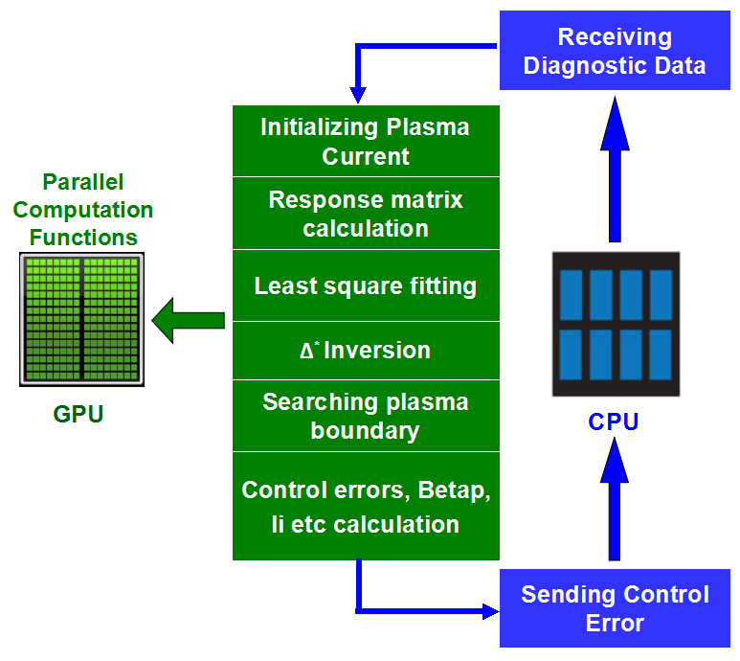
High performance equilibrium reconstruction
HPFIT code is based on the EFIT framework but using massively parallel GPU cores to significantly accelerate the computation with hundreds times.
HPFIT/ISOFLUX has been applied for EAST plasma shape control. It also provides profile information for kinetic control.
HPFIT shows good performance for DIII-D offline reconstruction and ITER discharge simulation.
 | RTEFIT | HPFIT
Current profile reconstruction | ✓ | ✓
Kinetic reconstruction | ✘ | ✓
Space resolution | 33x33 | 129x129
Time resolution | 2ms | 300μs
Least square fitting
Promising reconstruction tool for ITER, BEST，CFETR…

Slide 22
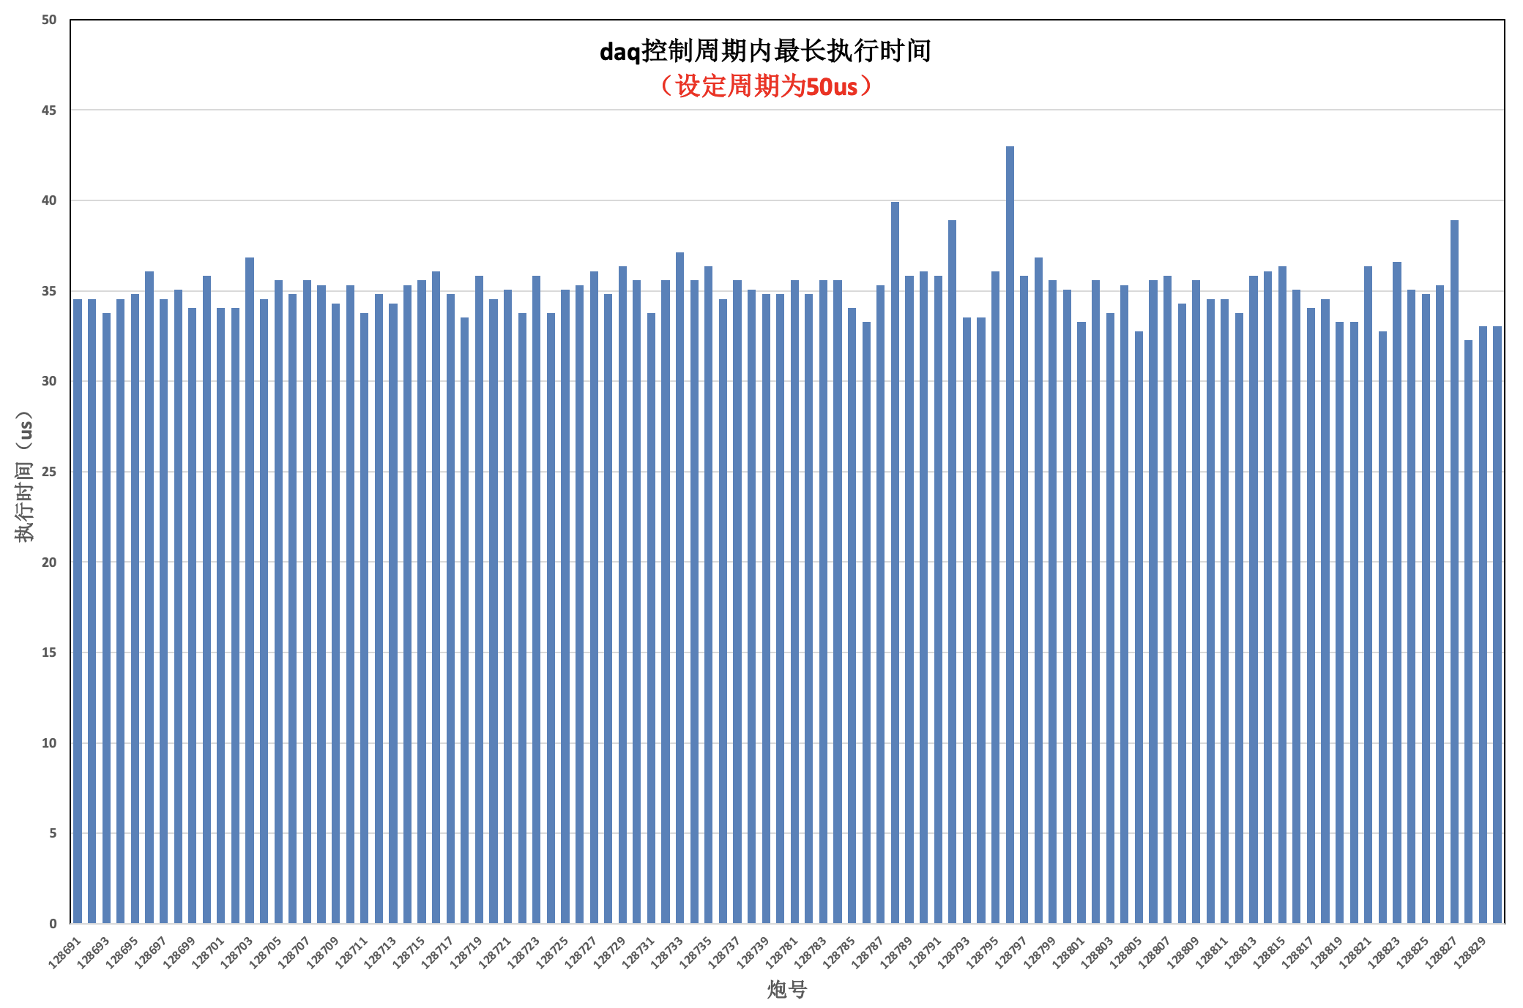
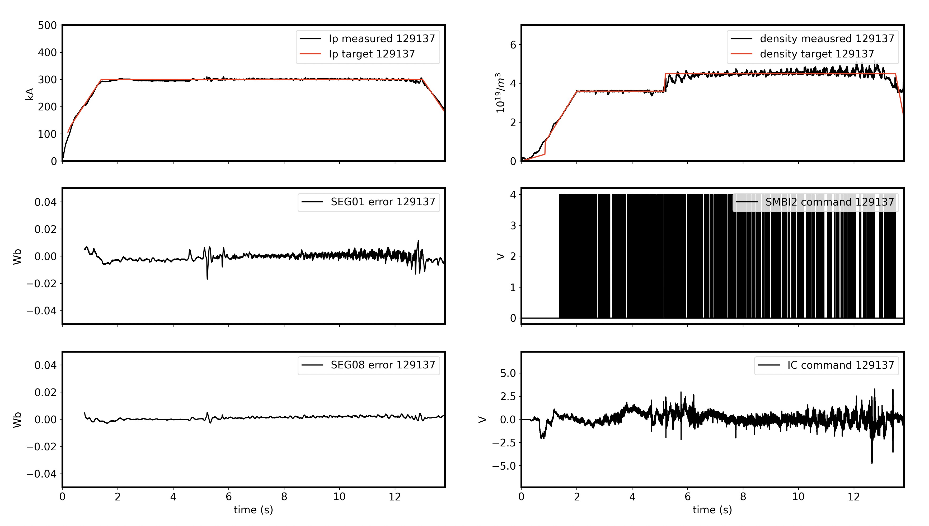
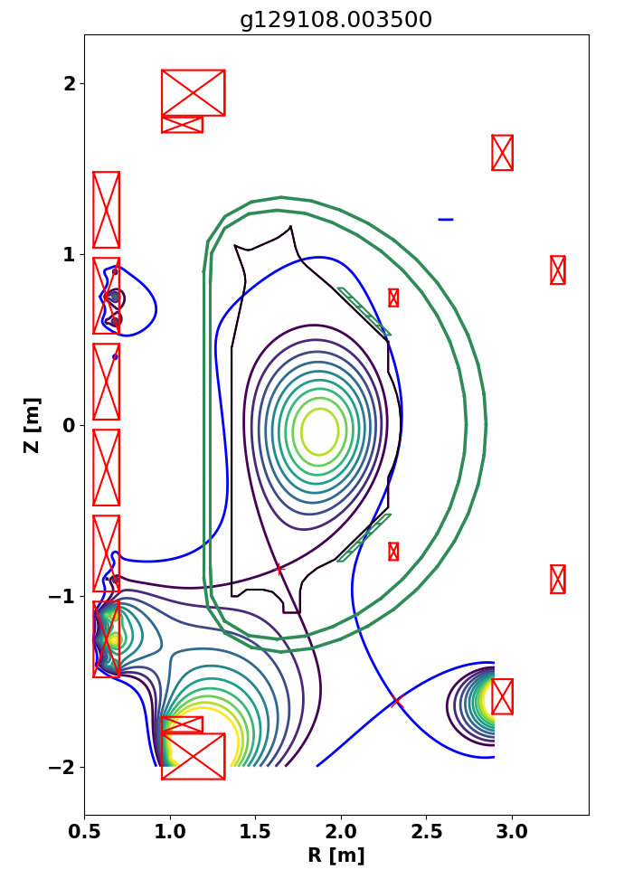
nt
New PCS applied on EAST
The new PCS was successfully applied in the 2023 EAST summer operation campaign.
Plasma current, position & shape, and density were controlled in total 286 shots with no system failure.
Fastest control cycle < 45 μs
Plasma current and density control
quasi-snowflake
Time /μs
Date | Aug.2 | Aug.3 | Aug.4 | Aug.5 | Aug.6 | Aug.7 | Aug.8 | Aug. 10
Shots | 9 | 7 | 7 | 3 | 53 | 53 | 100 | 54
Topic | Communication, and Verify CC, RZIP and density control | Routine exp test shots and RZIP, density control | Repeat | Verify plasma shape control | Serve the physics experiment | Verify the vloop control and system reliability | Serve the physics experiment | Verify the quasi-snowflake shape control and serve the experiment
Success rate | 100% | 100% | 100% | 100% | 100% | 100% | 100% | 100%
Notes:
After 4 years of design and development, the prototype system is established. Two sets of clusters are deployed as redundant system. After integrating the main control algorithms, the new PCS was successfully applied in the last week of 2023 EAST summer operation campaign. In near 300 shots, the plasma current, position & shape, density were controlled with no system failure.

Slide 23
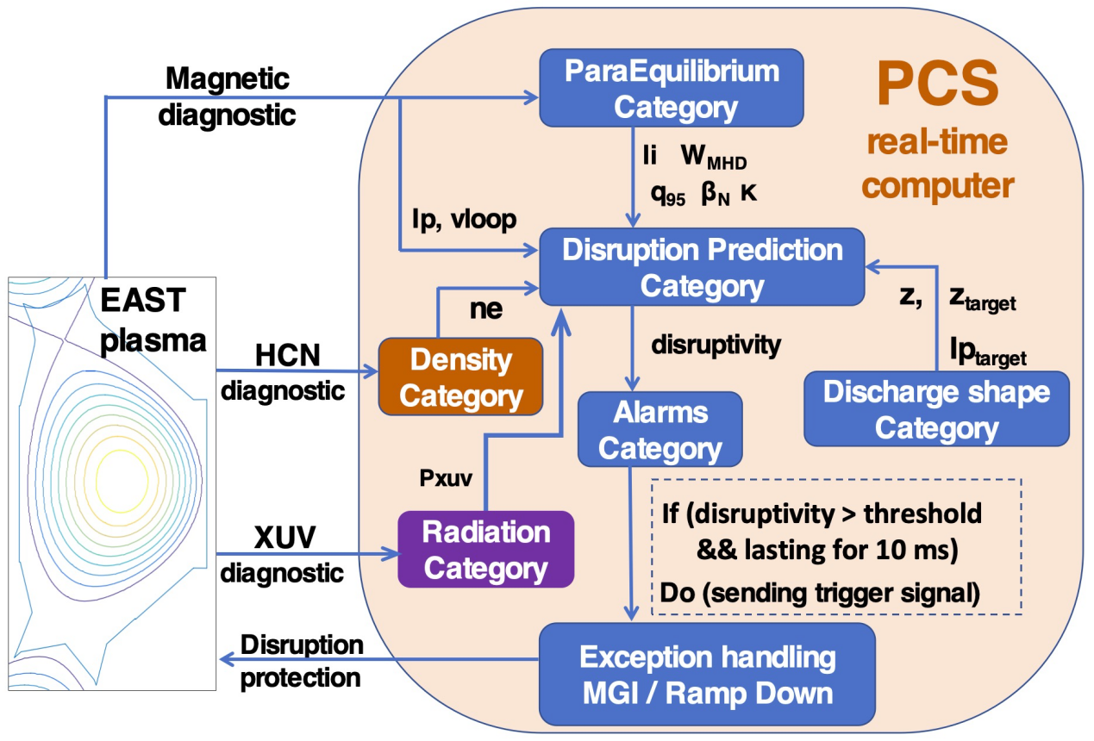
Off-normal event detection and handling on EAST
Event | Detection | Handling
External system fault | From CIS | mitigation
Off-normal status of diagnostic/actuator systems Temperature of key components is too high | Real-time diagnostic, AI model check diagnostic quality | Recovery, mitigation
Abnormal plasma VDE Density limit High beta limit Impurity burst/accumulation Excessive helium ash … | AI model predict abnormal event | Controlled shutdown, avoidance and mitigation
EAST plasma off-normal events detection&handling system
Input:
Density
HPFIT
Shape
Radiation
Magnetic
...
...
Discharge time sequence
Stage1-Recovery: Plasma control
Stage2-Avoidance: Soft-landing
Stage3-Mitigation: MGI&SPI
Notes:
The off-normal events of external systems and the transient plasma can be detected and handled in PCS.

Slide 24
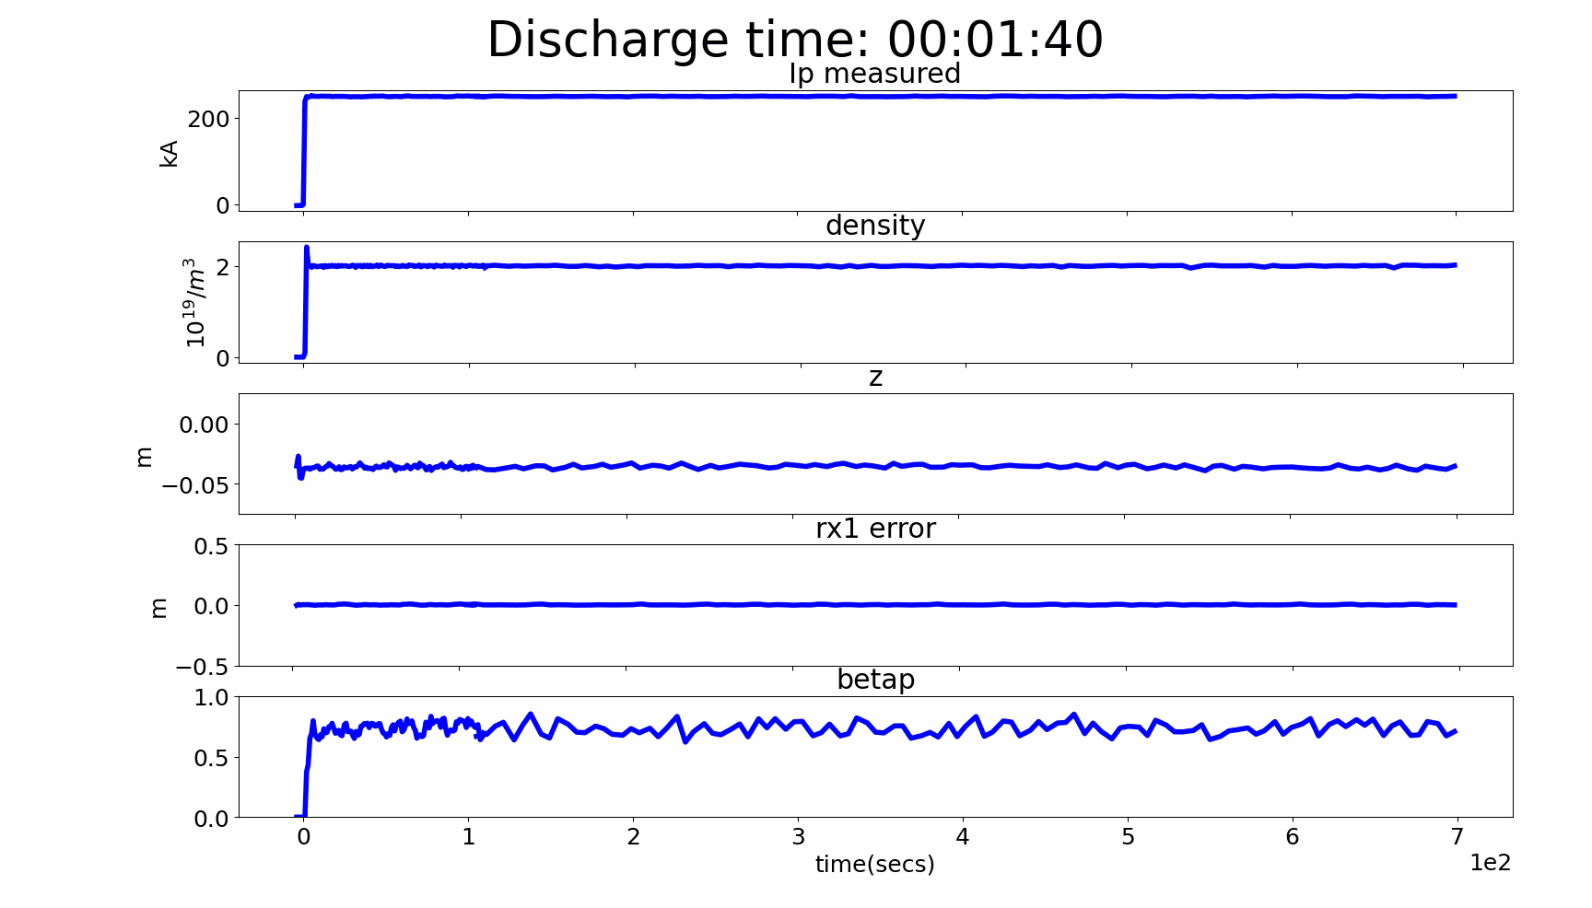
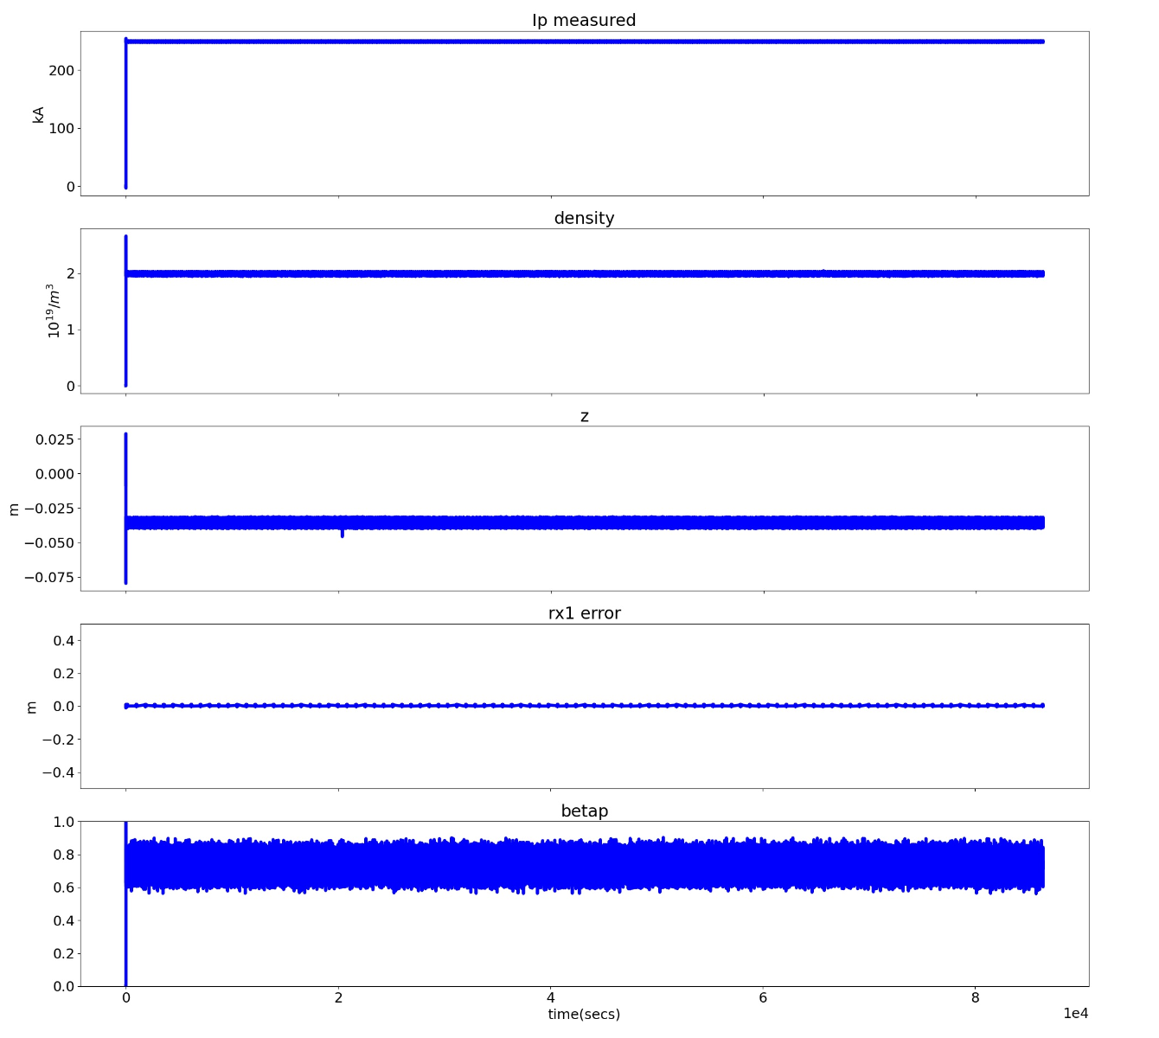
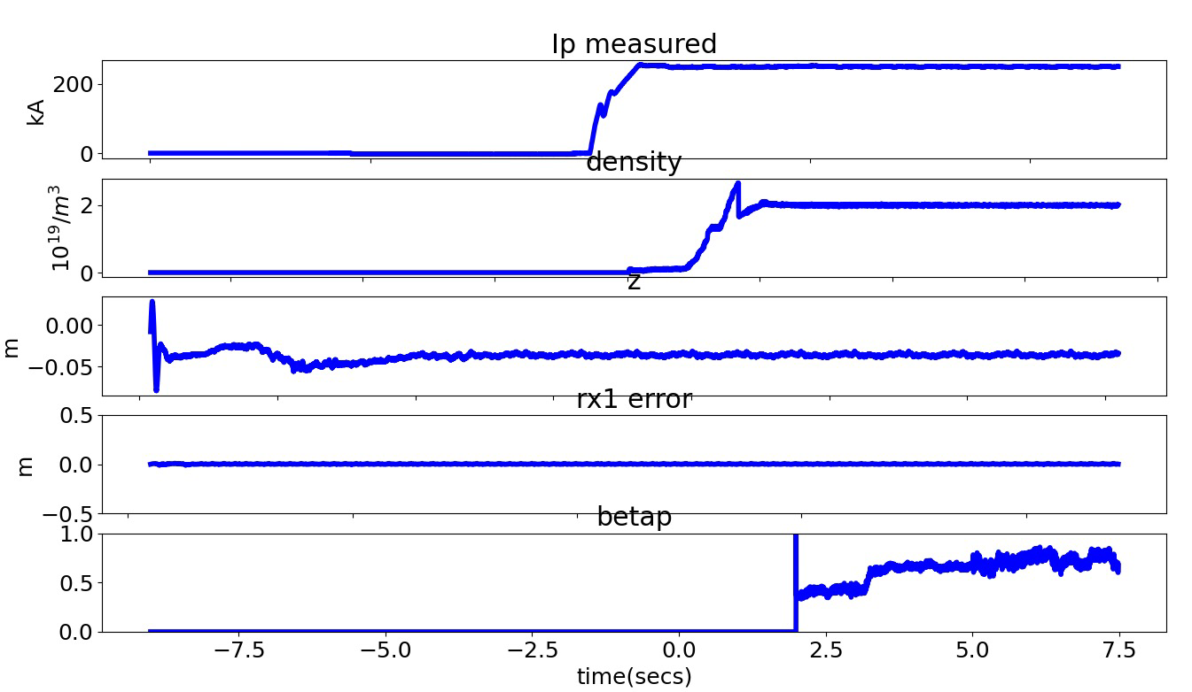
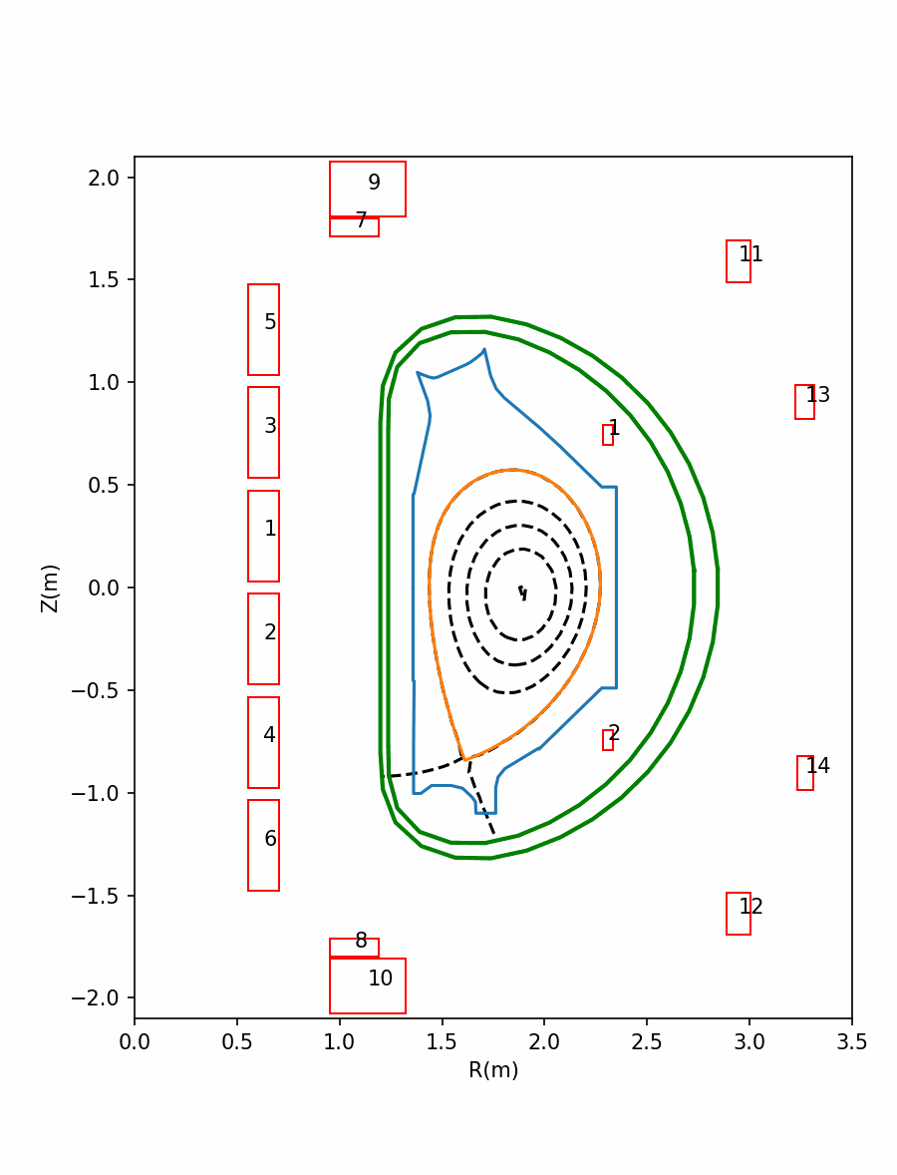
New PCS supports steady-state operation
More than 24 hours continuous running has been tested with real hardware and all algorithms based on the extended historical data.
The data are saved at the preset sample interval, and all data at the time of the exception is saved.
50 hours running
shot | Length(h) | Data
9162026 | 24 | 714G
9181415 | 26.8 | 797G
9230029 | 24 | 714G
9281601 | 50 | 1488G
10021807 | 25 | 744G
672G （sample rate,2ms）+42G（time slice, 20ms）
Notes:
The new PCS supports SSO through…

Slide 25
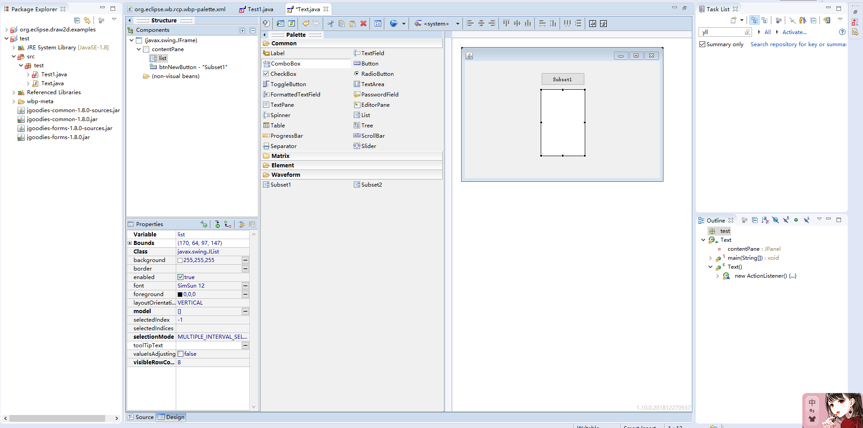
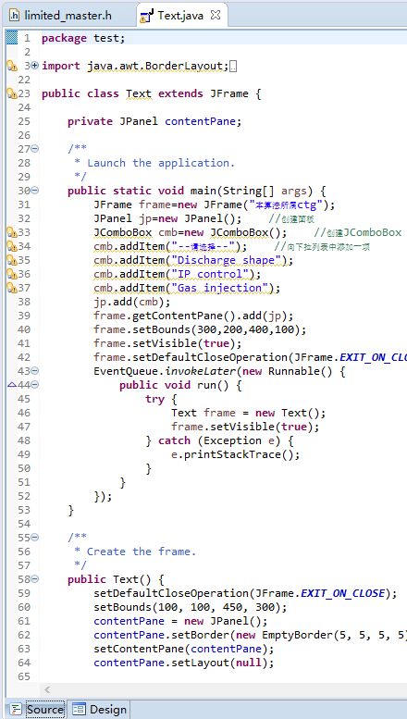

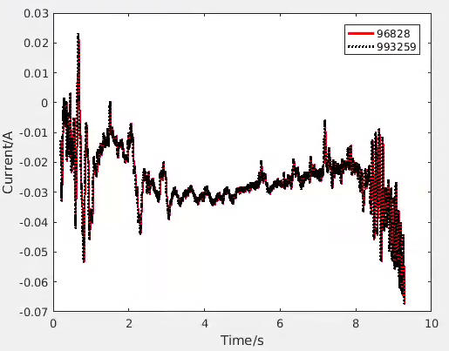

Software development platform is applied on EAST
Shield the difference of control framework
Visual interface development
Plasma current, position and density control algorithms have been developed and verified.
Alg category
Custom components
Design area
Property panel
User interface
R_error compared with historical data
PID calculation result of Z compared with historical data
Notes:
Algorithm template compatible with real-time framework，Shield the difference of control framework

Slide 26



Simulation platform and toolkits are developed
Target:
Digital Tokamak is being developed to assist in the provide guidance and evaluation for the discharge of existing devices.
Control algorithm verification
Control matrix generation
Scenarios design for plasma control
PCSVP Plasma Control Simulation Verification Platform
HCI is designed to drive the hardware and map its channel by RCN for data reading and writing.
SPACE
Simulation suites for PlAsma Control on EAST/BEST/CFETR
Notes:
The python based plasma control simulation verification platform PCSVP has been developed. It supports visual modelling, customized modules…. The toolkits called space have been developed to support the platform.

Slide 27









Python based prototype of PCSVP
  Python based framework
  Visual modelling
  Support customized modules, hardware interface, AI interface
Digital Tokamak is being developed to assist in the provide guidance and evaluation for the discharge of existing devices.
Custom libraries
Event Generation
RL Interface
RFM Interface
Device subsystem models
Algorithm models
Notes:
The python based plasma control simulation verification platform PCSVP has been developed. It supports visual modelling, customized modules…. The toolkits called space have been developed to support the platform.

Slide 28









PCSVP is successfully applied on EAST
Plasma control and event simulation
Hardware in loop test with PCS
RZIp Control and actuator failure event were simulated.
The results are consisted with the MATLAB Simulink.
The communication delay is less than 100 μs.
Control results are consisted with the experiment.
plasma model
Hardware interface
Event Schedule
Event Detector
blue line - simulated I_{PF}
yellow line - experimental I_{PF}
RL interface module test
  Vertical control policy was trained and tested with the plasma model.
Z position
IC command
AI model
R position control result
IC failure detection and handling
Notes:
The close loop simulation with PCS has been realized, which can be used for control algorithm verification, event detection and handling simulation, scenarios design and control optimization for EAST.

Slide 29
Outline
Overview
System infrastructure design
System prototype and EAST application
Summary
Notes:
Next, I will talk about the control simulation progress.

Slide 30
New PCS feature summary
 | New PCS
Real-time performance | The fastest control cycle: 50 μs
Reliability | On-line switching mechanism, command output switching time<13 μs, system reliability >99%
Reconstruction | HPFIT: 300 μs
AI support | Disruption prediction, parameter identification, and control optimization
Steady-state support | Support >24 hours continuous running
Usability | With the assistance of the PCS-SDP, visual algorithm development can be achieved.
Testability | With the assistance of the PCSVP+SPACE, drag & drop modelling and simulation can be realized.
Notes:
The new PCS infrastructure has good real-time performance, reliability, usability and testability. It supports AI application and steady-state operation.

Slide 31



Thanks for your attention!
Welcome to join us!

