Slide 1
Material development & strategy in EU
4th Technical Exchange Meeting on CFETR and EU-DEMO
Gerald Pintsuk¹, Giacomo Aiello²
¹Forschungszentrum Jülich GmbH
²EUROfusion

Slide 2
European Fusion Roadmap: Mission 3
Characterization and qualification of the in-vessel baseline materials EUROFER97, CuCrZr and tungsten
Development, characterization and qualification of advanced structural and high heat flux materials for risk mitigation
Characterization and qualification of optical and dielectric functional materials for application in diagnostics, the heat and current drive systems and as insulators
Assembling of qualified data and generating of material property handbooks, material assessment reports, DEMO design criteria and material design limits for DEMO thermal, mechanical and environmental conditions comprising high fluence neutron irradiation
Assessment of the material properties as well as the system integrated material performance under fusion neutron irradiation / operational conditions in a FNS (e.g. IFMIF-DONES)
Theoretical understanding and simulation of (fusion) neutron effects on material microstructure and properties in dependence on operational boundary conditions → risk mitigation
System integrated assessment of the materials readiness

Slide 3
Material Technology Readiness Level (MTRL)
MTRL | Horizon 2020 definition
1 | Basic principles observed
2 | Technology concept formulated
3 | Experimental proof of concept
4 | Technology validated in laboratory
5 | Technology validated in relevant environment
6 | Technology demonstrated in relevant environment
7 | System prototype demonstration in operational environment
8 | System complete and qualified
9 | Actual system proven in operational environment
EUROFER97: 4.2
Tungsten & CuCrZr: 3.9
Level 4 is the maximum that can be achieved without defining the related system and the operational conditions
‘Fully integrated’ material testing
IFMIF/DONES + ITER + ...
DEMO
More details see M. Richardson et al, J. Nucl. Mater. 550 (2021) 152906

Slide 4

Materials development and qualification issues
Data needs
The roadmap for fusion materials and increase in MTRL is driven by the need of data
Requires time as well as sufficient financial support
Requires new and unprecedented facilities
Unlimited resources would allow parallelization but it will not build IFMIF / DONES (significantly) faster (faster decisions would have a stronger effect)
May benefit from modelling tools with predictive capability
Design evolution
Design / operational parameters are still evolving and issues may appear or vanish because of design changes
Keep the development, characterization and qualification as open as possible

Slide 5
Materials development organization structure
Breeding Blanket
Divertor
Diagnostic & Control
Heat &
Current Drive
Safety
Plasma Wall Interaction
Engineering Data and Design Integration (MPH, DDC, SSTT)
Steel Development & Qualification
High Heat Flux Materials
n-Irradiation Campaigns
Functional Materials
MAT-TECH
Integrated Radiation Effects Modelling and Experimental Validation

Slide 6
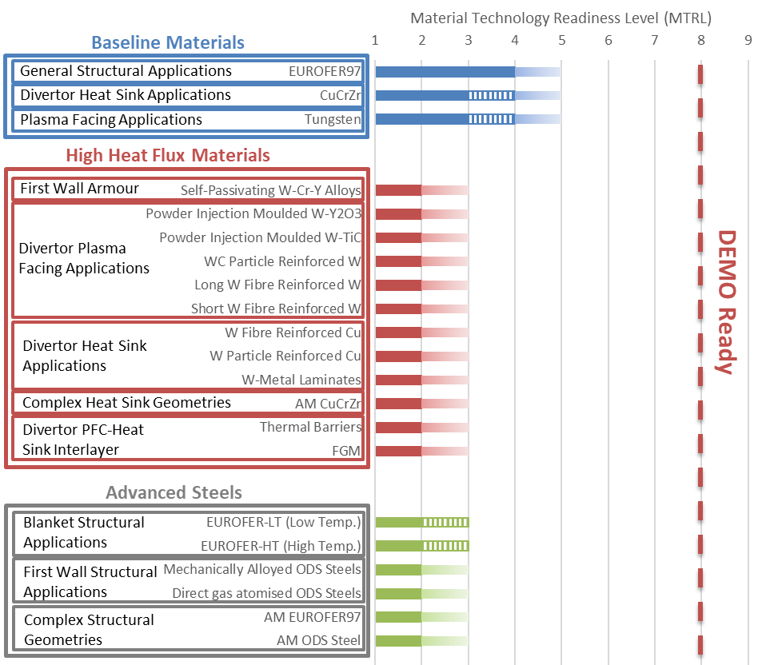
Engineering Design and Data Integration: MTRL & MPH
Material Technology Readiness Level (MTRL)
Further steps
EUROFER97: Complete introduction in RCC-MRx
CuCrZr & W: qualification campaigns based on gap analyses and defined test program including irradiation
Advanced RAFM steels: Validation irradiation for continued down-selection & fabrication upscaling
ODS “steels”: Fabrication upscaling
Advanced Cu & W-alloys: Fabrication upscaling, irradiation screening and down-selection
K-doped W
X
X
ODS-Cu
X
Critical issues
X
X
Supply of material in large amount providing homogeneity and reproducible properties
Fusion neutron source
Development of fusion-specific material test standards → Small Specimen Test Techniques
X

Slide 7
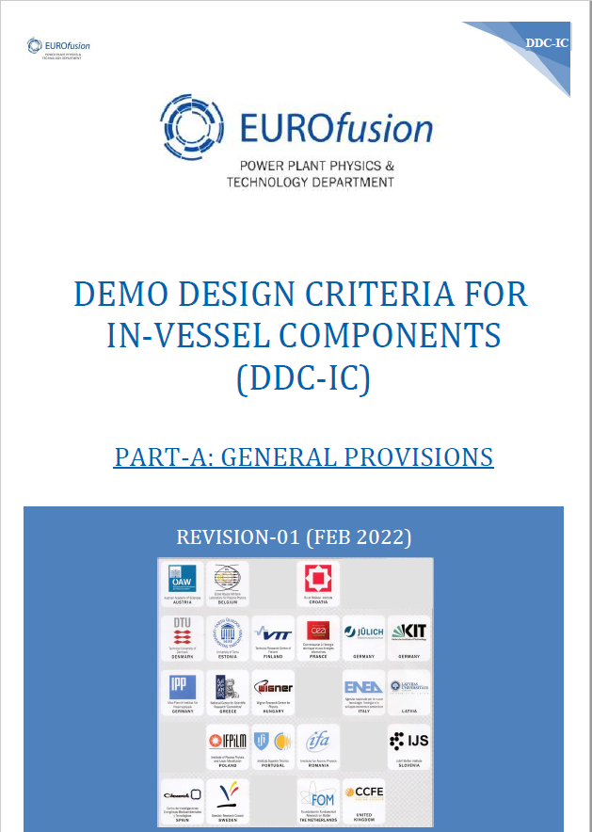
Engineering Design and Data Integration - DDC
DEMO Design Criteria for In-Vessel Components (DDC-IC)
First official draft version issued as part of Gate Review in 2020
  DDC-IC scope, methodology and approach clarified
  Design rules drafted for immediate plastic flow localization (IPFL), multi-axial fatigue, ratcheting, creep-fatigue interaction, brittle fracture and FCG
  Analysis examples and justification provided
On-going work towards the Gate 2 and issue of the first formal edition as part of the Gate 3
  Validation of design rules for DEMO-relevant materials and loading conditions → availability of experimental facilities and material for non-standard tests critical
  Benchmarking with other C&S, assessment of conservatism, definition of margins → performed by specific FEM simulations: interaction with designers and availability of codification experts critical
  Harmonization with other C&S, definition of an integrated design methodology → yearly code review and audit by C&S experts from AFCEN: also steers the 2 previous points
Underlying issue: Lack of an established safety framework and requirements for IVCs

Slide 8
Irradiation campaigns and PIE – Status and future plans
Task title | Irradiation facility | Materials & parameters
PIE of EUROFER97 | HFIR, ORNL | EUROFER97/2 20 dpa @ 220 / 250 / 300 / 350 °C
High-dose irradiation in BOR60 and PIE | BOR-60, RIAR | EUROFER97/3 and welds 20 / 40 dpa @ 330 / 550 °C
Irradiation and PIE of isotopic tailored EUROFER | HFIR, ORNL | ⁵⁴Fe and ^{58/60}Ni doped EUROFER97 12-15 / 25-35 dpa @ 300 / 400 / 500 °C
Irradiation of advanced steels for the down-selection of the SDQ project | BR-2, SCK.CEN | EUROFER97/2 and /3, advanced EUROFER-type steels 3 dpa @ 300 °C
PIE of CuCrZr | LVR-15, Rez PIE: VTT | CuCrZr 0.7-1.3 dpa, 150 / 250 °C
Low temperature irradiation of divertor materials | BR-2, SCK.CEN | CuCrZr, OFHC-Cu, EUROFER97 1 / 3 / 6 dpa @ 50 / 150 / 250 / 350 / 450 °C
Irradiation of plasma facing materials with thermal neutron shielding | BR-2, SCK.CEN | Commercial W, Tohoku-W & K-doped W, self-passivating W, W-ZrC 1 dpa @ 400 / 800 / 1100 °C
Future plans
Screening and data generation for advanced heat sink materials
High temperature irradiation of advanced steels (incl. ODS)
Shielded irradiation of PFMs only when data from actual campaign are available
Qualification of advanced materials on component level (MTRL 5-6) in collaboration with system WP

Slide 9
Key challenge(s) in the roadmap for materials
The challenges presented here can be related to:
Industrial upscaling and material manufacturing → alternative production routes for large quantities, reproducibility and homogeneity of physical and mechanical properties
Generation and exploitation of material data → limited availability of MTRs, waiting time for 14 MeV neutron source, systems’ design and operating conditions still evolving, safety/licensing approach tbd
Main challenge: How to achieve MTRL 7- Qualification of materials in operational environment
Facilities for the evaluation of synergistic effects via sequential loading
  Mechanical and physical properties, corrosion effects, (high heat flux performance and particle loads, ...)
Lack of facilities for the qualification of materials (incl. welds and components) via simultaneous loading
  Combination of temperature / stress gradients and high neutron dose & neutron dose gradients on materials and components
These facilities and the gained information / confirmation on end of life performance are a prerequisite for any DEMO-like fusion facility

Slide 10
Timeline for DEMO material qualification
Conceptual design phase
Engineering design phase
Construction phase
irradiation in MTRs / irradiation modelling ...
DDC-IC, MPHs for EDA
(draft)
DDC-IC, MPHs for EDA
(consolidated)
DDC-IC, MPHs incl. RMMs and based on REX
SSTT guidelines for steels
standardization of SSTT
IFMIF/DONES
decision on RMMs for EDP
ITER/VNS operation
breeding blanket
decision on material test strategies / options in DEMO
DEMO
2022
2025
2030
2035
2040
2045
2050
EUROFER97 for TBM
base metal and welds (2-3 dpa)
codification in RCC-MRx
DEMO 1st phase
EUROFER (+welds) data at 20 dpa
long term effects (creep, C/F)
qualification of baseline W and CuCrZr
DEMO 2nd phase
EUROFER (+welds) data at 40-50 dpa
Effects of fusion neutrons
industrialization of (selected) RMMs
“PROTO”
development of advanced materials / concepts to be tested in DEMO

Slide 11











WPMAT / WPPRD-MAT Members
Ecole Royale Militaire
Laboratory for Plasma Physics
Institute of Plasma Physics
Academy of Sciences of the
Czech Republic
Technical University
of Denmark
Technical Research Centre
of Finland
AUSTRIA
BELGIUM
Ruđer Bošković Institute
University of Tartu
FINLAND
CROATIA
CZECH REPUBLIC
DENMARK
ESTONIA
The French Alternative
Energies and Atomic Energy
Commission
National Centre for Scientific
Research “Demokritos”
Italian National Agency for
New Technologies, Energy
and Sustainable Economic
Development
Centre for Energy Research
FRANCE
GERMANY
GERMANY
GERMANY
GREECE
HUNGARY
ITALY
Institute of Plasma Physics
And Laser Microfusion
Institute for Atom Physics
Jožef Stefan Institute
LATVIA
POLAND
PORTUGAL
ROMANIA
SLOVENIA
Centre for Energy, Environment
And Technology Research
Swedish Research Council
Kharkov Institute of Physics
and Technology
SPAIN
SWEDEN
SWITZERLAND
UKRAINE
UNITED KINGDOM

