Slide 1
R&Ds for Fusion Reactor Materials at SWIP
Presented by：CHEN Jiming
Southwestern Institute of Physics, Chengdu, China
Co-authors:
PENGFEI ZHENG, LONG ZHANG, YOUYUN LIAN, PINGHUAI WANG, JUAN DU, LONG WANG, Fusion Reactor Material Research Team at SWIP;

Slide 2
Outlines
1. Introduction
2. Material strategies for reactors
3. Progress of material researches
3.1 W-base PFMs
3.2 CLF-1 RAFM steel
3.3 V-base alloy
3.4 Tritium-breeding materials permeation barrier
3.5 Neutron irradiation tests
4. Summary

Slide 3
Scopes
SWIP has been focused on materials for in-vessel components for > 35 years.
Structural material for blanket and divertor, including ITER TBM
PFMs for FW and divertor
Tritium breeders and n-multipliers
Tritium permeation barrier
For ITER FW and shielding blocks
Copper alloys for ITER FW and DEMO divertor
1

Slide 4
List of the materials and technologies
PFMs
B-, Si-doped Gs for Tokamak
VHP-Be from ITER
CVD W coating (0.5mm/h)
W-K, W-Y₂O₃
W-Ta alloy
Liquid metal surface
Large-scale ingots
RT ductility
High recrystallization temp.
Thermal shock test
W/Cu brazing & HIP joining
Thermal fatigue performance
Structural mateials
316L with Ti-modified
HT-9, HT-7 ferritic steel
CLF-1 RAFM steel
ODS-RAFM steel
V-W-Ti, V-Ti-Al, V-4Cr-4Ti
CDS-V4Cr4Ti
Large-scale products
Neutron irradiation
Mechanical strength
thermal creep / fatigue
Corrosion in liquid Li / He
Electron irradiation damage
Heat sink materials
CuCrZr alloy
ODS-Cu
Strengthening
Bonding techn.
Functional mater.
Li₄SiO₄ pebbel
Be pebbles
Pebble bed
Compatibility with RAFM steel
......
2

Slide 5
1. Introduction
2. Material strategies for reactors
3. Progress of material researches
3.1 W-base PFMs
3.2 CLF-1 RAFM steel
3.3 V-base alloy
3.4 Tritium-breeding materials permeation barrier
3.5 Neutron irradiation tests
4. Summary
3

Slide 6
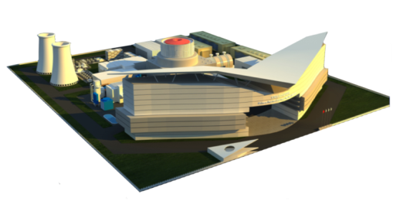
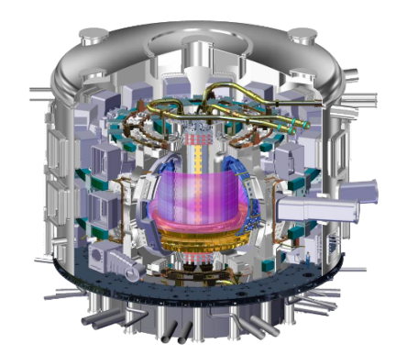
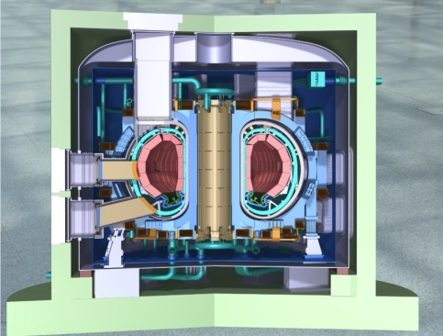

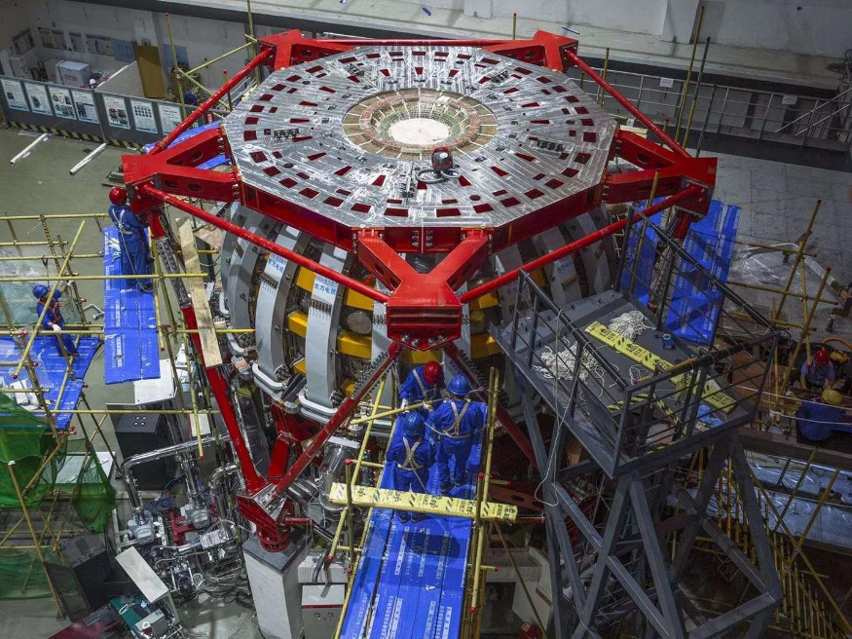
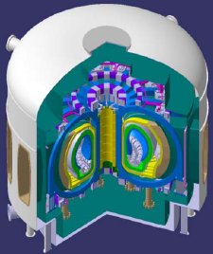
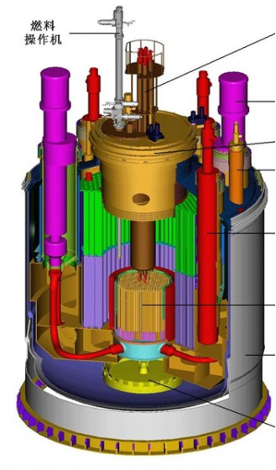
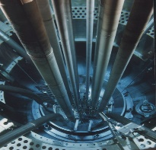
Map for neutron irradiation
ITER
（2038~2052 ？）
1~2 GW DEMO
(2040~ )
Material for TBM & W FW
HL-3 Tokamak
? dpa
? dpa
FPP (2050~ )
Max. > 200 dpa
~2050 in operation
3~4 dpa
> 50 dpa
Test Reactor
(2035~ )
Maximum 50~100 dpa
DT, Material with fusion n
200~300 dpa
> 20 dpa
<50 dpa
HFETR
<100 dpa
10~20 dpa
Steady burning
T self-sustaining
Max. 10~20dpa
Fission neutron
7~8 dpa/y
Fast reactor (2035~ )
30~50 dpa/FPY
D⁺→Li or D⁺→T (under design) Fusion neutron sources (10 dpa/FPY, 2~10 appm He/dpa)
Material changes? limited volume for material irradiation of the fusion neutron source?
4

Slide 7

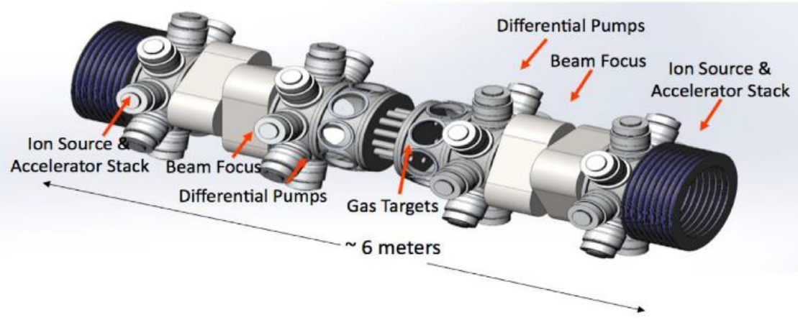
Fusion neutron source under design
Mission: to verify other irradiation, to provide support for test reactor.
Similar the one in US, to be constructed from 2024~2028.
D-T source: 300kV 100mA D⁺, 100 kPa T gas target.
Neutron fluence: 2.67×10¹⁶ n/s.
To provide an ~60 cm³ volume, ~10 dpa/FPY for materials test.
Considering more material to be irradiated and high dose irradiation demand, more fusion neutron sources are required.
5

Slide 8
Missions for a test reactor before DEMO
500~600 MW, 20~30% duty factor, 3~5 dpa/FPY, as a fusion neutron source to test its materials and those for DEMO.
Deasign based on fission neutron irradiation, together with a fusion neutron source for verification
Blanket & divertor structure: CLF-1 RAFM steel (reuqire >20 dpa data)
PM W and CuCrZr as PFM and heat think ( require > 2~5 dpa data)
Develope materials to large scale for reactor component.
Develope material technologies for components, such as W/CuCrZr
To establish correlation between fission and fusion neutron irradiation.
6

Slide 9
Material approches for DEMO and FPP
HFTER fission neutron to 50~100 dpa for DEMO;
D⁺ accelerator type neutron source to varify the fission neutron irradiation results, together with test reactor results
FPP, too high dose to be reached by fusion neutron sources, assuming to use fast reactor (in plan) for the purpose.
CLF-1 RAFMs as the major structural materials for DEMO, Partially ODS or V4Cr4Ti alloy, aimed at future use in FPP;
W-K or Wf/W as the major PFMs; Cu alloy or ODS-Cu as heat sink;
Supposing no material capable for > 200 dpa fusion neutron irradiation—— no higher dose irradiation test is required. In-situ annealing to recover irradiation damage should be investigated (with its demonstration in test reactor and DEMO).
7

Slide 10
1. Introduction
2. Strategies for various reactors
3. Progress of material researches
3.1 W-base PFMs
3.2 CLF-1 RAFM steel
3.3 V-base alloy
3.4 Tritium-breeding materials permeation barrier
3.5 Neutron irradiation tests
4. Summary
8

Slide 11
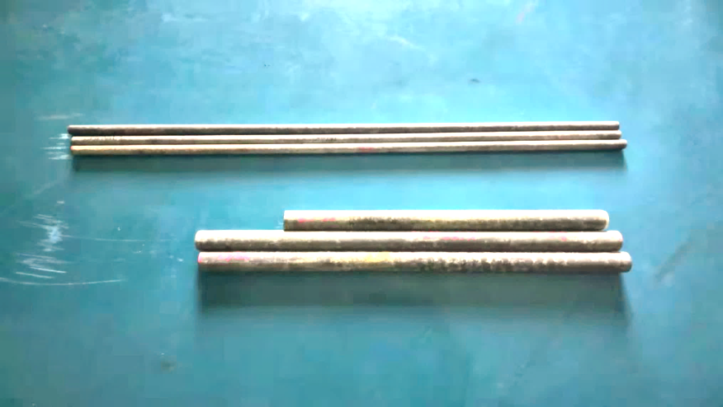
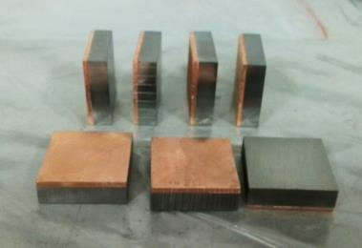
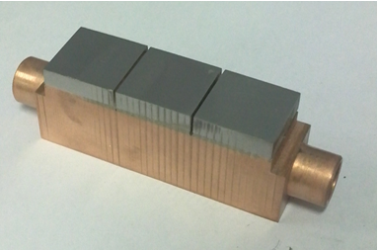
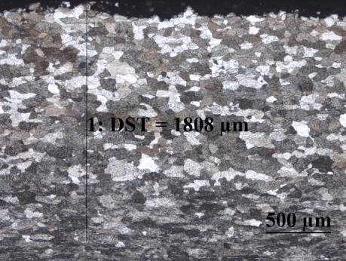
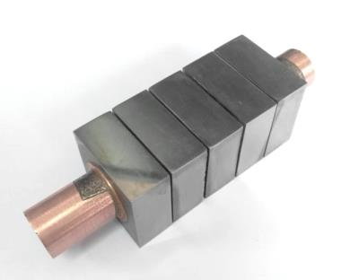
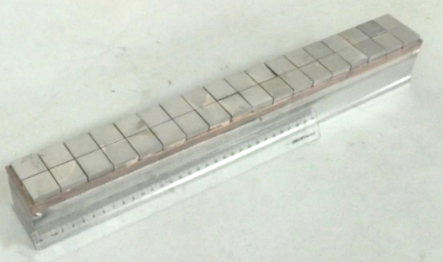
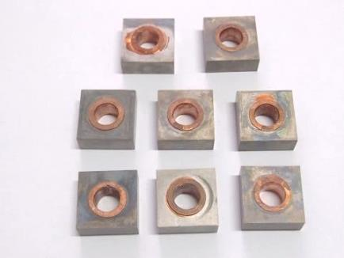
3.1 W-base PFMs and mock-ups technologies
Aiming at large-scale W alloy with RT ductility and >1600℃ recrystallization;
High strength ODS-Cu developed;
Brazing W (alloy)/CuCrZr for mono-block and flat moch-ups.
(see report from Dr. LIAN Youyun, day 2)
40 kg/pc,
Swaged W-Y₂O₃ and W-K bars
SWIP: Cu Casting + Vacuum Brazing Tech.
6mm W
W/OFCu joints
Flat W Mock up, 15MW/m², 300 cycles
Mono-block
20MW/m² Tolerability.
Divertor unit with HVT cooling
9

Slide 12
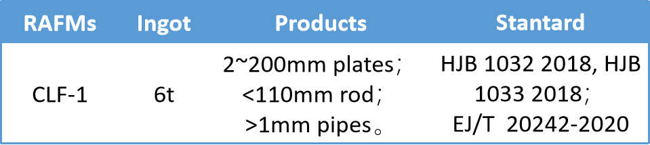
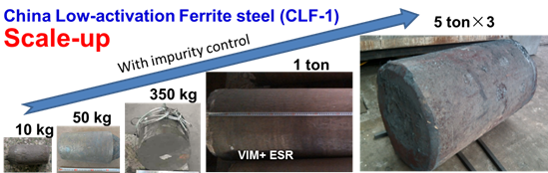
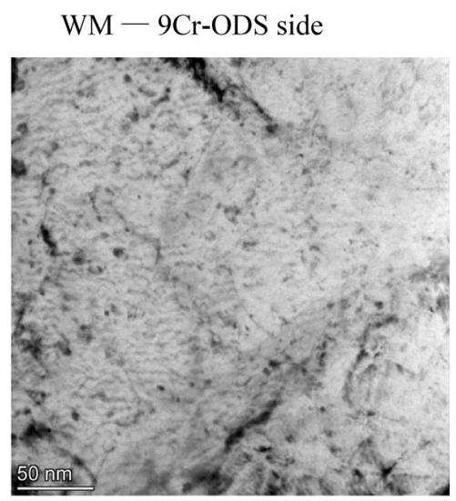
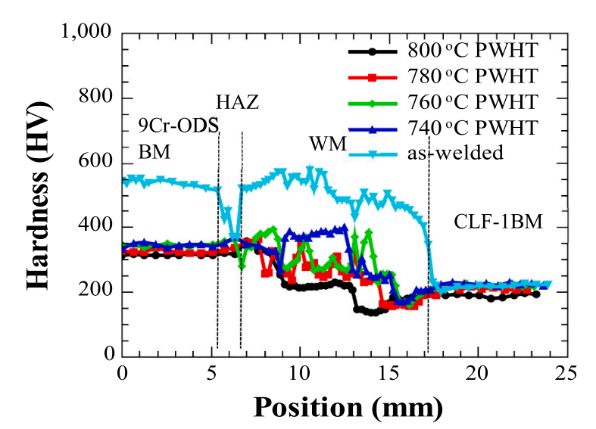
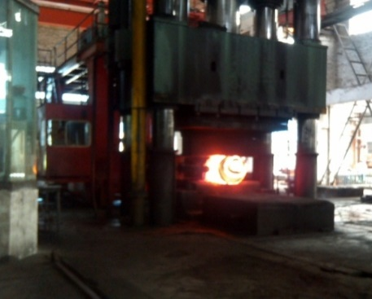
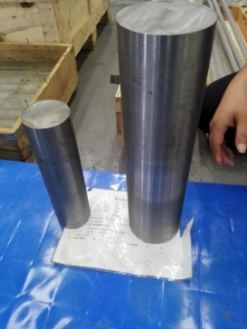
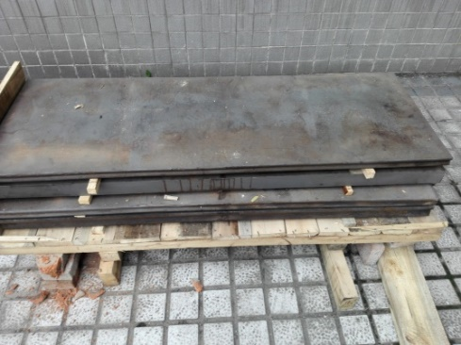
3.2 CLF-1 RAFM steels
(See report from Dr. ZHANG Long, Day 3)
  Database established
  Physical & tensile properties @ RT-650℃
  Impact properties @ -120℃ ~ RT
  Aging @ 550℃ & Creep tests, up to 10,000 hrs
  Fatigue @ RT-600℃, million cycles
  Neutron irradiation: on-going to 28 dpa
  Spallation neutron irradiation >20 dpa
  Ion irradiation to 200 dpa.
Engineering qualification completed.
Various welding technologies developed, including TIG, Laser, EB, HIP bonding, friction stir welding. etc.
Friction stir welding
10-55mm Plates
Forging
Forged Bars
10

Slide 13
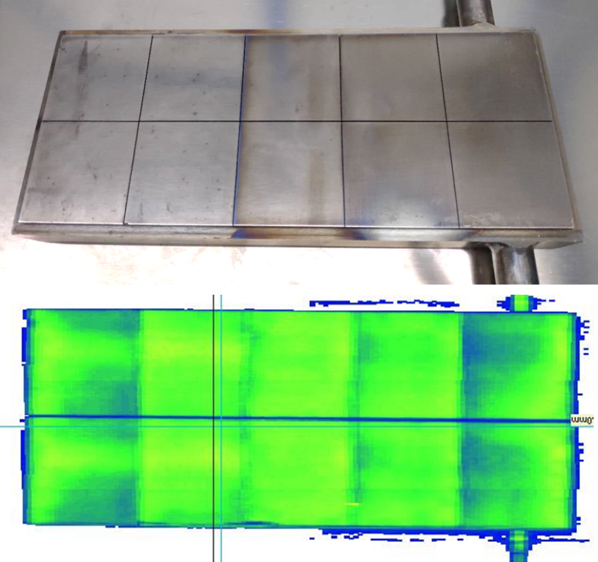
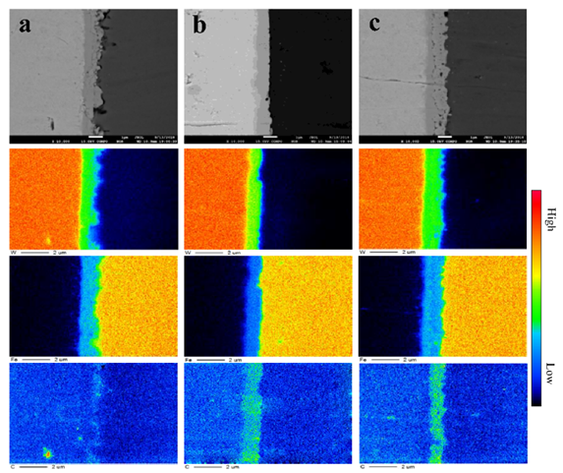
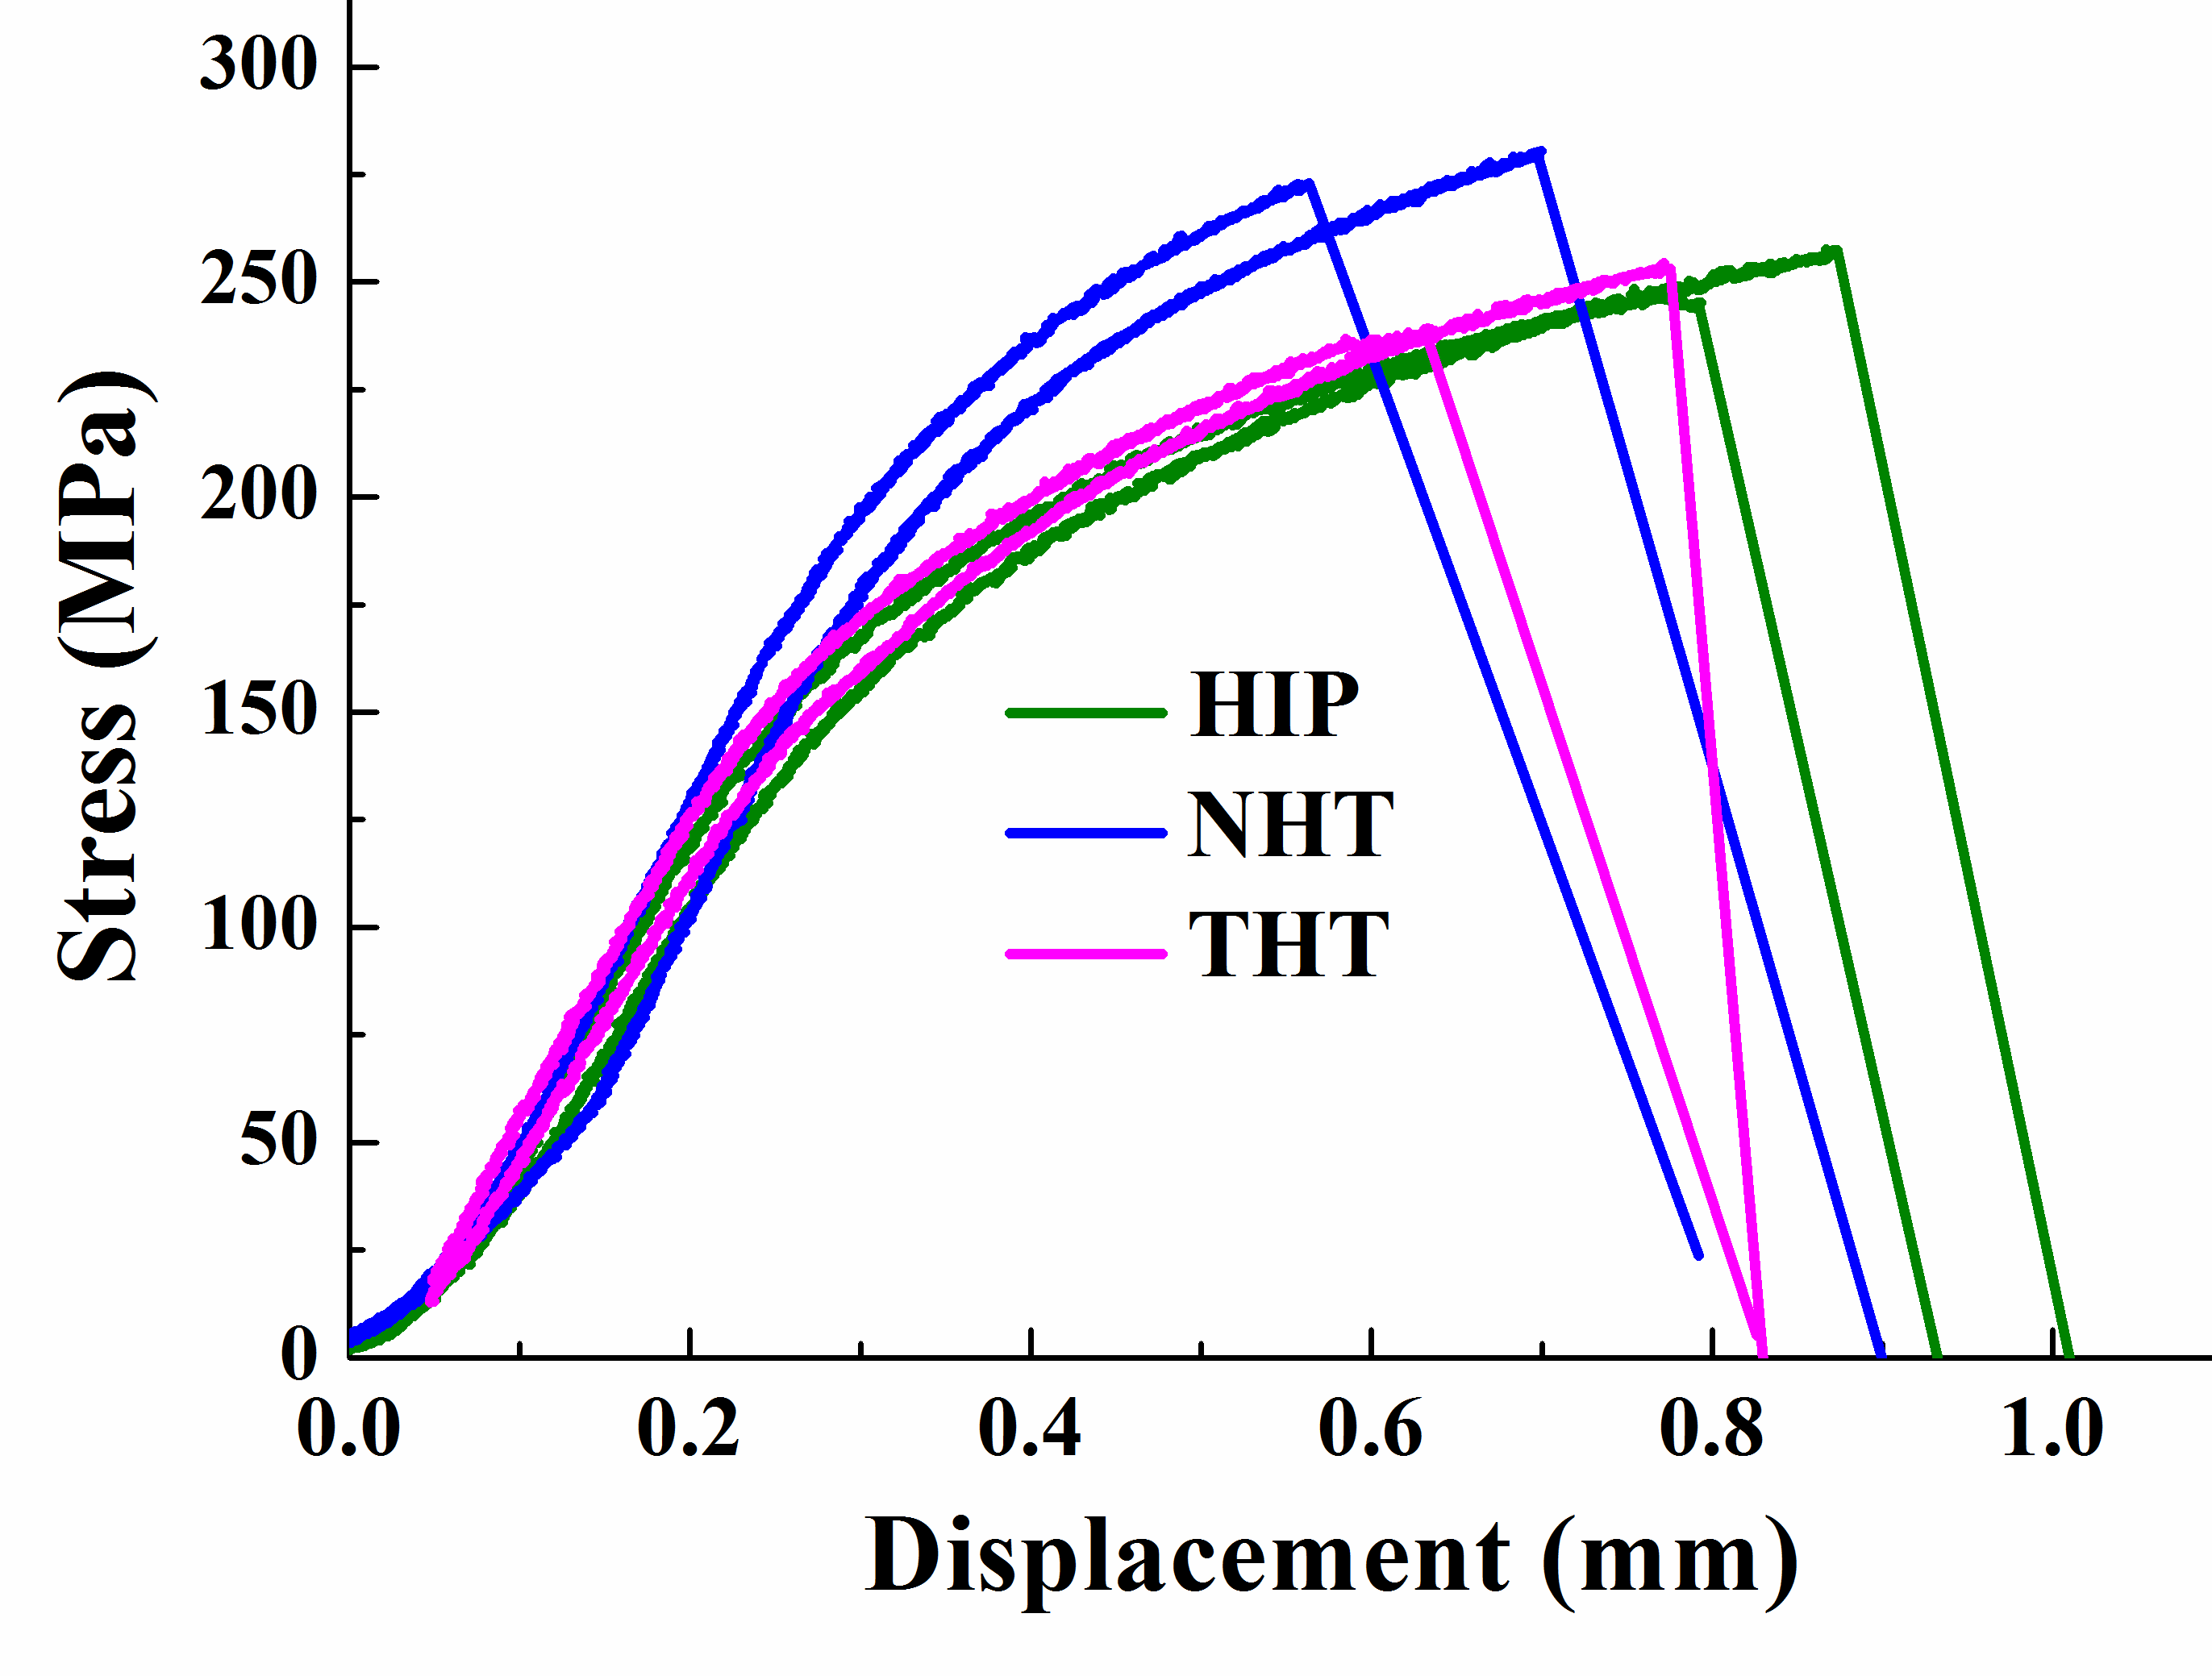
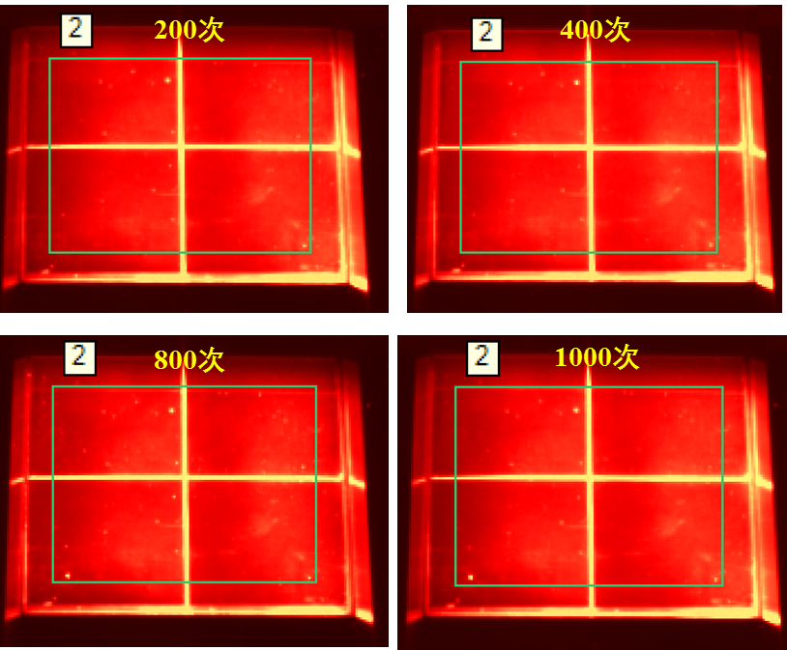
CLF-1/ W bonding FW technologies
HIP bonding joint at 900℃ / 150 MPa
HHFT at 1MW/m²,1000 cycle: 70℃ water cooling
NHT: 980℃/45min + Air Cooling,
Stable bonding strength: > 250 MPa
(by RT shear test)
THT: NHT+ 740℃/90min+ Air Cooling
HIPed
(Fe2W)
HIPed+NHT
(Fe2W+C)
HIPed+THT
(Fe2W+Fe3W3C)
HIPed. NHT & THT
11

Slide 14
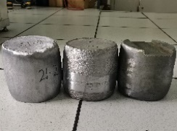
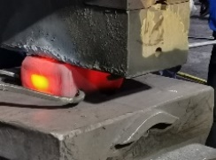
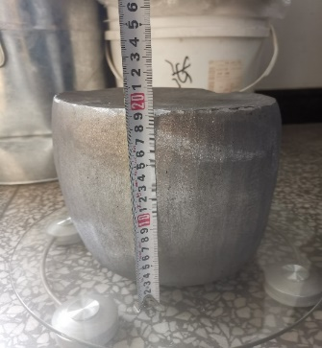
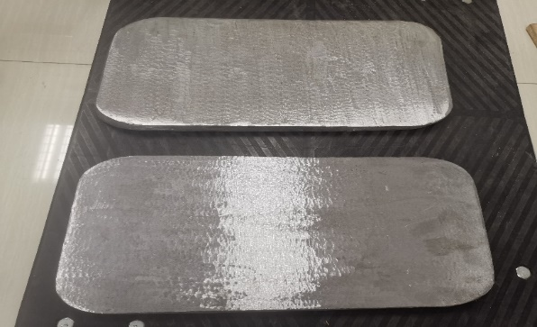
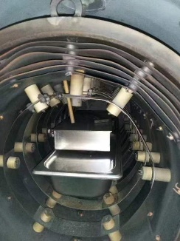
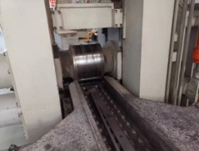
3.4 Development of vanadium alloy
V4Cr4Ti alloy product in 100 kg scale
Flowchart of vanadium alloy preparation
(a)
(b)
Ingot casting
Hot forging
Three ingot, 34.6 kg for each
17.5kg vanadium alloy hot-rolled plate from each ingot.
Heat treatment
Hot rolling
12

Slide 15
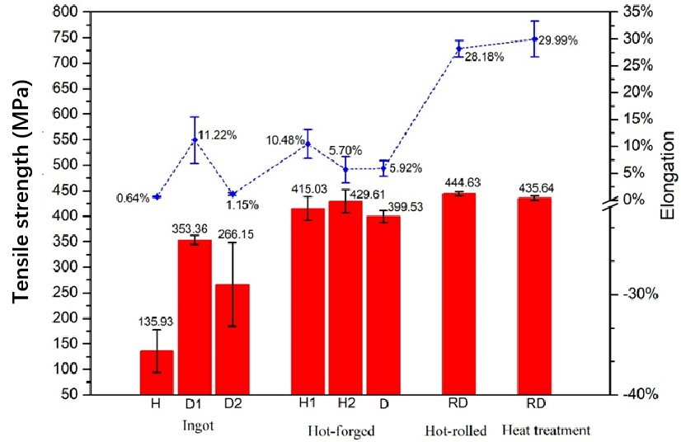
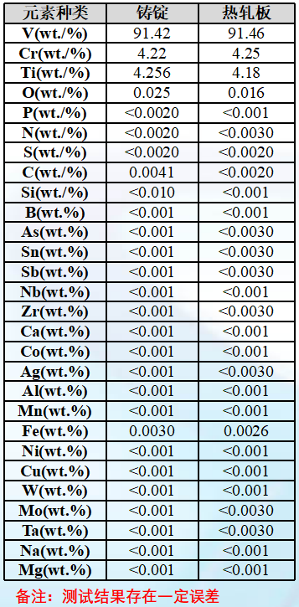
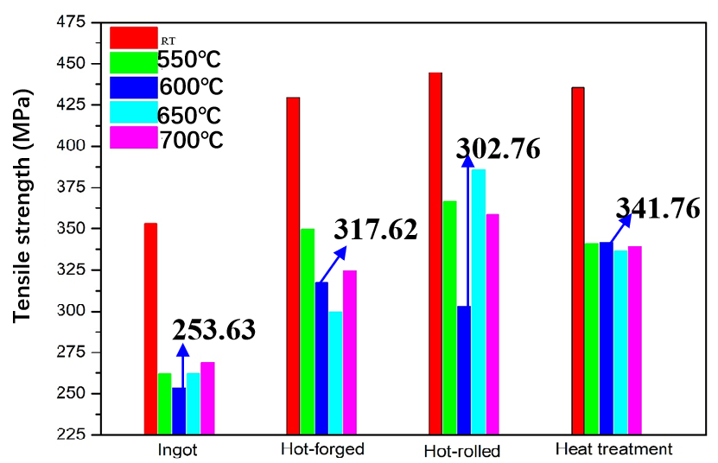
Good impurities control and high strength at elevated temperature
The total highly active elements: < 150wppm;
C + N + O: < 210 wppm.
RT TE: 30%, ~340 MPa strength to 700℃
Element
Ingot
Hot-rolled plate
13

Slide 16
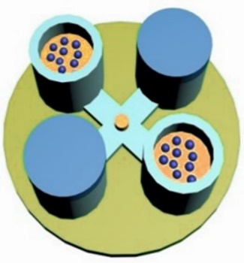
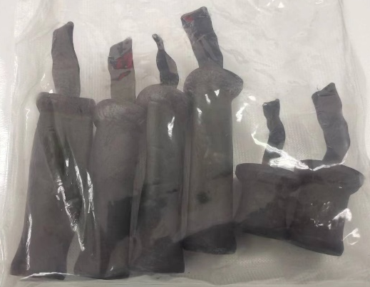
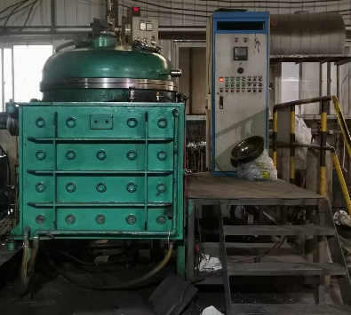
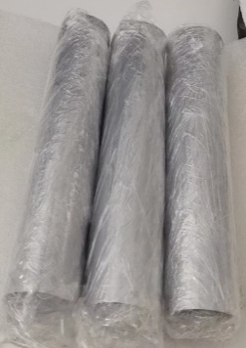
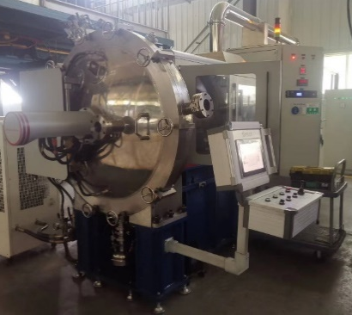
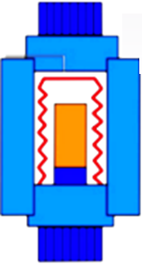
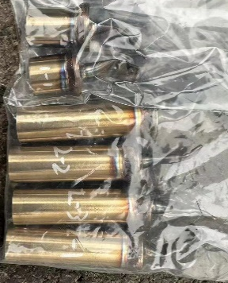
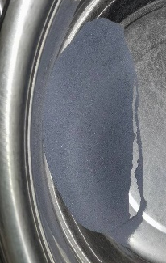
MAX Phases Dispersion Strengthened V-4Cr-4Ti Alloy
V-4Cr-4Ti
Powder Process
Ball-milling
Sintering
Casting molding
Ball-milling
Hot rolling
Good impurities control & much better thermal creep property.
V-4Cr-4Ti + MAX Phases
Plasma Rotating Electrode
HIP Sintering
Table1: Chemical composition test /wt.%
Sample | Cr | Ti | C | N | O
Original | 4.22 | 4.26 | 0.0041 | <0.002 | 0.025
Casting | 4.23 | 4.68 | 0.0042 | <0.002 | 0.044
Powders | 4.16 | 4.66 | 0.0059 | <0.002 | 0.050
14

Slide 17
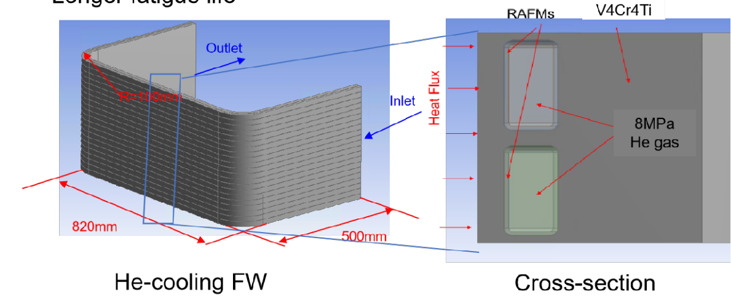
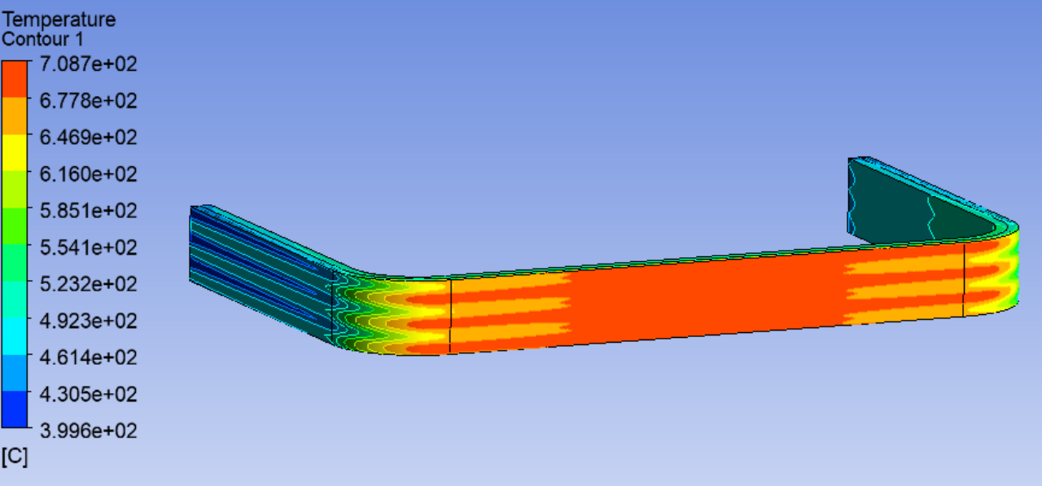
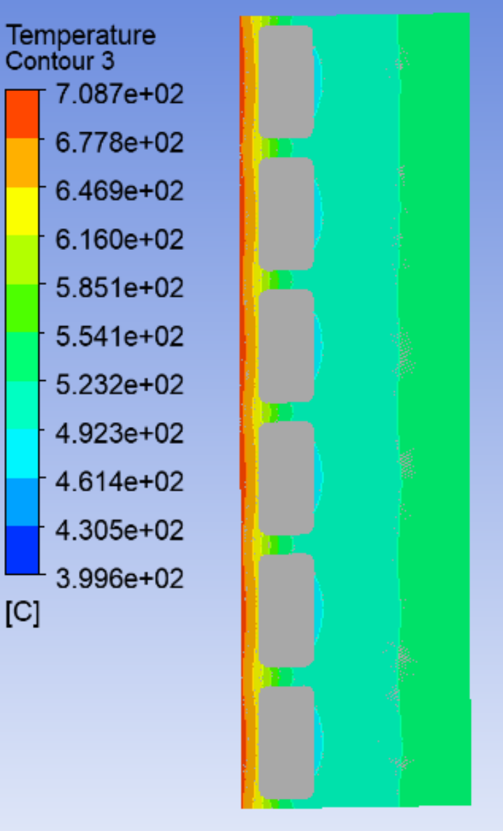
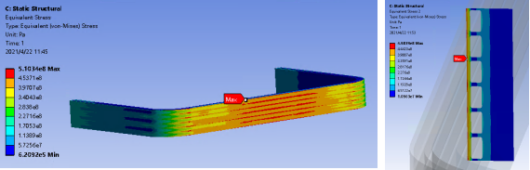
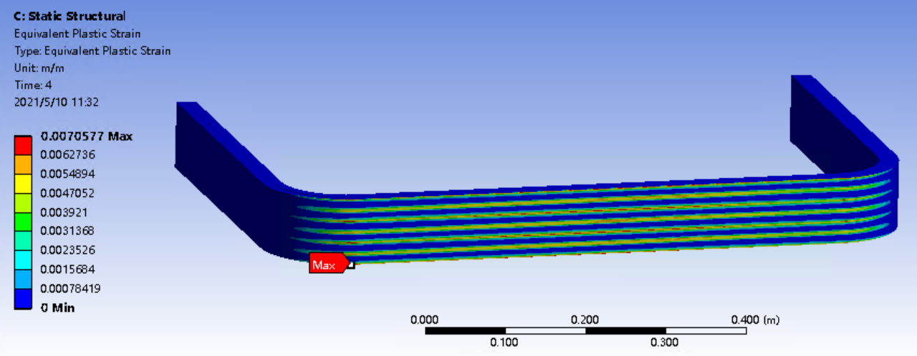
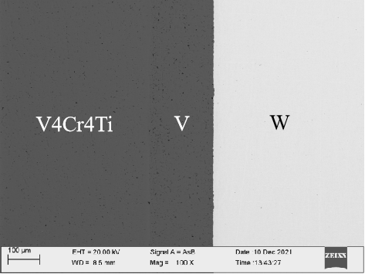
Vanadium first wall technologies
Temperature map
at 1 MW/m²
399~709℃
Equivalent stress
at 8MPa + Temp. field
≤ 510 MPa
Nuclear heating：27MW/m³；Coolant flow：100m/s；In/outlet temp.:400/490℃
Pressure drop: 0.14MPa
V4Cr4Ti/W diffusion bonding developed, > 100 MPa
Equivalent strain (%)
≤ 0.71%
15

Slide 18
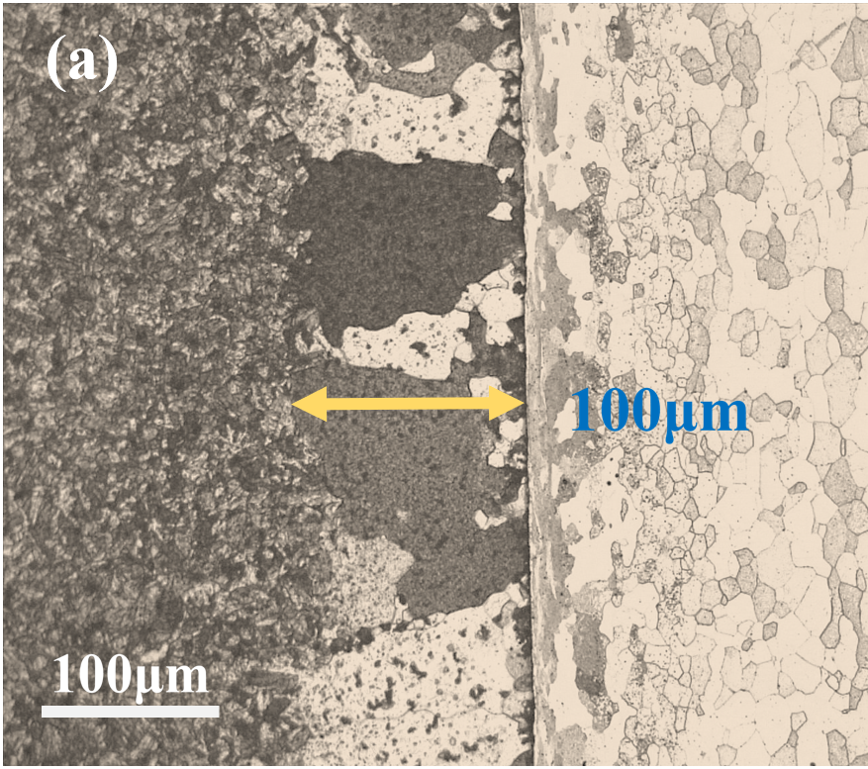





Reliable diffusion-bonding with RAFMs and CDS-V4Cr4Ti
Good HIP diffusion bonding V4Cr4Ti/RAFMs and V4Cr4Ti-melted /CDS-V4Cr4Ti.
Bonding strength > 240 MPa achieved.
Tritium permeation under investigation.
CLF-1 RAFM steel
SWIP-30
V4Cr4Ti
Interface
CDS vanadium alloy
V4Cr4Ti
V4Cr4Ti
V4Cr4Ti
CDS-V
Interface
Hardness (HV)
CDS-V
CDS-V
CDS-V
100μm
V4Cr4Ti-1.5Y-0.3Ti₃SiC₂
RT shear bonding strength > 300 MPa
Position (mm)
16

Slide 19











V4Cr4Ti mock-ups for FW
Reliable materials bonding
No UT indication of defect
No damage at 1.25 MW/m² for 1500 cycles.
2mm-thick W, >700℃ of V4Cr4Ti
He-cooling W/V4Cr4Ti/CLF-1 FW mock-up
Water-cooling W/V4Cr4Ti/CLF-1 FW mock-up, with equivelent stress and Maxi. temperature
EMS-400 at SWIP for HHFT, to be updated to 800 kW
17

Slide 20





3.4 T-breeding materials
Ceramic: Up to 10kg / batch.
New facilities for Li₄SiO₄ in SWIP.
Physical & mechanical properties measured.
(see report from Dr. ZHANG Long, day 3)
Liquid LiPb
Loop under construction, for (1) MHD study, (2) Material corrosion test, (3) heat transfer, etc
Li-Pb loop 300-550℃, 0-5m³/h
Into operation by 2025
8500mm
Li₄SiO₄ pebbles
Li₄SiO₄ producing facility (new in SWIP)
Superconductor Magnet
Ha:0-10⁴
Magnetic filed B: 0-4T
200*500*500mm³
Beryllium pebbles
Beryllium fabrication facility
18

Slide 21






Hydrogen isotopes permeation— facilities
Comprehensive hydrogen analysis platform (CHAP) at SWIP
Thermal desorption spectrum (TDS)
In situ testing design
Hydrogen retention amount
Hydrogen desorption temperature
High temperature for W
Distinguish He and D (ongoing)
in situ testing after D He implantation
(ongoing)
Gas driven permeation systems
Small atoms analysis
(H、D、T、He、Li)
Gas chromatography
Hydrogen permeability, diffusion coefficient
High downstream vacuum (10⁻⁸Pa)
High heating rate (W heater)
Tubes and module testing
Distinguish He and D (ongoing)
He content in Ar
He content in H₂
H₂ content in Ar
H₂ content in He
Test scope (＞20ppm)
Laser-induced breakdown spectroscopy
Hydrogen amount in materials
H test scope (0.08ppm-2500ppm)
Precision (0.04ppm or 0.4%RSD)
Depth distribution of H and Li
＞10ppm
Spectral resolution of 0.1nm（FWHM）
Wavelengths of180nm-1100nm
N/O/H analysis instrument
19

Slide 22







Progress on Hydrogen isotopes permeation
Fusion Engineering and Design 201 (2024) 114280
Electrolytic cell for Hydrogen permeation
Annealing decreased hydrogen traps
Irreversible hydrogen traps in CLF-1
Hydrogen traps density of RAFM (CLF-1) steel was evaluated by electrochemical method.
Fusion Engineering and Design 173 (2021) 112856
Corrosion product with a double layered structure decreased the deuterium permeability
Hydrogen permeation test under corrosion can be achieved.
Corrosion of RAFM (CLF-1) steel by Li₂TiO₃ and Li₄SiO₄was studied.
20

Slide 23







Progress on Hydrogen isotopes permeation
Surface & Coatings Technology 410 (2021) 126960
Preparation of ZrN, Al₂O₃ etc. coating
Al₂O₃ coating can protect CLF-1 from being corroded by Li4SiO4 with the formation of LiAlO₂.
Tritium permeation barrier with high corrosion resistance are being stuied.
Al₂O₃ composite coating was complete after 50 dpa Au+ irradiation.
Al₂O₃ composite coating behaved good hydrogen resistance after irradiation.
Al₂O₃ composite coating with high irradiation resistance was developed.
21

Slide 24






3.5 Neutron irradiation
Miniature specimens:
Tensile, bending, Charpy, TEM discs, etc.
Al tube
Fillers
Specimens
Fuse wire
to monitor temperature
Capsual
Nuclear heating up specimens
N Fluence (E>1MeV): 2.5E+14 n/(cm².s)
22

Slide 25

HFETR Neutron irradiation progress
Bi-Sb fuse wire developed for temperature monitoring from 300~600℃
7 and 14 dpa irradiation completed.
Data available in this year.
Bi-Sb alloy stub for temp. monitoring.
An ODS steel to 7 dpa:
Irradiation hardening,
Reduction in ductility
(Sb content →)
23

Slide 26
Summary
Great challenge for fusion reactor materials, a step-by-step approach is supposed.
SWIP is heading forwards to actual nuclear fusion, including DT operation of HL-3, an engineering test reator and a D-T neutron sources to solve the material issues.
Materials are scaling up for reactor construction, focusing on material data base construction, neutron irradiation test and material technologies for in-vessel components.
24

Slide 27
Thanks for listening!
Questions or Comments?

