Slide 1
Development of tungsten-based improved amour materials in EU
4th Technical Exchange Meeting on CFETR and EU-DEMO
Gerald Pintsuk
Forschungszentrum Jülich GmbH

Slide 2
Introduction
Baseline material
  Pure W, plate with 12 mm thickness, ITER grade
  Qualification program (non-irradiated and irradiated – with thermal neutron shielding) is ongoing
What are the issues advanced materials have to “solve” or “alleviate”?
  Recrystallization in general and neutron induced recrystallization in particular?
  Brittleness in general and neutron induced embrittlement in particular?
  Fatigue induced plastic deformation at high temperatures (high heat flux ≥ 20 MW/m²)?
  Oxidation and sublimation during accidental conditions?
  Thermal expansion mismatch between plasma-facing and heat sink material?
  Thermal shock induced surface roughening and crack formation? Macro-crack formation?
  Workability?
  Intrinsic: irradiation induced reduction of thermal conductivity due to transmutation?
Non-scientific boundary conditions
  Economic viability!?

Slide 3
Advanced plasma facing materials – First Wall
First Wall – temperatures should stay below 1000°C, so embrittlement by irradiation will occur in any case, but no structural function, only erosion resistance – should keep the joint with the structural material below – protection against LOCA?
TOPIC: Oxidation resistance
First wall
Not suitable for strike point. Other divertor parts?
SMART W-alloys (WCrY, WCrYZr)
Competing with pure plasma sprayed W (incl. plasma sprayed W/steel interface)
Composition / heat treatment are set
Industrial upscaling of MA (similar to ODS-steel development)
Industrial upscaling of FAST technology (as alternative to HIP)
Next steps: Mock-up manufacturing → joining to EUROFER97
Open issues: Irradiated material properties and in particular oxidation resistance

Slide 4
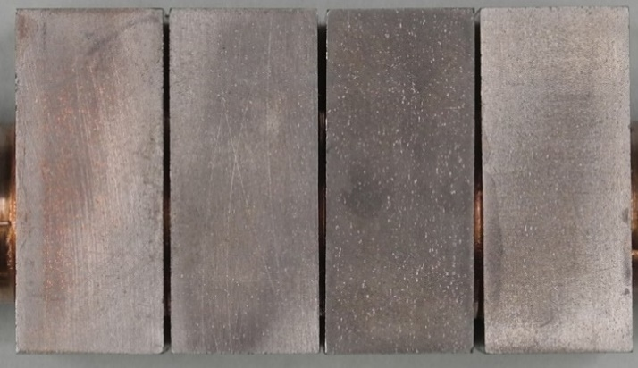
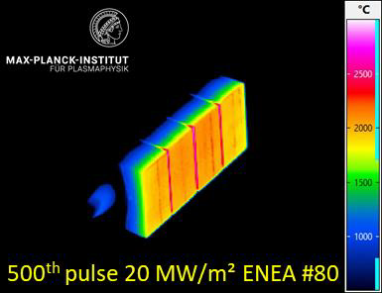
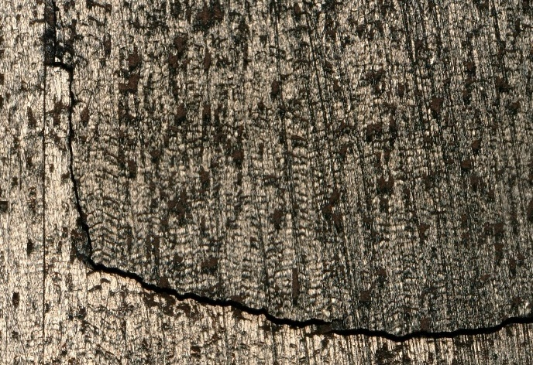
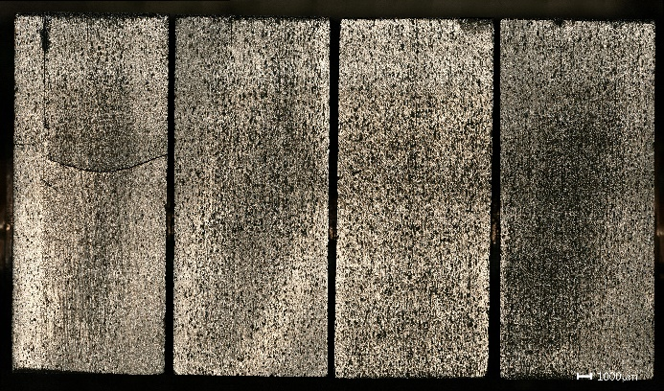
Advanced plasma facing materials - Divertor
TOPIC: Fatigue damage
W-W-laminates (K-doped)
High heat flux: 20 MW/m² @ GLADIS
before
500 cycles
1500 cycles
  Crack formation has no effect on performance
  No barreling after 1500 cycles @20 MW/m² was observed

Slide 5
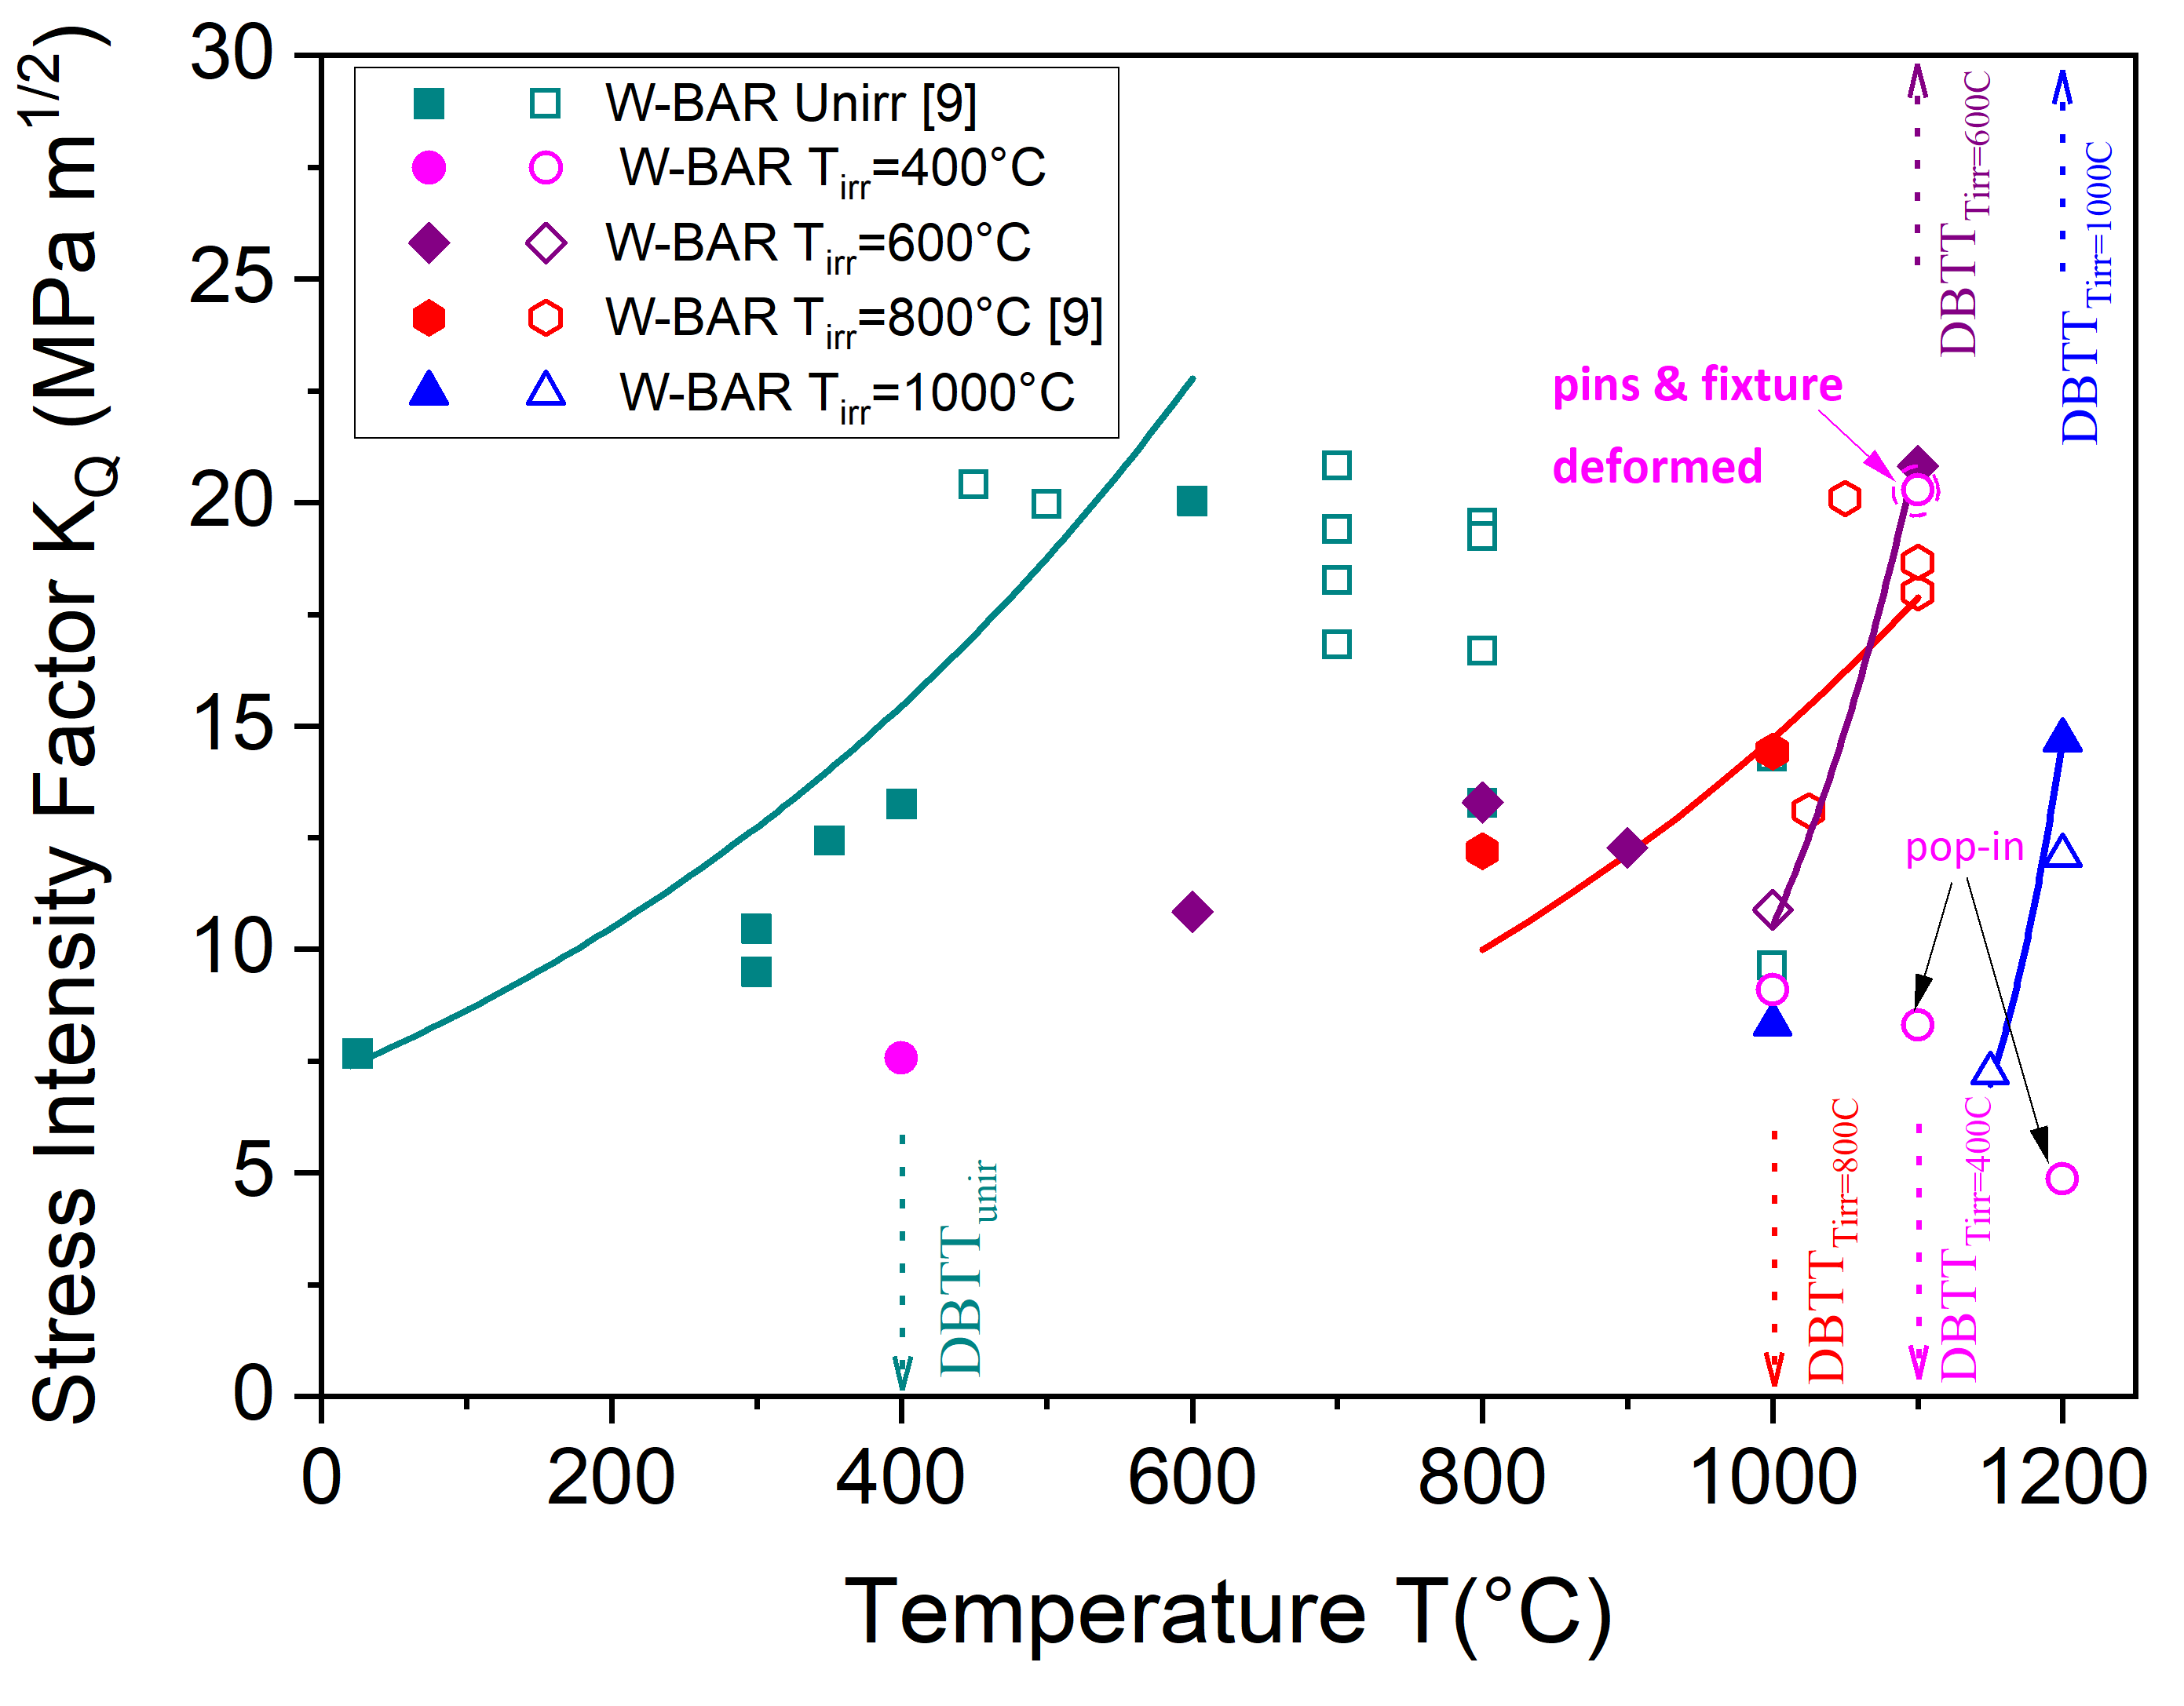
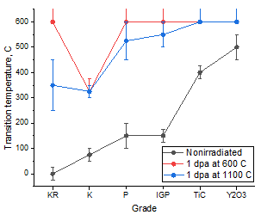
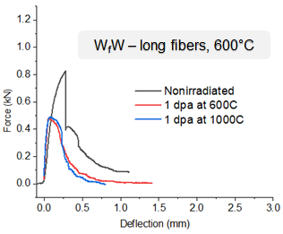
Advanced plasma facing materials – down-selection process
TOPIC: Recrystallization / grain growth, irradiation embrittlement
Divertor strike point
KLST
T-orientation
Effect of Re-transmutation?
ΔT=250°C
3pt-bending
L-orientation
ΔT=350°C
Pure W (IGP)
Tohoku
PIM
Discarding of technologies (e.g. PIM) and materials (e.g. W-TiC, W-Y₂O₃, ...)

Slide 6
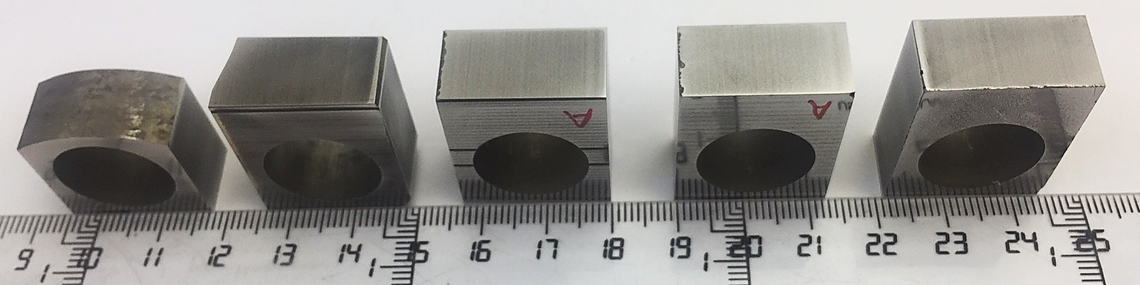
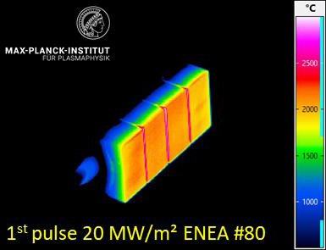
Advanced plasma facing materials - summary
Current status
SMART W
Multitude of materials at MTRL 2-3
  Self-passivating W-alloys (SMART)
  W-W laminates (incl. K-doping)
  WC reinforced W?
  Additive manufactured W (e.g. via LM or EBM)?
  W-fiber reinforced W?
AM W
W-W laminates
Open questions
Confirmation of W-issues: recrystallization, surface crack formation, macro-crack formation, brittle cracking, ...? → irradiation of materials and components
SMART alloys – coordination with SAFETY
  Coating thickness on the First Wall?
  For divertor areas with low heat flux?

Slide 7
Advanced plasma facing materials - summary
Running programs
Irradiation program on advanced plasma facing materials
  Irradiation with thermal neutron shielding: commercial pure W, self-passivating W, K-doped W (Japan), W-ZrC (China)
  Irradiation temperatures: 400, 800 and 1100°C; dose (in W): 1 dpa
  Irradiation start in Q1/2024
Further steps
Further down-selection based on mechanical properties & irradiation performance
Large scale fabrication
In-depth characterization in the full operational temperature window as input for MPH

Slide 8











WPMAT / WPPRD-MAT Members
Ecole Royale Militaire
Laboratory for Plasma Physics
Institute of Plasma Physics
Academy of Sciences of the
Czech Republic
Technical University
of Denmark
Technical Research Centre
of Finland
AUSTRIA
BELGIUM
Ruđer Bošković Institute
University of Tartu
FINLAND
CROATIA
CZECH REPUBLIC
DENMARK
ESTONIA
The French Alternative
Energies and Atomic Energy
Commission
National Centre for Scientific
Research “Demokritos”
Italian National Agency for
New Technologies, Energy
and Sustainable Economic
Development
Centre for Energy Research
FRANCE
GERMANY
GERMANY
GERMANY
GREECE
HUNGARY
ITALY
Institute of Plasma Physics
And Laser Microfusion
Institute for Atom Physics
Jožef Stefan Institute
LATVIA
POLAND
PORTUGAL
ROMANIA
SLOVENIA
Centre for Energy, Environment
And Technology Research
Swedish Research Council
Kharkov Institute of Physics
and Technology
SPAIN
SWEDEN
SWITZERLAND
UKRAINE
UNITED KINGDOM

