Slide 1
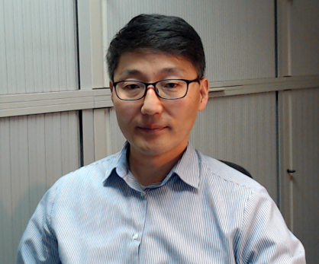







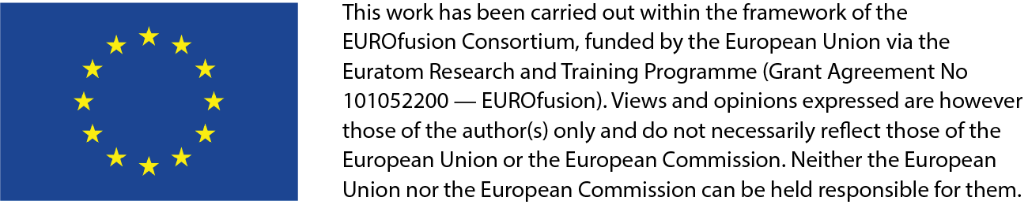







4th Technical Exchange Meeting on the China-EU Collaboration on CFETR and EU-DEMO Reactor Design
19-22.03.2024
EU DEMO Divertor: Design revision and R&D
Jeong-Ha YOU
on behalf of EUROfusion DEMO Divertor team

Slide 2
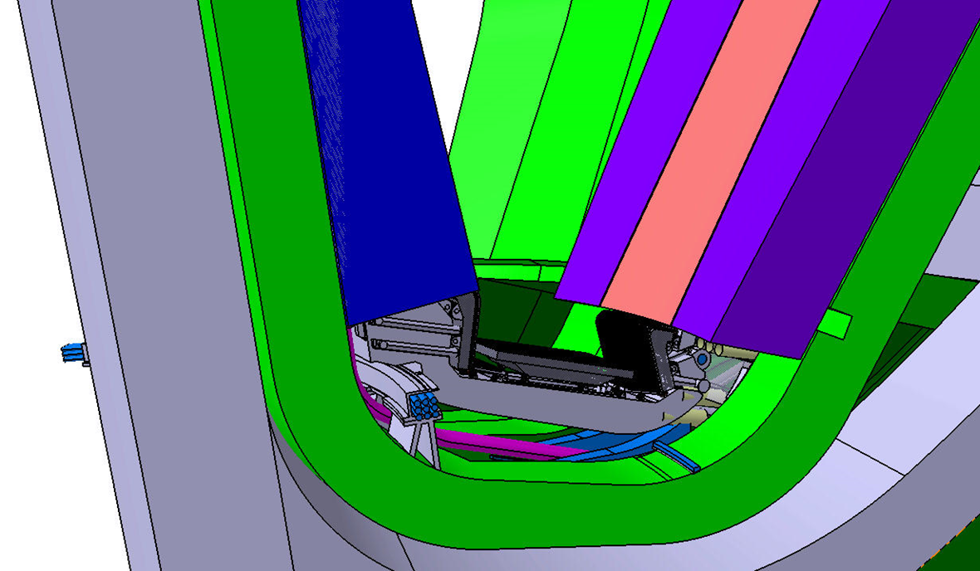
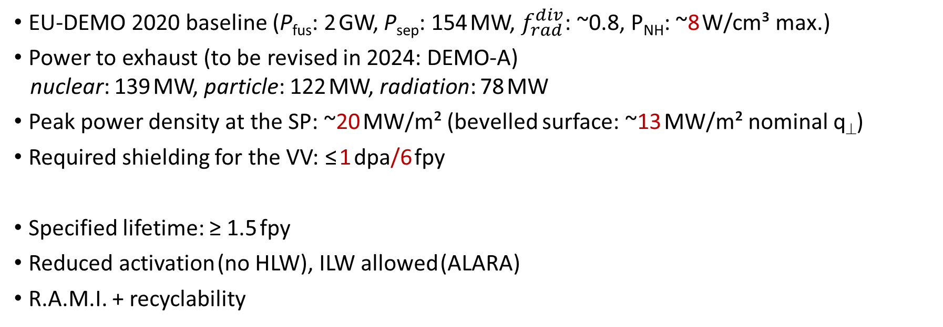
EU DEMO Divertor: high-level requirements
EU-DEMO 2020 baseline (P_{fus}: 2 GW, P_{sep}: 154 MW, $f_{rad}^{div}$: ~0.8, P_{NH}: ~8 W/cm³ max.)
Power to exhaust (to be revised in 2024: DEMO-A)
nuclear: 139 MW, particle: 122 MW, radiation: 78 MW
Peak power density at the SP: ~20 MW/m² (bevelled surface: ~13 MW/m² nominal q⊥)
Required shielding for the VV: ≤ 1 dpa/6 fpy
Specified lifetime: ≥ 1.5 fpy
Reduced activation (no HLW), ILW allowed (ALARA)
R.A.M.I. + recyclability
48 cassette modules, 16 lower ports
2

Slide 3
EU DEMO Divertor: objectives
Pre-conceptual design phase (2014-2020)
deliver a first feasible design concept compatible with the DEMO requirements (done)
2. develop & verify high-heat-flux technologies for the targets (done)
Conceptual design phase: 1st stage (2021-2023)
explore alternative design options to enhance RAMI (done)
2. launch key technology R&D for the entire cassette/PFCs system (done)
Conceptual design phase: 2nd stage (2024-2027)
define & verify baseline design with justification
2. demonstrate manufacturing technologies with small/medium-scale mock-ups
3

Slide 4
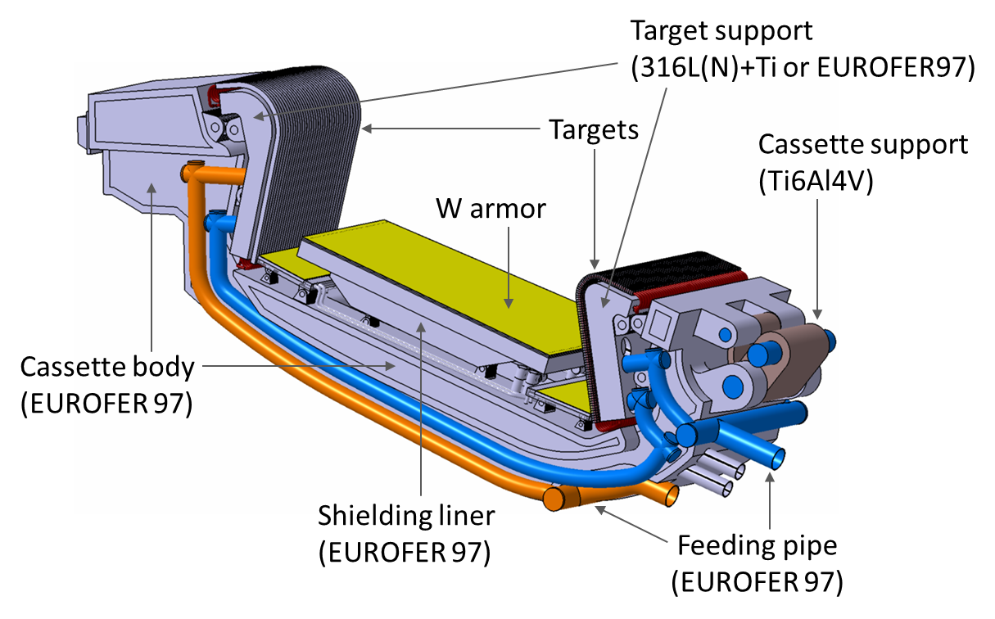
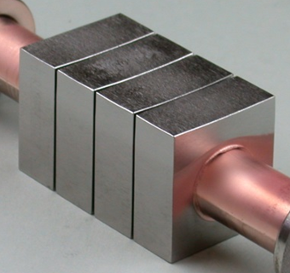
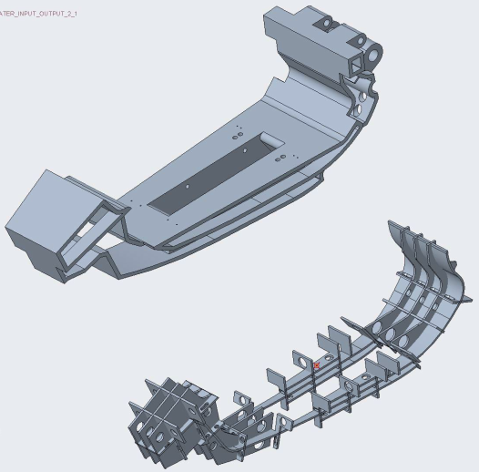
EU DEMO Divertor: architecture
Baseline 2 (as of 2023): DEMO-A
- Water-cooled (single-phase)
- Dual cooling circuits (CB/VT)
- Parallel circuit for IVT/OVT
- PWR cooling for the steel CB
- ITER-like HHF technology (LT coolant)
- XPR / MD / reattachment considered
- Suppressed ELMs
ITER-like target (Baseline 1)
Block width: 23 mm (ITER: 28 mm)
Armor thickness: 8 mm (ITER: ~7 mm)
Block thickness: 12 mm
W
CuCrZr
W block: stress mostly strain-controlled (not load-controlled)
→ UTS_{irr} is more relevant than (pseudo)ductility/toughness
J.H. You et al., FED (2022)
4

Slide 5
EU DEMO Divertor: design baselines
Baseline design I (as of 2020): water-cooled (separate dual cooling circuits)
Cassette body/shielding liner: EUROFER97 (180-210 °C, 3.5 MPa)
2. Target: W monoblocks/Cu pipe (130-137 °C, 5 MPa)
Baseline design II (as of 2024): water-cooled (separate dual cooling circuits)
Cassette body: EUROFER97 (295-328 °C, 15.5 MPa)
2. Target: W monoblocks/Cu pipe (140-147 °C or 150-157 °C, 7.5 MPa)
Technology R&D topics: (2021-2027)
Cassette body: joining (welding/HIP), AM, fixation units, pipe joining, insulation
2. Target: W wire-Cu composite pipe, support unit (steel), fixation, baffle, end cap, armor shaping
corrosion protection, swirl tape fretting, laminate W armor block (UTS_{irr}?)
3. Shielding liner/dome: W coating, joining (welding/HIP)
5

Slide 6
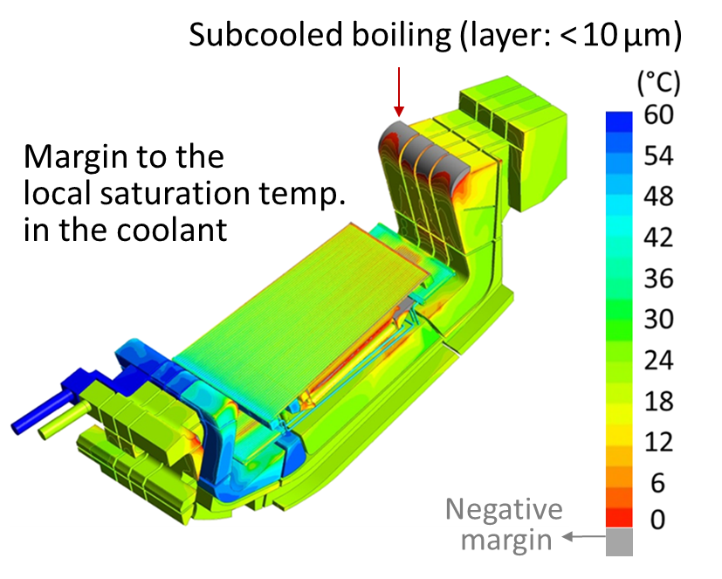
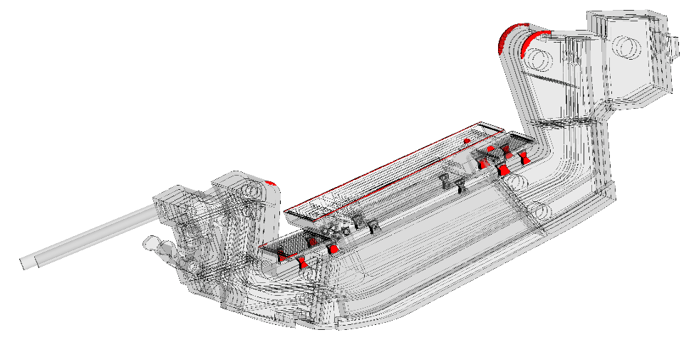
EU DEMO Divertor: cooling issues (cassette body: EUROFER steel)
Baseline 1 (as of 2020)
- Coolant temp. in CB: 180 - 210 °C
- Solid temp. in CB: 200 - 555 °C
Baseline 2 (as of 2023)
- Coolant temp. in CB: 295 - 325 °C
- Solid temp. in CB: 315 - 670 °C
Too cold (embrittled)
Optimal (ductile)
Too hot (softened)
Regions where
temp. > 550 °C
ODS EUROFER/HT EUROFER: low TRL, weldability? code/MPH (irrad.)?
J.H. You et al., FED (2022)
6

Slide 7
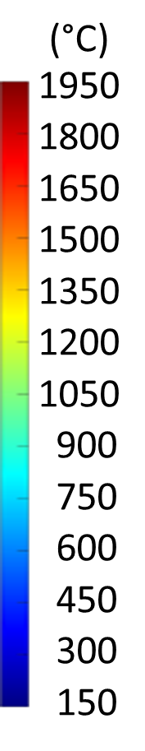
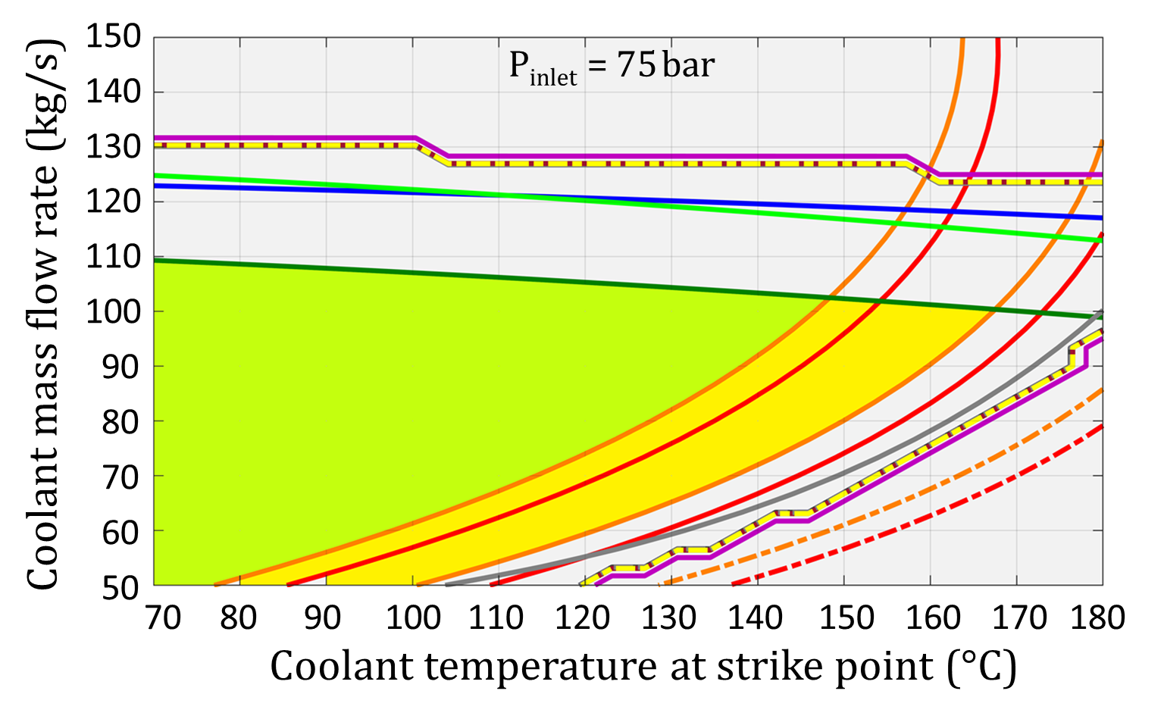
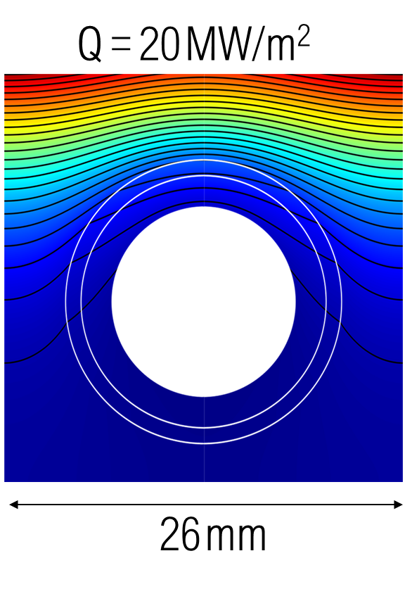
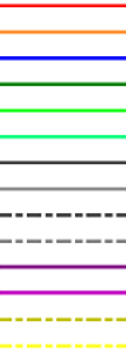
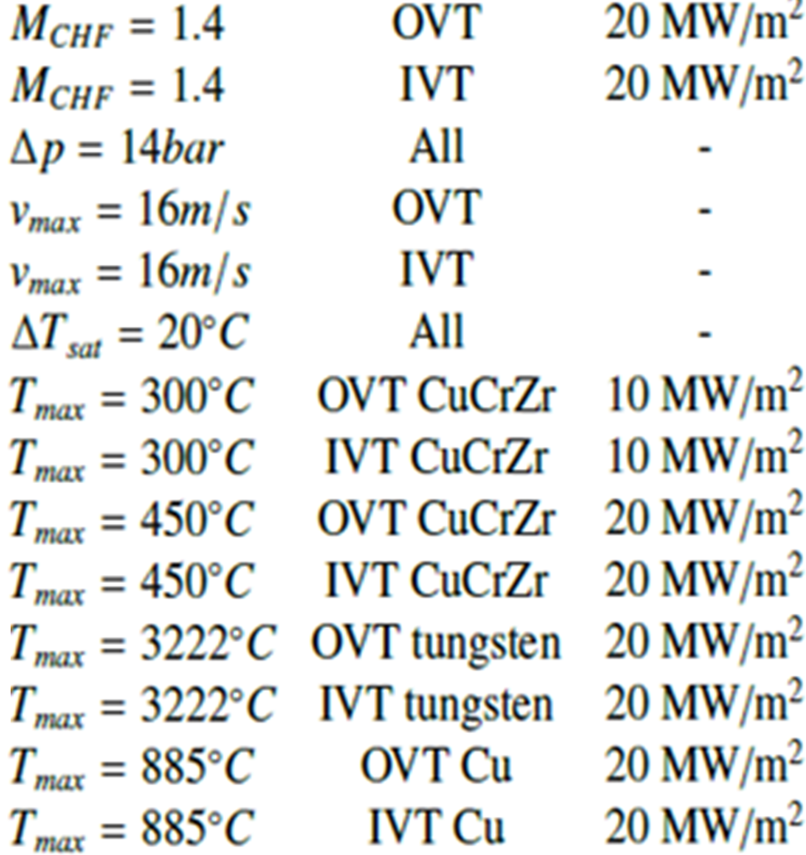
EU DEMO Divertor: cooling issues (new design space)
1900°C
1.4
1.2
150 °C
allowable cooling regime
for 10 - 20 MW/m²
(≤ 16 m/s, CHF margin: ≥ 1.4)
1.0
monoblock width: 26 mm
armour thickness: 6 mm (shaped)
pipe thickness: 2 mm
peaking factor: 1.7
D. Marzullo, A. Quartararo, FED (2024)
7

Slide 8
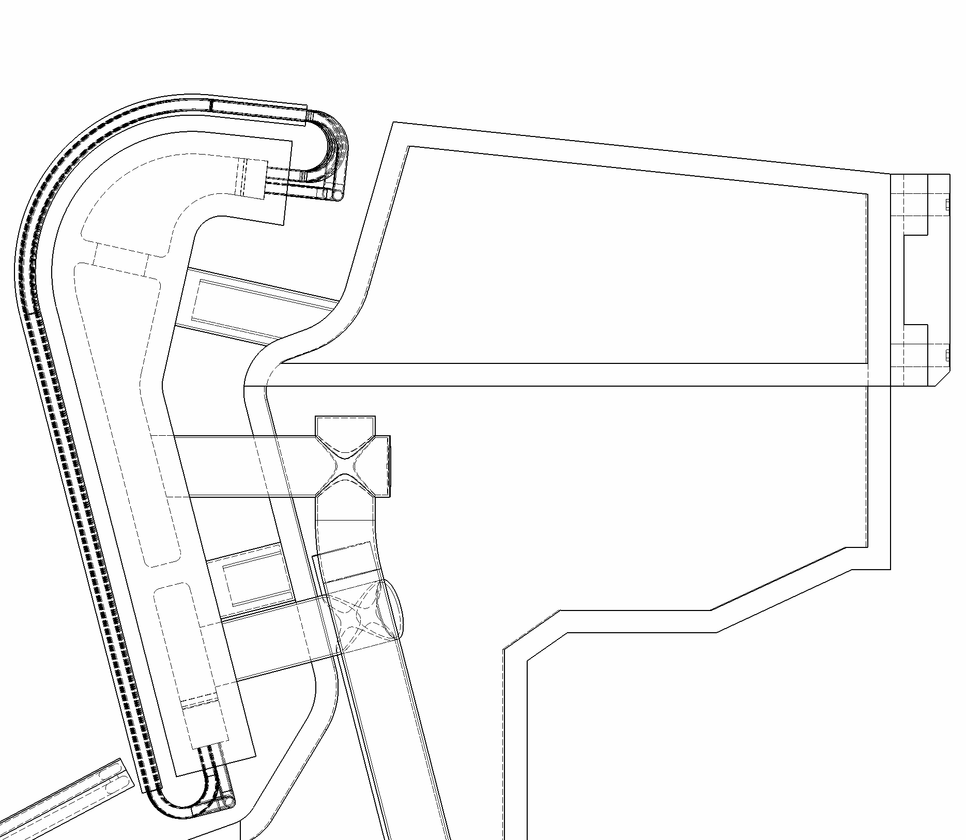
EU DEMO Divertor: cooling issues (new design space)
1.4
1.2
allowable cooling regime
for 10 - 20 MW/m²
(≤ 16 m/s, CHF margin: ≥ 1.2?)
1.0
8

Slide 9
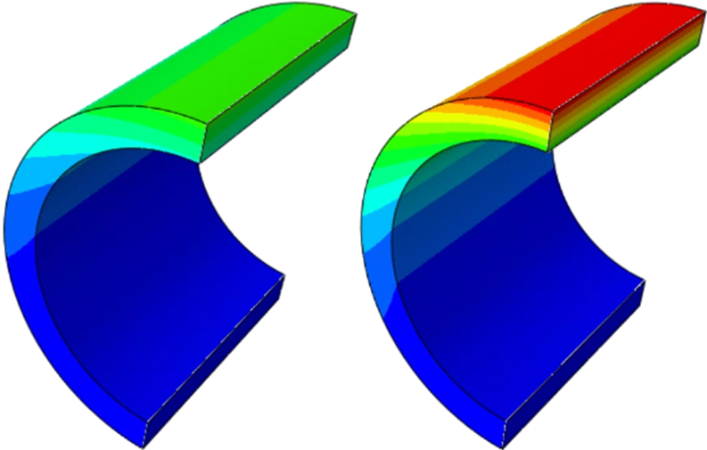
EU DEMO Divertor: cooling issues (target: CuCrZr pipe)
~7 dpa/fpy (effects saturated?)
Baseline 1 (as of 2020)
- Coolant temp. in VT: 130 - 137 °C
- Solid temp. in VT pipe: 174 - 293 °C (10 MW/m²)
213 - 431 °C (20 MW/m²)
10 MW/m²
20 MW/m²
Baseline 2 (as of 2023)
- Coolant temp. in VT: 140 - 147 °C
- Solid temp. in VT pipe: 183 - 302 °C (10 MW/m²)
218 - 436 °C (20 MW/m²)
Operation temp. range of the cooling pipe
(cooling) (10 MW/m²) (20 MW/m²)
130/140°C 174/183°C - 293/302°C ~430/440°C
Too cold (embrittled)
Optimal (ductile)
Too hot (softened)
optimal range
(250°C - 300°C)
loss of ductility reduced strength
He: ~60 appm/fpy
(effects not saturated)
J.H. You et al., FED (2022)
Pipe: ODS copper? (loss of toughness at HT, embrittlement at LT irradiation, swelling by deoxidiser?, anisotropy, low MTRL)
9

Slide 10
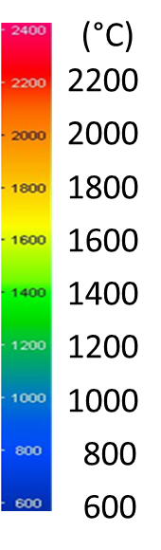
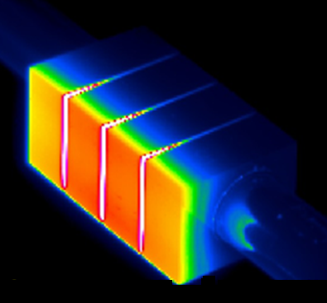
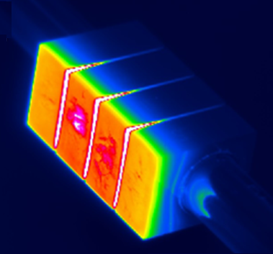
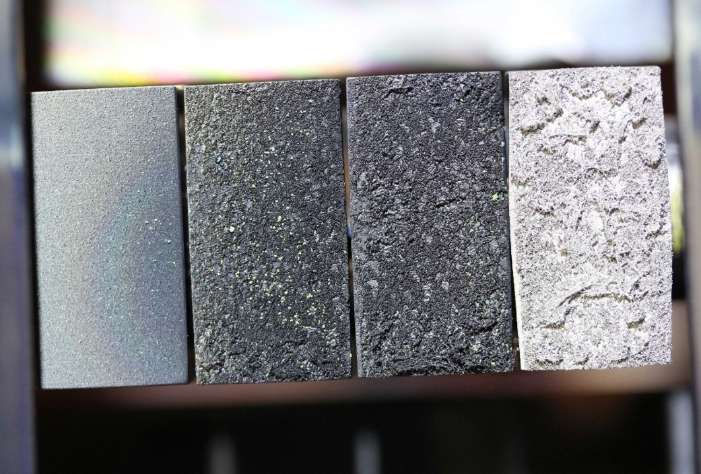
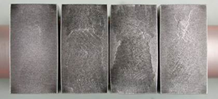
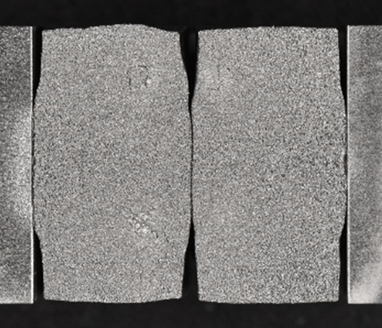
High-heat-flux performance: ITER-like tungsten monoblock target (20 MW/m²)
H beam irradiation (GLADIS) with short pulses (10s)
e⁻ beam irradiation (JUDITH2) with long pulses
1st pulse
500th pulse
1
2
3
4
500 cycles
2000 cycles
G. Pintsuk, J.H. You et al., NME (2024)
1: 20 MW/m², 10 s / 10 s, 200 cycles
2: 20 MW/m², 300 s / 10 s, 200 cycles
3: 20 MW/m², 600 s / 10 s, 200 cycles
4: 20 MW/m², 120 s / 10 s, 1000 cycles
No crack found (in all 292 tested monoblocks)
Remained fully intact (at least up to 2000 cycles)
Surface damage insignificant (at least up to 2000 cycles)
(HADES)
Effect of focused e⁻ beam scanning?
New tests with a larger beam spot in plan
J.H. You, J. Nucl. Mater. (2021)
10

Slide 11
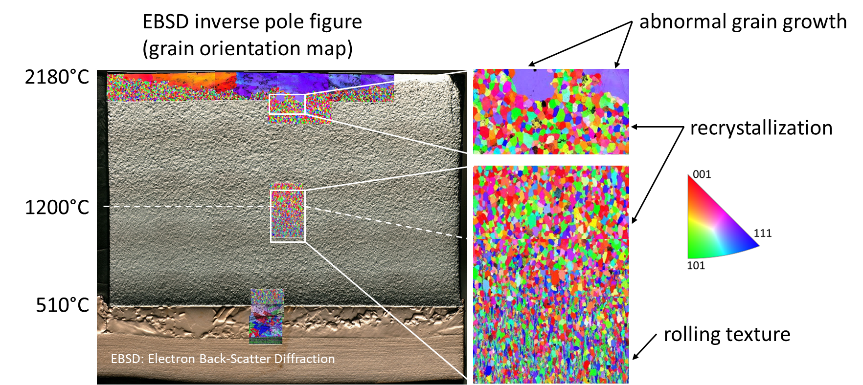
High-heat-flux performance: ITER-like tungsten monoblock target (20 MW/m²)
dpa damage present?
H/He outgassed?
Re/dpa effect?
J.H. You, et al. JNM (2021)
Irreversible microstructural change unavoidable regardless of metallurgy or grades
Recrystallization or grain growth is not necessarily a cause of crack initiation
J.H. You, Nucl. Mater. Ener. (2022)
11

Slide 12
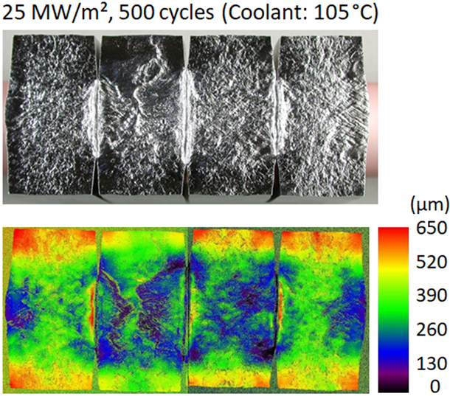
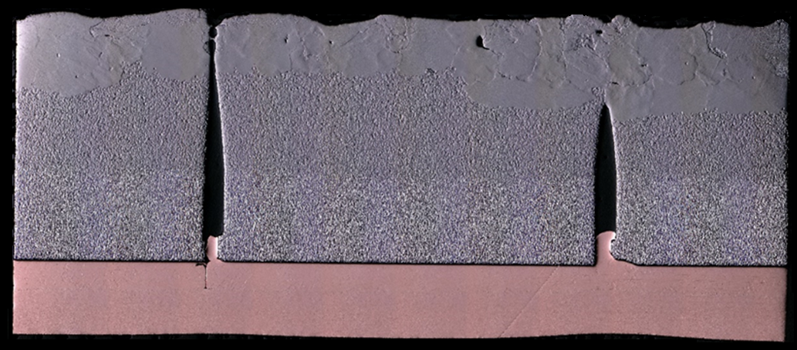
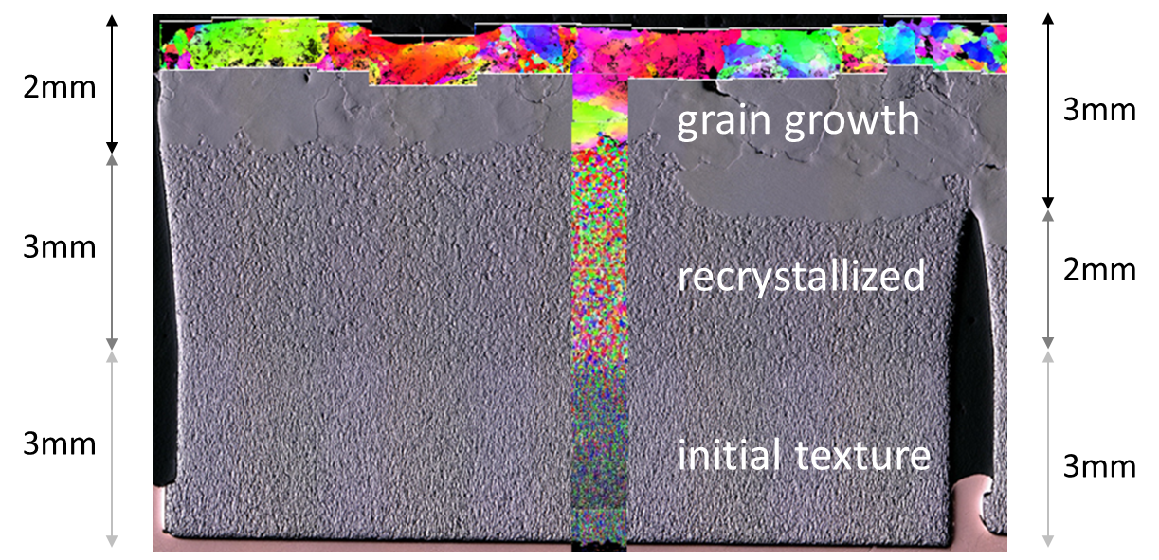
High-heat-flux performance: ITER-like tungsten monoblock target (25 MW/m²)
25 MW/m², 500 cycles (longitudinal cut)
ENEA 23
(coolant: 20 °C)
T_{max}: 2500 - 2700 °C
Neutral H beam, GLADIS (MPG-IPP)
J.H. You, Nucl. Mater. Ener. (2022)
12

Slide 13
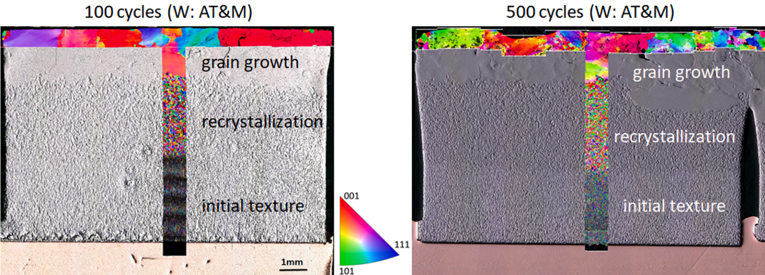
High-heat-flux performance: ITER-like tungsten monoblock target (25 MW/m²)
T_{max}: 2500 - 2700 °C
J.H. You, Nucl. Mater. Ener. (2022)

Slide 14
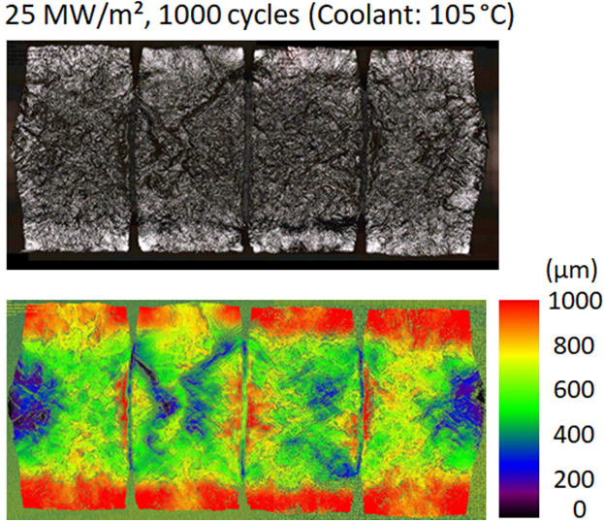
High-heat-flux performance: ITER-like tungsten monoblock target (25 MW/m²)
Surface temperature matters!
(heat loads, armour thickness, thermal conductivity: no internal barriers)
J.H. You, Nucl. Mater. Ener. (2022)
14

Slide 15
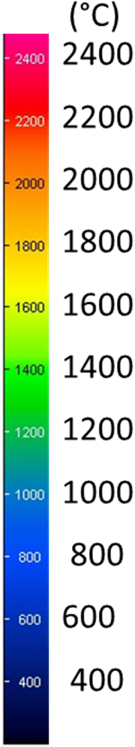
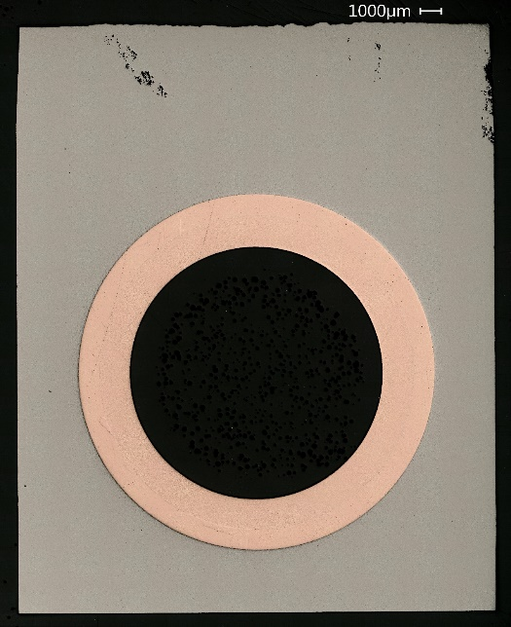
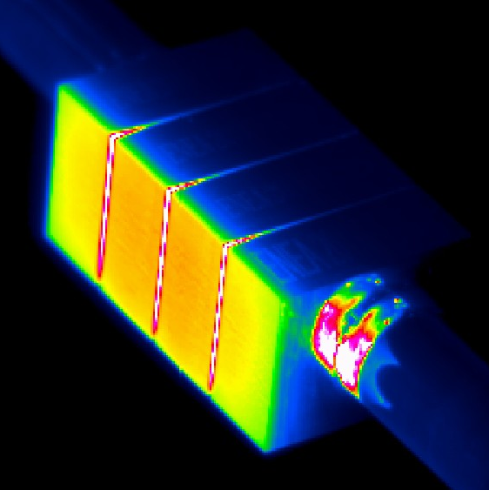
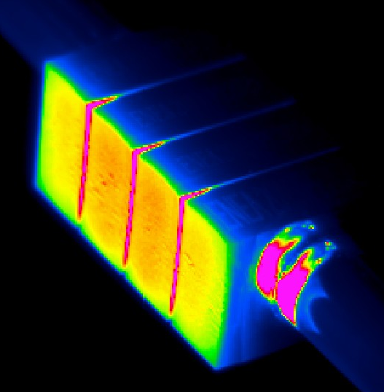
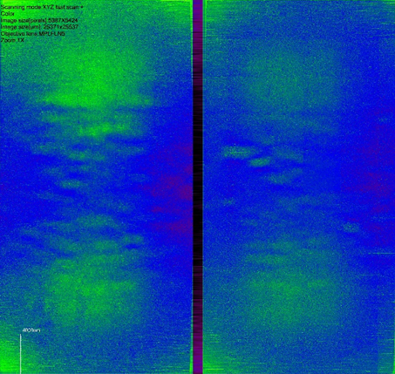
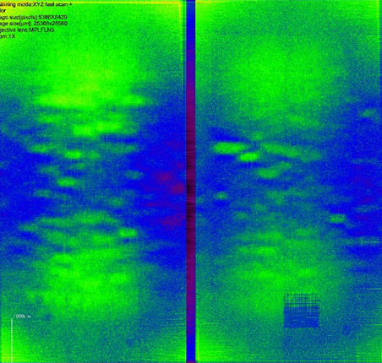
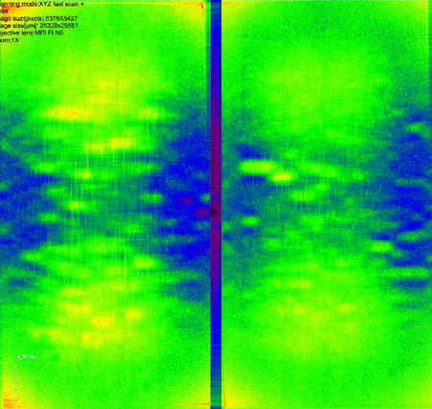
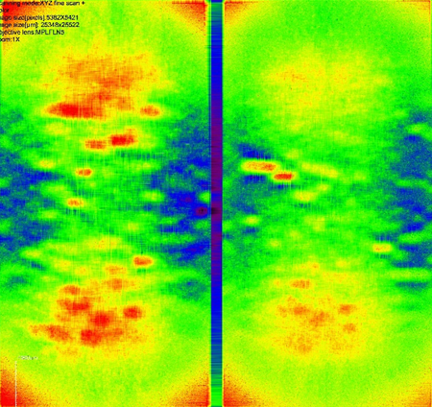
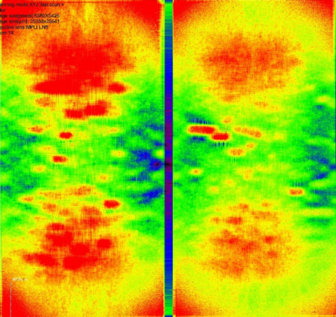

High-heat-flux performance: ITER-like tungsten monoblock target (40 MW/m²)
IR thermography
H beam (GLADIS)
Pulse: 0.4 s (transient)
Pause: 1.2 s
0.63 Hz
500 pulses
5000 pulses
(µm)
350
280
210
140
70
0
500 pulses
1000 pulses
2000 pulses
4000 pulses
5000 pulses
Front face roughness (laser profilometry)
15
J.H. You, Nucl. Mater. Ener. (2022)

Slide 16
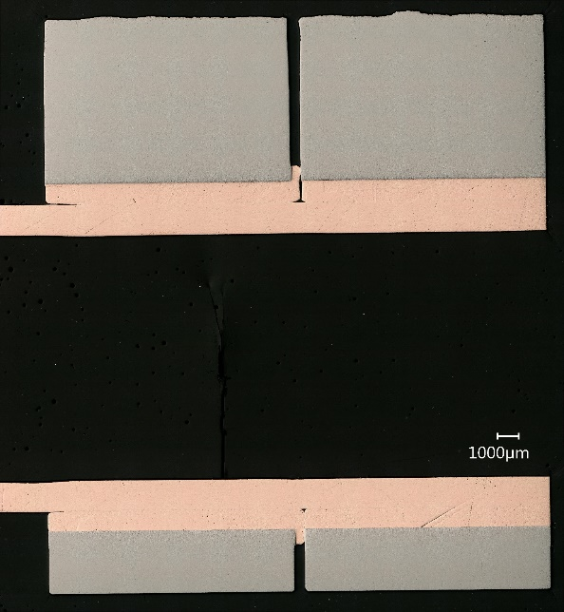
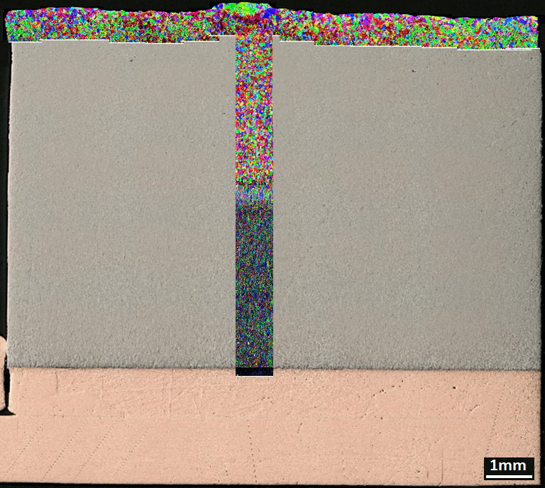
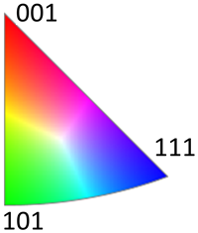
High-heat-flux performance: ITER-like tungsten monoblock target (40 MW/m²)
H beam (GLADIS)
Pulse: 0.4 s
Pause: 1.2 s
0.63 Hz
No armour crack found
Structural integrity remained intact
Similar recrystallization feature as the 20 MW/m² load case
No abnormal grain growth
J.H. You, Nucl. Mater. Ener. (2022)

Slide 17
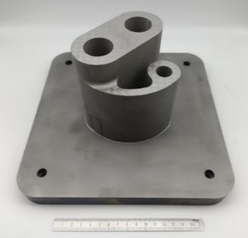
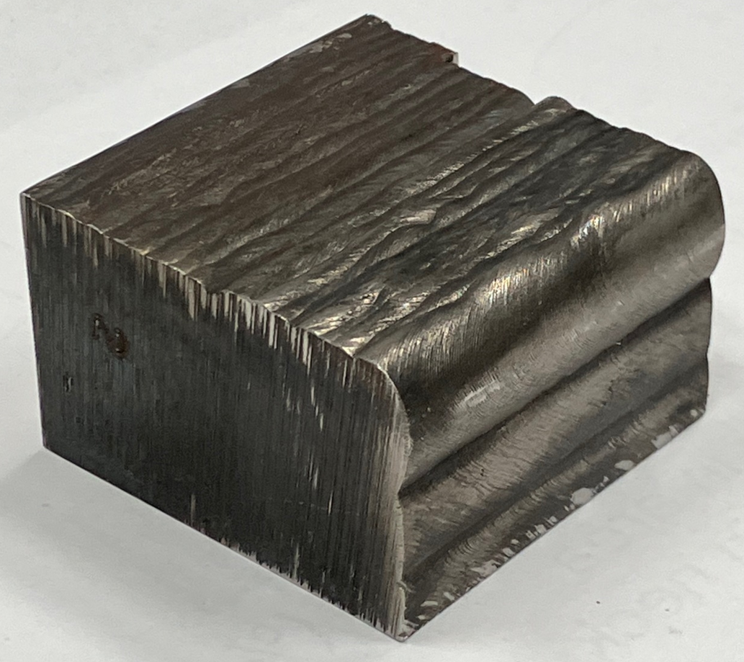
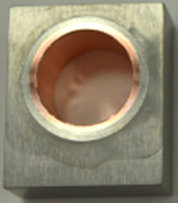
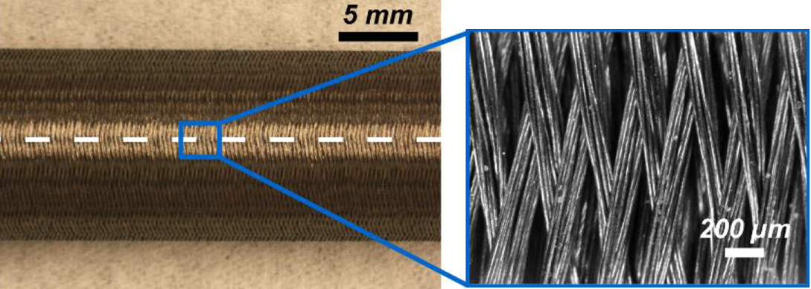
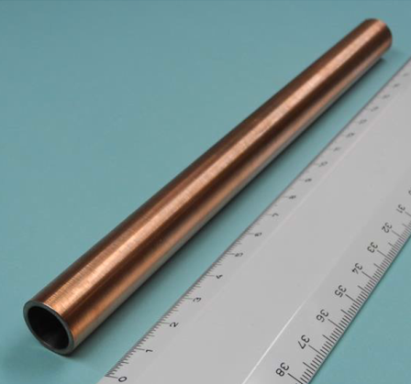
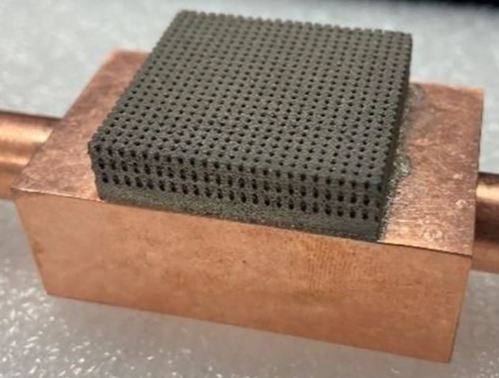
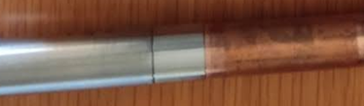
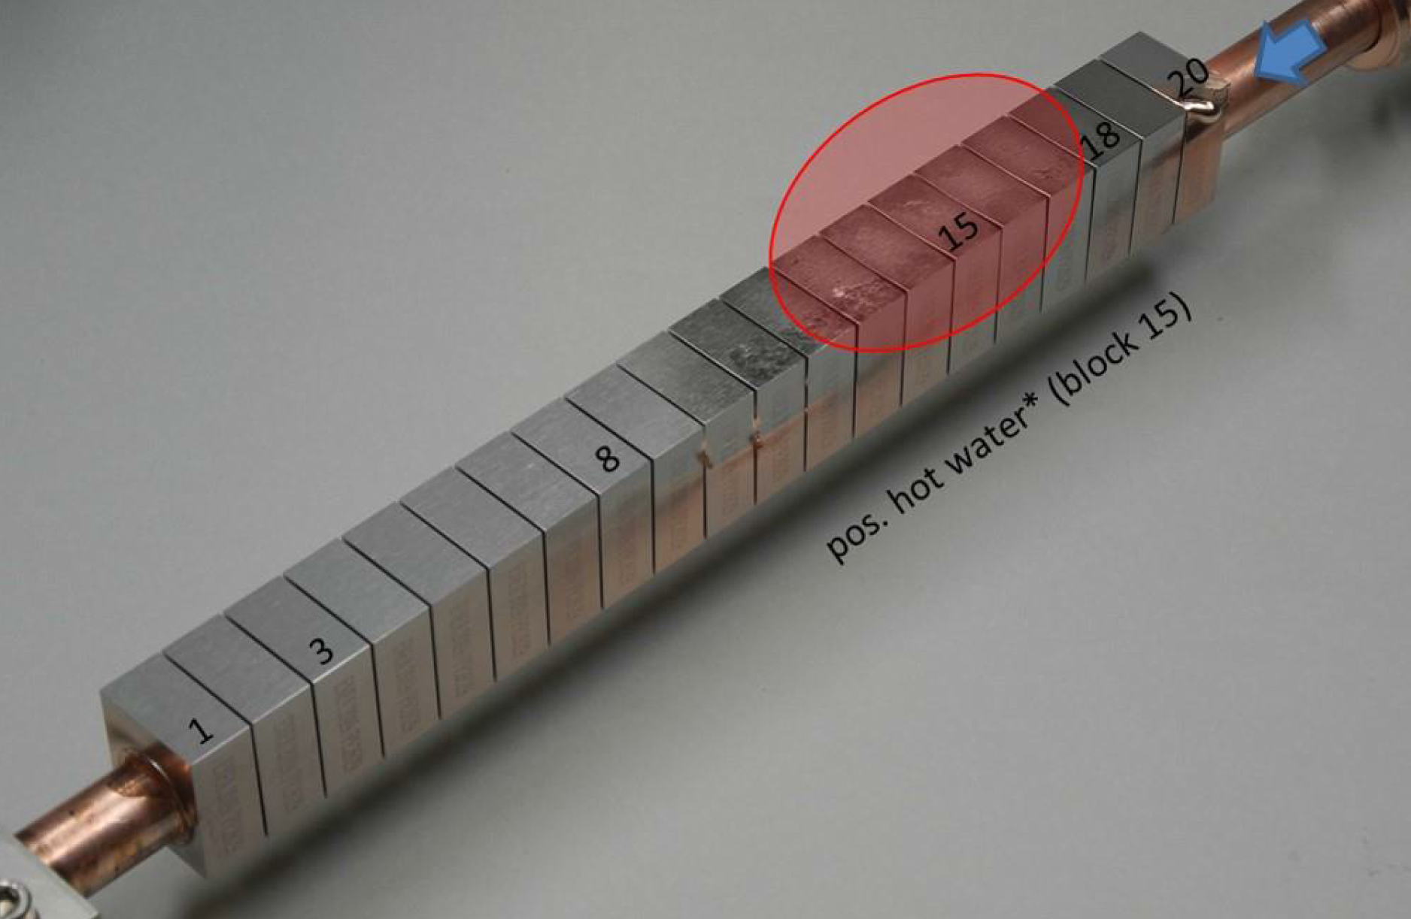
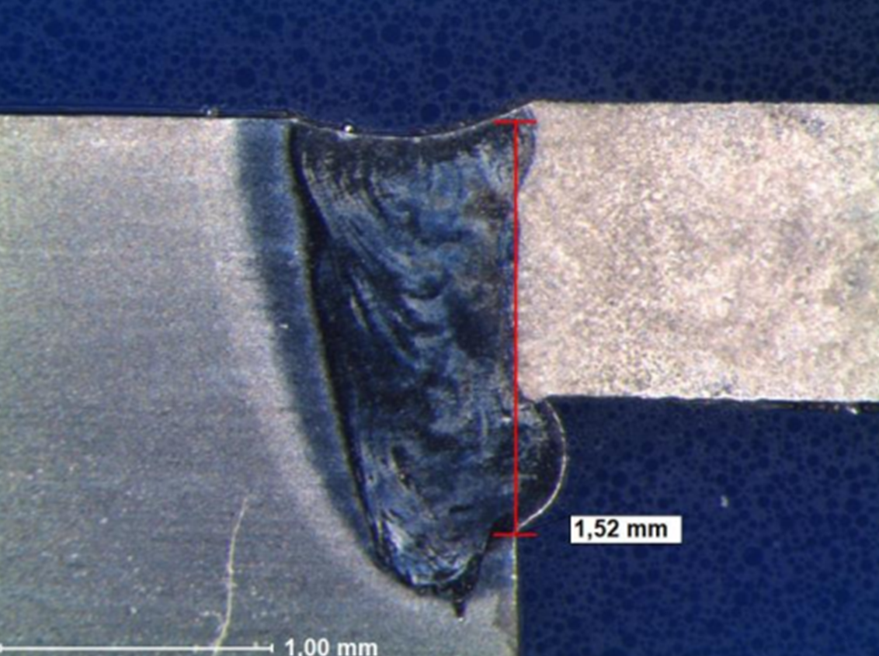
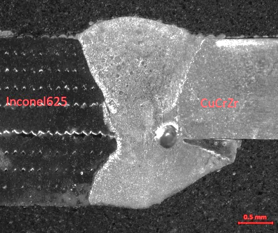





EU DEMO Divertor: technology R&D activities
Additive manufacturing (LPBF/WAAM)
HRP/Brazing
Wire-reinforced composite pipe
& target
9Cr steel
W
Ti alloy
Cu
W lattice
Welding
9Cr steel
CuCrZr
Pipe joining
9Cr steel
Plasma-sprayed W coating
PFC insulation
HIP (9Cr steel)
Corrosion protection coating
DLI-MOCVD
17

Slide 18


Flow-assisted corrosion: CuCrZr cooling pipe
Oxidizing medium
Reducing medium
Exposure time: 425 h
Flow rate: 9 m/s (80 bar)
Temperature: 250 °C (water/Cu)
Dissolved O₂: 5 ppm O₂ (in effluent)
Erosion rate: 20 µm (~600 µm/fpy)
Exposure time: 828 h
Flow rate: 9 m/s (80 bar)
Temperature: 250 °C (water/Cu)
Dissolved O₂: <0.01 ppm (in effluent)
Dissolved H₂ 4 ppm (in effluent)
Erosion rate: < 0.1 µm (~1 µm/fpy)
J. Öijerholm et al, Nucl. Mater. Ener. (2023)
18

Slide 19
Summary: status & outstanding issues
Baseline design I (completed: frozen as it is)
Cassette body/shielding liner: justification for semi-brittle steel, lifetime/waste, nucleate boiling
2. Target: uncertainty in heat loads, long-pulse, justification for brittle pipe, He transmutation (Cu)
Baseline design II (in progress: design dossier due by Q2 2025)
Cassette body: nucleate boiling, local hot spots (> 550 °C), creep-fatigue, semi-brittle rule (< 350 °C)
2. Target: the same issues as in baseline l, design modification (dimensions, shaping), refurbishment
Technology R&D (launched recently: long-term program)
Cassette body: low TRL, design-dependent, irradiation/PIE
ITER-like target: new design, advanced target (low TRL), irradiation/PIE (HHF test): mock-up test?
3. shielding liner/dome: low TRL (options t.b.d.)
4. DDC/MPH/SSTT/IRRAD for the baseline materials (critical basis for design)
(BR2/JUDITH3)
19

Slide 20



EU DEMO Divertor: project organigram
WPDIV
(IDTT, W7X, JT-60SA)
DEMO Central Team
(Plant System Design, Plasma)
WPDIV-DEMO
Divertor Cassette
Architecture design
Divertor Cassette
Technology R&D
Divertor Target
Technology R&D
Limiter PFCs
Design/Technology R&D
Structural Integrity
Corrosion test
& protection
High-heat-flux Testing
Laboratories (EUROfusion RUs)
Universities (EUROfusion LTP)
Industry partners,
External collaborators
20

Slide 21

D. Terentyev, NF (2022)
21

