Slide 1
Divertor Design in BEST
Rui Ding, Xuebing Peng for the BEST team

Slide 2
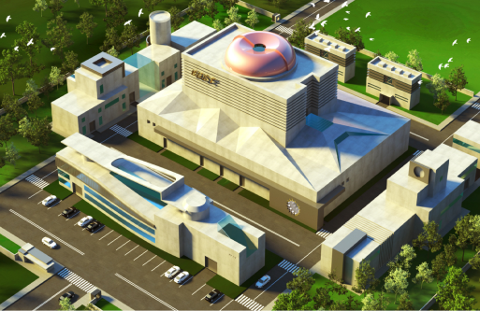
Requirements and Considerations
Physics basis
Engineering design
Summary
CONTENTS
2

Slide 3
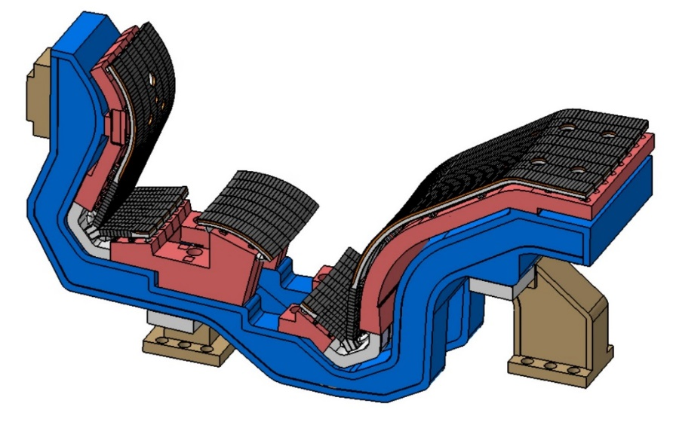
Requirements on Plasma Exhaust Solution for BEST
Main requirements
High heat load on divertor target (P_{Sep}/R ~14)
Efficient particle exhaust for long pulse operation
Reliable and robust operation
Remote handling maintenance
Limits on Physics parameters
P_{peak} ≤ 10 MW/m²
T_{e} ≤ 5-10 eV
Z_{eff, sep} < ~ 2.5
C_{He, sep} < ~ 3%
3

Slide 4
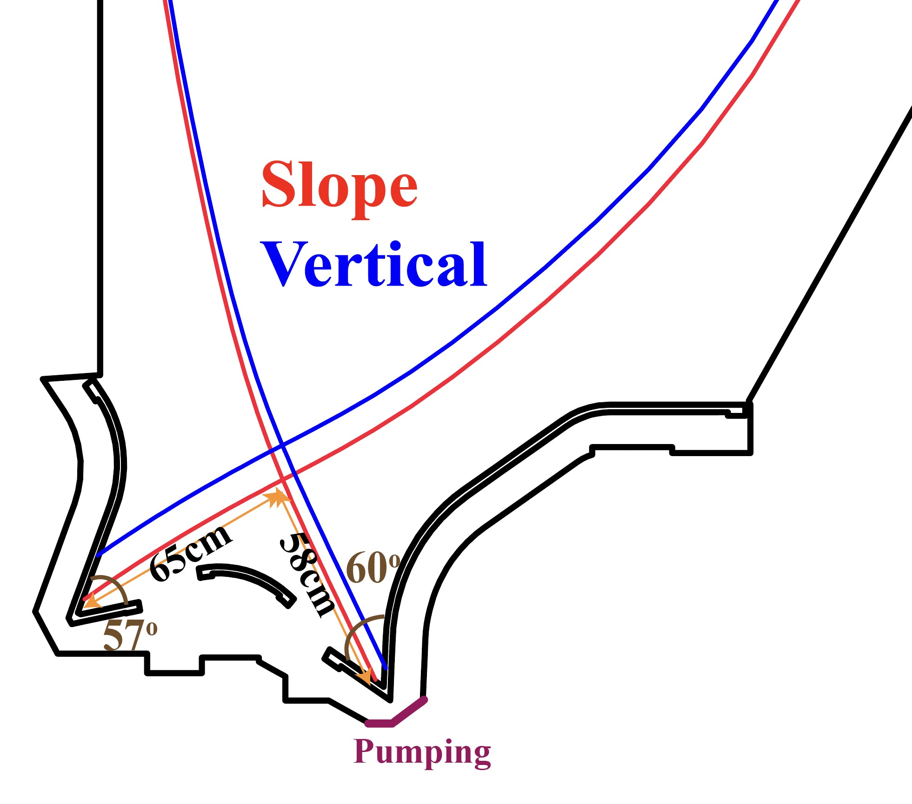
The Conventional Divertor Design
A V-shape corner
Higher neutrals compression
Same heat exhaust ability of vertical target and reflector plate
Flexible OSP locations for the outer divertor
Slope target: recycling of neutrals towards the SOL for deeper detachment
Vertical target: easier detachment near strike point
Pumping slot at the outer corner
W-based materials for PFCs
Impurity seeding for power dissipation
4

Slide 5
Requirements and Considerations
Physics basis
Engineering design
Summary
CONTENTS
5

Slide 6
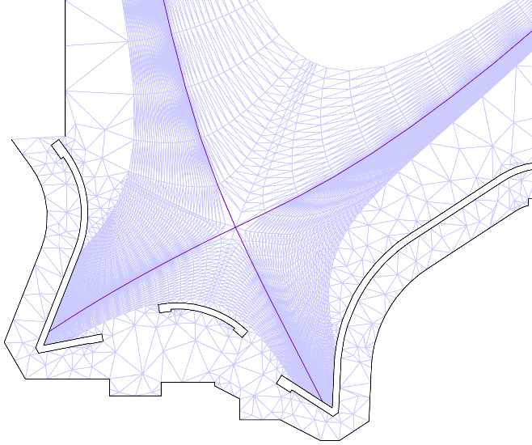
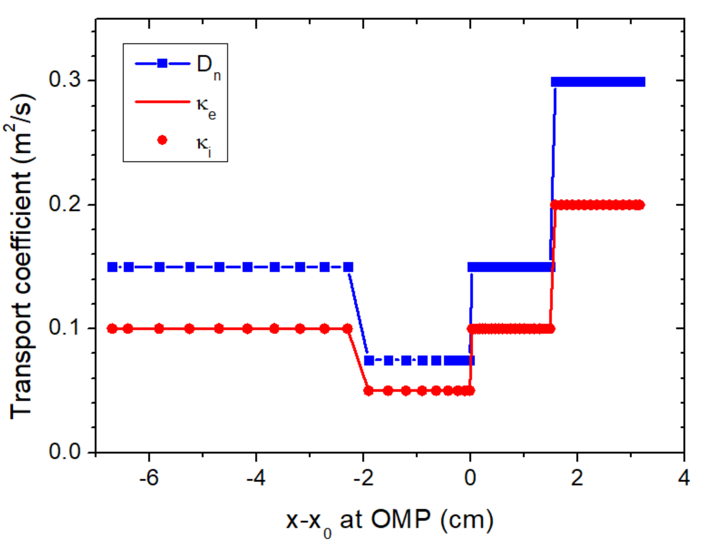
Modeling of Edge Plasma for BEST Using the SOLPS-ITER
Simulation setup
P_{CEI}= 50MW (Q>5), P_{e}=P_{i}
Transport coefficients for H mode condition
Impurity puffing at outer divertor: Ne/Ar
D₂ puffing from upstream
Different strike point locations: Slope target / Vertical target
Drift effects included
D₂ puff
𝝀_{𝒒} ~ 1.0mm
Ne, Ar
Pump
6

Slide 7
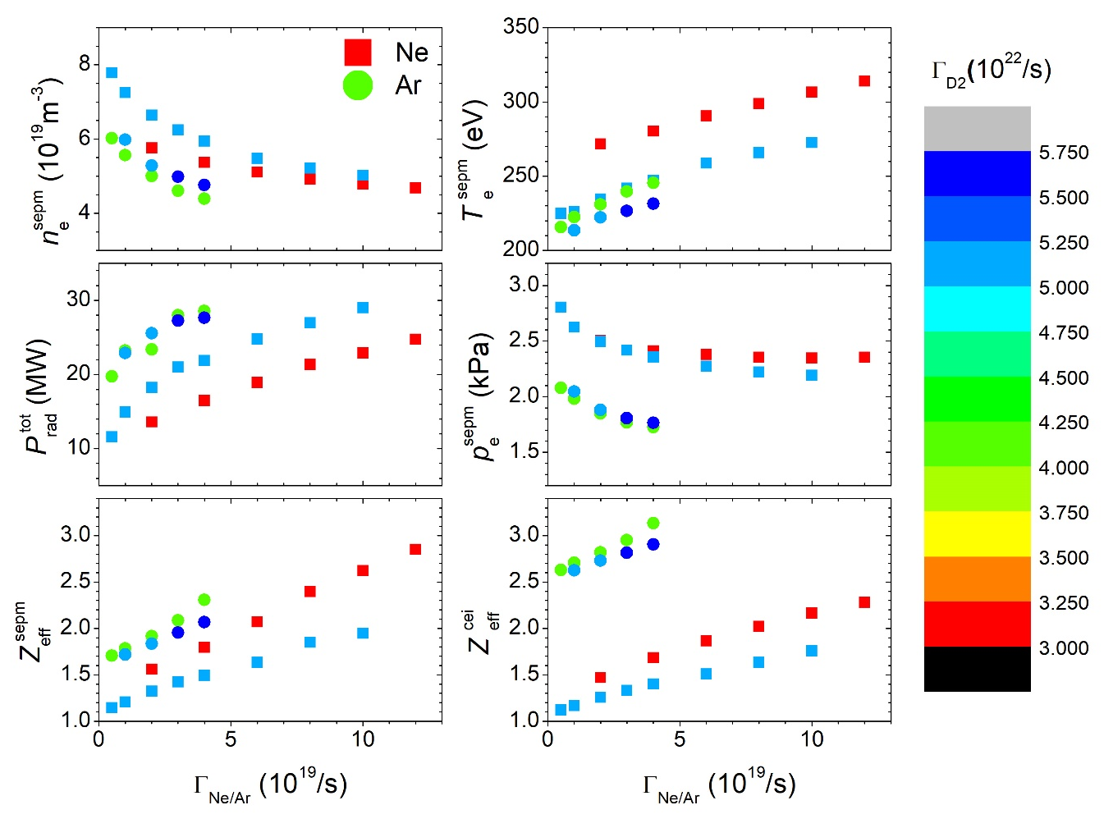
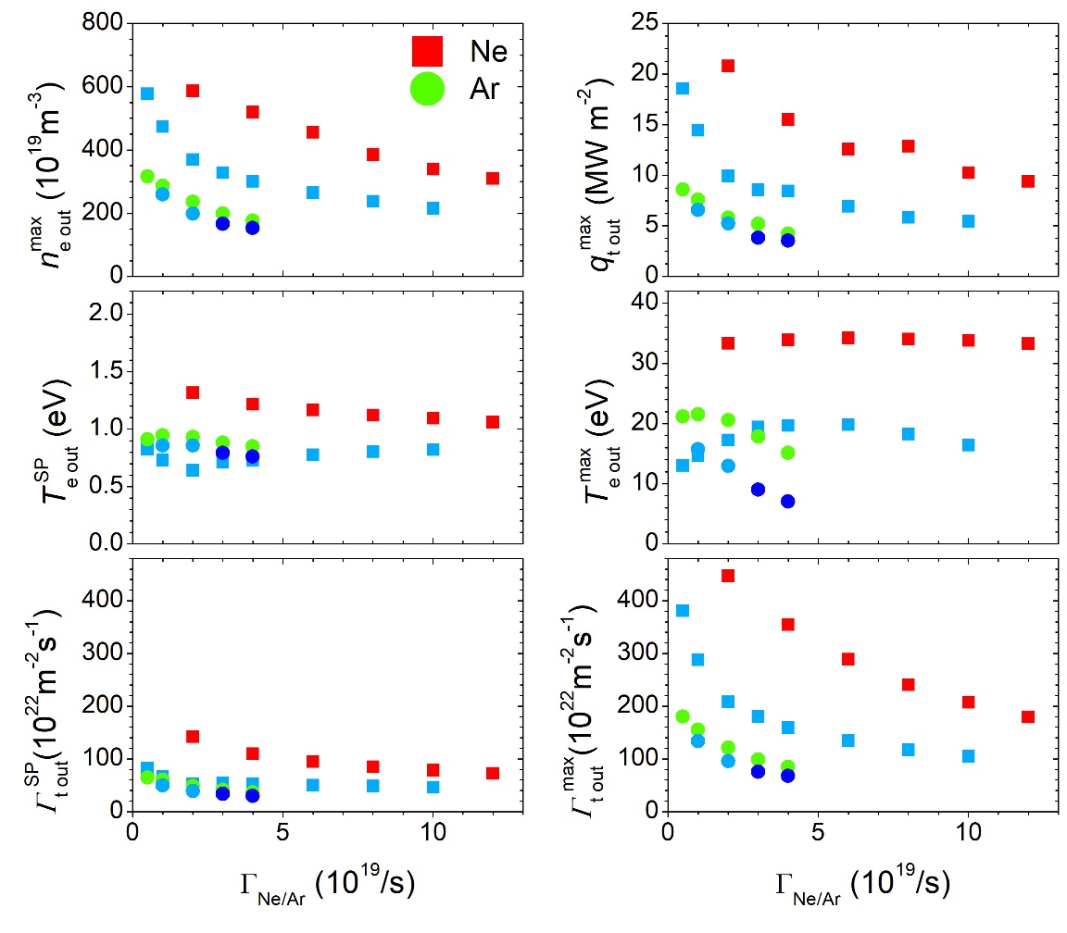
Higher Power Dissipation and Core Contamination by Ar seeding
Upstream
Vertical targets
Downstream
Radiation can be increased by higher impurity seeding rate and fueling rate, Z_{eff} can be effectively reduced by enhancing D₂ puffing
Much higher Z_{eff} and Lower upstream pressure by Ar Seeding
Lower heat flux and T_{e} at the target
7

Slide 8
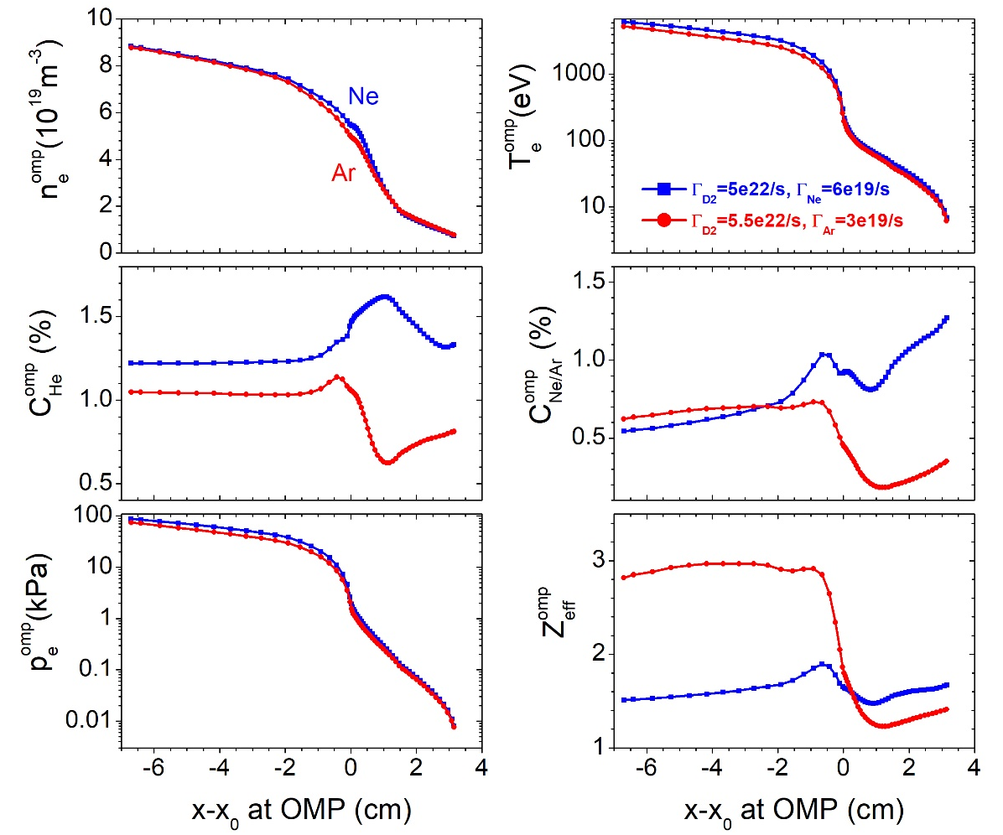
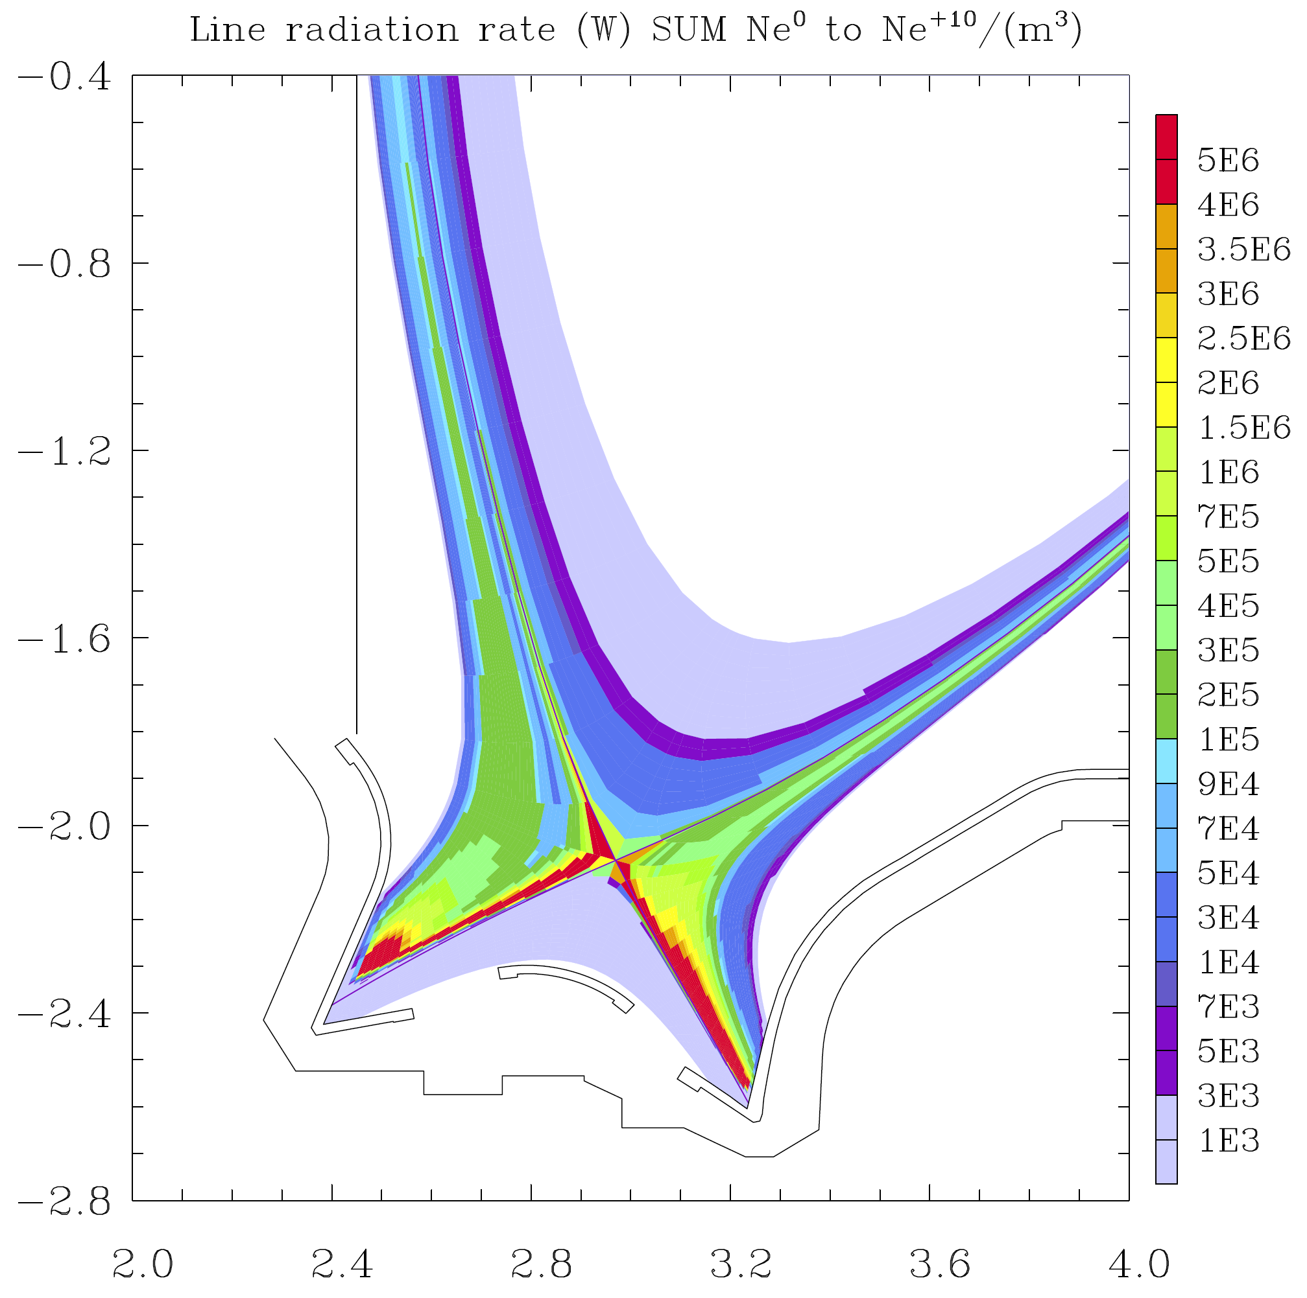
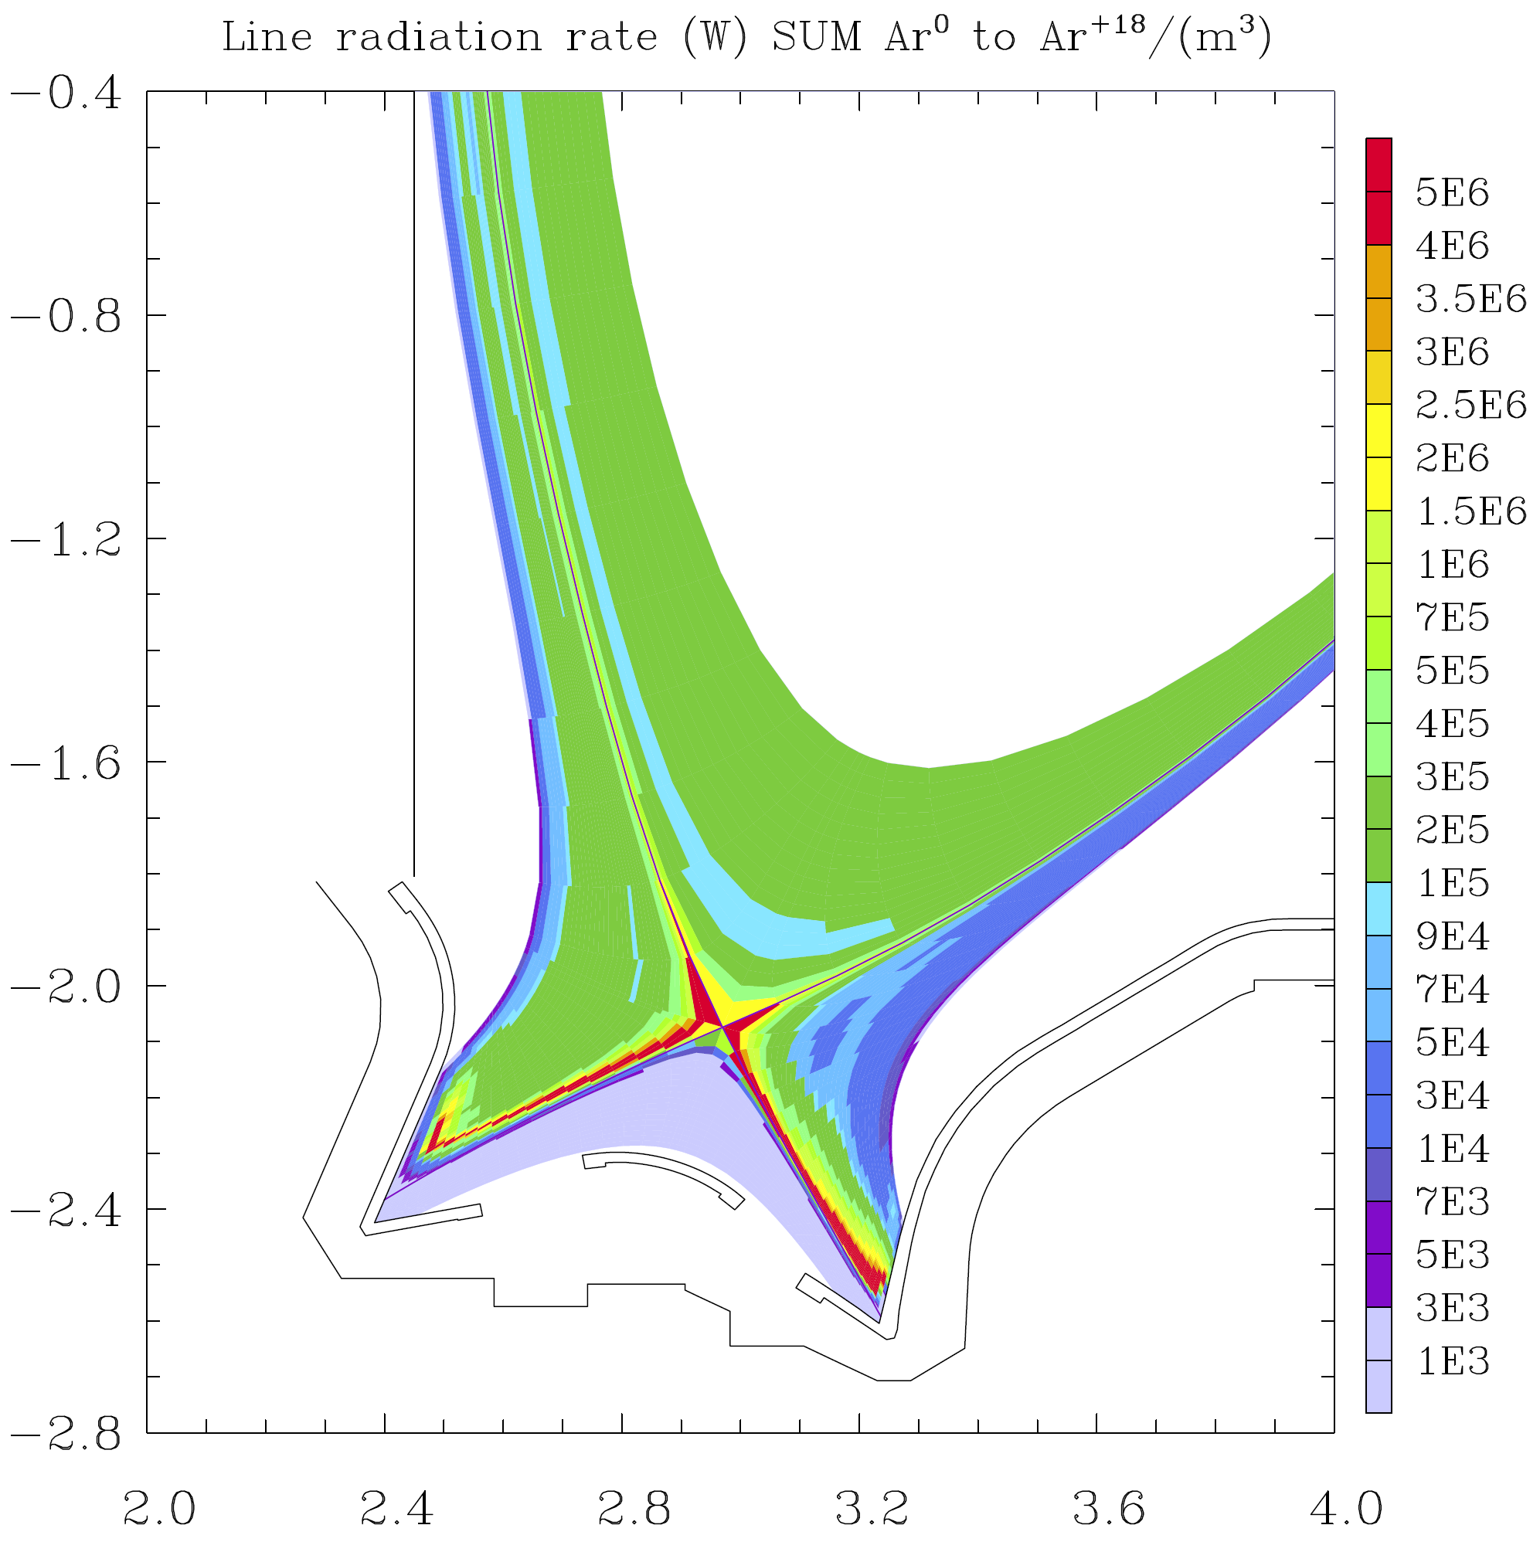
Higher Power Dissipation and Core Contamination by Ar seeding
Vertical targets
Γ_{D2}=5.0×10²²/s, Γ_{Ne}=6.0×10¹⁹/s
Γ_{D2}=5.5×10²²/s, Γ_{Ar}=3.0×10¹⁹/s
P_{rad}= 24.8MW
P_{Core}=0.8MW
P_{rad}= 27. 3MW
P_{Core}=6.8MW
Radiation fraction in the core plasma is much higher for Ar seeding even with lower seeding rates
6% for Ne, 26% for Ar
2 times Z_{eff} in the core for Ar
8

Slide 9
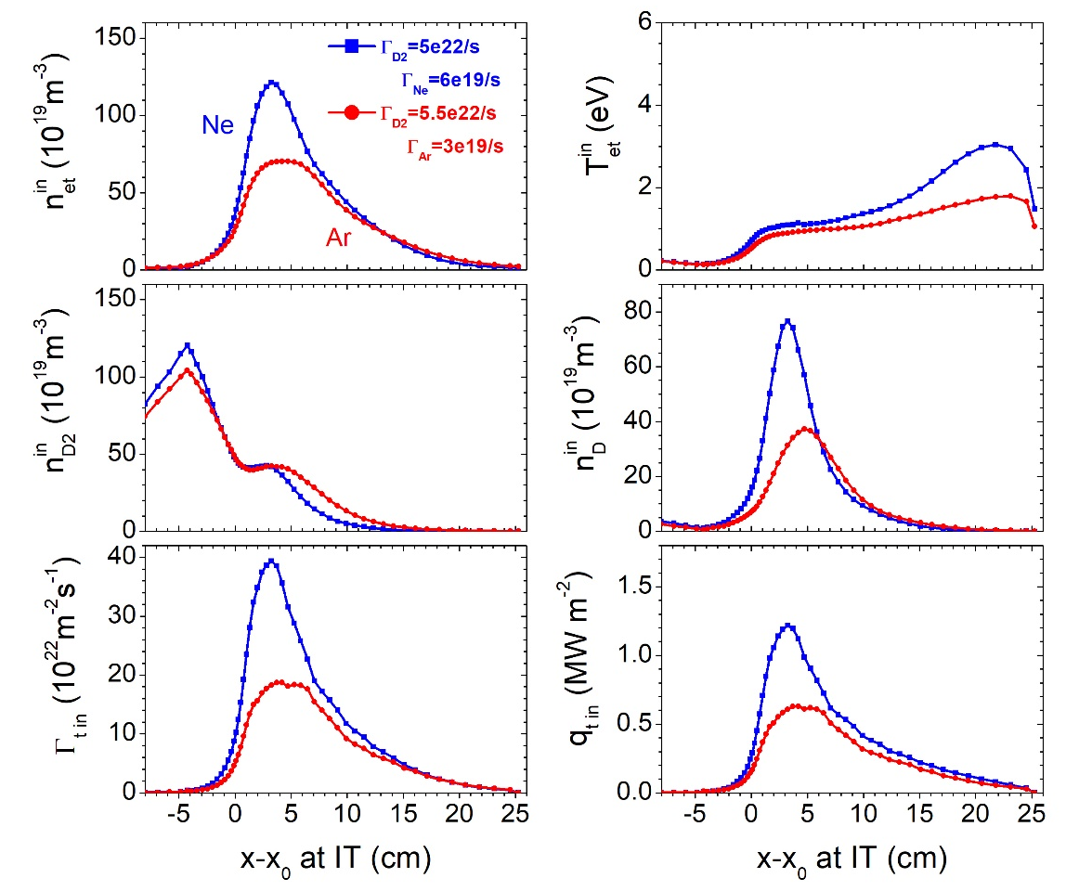
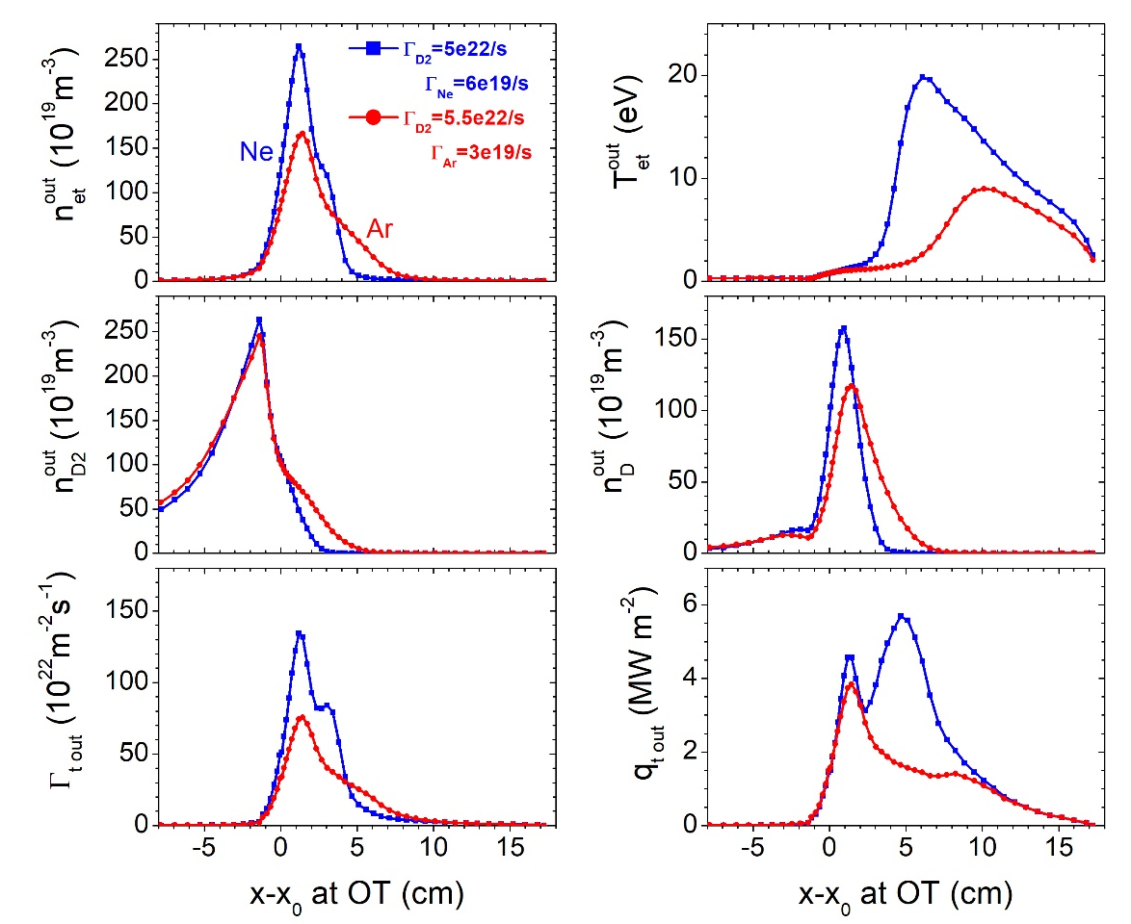
Higher Power Dissipation and Core Contamination by Ar seeding
Inner target
Vertical targets
Outer target
Deeper detachment at the inner target than the outer target
Higher T_{e} at the far-SOL region at the outer target
9

Slide 10
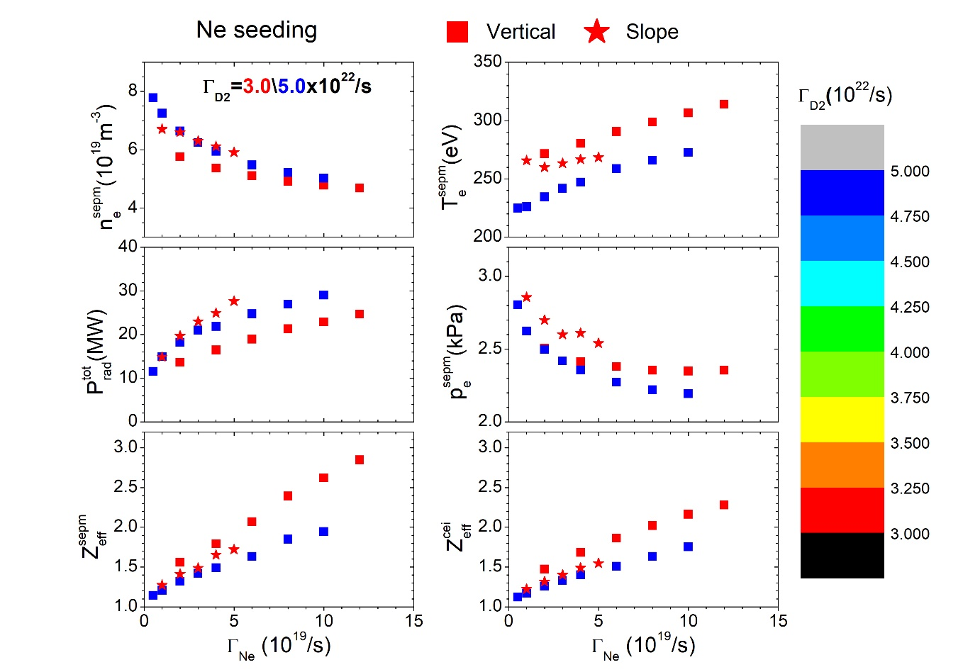
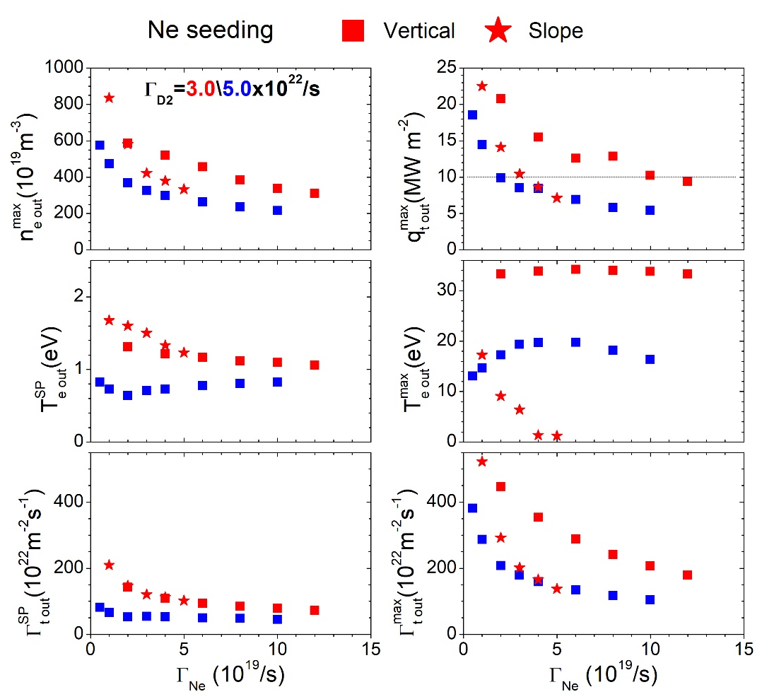
Deeper Detachment for Slope Target Compared to Vertical Target
Upstream
Ne seeding
Downstream
Full detachment for slope target and partial detachment for vertical target achieved with Ne Seeding
Low core contamination can be maintained with full detachment slope target
10

Slide 11
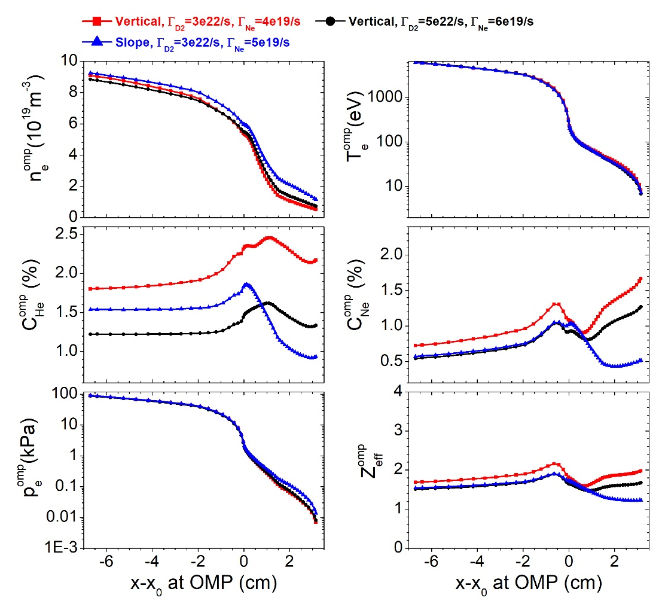
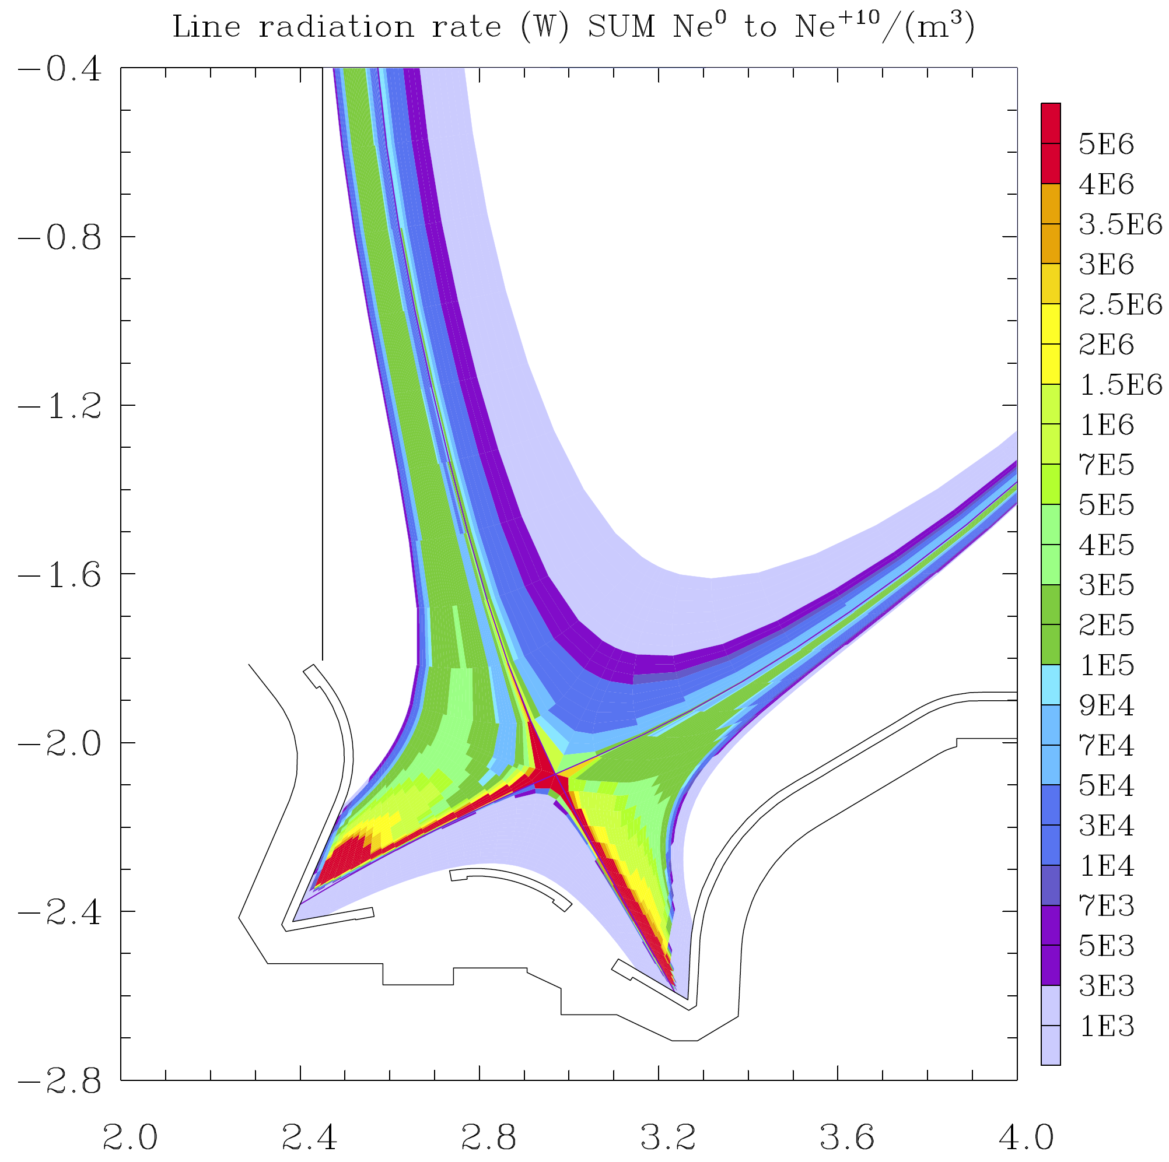
Deeper Detachment for Slope Target Compared to Vertical Target
Ne seeding
Γ_{D2}=3.0×10²²/s, Γ_{Ne}=5.0×10¹⁹/s
Γ_{D2}=5.0×10²²/s, Γ_{Ne}=6.0×10¹⁹/s
P_{rad}= 27.7MW
P_{Core}=1.5MW
P_{rad}= 24. 8MW
P_{Core}=0.8MW
slope
Vertical
Power radiation is higher for slope target even with lower seeding rates
Similar upstream profiles for both targets
11

Slide 12
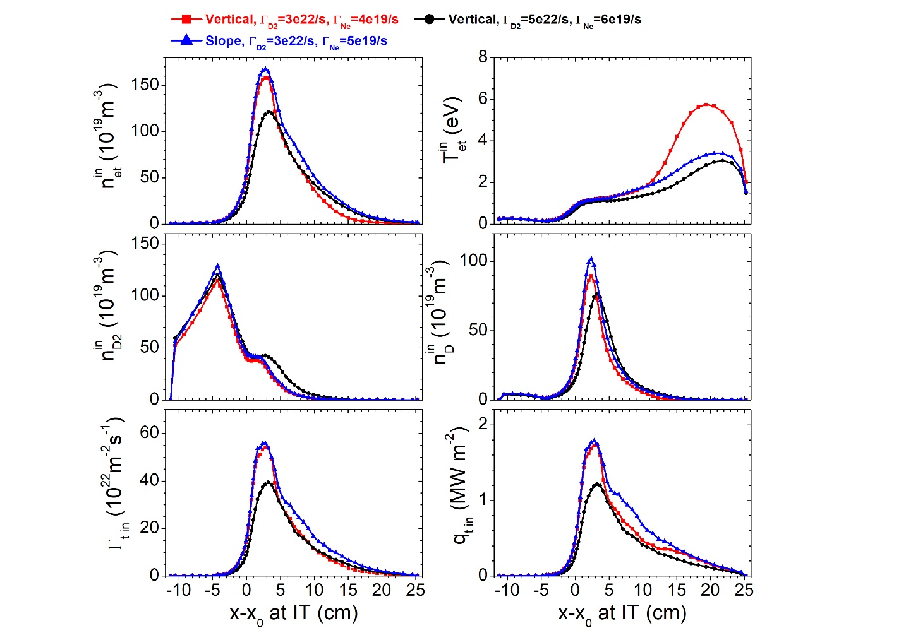
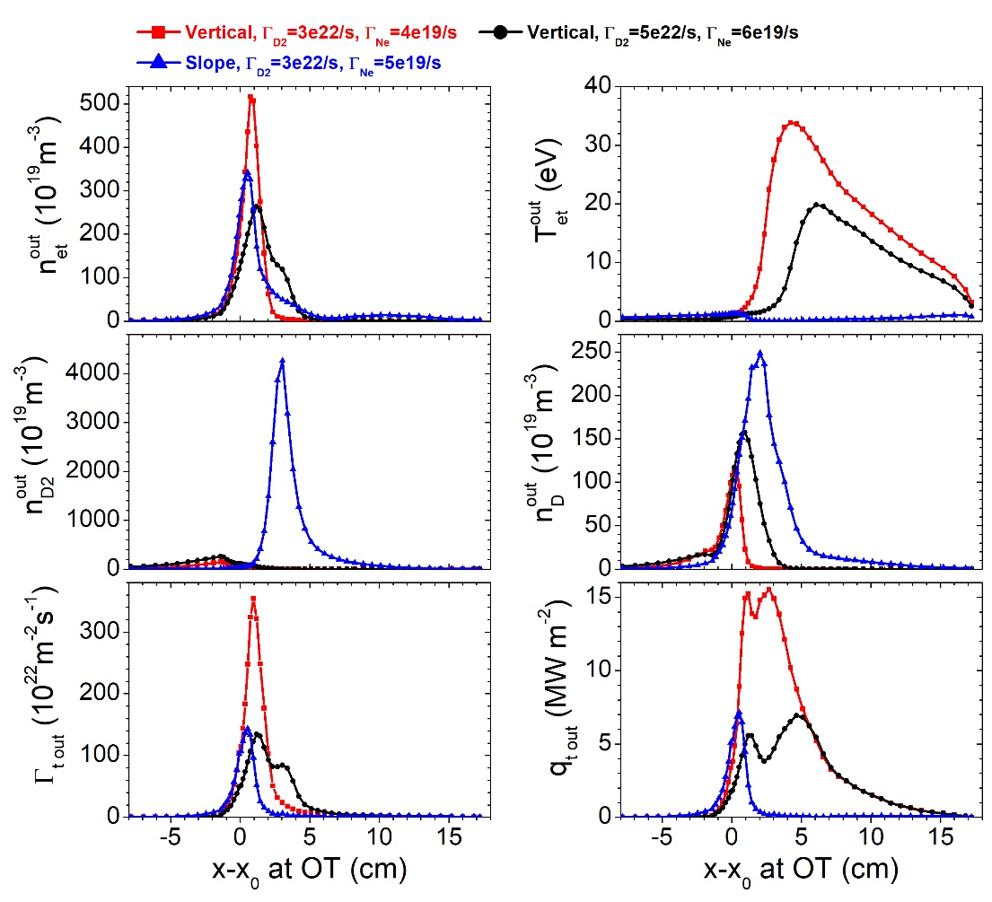
Deeper Detachment for Slope Target Compared to Vertical Target
Inner target
Ne seeding
Outer target
Slope target enhance the buildup of neutral density near the strike point and the far-SOL region
Pumping requirements: ~65 Pa m³/s
12

Slide 13
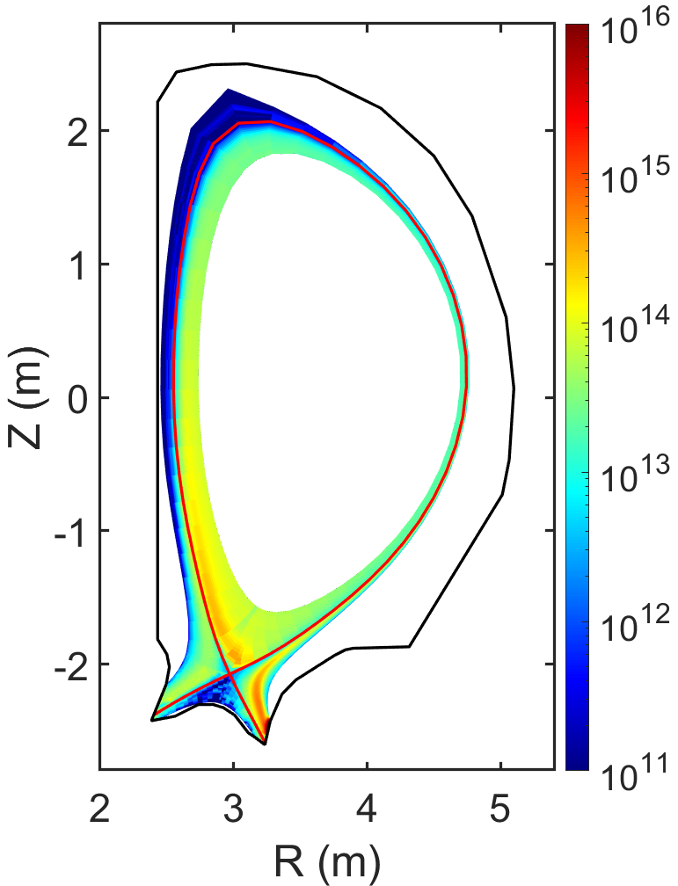
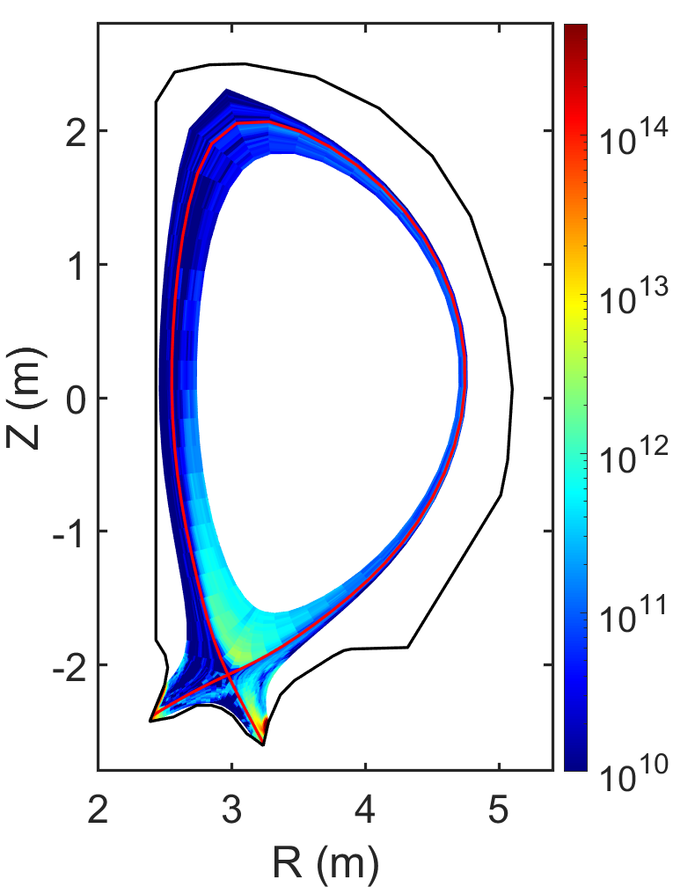
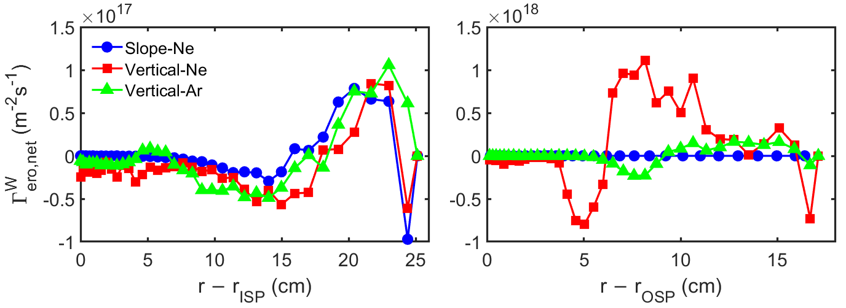
Evaluation of W Erosion Rate and Core Contamination
W density
DIVIMP modeling with background plasma from SOLPS
Much higher W erosion rate and impurity concentration for vertical target
W concentration is below the limit for all the cases
Slope target has a longer target lifetime
Ne
vertical target
Ar
vertical target
W net erosion rate
c_{W, sep} = 5.4x10⁻⁷
c_{W, sep} = 2.2x10⁻⁹
 | Ne slope Γ_{D2}=3.0×10²²/s Γ_{Ne}=5.0×10¹⁹/s | Ne vertical Γ_{D2}=5.0×10²²/s Γ_{Ne}=6.0×10¹⁹/s | Ar vertical Γ_{D2}=5.5×10²²/s Γ_{Ar}=3.0×10¹⁹/s
Target lifetime | $2.5×{10}^{9}$s | $1.6×{10}^{8}$s | $9.6×{10}^{8}$s
13

Slide 14
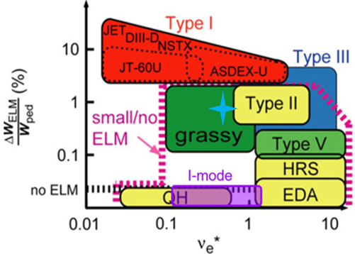
Estimation of ELM Type and Transient Heat Flux
BOUT++ nonlinear modeling suggests different ELM regime for Q>1 scenario and Q>5 scenario
Q>1 scenario
Grassy ELM, ΔW/W ~ 0.2%
$q_{⊥,ELM}$~56 MW/m², $t_{ELM}$~0.2ms
Q>5 scenario
Type-I ELM, ΔW/W ~ 4%
$q_{⊥,ELM}$~628 MW/m², $t_{ELM}$~0.5ms
Q>5
Q>1
14

Slide 15
Requirements and Considerations
Physics basis
Engineering design
Summary
CONTENTS
15

Slide 16
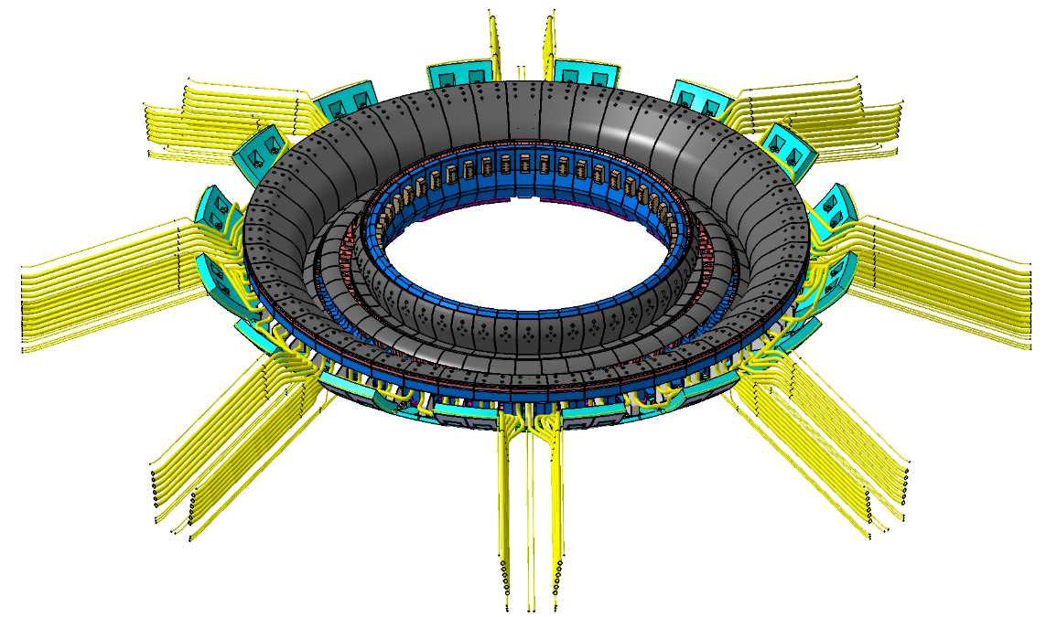
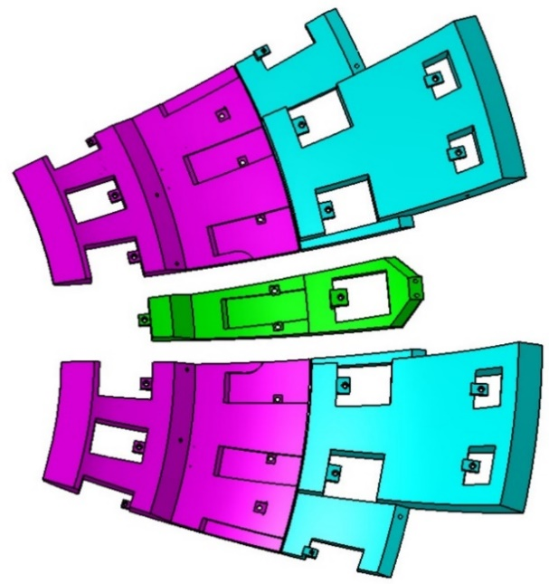
Overall Design
Overall features
PFU: integrated design with flat type and monoblock
All PFCs are actively cooled
PFCs separately maintained (IVT + Dome , OVT).
Main parameters
Toroidal degree | 7.5°
Quantity | 48
L, W and H | 2.0×(0.28-0.56)×1.02 m
Deadweight | ~1.6 t
Design heat flux of PFU/PFC | 15 MW/m²/10 MW/m²
48 divertors (360°)
Divertor (7.5° toroidally)
Shielding structure
(45° in toroidal)
16

Slide 17
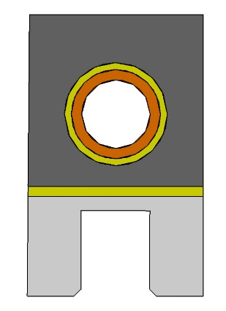
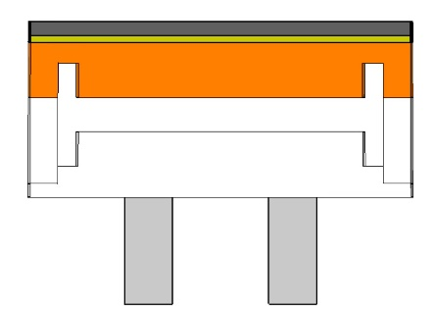
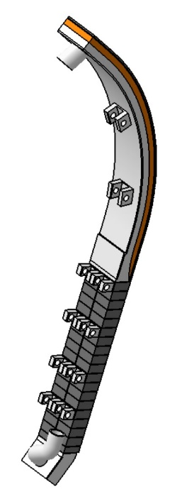
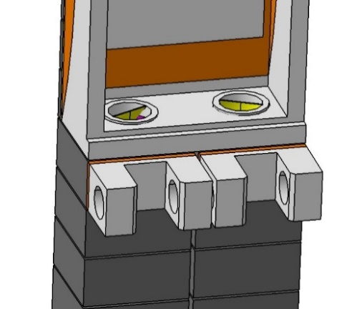
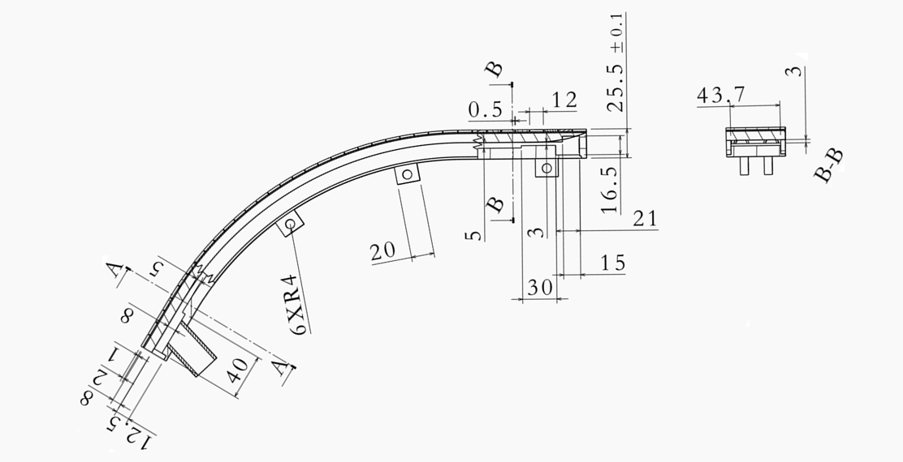
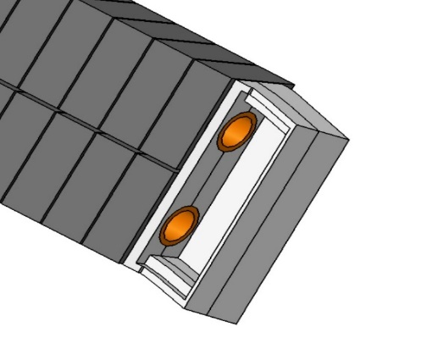
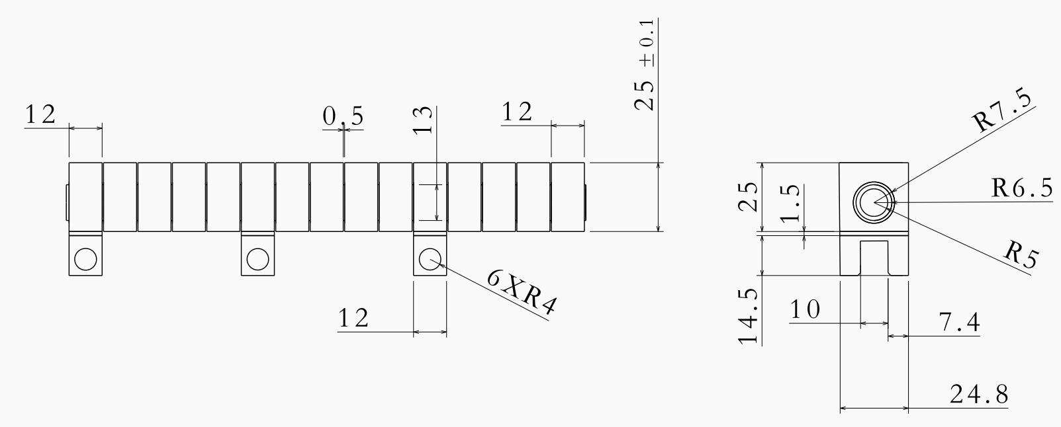
Design of PFU
Tungsten
PFU with Monoblock and Flat-type
Strike zone: monoblock, non-strike zone: flat type.
DOME is similar to non-strike zone of IVT/OVT PFU.
Interface: explosive welding R120, ribs to strength the structure.
Copper
CuCrZr
316L
~51mm
Flat-type
~614mm
Monoblock
17

Slide 18
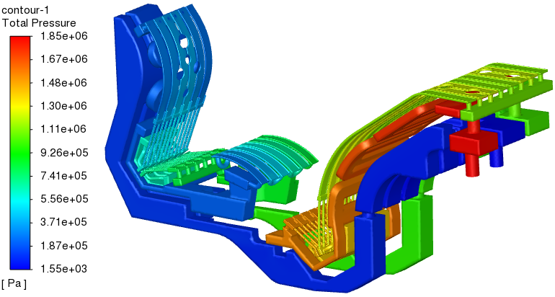
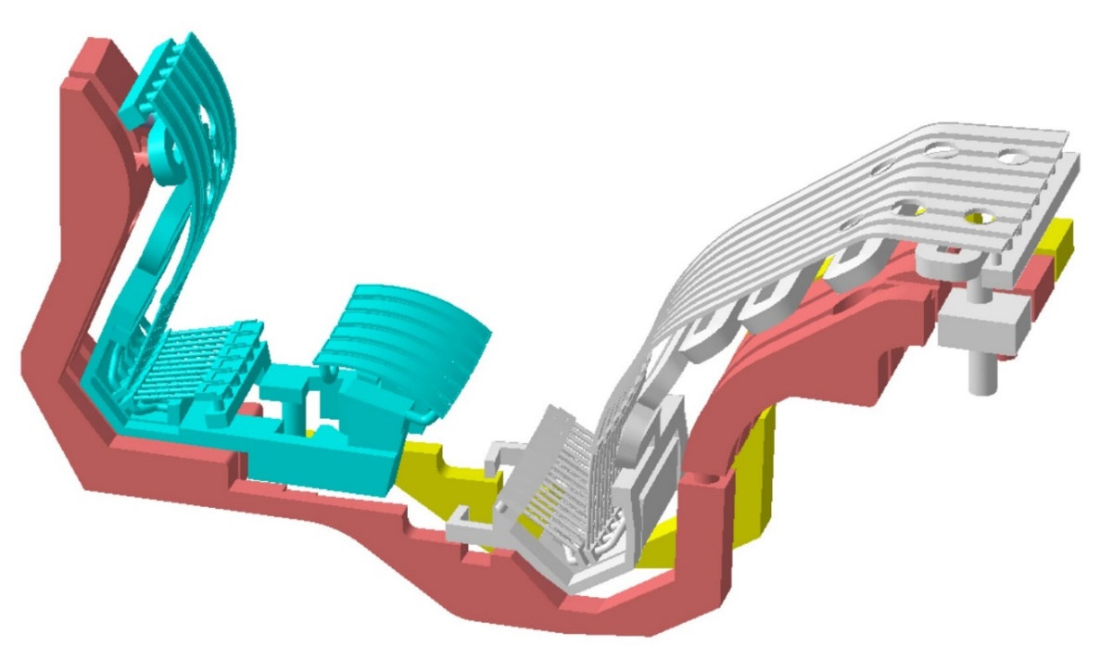
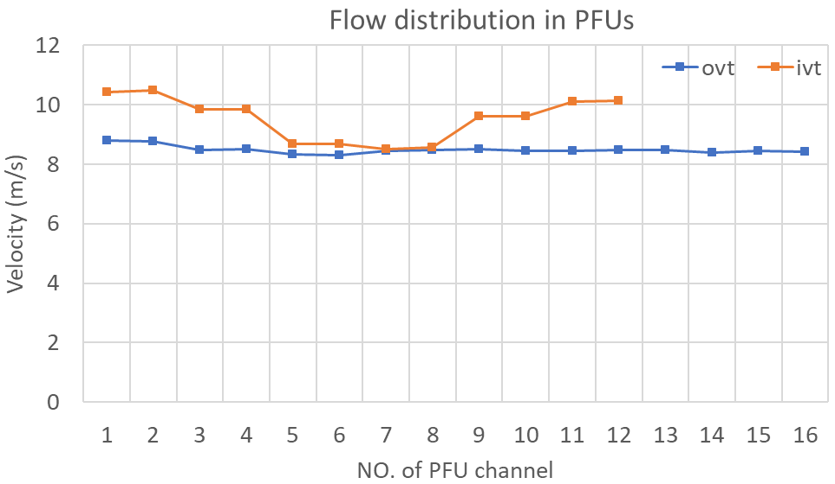
Design of Cooling Circuit for PFCs
Total mass flow rate is 10.3 kg/s, total pressure drop of Divertor, IVT & Dome and OVT are about 1.85 MPa, 0.72 MPa and 0.78 MPa, respectively.
Flow distributions within each branch channels of IVT and OVT are acceptably uniform, the average deviations of IVT and OVT are about 6.28 % and 0.96 %.
∆P = 1.85 MPa < 2MPa
6
5
4
3
2
1
Coolant flow direction
1
2
3
4
5
6
7
8
Velocity in the high heat flux zone
@ OVT: ~ 8.5 m/s
@ IVT: ~9.5 m/s
@ Dome: ~ 7.8 m/s
outlet
8-10 m/s
inlet
inlet
10.3 kg/s
Meet requirement
18

Slide 19
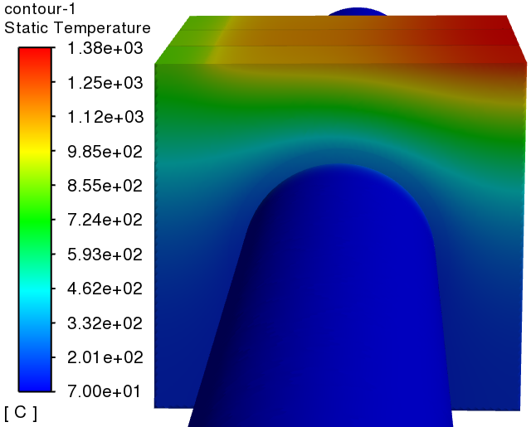
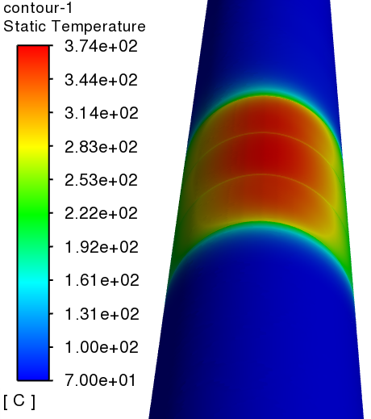
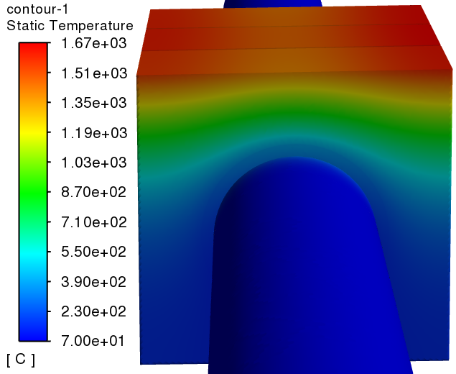
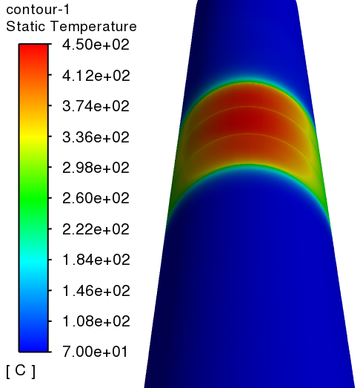
Design of shaping for PFCs
Monoblock shaping
Toroidal chamfer: 0.5 mm
Monoblock Shaping, radial misalignment= 0.3 mm
High heat flux
θ
Shadow length: X
 | Location | Dimension | Tolerance
Toroidal gap dimension | Inter-PFU | 1 mm | ± 0.2 mm
 | Inter-cassette | 10 mm | ± 2 mm
Radial step | Inter-PFU | -0.5 mm | ± 0.3 mm
 | Inter-cassette |  | ± 2 mm
0.3 mm
W 1380 ℃
1 mm
1.3 mm
1200 ℃
Tungsten thickness
6 mm
CuCrZr
374 ℃
IVT& OVT shaping
Rotation: β = 0.83 °
W
1670 ℃
3.3 mm
IVT & OVT shaping, radial step = 2 mm
Rotation: β
1200 ℃
High heat flux
Tungsten thickness
6 mm
CuCrZr
450 ℃
Shadow length: X
19

Slide 20
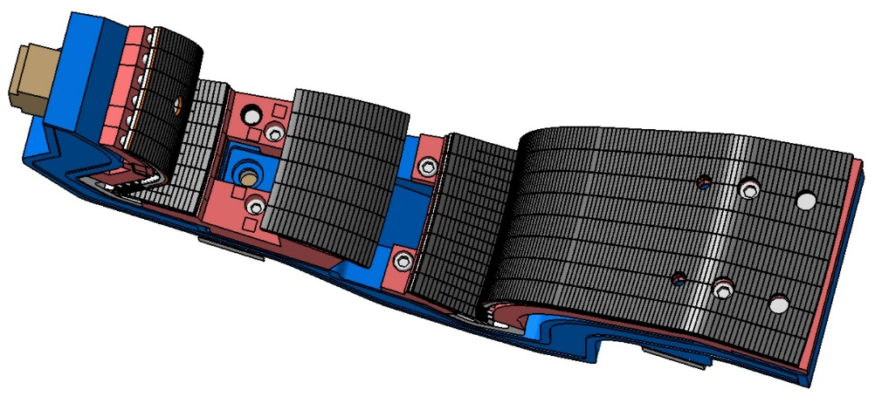
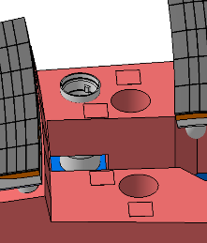
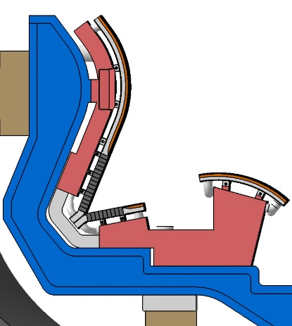
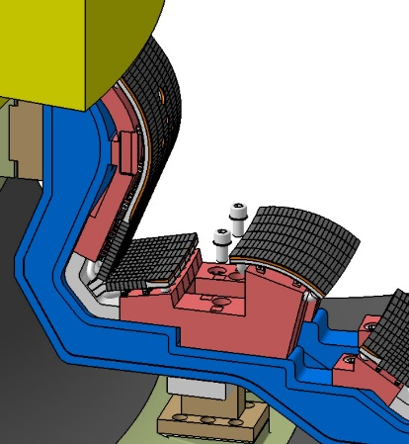
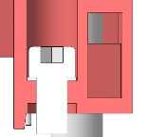
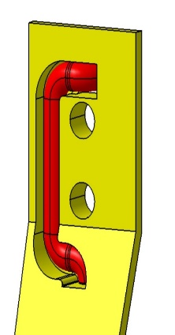
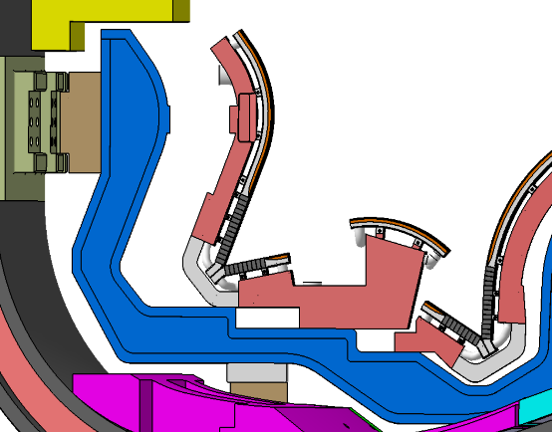
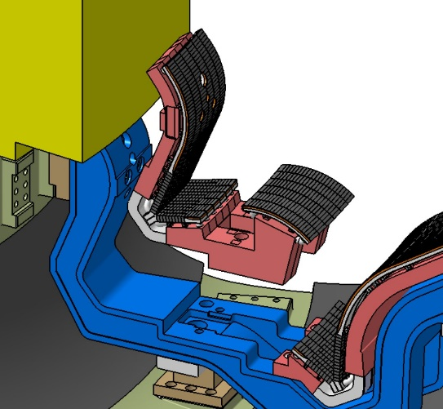
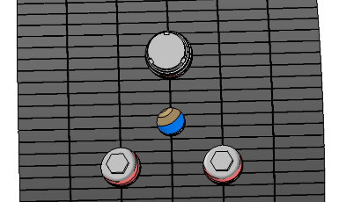
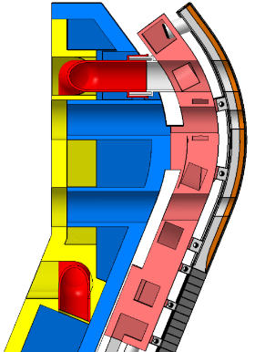
RH Compatible Design
PFCs maintained separately
RH process for PFC: cut pipe → remove bolts → grab PFC → move PFC
PFCs bolts and pipe covers
IVT&Dome removal procedure
Pipe cover
Cutting pipe（Φ51x3）
Bolts removal
DOME
Pipe cover
120
116
4xM30
Area 1
Area 2
IVT
193
M30
OVT
85
Pipe cover
M36
U shape pipe
Pipe cover
IVT&Dome moving
IVT&Dome lifting
160mm
315
85
M30
70
Area 1
mm
Area 2
20
Cross section

Slide 21
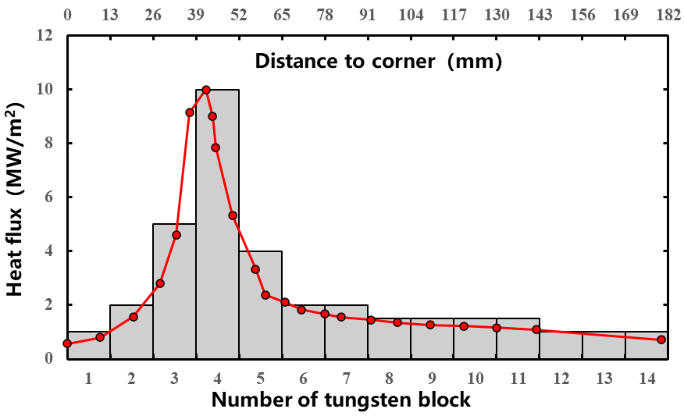
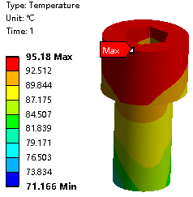
Thermal results: steady state heat load
Max. temperature is within the allowable value
Component |  | T_{max} (℃) | Allowable value (℃)
PFU | Tungsten | 1096 | 1200
PFU (Copper) | Cooper | 384 | 550
PFU () | CuCrZr | 338 | 450
PFU () | SS316L(N)-IG | 261 | 450
SSS |  | 110 | 450
Cassette body |  | 131 | 450
Bolt |  | 96 | 450
Heat flux distribution near SP
Temperature distribution on bolt
HTC near SP
~ 10⁵ W/(m²·K)
21

Slide 22
Thermal results: transient heat load
Temperature during ELMs
The “base” surface temperature depends on the energy fluence
Type I ELM may not lead to W melting and W recrystallization
ELM type | Q_{ELM}$⏊$ (MW/m²) | t_{ELM} (ms) | f_{ELM} (Hz) | Q_{inter}$⏊$ (MW/m²) | T_{base} (℃) | ∆T_{ELM} (℃)
Type I | 628 | 0.5 | 10 | 3 | 348 | 846
Grassy | 56 | 0.2 | 500 | 3 | 495 | 41
Grassy, $q_{⏊,ELM}$=56MW/m²
Type I, $q_{⏊,ELM}$=628MW/m²
Q>1 Scenario
Q>5 Scenario
22

Slide 23
Structural results: load combinations
All the stress can meet the design criteria, the value listed in the table is safety factor.
Component materials |  | Stress type | Safety factor
 |  |  | Testing | Baking | NO | MD event | VDE event
PFU | SS316L(N)-IG | P_{m} | 1.46 | 12.10 | 11.31 | 11.31 | 12.25
 |  | P_{L}+P_{b} | 1.06 | 15.13 | 13.78 | 13.78 | 13.78
 |  | P_{L}+P_{b}+Q | - | 1.88 | 1.20 | 1.20 | 1.20
PFU pipe |  | P_{m} | 4.18 | 12.18 | 12.18 | 12.55 | 7.39
 |  | P_{L}+P_{b} | 1.35 | 8.75 | 16.34 | 16.34 | 2.42
 |  | P_{L}+P_{b}+Q | - | 3.73 | 5.26 | 5.26 | 3.18
SSS | SS316L(N)-IG | P_{m} | 3.20 | 9.31 | 12.25 | 24.50 | 8.65
 |  | P_{L}+P_{b} | 2.48 | 4.65 | 10.02 | 15.75 | 7.88
 |  | P_{L}+P_{b}+Q | - | 1.68 | 1.39 | 1.42 | 2.86
 | XM-19 | P_{m} | 5.91 | 1.90 | 2.39 | 2.22 | 3.36
 |  | P_{L}+P_{b} | 1.13 | 1.73 | 2.16 | 2.04 | 3.51
 |  | P_{L}+P_{b}+Q | - | 2.08 | 2.27 | 2.20 | 3.45
CB |  | P_{m} | 4.90 | 13.44 | 16.33 | 9.19 | 21.00
 |  | P_{L}+P_{b} | 3.45 | 10.68 | 12.97 | 10.50 | 16.96
 |  | P_{L}+P_{b}+Q | - | 1.12 | 1.02 | 1.01 | 1.31
Support |  | P_{m} | 4.45 | 15.13 | 18.38 | 10.50 | 18.38
 |  | P_{L}+P_{b} | 2.04 | 22.69 | 14.70 | 7.11 | 14.70
 |  | P_{L}+P_{b}+Q | - | 1.37 | 1.44 | 1.37 | 1.44
Bolt |  | P_{m} | 4.5 | 4.88 | 5.04 | 5.13 | 5.04
 |  | P_{L}+P_{b} | 2.67 | 2.58 | 2.59 | 2.6 | 2.59
 |  | P_{L}+P_{b}+Q | - | 2.42 | 1.91 | 1.92 | 1.91
23

Slide 24
Electro-Magnetic analysis
VDE event
The Halo current direction and distribution refer to two cases¹；
In case 2, according to the plasma evolution², the halo current is up to 2.05 MA.
TPF³=2 was selected as the worst case for evaluation.
case 1
I_{halo} =104.2 kA
case 2
I_{halo} =85.5 kA
I_{p}=7.3 MA, TPF=2
I_{total halo}=2.5MA
I_{divertor halo} =2*2.5MA/48=104.16 kA
I_{p}=7.3 MA, TPF=2
I_{total halo}=2.05MA
I_{divertor halo} =2*2.05MA/48=85.42 kA
BEST VDE halo current definition-V1.0_20230306；
TSC simulation BEST down&up halo current description of inputing file _20230306；
best disruption physical input_20221212
24

Slide 25
Electro-Magnetic analysis
VDE event
inflow of current
outflow of current
analysis method
analysis result(maxwell distribution )
analysis method
Maxwell electromagnetic analysis model
According to the current distribution, 1/16 model was used。
65%
65%
20%
40%
？%
40%
Current distribution in
VDE event 1
Current distribution in
VDE event 2
20%
25%
？%
？%
Current flow in
VDE event 1(ideal distribution)
Current flow in
VDE event 1(maxwell distribution)
100%
100%
0%
100%
？%
100%
0%
0%
？%
？%
Current flow in
VDE event 2(ideal distribution)
Current flow in
VDE event 2(maxwell distribution)
Magnetic field distribution in VDE event 1
Magnetic field distribution in VDE event 2
25

Slide 26
R&D for the divertor
PFUs and HHF test
Two methods (Explosive welding + brazing and HIP) were implemented for PFUs. .
One PFU passed 1000 + 1000 cycles HHF test of 15 MW/m².
‘V’ PFC passed 1000 cycles HHF test of 10 MW/m².
RH compatibility
Successfully tested for PFCs grabbing and move horizontally and vertically.
Pipe welding and cutting process are under developing and testing.
750 ℃ @ 15 MW/m²
620 ℃ @ 10 MW/m²
PFU mock-up and HHF test
‘V’ PFC mock-up and HHF test
RH tool for PFC
26

Slide 27
Requirements and Considerations
Physics basis
Engineering design
Summary
CONTENTS
27

Slide 28
Summary
A conventional divertor solution has been designed and evaluated by edge modeling, which can meet the physics requirements for BEST divertor operation
Deeper detachment can be achieved with Ne seeding for the slope target compared to the vertical target.
Divertor engineering Design was performed to fulfill the requirements in heat flux, cooling, EM loads, RH maintenance, etc.
Design loads including the coolant pressure, heat loads, EM loads (VDE, MD) were assessed against design criteria from the thermal, structural and fatigue points of view, justified the structural integrity.
Next step:
Full cycles of HHF test for PFCs mock-up.
Divertor cassette module fabrication and series test (HHF, mass flow rate distribution, pressure drop, baking cycles, accuracy of manufacture and assembly).
Further RH test using CRAFT RH platforms (bolting, unbolting, welding, leak test).
28

Slide 29
Thank You for Your Attention!

