Slide 1
Development of COOL blanket technology in ASIPP
EU – China collaboration on CFETR and EU-DEMO Reactor Design
4th Technical Exchange Meeting
Lei Chen
On behalf of blanket team in ASIPP
Topic: Breeding Blanket
KIT, Karlsruhe, Germany, 19-21 March 2024
Notes:
Hello, ladies and gentlemen!
I am Lei Chen, working in the blanket group in ASIPP.
Today, on behalf of my group, I will show a presentation titled “…”.

Slide 2
Outline
Introduction
COOL blanket analysis
R&D progress
BEST Test Blanket System
Summary
Notes:
This is the outline of my presentation.
First is going to be the introduction.
Following that it is the performance analysis and the preliminary R&D progress for COOL blanket
Finally, I will give the summary.

Slide 3
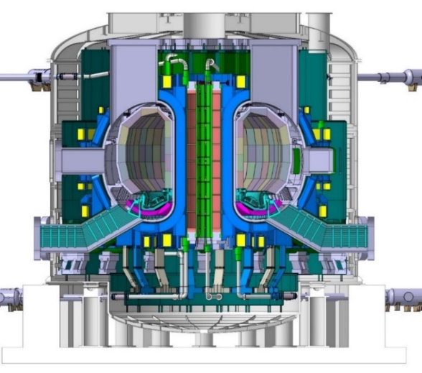
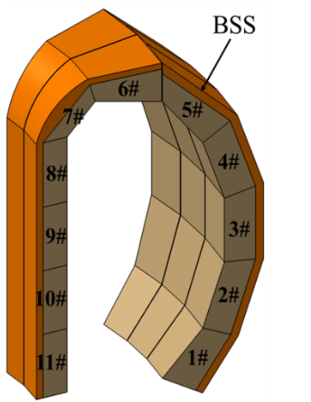
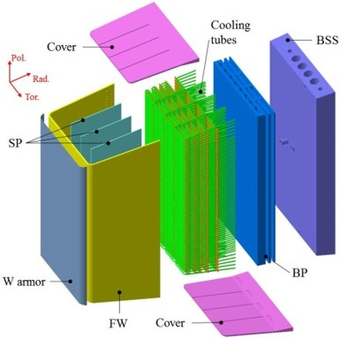
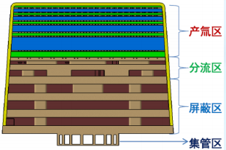
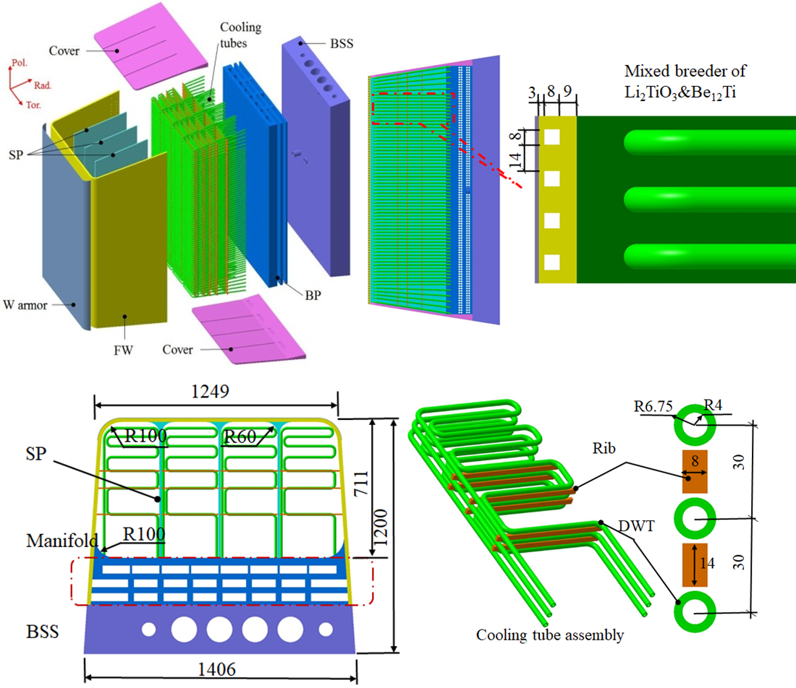
CFETR Solid Blanket Candidates
HCCB & WCCB concepts in the near term
HCCB BLK option by SWIP
Coolant: Helium @ 12 MPa, 300 ℃/ 550 ℃
Structure: RAFM/ODS steel
FW armor: 2 mm Tungsten
Breeder/Multiplier: Li₄SiO₄/Be
Purge gas: He + 0.1vol% H₂ @1-3 bar
Thermal efficiency: ~36%
WCCB BLK option by ASIPP
Coolant: pressurized water of 15.5 MPa, 285 ℃/325 ℃
Structure: RAFM/ODS steel
FW armor: 2 mm Tungsten
Breeder/Multiplier: Li₂TiO₃/Be₁₂Ti mixed bed
Purge gas: He + 0.1vol% H₂ @1-3 bar
Thermal efficiency: ~33%
CFETR configuration
（R=7.2m, a=2.2m, FP200/500/1000/1500MW）
Cover
Li₄SiO₄
Be
BZ
FW
Mainifold
Shield
Typical Helium Cooled Ceramic Breeder (HCCB) Blanket module 3#
Same blanket sector configuration
（16 sectors, each including 3×5 outboard and 2×6 inboard blankets）
Typical Water Cooled Ceramic Breeder (WCCB) Blanket module 3#
High-efficient and safe fusion blanket with low construction cost is more competitive for fusion energy application
Notes:
In the latest design of CFETR ( with major radius of 7.2m and fusion power up to 1500MW), there are two solid blanket candidates for the near term, one is HCCB BLK designed by SWIP and anther one is the WCCB BLK designed by ASIPP.
Both BLK options use the high-pressure coolant that may induce complicated safety problems, and the expensive neutron multiplier of beryllium or beryllide. Besides, the thermal efficiency is only about 36% and 33%, respectively.
On the contrary, a high-efficient and safe fusion blanket with low construction cost is more competitive for fusion energy application.

Slide 4
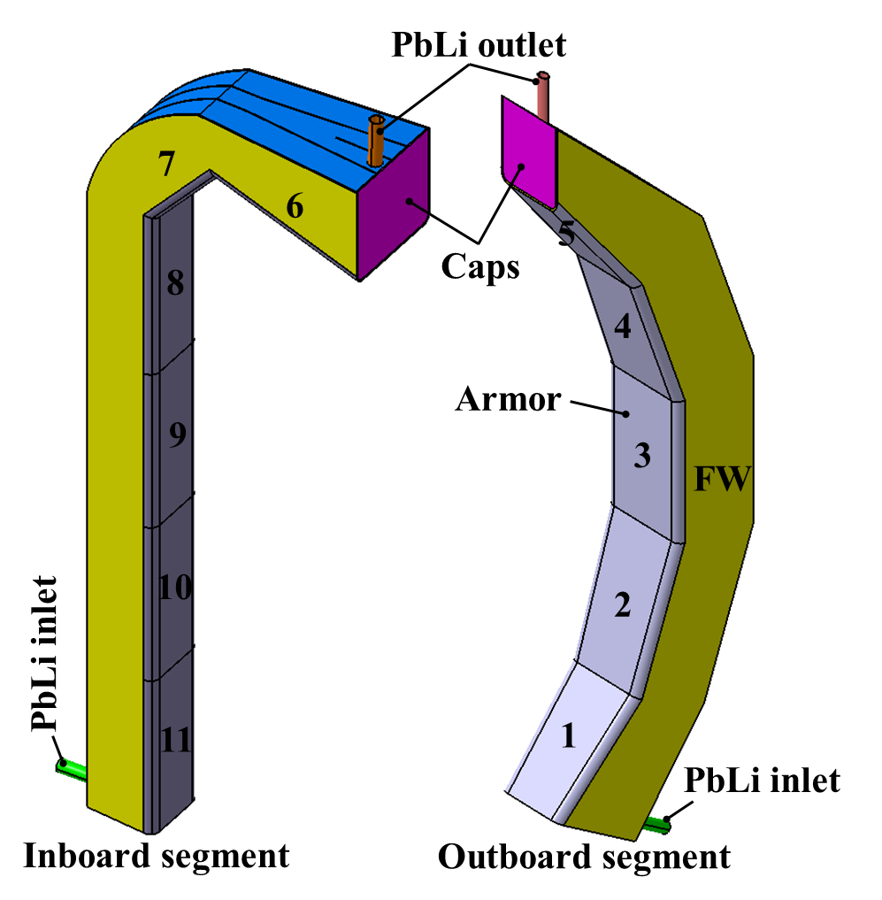
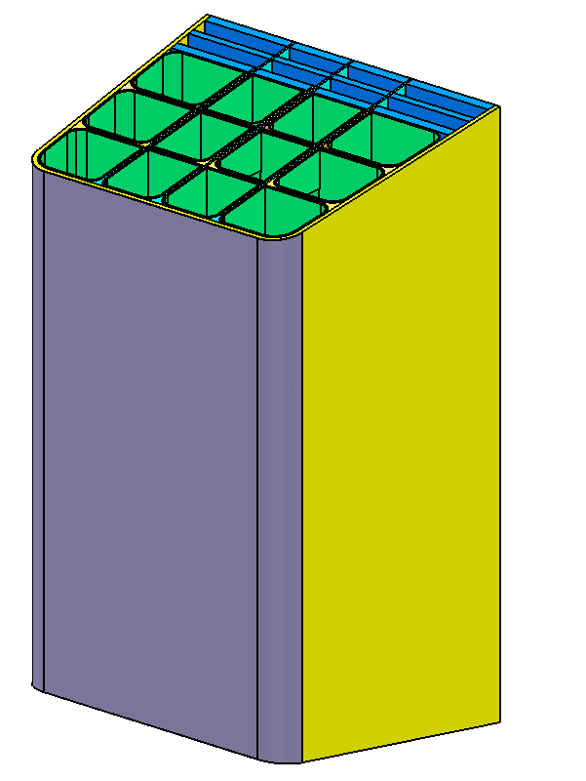
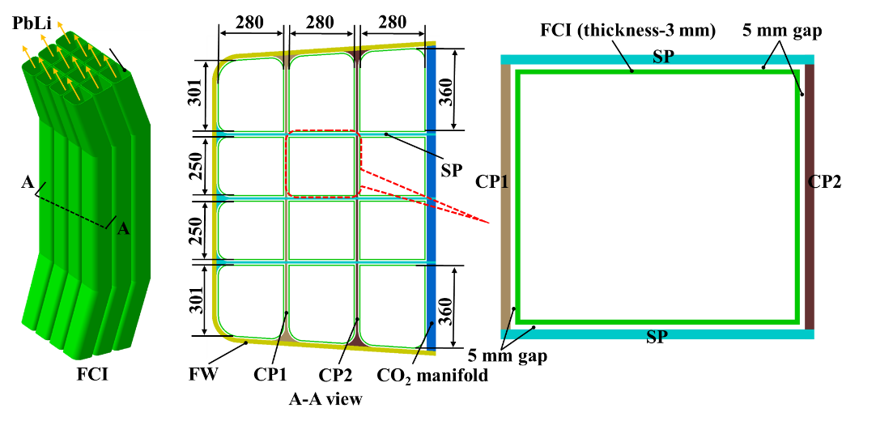
Supercritical CO₂ Cooled Lithium-lead (COOL) Blanket
COOL blanket (BLK): an advanced BLK option for CFETR in the long term
S-CO₂ manifold
SP
CP
FW
Armor
CFETR configuration
（R=7.2m, a=2.2m, 0.2/0.5/1/1.5GW）
Typical COOL BLK segment
Typical COOL breeding unit
Cross section
Design features
  Single-module segment
  Dual coolant
    8-9 MPa S-CO₂ cooling structures, 350 ℃ ~390 ℃
    PbLi self-cooling BZ, outlet 600-700 ℃
  RAFM steel as structural material
  Tungsten as armor material
  SiC_{f}/SiC composites as Flow Channel Inserts (FCI) material
  Thermoelectric conversion efficiency: ~45%
Advantages and disadvantages
  High thermal efficiency: high PbLi outlet temp. and more suitable for efficient power conversion
  Acceptable construction cost: (1) cheaper neutron multiplier of Pb; (2) abundant CO₂ in natural world
  Enhanced heat removal capacity of S-CO₂ for FW cooling: larger density than helium (over 10 times @8MPa, 400℃)
  MHD effect and metal corrosion problems: mitigate by using electrical and thermal insulating Flow Channel Inserts (FCIs)
Notes:
Therefore, the supercritical CO2 Cooled Lithium-lead Blanket, or the COOL blanket, is proposed as an advanced BLK option for CFETR in the long term.
It features a single-module segment with once-through PbLi flow channels in the poloidal direction. Dual coolant is used in this blanket concept, namely S-CO2 of 8 MPa is used to cool the structures, and PbLi is used to cool the breeder zone of PbLi. As for the material selection, RAFM steel is used as structural material, tungsten as armor material, SiCf/SiC composites as FCI material.
This concept has a high thermal efficiency because it has a high PbLi outlet temp. up to 600-700 degC and more suitable for efficient power conversion. Besides, it uses cheaper neutron multiplier of Pb and abundant CO2, which will decrease the construction cost significantly. What’s more, it has enhanced heat removal capacity of S-CO2 for the FW cooling because S-CO2 has over 10 times of density larger than helium.
Of cause, It also has some drawbacks, for example, the MHD effect and metal corrosion problems, but this can be mitigated by using electrical and thermal insulating Flow Channel Inserts (FCIs).

Slide 5
Outline
Introduction
COOL blanket analysis
  BLK performance analysis
  Thermal efficiency estimation
R&D needs and progress
BEST Test Blanket System
Summary
Notes:
This is the outline of my presentation.
First is going to be the introduction.
Following that it is the performance analysis and the preliminary R&D progress for COOL blanket
Finally, I will give the summary.

Slide 6
Nuclear Analysis (1/2)
Tritium breeding ratio (TBR)
  TBR=1.183 without considering port effects of heating and diagnostic systems of CFETR
  TBR=1.113 considering port effects of CFETR
  TBR=1.166 considering port effects of CFETR and contribution of divertor blankets behind divertors
TBR=1.183
Neutronics Model
TBR
Nuclear heating
  Total nuclear heat is 1.2 GW at FP of 1.5 GW
  Exponential decay along the radial direction
Shielding performance
  Enough shielding for the magnet coils
Total nuclear heat： 1191.64MW
Nuclear heating in TFC
Radial nuclear heat distribution
Fast neutron ﬂuence in TFC
Nuclear heating in TFC
Notes:
This slide gives the main results of nuclear performance analysis.
The total global TBR is 1.183 without considering port effects of heating and diagnostic systems of CFETR.
If the port effect is considered, TBR decreases to 1.113, still higher than the design limit of CFETR. When considering the contribution of divertor blankets, the total TBR increase to 1.166 by about 5%.

Slide 7
Nuclear Analysis (2/2)
Irradiation damage and gas(He/H) production rate in one FPY @1.5GW
SiC > SS > W
 | 3# |  | 9#
 | PFC | FW | PFC | FW
DPA/FPY | 5.96 | 14.52 | 5.33 | 12.33
He appm/FPY | 7.86 | 146.80 | 6.62 | 113.64
H appm/FPY | 19.26 | 612.76 | 16.21 | 475.12
SiC/WC: He>H
SS/W: H>He
Irradiation on PFC and FW for unit #1-11
Irradiation on structural components for unit #3
Notes:
The irradiation damage including gas (H/He) production and DPA were calculated.
The left three Figs. show the DPA, He production and H production of PFC and FW for each breeding unit, respectively, and results were normalized to full power year (FPY). the #3 and #9 units have the max damage due to larger NWL distribution, and the irradiation damage of FW is more severe than that of PFC.
The irradiation results of breeding unit #3 and #9 were listed in the Table. The maximum damage is located at the FW of breeding unit #3, which were 14.52 DPA/FPY, 146.80 He appm/FPY and 612.76 H appm/FPY, respectively.
The right two Figs. present the DPA and gas production of structural and functional components for breeding unit #3, including FCI, CP and SB. It shows that nuclear responses decreased with the distance away from the plasma, and the irradiation damage of SiC is higher than that of the adjacent structural steel and PFC. He production is higher than H for SiC, especially for WC owing to its larger reaction cross section of He production. Whilst for the structural steel and W, the H production is higher than that of He.

Slide 8
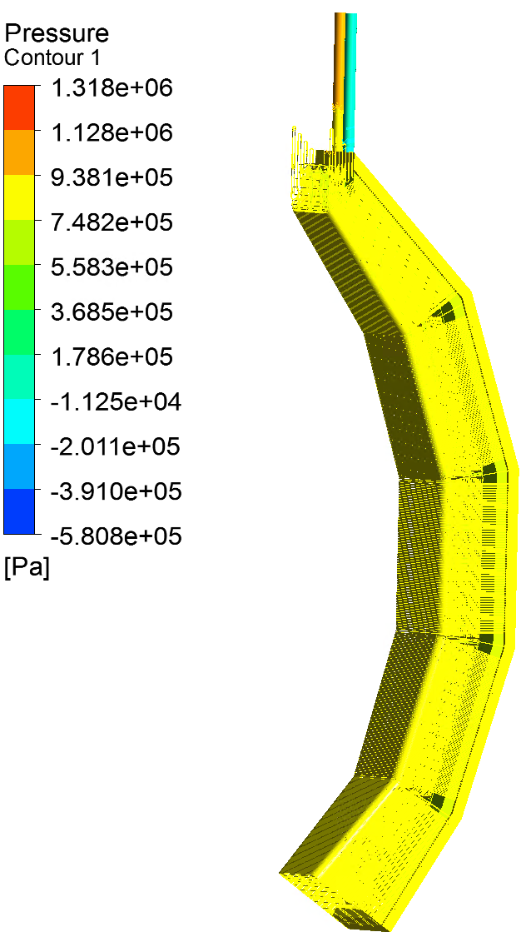
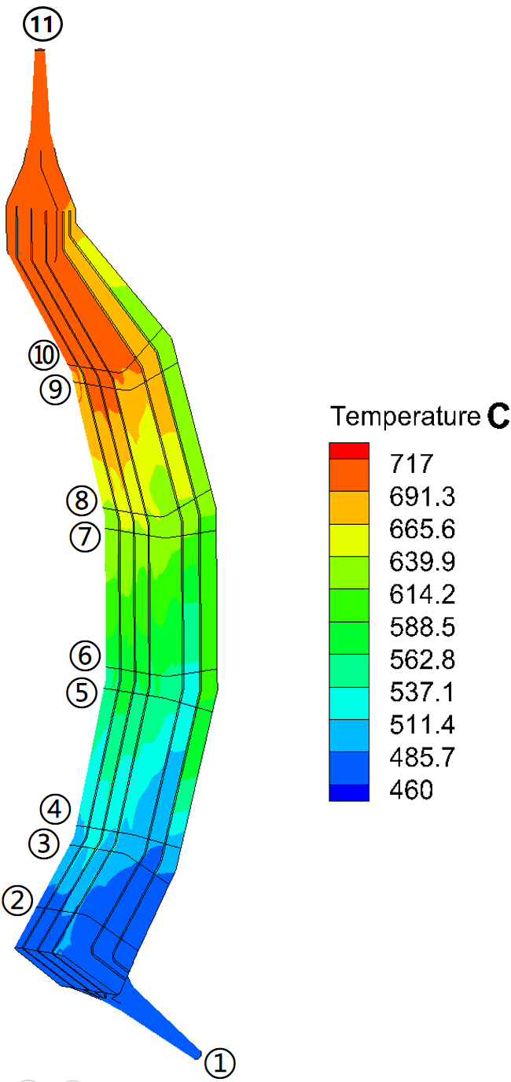
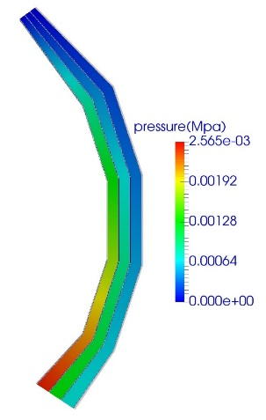
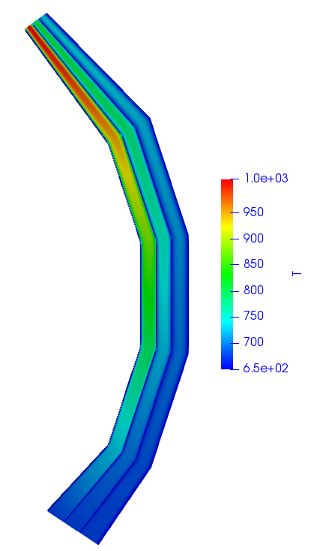

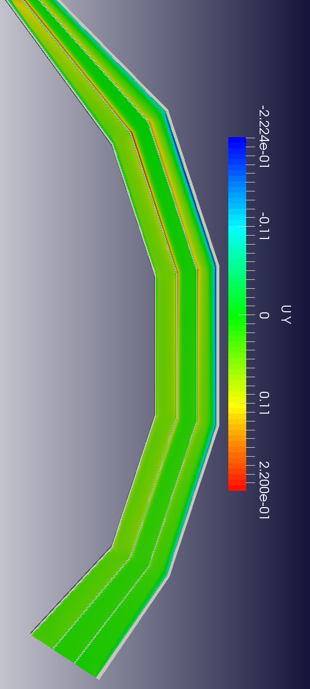
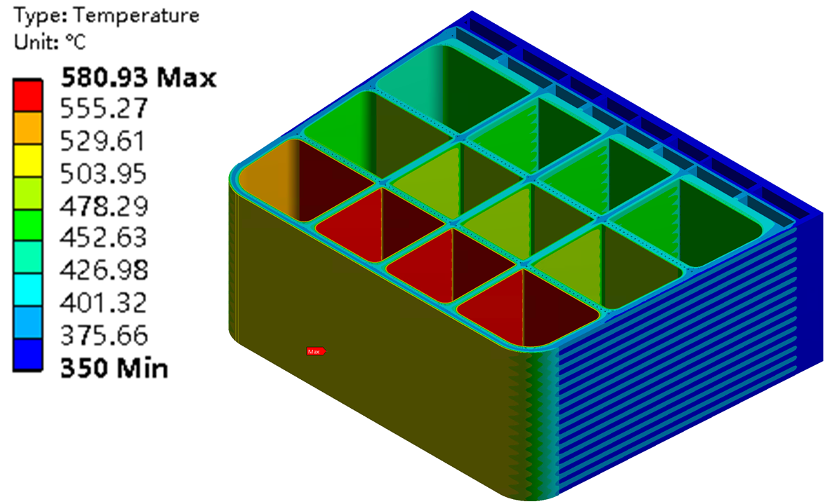
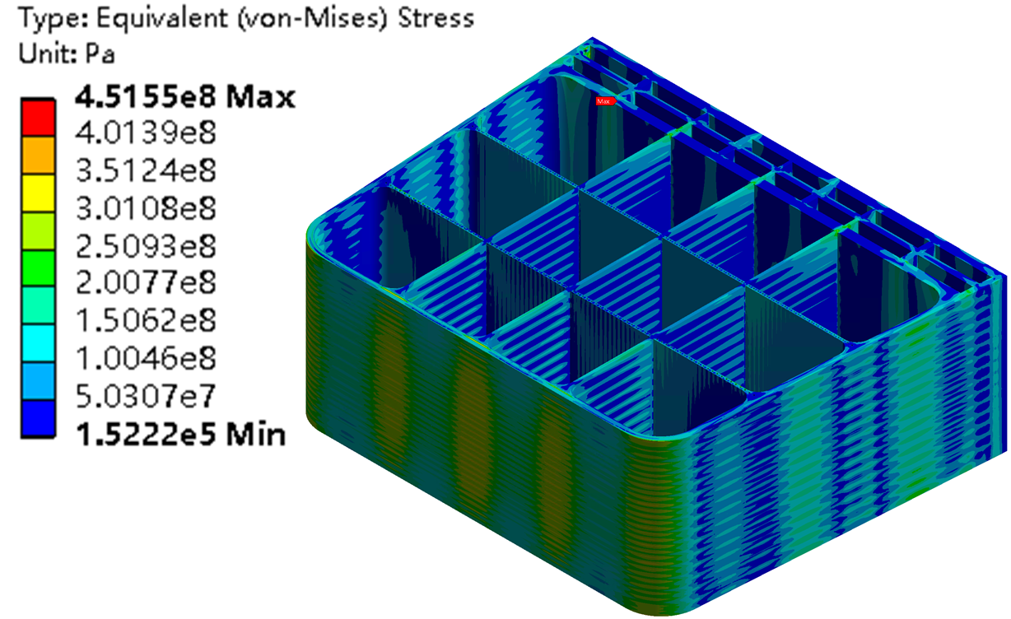
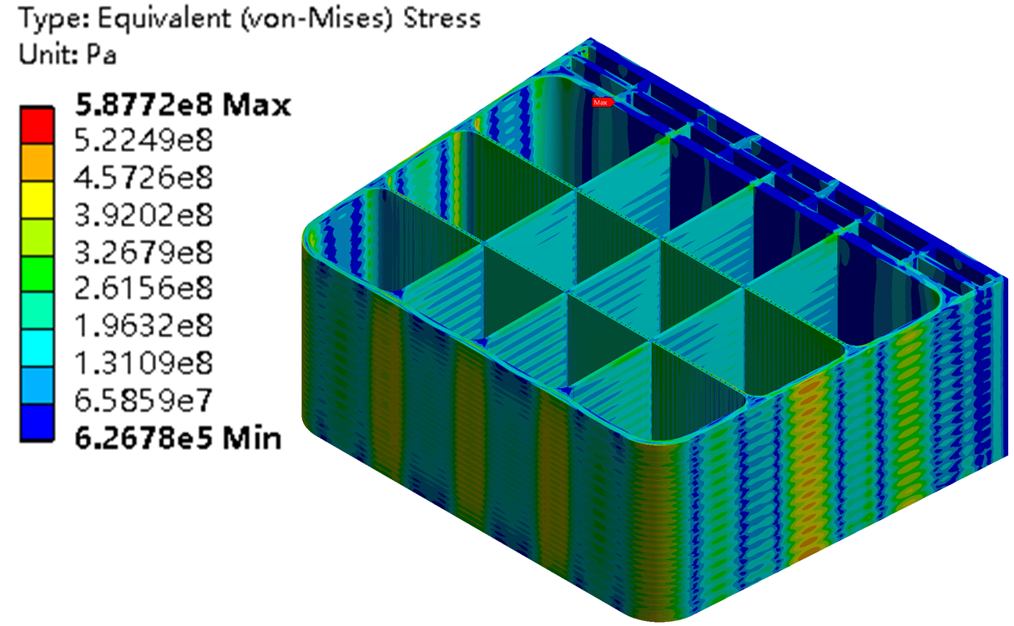
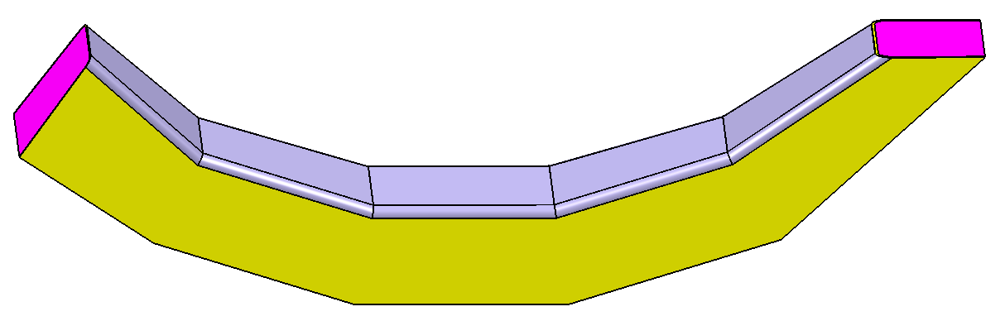
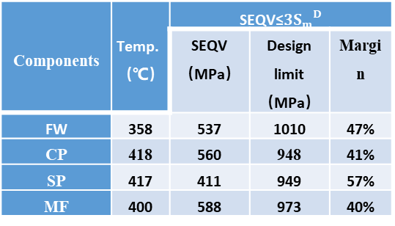
TH/MHD/TM analysis
TH/MHD analysis
  600~700 ℃ is achievable by using thermal insulating SiC FCIs
  Pressure drop of S-CO₂ is 0.34 MPa in FWs and 82% flow through FWs.
  Pressure drop is 2.5kPa in straight part of PbLi flow channels and peak temperature is 740℃ when MHD considered but neglecting the buoyancy effects.
  Reversed flow for PbLi and high speed jet will induce flow instability near the channel wall when considering buoyancy effects.
Reverse flow
T_{Ave.Out}=700℃
T_{Ave.Out}=700℃
Temp. field
(non-MHD)
Temperature field (MHD)
(B=5T, k_{SiC}= 3.5 W/(m·K))
Velocity (MHD)
Pressure field
(non-MHD)
MHD Pressure field (MPa)
Thermo-mechanical analysis for typical outboard breeder unit (BU#3)
  BU#3 is below material temperature limits and stresses under normal & in-box LOCA satisfy ITER SDC-IC code
Components | Temp.（℃） | SEQV≤$3{S_{m}}^{D}$
 |  | SEQV （MPa） | Design limit （MPa） | Margin
FW | 358 | 537 | 1010 | 47%
CP | 418 | 560 | 948 | 41%
SP | 417 | 411 | 949 | 57%
MF | 400 | 588 | 973 | 40%
Outboard segment
BU#3
Temperature field of BU#3
BU#3 stress field in normal condition
BU#3 stress field in in-box LOCA condition
PbLi outlet @700℃
Notes:
This slide shows the results of the TH/MHD/TM analysis for the blanket segment.
It can be seen that the PbLi outlet temp. at 600 ℃ and 700 ℃ is achievable by using thermal insulating SiC FCIs (k=3.5W/(m·K)). Meanwhile the RAFM-PbLi interface is below 480 ℃ (corrosion temp. limit for RAFM).
According to the TH analysis of full banana, Pressure drop of S-CO2 is 0.34 MPa in FWs and 82% of S-CO2 flow through FWs.
For PbLi coolant, When neglecting the buoyancy effects but considering the MHD flow with electric insulating wall of SiCf/SiC FCI, the peak temperature is able to reach 740℃. And with the effects of MHD and buoyancy, there is a reversed flow for PbLi and the high speed jet will induce flow instability near the channel wall, which will be studied in particular in the future.
These figs show the thermo-mechanical results for Breeding Unit 3.
The peak temperatures of all the components meet temperature limit for materials.
The von Mises stress of most structural components satisfies the 3Sm verification criteria, showing a global satisfying behavior. However, the structural strength of manifold need to be improved. Besides, Thermo-mechanical Analysis for the rest breeding unit need to be performed.

Slide 9

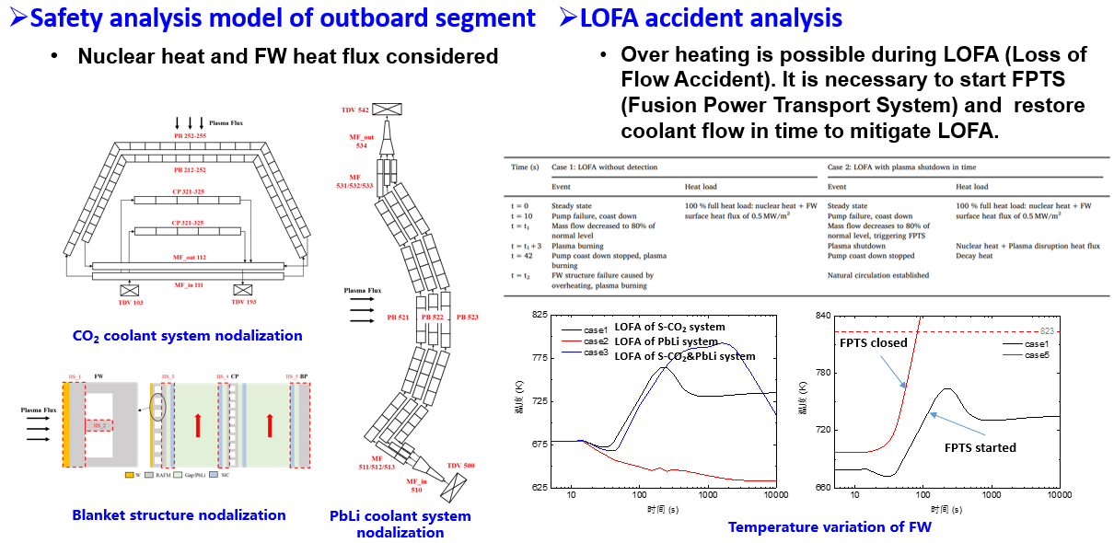
Preliminary safety analysis
Notes:
And, we also perform the preliminary safety analysis for the COOL blanket.
First, we develop the safety model by Relap5. the physical properties and heat transfer equations have been implemented in Relap5. And, the model were verified by comparison with results from litertures.
This is the safety model and results for the outboard segment. The left figures show the coolant system and blanket structure nodalization. And, the nuclear heat and the FW heat flux have been considered as the input.
As it can be seen from the right figures, we can see overheating is possible during the Loss of Flow Accident of the SCO2 and PbLI coolant system. So in this case, it is necessary to start FPTS (Fusion Power Transport System) to shut down the fusion reactor and recover the coolant flow rate in time to mitigate LOFA.

Slide 10
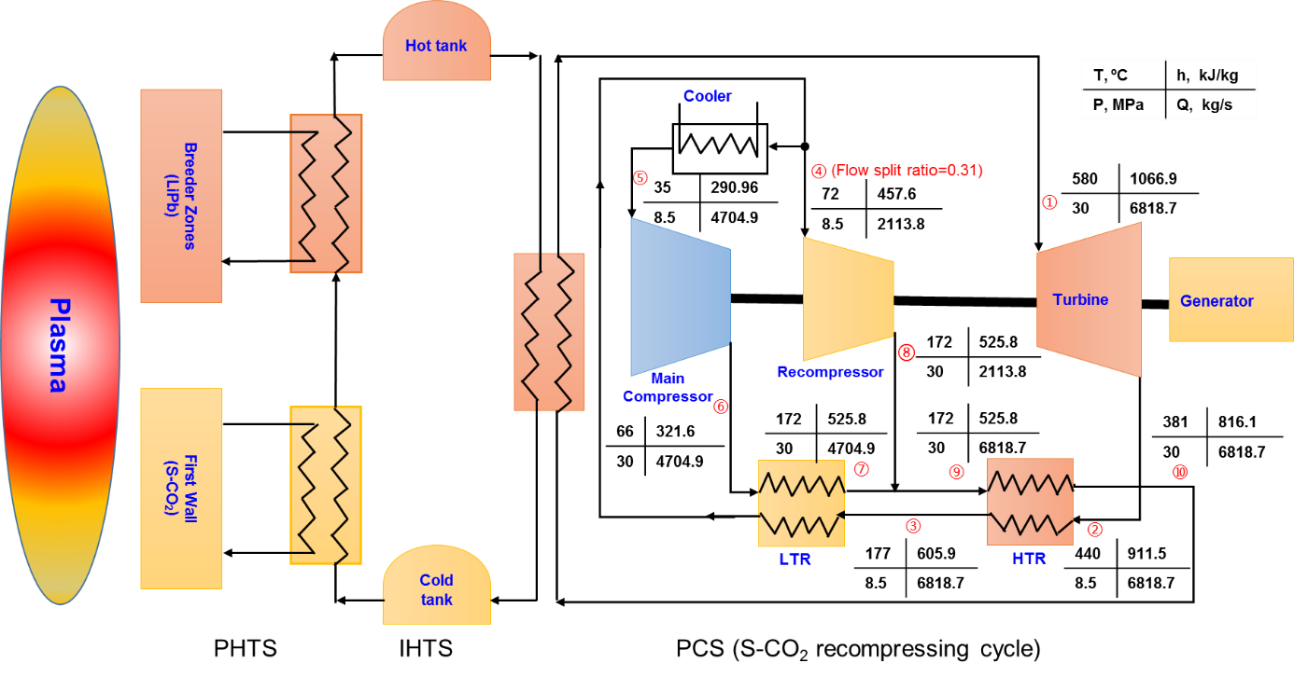
BoP sheme 1: PCS by S-CO₂ recompressing cycle
Preliminary conceptual design for Balance of Plant (BoP)
  BLK and Primary Heat Transfer System (PHTS): preheated by S-CO₂ to ~400 ℃ and reheated by PbLi to 600-700 ℃
  Power Conversion System (PCS): S-CO₂ recompressing cycle with turbine inlet conditions at 550-650 ℃, 25-30 MPa
Gross thermal efficiency: ~43%~48% (without consideration heat loss in PHTS)
  High turbine inlet temp. and pressure is beneficial for high efficiency, but increases the S-CO₂ inlet temp. in BLK
  Recommended operation condition for PCS: turbine inlet condition fixed at 580 ℃ and 30 MPa, and thermal efficiency estimated as 45%. The necessary BLK S-CO₂ inlet temp. is above 380 ℃, and the necessary PbLi outlet temp. could be 600 ℃.
Cases | Turbine inlet T / °C | Turbine inlet P / MPa | BLK inlet T_{required} / °C | η_{gross}
1 | 650 | 30 | >445 | 48.4%
2 | 650 | 25 | >467 | 46.9%
3 | 600 | 30 | >403 | 46.6%
4 | 600 | 25 | >423 | 45.4%
5 | 580 | 30 | >387 | 45.7%
6 | 580 | 25 | >406 | 44.8%
7 | 550 | 30 | >363 | 44.5%
8 | 550 | 25 | >381 | 43.3%
Notes:
A preliminary conceptual design for Balance of Plant has been proposed. First I would like to talk the directly coupling BoP scheme.
the BoP consists of two separate systems. Namely the BLK and Primary Heat Transfer System (PHTS), and the Power Conversion System (PCS). The efficient S-CO2 recompressing Brayton cycle is used in the PCS for thermoelectric conversion. The SCO2 coolant from PCS is initially preheated by S-CO2 to ~400 ℃ and then reheated by PbLi to 600-700 ℃. In case of pulse operation, IHTS equipped with the Energy Storage System (ESS) is used to convert the transient pulsed plasma heat production to the steady energy output.
According to the calculation, the gross thermal efficiency has been estimated as 43%-48%, without consideration heat loss in PHTS. Results of serval cases at different turbine inlet temp. and pressures are listed in the table. We can see that High turbine inlet temp. and pressure is beneficial for high efficiency, but increases the S-CO2 inlet temp. in BLK.
Finally, a recommended operation condition for PCS is given as case 5, namely the turbine inlet condition is fixed at 580 ℃ and 30 MPa. In this case, thermal efficiency is about 45%. The necessary BLK S-CO₂ inlet temp. is above 380 ℃, and the necessary PbLi outlet temp. could be 600 ℃.

Slide 11
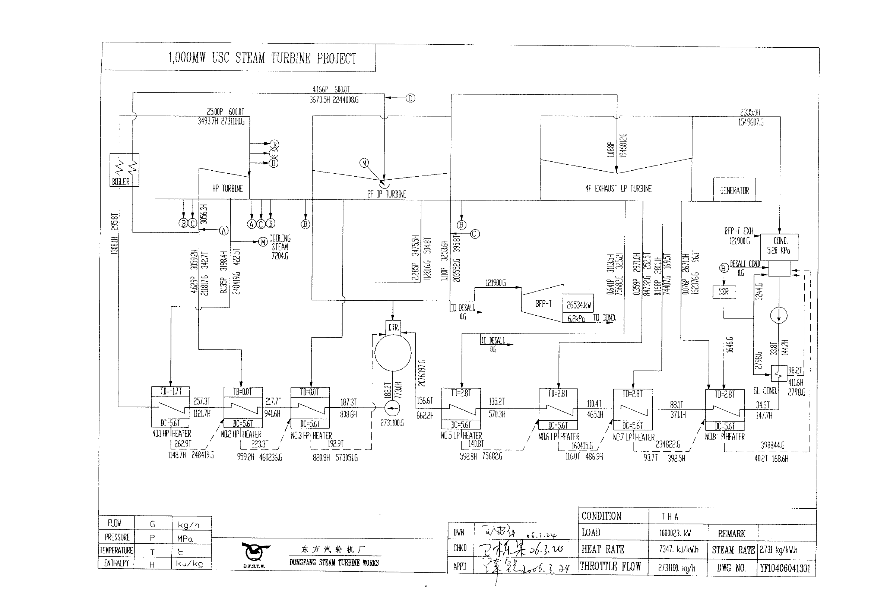
BoP sheme 2: PCS by USC
Ultra-supercritical (USC) water generator units
  Ultra-supercritical water generator unit (8-stage regenerator) is used in PCS, with turbine inlet temperature of 600-630℃, pressure of 25-35MPa, and thermal efficiency of 45%-50%;
  USC technology is mature, and domestic Shanghai Electric/Dongfang Electric/Harbin Electric have 1000MW gernerator units. But the systems are complex (generally 7-8 stages of regenerators), and the investment cost is high.
Type of PCS | Turbine Inlet T/ °C | Turbine Inlet P/ MPa | Domestic commercial Cases | η
SC-600MW | 566 | 24.2 | Xinbei, Henan （Harbin Electric, operated in 2004） | 43.6%
USC-600MW | 600 | 25 | Zhouxian, Shandong （Dongfang Electric, operated in 2006） | 45.4%
USC-1000MW | 600 | 27 | Waigaoqiao, Shanghai （Shanghai Electric, operated in 2008） | 45.7%
Double reheat USC-1000MW | 620 | 31 | Taizhou, Jiangsu （Harbin Electric, operated in 2015） | 47.8%
Double reheat USC-1000MW | 630 | 35 | Yuncheng, Shandong （Dongfang Electric, constructing from 2023） | >50%
USC-1000MW at Dongfang Electric
Notes:
We also have another option for the PCS, namely the Ultra-supercritical (USC) water generator units.
USC technology is mature, and domestic Shanghai Electric/Dongfang Electric/Harbin Electric have 1000MW gernerator units. Normally, with turbine inlet temperature of 600-630℃, pressure of 25-35MPa, and thermal efficiency is going to be 45%-50%.

Slide 12
Outline
Introduction
COOL blanket analysis
R&D progress
  Design of neutronics experiments
  Thermal hydraulic testing facilities
  SiC_{f}/SiC material preparation
BEST Test Blanket System
Summary
Notes:
This is the outline of my presentation.
First is going to be the introduction.
Following that it is the performance analysis and the preliminary R&D progress for COOL blanket
Finally, I will give the summary.

Slide 13
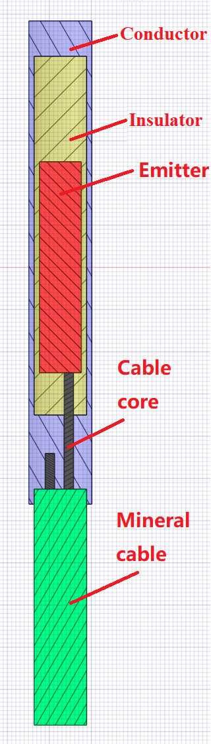
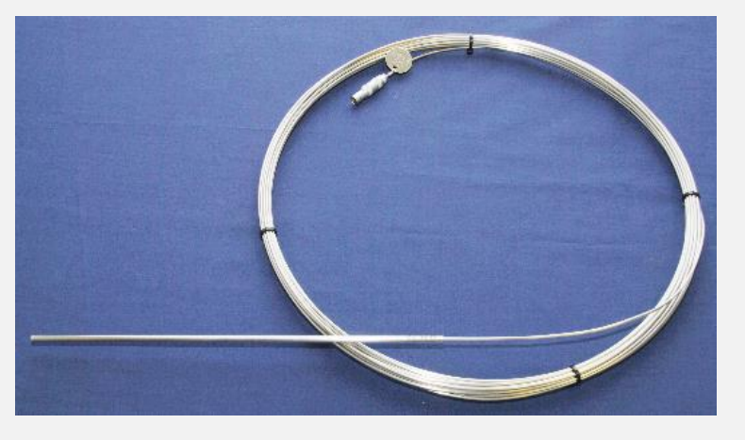
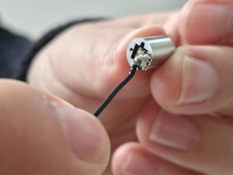
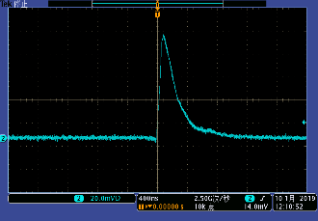
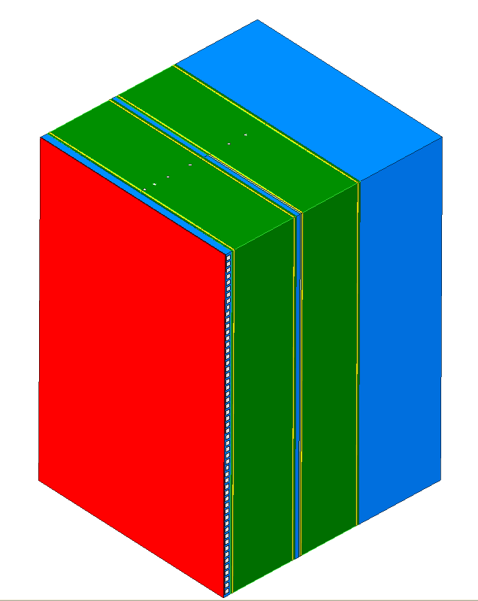
Design of neutronics experiments
Self-power neutron detector (SPND) to monitor neutron flux, and lithium glass detector to measure tritium production rate
Testing for detectors is ongoing
SPND detector
Li-glass detector
Neutronics experiments of COOL blanket mockup will be performed by using DT neutron source in 2024
Design of experimental mockup
13
Notes:
SPND: Self-powered neutron detector

Slide 14
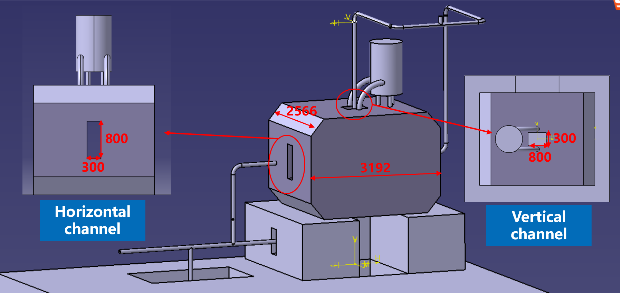
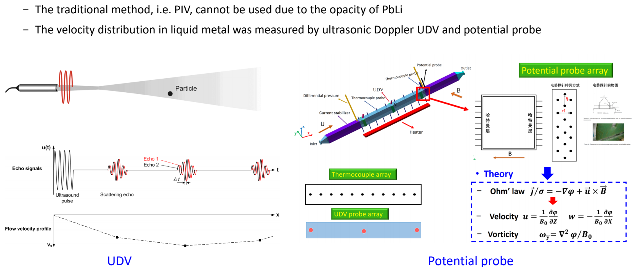
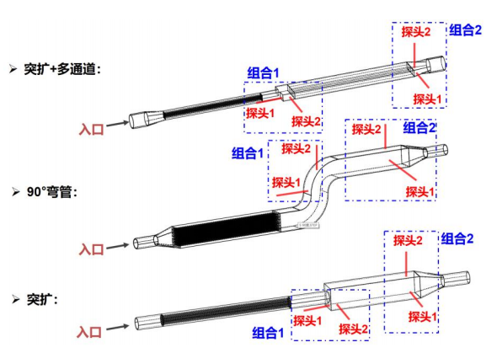
High temp. LiPb loop with 3T magnet
Superconducting magnet
The construction will be finished in 2024
Main parameters
Operating pressure | 1.5 MPa
Design temperature | High temp. section (310s) 750 ℃ Low temp. section (316L) 550 ℃
PbLi operation temperature | 270-700 ℃
PbLi flow rate | 30 m³/h
PbLi inventory | 10 t
Magnetic field | 0~3 T, uniformity of 8% in 0.25 m*0.6 m*1.0 m region
Oil design parameter | 1.6 MPa, 350 ℃, 130 m³/h
Water design parameter | 0.5 MPa, 80 ℃
Heating power | 1.5 MW
Key experiments
Turbulent heat transfer
– Thermal boundary layer flow on forced convection
– PbLi flow in complex geometry channel
MHD effects
– Phase diagram and turbulent transition mechanism under different Re/Ha
– The effects of FCI on the flow and heat transfer
– MHD flow in complex geometry channel
– Multi channel under electromagnetic coupling effect
Mixed convection
– One-side heat flux conditions
– Large magnetic/heat source
Kecheng Jiang, et al. Development of the high temperature PbLi experimental loop for CFETR, ISFNT15 Blanket technology session, Monday, 11th Sept. 2023.

Slide 15
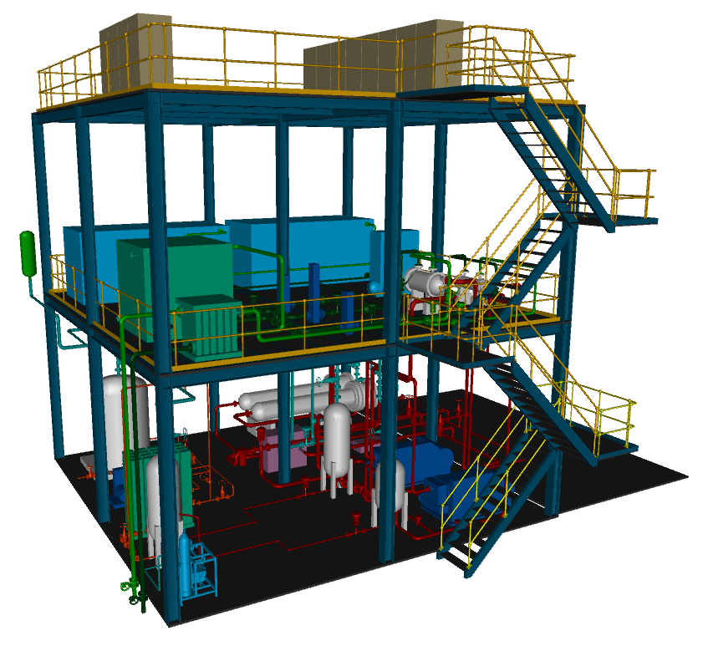
High temp. S-CO₂ loop
Objectives
  Provide thermal-hydraulic testing environment of COOL blankets
  Validate the design codes/methods/models
Main parameters
Operating pressure | 8-9 MPa
Operating temperature | 300-500 ℃
Flow rate | 0.2-6 kg/s
Heating power | 1.7 MW
Key experiments
Heat removal capability of S-CO₂ with one-side high heat flux
Coupling heat transfer performance with PbLi
Flow characteristics of S-CO₂ in complex channels of blanket and heat exchangers
The construction will be finished in 2025
S-CO₂ loop (10×10×10 m³)

Slide 16
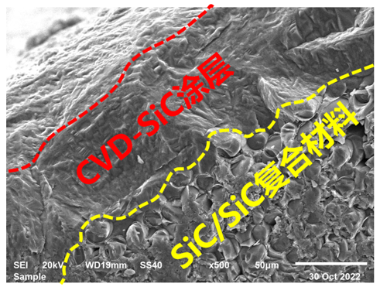
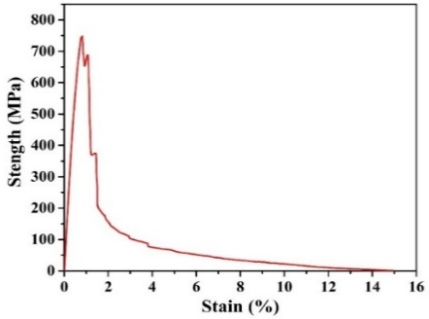
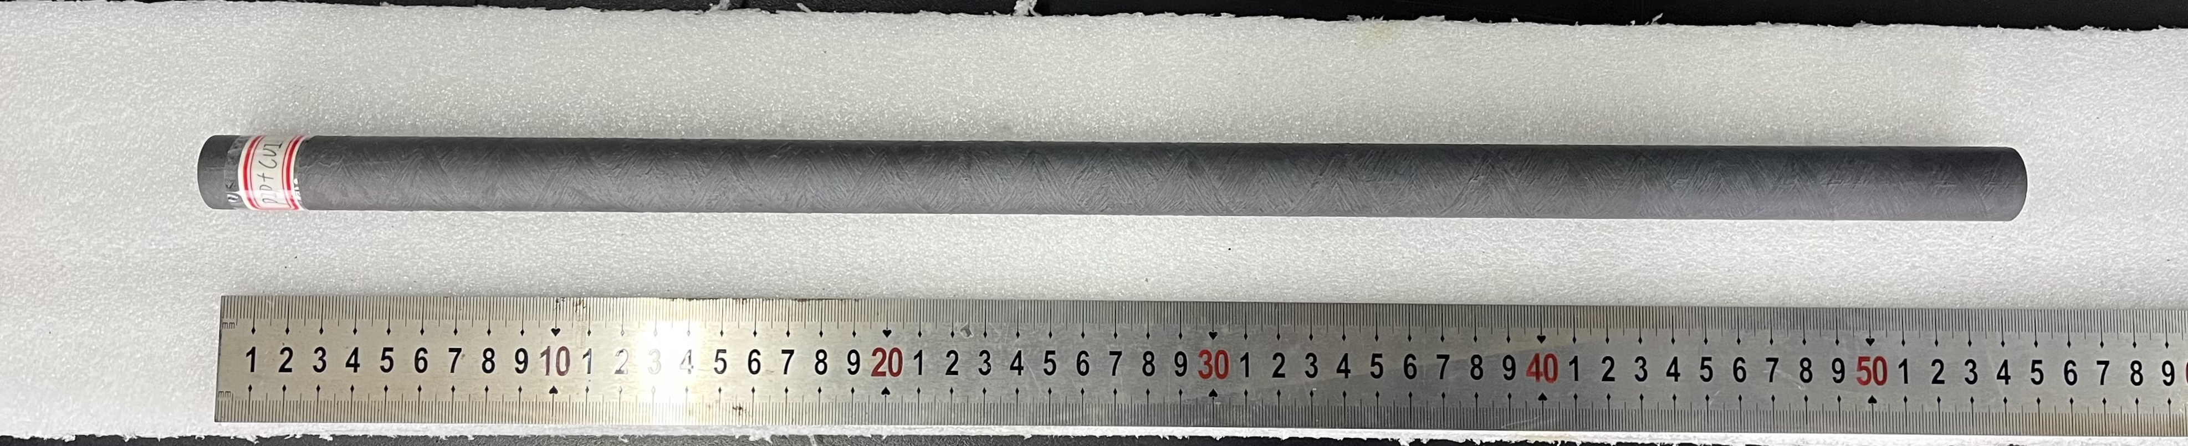
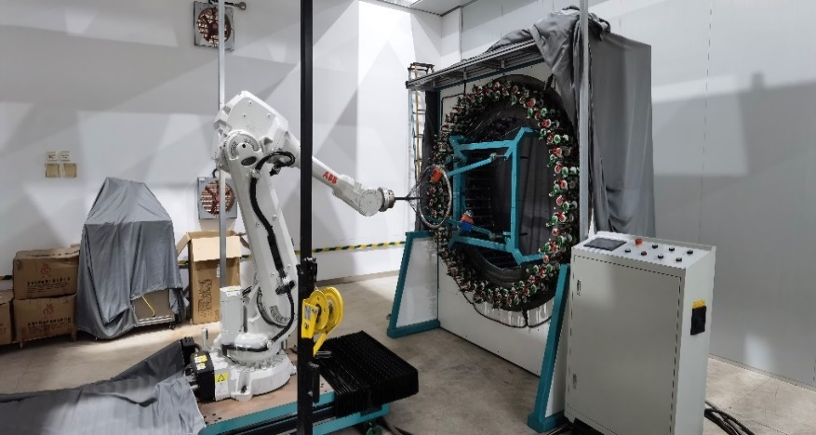
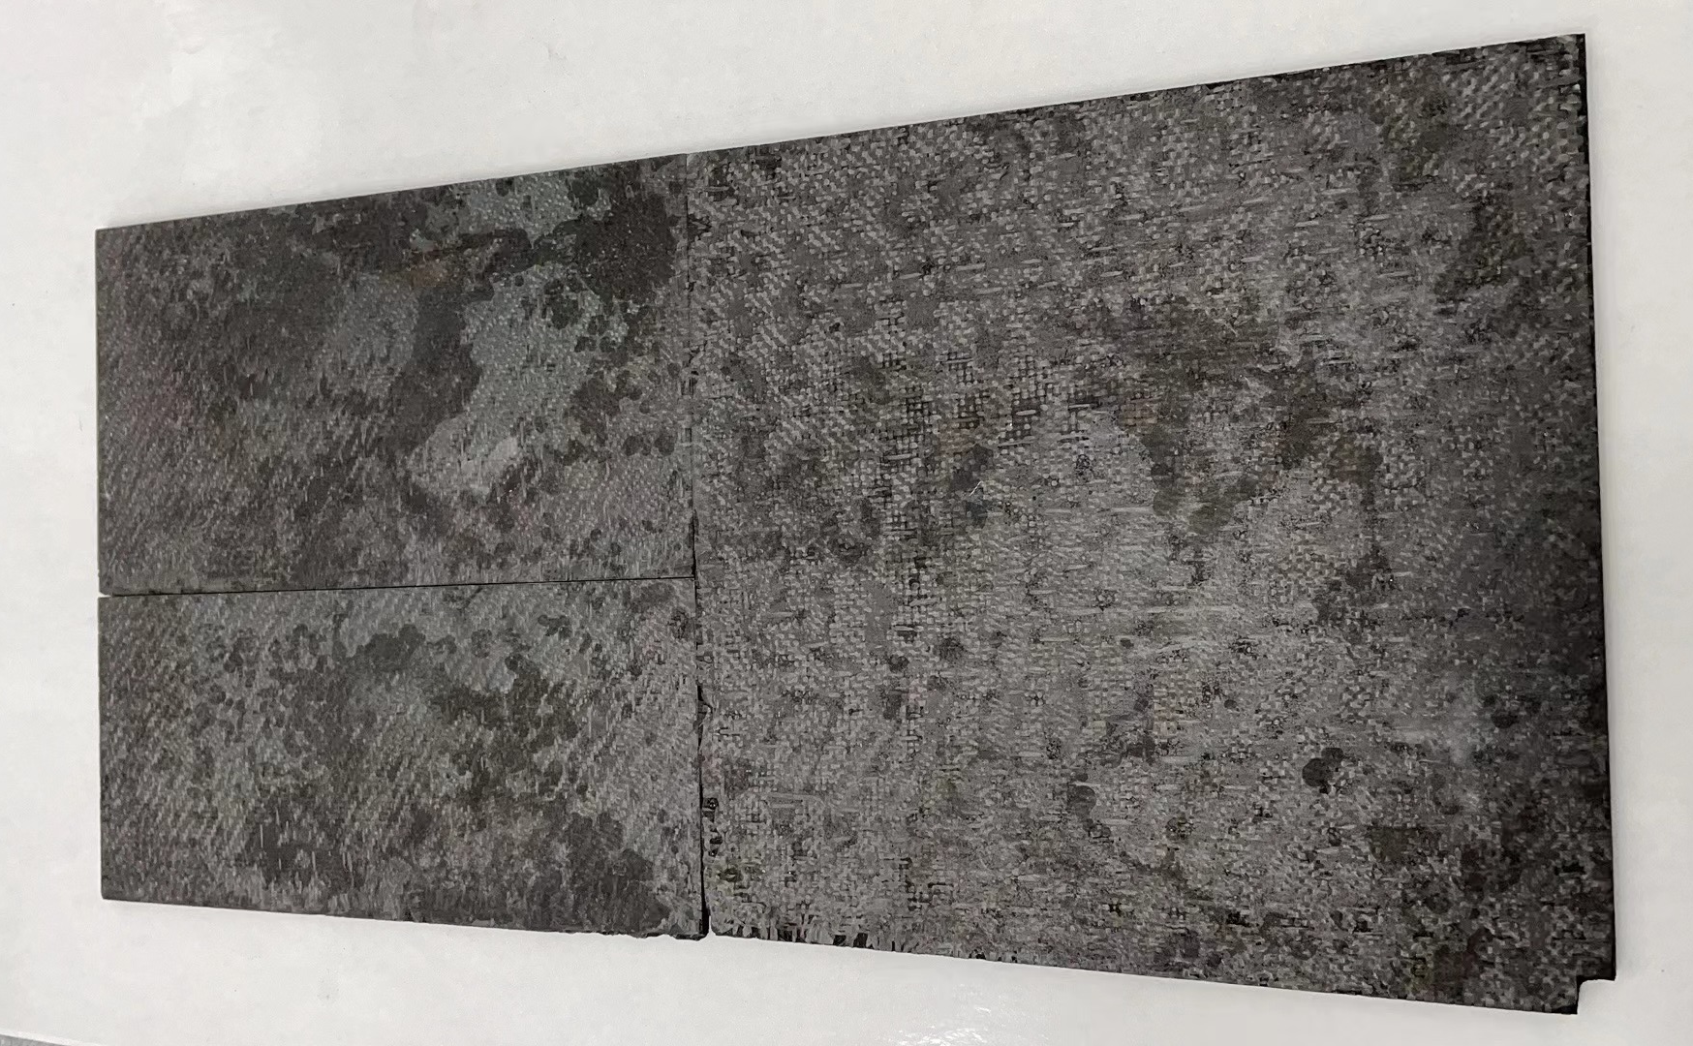
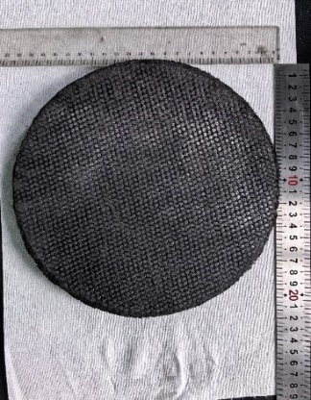
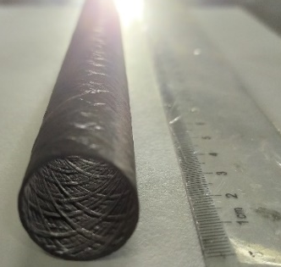
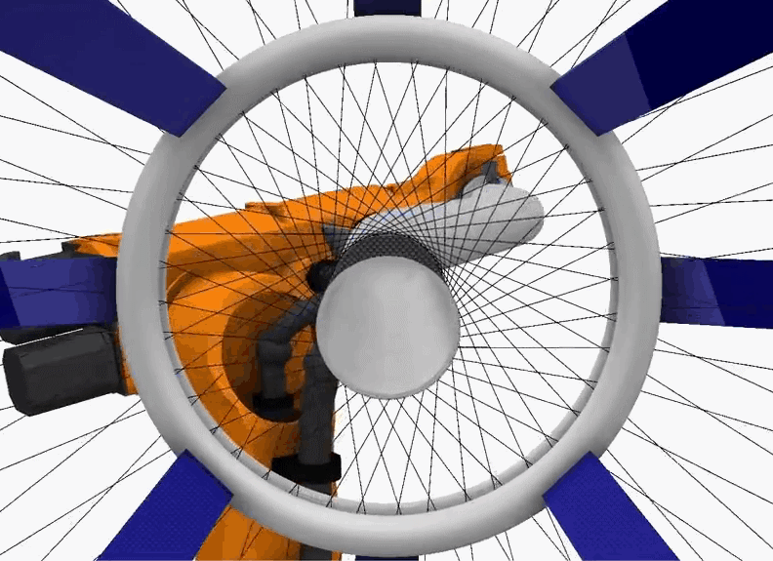
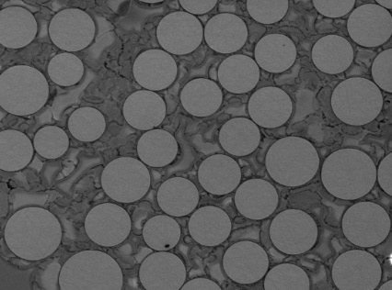
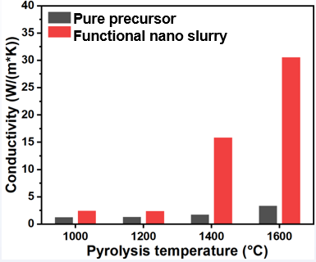
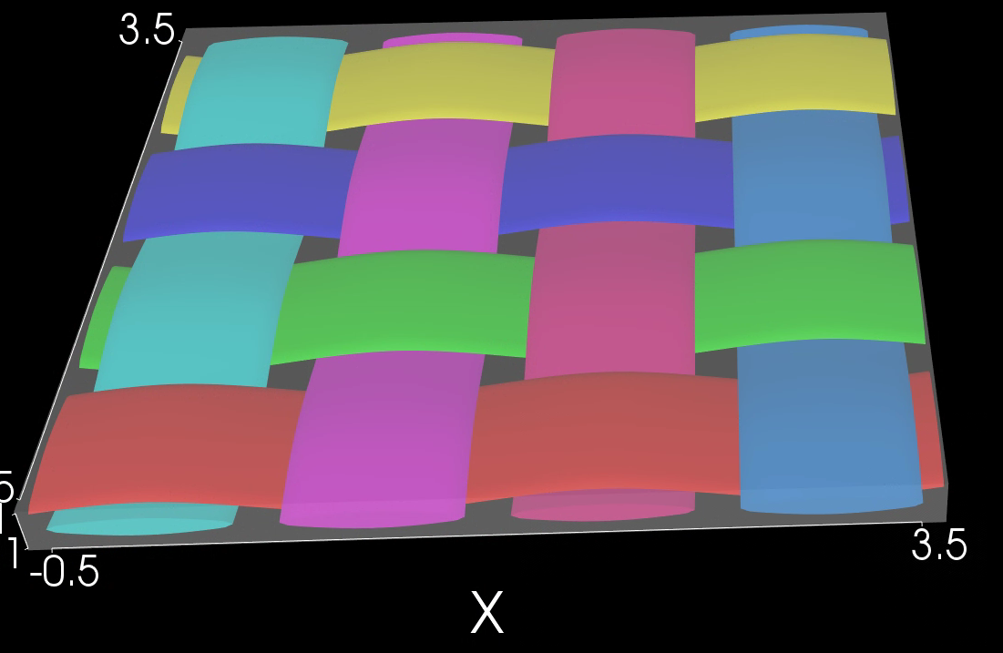
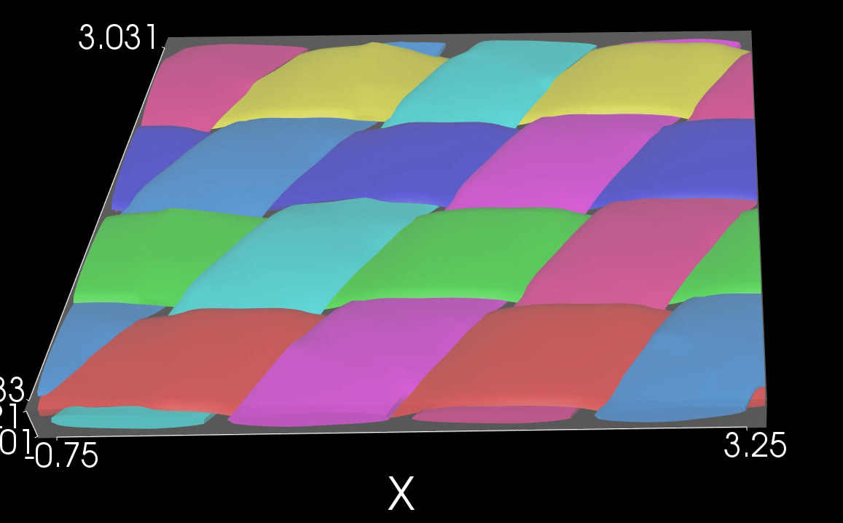
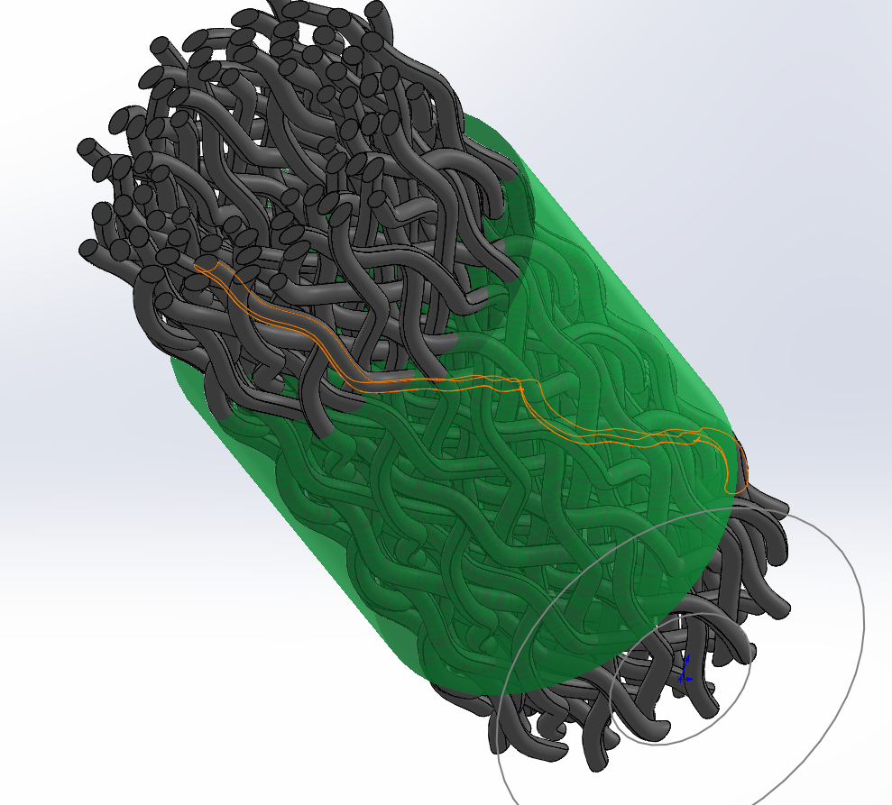
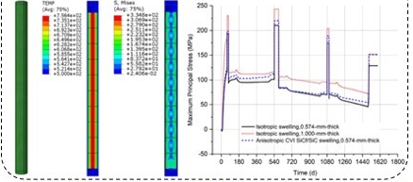



SiC_{f}/SiC composites preparation
Densification technology of SiC_{f}/SiC composite
(1) Functional nano slurry impregnation-pyrolysis: The introduction of functional nano metal powders can eliminate free carbon in the pyrolysis products of precursor polycarbosilane, while improving crystallinity and thermal conductivity
(2) Reactive infiltration in mesoporous carbon networks: By regulating the pore structure of mesoporous carbon networks, efficient conversion, high density, high thermal conductivity and low Si residue can be achieved
Composite and properties (Density ~2.8g/cm³, axial/circumferential tensile strength up to 280MPa/200MPa, resistant to 1600 ℃ water vapor corrosion)
High strength
Microstructure
High thermal conductivity
SiC_{f}/SiC composite（plate and pipe）
Fibre winding machine
Master the 3D modeling technology of SiC composites from preform to interface layer to matrix and the life prediction method based on AI technology under multi-physical field
Weaving angle：90°
Weaving angle：30°
Matrix +preform

Slide 17
Outline
Introduction
COOL blanket analysis
R&D needs and progress
BEST Test Blanket System
  Objectives & Strategies of BEST TBM
  Plan of BEST TBM
  Design of COOL TBS
  Comparison with ITER/CFETR
Summary
Notes:
This is the outline of my presentation.
First is going to be the introduction.
Following that it is the performance analysis and the preliminary R&D progress for COOL blanket
Finally, I will give the summary.

Slide 18
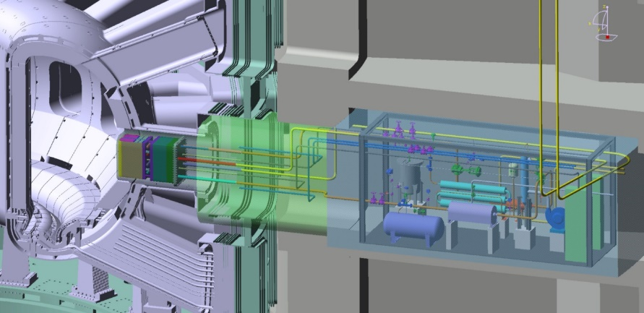
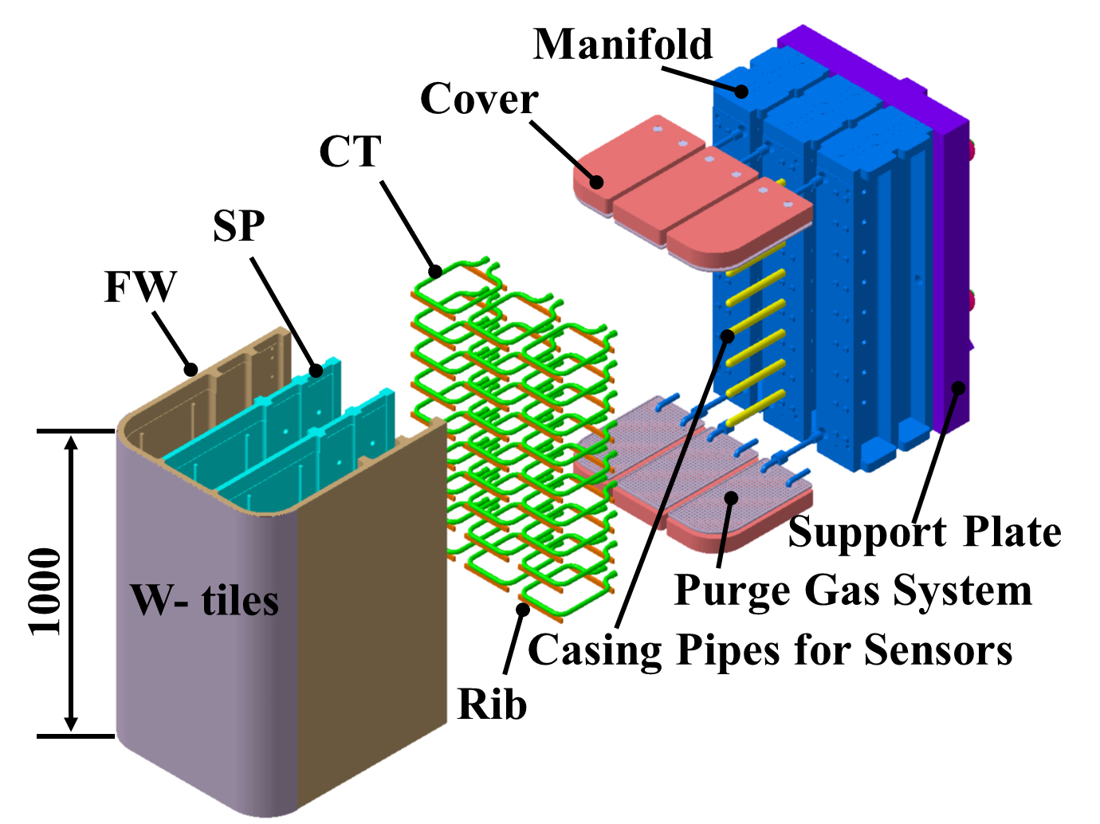
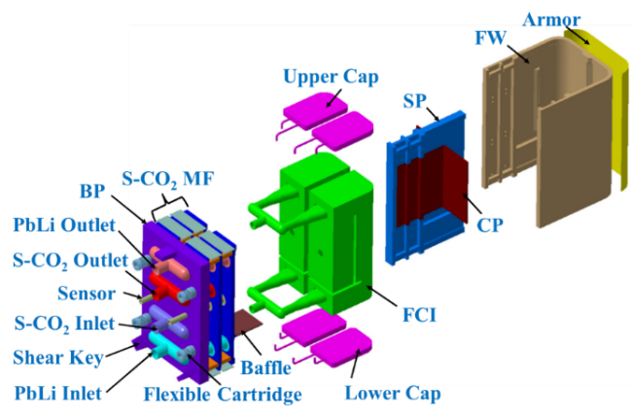
BEST Test Blanket Systems (TBS)
General objective: validate tritium breeding and energy extraction
Strategies
Keep relevancy to CFETR/DEMO to provide prediction for full size tritium breeding blanket designs
Select one solid blanket concept and one liquid concept to test
Start from low/near-term technology then move to high/long-term technology
Verify TBM thermal hydraulic performance out-of-pile before DT operation
Port Configuration
  Middle Port L: COOL TBM
  Middle Port M: WCCB TBM
  Module size: Tor.640mm×Pol.1000mm×Rad.700mm
Operation condition
DT fusion power: 20~40 MW (40MW as the design basis condition)
Burning time/cycle time: 1000 s/pulse and 10 pulses/day for 180 days
Neutron Wall Loading: 0.085 MW/m² @ 20 MW and 0.17 MW/m² @ 40 MW
FW plasma heat flux: 0.1 MW/m² @ 20 MW and 0.3 MW/m² @ 40 MW
Cryostat
Bio-shield
TBM set
Ancillary Equipment Unit
Port configuration in BEST
BEST COOL TBM
BEST WCCB TBM

Slide 19
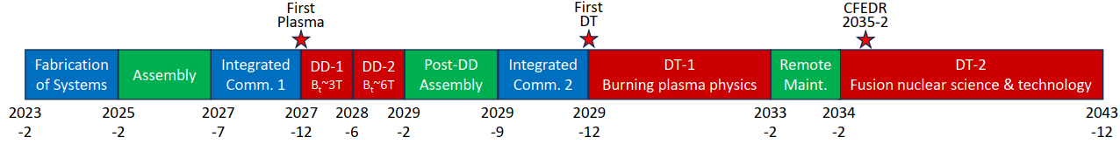
Design, R&D, Fabrication, Assembly Plan of BEST TBS
by Guosheng Xu, BEST PAC 2023
BEST Construction Phase | 2022 |  |  |  | 2023 |  |  |  | 2024 |  |  |  | 2025 |  |  |  | 2026 |  |  |  | 2027
 | 1 | 2 | 3 | 4 | 1 | 2 | 3 | 4 | 1 | 2 | 3 | 4 | 1 | 2 | 3 | 4 | 1 | 2 | 3 | 4 | 1 | 2 | 3 | 4
Conceptual Design
Engineering Design
R&D of Material /Components /Subsystems
System Fabrication & Testing
System Assembly
PDR
WCCB FDR
COOL FDR
TBM mockup
Li₁₇Pb₈₃/Li₂TiO₃
SiC_{f}/SiC FCI
TES/TAS
Be₁₂Ti
NMS
S-CO₂ loop
PbLi loop
TES/TAS
TBM/PP
WCS
NMS
Integrated Assembly
*Both WCCB/COOL TBM plan included

Slide 20
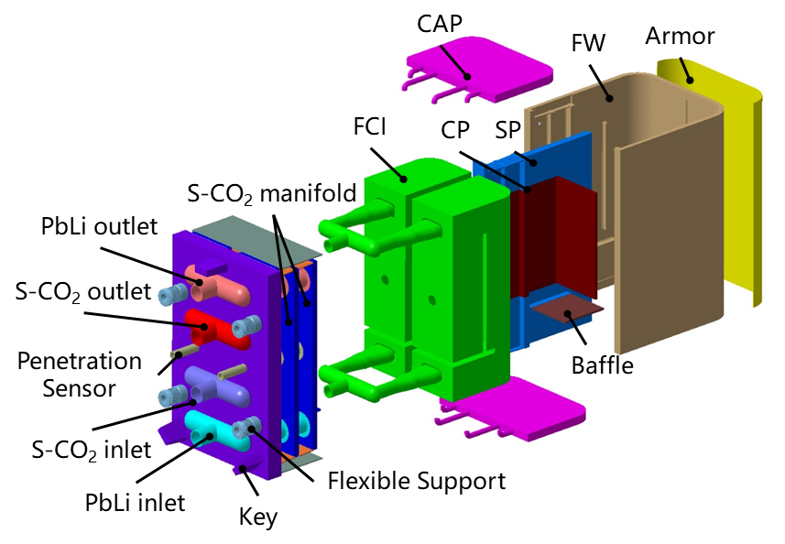
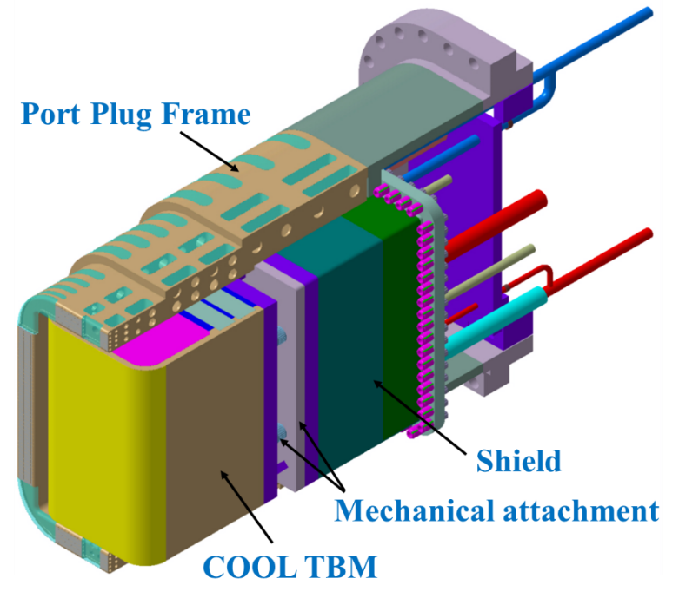




Design of COOL TBS
Main design features
  CFETR/DEMO relevancy: same material/TH cond.
  SiC_{f}/SiC composites to mitigate MHD/corrosion
  Operation scheme starting from a low-temp. mode
    Low-temp. mode: S-CO₂@8 MPa, 350/390 ℃; PbLi@ 400/450 ℃
    High-temp. mode: S-CO₂@8 MPa, 350/410 ℃; PbLi@460/600℃
  Out-of-pile test before operation in BEST
  Enriched lithium material will be used
COOL TBM
Port Plug
Coolant | Items | Unit | High mode | Low mode
PbLi | Power | kW | 23
 | Inlet T | ℃ | 460 | 400
 | Outlet T | ℃ | 600 | 450
 | Mass flow | kg/s | 0.2 | 1.41
Coolant | Items | Unit | High mode | Low mode
S-CO₂ | Power | kW | 76
 | Inlet T | ℃ | 350 | 350
 | Outlet T | ℃ | 410 | 390
 | Mass flow | kg/s | 1.1 | 1.88
Item | Value
PbLi volume | 0.3 m³
PbLi mass flow rate in PAV | Low/high temp. mode: 0.8/0.3 kg/s
Extraction temp. in PAV | 535 ℃
T at PAV inlet | Low/high temp. mode: <0.001/0.004 ppm
T extraction efficiency | ≥ 90%
Vacuum of vacuum vessel | 1×10⁻⁴ Pa
PbLi loop
S-CO₂ loop
TES/TAS

Slide 21
BEST COOL TBM compared with ITER/CFETR
NWL of BEST is ~20% of that of ITER and the maximum irradiation damage is ~0.02 DPA in BEST TBM. Therefore, the material irradiation effect cannot be tested in BEST.
Neutron yield of BEST is 2.5E25, close to that of ITER in DT-1 operation stage (3E25), which indicates BEST will have a comparable tritium production with ITER in DT-1 by similar FW size of TBM.
Similar systems (PHTS/TES/TAS/NMS) and technologies (BLK fabrication, BLK test facilities) will be tested by BEST TBS, which are also beneficial and applicable to ITER.
BEST probably starts the TBM testing and acquire data before ITER, which should be able to provide a reference for ITER.
The concept of dual coolant blanket will be demonstrated for the first time in the world by BEST COOL TBS under relevant fusion environment, which is an important supplement to ITER TBM.
 | BEST COOL TBM | ITER WCLL TBM | CFETR COOL (BU #3)
FP of plant | 40 MW | 500 MW | 1500 MW
NWL | 0.17 MW/m² | 0.78 MW/m² | 1.82 MW/m²
FW heat flux | Average ≤0.3 MW/m² | Average 0.3 MW/m² | Average 0.5 MW/m²
Burning time | 1000s/pulse | 450s/pulse per 1800s | 8h running &15min dwell
Size (Rad.×Tor.×Pol.) | 780×640×1000 | 685×462×1670 | 948×1249×2090
Total power | ≤262 kW | 722 kW | 5.56 MW
Nuclear heat | 70 kW | 488 kW | 4.24 MW
Irradiation damage | Max. ~0.02 dpa/life | ~<0.2 dpa/DT-1 & ~<0.5 dpa/DT-2 | Max. ~14.5 dpa/FPY
TPR (Tritium Production Rate) | 0.094 mg/pulse (8.1 mg/FPD) (1000s/pulse, 1 pulse/day) | 0.35 mg/pulse (66.4 mg/FPD) (450s/pulse, 48 pulses/day, duty factor=0.25) | 15.2 g/FPD

Slide 22
Outline
Introduction
COOL blanket analysis
R&D needs and progress
BEST Test Blanket System
Summary
Notes:
This is the outline of my presentation.
First is going to be the CFETR COOL blanket concept design.
Following that it is the performance analysis and the preliminary R&D plan for COOL blanket
Finally, I will give the summary

Slide 23
Summary
COOL blanket is proposed as an advanced BLK option for CFETR and related N /TH /MHD /TM /safety analyses prove fesiblity of the BLK concept.
Preliminary schemes of PCS based on the S-CO₂ recompressing cycle & Ultra-supercritical water generator unit are proposed for COOL BLK and the gross thermal efficiency is estimated to be ~ 45% at high turbine outlet temp. of ~600 ℃.
R&D related to design of neutronics experiment is being done, and construction of high temp. LiPb loop with 3T magnet, high temp. S-CO₂ loop, & FCI material preparation are ongoing.
Both WCCB and COOL TBM will be tested by the BEST machine. TBM system design has been updated and test plan will start from 2027.

Slide 24
Thank you for your attention！
Notes:
Q1: tritium transport, >99%,
Q2: tritium extraction technology, 40% by PAV technolgy. R&D will be done in 2024-2025 by ICEP.
Q3: safety analysis of in-box LOCA
Q4: Qualification

Slide 25
CO₂ activation results
Activation products
  ³H, ¹⁴C, ¹⁶N, ¹⁷N
  ¹⁴C comes mainly (>95%) from O
  COOL < WCCB
Activation decomposition
  Decomposition fraction is very small, less than 1.7% under 0.9~1.7×10¹⁸ eV•g⁻¹•min⁻¹) . It does not impact the CO₂ stability.
Activation products origin
Nuclide | Half-life (s) | Origin (Fusion FW spectrum)
H3 | 3.891E8 | C13(n,t)H3 (86.596%) O17(n,t)H3 (13.238%)
C14 | 1.799E11 | O17(n,a)C14 (55.177%) O18(n,na)C14 (40.491%) C13(n,g)C14 (4.317%)
N16 | 7.130E0 | O16(n,p)N16
N17 | 4.170E0 | O17(n,p)N17
Coolant activation COOL vs. WCCB
Activation products concentration
 | COOL | WCCB
Operation time | 1.5GW 2FPY; pulse time 3600 s, dewell 3600 s
Coolant | S-CO2 | Pressiured water
Density (g/cm³) | 0.065 | 0.75
Neutron flux (n/cm²/s) | 1.76046E+14 @blanket | 3.43368E+14 @blanket
Residue time of (irradiation/non-irradiation) (s) | 0.067/20 | 1.38/20
¹⁴C specific activity (Bq/kg) | 9.068E+04 | 1.177E+07
¹⁶N specific activity (Bq/kg) | 1.958E+10 | 1.758E+13
¹⁷N specific activity (Bq/kg) | 3.534E+06 | 4.937E+09
P_{fu} (MW) | FPY | ¹⁴C atoms (atoms/kg) | ¹⁴C activity (Bq/kg)
200 | 1 | 1.56796E+15 | 6.042E+03
500 | 2 | 7.84378E+15 | 3.023E+04
1000 | 5 | 3.92210E+16 | 1.511E+05
1500 | 2 | 2.35315E+16 | 9.068E+04
T. B. COPESTAKE, N. S. CORNEY. Irradiation Decomposition of Carbon Dioxide[J]. Nature, 1961, 191:1192

Slide 26
BEST WCCB TBM compared with ITER/CFETR
 | BEST WCCB TBM | ITER WCCB TBM | CFETR WCCB (BLK #3)
FP | 40 MW | 500 MW | 1500 MW
NWL | 0.17 MW/m² | 0.78 MW/m² | 1.82 MW/m²
FW heat flux | Average ≤0.3 MW/m² | Average 0.3 MW/m² | Average 0.5 MW/m²
Burning time | 1000s/pulse | 400s per 2000s | 8h running &15min dwell
Size (Rad.×Tor.×Pol.) | 700×640×1000 | 600×680×1940 | 948×1249×2090
Total power | ≤284 kW | 1.55 MW | 6.57 MW
Nuclear heat | 92 kW | 1.15 MW | 5.25 MW
Irradiation damage | Max. ~0.02 dpa/life | ~<0.2 dpa/DT-1 & ~<0.5 dpa/DT-2 | Max. ~10 dpa/FPY
TPR | 0.147 mg/pulse (12.7 mg/FPD) (1000s/pulse, 1 pulse/day) | ~0.42 mg/pulse (~80 mg/FPD) (450s/pulse, 48 pulses/day, duty factor=0.25) | 15.7 g/FPD
Technology ready: Pressurized water loop, EBG for high heat flux, Preparation of Li₂TiO₃ of nature abundance, FW mock up fabrication, out-of-pile neutronics experiments
R&D needs: Key components fabrication & module assembly, production of Be₁₂Ti and enriched Li₂TiO₃, R&D for TES/TAS/NMS, out-of-pile thermal hydraulic test

Slide 27
Preliminary Test Plan of BEST TBM
by Guosheng Xu, BEST PAC 2023
BEST Operation Phase | 2027 |  |  |  | 2028 |  |  |  | 2029 |  |  |  | 2030 |  |  |  | 2031 |  |  |  | 2032 |  |  |  | 2033 |  |  |  | 2034-2043
 | 1 | 2 | 3 | 4 | 1 | 2 | 3 | 4 | 1 | 2 | 3 | 4 | 1 | 2 | 3 | 4 | 1 | 2 | 3 | 4 | 1 | 2 | 3 | 4 | 1 | 2 | 3 | 4
Integrated Commission 1
DD-1: B~3T
DD-1: B~6T
Post-DD Assembly
Integrated Commission 2
DT-1: Trace T
DT-1: DT short,Q~1,20-50MW for ~10s
DT-1：DT short,Q~5,120-200MW for ~10s
DT-1: DT long,Q~1,20-50MW for ~1000s
Remote Maintenance
DT-2：Q~0.3,10MW for ~1h
DT-2：Q~10,400MW for <5s
Int. Comm. 1
EM/S/MHD-Test 1
EM/S/MHD-Test 2
TBM replaced with enriched Li₁₇Pb₈₃/Li₂TiO₃
Int. Comm. 2
N/T-Test 1
N/T-Test 2
EM-Test: Electromagnetic Test
S-Test: Structural Test
MHD-Test: Magnetohydrodynamics Test
N-Test: Neutronics Test
T-Test: Tritium-operating Test
TM-Test: Thermal Hydraulic/MHD Test
Int-Test: Integrated Test
TM/T/Int-Test
TBS Maint.
Additional Test
27

Slide 28
Test Plan of BEST TBM during DT-1 and DT-2
DT-1: DT long pluse, Q~1, 20-50MW for ~1000s
  N-yield during DT-1: ~1E24
  Tritium production during DT-1: ~105mg by COOL TBM & ~165mg by WCCB TBM
  Testing Plan:
    Thermal Hydraulic Test at high temp. for high-grade energy extraction
    MHD Test at low/high temp. mode
    Tritium-operating Test periodically for tritium extraction and accountancy
    Integrated Test of the whole TBS including all sub-systems
DT-2: DT long pluse, Q~0.3, 10MW for ~1h
  N-yield during DT-2: ~2.5E25
  Tritium production during DT-2: ~2600mg by COOL TBM & ~4100mg by WCCB TBM
  Testing Plan:
    Thermal Hydraulic Test at steady state for high-grade energy extraction
    Tritium-operating Test periodically for tritium extraction and accountancy
    Integrated Test for an extended period of time in order to obtain initial reliability data

