Slide 1
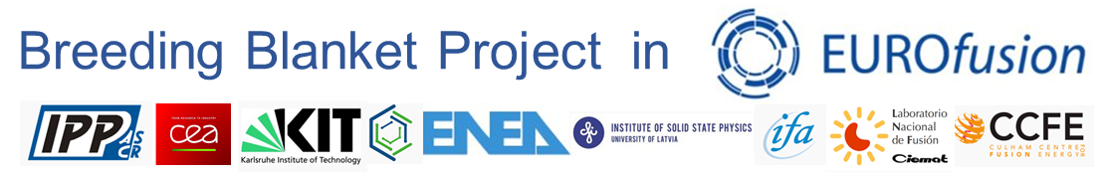
European Breeding Blanket Concepts
4th Technical Exchange on the CH-EU Collaboration on CFETR and EU-DEMO Reactor Design
Francisco A. Hernández¹, P. Arena², I. Cristescu¹, S. D’Amico^{1,3}, A. Venturini³, G. Zhou¹
and the WPBB Team
¹Karlsruhe Institute of Technology
²ENEA Brasimone
³EUROfusion

Slide 2
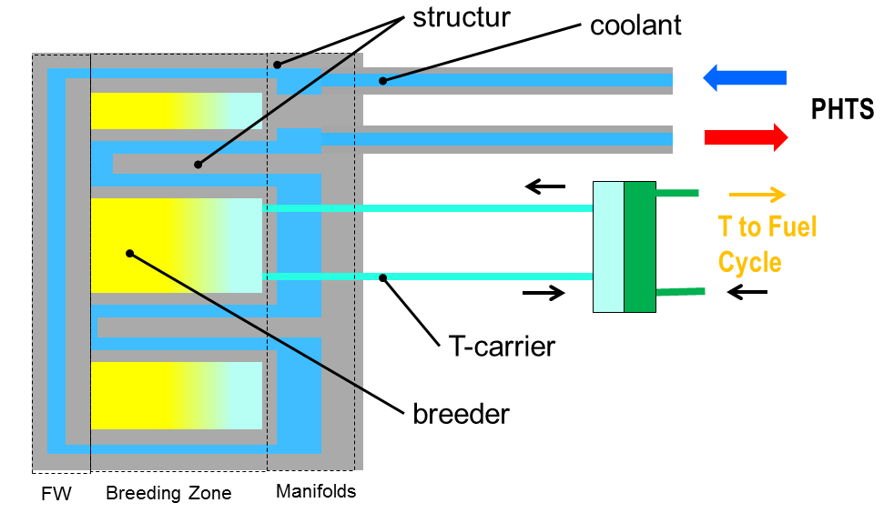
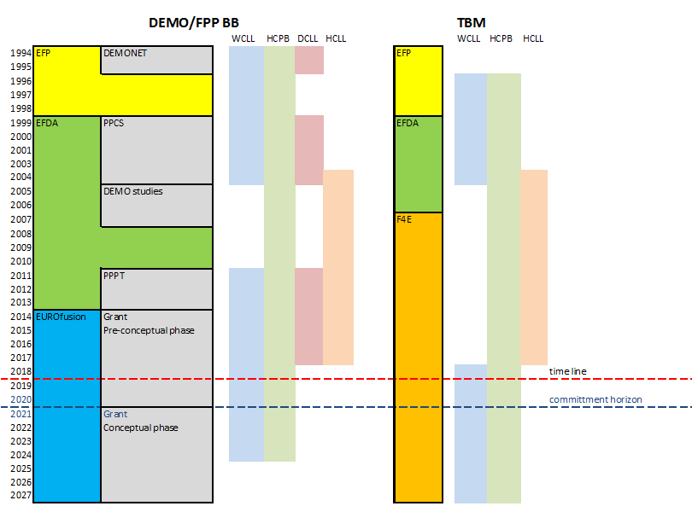
Introduction – EU Concepts History
  Since 80s, EU BB concepts based on liquid and solid breeders
  2003: WCLL replaced by HCLL in TBM (budget limitations).
  2017: identification of most mature BB concepts, narrow down to conservative solutions also in terms of interfacing systems
  2017-2018: DEMO-TBM re-alignment, WCLL replaced HCLL
  2017: holistic BB design principles
  Primary concept principle: „Near-term“ BB Architecture (EFPW, 2018): separate coolant and breeder loops
    …i.e. concepts like DCLL, SCLL, FliBe are not taken into account
  2021: DEMO DCT -> Mandate to investigate innovative concepts (parallel to WPBB) to address issues by design
    BUT BB „ingredients“ are kept: Coolants (water & He), functional (breeder ceramics, Be-Ti, Pb-Li) and EUROFER97
  2023: GA WGBB & FC
    “[…] In the sense of risk reduction, it is recommended to avoid any early down-selection and to pursue in parallel complementary BB concepts up to a relevant stage of testing / qualification for making the necessary choices in order to realize DEMO, unless a clear show-stopper occurs earlier
G1
G2

Slide 3
EU Reference Concepts: WCLL

Slide 4
WCLL: Challenges & Opportunities
  Key challenges
  Low reliability of BB
  Low Tritium Breeding Ratio
  Un-even coolant distribution among several parallel channels
  Tritium permeation from PbLi to water coolant
  Poor margin against temperature limits in EUROFER components
  Uncertainties in the PbLi – water interaction
  Opportunities
  Change of the DWT shape (from C-shaped tubes to helicoidal ones) allowed to:
    ⬇ number of welds → impact on 1)
    ⬇ water amount in the BZ → impact on 2)
    ⬇ contact surface between PbLi and DWTs → impact on 4)
    improving the cooling performances → impact on 5)
  Tailored distribution of FW channels → improving in 2)
  Re-design and R&D on water manifolds → improving in 3) and 5)
  R&D activities on coatings → improving in 4)
  Experiments in LIFUS5/Mod4 → improvement in 6)

Slide 5
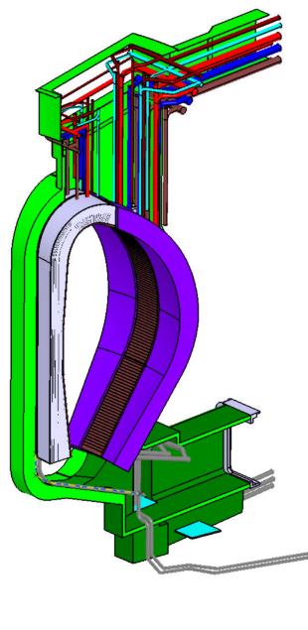
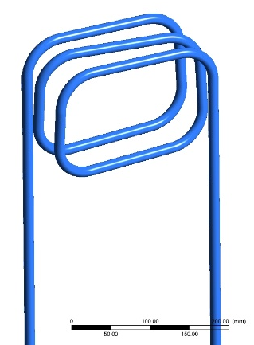
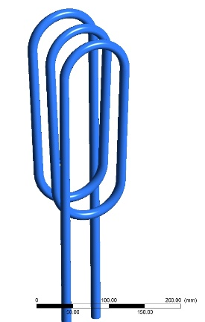
WCLL BB: Architecture
  Coolant: Water @155 bar, 295-328°C
  Double Walled Tubes (DWT) for heat removal from Breeding Zone (BZ); square channels for heat removal from First Wall
  Structural material: EUROFER97 RAFM steel
  T-breeder/neutron multiplier: PbLi eutectic alloy with Lithium enriched at 90% in ⁶Li
  New design for helicoidal DWTs

Slide 6
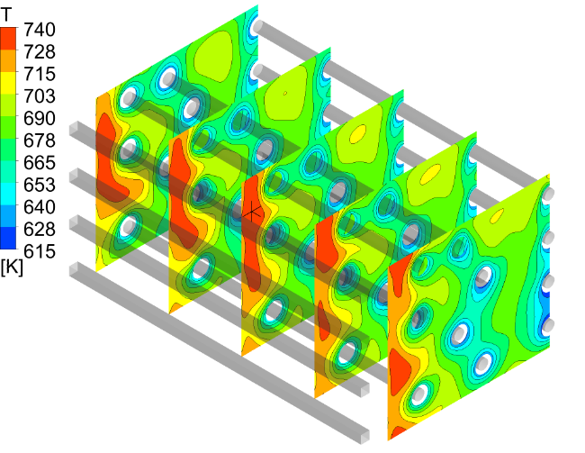
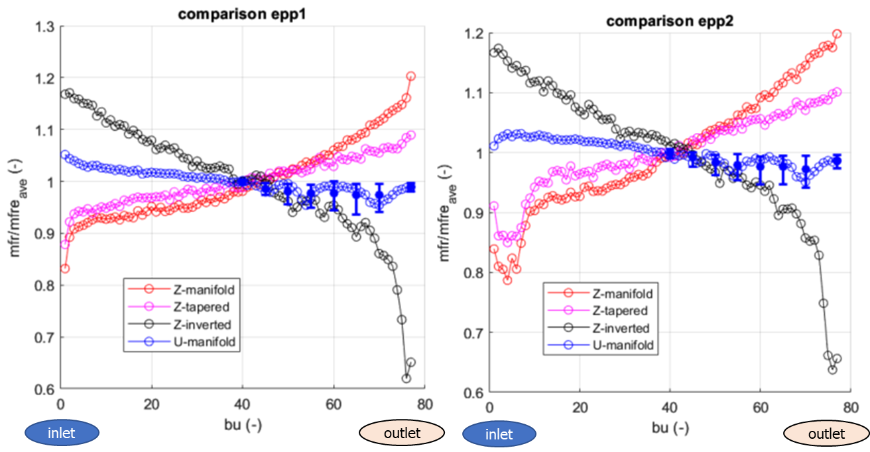
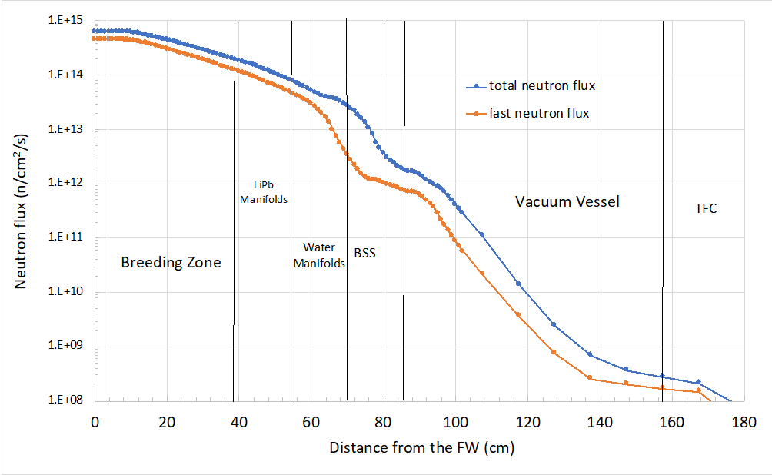
WCLL BB: Performance Figures
    Nuclear analyses in sector. TBR=1.142, shielding performances with significant margin
    Thermal and structural analyses of the OB segment equipped with helicoidal DWTs
    Hydraulic assessment of different water manifold arrangement for a better coolant distribution among different breeder units
    MHD analysis of the elementary cell to study the magneto-convective phenomena occurring in the BZ
4
2
IB neutron fluxes, equatorial plane
1
3

Slide 7
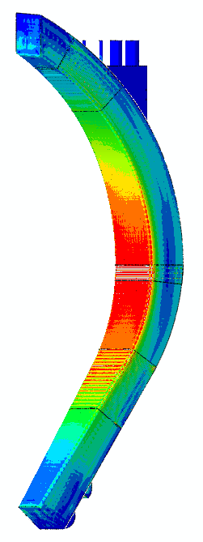
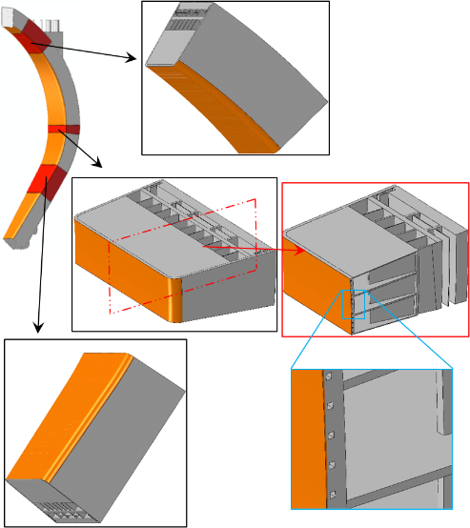
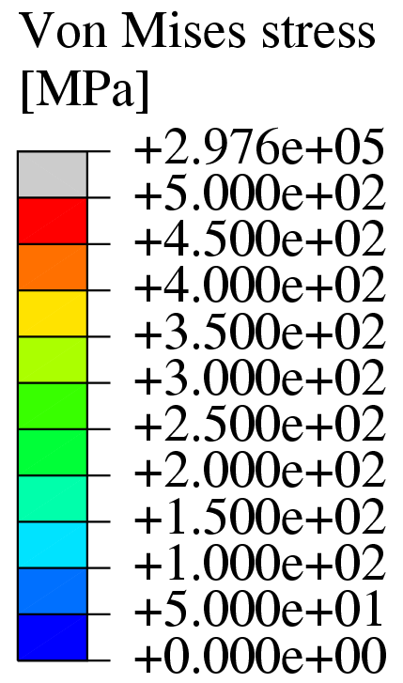
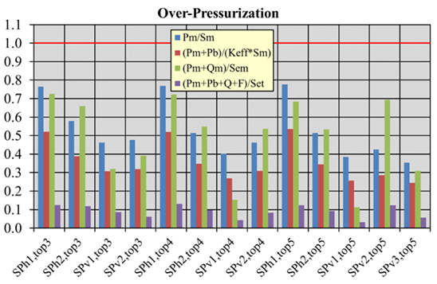
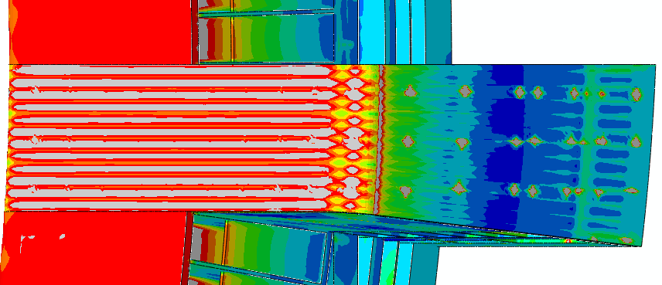
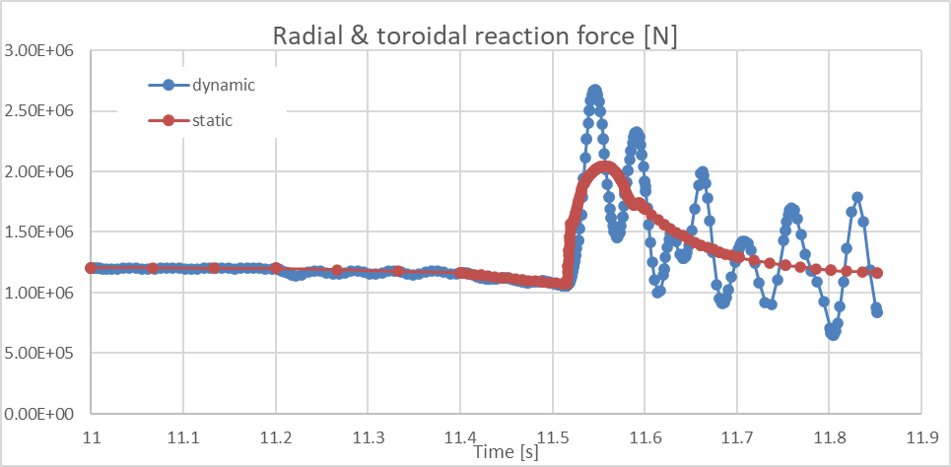
WCLL BB: Performance Figures
    Thermo-mechanical analysis of COB and LOB segments, as well as detailed assessment of selected regions through the adoption of the sub-modelling technique and verification of the RCC-MRx criteria
    Detailed design of the bottom cap region adopting the sub-modelling technique
    Structural dynamic analysis of the Outboard segment under VDE-up scenario and determination of Dynamic Amplification Factors
5
7

Slide 8
EU Reference Concepts: HCPB

Slide 9
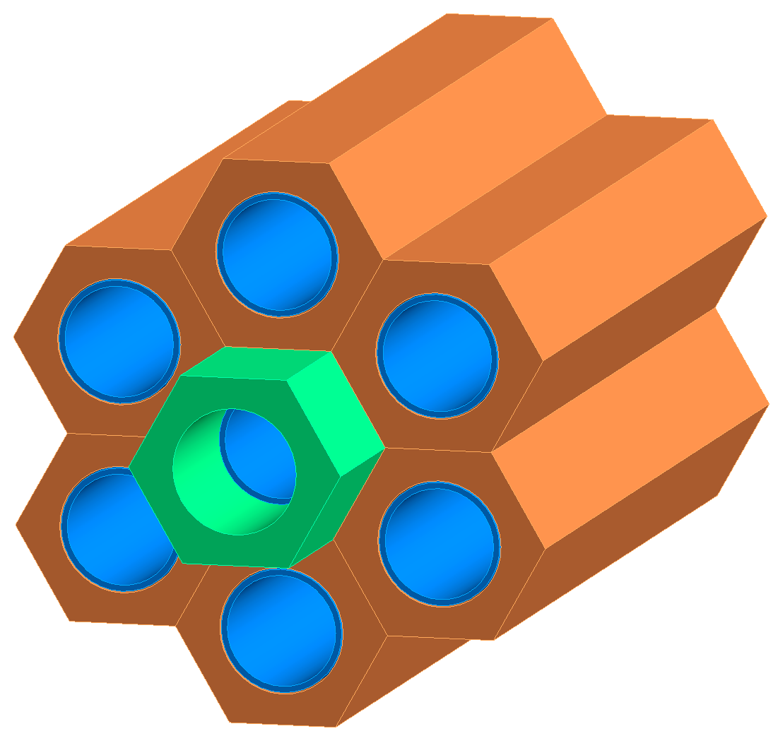
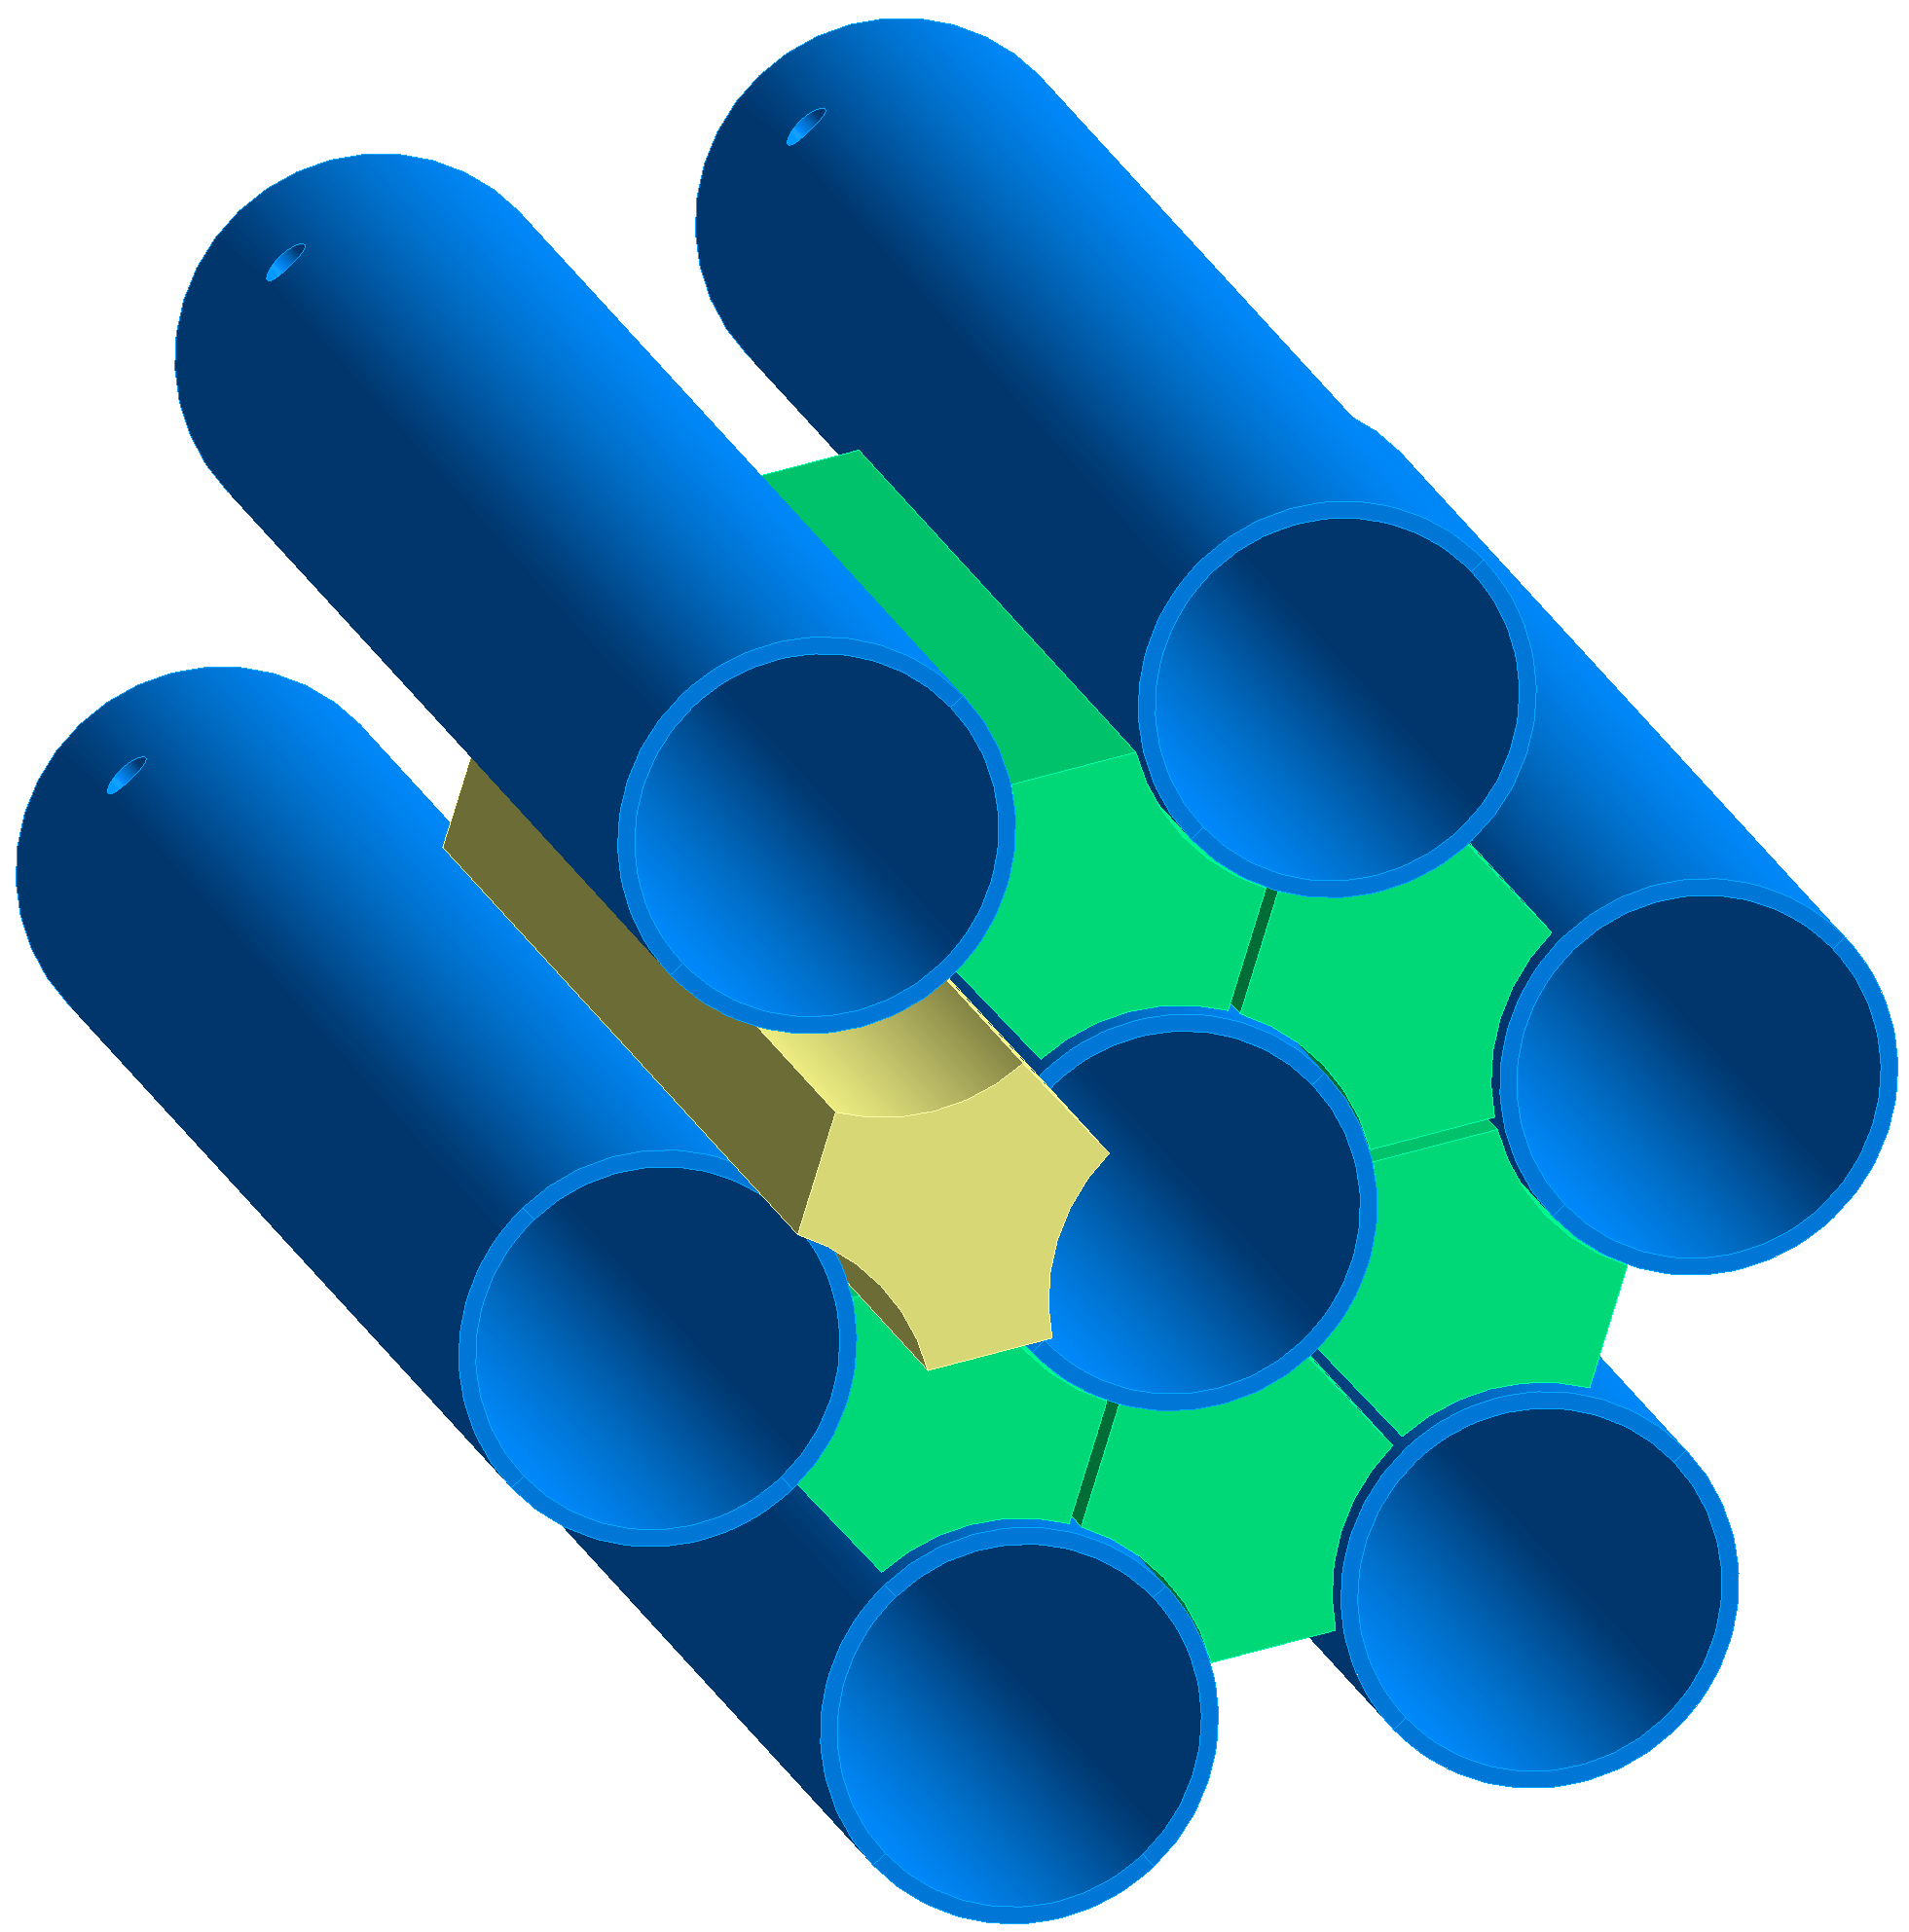
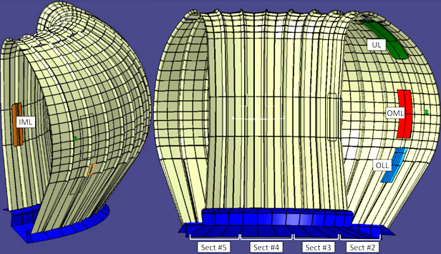
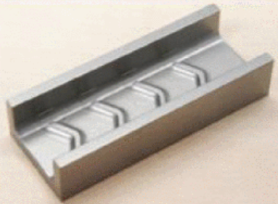
HCPB: Challenges & Opportunities
  Key Challenges
  Low reliability of BB system under DEMO conditions → addressed in I)
  Loss of structural integrity of beryllide blocks and costs → addressed in II) + R&D
  Degradation of EUROFER97 at contact with pebbles in purge gas environment → addressed in I) & R&D
  Low BB shielding capability → addressed by implementing a neutron shield (atm. not required)
  Limited heat flux removal capability of the He-cooled FW
  Opportunities
  Establish a fault-tolerant design by operating the purge gas at coolant pressure under normal operation
  Simpler, manufacturing friendly TiBe₁₂ blocks:
2 bar
80 bar
2 bar
Failure rate of welds:
2.58e-08 (1/h)
Large number of welds:
400e3
400e3 x 2.58e-08
~ O(0.01) (1/h)
80 bar
2 bar
80 bar
2 bar
HCPB (G1)
  Hexagonal prismatic blocks with a central hole
HCPB-HP (G2)
Limiters
Triangular prismatic blocks with lateral edges filleted

Slide 10
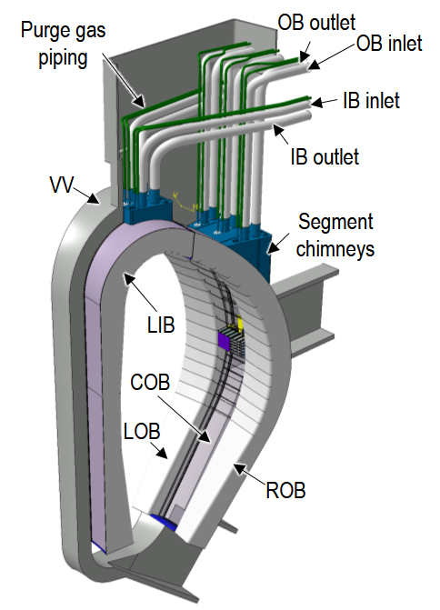
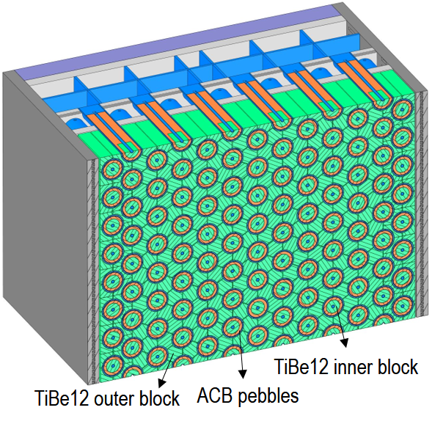
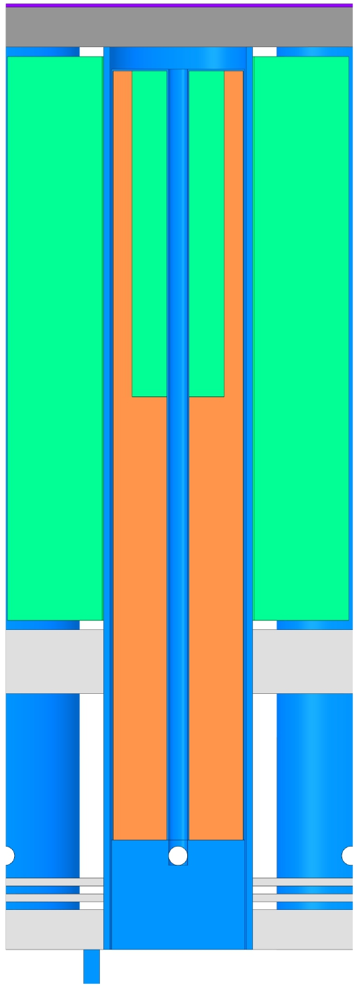
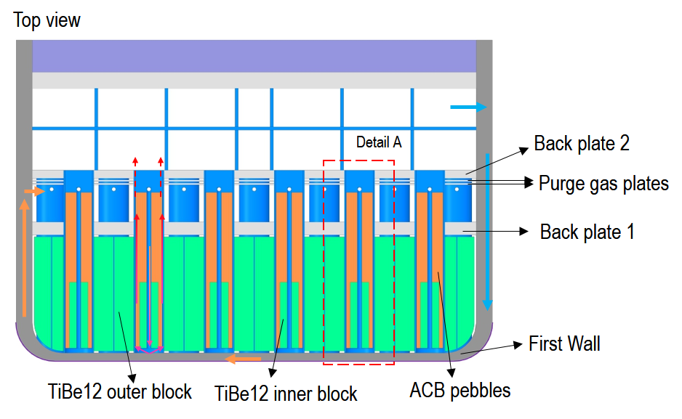

HCPB BB: Architecture
  Coolant: He @80 bar, 300-520°C
  Structural steel: EUROFER97
  Fuel-pins: ACB pebble bed (⁶Li 60%) + TiBe₁₂
  T-extraction: He + 200 Pa H₂ @80 bar
  TiBe₁₂ neutron multiplier triangular prismatic blocks
Shield
Detail A:
Fuel-breeder pin
ACB pebble bed
TiBe12 inner block
TiBe12 outer block
FW
Armor
80 bar
Closing disk
HCPB-BL2017-HP-v1
Pressure tube

Slide 11
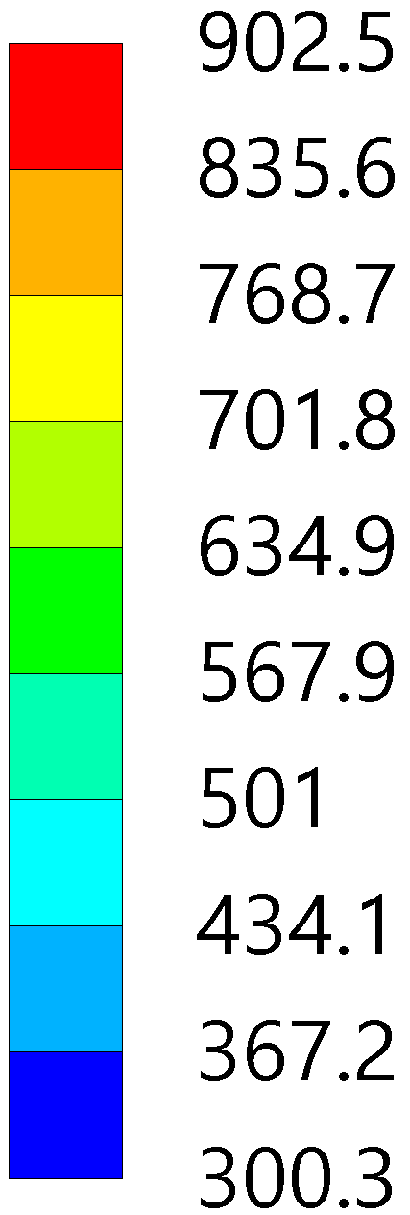
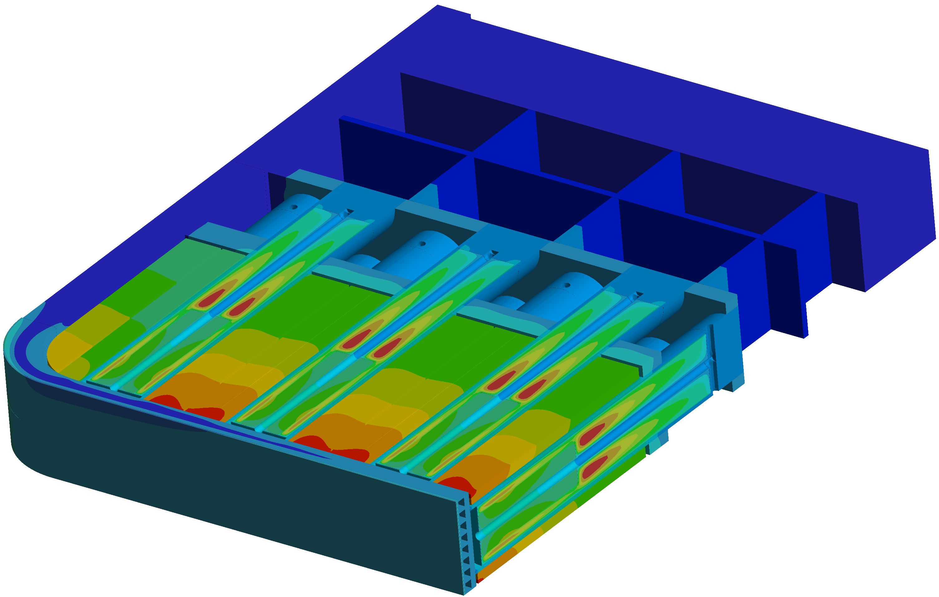
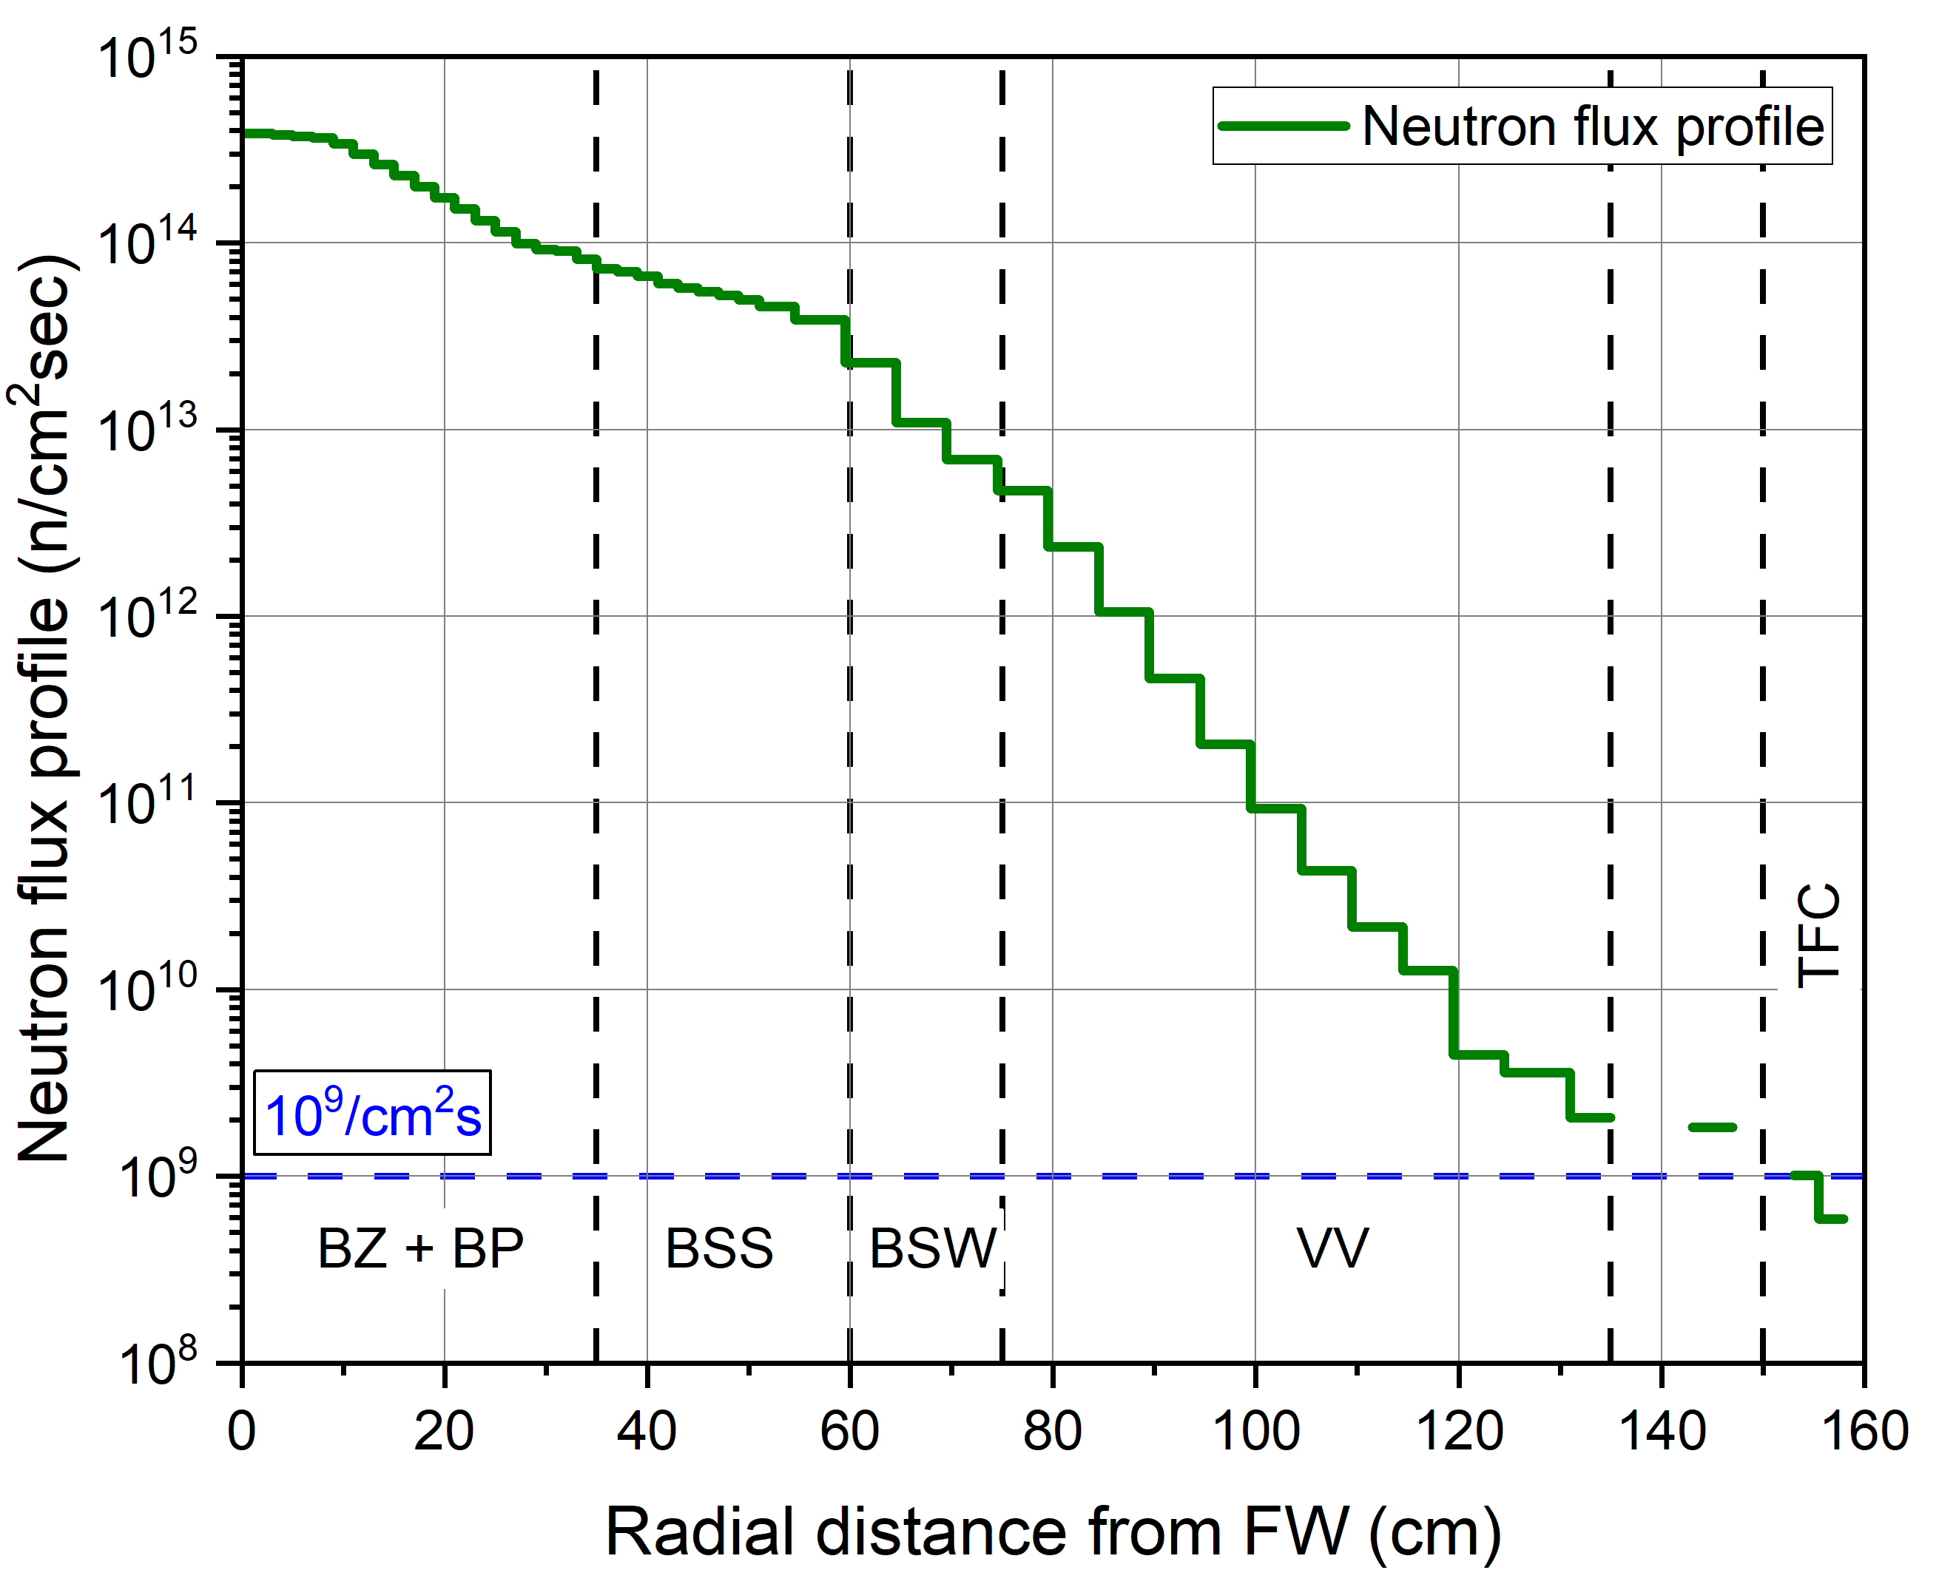
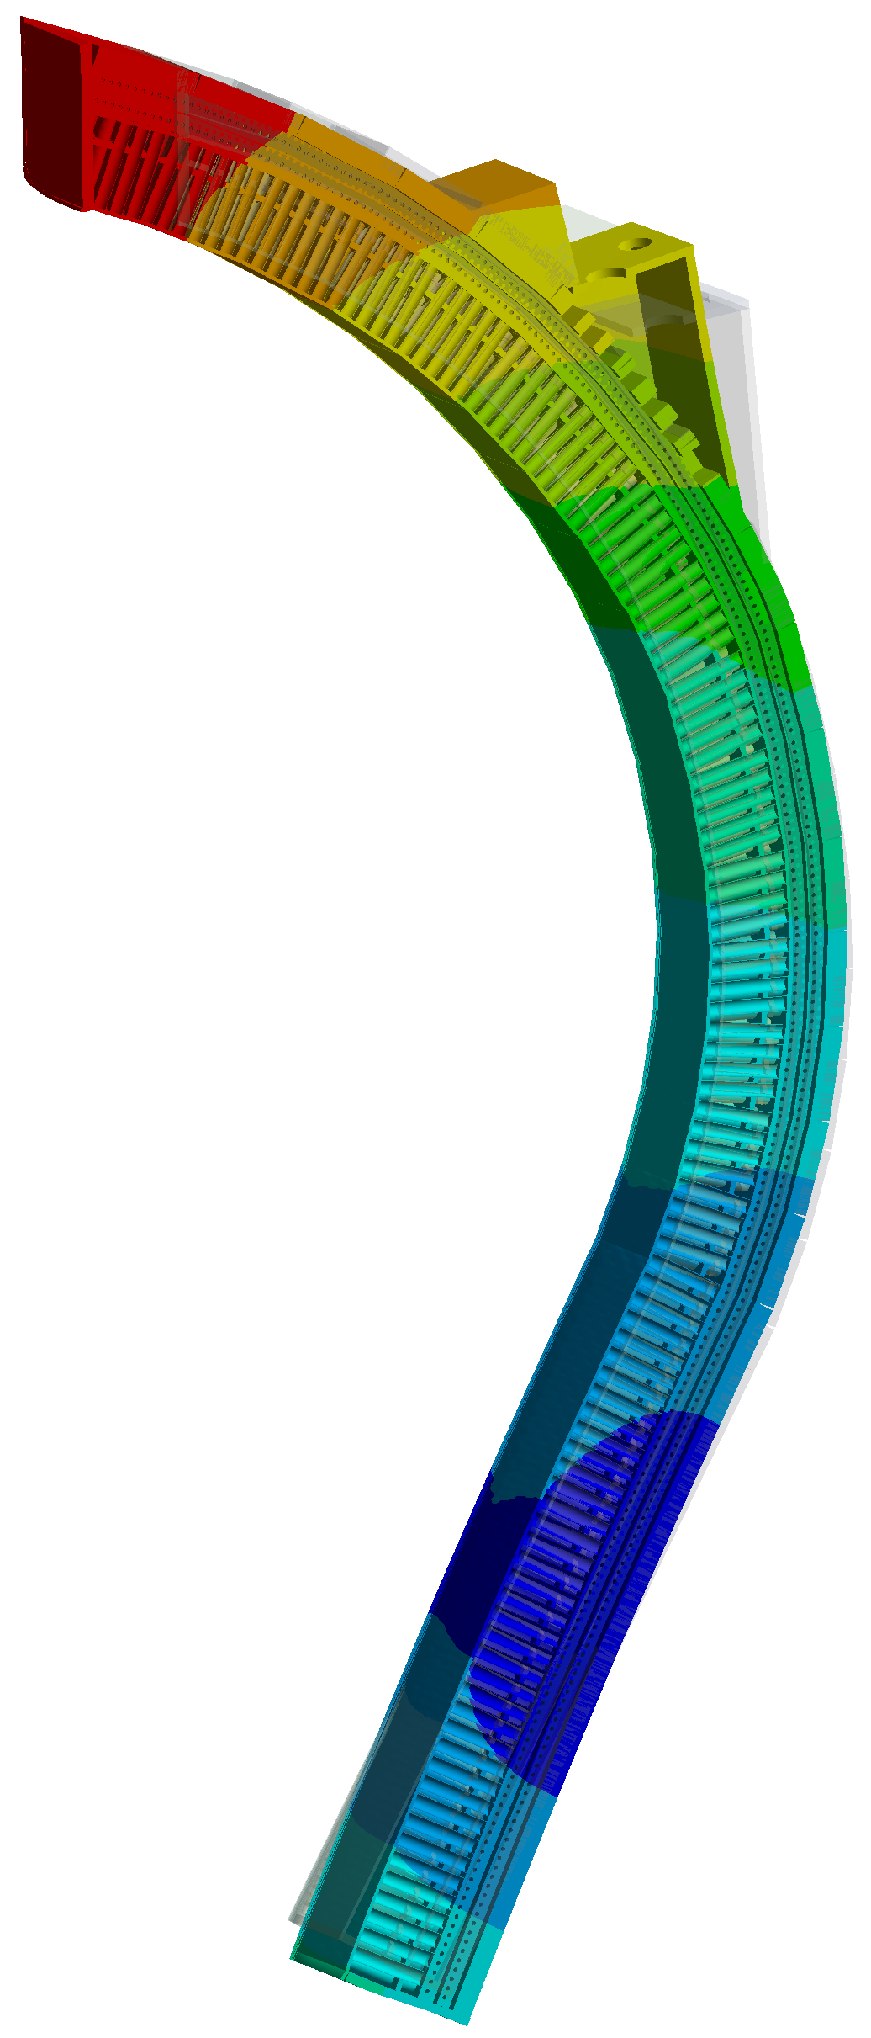
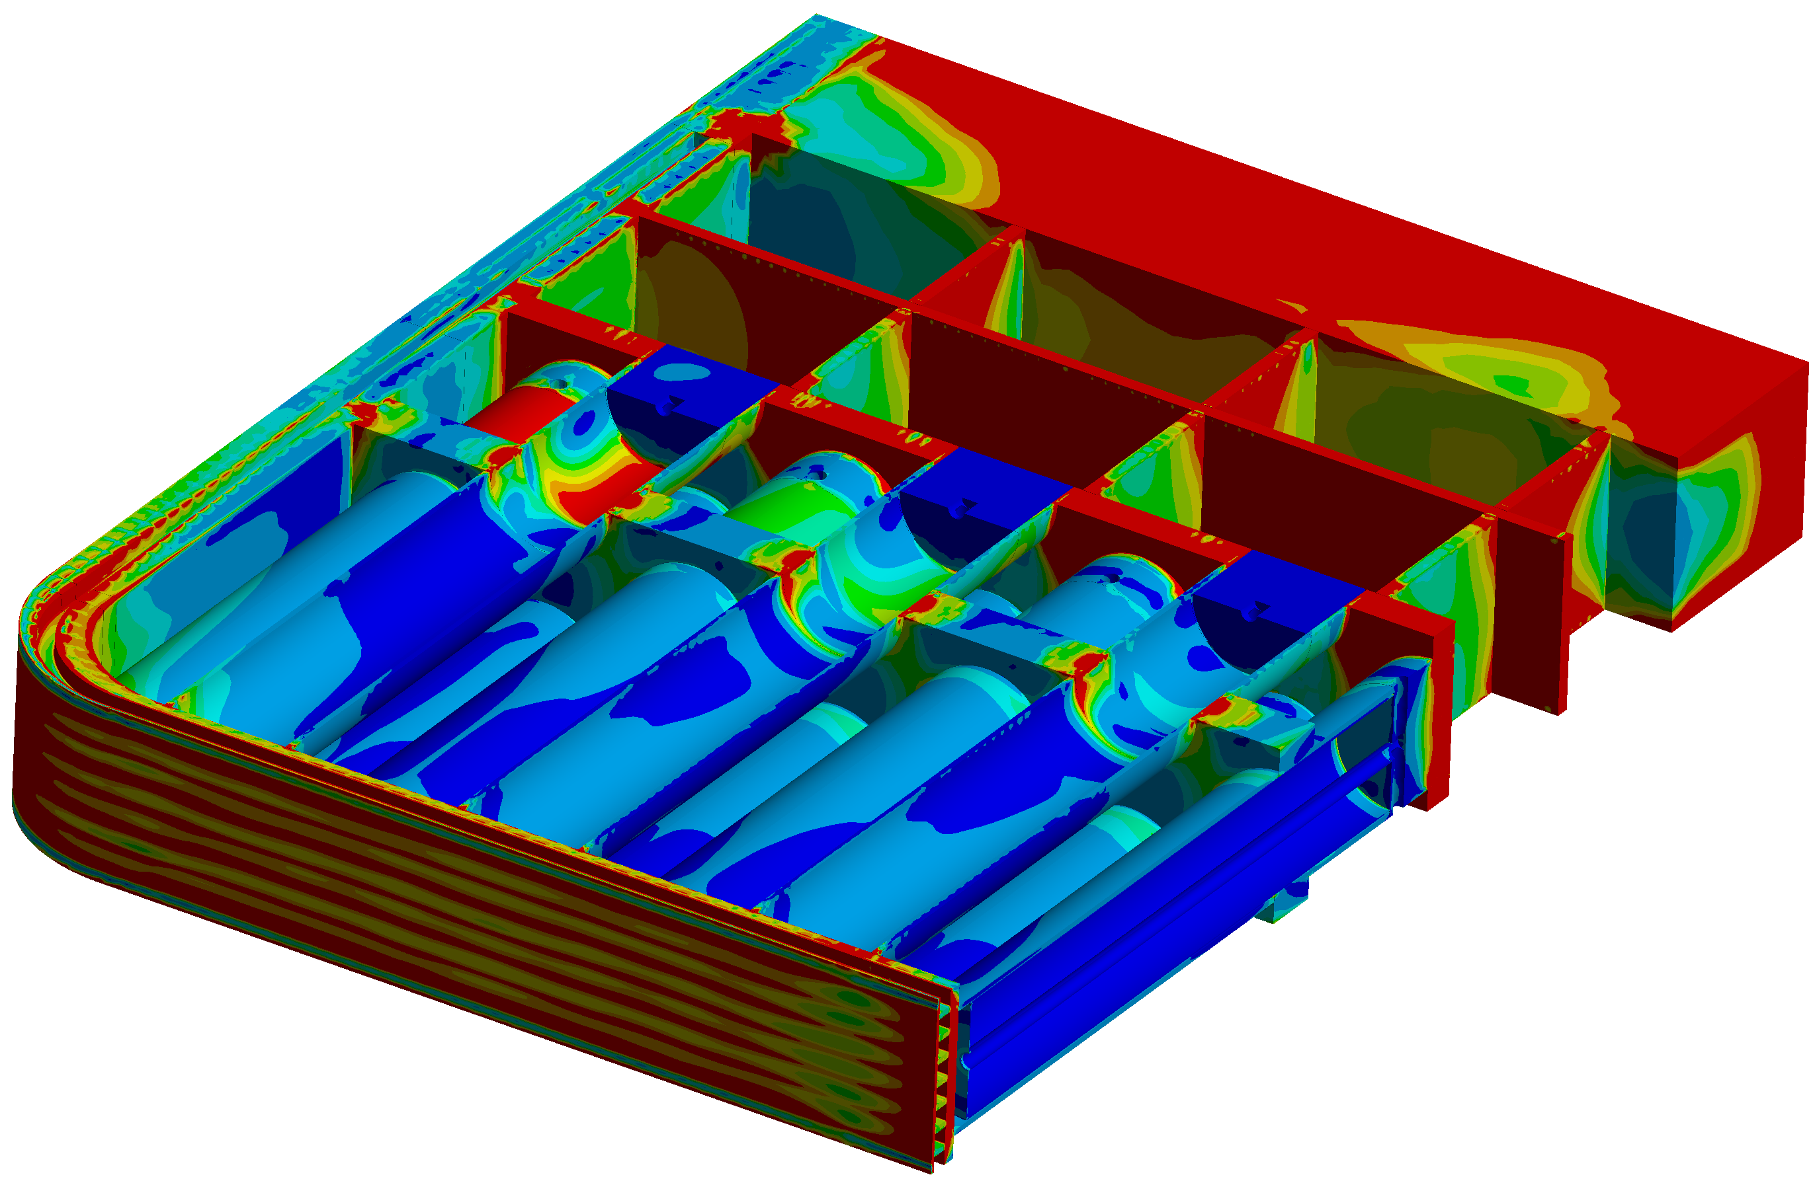
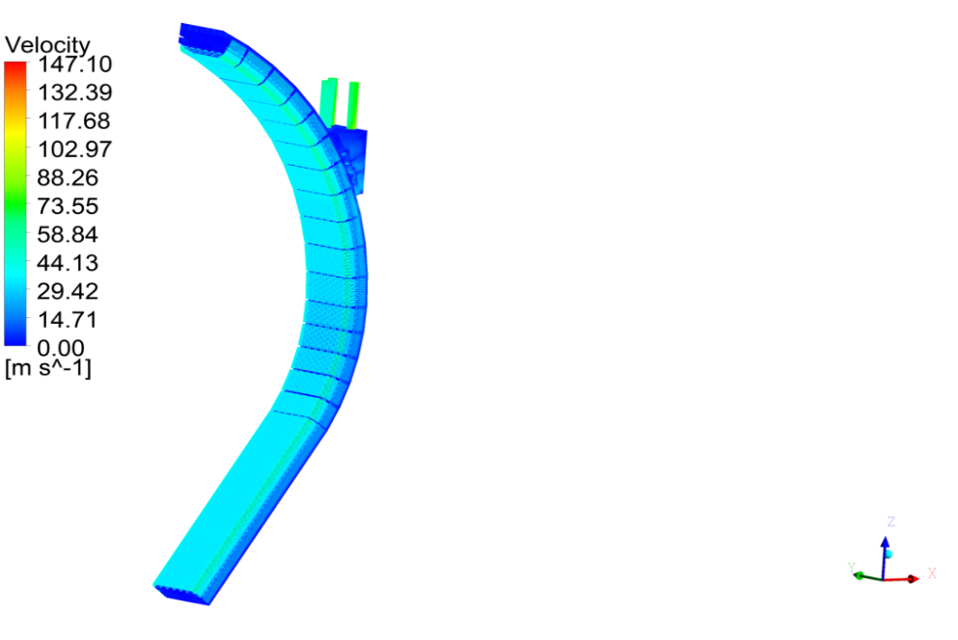
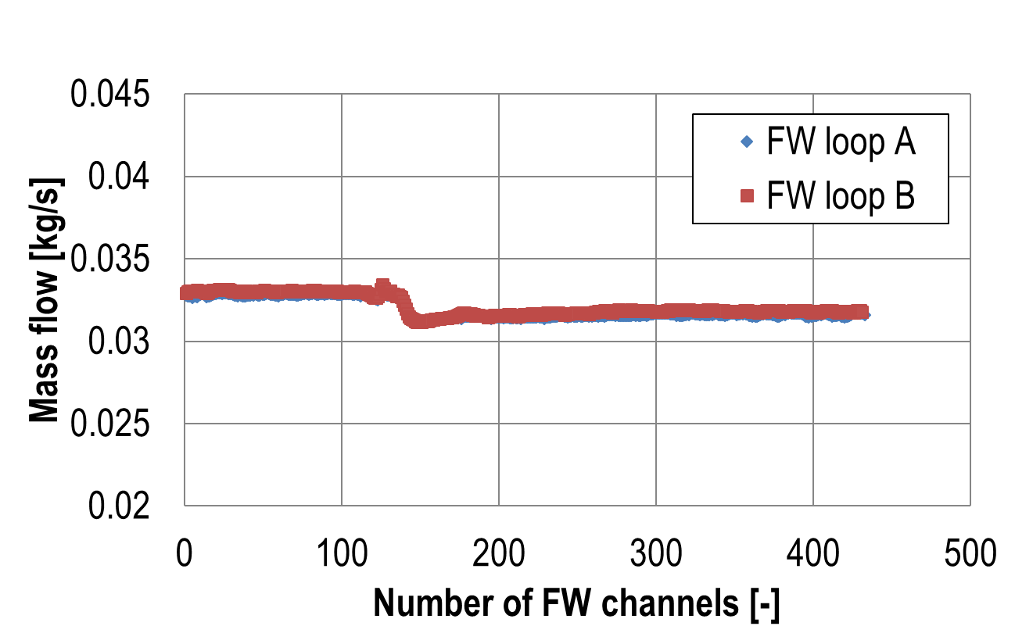
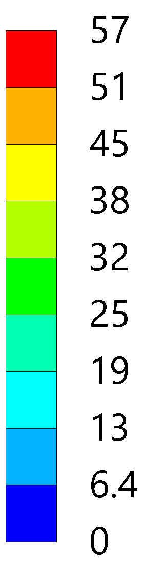
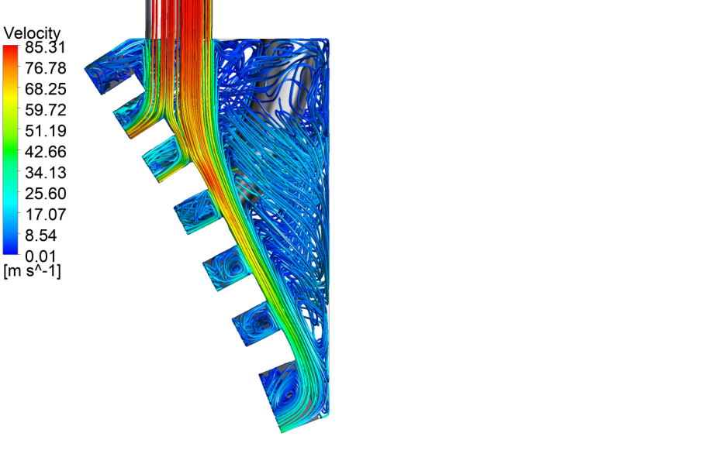
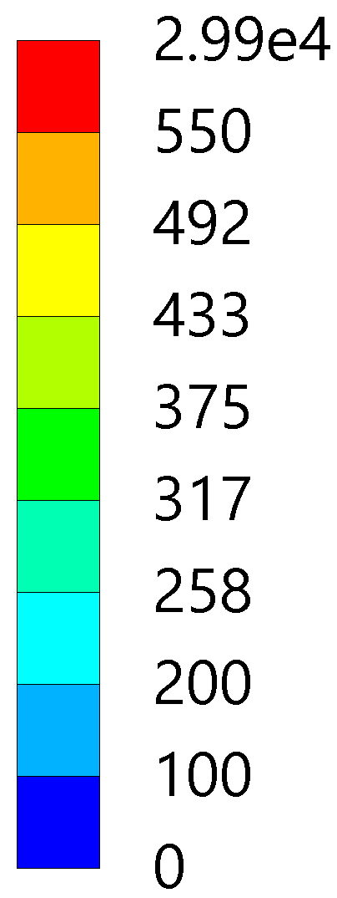
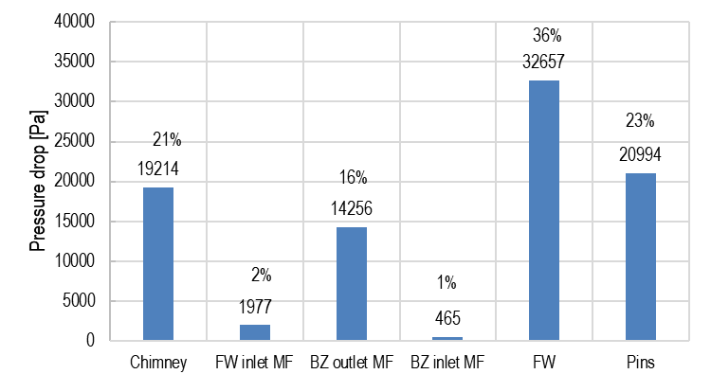
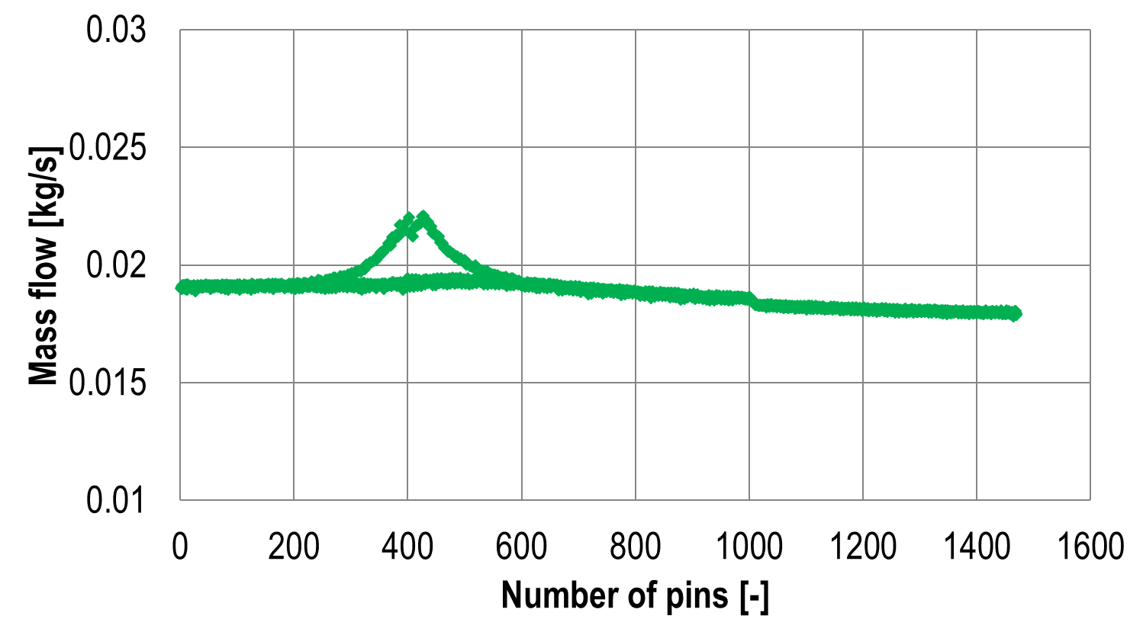
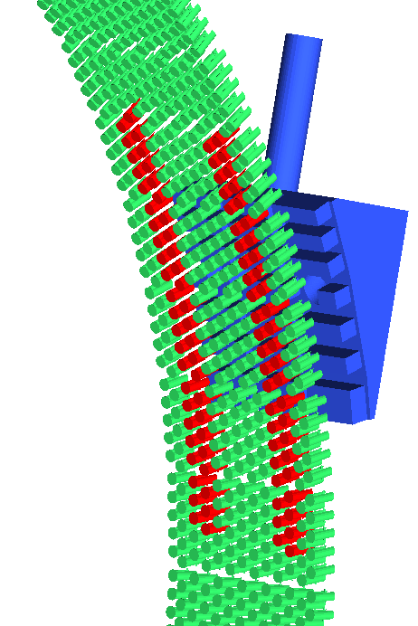
HCPB BB: Performance Figures
388 °C
2
    Nuclear analyses in sector. TBR=1.17, shielding performances marginally acceptable
    Thermal and hydraulic analyses of the OB & IB: mass flow distribution and pressure drops
    Structural analyses of COB segment, global + sub-modelling technique + RCC-MRx evaluation
1
432 °C
T [°C]
441 °C
Press. Tube: 513 °C
Temp. field of half unit-slice of COB
[mm]
3
Mass flow rate distribution in FW
860 FW channels
max. dev. 4.4%
2
Pressure drop distribution
(total: 0.89 bar)
[MPa]
Mass flow rate distribution in pins
Primary+Secodary stress of COB
1469 pins max. dev. 17.3%

Slide 12
New water-cooled variants: WCLL-DB

Slide 13
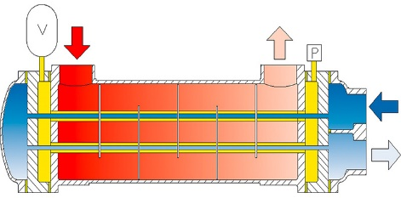
WCLL „Double Bundle“: Motivation
  Motivation:
  Poloidal water tube distribution:
    Poloidal tubes:
      Less tubes, less welds, ⬆ reliability
      Less tubes, less surface, ⬇ T-permeation
      Less tubes, less water, more PbLi, ⬆ TBR
      Easier draining and less He accum. risks
    BB similar to HX/SG => ⬆ TRL/RoX
    Segments split in several poloidal regions
      Limit heat flux per tube
      Allows systems integration (H/CD, limiters…) w/o splitting segments
WCLL | ID | Risk | Addressed by
 | 1 | Low reliability of BB system | (1)
 | 2 | Low efficiency of PbLi draining | (4)
 | 3 | FW based on thin EUROFER + W-armor | limiters
 | 5 | Low tritium breeding performance | (3)
 | 6 | Large amount of transmutation He in PbLi
 | 10 | Large T permeation to coolant | (2)(6)
 | 12 | WCLL operating with EUROFER temp. irradiated <400 °C (DBTT shift)
 | 13 | Pressure transient uncertainties due to PbLi-water interaction: | (5)
 | 22 | Diffusion of Li into anti-permeation barriers and production of He there | (2)(6) may avoid barriers
L. Giancarli et al. (1995)
“3rd chamber”
PbLi inflow
  „Double bundle“ of simple tubes
    3-chamber idea of S&T HX (K.-H. Funke)
      Intermediate chamber between PbLi and water to avoid contact in case of internal LOCA
      3rd chamber filled with He gas: used to remove permeated T before it reaches water
“3rd chamber”
PbLi outflow
“3rd chamber”
Water at PWR conditions

Slide 14
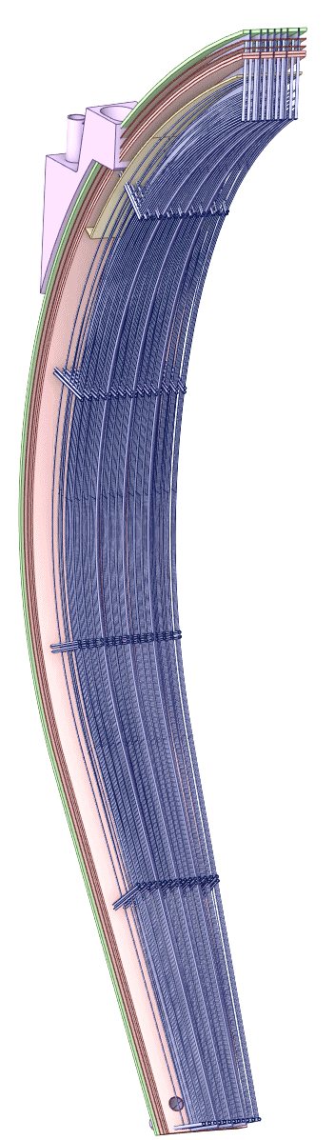
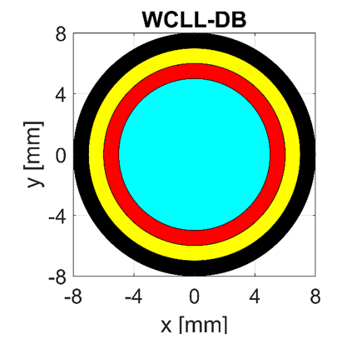
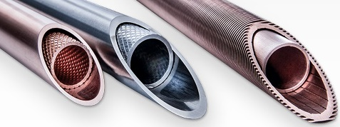
WCLL „Double Bundle“: Architecture
  Design description:
    Segment outlet, 325°C
    Detail of the purge gas flow in 3rd chambers of FW and BZR
    PWR cooling (285-325°C, @15.5 MPa)
    BZ and FW in series (T_{in,FW}≈315 °C)
    5 BZRs, poloidal PbLi flow
    „3rd chamber“ between the double bundle, filled with a He purge gas
    Segment inlet, 285°C
fins
WCLL-DB, FW
BZR
3
Thermal contact conductance (TCC)
fins
Gas gaps (e.g. He purge gas)
COB segment
    E.g. Wieland Safety Tubes:
    https://www.wieland-thermalsolutions.com
PbLi

Slide 15
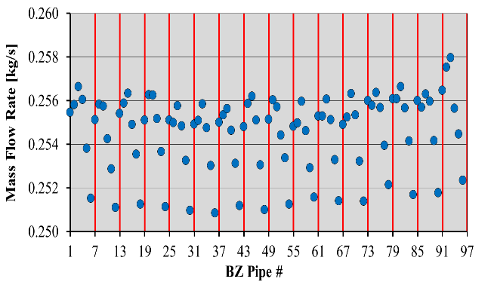
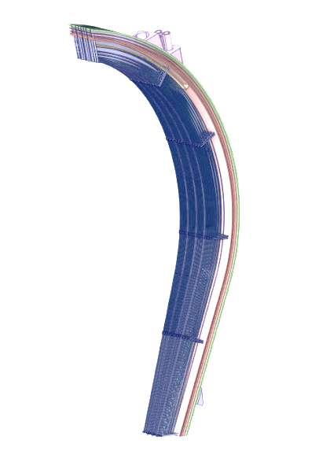
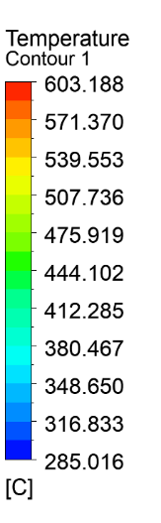
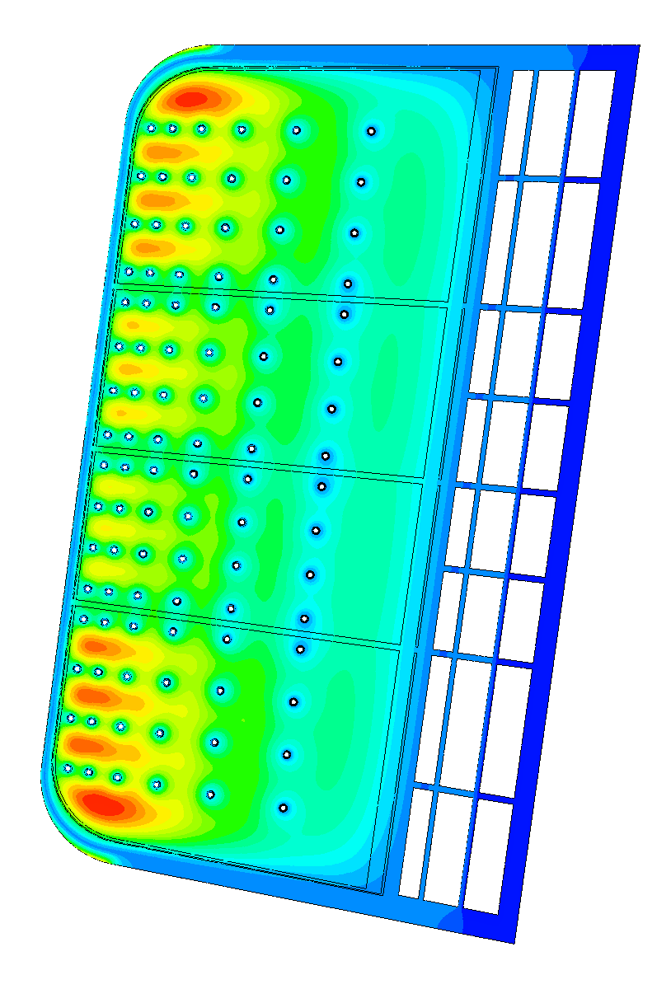
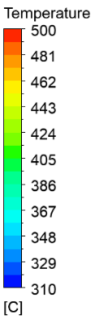
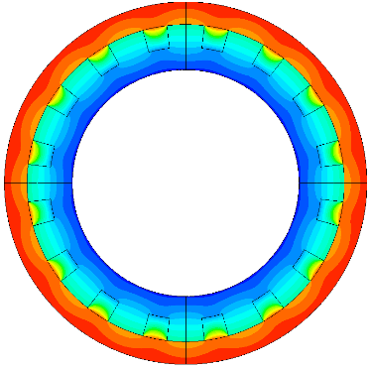
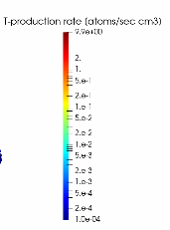
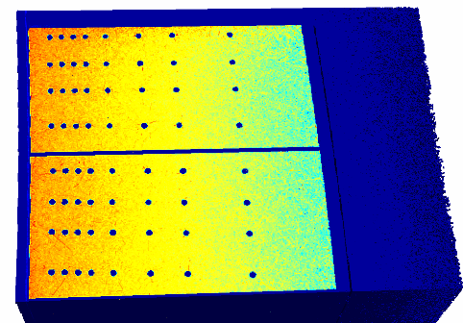
WCLL „Double Bundle“: Performance Figures
    Nuclear analyses in sector. TBR=1.17, shielding performance similar to WCLL-DWT
    Thermal and hydraulic analyses of the BZR3 OB: flow distribution, temperature distributions, Δp_{FW} = 0.555 bar, Δp_{BZ} = 0.693 bar and sensitivity studies on double bundle gas gap
    Structural analyses of COB BZR3 OB slice: normal operation and 3rd chamber LOCA
    MHD: PbLi pressure drop through segment
1 to 6
BZR3
2
0.5 mm He gap
1 mm fins
91 to 96
R_{contact} = 10⁻⁴ m² K/W
4
 | WCLL-db (semi-emp. corr.) | WCLL-db (RELAP5*) | WCLL [1]
Total ∆p [kPa] | 151.5 | 156.0 | 1512.0
1
3

Slide 16
New water-cooled variants: WLCB

Slide 17

WLCB: Motivation and Architecture
WLCB
HCPB
WCLL
  Water cooled Lead and Ceramic Breeder (WLCB)
  Trade-off between HCPB and WCLL:
    Mitigate n-shielding issues, n-mult. tech. and high costs of HCPB
    Mitigate T-permeation issues and tech. risks on PbLi TER
    Reduce dependency on anti-permeation barriers in BB (tbd)
T extraction from ACB
Low T permeation
Available TER technology
Good TBR in compact space
Proven water PWR tech
Excellent neutron shielding
More mature PHTS/BoP
ACB pebbles in cassettes
    Segment outlet, 325°C
    Segment inlet, 285°C
  Conceptual Idea
    PWR cooling (285-325°C @155bar)
    BZ and FW in series (as in WCLL-db)
    Purge gas: He + %H2 @2bar (tbd)
    Radial cooling plates (also stiffeners)
    ACB pebble beds in canisters (tbd)
    Molten Pb (n-mult.) filling interspaces
Second pass, T extraction
First pass, advection
WLCB COB, BZR3
Cooling Plates
Pb in cassettes
Be12Ti in cassettes

Slide 18
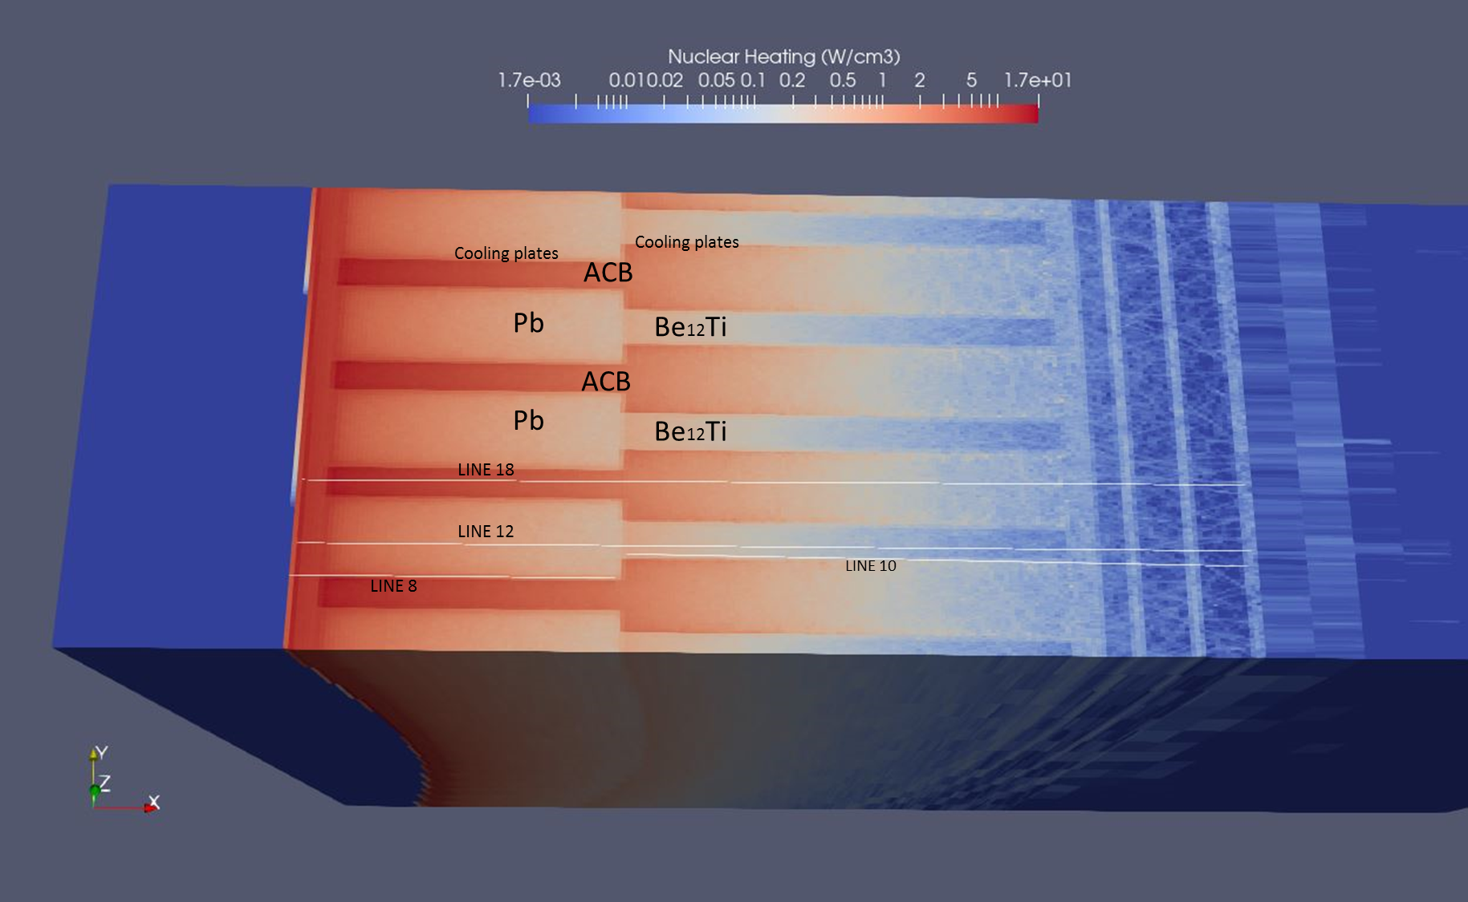
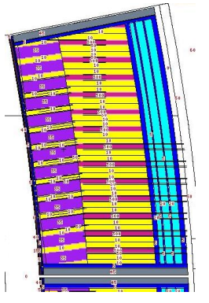









WLCB: Performance Figures
1
    Nuclear analyses in sector. TBR=1.137-1.168, shielding performance similar to WCLL-DWT
    Thermal-hydraulic analyses of the BZR3 OB
    Structural analyses of COB BZR3 OB: normal operation, LOCA
    Structural analyses of top-cap OB: normal operation, LOCA
Front & Back zones
CP: 50-25-25% (E97-H2O-Pb)
ACB, Li-6 90%, PF=64%
TBR=1.137
ACB+LOP, Li-6 90%, PF=64%
TBR≈1.168
2
3
Von Mises
Stress [MPa]
4
Shift channels 2mm inwards

Slide 19


Tritium Permeation and Reliability Analyses
  FMEA (& Reliability)
  Simplified T-transport analyses
Permeation rates to water circuits (g/d) | WCLL reference (PRF = 1) | WCLL-DB |  | WLCB cassettes
 |  | Flowing purge gas (${\dot{m}}_{HCPB}$=0.5kg/s) |  | Flowing purge gas (${\dot{m}}_{HCPB}$) 2 pass flow (gaps + CB)
 |  | 330 °C | 330 °C
 |  | Perfect contact fins | No contact fins | No contact fins p.g. from TER | No contact fins aux. He supply (0.5kg/s)
Water tubes | 44.18 | 2.194 | 2.5E-02
Feeding manifolds | -- | 2.7E-01 | 2.8E-03
First wall | 2.38 | 1.4E-01 | 1.3E-02
Back wall | -- | 1.1E-02 | 1E-02
Total | 46.56 | 2.614 | 1.7E-01 | 5.40E-01 | 2.0E-03
    WLCB permeation similar to HCPB (~0.5 - 1 g/d), less dependency on high performant (PRF) coatings
    T concentration in purge gas at the inlet of WLCB is key to further reducing T permeation (e.g. auxiliary fresh He supply to be afterwards processed)
    WLCB: #elements joined reduced ~1/10 w.r.t. WCLL or HCPB (FP8), therefore positive impact in failure rate
    Latest WCLL-ref: #elements halved, expected FR in-between WCLL (G1) and WLCB
    HCPB-HP: fault-tolerant, expected similar FR as WLCB

Slide 20
Tritium Extraction and Removal: TER PbLi and purge gas

Slide 21
WCLL TER: Architecture
  PbLi eutectic alloy flowing at about 150 kg/s, 330°C
  Six loops to feed the BB segments: 4 for the Outboard segments, 2 for the Inboard ones
  Structural material: P91 FM steel
  1 single Storage Tank shared by the six loops and located in the basement of the tokamak building

Slide 22




WCLL TER: TEU Technology Development
  Permeator Against Vacuum was selected as reference tritium extraction technology for WCLL TER among three options:
Permeator Against Vacuum
Gas-Liquid Contactor
Liquid-Vacuum Contactor
  The selection followed a scoring process, based on the overall objectives and safety goals to be achieved. The scoring process took into account 5 categories: safety-waste, design-integration, technology, operation and economics.
Objectives
To extract tritium from PbLi
To route tritium to the fuel cycle
Safety goals
To minimize tritium inventory in PbLi
To minimize tritium permeation
To be reliable and available

Slide 23


HCPB TER: Architecture
    The Tritium Extraction and Recovery system (TER) consists in a helium purge gas loop that extract tritium from the BB followed by tritium recovery from the purge gas.
    The TER HCPB shall remove the tritiated water and the Q2 (mainly HT) from the purge gas;
    Regardless of the amount of steam in the purge gas, the tritiated water will be removed by Reactive Molecular Sieve Bed (RMSB)
    The Q2 (mainly HT) will be removed from the purge gas by Q2 adsorption getter beds (GB)
    The TER shall provide the preliminary tritium recovery in view of minimization of the load on Tritium Plant
Tritium Plant
DN400 BB connection lines
Tokamak building
HX-02A/B
Transfer lines
HX-01A/B
Overview of TER equipment inside Tokamak and Tritium Plant buildings

Slide 24






HCPB TER: Technology Development
Overview of HCPB TER equipment inside Tritium Plant building
RMSB’s and process compressors
RMSB mock-up 1:10 for testing
RMSB-01/02
PC-01A/B/C
GB-01/02/03/04
RMSB-01/02
The performances of the RMSB mock-up 1:10 from DEMO scale will be evaluated
Endurance tests for the getter bed materials are under preparation

Slide 25
Conclusions
    BB design development history >30 years… yes, but a holistic view of the BB problem only from mid 2017
    Since 2017 (EU DEMO BB & TBM realignment): EU focus on 2 coolants, water & He (gas cooling), and 2 breeders, solid (ceramics + Be12Ti) and liquid (PbLi) -> maximization of RoX
    Ever since: designs have been proposed following those basic “ingredients”
    Many issues can be already solved by design. R&D to cover the rest
    We are getting there, where:
      We learn how to design for manufacturing and reliability.
      First example: WLCB failure rate is predicted to be good enough (considering a very conservative calculation base). Results after improvements in HCPB-HP and WCLL-ref by summer 2024.
      Dimensioning of auxiliary systems (TER, PHTS…), their integration in the reactor is now realistic, scaling up in TRL
    To-do’s:
      Selection of WCLL-DWT vs. WCLL-DB. WLCB as new concept in FP9 (in line with GA’s WGBB recommendation)
      Reactor integration topics: how many custom segments to allow penetrations look like?

Slide 26
  Back-up slides

Slide 27
WCLL TER: Technology development
Main components | Status | Ongoing R&D
1) Tritium Extraction Unit (TEU) | PAV selected as reference tech Manufacturing at small scale demonstrated Performances at relevant op. conditions demonstrated Numerical model validation ongoing | Further experiments to improve database Experiemnts to drive design optimization Validation of numerical models against experiments
2) Corrosion Products (CP) Removal System | Cold traps are considered the reference technologies Large uncertainties of CP solubilities and temperature dependence Cold traps designs have been developed but never tested in PbLi | Measurement of CP solubilities at different temperatures Testing of cold traps (or other tech?) in flowing PbLi
3) Activation Products (AP) Removal System | Main AP identified from neutronics (Hg, Th, Po) Removal system takes advantage of their volatility Conceptual design ongoing based on a Vacuum Sieve Tray approach | Small size mock-up under testing at CV Rez to characterize its operation and performances
4) Helium Removal System | Helium solubility in PbLi is considered very low Helium removal should be easily achieved by desorption from a PbLi free surface | Measurement of helium solubility in PbLi Development of molecular dynamics for helium-PbLi systems

Slide 28






HCPB BB: Performance Figures
A-A
  Without considering cut-outs
    3D heterogenous model calculated using MCNP6.2 and JEFF-3.3
Pitch
    The smaller the pitch, the higher TBR (TBR=1.16~1.20 ±0.01%)
    Larger gap facilitates neutron streaming, saturates at 5 mm
A-A: Poloidal-toroidal view
Considering cut-outs by Heating system & Limiters
Gap between TiBe12 and tube
TBR reduction of about 10 % (TBR=1.04~1.07)
Radial-toroidal cut view – MCNP model
Scheme of the IVCs arrangement
Cut-outs of BB

Slide 29







WCLL
Stress assessment using plane strain
[mm]
[MPa]
[MPa]
Primary stress of COB
Primary+Secodary stress of COB
Stress assessment using submodelling technique
[MPa]
[MPa]
Submodel
Primary stress of COB
Primary+Secodary stress of COB
Displacement
of global model
Developed a sub-modelling technique to transfer the global displacement to submodel
Generalized or plane strain boundary conditions not conservative
Most critical regions met the immediate plastic instability, plastic collapse and thermal creep damage modes

Slide 30
WCLL
  Summary: Scenarios with highest yearly failure rate (FR)
    Most scenarios show low yearly FR <10⁻², but some cases (table below) requires attention
    For first time, a design keeps yearly FR < 10⁻¹ for all failure modes => potential to meet availability targets
Failure and element |  | WCLL-Ref |  |  | WCLL-DB |  |  | WLCB |  |  | Consequence
 |  | FR min [1/y] | FR max [1/y] | Multip. | FR min [1/y] | FR max [1/y] | Multip. | FR min [1/y] | FR max [1/y] | Multip.
Leak/rupture F/T pipe PbLi |  | 4.91E-02 | 4.09E-01 | 416 | 6.56E-02 | 5.47E-01 | 416 | N/A |  |  | In-VV leak
Leak/rupture of poloidal welds between LiPb-BP and FW |  | 2.57E-01 | 3.69E+00 | 72576 | N/A |  |  | N/A |  |  | In-box LOCA
Leak of the LiPb-BP double welds |  | 2.10E+00 | 2.33E+00 | 354816 | N/A |  |  | N/A |  |  | In-box LOCA
Leak/rupture of pol. and tor. welds in the LiPb outlet manif. |  | 2.34E+00 | 3.36E+01 | 661248 | 3.03E-04 | 4.34E-03 | 64 | N/A |  |  | Bypass PbLi
Leak/rupture of weld of water pipes with water feed in/out feeder manifold halves | sw | N/A |  |  | 3.62E-01 | 5.19E+00 | 76544 | N/A |  |  | In-tube LOCA
 | dw |  |  |  | 3.62E-02 | 5.19E-01
Leak/rupture weld of purge gas pipes with purge gas in/out feeder manifold halves | sw | N/A |  |  | 3.62E-01 | 5.19E+00 | 76544 | N/A |  |  | In-tube leak PbLi
 | dw |  |  |  | 3.62E-02 | 5.19E-01
Leak/rupture of purge gas feeder manifold |  | N/A |  |  | 2.78E-01 | 7.41E+00 | 11008 | N/A |  |  | In-tube leak PbLi
Leak/rupture of purge gas chamber in FW |  | N/A |  |  | 1.10E+00 | 2.94E+01 | 10000 | N/A |  |  | In-tube leak PbLi
Leak/rupture of purge gas poloidal tubes | ST | N/A |  |  | 3.62E+00 | 9.66E+01 | 38272 | N/A |  |  | In-tube leak PbLi
 | DWT |  |  |  | 2.11E-03 | 3.62E-02
Leak/rupture weld connection of the manif to the manif. from next breeder zone region | sw | N/A |  |  | 2.72E-02 | 3.25E-01 | 4800 | 1.97E-02 | 2.82E-01 | 4160 | In-tube/box LOCA
 | dw |  |  |  | 2.72E-03 | 3.25E-02 |  | 1.97E-03 | 2.82E-02
Loss of structural integrity of the purge gas chamber |  | N/A |  |  | N/A |  |  | 4.38E-01 | 4.38E-01 | 400 | In-VV leak p.g.
Leak/rupture of structural weld of water manif. to the water CPs |  | N/A |  |  | N/A |  |  | 5.75E-02 | 8.24E-01 | 12160 | In-box LOCA

