Slide 1
Evaluation of heat loads on the first wall in BEST
R. Ding, C.J. Li, M.Z. Lei, B.F. Gao, Y.F. Zheng, G.Q. Li, X.B. Peng, the BEST team

Slide 2
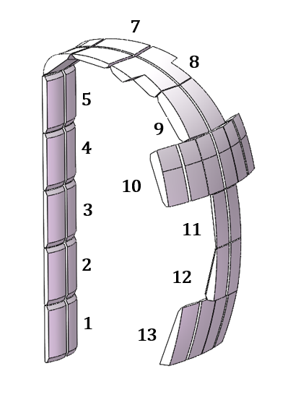
Design of the first wall (FW) as shielding blanket
Outline of the FW design
Poloidal contour profile fitting the magnetic configuration
Blanket modules (BMs) as the FW: shaping design
Radial location of the FW: heat loads Vs RF coupling
Heat loads on the FW
SOL plasmas
Charge-exchange neutrals
Radiation
Fast ion loss
Transient heat loads
Nuclear heating

Slide 3
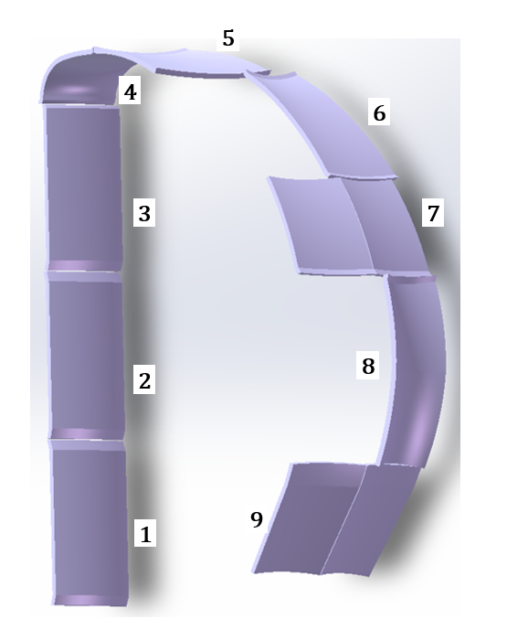
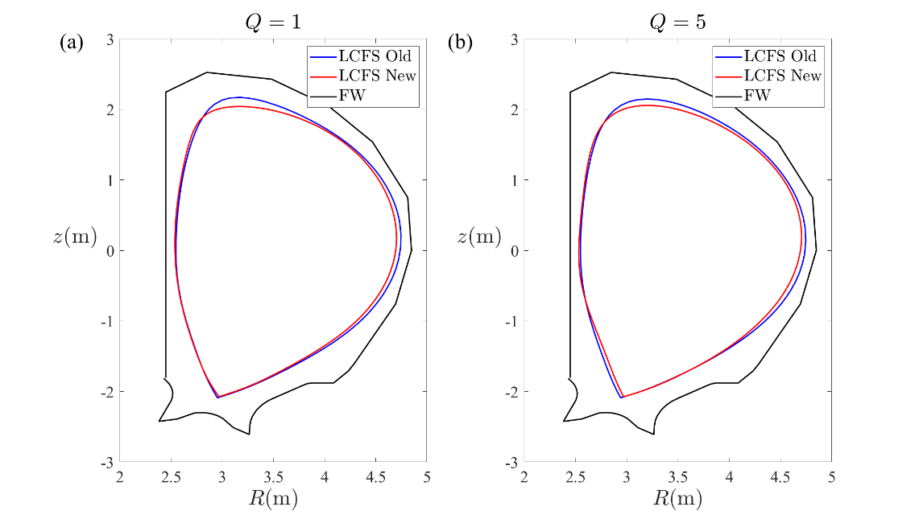
Updates of the first wall (FW) design in BEST
before
now
Poloidal blanket modules (BMs): 9→13
BMs design: one panel → two wings with 6cm slot
Radius of the FW (@OMP LFS): 4.95m → 4.85m
Magnetic configuration optimization: gap between LCFS and FW @OMP: ~15cm
Slight change on the FW poloidal contour
Ripple: 1.5% →0.75% (ferromagnetic inserts)

Slide 4
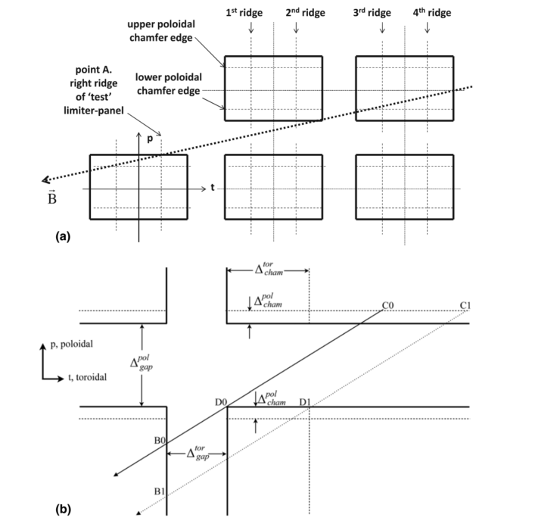
Shaping Design of the FW Panels
The FW panels need to be shaped to protect the leading edges caused by radial misalignment (inter-BM 10 mm, intra-BM 0.3mm) and gaps (inter-BM 10 mm, intra-BM 60mm)
Both toroidal (inter-BMs and intra-BM) and poloidal chamfering have been considered, respectively
Initial chamfering dimensions: theoretical calculation (Nucl. Fusion 51 (2011) 103015) 10% rule: $q_{dep−edge}∆_{pen}≤10\% q_{dep−face}L_{tile}$
Iterative optimization: 3D models → field line tracing (PFCFlux) for shadowing poloidal and toroidal leading edges
P.C. Stangeby Nucl. Fusion 51 (2011) 033008
4

Slide 5
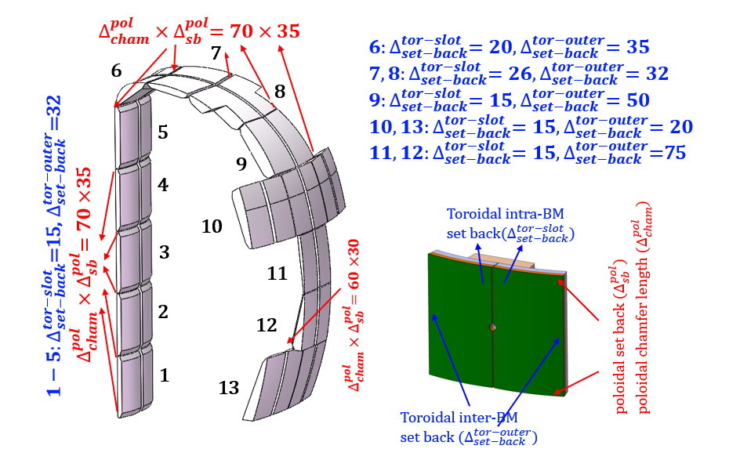
Current Shaping Design of the FW Panels in BEST
BEST FW shaping design
Poloidal: 13 blanket modules (each has 2 wings/panels)
Toroidal: 16 modules(BM 1#-7#, 8#&9#-up port, 11#&12-equatorial port); 32 modules(BM 10#,13#)
R_{IW}=2.45m; R_{OW}=4.85m
Toroidal circular arc surface and poloidal chamfer
5

Slide 6
FW heat fluxes during limiter start-up phase
The inner FW is used as limiter during start-up and ramp-down stage
Start-up (<4s) → as limiter
With 10mm radial misalignment
Heat flux distribution from PFCFlux code
q// defined by a double exponential radial profile
(Nucl. Fusion 60 (2020) 036011):
$λ_{q,near}\left(mm\right)=\left(0.63±0.08\right)×B_{pol,OMP}^{−1.19±0.08}$
$λ_{q,main}\left(m\right)=10×{\left(\frac{P_{TOT}}{V}\left(Wm^{−3}\right)\right)}^{−0.38}{\left(\frac{a}{R_{0}κ}\right)}^{1.3}$
$q_{∥}=q_{∥,main}+q_{∥,near}=q_{∥0,main}e^{−\frac{Δr_{LCFS}}{λ_{q,main}}}$+$q_{∥0,near}e^{−\frac{Δr_{LCFS}}{λ_{q,near}}}$
Peak surface heat load ~3.07 MW/m² on panel 3# during start-up phase （at 3s）
4#
Contact point
3#
$$P_{SOL}(MW)$$ | 1.58
$$λ_{q,main}(mm)$$ | 22.22
$λ_{q,near}$(mm) | 5.17
$q_{||0,main}$(MW/m²) | 20.01
$q_{||0,near}$(MW/m²) | 80.04
R_{OMP}(m) | 4.3533
2#
6

Slide 7
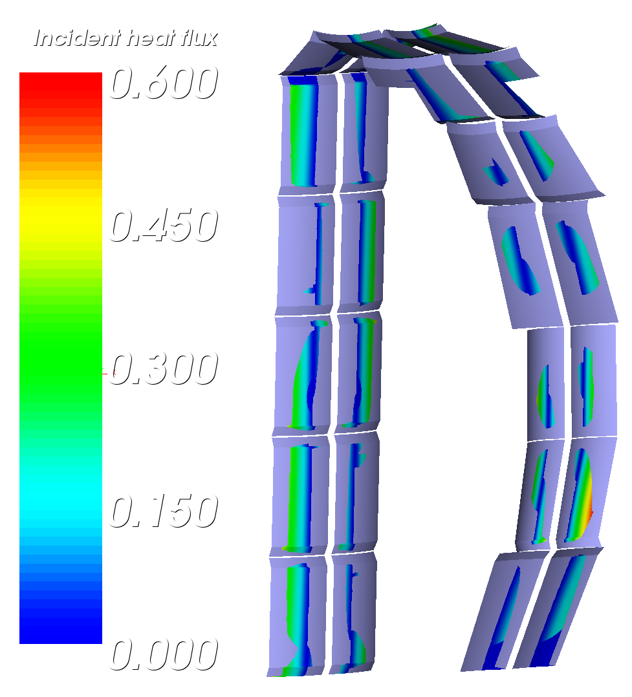
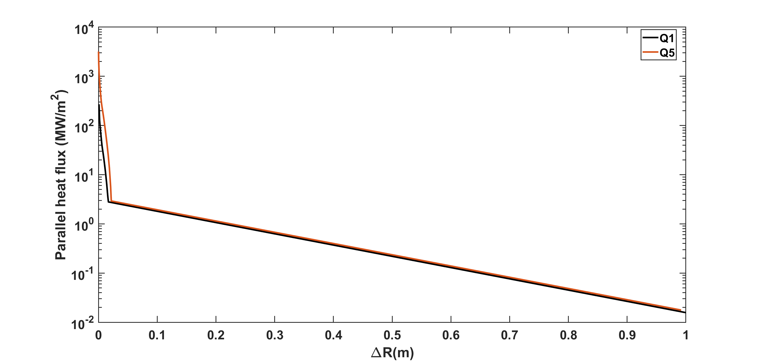
FW heat loads during flat-top phase(Q=1)
Main contributions of heat flux:
SOL (SOLPS-ITER+PFCFlux)
Near SOL (r-r_{sep}<2.184 cm): SOLPS
Far SOL:
Radiation and CX particles (SOLPS-ITER)
Ripple loss of fast ions (ISSDE)
Field line tracing taking into account 10 mm radial misalignment
Maximum surface heat load from SOL ~0.51 MW/m² on panel 12#
12#
7

Slide 8
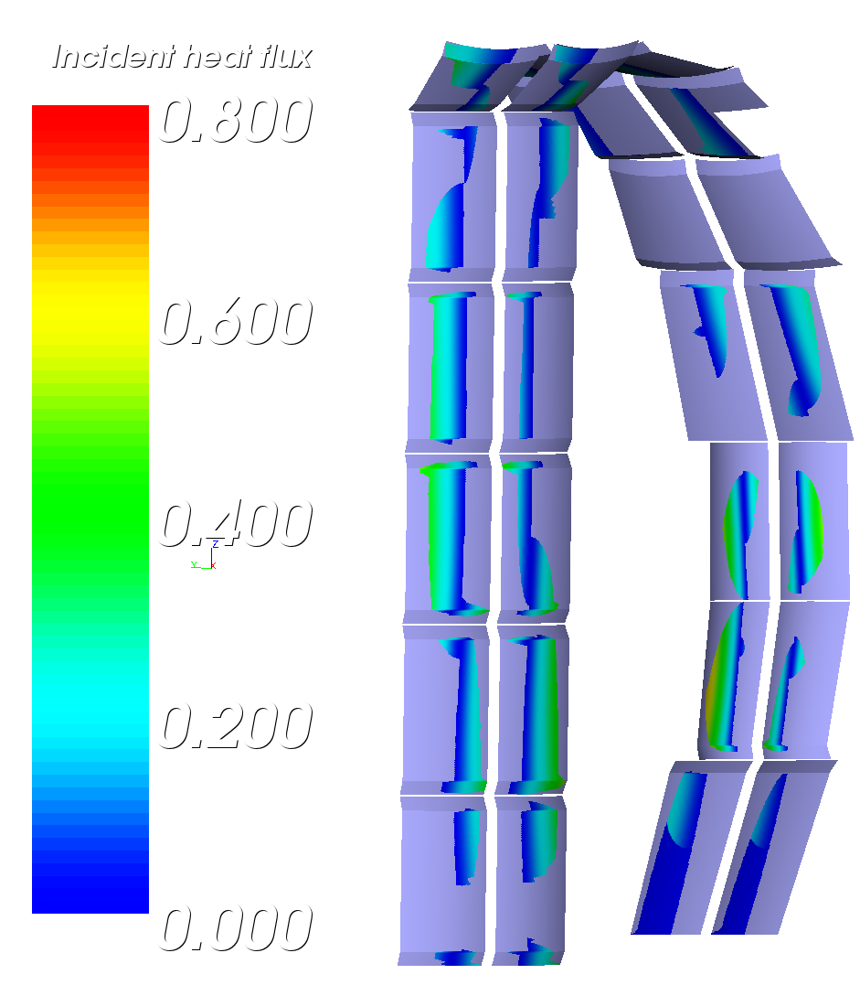
FW heat loads during flat-top phase(Q=5)
Main contributions of heat flux:
SOL (SOLPS-ITER+PFCFlux)
Near SOL (r-r_{sep}<2.184 cm): SOLPS
Far SOL:
Radiation and CX particles (SOLPS-ITER)
Ripple loss of fast ions (ISSDE)
Field line tracing taking into account 10 mm radial misalignment
Maximum surface heat load from SOL ~0.60 MW/m² on panel 12#
12#

Slide 9
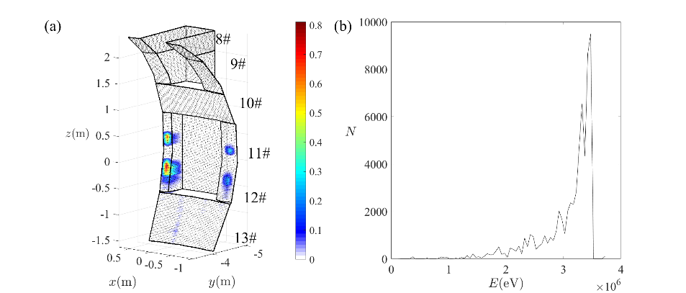
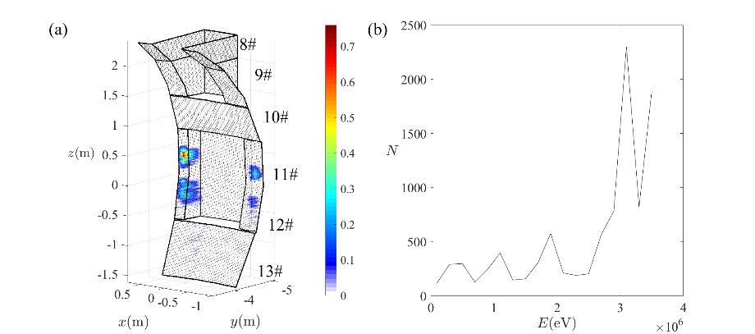
FW heat loads from fast ion loss
Fast ion loss calculation
Alpha particles ; NBI fast ions
Prompt loss; Pitch angle scattering loss; Ripple well loss and stochastic ripple diffusion loss
NUBEAM : initial distribution
ISSDE: fast ion loss (Ripple field and Coulomb collision, first wall chamfering)
Ripple decrease from 1.5% to 0.75% @OMP of separatrix due to ferromagnetic inserts (FIs)
Main results
P_{fusion}=44MW(Q=1); 168MW(Q=5) (20% for α particles)
Maximum heat load on FW: 0.83MW/m²(Q=1@12#); 0.76MW/m²(Q=5@11#)
The fast ion loss fraction of Q>1 is greater than that of Q=5 case, due to the lower Ip.
Ripple field distribution (with and without FIs)
Q=1
Q=5
9

Slide 10
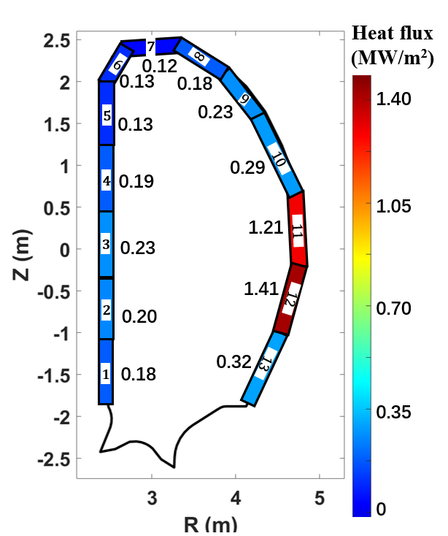
FW heat loads during flat-top phase （Q=1）
Panel number | SOL (MW/m²) | Ripple loss of fast ions (MW/m²) | Radiation and CX particles (MW/m²) | Total Heat flux
1 | 0.07 | 0 | 0.11 | 0.18
2 | 0.09 | 0 | 0.11 | 0.20
3 | 0.12 | 0 | 0.11 | 0.23
4 | 0.09 | 0 | 0.10 | 0.19
5 | 0.05 | 0 | 0.08 | 0.13
6 | 0.05 | 0 | 0.08 | 0.13
7 | 0.04 | 0 | 0.08 | 0.12
8 | 0.11 | 0 | 0.07 | 0.18
9 | 0.16 | 0 | 0.07 | 0.23
10 | 0.21 | 0 | 0.08 | 0.29
11 | 0.42 | 0.71 | 0.08 | 1.21
12 | 0.51 | 0.83 | 0.07 | 1.41
13 | 0.15 | 0.10 | 0.07 | 0.32
~59% of total heat flux on panel 11 and 12 contributed by ripple loss of fast ions
Radiation and CX particles ~0.07-0.11 MW/m²
10

Slide 11
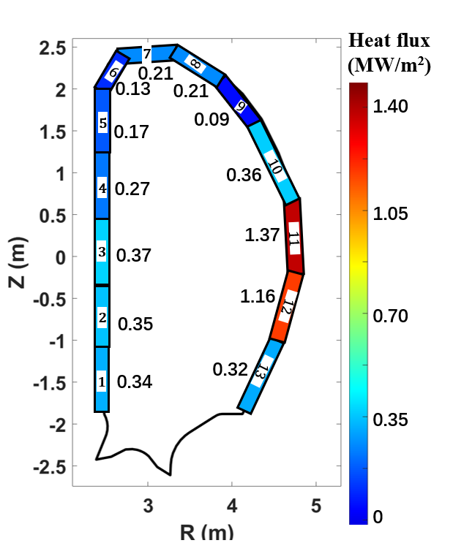
FW heat loads during flat-top phase （Q=5）
Panel number | SOL (MW/m²) | Ripple loss of fast ions (MW/m²) | Radiation and CX particles (MW/m²) | Total Heat flux
1 | 0.15 | 0 | 0.19 | 0.34
2 | 0.22 | 0 | 0.13 | 0.35
3 | 0.25 | 0 | 0.12 | 0.37
4 | 0.17 | 0 | 0.10 | 0.27
5 | 0.08 | 0 | 0.09 | 0.17
6 | 0.03 | 0 | 0.10 | 0.13
7 | 0.12 | 0 | 0.09 | 0.21
8 | 0.12 | 0 | 0.09 | 0.21
9 | 0 | 0 | 0.09 | 0.09
10 | 0.25 | 0 | 0.11 | 0.36
11 | 0.50 | 0.76 | 0.11 | 1.37
12 | 0.60 | 0.47 | 0.09 | 1.16
13 | 0.17 | 0.06 | 0.09 | 0.32
41%-55% of total heat flux on panel 11 and 12 contributed by ripple loss of fast ions
Radiation and CX particles ~0.09-0.19 MW/m²
11

Slide 12
Summary
Stationary heat loads on FW have been evaluated
Shaping design of the FW panel and radial misalignment is taken into account
3D heat flux is obtained with mapping of magnetic flux surface and local pitch angle
Fast ion loss dominates the heat loads on the LFS FW panels
New optimization and iteration being carried out to further reduce the fast ion losses
Heat load due to major disruption and VDE is under evaluation

Slide 13
Thank You for Your Attention!

