Slide 1
Thermal Conditions of IVCs
4th Technical Exchange Meeting on the China-EU collaboration on
CFETR and EU-DEMO Reactor Design
I. Moscato
DEMO Central Team
Acknowledgments:
WPBB, WPBOP, WPDES, WPDIV

Slide 2
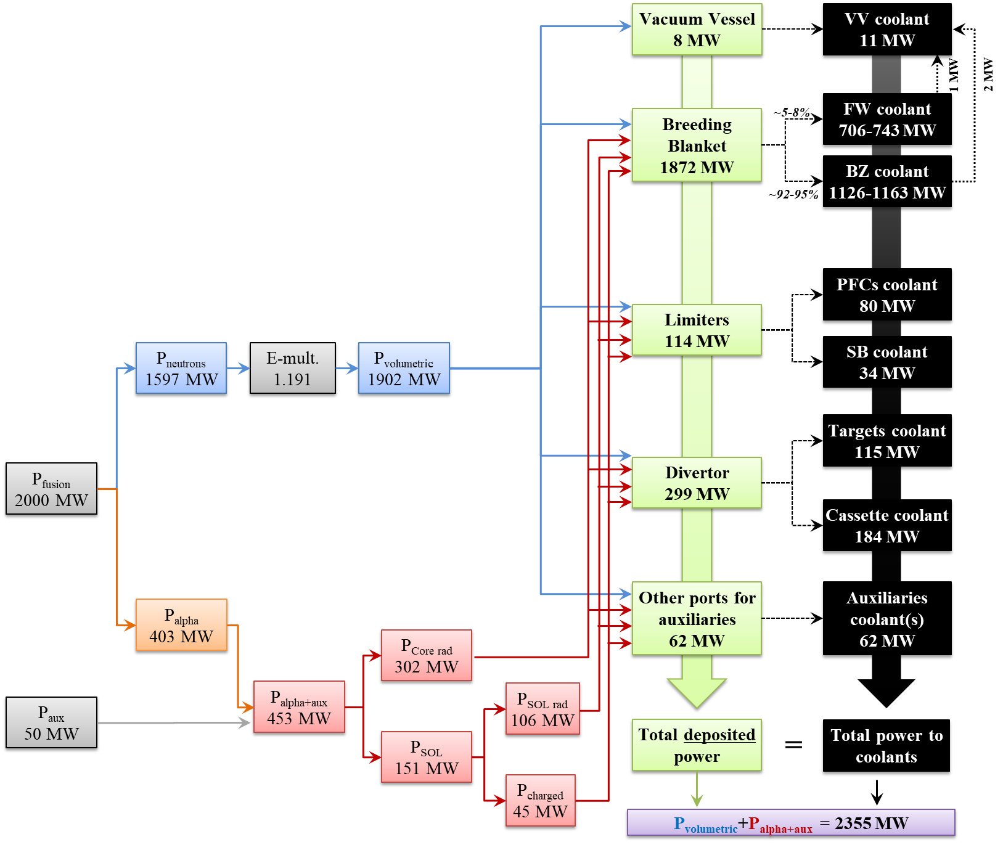
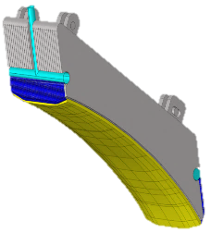
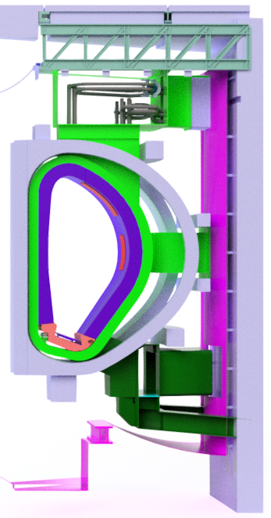
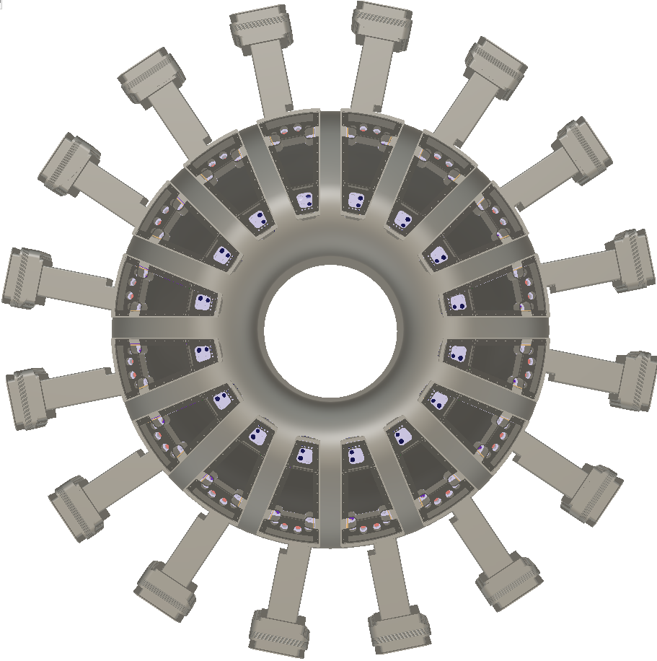
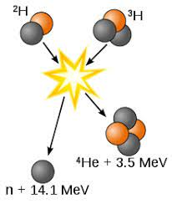

EU-DEMO In-VV components
Several clients to feed
Tokamak top view with the 16 sectors
HCPB BB
WCLL BB
Several In-Vessel components encompassed by the VV.
Breeding Blanket: 80 segments (48 outboard BB + 32 inboard BB)
Divertor: 48 cassettes (3 per tokamak sector)
Limiters: 20 discrete limiters are currently considered.
Vacuum Vessel: 16 sectors
Other auxiliaries (additional heating antennas, port plugs etc.)
Due to the different requirements of the clients a single coolant circuit cannot be adopted.

Slide 3
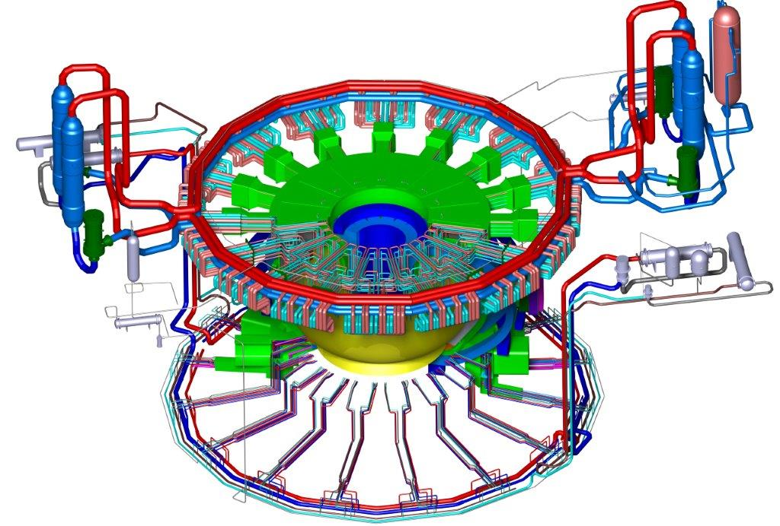
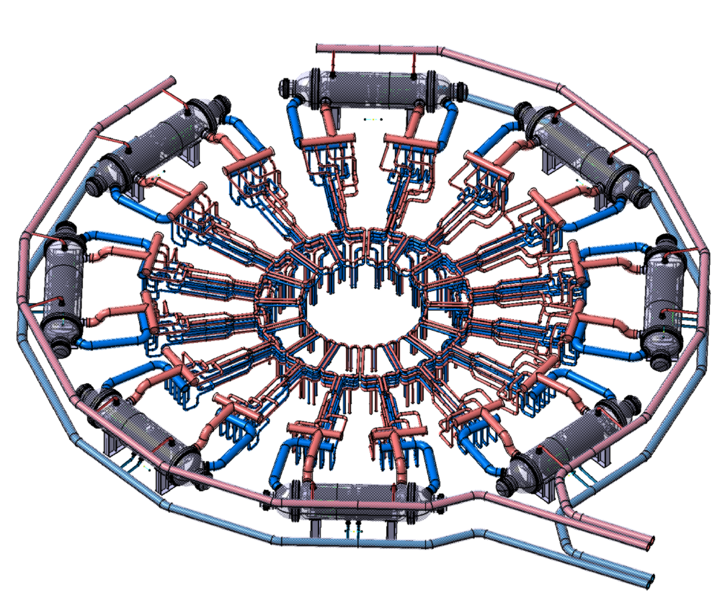
EU-DEMO In-VV components
Tokamak Coolants System
Integration of Tokamak Coolants System with all 3 PHTS
Water-cooled BB PHTS
Tokamak Coolants system:
3 main Primary Heat Transport Systems
Quantity | Breeding blanket PHTS |  | Shielding Components PHTS | High Heat Flux PHTS
 | WCLL | HCPB
Nom. thermal-power [MW] | 1900 | 2100 | 230 | 240
Primary volume [m³] | 630 | 1900 | 140 | 280
Primary temperatures °C | 295-328 | 300-520 | 180-210 (295-328)* | 130-136
Primary pressure [MPa] | 15.5 | 8.0 | 3.5 (15.5)* | 5.0
Mass flow rate [kg/s] | 9754 | 1840 | 1718 | 9394
*Values in () for high temperature option
Helium-cooled BB PHTS

Slide 4
EU-DEMO primary system components
Facing pulsed load and other operational transients
The service life of any coolant system pressure component depends upon a number of factors: material irradiation, unit operational thermal cycles, quality manufacturing standards, environmental protection, and adherence to established operating procedures.
All components of primary cooling system must be designed to withstand the effects of cyclic loads due to coolant system temperature and pressure changes.
Thermal and loading cycles are introduced by a number of events:
Normal conditions: heatup and cooldown cycles, power changes, normal cyclic variations, baking, … → 100s to 10⁶s cycles
Upset conditions: reactor trip, turbine trip, loss of flow, … → 10s to 100s of cycles
Emergency and Faulted conditions: → small to large LOCAs, feedwater and steam line breaks, pump locked motor… → a few to 10s cycles
Test conditions → primary/secondary side hydrostatic tests, primary/secondary sides leak tests, tube leak tests … → 10s to 100s cycles
The EU-DEMO foresees about 11 pulses per day with a with 100%-0% reactor load swing up to 1% per second
Fission reactors generally consider 1 load variation per day in the range 15% to 100% of full power.

Slide 5
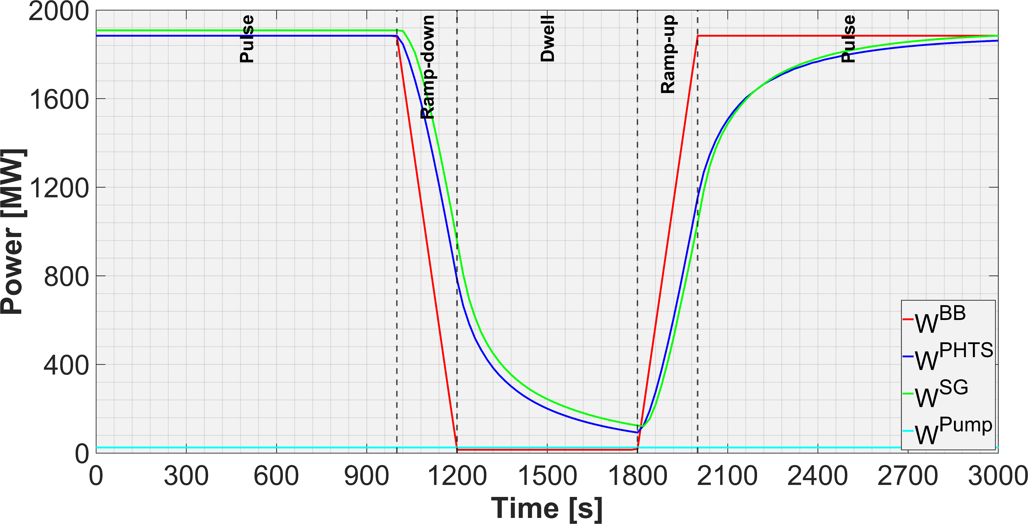
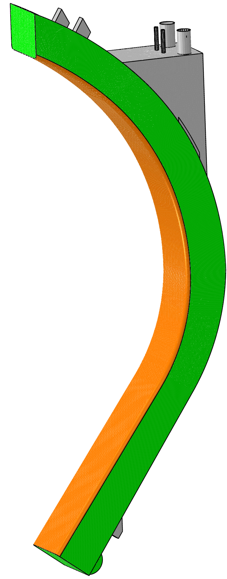
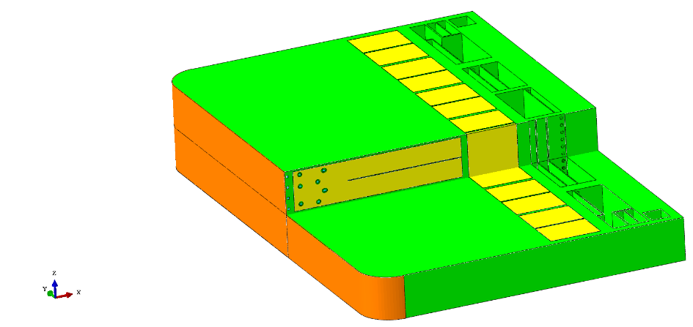
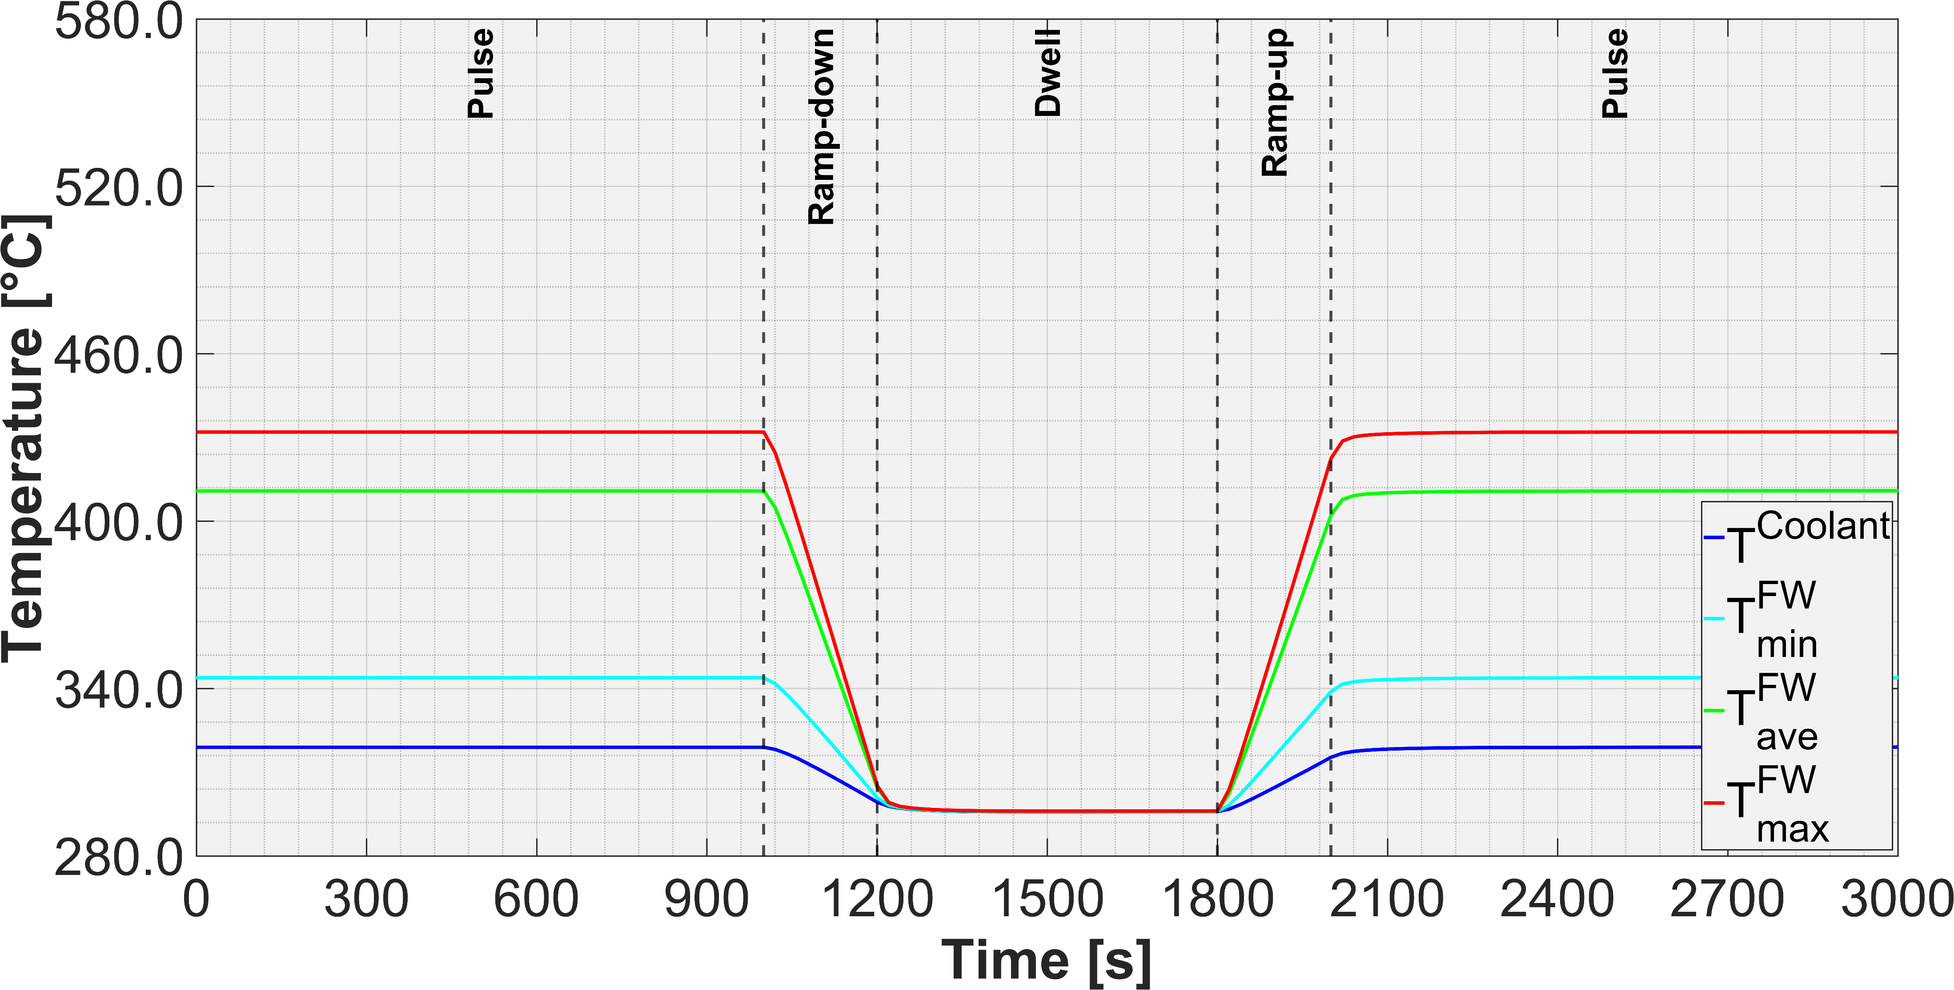
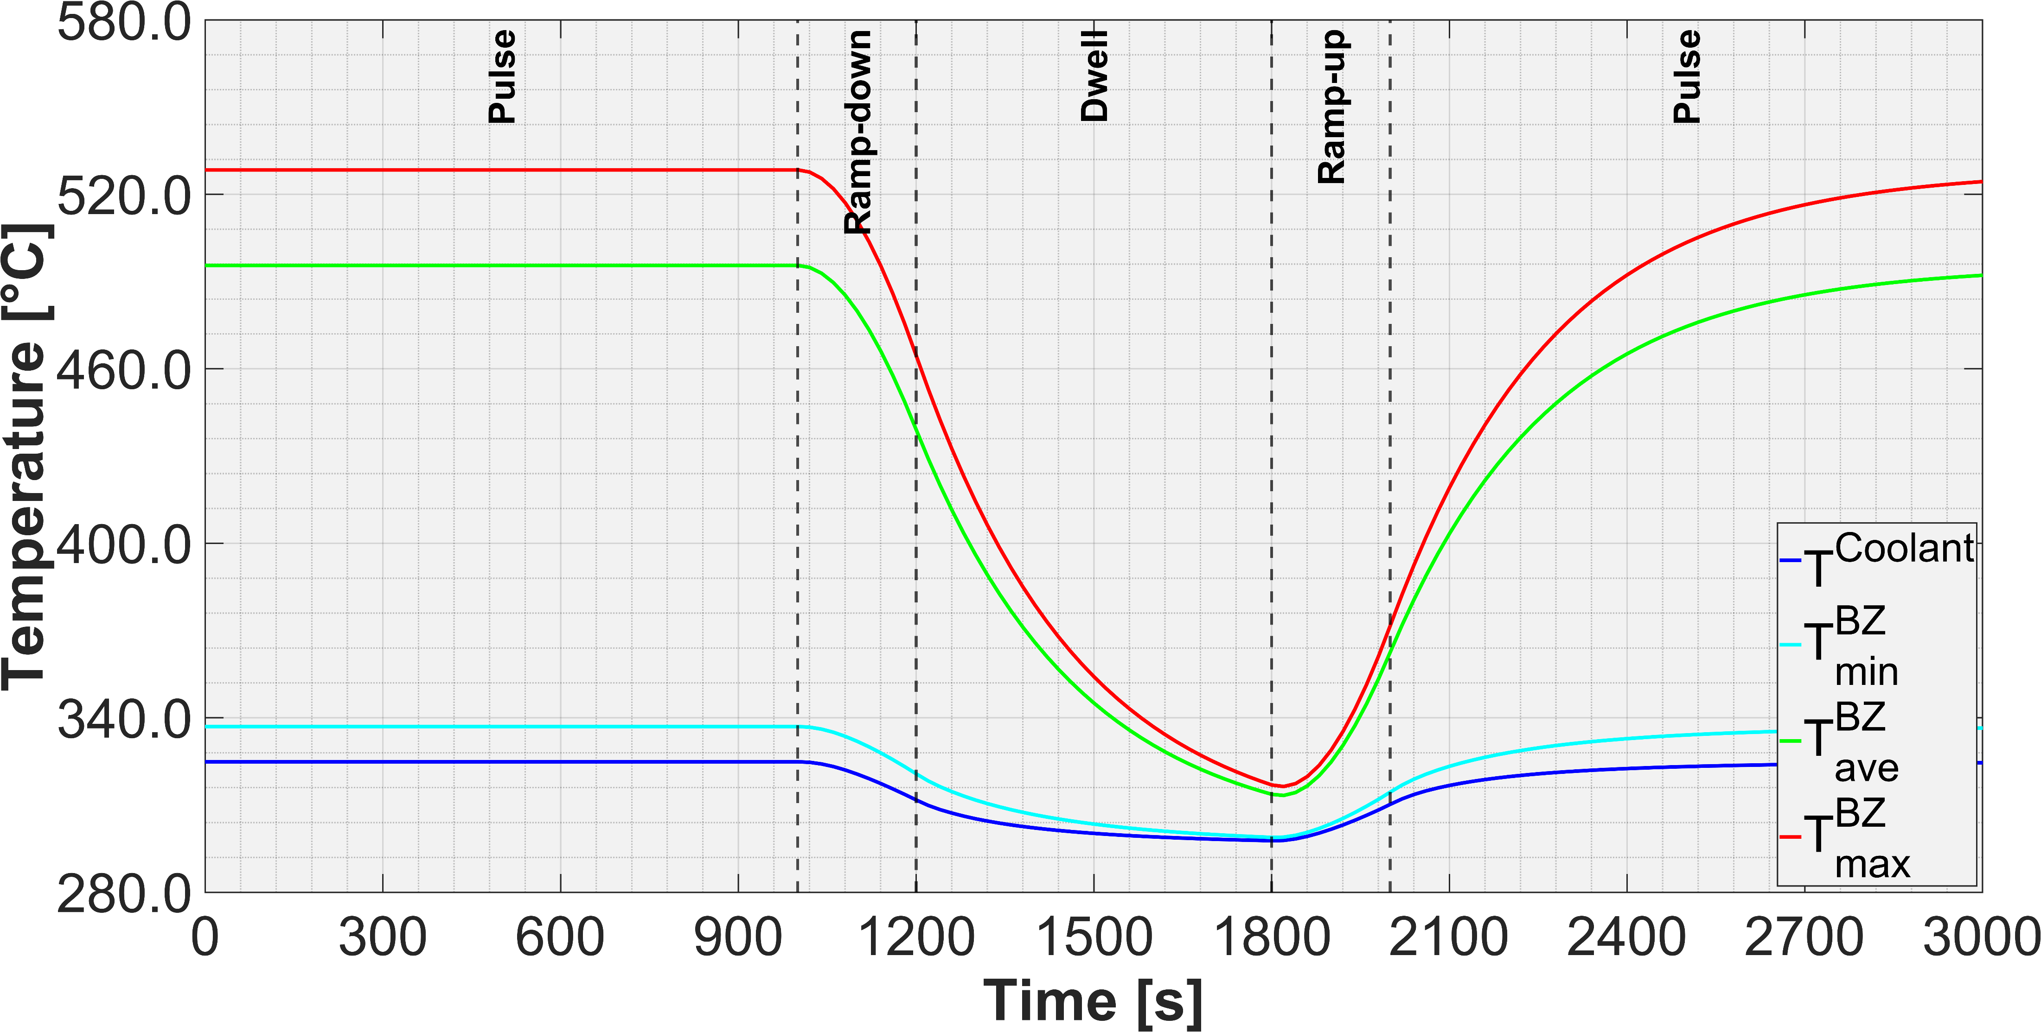
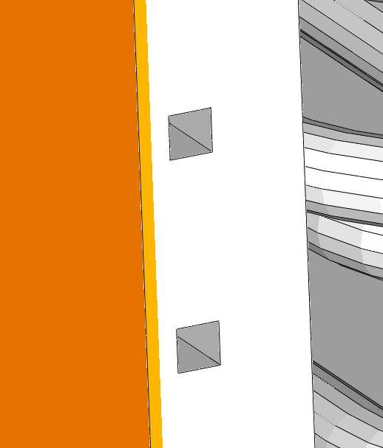
Ramp-up/down thermal behaviour of In-VV components
Example of WCLL Breeding Blanket cooling circuit
200s ramps assuming linear power decrease
Thermal-power delivered to the balance of plant at the end of 10 min Dwell still 7% of nominal power.
First wall thermal inertia nearly negligible, whereas breeding zone far from reaching steady thermal conditions in between two flat-tops. Overall, the BB thermal inertia is significant.
BB temperature histories require detailed transient assessments.
Thermal power to BB structures
Thermal power to Balance of Plant
Exchanged thermal power
First Wall temperatures
W temp.
Breeding Zone temperatures
Volumetric average temp.
Channel wall temp.
Coolant temp.
All temperatures are indicative

Slide 6
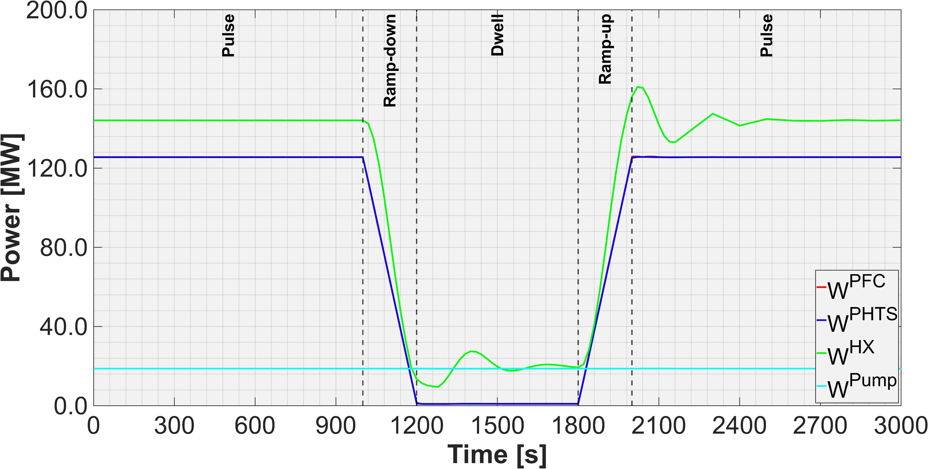
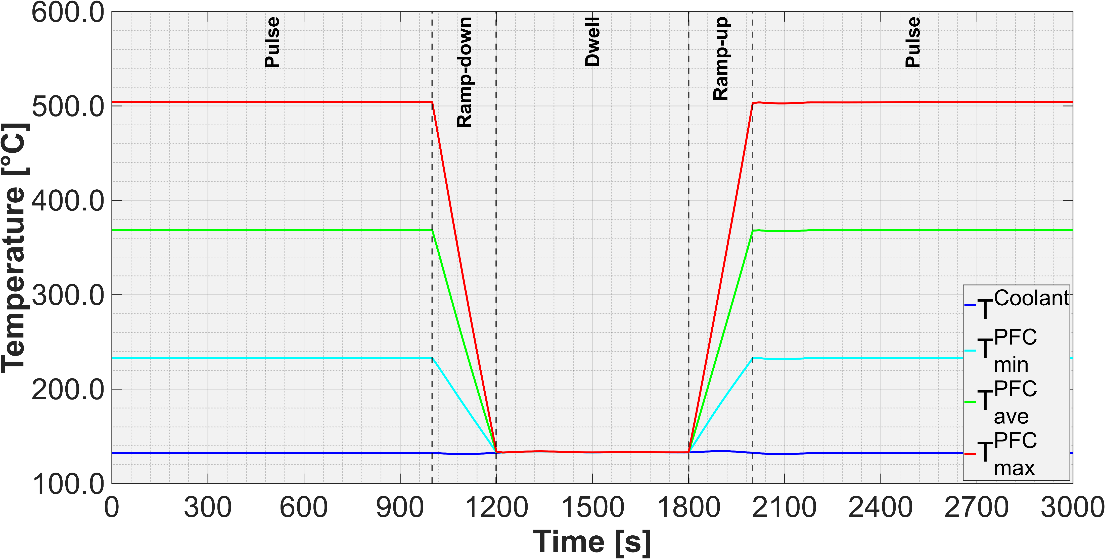
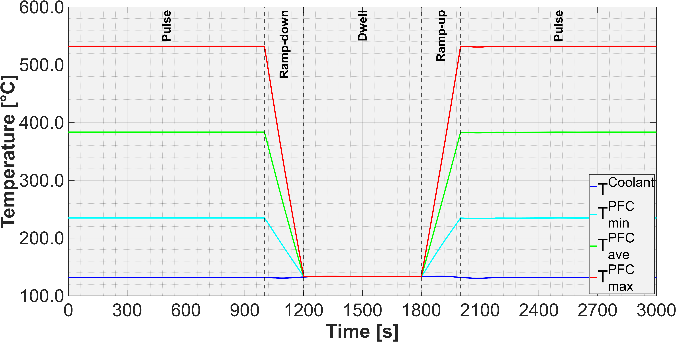
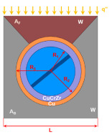
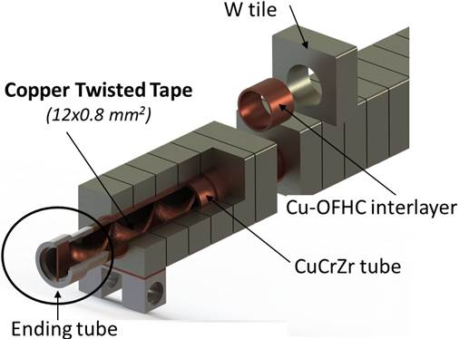
Ramp-up/down thermal behaviour of In-VV components
Example of Divertor Plasma Facing Components cooling circuit
Divertor load conditions: fully-detached divertor with heat flux <10 MW/m²
200s ramps assuming linear power decrease
Thermal-power delivered to the balance of plant at the end of 10 min Dwell “only” decay heat + pumps.
Monoblocks thermal inertia negligible. As expected, divertor PFCs thermal inertia is basically negligible.
Thermal power to BB structures
(below blue plot)
Thermal power to Balance of Plant
Exchanged thermal power
W temp.
W temp.
Inner target
Outer target
Volumetric average temp.
Volumetric average temp.
Channel wall temp.
Channel wall temp.
Coolant temp.
Coolant temp.
All temperatures are indicative

Slide 7
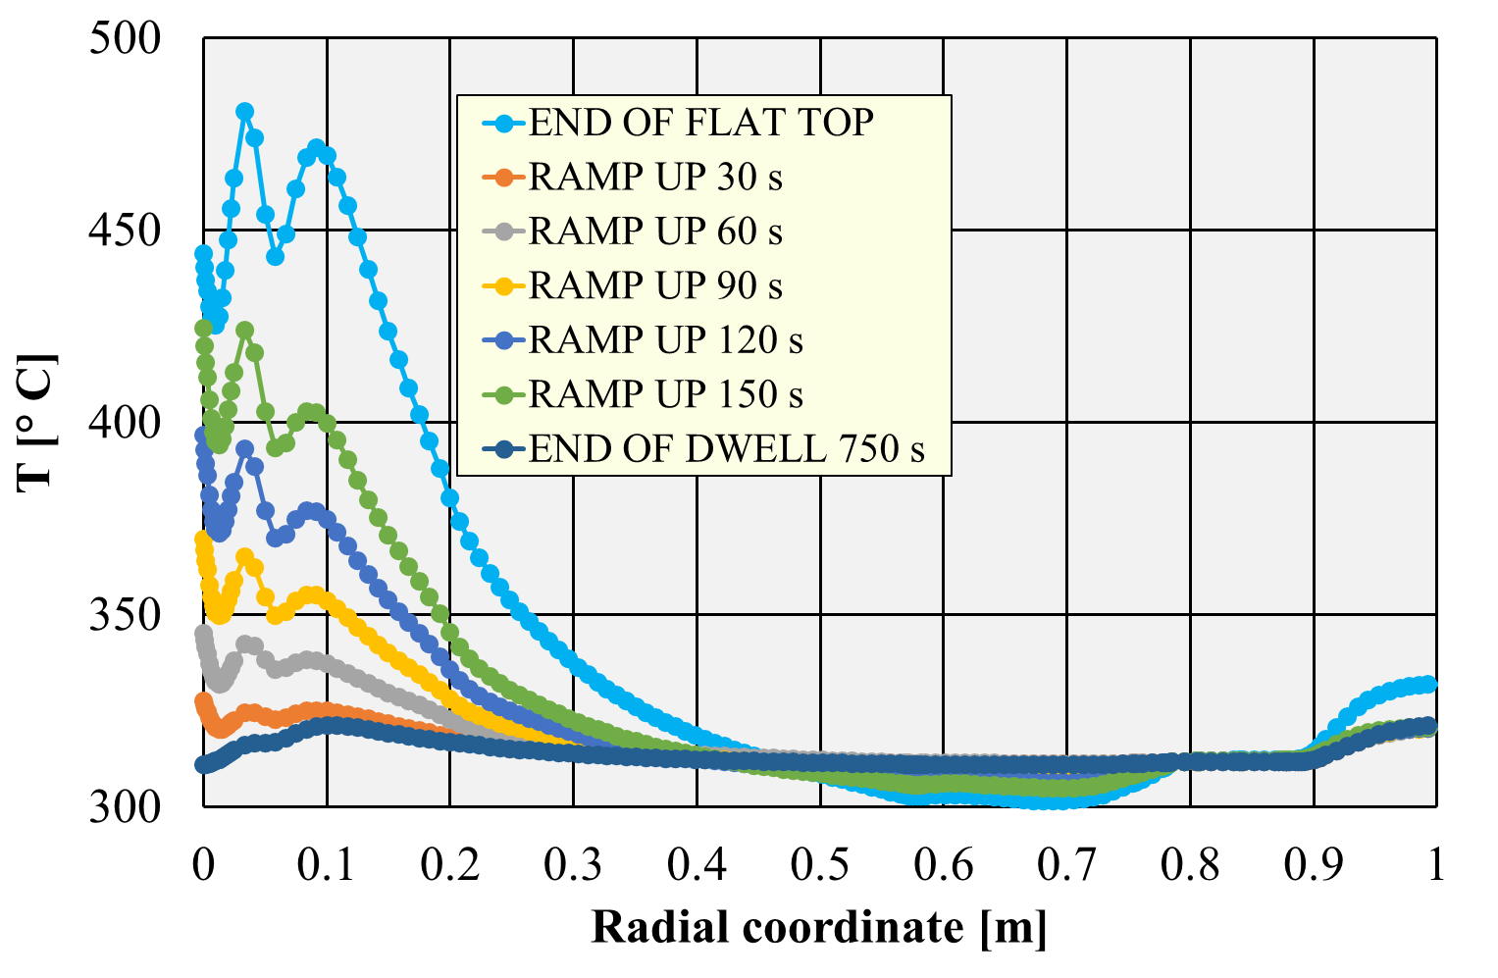
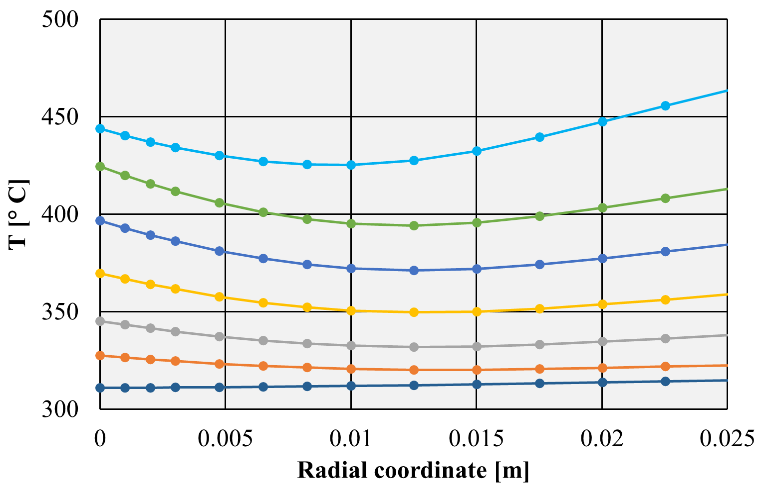
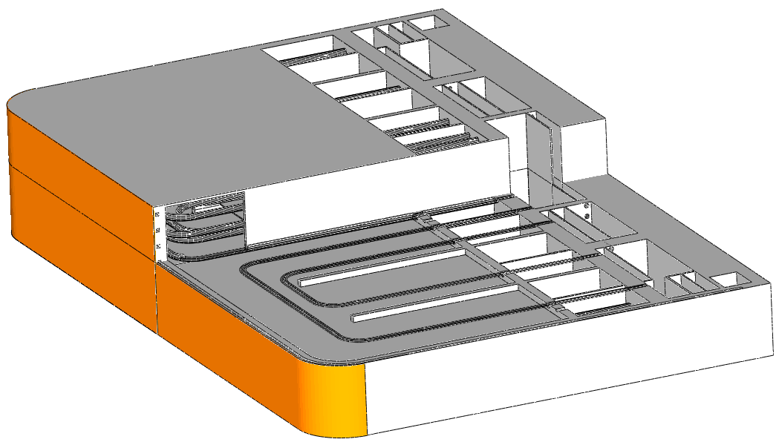
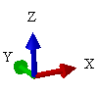
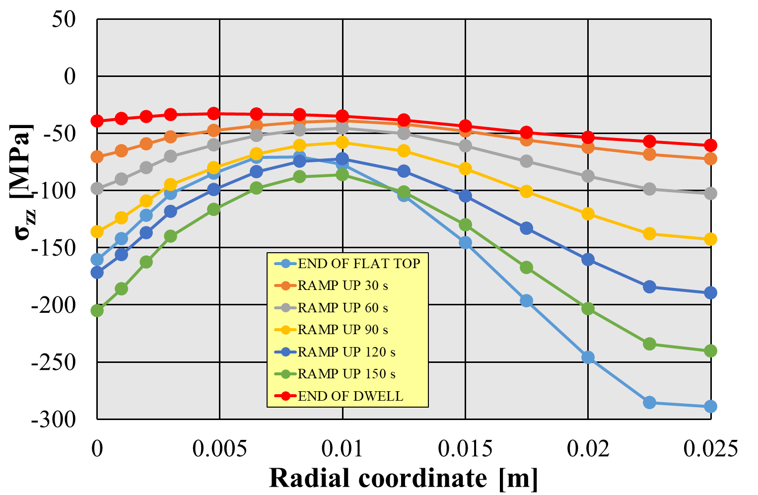
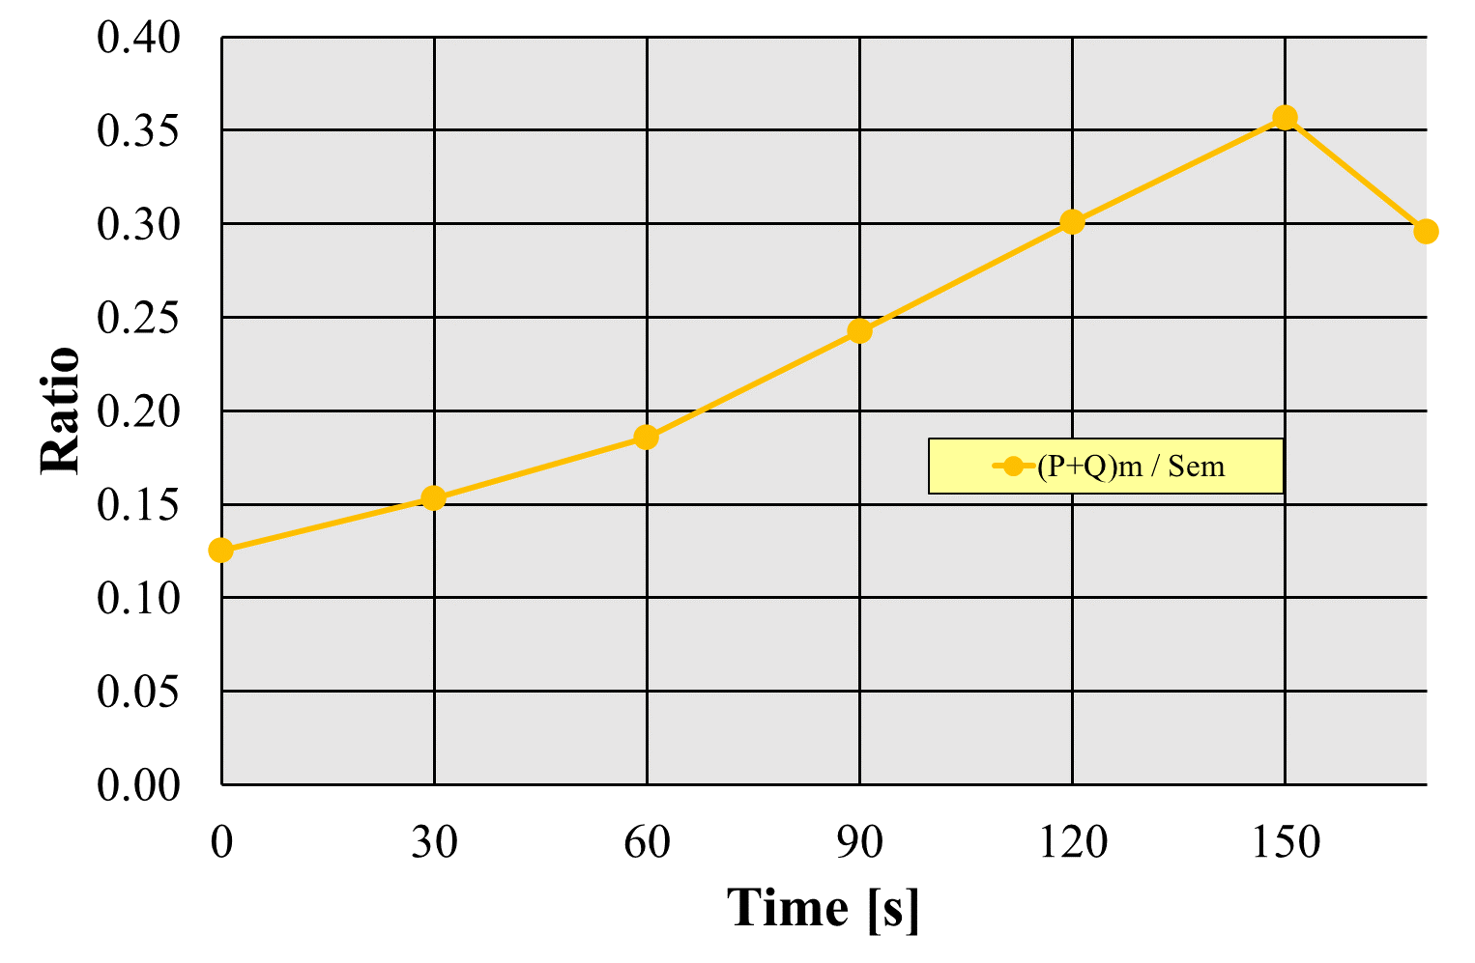
EU-DEMO In-VV components thermal conditions
Example of stress field in breeding blanket first wall during ramp-up
Ramp up phase – temperarure radial profile
Top face
Stress path
Loads and boundary conditions
Time-dependent heat flux and nuclear heating (as per the DEMO duty cycle).
Constant coolant mass flow rate.
Coolant design pressure (17.8 MPa).
Generalised plane strain/Z symmetry conditions on the model top/bottom face.
Radial- toroidal contraints on the model back face.
Back face
Bottom
face
Temperature paths
Ramp up phase – σ_{zz} stress radial profile
DEMO duty cycle
Immediate plastic flow localisation criterion
Ramp up 150 s
Pulse period 7200 s
Dwell period 600 s
Ramp down 150 s
In the back region, temperature decreases during ramp up.
Within the first wall, some stress components achieve values during the ramp up higher than the end of flat top.
Generally, most severe conditions can be reached during ramp up than at the end of flat top. Transient analysis is necessary.

Slide 8
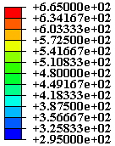
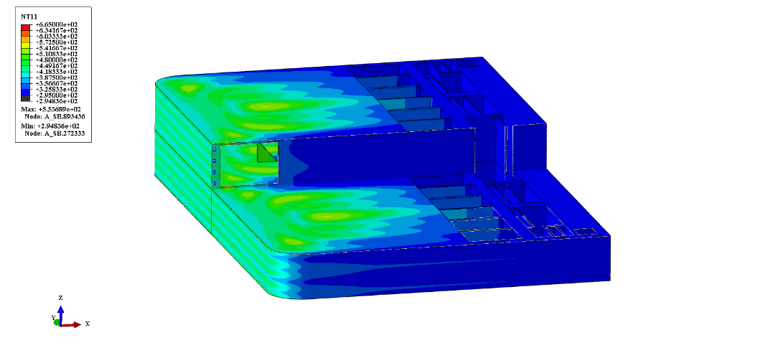
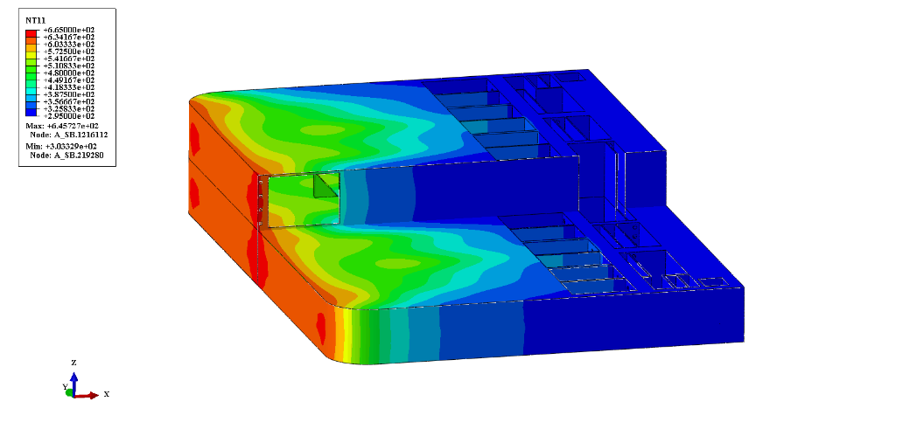
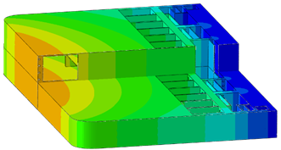
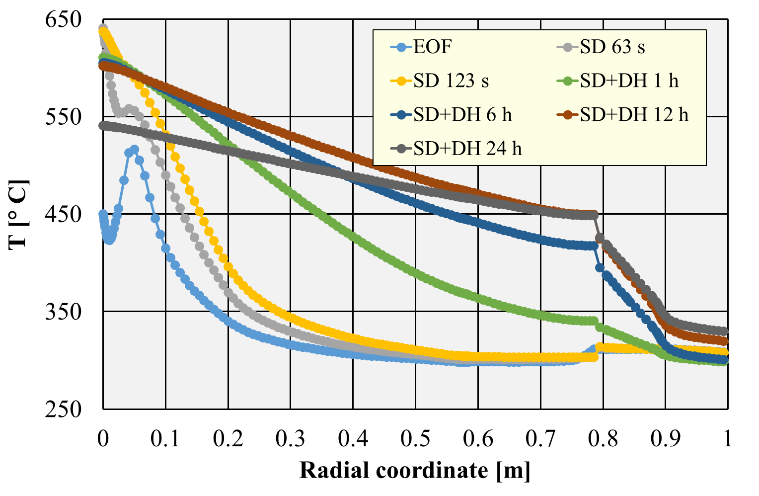
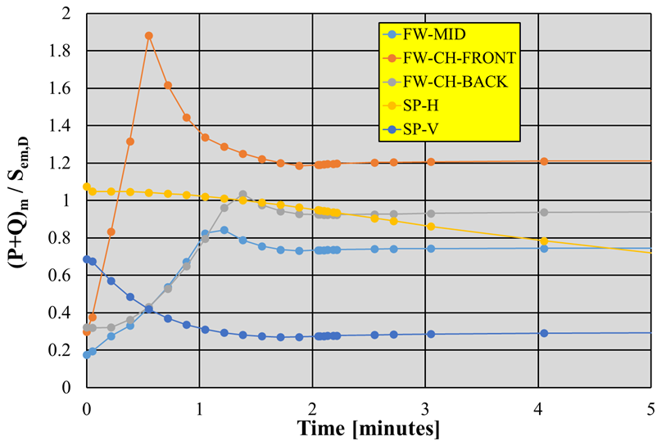
EU-DEMO In-VV components thermal conditions
Large guillotine break of main PHTS pipe, i.e. ex-vessel LOCA
Temperature [°C]
End of Flat Top
t = 123 s
t = 12 h
Accident sequence
t = 0⁻ s: End of flat top
t = 0⁺ s: LOCA occurrence
t = 0-3 s: plasma still at full power
t = 3-123 s: fusion power ramp-down
t = 123 s - ∞ : decay heat only

Slide 9
Summary
Individual cooling circuits required for different types of DEMO in-vessel components to comply with different requirements.
Cyclic loads on PHTS components e.g. heat exchangers, due to coolant temperature and pressure changes must be considered.
Breeding Blanket thermal inertia is significant. → Various thermal states occur in the BB during the pulse. → Thermal transients of the BoP due to pulsed operation are smoothed. On the contrary Divertor targets have negligible thermal inertia.
During ramp-up the thermal gradient in the first wall is higher than during flat-top. Global analyses are needed to capture relevant global thermal stresses in the entire BB segment. The attachment system must be designed to accommodate the various thermal expansion states.
In the unlikely event of large ex-vessel LOCA, the structural integrity of the blanket might be challenged and unrecoverable large deformations may occur. Nonetheless, the BB temperature remains below melting or collapsing limits.

Slide 10
Thank you for your attentions

Slide 11
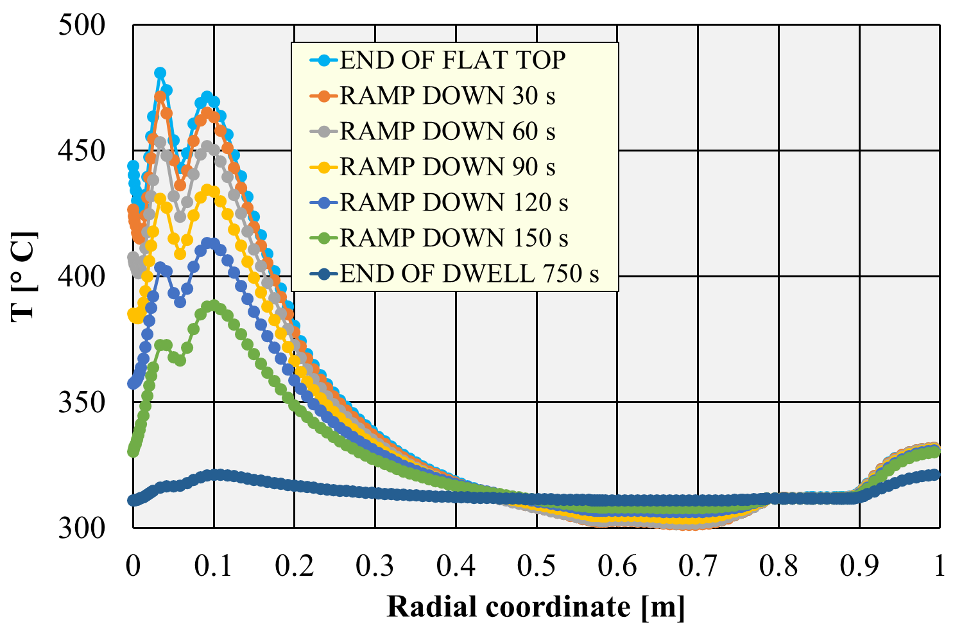
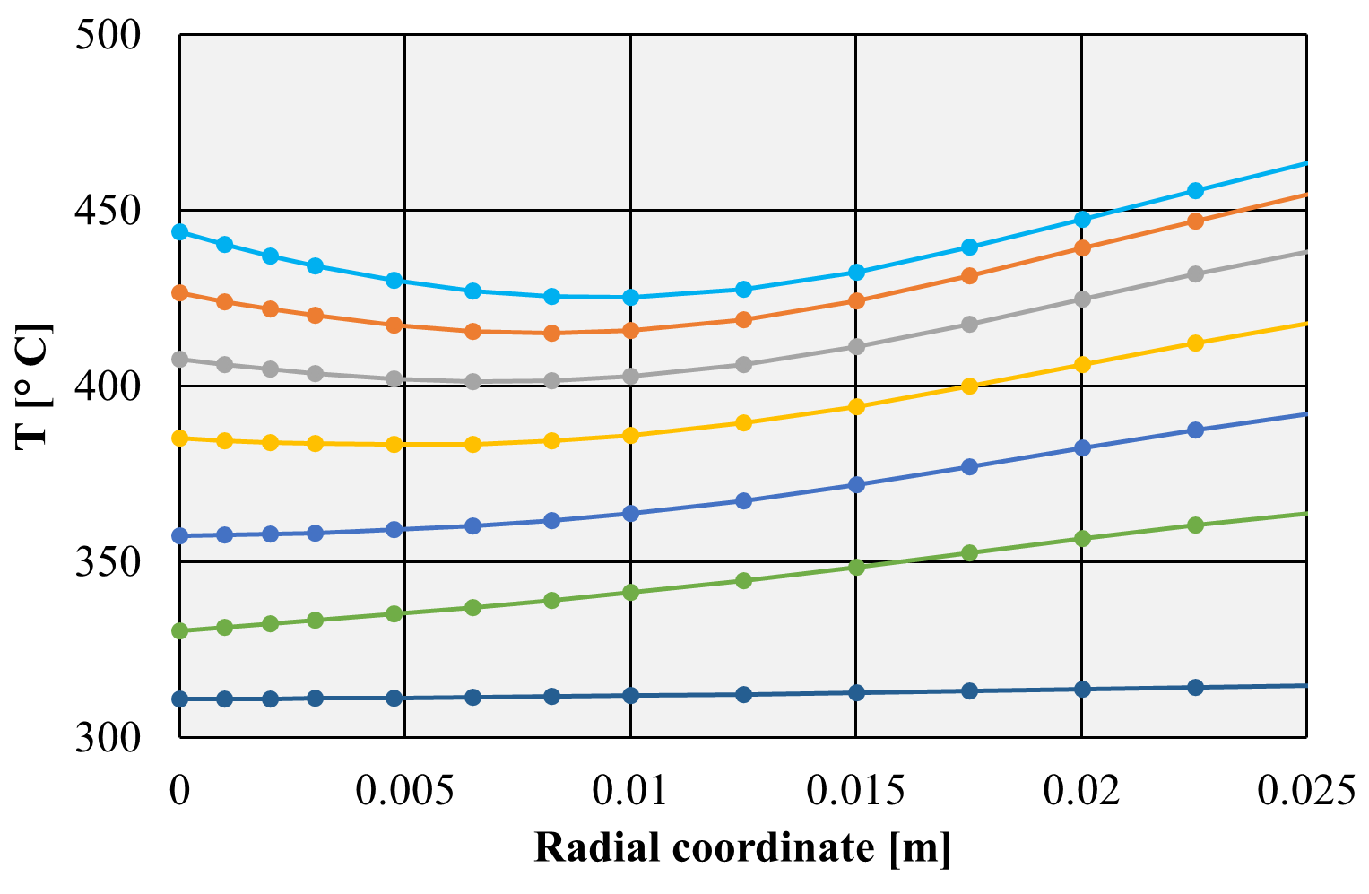
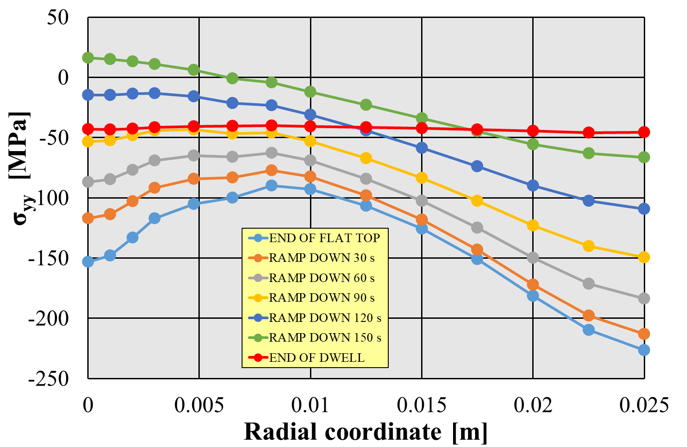
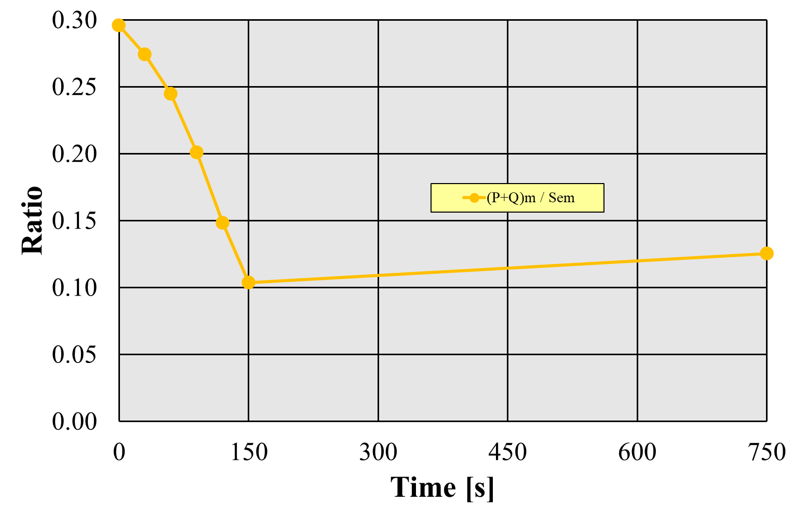
Additional slide 1
Example of stress field in breeding blanket first wall during ramp-down
Ramp down phase – temperarure radial profile
Loads and boundary conditions
Time-dependent heat flux and nuclear heating (as per the DEMO duty cycle).
Constant coolant mass flow rate.
Coolant design pressure (17.8 MPa).
Generalised plane strain/Z symmetry conditions on the model top/bottom face.
Radial- toroidal contraints on the model back face.
Top face
Stress path
Back face
Bottom
face
Temperature paths
Ramp down phase – σ_{yy} stress radial profile
Immediate plastic flow localisation criterion
DEMO duty cycle
Ramp up 150 s
Pulse period 7200 s
Dwell period 600 s
Ramp down 150 s
In the back region, temperature increases during dwell.
Within the first wall, some stress components achieve values during the ramp down higher than the end of flat top.
Generally, most severe conditions can be reached at the end of dwell than at the end of ramp down. Transient analysis is necessary.

Slide 12
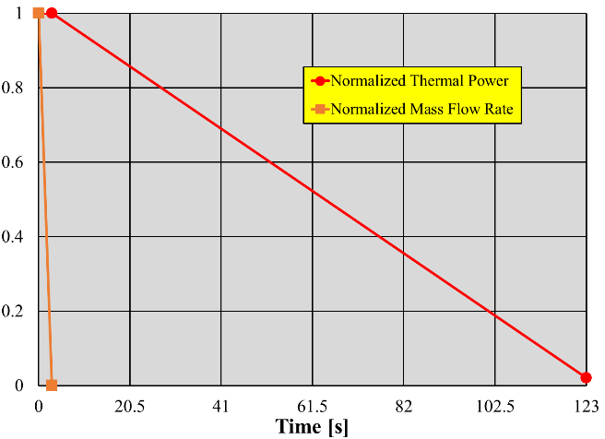
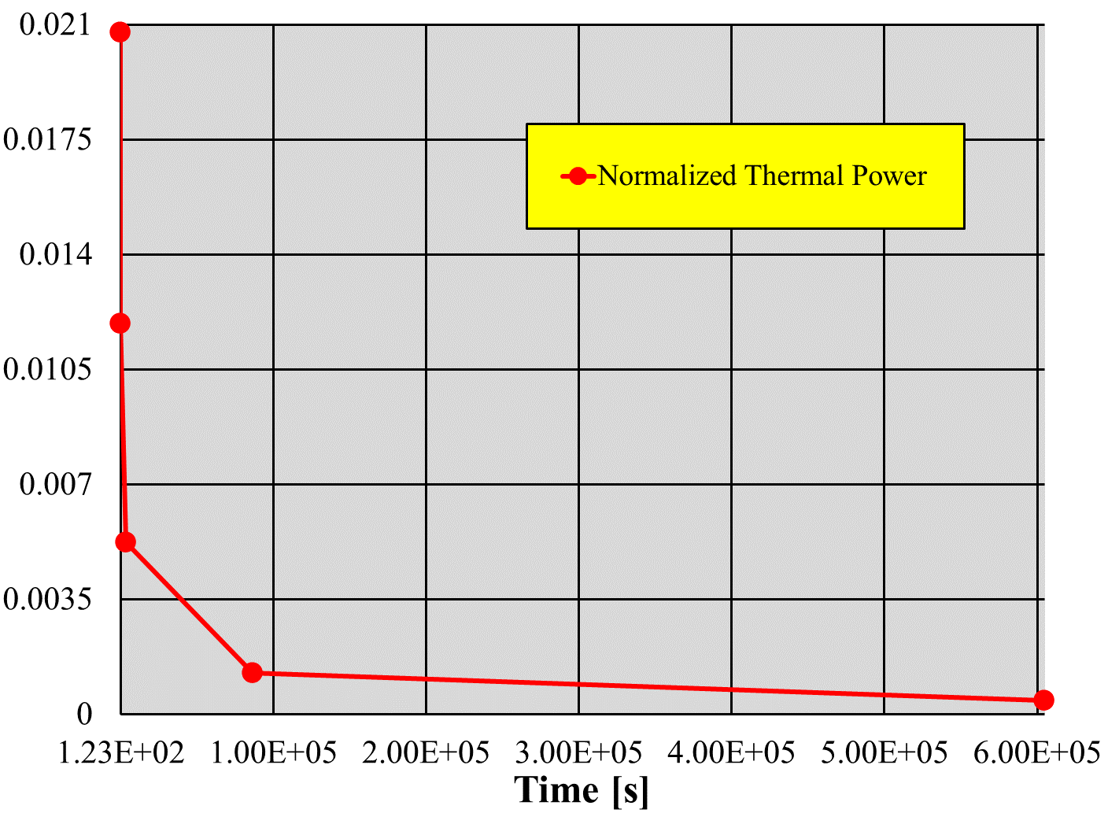
Additional slide 2
Example of stress field in breeding blanket first wall during LOCA events
Ex vessel LOCA with soft plasma shutdown
Accident sequence
t = 0⁻ s: End of flat top
t = 0⁺ s: LOCA occurrence
t = 0-3 s: plasma still at full power
t = 3-123 s: fusion power ramp-down
t = 123 s - ∞ : decay heat only
Loads and boundary conditions
Time-dependent heat flux and nuclear heating.
Time-dependent decay heat.
Time-dependent coolant mass flow.
Back face radiating toward vacuum vessel.
Time-dependent coolant pressure according to the mass flow rate time trend.
Generalised plane strain/Z symmetry conditions on the model top/bottom face.
Radial- toroidal contraints on the model back face.
Top face
Back face
Bottom
face
Temperature
paths

