Slide 1
EM loads of DEMO in-vessel components
EU – China collaboration on CFETR and EU-DEMO Reactor Design 4th Technical Exchange Meeting
I. A. Maione
Karlsruhe Institute for Technology, Hermann-von-Helmholtz-Platz 1, 76344 Eggenstein-Leopoldshafen, Germany

Slide 2
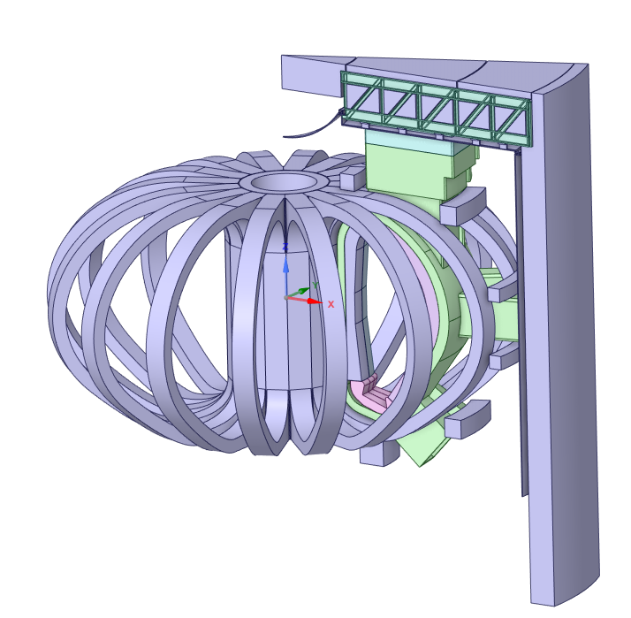
Introduction (1/2)
Electrical current
Limiter system
Magnetic field
Magnetic materials
EM loads
EC launcher
Their distribution and magnitude strongly depend on:
  the tokamak magnetic configuration,
  system design,
  electrical connections with other conductive structures (e.g. the vacuum vessel)
  the considered EM scenario.
Breeding blanket system:
  HCPB
  WCLL
Divertor system

Slide 3
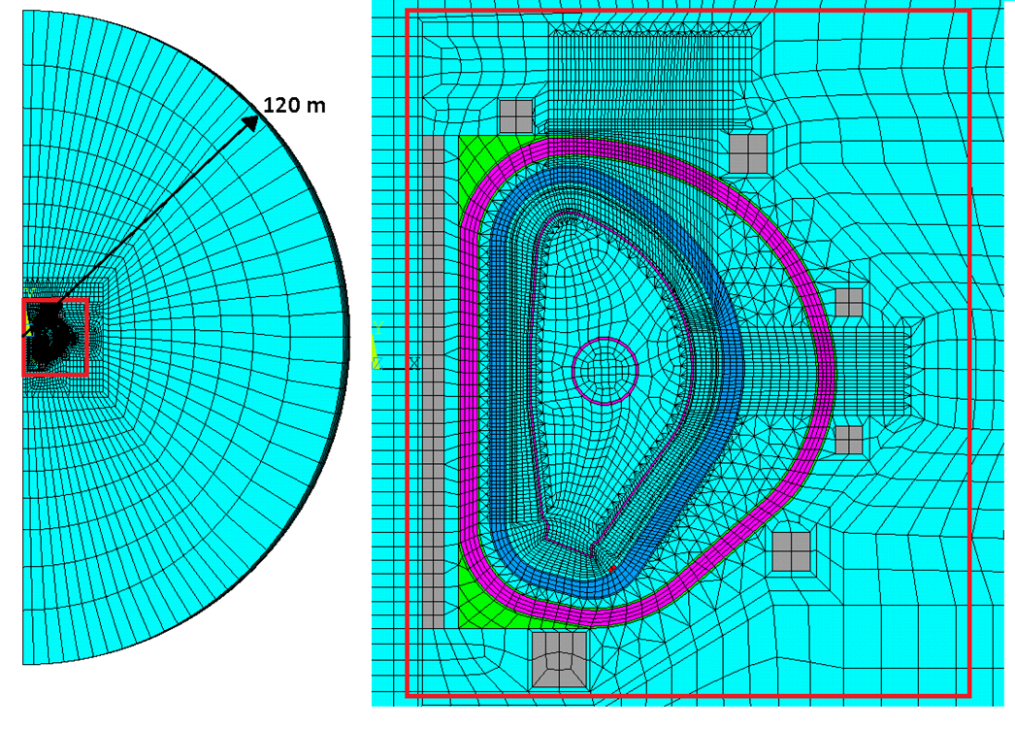
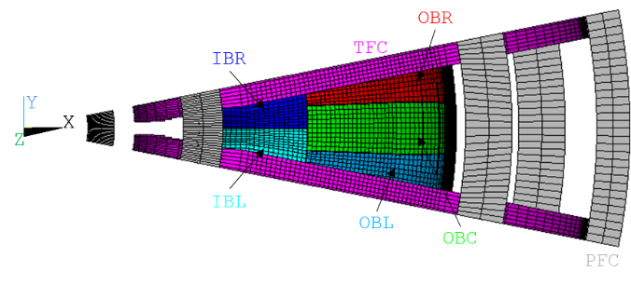
Introduction (2/2)
The evaluation of the EM loads in tokamak reactors is not straightforward and must cope with different problems as:
  the implementation of all sources of magnetic field (including the plasma during its evolution);
  the identification of conductive structures that contribute to the behavior of the eddy currents inside the region of interest;
  a reasonable simplification of the implemented model to reduce the computation time;
  the post-processing of the analysis results in a format useful for the importing in the structural analyses.
All these steps comply with a certain number of assumptions and simplifications that have to be carefully assessed in order to produce reliable results.

Slide 4
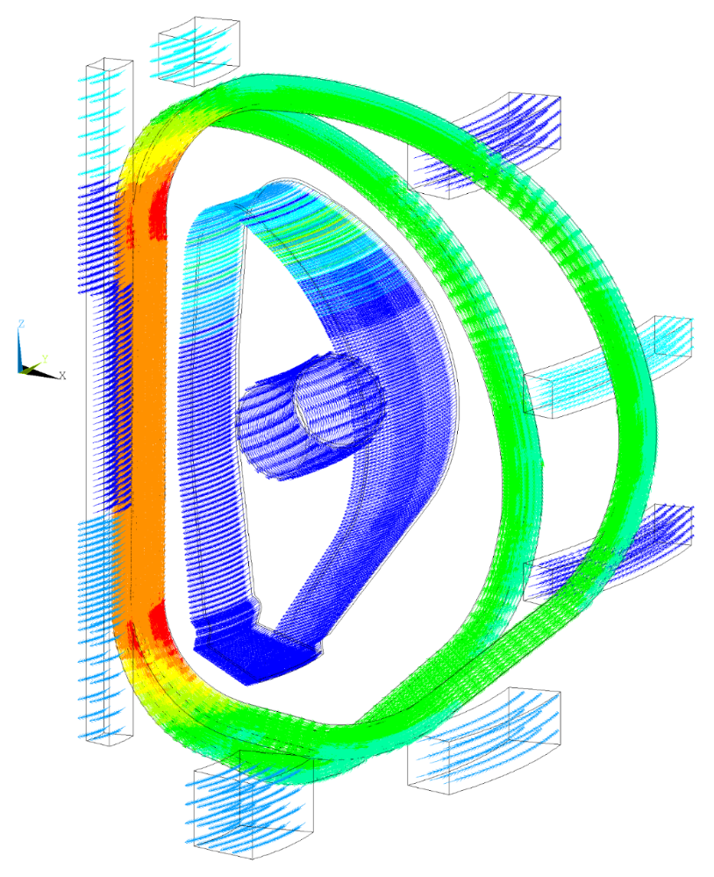
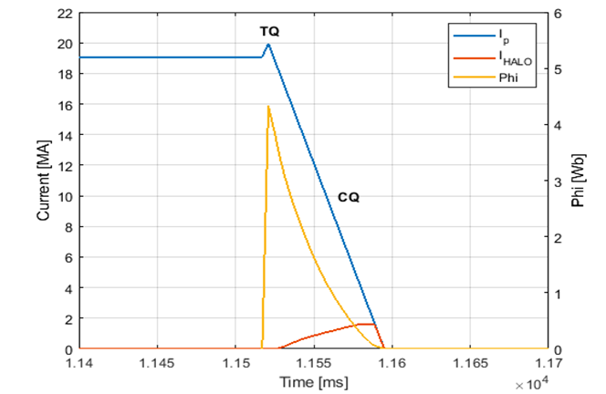
Electromagnetic scenarios
Both normal and off-normal conditions have to be analyzed
For structures that have a considerable amount of EUROFER, “static” ferromagnetic forces can be critical for the design of components as attachment systems.
Current density distribution [A/m²]
Example of plasma integral parameters behavior during a plasma instability (fast VDE-UP)
EM scenario | Characteristic time | Additional information
MD | 74 ms | TQ 4 ms + HC
Fast VDE – UP | 74 ms | TQ 4 ms + HC
Fast VDE – DOWN | 74 ms | TQ 4 ms + HC
Slow VDE – UP | 400 ms | TQ 4 ms + HC
Slow VDE – DOWN | 400 ms | TQ 4 ms + HC
TFCFD | 27 s
PFV
TFV
For what concerns the halo currents, since the plasma input for the EM simulations is 2D axisymmetric, specific methods are implemented to cope with the interpolation of such a data into a 3D structure.

Slide 5
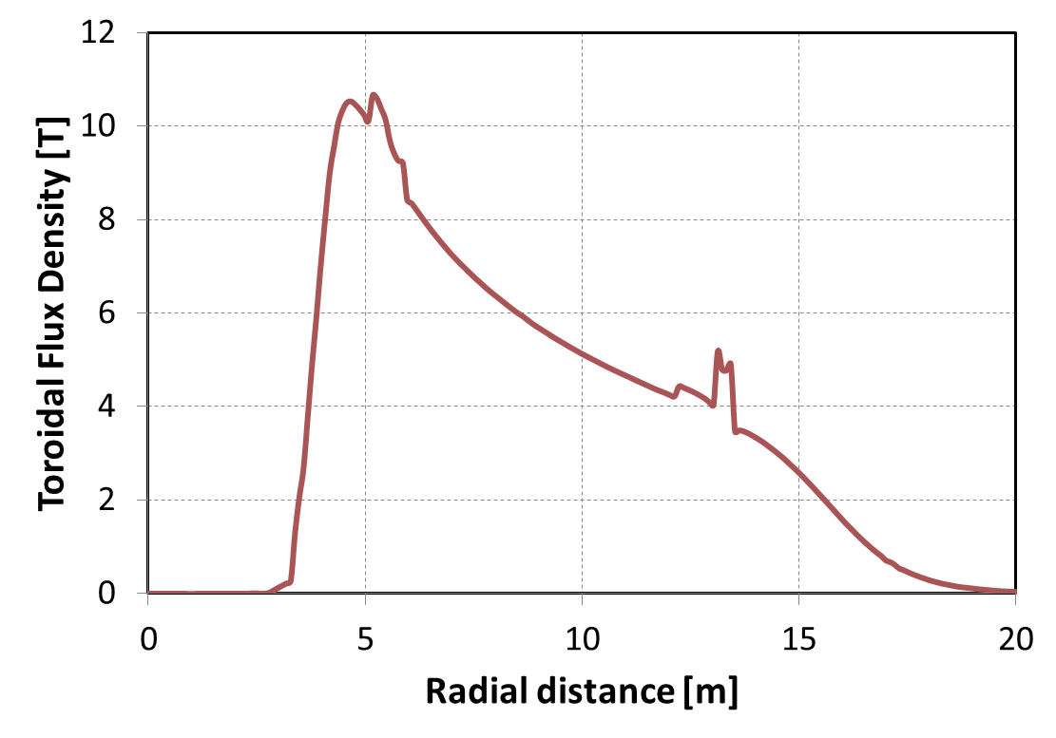
Effect of ferromagnetic materials
Effect of
ferromagnetic
materials
The coils and plasma magnetic field magnetize the structural components made of EUROFER97, generating forces that act during all operational states of the machine.
Additionally, there is an increase in the magnetic field within the region inside the magnetized structures, leading to increased electromagnetic (EM) loads due to eddy currents.

Slide 6
Breeding Blanket
system

Slide 7
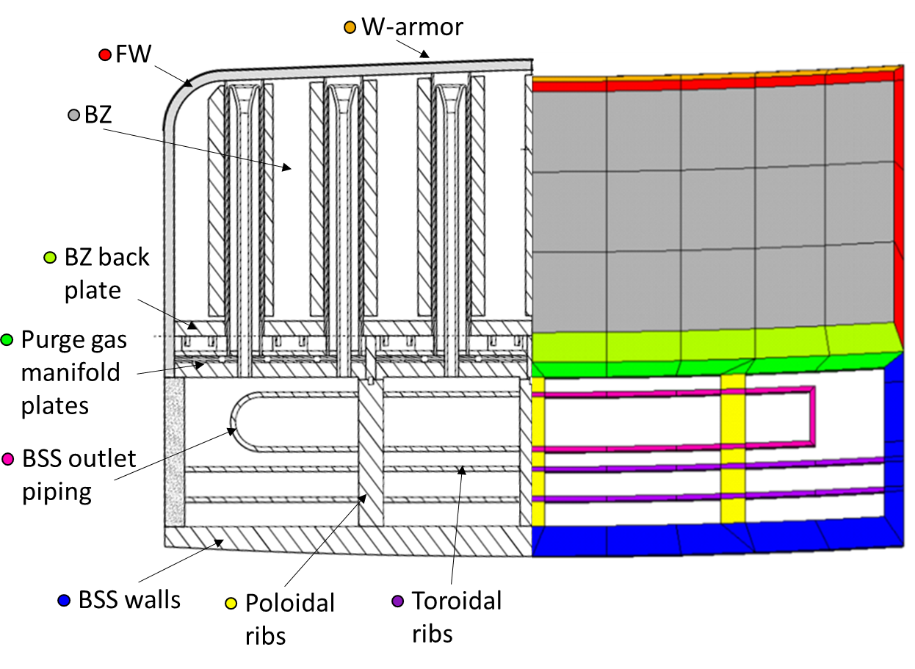
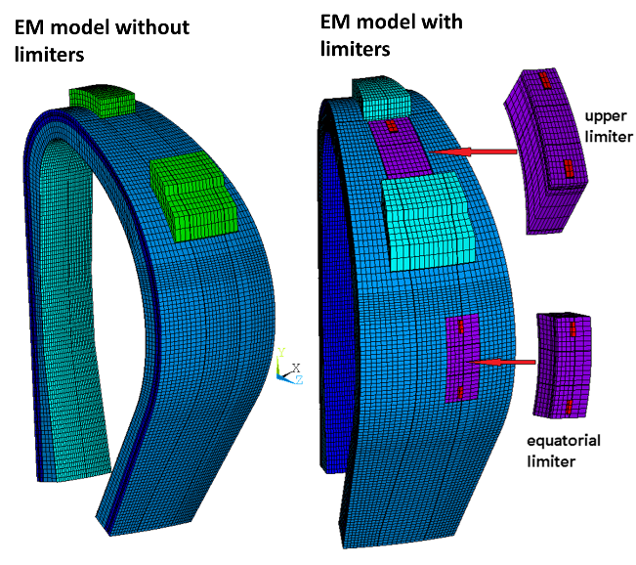
BB EM modeling
Need of implementing homogenized material properties for each defined component in the EM model in order to reduce the computational time.
In order to reduce the model size, only a sector is implemented under the assumption that differences in the other sectors can be, in first approximation, neglected. However, different models have to be implemented in order to evaluate the impact of interface with other systems such as limiters, electron cyclotron, etc.
This is usually an issue when interfacing with structural models.
Comparison between the CAD sketch for the radial-toroidal cross-section of the DEMO 2017 HCPB OBC segment (on the left) and the implemented components in the FEM model (on the right).

Slide 8
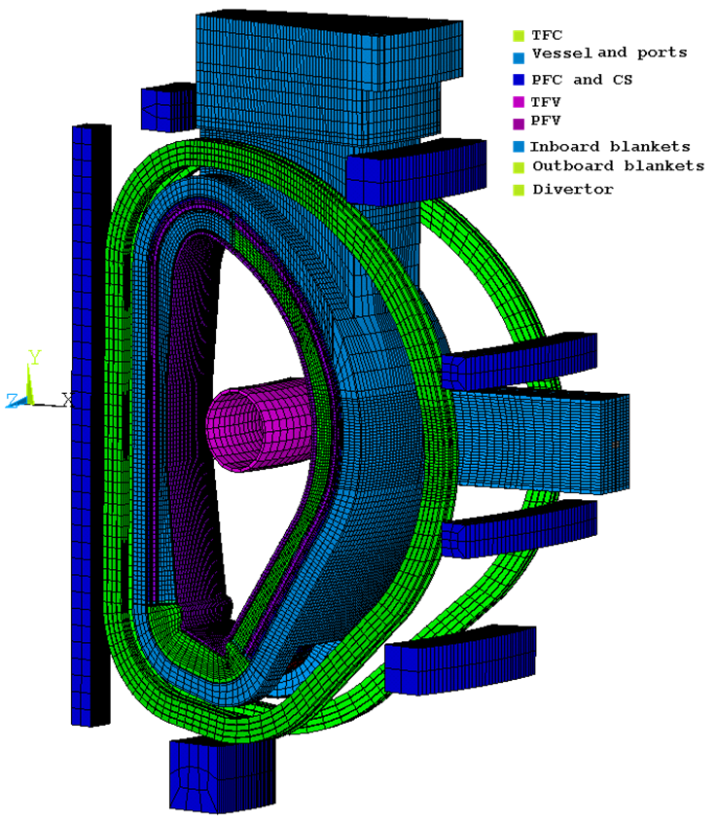
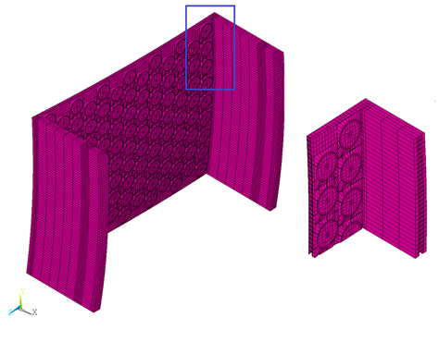
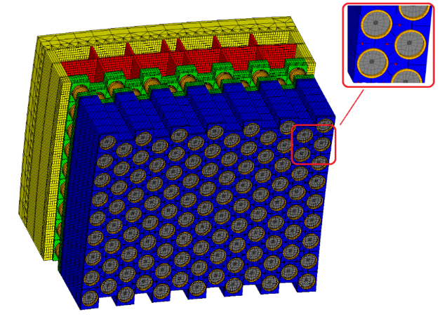
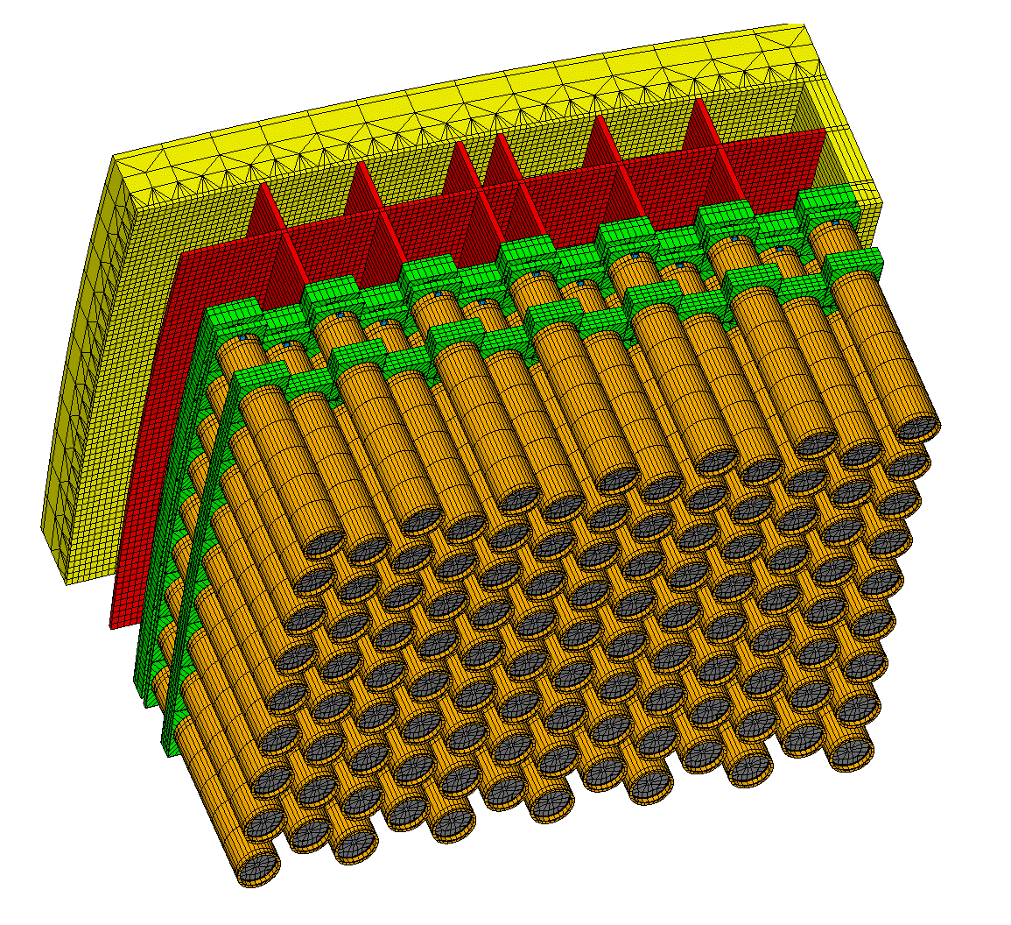
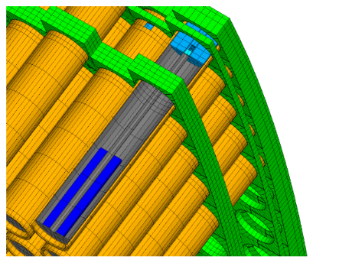
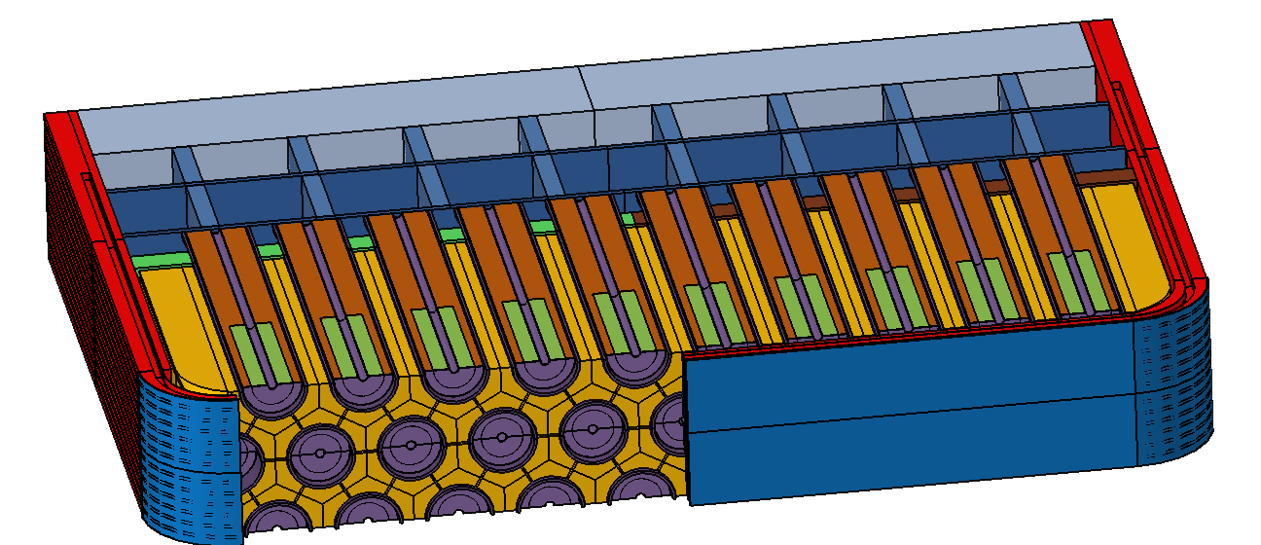
Sub-modeling
Global (coarse) Model
Detailed (sub) Model
BB sub-models are also implemented in order to obtain a more detailed distribution of EM loads inside the complex BB internal structure. However, the implementation of the electromagnetic sub-modeling method strongly depends on the used formulation and, usually, a strong effort is necessary to develop ad-hoc macros.

Slide 9
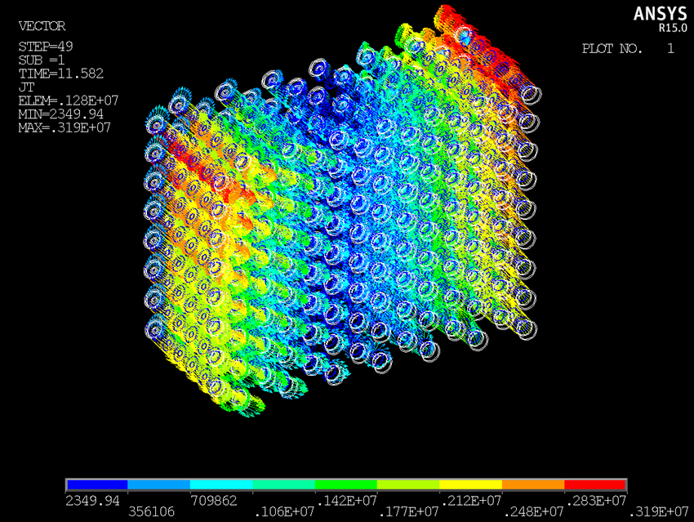
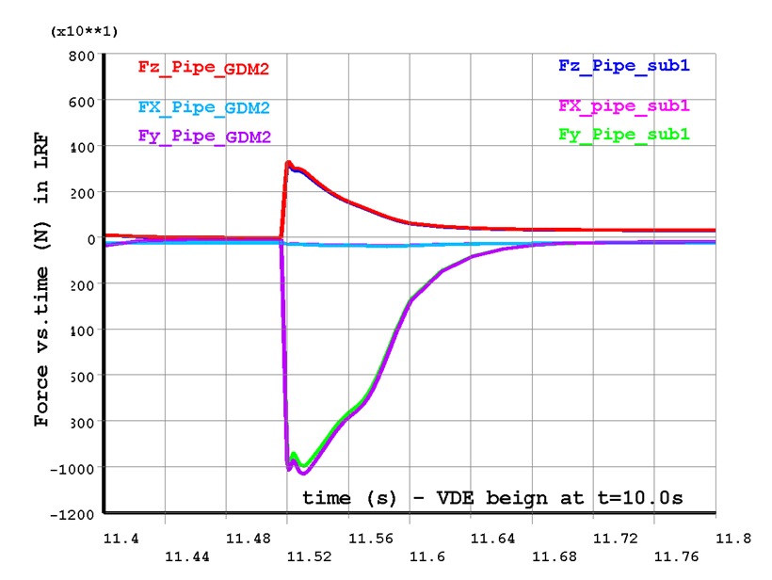
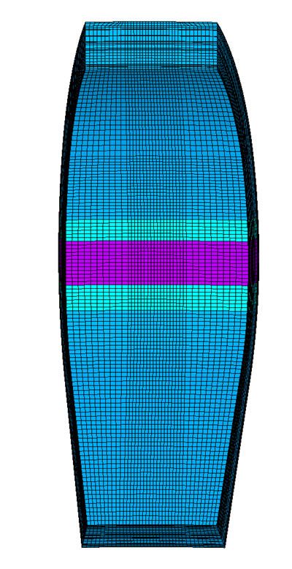
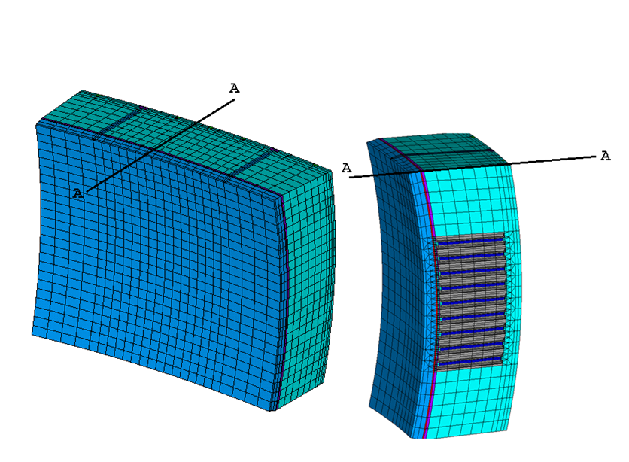
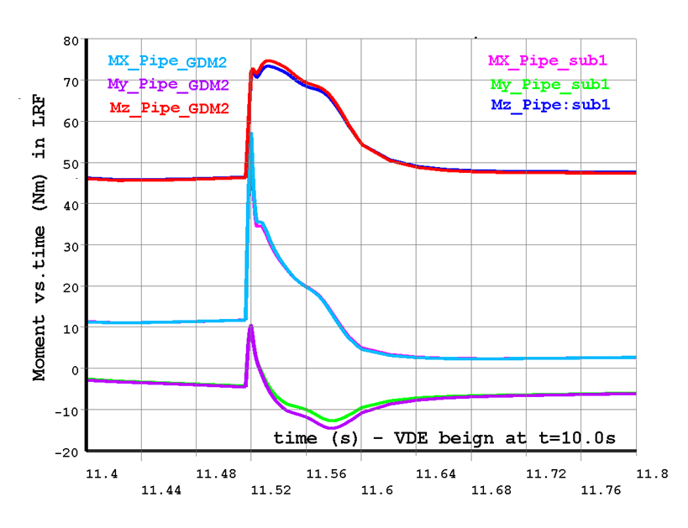
Example of sub-modeling results
Force and Moment resultants on the most loaded BZ pipe - Comparison component by components between SUB-model (SUB1) and Global detailed model (GDM2) results.

Slide 10
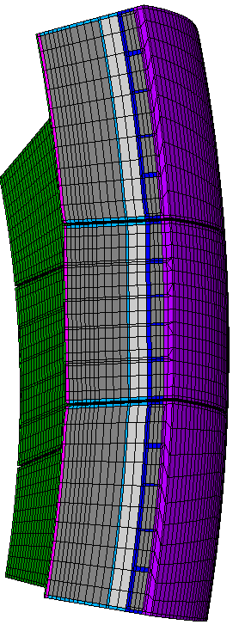
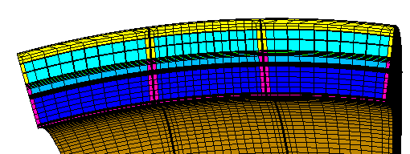
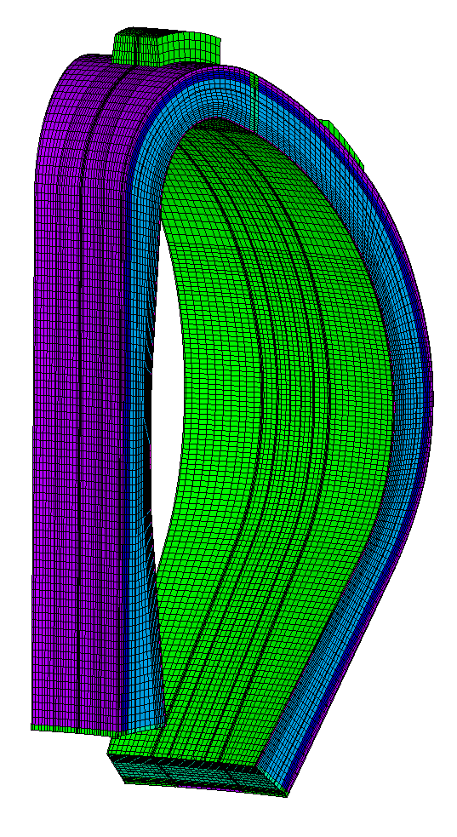
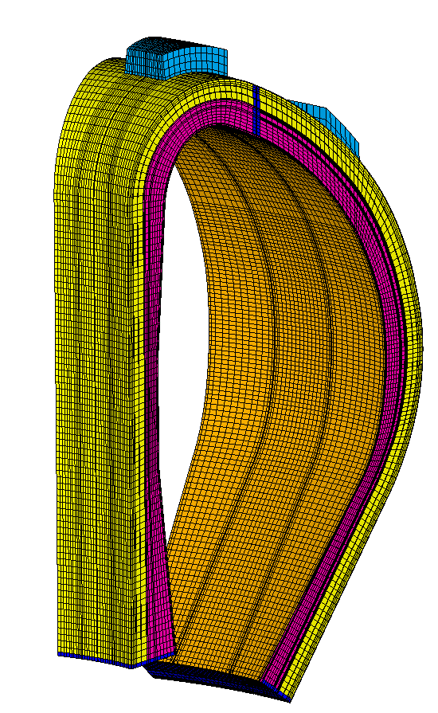
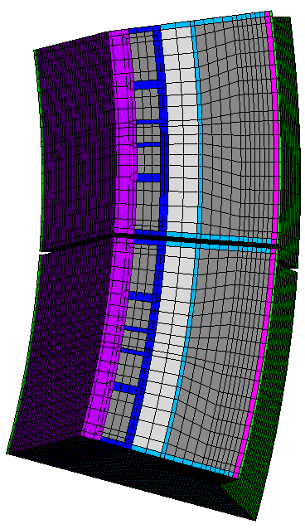
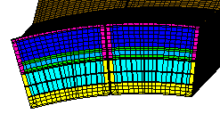
HCPB and WCLL EM models
HCPB
WCLL
HCPB Out-board blanket section
WCLL Outboard blanket sections
HCPB In-board blanket sections
WCLL Inboard blanket sections
Low content of conductive material (mainly EUROFER) inside BZ and manifold
High content of conductive material (mainly PbLi) inside BZ and manifold

Slide 11
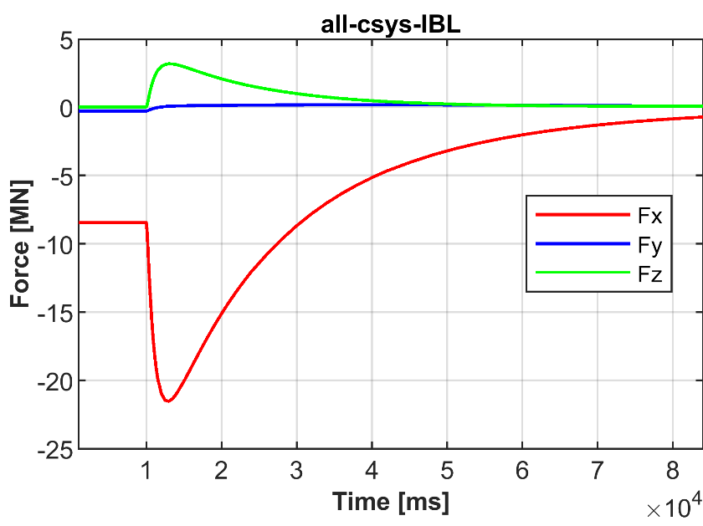
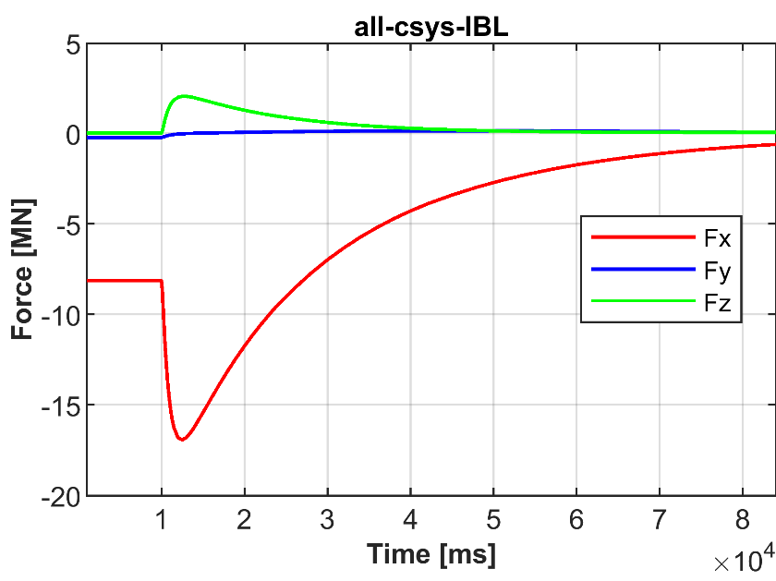
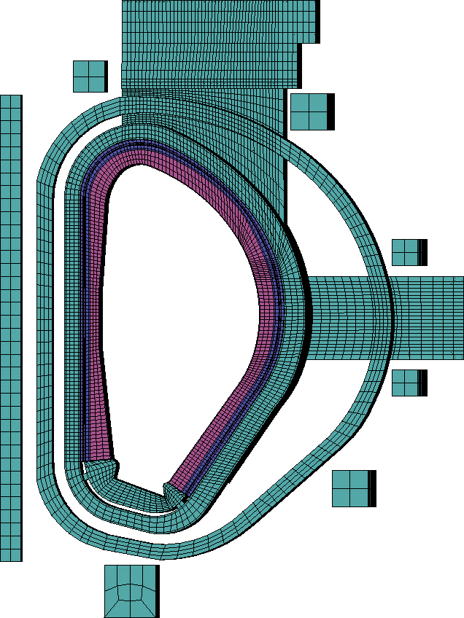
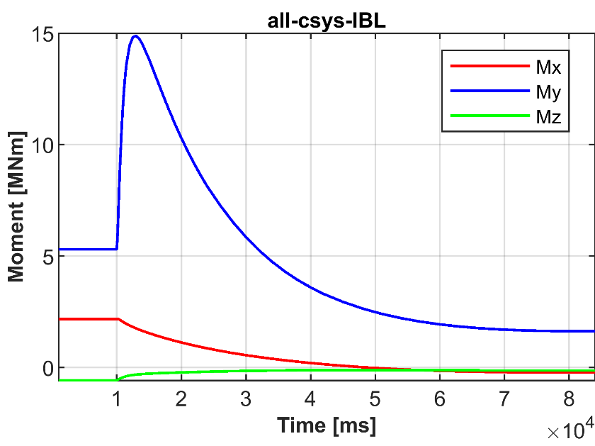
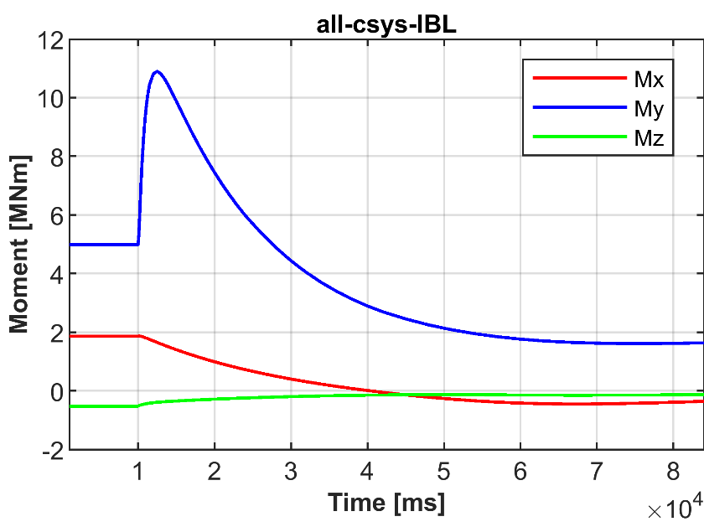
TFCFD 27ms
Exponential decay TF coil current
WCLL
HCPB
F
BT
I

Slide 12
Example: HCPB peak loads during TFCFD
Loads during Flat-top
 | Total loads (ferromagnetic + Lorentz) |  |  |  |  |  | Lorentz loads |  |  |  |  |  | Ferromagnetic loads
COMP | Ftotx [MN] | Ftoty [MN] | Ftotz [MN] | Mtotx [MNm] | Mtoty [MNm] | Mtotz [MNm] | FLorx [MN] | FLory [MN] | FLorz [MN] | MLorx [MNm] | MLory [MNm] | MLorz [MNm] | FFerx [MN] | FFery [MN] | FFerz [MN] | MFerx [MNm] | MFery [MNm] | MFerz [MNm]
IBL | -8.13 | -0.22 | 0.02 | 1.86 | 4.99 | -0.52 | 0.00 | 0.00 | 0.00 | 0.00 | 0.00 | 0.00 | -8.13 | -0.22 | 0.02 | 1.86 | 4.99 | -0.52
IBR | -8.15 | 0.26 | -0.21 | -2.20 | 4.91 | 0.62 | 0.00 | 0.00 | 0.00 | 0.00 | 0.00 | 0.00 | -8.15 | 0.26 | -0.21 | -2.20 | 4.91 | 0.62
OBL | -2.18 | -0.39 | -0.30 | 1.38 | -0.47 | 0.32 | 0.00 | 0.00 | 0.00 | 0.00 | 0.00 | 0.00 | -2.18 | -0.39 | -0.30 | 1.38 | -0.47 | 0.32
OBC | -2.93 | -0.02 | -0.38 | 0.12 | -0.80 | 0.02 | 0.00 | 0.00 | 0.00 | 0.00 | 0.00 | 0.00 | -2.93 | -0.02 | -0.38 | 0.12 | -0.80 | 0.02
OBR | -2.20 | 0.38 | -0.09 | 0.42 | -0.24 | -0.36 | 0.00 | 0.00 | 0.00 | 0.00 | 0.00 | 0.00 | -2.20 | 0.38 | -0.09 | 0.42 | -0.24 | -0.36
Max loads during TFCFD
COMP | Ftotx [MN] | Ftoty [MN] | Ftotz [MN] | Mtotx [MNm] | Mtoty [MNm] | Mtotz [MNm] | FLorx [MN] | FLory [MN] | FLorz [MN] | MLorx [MNm] | MLory [MNm] | MLorz [MNm] | FFerx [MN] | FFery [MN] | FFerz [MN] | MFerx [MNm] | MFery [MNm] | MFerz [MNm]
IBL | -16.93 | -0.22 | 2.05 | 1.87 | 10.89 | -0.52 | -10.48 | 0.23 | 2.31 | -0.07 | 6.99 | 0.07 | -8.13 | -0.24 | -0.26 | 1.86 | 4.99 | -0.52
IBR | -16.89 | 0.57 | 1.84 | -2.44 | 11.09 | 0.71 | -10.41 | 0.31 | 2.32 | -0.49 | 7.28 | 0.16 | -8.15 | 0.27 | -0.47 | -2.20 | 4.91 | 0.62
OBL | -2.18 | -0.48 | -0.43 | 1.38 | -2.03 | 0.32 | 2.82 | -0.08 | 0.28 | -1.28 | 0.24 | -0.04 | -2.61 | -0.41 | -0.43 | 1.38 | -2.06 | 0.34
OBC | -2.93 | -0.03 | -0.47 | -1.18 | -2.91 | -0.07 | 3.27 | 0.00 | 0.44 | -1.37 | 1.72 | -0.11 | -3.44 | -0.03 | -0.48 | 0.31 | -2.93 | 0.04
OBR | -2.20 | 0.42 | -0.38 | -0.62 | -1.95 | -0.41 | 2.74 | 0.01 | 0.27 | -1.40 | 0.09 | -0.02 | -2.63 | 0.41 | -0.39 | 1.02 | -1.94 | -0.39

Slide 13
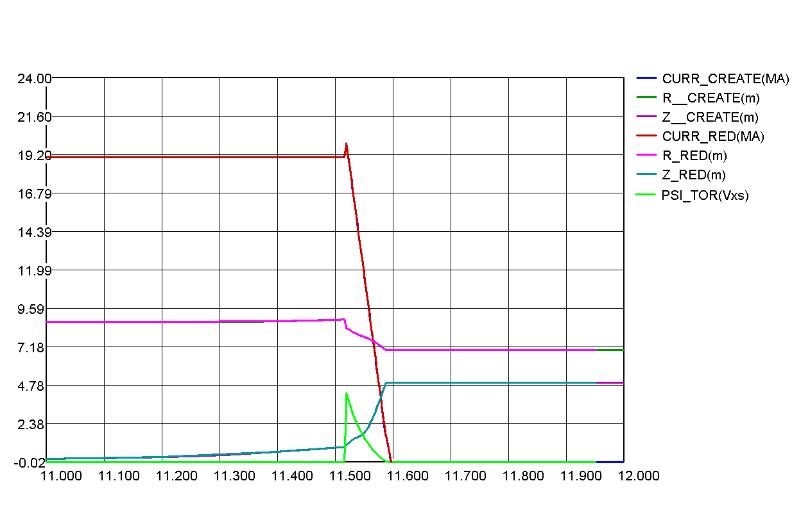
Plasma disruptions: general overview
TQ
I_{p}
Only Lorentz contribution
R_{p}
Psi_{tor}
Z_{p}
Slow plasma movement
CQ
No plasma

Slide 14
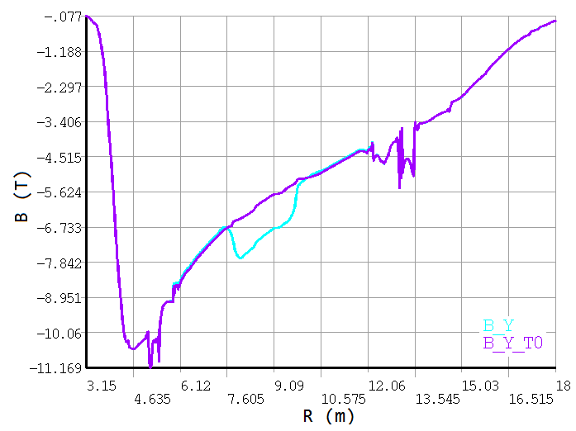
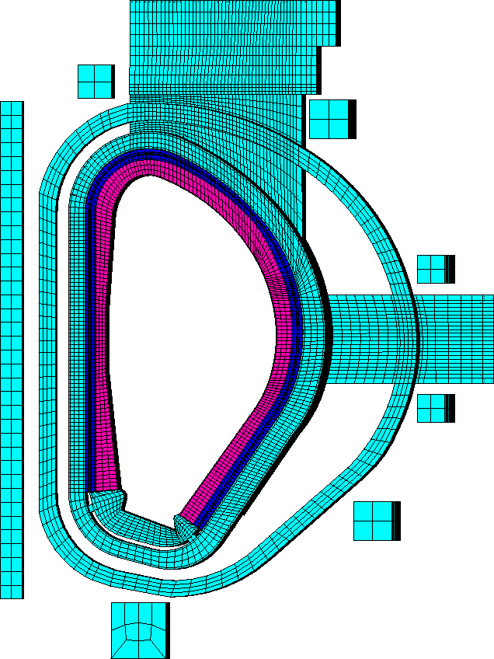
Plasma disruptions : variation of toroidal magnetic flux
TQ
Variation of the toroidal magnetic flux
I_{p}
R_{p}
Z
I
F
Y
X
BT
Psi_{tor}
Z_{p}
Slow plasma movement
CQ

Slide 15
Plasma disruptions: Variation of the plasma poloidal current
TQ
Variation of the plasma toroidal current
I_{p}
Variation of the poloidal magnetic flux
R_{p}
Psi_{tor}
Z_{p}
Eddy current loops within the BB segments toroidal/radial cross-section
Slow plasma movement
CQ

Slide 16
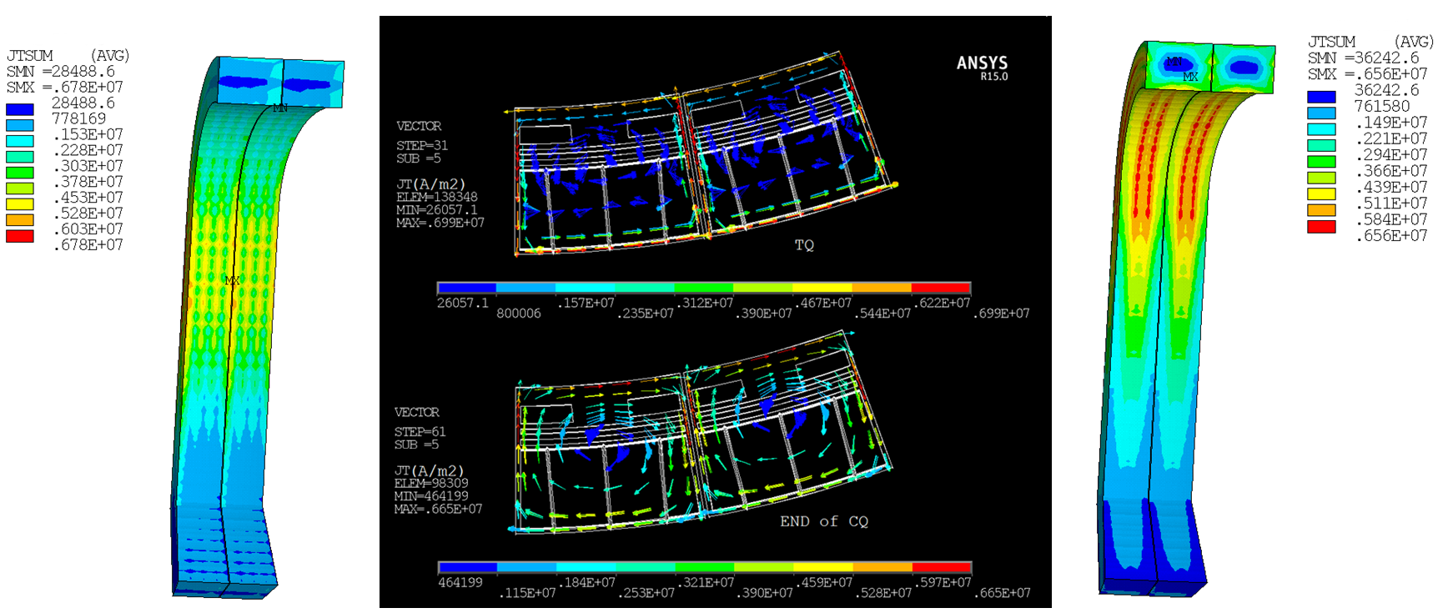
Plasma disruptions: Variation of the plasma poloidal current

Slide 17
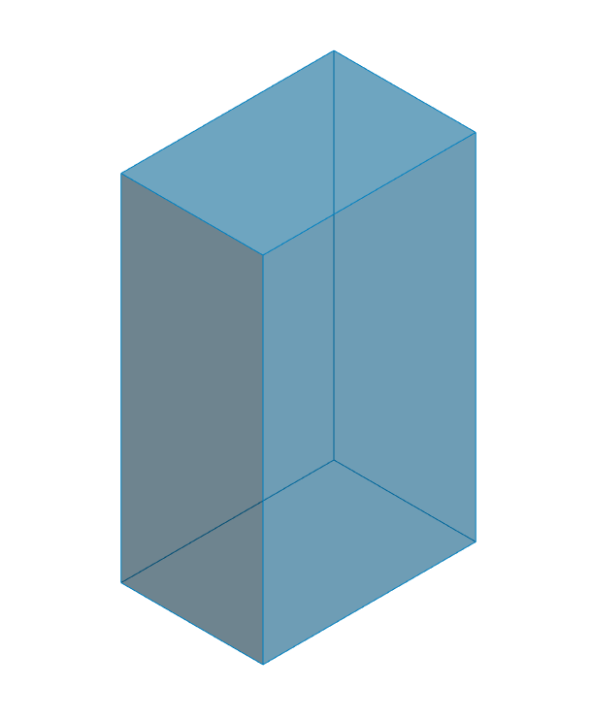
Plasma disruptions: EM loads peaks comparison
MDDW74ms
HCPB - IBL
Force [MN] - Moment [MNm]
F
eddy
B
F

Slide 18
Limiter system

Slide 19
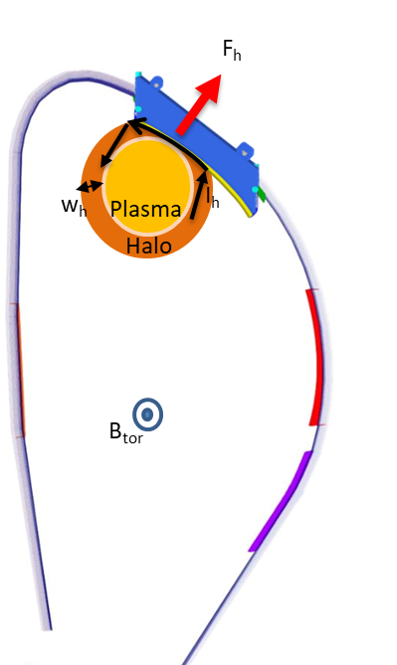
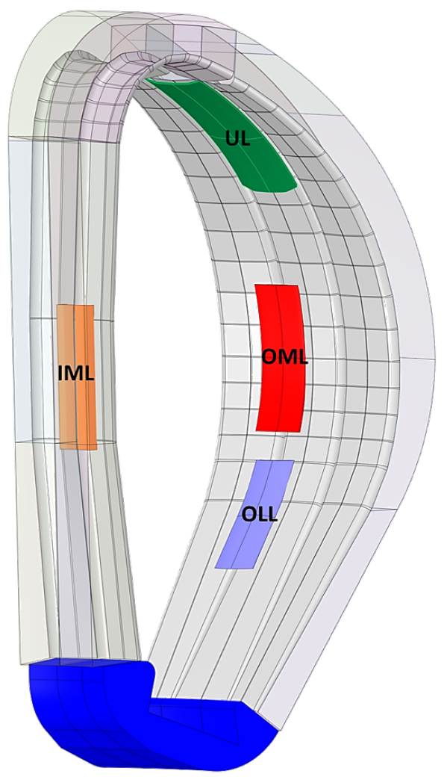
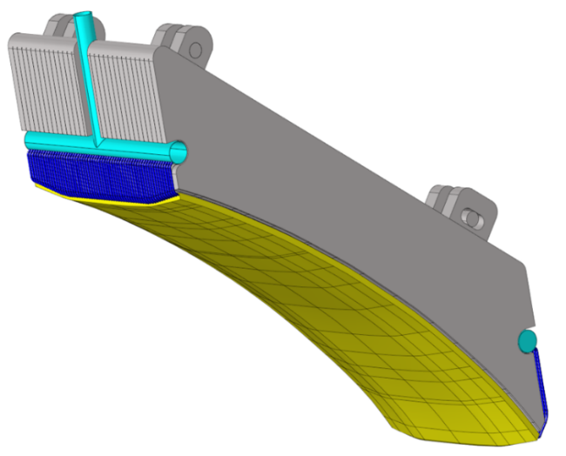
Limiter system
Shielding Block
(SB)
Plasma Facing Wall
(PFW)
Two possible designs have been investigate:
Full SB
Sliced SB

Slide 20
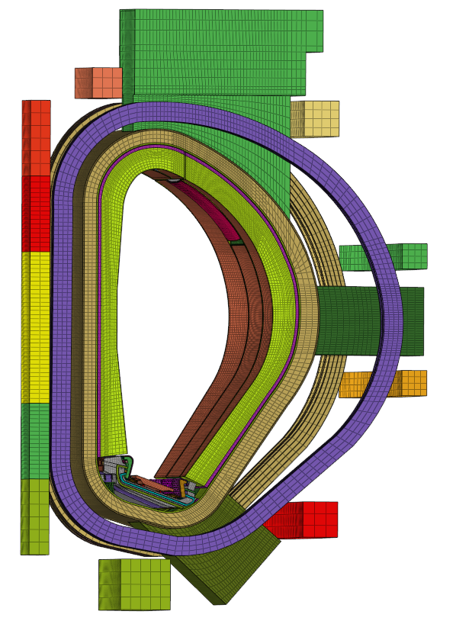
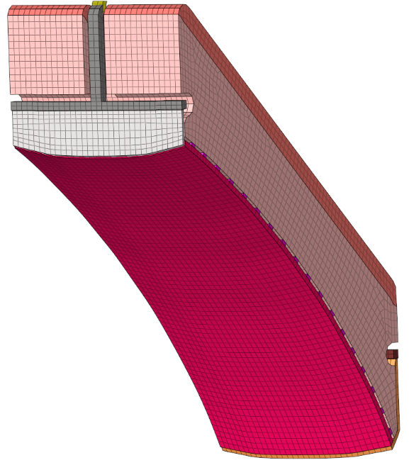
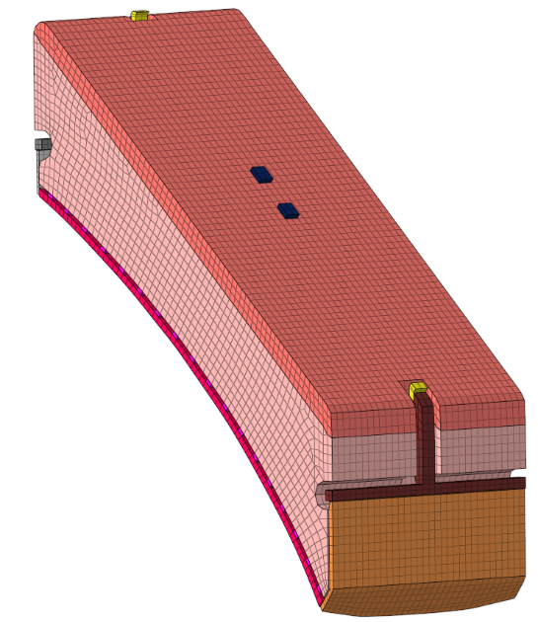
Electromagnetic FEM model
SB_TILES
Schilding block inner part
CONN
Electrical connection with port plug
MANIFOLD
FPW pipes manifold
SB_ISO
Shielding block manifold
COOL_PIPES
FPW pipes (without tungsten tiles)
FPW
Plasma facing wall
PFW_CONN
Connections between PFW and SB_TILES
Equivalent Material properties (full and sliced box)
Component name | Material | Temperature (°C) | ρx (µΩ m) | ρy (µΩ m) | ρz (µΩ m)
CONN | SS316 | 320 | 0.95 | 0.95 | 0.95
FPW_CONN | EUROFER97 | 320 | 0.85 | - | 0.85
FPW | CuCrZr | 150 | 0.48 | - | 0.48
SB_ISO | EUROFER97 | 320 | 1.01 | 1.01 | 1.01
COOL_PIPES | SS316 | 150 | 0.70 | - | 0.70
MANIFOLD | SS316 | 150 | 3.11 | 3.11 | 3.11
SB_TILES (full box) | EUROFER97 | 350 | 1.05 | 1.05 | 1.05
SB_TILES (sliced box) | EUROFER97 | 350 | 1.05 | - | 1.05

Slide 21
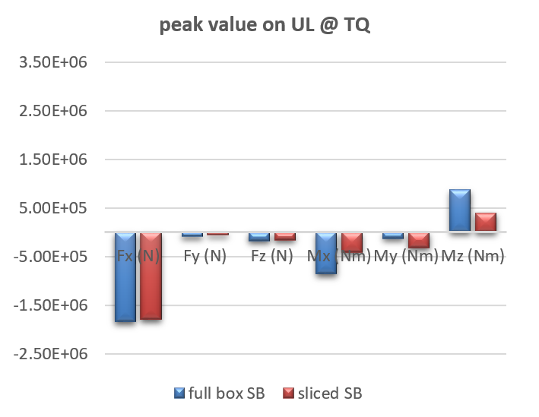
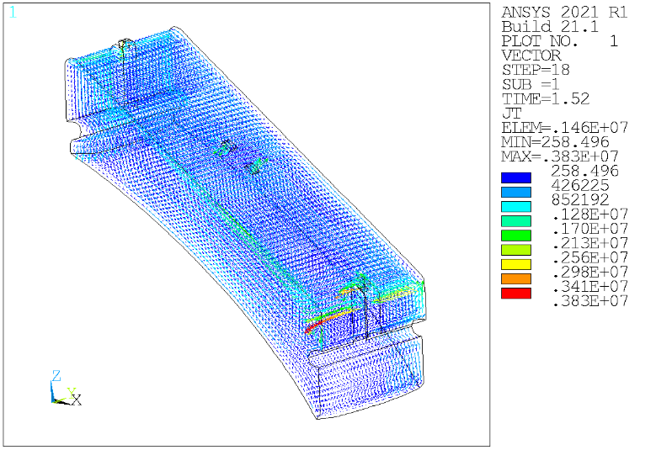
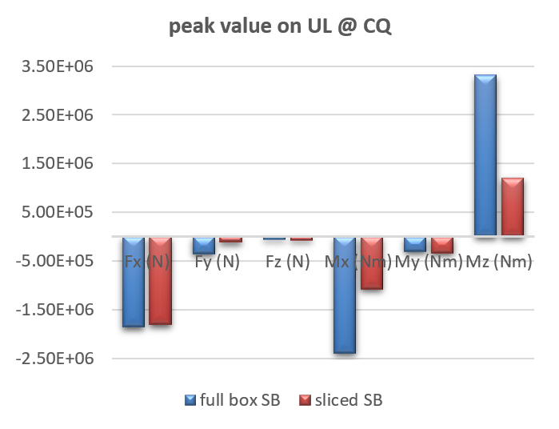
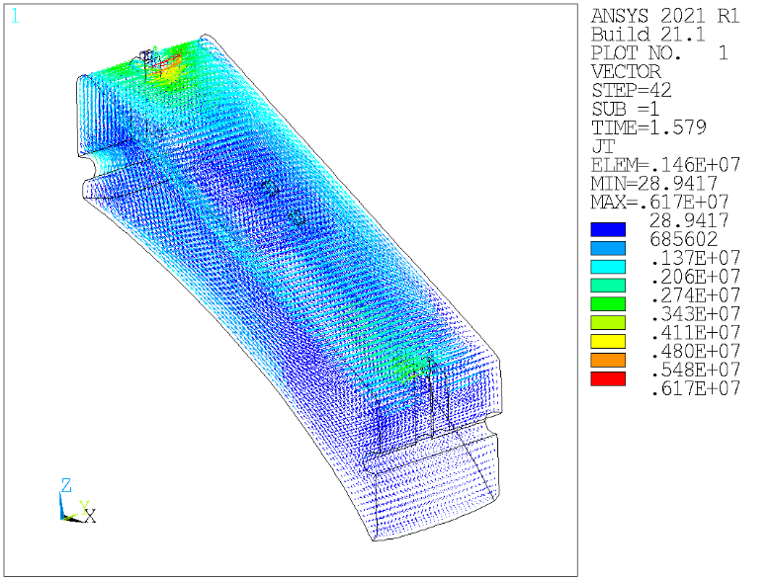
EM loads: peak values during TQ and CQ
During the TQ, the main eddy currents flow in the vertical-poloidal direction.
Since the sliced SB configuration only introduces minimal effects on the poloidal current path, the forces for both configurations are quite similar.
On the other side, moments are almost low (if compared with that produced during the CQ ) due to the lower plasma poloidal flux variation.
TQ
During the CQ, a general reduction of loads, mainly the moment, happens in sliced configuration. In this time range, the loads are due to poloidal magnetic flux variation, that generates current loops into the SB structures.
In sliced SB configuration, eddy current loops are cut due to the presence of the gaps between the slices. This reduces the moment by ~60%.
CQ

Slide 22
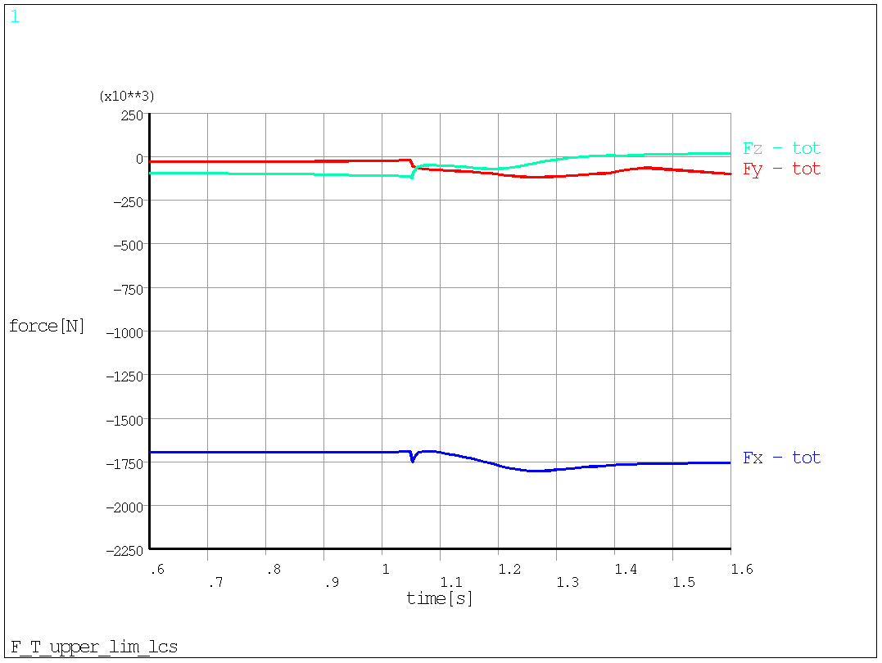
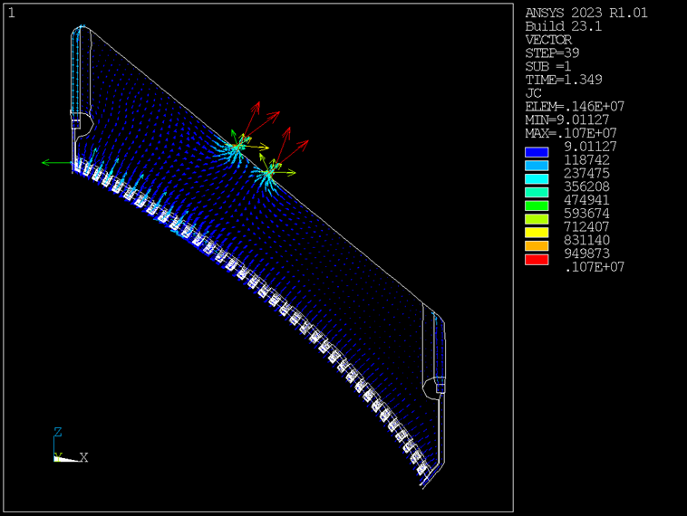
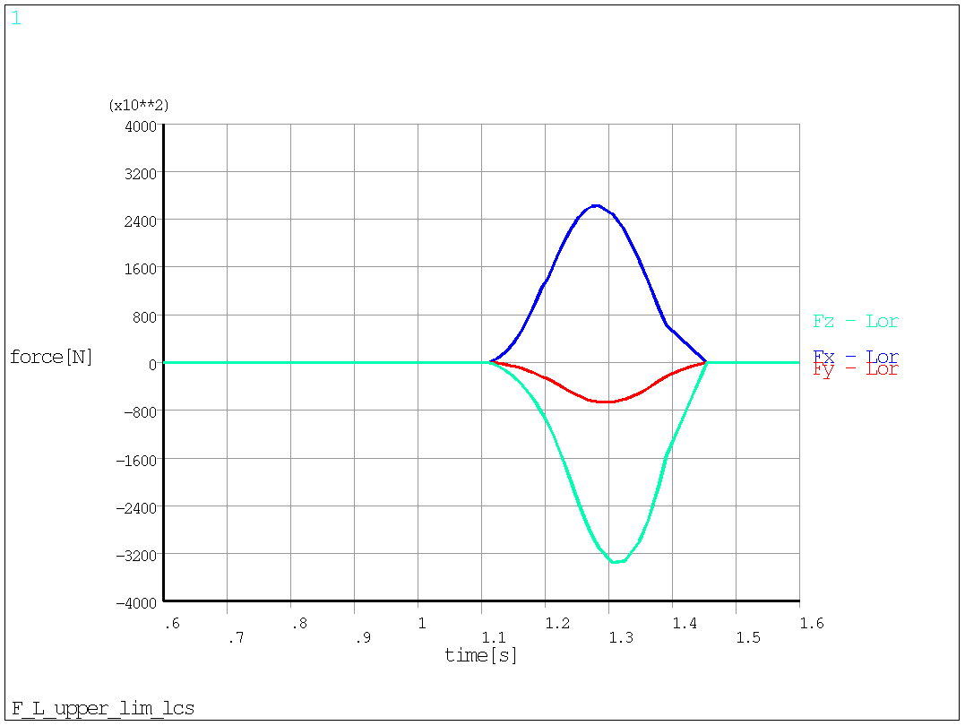
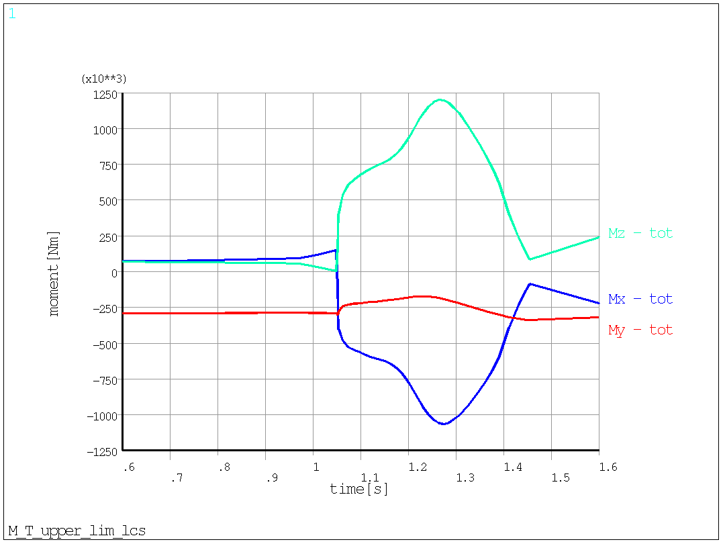
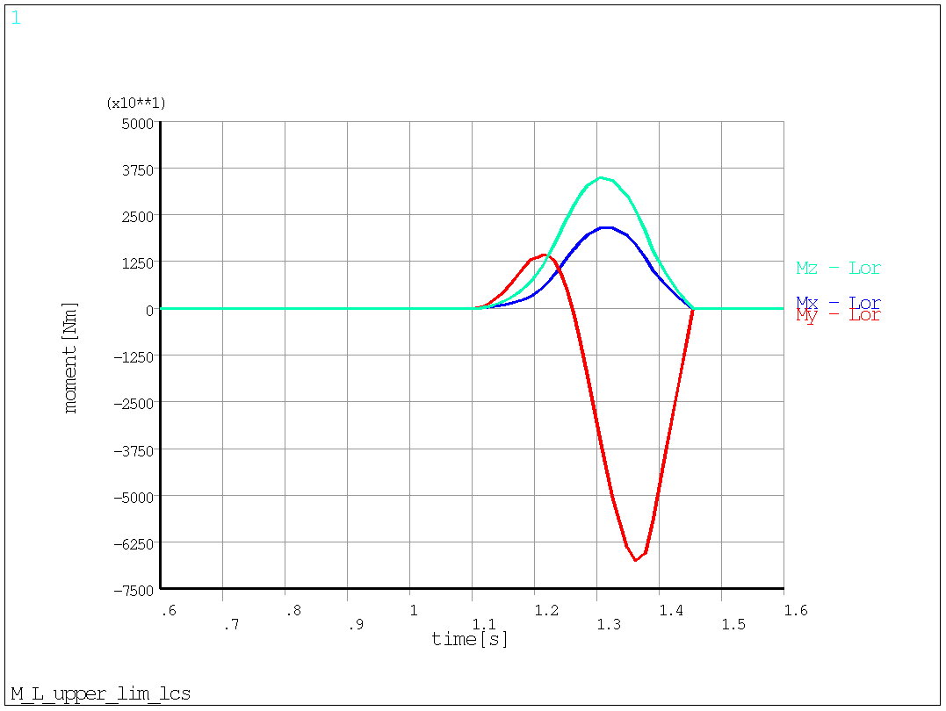


EM loads: HC contribution
Force due to ferromagnetic, PFV, and TFV
Force due to HC
(no ferromagnetic contribution)
TOTAL LOADS
Moment due to ferromagnetic, PFV, and TFV
Moment due to HC
(no ferromagnetic contribution)

Slide 23
Outlook
The electromagnetic (EM) loads have been computed for various in-vessel components (IVCs) and across different electromagnetic transients.
During both normal and off-normal conditions, EM loads act on IVCs due to the presence of ferromagnetic material (EUROFER) and the interaction of eddy and halo currents with the magnetic field.
The intensity and behavior of these loads heavily rely on the specific EM scenario considered, the design of the components, and their electrical connections with other structures.
Within EUROfusion, significant efforts have been devoted to establishing methodologies for conducting consistent EM analyses. Continuous attention is given to enhancing the models utilized to assess EM loads during various electromagnetic transients.
In terms of interfacing with structural analyses, integrating EM loads, especially those arising from ferromagnetic materials, into structural models presents challenges. This is primarily due to discrepancies resulting from differing model approximations, leading to a lack of direct mesh correspondence.
Thanks for your attention!

