Slide 1
In-Vessel Components Integration Design of BEST
X. PENG, M. Lei, X. Huang, Z. Wang, P. Liu,
K. Chen and BEST Team
with fruitful discussion with EU-DEMO Team
pengxb@ipp.ac.cn

Slide 2
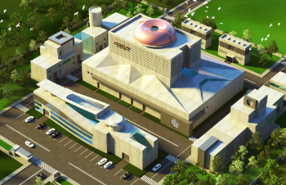
IVC layout and design requirements
Divertor
Shielding blanket
Vertical stabilization system
In-vessel diagnostic integration
Assembly procedure
Summary
CONTENTS

Slide 3
Part 01
IVC Layout and Design Requirements

Slide 4
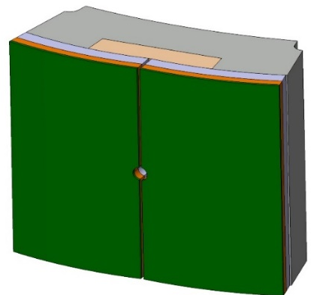
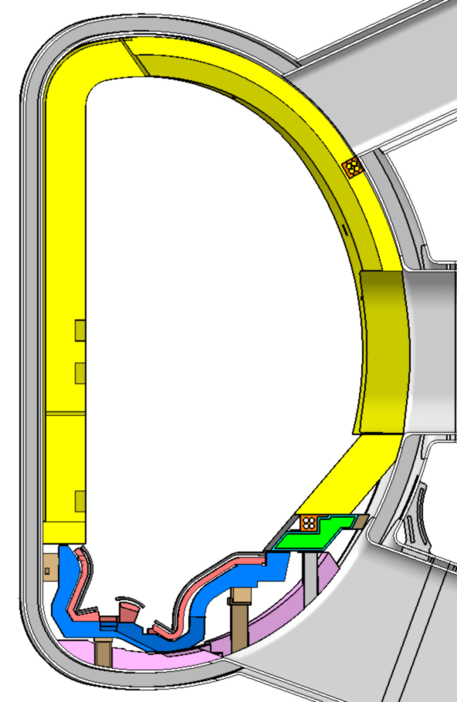
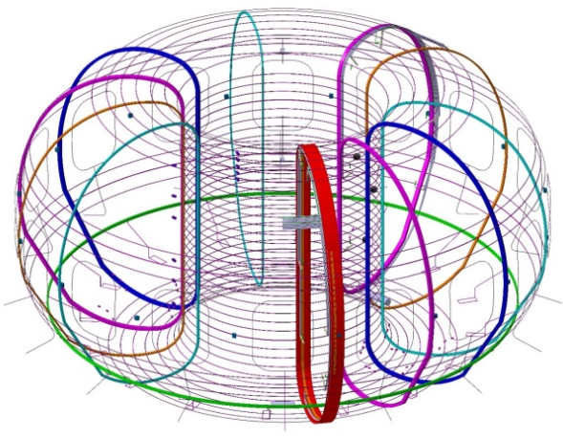
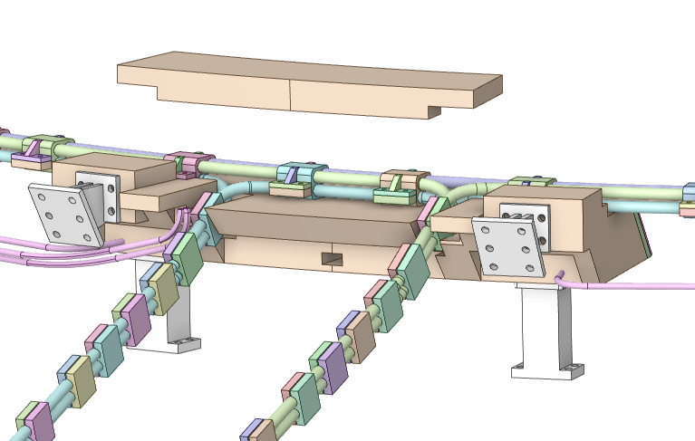
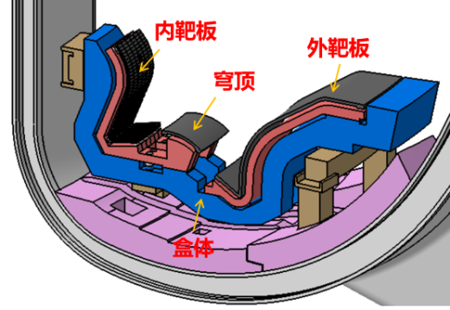
Functions required and Poloidal layout
Functions | Engineering
Heat and particle exhaust: 10MW/m², 63Pam³/s in SS | Divertor (in blue) (PFU~15MW/m²), 8 cyropumps in the lower ports
Neutron shielding for VV and TF coils | Shielding blanket (in yellow), passive stabilization plate and shielding structure below the divertor
Plasma vertical stabilization control: m_s≥0.2 | Vertical stabilization coil (in brown) and passive stabilization plate (in green)
Diagnostics for machine safety, operation and physics study | 28 sets for measuring 43 physical parameters Dozens of in-vessel diagnostics need to be integrated with IVC
Shielding blanket
In-vessel diagnostic
Vertical stabilization system
Divertor

Slide 5
Main design requirements / guidelines
Utilize mutual and reliable technologies for IVC, to realize the functions required from physics.
Fast implementation in 3-4 years into BEST .
Robust to sustain various loads in fusion power of SS 20 MW and 5-10 s 200 MW, the I_{p} of 7.3 MA.
Baking @ 190 °C (divertor @ 240 °C ).
Vacuum quality class 1, quality control class 1.
Remote handling compatible from plasma side for Divertor PFCs, First Wall in shield blanket and passive stabilization plate.
Other components are design for life in BEST

Slide 6
Part 02
Divertor

Slide 7
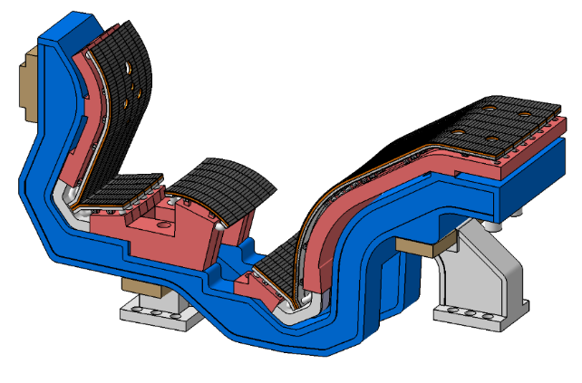
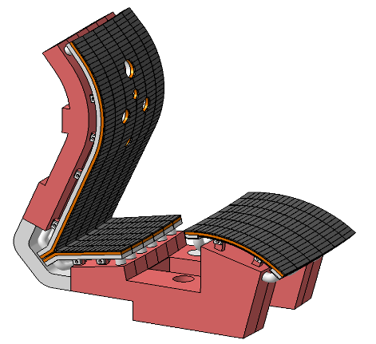
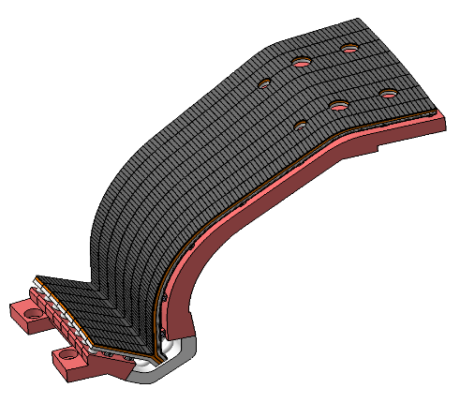
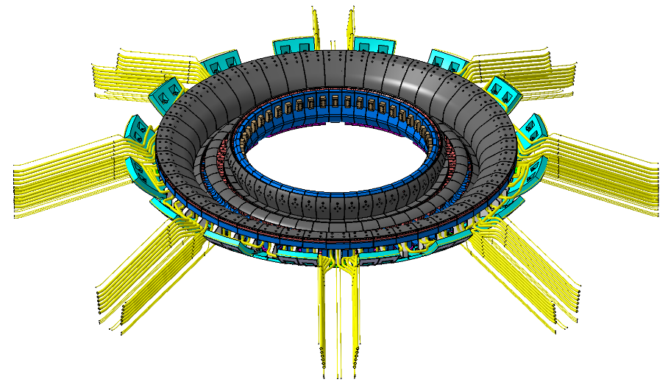
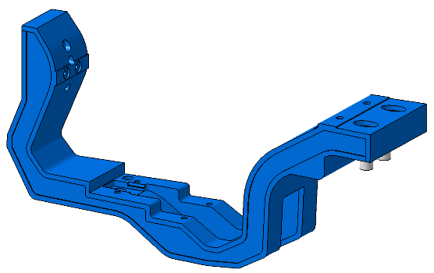
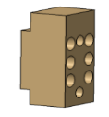
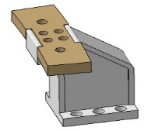
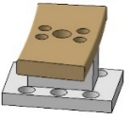
Divertor overall design
48 divertors in toroidal, 7.5° for one module.
RH maintenance for PFCs.
PFU: monoblock (strike zone) combined with flat-type，heat flux removal capability of 15 MW/m² .
3 SS supports to connect VV with bolts.
Main parameters for one module
Toroidal | 7.5°
L/W/H | 2.01×(0.28-0.53)×1.02 m
Weight | ~1.6t
Design heat flux | 15 MW/m²
Divertor module
Inner Target
DOME
Outer Target
Cassette
Support
One PFU

Slide 8
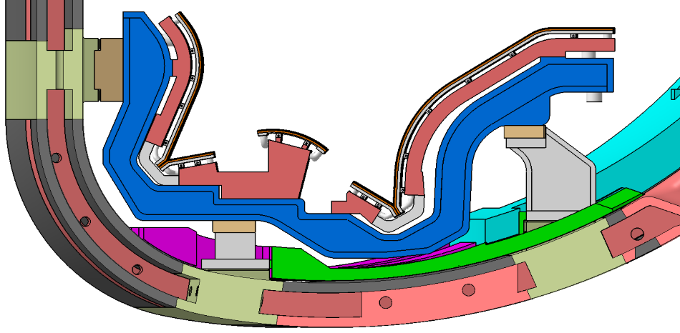
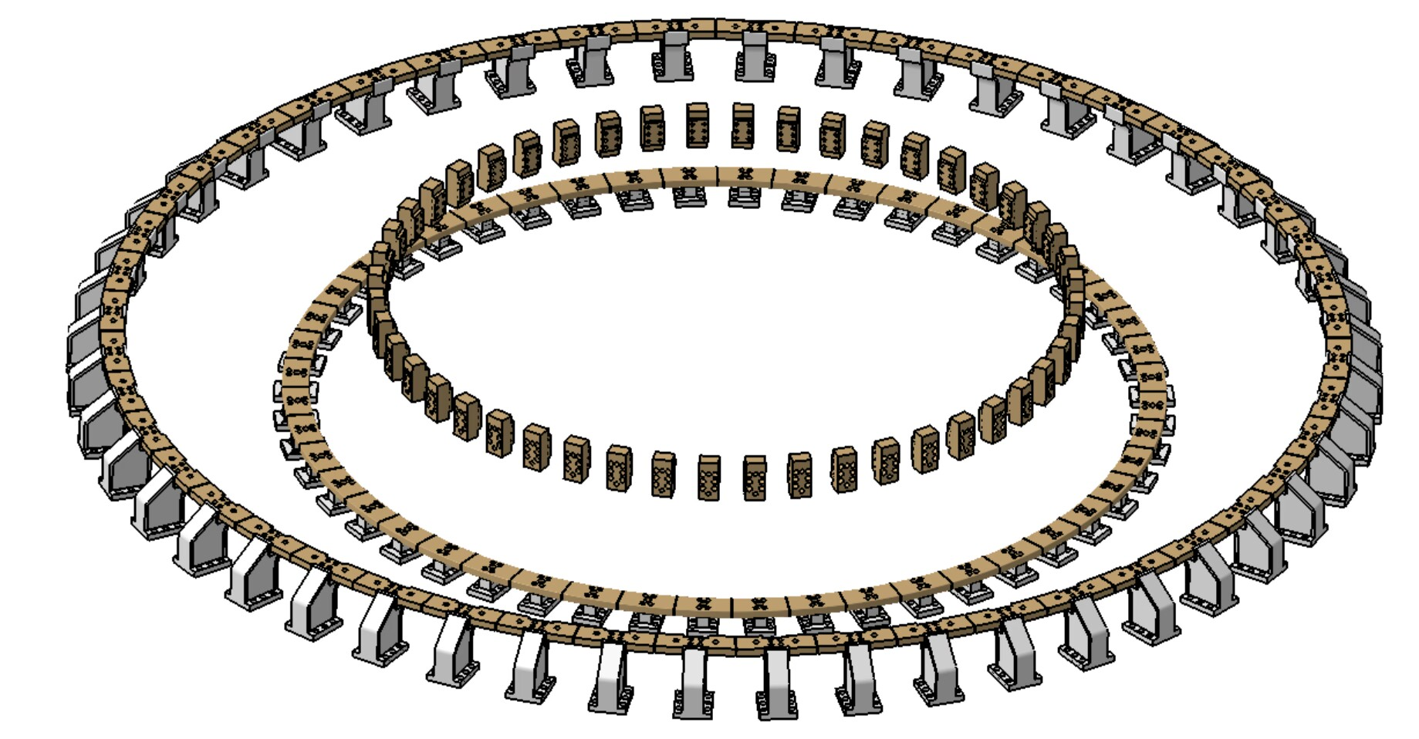
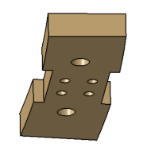
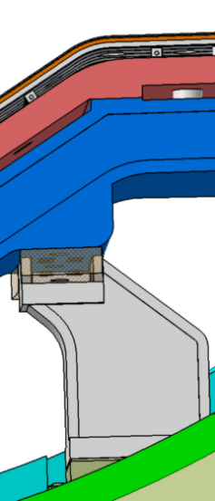
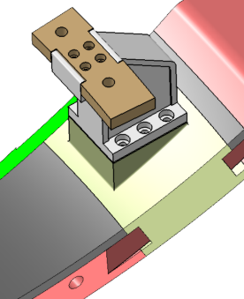
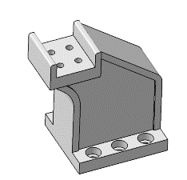
Divertor supports
Assembly and installation
2xM36
3 supports;
CB fixed to supports by bolts;
Customed compensation.
2xM30
Surface machining
M45
Surface machining
Divertor and supports
Compensation
M20x4
Bolt M36
Surface machining
Compensation
M24x6
VV supprot
VV

Slide 9
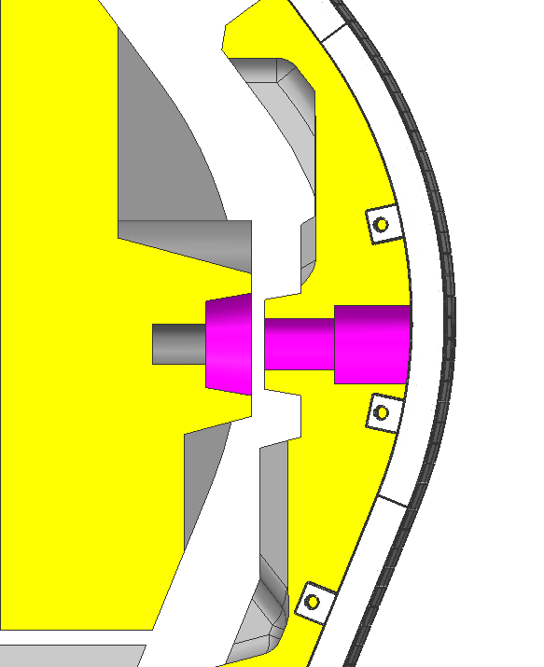
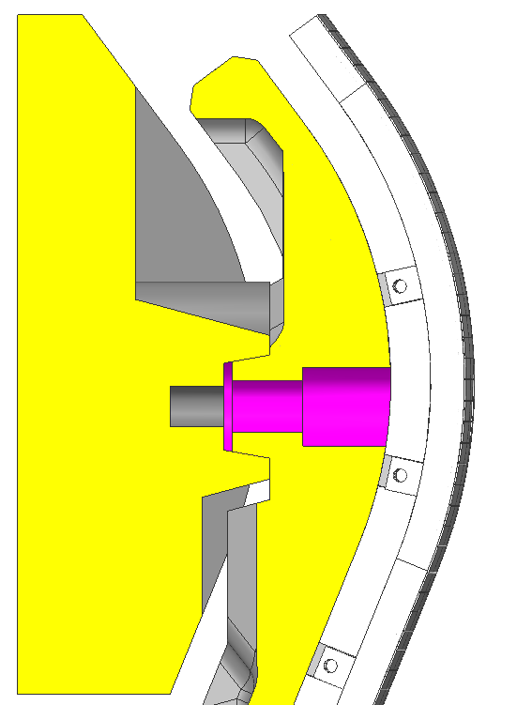
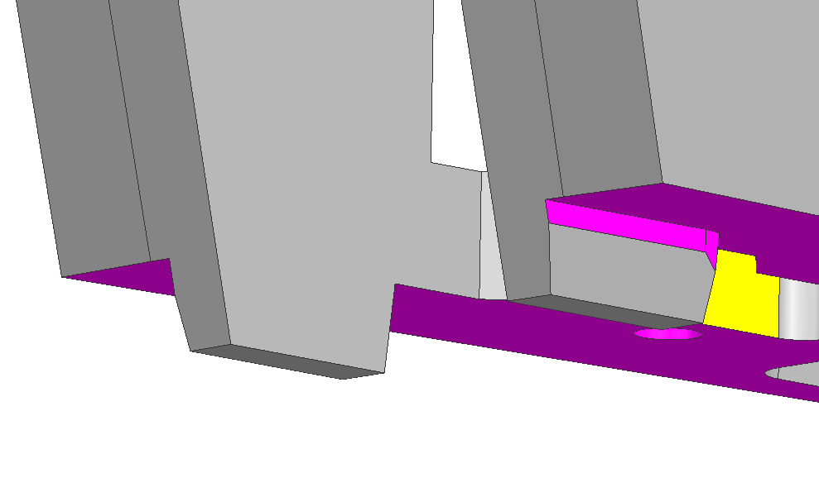
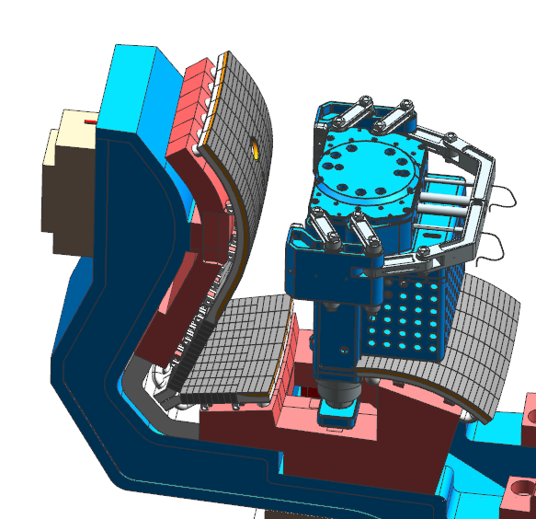
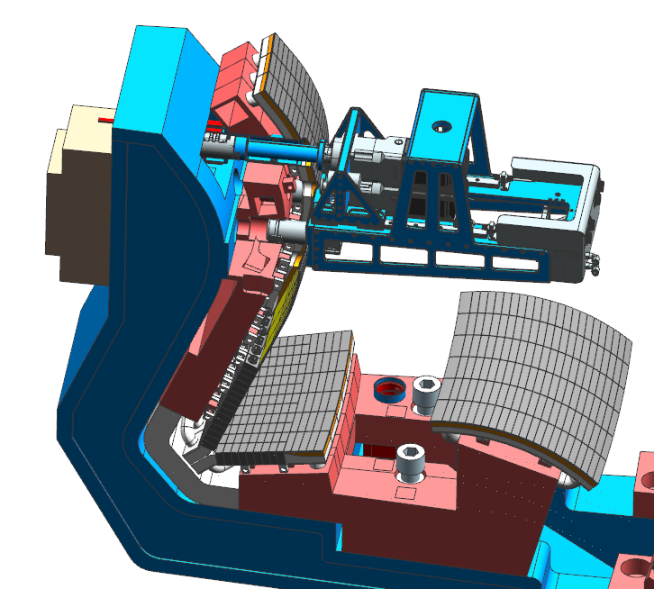
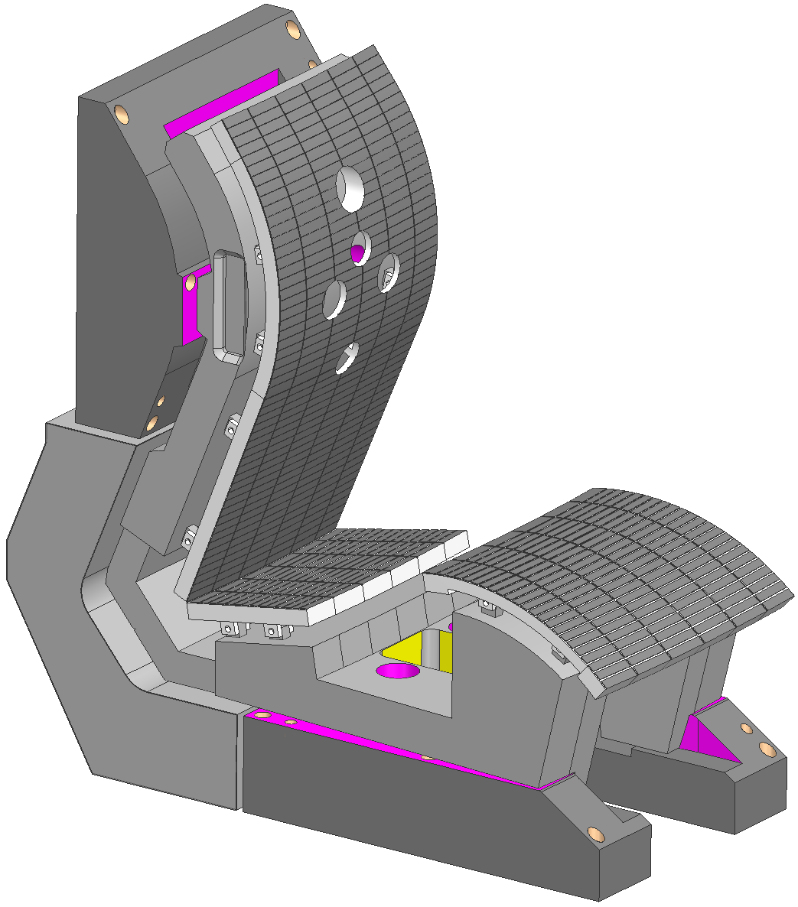
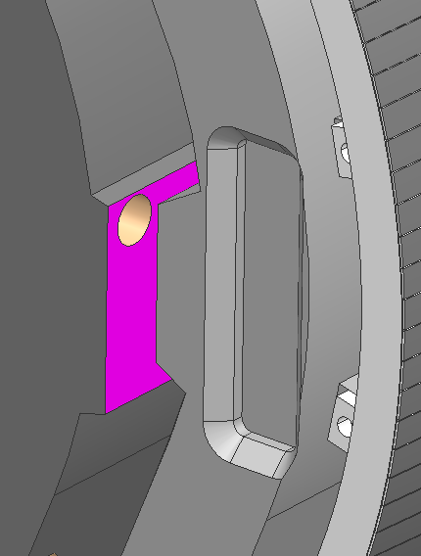
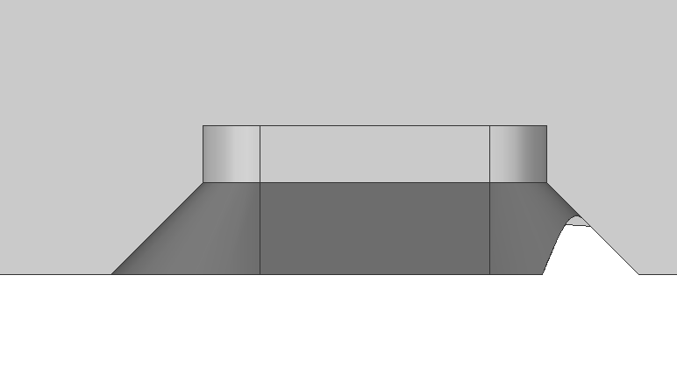
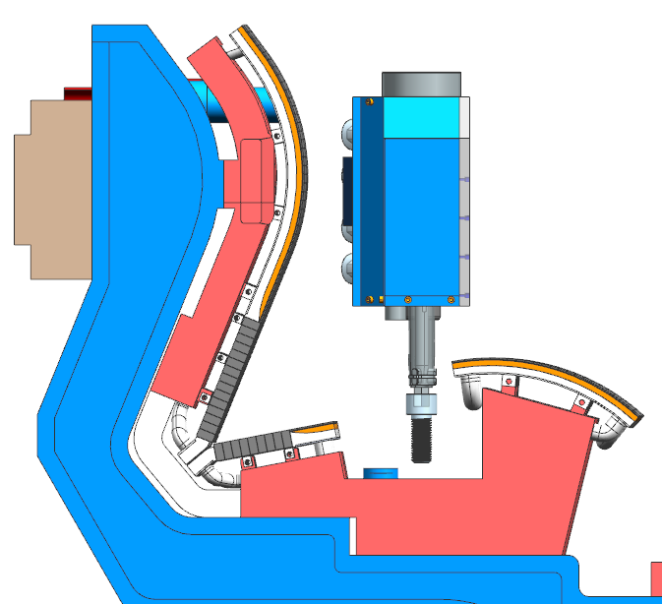
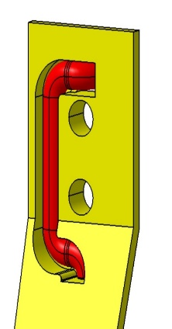
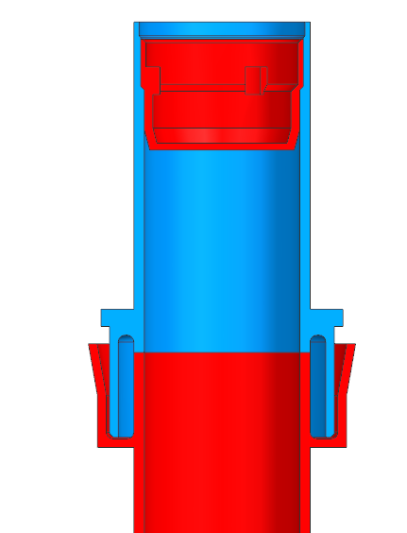
Divertor RH compactible features
Guide block
Guide slot
8mm
90°
10°
Grabbing feature
Guide slot
PFC Grabbing
Pipe cutting
U shape pipe
TIG
A
Welding
position
315
85
Tube cap
Welding
position
B
C
70
mm
Tube
Pipe welding
Bolts removal
9

Slide 10
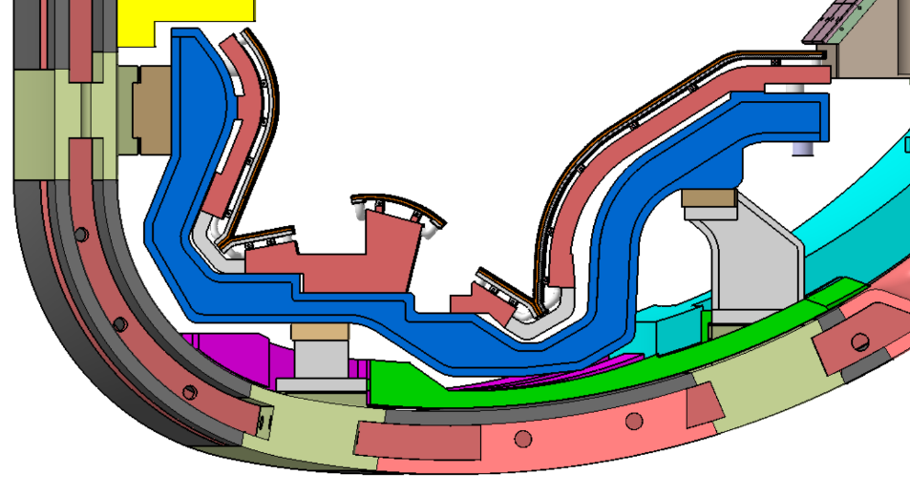
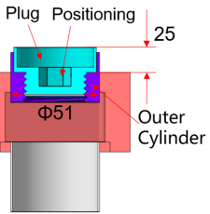
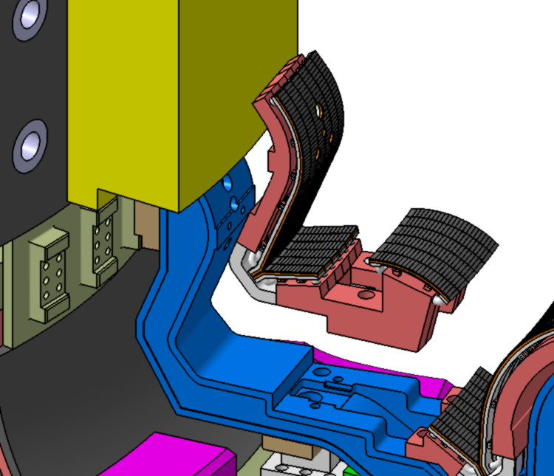
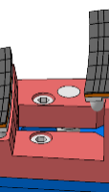
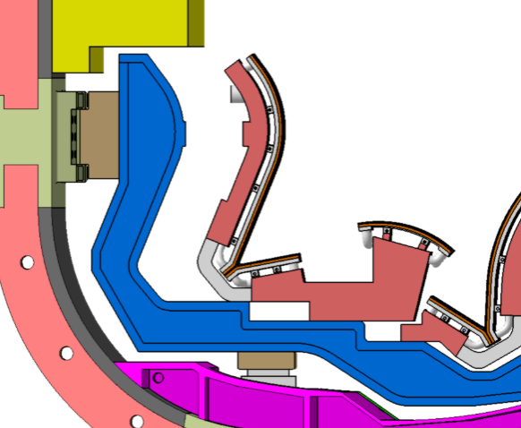
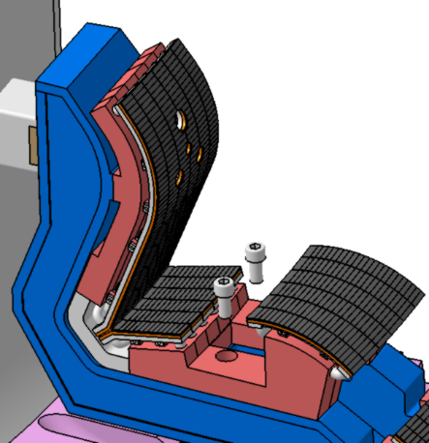
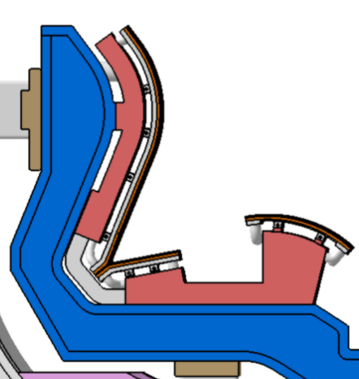
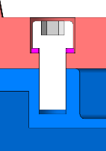
Divertor RH procedure
Remote Handling maintenance:
Cut the coolant pipe end cover;
Internal pipe cutting;
Remove the bolt;
Move horizontally to the right;
Vertical lift.
M36
M30
IVT&Dome
IVT&Dome lift
IVT&Dome move
Unbolt
Cut pipe（Φ51x3）
120
116
160mm
（4xM30）
193
85

Slide 11
Part 03
Shielding Blanket

Slide 12
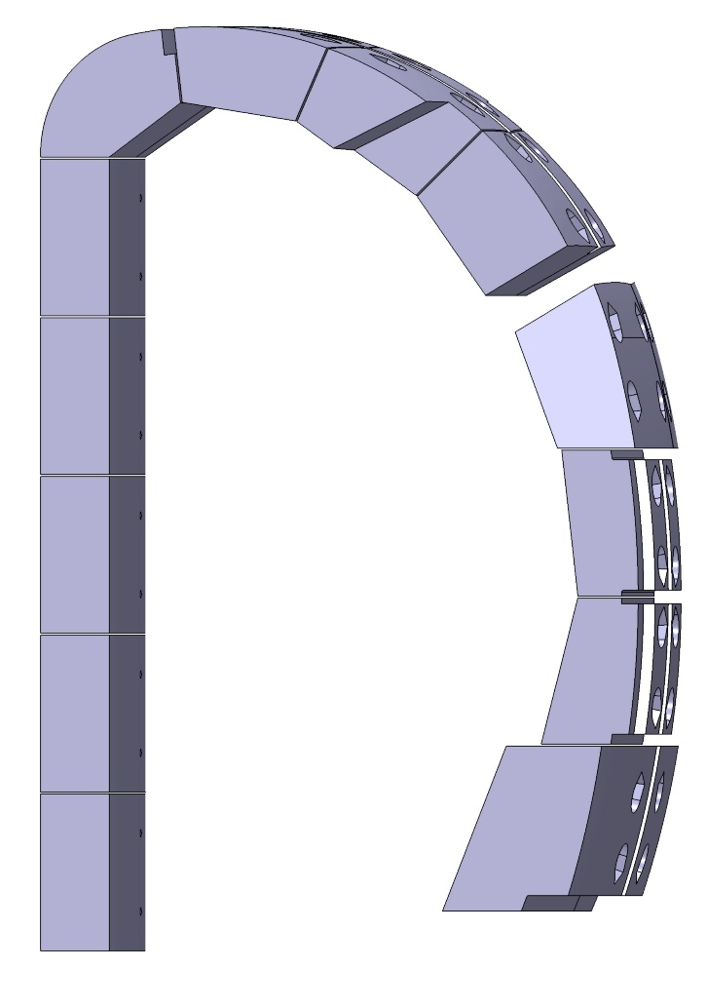
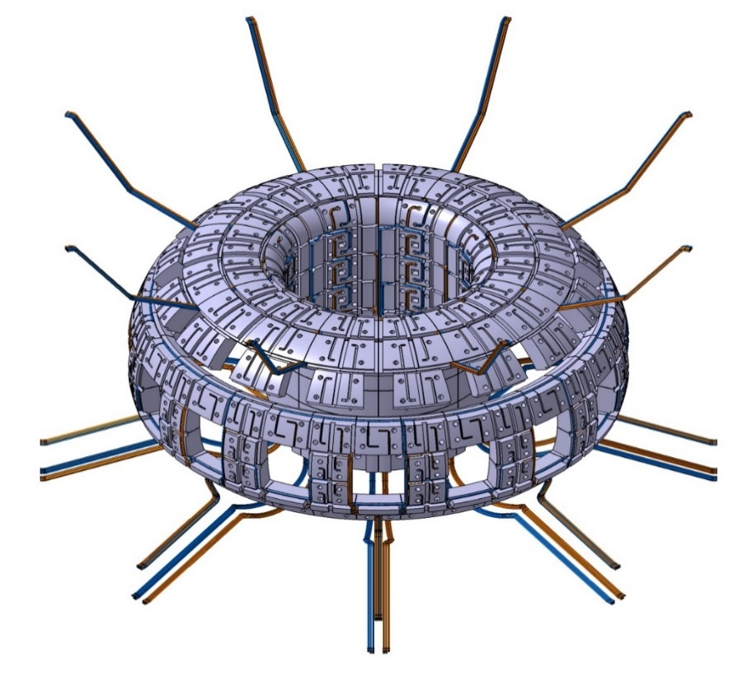
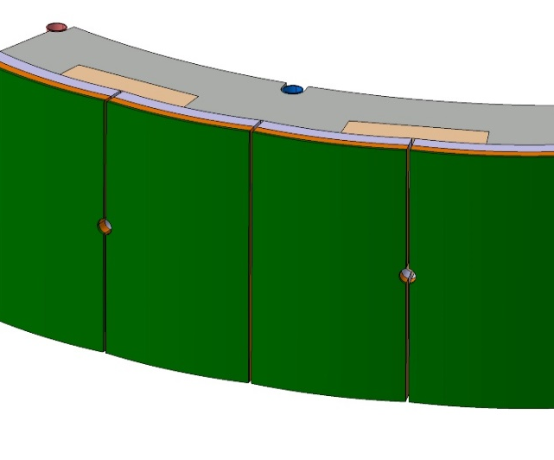
Overall Configuration
Poloidal: 13 modules (inboard – BM 1#-5#; upper – BM 6# - 9#; outboard – BM 10#-13# )
Toroidal (FW): 16 modules(FW 1#-9#, 11&12#-equatorial port); 32 modules(FW 10#,13#)
Toroidal (SB): 8 modules(SB 1#-5#); 16 modules (SB 7#-9#, 11#-13#); 32 modules(SB 10#)
#7
#8
176 SB +240 FW
#6
#9
#5
#10
#4
1 SB+1 FW
#11
#3
#12
#2
#13
#1
Layout of shielding blanket modules
1 SB+2 FW
The gaps between blanket modules are 10 mm both poloidally and toroidally for installation and disassembly.

Slide 13
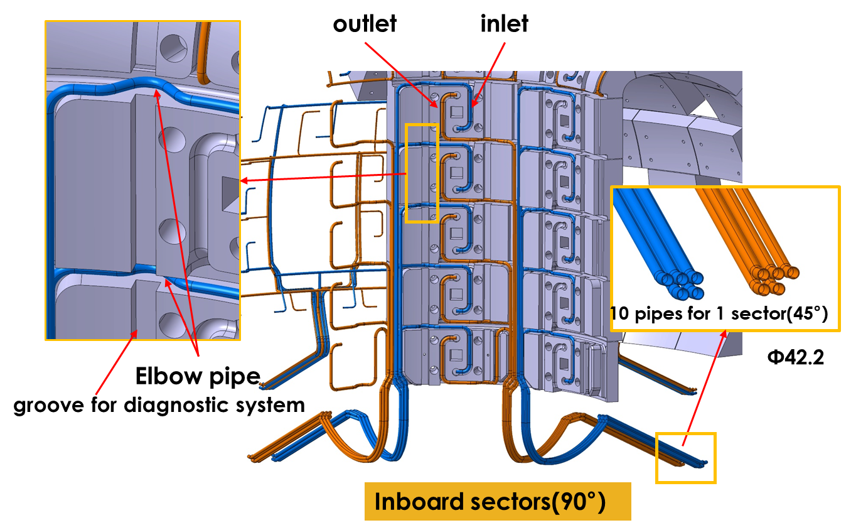
Manifold Configuration

Slide 14
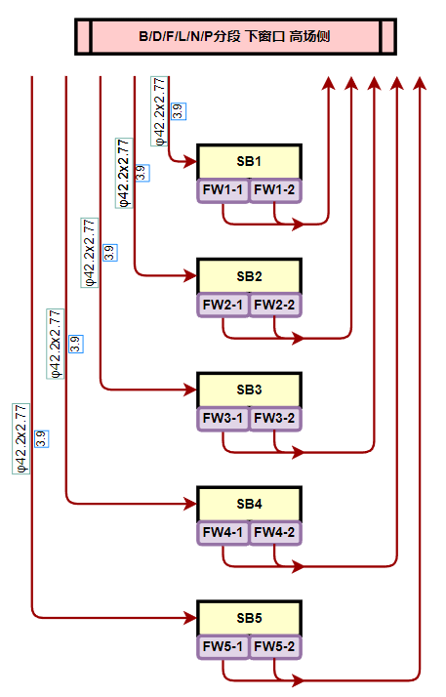
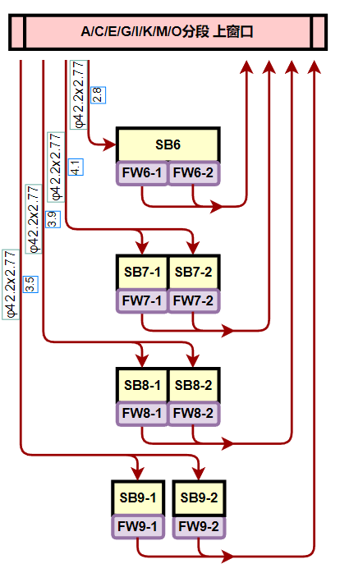
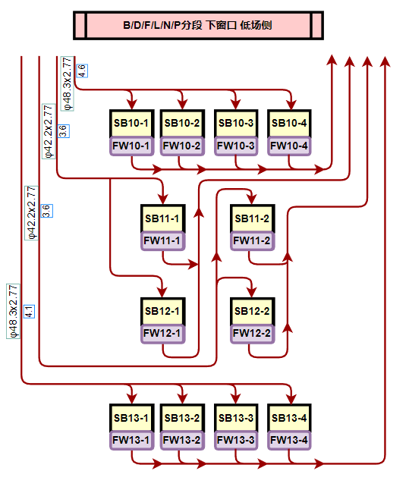
Manifold Configuration
Three bunches of manifolds and water flow chart for 45° shielding blanket

Slide 15
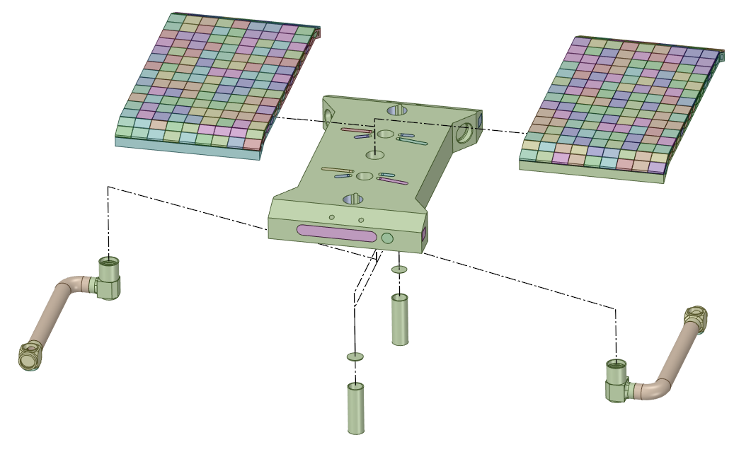
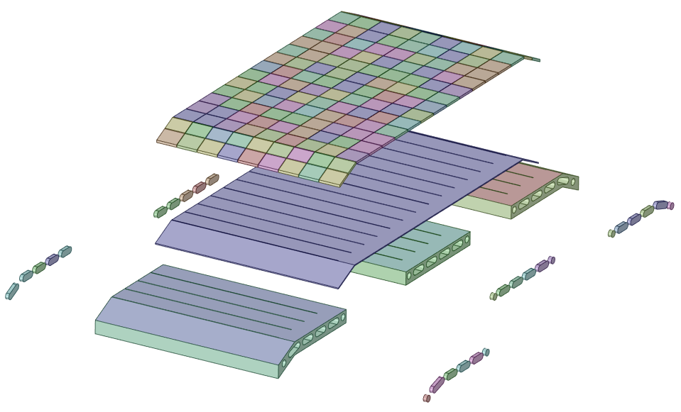
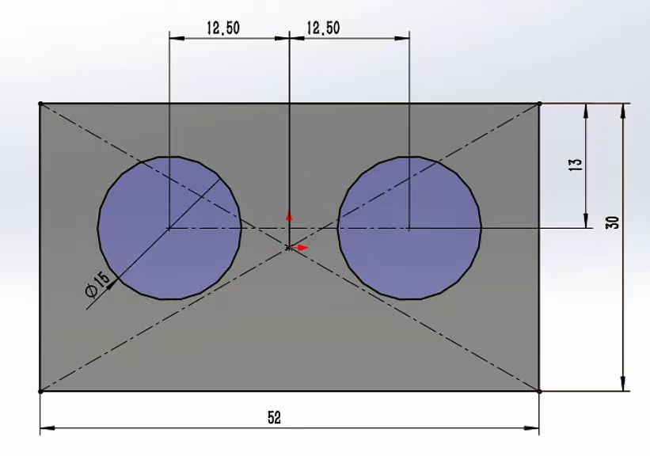
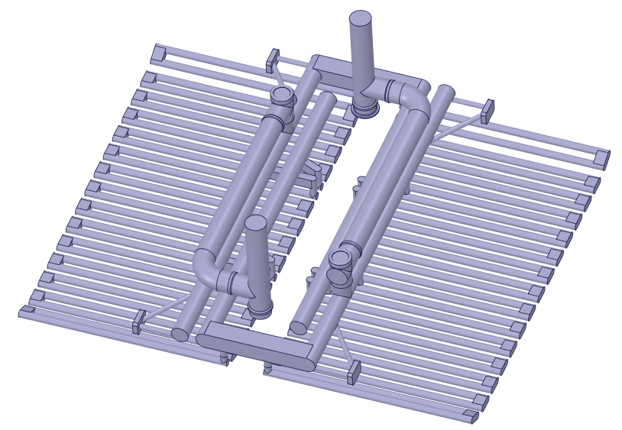
First Wall Design
FW= Left/Right Fingers + Beam + Connection Pipes
Slots ↓ EM load/ Thermal stress
W tiles
Cu foils
CuCrZr plate
Coolant distribution
CuCrZr covers
Cooling of PFU
Inlet from beam
RH Positioning/ grabbing holes
Mechanical connection
Coolant pipe connection
Cooling channels
Coolant back to beam

Slide 16
Shielding block design
Preliminary design of one shield block has two first wall.
Nuclear heating <0.3W/cc, mass flow rate 2.0114kg/s，inlet temperature 143.3℃, coolant pressure 4MPa
Φ24
Φ42.2
Peak T 227℃
Φ15
Peak stress 339MPa
From FW1
From FW2
To Manifold
To Manifold
From FW1
From FW2

Slide 17
Connection with VV
Key pad
Housing
VV
Direction of thermal expansion
The Key pad is arranged in a direction parallel to the expansion direction of the SB. The key pad supports the SB without preventing thermal deformation
Inboard SB Module
M50 bolt
Housing
SB Support Structure

Slide 18
Part 04
Vertical Stabilization System

Slide 19
Vertical Stabilization System
Maximum controllable vertical drift of 11 cm;
Vertical displacement growth rate <100/s.
Welded on VV
Upper support structure bolted
VS coils clamp bolted on Upper support structure and Lower passive plate
Support bolted on VV
Lower passive plate bolted on the support

Slide 20
Vertical Stabilization System
VS coils
two coils, each with 4 turns, 2 feeders X 2 ports.
200 brackets bolted to upper support structure and lower passive plate.
In-port brackets welded to VV
VS coils conductor
Max Current per turn (kA) | 26.2
Current per turn effective(kA) | 2.2
Turns effective | 4
Length per turn（m） | 44
Neutron heating rate(W/cc) | <0.3
Rated voltage(V) | 1200
Jacket OD (mm) | 38
Jacket ID (mm) | 33
Insulation thickness (mm) | 3.5
Conductor OD (mm) | 26
Conductor ID (mm) | 16
Flow velocity (m/s) | 3
Water Inlet Temperature (℃) | 70
Coil delta_T (℃) | 10
VS Design-Basis Current Waveform
Insulation: MgO
Jacket: 316L
Conductor: Cu
Type | Unit: MPa | SS jacket | Cu conductor | Brackets | Bolts
Baking | Stress results | 158 | 58 | 304 | 274
 | Allowable | 381 | 90 | 381 | 381
 | result | √ | √ | √ | √
Lorentz + Thermal | Stress results | 218 | 70 | 322 | 207
 | Allowable | 411 | 100 | 411 | 411
 | result | √ | √ | √ | √
VS Bracket Design
（SS316L）
In Port Bracket Design
（SS316L）

Slide 21
Vertical Stabilization System
Passive stabilization plate
Contact resistance test on passive plate
Water cooled body:316L
Water cooled body:316L
Tungsten first wall
1MW/m²
X16
X16
Upper support structure
Lower passive plate
Passive structure resistivity coefficient | 4.82
m_{s} | 0.19
gamma | 100.0/s
n_{decay} | -1.0983
n_{crit} | -1.3054
n_{decay}/n_{crit} | 0.8414
Imax(kA) | 24.3
Umax(V) | 1740
Pmax(MW) | 42.3
The minimum contact resistance of a single contact surface is 0.1μΩ, totally 3.2μΩ for all 32 contacts.

Slide 22
Part 05
In-Vessel Diagnostic Integration

Slide 23
Magnetics
11 D-shaped loops: continuous coils or a set of probes/cables on support, including Rogowski+FOCS, pickup coils, Mirnov coil, diamagnetic coil. (slotting needed in blanket)
Pickup coils to measure toroidal mode number (one for each of 16 sectors. slotting needed in blanket)
Flux loop (for a total of 95, i.e. 45 groups, mounted on VV inner wall)
Saddle loop (mounted on VV inner wall, for total of 16 - every equatorial port)
Partial Rogowski coil (16 toroidal location divertor leg×3; port A, E, I and M lower passive plate leg×4)
Toroidal cable tray (between LFS blanket and PS plate)
Flux loop centralized outlet cable（mounted on VV between A-B, slotting in blanket needed)
Feedthrough (lower port B, F, J and N for outlet cables)
Saddle coil
D loop
Flux loop
Partial Rogowski Coil
Feedthrough
Outlet cable
Toroidal cable tray

Slide 24
Other In-VV Diagnostics
NAS&MFC in section O, DNFM in section O&G
TS dump in sector G
POINT CCR in section J
Faraday cup in section I
NAS&MFC
NAS pipe & MFC cable
NAS&MFC
NAS&MFC
NAS&MFC
NAS&MFC
NAS&MFC
DUMP
CCR
DNFM
NAS
Faraday Cup
NAS & MFC & DNFM
NAS and MFC: located between O-P, 7 for NAS and 6 for MFC, shared slotting in blanket.
DNFM: located in sectors O and G. Space reservation in divertor area.
Faraday Cup: 2 detectors in LFS blanket I.
CCR: mounted in HFS blanket J.
TS DUMP: mounted in HFS blanket G.
Bolometer: detector and LoS in the front, and cable in the back and bottom of HFS blanket A.
DDMS: A Φ50 tube for each lower port, below divertor.
Slotting and cooling needed
HFS bolometer in sector A
A DDMS pipe below divertor for each lower port

Slide 25
Part 06
Assembly procedure

Slide 26
Assembly procedure
Assembly Strategy:
With the updating of VV and shielding blanket design, the IVCs can be assembled starting from 3/8 VV completed (for some shield blocks).
After the VV torus formed, (3-4) multi-construction workstations would be set up to transfer the IVCs from equatorial ports into VV for final assembly.
Start
#6
#7
#8
#5
1
#9
Assembly Sequence:
#4
#10
BM #10, #11, #12
2
Diagnostic Integration
#3
3
#11
BM #2, #1
#12
#2
BM #6, #7, #8, #9
Divertors
#1
#13
4
BM #5, #4, #3
Lower Vertical Stabilization System
Upper Vertical Stabilization System
Close
BM #13

Slide 27
Assembly procedure
Key steps:
Establish ①assemble platform in VV, which is fixed onto the divertor supports.
Establish ②transport frame from port cells to equatorial ports , to transfer the IVCs and tools into VV.
Use purpose-build ③lifting tools, ④upending and adjusting tools (series of tools under design to adapt the special structure blankets and VS) to assemble BM #3 to BM#12 and upper VS system.
②
③
④
①

Slide 28
Assembly procedure
Disassemble the platform and transport frame used in previous steps.
Establish ⑤transports hanging rail system and ⑥bottom circular rails.
Use ⑦lifting hooks to transfer the left IVCs into VV.
Use the ⑧assembly trolley (can move on the circular rails) to assemble the IVCs to final positions.
During divertors assembly, the bottom circular rails will be removed gradually to expose the supports.
Beams support on TFCs
⑧
⑤
⑦
⑥
Slings

Slide 29
Part 07
Summary

Slide 30
Summary
BEST In-Vessel Components (IVC) have the functions of heat and particle exhaust, neutron shielding, plasma vertical stabilization, and in-vessel diagnostic integration.
The IVC includes divertor, shielding blanket, VS coil, passive stabilization plate and in-vessel relevant diagnostics.
The IVC integration has being progressed well with the focus on the overall design, interfaces, and supporting structure.
The shielding blanket and the plasma vertical stabilization system need more effort to detail the engineering design.
More R&D will be carried out to verify the critical interface design, such as the RH interface of the cooling pipes for divertor and shielding blanket.
All your comments are appreciated!

Slide 31
Thanks for Your Attention!

