Slide 1
DEMO Blanket Attachment Concept Based on [C. Bachmann et al, Mechanical support concept of the DEMO breeding blanket, Fus. Eng. Des. 173, (2021) 112840]
21/03/2024
C. Bachmann
PMU-DCT

Slide 2
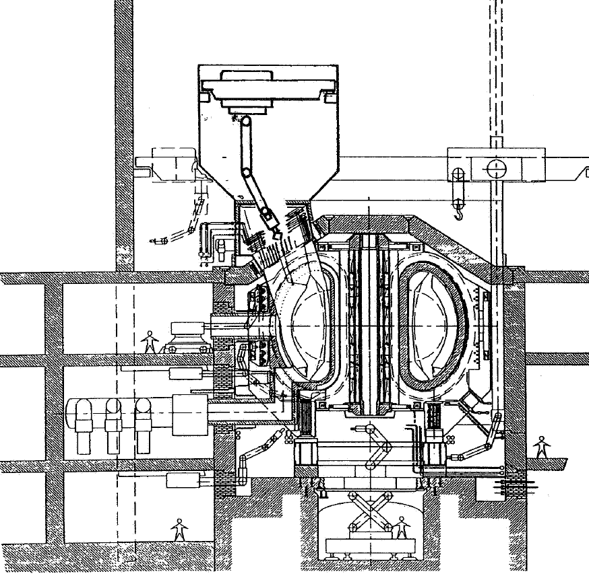
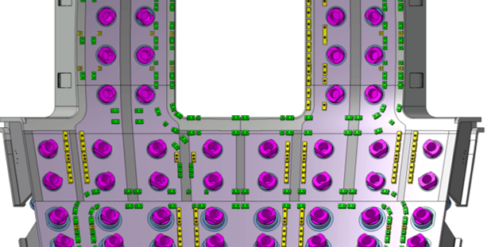
History of mechanical attachments of vertical segments – NET/ITER
Vertical segments were considered in the late 1980s / early 1900s for the Next European Torus (NET) and ITER.
In 1991, 5 potential mechanical attachment concepts were identified but none fulfilled all requirements.
The full segment was discarded later in favor of smaller blanket modules. This has the following consequences:
Large number of interfaces blankets – VV
Blanket RH designed to replace single damaged blankets but not to replace all blankets.
[Next European Torus – Introduction, executive summary, Fusion Eng. Des. 21 (1993) 3–15]
ITER VV
inner shell:

Slide 3
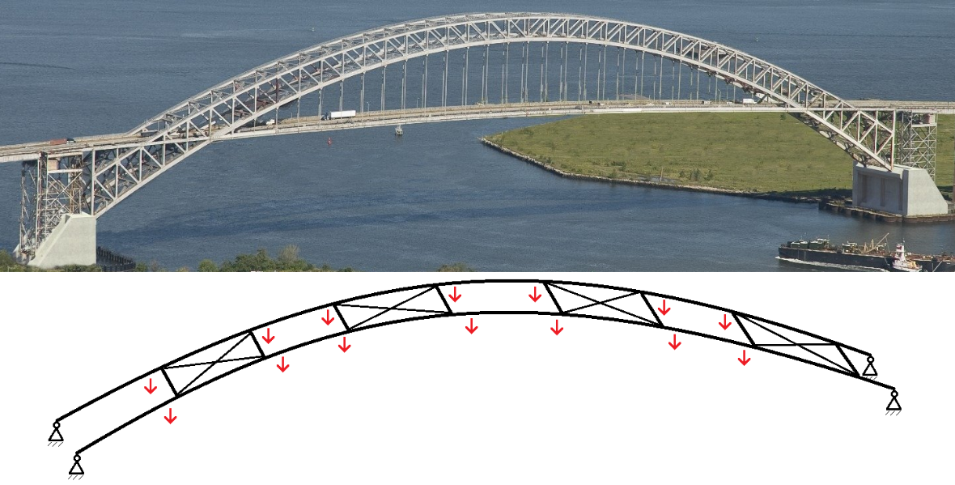
Principles of proposed DEMO BB support concept
Attachment concept relies heavily on the radial ferromagnetic force always present and constant when the TF is on.
Attachment concept is that of an arch bridge, fixed on both ends to control deformation, statically over-determined → stiffness of BB segments must be considered.
No bolts.
No electrical straps because the blankets are always in contact at the vertical supports, concept relies on thermal expansion of BB segments.

Slide 4
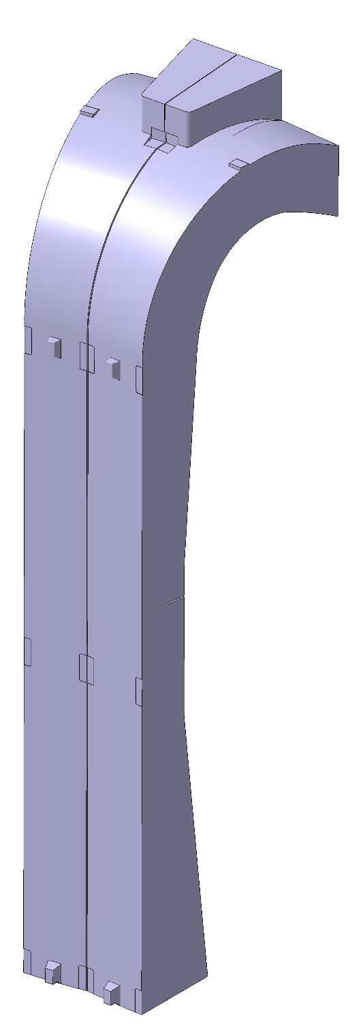
Generic principles of BB support concept
Each segment is supported individually by the VV, no physical connection to other IVCs.
To support the inboard segments against the large radial loads, currently radial supports are incorporated at four poloidal locations.
All BB support structures can be custom-machined to compensate VV tolerances.

Slide 5
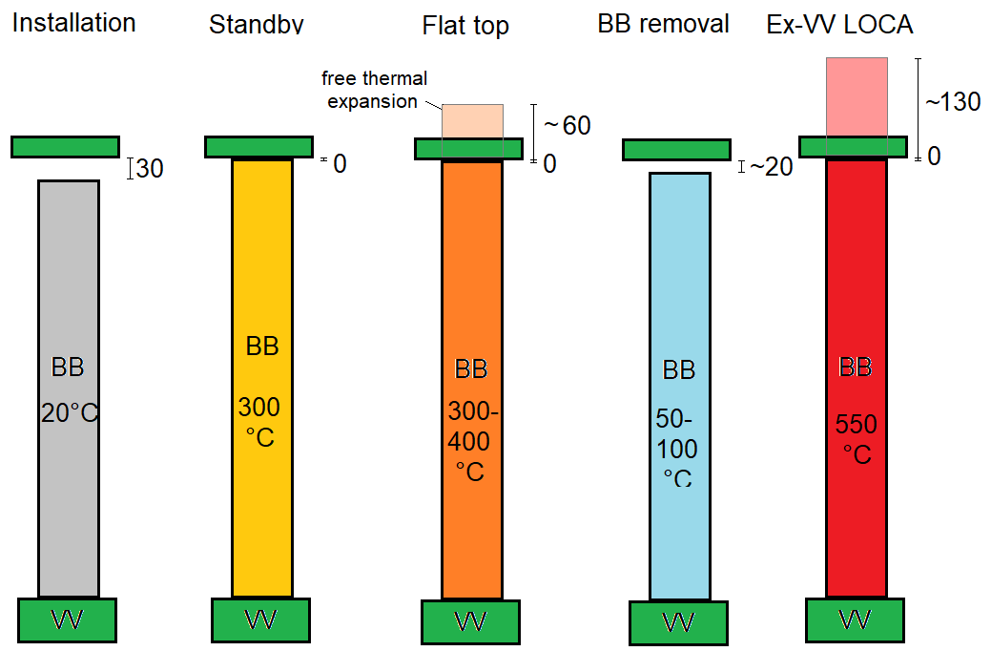
Machine states
Thermal expansion of BB segments is large (see also presentation by I. Moscato) → BB supports must be designed considering the expansion.

Slide 6
Radial supports
Reliability of radial pre-compression:
Inboard segments: Today (3.5m³ of Eurofer/segment) ferromagnetic force (~-7MN) exceeds all possible loads acting in opposite direction (7MN during thermal quench, 1-2 MN during fast current quench).
Outboard segments: Ferromagnetic force (~-2.5MN) smaller than loads acting in opposite direction (TFCFD: 3.2; plasma disruption: 1-3MN).
→ Physical contact at radial supports could be lost → electrical connection at vert. supports.
Load | Value | Assumption
Dead weight | 125-180 tons | WCLL
Seismic | a_{horiz} = 0.25g, a_{vert} = 1.0g | SL-2, Cadarache
Ferromagnetic | F_{rad}: -7MN (inb.) / -2.5MN (outb.) | 3.5m³ Eurofer/segment
TFCFD | F_{rad}: -12MN (inb.) / +3.2MN (outb.) | τ_{discharge} = 20s
Thermal quench | F_{rad}: ~7MN (inb.) / ~-3MN (outb.)
Slow VDE up (halo) | F_{vert}: -9MN (inb.) / 2.3MN (outb.)

Slide 7
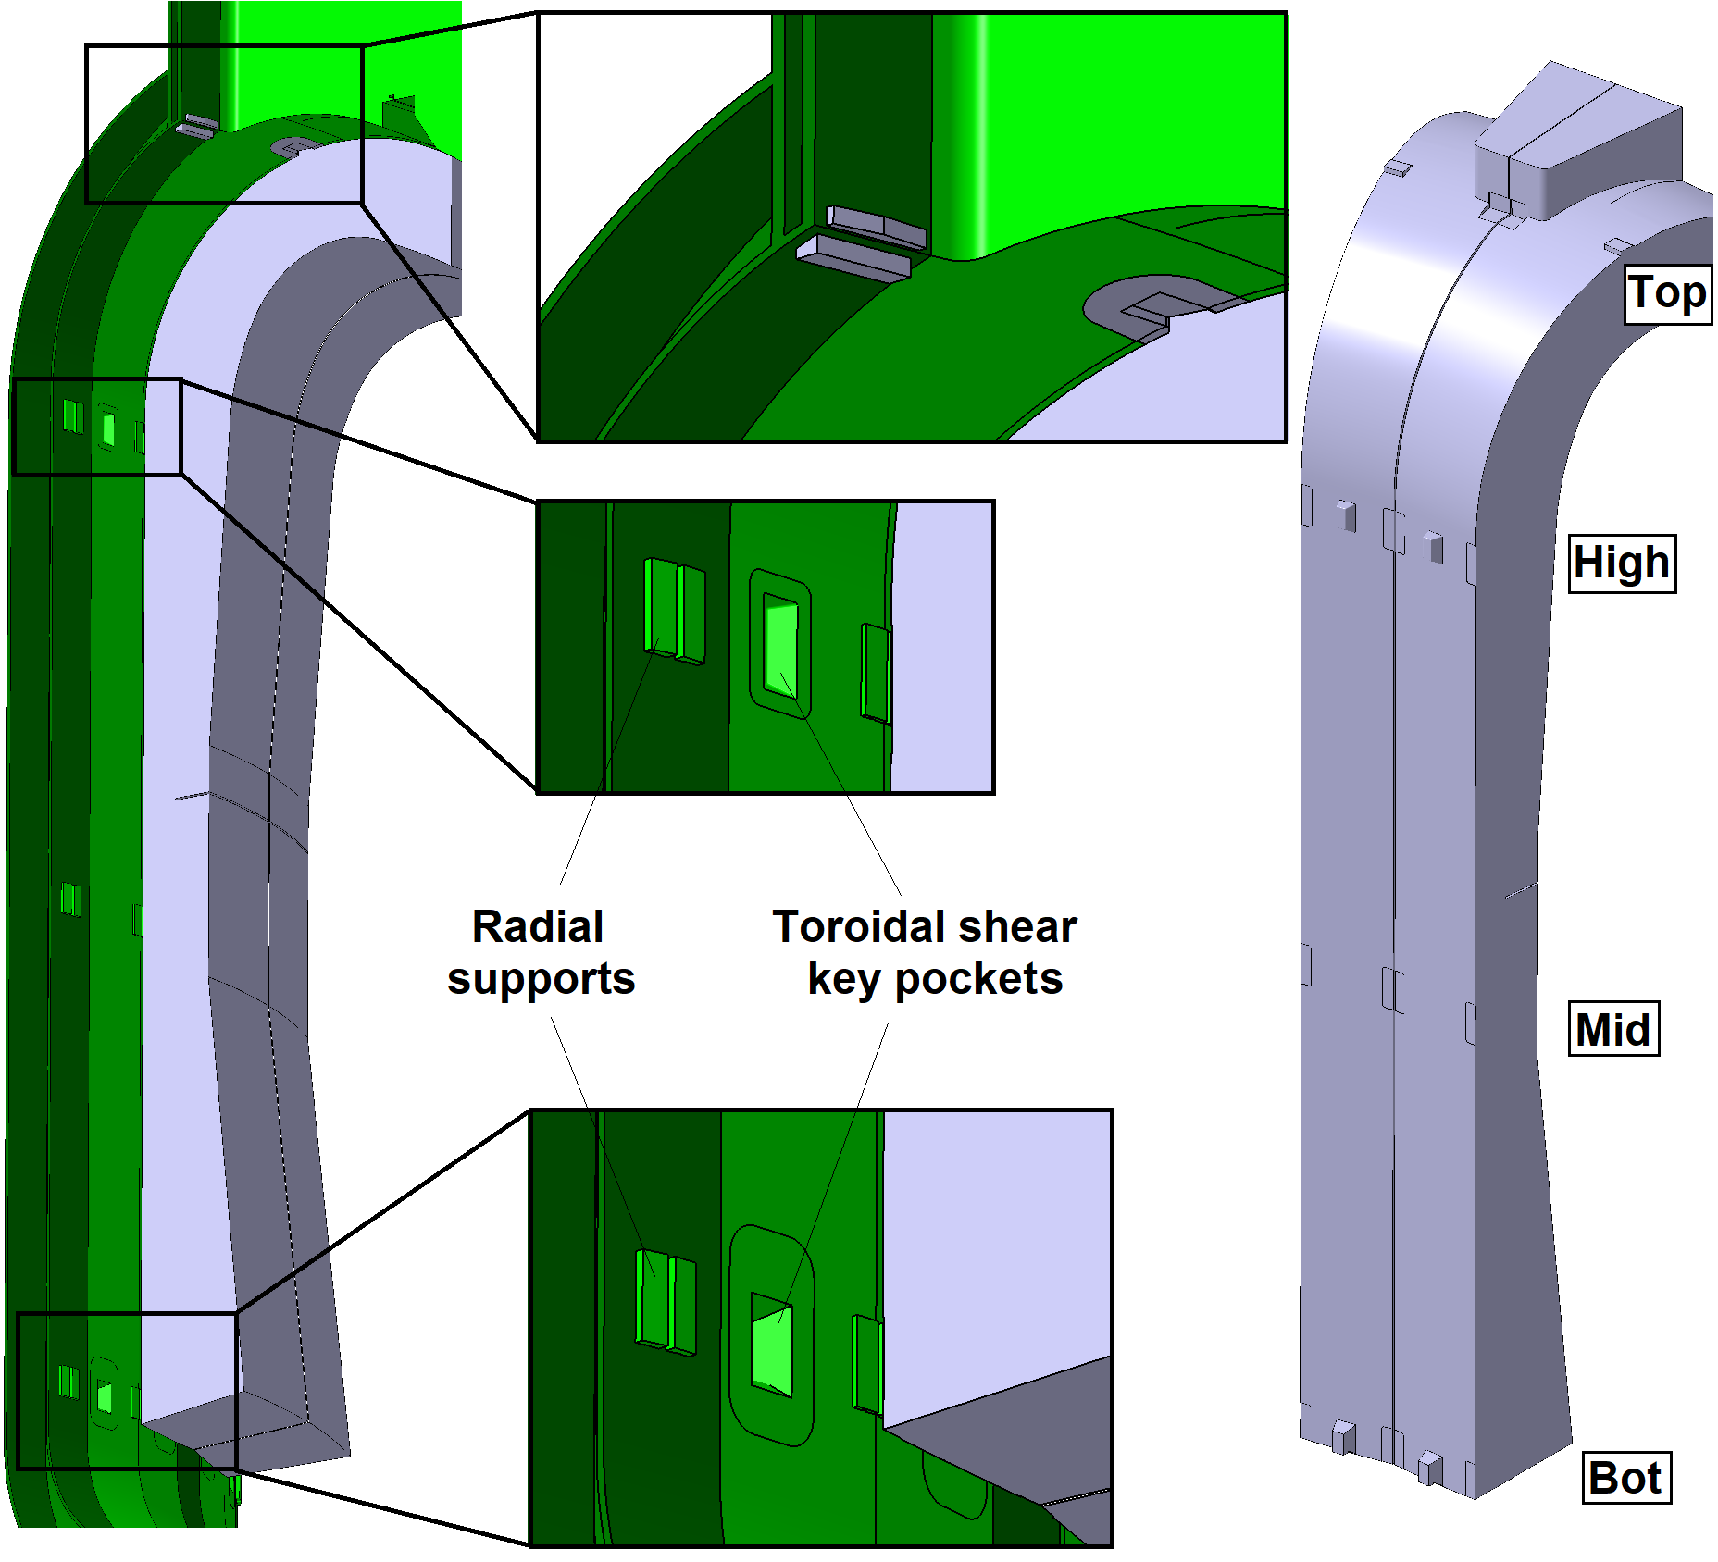
Design of inboard BB supports
Vertical supports at top and bottom (to be moved radially)
Radial supports on both side of the blanket segment.
Toroidal shear keys at two locations.

Slide 8
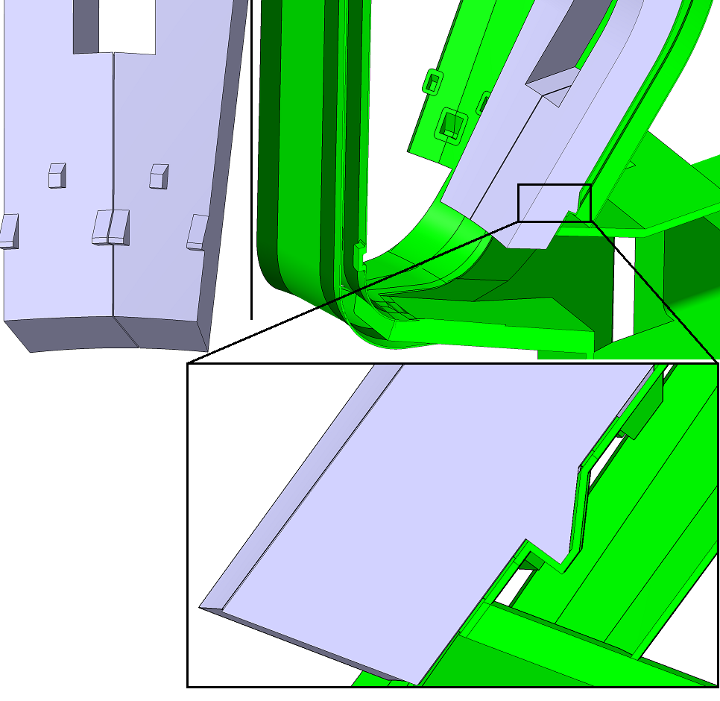
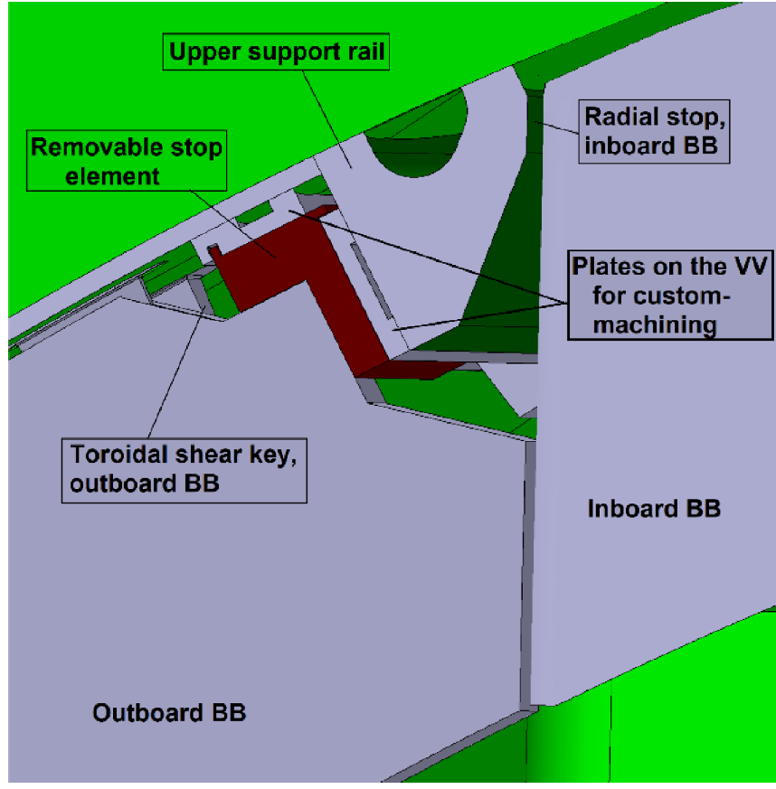
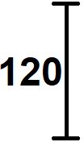
Design of outboard BB supports
Upper supports:
Toroidal shear keys
Radial/vertical supports

Slide 9
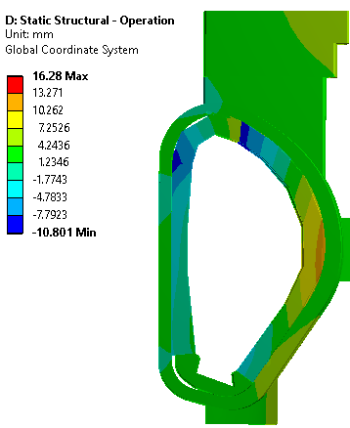
Radial displacement during flat top operation
Misalignment of the FW occurs due to the thermal deformation of the BB segments: ~±7mm in flat top.
To be added to BB shape and installation tolerances.

Slide 10
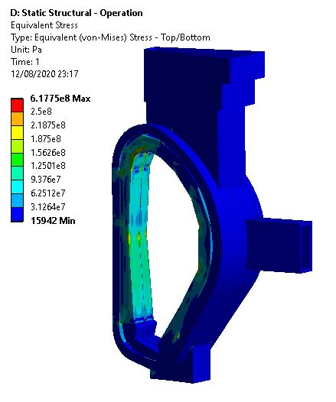
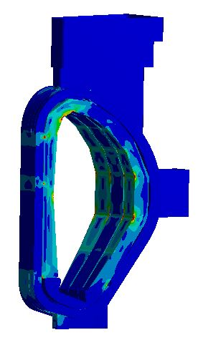
Stresses – flat top
BB temperature: [300-400°C]
~100 MPa

Slide 11
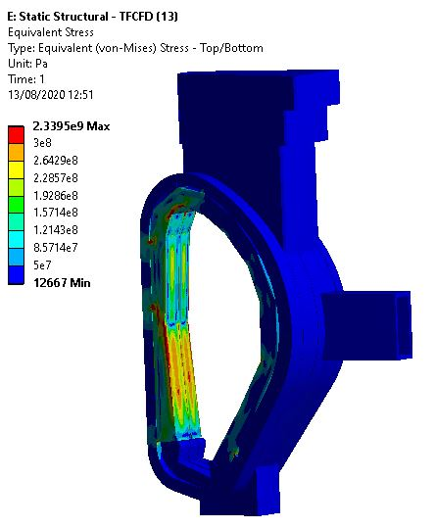
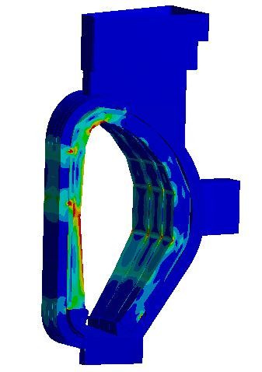
Stresses – TF coil fast discharge
~250 MPa

Slide 12
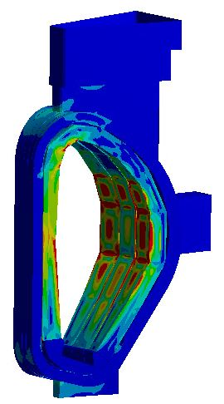
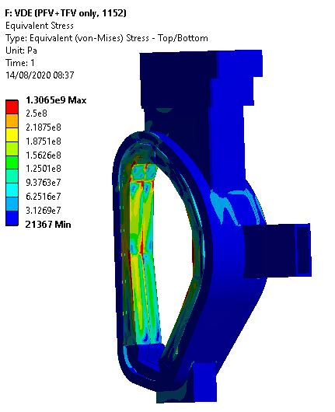
Stresses – VDE
~280 MPa
~200 MPa

Slide 13
Discussion
Main identified issues:
Significant stress level in blanket first wall, already during flat top, e.g. due to constrained thermal expansion.
High stress levels in blankets during TF coil fast discharge and during disruptions due to high EM loads.
Potential mitigations:
Additional radial supports on the inboard side.
Reduce temperature gradient in BB segment during operation:
Consider temperature gradient in BB FW more accurately.
Use water as coolant.
Reduce EM loads:
Prolong magnet fast discharge time constant.
No obvious solution for disruption loads.
Readiness of blanket segment support concept:
The concept is attractive because no bolts / no electrical straps are needed, and fewer interfaces blanket – VV → power plant relevant.
No show-stopper found, but both design and verification are not sufficiently developed yet to conclude on the feasibility.
Finally, the validation on a test stand will be required.

Slide 14
Thank you for your attention

