Slide 1
Integration concepts of VNS in-vessel components
21/03/2024
C. Bachmann

Slide 2
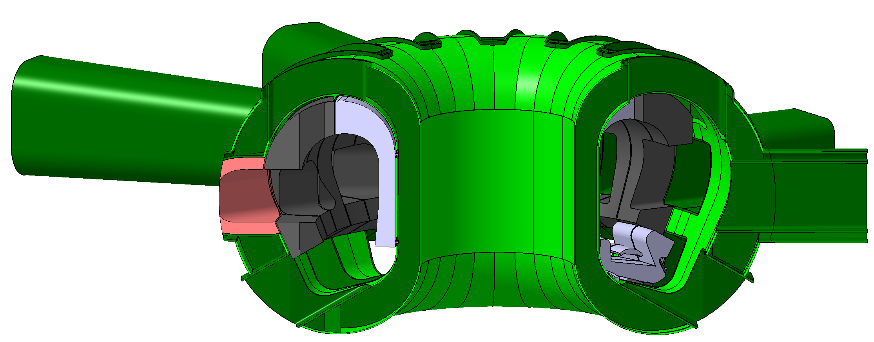
VNS Vacuum vessel
Design: ITER-like
Double-wall structure: stainless steel XM-19, 316(L)N
Shell thickness (tentative): 20 mm
Mechanical supports of in-vessel components to the VV:
Inboard side: Interference with VV ribs to be considered.
Outboard side: Only areas available outside the VV ports (which are irregular).

Slide 3
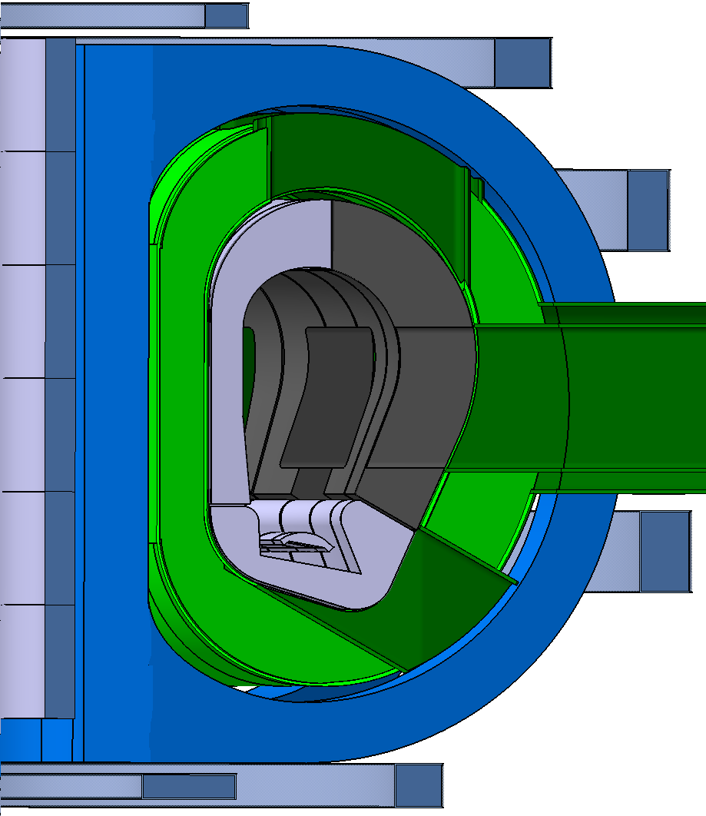
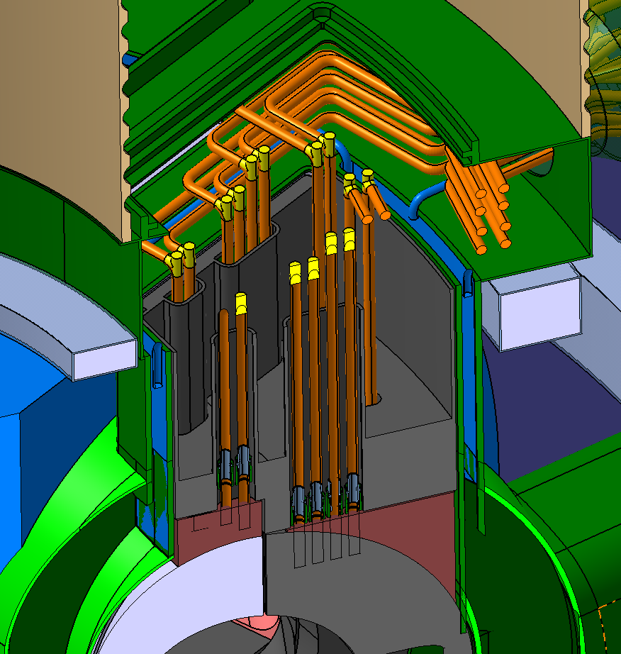
DEMO-like RH-compatible machine architecture
[C. Bachmann et al., Fus. Eng. Des. 136 (2018), 87-95]
Cooling pipes inside ports (no access required from plasma side through first wall, reduced gamma radiation, no bolts – tbd.).
Divertor cassettes, vertical blanket segments (integration studies only for inboard segments so far).
Lower horizontal, vertical upper ports.
Blanket cooling pipes integrated and accessible inside the 12 upper ports.
Divertor cooling pipes:
In lower RH ports: direct access.
In lower pumping ports: Separate access hatch for pipe tools above cryopump flange.

Slide 4
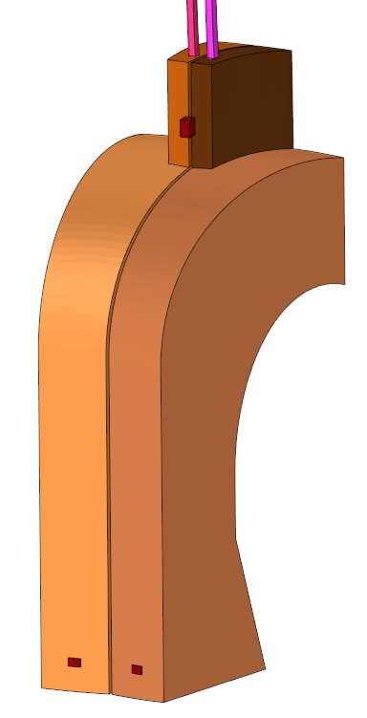
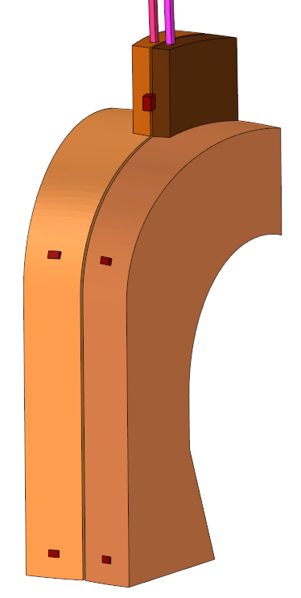
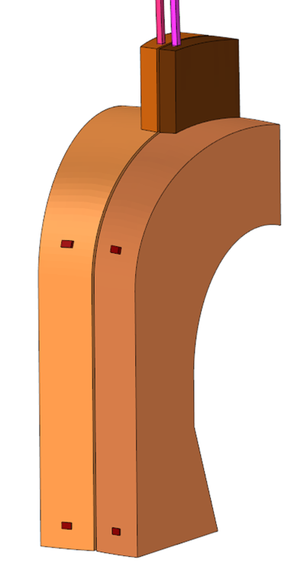
Electrical connections
Electrical connections to VV
Design: Small thermal expansions.
Inboard blanket: Radial electrical connections guaranteed by ferromagnetic force. (Currents in pipes to be verified.)
Outboard blankets: electrical connections possibly guaranteed by bolts (not decided yet).
Divertor: electrical contacts guaranteed by preloaded cassette.
EM Loads:
Asymmetric electrical connections cause large asymmetric EM loads → electrical connections in the center of the blanket, see also [I. Maione et al., Fus. Eng. Des. 166 (2021) 112285]
Phenomenon not fully understood, will be studied this year.
2.2
2.3
1.0
2.1
Radial loads during plasma disruption on left/right inboard segment:
±512 kN ±444 kN ±79 kN ±424 kN
Chosen concept

Slide 5
Identification of design loads acting on in-vessel components
Loads considered in the concept definition phase (currently estimates) | Divertor cassette | Inboard blanket segment | Outboard blanket segment
Dead weight | F_{z} = -12 kN (1.2 tons) | F_{z} = -30 kN (3 tons) | F_{z} = -70 kN (7 tons)
Ferromagnetic force | Tbd. | F_{rad} = -200 … -600 kN (tbd) | Tbd.
EM loads due to TF coil fast discharge | F_{z} = -600 kN | F_{rad} = -1200 kN | F_{rad} = 400 kN
EM loads in disruptions (Lorentz forces) (current quench time: 4.7 ms, based on review of ITER Physics basis and other relevant literature) | F_{z} = -100 kN F_{tor} = 40 kN M_{rad} = 60 kNm M_{z} = 110 kNm | F_{tor} = 90 kN M_{rad} = 550 kNm M_{z} = 150 kNm | Tbd.
Halo current loads (halo current magnitudes defined based on ITER Physics basis, to be revisited.) | Tbd. | F_{z} = ±100 kN (25 kA / BLK) | F_{z} = ±60 kN (20 kA / BLK)

Slide 6
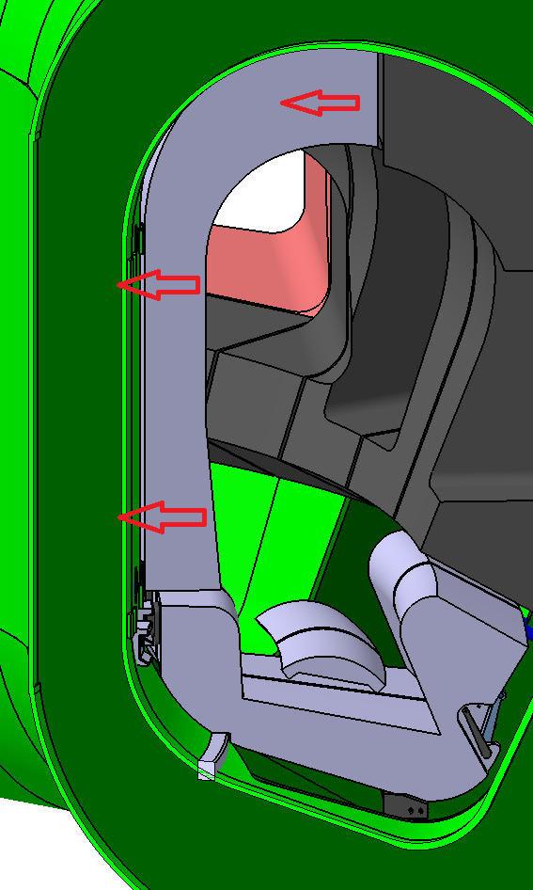
Mechanical attachments - blankets
Inboard blankets:
Design:
Ferromagnetic (radial) force replaces the preload of radial bolts.
Pre-compressed radial supports on both sides of the blanket provide support against M_{z}.
Pair of toroidal shear keys react the large radial moment due to disruptions.
Outboard blankets: design tbd.

Slide 7
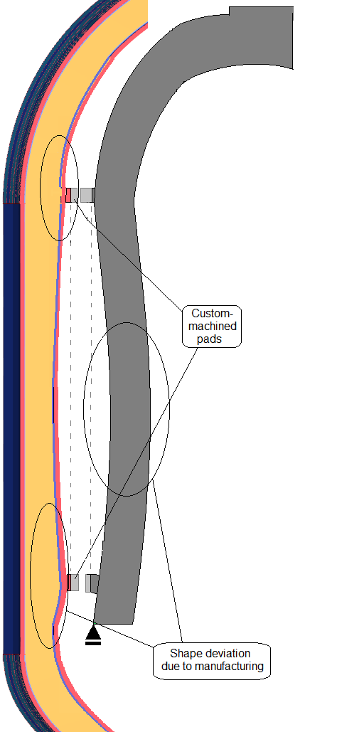
Alignment of first wall
Prior to in-vessel component installation:
VV assembly and survey of VV shape.
Customization of support structures on VV → correct VV shape tolerances.
Customization of support structures on in-vessel components → correct shape tolerances of blankets/divertor cassettes.
→ Must foresee excess material for machining.
→ Good FW alignment at the support locations.
→ Misalignment of the wall in-between support locations due to manufacturing imperfections and thermal deformations.

Slide 8
Summary
 | Inboard blankets | Outboard blankets | Divertor cassette
RH approach | 12 upper vertical RH ports |  | 4 lower RH ports
Service of cooling pipes | 12 upper vertical RH ports |  | 4 lower RH ports 8 lower pumping ports access without removing pumps
Electrical integration | Contact on radial supports ensured by ferromagnetic force | Tbd. | Contact on radial supports ensured by cassette preload
Mechanical integration | Shear keys and contact pads, no bolts | Tbd. | Shear keys, pins, contact pads, no bolts (ITER-like)
Design to be developed in 2024!

Slide 9
Thank you for your attention

