Slide 1
RH concept of EU DEMO blankets
21/03/2024
C. Bachmann
PMU-DCT

Slide 2
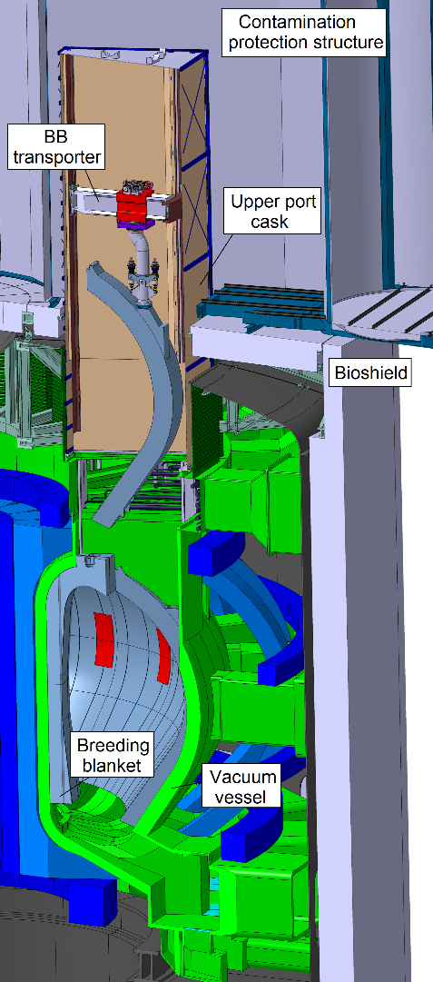
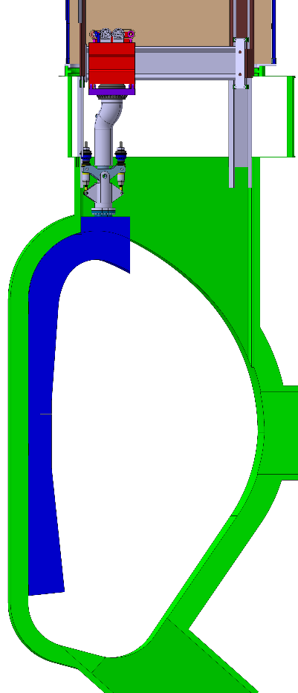
Overview
[C. Bachmann et al, Fus. Eng. Des. 177 (2022) 113077]
BB is segmented into vertical segments and lifted from the top.
The installation of the new BB follows the removal of the used BB in reverse order.
Prior to BB maintenance the pipe handling cask removes BB piping from the upper port, the divertor is removed through the lower port.
BB transporter is operated inside VV cask, it replaces sequentially 3 outboard + 2 inboard segments through one upper RH port.
BB transporter can be lowered into the lower port, the cask vertical rail system is extended by equivalent rails on the port walls.
The same tool disengages the BB from the VV, lifts it into the cask and supports it during cask transfer → No passing-over to 2nd lifting tool/support frame etc.
Common interface to BB segment in one single point, which is designed for the transfer of large bending moments.

Slide 3
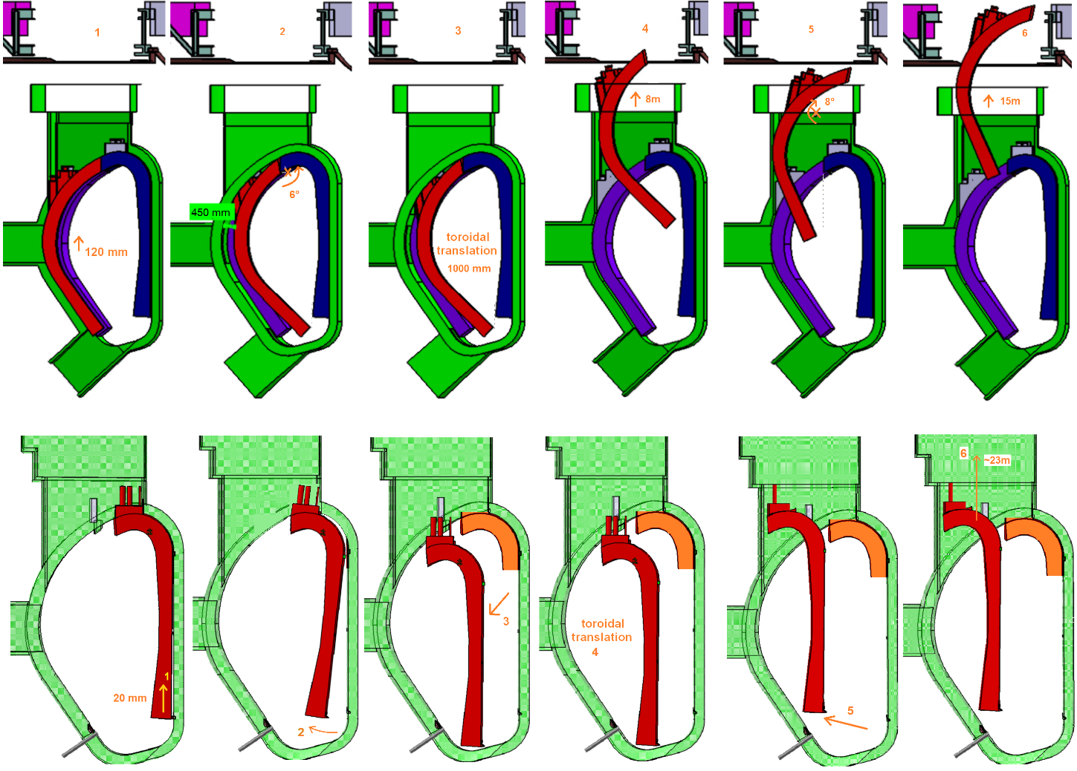
Blanket segment removal kinematics
Divertor is removed prior to BB.
Challenges of the lifting operation as compared to conventional lifting devices:
Tilting movements required
Stiff connection to blanket
Relatively small free space around the lifted component requires good positional control.

Slide 4
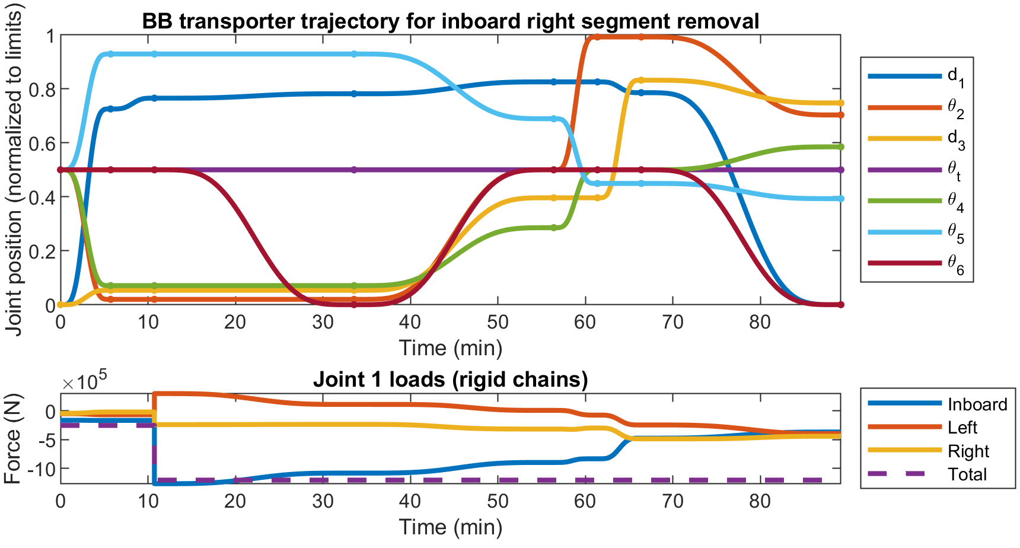
BB segment removal
First (incomplete) rigid body dynamics simulation:
Estimated duration of removal of 1 segment: ~1-2h.
Critical joint: gripper tilting joint (joint 6, $θ_{6}$).
Actuators/drivetrains of some joints require revision.
Animation showing collision-free trajectory waypoints
Position and forces at the individual joints:
from Aarhus university
Bachmann | March 2024

Slide 5
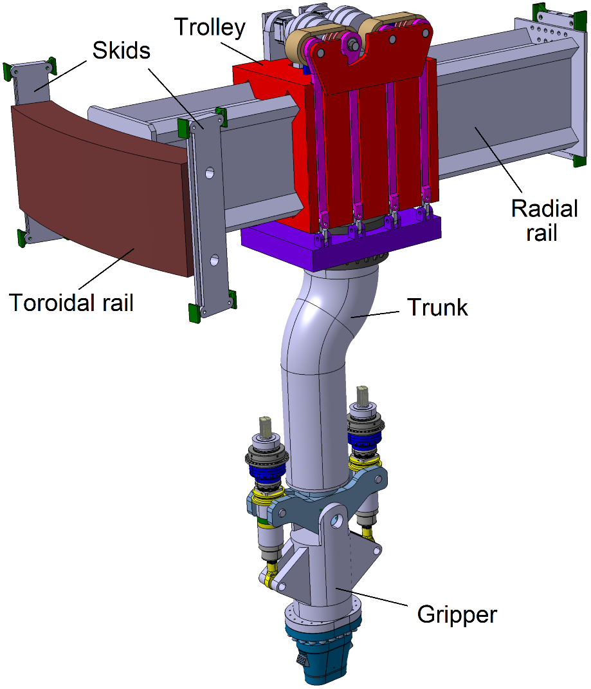
Design of BB transporter
[C. Bachmann et al, Fus. Eng. Des. 194 (2023) 113715]
Designed for high payloads up to 180 tons.
Design of joints is critical → at each joint only one degree of freedom.
Translational movements are horizontal → no “downhill” movements in case of drivetrain failure.
Highest loads occur during the initial lifting of the inboard blanket due to the large distance between c.o.g. and gripper.
All critical components and parts incl. the drivetrains have been sized.

Slide 6
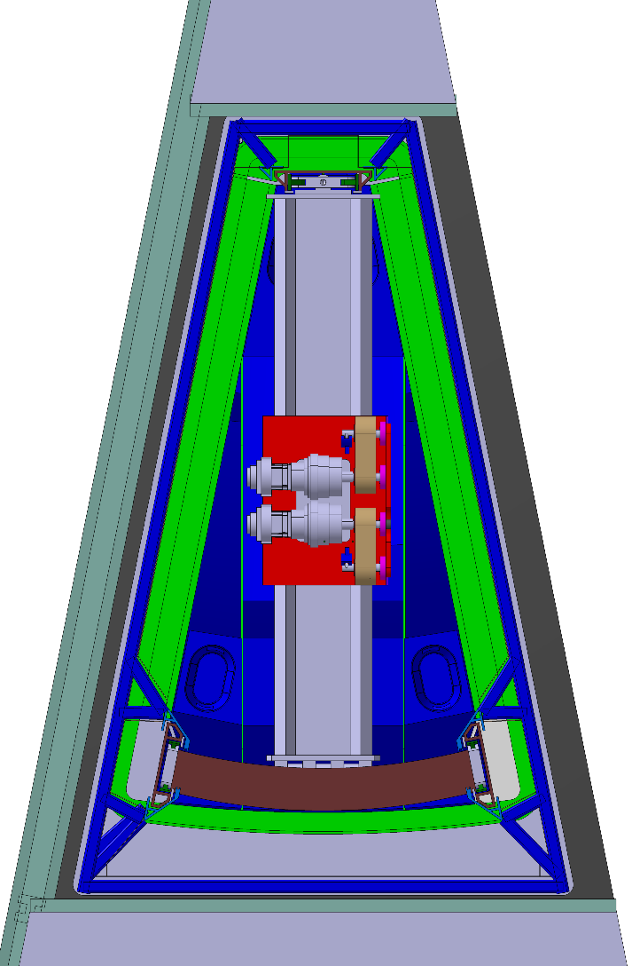
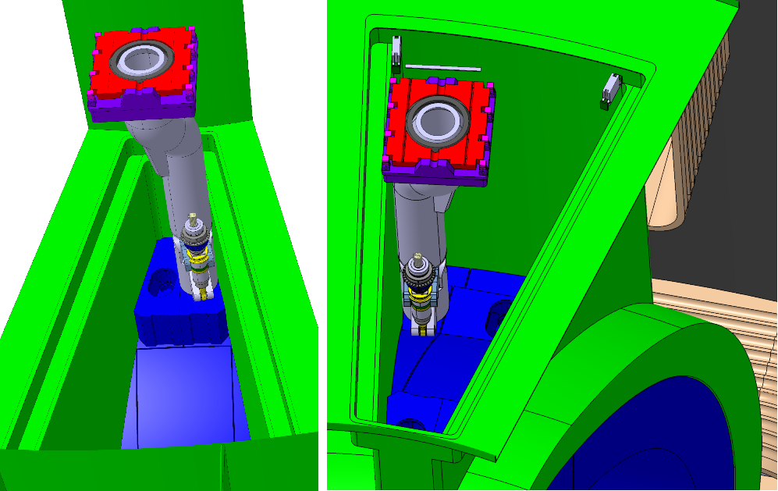
Space constraints inside the upper port
The trolley (red) must be small to get close to the centres of gravity of the BB segments.
The gripper must be slender to not clash with the port sidewall when engaging with the BB segments.
The kink in the trunk allows reaching into the corners of the upper port.

Slide 7
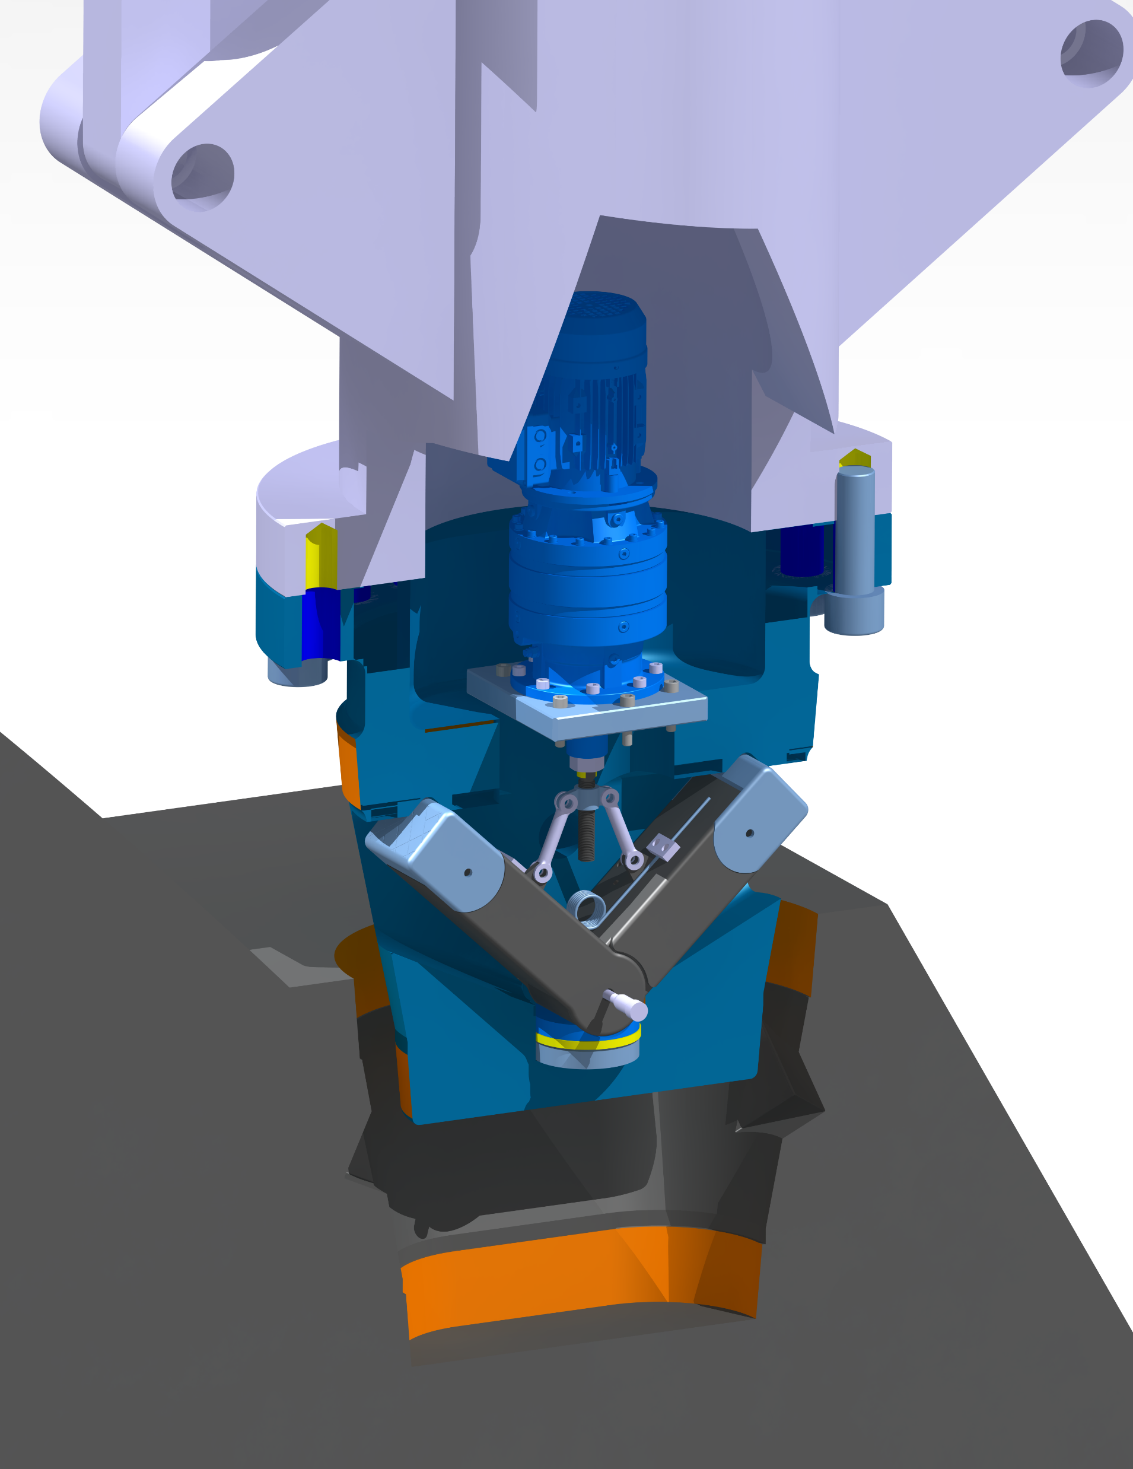
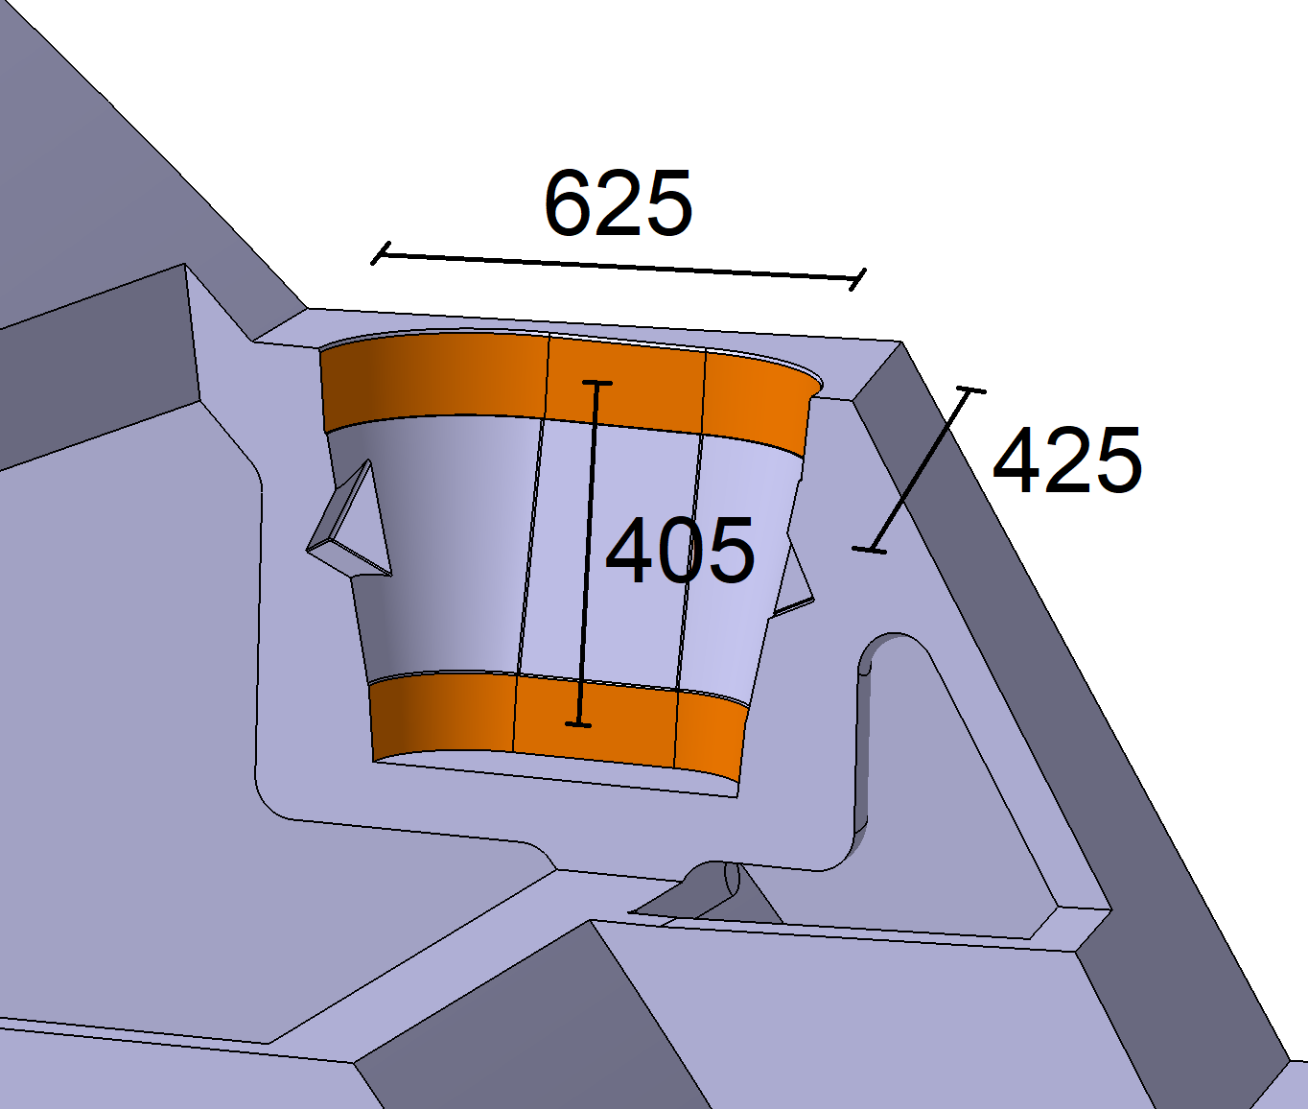
Engagement with BB
[T. Steinbacher et al, Fus. Eng. Des. 193 (2023) 113641]
Rigid attachment to transfer moments.
→ Requires the precise alignment of the vertical axes.
Section through BB engagement point
Bachmann | March 2024

Slide 8
Deflection and correction
Due to off-centered lifting.
A preload must be applied prior to lifting. This prevents a sudden deflection of the BB segment when it disengages from its bottom support.
The preloading movement is very small, e.g. ±0.6°.
Rotation about toroidal axis: by gripper tilting mechanism
Rotation about radial axis: by trolley tilting mechanism

Slide 9
Summary
Status:
Design of an integrated concept for BB remote replacement:
Design withstands all loads that occur during the handling.
Capability to perform the required manipulations and the engagement with the BB.
Fits within the available space.
Suitable interface to BB identified.
Next steps:
Further design developments e.g., cable routing.
Recovery scenarios
BB position monitoring and control system development.
Validation in test facility.

Slide 10
Thank you for your attention

