Slide 1
SP B update and plans for 2024
WPPWIE midterm meeting, Espoo, Finland, 6-9 February 2024
Antti Hakola
On behalf of the SP B team and task holders

Slide 2
Introduction and overview of SP B in 2024
SP B has the same activity areas (SP B.1, SP B.2, SP B.3, SP B.4, and SP B.5) in 2024 as in the previous years but with the following changes:
SP B.1: focus on cross-machine investigations
  Impact of flux on erosion (continuation from 2023); extend the investigations to samples with re-deposited W
  Include B-containing layers on the agenda, in the first place as proxies for potential re-deposits following material-migration steps
  Dust-impact studies returned here
SP B.2: concentrate on WEST ITER-like PFUs and samples from boronization studies
  Analyses of WEST C3-C5 marker tiles finished except for a few specific tasks, monoblock samples slowly becoming available for analyses
  Production of samples for AUG boronization studies and analyses of AUG/WEST components for their B profiles
  W7-X activities on manipulator samples from OP2
SP B.3: service tasks as before – samples coming from SP B.1 and SP B.2 (+ SP B.4)
SP B.4: production of layers as before – but now B and W (previously Be and W)
  Also here we can start with potential proxies for re-deposits following material migration, actual boronization layers hard to be mimicked and would require in situ approaches
SP B.5: dust activities as in 2023 but some tasks pending for decision on additional resources
  Analyses of laboratory-made B and W dust and their link to the produced reference layers
  Analyses of AUG, WEST, and W7-X dust following boronizations (pending for funding decision)
No big changes to the already established PM levels (=envelope integrated over all SP B.x) – until the scope of the new SP F on boronizations becomes clearer + more funding received from EUROfusion
Also implies that the production schedule for B layers is still largely open while W layers represent a clearer case

Slide 3
Feedback from the Tervaniemi meeting (6-9 February)
Boronizations ↔ impact on the SP B.2 and SP B.4 plans
  Open questions: (i) remobilization of B, (ii) how will boronizations change W sputtering?, (iii) complex boron chemistry
  Boronizations will result in the formation of a-B:H/B:D layers – and upon exposure to vents may change composition drastically
  B reservoir can be limited, which also impacts T retention and in present-day devices C changes the stability of the layers
W sputtering ↔ impact on the SP B.1 and SP B.2 plans
  Role of oxygen may be crucial besides seeding impurities (like Ne) → calls for understanding the role of O, also with B and W
  We have large differences between the co-deposits on AUG and WEST → what is the reason for this?
  Self-sputtering may be a true issue in ITER/DEMO conditions at the divertor for high-energy particles
Recommendations for next steps were also put forward in the ITPA DiVSOL meeting (Kyoto, Japan, 26-29 February) but the consolidated recommendations are not yet available

Slide 4
SP B milestones in 2024
WM86 | SP B | Production and detailed characterization of co-deposited boron layers (B, B-O, B-W) with varying amounts of fuel (D) for erosion and fuel-retention studies (ITER) | 31.12.2024
WM87 | SP B | Erosion and re-deposition rates of model systems for re-deposited W layers in metallic fusion devices as a function of plasma para-meters expected in a reactor estimated (ITER+DEMO) | 31.12.2024
WM88 | SP B | Comparison between deposition and surface-modification patterns on marker tiles and ITER-like PFUs after the Phase 1 and long-pulse operation of WEST done (ITER) | 31.12.2024
WM89 | SP B | Characteristics of dust produced in metallic fusion devices with and without boronizations and comparison with B-containing dust produced in corresponding laboratory experiments (ITER+DEMO) | 31.12.2024

Slide 5
SP B.1 deliverables in 2024
Activity | Deliverable ID(s) | Title
SP B.1 | D001 4 PM (5 PM) | Erosion rates of W model systems in Ar/He/D plasmas and sputtering rates of B and W+B layers at varying D plasma conditions in MAGNUM-PSI (DIFFER)
SP B.1 | D002 4 PM | Erosion rates of W model systems in Ar/He/D plasmas and sputtering rates of B and W+B layers at varying D plasma conditions in GyM (ENEA)
SP B.1 | D003 7 PM | Erosion rates of W model systems in Ar/He/D plasmas and sputtering rates of B and W+B layers at varying D plasma conditions in PSI-2 (FZJ)
SP B.1 | D004 5 PM | Erosion rates of re-deposited W and W+B model systems following exposure to controlled D ion beams (ÖAW)
SP B.1 | D005 1 PM | Erosion and deposition patterns following high-energy dust impacts on W model systems and comparison to data from tokamaks (ENEA)
Machine resources: 6 days on MAGNUM-PSI, 20 days on GyM, 10 days on PSI-2 + accelerator days

Slide 6
Cross-machine experiments in linear devices
MAGNUM-PSI (DIFFER):
  Study 1: determining sputtering rates of B+D layers with varying D/B ratios
    Determine B transport under deposition conditions and its subsequent erosion by plasma → in situ NRA applied
  Study 2: comparing W erosion rates by Ar to data available from PSI-2 and GyM
  Study 3: exposing re-deposited W layers to determine their erosion characteristics
GyM (ENEA):
  Study 1: exposing nanocolumnar W samples to Ar plasma (leftover samples from 2023)
    Ion flux 1.4×10²⁰ m⁻²s⁻¹, fluence up to 1.0×10²⁵ m⁻², bias voltage to be decided
    Characterization using AFM and SEM-EDX
  Study 2: studying erosion of B and W+B layers – pending for decisions
    NB! GyM shutdown in late 2024
PSI-2 (FZJ):
  Study 1: preparing B layers and mixed B+W layers by magnetron sputter deposition and characterization in house
    Work to be done under SP B.4, also linked to SP C activity “Hydrogen permeation and retention in B coated W or steel”
  Study 2: exposing B layers to PSI-2 plasmas
    B I and B II spectroscopy possible at PSI-2 (including VUV regime), also high-resolution spectroscopy similarly to that of W I
  Study 3: exposing bulk W and fuzzy W to Ar plasma in PSI-2
    Combined with post-mortem FIB/SEM investigations – also erosion FIB markers on the agenda
1 μm W films by HiPIMS
1 μm W + 15 at.% O films by PLD
2 μm
5.1 μm W films by CMSII
4 μm W + 3 at.% O
films by HiPIMS
Follow-up meetings in the near future: (i) production of in situ layers vs. ex situ ones?; (ii) layer parameters for systematic studies of erosion rates and choice of exposure parameters?

Slide 7
Cross-machine experiments in linear devices
MAGNUM-PSI (DIFFER):
  Study 1: determining sputtering rates of B+D layers with varying D/B ratios
    Determine B transport under deposition conditions and its subsequent erosion by plasma → in situ NRA applied
  Study 2: comparing W erosion rates by Ar to data available from PSI-2 and GyM
  Study 3: exposing re-deposited W layers to determine their erosion characteristics
GyM (ENEA):
  Study 1: exposing nanocolumnar W samples to Ar plasma (leftover samples from 2023)
    Ion flux 1.4×10²⁰ m⁻²s⁻¹, fluence up to 1.0×10²⁵ m⁻², bias voltage to be decided
    Characterization using AFM and SEM-EDX
  Study 2: studying erosion of B and W+B layers – pending for decisions
    NB! GyM shutdown in late 2024
PSI-2 (FZJ):
  Study 1: preparing B layers and mixed B+W layers by magnetron sputter deposition and characterization in house
    Work to be done under SP B.4, also linked to SP C activity “Hydrogen permeation and retention in B coated W or steel”
  Study 2: exposing B layers to PSI-2 plasmas
    B I and B II spectroscopy possible at PSI-2 (including VUV regime), also high-resolution spectroscopy similarly to that of W I
  Study 3: exposing bulk W and fuzzy W to Ar plasma in PSI-2
    Combined with post-mortem FIB/SEM investigations – also erosion FIB markers on the agenda
M. Sackers et al, Phys. Scripta (2023) 98 115603
Example of high-resolution spectroscopy on W I for erosion studies
Follow-up meetings in the near future: (i) production of in situ layers vs. ex situ ones?; (ii) layer parameters for systematic studies of erosion rates and choice of exposure parameters?

Slide 8
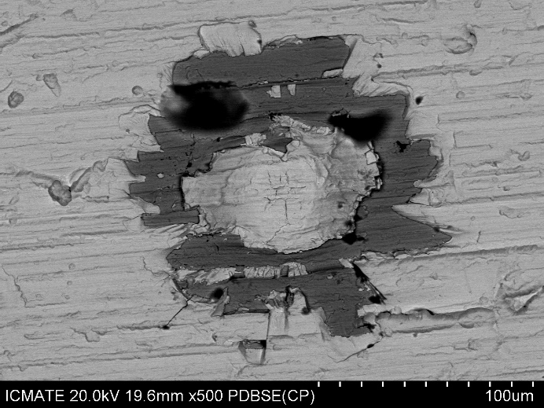
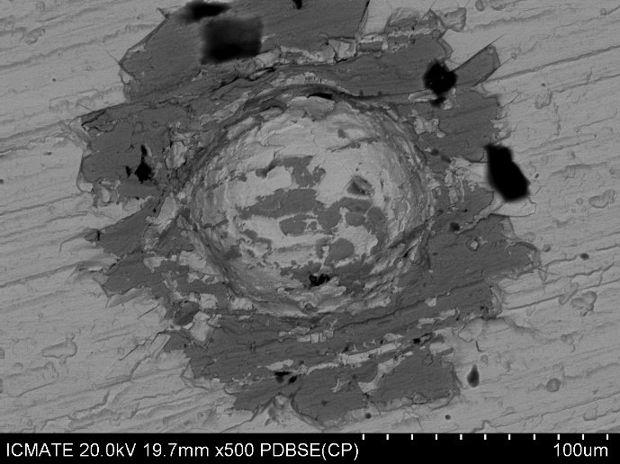
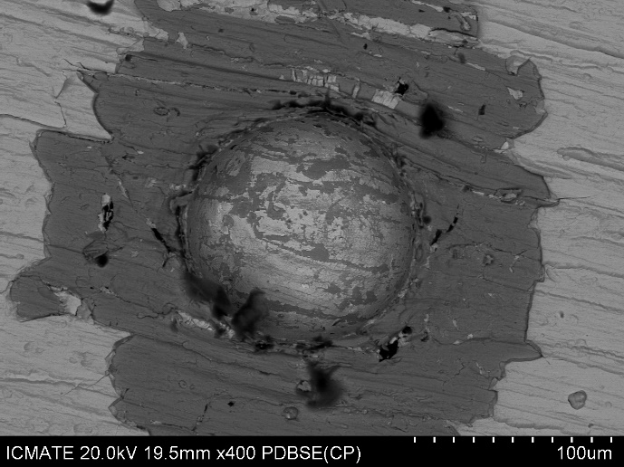
Laboratory studies
Erosion investigations in laboratory conditions (ÖAW)
  determine sputter yields for W and W+B model systems under bombardment of 2 keV D₂⁺ ions using the QCM measurement technique
  measure the angular dependence of sputter yield values
  results can be complemented by using Ar as a projectile species
  measured values can be further compared to simulation results → synergy with SP D
Influence of dust impacts on erosion and other properties of the co-deposits (ENEA):
  Investigate the vanishing bounding regime vs W-O co-deposit thickness
  Investigate the vanishing bounding regime vs different co-deposited type or O concentration in W-O co-deposit
  Investigate the W-O co-deposit delamination vs samples temperature (from RT to 400°C) to be closer to the actual environment in tokamaks
Already agreed: evaluate the amount of W-O co-deposit removed upon dust impacts → thickness of the co-deposits should be up to 4-5 μm and different dust speeds to be applied (e.g., 600, 1000, and 1500 m/s)
Electron back scattered images of IAP samples shot at 830 m/s (left), 1244 m/s (centre), and 2066 m/s (right). Light colour: W; darker one: Mo.

Slide 9
SP B.2 deliverables in 2024
Activity | Deliverable ID(s) | Title
SP B.2 | D001 2 PM | WEST campaigns: erosion and deposition patterns on PFUs after WEST Phase 1 (C1-C5) and Phase 2 (C6-C7) operations (CEA)
SP B.2 | D002 2 PM | WEST campaigns: deposition profiles of He and B on PFUs after WEST Phase 1 operations (RBI)
SP B.2 | D003 3 PM | WEST campaigns: detailed investigation of selected PFUs, including side faces of marker tiles, after WEST Phase 1 and Phase 2 operations for their erosion, deposition, and surface-modification patterns (MPG)
SP B.2 | D004 3 PM | AUG manipulator experiments: pre- and post characterization of samples exposed to AUG plasmas for their erosion, deposition, and surface-modification patterns (MPG)
SP B.2 | D005 3 PM | AUG manipulator experiments: deposition profiles of B and D on samples exposed to AUG plasmas (VTT)
SP B.2 | D006 2 PM | W7-X manipulator experiments: erosion and deposition characteristics on manipulator and other samples exposed to OP2 plasmas on W7-X (FZJ)
SP B.2 | D007 4 PM | W7-X manipulator experiments: erosion and deposition characteristics of manipulator samples and wall components from OP2 experiments in W7-X (MPG)
SP B.2 | D008 2 PM | WEST campaigns: microscopy investigations of He-exposed PFUs after WEST Phase 1 (CEA)

Slide 10
Priorities for WEST and AUG analyses
WEST analyses (CEA, RBI, MPG, SP B.3)
  Summarize (and complete the work) on the C1-C5 erosion markers (CEA, MPG, SP B.3)
    Focus on top surfaces and side faces of the skeletons
  Cut samples (CEA) + start analyses on the ITER-like PFUs from Phase 1 (CEA, MPG, SP B.3)
  Continue investigating He-exposed standard graphite tiles (CEA, RBI)
  Priority 2 activities
    Evaluate the erosion profile of C5 standard graphite tiles (toroidal/poloidal directions (CEA)
    Prepare 1 ITER-like PFU phase 2 for surface analysis (CEA + MPG)
    Continue the work on the gaps (CEA + MPG)
AUG analyses (MPG, VTT)
  Focus on samples coming from old and new boronization investigations (manipulator samples + silicon collector samples)
  Revisit results from depositions on WEST (C1-C5) regarding behaviour of boron → more difficult than originally thought
  Revisit observed boron splashes on AUG (from dust dropper or ICRH protection limiters) → clear deposits observed in the grooves of coatings on ICRH limiter tiles
Potentially other samples – pending for AUG re-start in the autumn to see the exact 2024 experimental programme
Follow-up meetings in the near future: (i) detailed discussion on AUG experimental plans → in connection with WPTE RT-06, (ii) WEST analysis meeting, now re-scheduled into 1-2 July, 2024

Slide 11
Priorities for W7-X analyses
MPG activities:
  Boronisations
    Exposing samples using the multipurpose manipulator (MPM) during individual boronizations
    Analysis of layers deposited during boronisations using RBS and NRA
    Summarizing results at the PSI conference
  Analysis of wall tiles:
    Analysis of about 30 wall tiles (including marker layers) from the inner wall and baffles for deposition of B and C and erosion of W
  Measurement of charge-exchange fluxes:
    Measure the CX flux using catcher probes with the MPM
    Analysis of the hydrogen content of the catcher probes using ERDA with incident He ions
    Development of a new technique for measuring the energy distribution of charge-exchange fluxes using layered metal samples
FZJ activities - requires careful discussion on which samples are still available and relevant for analyses
  Scheduled analysis of existing samples exposed to OP2 plasma on W7-X, focus on MPM samples (after boronizations) and CX catcher probes using LIBS, FIB/SEM/EDX/TEM, and NRA
  Proposals to participate in operation campaigns OP 2.2 and OP 2.3 submitted – both using the multisample near-SOL manipulator
    Erosion and re-deposition of bulk W
    Erosion and redeposition mechanisms of boron and boron tungsten layers
Boronization on 4.2.2023

Slide 12
SP B.3 deliverables in 2024
Activity | Deliverable ID(s) | Title
SP B.3 | D001 2 PM | Depth profiles and surface morphology of selected B or W+B layers (CIEMAT)
SP B.3 | D002 4 PM | Surface modifications and fuel content of selected AUG, WEST, W7-X, and PSI-2 samples (FZJ)
SP B.3 | D003 1 PM | Composition of layers on selected WEST monoblock samples (IAP)
SP B.3 | D004 3 PM + 2 PM (AR) | Surface modifications of selected WEST, W7-X, MAGNUM-PSI, PSI-2, and GyM samples (IPPLM)
SP B.3 | D005 3 PM | Composition and fuel content of layers on selected WEST monoblock samples (IST)
SP B.3 | D006 4 PM | Micro- and macroscale composition of layers on selected AUG, WEST, and GyM samples (JSI)
SP B.3 | D007 2 PM | Surface modifications and erosion/deposition profiles of samples and wall tiles from AUG, WEST, W7-X, and MAGNUM-PSI (MPG)
SP B.3 | D008 4 PM | Surface modifications and composition of layers on selected WEST monoblock and GyM samples (NCSRD)
SP B.3 | D009 2 PM | Micro- and macroscale composition of layers on selected AUG, WEST, MAGNUM-PSI, and PSI-2 samples (RBI)
SP B.3 | D010 2 PM | Erosion and deposition patterns on selected WEST monoblock samples as well composition of plasma-exposed B, W, or W+B layers (VR)
SP B.3 | D011 2 PM | Depth profiles and composition of deposited layers of selected samples from AUG, WEST, W7-X, and MAGNUM-PSI (VTT)
SP B.3 | D012 0 PM (2 PM) | Depth profiles and fuel content of selected B or B+W layers (ENEA)

Slide 13
Priorities for surface analyses (ion-beam analyses)
FZJ:
  Analyses of samples from SP B.1 and SP B.2 experiments
IST:
  Comparative analysis between SIMS (VTT) and NRA/EBS/PIXE (IST)
  Analysis of D, C, B contents by NRA, erosion studies by RBS/EBS
  Analysis of main heavier contaminants by PIXE
JSI:
  Broad-beam analyses (NRA, RBS, PIXE) for selected samples
  Micro-beam analyses (RBS, PIXE) for selected samples
MPG:
  Analyses of samples from SP B.1 and SP B.2 experiments
NCSRD:
  Characterization of plasma-exposed samples using ion beam analysis (RBS/NRA, PIXE/PIGE, TOF-ERDA)
RBI:
  Broad-beam (RBS, NRA, TOF ERDA, PIXE) and micro-beam (RBS, NRA, PIXE) analysis of samples
VR:
  Surface composition and depth profiles using ion beam analysis, with focus on TOF-ERDA and RBS
  Resonant-NRA at low energies combined with RBS will be performed in selected samples to obtain
  high-sensitivity and high-resolution boron depth profile (E. Pitthan et al. Surf. Coat. Tech. 417 (2021) 127188)
  Setups at Tandem Laboratory at Uppsala University (P. Ström and D. Primetzhofer, J. Instrum. 17 (2022) P04011)
VTT:
  Analyses of samples from SP B.1 and SP B.2 experiments
W7-X, PSI-2, WEST
WEST, MAGNUM-PSI
WEST, GyM, PSI-2
W7-X, WEST, MAGNUM-PSI
WEST, GyM, MAGNUM-PSI, PSI-2
WEST, GyM
WEST, W7-X, PSI-2
WEST, GyM, MAGNUM-PSI

Slide 14
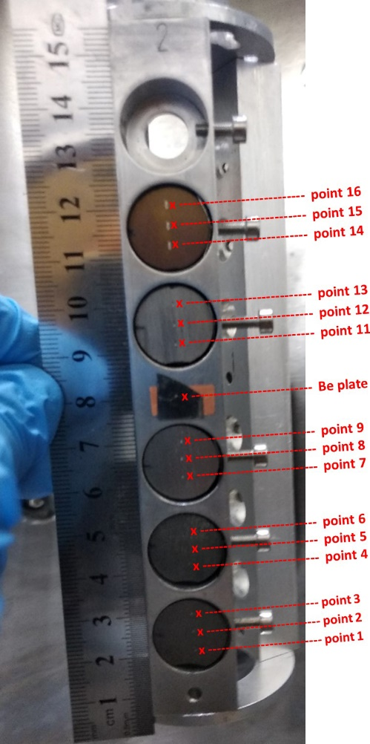
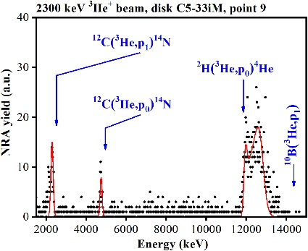
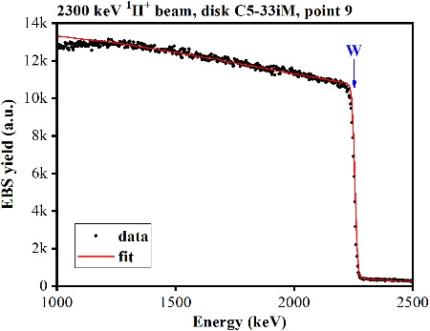
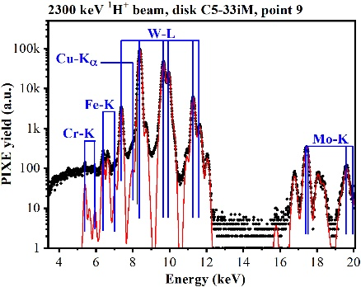
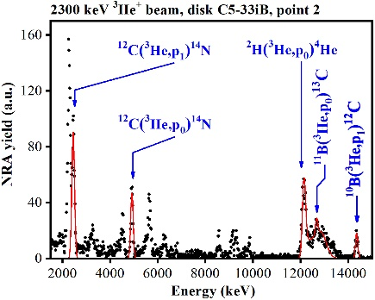
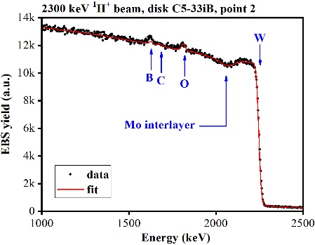
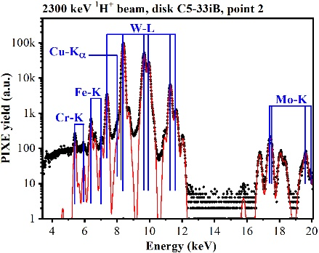
Example: ion-beam analyses of WEST C5 samples (IST)
Analysed points: x – IBA / IST
(small white dots – SIMS / VTT)
Quantification of elemental co-deposition in exposed C5 WEST tiles by IBA at IST:
NRA, EBS and PIXE nearby the points previously analysed by SIMS at VTT
EBS - deposition areas - Mo layer easily identified in C5-33iB, C5-21oJ
Mo layer difficult to identify in C5-33iK
erosion areas - Mo layer eroded from C5-33iM, C5-22oE
Example of IBA spectra collected for the elemental analysis of tile C5-33iB at point 2 :
PIXE - quantification of Cu, Fe, Cr, identified as the main heavier impurities
C5-21oJ
NRA
PIXE
EBS
C5-21oE
C5-33iM
C5-33iK
PIXE
NRA
EBS
C5-33iB

Slide 15
Priorities for surface analyses (other techniques)
CIEMAT:
  SIMS and SEM analyses for samples coming from SP B.1 experiments and SP B.4
ENEA:
  SIMS, XPS, TDS (950 °C), LEIS devices available
FZJ:
  Microscopy analyses of samples from SP B.1 and SP B.2 experiments
IAP:
  GDOES and XPS for WEST samples (similarly to C3-C5 marker tiles)
IPPLM:
  Microscopy analyses of samples from SP B.1 and SP B.2 experiments
MPG:
  SEM and FIB analyses of samples from SP B.1 and SP B.2 experiments
NCSRD:
  Determination of surface state and crystalline structure of plasma-exposed samples (SEM/EDS, XRD)
VTT:
  SIMS analyses of samples from SP B.1 and SP B.2 experiments
GyM, MAGNUM-PSI, PSI-2
TBD
W7-X, WEST, PSI-2
WEST
WEST, GyM, MAGNUM-PSI, PSI-2, dust gun
WEST, W7-X, MAGNUM-PSI
WEST, GyM, MAGNUM-PSI, PSI-2
WEST, GyM, MAGNUM-PSI
Follow-up meetings in the near future: (i) Make a detailed decision on who should analyse what and (ii) consider adding other analyses like indentation and phase-change studies in the task descriptions for 2025

Slide 16
SP B.4 deliverables in 2024
Activity | Deliverable ID(s) | Title
SP B.4 | D001 3 PM | W- and B-based coatings with pre-defined composition and morphology for experiments in linear plasma facilities (ENEA)
SP B.4 | D002 2 PM | W-based coatings with pre-defined composition and morphology for experiments in linear plasma facilities (IAP)
SP B.4 | D003 6 PM | B- and W+B coatings with pre-defined composition and morphology for comparison with data from tokamaks (IAP)
SP B.4 | D004 2 PM + 1 PM (AR) | Microscopy investigations of selected B, W+B, and W reference samples (IPPLM)
SP B.4 | D005 2 PM | Raman analyses of selected B and W+B reference samples (CEA)
SP B.4 | D006 1 PM | SEM and SIMS analyses of selected B, W+B, and W reference samples (CIEMAT)
SP B.4 | D007 2 PM | LIBS and SEM analyses of selected B and W+B reference samples (FZJ)
SP B.4 | D008 5 PM | Ion-beam analyses of selected B, W+B, and W reference samples (IST)
SP B.4 | D009 3 PM | XPS and TDS analyses of selected B and W+B reference samples (JSI)
SP B.4 | D010 4 PM | Ion-beam and structural analyses of selected B and W+B reference samples (NCSRD)
SP B.4 | D011 1 PM | TOF-ERDA analyses of selected B, W+B, and W reference samples (RBI)
SP B.4 | D012 2 PM | Ion-beam analyses of selected B and W+B reference samples (VR)
SP B.4 | D013 1 PM | SIMS measurements of selected B, W+B, and W reference samples (VTT)

Slide 17
Production and analyses of the reference samples (part I)
B- and W-based layers and their characterization using PLD and HiPIMS/magnetron sputtering (ENEA):
  Production of reference coatings with different morphologies and crystallinity - from compact to porous, from crystalline to “amorphous”
    Use both metallic and patterned Si substrates (flat vs. pyramidal)
  Varying the impurity content of the layers (O, N, Ne)
    For B-based layers, concentrate on varying the oxygen content (from 10% to 60%)
  Production of multilayer structures of W and bilayers of W and B and O and mixed B+W layers (from a mixed target)
  Characterization by SEM, EDX, and AFM
Production of B-based layers for PSI-2 experiments (FZJ):
  Preparation of pure and mixed layers using magnetron sputtering and characterization in house
    Analysis of the samples with LIBS, FIB/SEM/EDX and TEM when required; NRA for comparison
    Comparison to magnetron produced B-D films on W
  First measurements on B layers produced on W substrates and on mixed B+W layers
    Good signals, 60-80 nm depth resolution
    Further optimize the setup to improve the detection limit and obtain absolute B quantification
    VUV spectroscopy being applied for W and D atomic + molecular lines
LIBS measurement spots on a B-W sample

Slide 18
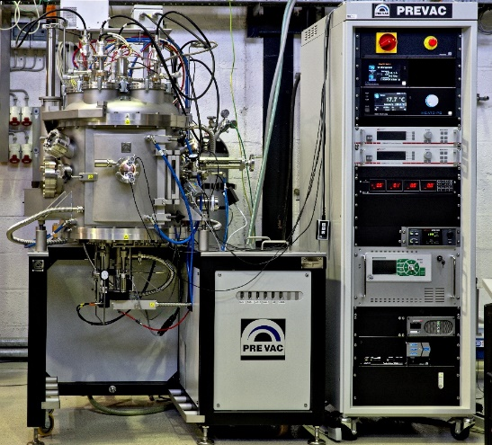
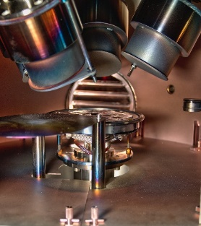
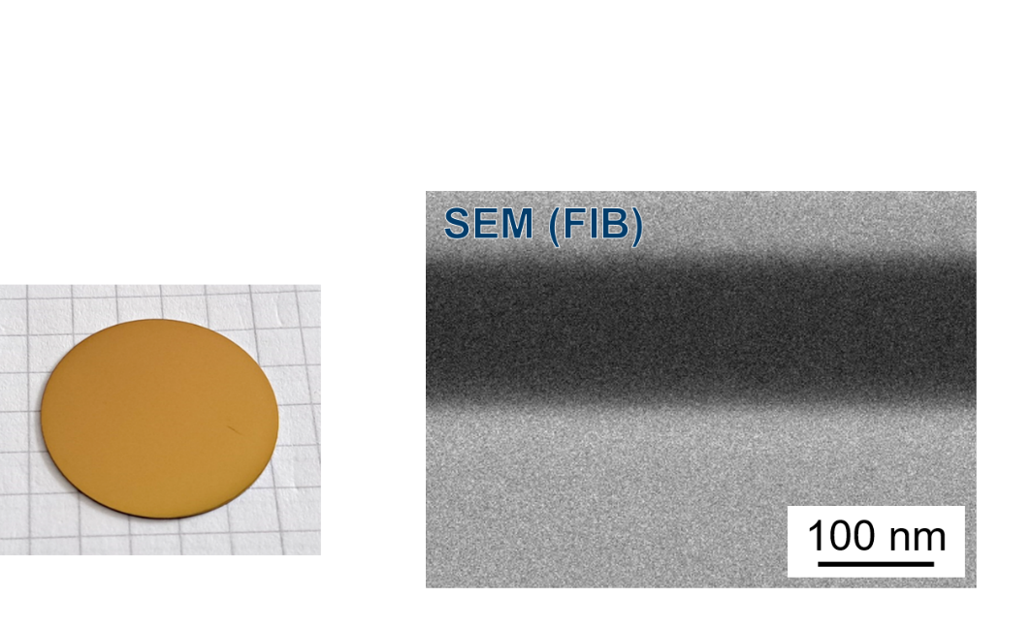
New FZJ capabilities for the production of B-based layers
Boron layer fabrication in laboratory: Magnetron sputter deposition
Polished 316L(N)-IG steel and W samples
RF magnetron deposition with boron target and Ar plasma
SEM(FIB): Homogeneous layer thickness, dense layer, XRD: amorphous
EDX: Oxygen on interface to steel, but less in layer
Layer thickness: 120 nm (6 h deposition time!)
Annealing in vacuum at 550°C for ~5 h → no change of sample state
4 magnetrons, simultaneous operation possible
Base pressure 10⁻⁷ mbar
Rotating sample stage → homogeneous layer
Biased and heatable sample stage
Gas injection ring close to sample for reactive sputtering (oxygen, hydrogen, nitrogen)
Large sample stage

Slide 19
Production and analyses of the reference samples (part II)
Production of W layers (IAP):
  Production of W coatings with varying H and D depth profiles simultaneously
  Analysis of the produced coatings:
    GDOES for depth profiling, XPS for chemical composition, XRD for phase composition
Production of B layers (IAP):
  Repeat the exercise performed with CEA in 2022 and 2023:
    2024: BD and BH with high H and D contents (more than 10%), thermally treated from 50°C to 500°C
    2025: Oxygen addition to the same set of samples
  Samples for permeation studies under SP C as follows:
    2024: different thickness samples 500 to 5000 nm, pure B
    2025: gaseous inclusions of the types of samples
  For micromechanical measurements and water exposure to check the delamination behavior of B surface layers exposed to boiling water
    2024: B-coated W substrates, 12×15×1 mm³, 5 μm, dense and porous
    2025: boron with D 10 % of 10×10×1 mm³ samples
  Additionally: B+W (pure and D doped) composite coatings for re-deposition studies
  Analysis of the produced coatings using SEM, TDS, XRD, Sputtered XPS and nanoindentation
Main points for consideration
Shall we concentrate on emulating co-deposits rather than layers from boronizations?
Should one produce a protective, passivating layer on top?
Should we perform comparative depositions using different techniques (PLD, magnetron sputtering, TVA,…)?
Should we make extensive pre-characterization of layers before sending them around?

Slide 20
Surface-analysis services for the produced reference layers
CEA:
  Raman investigations of the produced B-based layers - comparison to Be-containing samples
CIEMAT:
  SIMS and SEM analyses for selected W- and B-based layers – start with W layers from ENEA and IAP
IPPLM:
  Microscopy analyses of selected W- and B-based layers – W layers for SP B.1 experiments and B layers to be compared to Be and JET data
IST:
  Implantation of huge D amounts in W-based coatings, followed by NRA/TOF-ERDA and SIMS (VTT) and LIBS (SP X)
  B quantification by NRA using proton beams
JSI:
  TDS and XPS analyses of the produced W and B layers – specific set to be produced for permeation studies (influence of B layers on retention and permeation through W and Eurofer)
NCSRD:
  Analysis of B and W+B based reference samples as a function of their H/D content, deposition/annealing temperature, and roughness using IBA, XRD, SEM/EDS
  In-situ (GI)XRD analysis to follow the crystalline structure, phase formation and crystallize size evolution
RBI:
  NRA, PIXE, and TOF-ERDA analyses of different samples
VR:
  RBS, TOF-ERDA, and (resonant)-NRA analyses for selected W- and B-based layers
  Sputtering deposition machine at Tandem Laboratory available for B and W+B depositions
VTT - may be delayed into 2025 due to the delivery of the new SIMS device
  SIMS analyses of the produced W- and B-based layers – comparison to the data available from Be-containing samples and from tokamaks

Slide 21
Collaborations with other SPs and EUROfusion activities
SP X collaboration and LIBS development
  Main point to be decided: Is our interest in (i) studying layers expected after a single boronization (<50 nm, B only) or (ii) investigating layers formed as a result of material migration (thicker layers and more complex in structure/composition)?
  In any case, depth resolution of ~15 nm (=shallow ablation depths) required for LIBS studies to efficiently determine the impurities and their concentrations as a function of depth
  LIBS can be applied for studying the composition and fuel retention in such layers
    Can also be combined with LID-QMS
  LIBS can be combined with linear-machine experiments in PSI-2, UPP and MAGNUM-PSI → in situ investigations
ENR collaboration
  There is a new ENR project on the production of B layers (involves ÖAW, VR, and VTT) → co-ordination needed
  Contents of the ENR project
    Deposit B + (W/EUROFER) in different atmospheres (including isotopically enriched B)
    Perform a detailed characterization of the samples, focus on (i) in situ material modifications during annealing and ion irradiation, (ii) sputtering yield and mechanical characterization
    Model the modifications of these structures with MD
Follow-up meetings in the near future: (i) Dedicated meetings on SP B – SP X as well as SP B – ENR collaborations, (ii) elaborate the sample production matrix for 2024

Slide 22
SP B.5 deliverables in 2024
Activity | Deliverable ID(s) | Title
SP B.5 | D001 1.5 PM | Database of the characteristics of produced W dust particles and comparison with data from tokamaks (IAP)
SP B.5 | D002 1.5 PM | Database of the characteristics of produced B dust particles and comparison with data from tokamaks (IAP)
SP B.5 | D003 2 PM | Document on the characteristics and amount of dust generated on ASDEX Upgrade during past experimental campaigns and on the connection of arcing on dust production (MPG)
SP B.5 | D004 2 PM | Document on the physical and remobilization characteristics of dust produced on ASDEX Upgrade and MAGNUM-PSI (VR)
SP B.5 | D005 0 PM (2 PM) | Microscopy analyses of the dust samples originating from WEST and W7-X (IPPLM)
SP B.5 | D006 0 PM (2 PM) | Surface analyses of dust generated on ASDEX Upgrade, WEST, and W7-X following boronizations (MPG)
SP B.5 | D007 0 PM (2 PM) | Ion-beam analyses of dust samples originating from ASDEX Upgrade, WEST, and W7-X (RBI)
SP B.5 | D008 0 PM (2 PM) | Report on the properties, composition, and amounts of dust produced on WEST during the Phase 1 operations (CEA)
SP B.5 | D009 2 PM | Fracture and strentgh properties of B and W reference layers on W (UKAEA)

Slide 23
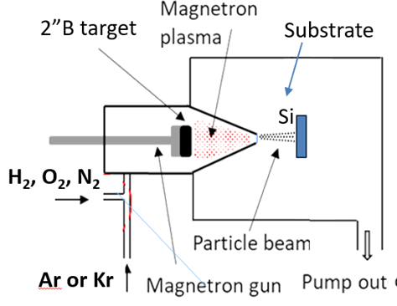
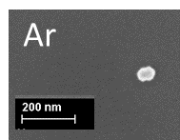
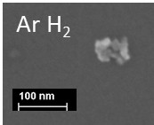
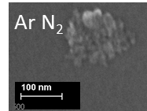
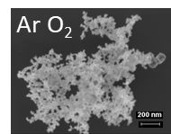
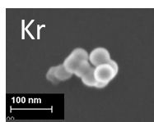
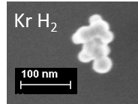
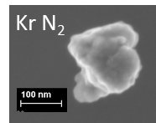
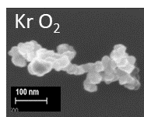
Dust production activities – laboratory activities
Laboratory investigations – continue the program initiated in 2021-2023 but now shift the focus away from Be (IAP)
  Continuation of the W dust synthesis activities performed in 2023 by MSGA :
    W dust generation by MSGA at high D₂ content in the presence of water leaks (off-normal operation);
    Measurement of D₂ retention in obtained W
    Dust characterization (SEM, XPS)
  Investigations for the synthesis of B dust using MSGA:
    Looking for the optimum parameters for B dust synthesis
    Investigations (SEM, XPS) of the obtained B-based material
MSGA experimental setup:
First B particles synthetized by MSGA - SEM results :
Preliminary conclusions:
Synthesis rate of the B dust is much smaller when compared to W;
It seems that H₂ does not increase the synthesis rate (unlike for W);
B nanoparticle synthesis rate is influenced by the impurities present
50 nm
~10 nm agglomerated
~10 nm agglomerated
30-40 nm
20-40 nm
~180 nm from small NPs
30-40 nm
Possible future activities:
Dust synthesis from a W target coated with B

Slide 24
Dust production activities – laboratory and tokamak activities
Laboratory investigations – continue the program initiated in 2021-2023 but now shift the focus away from Be (IAP)
  Investigations of B dust production using the plasma-arc device
    2024: systematic study on B dust particle formation and size with the arc parameters
    2025: extend the studies to dust with gaseous addition (air leak and water vapors)
    Characterization using SEM, TDS, XPS → calling for XRD collaboration
    Investigations of B/W mixed and pure W dust production using the plasma-arc device
    2024: B/W particle formation using pure B or B/W composite coatings on W substrates, as well as W dust production by plasma arcing
    2025: extend the studies to dust with gaseous addition (D, He, etc, air leak and water vapors)
    Characterization as above
Dust generation in toroidal and linear devices – main lines of research for 2024 (MPG, VR)
  Finalize the documentation on existing knowledge on dust generation in AUG → pending
  Analyse dust particles collected in W7-X after O.P 2.1 and the latest dust collector samples from AUG
  Compare W dust particle size distributions collected in lab arc device with those measured optically therein and with those observed in AUG
  Survey in support of modelling the production and migration of boron or boron-rich dust/debris
  Obtain understanding on thermophysical properties of B dust and plasma-boron surface interactions
    Will be fed back into MIGRAINe modelling activity of intrinsic boron dust or injected boron powder → synergy with SP D

Slide 25
Dust production activities – impact of interfaces on layer degradation
  Aims of the task
      perform studies of mechanical properties of interfaces of reference B coatings on W substrates, using small-scale mechanical testing, to evaluate their potential for dust generation, and
      perform studies of the effects of water exposure of B coatings (mimicking water ingress into the vessel), to evaluate their potential for dust generation in accident conditions
  Samples will be provided by IAP (sample manufacturing has been already agreed)
  Fabrication and testing of microcantilevers at the interfaces will be performed at UKAEA:
      polishing equipment for producing a mirror polished cross-sectional surface suitable for FIB;
      FIB-equipped SEM for fabrication of microcantilevers; and
      nanoindentor for bending/fracture testing of microcantilevers.
      apparatus for water exposure experiments
  Expected outcomes
      estimates of interfacial strength and toughness of B coatings on W substrates, and
      estimates of the effects of water exposure
Follow-up meetings in the near future: (i) Discussion with FTD to decide on sharing the dust work between WPPWIE and WPSAE, (ii) coordination of reports summarizing the 2023 dust-survey tasks

Slide 26
Concluding remarks
SP B activities are proceeding at the moment at low speed due to
  ITER re-baselining work to shift the focus from Be to B and the need to agree on overall focus points
  Production of B-based samples to start only once the re-baselining exercise is completed and conclusions are drawn
  Delayed delivery of WEST samples, small number of W7-X samples and AUG only starting operations in late 2024
  Dust analysis tasks waiting for additional resources from EUROfusion
However, progress is being made for producing and exposing W-based samples in linear facilities (SP B.1)
  Requires agreeing on the relevant rows in the ”Master Excel” for W samples
First set of meetings to be held in April
  Discussion on exposure parameters for W samples (SP B.1)
  Updating Master Excel and analysis plan for W samples (SP B.4)
  Coordination meetings with SP X and the ENR project of VR

