Slide 1
WP PWIE: Re-deposition of W in the WEST divertor based on post-mortem analyses
M. Diez, C. Arnas, M. Balden, I. Bogdanovic, E. Fortuna-Zalesna, C. Martin, M. Richou, Z. Siketić, E. Tsitrone
09.04.2024
Notes:
Overview of the activities regarding WEST within SPB.
Give you a taste of what is going in SPB regarding WEST, and
Not everything is presented here ; it is just to give a taste of the activities

Slide 2


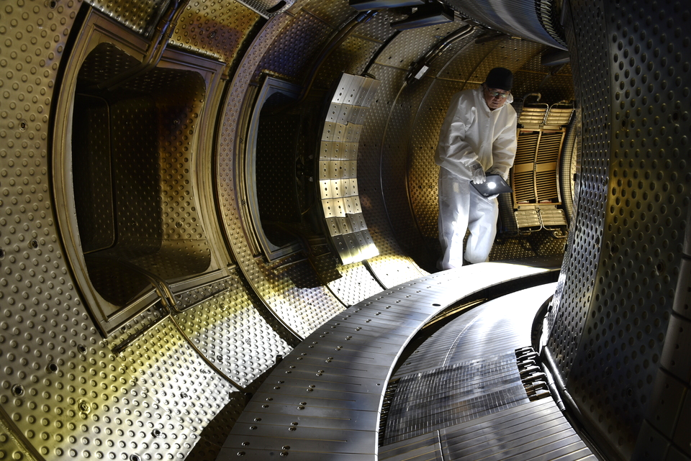
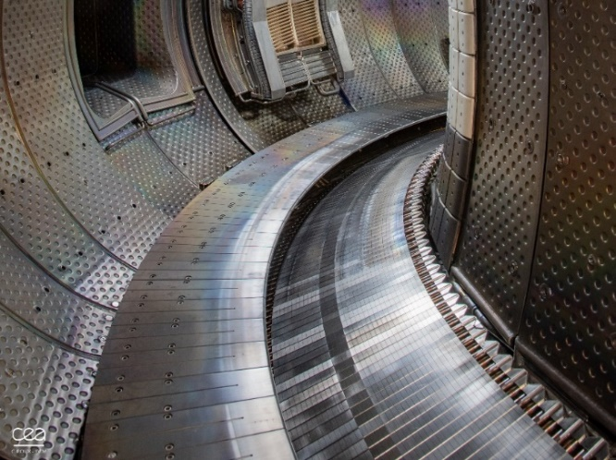
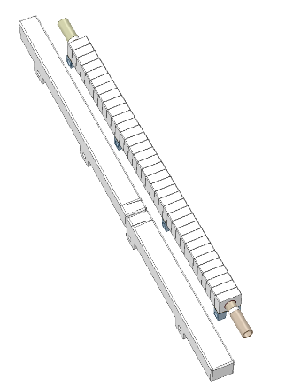
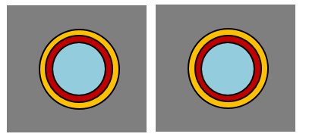
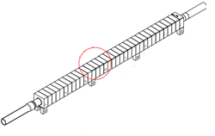
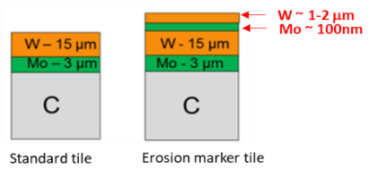

Configuration of the WEST divertor
today
Beveled W coated Gr tiles, including erosion markers
Actively cooled bulk W ITER-like PFUs -> “non beveled PFUs phase 1”
WEST phase 1
WEST phase 2
full ITER-like divertor -> « beveled PFUs phase2 »
PFUs phase 2
PFUs phase 1
W coated Gr tiles

Slide 3








A large variety of tiles available for the erosion/redeposition programme
today
Beveled W coated Gr tiles, including erosion markers
Actively cooled bulk W ITER-like PFUs -> “non beveled PFUs phase 1”
WEST phase 1
WEST phase 2
full ITER-like divertor -> « beveled PFUs phase2 »
Non beveled PFUs phase 1
Surface characterization on whole tiles 2020-2023
Cutting on progress 2024
Analysis of a few samples 2023
Beveled PFUs phase 2
Post mortem not available yet BUT
in-situ collection of deposited layers 2023
Surface chemical composition 2023
Beveled erosion Markers C1-C5
Surface characterization on whole tile + coring + samples analysis 2020-2023
Beveled standard Gr tiles
C4 tiles: Coring + helium content analysis
C5 tiles: Cutting + cross section analysis 2024

Slide 4
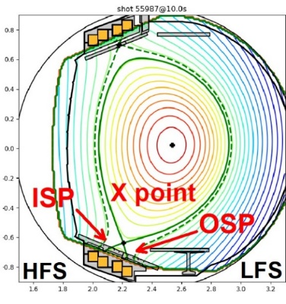
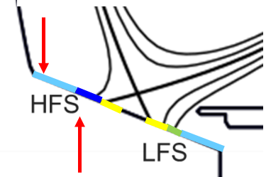
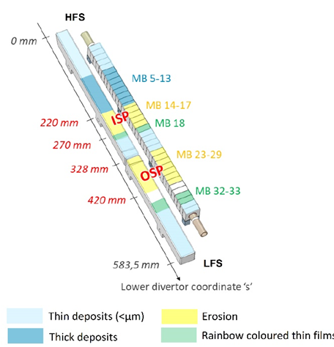
OUTLINE
Redeposition profile on WEST divertor: thin films
Redeposition profile on WEST divertor : thick films
Effect of the bevel on the redeposition profile
4. Conclusion and perspectives
[M. Diez, NME 2023]

Slide 5
OUTLINE
Redeposition profile on WEST divertor: thin films
Redeposition profile on WEST divertor : thick films
Effect of the bevel on the redeposition profile
4. Conclusion and perspectives
[M. Diez, NME 2023]

Slide 6
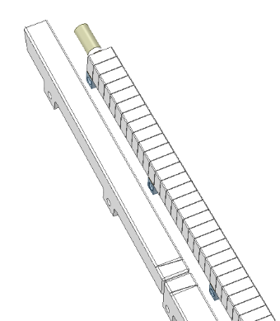
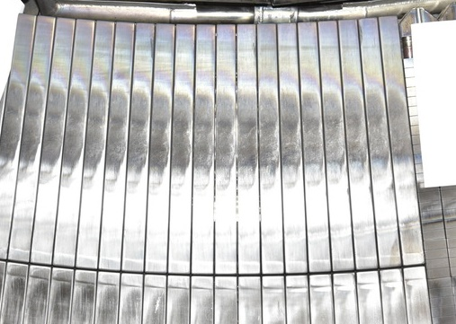
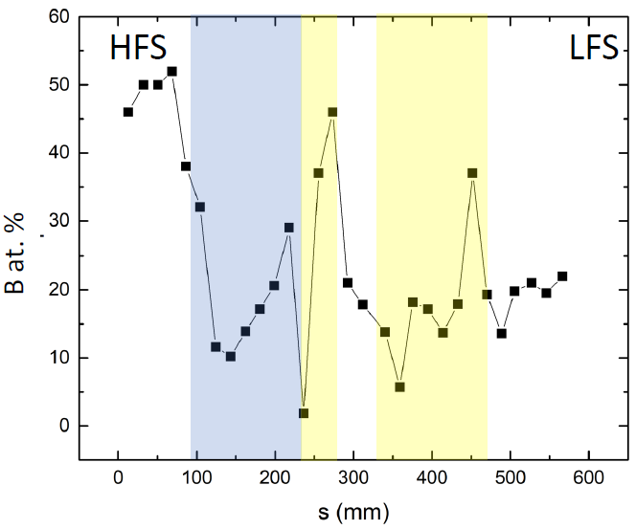
Thin boron rich layers at the inner end of the divertor
Thin films area : inner end of HFS
[I. Bogdanovic, ISFNT 2023]
Boron
Gr tiles
Post C4
  IBA, LIBS, SEM, Raman, SIMS performed either on Gr tiles or/and ITER-like PFUs
  Rainbow coloured structured films (W oxides)
  Significant B found in far SOL thin deposits by Tof-ERDA (but also evidenced in thick deposits)
  Thickness of deposited layers < 1µm
  Arcing, delamination on Gr tiles (=> C source)
Notes:
Significant B found in far SOL thin deposits by Tof-ERDA (but also evidenced in thick deposits), in agreement with results obtained with other techniques (SIMS, NRA)

Slide 7
OUTLINE
Redeposition profile on WEST divertor: thin films
Redeposition profile on WEST divertor : thick films
Effect of the bevel on the redeposition profile
4. Conclusion and perspectives
[M. Diez, NME 2023]

Slide 8
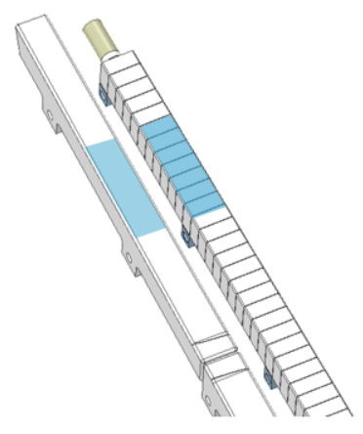



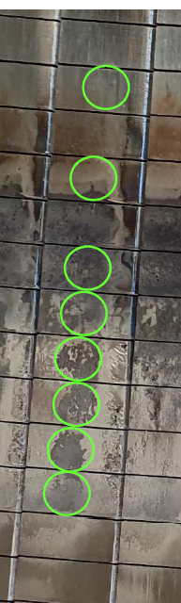
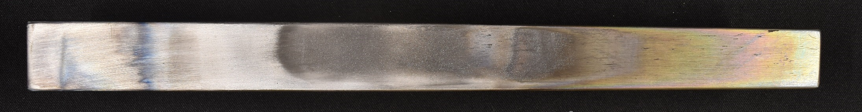
Experimental procedure to measure the thickness of redeposited layers
Thick deposits
  FIB cuts on the whole EM tiles (C3, C4, C5)
  FIB cuts on the EM cored samples (C3, C4, C5)
  Metallographic cuts on standard tiles (C5)
  FIB cuts on tape samples from ITER-like PFUs phase 2 (C5-C7)
All tiles have a toroidal bevel ; All tiles are located on max ISP
s = 0 mm
s = 326 mm

Slide 9
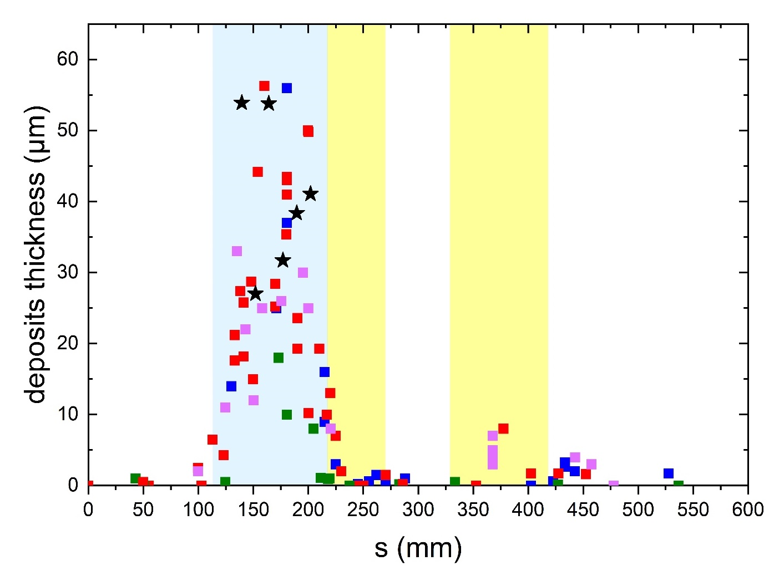
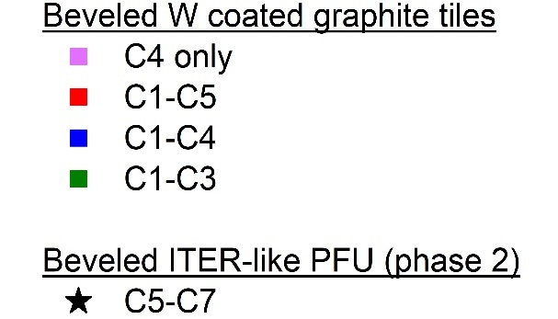
Deposited layers over 50µm thick
 | Cumulated plasma duration | Thickness (µm)
C1-C3 | ≈2h30 | 10-15 | W coated Gr tiles
C1-C4 | ≈6h | 30-35
C1-C5 | ≈7h15 | 45
C5-C7 | ≈6h45 | 40-50 | ITER-like
Data points resulting from "different techniques & analysis"
Thickness gradually increasing with plasma duration
> 50 µm after ≈7h of plasma
25-30 µm attributed to C4 only

Slide 10
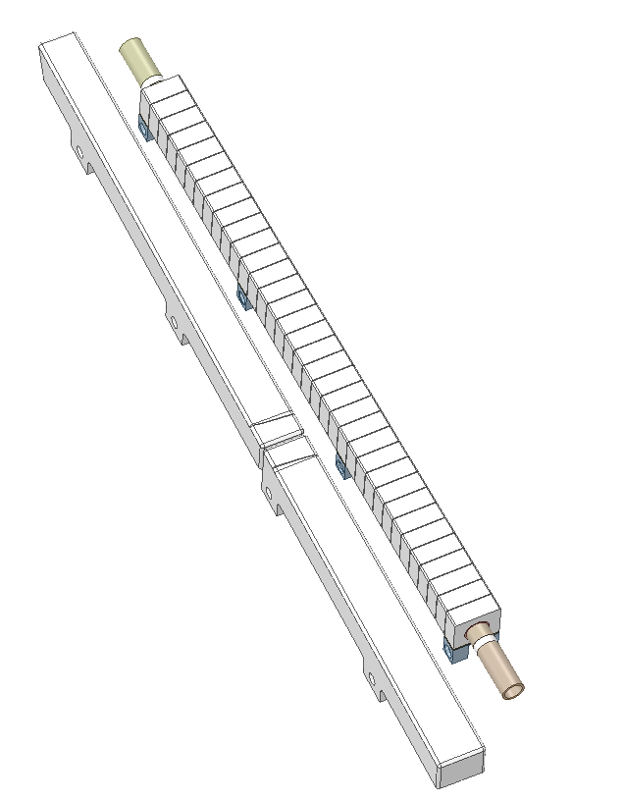
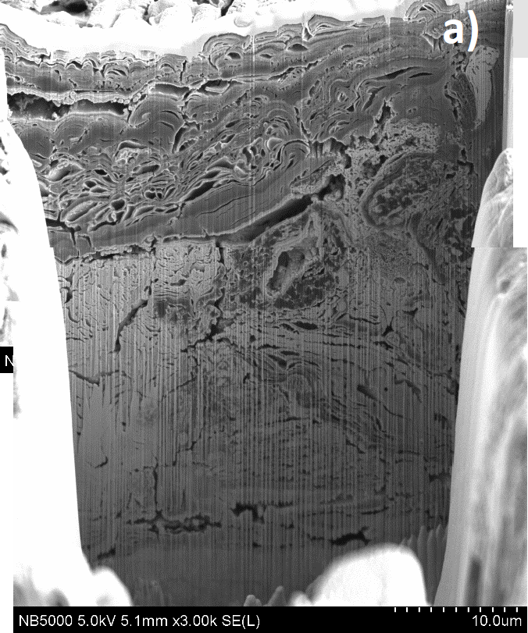

Deposits with very complex structure
Competition between erosion and redeposition
Thick deposits
sample ‘iJ’
s = 180 mm
10 µm
41 µm
C5
Not homogeneous deposits over the surface
W rich layers
Boron-rich crystals
W+O, W+B
C3
Multi layers
Mix of W, O, B, C

Slide 11

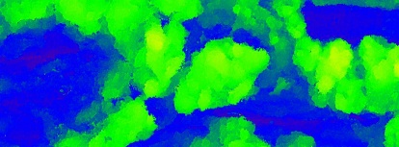
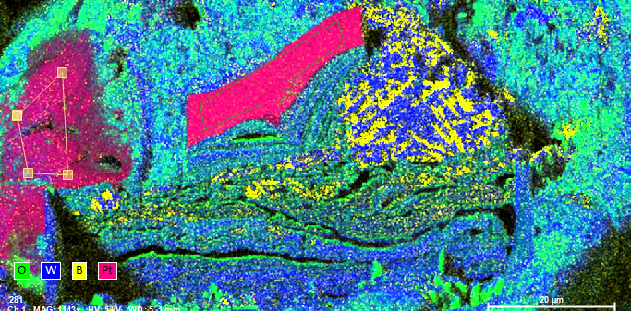
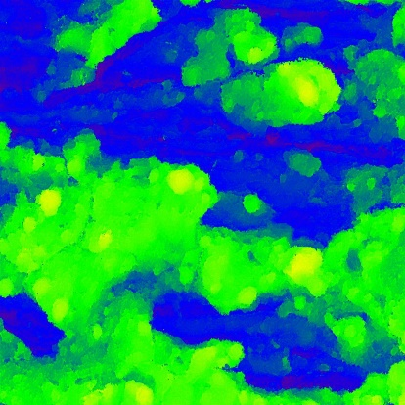
Local delamination observed in the thick deposits area
Thick deposits
s = 200 mm
5 µm
50 µm
D~5 µm
b
D~50 µm
> 30 µm
a
100 µm
D~30 µm
0
W O B Pt
C5 erosion marker tile
Notes:
When Delamaination happened ? During campaign ? After campaign ?

Slide 12
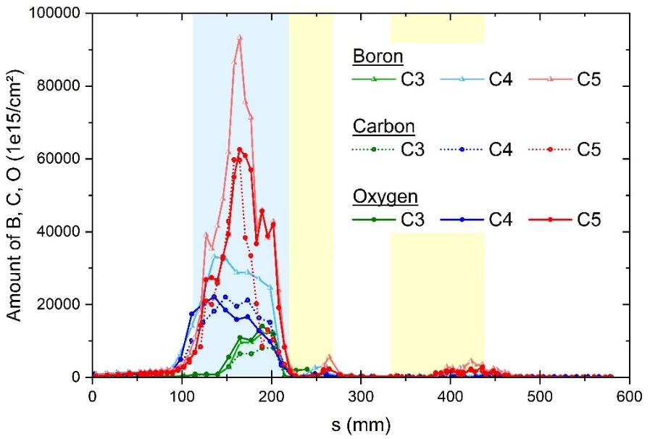
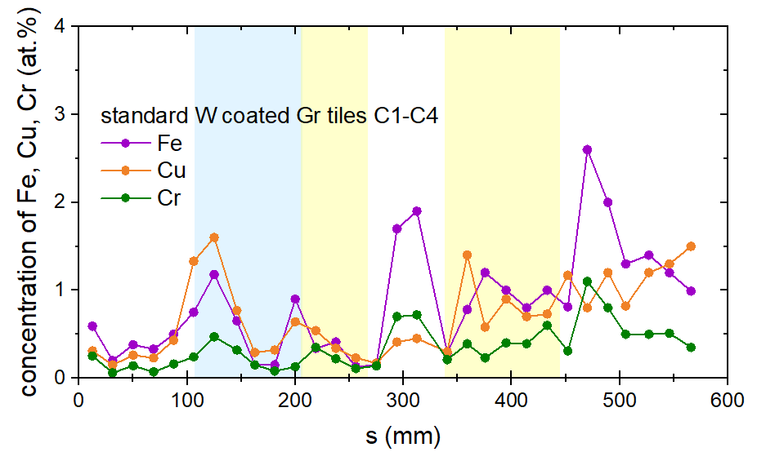

Impurities content using RBS / NRA / Tof ERDA
ISP
OSP
W as main element of the deposits. Source of W? ISP/OSP erosion? Upper divertor ? Antennas protections ?
Large contribution of B, C and O in the thick deposits
Boron contributes largely to the impurities content, more or less in line with conditionning
  C3 (3 boro)
  C4 (13 boro)
  C5 (2 boro)
Few metallic impurities detected in the thick deposits: Cu, Fe, Cr
Tof ERDA analysis at very near surface (up to 250nm)

Slide 13
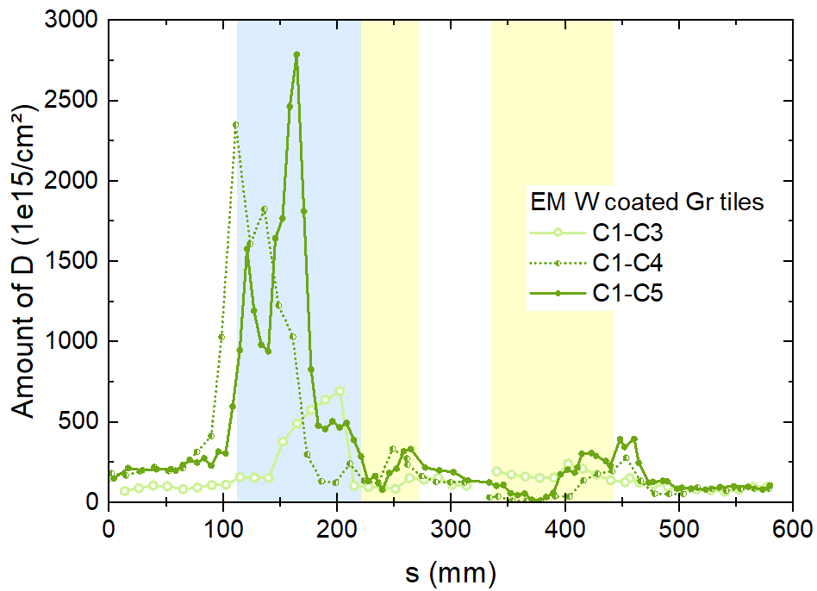
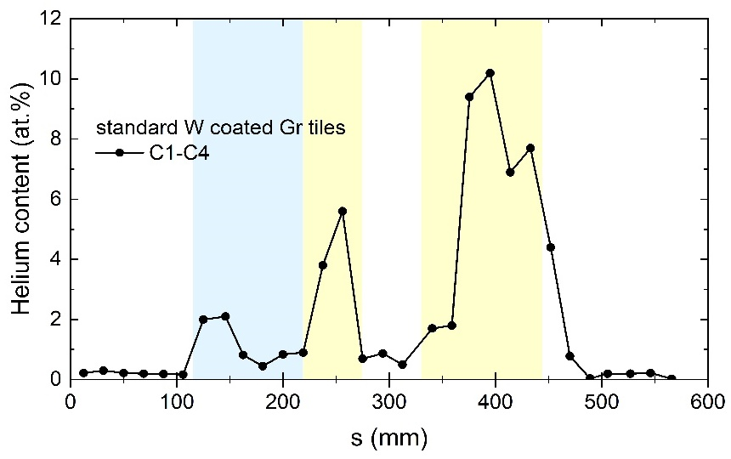
Deuterium in the deposits, helium in the erosion area
ISP
OSP
Highest D content in the deposits. D into C? B? WO?
Significant He amount found in the strike point areas (Tof-ERDA)
  6 at.% at ISP
  10 at.% at OSP
He retention >10²¹ He/m² in WEST at the OSP >> He retention in ASDEX for He campaign in 2015
He implanted deeper than 150nm -> FIB/TEM scheduled on OSP sample (@PIIM) to see helium/W interactions (He nanobubbles? nanostructures?)
Deuterium
ISP
OSP
Helium

Slide 14
OUTLINE
Redeposition profile on WEST divertor: thin films
Redeposition profile on WEST divertor : thick films
Effect of the bevel on the redeposition profile
4. Conclusion and perspectives
[M. Diez, NME 2023]

Slide 15
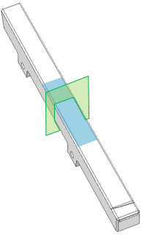
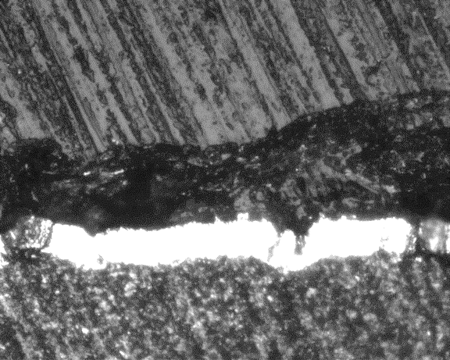
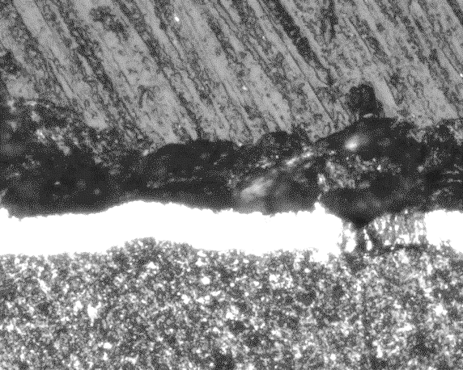
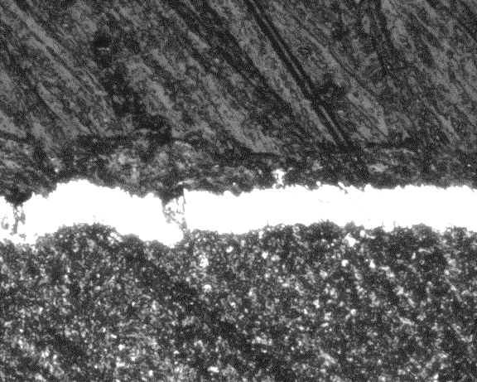
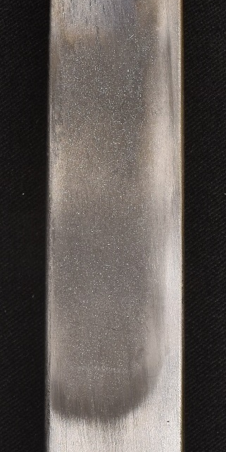
Non uniform deposition due to the toroidal bevel
C5 tiles
s=160mm
Toroidal bevel: designed to protect leading edges from plasma overloading
Change of redeposition profile evidenced during visual inspections
Deposits thick in exposed area, thinner and thinner as approaching shadowed area
Strong adhesion of deposited layers, no flaking (Gr tiles)
xt
4,5
13,5
22,5
xt = 4,5 mm
xt = 13,5 mm
xt = 22,5 mm
55 µm
25 µm
26 µm
14 µm
36 µm
Deposits
Deposits
Deposits
W
W
W
Exposed
area
Shadowed
area
C
C
20 µm
C
20 µm
20 µm

Slide 16
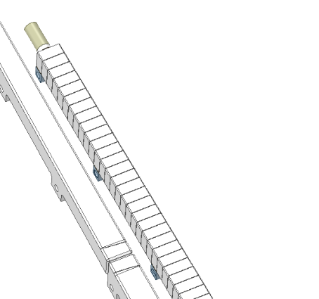
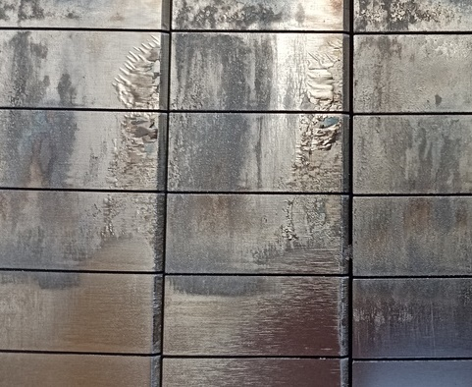
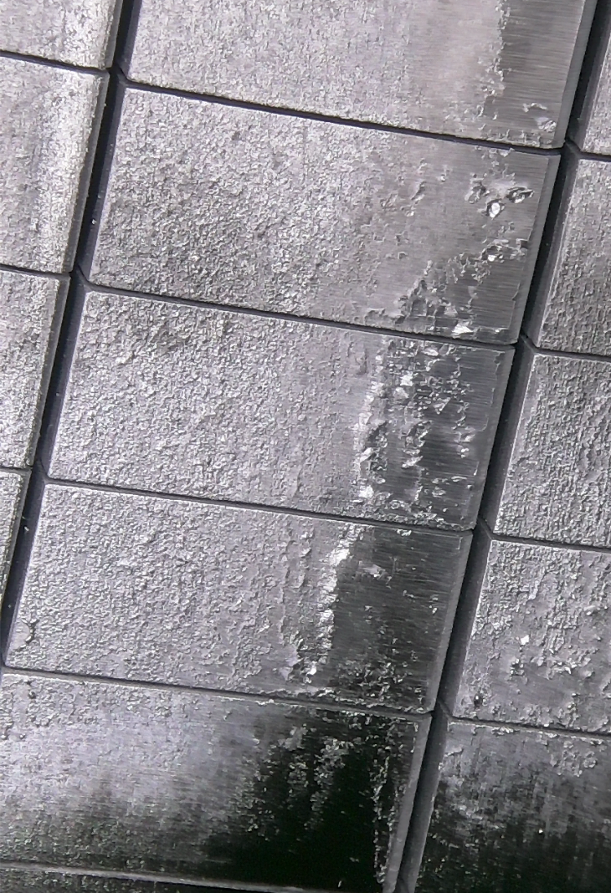
Toroidal bevel on PFUs phase 2 gives rise to flaking deposits
Photographs taken after C7 (high fluence)
MB 8
MB 8
Thick deposits
- adherent -
Thin deposits
- tend to delaminate easily -
s=202mm
MB 12
Thin deposits in areas shadowed by the toroidal bevel
These deposits tend to flake when exposed to air (?)
Transport mechanisms ?
MB 12
Notes:
Deposits observed on areas shadowed by the toroidal bevel
In contrast with the adherent HFS thick deposits, these deposits have a different thin foil like structure, and tend to delaminate easily.

Slide 17

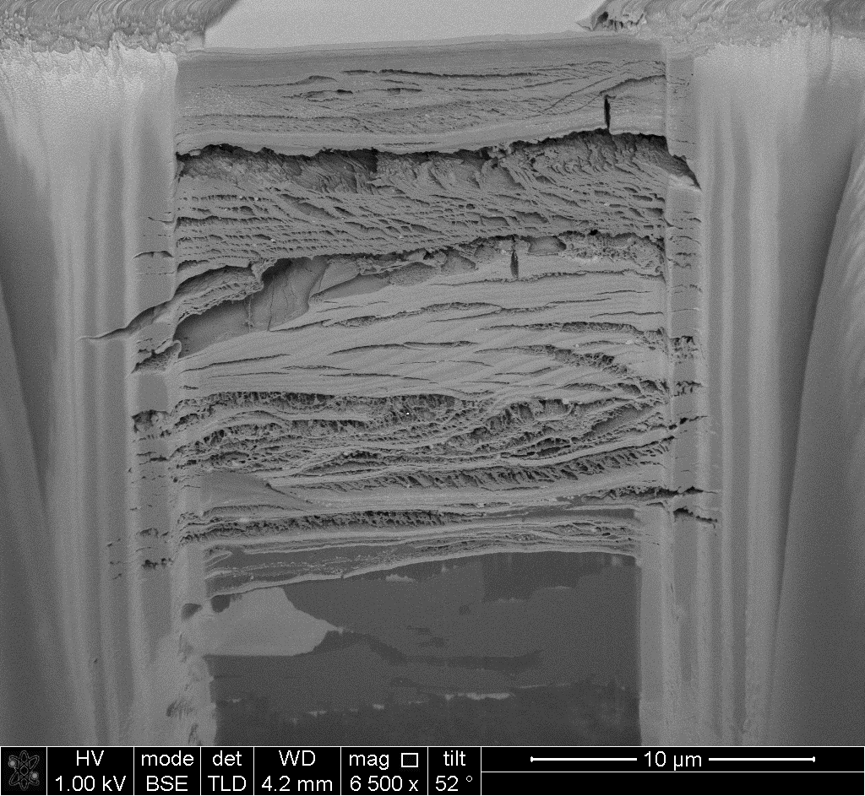





Adherent thick deposits in the plasma exposed area
Thick deposits
Deposited layer collected after C5+C6+C7 on WEST beveled PFUs phase 2
[C. Martin, PSI 2024]
23 µm
Complex structure with different layers, structures and composition
25-55 µm thick
Dense W layers attributed to high fluence campaign
Light elements detected (B, O, C) but less carbon than during phase 1
Tape sampling method
FIB cut
Notes:
No post mortem / only analysis performed on these thick deposits. Chemical composition missing although EDX shows W, O, B in agreement with plasma scenarios

Slide 18
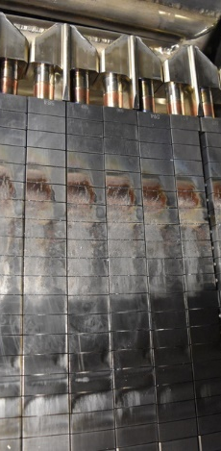
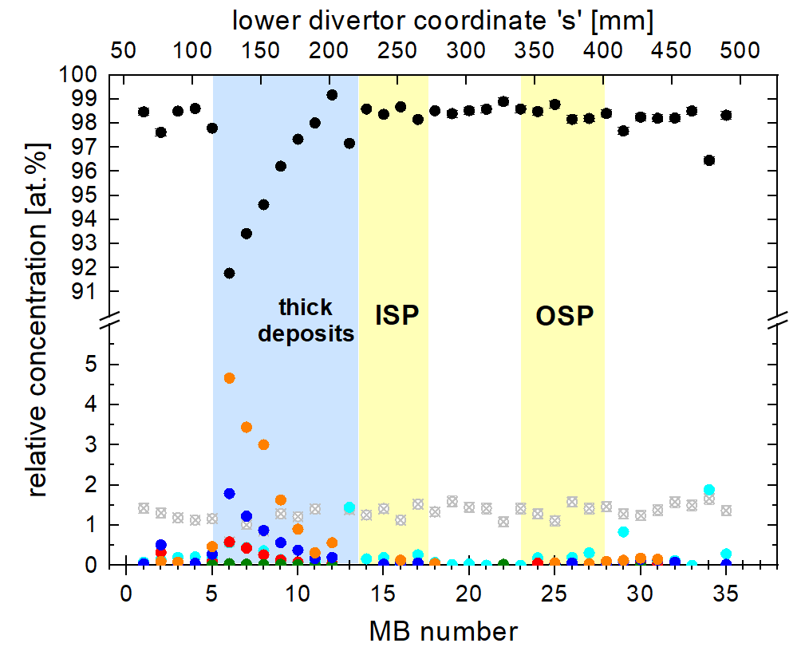
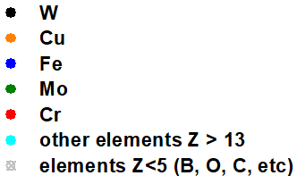
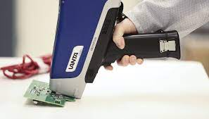
Composition of deposits by XRF in line with visual observations
[M. Richou, private comm.]
Thick deposits
MB 1
XRF measurements along PFU phase 2 after high fluence campaign
XRF Not suitable for light elements detection
W predominates but Cu and Fe are present in the deposited layers (max at s=125mm)
Notes:
No post mortem / only analysis performed on these thick deposits. Chemical composition missing although EDX shows W, O, B in agreement with plasma scenarios

Slide 19
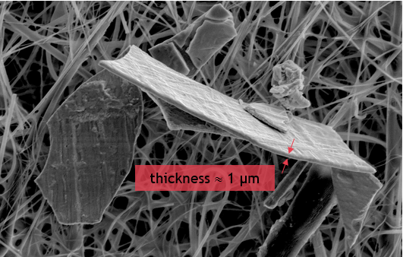
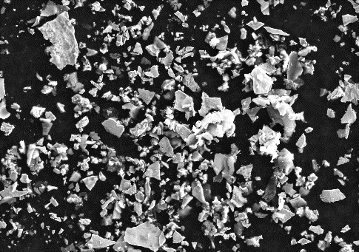
Flaking thin deposits in the shadowed area
High magnification
Thin deposits
1 µm
W
100 µm
[C. Arnas, PSI 2024]
Low magnification
20 µm
Flakes collected during dust collection (post high fluence)... but also easily manually detachable for characterization
Foil-like structure
2-3 µm thick
Pure W
Still under investigation
10 µm
Notes:
these deposits have a different thin foil like structure, and tend to delaminate easily.

Slide 20
OUTLINE
Redeposition profile on WEST divertor: thin films
Redeposition profile on WEST divertor : thick films
Effect of the bevel on the redeposition profile
4. Conclusion and perspectives
[M. Diez, NME 2023]

Slide 21
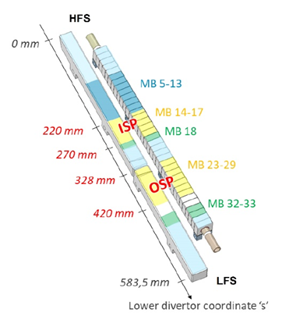
Summary and perspectives
Summary
Successful collaboration work within SP.B !
Post mortem data about redeposition in WEST -> detailed characterization of the deposited layers (thickness, composition, fuel retention)
Results presented here have to be completed with IBA/LIBS/GDOES/SIMS data
Thin deposits
< 1µm thick
B-rich + oxydes
Thick deposits
Up to 50 µm after 7h of plasma
Mix of B, O, C, W + traces of Cu, Fe
Non uniform deposition along toroidal bevel
Flaking of thin deposits in the shadowed areas
Perspectives
Transport of W in the shadowed area (and into the poloidal gaps) ?
Effect of the ripple on the deposited layers ? Beveled tiles vs unbevelled tile ?
Effect of toroidal bevel on deposition (and erosion) ?
Interactions between W and He ?
etc
Notes:
PFUs phase 2 : investigation of thick + flaking deposits

Slide 22
Thank you for your attention !

Slide 23
Progress on cutting ITER-like PFU samples

Slide 24
Some history…
2020
ITER-like PFUs phase 1 retrieved from WEST -> available for post mortem analysis
2021
Surface analysis on the whole PFUs : identification of areas of interest
Analysis of thin films, erosion/redeposition pattern, heavy impurities, emissivity, …
2022
PFU cut into 3 segments so it could fit into AURIGA
Erosion/redeposition pattern, arcing, fuel retention
Purchase of a cutting machine
2023
Construction of a temporary « contaminated area »
ITER-like PFU cutting into small samples
2024

Slide 25
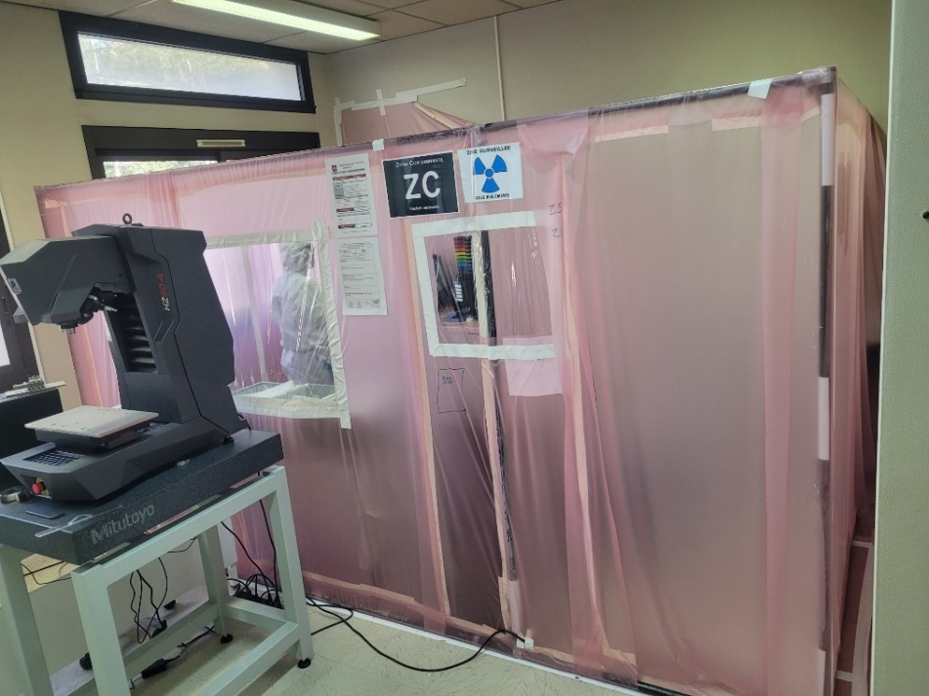
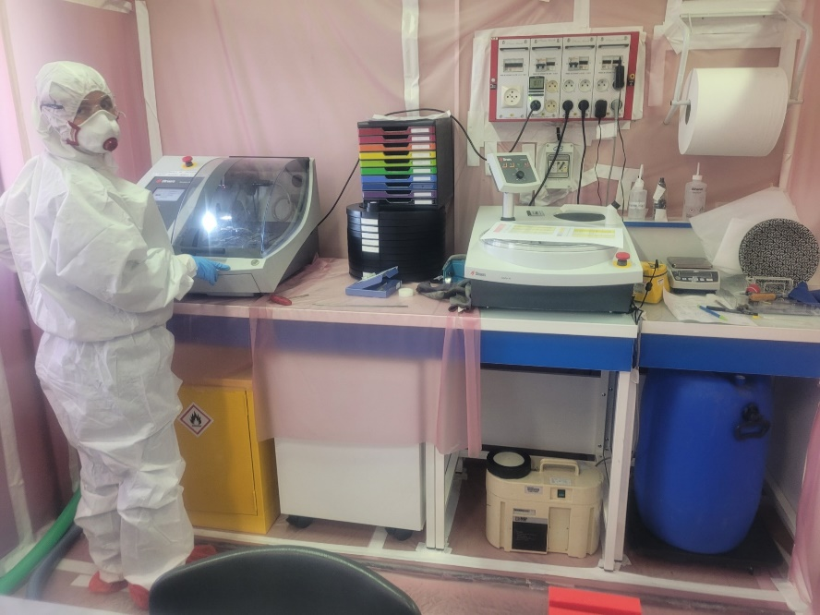
Construction of a temporary « contaminated area »
Cutting machine
Portable contamination monitor
Polishing machine
Container for contaminated water
Air measurement
Notes:
Environnement contrôlé
Travail en tenue
Decoupes -> contrôle en surface pour sortie de ZC -> contrôle en volumique pour envoi public domain

Slide 26
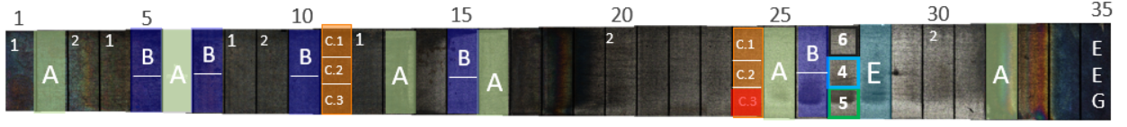
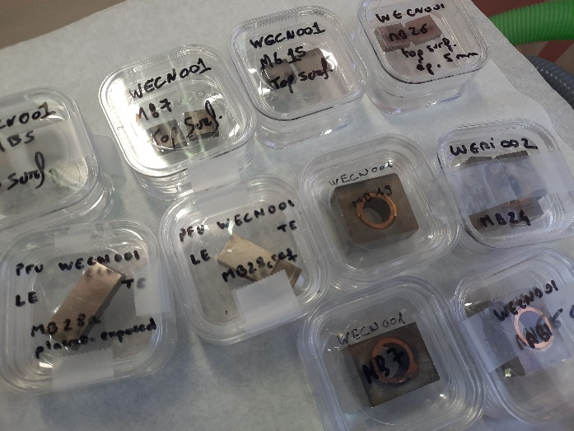
Status of the work
Cutting of the monoblock samples takes much more time than originally anticipated -> re-prioritization performed
  Batch A (VTT, NIFS, UT)
  Batch B + batch C (RBI, WUT, CEMTHI or PIIM)
  Batch E (Demokritos, RBI, PIIM)
All samples cut !
Post-cutting radiation measurements on going ; the samples will be sent right after receiving the results !

Slide 27
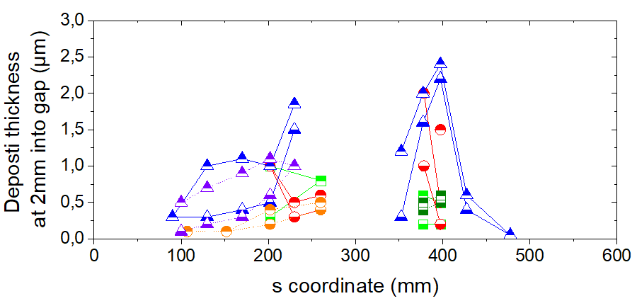
Transport of deposited material inside the poloidal gaps
Thick deposits
Side A and B : similar deposition deposition pattern
Chemical composition
Fe+Cu close to the top surface, Oxygen
W, C, B
Transport mechanisms into the the gaps ?

