Slide 1
Impact of surface temperature, roughness and impurities on fuel retention & crystalline structure in Be reference samples
P. Tsavalas¹, K. Mergia¹, D. Papadakis¹, A. Lagoyannis¹, S. Fazinic², G. Provatas², C. Pardanaud², C. Porosnicu³
¹National Center for Scientific Research “Demokritos”, Athens, Greece
²Ruder Boškovic Institut, Zagreb, Croatia
³Aix-Marseille Université, Marseille, France
³National Institute for Laser, Plasma and Radiation Physics, Magurele, Bucharest, Romani

Slide 2
Be-(O)-D/H on W - Reference Samples
Deposition Temperature & Roughness
Annealing Temperature, hydrogen isotope & O effect
Film Composition | Deposition Temperature (ºC) | Roughness (nm)
Be-D(5%) | 25 | 100
 | 100
 | 400
 | 25 | 500
 | 100
 | 400
 | 25 | 2000
 | 100
 | 400
Be-D(10%) | 25 | 400
 | 100
 | 200
 | 400
Film Composition | Annealing Temperature (ºC)
Be-O-D(20%) | 25
 | 50
 | 100
 | 150
 | 200
 | 250
 | 300
 | 350
 | 400
 | 450
 | 500
Be-O-H(20%) | 25
 | 50
 | 100
 | 150
 | 200
 | 250
 | 300
 | 350
 | 400
 | 450
 | 500
Film Composition | Annealing Temperature (ºC)
Be-D(20%) | 25
 | 50
 | 100
 | 150
 | 200
 | 250
 | 350
 | 400
 | 450
 | 500
Be-H(20%) | 25
 | 50
 | 150
 | 200
 | 250
 | 300
 | 350
 | 400
 | 450
 | 500

Slide 3
Methodology
Nuclear reaction analysis (NRA)
²H(³He, ¹H)⁴He
Experimental details
Determination of
Elemental amount & depth profile
³He
²H
Beam: ³He(2 MeV), d(1.6 MeV)
Detection angle: 135°(³He), 170°(d)
⁴He
135º
¹H
Q-value = 18352 keV
Grazing Incidence XRD (GIXRD)
Q
Experimental details
Source: Cu, K_{α}
Incidence angle: 1°
Determination of
Texture
Crystallite size
Lattice strain
k_{diff}
k_{in}
θ_{inc}
2θ₂
2θ₁
θ_{inc} is kept constant
The scattering vector Q rotates as 2θ is scanned
SEM
Experimental details
Energy: 20 keV
Determination of
Surface morphology

Slide 4
Be-D(5%) on W Deposition Temperature & Roughness Effect

Slide 5
Be-D(5%): D quantification vs T_{dep} & Roughness
³He NRA spectrum
D amount
Be-D Layer Thickness
- 0.021∙T+8.1
- 0.023∙T+9.1
- 0.020∙T+7.7
D Concentration
D amount decreases as the deposition temperature increases; similar rate for the 3 roughness values
D concentration is at all deposition temperatures below 2 at% which is lower than the nominal value (5 at%)

Slide 6
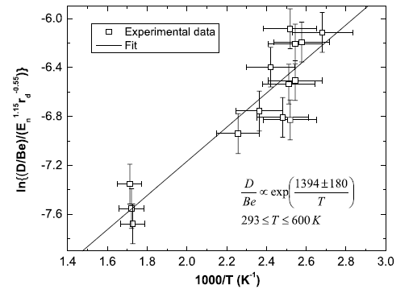
Be-D(5%): D release activation energy
An Arrhenius relation is assumed since the desorption
of gases from metals is a thermally activation process
The determined activation energy is in agreement with that obtained by A. De Temmerman et al. Nucl. Fusion 48 (2008) 075008
E=(0.12±0.02) eV
E=(0.11±0.01) eV

Slide 7
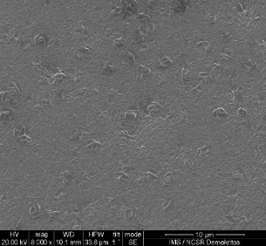
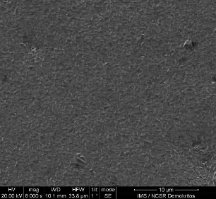
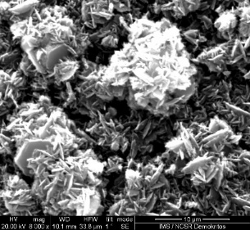
Be-D(5%): Structural characterization vs T_{dep} & Substrate Roughness
GIXRD spectrum
Crystallite size
Lattice Strain
$$\frac{d_{hkl}\left(T\right)−d_{hkl}(T_{max})}{d_{hkl}(T_{max})}$$
Non-textured Be: I(100):I(002):I(101)=30:25:100
Be crystallizes at hexagonal P63/mmc space group
Texture evolution with the increase of T_{dep}:
From enhanced texture at RT along Be [002] to non-textured material at 400ºC
T=100ºC: highest C.S., T=400ºC: lowest C.S.
The increase of the T_{dep} results in the relief of the tensile lattice strain in Be
T=400ºC: Rough surface
Substrate Ra: 100 nm
RT
100 ºC
400 ºC
10 μm
10 μm
10 μm

Slide 8
Be-D(10%) on W (Ra = 400 nm) Deposition Temperature Effect

Slide 9
Be-D(10%): D quantification vs T_{dep}
D Content
Be-D Layer Thickness
D Concentration
10∙e^{-0.01∙T}
Decrease of D content as the deposition temperature increases (exponential decrease)
T=400°C: D concentration decreases by a factor of about 80 from that at RT
D is found at depths in the range from 2 to 5 μm; no clear dependence on deposition temperature

Slide 10
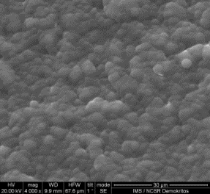
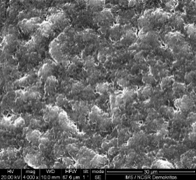
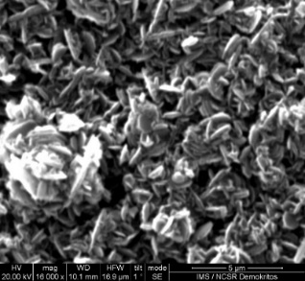
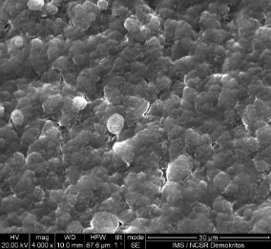
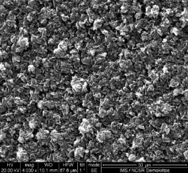
Be-D(10%): Structural characterization vs T_{dep}
GIXRD spectrum
Crystallite size
Lattice Strain
A-Be^{-kT}
-1.24∙10⁻⁵∙T+0.005
RT
200 ºC
Be crystallizes at hexagonal P63/mmc space group
As T_{dep} increases the texture changes as follows:
Enhanced texture along [002] at RT; enhanced texture along [100] at 200 °C to non textured material at 400 °C (similar behavior with Be-D(5%))
The crystallite size increases up to T=200ºC; for higher T_{dep} is almost constant (exponential behavior vs T)
The lattice strain along [101] decreases almost linearly
The roughness increases as T_{dep} increases
400 ºC
30 μm
30 μm
100 ºC
400 ºC
5 μm
30 μm
30 μm

Slide 11
Be-(O)-D/H (20%) on W
Annealing Temperatures Effect

Slide 12
Be-O-D(20%): D quantification vs T_{ann}
d NRA spectrum
D amount
Be-O-D(20%) layer thickness
D concentration
Depth Profile
100ºC
D amount shows non monotonous behavior; a peak at 300ºC appears
D concentration decreases linearly for T>=350ºC
Depth profile:
Similar depth profile for all annealing temperatures
A small increase of D concentration at around 5 μm depth
Carbon (8-15 at%) is found at the interface of Be-O-D layer with W

Slide 13
Be-(O)-D/Η(20%): GIXRD spectra vs T_{ann}
Be-O-D(20%)
Be-O-H(20%)
Oxygen affects texture: Enhanced texture along [002] at the most of the temperatures
Be-D/H: no enhanced texture material
Oxygen results on non monotonous texture evolution (not expected) with the increase of the annealing temperature
The texture for Be-O-D differs with that of Be-O-H (the most pronounced difference is at 200, 300, 400 and 450 ºC)
FWHM of the Bragg peaks decreases as T increases; this indicates increase of crystallite size
Lattice constants change with the increase of the annealing temperature
Be-D(20%)
Be-H(20%)
Non-textured Be:
I(100):I(002):I(101)=30:25:100

Slide 14
Be-(O)-D/Η(20%): Crystallite size vs annealing temperature
Be-(O)-D(20%)
Be-(O)-H(20%)
0.031∙T+6.5
0.018∙T+8.1
0.027∙T+5.9
10+0.05∙e^{0.11∙T}
For Be-O-D(20%) and Be-D(20%) crystallite size increases linearly with temperature with similar rate
For Be-O-H(20%) crystallite size increases exponentially with T; whereas for Be-H(20%) the crystallite size increases linearly

Slide 15
Be-(O)-D/Η(20%): Lattice strain vs T_{ann}
Be-(O)-D(20%)
$$Strain=\frac{d_{hkl}\left(T\right)−d_{hkl}(T_{max})}{d_{hkl}(T_{max})}$$
Be-(O)-H(20%)
-1.10∙10⁻⁵∙T+0.005
-8.7∙10⁻⁶∙T+0.004
-1.52∙10⁻⁵∙T+0.007
-9.0∙10⁻⁶∙T+0.004
Annealing temperature of 500ºC results in the relief of the lattice strain of the Be films; no significance dependence on O presence or hydrogen isotope
Lattice strain along the [101] direction is reduced with temperature almost linearly for all compositions with a similar rate

Slide 16
Summary Results
Crystallite size
Lattice strain
Deposition
Temperature
Annealing
Temperature
Deposition temperature affects more drastically the crystallite size than the annealing temperature (a small linear increase)
Lattice strain along the [101] direction is reduced with surface (deposition & annealing) temperature almost linearly for all compositions with a similar rate

Slide 17
Conclusions
The impact of the surface temperature, substrate roughness and oxygen on the fuel retention and the crystalline structure was investigated on Be – based reference layers
The increase of deposition temperature results in the rapid decrease of the D concentration; non monotonous behavior of D concentration as the annealing temperature increases
Oxygen affects the texture evolution as a function of annealing temperature; enhanced texture along [002] is observed after annealing at 300°C in Be-O-D different from that in Be-O-H;.
The increase of the annealing temperature causes a linear increase of the crystallite size (grain growth); Deposition temperature has a more drastic effect in grain growth.
The increase of the annealing/deposition temperature results in the relief of the tensile strain of the Be layers

Slide 18
Thank you for your attention

