Slide 1
WP PWIE PWIE Midterm Meeting
SPE Updates and Plan
Jari Likonen
On behalf of the SP E team and task holders

Slide 2
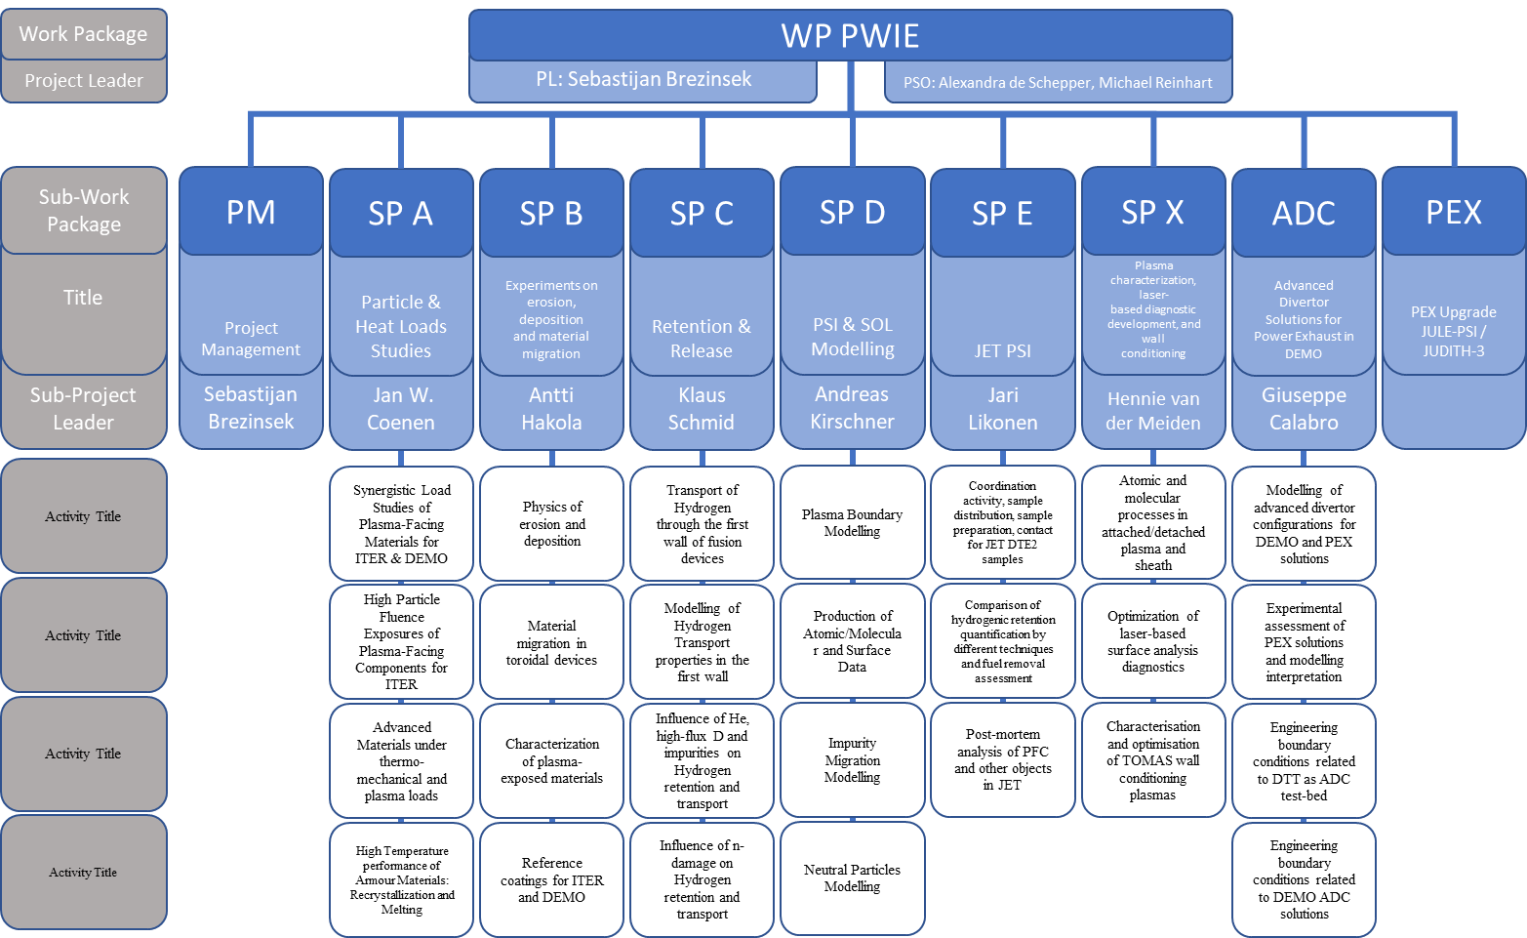
WPPWIE Structure 2024
LIBS RH
Post-mortem
tile analysis

Slide 3
SP E focus points in 2024
I: LIBS on a Remote-Handling arm in JET→ SP E.1
II: Comparison of hydrogenic retention quantification by different techniques and fuel removal assessment (ITER housekeeping approach) → SP E.2
III: Post-mortem analysis of PFC and other objects in JET→ SP E.3

Slide 4
SP E resources 2024
Deliverable Owner | Beneficiary | PM
P. Veis | CU | 4
S. Almaviva | ENEA | 9
T. Dittmar | FZJ | 13
E. Grigore/C. Porosnicu | IAP | 8
P. Gasior | IPPLM | 4
E. Fortuna-Zaleśna | IPPLM | 2
J. Butikova | ISSP-UL | 4
E. Pajuste | ISSP-UL | 12
N. Catarino | IST | 7
P. Paris | UT | 6
D. Primetzhofer | VR | 6
J. Likonen | VTT | 12
Total |  | 87
Device | Beneficiary | Days
Accelerator | IST | 7
Accelerator | VR | 3
Accelerator | VTT | 2

Slide 5
SPE program 2024
LIBS experiment at VTT using the JET LIBS setup (February & March 2024)
Data analysis of VTT LIBS experiment (on-going)
LIBS experiment at JET (June-July)
Data analysis of JET LIBS experiment
Completion of tile analysis (e.g. C39 baking studies)
Analysis of limiter tiles from top and bottom of IWGL and WPL limiters
Completion of metallography and microstructural studies of Langmuir probes and W lamellae
Analysis of louvre clip and mirror cassettes
Analysis of W lamellae
Removal of in-vessel components (UKAEA)

Slide 6
SP E updates and planning
Notes:
PD: Plasma Devices as in PEP listed
HHF: High Heat flux as in PEP listed
IBF: Ion beam Facility as in PEP listed
Other facilties as in PEP listed

Slide 7
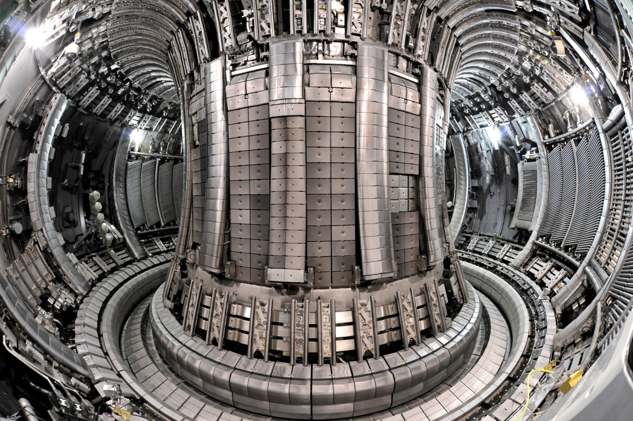
Typical PWIE materials for post-mortem analysis
MAIN CHAMBER
Upper Dump Plates (UDP)
Inner Wall Guard Limiters (IWGL)
Outer Poloidal Limiters (OPL)
Inner Wall Cladding (IWC)
Bulk Be
Be coated inconel
W – coated CFC
DIVERTOR
Inner & outer divertor
W-wedge, tile 5
W – coated CFC
Bulk W
PROBES
Rotating collectors
W sticking monitors
Mirrors, cassettes

Slide 8
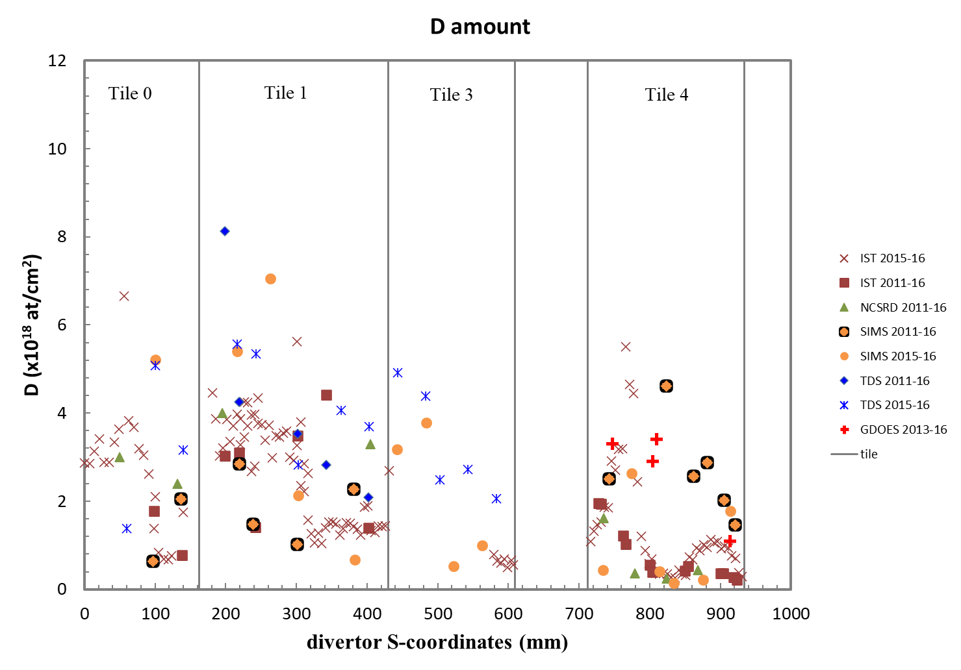
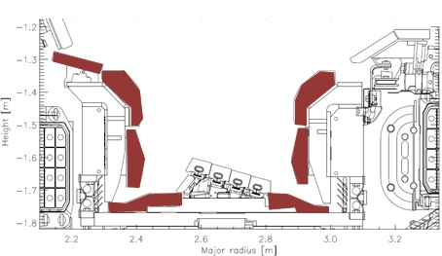
SPE.2: Characterization of samples from JET divertor tiles
D retention in inner divertor tiles
Tasks and questions to be addressed
Fuel retention in divertor tiles exposed during ILW1-ILW3 and ILW2-ILW3
Comparison with single campaign results
RUs: IAP,IST,MPG,NCSRD,VTT,UKAEA
Main results
Tile 0 (2011-2016): co-deposited layer > 30µm
Tile 1 (2011-2016) apron: co-deposited layer, thickness ~30µm
Tiles 0 and 1: no correlation between exposure periods
Tile 3:
No Tile 3 (2011-2016) available
IBA results somewhat lower than TDS and SIMS
Tile 4:
no correlation between exposure periods (IBA)
SIMS shows higher D amounts for ILW1-3 samples
GDOES results comparable to SIMS
Some results still missing (e.g. IBA 2011-16)
tile C
0
tile B
1
8
3
5
7
4
6
Notes:
PD: Plasma Devices as in PEP listed
HHF: High Heat flux as in PEP listed
IBF: Ion beam Facility as in PEP listed
Other facilties as in PEP listed

Slide 9
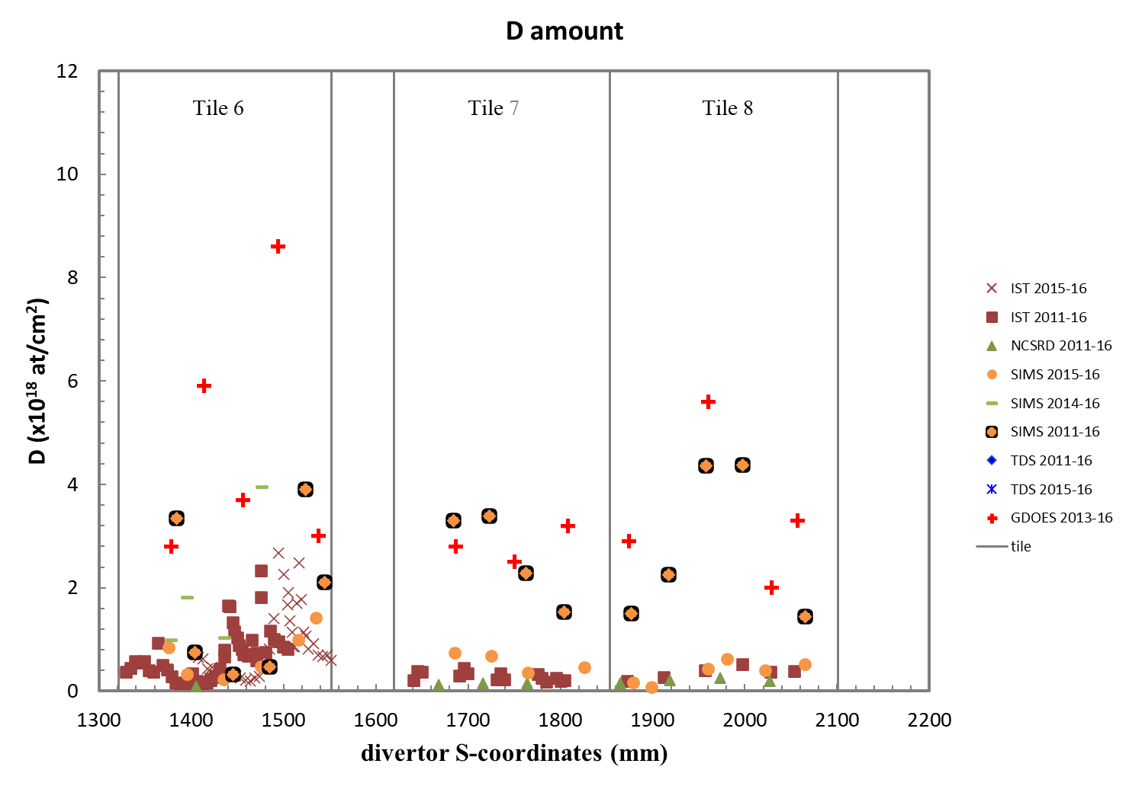
SPE.2: Characterization of samples from JET divertor tiles
Main results
Tile 6:
        main retention towards the shadowed corner
          no clear correlation between exposure periods
          GDOES results high, due to deep migration of D
Tile 7&8:
SIMS and GDOES results (2013-2016) somewhat higher than IBA data
SIMS and GDOES show deep depth profiles for D
IBA data (IST, NCSRD) agree well
Fuel retention not necessarily higher for multiple
campaign tiles
D retention in outer divertor tiles
10
100
W
W
W
9
80
C
C
8
Mo
7
O
6
GDOES depth profiles
from centre of Tile 7
Concentration W, Mo, C, O (at.%)
Concentration Be, D (at.%)
60
Be
D
5
Be
4
40
D
3
20
Mo
2
O
Be
D
Mo
1
0
0
5
10
15
20
25
30
35
0
40
μ
Depth (
m)
Notes:
PD: Plasma Devices as in PEP listed
HHF: High Heat flux as in PEP listed
IBF: Ion beam Facility as in PEP listed
Other facilties as in PEP listed

Slide 10
SP E – UKAEA contribution
SP E.2: Comparison of hydrogenic retention quantification by different techniques and fuel removal assessment
LID-QMS quantification:
  Analysis of measurement and calibration data – ongoing.
  Analysis of tritium injection data for correlation with RGA results – ongoing.
Baking cycle measurements:
  Baking cycle simulations (long TDS) – completed.
  Pre-baking and post-baking IBA – completed.
  Pre-baking SIMS completed, post-baking SIMS – ongoing.
Removal efficiency for Be samples (4D15, ILW1-3)
  Hold at 250 ºC, for 100 hours →IBA → Hold at 775 ºC for 5 hours
 | Near-surface removal efficiency (IBA), % | Total removal efficiency (TDS), %
Be689 | 98.9 | 4.1
Be710 | 97.4 | 3.7
Be728 | 94.4 | 3.8

Slide 11
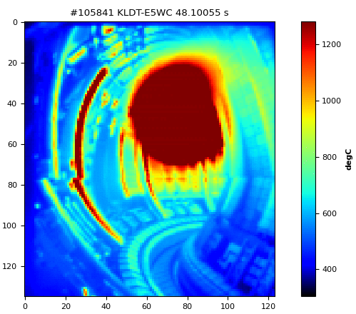
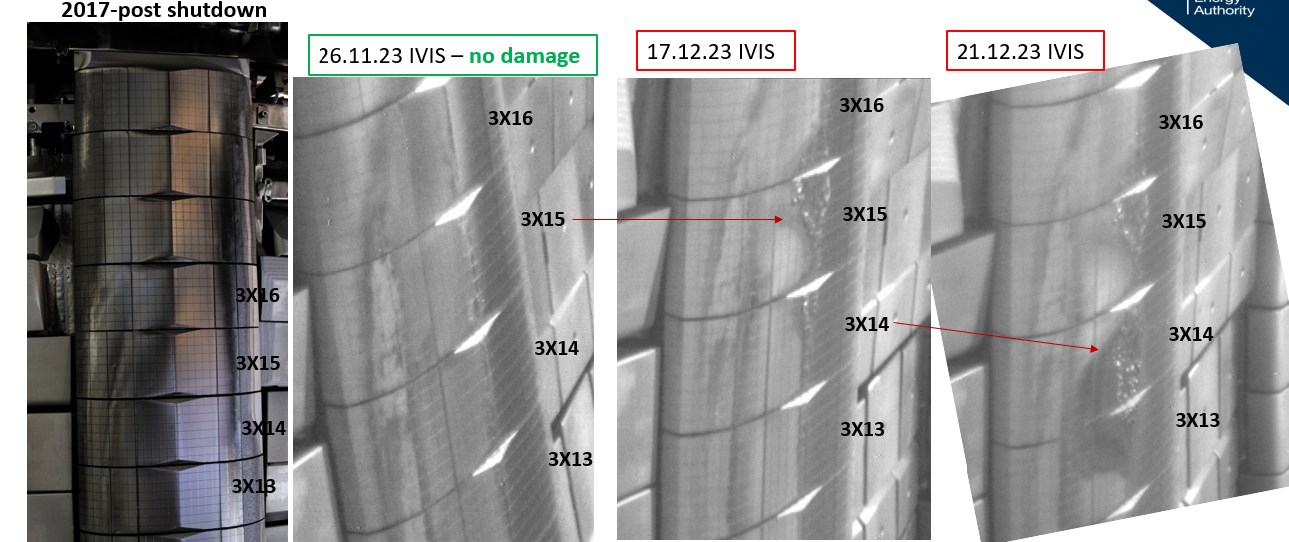
SP E – UKAEA contribution
SP E.3: Post-mortem analysis of PFC and other objects in JET:
Additional tiles that suffered RE damage in the identified pulses identified for post-DTE3 component removal – for follow-up RE damage study.
  Plasma conditions at the time of damage known, so correlation with damage results is possible.
18.12.2023
RE damage on upper inner wall

Slide 12
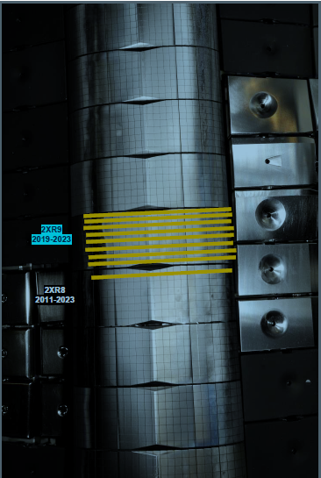
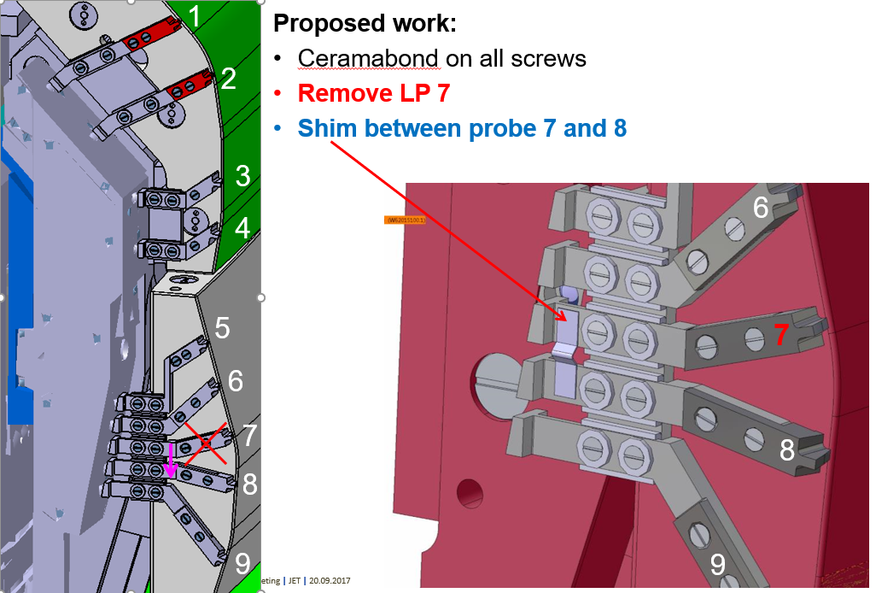
SPE planning 2024
2XR19(ILW3) and 2XR9 (ILW2+3):
  to compare with LIBS on 2XR19 and 2XR9 (2019-2023)
  erosion/deposition, fuel retention
  IBA, TDS/FC
4D23 (ILW3) and 4D3 (ILW3):
  to compare with LIBS on 4D23 and 4D3 (2019-2023)
  IBA of 4D3 done, IBA, TDS of 4D23
Langmuir probes 16IN probes 5, 7,8, 9 (removed in 2015)
  Metallography at IPPLM
  IBA at VR done
2XR9

Slide 13
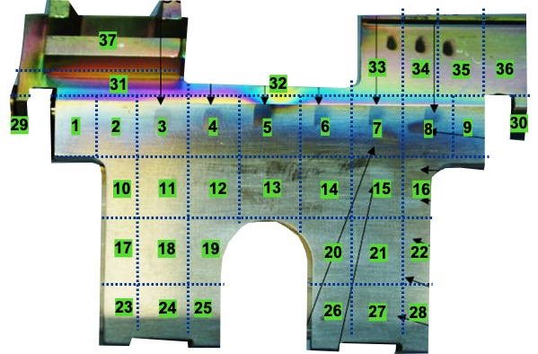
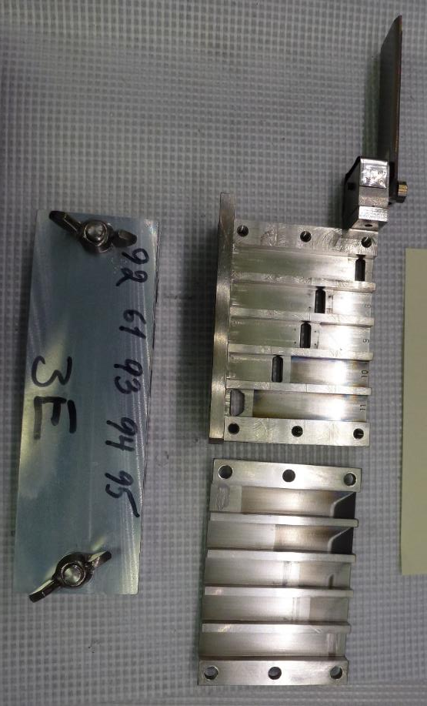
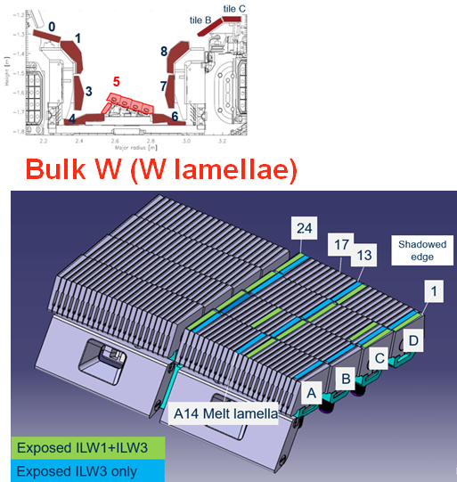
SPE planning 2024
Louvre clips (ILW3)
  Cutting completed at IAP
  Transport to remote areas
  Chemical structure of deposits
  Modelling of Be, W migration under SP D
  FT-IR at UoL
Mirror cassettes
    Erosion/deposition in recessed areas
    Metal migration inside cassette
    3E (ILW1, outer wall) for SPE
    IBA at IST
W lamellae
Microstructure, fuel retention
Lamellae A14 already cut
C1, D1 and D2 to IST for IBA
2XR9

Slide 14
SPE planning 2024
Call for expression of interest for post-mortem analysis of JET tiles and samples following T&DT campaigns within the EUROfusion Work package Plasma Wall Interaction and Exhaust (WP PWIE)
  Deadline April 26th
  Outcome of the call will be discussed in the near future
  Meeting with involved RUs will be arranged later
LIBS experiment at JET (LIBS=Laser Induced Breakdown Spectroscopy)
  Current planning: 12 June – 8 July
Tile removal
    After LIBS experiment at JET
2XR9

Slide 15
LIBS at JET
Notes:
PD: Plasma Devices as in PEP listed
HHF: High Heat flux as in PEP listed
IBF: Ion beam Facility as in PEP listed
Other facilties as in PEP listed

Slide 16
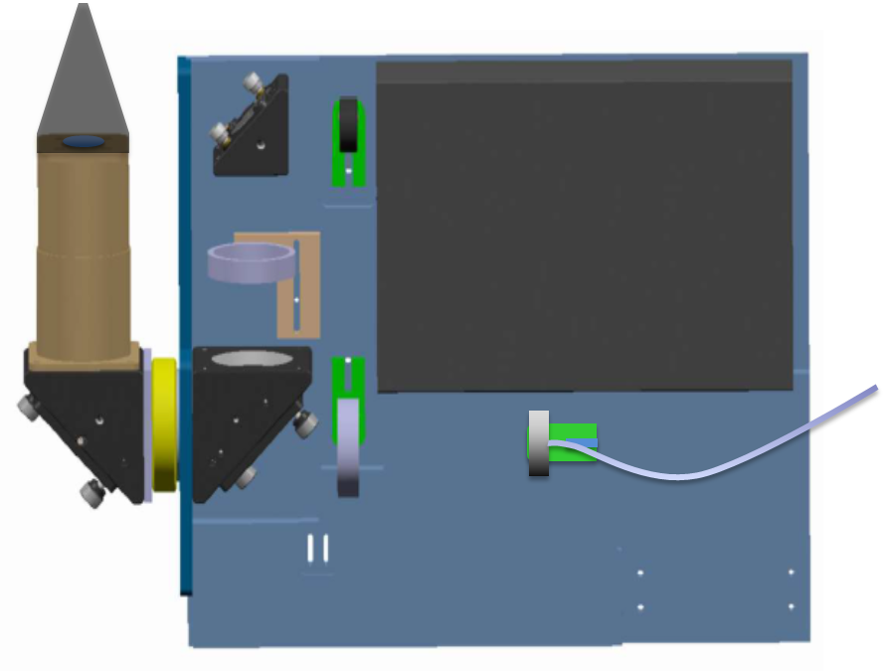
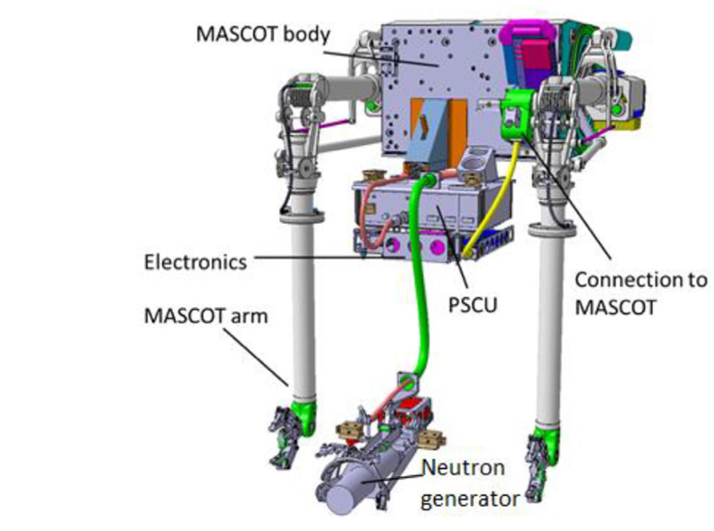
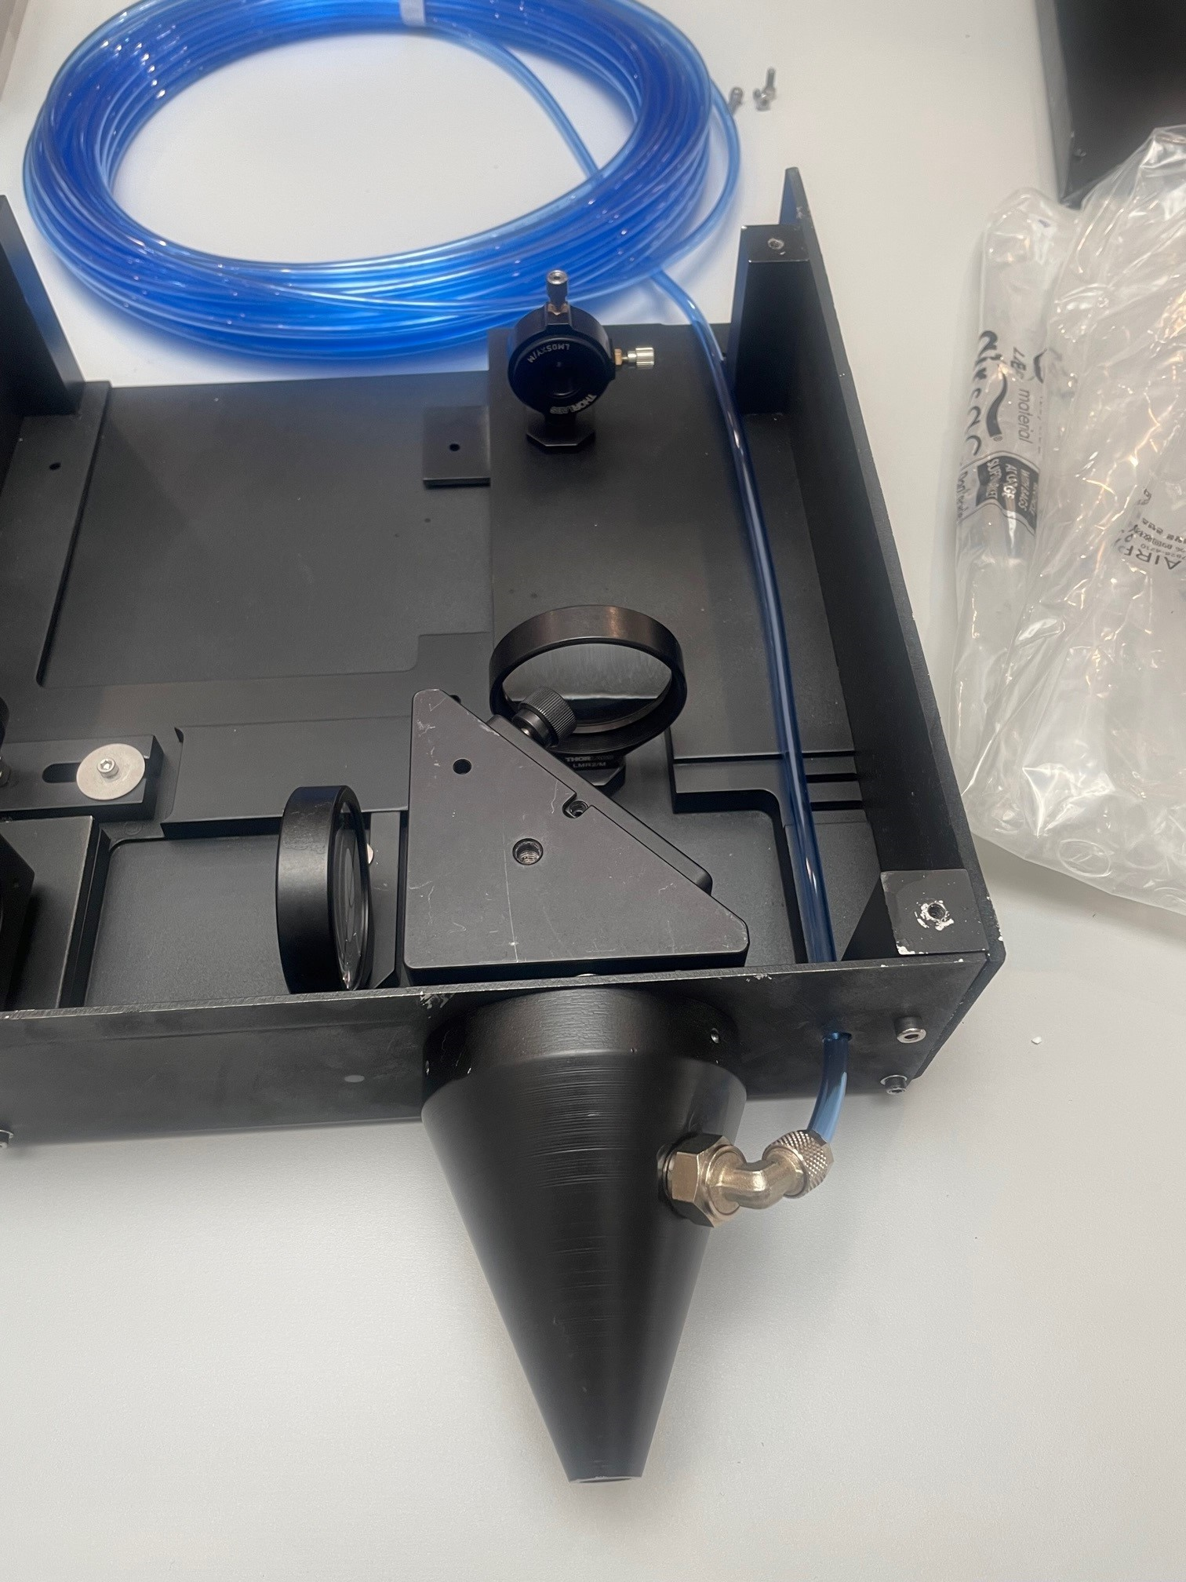
LIBS at JET
MASCOT telemanipulator robot is a two-armed machine with back-drivable actuators and a large dexterous workspace in which each arm can operate within the full 6 degrees of freedom.
The manipulator is remotely operated from a control room.
LIBS experiment will be executed at JET in June-July 2024
JET-PFC
3)
2)
4)
1)
6)
5)
7)
8)
9)
Laser beam
LIBS head
Plasma light

Slide 17
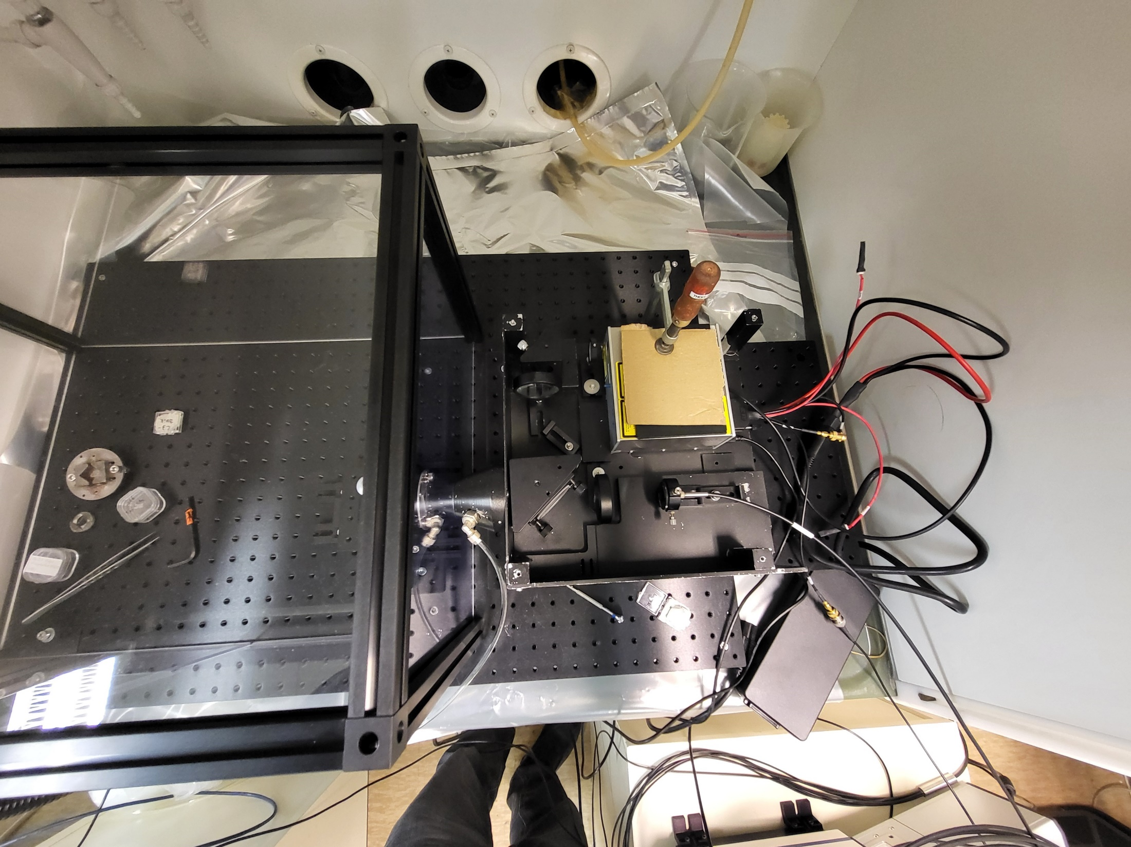
LIBS setup at VTT
ps-laser
sample
20m long optical fibre
Ar gas
Aryelle spectrometer+camera

Slide 18
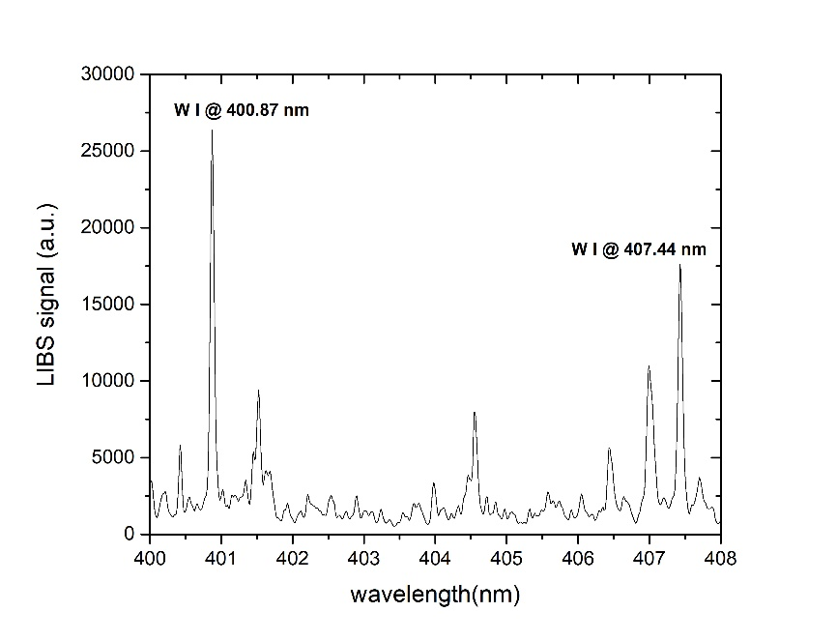
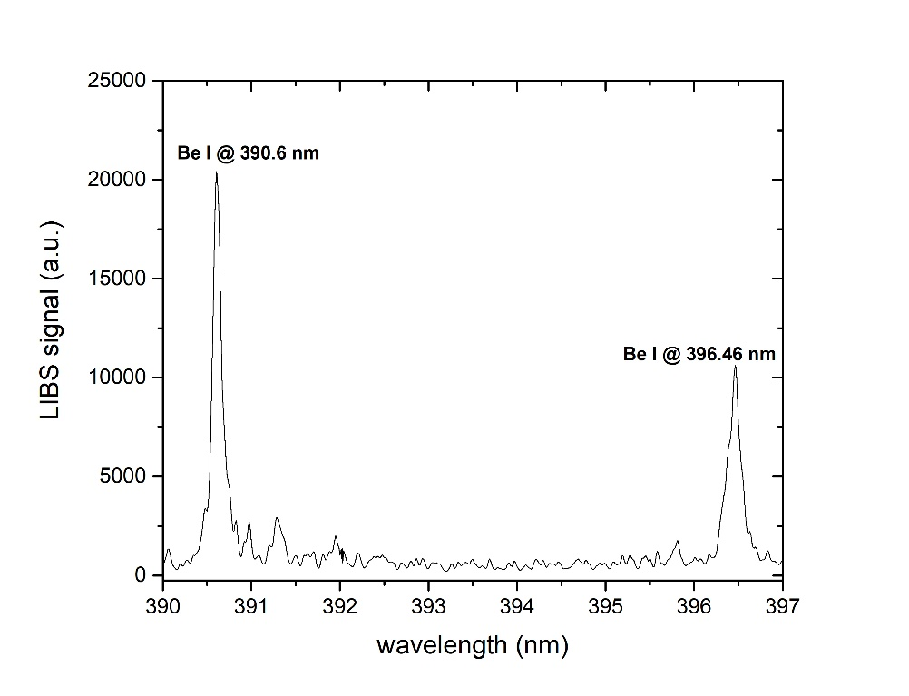
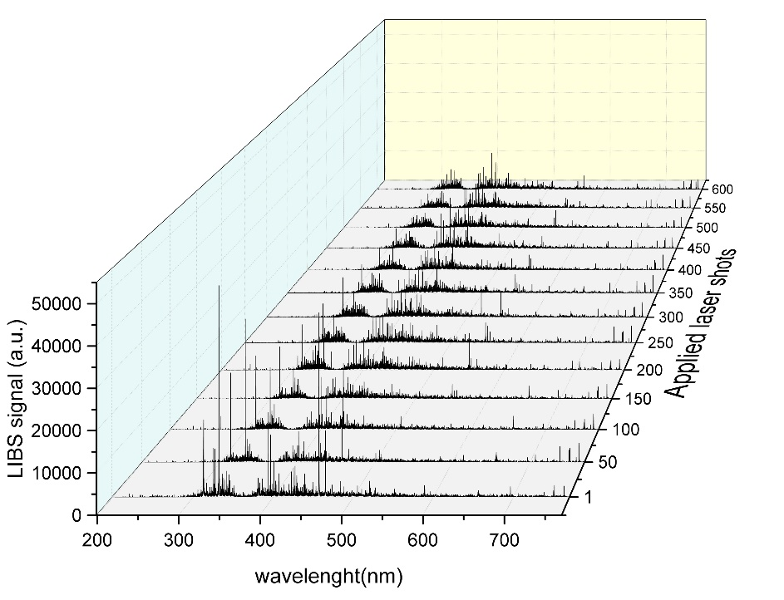
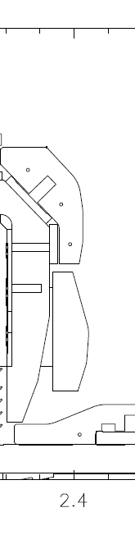
LIBS spectra
Pure W sample
Be sample
JET sample 2IWG3A_6a
W lines
W lines
0
1
Be lines
Be lines
6a
Mo lines
3
4
Jari Likonen | WPPWIE Midterm Meeting | VTT Espoo| 9.4.2024 | Page 18

Slide 19
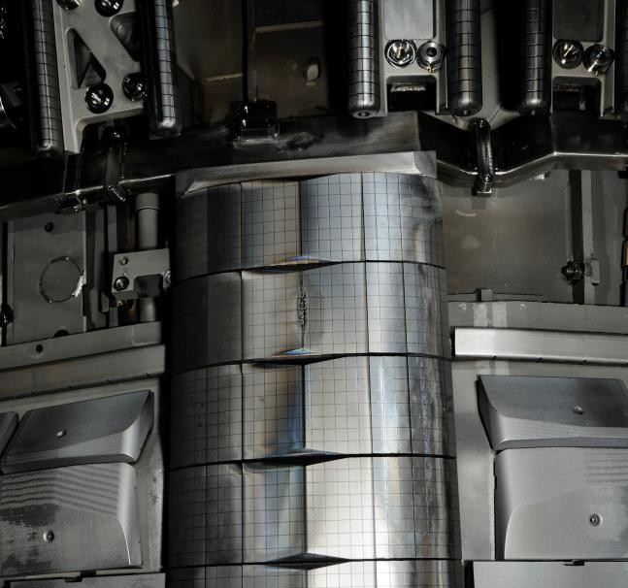
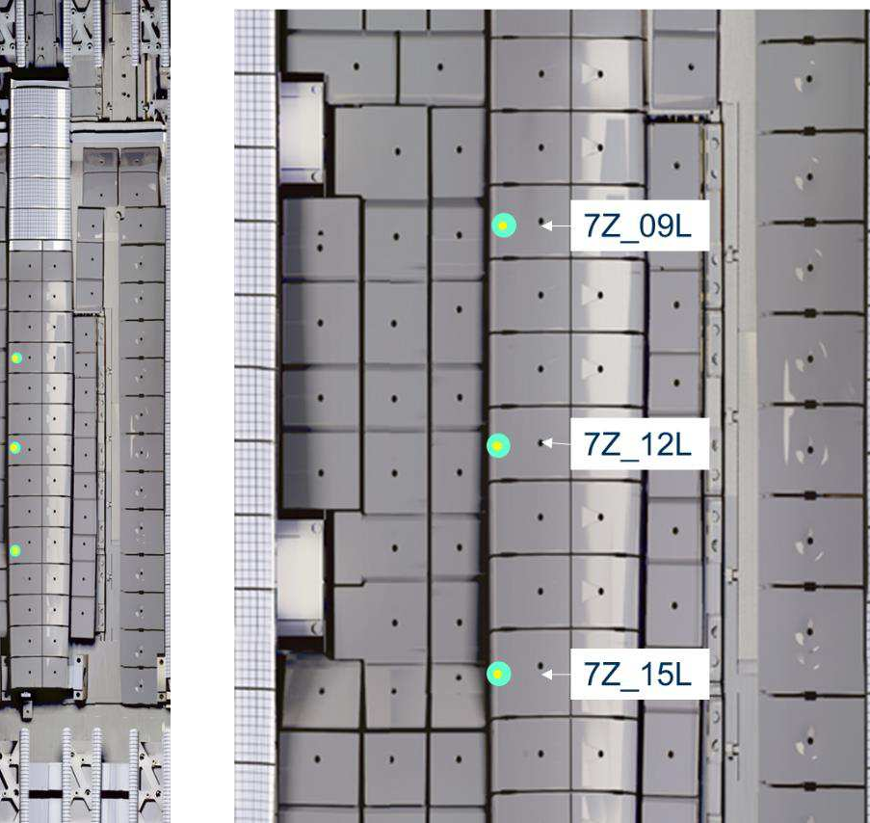
LIBS programme at JET, IWGL tiles
Tile ID | LIBS Detail | Number of Spots
2XR19 W Top Tile | R1 (All columns) | 25
2XR19 | R2 (All columns) | 25
2XR17 | R7 (All columns) | 25
2XR9 | High resolution | 200
2XR8 | R7 (All columns) | 25
2XR4 | R2 (All columns) | 25
2XR3 | R7 (All columns) | 25
3X14 | C3, RW | 31
8Z10 | R5 LM2-C3; R5 LW1-C2 | 2
8Z14 | C3 | 22
7X7 | R5 LW1-C3 | 1
TOTAL |  | 406
2XR19
2019-2023
2XR18
2019-2023
not taken out
2XR17
2011-2023
Tile ID | LIBS Detail | Number of Spots
7Z_9L | Single Spot in KS8 shine through | 1
7Z_12L | Single Spot in KS8 shine through | 1
7Z_15L | Single Spot in KS8 shine through | 1
TOTAL |  | 3
Notes:
PD: Plasma Devices as in PEP listed
HHF: High Heat flux as in PEP listed
IBF: Ion beam Facility as in PEP listed
Other facilties as in PEP listed

Slide 20
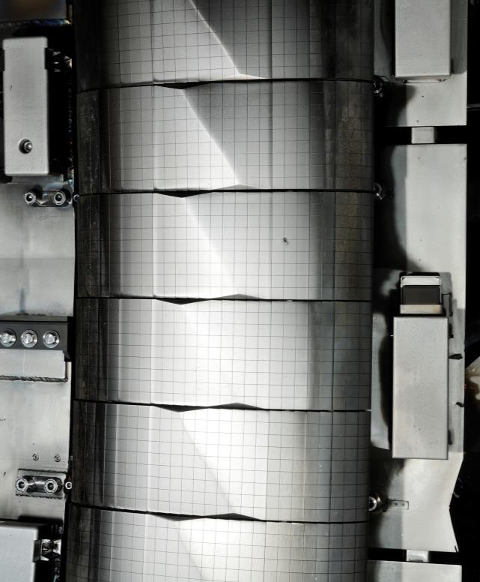
LIBS programme at JET, WPL tiles
Tile ID | LIBS Detail | Number of Spots
4D23 | R2 (All columns) | 26
4D22 | R8 (All columns) | 26
4D14 | R2 (All columns) | 26
4D13 | High Resolution | 234
4D4 | R2 (All columns) | 26
4D3 | R8 (All columns) | 26
TOTAL |  | 364
4D14
4D13
4D09
Notes:
PD: Plasma Devices as in PEP listed
HHF: High Heat flux as in PEP listed
IBF: Ion beam Facility as in PEP listed
Other facilties as in PEP listed

Slide 21
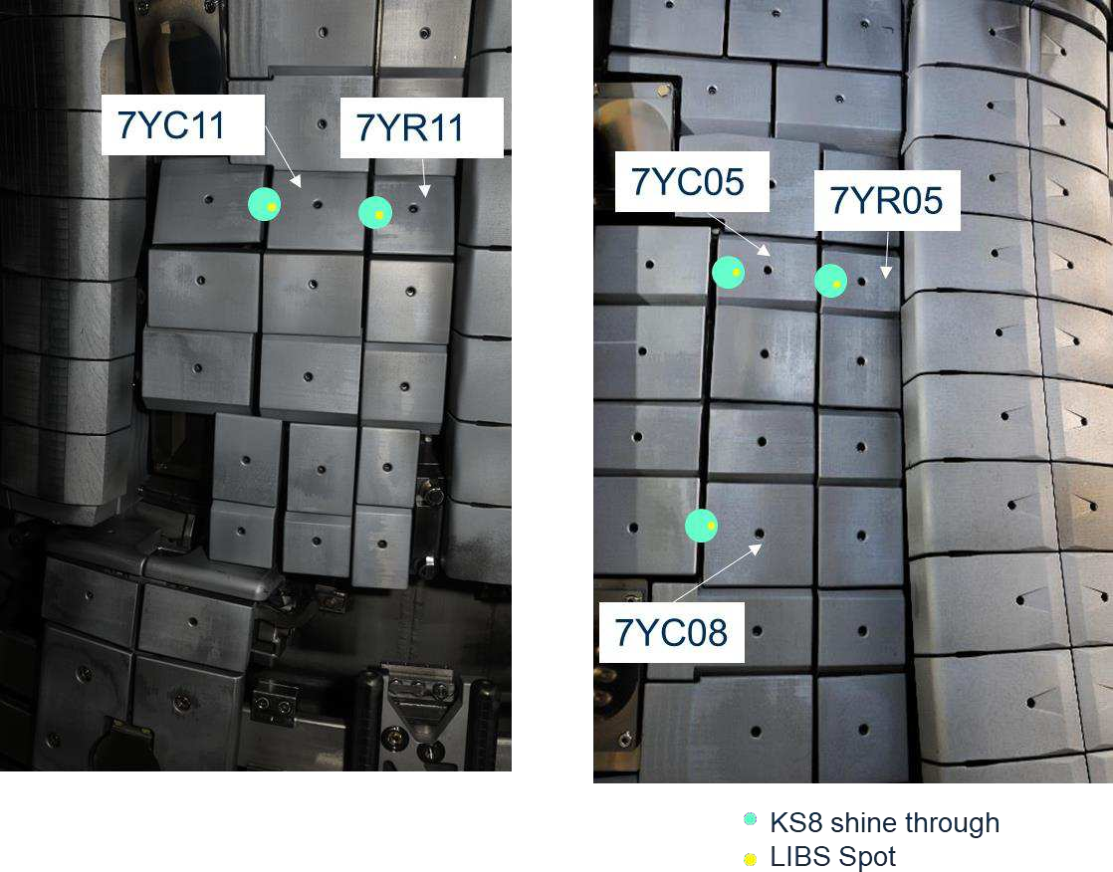
LIBS programme at JET, Inner Wall Protection (IWP) tiles
Tile ID | LIBS Detail | Number of Spots
IWP_428 | 20nm W calibration 2 micron Be calibration 8 micron Be calibration | 3
IWP_408 | Single Spot | 1
IWP_402 | Single Spot | 1
IWP_411 | Single Spot | 1
IWP_805 | Single Spot | 1
IWP_808 | Single Spot | 1
7YC05/705C | Single Spot in KS8 shine through | 1
7YR05/705R | Single Spot in KS8 shine through | 1
7YC08/708C | Single Spot in KS8 shine through | 1
7YC11/711C | Single Spot in KS8 shine through | 1
7YR11/711R | Single Spot in KS8 shine through | 1
TOTAL |  | 13
Notes:
PD: Plasma Devices as in PEP listed
HHF: High Heat flux as in PEP listed
IBF: Ion beam Facility as in PEP listed
Other facilties as in PEP listed

Slide 22

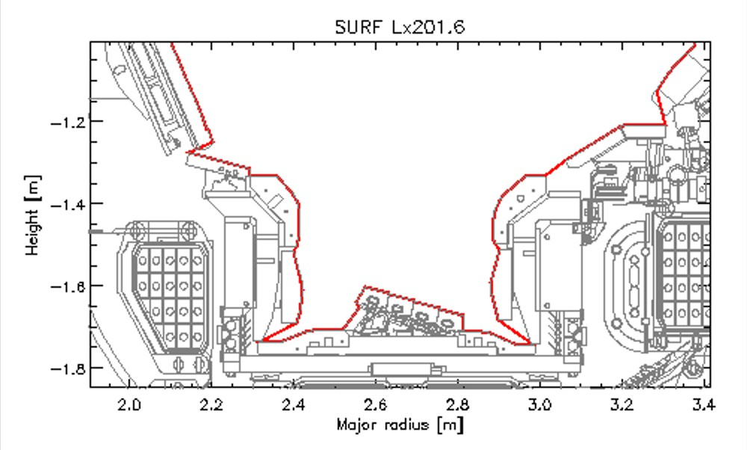


Module 14 – LIBS cross section
tile C
0
tile B
1
8
3
7
5
4
6
AW 3/11/23: Accessible locations needs updating

Slide 23
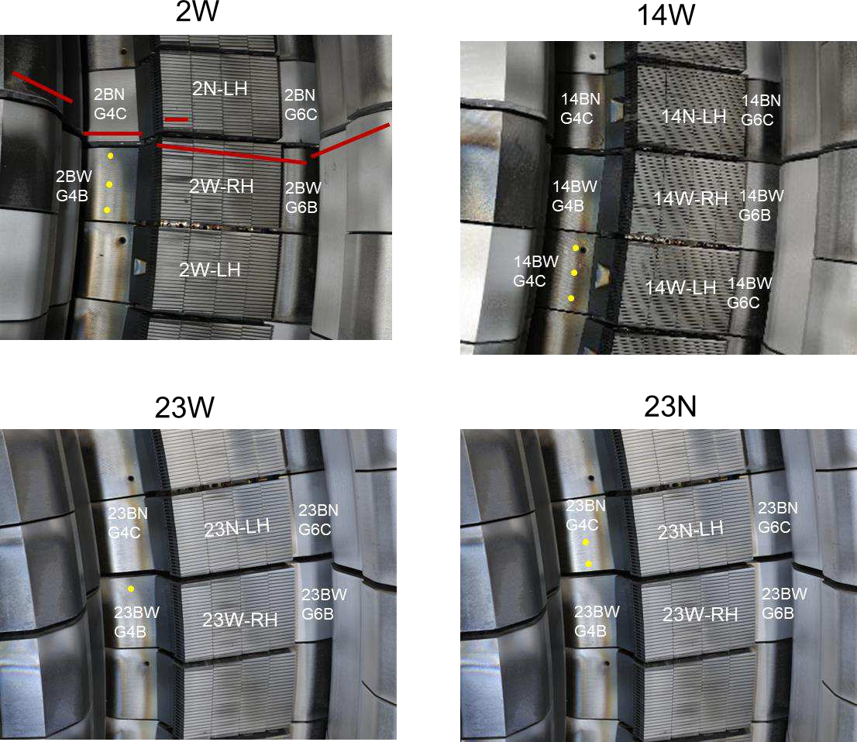
LIBS programme at JET, Base Divertor Carriers
Tile ID | LIBS Detail | Number of Spots
14BW | 1 row, 3 columns | 3
02BW | 1 row, 3 columns | 3
23BW | Single Spot | 1
23BN | 1 row, 2 columns | 2
TOTAL |  | 9
Notes:
PD: Plasma Devices as in PEP listed
HHF: High Heat flux as in PEP listed
IBF: Ion beam Facility as in PEP listed
Other facilties as in PEP listed

Slide 24
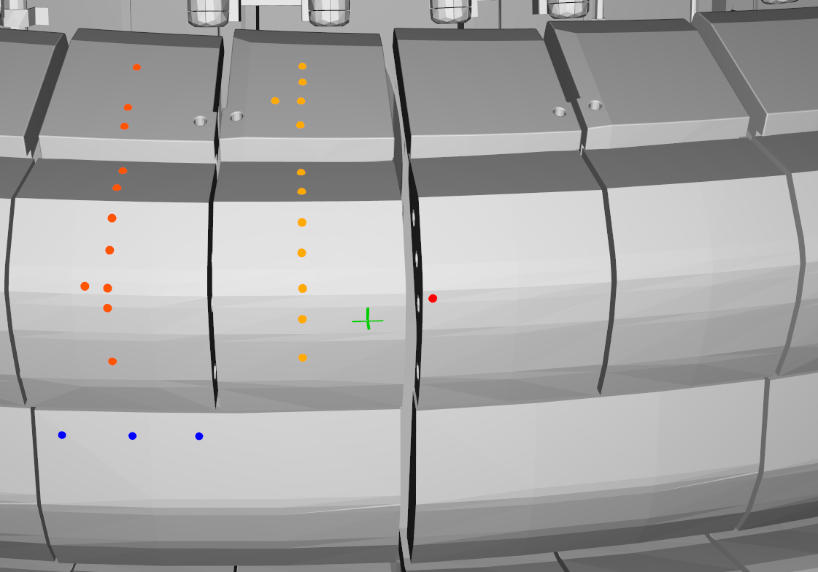
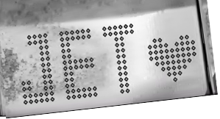
LIBS programme at JET, Inner Divertor Carriers
Tile ID | LIBS Detail | Number of Spots
14IW | See fig. below | 22
02IW | 7 rows, 3 columns | 21
TOTAL |  | 43
LH14W
2011-23
RH14W
2011-23
LH14N
2019-23
RH14N
2019-23
14IWG1A
2019-23
14IWG1B
2011-23
14ING1C
2019-23
14ING1D
2011-23
RE damage
14IWG3A
2011-23
14ING3B
Mo 2011-23
24
Notes:
PD: Plasma Devices as in PEP listed
HHF: High Heat flux as in PEP listed
IBF: Ion beam Facility as in PEP listed
Other facilties as in PEP listed

Slide 25
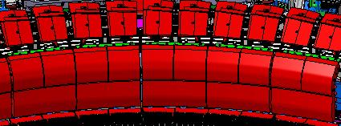
Octant 5 Module 14 Outer divertor
Tile ID | LIBS Detail | Number of Spots
14ON | 5 rows, 3 columns | 15
02ON | 5 rows, 3 columns | 15
TOTAL |  | 30
14ON removed
14OW Not removed
14OWG8D
14ONG8B
14ONG8A
2019-23
14OWG8C
14OWG7B
14ONG7A
2019-23
Modules 15, 16, 17 etc
Modules 13, 12, 11 etc
Shadowed end

Slide 26
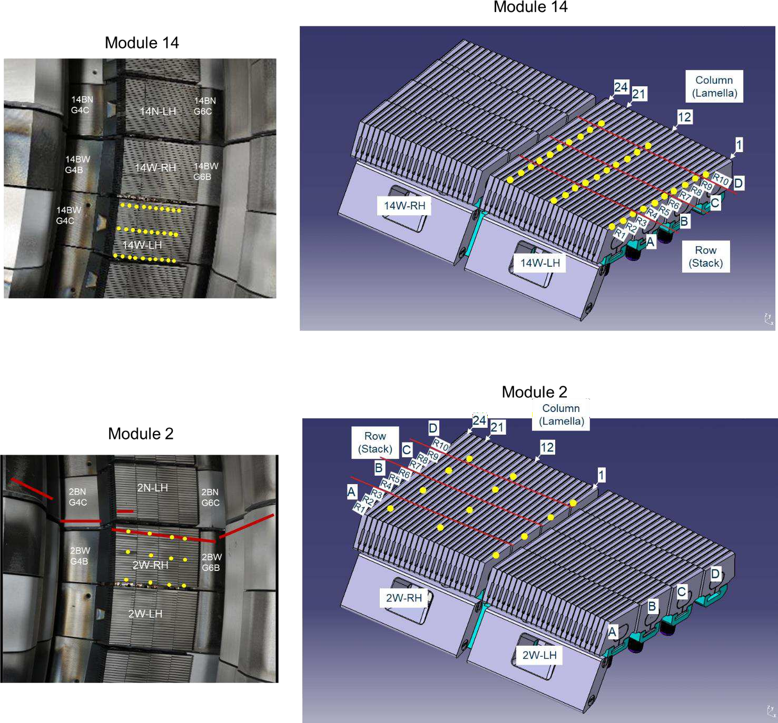
LIBS programme at JET, LBSRP Tiles
Tile ID | LIBS Detail | Number of Spots
LBSRP_14W | 3 Spots on: | 30
 | A1, B1, C1, A12, B12, C12,
 | A21, B21, C21
 | 1 spot on:
 | D1, D12, D21
LBSRP_2W | 1 Spot on: A1, B1, C1, D1, A12, B12, C12, D12, A21, B21, C21, D21 | 12
LBSRP_23W | 3 Spots on: A21, B21, C21 1 Spot on: D21 | 10
LBSRP_23N | 3 Spots on: A1, B1, C1, A12, B12, C12 1 Spot on: D1, D12 | 20
TOTAL |  | 72
Notes:
PD: Plasma Devices as in PEP listed
HHF: High Heat flux as in PEP listed
IBF: Ion beam Facility as in PEP listed
Other facilties as in PEP listed

Slide 27
LIBS programme at JET, LBSRP Tiles
Tile ID | LIBS Detail | Number of Spots
LBSRP_14W | 3 Spots on: | 30
 | A1, B1, C1, A12, B12, C12,
 | A21, B21, C21
 | 1 spot on:
 | D1, D12, D21
LBSRP_2W | 1 Spot on: A1, B1, C1, D1, A12, B12, C12, D12, A21, B21, C21, D21 | 12
LBSRP_23W | 3 Spots on: A21, B21, C21 1 Spot on: D21 | 10
LBSRP_23N | 3 Spots on: A1, B1, C1, A12, B12, C12 1 Spot on: D1, D12 | 20
TOTAL |  | 72
Notes:
PD: Plasma Devices as in PEP listed
HHF: High Heat flux as in PEP listed
IBF: Ion beam Facility as in PEP listed
Other facilties as in PEP listed

Slide 28
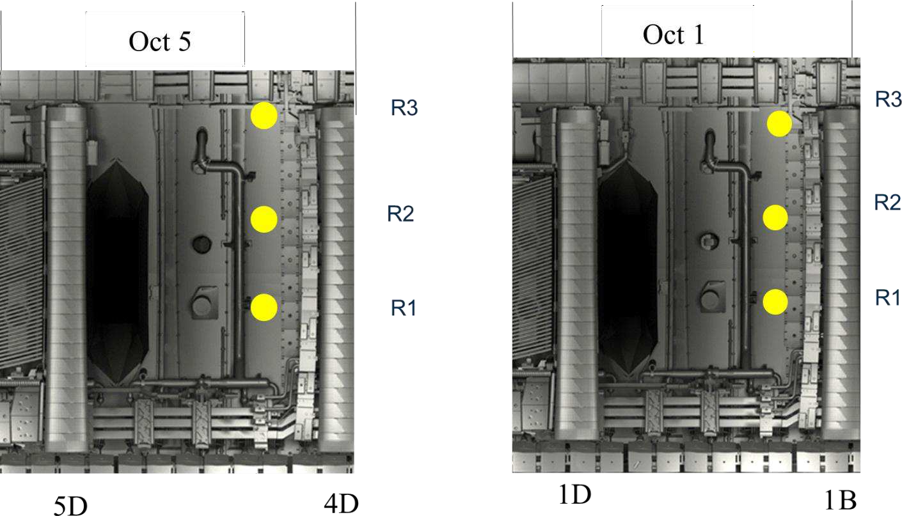
LIBS programme at JET, Vessel Wall
Location ID | LIBS Detail | Number of Spots
Vessel Wall Oct 1 | 3 rows, 1 column | 3
Vessel Wall Oct 5 | 3 rows, 1 column | 3
TOTAL |  | 6
Notes:
PD: Plasma Devices as in PEP listed
HHF: High Heat flux as in PEP listed
IBF: Ion beam Facility as in PEP listed
Other facilties as in PEP listed

Slide 29
LIBS programme at JET, summary
Location ID | LIBS Detail | Number of Spots
IWGL |  | 409
WPL |  | 364
IWP inner wall protection |  | 13
Inner +base divertor carriers |  | 52
HFGC tiles |  | 21
LBSRP tiles |  | 72
Outer divertor carriers |  | 30
Vessel wall |  | 6
TOTAL |  | 967
Notes:
PD: Plasma Devices as in PEP listed
HHF: High Heat flux as in PEP listed
IBF: Ion beam Facility as in PEP listed
Other facilties as in PEP listed

Slide 30
Tile removal
Notes:
PD: Plasma Devices as in PEP listed
HHF: High Heat flux as in PEP listed
IBF: Ion beam Facility as in PEP listed
Other facilties as in PEP listed

Slide 31
SP E – UKAEA contribution
SP E.3: Post-mortem analysis of PFC and other objects in JET:
Estimates of the tritium retention and activity in the components to be removed in the next intervention (post-DTE3).
Important for the licensing of the laboratories which will be involved in the processing of components and analysis of samples.
Calculations of activation products activities – ongoing:
  It is expected that tritium activity is predominant.
  Final determination of activity only after component extraction and measurement.
 | Whole tiles |  |  | Samples
Tile type | T atoms/tile | Bq/tile | Specific activity (Bq/g) | Bq/sample | Specific activity (Bq/g)
Tile 0/HFGC | 2.14E+20 | 4.00E+11 | 3.08E+08 | 6.00E+09 | 1.07E+09
Tile 1 | 2.27E+20 | 5.00E+11 | 1.79E+08 | 5.00E+09 | 8.82E+08
Tile 3 | 2.30E+20 | 5.00E+11 | 1.19E+08 | 3.00E+09 | 4.47E+08
Tile 4 | 1.04E+20 | 2.00E+11 | 9.52E+07 | 2.00E+09 | 3.40E+08
Tile 6 | 6.35E+19 | 2.00E+11 | 9.52E+07 | 1.00E+09 | 1.96E+08
Tile 7 | 1.64E+20 | 3.00E+11 | 6.12E+07 | 2.00E+09 | 2.69E+08
Tile 8 | 4.44E+19 | 8.00E+10 | 2.29E+07 | 7.00E+08 | 1.33E+08
Tile 5 Tungsten lamella | 8.86E+16 | 2.00E+08 | 1.00E+06 | 4.00E+07 | 2.31E+06
IWGL (5 tile pieces) | 2.05E+19 | 4.00E+10 | 1.60E+07 | 3.00E+08 | 7.32E+07
OPL (7 tile pieces) | 5.03E+19 | 9.00E+10 | 3.10E+07 | 4.00E+08 | 1.07E+08
IWC | 3.04E+19 | 6.00E+10 | 4.29E+07 | 6.00E+08 | 5.89E+07
DP | 1.02E+19 | 2.00E+10 | 2.86E+07 | 2.00E+08 | 6.35E+07
Notes:
~7x10²⁵ T atoms injected between 2020-2023.
0.2% retention fraction assumed.
No clean-up assumed – listed here is the upper limit.

Slide 32
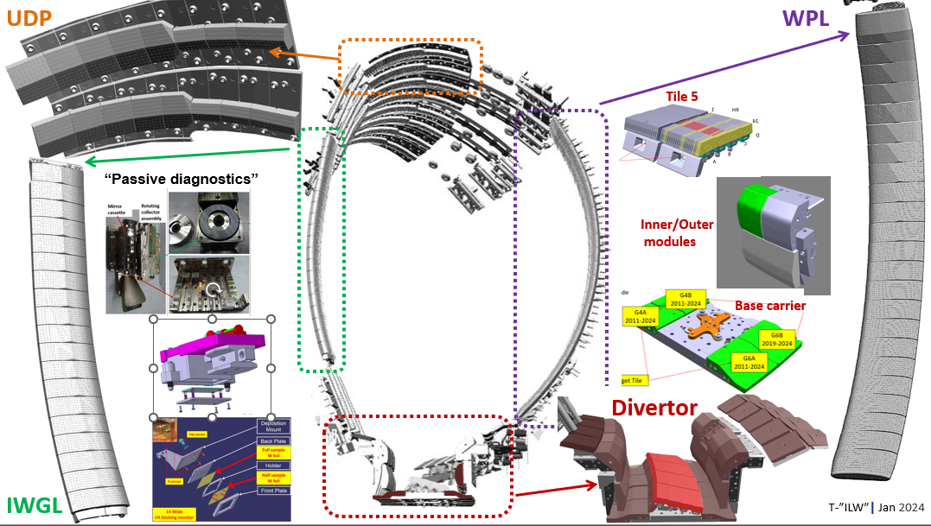
2024 JET intervention plan – typical JET tile removal

Slide 33
Passive diagnostics
Main chamber wall:
Rotating collectors
Mirrors
Sticking monitors
Wall inserts (inner wall cladding)
Remote divertor and
under the wedge:
Rotating collectors
Mirrors
Deposition / sticking monitors
Quartz micro-balance
tile C
0
tile B
1
8
3
5
7
4
6

Slide 34
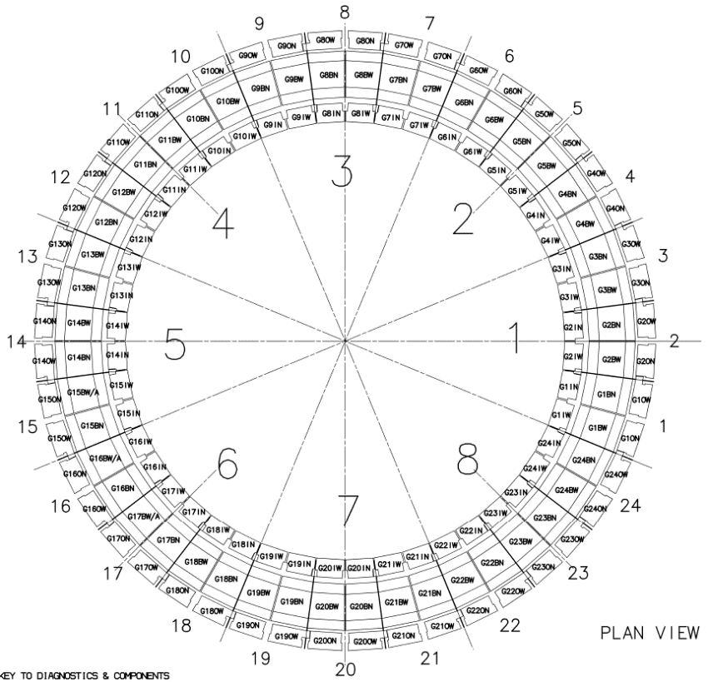
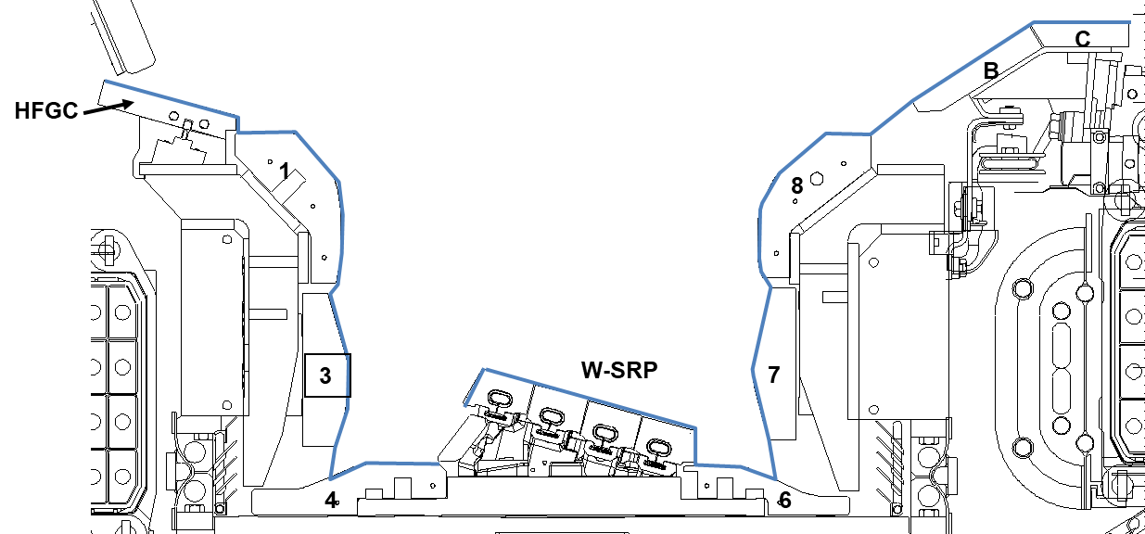
Dust collection: One vacuuming
Inner & outer divertor
360° around divertor, excluding modules where tiles for analysis are located
Surfaces not to be vacuumed:
Module 14: 14IW, 14BW, 14W-WLBSRP,14N-WLBSRP, 14ON 14W-HFGCs, 14NHFGCs
Module 2: 2IW, 2ON
TBC: additional HFGC
Collection <2g for both JET-ILW 2011-12 & 2013-14
Significantly lower than in JET carbon wall ~ 300 g
Request to consider separate inner and outer divertor vacuuming

