Slide 1
Material deposition, fuel retention and W re-deposition using NRA and SEM on JET W-coated divertor tiles
P. Tsavalas¹, K. Mergia¹, A. Lagoyannis¹, M. Axiotis¹, S. Fazinic², G. Provatas², J. Likonen³
¹National Center for Scientific Research “Demokritos”, Athens, Greece
²Ruder Boškovic Institut, Zagreb, Croatia
³VTT Technical Research Centre of Finland, Finland

Slide 2
Outline
ILW 1-3 JET Tokamak Divertor Tile 0 & 1
Elemental deposition & fuel retention → amount & depth profile
SEM & elemental mapping of characteristic feature
ILW 2-3 JET Tokamak Divertor Tile 4, 6, 7 & 8
Elemental deposition, erosion & fuel retention → amount & depth profile
SEM & elemental mapping of characteristic feature

Slide 3
ILW 1-3 JET Tokamak Divertor Tile 0 & 1

Slide 4
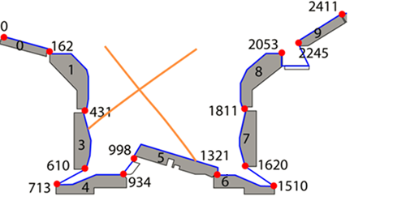
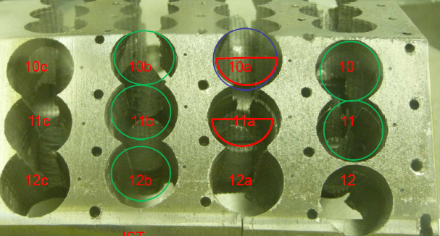
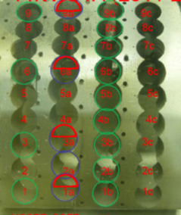
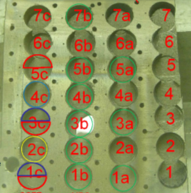
Divertor Tile 0 & 1: Samples & Methodology
Surface analysis
³He NRA (2 MeV)
d NRA (1.62 MeV)
SEM & EDS (10 keV)
Cross Section analysis
SEM & EDS (10 keV)
HFGC
14IW G1A (2011-16)
G1A
11
10
9
HFGC 14NRH (2011-2016)
Exp. Campaign | Tile | Sample No | S-coordinates
2011-16 | HFGC 14NRH (Tile 0) | 1a | 132
 |  | 3a | 90
 |  | 5a | 50
 | 14IW G1A (Tile 1) | 1 | 405
 |  | 3 | 363
 |  | 6 | 301
 |  | 9 | 240
 |  | 10 | 217
 |  | 11 | 195
6
5a
3
3a
1
1a

Slide 5
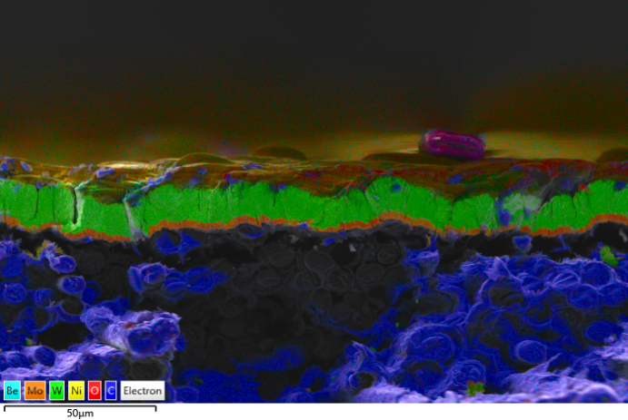
Tile 0 Sample 1a: Deposition & fuel retention
NRA spectra
NRA quantitative results
Elemental depth profile
³He beam
d beam
Element | Amount (10¹⁸ at/cm²)
D | 2.4
Be | 54.4
C | 1.9
N | 1.1
O | 20.3
W | 1.0
For layer thickness of 10 μm
Cross section
Mo layer
Elemental concentration
Deposition layer
W layer
Near Tile 1: High deposition region
Deposited layer thickness:
NRA: >12 μm
SEM/EDS: (6 - 23) μm; Not constant
Deposited layer composition:
Rich in D, Be (dominant), C, N & O
Plenty of impurities (EDS)
50 μm
For the top layer (2-3) μm
Rest elements: Al, Cl, Ca, Ti, Cr, Mn, Fe, Ni, Cu & Mo
CFC

Slide 6
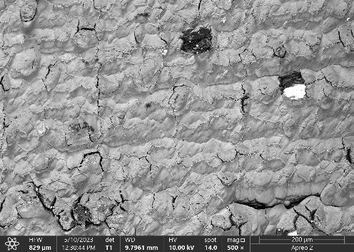
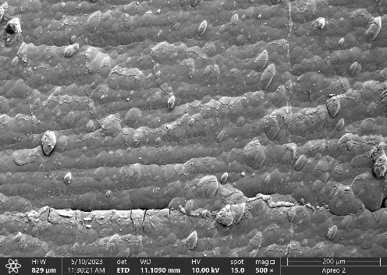
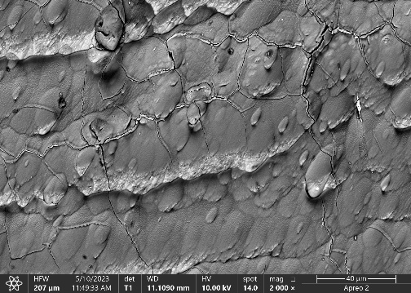
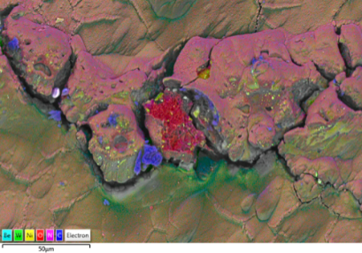
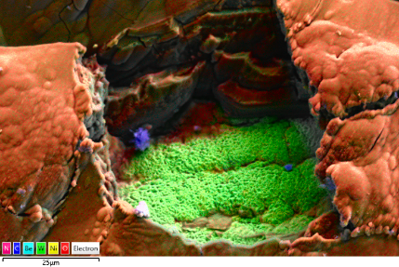
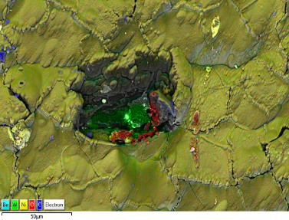
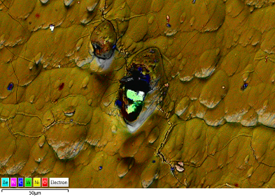
Tile 0 Sample 1a: SEM - characteristic surface features
SEM image
Area rich in O
200 μm
200 μm
40 μm
50 μm
Areas rich in W
Smooth surface with cracks
Areas/particles:
Rich in W due to absence of deposition
Rich in O
25 μm
50 μm
50 μm

Slide 7
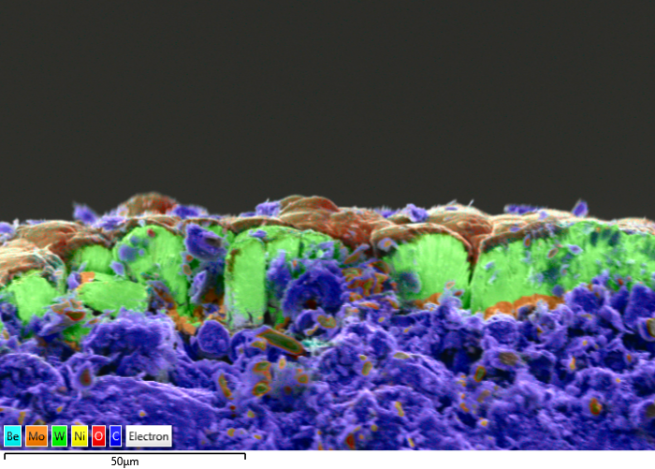
Tile 0 Sample 5a: Deposition & fuel retention
NRA quantitative results
Elemental depth profile
Elemental concentration
Element | Amount (10¹⁸ at/cm²)
 | Sample 5a | Sample 1a
D | 3.0 | 2.4
Be | 28.4 | 54.4
C | 1.7 | 1.9
N | 0.7 | 1.1
O | 11.5 | 20.3
W | 21.7 | 1.0
For layer thickness of 10 μm
For the top layer (2-3) μm
Rest elements: Al, Cl, Ca, Ti, Cr, Mn, Fe, Ni, Cu & Mo
Cross section
In the middle of Tile 0; Low deposition region
Be & O amount almost half
Much more W amount
Deposited layer thickness:
NRA: 8 μm
SEM/EDS: (3 - 9) μm
Rich in impurities (same as Sample 1a)
Deposition layer
W layer
Compared with Sample 1a
Mo layer
CFC
50 μm

Slide 8
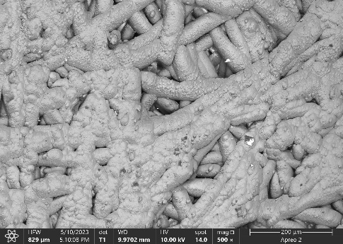
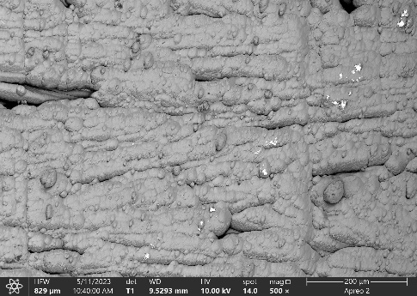
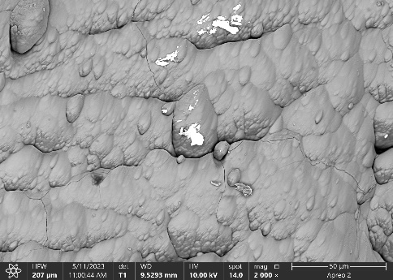
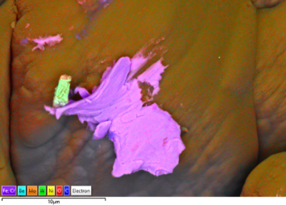
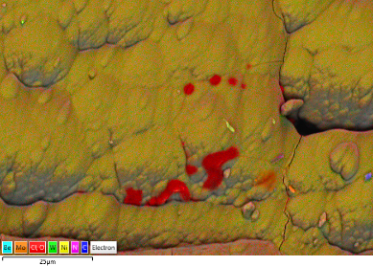
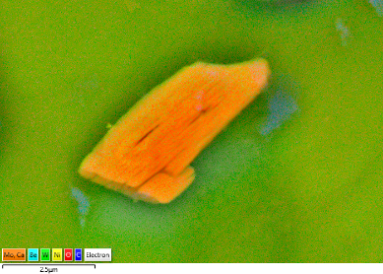
Tile 0 Sample 5a: SEM - characteristic surface features
SEM image
Particle rich in Fe & Cr
10 μm
200 μm
200 μm
50 μm
Morphology of fibers BUT NOT enhanced C concentration
Smooth surface with cracks
Oriented Humps
Areas/particles:
Rich in Fe & Cr
Rich in Cl & O
Rich in Mo & Ca
Areas rich in O & Cl
Particle rich in Mo & Ca
10 μm
25 μm
25 μm

Slide 9
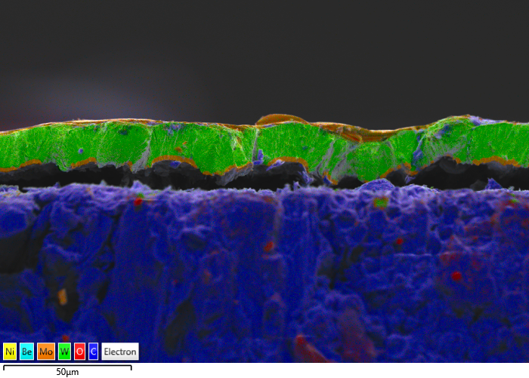
Tile 1 Sample 1: Deposition & fuel retention
NRA quantitative results
Elemental depth profile
Elemental concentration
Element | Amount (10¹⁸ at/cm²)
D | 3.3
Be | 30.1
C | 1.5
N | 0.7
O | 9.0
W | 26.4
Cross section
For the top layer (2-3) μm
Rest elements: Al, Cl, Ca, Ti, Cr, Mn, Fe, Ni, Cu & Mo
Deposition layer
(Mostly Be)
W layer
Near Tile 3: Low deposition region
Deposited layer thickness:
NRA: 6 - 8 μm
SEM/EDS: (1 - 6) μm
Rich in impurities
Mo layer
CFC
50 μm

Slide 10
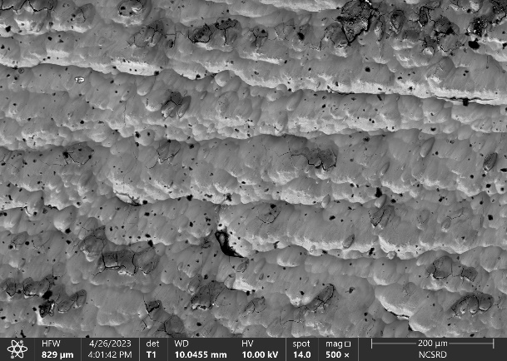
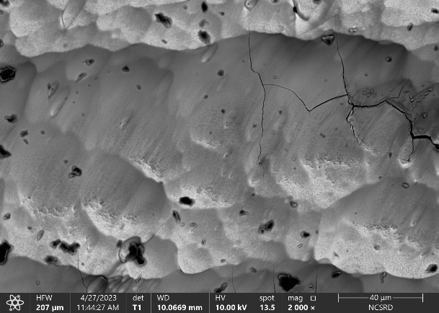
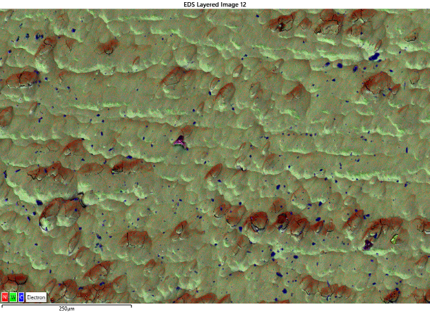
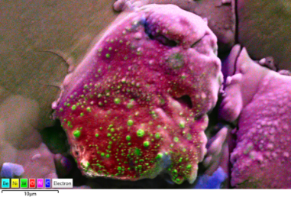
Tile 1 Sample 1: SEM - characteristic surface features
SEM image
Rich in N
200 μm
40 μm
200 μm
Particle rich in W, O and N
Smooth surface with cracks
Oriented humps
Deposited areas/particles:
Rich in N; the rest of elements have homogeneous distribution
Rich in W, O and N
10 μm

Slide 11
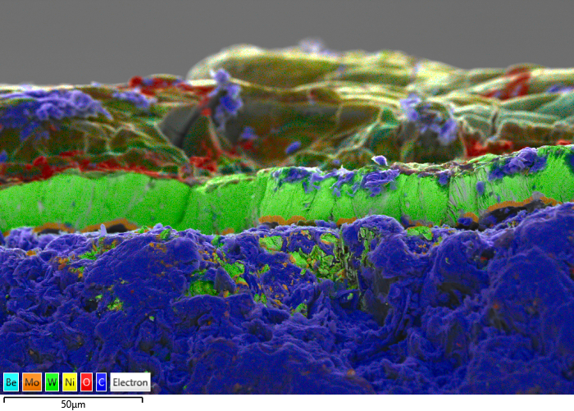
Tile 1 Sample 9: Deposition & fuel retention
NRA quantitative results
Elemental depth profile
Elemental concentration
Element | Amount (10¹⁸ at/cm²)
 | Sample 9 | Sample 1
D | 5.8 | 3.3
Be | 77.9 | 30.1
C | 7.1 | 1.5
N | 2.0 | 0.7
O | 25.8 | 9.0
W | 1.6 | 26.4
For layer thickness of 10 μm
For the top layer (2-3) μm
Rest elements: Al, Cl, Ti, Cr, Fe, Ni, Cu & Mo
Cross section
Deposition layer
In Tile 1 middle; High deposition region:
Be, N & O amount more than double
C amount more than triple
Very low W amount
Highest D retention
Deposited layer thickness:
NRA: > 16 μm
SEM/EDS: (25- 45) μm
W layer
Compared to
Tile 1 Sample 1
Mo layer
CFC
50 μm

Slide 12
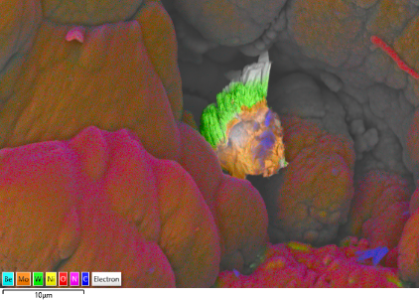
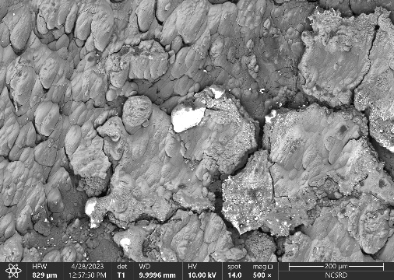
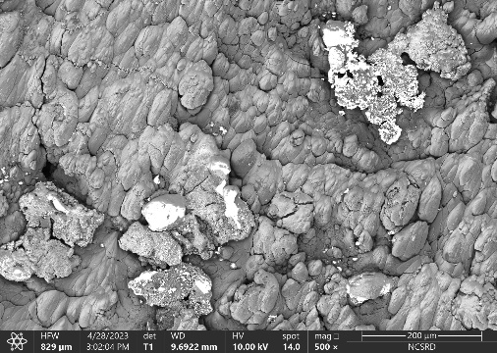
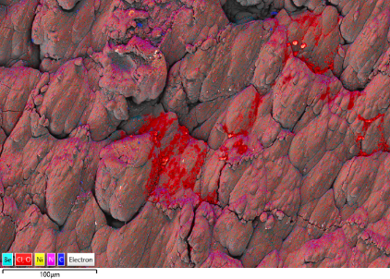
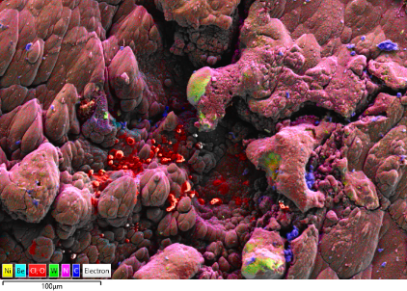
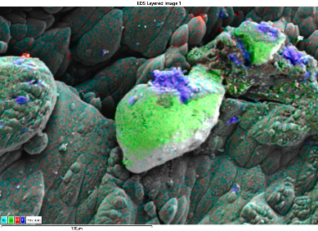
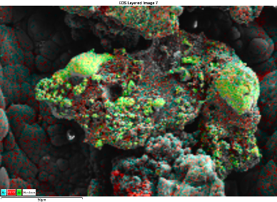
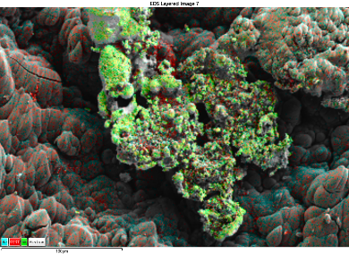
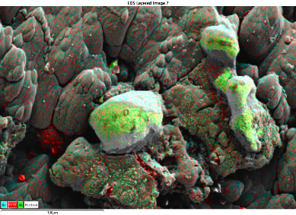
Tile 1 Sample 9: SEM - characteristic surface features
SEM images
Rich in W - Mo
Rich in O & Cl
10 μm
200 μm
200 μm
100 μm
100 μm
Deposited W with impurities
Rough surface with wide cracks
Oriented humps
Deposited areas/particles:
Rich in W with Cr, Ti, Fe & Ni
Rich in W – Mo
O & Cl
100 μm
100 μm
100 μm

Slide 13
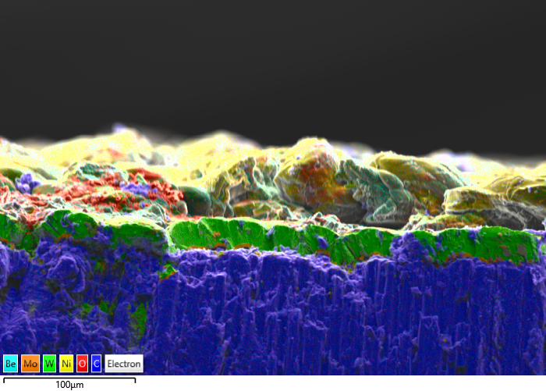
Tile 1 Sample 11: Deposition & fuel retention
NRA quantitative results
Elemental depth profile
Elemental concentration
Element | Amount (10¹⁸ at/cm²)
 | Sample 11 | Sample 9 | Sample 1
D | 4.0 | 5.8 | 3.3
Be | 79.9 | 77.9 | 30.1
C | 4.8 | 7.1 | 1.5
N | 1.9 | 2.0 | 0.7
O | 23.0 | 25.8 | 9.0
W | 1.4 | 1.6 | 26.4
For layer thickness of 10 μm
For the top layer (2-3) μm
Rest elements: Al, Cl, Ca, Ti, Cr, Mn, Fe, Ni, Cu & Mo
Cross section
Deposition layer (Mostly Be)
W layer
Near Tile 0; High Be deposition region:
Similar deposition with Sample 9
Deposited layerthickness:
NRA: > 16 μm
SEM/EDS: (25 – 55) μm
Mo layer
CFC
100 μm

Slide 14
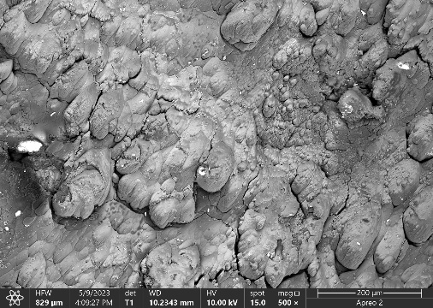
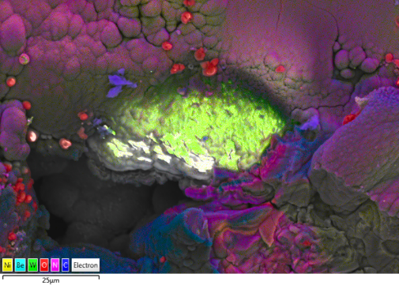
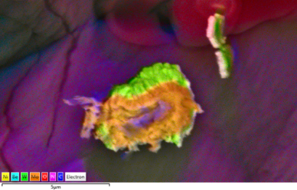
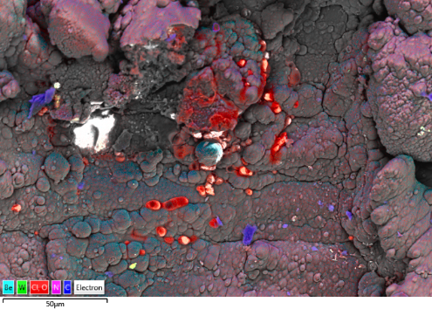
Tile 1 Sample 11: SEM - characteristic surface features
SEM images
Deposited W with impurities
200 μm
200 μm
Rich in O & Cl
Rich in W - Mo
Rough surface with cracks
Deposited areas/particles:
Rich in W along with Cr, Fe, Ni &Cu
Rich in W - Mo
Rich in O & Cl
5 μm

Slide 15
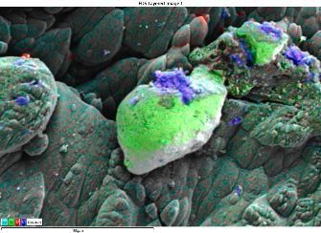
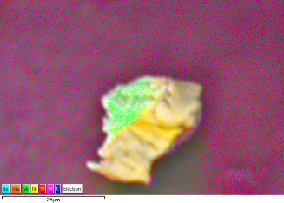
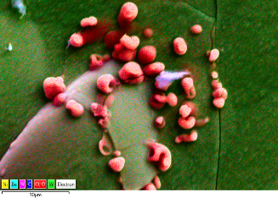
Tile 0 & 1: Summary Results
Deposition & Fuel retention
Composition of deposited layer: Be (dominant), D, C, N, O & many impurities
S- coordinate 50: Low deposition: layer thickness ~6 μm
S- coordinate 95 - 240: High deposition region: layer thickness >16 μm
S- coordinate 240 - 405: Low deposition: layer thickness <8 μm
Morphology
S- coordinate 50 - 132: fibre morphology, smooth surface & cracks
S- coordinate 195 – 240: rough surface & wide cracks
S- coordinate 301 – 405: smooth surface & cracks
Surface characteristic features
W deposition
W – Mo deposition
O - Cl deposition
Fe - Cr deposition
2.5 μm
10 μm
10 μm
100 μm

Slide 16
ILW 2-3 JET Tokamak Divertor Tile 4, 6, 7 & 8

Slide 17
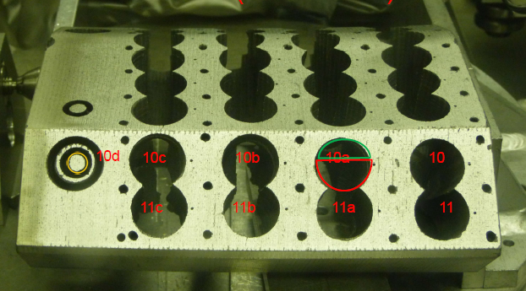
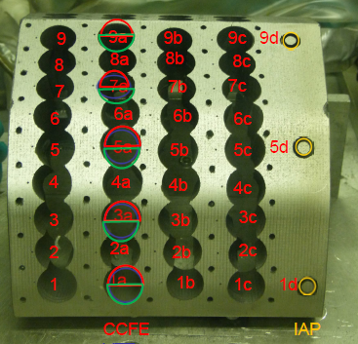
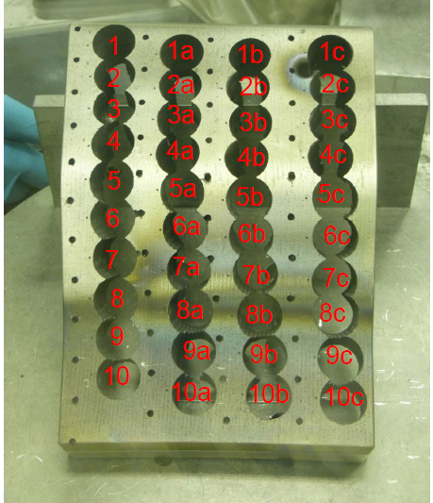
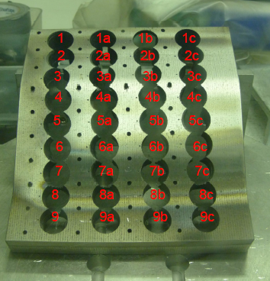
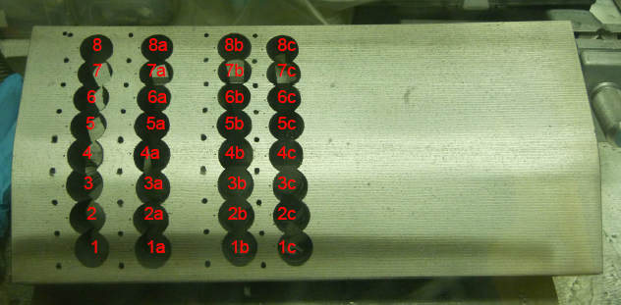
Tile 4, 6, 7 & 8: Samples & Experimental Details
Surface
d NRA (1.6 MeV)
SEM & EDS (5 keV & 30 keV)
JET Tokamak Divertor
2ONG8B
10b
Exp. Campaign | Tile | Sample | S-coordinate
2013-16 | 14BN G4D | 3b | 868
 |  | 5b | 824
 |  | 7b | 779
 |  | 9b | 735
 | 2BN G6C | 5a | 1405
 |  | 7a | 1447
 | 2ON G7A | 2 | 1668
 |  | 4 | 1716
 |  | 6 | 1764
 | 2ON G8B | 2b | 1865
 |  | 4b | 1919
 |  | 6b | 1973
 |  | 8b | 2027
 |  | 10b | 2053
8b
6b
14BN G4D
4b
2b
2BN G6C
3b
2ONG7A
5b
7b
5a
6
9b
4
7a
2

Slide 18
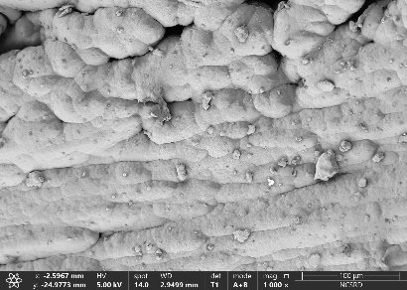
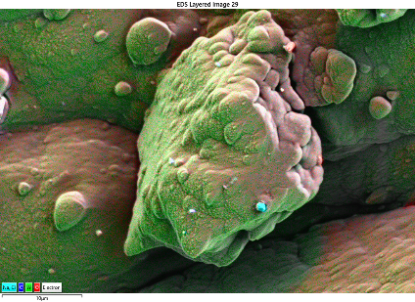
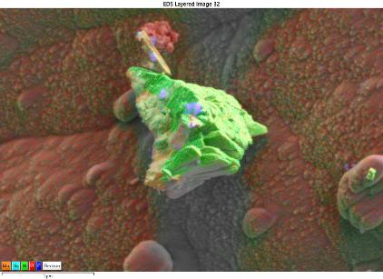
Tile 4 Sample 9b
NRA quantitative results
Elemental depth profile
Elemental concentration
Element | Amount (10¹⁷ at/cm²)
D | 16.1
Be | 36.9
C | 40.75
N | 5.8
O | 36
Highest D
retention
Rest elements: Cu, Fe, Cl
100 μm
Highest D amount
Elemental concentration decreases with depth (up to depth of ~4 μm)
Smooth surface
Detection of W, W - Mo, O and Cl & Na deposition areas
W deposition
W - Mo deposition
Cl - Na deposition
5 μm
5 μm
2.5 μm

Slide 19
Tile 6 Sample 7a
NRA quantitative results
Elemental depth profile
Elemental concentration
Element | Amount (10¹⁷ at/cm²)
D | 3
Be | 910
C | 128
N | 34
O | 58.5
Highest deposition
Highest Be
Rest elements:
Cu, Fe, Cl, Mo, Na, Al
Particle rich in W - Mo
100 μm
The sample with the highest deposition (Be, C, N & O)
Thick deposition layer (>13 μm)
Rough surface with wide cracks
W deposition on Be deposition layer
W - Mo deposition particle
W deposition on thick Be layer
5 μm
100 μm
10 μm

Slide 20
Tile 7 Sample 2
NRA quantitative results
Elemental depth profile
Elemental concentration
Element | Amount (10¹⁷ at/cm²)
D | 1.2
Be | 35.1
C | 19.6
N | 6.1
O | 8.4
Rest elements: Ni, Fe, Cu
(Be under detection limits)
Highest Mo
100 μm
Mo after W erosion
W - Mo deposition on Mo
Elemental deposition decreases, but the deposition depth is higher than 6 μm (detection limit)
Sample has suffered erosion and W - Mo deposition
Mo spots
10 μm
2.5 μm
100 μm

Slide 21
Tile 8 Sample 2b
NRA quantitative results
Elemental depth profile
Elemental concentration
Element | Amount (10¹⁷ at/cm²)
D | 1.5
Be | 5.645
C | 4.9
N | 0.975
O | 0.75
Lowest deposition
Rest elements: Fe, Cu
Highest W
Ni & O
W - Mo deposition
W deposition
Lowest deposition, thinnest deposition layer (<1 µm)
Poor in elemental abundance (EDS)
Smooth surface with cracks
W - Mo and W deposition
100 μm
10 μm
50 μm

Slide 22
Tile 4, 6, 7 & 8: Summary
Fuel retention
High D amount ((2.4 - 16.1) × 10¹⁷ at/cm²) on Tile 4, the highest one near Tile 3
Material deposition
The elemental (Be, C & N) amounts change similarly versus S-coordinate:
Tile 4: Material deposition decreases from tile 3 to tile 5
Tile 6: The highest deposition at the same S-coordinate (1447)
Tile 7: It presents higher deposition than Tile 8
Tile 8: Elemental amounts almost constant with S-coordinate
Surface characteristic features
W erosion &
Mo-W deposition
W erosion
W deposition
W - Mo deposition
Ni-O areas
Mo
W
10 μm
2.5 μm
10 μm
5 μm
10 μm
O
Al-O
Cl-Cu
Cl-Na
Fe
10 μm
10 μm
5 μm
2.5 μm
2.5 μm
Tile 3
Tile 9

Slide 23
Thank you for your attention

