Slide 1
Retention in Be limiter tiles of JET – comparison of single-campaign vs three-campaign samples
Yevhen Zayachuk, Norberto Catarino, Marek Rubel, Jari Likonen, Anna Widdowson

Slide 2
Motivation (1/2)
Question: how is retention dynamics changing with time of exposure to plasma in a tokamak?
How is total retention changing?
How are the shapes of desorption spectra changing?
Experiment:
Compare samples of Be limiters exposed to a single campaign and multiple campaigns.
IBA – retention in the near-surface region.
TDS – total (bulk) retention.
TDS – desorption spectra.
Y. Zayachuk | WP PWIE mid-term meeting | VTT | 09.04.2024 | Page 2

Slide 3
Motivation (2/2)
Question: how is retention dynamics changing as a result of melt damage?
How is total retention changing – is all hydrogen released?
How is trapping (i.e., shapes of desorption spectra) changing – what is the difference between pristine and resolidified Be?
Experiment:
Compare samples of Be limiters (upper dump plates) that suffered melt damage and non-damaged ones.
TDS – total (bulk) retention.
TDS – desorption spectra.
Y. Zayachuk | WP PWIE mid-term meeting | VTT | 09.04.2024 | Page 3

Slide 4
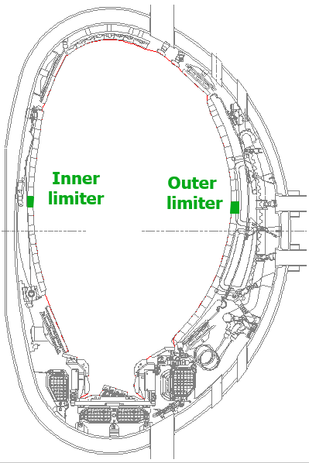
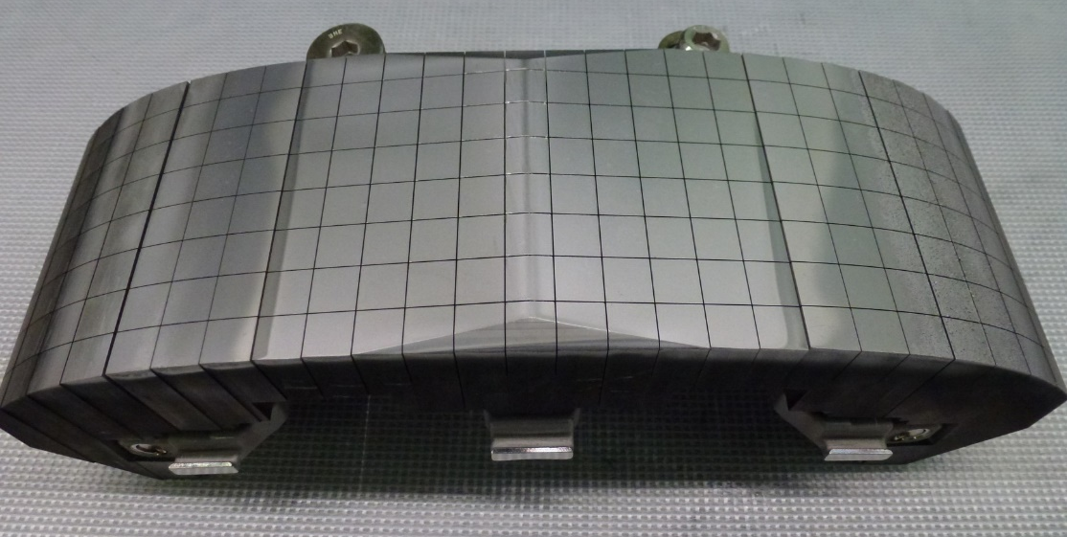
Single- vs multiple campaigns: samples
Inner wall guard limiter (IWGL) and wide poloidal limiter (WPL) tiles.
Castellations/sub-castellation samples (quarter samples).
Different toroidal locations – erosion-dominated and deposition-dominated zones.
Single campaign – ILW3 (in vessel 2015-2016, removed in 2016).
4D14 (WPL) and 2XR10 (IWGL).
For reference – also 4D14 and 2XR10 samples retrieved after ILW1 and ILW2.
Multiple campaigns – ILW1-3 (in vessel 2011-2016, removed in 2016).
4D15 (WPL) and 2XR11 (IWGL).
(2XR10)
x
x
x
x
x
x
x
Y. Zayachuk | WP PWIE mid-term meeting | VTT | 09.04.2024 | Page 4

Slide 5
Total retention: TDS
IWGL: 2XR10 (ILW3) vs 2XR11 (ILW1-3)
WPL: 4D14 (ILW3) vs 4D15 (ILW1-3)
Distribution of retention across tiles follows general pattern of an individual campaign – erosion-dominated zone in the center and deposition-dominated zones at the periphery.
Retention is systematically higher across the entire tile after 3 campaigns compared to 1 last campaign → retention is cumulative and not the effect of the very end of exposure.
Y. Zayachuk | WP PWIE mid-term meeting | VTT | 09.04.2024 | Page 5

Slide 6
Total retention: TDS
IWGL: ILW1 / ILW2 / ILW3 vs ILW1-3
WPL: ILW1 / ILW2 / ILW3 vs ILW1-3
Retention is comparable between individual campaigns (ILW1, ILW2, ILW3).
Increase of retention in 3 campaign samples compared to any one individual campaign.
Y. Zayachuk | WP PWIE mid-term meeting | VTT | 09.04.2024 | Page 6

Slide 7
Total retention: TDS
IWGL: ILW1+ILW2+ILW3 vs ILW1-3
WPL: ILW1+ILW2+ILW3 vs ILW1-3
Retention after 3 campaigns is not equivalent to the combination of campaigns:
Summation of retention measured after each individual campaign – ILW1+ILW2+ILW3 – is consistently higher than retention in the samples that were exposed to the entire duration, i.e. ILW1-3.
Y. Zayachuk | WP PWIE mid-term meeting | VTT | 09.04.2024 | Page 7

Slide 8
Campaign comparison
Campaign | Plasma time (h) Limiter/x-point | Input energy (GJ)* | Characteristics | Comment
ILW-1 | 19 6/13 | 150 | Low power D plasma | C30C 151 # H-mode 83621-83794 ¹⁵N injection GIM14 83632-83635
ILW-2 | 20 5.2/14.2 | 201 | High(er) power D plasma | Finished with 300 # (0.6 h) H 87584-87944
ILW-3 | 23.4 4.9/18.5 | 245 | D plasma H plasma D plasma (high power) | Finished with ¹⁵N₂ seeded H-mode (0.25 h) and ¹⁸O₂ injections 92469-92504
Total plasma time: ILW3 – 23.4 h, ILW1-3 – 62.4 h → ratio 2.7.
Limiter plasma time: ILW3 – 4.9 h, ILW1-3 – 16.1 h → ratio 3.3.
Y. Zayachuk | WP PWIE mid-term meeting | VTT | 09.04.2024 | Page 8

Slide 9
Total retention: TDS
IWGL: 2XR10 (ILW3) vs 2XR11 (ILW1-3)
WPL: 4D14 (ILW3) vs 4D15 (ILW1-3)
Retention is systematically higher across the entire tile after 3 campaigns compared to 1 campaign.
On average, for IWGL it is higher (after ILW1-3 compared to ILW3) by a factor of ~1.8-2, for WPL by a factor of ~1.4.
Pure diffusion → retention should scale as a √t, i.e √2.7=1.6 or √3.3=1.8 // √3=1.7.
Retention is roughly consistent with the diffusion-dominated dynamics.
Y. Zayachuk | WP PWIE mid-term meeting | VTT | 09.04.2024 | Page 9

Slide 10
Total retention: IBA
IWGL:
2XR10 (ILW3) vs 2XR11 (ILW1-3)
In the IWGL, in the erosion zone retention is essentially the same between 1 and 3 campaigns; while in the deposition zone there is a slight increase for the case of 3 campaigns.
Dynamics of IWGL is clear:
if the main effect of longer exposure is deeper diffusion, it is understandable that near-surface content is the same (or similar) in 3 campaign case compared to 1 campaign.
Y. Zayachuk | WP PWIE mid-term meeting | VTT | 09.04.2024 | Page 10

Slide 11
Total retention: IBA
WPL:
4D14 (ILW3) vs 4D15 (ILW1-3)
In the WPL, in the erosion zone there is a strange “bump” in the center of the 3-campaign tile, and overall retention is higher for 3 campaigns compared to 1 campaign; while in the deposition zone retention seems to be systematically lower for the case of 3 campaigns.
Dynamics of WPL is mysterious:
It is not clear why there is that bump in retention in the center, is it some kind of local effect, like contamination with a deposit during the campaign?
Why is retention lower in the deposition zone?
Y. Zayachuk | WP PWIE mid-term meeting | VTT | 09.04.2024 | Page 11

Slide 12
Total retention: TDS vs IBA
IWGL: 2XR10 (ILW3) vs 2XR11 (ILW1-3)
Erosion zone: retention measured by TDS considerably higher than that measured by IBA → indicative of the deep diffusion, with majority of D beyond IBA range.
Deposition zone: retention measured by TDS much closer to that measured by IBA → indicating that most of retention is within deposited layer and is covered by IBA (so both TDS and IBA signals are coming from the same depth range);
although clearly there is a considerable contribution of the bulk as well.
Y. Zayachuk | WP PWIE mid-term meeting | VTT | 09.04.2024 | Page 12

Slide 13
Total retention: TDS vs IBA
IWGL: 2XR10 (ILW3) vs 2XR11 (ILW1-3)
Erosion zone: after 3 campaign TDS/IBA ratio is systematically higher than after 1 campaign → near-surface inventory is constant (saturated), and relative contribution of the bulk increases as diffusion front moves inwards).
Deposition zone: TDS/IBA ratio is more comparable after either 3 or 1 campaign (with notable exceptions) → indicating that large fraction of retention is within deposited layer and is covered by IBA (so both TDS and IBA signals are coming from the same depth range) → although clearly there is a considerable contribution of the bulk as well.
Y. Zayachuk | WP PWIE mid-term meeting | VTT | 09.04.2024 | Page 13

Slide 14
Total retention: TDS vs IBA
WPL: 4D14 (ILW3) vs 4D15 (ILW1-3)
Erosion zone: retention measured by TDS somewhat higher than that measured by IBA, with the difference less significant that for IWGL → relatively smaller contribution of the bulk compared to near-surface region.
Deposition zone: retention measured by TDS close to that measured by IBA after 1 campaign, but systematically higher after 3 campaigns compared.
Y. Zayachuk | WP PWIE mid-term meeting | VTT | 09.04.2024 | Page 14

Slide 15
Total retention: TDS vs IBA
WPL: 4D14 (ILW3) vs 4D15 (ILW1-3)
Inconsistent difference in TDS/IBA ratio between 1 and 3 campaigns.
Hypothesis: in the WPL it seems that the near-surface layer of deposit was debonded and flew away, some of it contaminating the surface of the erosion zone – thus artificially reducing near-surface contents in the deposit zone and artificially increasing it in the erosion zone.
Y. Zayachuk | WP PWIE mid-term meeting | VTT | 09.04.2024 | Page 15

Slide 16
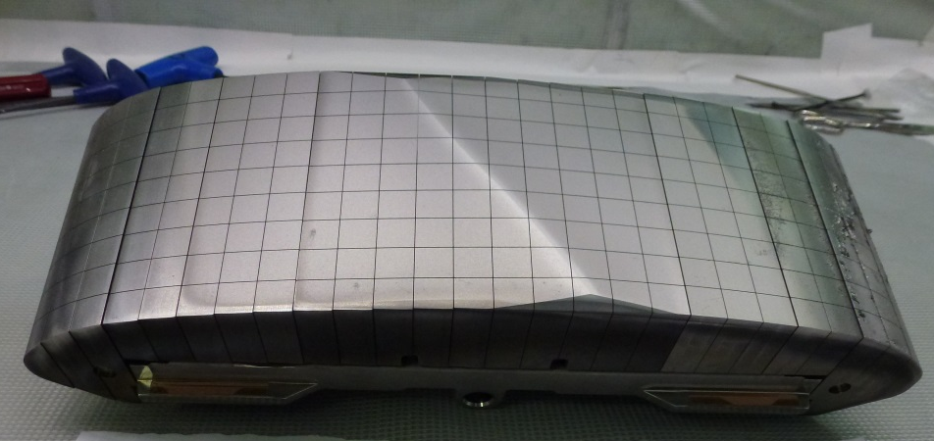
Desorption spectra
4D14
After 3 campaigns there is a systematic shift of maxima of release peaks towards higher temperatures.
Y. Zayachuk | WP PWIE mid-term meeting | VTT | 09.04.2024 | Page 16

Slide 17
Desorption spectra
IWGL: 2XR10 (ILW3) vs 2XR11 (ILW1-3)
WPL: 4D14 (ILW3) vs 4D15 (ILW1-3)
There seems to be a certain asymmetry in the shift for WPL and IWGL. WPL seems to have a larger shift – on average ~100 K, while for IWGL it’s ~60 K.
Consistent with deeper diffusion over the duration of 3 campaigns, the deeper is deuterium, the higher temperature of release peaks.
Overall retention behaviour seems to be consistent with longer exposure leading to deeper diffusion and retention being dominated by the bulk.
Y. Zayachuk | WP PWIE mid-term meeting | VTT | 09.04.2024 | Page 17

Slide 18
General observations
Differences in retention between single and three campaigns point towards retention dynamics roughly consistent with diffusion-dominated process:
Increase of retention not proportional to exposure time.
Increase of retention proportionality factor ~1.4-2, comparable to √t, i.e √3=1.7.
TDS/IBA ratio increases with exposure time, indicating increase of the contribution of the bulk – i.e., diffusion front being deeper.
Positions of release peaks systematically shift towards higher temperatures, consistent with release from larger depth – again, diffusion front being deeper.
Mysteries:
Asymmetry between WPL and IWGL → possibly related to deposited layers being disturbed on WPL tile exposed to 3 campaigns?
It seems that this diffusion-dominated-like behaviour also occurs within the deposition zone → does this make sense? If retention is due-to co-deposition, why would it be determined by the propagation of the diffusion front?
Y. Zayachuk | WP PWIE mid-term meeting | VTT | 09.04.2024 | Page 18

Slide 19
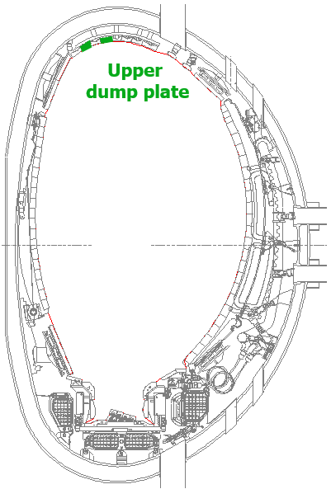
Melted Be: samples
Upper dump plate tiles.
Castellations/sub-castellation samples (quarter samples).
Single campaign – ILW3 (in vessel 2015-2016, removed in 2016).
2B2C (ILW3) – reference (not melted).
2B4C (ILW3) – melted.
Multiple campaigns – ILW1-3 (in vessel 2011-2016, removed in 2016).
3A8 (ILW1-3) – melted.
Y. Zayachuk | WP PWIE mid-term meeting | VTT | 09.04.2024 | Page 19

Slide 20
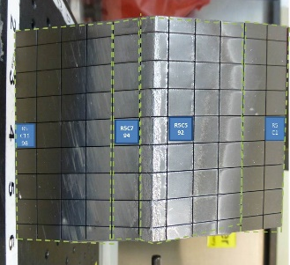
Reference UDP Be samples
UDP: 2B2C (ILW3), different toroidal positions
High field side
Inner wall
2B2C ILW3
465
463
460
Ion drift
Low field side
Outer wall
Considerable difference between different toroidal positions – especially regions near the ridge and further from the ridge.
Y. Zayachuk | WP PWIE mid-term meeting | VTT | 09.04.2024 | Page 20

Slide 21
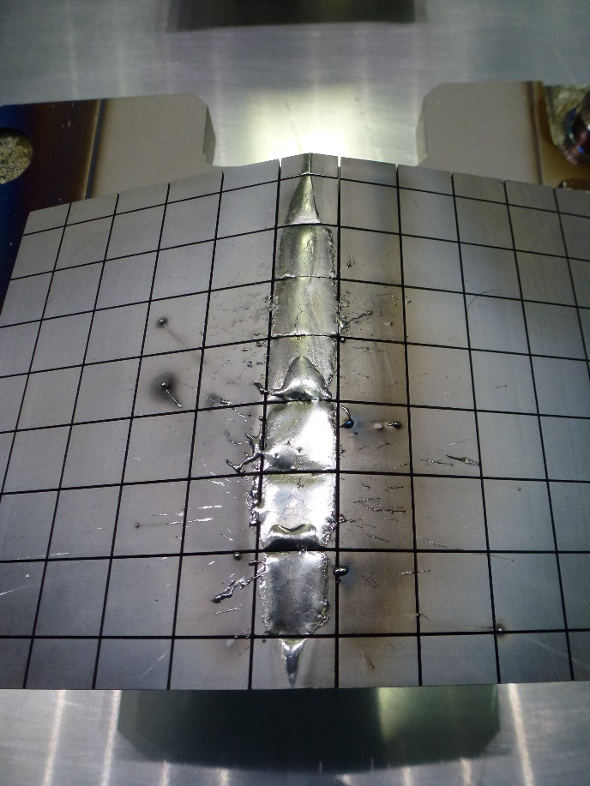
Melted vs reference UDP Be samples
UDP: 2B2C (ILW3) vs 2B4C (ILW3, melt)
463B from 2B2C most comparable to molten samples, as it is close to the center of the tile.
2B2C ILW3
465
463
460
2B4C ILW3
443
442
439
Y. Zayachuk | WP PWIE mid-term meeting | VTT | 09.04.2024 | Page 21

Slide 22
Melted vs reference UDP Be samples
UDP: 2B2C (ILW3) vs 2B4C (ILW3, melt)
Peak shifts to lower temperatures as a result of melting.
Microstructural change occurred, material became recrystallized – ie, fewer defects, which is why release peak shifted to lower temperature.
Another possible reason for peak shift to lower temperature is that if D was removed and started diffusing in again at a later time, diffusion depth (ie., the depth from which D comes during the TDS) is smaller.
Y. Zayachuk | WP PWIE mid-term meeting | VTT | 09.04.2024 | Page 22

Slide 23
Melted vs reference UDP Be samples
UDP: 2B2C (ILW3) vs 2B4C (ILW3, melt)
Overall retention decreases as a result of melting.
Interpretation: retention is lower because deuterium was removed during melting event, but non zero because either not all of it was removed, OR additional deuterium was implanted after the melting, OR a combination of the two. Probably can’t tell the contributions apart.
Y. Zayachuk | WP PWIE mid-term meeting | VTT | 09.04.2024 | Page 23

Slide 24
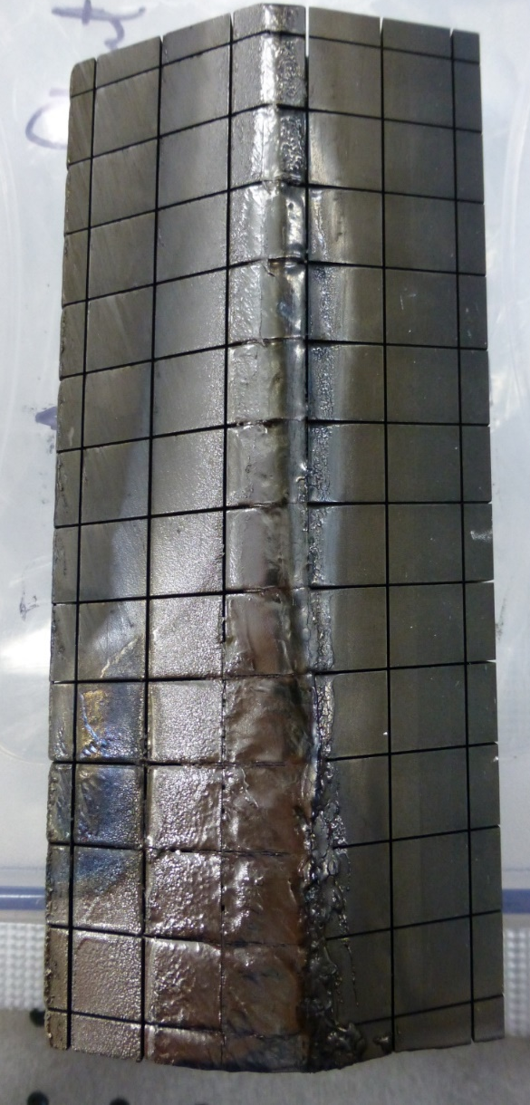
Melted vs reference UDP Be samples
UDP: 2B2C (ILW3) vs 3A8 (ILW1-3, melt)
3A8 ILW1-3
2B2C ILW3
465
463
460
401
463B from 2B2C most comparable to molten samples, as it is close to the center of the tile.
398
396
Y. Zayachuk | WP PWIE mid-term meeting | VTT | 09.04.2024 | Page 24

Slide 25
Melted vs reference UDP Be samples
UDP: 2B2C (ILW3) vs 3A8 (ILW1-3, melt)
3A8 was molten during ILW2 → meaning that if D was removed then, it had the whole ILW3 to uptake D, so that in a way normal ILW3 is comparable with molten in ILW2 → exposed ILW3 sample.
In molten Be release peak temperature shifts towards lower temperatures even for “comparable” exposure durations → microstructural changes affect retention, and recrystallization causes traps to become shallower by annealing the defects.
Y. Zayachuk | WP PWIE mid-term meeting | VTT | 09.04.2024 | Page 25

Slide 26
General observations
Melt damage leads to the lowering of the release temperature:
Microstructural changes noticeably change the trapping dynamics.
Trapping sites in the molten and recrystallized Be have lower trapping energy then in the pristine material.
Y. Zayachuk | WP PWIE mid-term meeting | VTT | 09.04.2024 | Page 26

