Slide 1




Material Migration Studies:
Tracer Experiments with ¹⁵N and ¹⁸O in JET-ILW
M. Rubel, P. Petersson, L. Dittrich, S. Moon, P. Ström, A. Widdowson

Slide 2
Background Information and Motivation
Oxygen is always detected on surfaces exposed to plasma in controlled fusion devices: PFC, wall probes, dust.
Nitrogen is always detected on PFC, probes & dust from devices with N-based edge cooling.
Questions about the origin of N and O on analysed surfaces:
Co-deposition of plasma impurity species during the machine operation?
Adsorption from air (water, oxygen) when materials are transferred/stored from the torus?
Does the oxidation take place in the vessel?
Injection of marker gases (tracers):
¹⁸O (natural abundance 0.37%)
¹⁵N (natural abundance 0.22%)
High resolusion, high sensitivity quantitative analyses:
Nuclear reaction analysis (NRA) using protons: ¹⁸O(p, α)¹⁵N ¹⁵N(p,γ⁴He)¹²C
Time-of-flight heavy ion elastic recoil detection (HIERDA) with ⁸⁰Br⁷⁺32 MeV or ¹²⁷I^{n+} n = 8 or 10; 36 or 44 MeV

Slide 3
A bit of history
1985, TEXTOR: first experiments with ¹⁸O, no success, difficulties in NRA measurements.
2009, TEXTOR: first ¹⁵N experiments, very conclusive experiment and HIERDA measurements
followed by a series of experiments and modelling of ¹⁵N and metal markers (W, Mo).
P. Petersson et al. Nucl. Instrum. Meth. B, M. Rubel et al., J. Nucl. Mater. 438 (2013) S170. A. Weckmann et al., Nucl. Mater. Energy 17 (2018) 83.
2011, ASDEX-Upgrade, conclusive experiments with ¹⁵N, NRA measurements and modelling.
P. Petersson et al., J. Nucl. Mater. 438 (2013) S616. P. Petersson et al., Phys. Scr. T159 (2014) 014042.
2012, TEXTOR, very successful experiments on ICWC with ¹⁸O tracer
A. Garcia-Carrasco et al., Phys. Scr. T159 (2014) 014017.
2012, JET-ILW, local injection of ¹⁵N in the divertor.
P. Petersson et al., J. Nucl. Mater. 463 (205) 814.
2016, JET-ILW, injection of ¹⁵N and ¹⁸O in separate discharges.
The original idea of Per Petersson: the use of ”isotopic air”: 80% ¹⁵N + 20% ¹⁸O

Slide 4
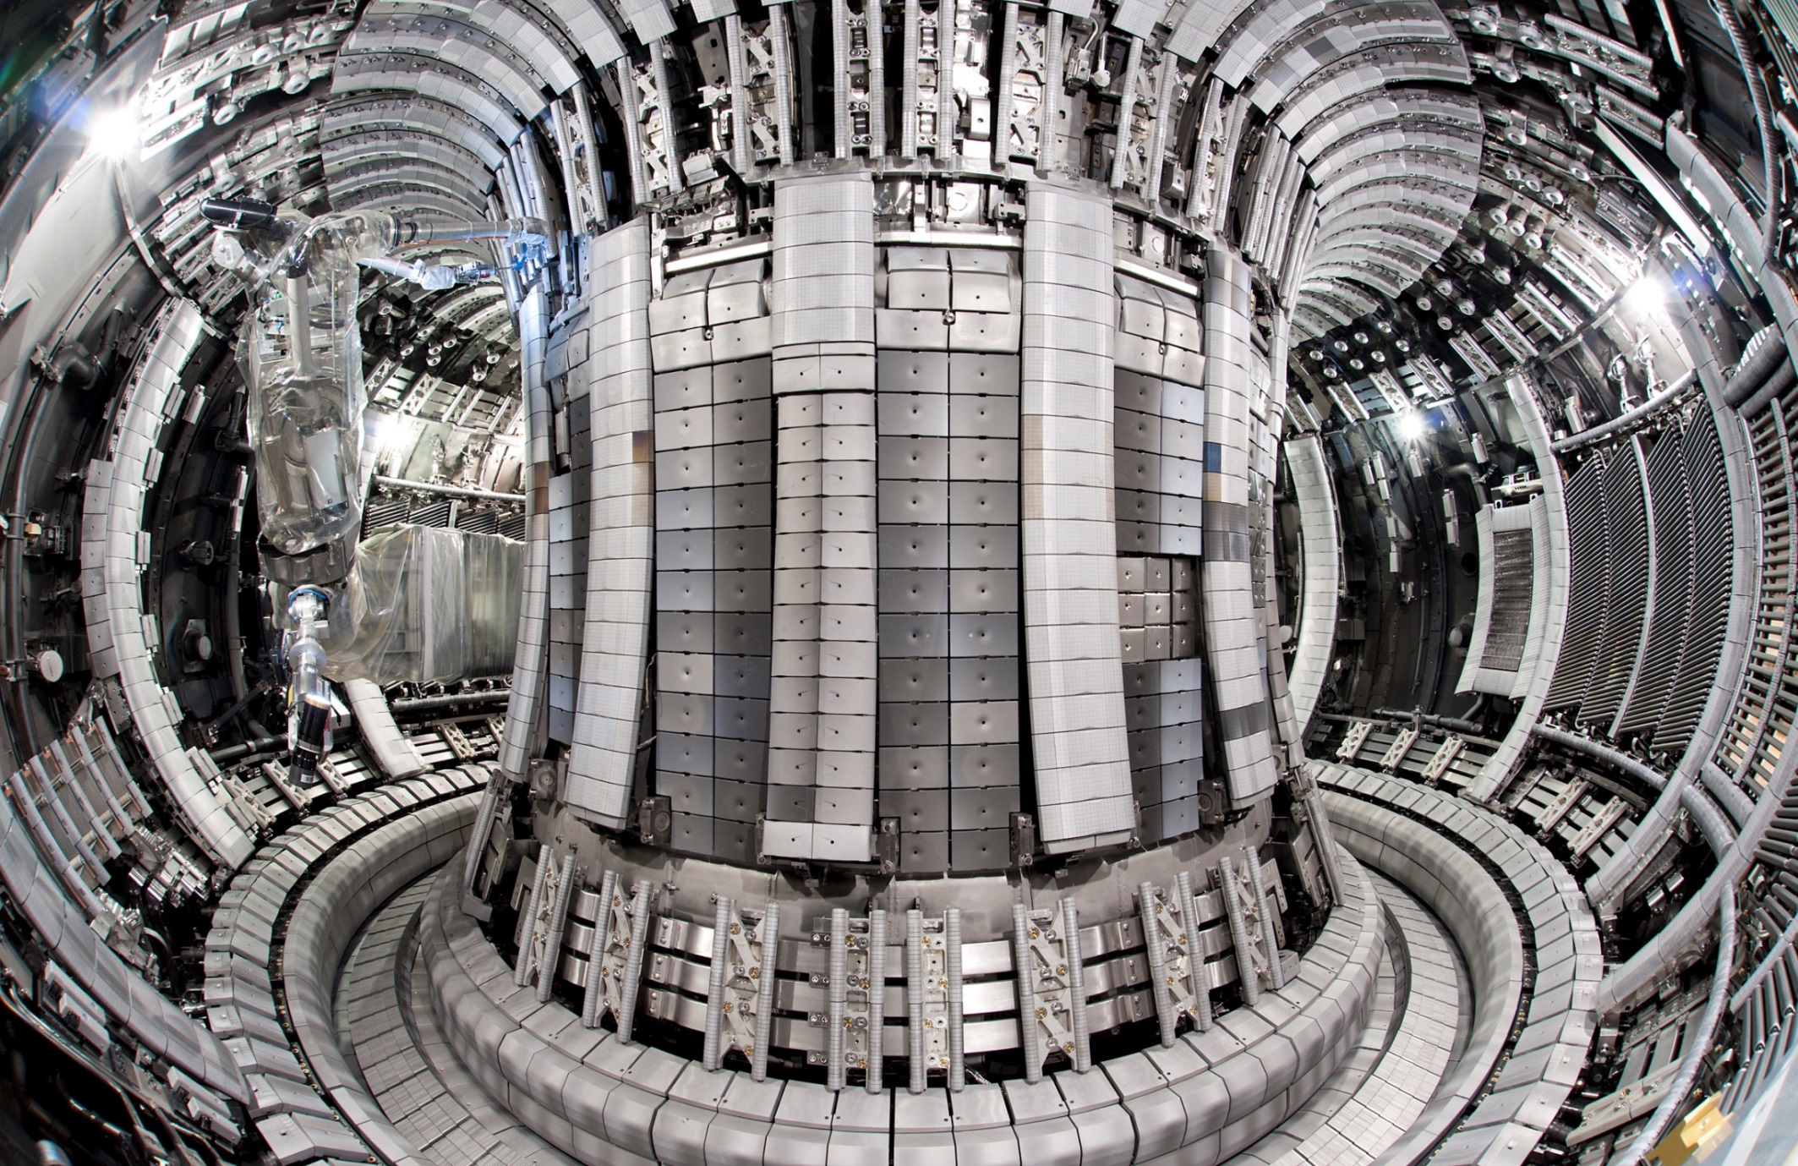
Tools: Erosion-Deposition Diagnostics in JET-ILW Marker Tiles and Probes
Be
Be
Be
Be
on
Inconel
Be
AN
RH
W/CFC
Bulk W
W/CFC
The aim is to have a complete overview of material migration and material damage, not just a number (even large) of analysis points and isolated findings.

Slide 5
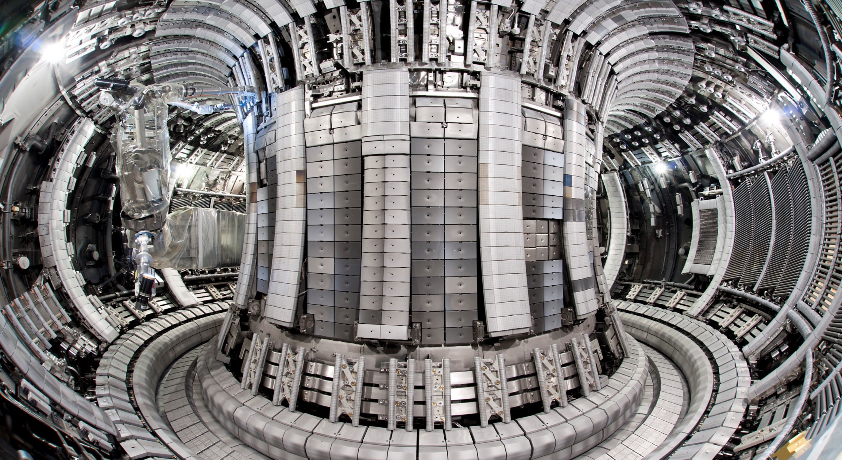
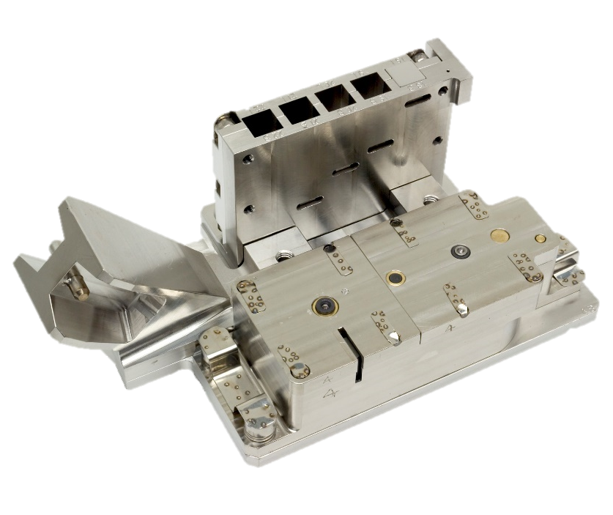
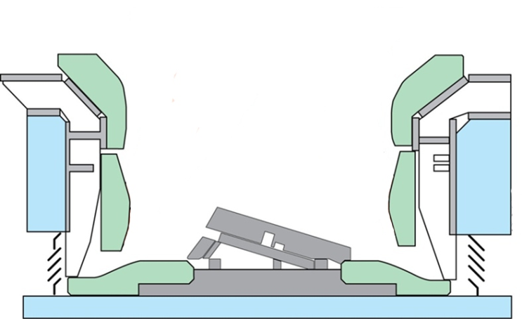
Quartz microbalance
  Covers
  Crystals
Test mirrors
Spatial blocks
Rotating deposition monitors
Louvre clips
Sticking monitors
Wall inserts in IWC
Dust monitors
Be
Inner
Outer
W
Base

Slide 6
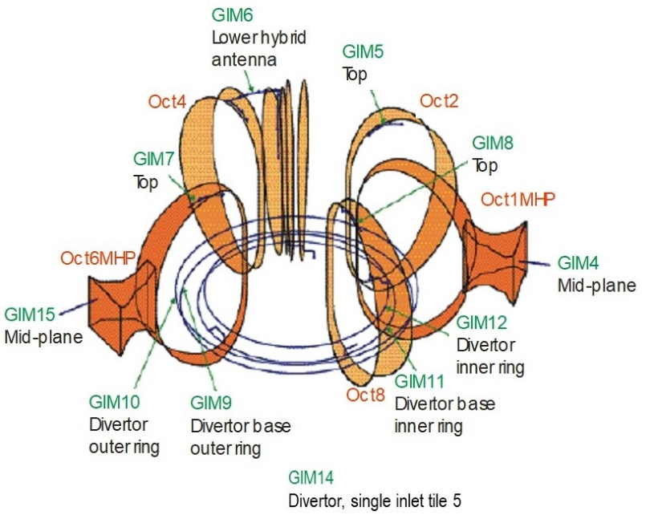
Gas injection system in JET
¹⁸O in ILW-3
¹⁵N in ILW-3
¹⁵N in ILW-1

Slide 7
Gas injection history
Gas | Injection point | ILW-1 | ILW-2 | ILW-3
¹H | GIM, pellets | 2.5·10²⁴ | 2.7·10²⁵ | 8.0·10²⁵
 | DMV | - | 1.3·10²⁴ | 1.0·10²⁵
²D | GIM, pellets | 9.1·10²⁶ | 5.8·10²⁶ | 6.4·10²⁶
 | DMV | - | 2.4·10²⁶ | 1.4·10²⁶
³He | main chamber GIM | - | 8.2·10²² | 7.4·10²²
⁴He | main chamber GIM | - | 2.5·10²¹ | 3.3·10²²
CD₄ | GIM 11 | - | - | 3.7·10²³ ª
C₂D₄ | GIM | - | - | 4.3·10²¹ ^{b}
¹⁴N | GIM 4, 8, 11 | 9.7·10²³ | 3.8·10²⁴ | 2.1·10²⁴
¹⁵N | GIM 14, 10 | 1.3·10²² (GIM 14) | - | 8.5·10²³ (GIM 10)
¹⁶O | GIM 11 | - | - | 2.0·10²² ^{d}
¹⁸O | GIM 11 | - | - | 2.8·10²²
Ne | divertor GIM | 2.1·10²¹ | 1.2·10²³ | 1.3·10²³
 | DMV | - | 3.8·10²³ | 1.2·10²⁴
Ar | divertor GIM | 2.9·10²¹ | 8.5·10²¹ | 1.3·10²²
 | DMV | - | 2.0·10²⁵ | 9.2·10²⁴
Kr | divertor GIM | - | - | 7.1·10²¹
 | DMV | - | 2.0·10²⁴ | 1.3·10²⁵
Xe | divertor GIM | - | - | 7.9·10¹⁹
ªCD₄ was puffed in two series: 1.1⋅10²³ in the middle of ILW-3 and 2.6⋅10²³ at the last session, 8 shots before the last one.
^{b}C₂D₄ puffed approx. 400 shots before the end of ILW-3.
¹⁵N injection during two last sessions in ILW-3.
¹⁸O injection during 4 shots in the penultimate ILW-3 session; 30 shots before the last discharge.
Laura Dittrich et al., Fusion Eng. Des. 192 (2023) 113620

Slide 8
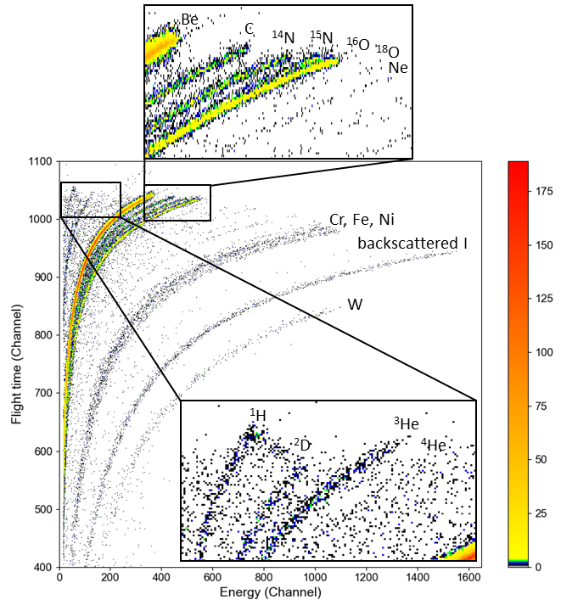
HIERDA spectra
All species present in the torus are then detected in co-deposits:
H, D, ³He, ⁴He, Be, ¹²C, ¹⁴N, ¹⁵N, ¹⁶O, ¹⁸O, Ne and heavier

Slide 9
Analysis of Outer Poloidal Limiters
Tile | Position | Areal density in 10¹⁵ atoms cm⁻²
 |  | ¹H | ²D | ³He | ⁴He | Be | C | ¹⁴N | ¹⁵N | ¹⁶O | ¹⁸O | Ne | Ar | Cr, Fe, Ni, Mo | W
4D14 (ILW-1) | LH wing C1R4 | 57 | 170 | - | - | 8054 | 183 | 132 | - | 320 | - | - | - | 91 | 12
4D14 (ILW-3) | LH wing C1R4 | 18 | 74 | 35 | - | 7854 | 207 | 224 | 44 | 527 | - | 10 | 3 | 84 | 9
 | LH Int. 1 C2R4 | - | 87 | - | - | 8637 | 68 | 35 | 19 | 216 | - | 1 | - | 22 | 1
 | LH Int. 2 C1R4 | 9 | 65 | - | - | 8908 | 12 | 3 | 13 | 80 | - | - | - | 9 | -
 | Center C4R4 | 10 | 32 | - | - | 8918 | 8 | 5 | 11 | 93 | - | - | <1 | 20 | 1
4D15 (ILW1-3) | LH wing C3R4 | 49 | 116 | - | - | 7472 | 257 | 165 | 68 | 773 | 0 | - | 25 | 119 | 31
 | LH wing C1R4 | 16 | 59 | 31 | 5 | 7818 | 206 | 226 | 37 | 567 | 1 | 3 | 7 | 101 | 12
 | LH Int. 1 C2R4 | 14 | 79 | - | - | 8240 | 168 | 135 | 31 | 356 | - | - | - | 68 | 9
 | LH Int. 2 C1R4 | - | 29 | - | - | 8974 | 8 | - | 13 | 58 | - | - | - | 13 | -
 | RH Int. 2 C3R6 | - | 72 | - | - | 8923 | 3 | 3 | 17 | 63 | 1 | - | - | 18 | 1
 | RH Int. 2 C1R6 | 2 | 58 | - | - | 8937 | 7 | 5 | 17 | 50 | 2 | - | - | 20 | 1
 | RH Int. 1 C2R6 | - | 112 | - | - | 8833 | 13 | 12 | 21 | 75 | 2 | - | - | 21 | 2
 | RH wing C3R6 | 21 | - | - | - | 6925 | 309 | 608 | 247 | 728 | 17 | - | - | 212 | 28
 | RH wing C2R3 | 35 | 33 | - | - | 6963 | 305 | 582 | 198 | 729 | 9 | - | <1 | 215 | 27
Laura Dittrich et al., Fusion Eng. Des. 192 (2023) 113620

Slide 10
Analysis of tiles
Analyses were also performed for Inner Wall Guard Limiters (IWGL) , Upper Dump Plates (UDP), Inner Wall Cladding (IWC); detailed data for IWGL and UDP are in the Appendix.
IWGL: ¹⁵N up to 290x10¹⁵ cm⁻² , ¹⁸O up to 14x10¹⁵ cm⁻²
in deposition zones at the end sections of the tiles.
UDP: ¹⁵N up to 9x10¹⁵ cm⁻², ¹⁸O detected only in one spot 1x10¹⁵ cm⁻², i.e. just above the
detection limit of 0.5- 1x10¹⁵ cm⁻².
However, ¹⁵N was clearly detected on the molten Be flake from the UDP.
IWC: ¹⁵N content at the detection limit of 0.5- 1x10¹⁵ cm⁻².
(Laura Dittrich et al., Phys. Scr. 96 (2021) 124071)

Slide 11
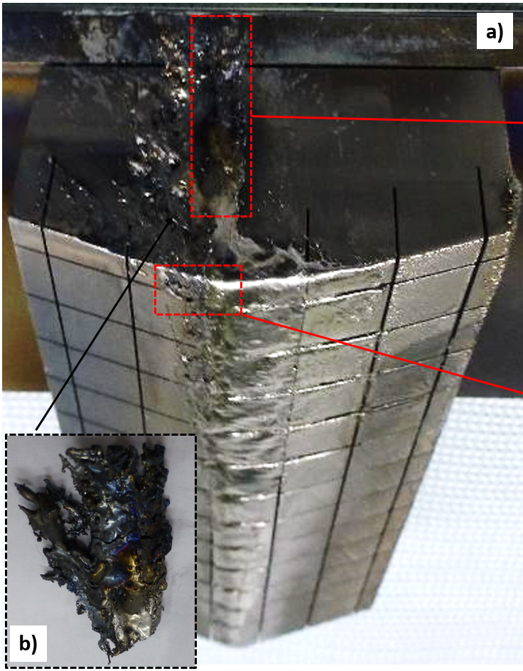
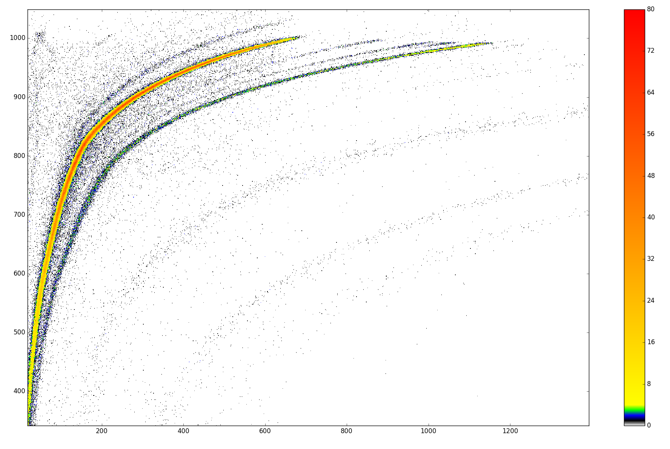
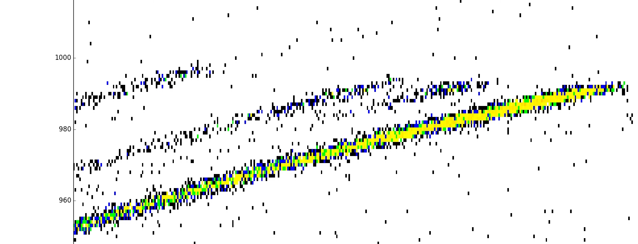
Upper Dump Plates: Be flake
ToF Heavy Ion ERDA on Be flake from the dump plate
1000
800
600
400
D
⁶Li
⁷Li
⁹Be
¹²C
¹⁴N
¹⁵N
¹⁶O
Inconel family
¹⁵N only on very surface
1000
800
¹²C
¹⁴N
¹⁶O
I (scattered beam)
¹⁵N
ToF channel
W
Something for modellers:?
How ¹⁵N reached the UDP?
0 400 800 1200
Energy channel
Petter Ström, Per Petersson, VR Stockholm

Slide 12

Tracers on the Wall Probes
Mirrors
QMB: covers and crystals
Spatial blocks

Slide 13
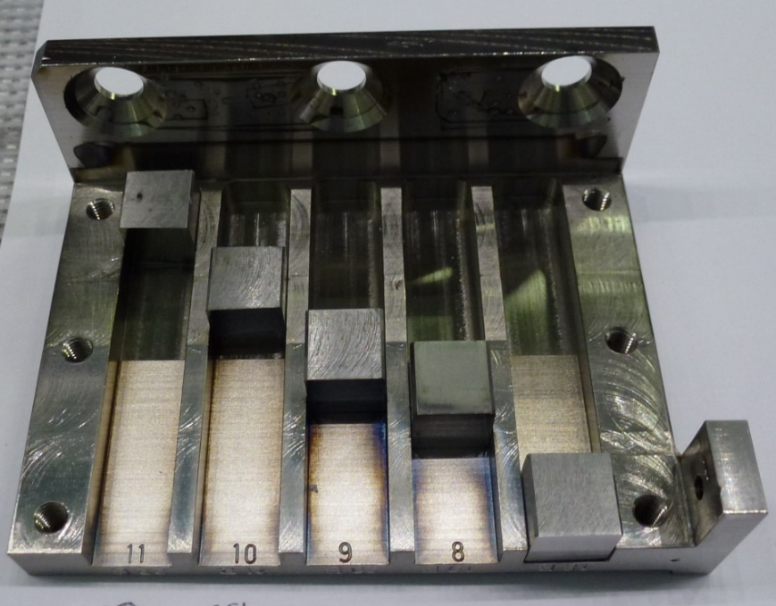
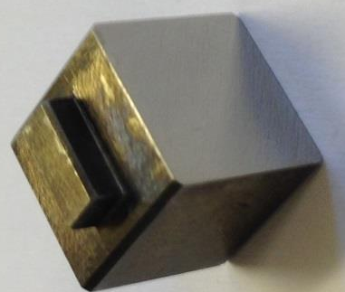
Mirror & Cassette
Standard
1 cm
Mo
4.5 cm
3.0 cm
2.0 cm
1.5 cm
0.0 cm
Notes:
The mirror is 1 cm cubic Polycrystalline Molybdenum.
Mirrors were installed with cassettes.
And the mirror carriers have several different position and baffles to test different aspect ratio and solid angle.
The position means distance from the mouth of cassettes.
And this is the baffles in cassette.
27 hours of JET operation
Correspondence to 20 ITER pulses (400s, full power) scaled by energy input,
2-3 pulse scaled by expected divertor fluxes (R. Pitts, PPCF, 47, 2005)

Slide 14
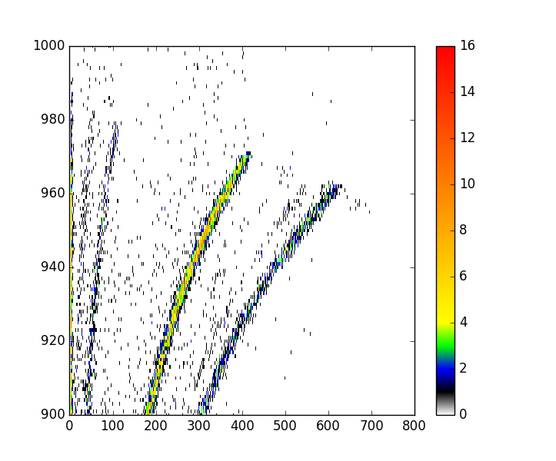
Mirrors are perfect deposition monitors in tracer experiments
Injection of ¹⁸O on the last operation day of ILW-3 to check in-vessel oxidation.
  Injected: 2.8 x 10²² atoms
  Position: inner divertor base
H
D
Be
C
N
¹⁸O
O
ToF channel
First Results :¹⁸O: 7 ×10¹⁵ cm⁻²
Detection of O-18
Deposition within campaign
Energy channel
Mirror from the Outer Divertor (1.5 cm ILW 1-3)
Sunwoo Moon et al., Nucl. Mater. Energy 19 (2019) 59.
Notes:
The mirror also works as deposition monitors
From the outer divertor, not only outer divertor, but I show this result, we can find oxygen eighteen and nitrogen fifteen on the top surface.
The mirror is perfect deposition monitor with flat surface

Slide 15
Tracers on QMB covers and crystals
¹⁵N not detected on the covers.
No tracers on the crystals.
Module13 IW
Module2 IW
Module2 IW
Module2 OW
Petter Ström et al., J. Nucl. Mater. 516 (2019) 202.
Notes:
The mirror also works as deposition monitors
From the outer divertor, not only outer divertor, but I show this result, we can find oxygen eighteen and nitrogen fifteen on the top surface.
The mirror is perfect deposition monitor with flat surface

Slide 16
Tracers on spatial blocks
Spatial blocks: Inconel 600 cubes (15 mm) attached to the CFC ribs of the divertor modules: Module 14 Inner Wide
¹⁵N not detected on the blocks.
Petter Ström et al., J. Nucl. Mater. 516 (2019) 202.
Notes:
The mirror also works as deposition monitors
From the outer divertor, not only outer divertor, but I show this result, we can find oxygen eighteen and nitrogen fifteen on the top surface.
The mirror is perfect deposition monitor with flat surface

Slide 17
Other Deposition Monitors
Dust monitors: analysed with HIERDA, no tracers detected. M. Rubel, Fusion Eng. Des. 136 (2018) 579.
Louvre clips: HIERDA done VTT, results to be re-analysed / evaluated.
Rotating deposition monitors: no HIERDA performed.
Wall inserts: no HIERDA performed, but no tracers detected on the IWC tiles.
Sticking monitors: no data available.

Slide 18
Concluding remarks
Tracers have been found on most studied surfaces thus indicating the long-range transport.
A large amount of data have been obtained:
  ¹⁸O - deposited mainly on probes from the inner divertor (close to the injection).
  ¹⁵N - little detected on the divertor probes, much more on the limiter tiles.
Modelling may be considered but with some caveats:
  Leaks and transport behind the tiles (as concluded after ¹³C experiments in JET)
  Interest from PWIE, ITER ??
We have good analysis tools. One can consider experiments with other tracers in several machines: ¹⁰B, ²¹Ne, ²²Ne

Slide 19
APPENDIX

Slide 20
Analysis of Inner Wall Guard Limiters
Tile | Position | Areal density in 10¹⁵ atoms cm⁻²
 |  | ¹H | ²D | Be | C | ¹⁴N | ¹⁵N | ¹⁶O | ¹⁸O | Ar | Cr, Fe, Ni, Mo | W
2XR10 (ILW-1) | RH wing C4R7 | 61 | 90 | 7476 | 298 | 84 | - | 910 | - | - | 172 | -
 | Center C7R2 | 14 | - | 8960 | 11 | 6 | - | 87 | - | - | 17 | 5
2XR10 (ILW-2) | RH wing C1R4 | 69 | - | 7677 | 166 | 103 | - | 948 | - | - | 122 | 15
 | RH wing C3R4 | 185 | - | 7104 | 249 | 261 | - | 933 | - | - | 157 | -
 | Center C6R4 | 15 | 29 | 8941 | 38 | - | - | 68 | - | - | 8 | -
 | Center C6R5 | 29 | - | 8933 | 25 | - | - | 70 | - | - | 5 | -
2XR11 (ILW1-3) | RH wing C1R4 | 19 | 45 | 8492 | 59 | 35 | 8 | 351 | 2 | 3 | 65 | 12
 | RH wing C3R3 | - | 125 | 7461 | 268 | 470 | 232 | 450 | 8 | 3 | 70 | 5
 | RH wing C3R7 | 8 | 135 | 7483 | 365 | 353 | 289 | 378 | 14 | 3 | 63 | 5
 | Center C5R4 | - | 10 | 9009 | 3 | 1 | 5 | 59 | - | 2 | 6 | 1
 | LH Int. C1R4 | - | - | 8952 | 22 | 16 | - | 97 | - | - | 11 | 1
 | LH Int. C3R4 | 16 | 113 | 7945 | 179 | 320 | 144 | 274 | 6 | 1 | 88 | 9
Laura Dittrich et al., Fusion Eng. Des. 192 (2023) 113620

Slide 21
Analysis of Upper Dump Plates
Tile | Position | Areal density in 10¹⁵ atoms cm⁻²
 |  | ¹H | ²D | ³He | Be | C | ¹⁴N | ¹⁵N | ¹⁶O | ¹⁸O | Ar | Cr, Fe, Ni, Mo | W
2B4C (ILW-3) | C6R2* | - | - | - | 9053 | 1 | 1 | 2 | 30 | 1 | 4 | 6 | 1
 | C6R8* | 10 | 4 | - | 8855 | 14 | 6 | 9 | 144 | - | 5 | 28 | 5
3A8 (ILW1-3) | C2R9 | 30 | 66 | - | 7295 | 175 | 191 | - | 970 | - | 5 | 293 | 57
 | C2R12 | 34 | 65 | - | 7021 | 171 | 236 | - | 1057 | - | 10 | 384 | 55
 | C2R14 | 32 | 54 | - | 7098 | 176 | 256 | - | 1049 | - | - | 350 | 51
 | C4R9* | <1 | 4 | - | 9012 | 3 | 3 | 3 | 57 | - | 1 | 12 | 1
 | C4R12* | 5 | 28 | - | 8698 | 21 | 61 | 7 | 224 | - | 10 | 37 | 5
 | C5R9 | 18 | 115 | 19 | 6574 | 207 | 175 | - | 1515 | - | 12 | 369 | 60
 | C5R12 | 21 | 127 | 26 | 6586 | 183 | 156 | - | 1550 | - | 14 | 356 | 56
 | C5R14 | 23 | 117 | 26 | 6647 | 167 | 153 | - | 1487 | - | 11 | 380 | 59
* Molten area
Laura Dittrich et al., Fusion Eng. Des. 192 (2023) 113620

Slide 22
Carbon and tracers (N-15 and O-18) on Be limiters
Deuterium, carbon, nitrogen and tracer species (N-15 and O-18) on beryllium limiters from ILW-3 in 10¹⁵ at/cm².
Table Limiter | Sample | N-14 | N-15 | O-18 | D | C*
OPL | 540 | 6 | 45 | 0 | 17 | 12
OPL | 546 | 24 | 67 | 6 | 18 | 20
OPL | 553 | 18 | 22 | 3 | 15 | 9
OPL | 558 | 85 | 25 | 3 | 15 | 59
IWGL | 511 | 3 | 14 | 0 | 11 | 7
IWGL | 513 | 36 | 131 | 5 | 29 | 48
* Very positive result: small C content on Be.

Slide 23
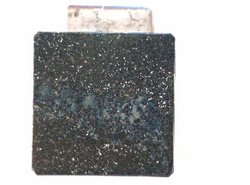
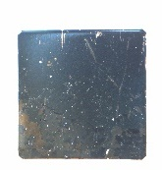
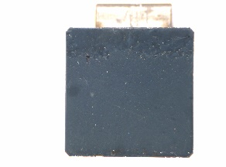
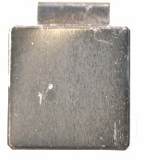
Mirrors from Divertor: Surface composition
ILW3
ILW1-3
Sunwoo Moon et al., Nucl. Mater. Energy 19 (2019) 59.

Slide 24
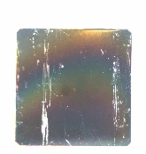
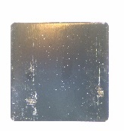
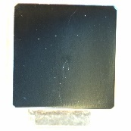
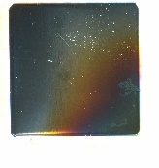
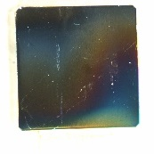
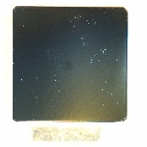
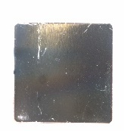
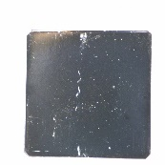
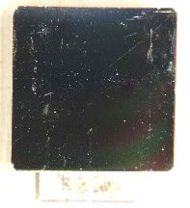
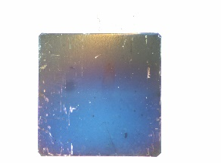
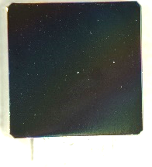
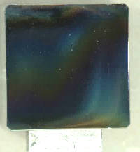
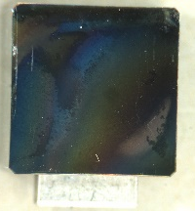
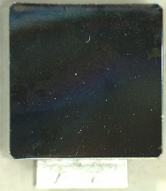
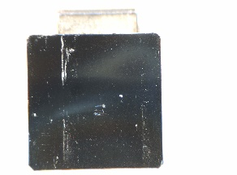
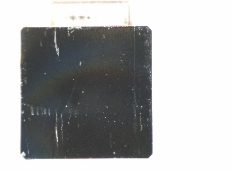
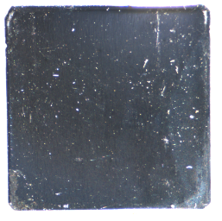
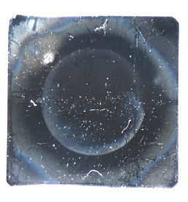
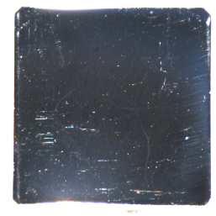
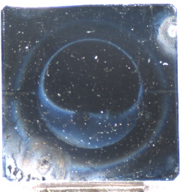
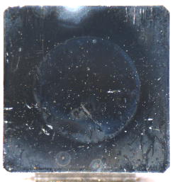
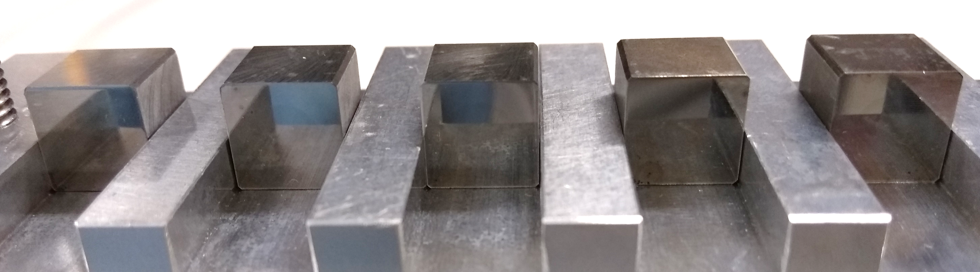
Mirrors: Visual inspection
Inner Divertor
Divertor Base
Outer Divertor
ILW3
ILW3
ILW3
ILW1-3
ILW1-3
ILW1-3
0.0 cm
2.5
4.5
0.0
1.0
1.5
2.8
0.0
1.5
3.0
Main Chamber Wall
Sunwoo Moon et al., Nucl. Mater. Energy 19 (2019) 59.
0.0 cm
1.5
1.5 b
4.5
4.5 b
Notes:
ILW1-3 mirror has only slight less
ILW1-3 Base 1.0 mirror was taken in different condition: exposure time 0.5 s. The others were in 1.0 second

Slide 25
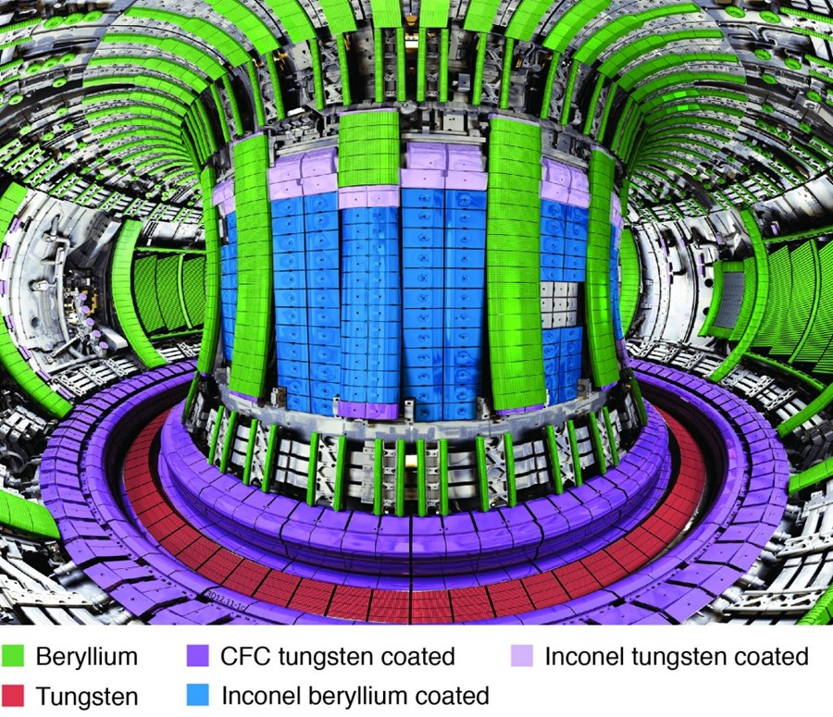
JET – ITER like Wall

