Slide 1


WP PWIE Midterm Meeting 2024
LID-QMS at FZJ and JET on tiles 0 and 1
M. Zlobinski, G. Sergienko, I. Jepu, C. Rowley, A. Widdowson, R. Ellis, D. Kos, I. Coffey,
M. Fortune, D. Kinna, M. Beldishevski, A. Krimmer, H. T. Lambertz, A. Terra, A. Huber,
S. Brezinsek, T. Dittmar, M. Flebbe, R. Yi, R. Rayaprolu,, J. Figueiredo, P. Blatchford,
S. Silburn, E. Tsitrone, E. Joffrin, A. Hakola, K. Krieger, Y. Corre,
THE EUROFUSION TOKAMAK EXPLOITATION TEAM AND THE JET CONTRIBUTORS

Slide 2
Outline
The LID-QMS method
Ex situ experimental Setup at FZJ: FREDIS
Ex situ measurements on JET tiles
Sample overview
In situ experimental Setup at JET
In situ measurements inside JET
Overview of all in situ LID-QMS measurements

Slide 3
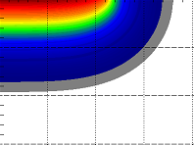
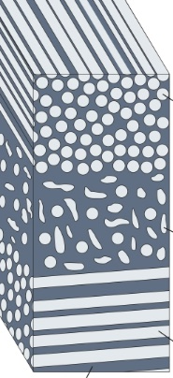
LID-QMS method
Laser-Induced Desorption (LID)
Laser only heats the surface,
no ablation, no crater formation,
no plasma needed
Possible surface modifications
due to heating :
roughening of surface
melting (only for high power)
minor evaporation
layer delamination due to
thermal stresses in short time
RGA
(Residual Gas Analysis) e.g. by QMS (Quadrupole Mass Spectrometry)
Example of calculated temperature
high energy laser (~20 J, 1 ms)
Be melting point
Laser spot
diameter ~3 mm
H₂, D₂, HD, DT,…
Be
Be
plasma deposit
W
Mo
W
Mo
substrate
CFC
CFC substrate
Be layer thickness in JET (thicker in ITER)
is heated and thermally releases retained gases
vacuum chamber
Gas released by the laser heating is quantified
→ space resolved in situ diagnostic of the fuel content

Slide 4
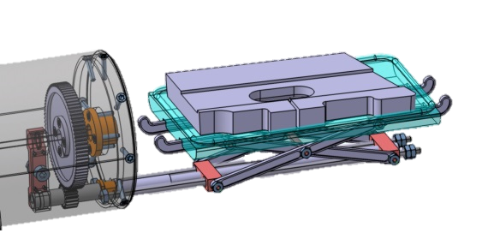
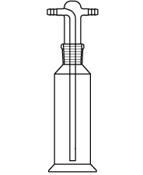



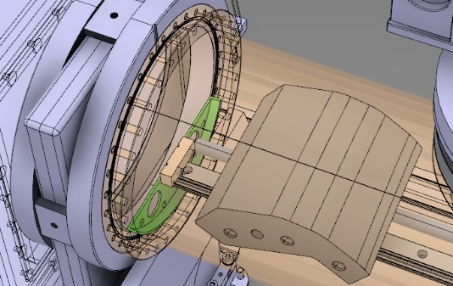

FREDIS (Fuel REtention Diagnostic Setup) @ FZJ
Laser-Induced Desorption
LID
Thermal Desorption Spectrometry
TDS
FREDIS features:
beryllium compatible
fibre-optic cable from laser
laser head
tritium trap
(under construction)
pyrometer
hi-res.
QMS
(MKS)
0-6 u/e
overview
QMS
(Pfeiffer)
0-100 u/e
filter
x/y/z
stage
camera
tritium compatible
located in radiation
controlled area
(HML)
glove boxes
for safe handling
of Be
filter
load lock
distance
measure-ment
gas washing
bottles
load lock
laser beam
CuO
catalyst
manipulator
drive
door
GV
air lock
(open)
TP
TP
GV
TP
exhaust
GV
1 m
GV
air stream
LID sample
GV
TDS
sample
TDS oven (open)
tritium
detector
TP
GV
TP
Ref: M. Zlobinski et al.,
Fus. Eng. Des. (2019)
doi:10.1016/j.fusengdes.2019.02.035

Slide 5
JET Sample Overview for LID-QMS @ FZJ
Tile 0 (HFGC14N LH, ILW3) remaining part after coring + core 3b
Tile 1 (14IN G1C, ILW3) remaining part after coring + core 11a
Tile 0 (HFGC??? RH, ILW1-3) remaining part after coring
Tile 1 (14IWG1A, ILW1-3) remaining parts after coring
W lamella cuts
Be limiter 2XR10 from ILW3 for poloidal D profile
IWC 4/2 (2011-2016) 19, 32

Slide 6
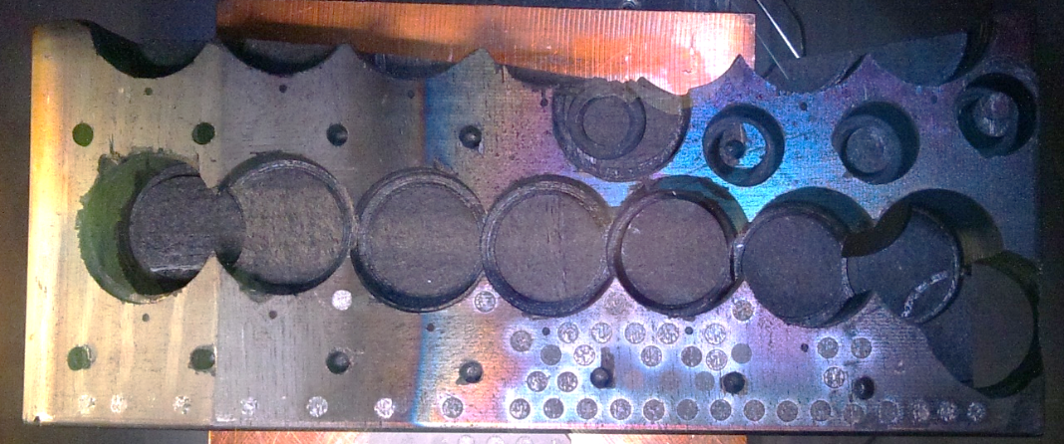
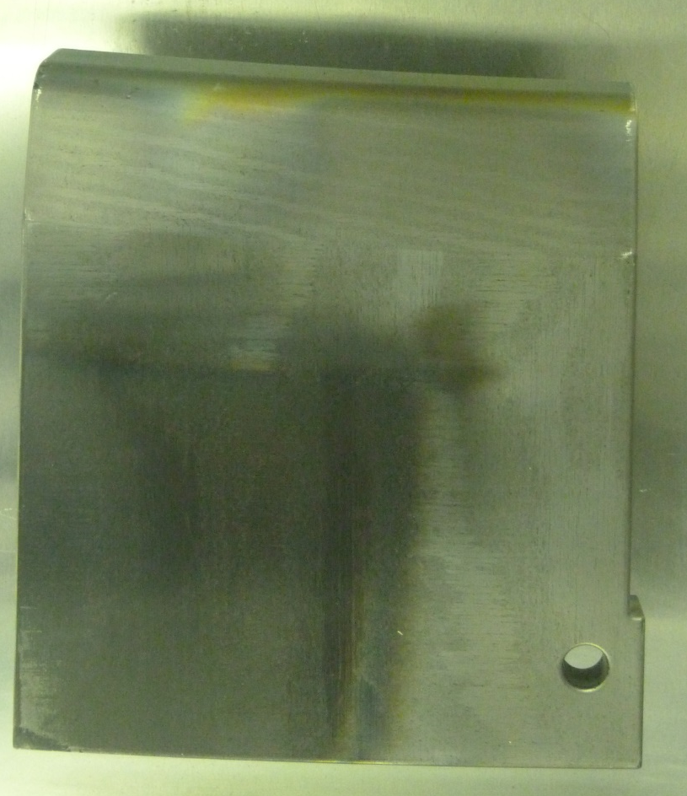
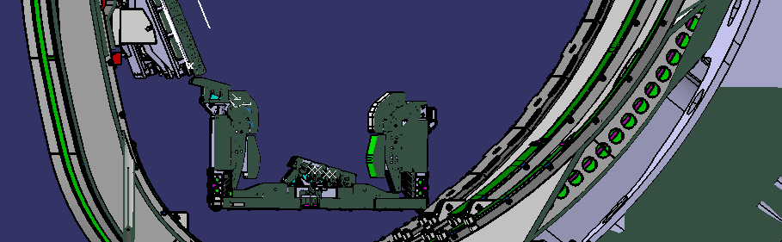
Ex situ LID-QMS of JET divertor tile 0 from ILW3
JET inner divertor tile 0 exposed in ILW3 (2014-2016). Then ex situ LID-QMS performed in FZJ.
TDS of
cored
samples
LH14N
7c
6c
5c
5c
low
3c
low
1c
low
4c
3c
2c
1c
tile 0
LID-QMS:
Ø3 mm
laser
spots
tile 1
Good agreement of LID-QMS with TDS
except close to plasma heated side
due to mechanical damage of surface before LID
constant D inventory
Ref [1]: J. Likonen et al, Nuc. Mat. En. 19 (2019) 300-306 doi:10.1016/j.nme.2019.03.012

Slide 7
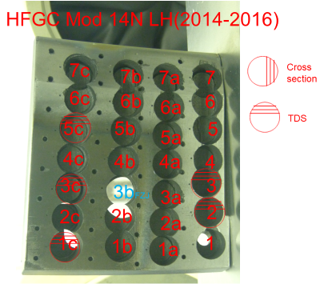
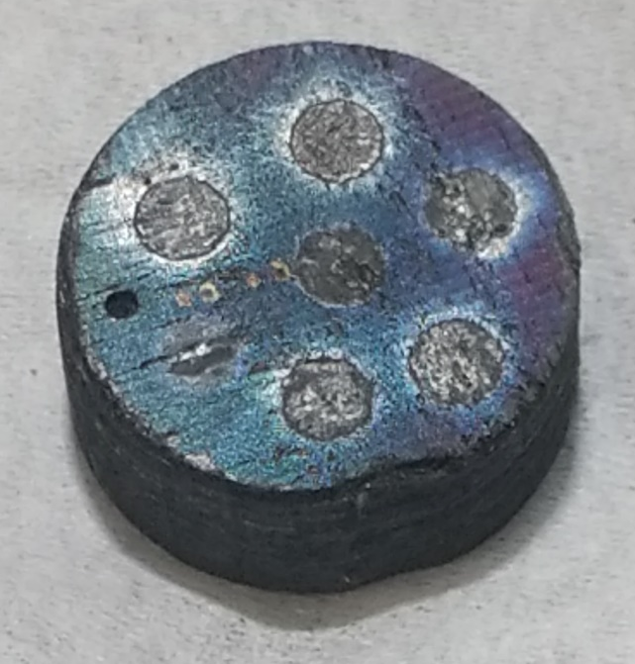
JET Sample Overview for LID-QMS @ FZJ
Tile 0 (HFGC14N LH, ILW3) remaining part after coring + core 3b
Tile 1 (14IN G1C, ILW3) remaining part after coring + core 11a
Tile 0 (HFGC??? RH, ILW1-3) remaining part after coring
Tile 1 (14IWG1A, ILW1-3) remaining parts after coring
W lamella cuts
Be limiter 2XR10 from ILW3 for poloidal D profile
IWC 4/2 (2011-2016) 19, 32
Requested for NRA
inside laser spots
different laser energies:
5 J, 7.5 J, 10 J, 4 pulses with 10 J, 12 J, 15 J @ 3 ms pulse duration
5 J shows incomplete D desorption
2nd shot with 10 J releases <5% of 1st shot

Slide 8
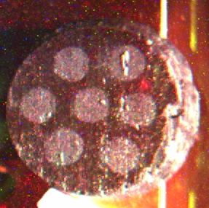
JET Sample Overview for LID-QMS @ FZJ
Tile 0 (HFGC14N LH, ILW3) remaining part after coring + core 3b
Tile 1 (14IN G1C, ILW3) remaining part after coring + core 11a
Tile 0 (HFGC??? RH, ILW1-3) remaining part after coring
Tile 1 (14IWG1A, ILW1-3) remaining parts after coring
W lamella cuts
Be limiter 2XR10 from ILW3 for poloidal D profile
IWC 4/2 (2011-2016) 19, 32
Requested for NRA
inside laser spots
different laser energies:
10 J, 15 J @ 3 ms pulse duration
No significant difference (both above limit for complete D desorption)

Slide 9
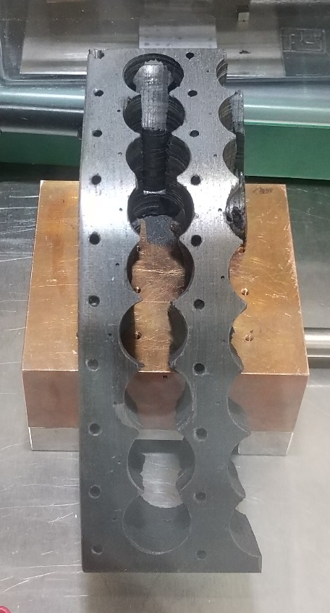
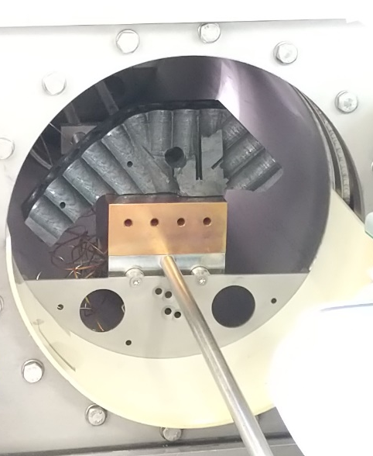
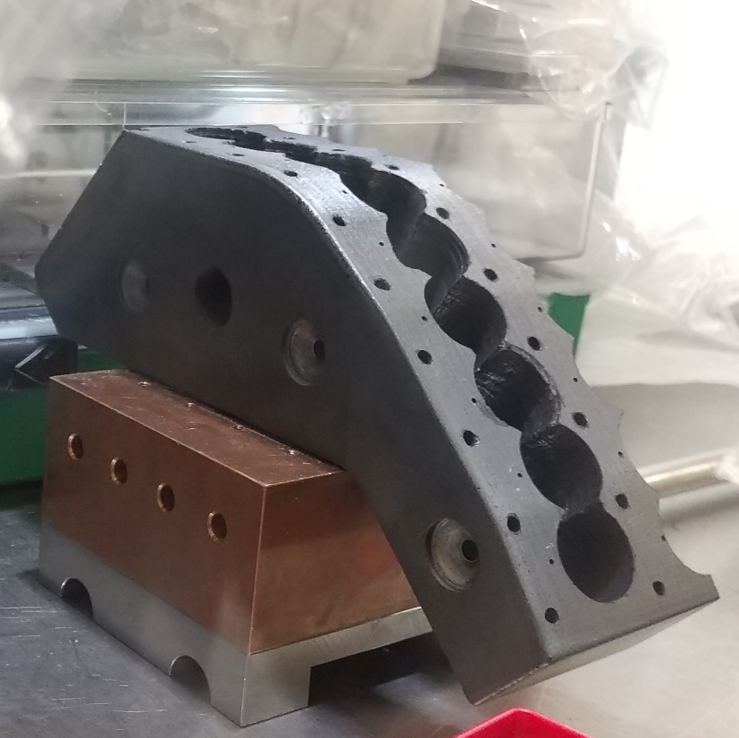
JET Sample Overview for LID-QMS @ FZJ
Tile 0 (HFGC14N LH, ILW3) remaining part after coring + core 3b
Tile 1 (14IN G1C, ILW3) remaining part after coring + core 11a
Tile 0 (HFGC??? RH, ILW1-3) remaining part after coring
Tile 1 (14IWG1A, ILW1-3) remaining parts after coring
W lamella cuts
Be limiter 2XR10 from ILW3 for poloidal D profile
IWC 4/2 (2011-2016) 19, 32
JET tile 1 from ILW3 now installed in FREDIS:
It will need 2 ventings for one poloidal scan
in order to shoot the laser rectangular onto the
3 slopes

Slide 10
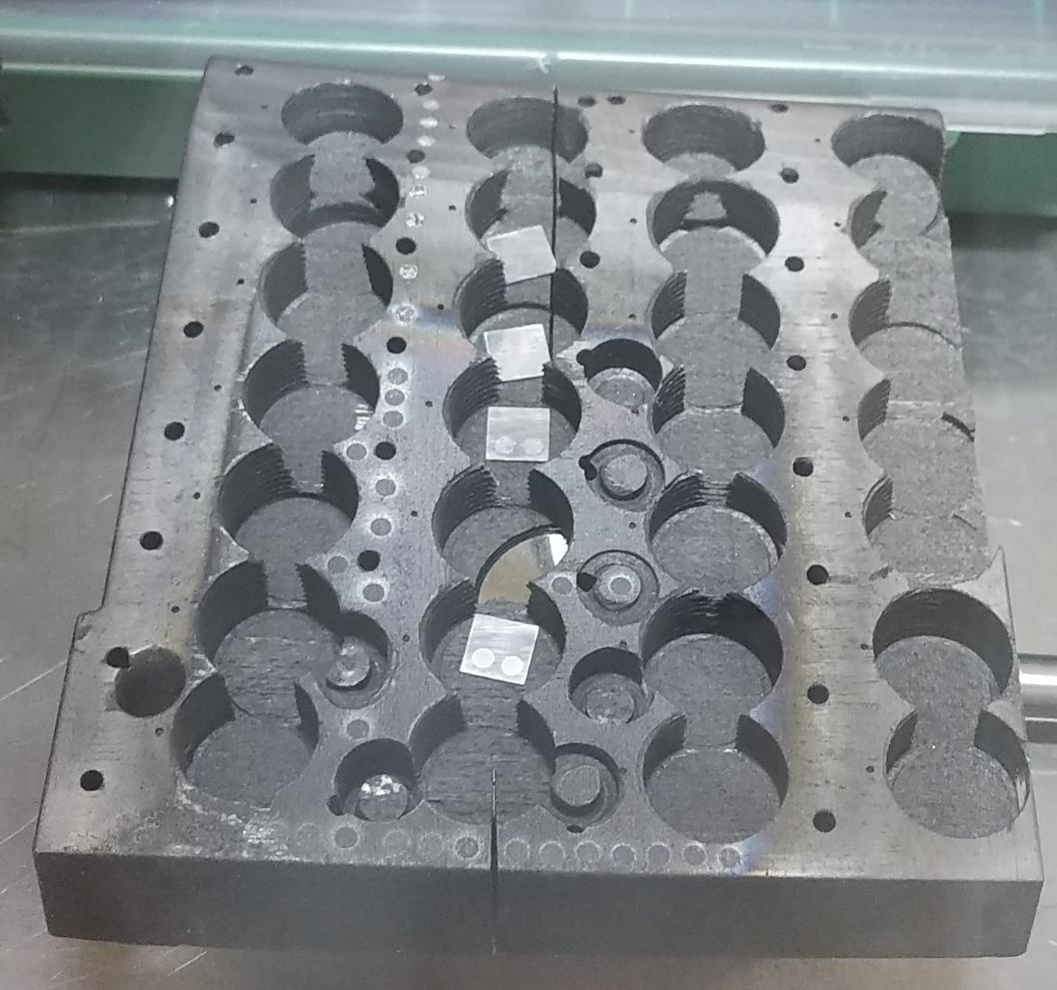
JET Tile 0 (HFGC??? RH, ILW1-3) remaining part after coring
Poloidal scan:
One retention plateau like for ILW3 only
2nd poloidal scan next to 1st scan can be done.
Toroidal scan:
D retention maximum quite far on the right-hand side
Toroidal scan could be continued. It was limited by motor movement of 7 cm.
Mass 3 desorption
to be added
Mass 3 desorption
to be added

Slide 11
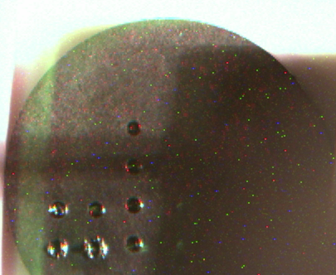
JET W lamella cuts
Sample name and surface dimensions:
175 (7.8 mm x 5.5 mm)
190 (8.1 mm x 7.7 mm) 5.1 mm before kink
176 (6.8 mm x 5.7 mm)
169 (8.2 mm x 5.7 mm)
Only one 3 mm diameter laser spot possible
Danger: no data if QMS in wrong sensitity range!
1st time to melt W in FREDIS:
Nominal laser max energy 100 J would be sufficient, but current max energy 75 J, not sufficient to melt W
Telescope optics after laser fibre changed to reduce spot size: 1 mm spot melts W, but no const temperature inside spot, only temperature gradient everywhere → spot edge effects dominate → uncontrolled desorption
New telescope optics for 2 mm diameter spot designed, in production
Two 2 mm laser spots on each sample will be possible
bulk W test sample

Slide 12
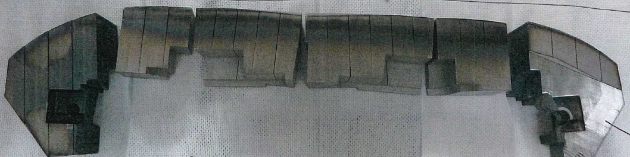
JET Sample Overview for LID-QMS @ FZJ
Tile 0 (HFGC14N LH, ILW3) remaining part after coring + core 3b
Tile 1 (14IN G1C, ILW3) remaining part after coring + core 11a
Tile 0 (HFGC??? RH, ILW1-3) remaining part after coring
Tile 1 (14IWG1A, ILW1-3) remaining parts after coring
W lamella cuts
Be limiter 2XR10 from ILW3 for poloidal D profile
IWC 4/2 (2011-2016) 19, 32
2XR10

Slide 13
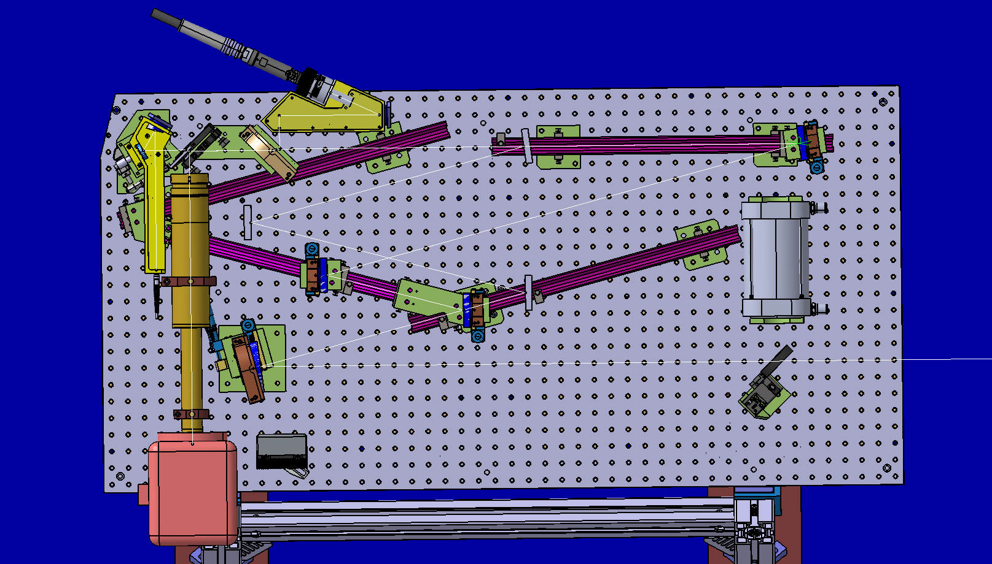
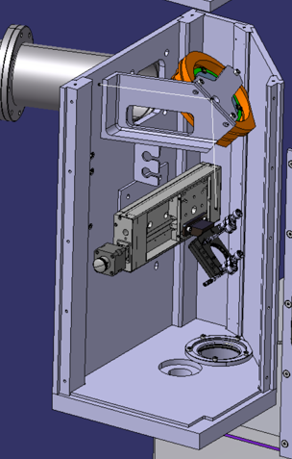

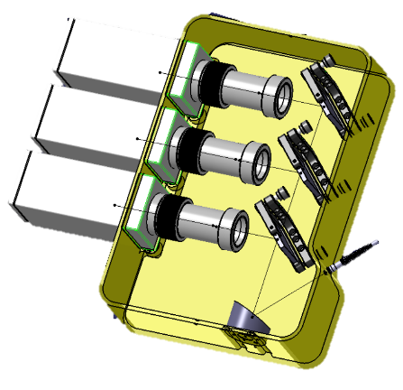
In situ LID-QMS setup at JET
Roof Lab
above Torus Hall
Diode-pumped Fibre Laser:
Ytterbium 1071 nm, 25 kW
(IPG YLS-25000)
Laser fibre
Optics Table
M11: flat, dielectric
M15: flat, dielectric
cooledBeam Dump
Fibre to pyrometers
Field
Lens
passive Beam Dump
movable mirror
Torus
Hall:
Coaxial Camera
M4
3 cylindric mirrors squeeze laser beam
to be circular on the target
M1
Pyrometers
1
M3
M2
M5
Coaxial camera observation and temperature measurement of the laser spot
Total Transmission of Laser beam path: ~53%
Transmission of vacuum window: ~85%
Light reflection on surface: ~25%
Total laser power for heating: ~34%

Slide 14
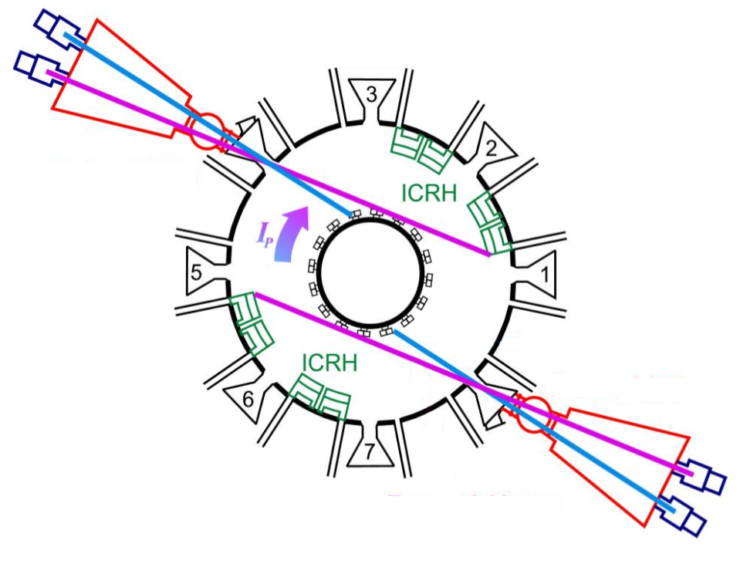
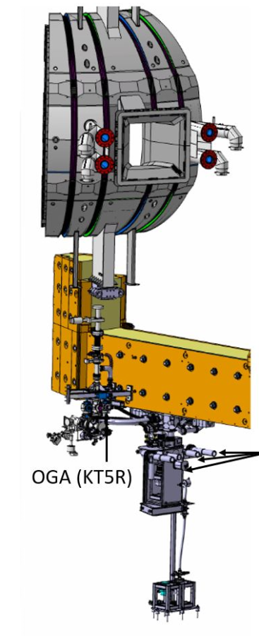
Detection System
JET torus
Laser
QMS1,QMS2
sub-divertor
QMS5
Octant 8
RGA3, RGA7, …
The gases desorbed from the laser spot
are quantified by Residual Gas Analysis (RGA)
using mainly Quadrupole Mass Spectrometers (QMS):
4 QMS in the sub-divertor
3 QMS in the main torus
Octant 8
RGA = Residual Gas Analyser
main type used:
QMS = Quadrupole Mass Spectrometer

Slide 15
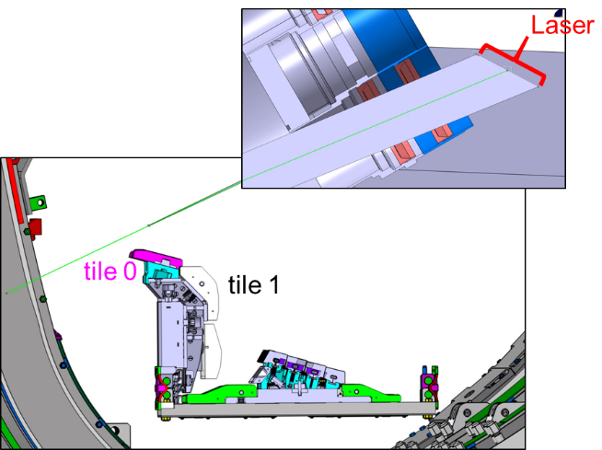
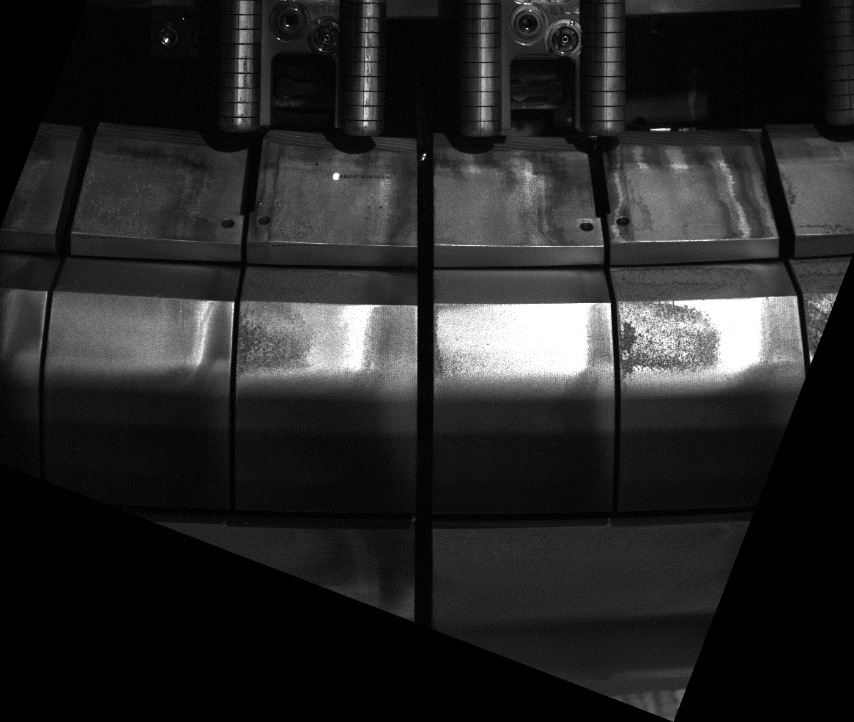
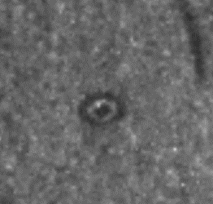
Laser accessible area
Vacuum window
Laser accessible area:
upper inner divertor of JET
tile 0
laser angle ≈ 48°
(to surface normal)
tile 1
≈ 64°
≈ 13°
≈ 27°
Laser spot ellipticity show
on front of tile 1:
poloidal direction
142 mm
2.29 mm
toroidal direction
3.06 mm
with beam ellipticity settings
for tile 0

Slide 16
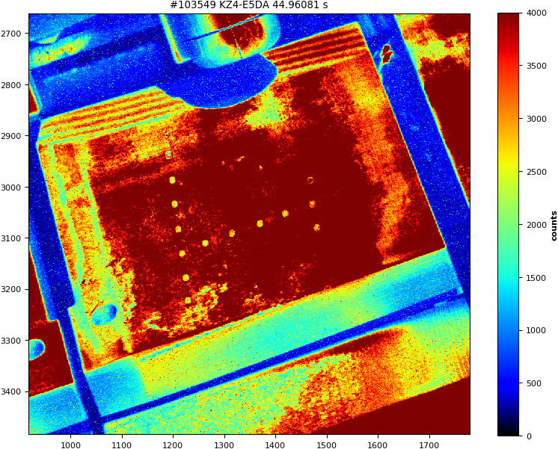

First LID results at JET: toroidal/poloidal scan of divertor tile 0
A fuel retention map can be obtained by evaluating
the partial pressure jump:
Tile: RH14W
Tile: RH14W
previously desorbed spot
area of const. D retention (green rectangle) identified

Slide 17
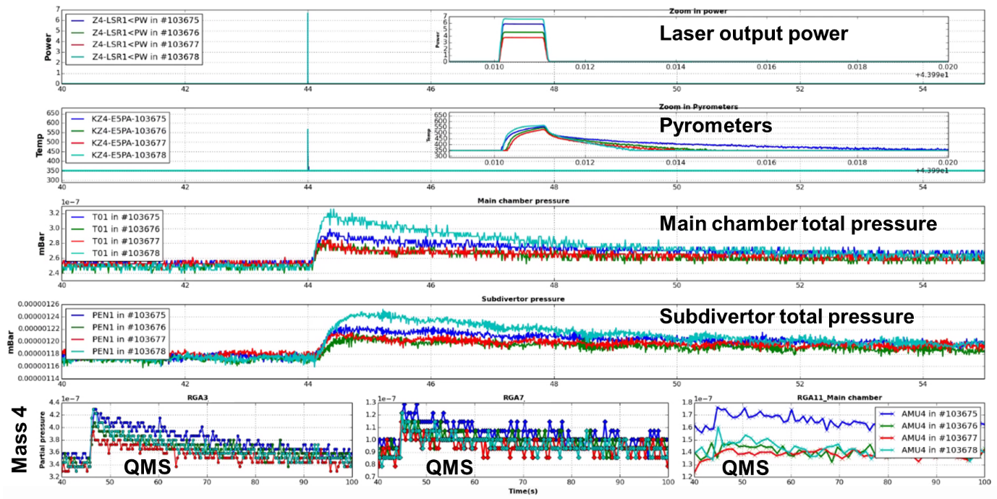
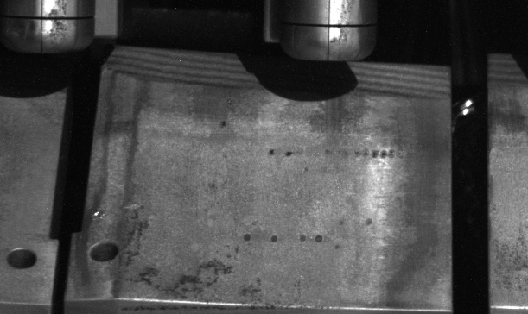
First Measurements with LID-QMS before T operation
21 kW
19 kW
Before this measurement: poloidal and toroidal scan to identify area of const. D retention (green rectangle)
Laser power scan to determine minimum power for complete fuel desorption: 19 kW for 1 ms

Slide 18
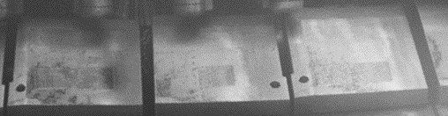
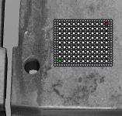
in situ Measurements with LID-QMS in DT campaign
Measurements during Deuterium-Tritium campaign at JET in September/October 2023:
  4 x 3 cm² rectangles “cleaned” from fuel by overlapping laser spots before tritium operation
  one rectangle measured every week in
  “Raster mode”: 99 laser spots every 3 mm
  every 20 ms to increase the desorbed area
  Additional weekly measurement of rectangle 1
Observations:
  Large signal on mass 4 (D₂) in all QMS
  Large signal on mass 5 (DT) only in QMS close to laser spots,
  but small signal in sub-divertor RGAs
  (probably in remote ducts/tubes walls saturated with D but not
  with T)
  Most constant signal with low pumping (cryo pump at liquid N2
  and only 1 of 4 turbo molecular pumps pumping)
  → QMS repetition time (~5 s) << pump-out time
  4 x 3 cm² “cleaned” rectangle
  99 laser spots

Slide 19
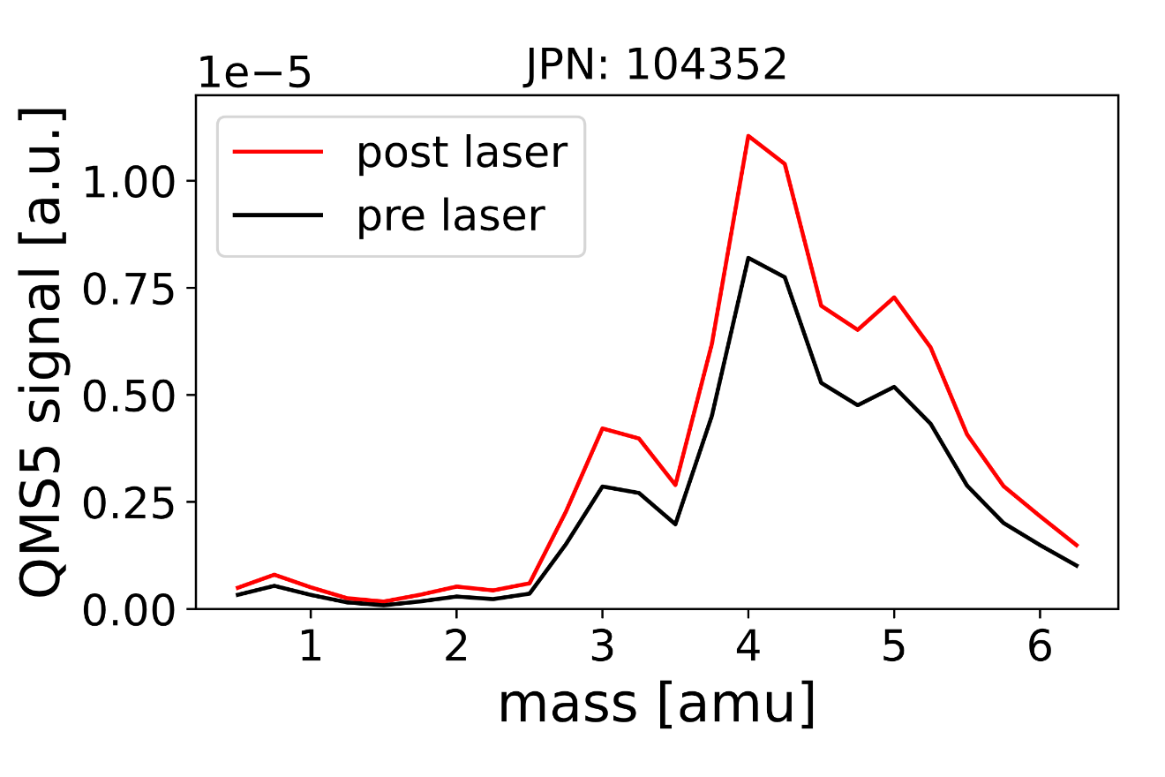
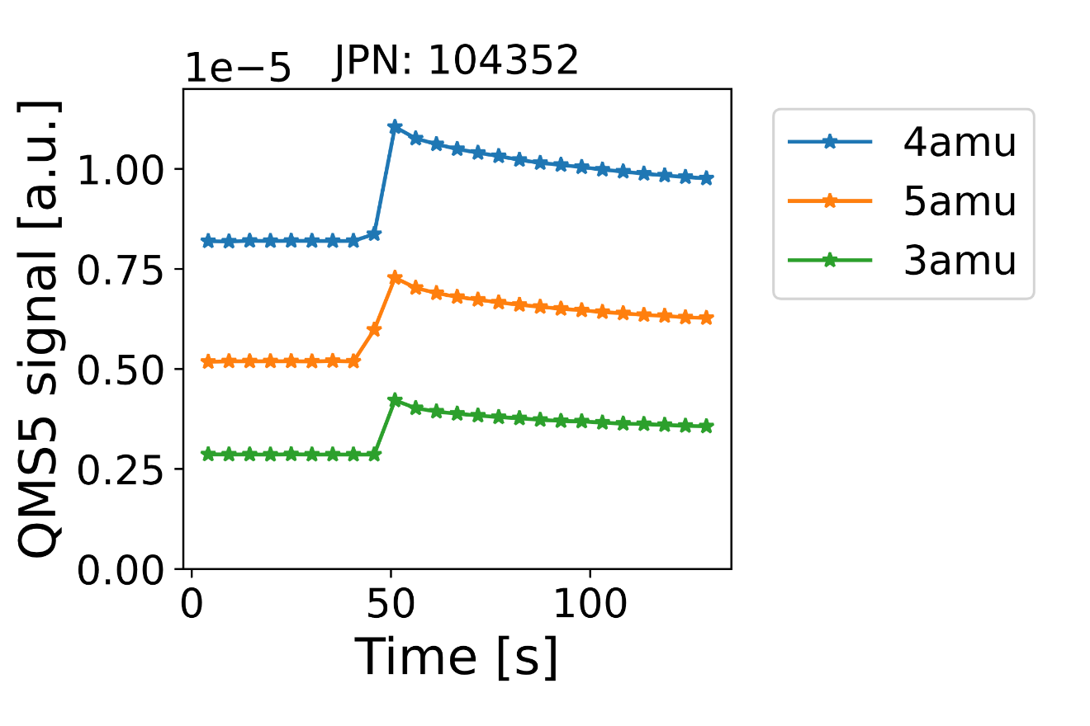
Tritium Measurements
Measurement with 99 spots inside an area cleaned 1 week before by overlapping laser spots
D₂ , (TH)
DT, (HD₂)
HD
DT
D₂
HD
TH and HD₂ can only have negligible contribution to mass 4 and 5 as there is little H₂ (mass 2)

Slide 20
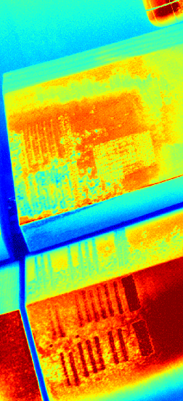
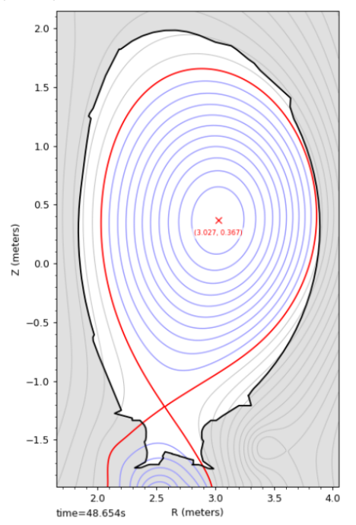
in situ Measurements with LID-QMS at JET
Measurements during Tritium Clean-up campaign at JET
in October/November 2023:
  Monitor the tritium content during different clean-up techniques:
    Backing to 320° C
    ICWC plasmas
    Raised Inner Strike Point plasmas (RISP)
    Glow discharge plasmas
  Measurement by repetition of a poloidal scan of the inner divertor with LID-QMS shifted by few mm after each cleaning method

Slide 21
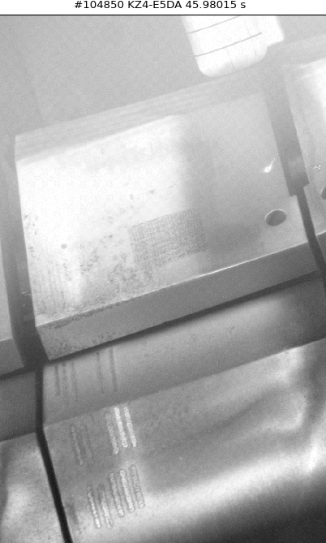
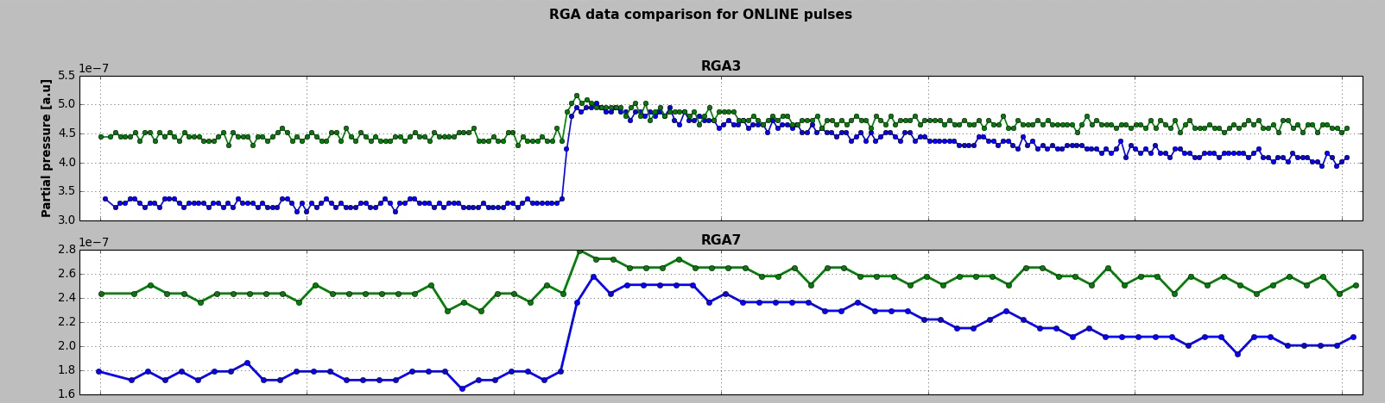
in situ Measurements with LID-QMS at JET
LID-QMS on top of tile 1 before and after RISP plasmas for mass 5 (DT)
Final Measurements at JET after last plasma
in December 2023:
comparison of ex situ to in situ LID-QMS
in 70 positions in the laser accessible area
on tiles to be retrieved from the torus

Slide 22
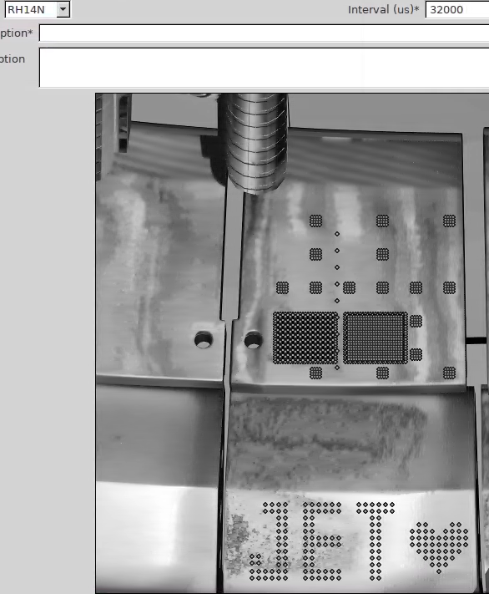
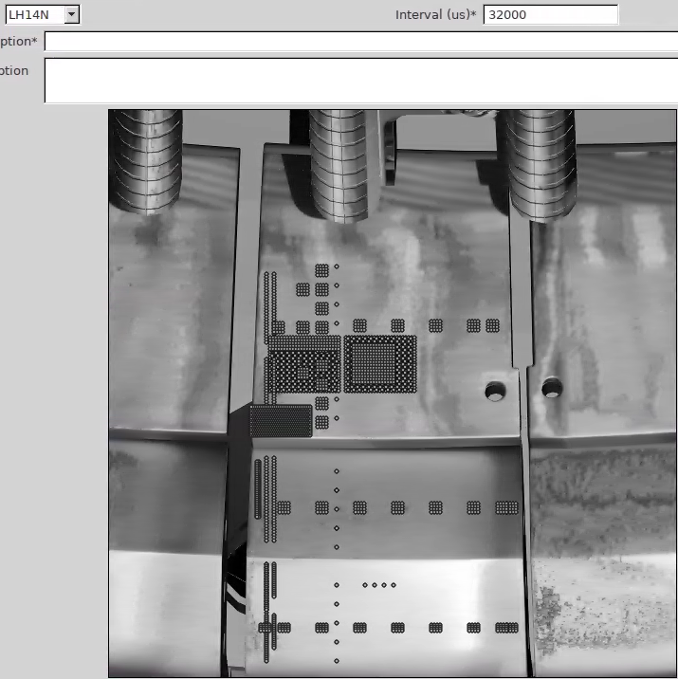
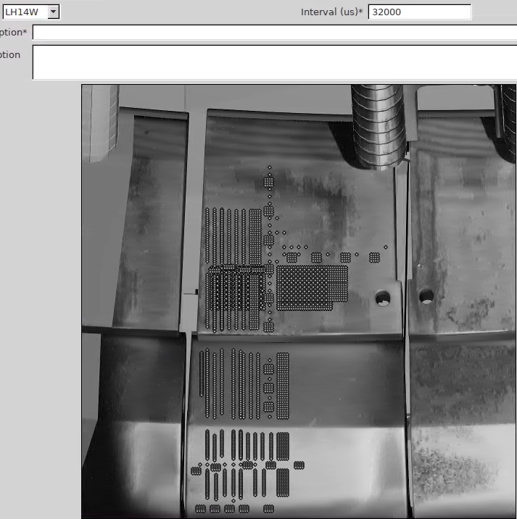
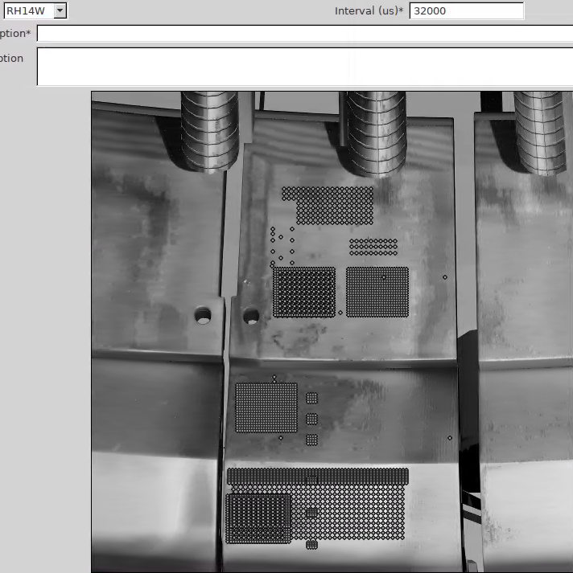
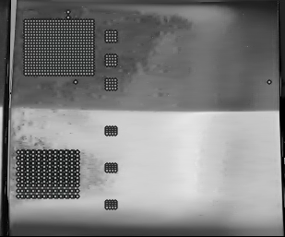
Overview of FULL LID-QMS work
LH14W
2011-23
RH14N
2019-23
RH14W
2011-23
LH14N
2019-23
14ING1C
2019-23
14ING1D
2011-23
14IWG1A
2019-23
14IWG1B
2011-23

Slide 23
Back-up Slides

Slide 24
Motivation
Problem: Hydrogen isotope retention at the wall
Risk of high tritium release in case of large leak (e.g. ITER limit < 1kg T in the vacuum chamber)
Tritium losses in the fuel cycle
Wall material issues
…
tile 0
tile 1
tile 3
[1]
[2]
JET (Joint European Torus)
Ref [1]: S. Brezinsek et al., Nucl. Fusion 55 (2015) 063021, doi:10.1088/0029-5515/55/6/063021
Ref [2]: K. Heinola et al., J. Nucl. Mater. 463 (2015) 961-965, doi:10.1016/j.jnucmat.2014.12.098

Slide 25
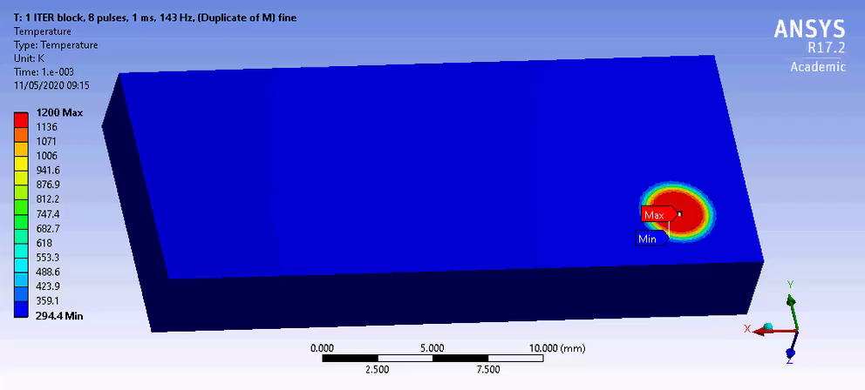
ANSYS Laser spot temperature calculation

Slide 26
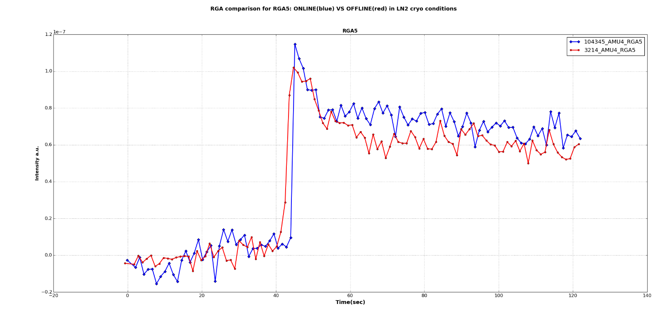
QMS Calibration
Quadrupole Mass Spectrometer calibration by short (~1 s) gas puff into the torus
Gas injection module volume V = 1.5 l
Pressure drop Δp in module after injection
N corresponds to the partial pressure jump in the mass spectrometer signal in the torus
Very low partial pressure jump is used, which is similar to the jump during the laser pulse
(~10¹⁸ D atoms)
repeated on each measurement day to account for different wall loading
injected gas molecules N
QMS5 with laser pulse
QMS5 calibration gas puff
Mass 4 (D₂)
N_{calib}
N_{signal}
Background of partial pressure on
mass 4 subtracted from both
Time / s

Slide 27
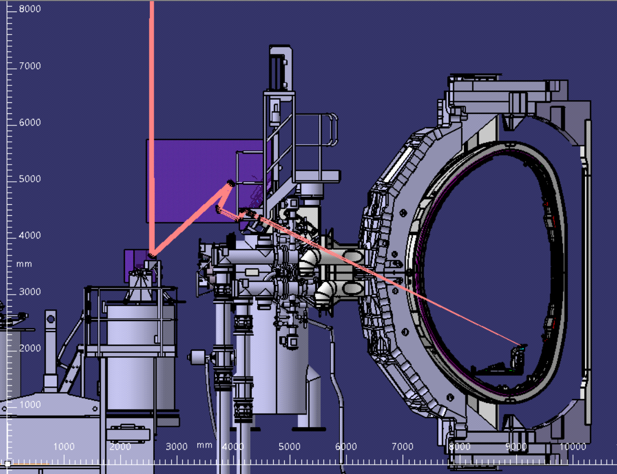
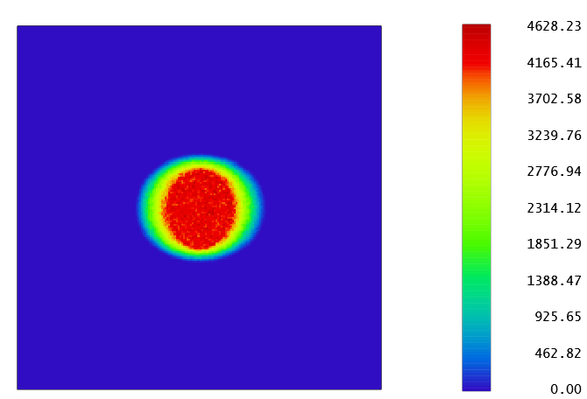

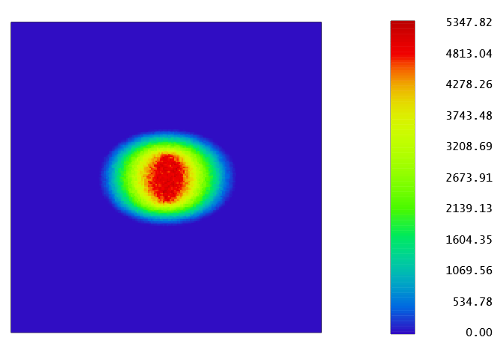
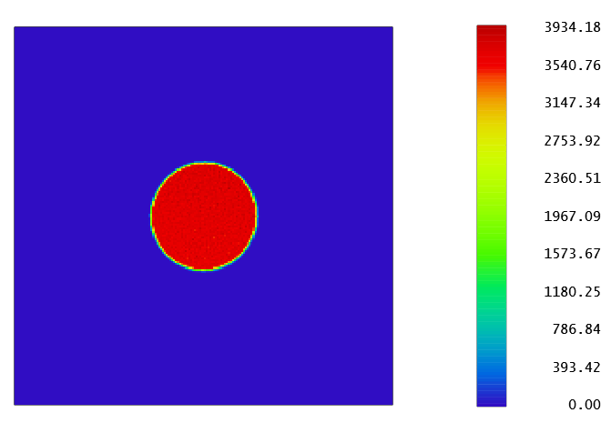
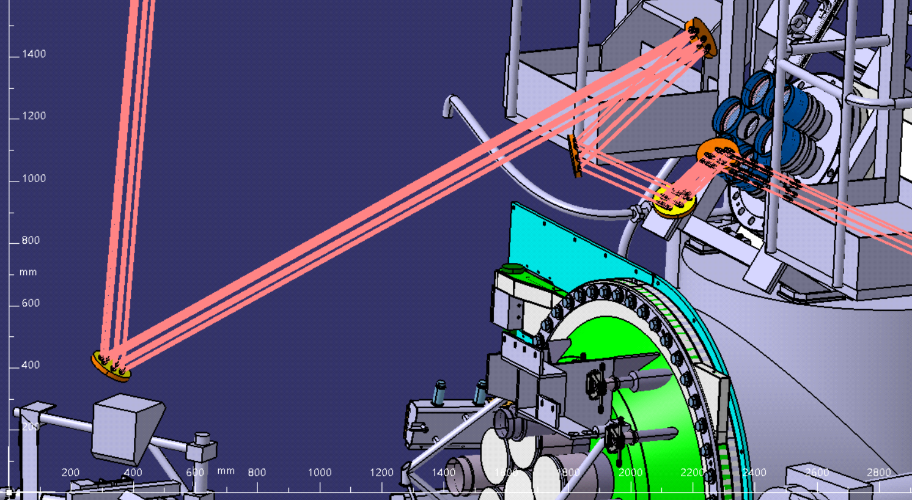
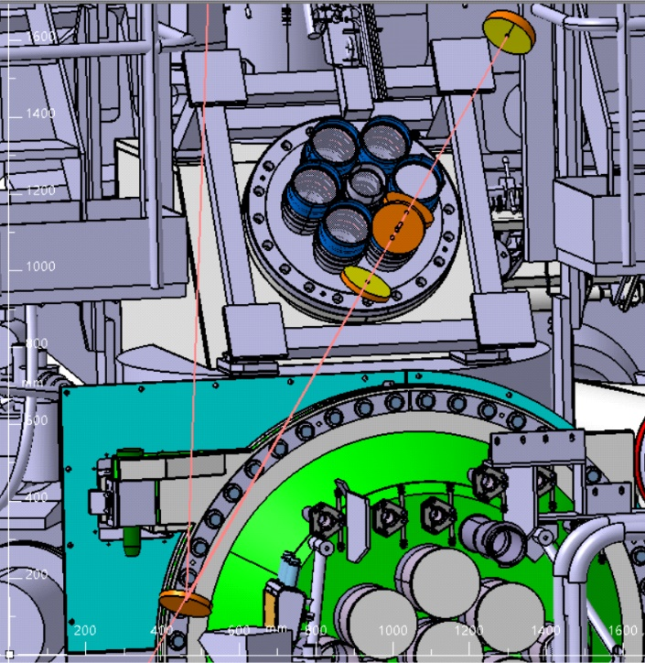
Beam Path Overview – Torus Hall
beam path: only mirror-based, no lenses, no fibres
to prevent transparent optic degradation by radiation
and to test ITER-like optical components
4
1
N° | mirror type | focal length / mm | size / mm
8 | flat mirror | infinity | diameter = 140
9 | off-axis parabolic mirror | 5149 | diameter = 140
10 | flat mirror | infinity | diameter = 140
11 | flat mirror | infinity | diameter = 140
12 | flat mirror (motor controlled 2-axis movement) | infinity | diameter = 140
3
2
5
Focussing
by 2 mirrors at 45° to each other
connected rigidly moving together to shorten/extend the beam path
4
4
1
1
3
3
2
2
mirror 5
mirror 5

Slide 28
Laser Parameter Scan
1 ms pulses
Complete D desorption requires
ca. 1 MJ/m² incident energy density
corresponding to a heat flux factor of
32 MW√s/m² on CFC
_
pulse duration | energy | intensity | energy density | heat flux factor
t_{p} / ms | E / J | I / MW/m² | E_{A} / MJ/m² | F_{HF} / MWs^{1/2}/m²
0.5 | 4.5 | 1254 | 0.63 | 28
1 | 6.3 | 884 | 0.88 | 28
2 | 9 | 627 | 1.25 | 28
3 | 11 | 514 | 1.54 | 28
5 | 14 | 397 | 1.98 | 28
10 | 20 | 280 | 2.80 | 28
The effect of pulse duration is within a factor of 1.3, but comparable to spatial signal scatter
→ A pulse duration of 3 ms seems to be adequate

