Slide 1

SP C Updates and Plan
K. Schmid
and SP-C taskholders:
    E. Bernard, T. Morgan, A. Houben , A. Manhard, S. Markelj, T. Schwarz-Selinger, L. Ciupinski, M. Fellinger, D. Primezhofer, Y. Ferro, M. Lavrentiev, R. Bisson, J. Zavaznik, A. Kärcher, M. Vadrucci, V. Nemanic, L. Gao
Notes:
Please Indicate your subproject

Slide 2
SP C.1 Transport of Hydrogen through the first wall of fusion devices

Slide 3
SP C.1 Transport of Hydrogen through the first wall of fusion devices: CEA
Permeation (D,T) through Liquid/Solid interfaces with interface characterization
  Task 1: Characterisation of the oxide grown during the loading phase -> “blank” Wapiti cell
  Task 2 : Tritium permeation at RT through Pd-coated Eurofer samples
Task 1: The blank Wapiti cell was built and tested in the glovebox environment but still sample is contaminated
  ➔we have a relevant sample with low T activity (only background contamination) : possibly below T exemption limit which broadens potential analysis setups at reach
Task 2: Samples were coated with Pd by the team of M. Cekada (JSI) on both sides, then loaded with 250 mbar of pure T₂ at 150°C to study permeation with/without water downstream
  Factor 100 increase in the permeated activity in the presence of water downstream
  Activity in downstream air is the same order of magnitude, whether we have water downstream or not
  Different behavior when Eurofer surface is protected: permeation flux establishes at 1,5·10³ Bq/day in Eurofer vs 7,7·10³ Bq/day in Eurofer coated with Pd ➔corrosion/oxidation play a role
Notes:
Task 1 hampered by T content in oxidised sample to be analyzed externally -> Try again
Task 2: Completed.
Most activity in Water
Activity in air is the same idependent on downstream interface
-> More permeation in presenc of water

Slide 4
SP C.1 Transport of Hydrogen through the first wall of fusion devices: CEA
Permeation (D,T) through liquid/solid interfaces with interface characterization
Pressure variation: EUROFER + Pd
one pristine EUROFER with "wapiti oxide".
"wapiti oxide" characterization.
KOM Feb-2024
Autoradiography T surface measurement
Oxide characterization still open.
RAMAN , SIMS maybe Sacley.
Pressure variation in April
Notes:
Task 1 hampered by T content in oxidised sample to be analyzed externally -> Try again
Task 2: Completed.
Most activity in Water
Activity in air is the same idependent on downstream interface
-> More permeation in presenc of water

Slide 5
SP C.1 Modelling of Hydrogen Transport properties in the first wall: CEA
Deliverable: Diffusion properties of hydrogen at the W/Cu interface: activation barriers for MRE modeling
Phonon properties of H at the W/Cu interface
Vibrational frequencies of H at the W/Cu were computed.
The solution of H was determined at the W/Cu interface
Grand-canonical ensemble is used
H reservoir is also considered as a real gas
H solubility is determined as function of temperature and chemical potential.
NEB calculations were performed at the W/Cu interface:
Due to the distortion of the Cu network, two diffusion paths have been considered (pink & green).
The activation barriers were determined for each path.
An additional path connecting the two previous ones was also considered (blue)
→ See presentation by Y. Ferro
Notes:
• We previously built a DFT model of the W/Cu interface where a hexagonal. The Cu network reconstructs at the interface where it adopts a hexagonal close packed structure. This work was submitted to Nuclear Materials and Energy Journal – minor revisions are completed, and the paper is resubmitted.
• We also, previously, determined the most stable interstitial positions for H at the W/Cu interface. These positions are plotted in blue (octahedral) and red (tetrahedral) on the figure above.
• We determined the vibrational frequencies of H atoms at the most stable interstitial positions.
• Those vibrational frequencies were used in a thermodynamic model to determine the solubility as a function of the temperature and chemical potential.
• we considered the grand-canonical ensemble where H reservoir was treated as real and ideal gas. Our model was validated against experimental data of H solubility in W and Cu bulks.
• H solubility at the W/Cu interface is higher at the plane of the interface than in the W and Cu networks.
• A draft paper is completed.
• In the following, nudged elastic band (NEB) calculations were carried out to determined the activation barriers that determine the diffusion properties. Due to the Cu reconstruction, two diffusion paths were considered: the pink and the green.
• It was obtained that the pink path has lower values of activation energies than the green one, which means that it is most energetically favorable for hydrogen to diffuse through it (see graphs).

Slide 6
SP C.1 Transport of Hydrogen through the first wall of fusion devices: CEA
Kinetic of hydrogen transport across the W/Cu interface and modeling distortions in Cu at the W/Cu interface
0D model of the interface.
Identification misfit defects by MD at the W/Cu interface with EAM potential
KOM Feb-2024
Many different interfaces between W/Cu due to different orientation
Build kinetic model (activation barriers etc.)
Different W/Cu orientation at the interface.
DFT & MD model of the interface. Build an MD potential.
Average model of H at interface over different interfaces.
Notes:
• We previously built a DFT model of the W/Cu interface where a hexagonal. The Cu network reconstructs at the interface where it adopts a hexagonal close packed structure. This work was submitted to Nuclear Materials and Energy Journal – minor revisions are completed, and the paper is resubmitted.
• We also, previously, determined the most stable interstitial positions for H at the W/Cu interface. These positions are plotted in blue (octahedral) and red (tetrahedral) on the figure above.
• We determined the vibrational frequencies of H atoms at the most stable interstitial positions.
• Those vibrational frequencies were used in a thermodynamic model to determine the solubility as a function of the temperature and chemical potential.
• we considered the grand-canonical ensemble where H reservoir was treated as real and ideal gas. Our model was validated against experimental data of H solubility in W and Cu bulks.
• H solubility at the W/Cu interface is higher at the plane of the interface than in the W and Cu networks.
• A draft paper is completed.
• In the following, nudged elastic band (NEB) calculations were carried out to determined the activation barriers that determine the diffusion properties. Due to the Cu reconstruction, two diffusion paths were considered: the pink and the green.
• It was obtained that the pink path has lower values of activation energies than the green one, which means that it is most energetically favorable for hydrogen to diffuse through it (see graphs).

Slide 7
SP C.1 Transport of Hydrogen through the first wall of fusion devices: MPG
Permeation of H isotopes through W heavy alloys (W/Fe-Ni)
Question: Transition of D between W and Fe-Ni phases
Investigate by ion-driven permeation (IDP)
  Produced layered model systems of Fe-Ni matrix
  on recrystallized W foil
  Measured IDP starting from matrix and W sides
W → matrix: practically identical to only W
  Issue: oxidation of downstream Fe-Ni
Matrix → W: strongly suppressed
  Issue: Fe-Ni sputtering, W island segregation
  Gas permeation not negligible!
Previous hypothesis qualitatively confirmed!
To Do: gas pressure calibration, modelling
Notes:
Question how is D transported through W-heavy alloys: Transport in W grains vs Fe/Ni matrix

Slide 8
SP C.1 Transport of Hydrogen through the first wall of fusion devices: MPG
Measurement and modelling of Ion Driven Permeation in "W-heavy alloys"
Measure permeation through HPM1850 and compare to modelling
KOM Feb-2024
Move from model system to real HPM
Modeling of 2D diffusion pathways

Slide 9
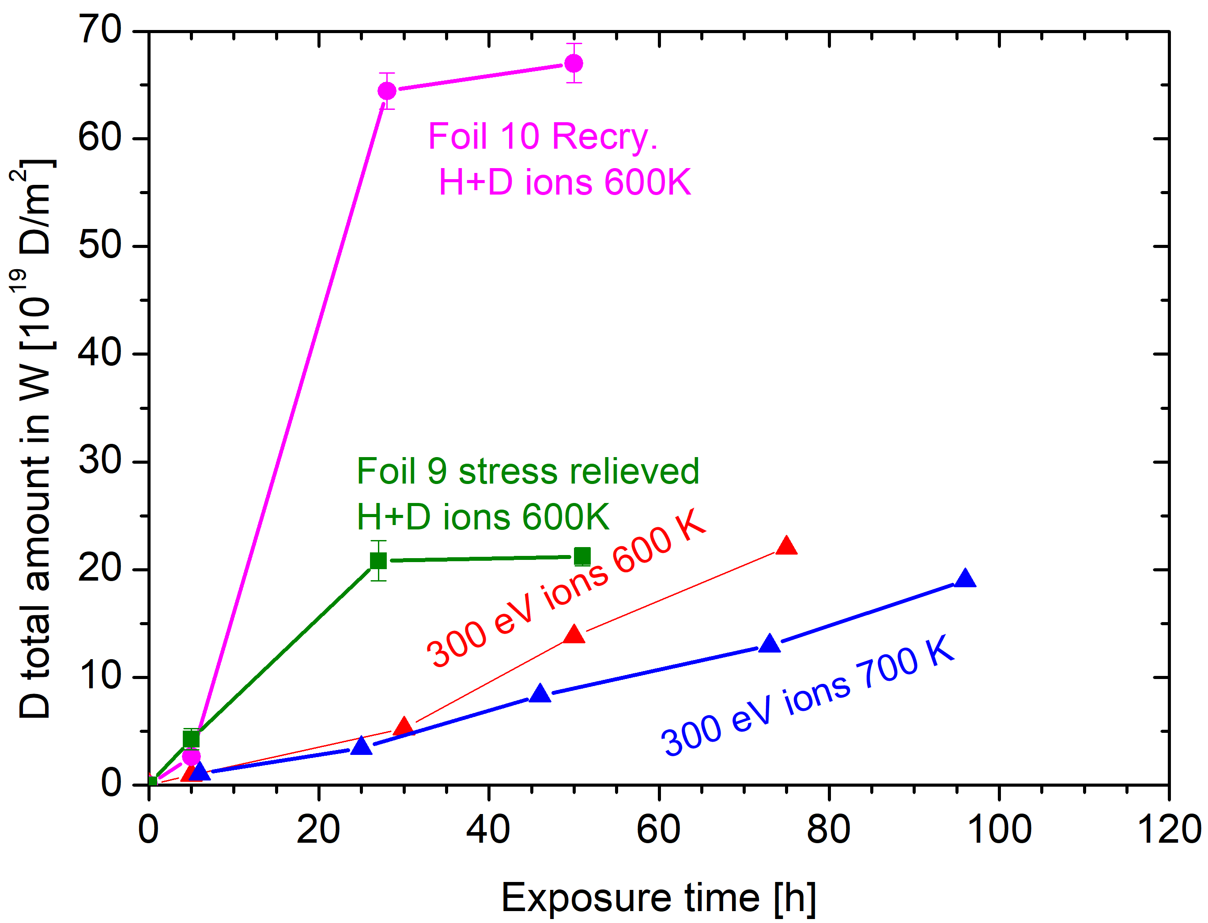
SP C.1 Transport of Hydrogen through the first wall of fusion devices: JSI
Compare D permeation through W with D atoms and 300 eV/D ions
Task: Study of D permeation in H-prefilled W foil
Experiment
Exposure of recrystalized or stress- relieved 50 µm W foils with protective layer
Exposure to H ions (flux ?x10¹⁸ H/m²s) at 600K for 24h
Exposure to D ions – flux 4x10¹⁸ D/m2s
Observations
Saturation of damaged layer by D after 28h – 3 times faster compared to no H-prefilled foil
Different saturation D concentration for recrystallized foil and stress-relieved foil ? (no explanation for that)
Deliverable: PWIE-SP C.1.T-003-D004
Status: completed
Facilities: accelerator 8 days
Linked WP or TSVV: if required

Slide 10
SP C.1 Transport of Hydrogen through the first wall of fusion devices: JSI
Study D-permeation on H-prefilled W foil at low temperatures
Permeated amount of D at low temperatures (400K, 500K)
KOM Feb-2024
Prefill @600K
D-iso ex at 400-500K
Start in June
Notes:
Task 1 hampered by T content in oxidised sample to be analyzed externally -> Try again
Task 2: Completed.
Most activity in Water
Activity in air is the same idependent on downstream interface
-> More permeation in presenc of water

Slide 11
SP C.1 Transport of Hydrogen through the first wall of fusion devices: CEA
Model D-permeation on H-prefilled W foil at low temperatures
Model permeation through H-pre-filled W
Use diffusion trapping code
Grain boundary diffusion?
KOM Feb-2024
Grain boundary diffusion
Swapping therm for iso-ex
First without pre-fill
600K iso-ex also works in classic desc.

Slide 12
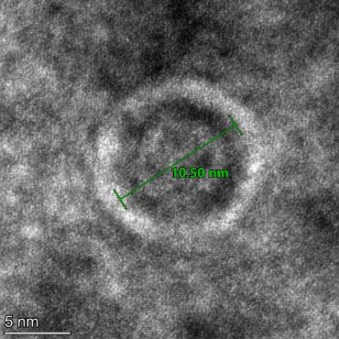
SP C.1 Transport of Hydrogen through the first wall of fusion devices: IPPLM
TEM observations of nanobubbles in tungsten subjected to He-irradiation and annealing
Determination of size and distribution of nanobubbles in defected zone
Density of nanobubbles depends on the distance from the surface
Size of the bubbles is not related directly with the density

Slide 13
SP C.1 Transport of Hydrogen through the first wall of fusion devices: IPPLM
TEM analysis of annealed, He implanted W. In cooperation with MPG
Analysis of void formation
KOM Feb-2024
M. Zibrov (MPG) provides samples.
First samples ready.
Start in March

Slide 14
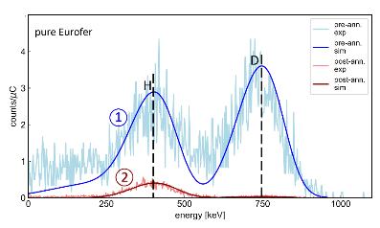


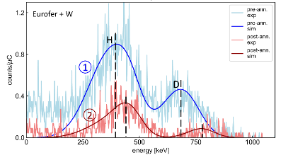
SP C.1 Transport of Hydrogen through the first wall of fusion devices: OEAW/VR
Task: Studying the influence of (re-deposited) W on Eurofer on D retention (OEAW, VR)
Deliverable: Variation of TDS with W-layer thickness on Eurofer
Two comparable TDS experiments were performed in close collaboration with UU:
exp. 2:
TDS on D loaded Eurofer + W coating layer structure
exp. 1:
TDS on D loaded Eurofer layer
  It was found that the top W layer functions as outgassing barrier:
  → higher T needed to release D retained in Eurofer + W layer
  → overall amount of retained D is larger with additional W layer

Slide 15
SP C.1 Transport of Hydrogen through the first wall of fusion devices: OEAW/VR
Studying the influence of (re-deposited) W/EUROFER layers on D retention
Influence of inverted layer system EUROFER layer on D-implanted W layer on D retention
KOM Feb-2024
Follow up Study
QCM & TDS & IBA
Start in May

Slide 16
SP C.2 T retention Release from B layers
New in 2024

Slide 17
SP C.2 T retention Release from B layers: CEA
Study the branching ratio of desorption products from B layers implanted with D ions
Branching ratio of deuterated desorption products from B-layers during TDS
Deuterium fluence effect on retention and desorption branching ratio from B-layers
KOM Feb-2024
Line of sight TDS
See molecules
Solid B-sample, sintered
Start end of March
Use D/H to create isotopolgues to detect cracking patterns

Slide 18
SP C.2 T retention Release from B layers: DIFFER
Evaluation of D/B ratio in co-deposited boron
Data on D/B ratio as function of B layer growth rate
KOM Feb-2024
Sputter target upstream or
Di-borane injection or
Pulsed laser deposition in-situ
In-situ analysis of B/D layers. (NRA)
Student starts in April

Slide 19
SP C.2 T retention Release from B layers: JSI
Influence of B layer on permeation
Permeation with vs. without B layer on EUROFER on the inlet side
KOM Feb-2024
B layers with different amounts of D (HiPIMS)
TDS & Permeation
Substrates: EUROFER for permeation W for TDS
Start in Second half of 2024

Slide 20
SP C.2 T retention Release from B layers: FZJ
Gas driven permeation and hydrogen retention in boron coated steel or W
Influence of boron coatings on the hydrogen permeation and retention on W or Steel
KOM Feb-2024
B coated steel permeation
B coated steel and W w.r.t retention
Magnetron Sputtered layers
360L
Project already running
D-ion beam loading 250eV
B on both sides

Slide 21
SP C.3 Influence of He, high-flux D and impurities on Hydrogen retention and transport

Slide 22
SP C.3 Influence of He, high-flux D and impurities on Hydrogen retention and transport: JSI
TEM analysis W damaged at high temperatures. In cooperation with MPG IPP
Analysis of void formation
KOM Feb-2024
Samples from L. Hess (MPG)
Three samples ready

Slide 23
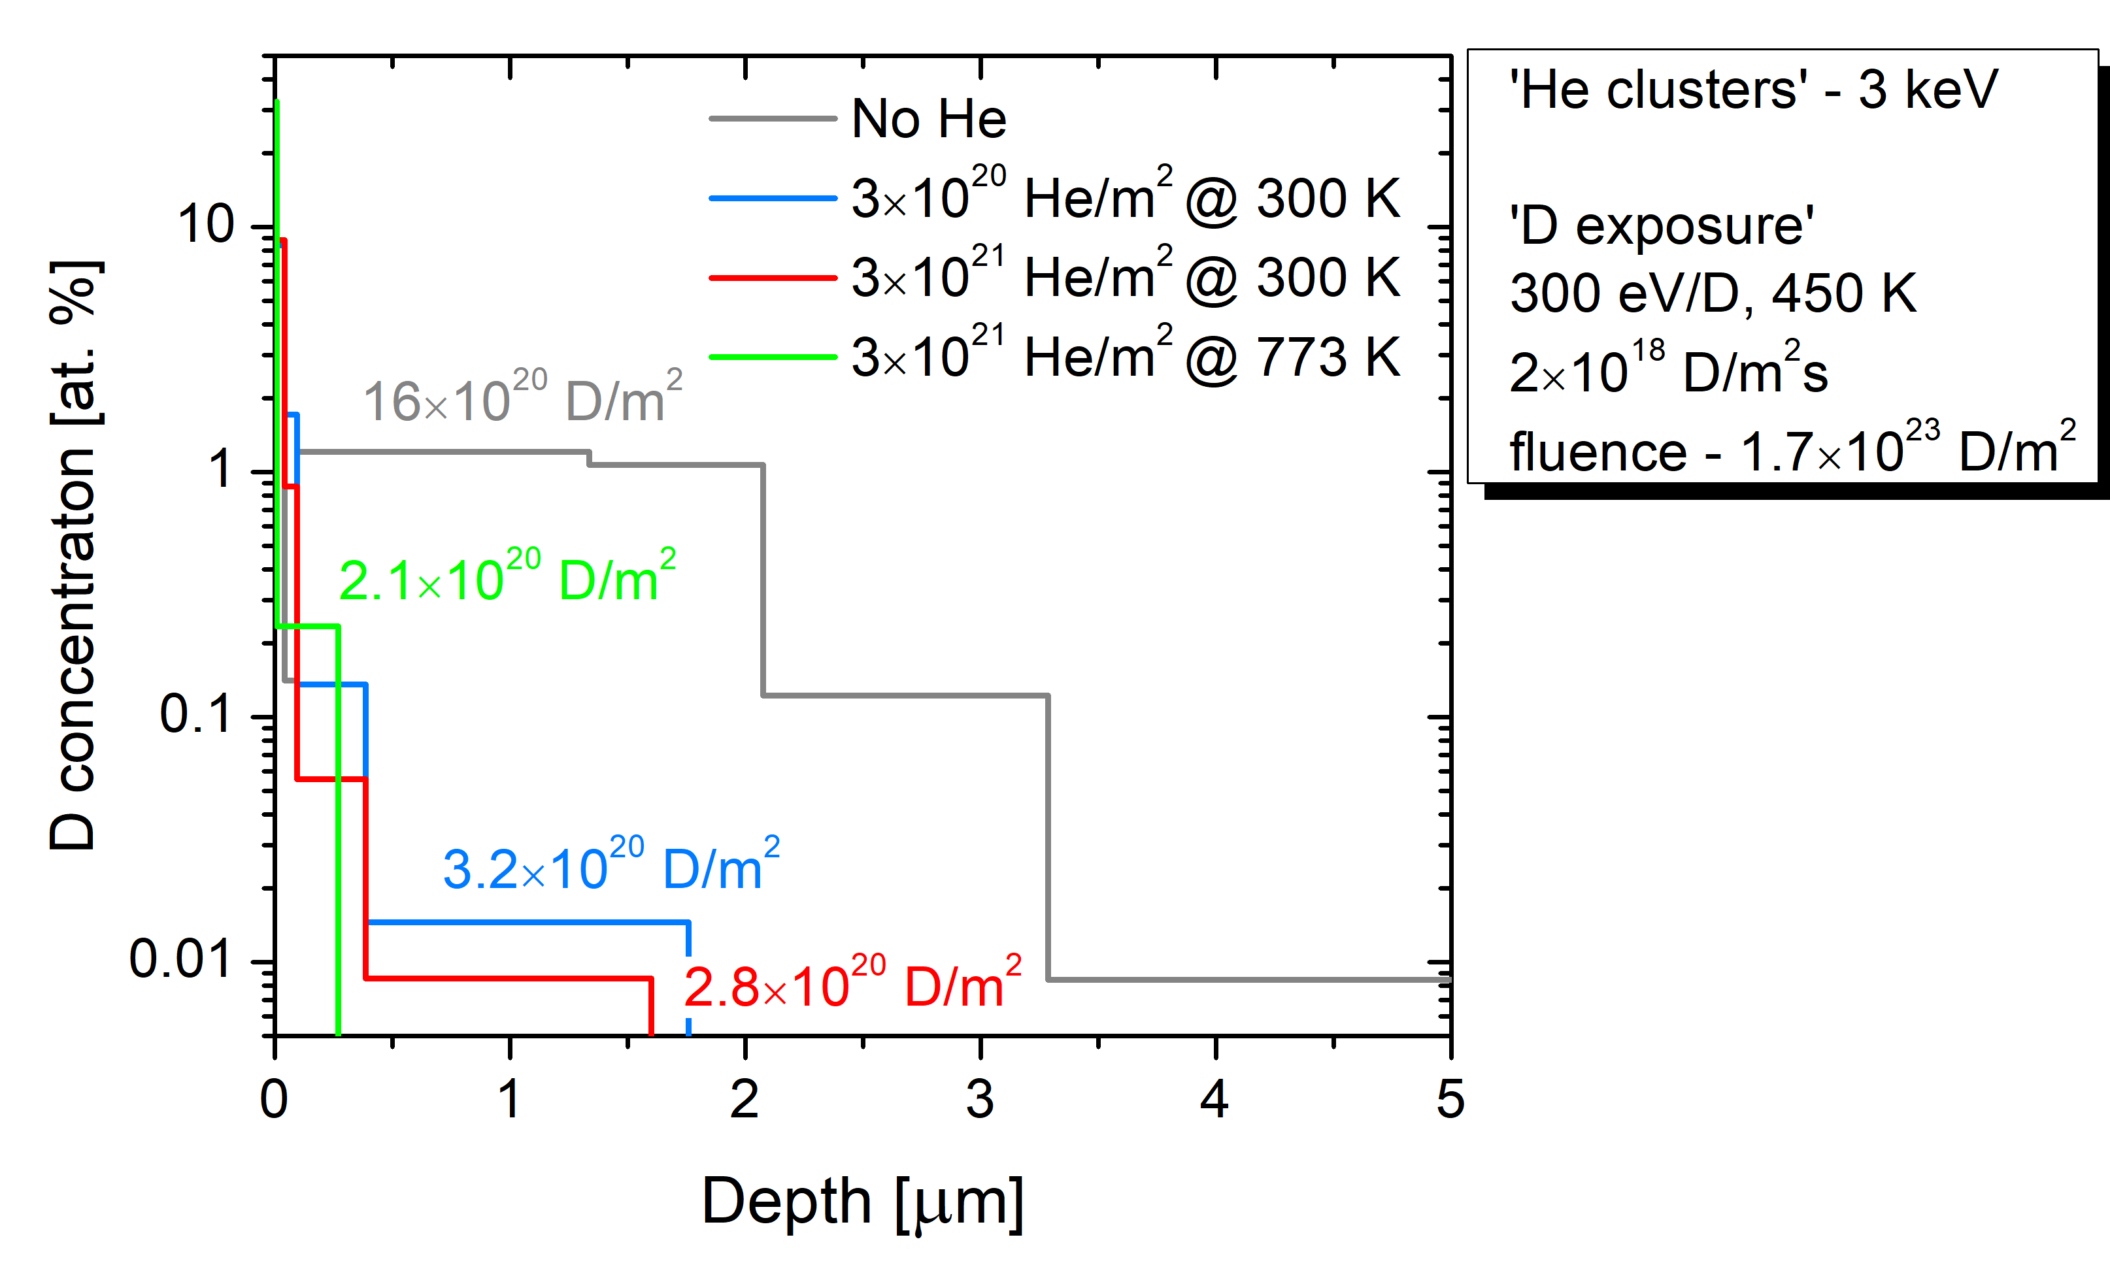


SP C.3 Influence of He, high-flux D and impurities on Hydrogen retention and transport: JSI
Influence of surface He pre-implantation on D retention in W
Sabina Markelj / Thomas Schwarz-Selinger
→ He implanted surface features increased recycling

Slide 24
SP C.3 Influence of He, high-flux D and impurities on Hydrogen retention and transport: JSI
Influence of surface He pre-implantation on D retention in EUROFER
D uptake and retention in EUROFER as a function of He fluence
KOM Feb-2024

Slide 25
SP C.4 Influence of n-damage on Hydrogen retention and transport

Slide 26
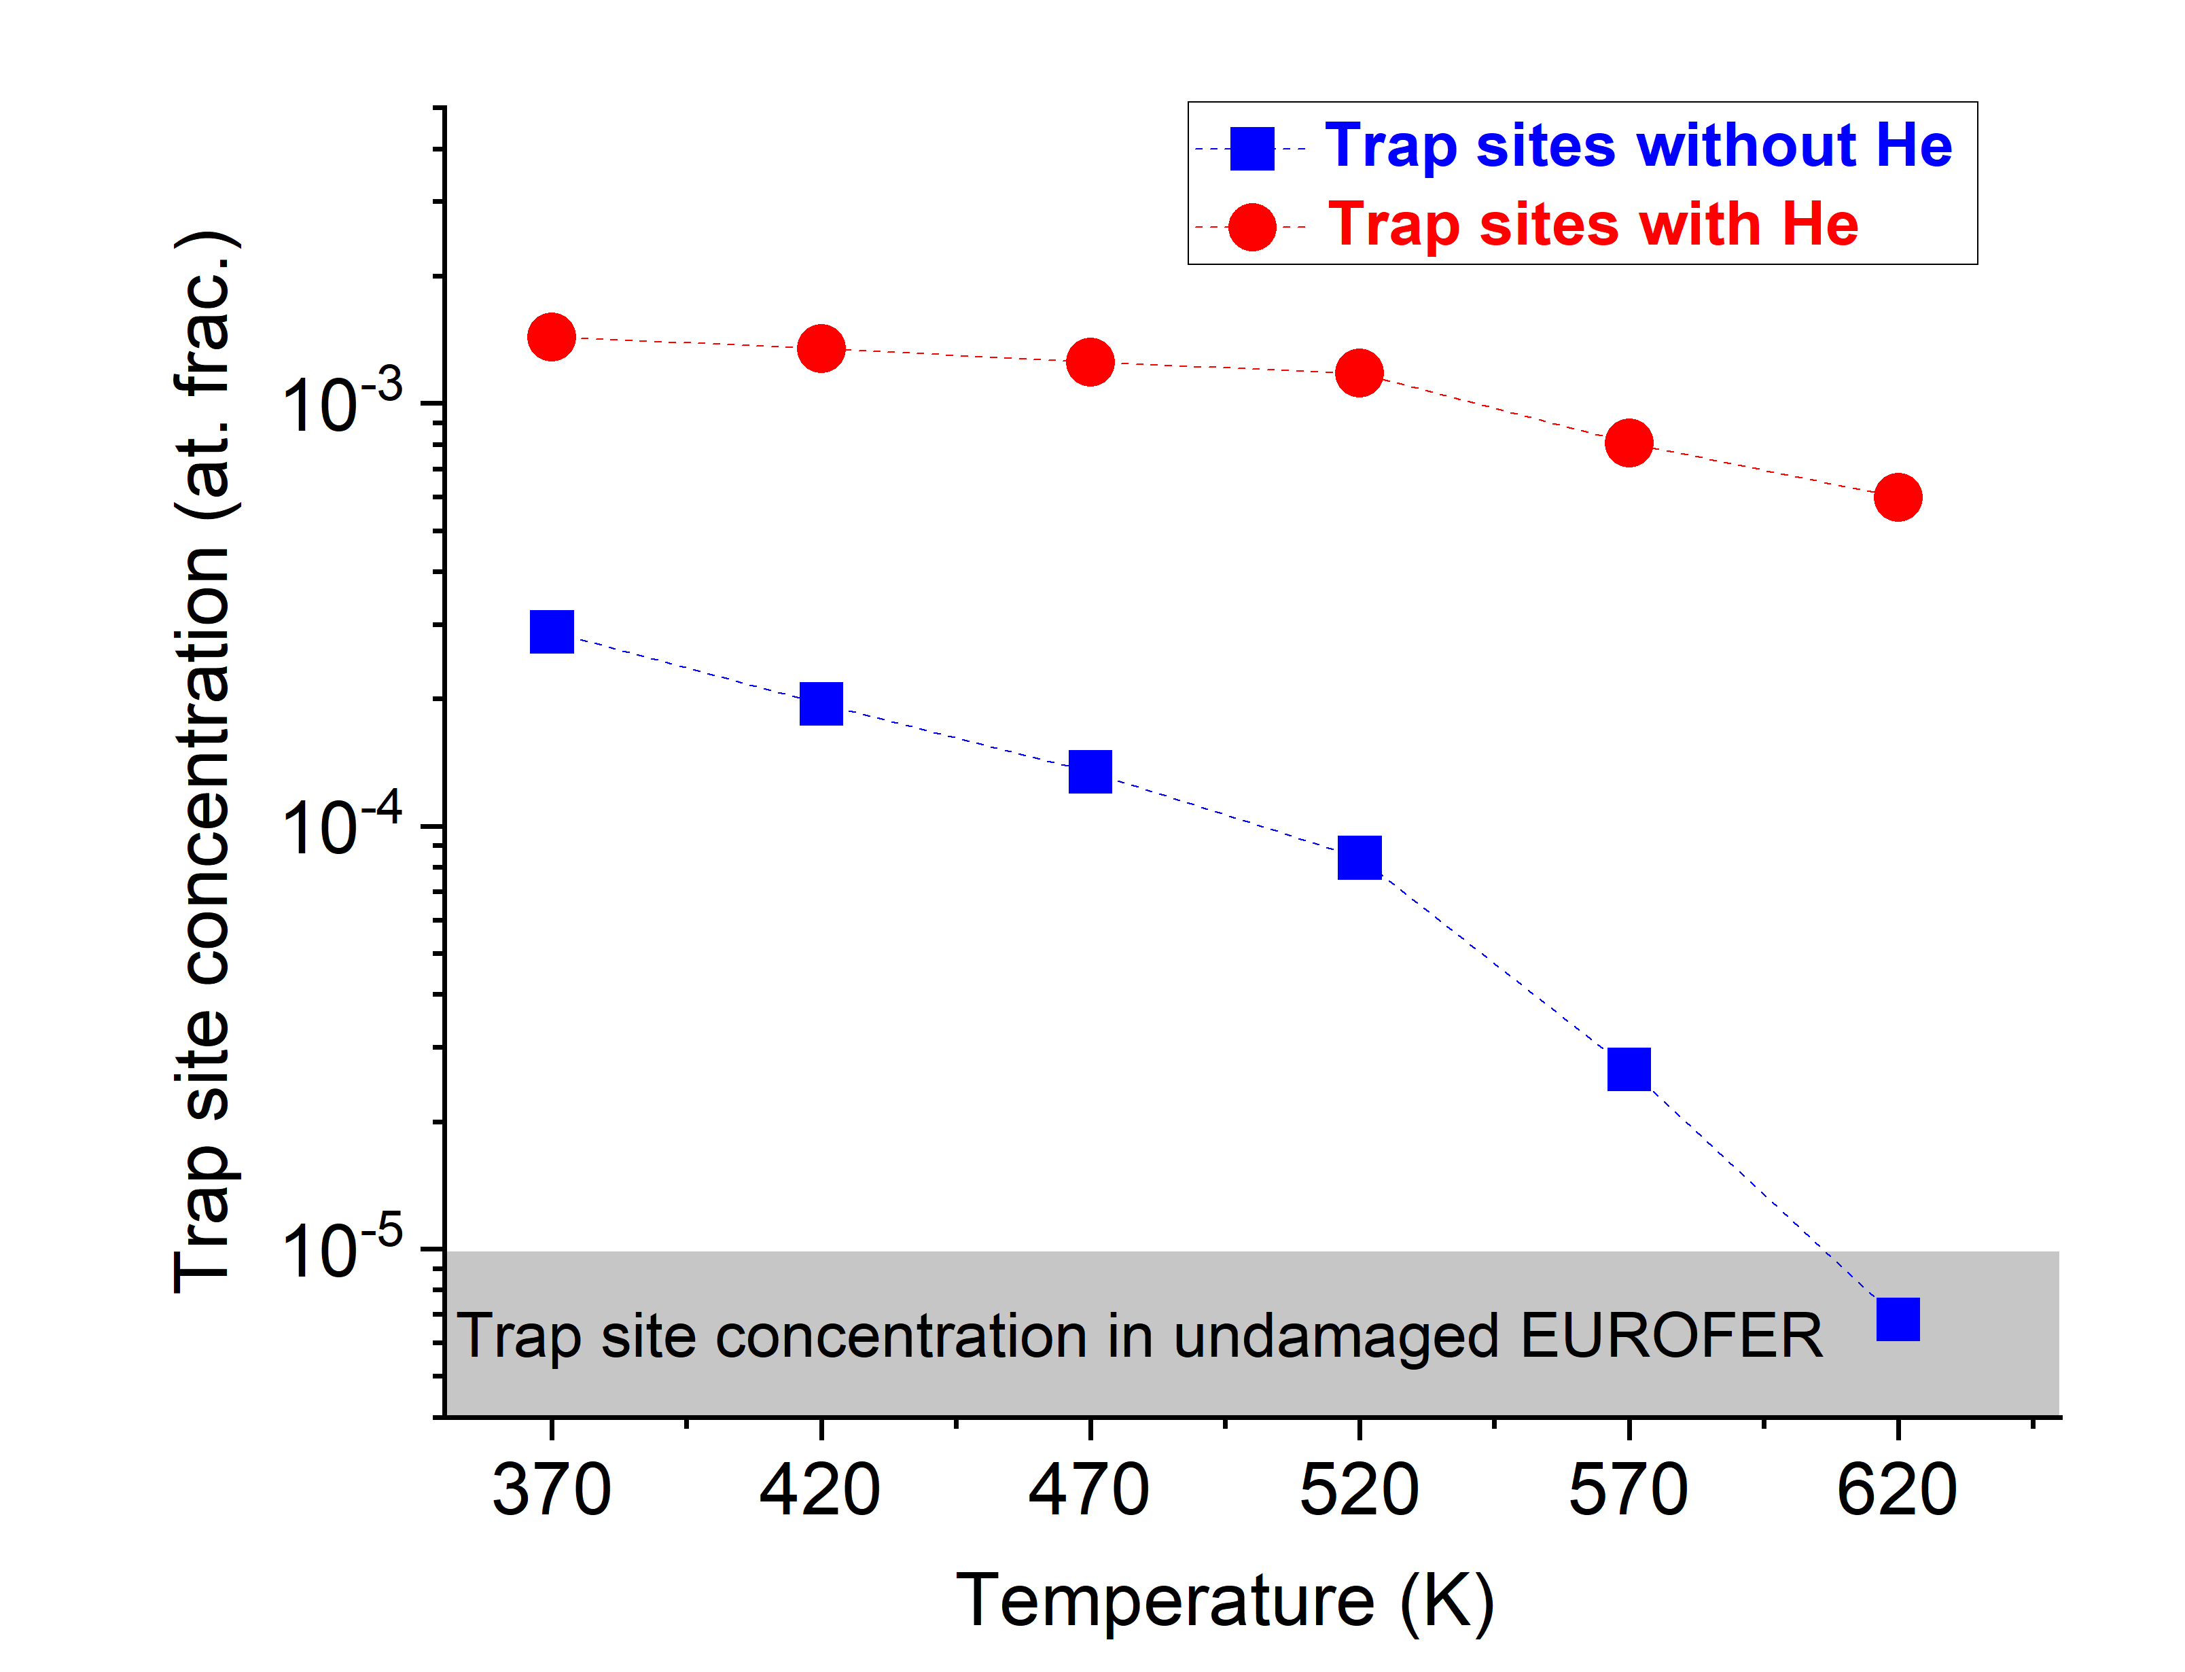
SP C.4 Influence of n-damage on Hydrogen retention and transport: MPG
Annealing of trap sites in He containing EUROFER
Task: Temperature needed to anneal trap sites in He containing displacement damaged EUROFER
Experiment:
20 MeV W ion irradiation at 290 K – 0.6 dpa
0.5 MeV He implantation at 290 K – 0.6 at. %
D plasma exposure (1e25 D/m²) at 370 K
Post-irradiation annealing followed by D loading and NRA
Results:
The presence of He atoms increases D retention by about 5 times compared with to the displacement damage case
D is released from He-containing displacement-damaged EUROFER at 520 K
He-related trap sites can survive up to 620 K

Slide 27
SP C.4 Influence of n-damage on Hydrogen retention and transport: MPG
Trap site generation by displacement damage in EUROFER at high T
Compare trap concentration for annealed EUROFER and EUROFER damaged at same high-T.
Annealing of traps sites generated in EUROFER at high-T.
KOM Feb-2024
Repeat with samples damaged at high temperature
Irradiation starts in March

Slide 28
SP C.4 Influence of n-damage on Hydrogen retention and transport: MPG
D plasma exposure of high-temperature self-ion irradiated W to study the dynamics of D trapping and release from cavities in W
D concentration profiles and TDS spectra from W samples damaged at high-T as a function of D fluence.
KOM Feb-2024
Experiments under way
Four samples ready

Slide 29
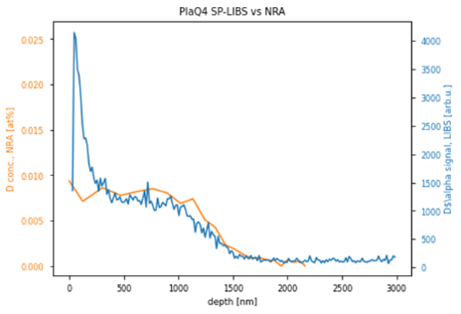
SP C.4 Influence of n-damage on Hydrogen retention and transport: MPG/FZJ
What we did and why:
LIBS exhibit great potential in online determination of fuel retention after proper signal calibration.
Reference D-containing W samples are required to further explore the LIBS technique.
Which experiments/calculations were performed
1. Recrystallization of 4x double-forged W samples
2. Self-damage (10.8 MeV W, 0.23 dpa) for 3x samples
3. D 1e25/m² loading at PlaQ (5eV/D, 370K, 4x): D decoration
4. Partial degassing of 2-PlaQ-loaded samples (450 & 600 K)
5. NRA D depth profiling of 4-PlaQ-loaded samples
6. Dual-pulse LIBS measurements of the 4 PlaQ-loaded samples
Brilliant Results: NRA and LIBS yields “identical” depth profile
Things will be done in 2023 and early 2024:
1. D/W and He/W co-deposited layers preparation
2. LIBS and ERDA measurements for He/W layer
3. Summary
Notes:
Task 1 hampered by T content in oxidised sample to be analyzed externally -> Try again
Task 2: Completed.
Most activity in Water
Activity in air is the same idependent on downstream interface
-> More permeation in presenc of water

Slide 30
SP C.4 Influence of n-damage on Hydrogen retention and transport: MPG/FZJ
Quantification of LIBS
Sensitivity study to determine the detection limit (LIBS vs LIA-QMS).
KOM Feb-2024
Samples underway
Experiments in March and April

