Slide 1
Boronization in ITER: ITER requests and PWIE activities
K. Schmid

Slide 2
Content
ITER’s open questions w.r.t boron
Hydrogen retention in boron co-deposits
Boronization layer lifetime
Summary

Slide 3
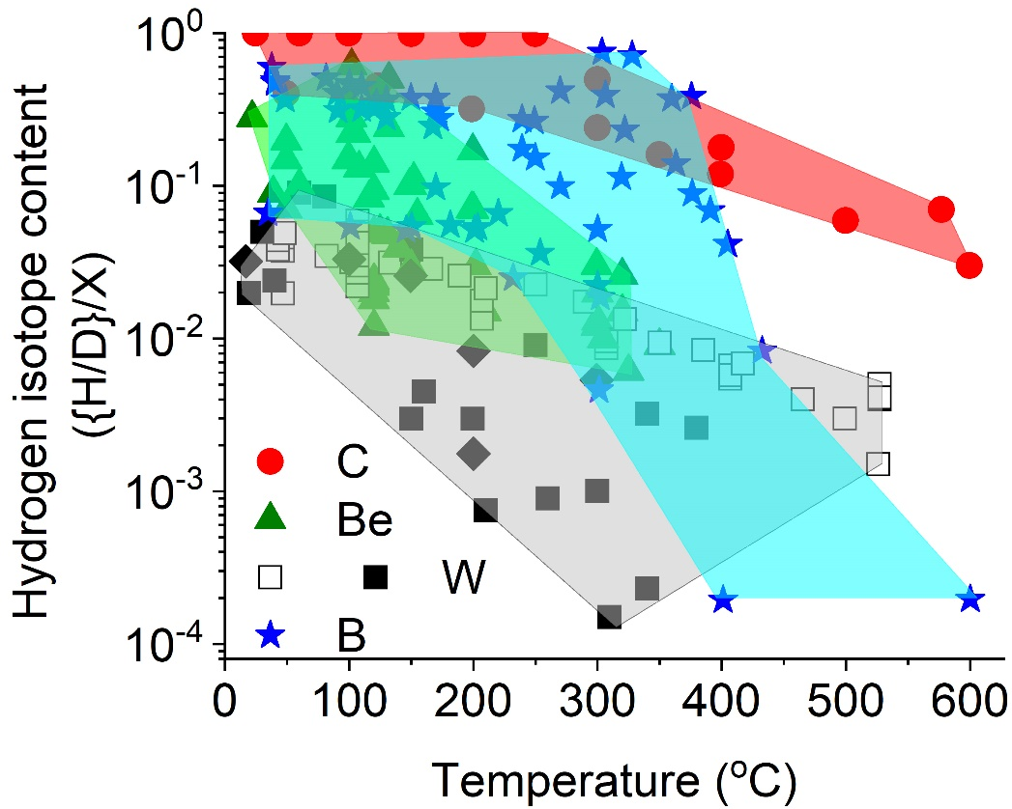
Literature review of hydrogen retention in boron [S. Krat ISFN]
Reduce retention in W by 50%
by thermal desorption and isotopic exchange

Slide 4
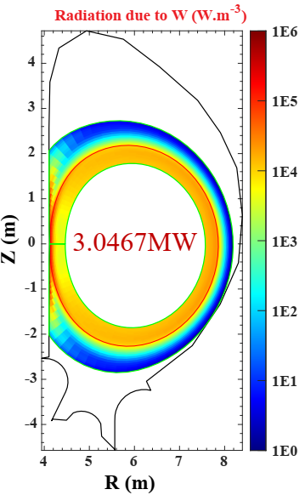
ITER’s open questions w.r.t boron taken from 34th ITPA DivSOL Uji Kyoto – T. Wauters
Need for boronization with high Z plasma facing components (PFCs)
Drawback of starting operation with W PFCs and no-boronization (e.g. plasma start-up/ramp-up)
SolPS simulation of ramp on inner heat shield
Hampered by excessive W self-sputtering and resulting radiation (75% of P_{SOL})
Simulations rather preliminary, e.g. lacks prompt re-deposition
Boronization could reduce W erosion :
Reduce low-Z impurity concentration (likely)
Cover W areas from erosion (unlikely/difficult)
Taken from ITPA DivSOL Kyoto by Andrei Pshenov

Slide 5
ITER’s open questions w.r.t boron taken from 34th ITPA DivSOL Uji Kyoto – T. Wauters
Need for boronization with high Z plasma facing components (PFCs)
Drawback of starting operation with W PFCs and no-boronization (e.g. plasma start-up/ramp-up)
Duration of boronization effects for:
W PFC coverage
Impurity gettering for good vacuum conditions
Reason for deterioration of vacuum conditions between boronization
Boron migration/layer lifetime
Optimum application of boronization
Required thickness
Frequency of boronization:
Only once for start up vs. repeatedly during campaign
Boronization scheme:
Glow discharge (requires field ramp down, but coats remote areas)
ICWD (works with field but only locally)
Dropper (works during diverted phase, deposition location?)
Boron migration/layer lifetime

Slide 6
ITER’s open questions w.r.t boron taken from 34th ITPA DivSOL Uji Kyoto – T. Wauters
Formation of boron deposits and fuel retention
← Most input from PWI
Location of boron deposits following plasma operation
Boron migration/layer lifetime
Boron layer in-situ reactivation (oxygen removed from layers in-situ leaving boron) by GDC/ ICWC
Layers may survive for a long time in remote ares
→ reactiveate their impurity gettering properties
→ Reduce number of required boronizations
Content of hydrogen, oxygen, etc., in boronized layers
Depends on layer structure
→ Layer growth rate dx/dt
→ Temperature T
→ Particle energy E
...
D/B (E,T, dx/dt,..)
Problem is similar to C or B: what is the D/B ratio

Slide 7
Hydrogen retention in boron co-deposits
D/B (E,T, dx/dt,..)
Mainly based on the work by A. Annen

Slide 8
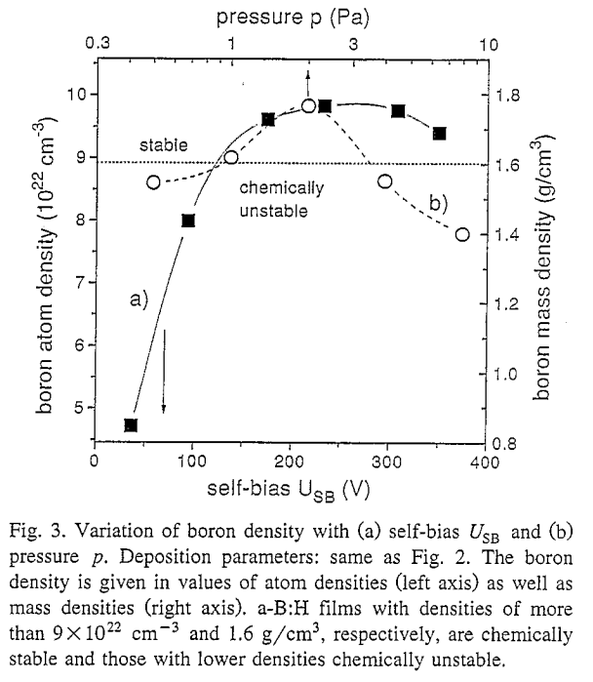
Hydrogen retention in boron co-deposits
Layer stability
Only films grown at high bias are chemically stable under ambient atmosphere
Impurity getter layers should NOT be stable under ambient atmosphere
→ ITER „relevant“ layers will be hard to analyse
Can‘t just carry them round exposed to ambient atmosphere
A. Annen et Al, J. non cryst. Solids 209 (1997) p. 240

Slide 9
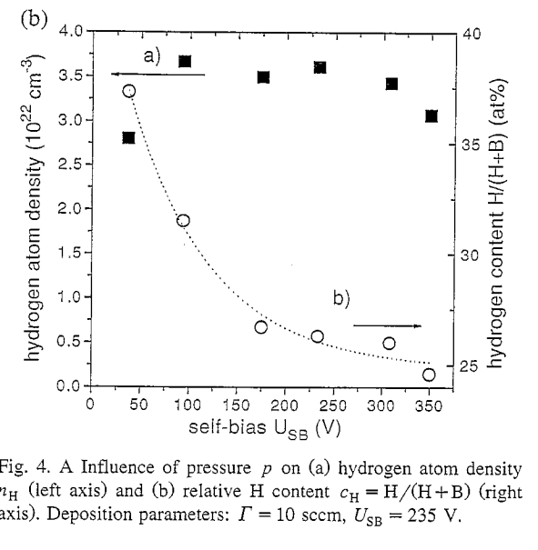
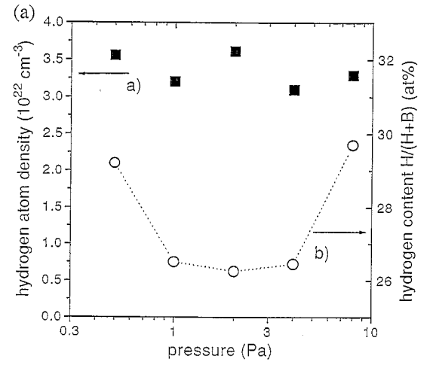
Hydrogen retention in boron co-deposits
H-content
At T < 375K $\frac{H}{B}=\frac{C_{H}}{{1−C}_{H}}≈0.3 to 0.6$
Depending on energy (bias) and pressure
A. Annen et Al, J. non cryst. Solids 209 (1997) p. 240

Slide 10
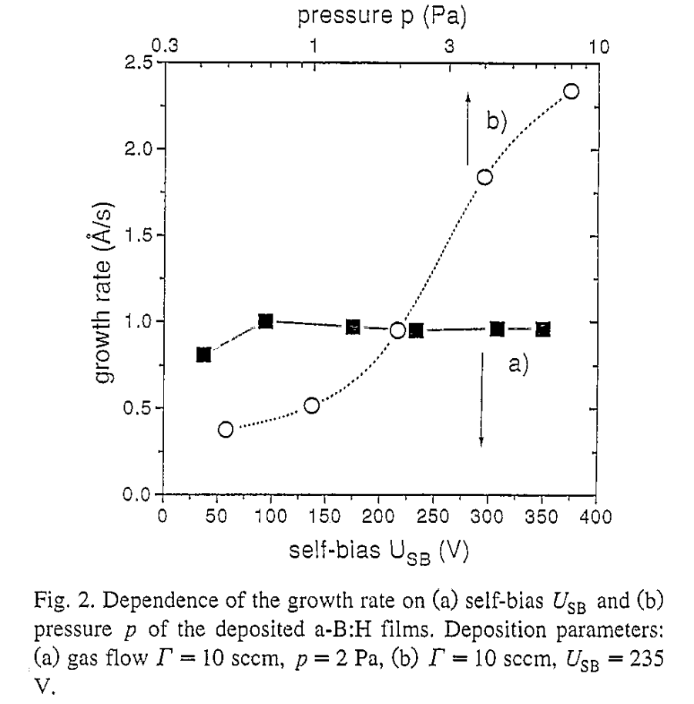
Hydrogen retention in boron co-deposits
H-content
Growth rate depends mainly on pressure
$\frac{H}{B}$ pressure dependence may actually be a growth rate depenence?
At T < 375K $\frac{H}{B}=\frac{C_{H}}{{1−C}_{H}}≈0.3 to 0.6$
Depending on energy (bias) and growth rate
A. Annen et Al, J. non cryst. Solids 209 (1997) p. 240

Slide 11
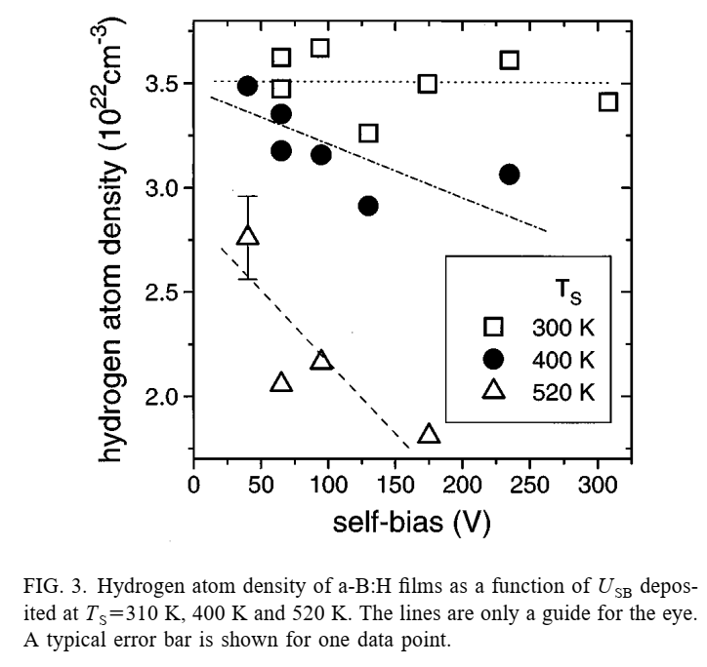
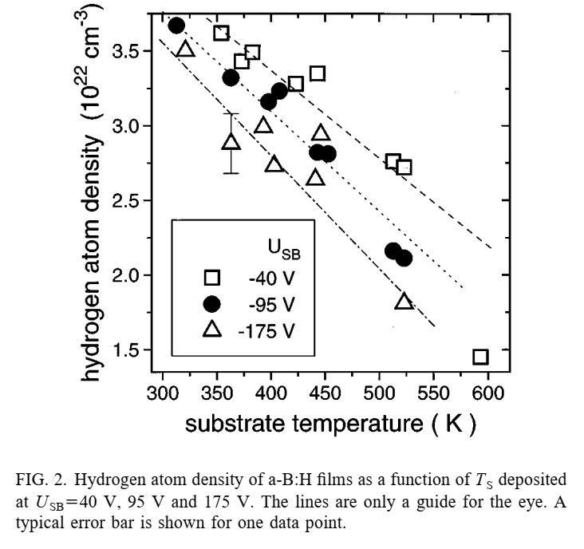
Hydrogen retention in boron co-deposits
H-content
H density drops from 3.5 at 300K to 1.5 at 600K → Factor 2.3
At T < 375K $\frac{H}{B}=\frac{C_{H}}{{1−C}_{H}}≈0.3 to 0.6$
At 600K $\frac{H}{B}$ drops by factor 2.3
→ Depending on energy (bias), growth rate and temperature
M. Saß et al, J. Appl. Phys. 82 (4) 1997 p. 1095

Slide 12
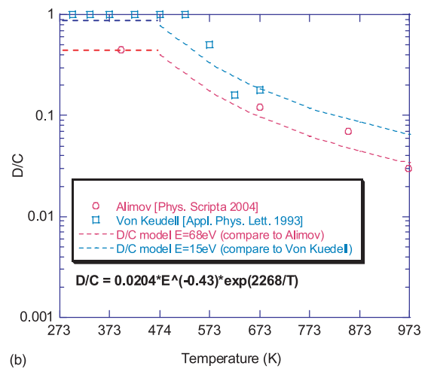
Hydrogen retention in boron co-deposits
H-content
At T < 375K $\frac{H}{B}=\frac{C_{H}}{{1−C}_{H}}≈0.3 to 0.6$
At 600K $\frac{H}{B}$ drops by factor 2.3
→ Depending on energy (bias), growth rate and temperature
Compare to C:
R.P. Doerner at Al Nucl. Fusion 49 (2009) 035002
a-BH layers retains H similar or slightly lower than a-CH layers
$\frac{H}{B}$

Slide 13
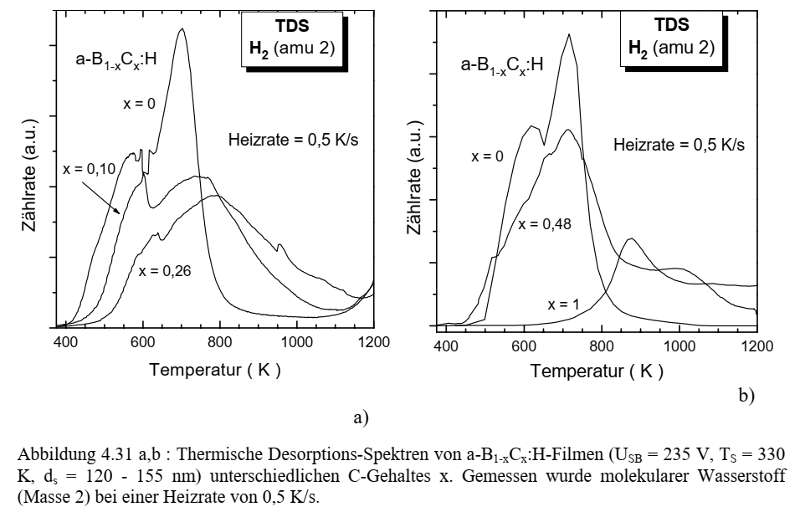
Hydrogen retention in boron co-deposits
H-release
Release starts at ~500K
Relase temperature increases with C content
These were „stable“ layers!
→ May be different for „relevant layers“
A.Annen PhD Thesis, IPP-Report: IPP 9/114 April 1997

Slide 14
Boronization layer lifetime
Boron migration/layer lifetime

Slide 15
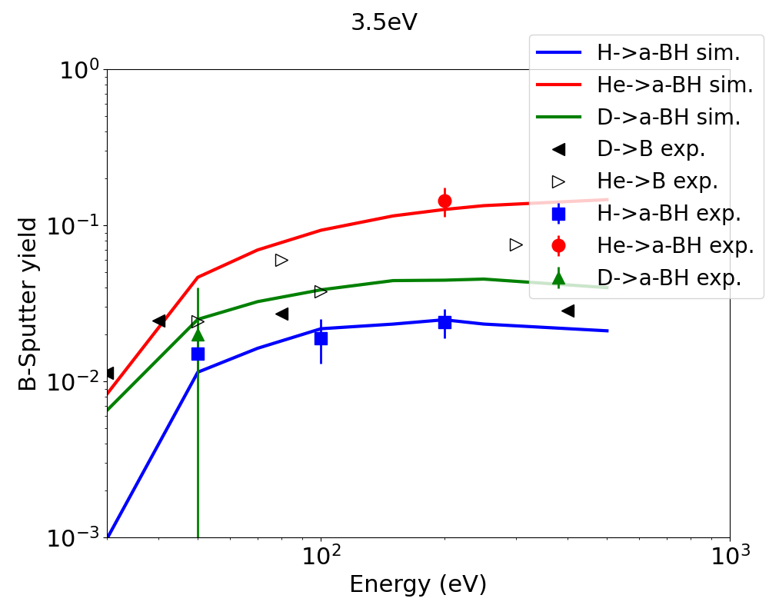
Boronization layer lifetime
Sputter yield of boronization layers is not well known:
Comparison of sputter yields of amorphous (a-BH) B/H layers [1] with pure B [2] and SDTrimSP simulations of a-BH.
a-BH layers sputter ~1.5 x more than pure B
„Best“ match to experimental data using a surface binding energy fo 3.5 eV in SDTrumSP
Build a yield data base: D, Ne, B, W → B/W mixtures
Y(E, $α$, C_{W}, C_{B})
R(E, $α$, C_{W}, C_{B})
[1] PhD A. Annend unpublishd
[2] „Sputtering data“ IPP report 9/82 Feb. 1993

Slide 16
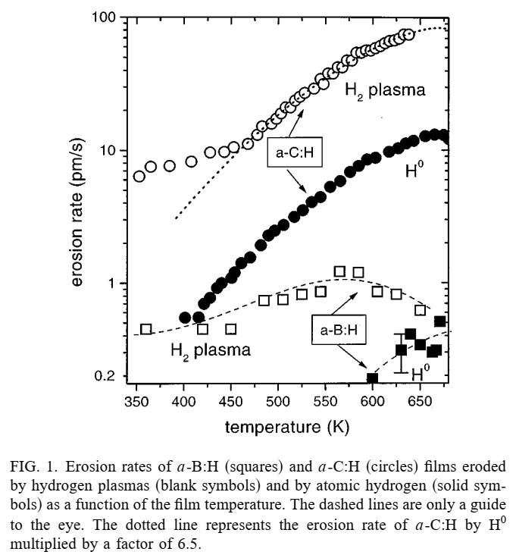
Boronization layer lifetime
Sputter yield of boronization layers is not well known:
Chemical erosion is much lower than for a-CH layer
Neglect for now in WallDYN3D calculations
A. Annen and W. Jacob Appl. Phys. Lett. 71 (10), 8 September 1997

Slide 17
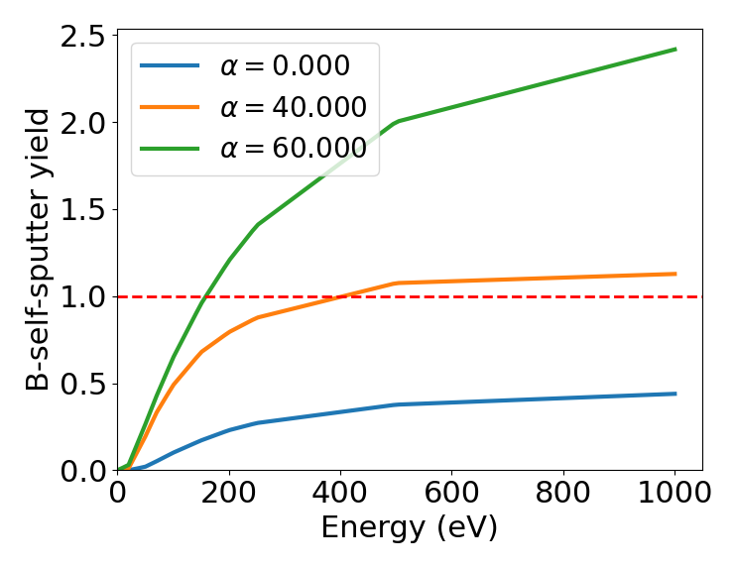
Boronization layer lifetime
Sputter yield of boronization layers is not well known:
Computed B self sputtering using „validated“ SDTrim.SP settings
For expected oblique angles B yields exceed 1
WallDYN has „difficulties“ with run-away self-sputtering
→ Limit impact angles to 40° for now

Slide 18
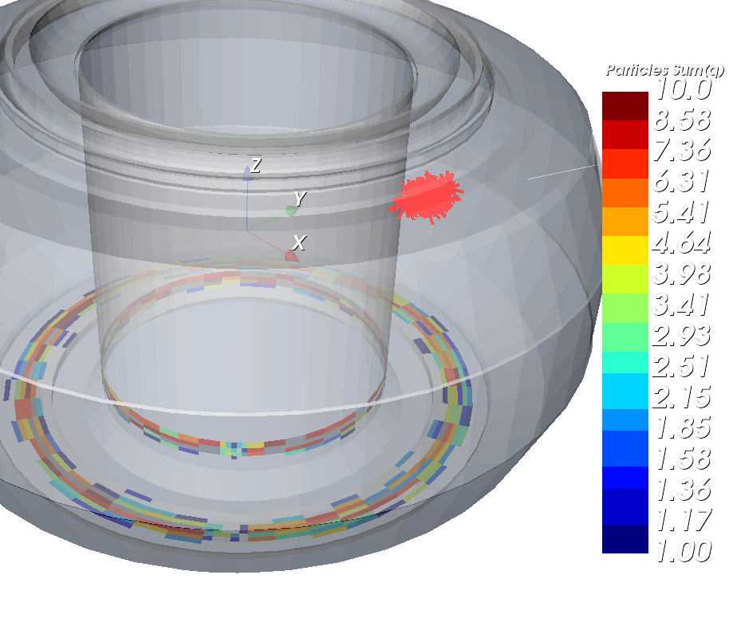
Boronization layer lifetime
Neutral B source from “Dust Injection Simulator (DIS)”
DIII-B benchmark experiment
(PPPL colaboration F. Effenberg)
EMC3-Eirene plasma case with grid only touching divertor targets
Quite high Te at targets ~30eV
Dominant charge states C⁺⁴, B³⁺
High impact energies:
3 q Te + 2 Ti
$$3∗4∗30+2∗30=420eV$$
Deposition of B/C on dimes head?
Impact angle given sheath ExB and oblique B-field angle
→ ~65° minus average surface angle ~20° = 45°
Self sputtering yield of C at 45° with 420eV ~0.8
→ Very high!
Assume 1% C-chemical erosion for D, D-CX

Slide 19
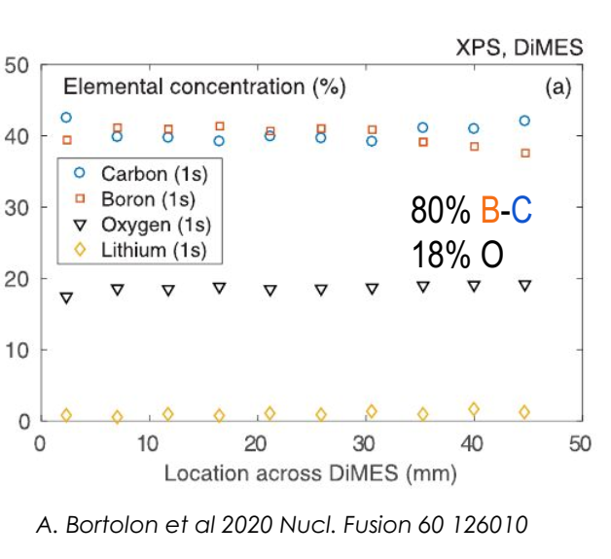
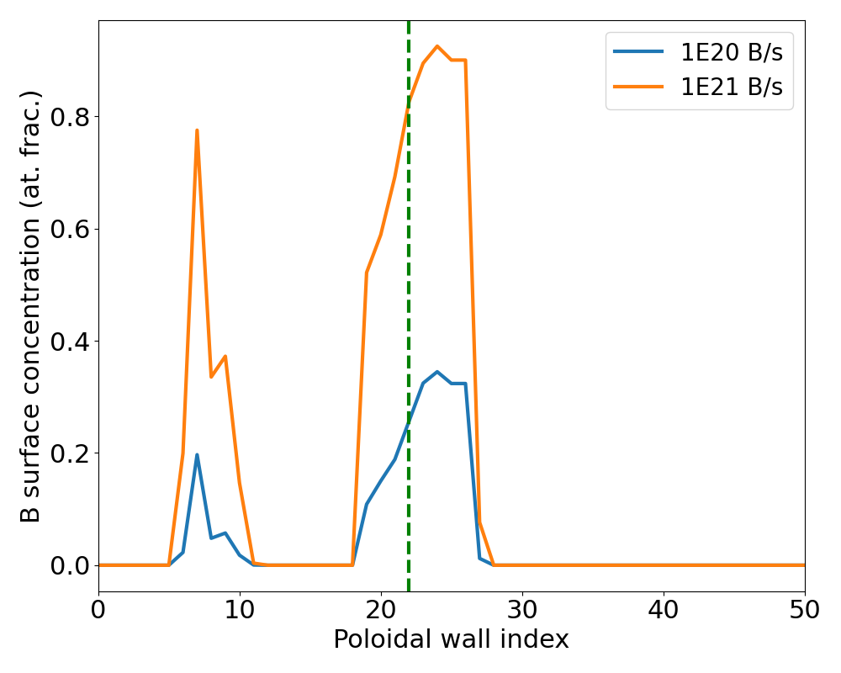
Boronization layer lifetime
DIII-B benchmark experiment
WallDYN3D matches surface analysis (...by chance)
(Experimental seeding strength = 2.8E20 B/s)

Slide 20
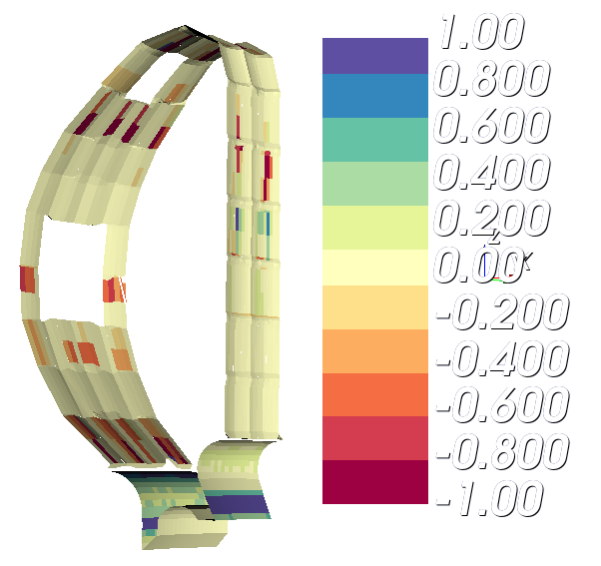
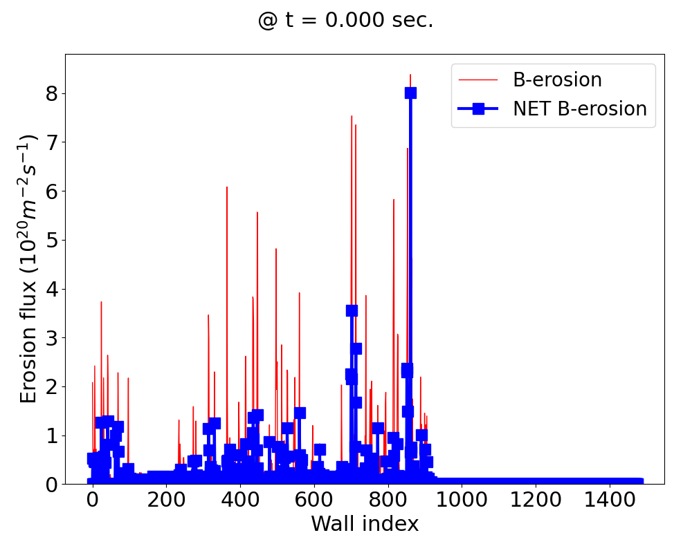
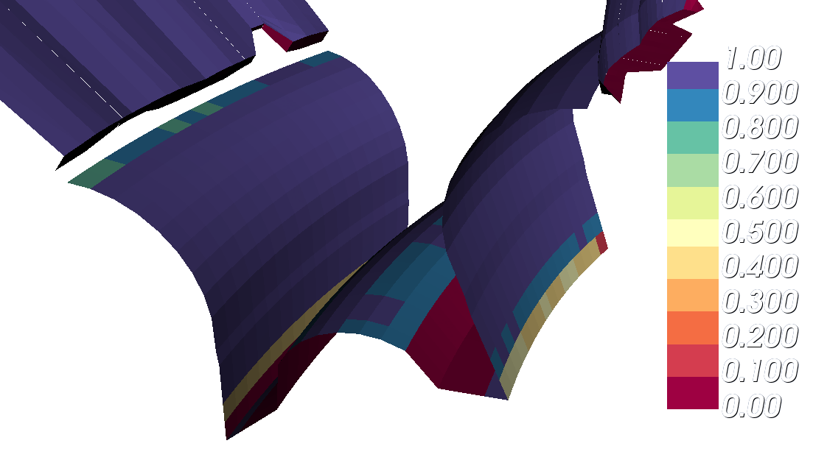
Boronization layer lifetime
Use ITER plasma background with Ne impurities a hot, stagnant ($M_{∥}=0$) far SOL
Put a thin B layer on top of W in main chamber and „measure“ the erosion rate
[10²⁰ B/(m² s)]
Migration matrix not perfectly normalized
B is lost at edge of calculation grid: PFR
In reality B probably ends up as dust down there
At t=0
B eroded from main chamber
and
deposits in divertor
B re-deposition slows down B erosion
B is eventually lost from „Plasma“

Slide 21
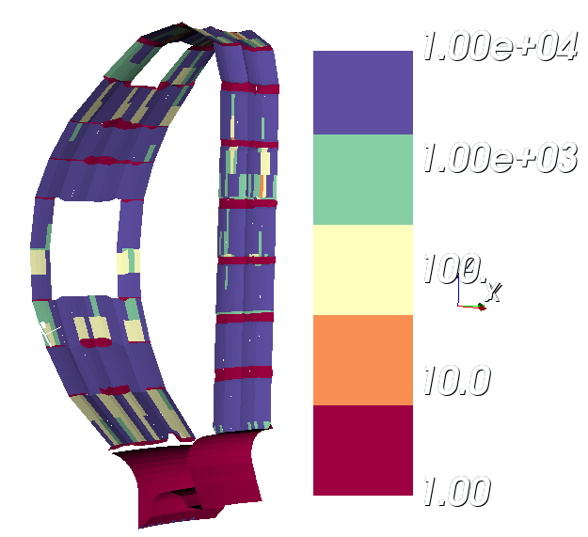
Boronization layer lifetime
Use plasma background 2481-00g with Ne impurities a hot, stagnant ($M_{∥}=0$) far SOL
Put a thin B layer on top of W in main chamber and „measure“ the erosion rate
Use „measured“ erosion rate to estimate life time of a 100 nm layer
Lifetime of 100 nm B
(erosion only)
Lifetime of 100 nm B
(NET-erosion only)
B remains in plasma shadowed regions, only eroded by CX
Significant fractions of the first wall have lifetime > 1000 s.
[s]
Lower limit
Upper limit

Slide 22
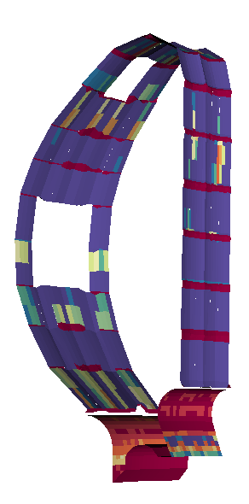
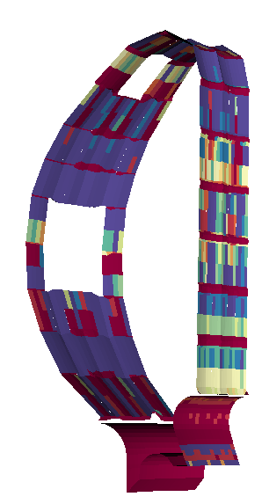
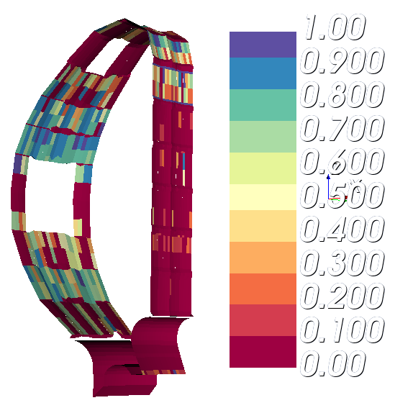
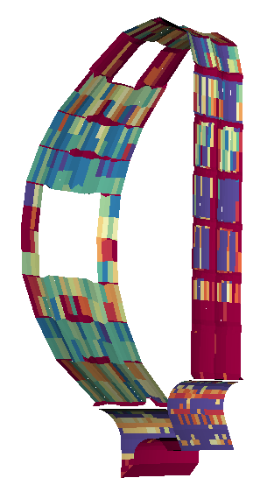
Boronization layer lifetime
Use plasma background 2481-00g with Ne impurities a hot, stagnant ($M_{∥}=0$) far SOL
Put a thin 1nm B layer on top of W in main chamber and „measure“ the erosion rate
Re-plenish B layer with a B dropper during diverted discharge?
t=1 s
t=10 s
t=100 s
B-conc.
t=100 s
B dropper re-plenishes B at heavily loaded areas
Not very efficient at coating weakly loaded areas
Depends on local erosion vs. dropper rate
10²¹ B/s dropped in each 20° sector
B quickly erodes
B deposits on inner target and baffles...
...as long as source lasts
Very pre-liminary!
B dropper modelled as B atom point source in SOL
Collaboration with PPPL for more realistic dust modelling

Slide 23
Summary
ITER wants/needs boronization to getter impurities and hopes B to maybe even cover W to reduce W ingress
From a lab/PWI perspective this requires:
a-BH erosion yields (chemical erosion?)
H/B ratios as function of deposition rate, particle energy and temperature
Look for weakly sticking BxHy species that might migrate to remote areas in ITER
Lab experiments will be hampered by the fact that relevant layers are unstable under ambient atmosphere
Deposit a-BH layer in e.g. a magnetron (varying dx/dt, E and T)
Cover them by e.g. Cu
Analyse H/B ration in accelerator
Once H/B(dx/dt, E, T) is known: WallDYN3D needed to predict B migration, layer formation and H-retention
Depending on „boronization scheme“ coupling to dust transport code needed

