Slide 1
Modelling of Ni and W erosion from main wall in JET and comparison of resulting redeposition
WP PWIE meeting Apr 9-11, 2024
Espoo, Finland
Pyry Virtanen, Henri Kumpulainen, Roni Mäenpää, Mathias Groth
Notes:
1

Slide 2
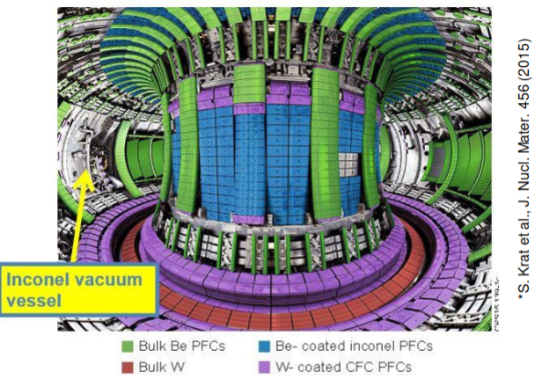
ERO2.0 is used to predict the erosion and deposition of nickel and tungsten in JET-ILW through years 2011-2016
Inconel vacuum vessel wall is the largest nickel source, divertor is the primary source of tungsten
Predict the deposition layer on the divertor tiles and limiters
Compare the predicted deposition layer to post-mortem tile analysis

Slide 3
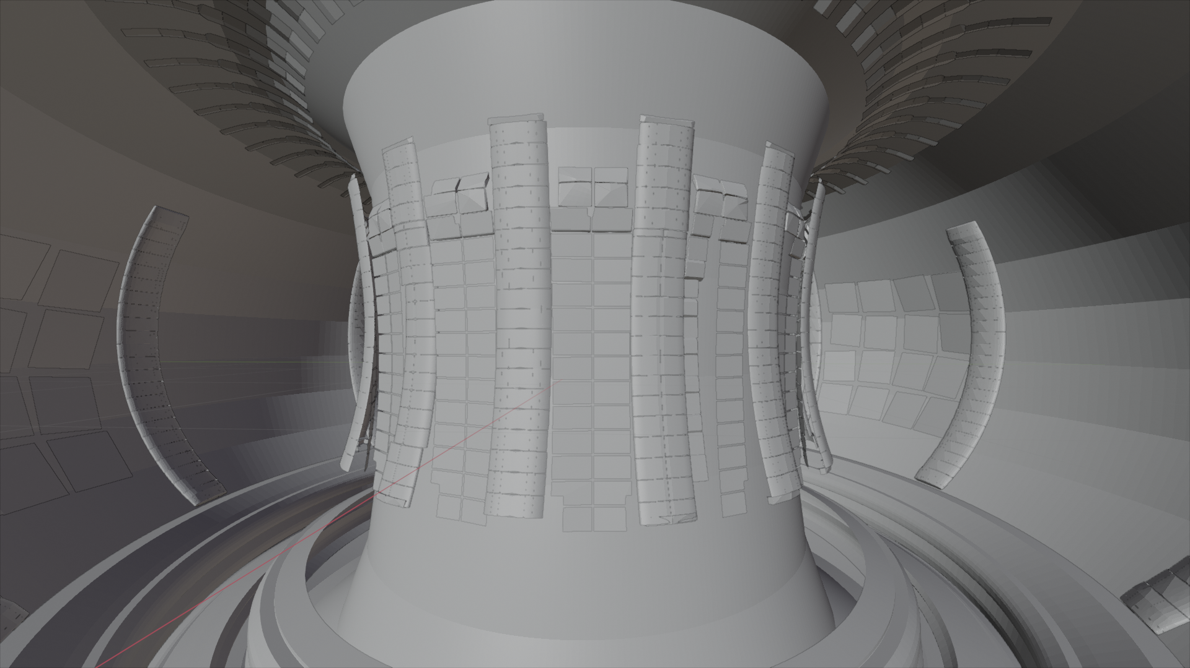
Atomic fluxes to Inconel vessel wall, used in ERO2.0, is estimated by projecting EIRENE fluxes onto vessel wall
Antennas
(Be)
Vessel wall (Inconel)
Limiters (Be)
ERO2.0 3D wall approximation includes Inconel vacuum vessel wall ⇒ EIRENE neutral fluxes teleported to vacuum vessel wall given limiter/antenna obstruction fraction
Divertor (W)

Slide 4
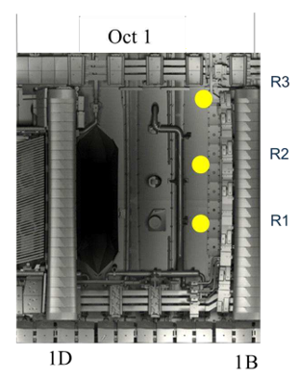
Main regions of interest are nickel erosion from vacuum vessel wall and deposition onto HFS divertor entrance
Anticipated Ni deposition on HFS divertor tiles 0 and 1
For W, focus on tiles 8 and 9 (LFS divertor entrance) ⇒ predicted dominant source for core W content
Laser Induced Breakdown Spectroscopy (LIBS) to measure net erosion/deposition on the vacuum vessel wall and the divertor tiles
At LFS main chamber wall, total of six LIBS spots
Locations of three of the six LIBS spots in the vacuum vessel wall (J. Likonen, SP E kick-off meeting, Jan 23, 2024)

Slide 5
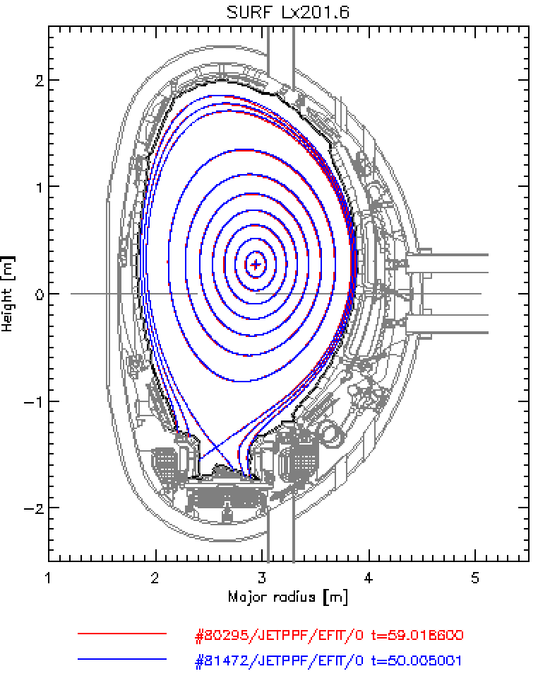
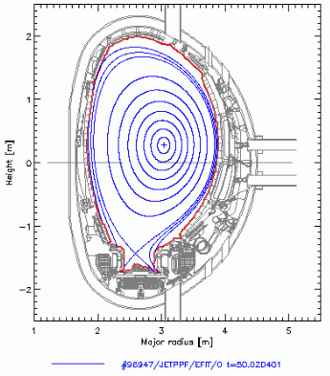
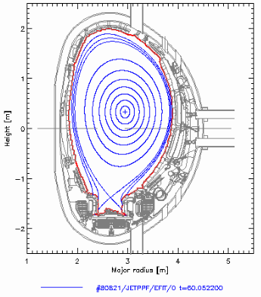
Ni and W erosion and deposition were predicted for representative plasma configs. and scenarios in JET-ILW campaigns 2011-2015
vert/horz
low-δ
cor/cor
low-δ
vert/vert
low-δ
Deuterium plasmas, EDGE2D-EIRENE density scan at low (2 MW) and moderate (up to 15 MW) heating power
Deuterium plasmas, JINTRAC (including EIRENE) density scan at low (2 MW) and high (up to 25 MW) heating power
Inter and intra-ELM time slices for subset of density/power scans
Deuterium plasmas, EDGE2D-EIRENE density scan at low (2 MW) and moderate (up to 10 MW) heating power

Slide 6
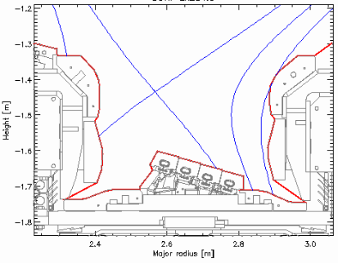
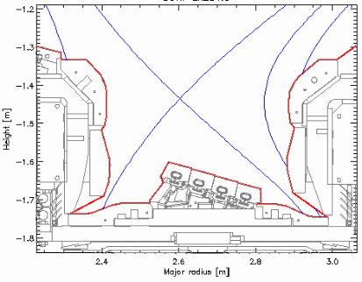
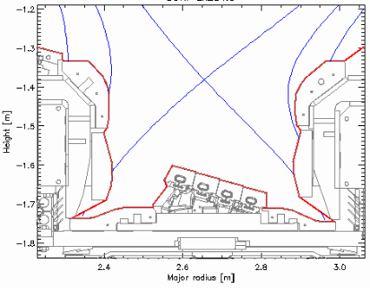
Ni and W erosion and deposition were predicted for representative plasma configs. and scenarios in JET-ILW campaigns 2011-2015
vert/horz
low-δ
cor/cor
low-δ
vert/vert
low-δ
Deuterium plasmas, EDGE2D-EIRENE density scan at low (2 MW) and moderate (up to 15 MW) heating power
Deuterium plasmas, JINTRAC (including EIRENE) density scan at low (2 MW) and high (up to 25 MW) heating power
Inter and intra-ELM time slices for subset of density/power scans
Deuterium plasmas, EDGE2D-EIRENE density scan at low (2 MW) and moderate (up to 10 MW) heating power

Slide 7
Weighting according to the amount of plasma-operational time: V5, 51% versus VV, 9% versus CC/VC, 40%
Density and heating power EDGE2D-EIRENE inputs
For each case ERO2.0 is used to obtain the erosion/dep. profiles
Each case weighted according to plasma operation time
Weighted sum of the profiles represent multiple campaigns
Plasma-ops time dominated by limiter phases ⇒ here, neglected due to modelling, not a source for Ni or W
V5 OMP​ (1e19/m³) | ​ P_IN (MW) | C-C​ OMP (1e19/m³) | ​ P_IN (MW) | V-C​ OMP (1e19/m³) | ​ P_IN (MW) | V-V​ OMP (1e19/m³) | ​ P_IN (MW)
0.85​ | 2.2​ | 0.85​ | 2.2​ | 0.85​ | 2.2​ | 0.85​ | 2.2​
1.8​ | 2.2​ | 1.5​ | 6​ | 1.8​ | 6​ | 4.0​ | 11.2​
2.0​ | 4.8​ | 2.5​ | 14​ | ​ | ​ | ​ | ​
4.0​ | 4.8​ | 1.6​ | 24​ | ​ | ​ | ​Limiter | ​
3.6​ | 6.6​ | ​ | ​ | ​ | ​ | ​ | ​
3.4​ | 10​ | ​ | ​ | ​ | ​ | ​ | ​
3.4​ | 15​ | ​ | ​ | ​ | ​ | ​ | ​
In V-C config the LFS strike point is in the radially outer corner of the divertor and the HFS strike point is on the HFS vertical
Due to issues in obtaining a VC grid, a CC grid is used instead

Slide 8
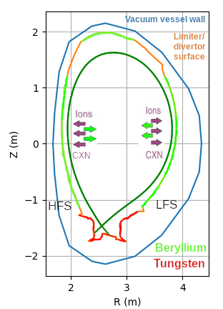
Source of Ni and W in the main chamber are assumed to be CX fluxes
Atomic fluxes and their energy spectra are obtained across diagnostic surfaces around the divertor/limiter wall
EDGE2D-EIRENE 2D wall approximation: atomic and molecular fluxes along Be (limiter) wall and W divertor surfaces
ERO.20 utilizes a 3D vacuum vessel wall
Set of designated EIRENE diagnostic surfaces to also tally energy spectra
Here, energy tallies over all main chamber “limiter” elements
Differential energy-angular resolved tallies under development

Slide 9
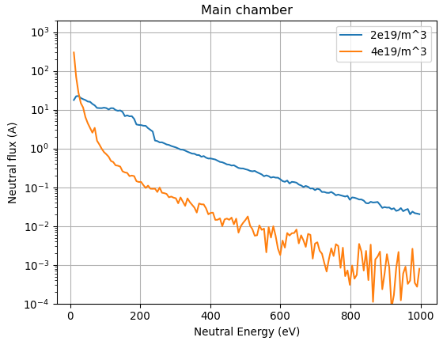
When raising the core plasma density by 2x, EIRENE predicts up to 50x lower high-energy CX atoms
Spatially averaged energy spectrum encompasses the entire (main chamber) limiter wall
In low density plasmas, atomic fluxes to main chamber limiters dominated by energies > 25 eV (80% of all CX atoms)
C.f., at high plasma density, 90% of the CX atoms are predicted to be below 25 eV
Limiter wall
P_{in} = 4.8 MW
Ni (threshold)
W (threshold)
Vertical/horizontal, P_{in} = 4.8 MW
hkumpul/80295/may0319/seq#1
hkumpul/80295/may1619/seq#4

Slide 10
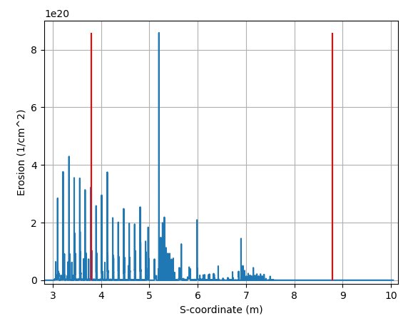
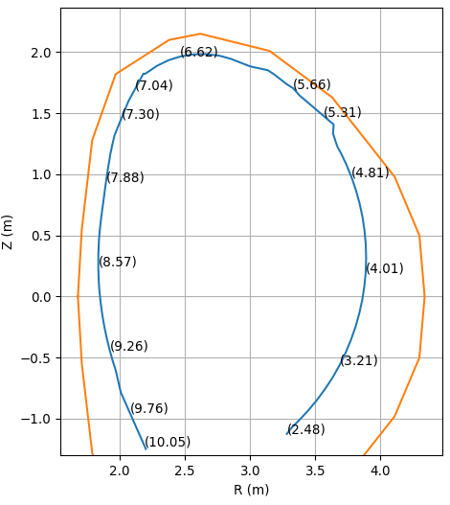
ERO2.0 predicts nickel to be eroded primarily for the LFS of the vacuum vessel wall
The erosion profile is the result weighted average of the cases. Poloidally erosion is averaged over a set distance (1 mm in the divertor, 1 cm in the main chamber)
Spikiness of the erosion profile is caused by the combination of poloidal averaging and back projection
Erosion is dominated at LFS: fewest obstructions of wall from CX neutrals
Negligible Ni source at HFS due to vacuum vessel wall being almost completely obstructed
Strong erosion zone on the LFS predicted at at upper edge of the LFS limiters (s = 5.2 m) ⇒ caused by?
Net deposition/bulk deposition is not shown due to current limitations in post processing
Top
HFS midplane
LFS midplane
Vacuum vessel wall
Limiter contour
Bulk erosion of nickel from the vacuum vessel wall in JET campaigns 2011-2016

Slide 11
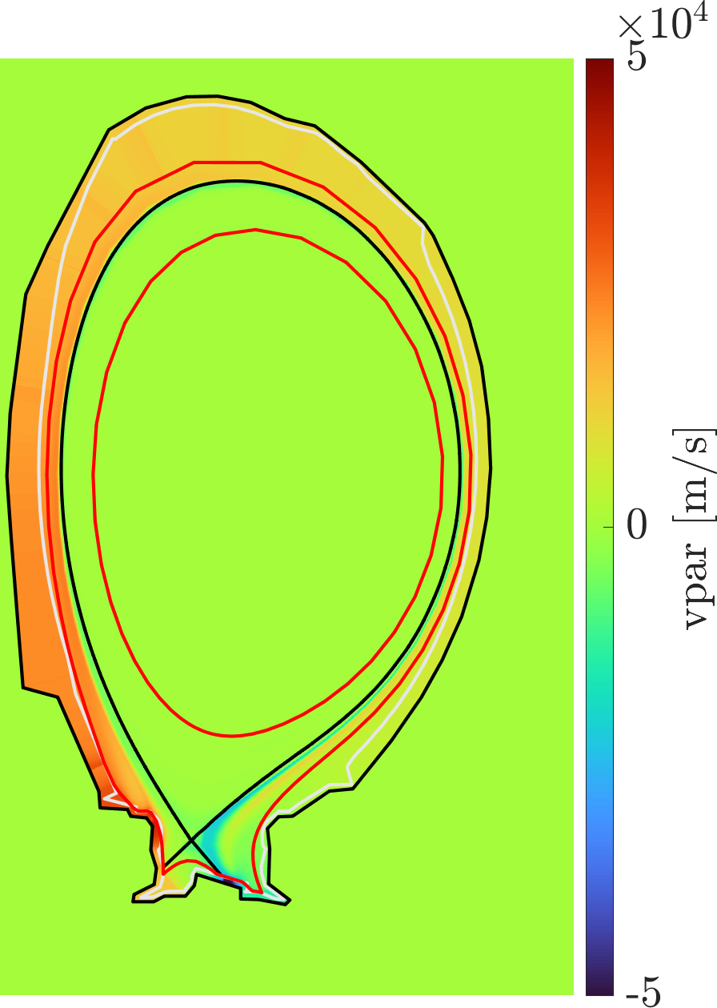
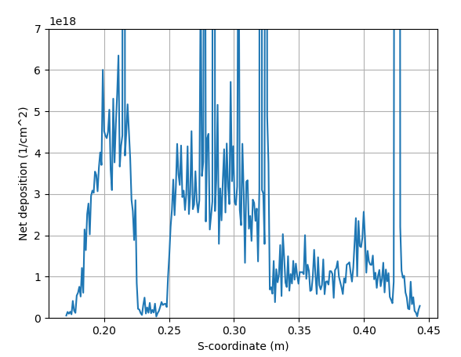
Nickel deposition is prominent on tile 1 due to SOL flow prompt deposition
Nickel deposition on tile 1, w/o re-erosion
Deposition
Deposition
Expected re-erosion zone
The SOL flow is towards the HFS divertor top

Slide 12
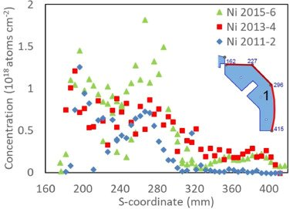
Nickel deposition is prominent on tile 1 due to SOL flow prompt deposition
Magnitude of predicted Ni deposition same order as measured for s ≈ 0.2 m
Ni re/erosion similar to Be ⇒ Ni re-erosion to be investigated
Nickel deposition on tile 1, w/o re-erosion
Deposition
Deposition
Expected re-erosion zone
Measured nickel concentration on tile 1
A. Widdowson et al. Nucl. Mater. & Energ. 19(2019)

Slide 13
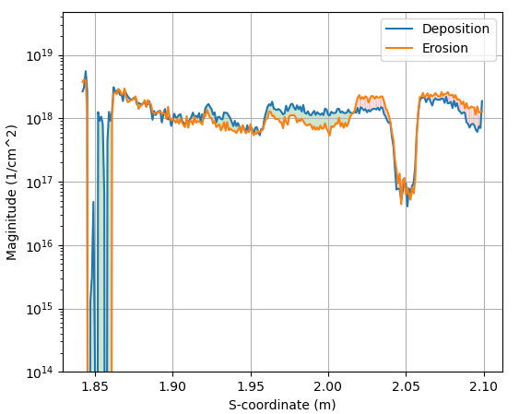
Tungsten net erosion on the top of tile 8 and 9 due to lack of redeposition
Top parts of tiles 8 and 9 are net erosion zones (of order 1x10¹⁸/cm²)
6x10¹⁸/cm² for 1 µm of erosion => predicted erosion layer approximately 0.17 µm => challenging to measure
Vertical portion of tile 8 is predicted to be a net deposition zone (of order 1x10¹⁷/cm²)
Vertical
Top

Slide 14
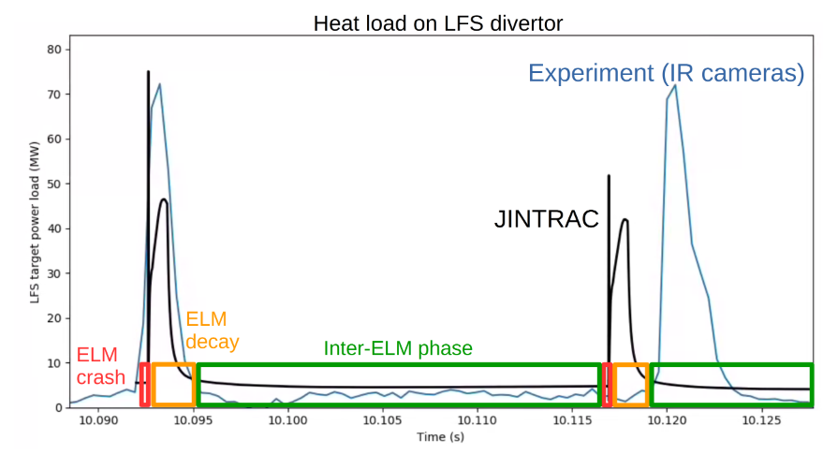
For P_{heat} > 5 MW: invoke EDGE2D-EIRENE ELM model: intra-ELM = 1% of ELM cycle, inter-ELM 60-90%
Henri Kumpulainen et al. EPS CPP, Bordeaux
Time evolution during ELMs

Slide 15
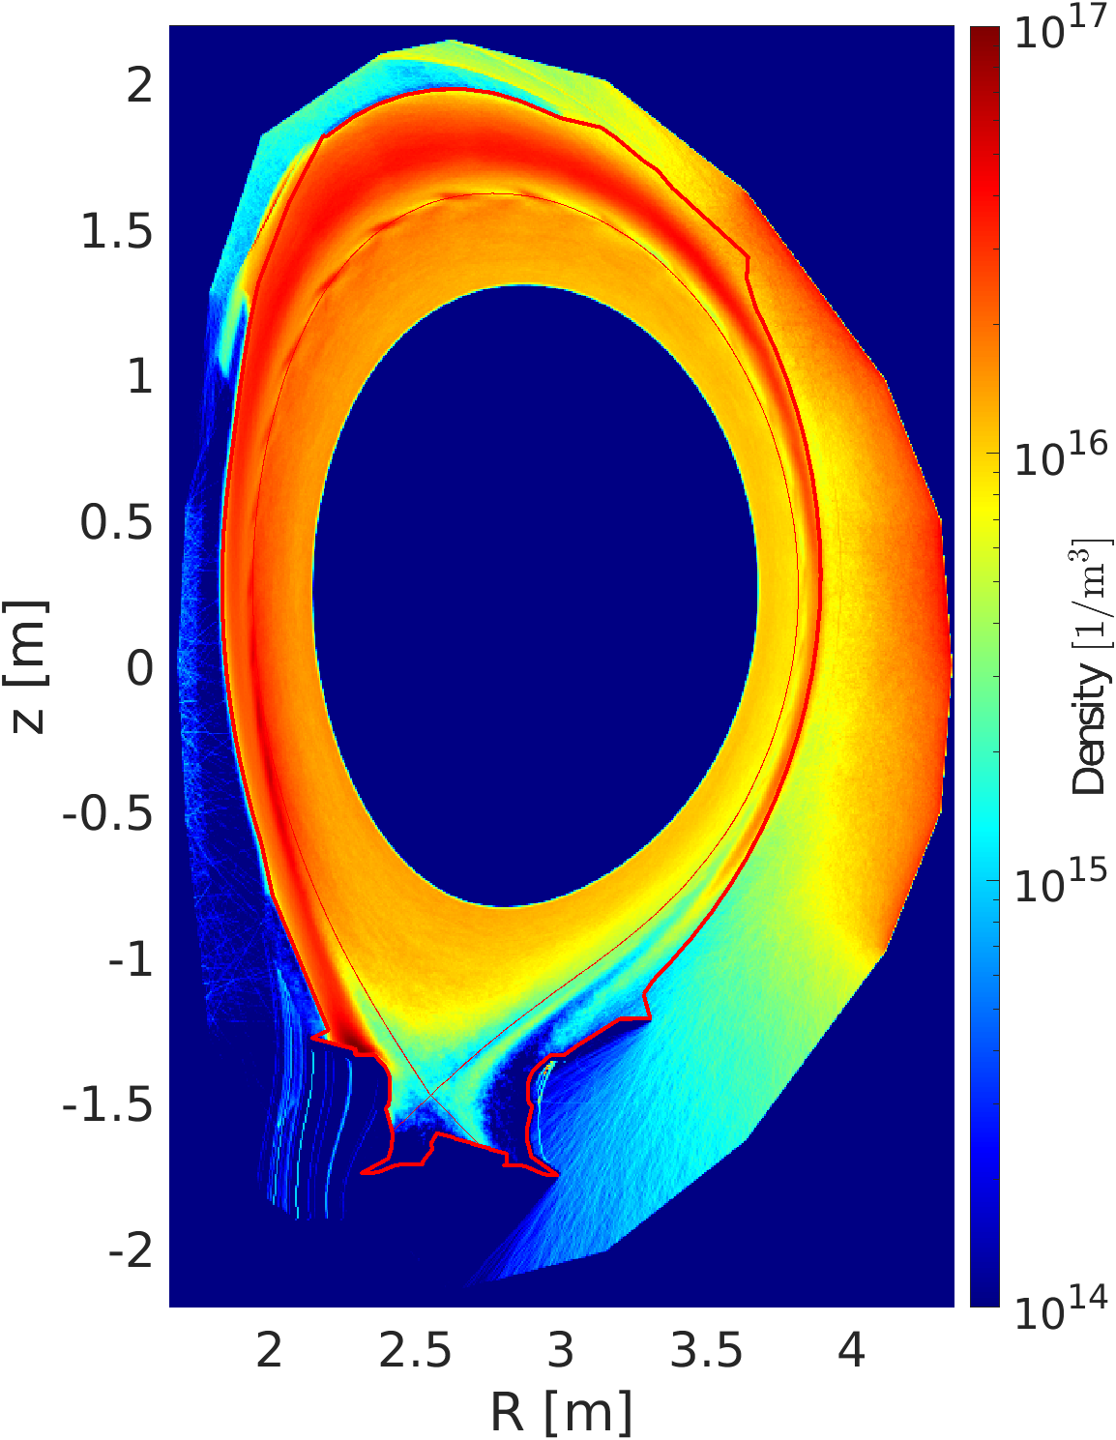
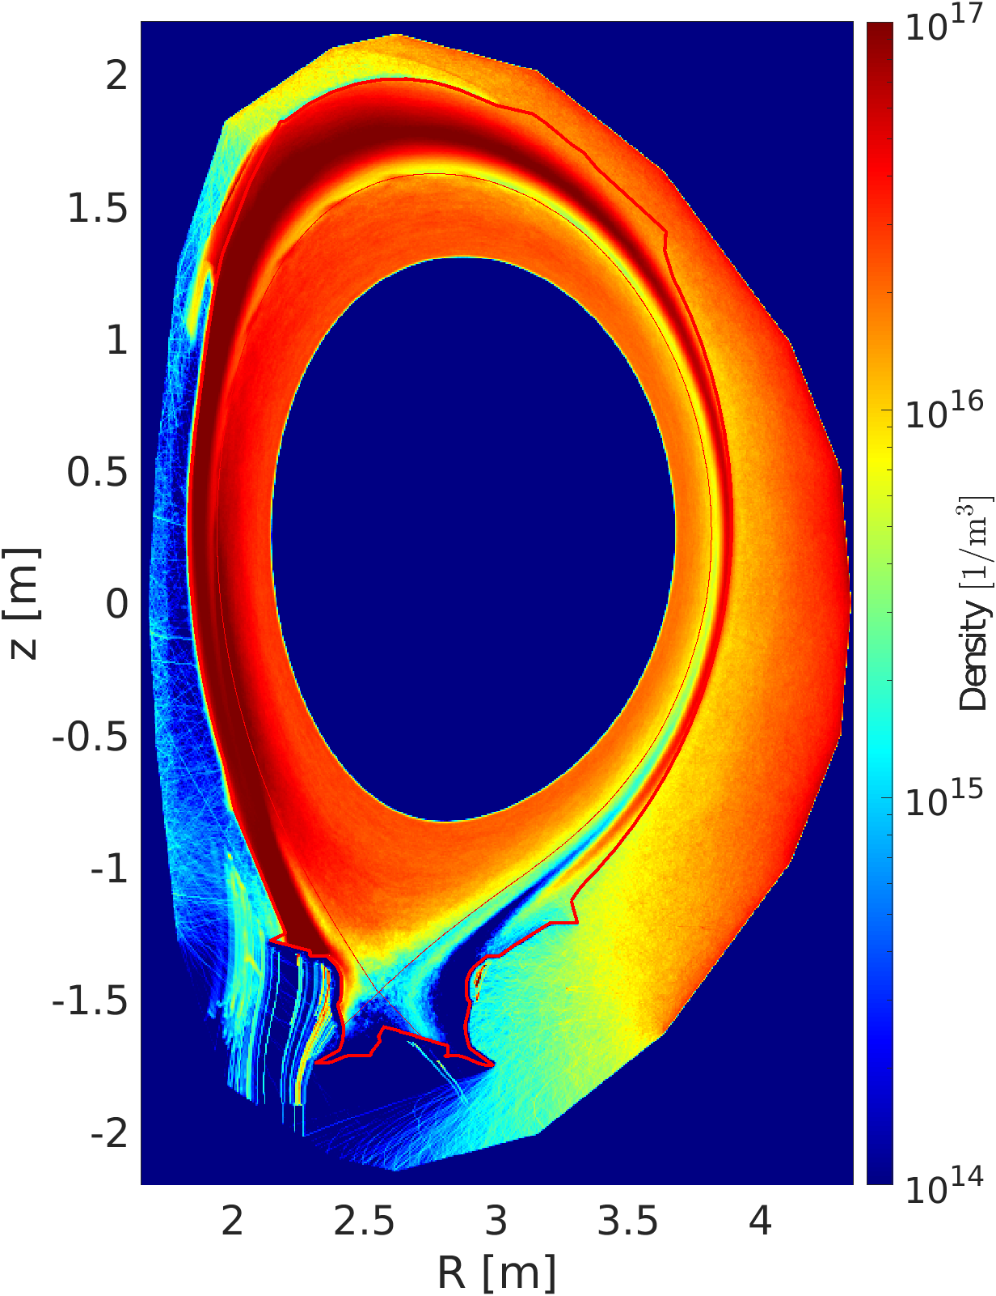
ELMs lead to higher Ni erosion, increasing the nickel density in the plasma
During ELMs, Ni erosion increases due to higher average energies of the CX atoms
Ion flux to vacuum vessel wall is expected to be insignificant for Ni sputtering
Despite causing more erosion ELMs have a flushing effect, removing Ni from core plasma

Slide 16
Conclusions
Update of 3D ERO2.0 wall: 2D atomic fluxes from EIRENE projected onto vacuum vessel wall, scaled according to actual limiter/antennae obstruction, used to assess Ni and W migration in JET-ILW
Total and energy-resolved atomic fluxes to JET-ILW main chamber “limiter wall” obtained from EIRENE for range of divertor plasma configs. and (core plasma density, heating power) scenarios in JET-ILW campaigns 2011-2016
Erosion of Ni from the Inconel vacuum vessel wall occurs primarily on the LFS, due to the vacuum vessel wall being most exposed to CX fluxes ⇒ transport and deposition onto tile 1
Predicted deposit layer the same order as measured post-mortem: low re-erosion anticipated due to insufficient energies of incoming particles
Tungsten net erosion occurs on the strike points and the LFS divertor shoulder

Slide 17
Uncertainties and caveats of the analyses
Role of limiter phases
Ion flux to nickel wall expected to be insignificant for Ni sputtering => reassess ion flux to divertor entrance for tungsten
ELMs lead to the creation of CX neutrals with higher mean energies than in the inter-ELM phase leading to higher erosion
Disruptions and vertical instabilities: strong source of Ni and W, redistribution of materials

Slide 18
Backup slides

Slide 19
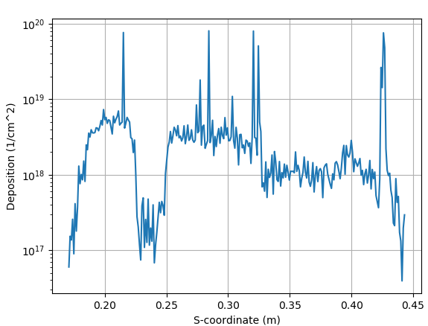
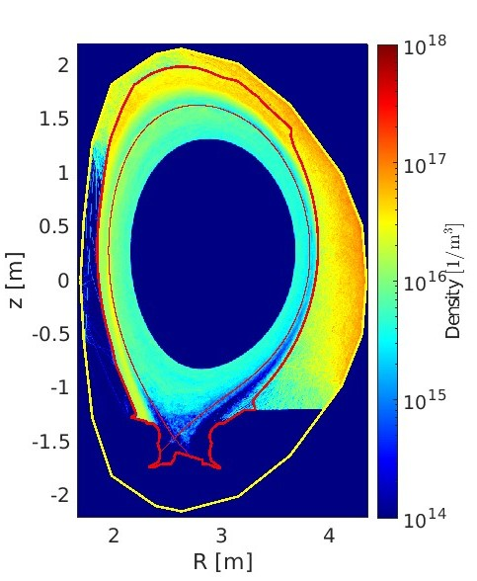
Nickel deposition is prominent on tile 1 due to SOL flow directly onto the tile
Magnitude of predicted Ni deposition same order as measured for s ≈ 0.2 m
Ni re/erosion similar to Be ⇒ Ni re-erosion to be investigated
Expected re-erosion zone
Deposition
Deposition
Nickel deposition on tile 1, re-erosion not accounted

Slide 20
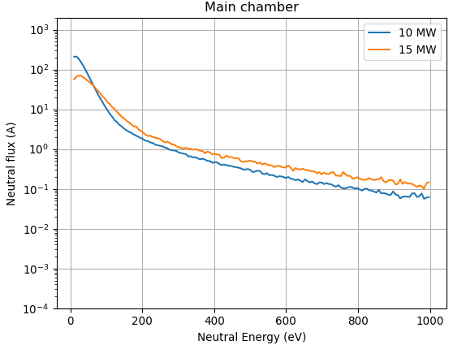
50% increase in heating power raises the high-energy tail of CX atoms to limiter wall surfaces by 2-3x: T_{i} ”wins”
70% increase in total CX atomic flux to limiter wall surfaces
n_{e} = 3.4x10¹⁹ m⁻³
10 MW
15 MW
Limiter wall
Vertical/horizontal, n_{e} = 3.4x10¹⁹ m⁻³
hkumpul/94605/run588s
jrs1740/94605/run018

Slide 21
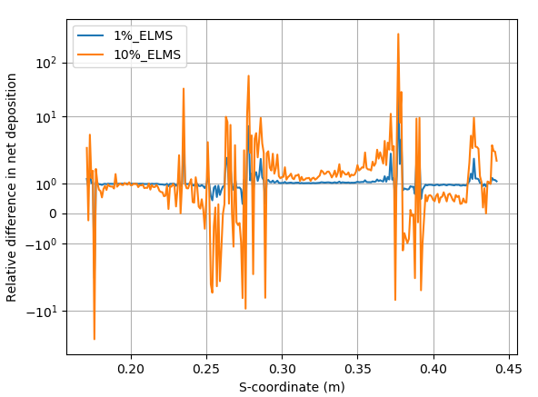
Introduction of ELMs affects beryllium deposition negligibly if ELMs are 1% of plasma time
With 10% of plasma time being ELMs some regions flip from deposition to erosion zones
Changes generally stay within an order of magnitude
Relative difference in net deposition when ELMs are introduced

Slide 22
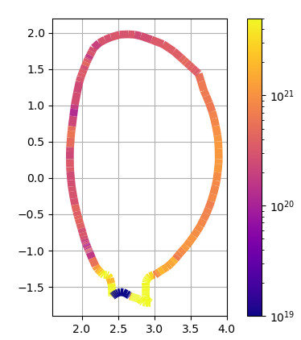
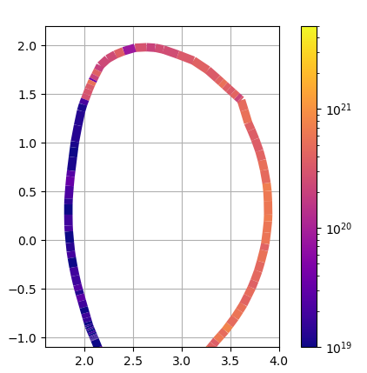
The HFS Inconel vacuum vessel wall is shielded by limiters and Be coated tiles
Modified atomic flux peaks ay the LFS, close to the midplane
CX flux on the vacuum vessel wall decreased from the limiter flux ad-hoc by the calculated obstruction fraction (of order 50%)
Atomic CX flux to top of vacuum vessel relatively unchanged, due to fewer limiter elements blocking path
Be limiter wall
=
EDGE2D-EIRENE wall
Inconel vacuum vessel wall
Limiters (Be)
Vessel wall (Inconel)
Vertical-horizontal, P_{in} = 10 MW, n_{e} = 3.4x10¹⁹ m⁻³
JPN#94605, run588s

Slide 23
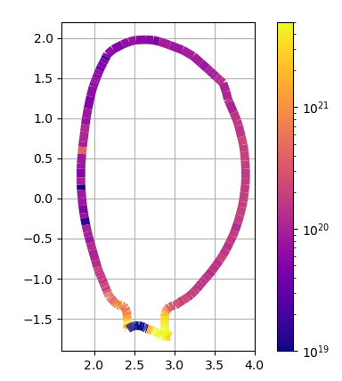
Vert./horiz. config.: total atomic flux to LFS midplane
Vertical/horizontal, P_{in} = 2.2 MW, n_{e} = 8.5x10¹⁸ m⁻³
hkumpul/81472,/jul2020/seq#2
8.5x10¹⁸ m⁻³
2.2 MW
Largest atomic fluxes (> 10²¹ atoms/s/m²) highest to LFS divertor surfaces: region of highest atomic density
Atomic flux to main chamber surfaces 5-50x lower than LFS divertor surfaces
Higher fluxes to LFS than to HFS midplane due to higher n_{D0} and lower flux expansion at LFS
10²¹
2x10²⁰ atoms/s/m²
10²⁰
5x10²¹ atoms/s/m²

Slide 24
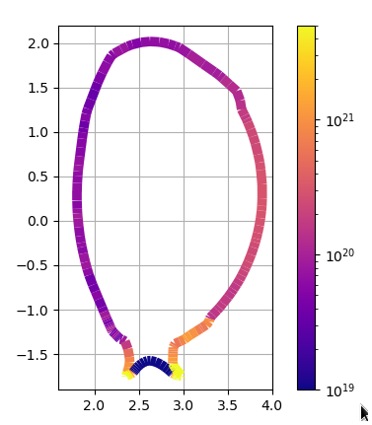
For same plasma conds., similar atomic fluxes onto the main chamber wall in vert./horiz. and corner-corner configs.
Vertical-horizontal, P_{in} = 2.2 MW, n_{e} = 8.5x10¹⁸ m⁻³
JPN#81472, jul2020/2
n_{e} = 3.4x10¹⁹ m⁻³
P_{in} = 2.2MW
Corner-corner, P_{in} = 2.2 MW, n_{e} = 8.5x10¹⁸ m⁻³
JPN#96947, run060
3x10²¹ atoms/m²
5x10²¹ atoms/m²

Slide 25
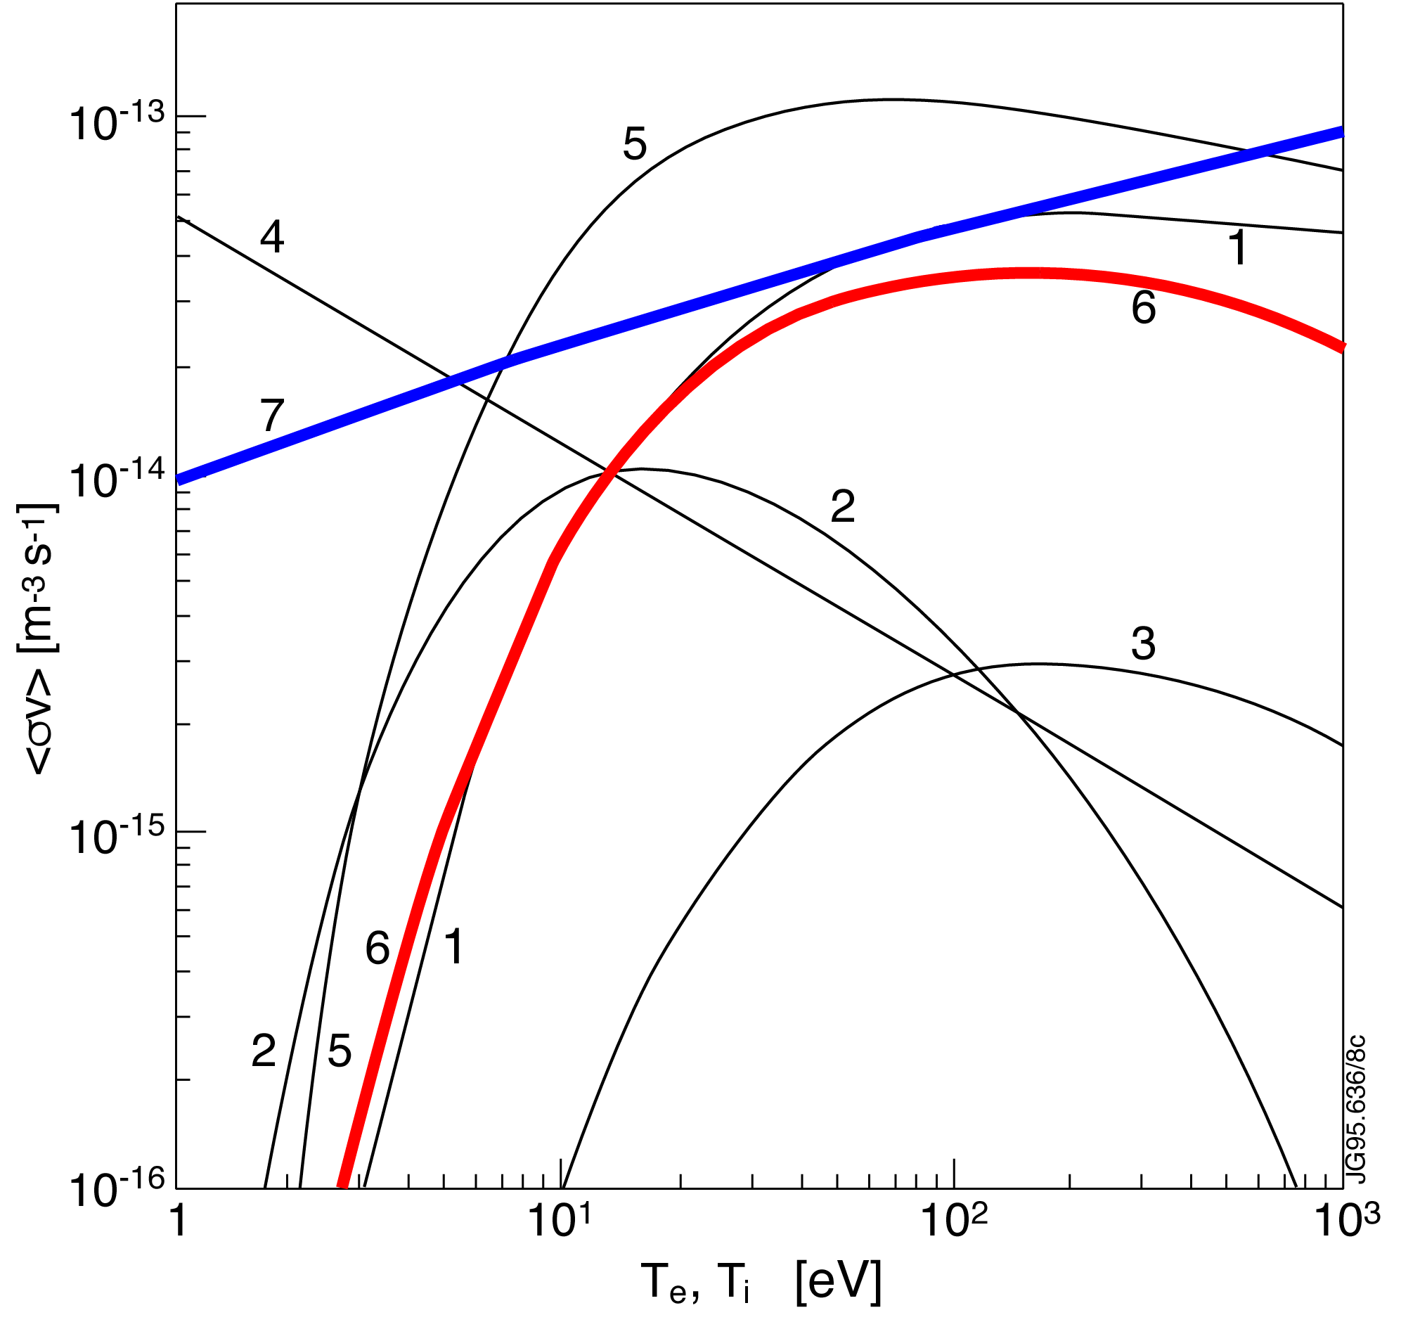
Charge-exchange events are more likely to occur than ionization for plasma below 30eV and above 200 eV
M. Harrison, in Physics of Plasma-Wall Interactions in Controlled Fusion, 1984
H⁰ + H⁺ ⇆ H⁺ + H⁰
H⁰ + e⁻ → H⁺ + 2e⁻

Slide 26
Screenshots of divertor configurations

Slide 27
Summary of cases (status Feb 19, 2024)
Configuation | Pi_{n} [MW] | n_{e,sep,LFS-mp} [10¹⁹ m⁻³] | Run case name
Hor./vert. | 2.2 | 0.85 | 81472/jul2020/seq#2
 | 2.2 | 1.8 | 81472/oct1919/seq#1, run041
 | 4.8 | 2.0 | 80295/may0319/seq#1, run042
 | 4.8 | 4.0 | 80295/may1619/seq#4, run043
 | 6.6 | 3.6 | 82486/may2520/seq#1
 | 10 | 3.4 | 94605 run668s
 | 15 | 3.4 | 94605 run018
Vert/vert. | 2.2 | 0.85 | 80821 run015
 | 11.2 | 4.0 | 80821 run031
Corner/corner | 2.2 | 0.85 | 96947 run060
 | 6 | 1.5 | 96947 run026
Corner/corner | 6 | 1.5 | 96947 run039 with ELMs
 | 14 | 2.5 | 96947 run030
 | 14 | 2.5 | 96947 run040 with ELMS
 | 24 | 1.6 | 96947 run098y_eps

Slide 28
Summary of cases (status Feb 19, 2024)
V5 OMP​ | ​ PSOL | C-C​ OMP | ​ PSOL | V-C​ OMP | ​ PSOL | V-V​ OMP | ​ PSOL
0.85​ | 2.2​ | 0.85​ | 2.2​ | 0.85​ | 2.2​ | 0.85​ | 2.2​
1.8​ | 2.2​ | 1.5​ | 6​ | 1.8​ | 6​ | 4.0​ | 11.2​
2.0​ | 4.8​ | 2.5​ | 14​ | ​ | ​ | ​ | ​
4.0​ | 4.8​ | 1.6​ | 24​ | ​ | ​ | ​Limiter | ​
3.6​ | 6.6​ | ​ | ​ | ​ | ​ | ​0.85 | 2.2​
3.4​ | 10​ | ​ | ​ | ​ | ​ | ​ | ​
3.4​ | 15​ | ​ | ​ | ​ | ​ | ​ | ​

Slide 29
power/density combinations for the V5 conf., colors represent groupings of conds. combined into a single case

Slide 30
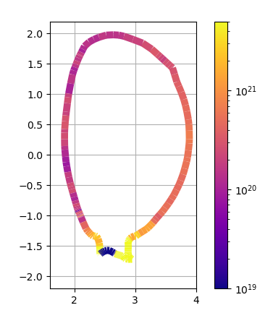
Vert./horiz. config.: total atomic flux to LFS midplane predicted to increase ~10x when raising density and power
Vertical/horizontal, P_{in} = 2.2 MW, n_{e} = 8.5x10¹⁸ m⁻³
hkumpul/81472/jul2020/seq#2
Vertical/horizontal,
P_{in} = 2.2 MW, n_{e} = 1.8x10¹⁹ m⁻³
hkumpul/81472/oct0919/seq#1
2x10²⁰ atoms/s/m²
1x10²¹ atoms/s/m²
10²¹
10²¹
8.5x10¹⁸ m⁻³
2.2 MW
10²⁰
1.8x10¹⁹ m⁻³
2.2 MW
10²⁰
2x10²¹ atoms/s/m²
10²¹
3.4x10¹⁹ m⁻³
10 MW
10²⁰
Vertical/horizontal, P_{in} = 10 MW, n_{e} = 3.4x10¹⁹ m⁻³
JPN#94605, run588s

Slide 31
Slide template

