Slide 1
Sputtering of pristine and D decorated W surfaces by various ions (MD)
Fredric Granberg
Faith Kporha, Alexandre Bergero, Kai Nordlund

Slide 2
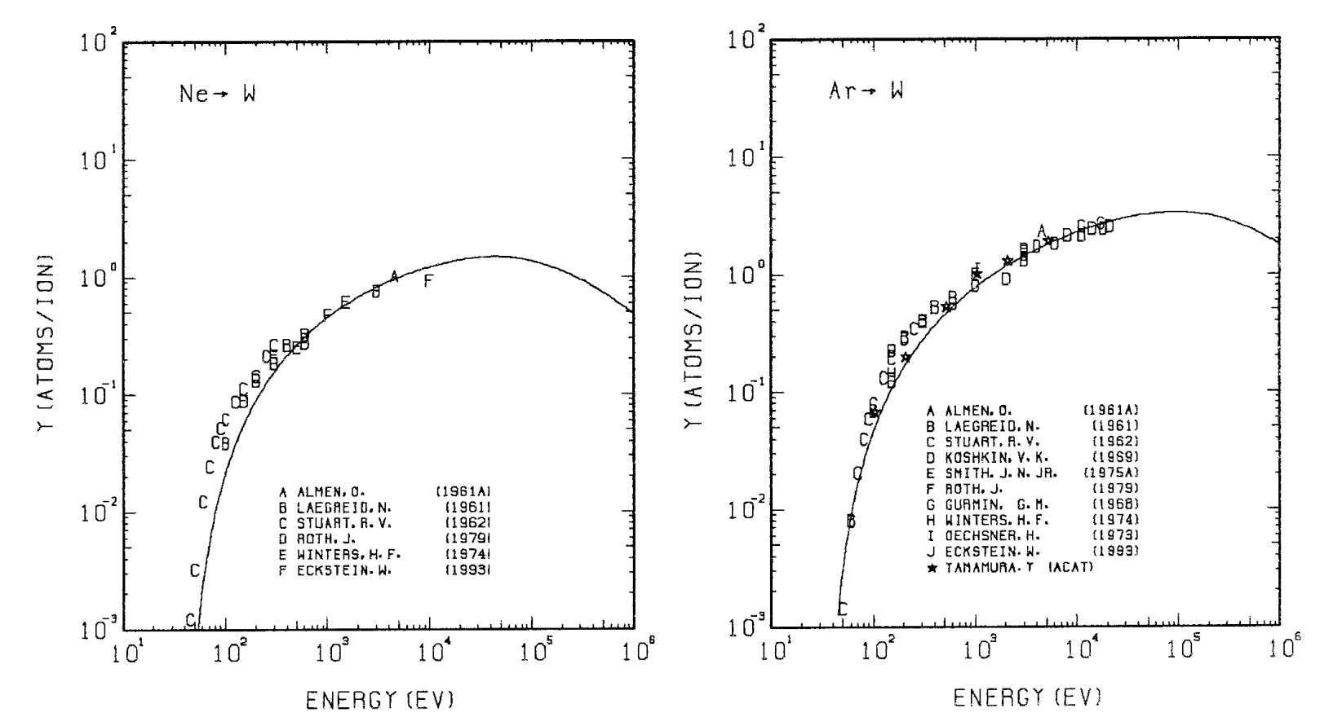
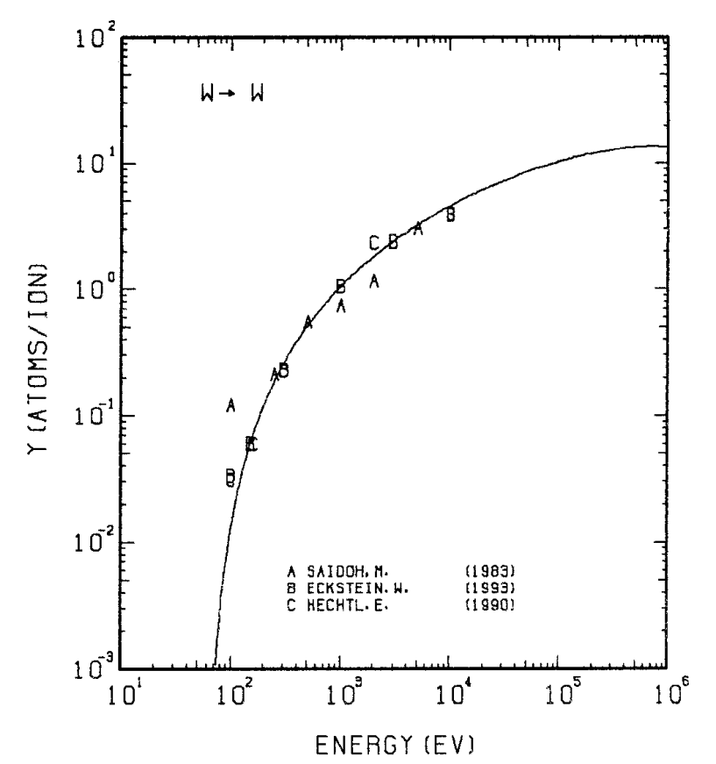
Introduction Sputtering of W
Exp. sputtering yields
Effect of ion and energy
Usually polycrystalline
For self-ion, only the net
”reflection” = ”sputtering”
Yamamura & Tawara, Atomic Data and Nuclear Data Tables 62 (2) 1996 149-253

Slide 3
METHODS Molecular Dynamics simulations
Classical MD simulations with different interatomic potentials
The Mason et al. EAM and the Li et al. Tersoff-type potential for W-W, W-H and H-H
Purely repulsive ZBL potential between Ne-W, Ne-H, Ar-W and Ar-H
Single impact simulations
Good for understanding the base phenomena
Caveat, might not be the most representative of experiments
Studies can be “easily” extended to multiple impact scenario
Main limitation is the CPU time, and the sequential workflow which is needed for these
Can not as easily be done for other than low-index surfaces

Slide 4
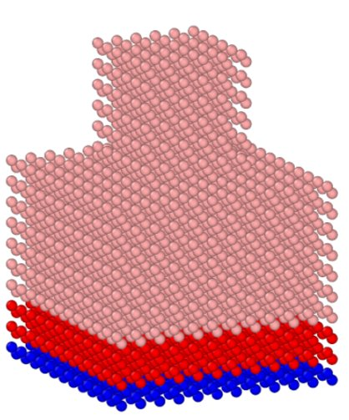
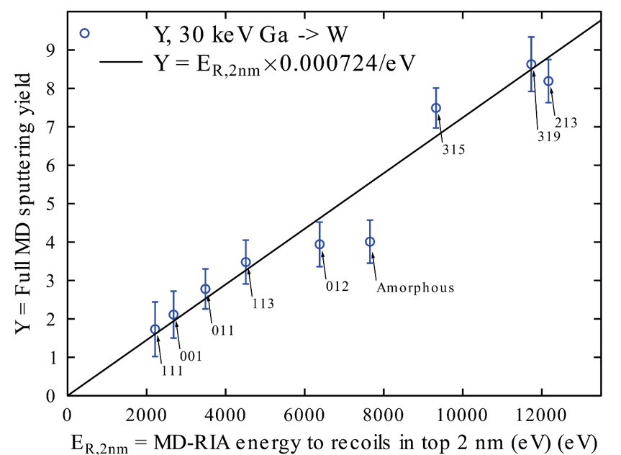
METHODS Simulation setups
BCA/RIA + MD
Low index surface
Arbitrary surface
Schlueter et al. Phys. Rev. Lett. 125:225502 (2020)

Slide 5
METHODS Simulation example (Note: not linear time)

Slide 6
METHODS Setup
Sample:
100, 110, 111 and 112 surface orientations, periodic cell
0%, 2.5%, 5% and 10% D (average concentration in topmost layers)
Ion: Ar, Ne and W
Energy: 100eV and 200eV, single impact
Incoming angle: 0, 15, 30, 45, 60 and 75 degrees
For random and amorphous surfaces, the non-periodic half-sphere setup
50 – 1000eV single impact Ar irradiation

Slide 7
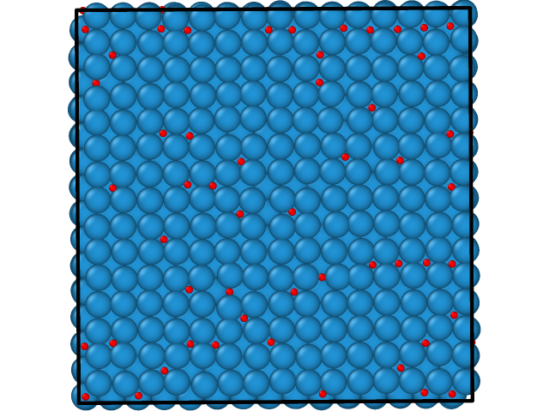
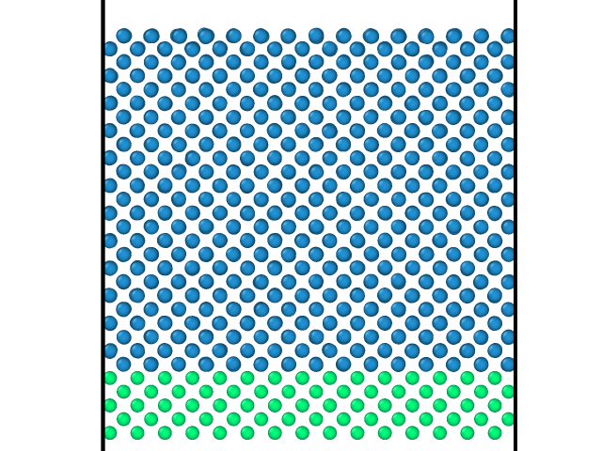
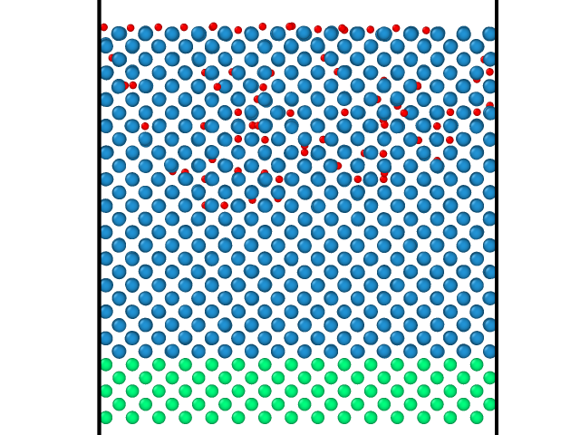
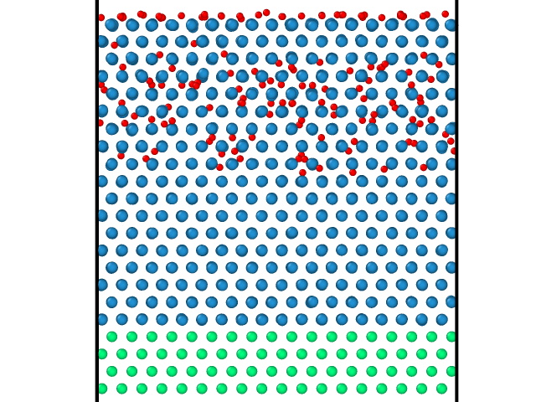
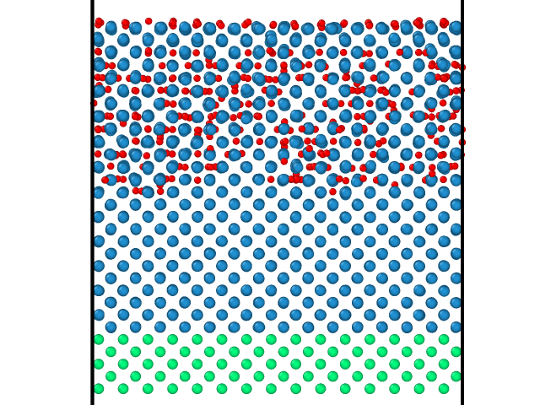
METHODS D-decorated cells
Side-view and top-view of the cells at different D concentrations
Pristine 2.5% 5% 10%

Slide 8
METHODS Analysis
Detected experimentally
Detected experimentally, self-ion problematic
Can be detected experimentally
Can be detected experimentally
Sputtering yield
Reflection yield
Outgoing angles
Outgoing particle energy
In MD all are inherently recorded
For tungsten self-irradiation, sputtering can be split into reflection and sputtering

Slide 9
RESULTS
Ar -> W and D-decorated surfaces
Surface orientation effect for Ar -> W
D-decoration effect for Ar -> W
Mechanisms present
Ne/Ar/W -> W
Ion-type effect on W surfaces
Ion-type effect on D-decorated surfaces
Parameter study of Ar -> W
D -> W surfaces

Slide 10
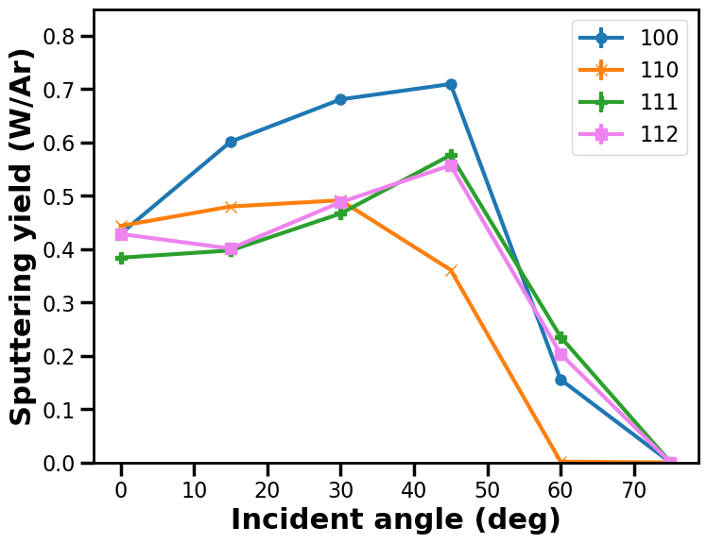
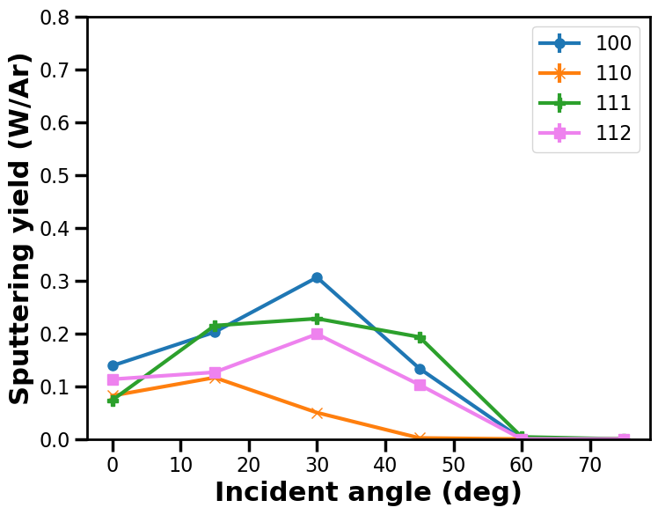
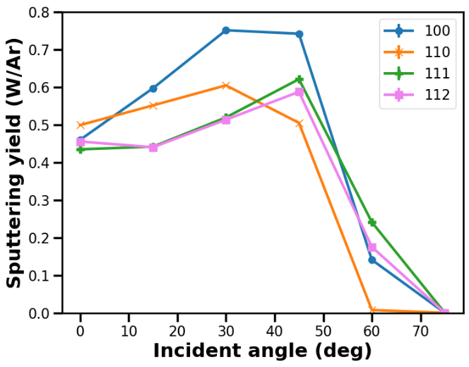
RESULTS Surface orientation effect for Ar -> W (pristine)
Tungsten sputtering a function of incoming angle
Mason et al. Li et al.
100 eV 200 eV 100eV 200eV
Both potentials agree well in both yields and trends, agrees with previous results

Slide 11
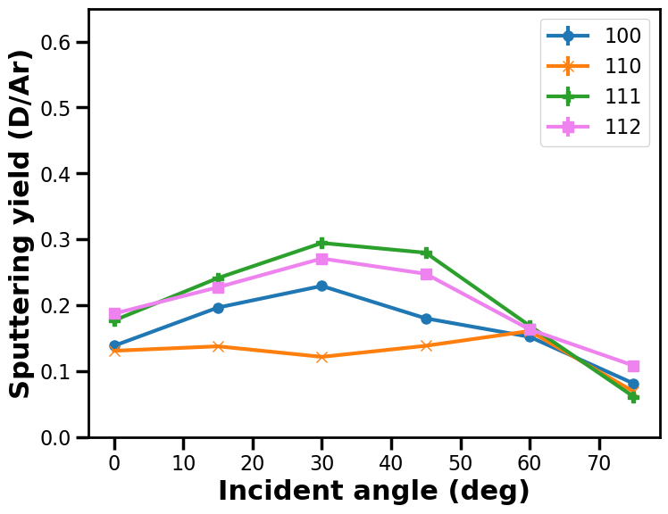
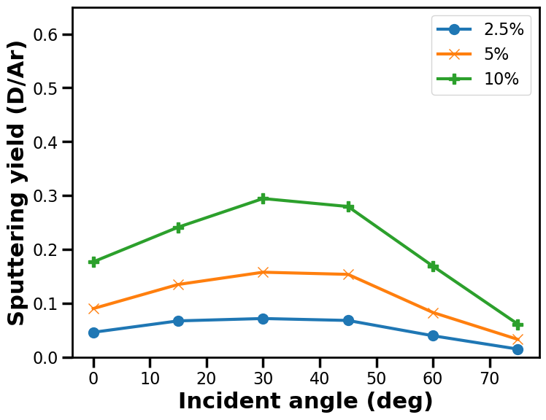
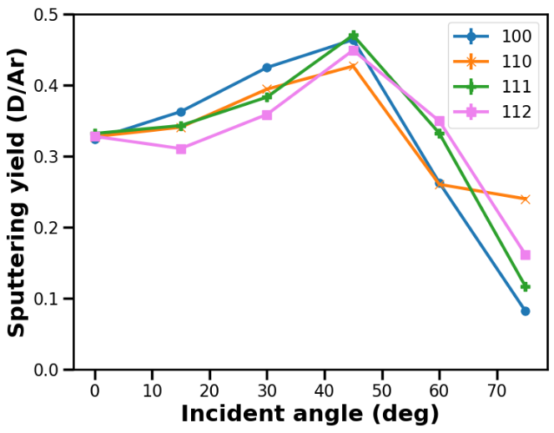
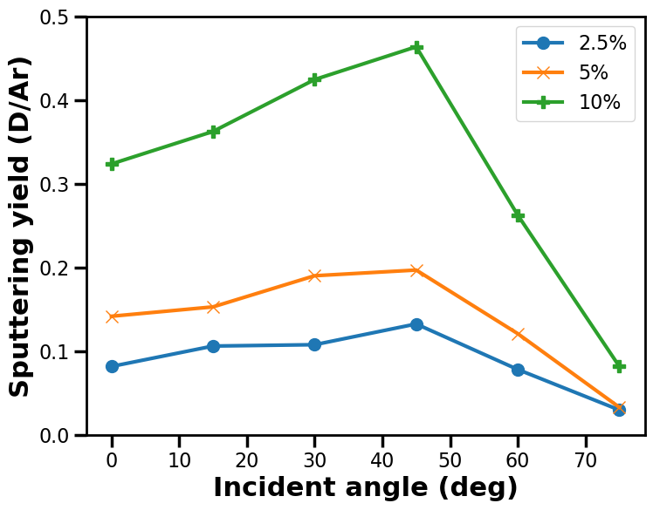
RESULTS D-decoration effect for Ar -> W
Deuterium sputtering from 10% D-decorated surfaces
Mason et al. Li et al.
100 eV 111 surface 200eV 100 surface
Both potentials agree well in both yields and trends
Increased D concentration linearly increase the D sputtering

Slide 12
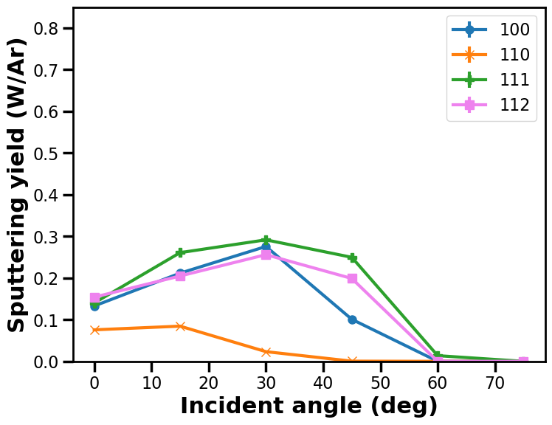
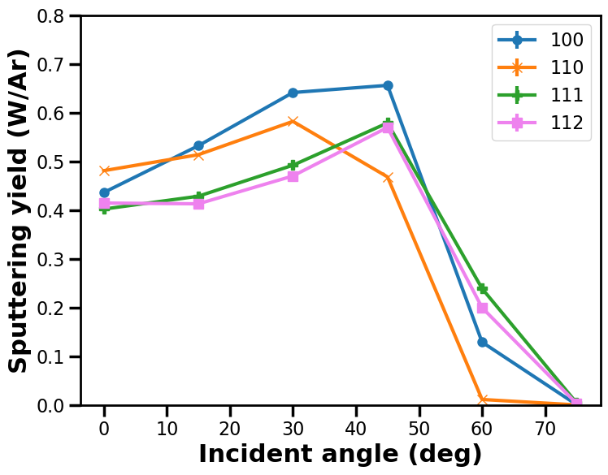
RESULTS D-decoration effect for Ar -> W
Tungsten sputtering for 10% D-decorated surfaces
Mason et al. 100eV Li et al. 200 eV
Pristine 10% D Pristine 10% D
Potentials give opposite trend, D-decoration increase sputtering in Mason et al. and decrese sputtering in Li et al.

Slide 13
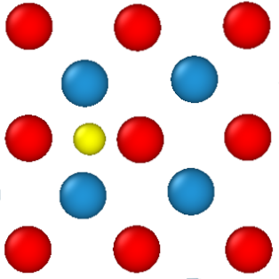
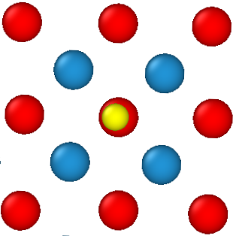
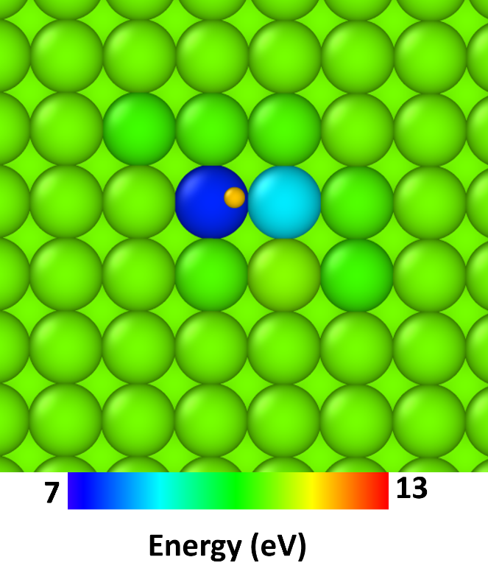
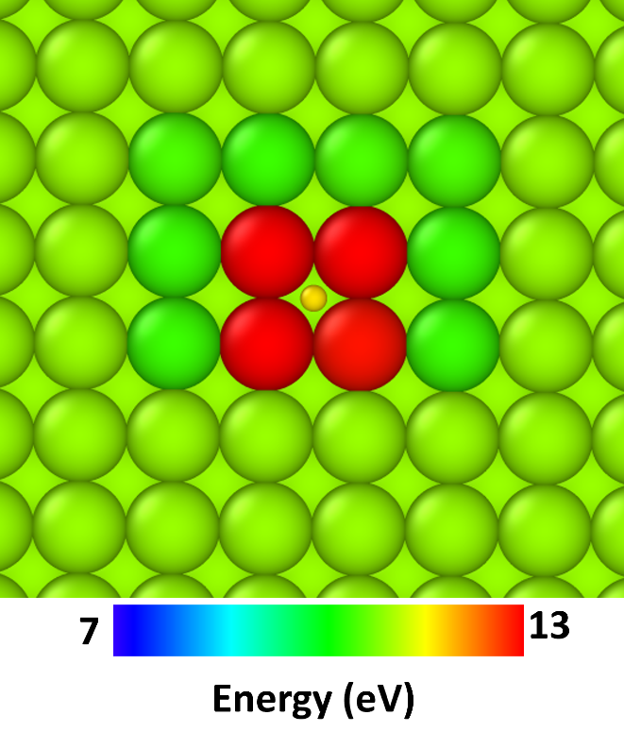
RESULTS Mechanisms present
Stable D position on W surfaces (100)
Energy required for sputtering
Mason et al. Li et al
Mason et al. Li et al
Mason et al. shows correct according to DFT

Slide 14
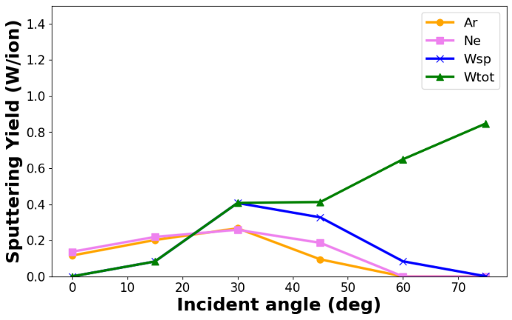
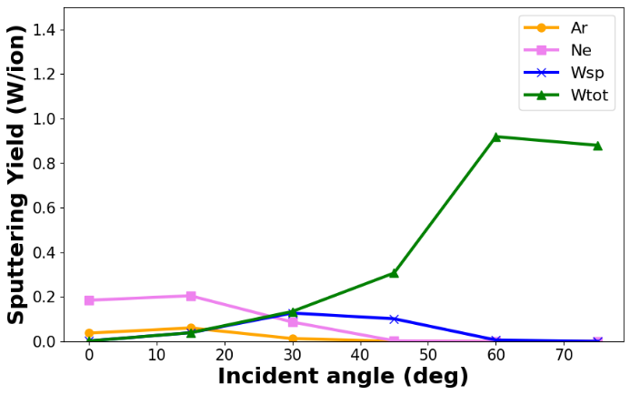
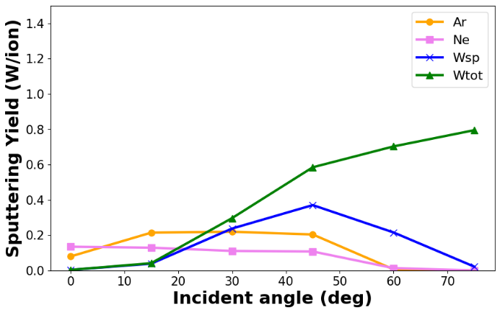
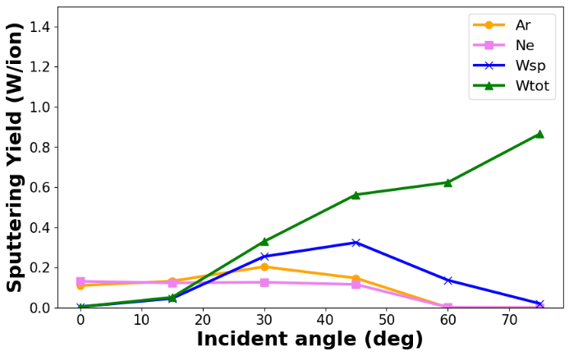
RESULTS Ion-type effect on pristine W surfaces
Tungsten sputtering for different ion species
Mason et al. 100 eV
100 surface 110 surface 111 surface 112 surface
Ar and Ne quite similar, except the close packed 110 surface
Smaller atom, can penetrate easier and transfer energy in correct direction? (Educated guess!)
W different, due to sticking to surface at small angles, and reflection at large angles

Slide 15
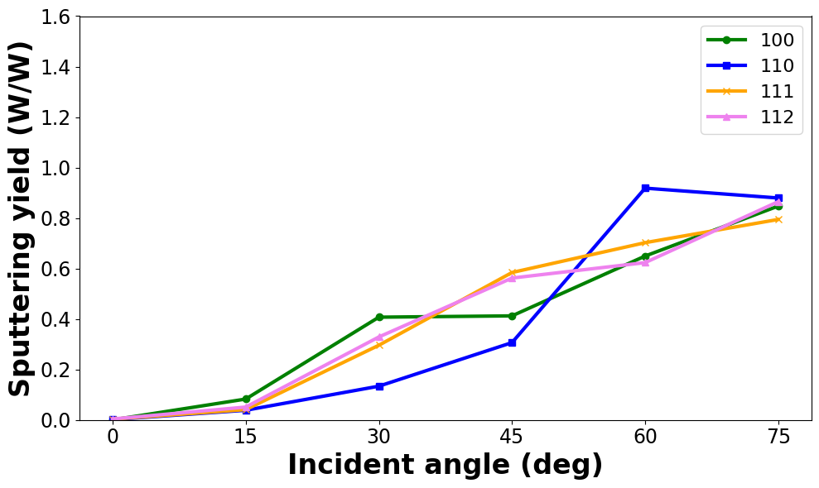
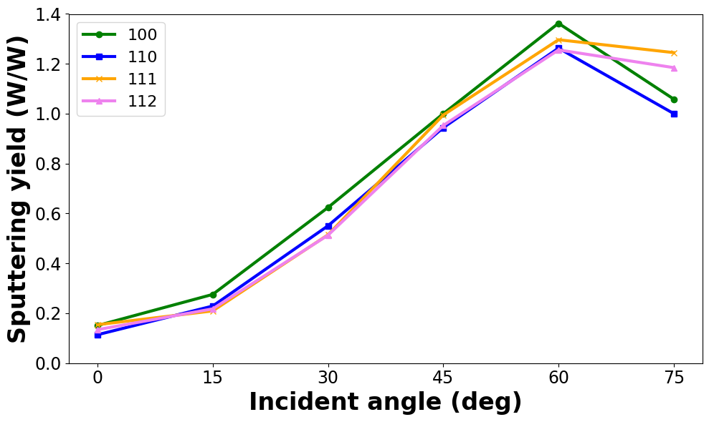
RESULTS Ion-type effect on pristine W surfaces
Total sputtering (sputtering + reflection) of tungsten by tungsten-ions
Mason et al. 100 eV Li et al. 200eV

Slide 16
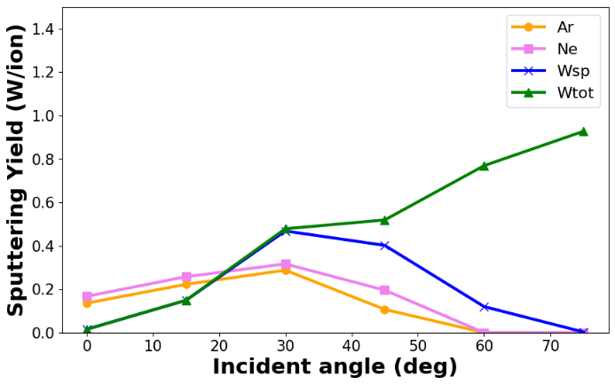
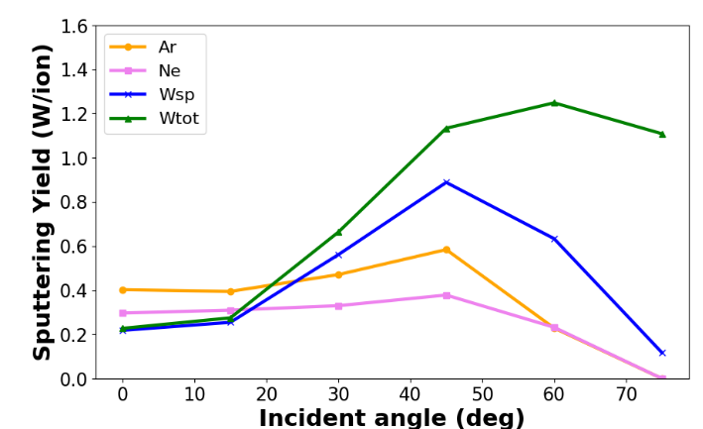
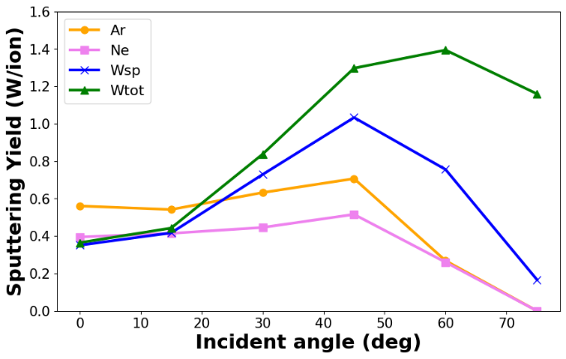
RESULTS Ion-type effect on D-decorated surfaces
Tungsten sputtering for some surfaces and energies for pristine and 10% decorated surfaces
Mason et al.
(100) 100 eV (100) 100 eV 10% D (111) 200 eV (111) 200eV 10%
Again, in the Mason et al. potential the sputtering is increased due to the deuterium present

Slide 17
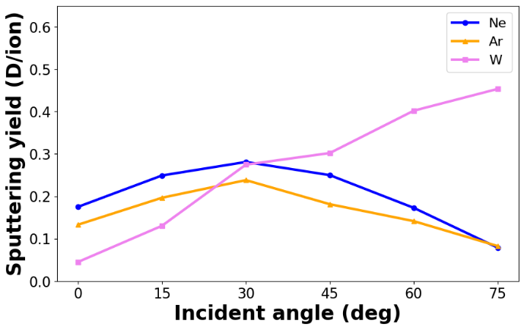
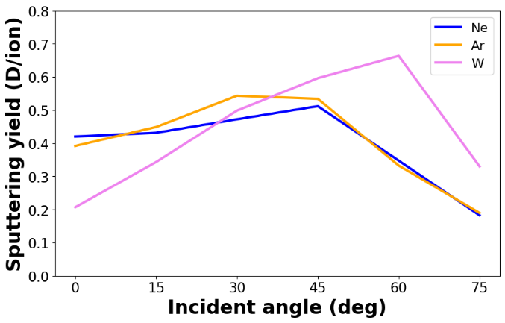
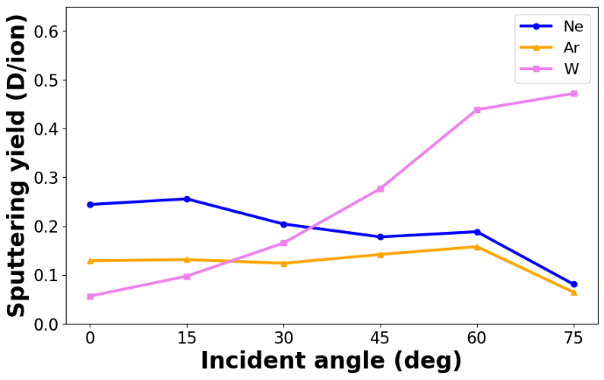
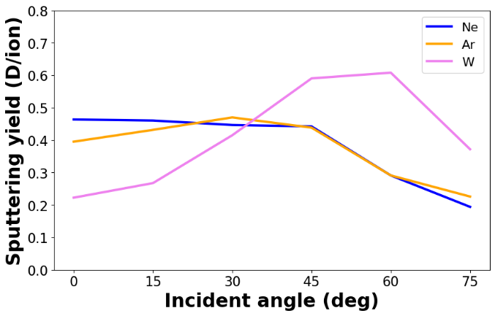
RESULTS Ion-type effect on D-decorated surfaces
Deuterium sputtering from 10% D-decorated surfaces by different ion species
Mason et al.
(100) 100 eV 10% (100) 200 eV 10% (110) 100 eV 10% (110) 200eV 10%
Ar and Ne similar, except at low energy when maximum energy transfer is different
W different from the others, due to attraction to D and the surfaces themselves

Slide 18
RESULTS Parameter study of Ar -> W
0deg | 100 | 110 | 111 | amo | rand | rand_min | rand_max
50 | 0 | 0 | 0 | 0 | 0 | 0 | 0
75 | 0.004 | 0 | 0.0028 | 0.0032 | 0.00294 | 0 | 0.0092
100 | 0.128 | 0.042 | 0.0892 | 0.067 | 0.06184 | 0.019 | 0.1258
200 | 0.4338 | 0.4532 | 0.4034 | 0.4062 | 0.415 | 0.379 | 0.4584
300 | 0.7428 | 0.7278 | 0.5532 | 0.6166 | 0.64055 | 0.5536 | 0.7088
60deg | 100 | 110 | 111 | amo | rand | rand_min | rand_max
50 | 0 | 0 | 0 | 0.0002 | 1.33E-05 | 0 | 0.0004
75 | 0 | 0 | 0 | 0.0056 | 0.00554 | 0 | 0.0218
100 | 0 | 0 | 0.0106 | 0.028 | 0.03014 | 0 | 0.0628
200 | 0.1446 | 0.001 | 0.2328 | 0.276 | 0.27487 | 0.1314 | 0.3392
300 | 0.643 | 0.1302 | 0.5464 | 0.5868 | 0.62169 | 0.3312 | 0.713
Still running
500eV and 1000eV
Other incoming angles

Slide 19
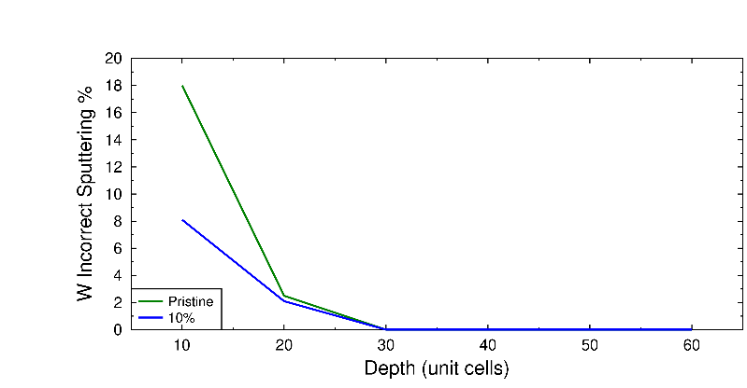
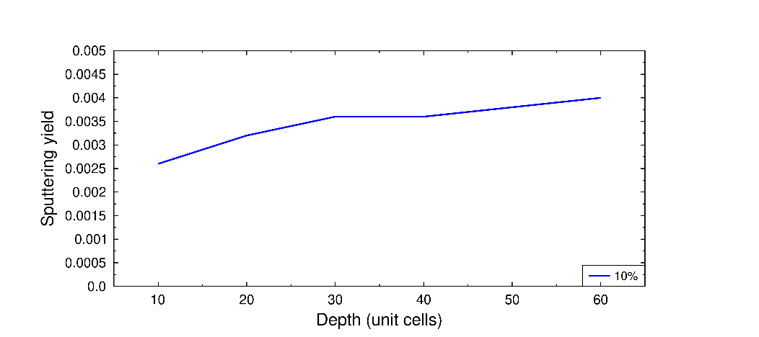
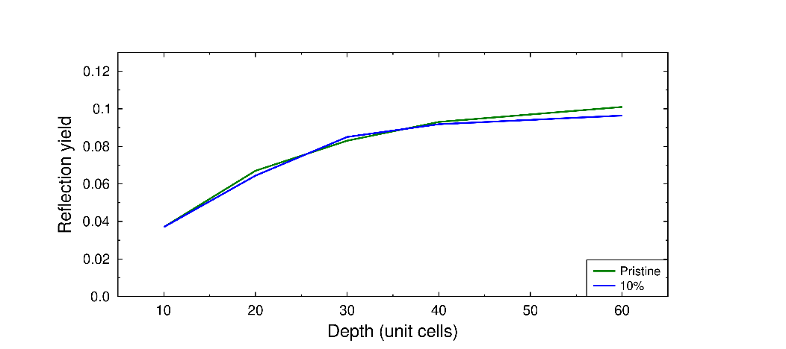
RESULTS D -> W surfaces
W ”incorrect ”sputtering
1 keV D -> (100) W surface and 10% D decorated surface
Statistics still low, but there is an effect (unfortunately)
This is the case for channeling directions, probably not others
The higher the energy / lower the ion mass, the worse it is
W sputtering
D sputtering
D ion reflection

Slide 20
OUTLOOK Current status
Ar -> W and D-decorated surfaces
Sputtering/reflection as a function of D decoration and surface orientation
Submitted to JNM (available on the pinboard)
Ne, Ar and W -> W and D-decorated surfaces
Sputtering/reflection as a function of D decoration, ion type and surface orientation
Outgoing angle and energy distributions
Simulations are completed, analysis ongoing and article under writing
Ar -> W low-index, amorphous and random surfaces
Ongoing simulations as input for ERO2.0 simulations / comparison to SD TRIM SP

Slide 21
OUTLOOK Current status
The irradiation of W by D ions is ongoing
Due to low sputtering yields, 100k + impacts are needed for statistics per data point
The cells needed are large compared to heavier ions
Extremely CPU heavy and a lot of CPU time is needed
We aim to obtain a “correction factor” that can be used, to use small cells and then add a correction to these results
Development of W-O-H & W-B interatomic potential ongoing
Also part of TSVV-7 project
We can obtain many parameters for different setups, but we need to know what!

Slide 22
THANK YOU FOR YOUR ATTENTION
F. Kporha, K. Nordlund and F. Granberg, Sputtering of deuterium decorated tungsten surfaces by argon: A molecular dynamics study, Submitted for publication in Journal of Nuclear Materials
F. Kporha, K. Nordlund and F. Granberg, Effect of ion type on the sputtering of pristine tungsten and deuterium decorated tungsten surfaces, Under writing

