Slide 1
DIVGAS modelling of neutral particle gas dynamics and exhaust for DEMO
S. Varoutis, C. Tantos, Y. Igitkhanov, C. Day
WPPWIE Midterm Meeting 2024, VTT Finland, 9-11 Apr. 2024

Slide 2
Outline
Objective of the work – DEMO particle exhaust
Description of the DIVGAS code
WPPWIE activities within 2021, 2022 and 2023
Electric and magnetic effects – Benchmark
Gas-surface interaction – Benchmark
Atomic & molecular processes
GPU acceleration
Exploitation of DIVGAS for building up the SN and XD albedo database
Comparison between SN and XD divertor
WPPWIE 2024 activities
Summary

Slide 3
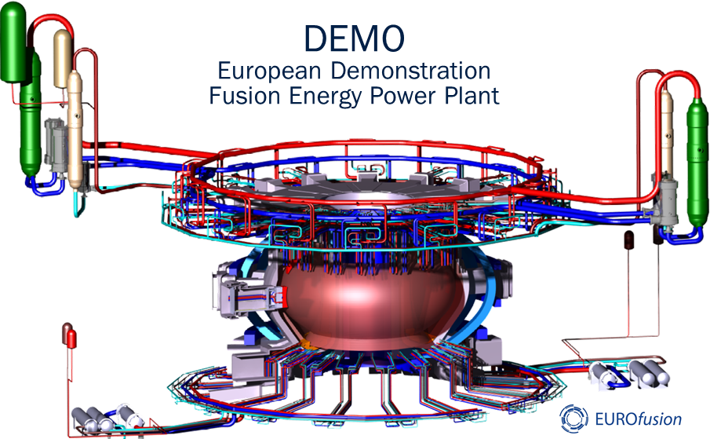
Objective – DEMO particle exhaust
Description of the gas flow in the divertor and vacuum systems → Challenging task, flow covers a wide range of Knudsen number.
Consider more relevant physics, which influence the divertor conditions and consequently the pumping requirements.
For DEMO, a reliable tool, which can predict overall quantities, the neutral recirculation and improve the exhaust pumping efficiency, is required.
Elaborate a self-consistent matrix of albedo values for a DEMO divertor. Albedo is a “hand-shake” parameter, which links plasma performance and pumping capability.
Often, albedo is considered as a “knob” having no real physics basis – Only for stability and convergence purposes.
Due to the high geometrical complexity the computational effort could be reduced by exploiting advanced parallelization techniques (MPI, CUDA etc) as well as large HPC clusters.

Slide 4
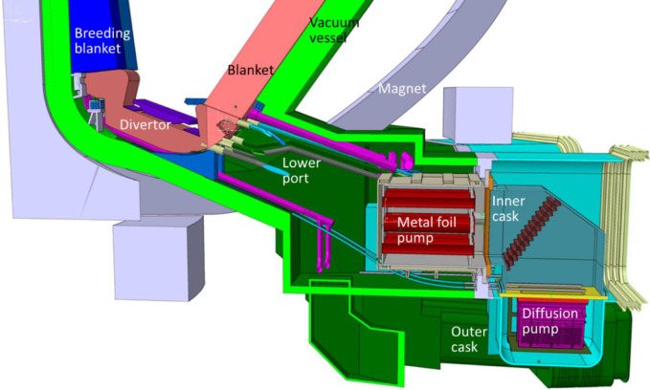
Particle Exhaust parameters
Γ_{puff}
CORE
Γ_{pump}$=\frac{1}{4}n_{div}vAξ$
SOL
Γ_{outflux}
At which pumping speed can the machine gas throughput be pumped?
Competition against recycling and conductance losses
Γ_{in}
re-circulation
Divertor
Pumping probability
S_{req} (noble gases)
Γ_{pump}
S_{req} (D,T)
ξ
Pump
duct
Pumps
Limited Conductance
Throughput = pressure x pumping speed
Throughput = pressure x pumping speed

Slide 5
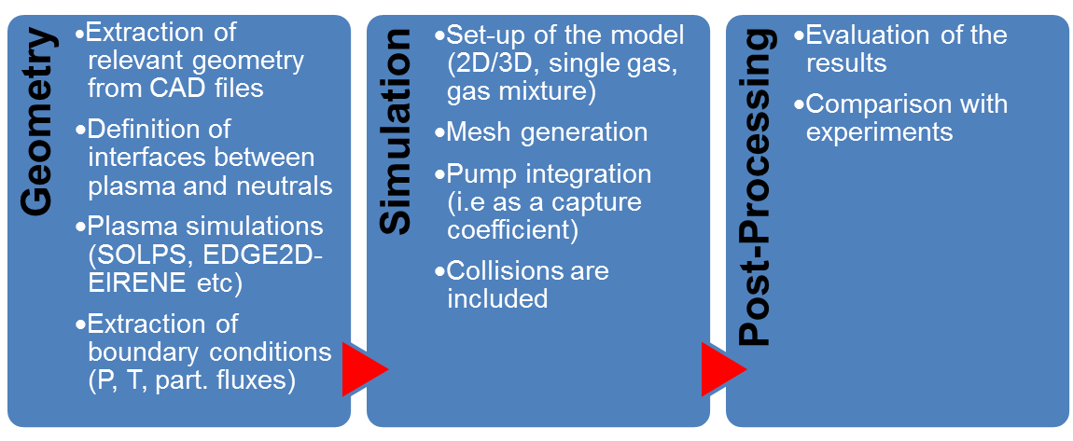
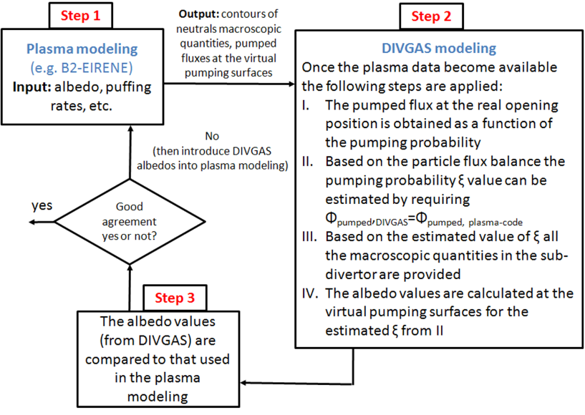
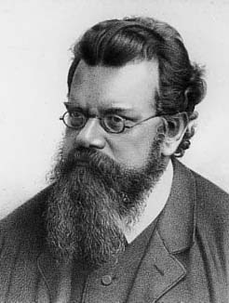
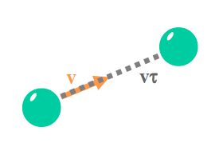
DIVertor GAs Simulator
DIVGAS 3-step workflow
Ludwig
Boltzmann
1872 Boltzmann equation
DIVGAS is based on the deterministic (Discrete Velocity Method) and stochastic (Direct Simulation Monte Carlo) numerical methods.
The solution of the Boltzmann equation is reproduced.
Conservation of momentum and energy.
Correct estimation of transport coefficients.

Slide 6
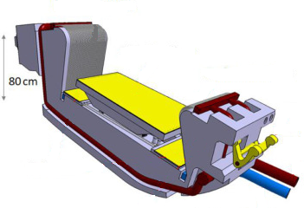
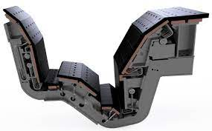
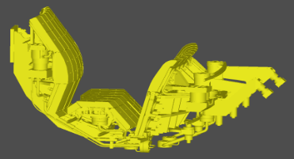
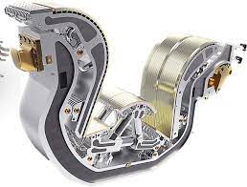
Objective of DIVGAS
The main objective of the DIVGAS code is to develop a multi-machine platform for divertor gas flows
DEMO
Validate the code with experimental results in JET and AUG.
Benchmark the code with the extensive ITER divertor database.
Apply the code for the design of particle exhaust in fusion devices.

Slide 7
Work plan 2021-2024
DIVGAS enhancements and studies within WPPWIE
Introduction of atomic and molecular processes (2021 activities)
Introduction of the CLL advanced gas-surface interaction model (2021 activities)
Introduction of the electric-magnetic field effects (2021 activities)
Acceleration of the DIVGAS code using GPUs for reducing the computational time (2021 activities)
Study the influence of the liner in the overall pumping efficiency of the divertor (2021 activities)
Exploitation of the improved DIVGAS code within WPPWIE
Apply the improved DIVGAS code in order to elaborate a self-consistent matrix of albedo values for a DEMO SN divertor (IDM: 2P57HS) (2022 activities)
Apply of the improved DIVGAS code in order to elaborate a self-consistent matrix of albedo values for a DEMO XD divertor (IDM: 2NNVBJ) (2023 activities)
Apply of the improved DIVGAS code in order to study the influence of the poloidal/toroidal leakages in the 3D DEMO SN divertor (2024 activities) – Ongoing work

Slide 8
Electric and magnetic effects
The computational kernel of the DIVGAS code demonstrates the numerical solution of the Boltzmann equation using the DSMC method:
F: is an external force which generally acts to any particle
Within WPPWIE, the DIVGAS code was extended to include the modeling of charged particles (ions and electrons) in presence of magnetic field or/and electric field, by replacing F by the Lorentz force as follows:
The free motion of the DSMC particles is performed using the explicit Boris scheme (phase space volume conserving and simulated particles typically remain along the correct trajectory)

Slide 9
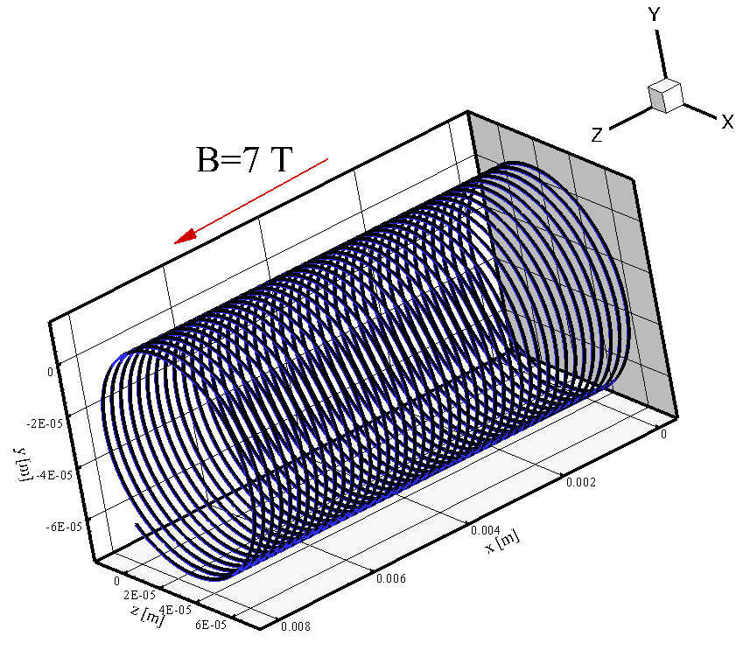
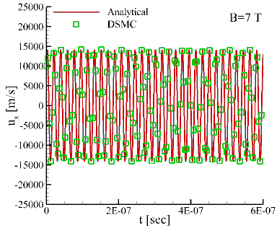
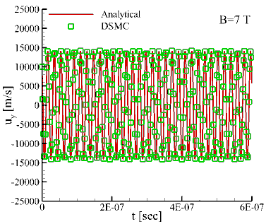
Benchmark
Numerical requirements/assumptions:
Cell sizes must resolve Debye length λ_{D} to avoid numerical heating, i.e. Δx< λ_{D}
Time step must resolve plasma frequency ω_{p}, i.e. Δt< 2/ ω_{p}
Should satisfy Courant-Friedrichs-Lewy (CFL) condition similar to continuum CFD, i.e. Δt< Δx/u_{max}, where u_{max} is the thermal velocity
Cell size must resolve the collision mean free path λ (and other vdf gradient length scales)
The computational cells should be sufficiently populated in order to preserve good statistics
The validity of the updated DIVGAS code has been confirmed by performing comparisons using some simplified examples with known analytical solutions:
Blue: DIVGAS
Black: Analytical

Slide 10
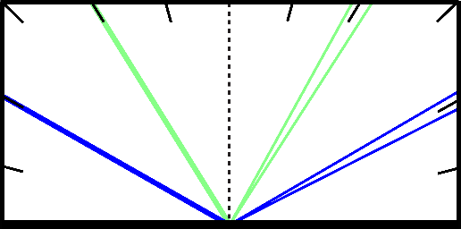
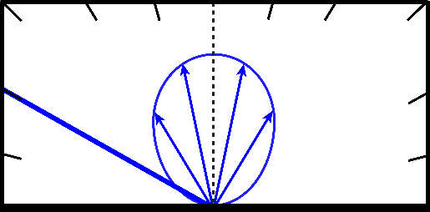
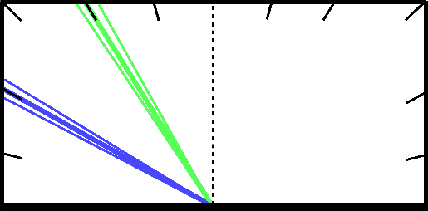
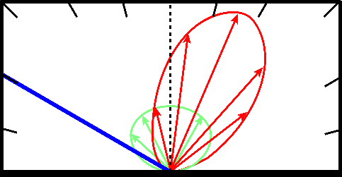
Gas-surface interaction
The particle collisions with the solid walls are modeled using the advanced CLL kernel:
Where R_{CLL} is a complex kernel which depends on two coefficients (a_{t}, a_{n}), one for the tangential momentum and another for the kinetic energy
Data for these coefficients for deuterium and impurities (Ne, Ar, He) were determined experimentally and are available in the literature
Typical values for (a_{t}, a_{n}) extracted from experimental data are: He (0.9,0.1), Ar (0.96, 1.0), D₂ (0.95,0.1)
a_{t}: 0.0
a_{n}: 0.0
a_{t}: 1.0
a_{n}: 1.0
a_{t}: 2.0
a_{n}: 0.0
a_{t}: 0.5
a_{n}: 0.5
specular
diffuse
back-scattering
CLL

Slide 11
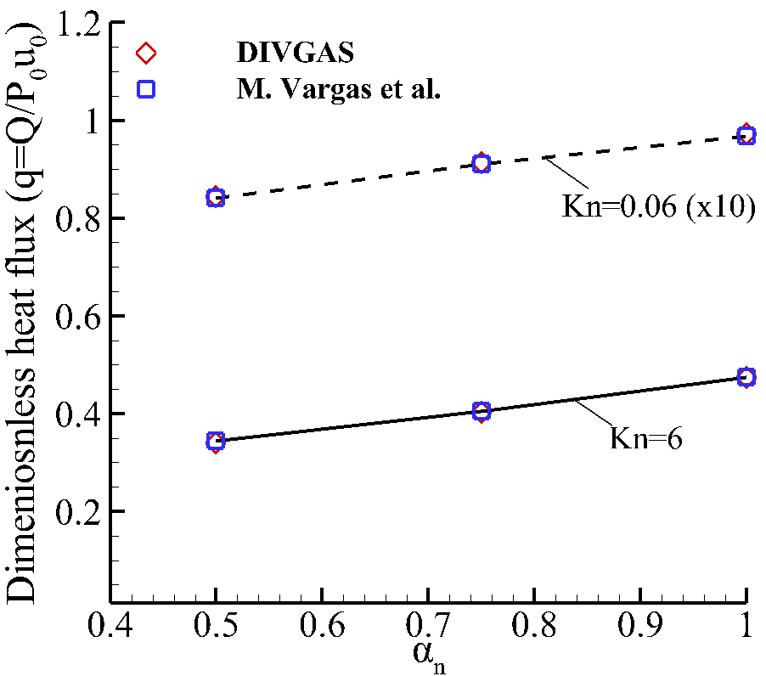
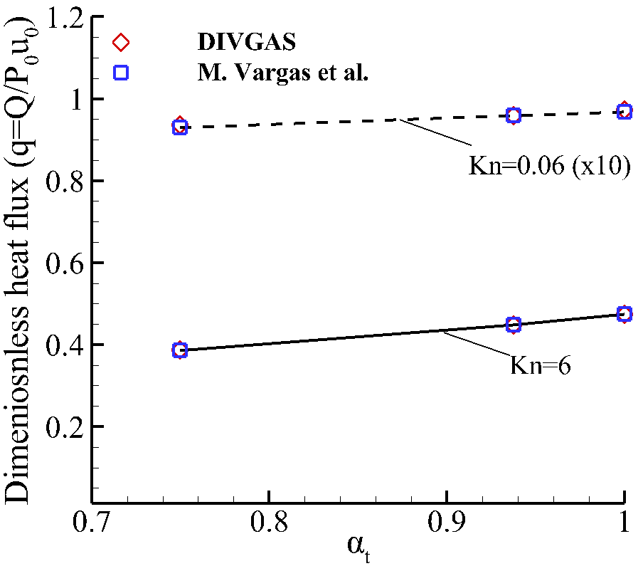
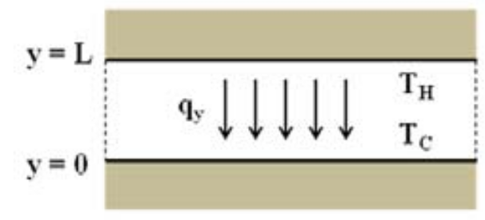
Benchmark
The classical Fourier problem (see the flow set-up shown below) is considered as benchmark in order to validate the accuracy of the CLL implementation in the DIVGAS code (one of the KIT tasks under WPPWIE) by performing comparison with existing data in the literature
Very good agreement is observed in a wide range of the coefficients a_{n} and a_{t} – Maximum relative deviation less than 0.9%
[1] M. Vargas et al., AIP Conference Proceedings 1333, 354 (2011)

Slide 12
Atomic & Molecular processes
Total Collision Energy (TCE) Model [2]
The rate of change in the number density of species A due to the bimolecular reaction $A+B\underset{→}{\text{k}}C+D$, with reaction rate coefficient $k(T)$, can be expressed as
$$\frac{ⅆn_{A}}{dt}=−n_{A}n_{B}k\left(T\right)=−n_{A}n_{B}\overline{σ_{T}c_{r}P_{R}}$$
where $σ_{T}$ and $c_{r}$ are the total cross-section and relative velocity for the A-B collision. Note the reaction probability can also be written in terms of the reaction cross-section, $P_{R}={σ_{R}}/{σ_{T}}$.
The TCE reaction probability can be expressed as:
Gas-phase Reactions | Surface Reactions
D₂+e→e+2D | D⁺→D
D₂+e→2e+D+D⁺ | D⁺→D₂
D+e→2e+D⁺ | D₂⁺→D₂
D₂+e→2e+D₂⁺ | D₂⁺→D
D₂⁺+e→e+D+D⁺ | D→D₂
D+D₂⁺→D₂ + D⁺ | D→D
D₂ + D⁺→D₂⁺ + D | D₂→D₂
D₂⁺+e→D+D
P_{R}=
The TCE formulation can reproduce ionization, dissociation/recombination and exchange reaction rates described in terms of $k\left(T\right)=ΛT^{η}exp(−{E_{a}}/{k_{B}T})$
Deuterium atomic and molecular processes have been implemented in the DIVGAS code considering a set of volumetric and surface reactions.
[2] I. Boyd and T. Schwarzentruber, Nonequilibrium gas dynamics and molecular simulations, Cambridge University Press, (2017).

Slide 13
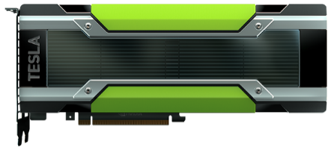
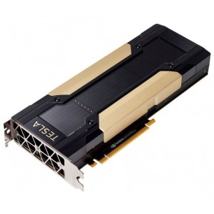
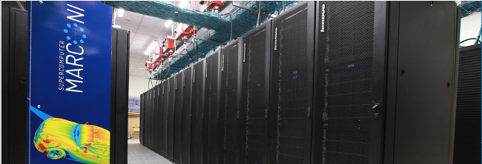
GPU acceleration – MPI, CUDA
NVIDIA Tesla K80 - 4992 NVIDIA CUDA cores with a dual-GPU design (2 x 12 GB of GDDR5 ) - Up to 2.91 teraflops double-precision performance
Source: https://www.nvidia.com
NVIDIA Tesla V100 - 5376 NVIDIA CUDA cores (32 GB HBM2) - Up to 7 teraflops double-precision performance
Source: https://www.nvidia.com
MARCONI A-3 partition – Nodes: 3188
CPUs/Node: 2 x 24-cores Intel Xeon 8160 (SkyLake) at 2.10 GHz
RAM: 196 GB/Node
Peak Performance: ~8 PFlop/s
Source: https://www.hpc.cineca.it/
https://www.hpc.cineca.it/hardware/marconi

Slide 14
SN and XD DIVGAS model
Γ⁺
Γ⁻
Γ⁺
2022 SN baseline DEMO
Species: D₂, D, He, Ar and corresponding ions
Parametric analysis: 0.2Γ⁺, Γ ⁺, 2Γ ⁺ and 5Γ ⁺
A pumping probability 0.05 ≤ ξ ≤ 0.3 is imposed on the pumping opening. The liner is included.
Γ⁻
HFS inlet of neutrals
HFS inlet of neutrals
2019 XD baseline DEMO
LFS inlet of neutrals
Liner
Γ⁺
Liner
Γ⁻
Albedo:
LFS inlet of neutrals
$$\frac{Γ^{−} (ξ)}{Γ^{+}}$$
Γ⁺
Pumping opening
Neutron radiation shields
Γ ⁻
Pumping opening
Γ_{pump}
Particle balance:
Γ_{pump}
$$Γ_{pump}=Γ^{+}−Γ^{−}$$

Slide 15
ITER-SOLPS plasma BCs
SN Divertor
X Divertor
 | P⁺ (Pa) |  | T⁺ (eV) |  | Γ⁺ (s⁻¹ m⁻¹)
 | LFS | HFS | LFS | HFS | LFS | HFS
D | 3.77 | 1.5 | 0.87 | 0.79 | 1.64E+22 | 6.86E+21
D₂ | 5.35 | 4.0 | 0.88 | 0.63 | 1.64E+22 | 1.62E+22
He | 0.5 | 0.3 | 0.9 | 0.99 | 1.48E+21 | 7.90E+20
Ar | 0.085 | 0.04 | 2.74 | 2.66 | 2.81E+19 | 2.08E+19
Albedo | 0.994 (for all neutrals)
 | P⁺ (Pa) |  | T⁺ (eV) |  | Γ⁺ (s⁻¹ m⁻¹)
 | LFS | HFS | LFS | HFS | LFS | HFS
D | 0.33 | 1.17 | 0.15 | 0.81 | 4.98E+21 | 5.46E+21
D₂ | 2.88 | 4.86 | 0.15 | 0.81 | 3.04E+22 | 1.59E+22
He | 0.011 | 0.21 | 0.15 | 0.81 | 1.17E+20 | 6.96E+20
Ar | 0.008 | 0.004 | 0.15 | 0.81 | 2.66E+19 | 4.47E+18
Albedo | 0.45 (for all neutrals)
The SN plasma simulation is based on the „kinetic“, while the XD is based on the „fluid“approximation.
The MARCONI HPC fusion cluster has been exploited.

Slide 16
Effect of A&M processes
It has been observed that in the case with the liner and plasma temperature 10 eV, the influence of A&M processes on neutral pumped flux and outflux is negligible (within ~2% difference). As the temperature increases to 20 eV the neutral outflux increases by ~22%, while pumped flux increases only by ~2%.
In the case without the liner the influence of A&M processes on neutral pumped flux and outflux is more significant and by increasing from 10 eV to 20 eV the outflux and the pumped flux are increased by 16% and 22% respectively.
The average neutral pressure below the liner (i.e in the pumping port) has a weak dependence on the considered A&M processes as well as on the plasma temperature.
In the case with liner, the gas-surface reactions related to the atomic deuterium (D) recombination have a higher impact compared to the gas-phase recombination on the particle exhaust, resulting to large production of molecular deuterium (D₂) close to the walls. Upon convergence, D₂ number density is one order of magnitude higher than atomic deuterium D.

Slide 17
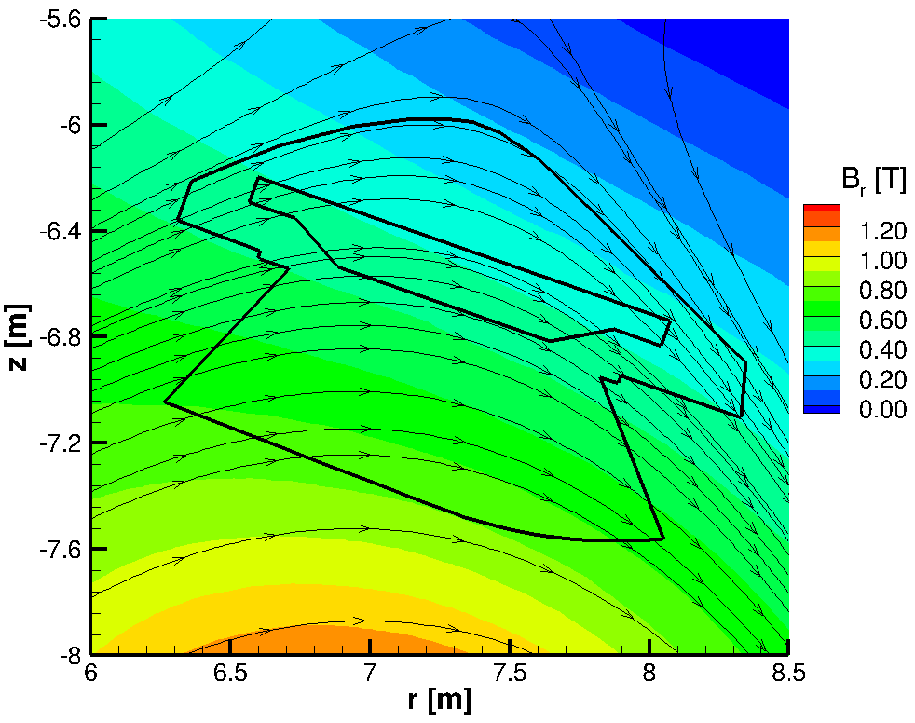
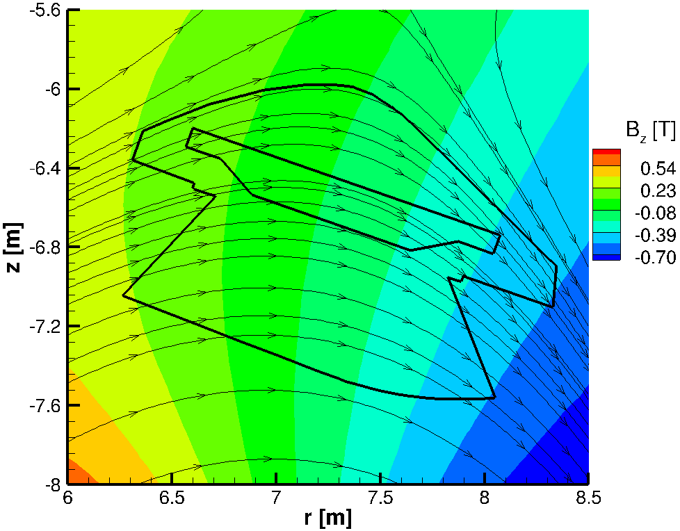
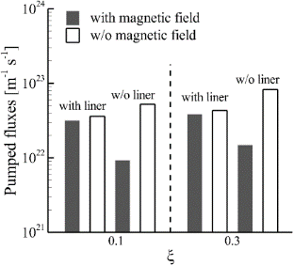
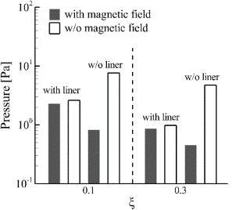
Effect of external fields
By considering the magnetic field in the DIVGAS code the results for a divertor w/o liner are affected significantly, while for the cases with liner the effect of the magnetic field on both pressure and pumped fluxes becomes weak.
The simulations have been performed assuming DEMO relevant magnetic field and boundary conditions (P⁺_{D}=10 Pa, T ⁺_{D} =1 eV, n_{e}=10¹⁹ m⁻³, T_{e}=10 eV).
In the cases w/o liner, the presence of the magnetic field leads to lower pumped fluxes and pressures at the pumping opening (about 80% in pumped fluxes and 90% in pressure).

Slide 18
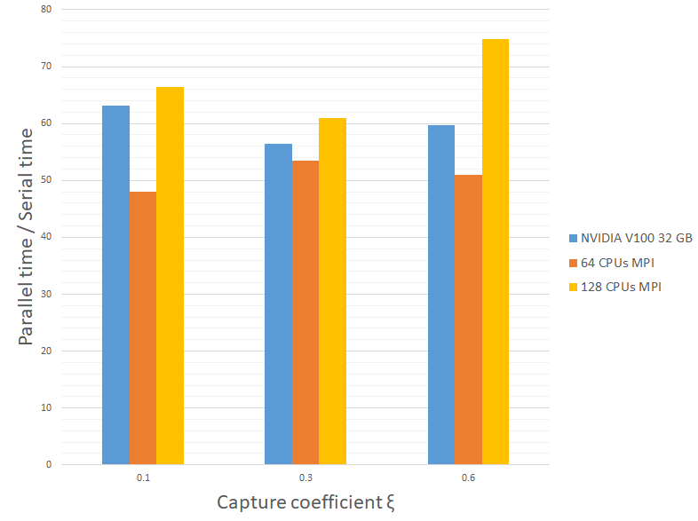
Computing performance
Since the DIVGAS simulations are time consuming, the parallelization optimization had to be completed initially – this task has been completed showing that the hybrid version CPU/GPU of the DIVGAS code can significantly reduce the required computational cost
The GPU simulations have a speed-up of ~60 compared with the serial case
The GPU simulations have a similar speed-up compared with ~96 CPUs
This part of the work has been already published in the Plasma Physics and Controlled Fusion journal: https://doi.org/10.1088/1361-6587/ac172b

Slide 19
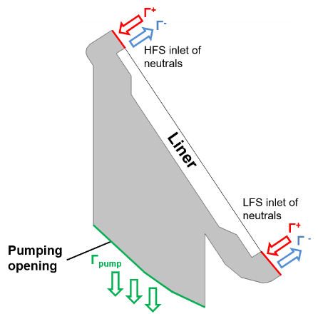
Comparison SN vs XD for Γ⁺ (1)
SN
XD
It has been confirmed that as the pumping probability ξ increases, the albedo decreases for both SN and XD divertor configurations.
It is deduced that the albedo is not the same for the gas species D₂, He and Ar.
For the same pumping probability ξ, the required albedo is lower → Results to lower neutral outflux.
The reason of having D₂ albedos higher than unity is due to the contribution of D to the D₂ outflux through the wall recombination process.

Slide 20
Comparison SN vs XD for Γ⁺ (2)
The presence of the neutron radiation shields results to a reduction ~40% of the pumped flux.
The XD divertor performs slightly better (following the total incoming flux behavior) in terms of pumping efficiency (considering the negative effect of the neutron shields) for deuterium, while for helium the SN performs better, owing to the higher helium incoming flux for SN case.
For reference Γ⁺

Slide 21
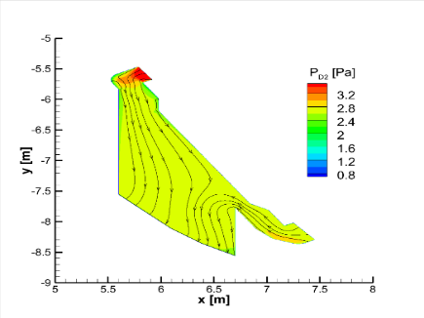
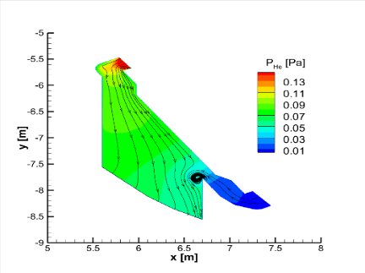
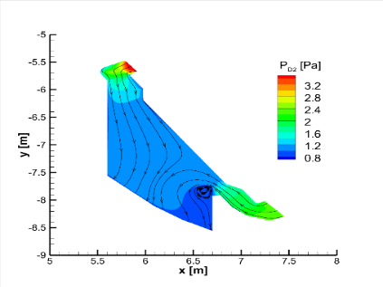
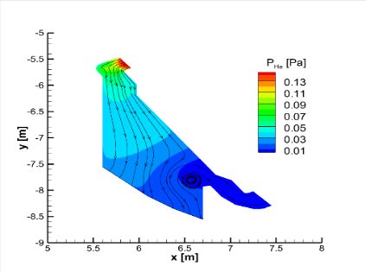
Comparison SN vs XD for Γ⁺ (3)
ξ=0.05
ξ=0.05
ξ=0.05
ξ=0.05
ξ=0.3
ξ=0.3
ξ=0.3
ξ=0.3
For the case of SN, as ξ increases by x6 the helium and deuterium pressure in the sub-divertor decreases by ~x4 and ~x3 respectively. For XD the corresponding values are ~x4 and ~x2 respectively.
At the pumping port, the XD deuterium pressure is ~x1.2-1.7 higher compared to SN.

Slide 22
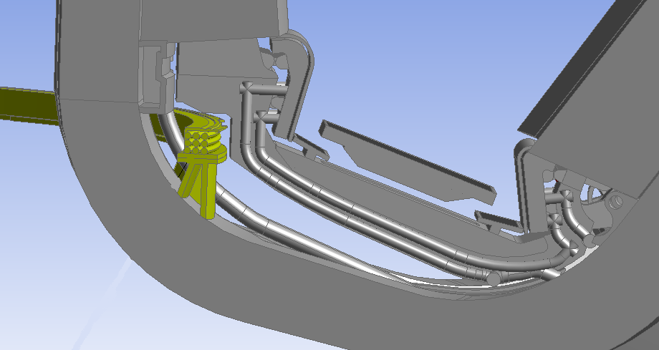
Work for 2024 (PWIE-SP D.4.T-T004-D001)
For 2024, the DIVGAS code will be applied to study the 3D effects (poloidal/toroidal leakages) on the pumping efficiency of the latest DEMO divertor design.
The above study will be based on a reference plasma scenario of SN magnetic configuration, which has been provided by Fabio Subba (email 14/07/2022).
A parametric analysis will be performed assuming different pumping speed scenarios, based on the current pumping system design (the range of pumping probability will be narrowed down in order to reduce the computational effort).
Ongoing work on the simplification of the original 3D CAD model.
After contacting the responsible officer of WPDIV for the divertor configuration (Jeong-Ha You), the latest SN divertor geometry has been provided and is available under the IDM link: https://idm.euro-fusion.org/?uid=2PPMQB

Slide 23
Summary
The DIVGAS code has been upgraded in terms of physics, considering the A&M processes, magnetic field and advance gas-surface interaction models. The DIVGAS code has been accelerated using GPUs.
The new DIVGAS code has been exploited for building-up the albedo database for SN and XD divertors. All the DIVGAS simulations are based on corresponding ITER-SOLPS plasma simulations.
The main outcome from the comparison between SN and XD divertors is that XD performs better in terms of pumping efficiency (considering the negative effect of the neutron shields). Lower albedos should be considered in plasma simulations, compared to the SN case.
For a given pumping probability ξ, the albedo for each specie varies significantly. We confirm that the assumption of having the same albedo for all species, is not realistic. Thus, the albedo values should be extracted from the provided database.

