Slide 1



2D and 3D modeling of WEST plasma background and
W sources and migration with SOLEDGE3X-ERO2.0 suite of codes
G. Ciraolo, S Varadarajan, S. Di Genova, N. Fedorczak, N. Rivals, R. Dull, A. Huart, A. Gallo, H. Bufferand, P. Tamain, E. Tsitrone, the TSVV 6 team and the WEST team.
WP PWIE Midterm Meeting 10/04/2024

Slide 2
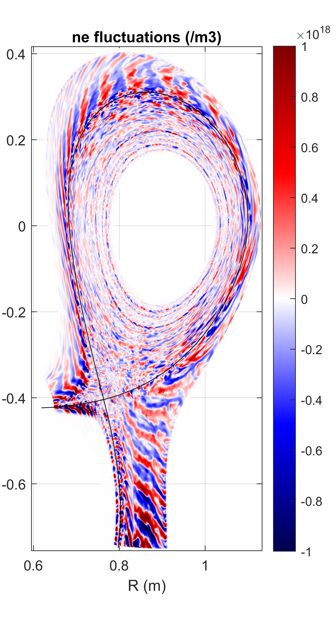
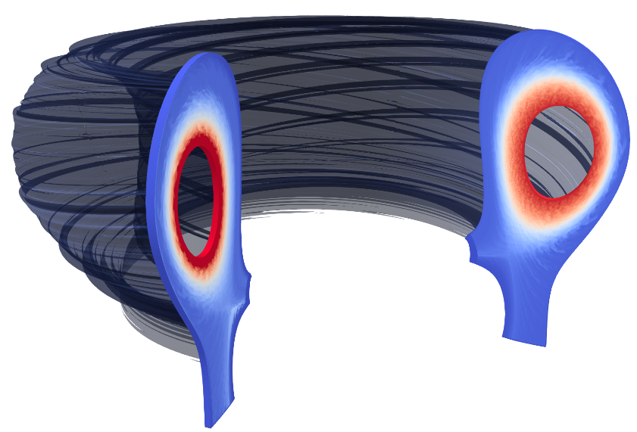

SOLEDGE3X: A VERSATILE FLUID CODE FOR EDGE AND SOL PLASMA
  SOLEDGE3X: multi-fluid modelling tool for the edge plasma resulting from merge of SOLEDGE2D (2D transport code like SOLPS) and TOKAM3X (3D turbulence code)
  Key features:
    Neutrals either fluid (embedded) or kinetic (EIRENE)
    Arbitrary plasma composition based on Zhdanov closure
    Complete plasma geometrical flexibility (arbitrary number of X-points)
    Simulations up-to-the first wall with full wall geometry
    Usable in 2D or 3D
    Usable as mean-field or self-consistent turbulence code
  More information and references on www.soledge3x.com
2D mean-field ITER simulations
 | Mean-field | Turbulence
2D | ✓ | ✓
3D | ✓ | ✓
3D turbulence TCV simulations

Slide 3
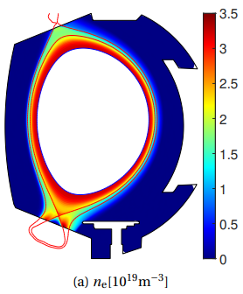
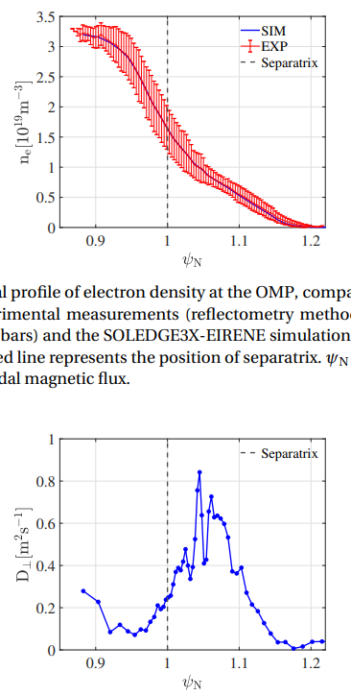
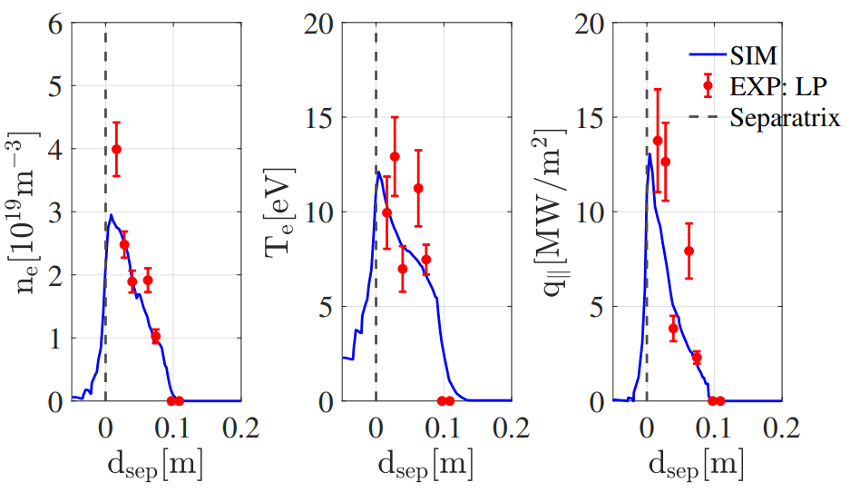
2D TRANSPORT MODE AND COMPARISON WITH EXPS
Radial outer midplane density profile
  SOLEDGE3X (and its predecessor SOLEDGE2D) have now been applied to numerous tokamaks, as for ex.:
    WEST
    TCV
    JET
    DTT, JT60SA, etc…
[H Yang, NME 2022; G Ciraolo, NF 2021; A. Gallo et al, NF 2020; G Ciraolo, NME 2019; K. Afonin NF 2023]
[H Yang et al 2023 Plasma Phys. Control. Fusion 65 125005]
[H Bufferand et al 2022 Plasma Phys. Control. Fusion 64 055001;
J Denis et al, https://hal.science/hal-03913287/]
Outer target profiles
JT60SA simulations: 2D plot of Carbon density in the case with Pedge = 15MW without seeding (left side) and with Neon injection (central plot). The corresponding Neon density is shown on the right side.

Slide 4
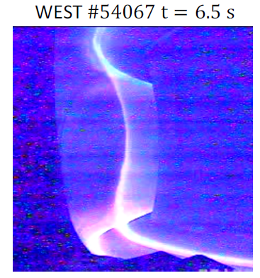
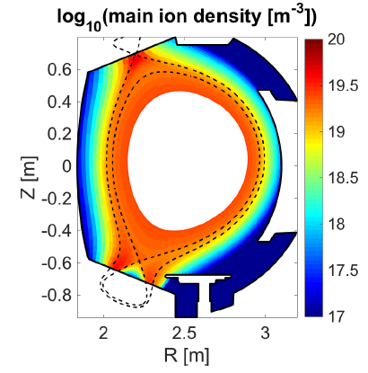
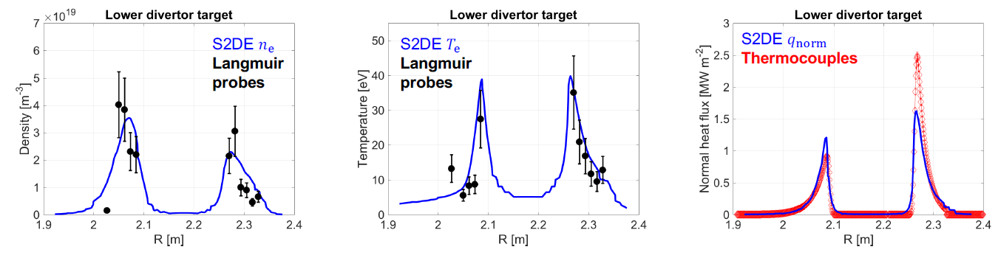

SOLEDGE3X in 2D TRANSPORT MODE AND COMPARISON WITH EXPS: Estimating LOW Z impurity content
Modelling should help understanding plasma radiation level and pattern
Application to Oxygen transport in the SOL [A. Gallo et al., Nuclear Fusion, 2020]
Exp.: WEST #54067 : $P_{SOL}=2MW (4MW$ LH heating - $2MW$ bulk radiation)
$n_{lid}=4⋅{10}^{19}m^{−2}$ (interferometry)
Simu.: D+O plasma (assumption 2% Oxygen in the core)
ad-hoc perpendicular diffusivity: $D=ν=\frac{χ}{2}=1m^{2}s^{−1}$
Top: Target profiles (Exp vs Simu). Right: top, snapshot of visible camera during pulse; bottom, density map of deuterium computed by SOLEDGE3X-EIRENE

Slide 5
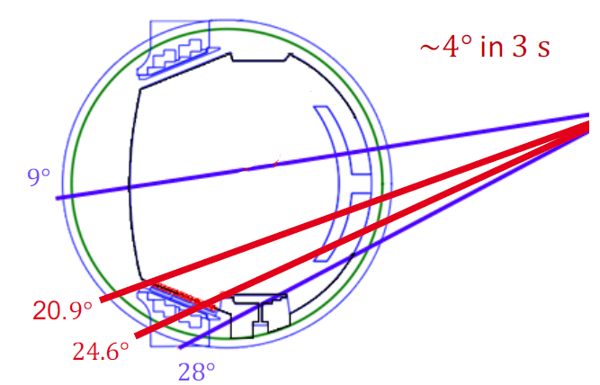
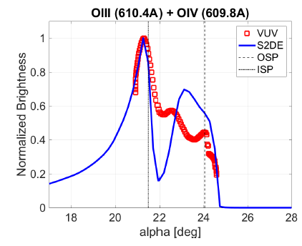
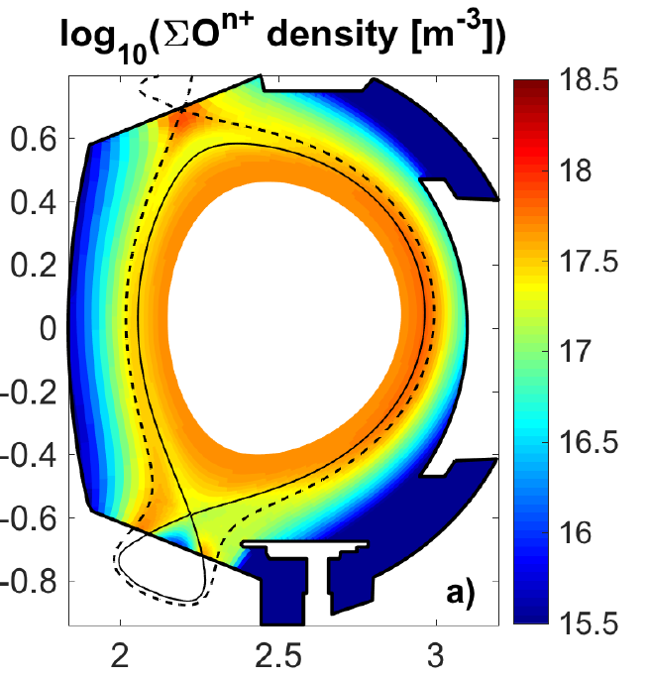
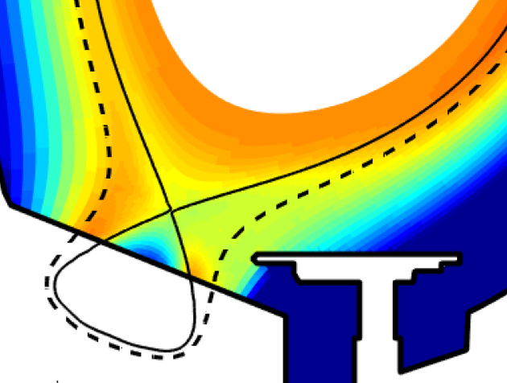
SOLEDGE3X in 2D TRANSPORT MODE AND COMPARISON WITH EXPS: Estimating LOW Z impurity content
Modelling should help understanding plasma radiation level and pattern
Application to Oxygen transport in the SOL [A. Gallo et al., Nuclear Fusion, 2020]
Exp.: WEST #54067 : $P_{SOL}=2MW (4MW$ LH heating - $2MW$ bulk radiation)
$n_{lid}=4⋅{10}^{19}m^{−2}$ (interferometry)
Simu.: D+O plasma (assumption 2% Oxygen in the core)
ad-hoc perpendicular diffusivity: $D=ν=\frac{χ}{2}=1m^{2}s^{−1}$
Maps of Oxygen concentration simulated with SOLEDGE3X-EIRENE showing inner-outer asymmetry. Comparison with VUV measurements (synthetic diagnostic)

Slide 6
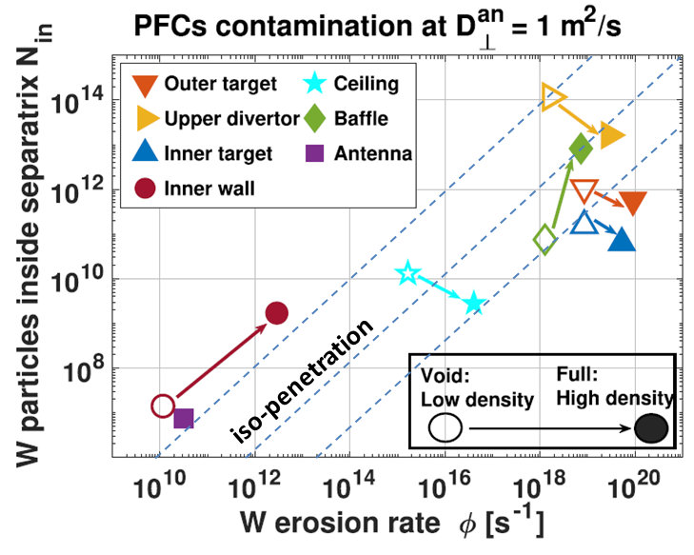
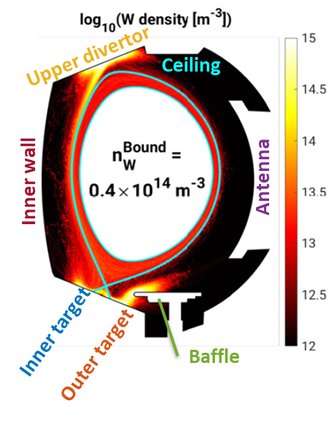
COMPUTATION OF W SOURCES AND MIGRATION WITH ERO2.0 USING SOLEDGE3X PLASMA BACKGROUND
[ S. DiGenova Nucl. Fusion 2021 ]
Lower divertor (main) dominates the source, but low penetration to core
  Importance of accurate frictions & thermal forces in ERO2.0 + accurate flows & // profiles in 2D backgrounds
  Impact of drifts under investgation
Upper divertor & baffles dominate contamination
Contamination highly sensitive to:
SOL regimes, PFC/plasma gaps
Accurate PFC geometry

Slide 7
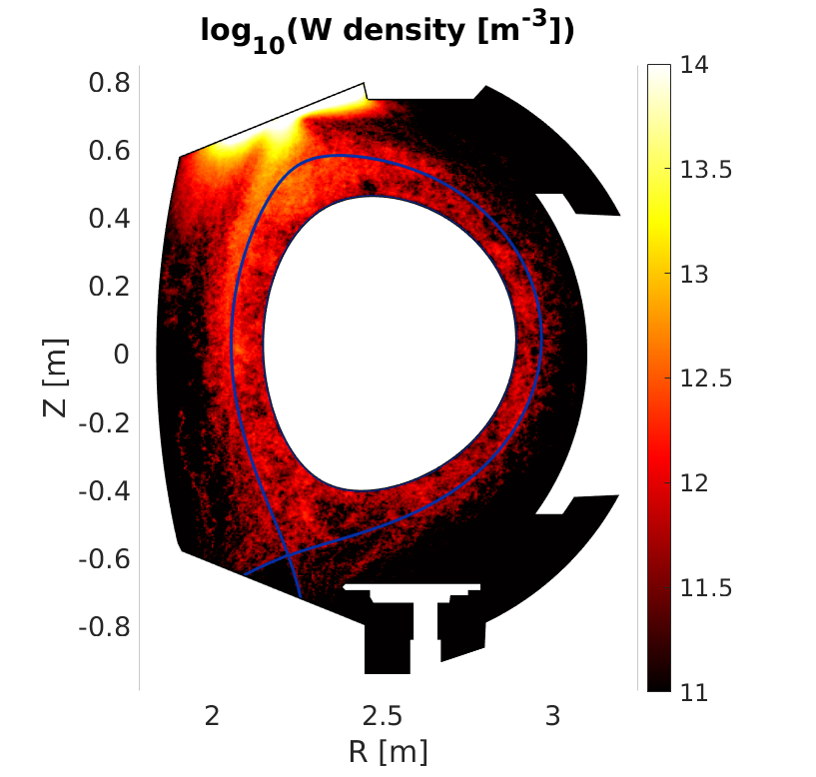
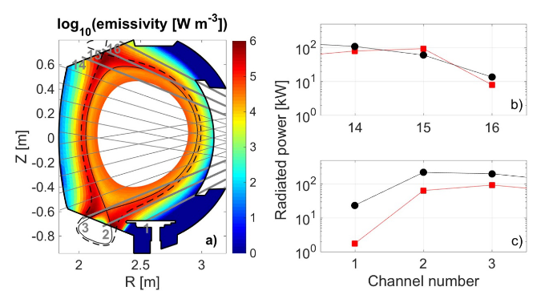
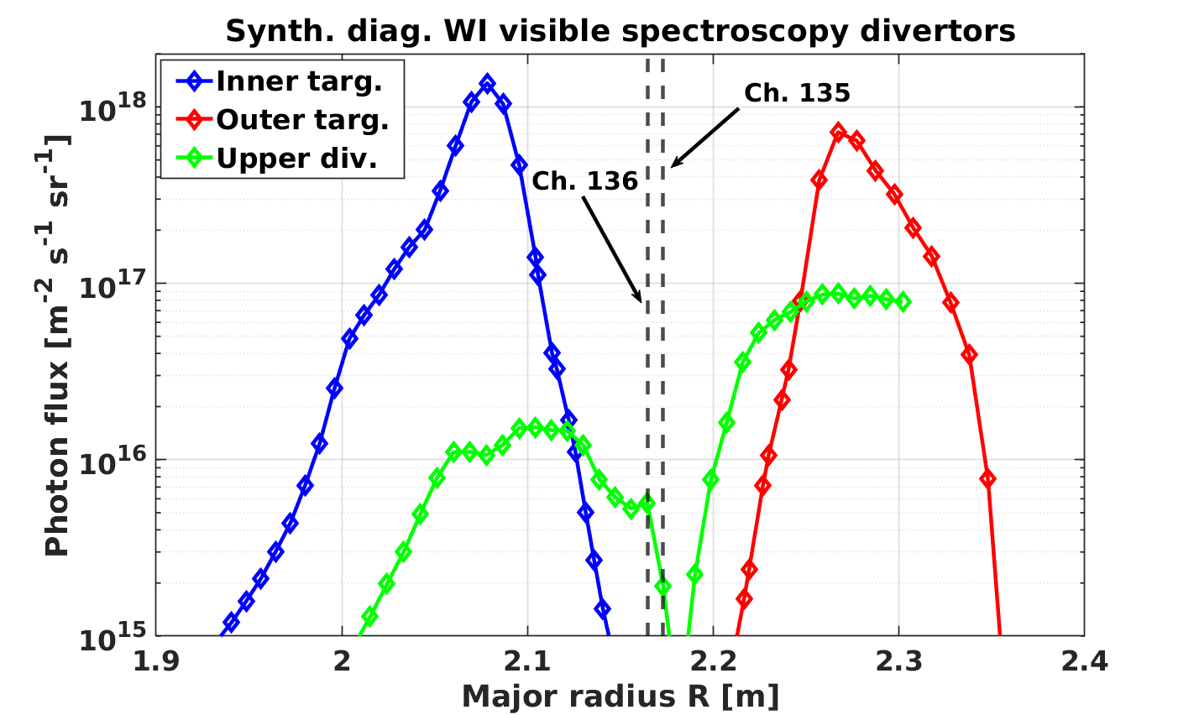
UPPER DIVERTOR CONTRIBUTION TO CORE CONTAMINATION
2D plasma background for WEST #54067
W migration from upper divertor still dominates contamination of the confined plasma
Good match of experimental measurments at upper divertor
Using synthetic diagnostics we compare W visible signal at lower and upper divertor
Upper divertor signal is 10-100 times smaller than lower divertor in simulations

Slide 8
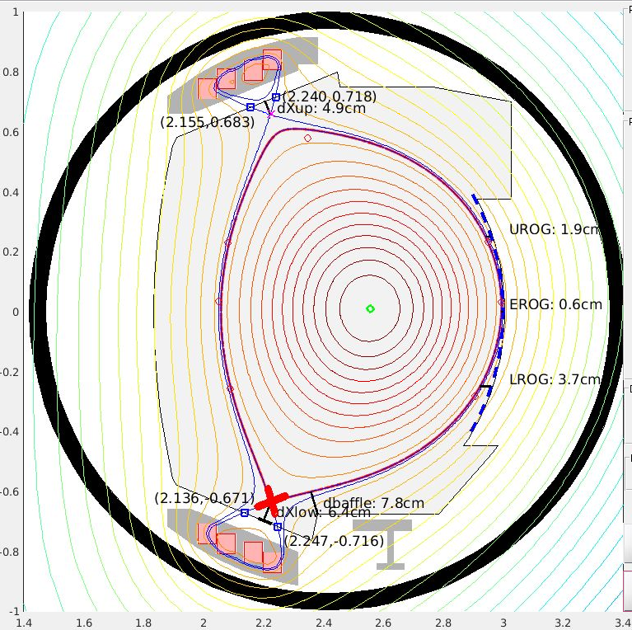
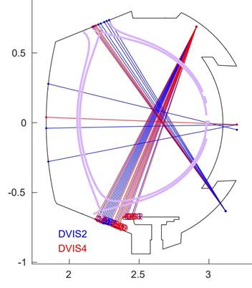
To go further on the estimation of upper divertor sources: experimental session on
“Impurity source characterization”
Proponents
A. Grosjean and the WEST team.
Scientific Background & Objectives
Characterize WEST impurity transport and migration (W & light impurities)
  Spin off C7 exp with extended operational area (n_{e}, P_{LH} scan)
  Emphasis on upper divertor contribution: main vs second separatrix
Experimental Strategy and essential diagnostics
Reference shot: 57953 (500 kA / n_{e} ~4 10¹⁹ m⁻² /P_{LH} ~ 4 MW)
  Plasma shape changes for upper divertor contribution
  Emphasis on gross vs net erosion for W (W I / W II) and B (B II / B IV)
Database for modeling (SOLEDGE-ERO2.0 / DIVIMP / GITR) to be compared with diagnostics
Diagnostics: LP (Flush, RCP, Pecker), visible spectroscopy (DVIS1?,2,7), SIR, bolometry, interfero & reflecto (for INTREF2ne).

Slide 9
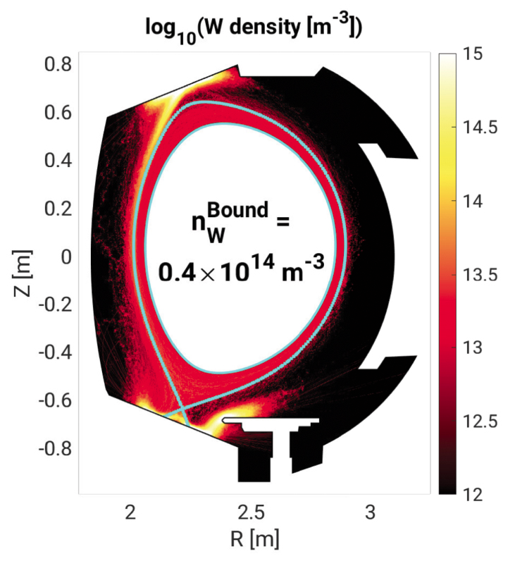
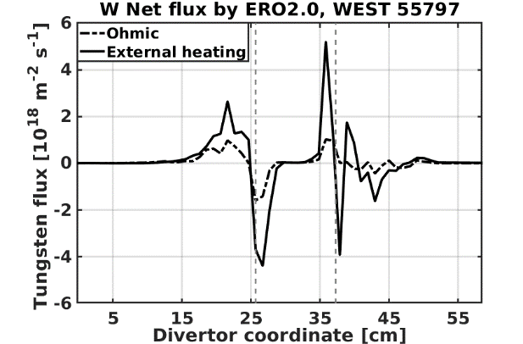
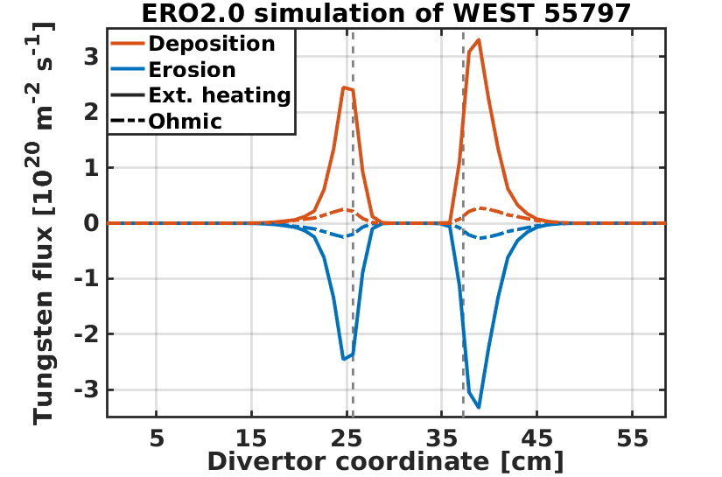
SOLEDGE-ERO2.0 simulations for erosion and deposition pattern on the lower divertor
Code settings:
2D ERO2.0 simulations with realistic WEST wall geometry
2 cases considered :
  Case 1: low density / ohmic (P_{SOL}= 0.45 MW)
  Case 2 : high density / additional power (P_{SOL}= 2.5 MW)
Plasma background from 2D simulations using SOLEDGE3X-Eirene, no drifts, constant transport coefficients (D⊥ = ν⊥ = 0.3 m²s⁻¹ and χ⊥_{e}=χ⊥_{i}=1 m²s⁻¹) ➔ attached plasma in both cases (Te ~15-30 eV at strike point), with higher divertor target density for case 2
3% of oxygen (including all O ionization states from O⁺ to O⁸⁺) as proxy for all light impurities (dominates over D sputtering in those plasma conditions)
No W self sputtering (additional 10-20 % erosion, demanding in computational time)
Poloidal W density map simulated by ERO2.0 using the SOLEDGE plasma background at low density case
Net erosion/deposition enhanced in the high density case
Both the W erosion / deposition fluxes significantly increased in the high density/high power case compared to the ohmic case
Net erosion/deposition profiles also increased for the high density/high power case compared to the ohmic case, but with a less dramatic factor.
Preliminary comparison with data from post mortem analysis :
Overall erosion/deposition pattern roughly recovered (net erosion in the strike point area, deposition elsewhere)
Experimental asymmetry with a strong deposition on the HFS not reproduced

Slide 10
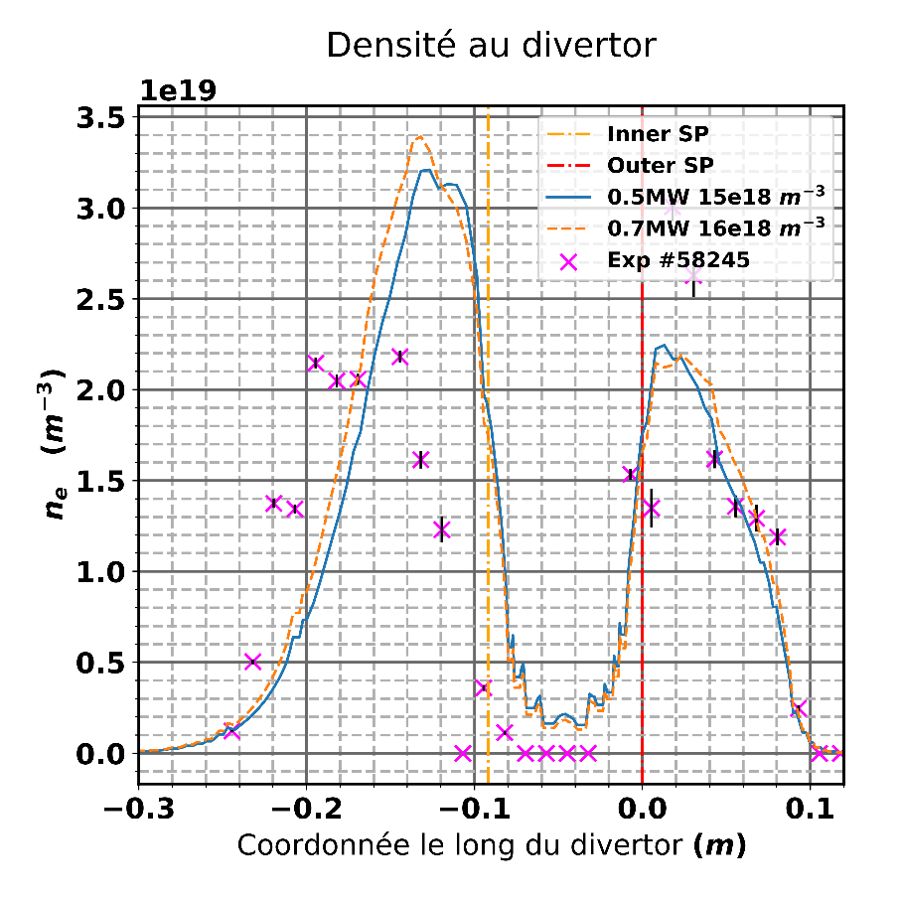
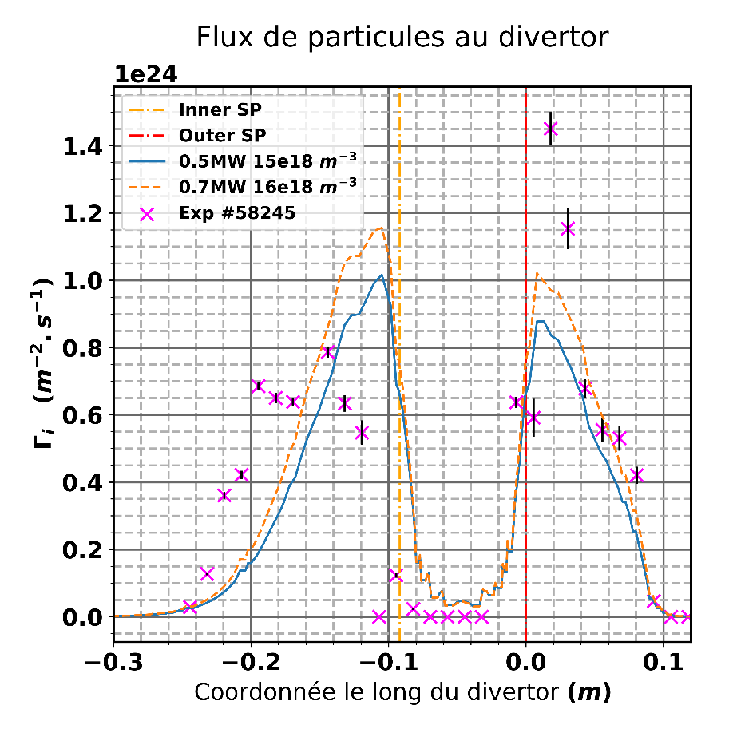
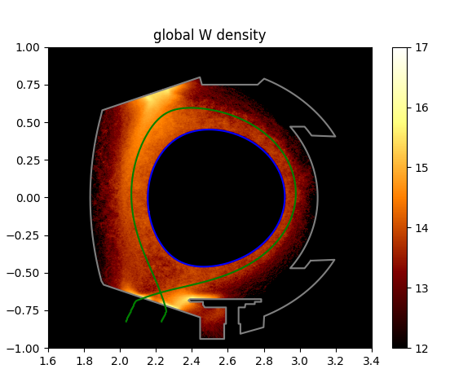
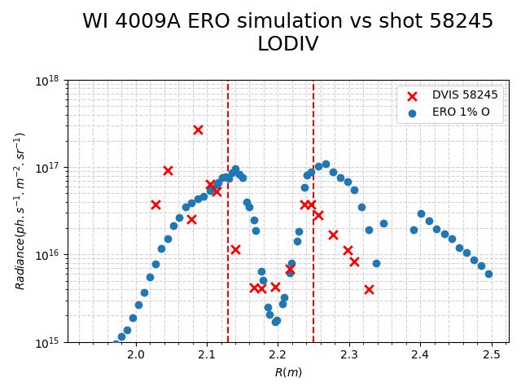
2024 contribution for SP D: Plasma background parameters of WEST for modelling of impurity migration experiments (focus on long-pulse, high fluence discharges)
WEST shot #58245 of the C7 high-fluence campaign
SOLEDGE3X 2D transport axisymmetric simulations: scan in input power, separatrix density, impurity content,…
Simulations and analysis performed by new PhD student, A Huart
target plasma profiles at the lower divertor
First results with ERO2.0 on this high fluence plasma background

Slide 11
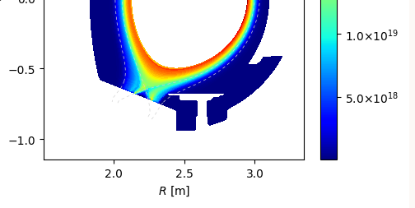
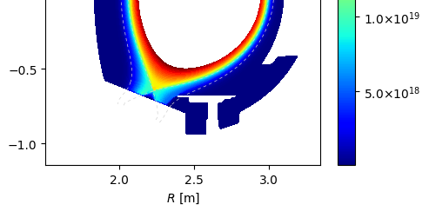
2024 contribution for SP D: Plasma background parameters of WEST for modelling of impurity migration experiments (focus on long-pulse, high fluence discharges)
WEST shot #58245 of the C7 high-fluence campaign
SOLEDGE3X 2D transport axisymmetric simulations: scan in input power, separatrix density, impurity content,…
Simulations and analysis performed by new PhD student, A Huart
target plasma profiles at the lower divertor
Next steps:
  activating drifts
  Radial Transport coefficients with poloidal dependence for reproducing the balooned transport at the OMP
  Plasma composition for SOLEDGE simulations? (D, O, C, B,…)
2D poloidal density map w/wo drifts

Slide 12
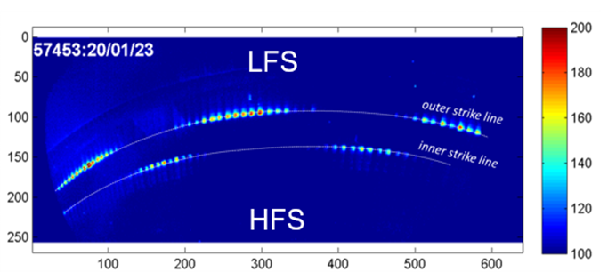
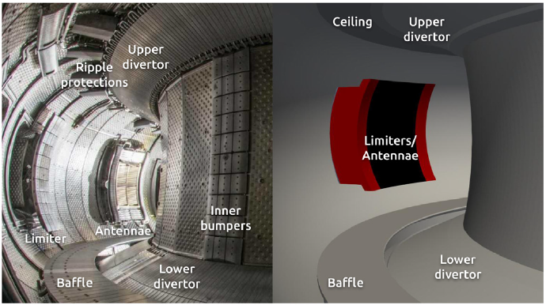
2024 contribution for SP D SOLEDGE3X--ERO2.0 simulations of tungsten transport in WEST, determination of main tungsten sources in WEST, comparison with spectroscopy and post-mortem data. One focus on long-pulse, high-fluence discharges and full 3D treatment (antennae, magnetic field ripple)
Impact of 3D plasma backgrounds (antennae and magnetic field ripple) on W sources and migration following previous analysis
Toroidally localized object (antenna limiters)
Toroidal small modulation of magnetic field (ripple)
3D magnetic field and impact on particle and heat flux toroidal distribution
Non axysimmetric 3D wall

Slide 13
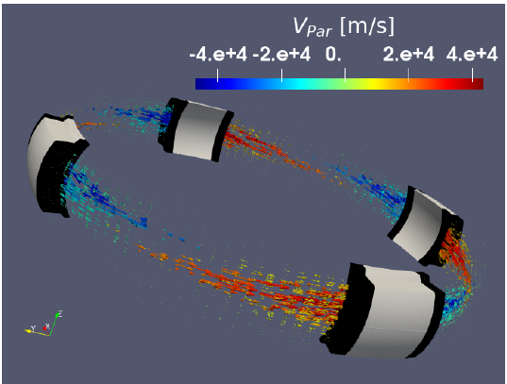
3D SOLEDGE backgrounds for midplane antenna limiters
[ S. DiGenova NME 2023 ]
Simplified wall for 3D SOLEDGE simulations (transport, no turb.)
1/4 torus simulation with SOLEDGE
Parallel flows in the secondary SOLs between antennas
SOLEDGE simulations: Pure Deuterium plasma, no drifts

Slide 14
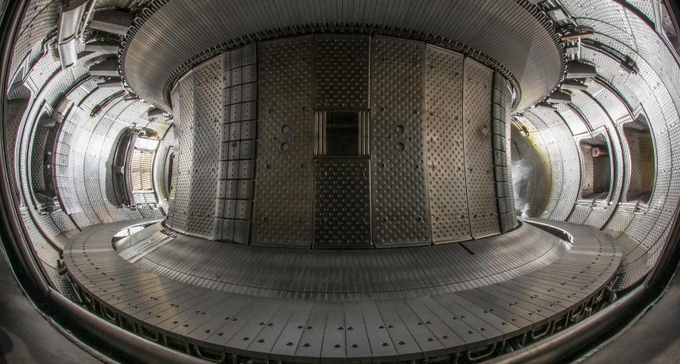
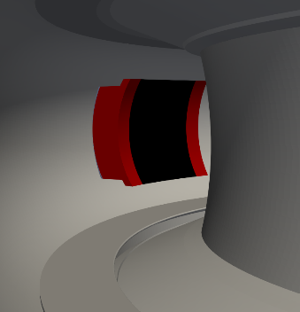
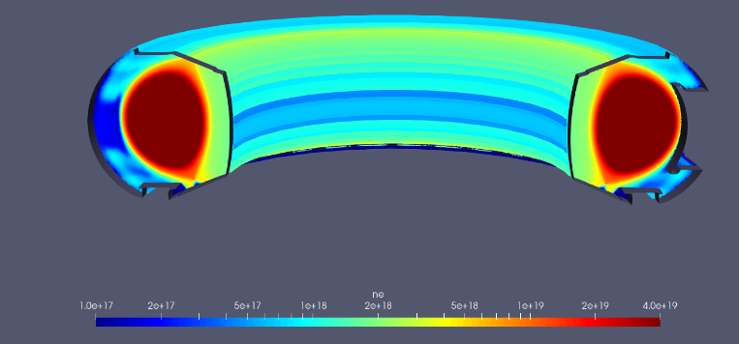
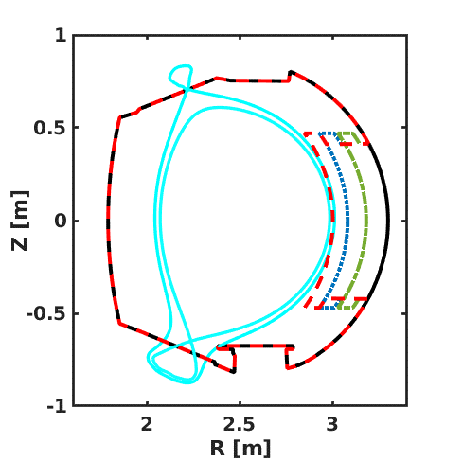
SP D.3 Impurity Migration Modelling: CEA
In order to investigate the role of toroidally localized objects for W sources and core contamination, we performed 3D transport SOLEDGE simulations with a non-axysimmetric wall
3D plasma background transport simulations considering several radial distances from the separatrix of the antenna limiter
3D map of the electron density obtaind with a toroidally localized antenna limiter

Slide 15
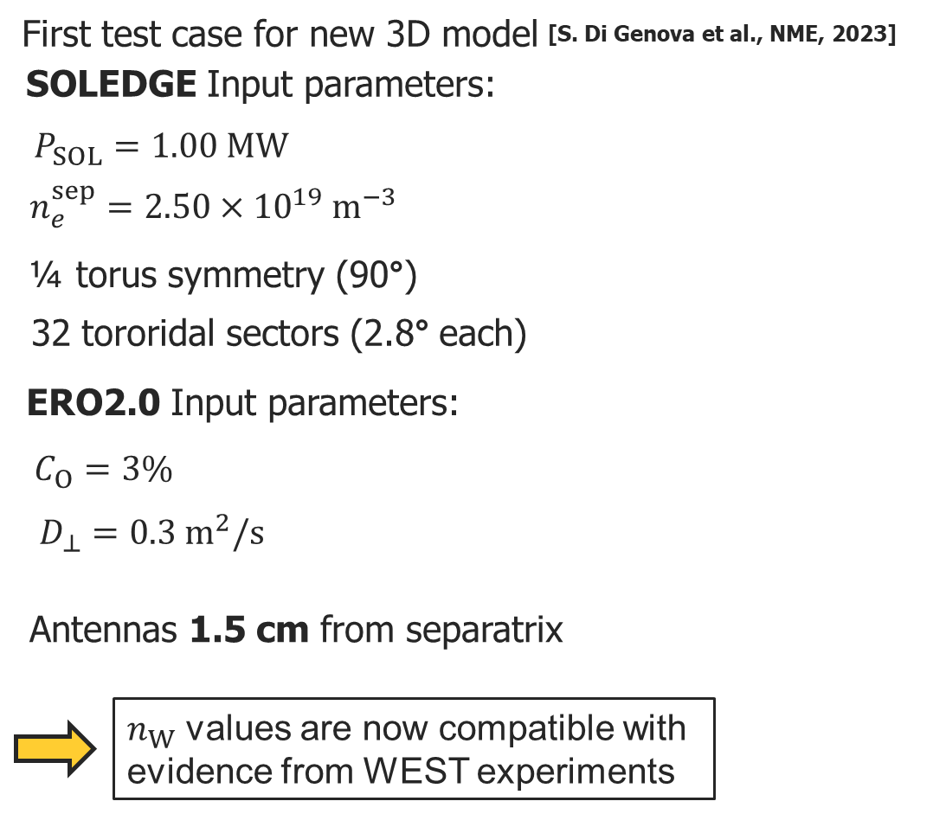
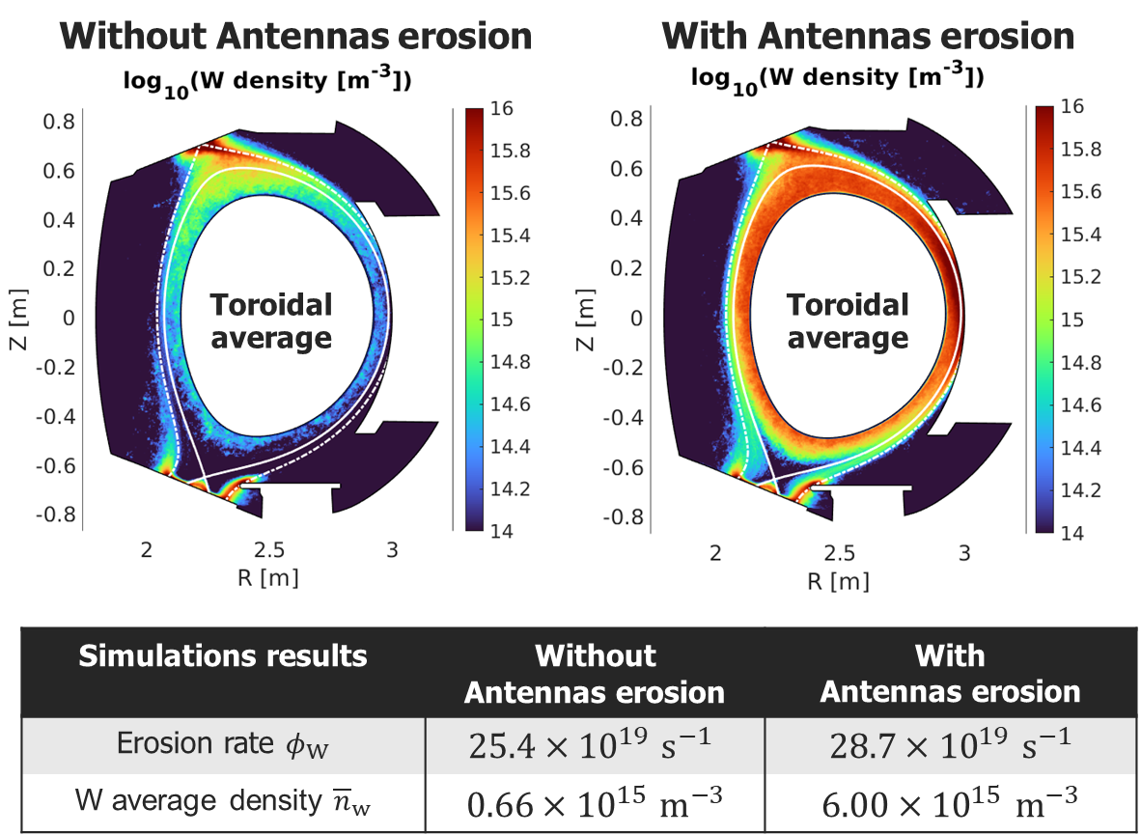
SP D.3 Impurity Migration Modelling: CEA
Simulations results suggests that Antennas erosion dominates W contamination of core plasma

Slide 16
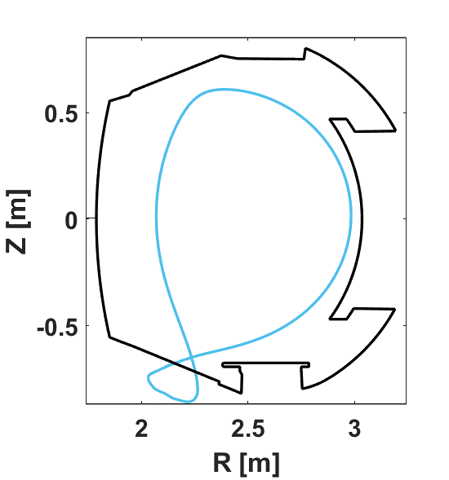
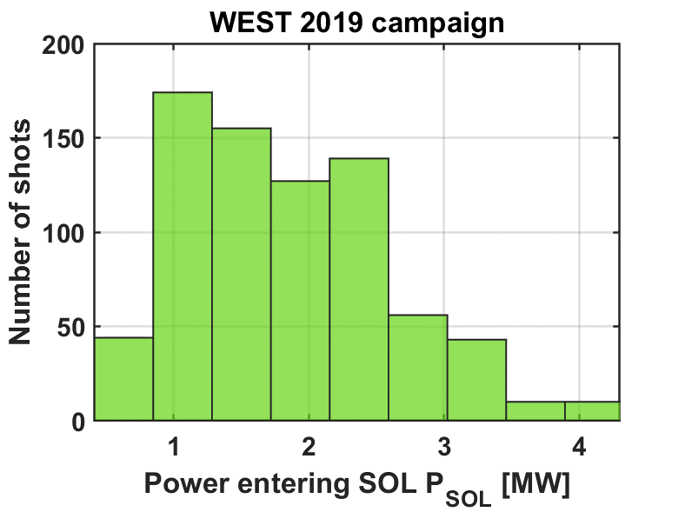
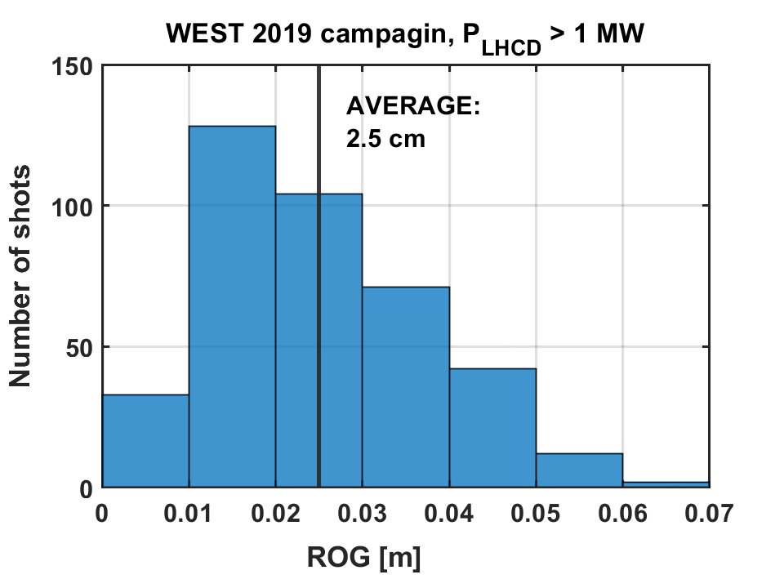
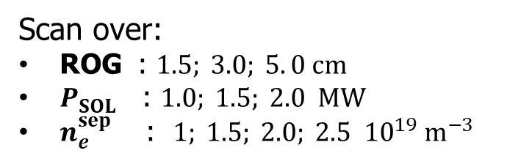
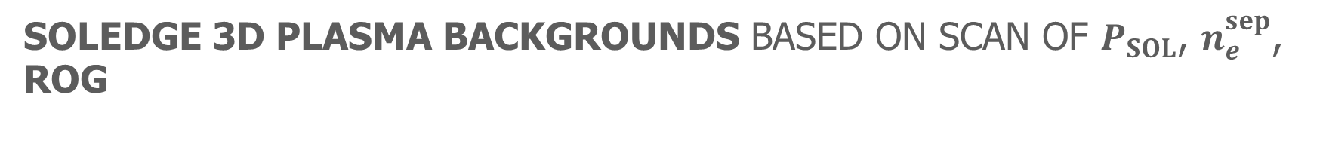
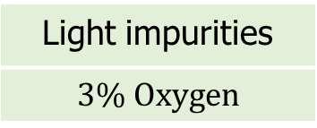

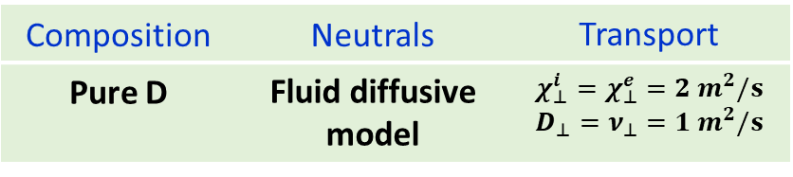

SOLEDGE 3D plasma backgrounds based on scan of $P_{SOL}$, $n_{e}^{sep}$, ROG
30 SOLEDGE 3D plasma backgrounds based on scan of $P_{SOL}$, $n_{e}^{sep}$, ROG
Scan over:
ROG : $1.5; 3.0; 5. 0 cm$
$P_{SOL}$ : $1.0; 1.5; 2.0 MW$
$n_{e}^{sep}$ : $1; 1.5; 2.0; 2.5 {10}^{19} m^{−3}$
Radial Outer Gap (ROG):
radial distance between separatrix and antennas
ROG
Input based on WEST database
$$(n_{e},T_{e},T_{i},\vec{v})$$
SOLEDGE simulations hypotheses:
Composition | Neutrals | Transport
Pure D | Fluid diffusive model | $$χ_{⊥}^{i}=χ_{⊥}^{e}=2 m^{2}/s$$ $$D_{⊥}=ν_{⊥}=1 m^{2}/s$$
$$(n_{W})$$
Fixed ERO2.0 simulations parameters:
Light impurities
$$3\% Oxygen$$

Slide 17
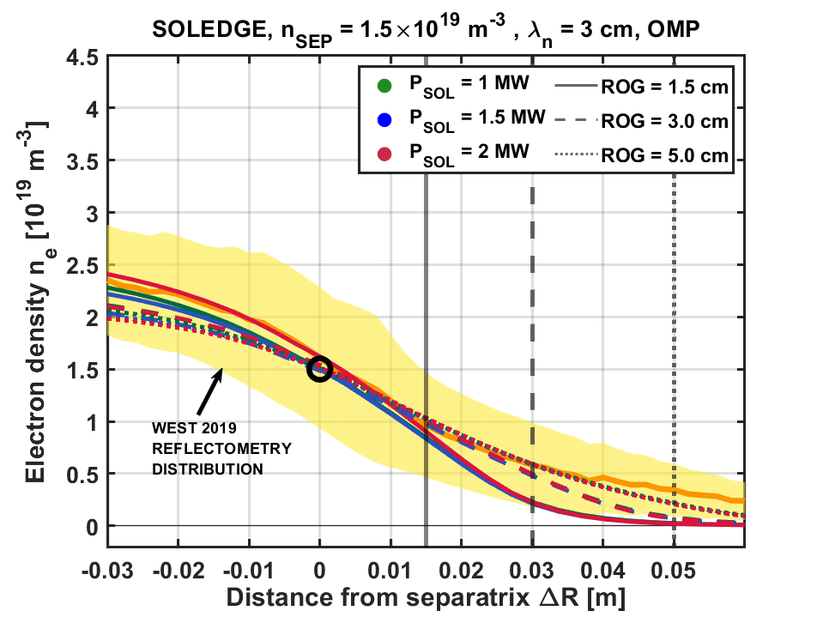
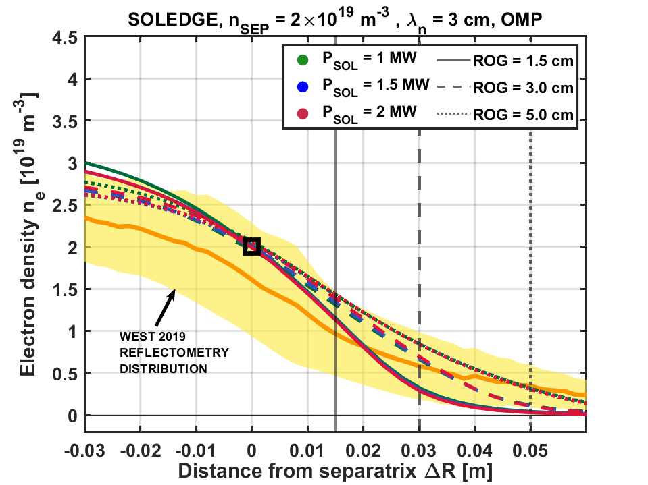
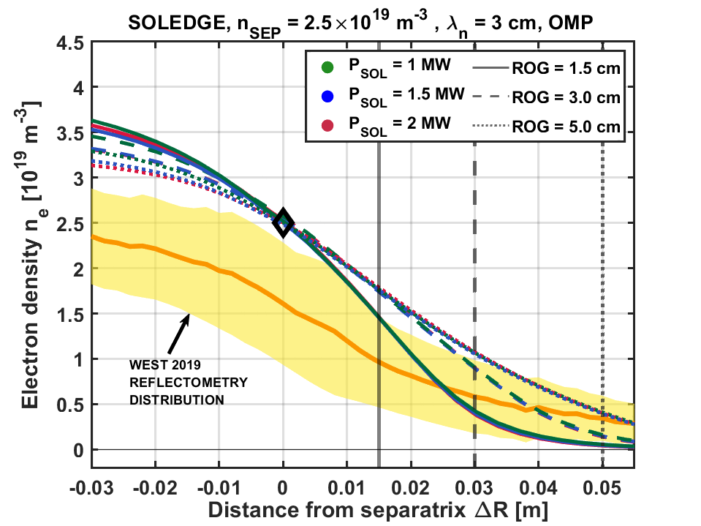



Simulations results in the range of WEST reflectometry data
We compare SOLEDGE simulations with WEST reflectometry at Outer Mid-Plane (OMP)
Orange line is the average measurements in the database
Yellow cloud encloses the SD of the measurements
Simulations results in same range as WEST data.
$$n_{e}^{sep}=1.5×{10}^{19} m^{−3}$$
$$n_{e}^{sep}=2.0×{10}^{19} m^{−3}$$
$$n_{e}^{sep}=2.5×{10}^{19} m^{−3}$$
WEST
DATA
WEST
DATA
WEST
DATA

Slide 18
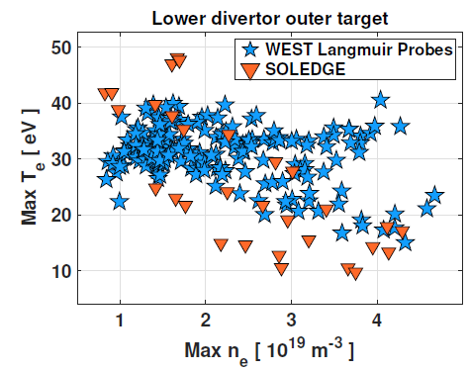
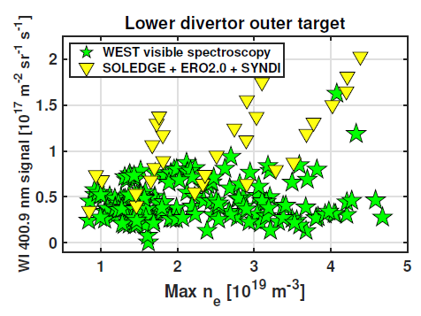
Scan of plasma density, power & outer gap: divertor solutions compatible with experimental tresnds
Divertor solutions compatible with experimental trends:
Plasma electron density & temperature globally matched
Tungsten sources (photons) matched with given Oxygen parameters:
  Full ionisation stages 1+ → 8+ taken from 2D simulations
  Concentration set to 3%
[ S. DiGenova PhD 2023 ]

Slide 19



Global power balance in line with experimental trend
Construct core radiation power from edge simulation:
ER0 2.0 → tungsten concentration inside separatrix → extend to core
Apply effective cooling factor + density peaking → $P_{rad}^{core}=\int{n_{e}^{2}c_{W}L_{W}dV}$
For given simulation @ P_{SOL}, construct $P_{TOT}=P_{SOL}+P_{rad}^{core}$
For $c_{0}=3\%$ , we obtain

Slide 20

Global power balance in line with experimental trend
Construct core radiation power from edge simulation:
ER0 2.0 → tungsten concentration inside separatrix → extend to core
Apply effective cooling factor + density peaking → $P_{rad}^{core}=\int{n_{e}^{2}c_{W}L_{W}dV}$
For given simulation @ P_{SOL}, construct $P_{TOT}=P_{SOL}+P_{rad}^{core}$
For $c_{0}=3\%$ , we obtain $f_{RAD}=60\%$ :
Close to experimental value (~50%)
Independent of plasma density (as experiment)
(Higher density→lower Te @antenna→lower sources)
colors = PSOL scan

Slide 21



Radial outer gap → key control parameter, but experiment less sensitive than simulations
Experiments:
Radial outer gap related to LHCD coupling, no dedicated scan done
Statistically, $f_{RAD}$ decreases by ~ 1.4 for ROG from 1cm to 5cm
Simulations:
$f_{RAD}$ decreases by factor 3 for same ROG
Promising!
Current concerns : detailed shaping of the antenna matters for correct redeposition
Real shape
Antenna limiter from simulations

Slide 22



Electromagnetic model in SOLEDGE3X to take into account 3D magnetic configurations
Introduction of the magnetic vector potential $A_{∥}$
Obtained from the parallel current density via Ampère‘s law:
${∇⋅∇_{⊥}A}_{∥}=−μ_{0}j_{∥}$
Inductive effects on the parallel electric field:
$E_{∥}=−b⋅∇Φ −∂_{t}A_{∥}$
    Impact on the electric potential $Φ$ and $E×B$ velocities
Electromagnetic flutter perturbates the magnetic equilibrium:
$\tilde{B}=\left(∇×b_{eq} \right){\tilde{A}}_{∥}−b_{eq}×∇{\tilde{A}}_{∥}$
    Small impact on parallel gradients $b⋅∇X$ and divergence $∇X⋅b$
    Non-axisymmetric magnetic configuration and radial field $B_{r}$
      → Major code refactoring required
Toroidal perturbations of $A_{∥}$ [in Tm]
On a 3D TCV diverted configuration

Slide 23





The electromagnetic vorticity equation
Implicit system on 3 fields: electric potential $Φ$; parallel magnetic vector potential $A_{∥}$; parallel current density $j_{∥}$
Vorticity equation
Ohm‘s law
Ampère‘s law
No points for $A_{∥}$ and $j_{∥}$ needed on the sheath:
  Dirichlet $A_{∥}^{BC}$=0 on the sheath and tangential wall BC
  The sheath current is directly enforced in the vorticity equation
  $${\left(1+\frac{σ_{∥}m_{e}}{n_{e}e^{2}}∂_{t}\right)j}_{∥}^{BC}=j_{sat}\left(1−e^{Λ−Φ/T_{e}}\right)$$
  Neumann ${∇_{}^{BC}j}_{∥ }=0$for the perpendicular diffusion operator on $j_{∥}$
$A_{∥}$ and $j_{∥}$ are defined on a poloidally and toroidally staggered grid

Slide 24


FIRST SOLEDGE3X SIMULATIONS WITH 3D MAGNETIC FIELD (in transport mode)
Simulations performed by R Dull, PhD CEA
set-up:
Single-species (Deuterium) simulation with SOLEDGE3X in transport mode
WEST configuration with a single lower X point
Fluid neutrals and a gas puff at the outer mid plane
Simulation of 1/18 of a full torus (corresponds to one ripple period) with 16 poloidal planes
Projection of plasma heat fluxes in the $R−φ$ plane in the lower divertor region
3D plasma backgrounds will be compared with experimental data from high fluence reference shot
Simulations with ERO2.0 using such 3D plasma background to study the impact on W sources, migration and core contamination

Slide 25


Progress Towards Integrated Tungsten Modelling with SOLEDGE-3X
N. Varadarajan, H. Bufferand, G. Ciraolo, L. Cappelli, P. Tamain, N. Rivals, S. Sureshkumar, V .Quadri, and the SOLEDGE3X team.

Slide 26
The Need for Integrated Tungsten Modelling
Impurity Dynamics
Edge Dynamics
Core Dynamics
COREDIV
METIS
FACIT
ERO 2.0. GITR
DIVIMP
Fuelling of core due to sources in edge/flushing out of impurities in core.
Feedback on main plasma.
Feedback between impurities.
Sputtering, deposition, oxide layers, edge transport: thermal, friction, pressure force balance.
Core transport: neoclassical effects, turbulence.
SOLEDGE-3X
SOLPS-ITER
PLASMA-WALL INTERACTION
Wall composition, analytic formulae for sputtering, redeposition + optional neural network.
EDGE PLASMA, W MIGRATION
SOLEDGE with D,W + light impurity proxy, fluid neutrals.
CORE PLASMA
1D multi-species particle, momentum, energy transport for the core native to SOLEDGE.

Slide 27



Simulation Domain for Integrated Modelling

Slide 28




Sputtering and Redeposition
Sputtering
Redeposition
Threshold energy below which no sputtering occurs ∝ E_sb.
Impact energy ∝ Sheath potential drop
Scattering cross-section.
Multiple elements in wall.
Balance of ionization mean free path, gyro-radius, sheath width
Redeposition related sputtering
^{[3]}
[1]
[2]
[L. Cappelli]
[1] Eckstein et al. (1993)
[2] Garcia-Rosales, Eckstein et al. (1993)
[3] D. Tskhakaya and M. Groth (2015)

Slide 29



Comparison of Fluid Model with ERO 2.0.
Simulation Setup:
Background: 2.5 MW in WEST geometry, Te_SP ~ 70 eV => E_0 ~ 250 eV > (216 eV)
Up to W30+ solved in SOLEDGE-3X
Parameters kept constant between SOLEDGE-3X and ERO 2.0:
  Zero flux through core as BC.
  Fixed incidence angle of 60 degrees.
  Eckstein-Rosales formula (ERO 2.0. uses TRIM by default).

Slide 30

Comparison of Fluid Model with ERO 2.0.
Simulation Setup:
Background: 2.5 MW in WEST geometry, Te_SP ~ 70 eV => E_0 ~ 250 eV > (216 eV)
Up to W30+ solved in SOLEDGE-3X => Number determined by calculating coronal equilibrium.
Parameters kept constant between SOLEDGE-3X and ERO 2.0:
  Zero flux through core as BC.
  Fixed incidence angle of 60 degrees.
  Eckstein-Rosales formula (ERO 2.0. uses TRIM by default).
Max T_e in edge

Slide 31




Comparison of Fluid Model with ERO 2.0. : Sources
SOLEDGE-3X
ERO 2.0.
Good agreement at OSP, underestimation at ISP

Slide 32


Comparison of Fluid Model with ERO 2.0. : Sources
SOLEDGE-3X
ERO 2.0.
Good agreement at OSP, underestimation at ISP
Possible Sources of Difference:
Diff formulae for incident energies.
Underestimation of non-redeposited fraction from Groth-Tskhakaya formulation.
Self-sputtering due to redeposited W not handled correctly in SOLEDGE-3X currently.

Slide 33



Comparison of Fluid Model with ERO 2.0. : Transport
SOLEDGE-3X
ERO 2.0.
W Accumulation
Baffle Deposition
SEAD? Bohm Condition? Thermal Forces?

Slide 34

Integrated Modelling: Preliminary Results
Simulation Setup and Goals:
Background: 4 MW, D and v_pinch set to get similar values in core to WEST.
Simulations run with D,O,W with diff wall compositions, E_sb = 2.67eV [1]. No self-sputtering.
Core profiles not correct shape.
Electron Temperature (eV)
[1] Gusev et al., 1999

Slide 35

Integrated Modelling: Preliminary Results
Simulation Setup and Goals:
Background: 4 MW, D and v_pinch set to get similar values in core to WEST.
Simulations run with D,O,W with diff wall compositions, E_sb = 2.67eV [1]. No self-sputtering.
Core profiles not correct shape => might be underestimating power radiated.
Electron Density (m^-3)
[1] Gusev et al., 1999

Slide 36

Integrated Modelling: 50% O, 50% W
N_W ~ 7.5e16 (0.04%), N_O ~ 2e17 (0.09%), P_rad ~ 0.88 MW (24%)

Slide 37
Conclusions and Outlook
Integrated Modelling Results
Good match for gross/net sources at OSP, differences at ISP possibly due to differences in incident energy formulae or redeposition sputtering.
Feedback on main plasma seen in integrated modelling case with 4 MW input power.
Sputtering and Redeposition Modelling
Better fit formula for gross yield to better capture behaviour around threshold energy. ^{[1]}
Better model needed for redeposition => Model created recently by L. Cappelli, WIP to understand and integrate it into SOLEDGE.
Current model for energy of redeposited particles is wrong => overestimates energy and hence yields.
Core Transport
For main ion profiles, need to either use diffusion/velocity map, or model for diffusion coefficients to get better match with experiment.
For impurities, need to add in neoclassical effects dependent on main ion gradient ^{[2]}.
Experiments to Model
Limiter experiment in WEST by P. Manas to evaluate W contamination during startup.
Impurity sources experiment by A. Grosjean to evaluate sources at both lower and upper divertors.
[1] Eckstein and Preuss (2003)
[2] D. Fajardo et al. (2023)

Slide 38
References
C. García-Rosales, W. Eckstein, and J. Roth, “Revised Formulae for Sputtering Data,” Journal of Nuclear Materials 218, no. 1 (January 1, 1995): 8–17, accessed June 6, 2023, https://www.sciencedirect.com/science/article/pii/0022311594003769.
Eckstein, Sputtering Data (International Atomic Energy Agency (IAEA): IAEA, 1993), https://pure.mpg.de/rest/items/item_2131245_1/component/file_2131244/content.
Y. Yamamura and Shigeru Shindo, “An Empirical Formula for Angular Dependence of Sputtering Yields,” Radiation Effects 80, no. 1–2 (1984): 57–72, accessed August 21, 2023, http://www.tandfonline.com/doi/abs/10.1080/00337578408222489.
Eckstein, Sputtering by Particle Bombardment, 2007, https://www-eng.lbl.gov/~dleitner/USPAS_2016_Fundamental_Of_Ion_Sources/Reference%20Material/Sputtering/Eckstein_Sputtering_Springer2007.pdf.
M. I. Gusev et al., “Sputtering of Tungsten, Tungsten Oxide, and Tungsten-Carbon Mixed Layers by Deuterium Ions in the Threshold Energy Region,” Technical Physics 44, no. 9 (1999): 1123–1127, accessed November 17, 2023, http://link.springer.com/10.1134/1.1259485.
D. Tskhakaya and M. Groth, “Modelling of Tungsten Re-Deposition Coefficient,” Journal of Nuclear Materials 463 (2015): 624–628, accessed September 8, 2023, https://linkinghub.elsevier.com/retrieve/pii/S0022311514007703.
H. Bufferand et al., “Numerical Modelling for Divertor Design of the WEST Device with a Focus on Plasma–Wall Interactions,” Nuclear Fusion 55, no. 5 (May 1, 2015): 053025, accessed August 8, 2023, https://iopscience.iop.org/article/10.1088/0029-5515/55/5/053025.
L. Cappelli et al., “Study of the Erosion and Redeposition of W Considering the Kinetic Energy Distribution of Incident Ions through a Semi-Analytical Model,” Plasma Physics and Controlled Fusion 65, no. 9 (July 2023): 095001, accessed July 28, 2023, https://dx.doi.org/10.1088/1361-6587/ace282.
Artaud et al., “METIS: A Fast Integrated Tokamak Modelling Tool for scenario Design” (2018): 50, accessed June 9, 2023, https://hal-cea.archives-ouvertes.fr/cea-01873853/document.
R. Zagórski, R.I. Ivanova-Stanik, and R. Stankiewicz, “Simulations with the COREDIV Code of DEMO Discharges,” Nuclear Fusion 53, no. 7 (July 1, 2013): 073030, accessed June 8, 2023, https://iopscience.iop.org/article/10.1088/0029-5515/53/7/073030.
D Fajardo et al., “Analytical Model for the Combined Effects of Rotation and Collisionality on Neoclassical Impurity Transport,” Plasma Physics and Controlled Fusion 65, no. 3 (March 1, 2023): 035021, accessed January 4, 2024, https://iopscience.iop.org/article/10.1088/1361-6587/acb0fc.

Slide 39


EXTRA: Groth-Tskhakaya Model

Slide 40


EXTRA: Comparison of FNR With ERO 2.0.
SOLEDGE-3X
ERO 2.0.

Slide 41


EXTRA: Comparison of Deposition Locations
SOLEDGE-3X
ERO 2.0.
Antenna
Upper Divertor

Slide 42


EXTRA: Neural Network [L. Cappelli]
Created from a simplified model of the sheath with the following assumptions:
No grad B forces or roughness.
No reflections/sputtering due to redeposition.
Collisionless.
Isothermal T_e.
No gradients along the surface.

Slide 43

EXTRA: Neural Network
Graph below shown for case with redeposition sputtering switched on - not well-suited for NN.

Slide 44

EXTRA: Comparison with TRIM
ERO 2.0.
ERO 2.0. (TRIM)
ERO 2.0.
Possible Sources of Difference:
Eckstein formula underestimates yield close to threshold as compared to expt.
TRIM data ERO uses is more coarse around the threshold.

Slide 45


EXTRA: Comparison with TRIM
SOLEDGE-3X
ERO 2.0. (TRIM)

Slide 46


EXTRA: Improved Sputtering Yield Formula
Better behavior around threshold for W -> W. Need to double check for D -> W

Slide 47


EXTRA: 50% O, 50% W
N_W ~ 7.5e16 (0.04%), N_O ~ 2e17 (0.09%), P_rad ~ 0.88 MW (24%)

Slide 48

EXTRA: 50% O, 50% W
N_W ~ 7.5e16 (0.04%), N_O ~ 2e17 (0.09%), P_rad ~ 0.88 MW (24%)

Slide 49

EXTRA: 50% O, 50% W
N_W ~ 7.5e16 (0.04%), N_O ~ 2e17 (0.09%), P_rad ~ 0.88 MW (24%)

Slide 50


EXTRA: 50% O, 50% W
N_W ~ 7.5e16 (0.04%), N_O ~ 2e17 (0.09%), P_rad ~ 0.88 MW (24%)

Slide 51


EXTRA: 50% O, 50% W
N_W ~ 7.5e16 (0.04%), N_O ~ 2e17 (0.09%), P_rad ~ 0.88 MW (24%)
Antenna
Upper Divertor
Lower Strike Points
Baffle

Slide 52

EXTRA: 80% O, 20% W
n_W ~ 6e16 (0.03%), n_O ~ 3.5e17 (0.17%), P_rad ~ 0.76 MW (19%)

Slide 53
EXTRA: 1D Core Model
Fluxes
Edge
Core
Density, Momentum, Energy
(+ asymmetry correction)
| PAGE 53

Slide 54

EXTRA: Neoclassical Model
What drives (radial) impurity transport in the core?
Mainly dominated by:
Interactions with main ion, rather than self-collisions. Can be subdivided into:
  Contribution from main ion density gradient.
  Contribution from main ion temp gradient => strong dep on collisionality. Usually (but not always) leads to outward flux, helping to screen impurities.
  The two effects above combine leading to strongly radially peaked impurity density.
Anomalous diffusion from turbulence. Can induce poloidal asymmetries.
Can model each diffusion coeff as comprised of three components: Classical, Pfirsch-Schluter, Banana-Plateau.
| PAGE 54

Slide 55

EXTRA: Neoclassical Model
Values shown are for W29+. High collisionality regime, BP component dominates. K,H orders of magnitude larger than D.
| PAGE 55

Slide 56


EXTRA: Neoclassical Model
SHOT #58245

Slide 57

EXTRA: Neoclassical Model
SHOT #58245
grad Ti < grad ni
grad Ti > grad ni

Slide 58



EXTRA: Estimation of Coronal Equilibrium
Detailed Balance:
Steady-State Solution:

Slide 59







SOLEDGE3X-ERO2.0 simulations and Core radiation: Using a 0-D model
SOLEDGE and ERO2.0 confined plasma computational
domain stops at inner boundary
We assume that the average W density in the core is given by the inner boundary value:
${\overline{n}}_{W}^{ }={ n}_{W}{\left.​\right|}_{ inner boundary}$
Inner
Boundary
WEST database
In WEST average $n_{e}$ in core is linked to $n_{e}^{sep}$through the correlation:
[C. Bourdelle et al., NF, 2023]
${\overline{n}}_{e}≈n_{e}^{bar}=\text{3.5}×{\left(\frac{n_{e}^{sep}}{{10}^{19}}\right)}^{0.3}$
$$\overline{n}=3.5×n_{sep}^{0.3}$$
[C. Bourdelle et al., NF, 2023]
Radiated power estimation:
Total power estimation:
$$P_{Rad}=\int_{V}{n_{e}n_{W}L_{W}\left(T_{e}\right)dV}∼Const×{\overline{n}}_{e}{\overline{n}}_{W}$$
$P_{TOT} = P_{SOL} + P_{Rad}$

Slide 60











Analysis of 3D results considering average $n_{W}$ on the inner boundary
Erosion weakens
$$n_{W}$$
decreases
Increasing ROG could decrease $n_{W}$
but it isn’t a free parameter
If ROG
increases
If $P_{SOL}$
increases
Stronger erosion
$$n_{W}$$
increases
$n_{W}$ almost proportional to $P_{SOL}$
$n_{W}∝$ $P_{SOL}$
If $n_{e}^{sep}$
increases
Higher screening
$$n_{W}$$
decreases
$P_{Rad}$ depends on ${ n}_{W}n_{e}$
$P_{Rad}$ may not change with${ n}_{e}^{sep}$

