Slide 1
WP PWIE: SPA reporting 2023
SPL A: Jan W. Coenen
Talk 10.04.2024
Notes:
Please Indicate your subproject

Slide 2
SPA Report - 2023
Focus on damage evolution of ITER-like MBs
(including WEST MBs)
Recrystallisation evolution in W (incl. modelling)
Focus on ITER-like MBs testing under multiple seeding, species, ELMs, and He
Plasma qualification of new materials for DEMO and other toroidal facilities (e.g. W7-X)
Disruption-like loading for DEMO (incl. OLMAT)
Melting of MBs => MEMETO modelling)
KIPT as possible during cicumstances
SP A.1 Synergistic Load Studies of Plasma-Facing Materials for ITER & DEMO
SP A.2 High Particle Fluence Exposures of Plasma-Facing Components for ITER
SP A.3 Advanced Materials under thermo-mechanical and plasma loads
SP A.4 High Temperature performance of Armour Materials: Recrystallization and Melting
Detailed information
Participants: CEA, CIEMAT, DIFFER, DTU, FZJ, JSI, KIPT, LPP-ERM-KMS, MPG, VR
https://idm.euro-fusion.org/default.aspx?uid=2PBXPU

Slide 3
Milestones 2023
Sequential WP-M ID | Related WBS ID | WP Milestone Title | Due Date [mm/yyyy]
WM53 | SP A | Viability of advanced plasma-facing materials for DEMO-assessed including prototype materials such as W VPS on steel (with WPBB). Lifetime assessment linked to WEST, MAGNUM-PSI, GLADIS and JUDITH testing. (DEMO) | 31.12.2023
WM54 | SP A | Characterisation of exposed WEST W-PFCs regarding recrystallization and damage. Further studies on material recrystallization physics incl. µ-CT studies (ITER). | 31.12.2023
WM55 | SP A | Exposure of DEMO baseline W mono-blocks (from WPDIV) in MAGNUM-PSI at high plasms fluence and mixed seeding species (DEMO) | 31.12.2023
WM56 | SP A | Benchmark of MEMOS-U and new MEMENTO code with W melt experiments in ASDEX Upgrade and WEST (with WPTE). (ITER+DEMO) | 31.12.2023
Notes:
Repalce by your SPX

Slide 4
WP PWIE: SPA Overview
Planing & Deliverables
Notes:
Please Indicate your subproject

Slide 5
Milestones 2024
Sequential WP-M ID | Related WBS ID | WP Milestone Title | Due Date [mm/yyyy]
WM82 | SP A | Feasibility of advanced plasma-facing materials for DEMO, including prototype materials like W FGMs on steel (with WPBB) assessed. Connecting the assessment of their lifespan to testing conducted in facilities such as WEST, MAGNUM-PSI, GLADIS, and JUDITH. (DEMO) | 31.12.2024
WM83 | SP A | The damage and evolution of material structure on WEST components, as well as linear facilities, analysed. Further investigations into the physics of material recrystallization, including µ-CT studies. (ITER+DEMO) | 31.12.2024
WM84 | SP A | High fluence experiments with transients on MAGNUM PSI executed to facilitate lifetime and component evolution for ITER and DEMO. (ITER+DEMO) | 31.12.2024
WM85 | SP A | Experimental studies on ITER relevant loads such as VDEs, related to new W-Wall PFCs executed and analysed. Accompanying studies utilizing modelling with e.g. Memento. (ITER) | 31.12.2024

Slide 6
SP A Tasks 2024
SP A1
Synergistic Load Studies of Plasma-Facing Materials for ITER & DEMO
SP A2
High Particle Fluence Exposures of Plasma-Facing Components for ITER
SP A3
Advanced Materials under thermo-mechanical and plasma loads
SP A4
High Temperature performance of Armour Materials: Recrystallization and Melting
SP A1
Continuation of activities
Include KIT FGMs
Include Pre-damage of W
Lifetime assesment
Add VDE Damage ?
SP A2
Continuation of activities
Choose new Materials / Mockups
PRD/MAT/DIV
Slow transients + analysis
SP A3
Continuation of activities
New Material Types / Samples
Synergistic Loads on SMART-W
SP A4
Continuation of Activities
µm- CT Analyse von Compositen
Further extension of Recrystallisation activities DTU.CEA.FZJ
Notes:
This is just a summary table – Michael will provide it.

Slide 7
Activity Sheets / Topics
Minor Adaptions for 2024
Feedback from Deliverable owners already worked in
Mostly Continuation of work
All information @
https://idm.euro-fusion.org/default.aspx?uid=2PBXPU

Slide 8
WP PWIE: SPA 1
Planning
Notes:
Please Indicate your subproject

Slide 9
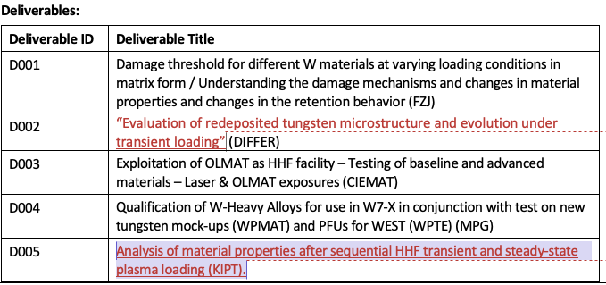
SPA 1
SP A.1 Synergistic Load Studies of Plasma-Facing Materials for ITER & DEMO
Talk by R. Neu
Deliverable Owner | Beneficiary | PM | Deliverable (Team)
M. Wirtz | FZJ | 5 | D001 (M. Gago, D. Dorow-Gerspach*)
T. Morgan | DIFFER | 4 | D002, (T. Morgan)
P. Tabares | CIEMAT | 6 | D003 (D. Alegre)
H. Greuner | MPG | 3 | D004 (H. Greuner, H. Maier, J.Riesch)
I. Garkusha | KIPT | 15 | D005 (I. Garkusha)
Total |  | 33
Device | Beneficiary | Days | Related Deliverable
PSI-2 | FZJ | 7 | D001
JUDITH | FZJ | 15 | D001
Accelerator | FZJ | 3 | D001 jointly with SPA 3/SPA 4
GLADIS | MPG | 5 | D004
MAGNUM-PSI | DIFFER | 5 | D002
UPP | DIFFER | 1 | D002
OLMAT | CIEMAT | 10 | D003

Slide 10
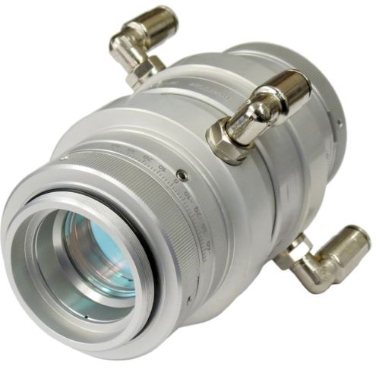
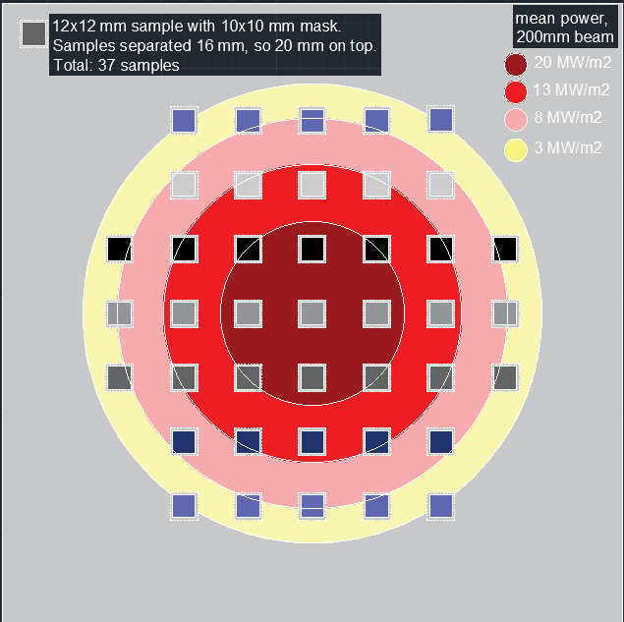
D003: EXPLOITATION OF OLMAT AS HHF: STATUS
DISRUPTION SIMULATION AT EDGES WITH LASER
Experiments performed showed ablation at power where it should not (like 600 MW/m²). Still being studied
Use a flat top lens to try to solve it.
Experiments scheduled at the end of the year.
FATIGUE CRACKING
Installing the water-cooled sample holder.
Experiments likely in June (3 OLMAT Operation days)
Materials: PoMA-WfW, ITER-like W, SMART-W.
We will test the laser for large number of cycles (10⁶⁻⁸) and low power (10-20 MW/m²).

Slide 11
WP PWIE: SPA 2
Planning
Notes:
Please Indicate your subproject

Slide 12
SPA 2
SP A.2 High Particle Fluence Exposures of Plasma-Facing Components for ITER
Deliverable Owner | Beneficiary | PM | Deliverable (Team)
T. Morgan | DIFFER | 5 | D001 (T. Morgan)
M. Balden | MPG | 2 | D002 (S. Elgeti)
Total |  | 7
Device | Beneficiary | Days | Related Deliverable
MAGNUM-PSI | DIFFER | 8 | D001
UPP | DIFFER | 1 | D001

Slide 13
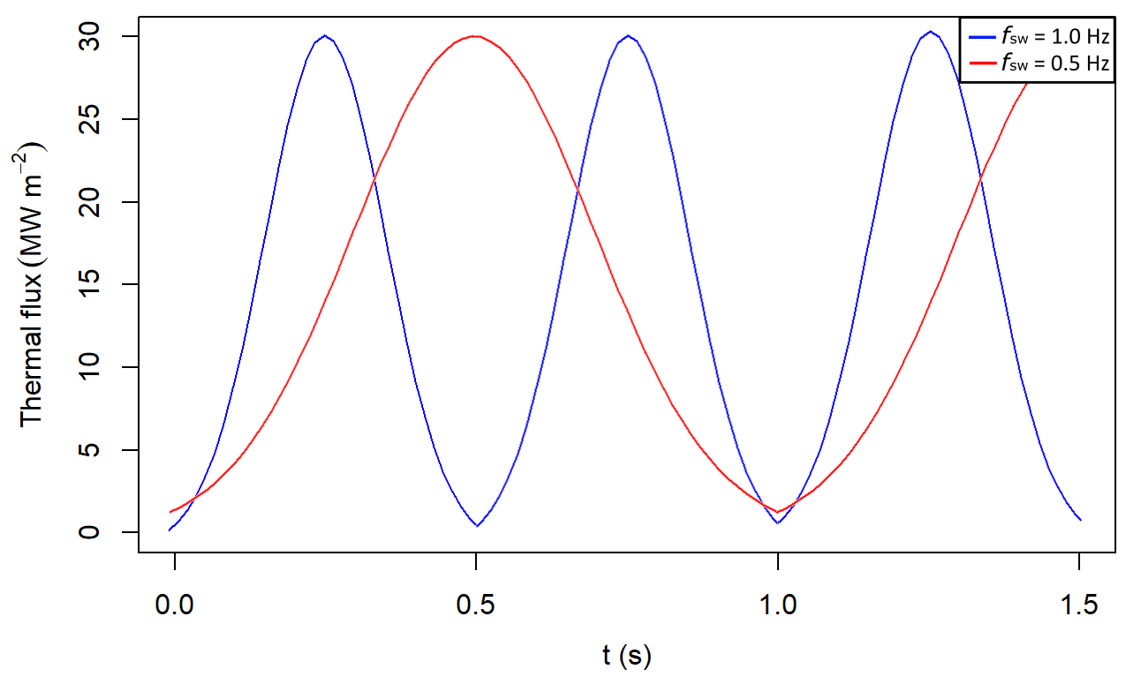
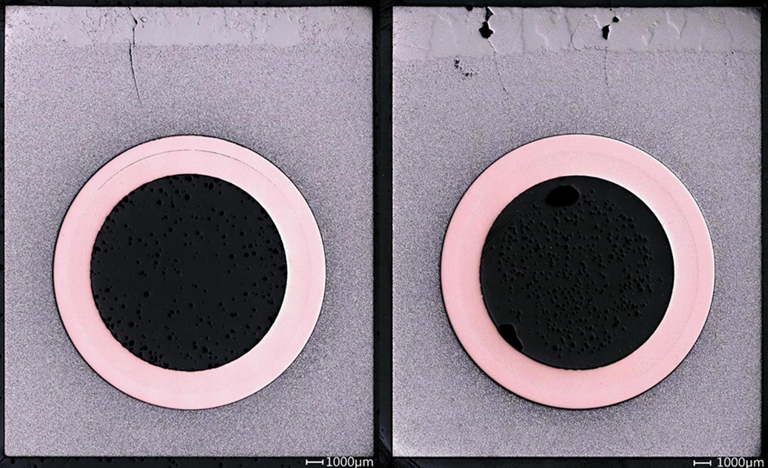
Fatigue cracking and creep evolution of W samples and W-monoblocks exposed to strike point sweeping
Experiment 1 (w/c 22nd April)
Experiment 2 (TBC, est. summer 2024)
Test Magnum-PSI modifications (plasma pulsing) that enable strikepoint sweeping testing under reattached DEMO divertor conditions (Maviglia 2016):
Q = 15, 30 MW m⁻², f_{sw} = 0.5 – 5 Hz, A_{sw} = 50 – 400 mm
Using the new Magnum-PSI test regime, expose pristine, ELM pre-cracked, and recrystalised monoblock mockups (and/or W samples) to DEMO-representative strikepoint sweeping at a range of base temperatures. Compare to existing studies without plasma effects (You 2022):
Fig. 1. Emulating strikepoint sweeping in DEMO by pulsing Magnum-PSI’s current source.
Fig 2. Surface cracking of monoblock mockups exposed to 100 cycles of 25 MW m⁻²
(You 2022)
Use Magnum-PSI to induce low cycle fatigue in W targets. Characterise via SEM/EBSD, and compare against literature data (Schmunk 1984) to explore how H⁺ plasma-loading affects W fatigue crack initiation.
Derive experimentally-validated Coffin-Manson parameters for pristine, recrystalised, and pre-cracked W under H+ plasma loading. Also explore effect of temperature on fatigue life (creep-fatigue interaction).

Slide 14
WP PWIE: SPA 3
Planning
Notes:
Please Indicate your subproject

Slide 15
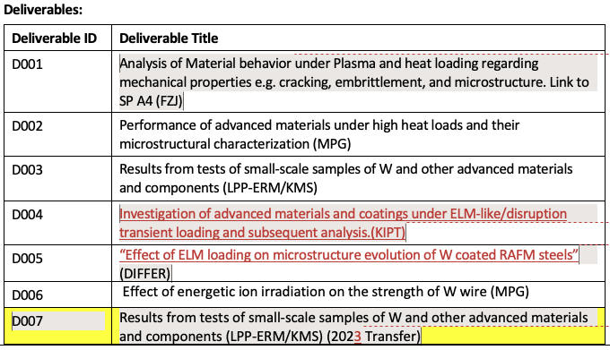
SPA 3
SP A.3 / Advanced Materials under thermo-mechanical and plasma loads
Deliverable Owner | Beneficiary | PM | Deliverable (Team)
J.W. Coenen | FZJ | 10 | D001 (M. Wirtz, J.W. Coenen, A. Litnovsky)
T. Morgan | DIFFER | 3 | D005
I. Garkusha | KIPT | 15 | D004
D. Terentyev | LPP-ERM/KMS | 4 | D003
J. Riesch | MPG | 2 | D002, D006 (B. Curzadd, S. Elgeti)
D. Terentyev | LPP-ERM/KMS | 1.91 | D007
Total |  | 29.91
Device | Beneficiary | Days | Related Deliverable
PSI-2 | FZJ | 6 | D001
JUDITH | FZJ | 10 | D001
GLADIS | MPG | 5 | D002, D003, D006
Accelerator | MPG | 10 | D002, D003, D006
QSPA | KIPT | 10 | D004
MAGNUM-PSI | DIFFER | 4 | D005
UPP | DIFFER | 1 | D005
Effect of transient loading on microstructure evolution of RAFM steels (Differ)

Slide 16
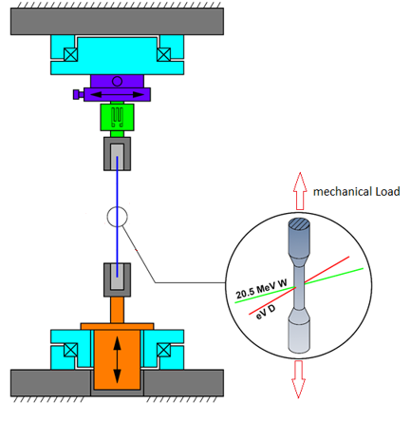
What is the GIRAFFE
General-purpose irradiated fiber and foil experiment
Dedicated experiment to investigate synergistic effects on materials in a simulated fusion environment
Possibility of three different loads simultaneously
Mechanical load using a linear piezo motor
Irradiation damage using MeV ions from the tandem accelerator
Deuterium loading via a low energy ion source
Rotary stage
Load cell
Sample
Linear actuator
Rotary stage
Bailey Curzadd | IPP

Slide 17
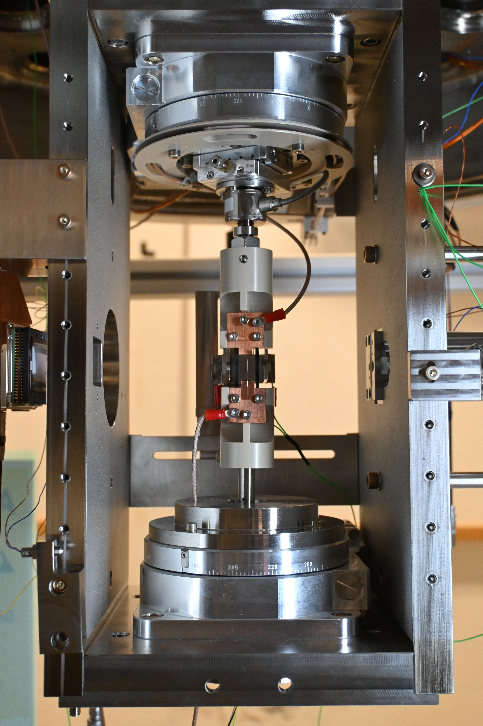
What is the GIRAFFE
General-purpose irradiated fiber and foil experiment
Dedicated experiment to investigate synergistic effects on materials in a simulated fusion environment
Possibility of three different loads simultaneously
Mechanical load using a linear piezo motor
Irradiation damage using MeV ions from the tandem accelerator
Deuterium loading via a low energy ion source
Rotary stage
Load cell
Sample
Linear actuator
Rotary stage
Robert Lürbke | IPP

Slide 18
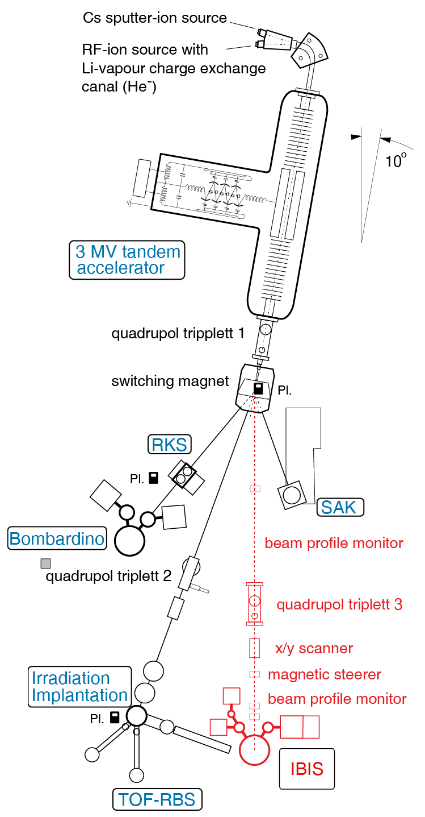
What is the GIRAFFE
General-purpose irradiated fiber and foil experiment
Dedicated experiment to investigate synergistic effects on materials in a simulated fusion environment
Possibility of three different loads simultaneously
Mechanical load using a linear piezo motor
Irradiation damage using MeV ions from the tandem accelerator
Deuterium loading via a low energy ion source
Installed in a UHV vessel at the accelerator laboratory
GIRAFFE
at the moment
in the future

Slide 19
Planned experiments

Slide 20
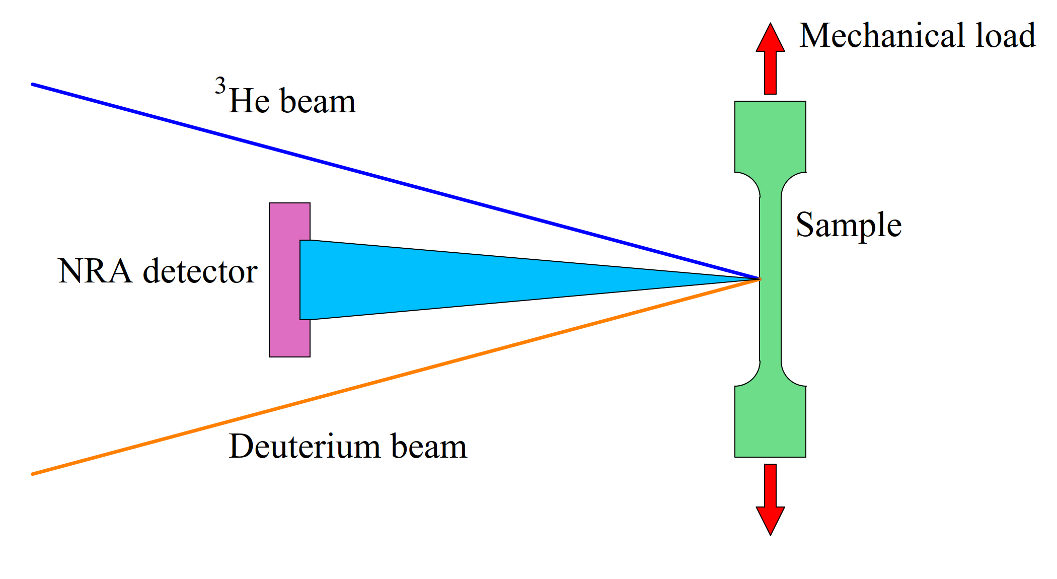
Influence of mechanical stress on deuterium retention
25 µm tungsten foils as samples
Sample is mechanically preloaded within the elastic region
Deuterium loading using low energy ion source
In situ NRA to determine the retained deuterium
Data for model building but also as a baseline for following investigations

Slide 21
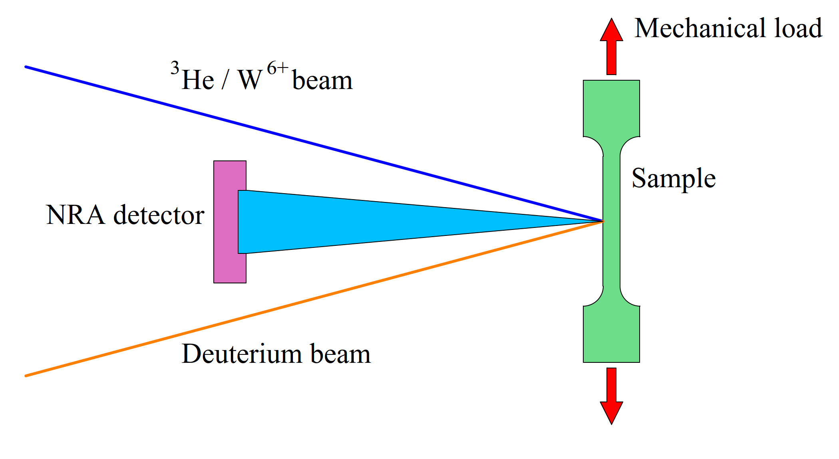
Influence of mechanical stress on the production of irradiation damage
Same samples as in the previous experiment
Damaging the sample with high-energy ions
Deuterium loading using low energy ion source
In situ NRA to determine the retained deuterium
Retained deuterium is a measurement of the produced irradiation damage

Slide 22
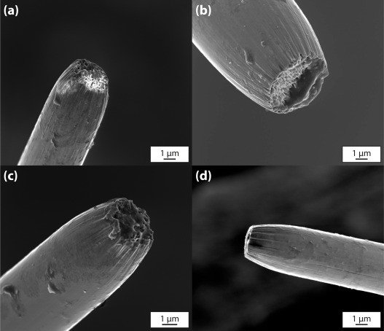
Influence of carbon on the mechanical properties of tungsten
Literature indicates that tungsten becomes brittle as a result of irradiation damage
We could not reproduce this in our tests on thin wires
Experimental verification by targeted implantation of carbon with subsequent mechanical testing
A initial experiment showed that it is possible to embrittle the samples using a carbon beam
(a) 0.0 dpa (b) 0.3 dpa
(c) 1.0 dpa (d) 9.0 dpa

Slide 23
Further plans for which there is not yet a detailed schedule
Creep under irradiation (strain measurement required)
Determination of the DBTT shift by irradiation (cooling required)
Change in microstructure due to thermal loads (heating required)
Embrittlement due to impurities (helium, deuterium, hydrogen)

Slide 24
Low Pressure Plasma Spraying of Tungsten
Status
Next steps
Overall:
Deposition efficiency ~ 70 %
Porosity ~3.5 %
PSI-2 samples and mask are prepared
Coatings on Tungsten substrate:
Coating of 400 µm successful produced
Compressive Stress ~ 50 Mpa in coating (XRD)
Coatings on Eurofer substrate:
Coating of 250 µm successful produced
Tensile Stress ~ 150 Mpa in coating (XRD)
Coatings on Carbon Fiber Composite (CFC) substrate:
Coating of 150 µm successful produced
Further upscaling failed due to residual stresses in coating
Increased scanning speed failed
Reduce of thermal gradient failed
Coatings on CFC substrate:
Further upscaling experiments e.g. stronger pre-heating of substrate
Investigation of possible ductile interlayer
Reduction of powder federate for thinner layer thickness
Coatings on Eurofer substrate:
Production of coating of 400 µm
Overall:
Expose successful samples to high temperature in "oven tests" to sort out and minimise high heat load tests
Coating PSI-2 samples for plasma exposure
Coating Magnum-PSI samples for plasma exposure
Dialogue with University of Alberta for AI based defect detection and path planning

Slide 25
WP PWIE: SPA 4
Planning
Notes:
Please Indicate your subproject

Slide 26
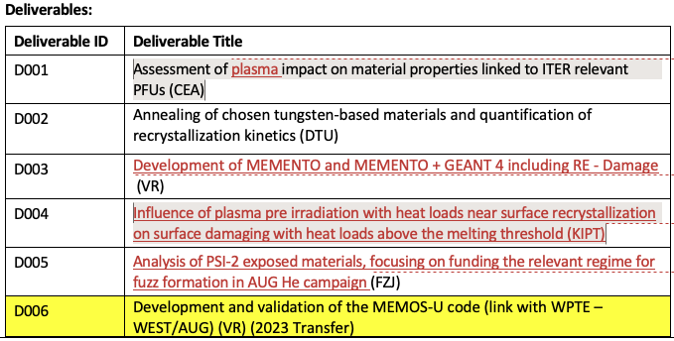
SPA 4
SP A.4 / High Temperature performance of Armour Materials: Recrystallization and Melting
Deliverable Owner | Beneficiary | PM | Deliverable (Team)
A.Durif | CEA | 6 | D001
W. Pantleon | DTU | 7 | D002
S. Ratynskaia | VR | 13 | D003 (S.Ratynskaia, P.Tolias, L.V. Ignitchouk F. Castello)
I. Garkusha | KIPT | 30 | D004
M. Rasinski | FZJ | 4 | D005 ( M. Rasinski, A. Kreter, M. Vogel)
S. Ratynskaia | VR | 7,84 | D006 (2023 Transfer)
Total |  | 67,84
Talk by S.Ratynskaia

Slide 27
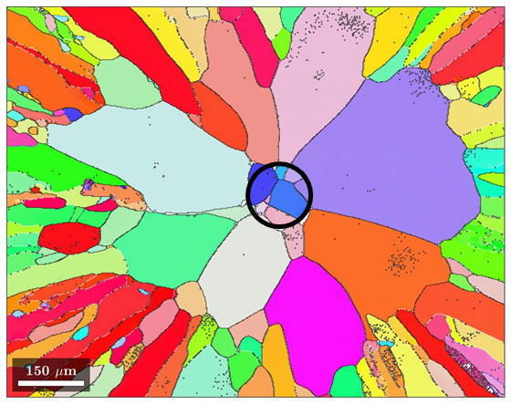
SP A.4 High Temperature performance of Armour Materials: Recrystallization and Melting (2024) DTU
Annealing of chosen tungsten-based materials and quantification of recrystallization kinetics (DTU)
Characterization of microstructural changes during heat exposure
Status / Plan 2024
Model tungsten fiber-reinforced tungsten composites with single fibers
Continuation from 2023
With 3 µm interlayer after 1 week of annealing at 1450 °C
Multi-fiber tungsten fiber-reinforced tungsten composites
New from 2024
Manufactured by powder metallurgy (Yiran Mao)
Notched specimens for bending tests
With continuous fibers
With short fibers
Characterization of microstructure (cross section)
Annealing at 1450 °C initiated

Slide 28
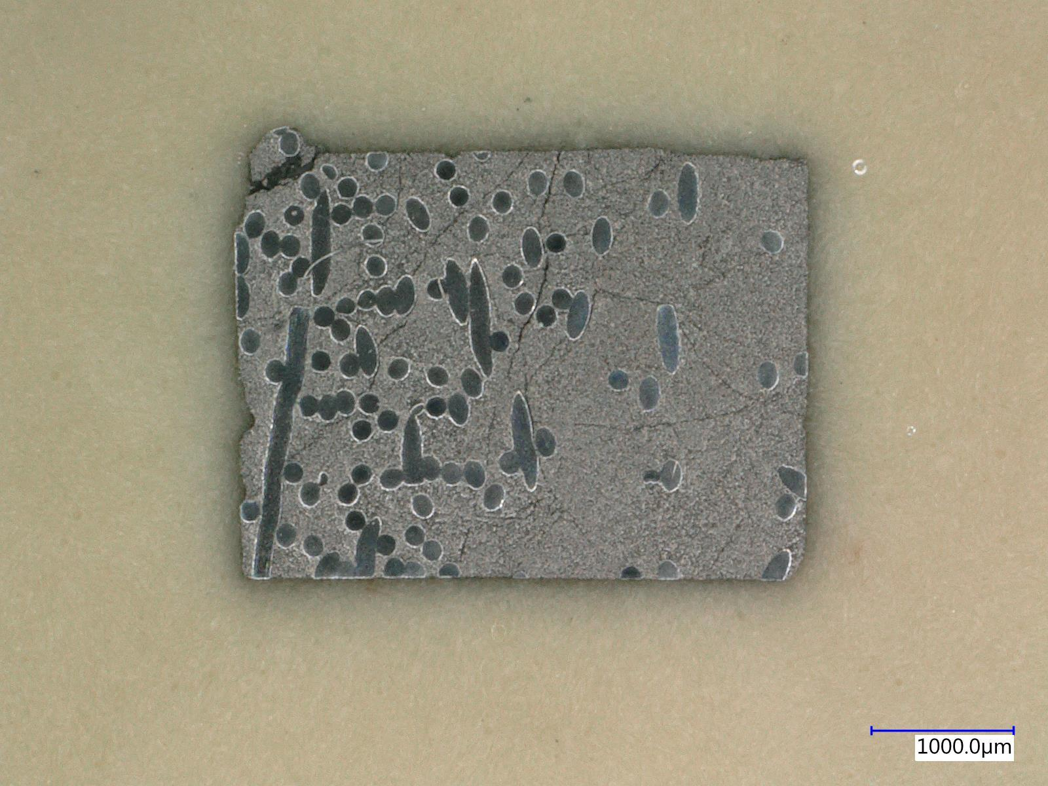
SP A.4 High Temperature performance of Armour Materials: Recrystallization and Melting (2024) DTU
Tungsten fiber-reinforced tungsten composites (cross sections of notched specimens for bending test)
 | Continuous fibers – compact matrix | Short fibers – porous matrix
LOM
SEM

Slide 29
Plans for 2024
Achived in 2023
Comparison between linear devices (PSI-2) and tokamak (AUG) environment for fuzz formation
Check previous exposures in PSI-2 with simultaneous plasma and laser loading
Check best conditions to reproduce AUG He fuzz
From existing exposures
New PSI-2 exposures (2 exposure finished)
PSI-2 He exposure - Fuzz formation
Base Temperature ~ 900 °C
Ion Flux ~ 6 - 8 × 10²¹ m⁻²s⁻¹
Fluence ~ 1 × 10²⁵ m⁻²
Energy ~ 160 eV
Laser
200 and 400 MW/m² 0,5 ms, 25 Hz
Temperature 1100 – 1700 °C
(600 °C increase during the laser shot)
Laser
100 0,5 ms, 25 Hz and 200 Hz
Plans for 2024
Finish all exposures in He plasma (additional 2-3)
Find best conditions to reproduce AUG He fuzz.
Based on the above:
Experiment: 94%D + 5%He + 1%Ne plus laser, in PSI-2 on W to be performed
(since no scheduled He campaing in ITER, the above would be most relevant exposure for normal ITER opperation)

Slide 30
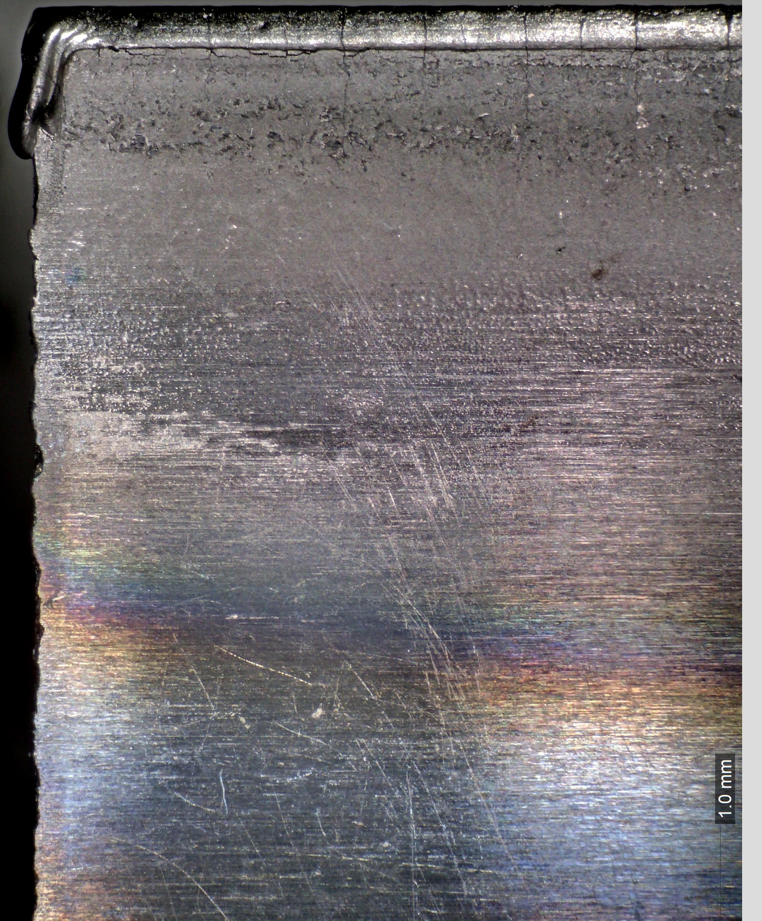
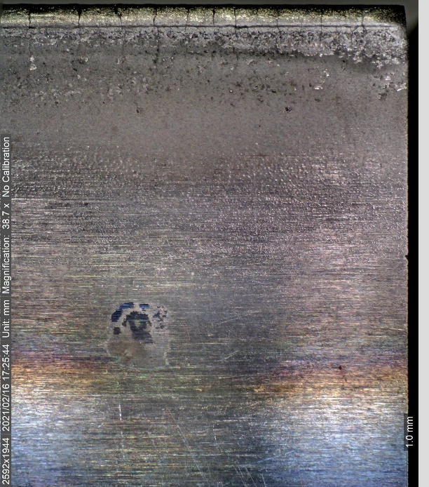
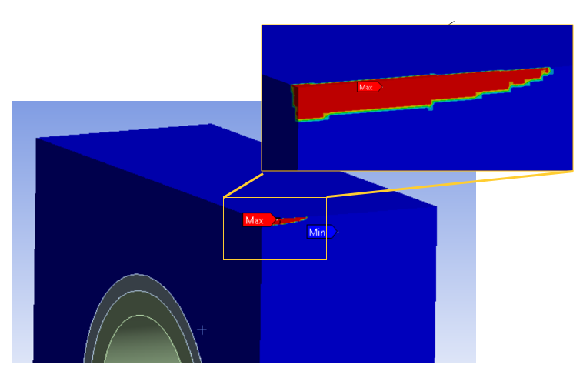
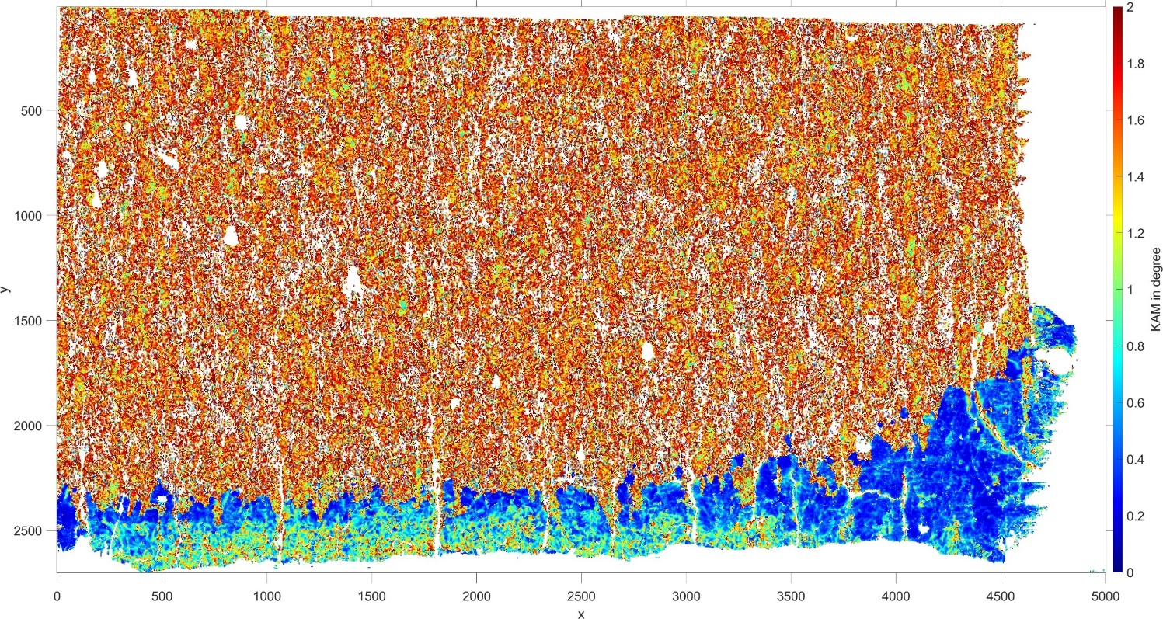
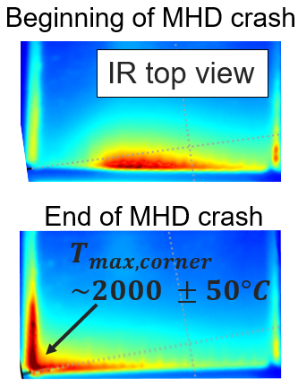
Assessment of plasma impact on W material properties linked to ITER relevant PFUs: WEST ITER-Like divertor recrystallization (MB24, WERI002)
30
Melted droplet
Cracks along the leading edge (LE) have been observed
Post C4 campaign (2019)→ melted droplet appeared (left LE side, )
Plasma
Leading edge
MB24
EBSD map outputs: Large grains (melted zone), small grains (along the LE)
12 mm
Deformed grains at the LE (due to thermal or H/He diffusion effects ?)
4.5 mm
Reverse analysis ongoing to assess the flux pattern & intensity (T-REX modeling)
Up to ?
1 mm
0,3 mm
y
As-received
Numerical recrystallization gradient fits with the EBSD observations applying 210 MW/m² on the LE (1s)
z
Melted/recrystallized
Deformed grains
5 mm
210 MW/m² → ~2630°C @ LE << W melting point → how explain the droplet (off-normal event?)
During WEST high confinement experiment (8MW injected) MHD crash observed (#55567) →
2000°C measured by the Very High Spatial resolution IR camera (50Hz) → Study on-going
In short term: continue EBSD analysis → assess the total recrystallization gradient length

Slide 31
MEMENTO + GEANT4 STATUS/UPDATES
MEMENTO numerical implementations updates completed
"The MEMENTO code for modelling of macroscopic melt motion in fusion devices“, K. Paschalidis, F. Lucco Castello, S. Ratynskaia, P. Tolias et al,
out of scope for Intern.J. Numer. Methods in Fluids (2023), to be resubmitted to Fusion Engineer. Design 2024
but new physics is yet to be explored (see Plans)
GEANT4 benchmarking activities for energy deposition in W initiated
‘GEANT4 modelling of runaway electron transport into bulk tungsten’, T. Rizzi, P. Tolias, S. Ratynskaia, PSI May 2024 , France
Brittle PFC explosion modelling with GEANT4 + thermo-elastic modelling in COMSOL started with newly initiated collaboration with KTH mechanics colleagues
‘Simulation of graphite sample explosion due to RE impact: DIII-D experiment’, T. Rizzi, S. Ratynskaia, P. Tolias et al Tervaniemi working session, Feb 2024, Finland
Tungsten PFC damage modelling GEANT4 + MEMENTO work flow development

Slide 32
MEMENTO + GEANT4 PLANS
MEMENTO under PWIE
Electrostatic problem with new current propagation solver → investigate dynamo term effects
Testing of possibility to include vapor shielding through simplified analytical model (feedback on incoming flux through released vapor calculations) similar to D. I. Skovorodin et al., POP 23, (2016).
For RE-induced PFC damage with GEANT4+MEMENTO and GEANT4+COMSOL work flows:
Brittle materials to benchmark input on the RE impact characteristics in 2024 start modelling of WEST evidence of destroyed BN tiles → significant investmentment to introduce BN properties
Tungsten : ITER-relevant grazing angle RE-impacts → testing regimes of strong vaporization due to ultra-shallow energy deposition
MEMENTO under TE: Melt across gap experiments in WEST (shifted from 2023 to 2024, currently planned April 12th) and AUG (2024 - 2025)
MEMENTO under TSVVV: Applications to disruption scenarios in DEMO

Slide 33
KIPT SPA 1,3,4
Planning
Notes:
Please Indicate your subproject

Slide 34
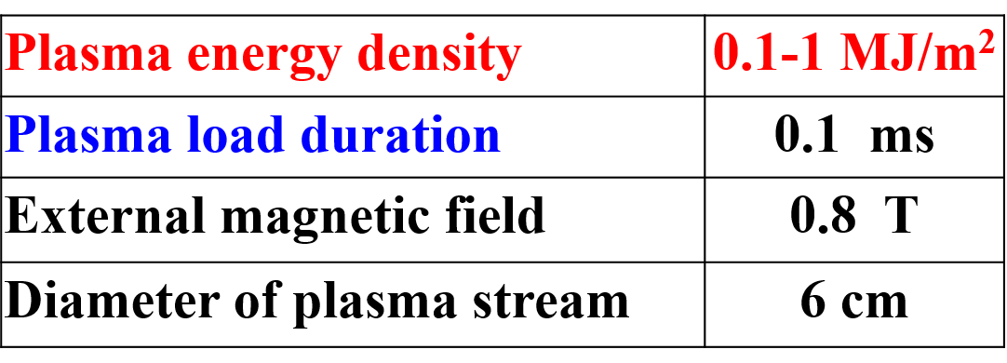
Experimental facilities: QSPA Kh-50; QSPA-M
QSPA-M
I.E. Garkusha et al 2017 Nucl. Fusion 57, 116011;
I.E. Garkusha et al 2019 Nucl. Fusion 59, 086023
V A Makhlai et al 2020 Phys. Scr. T171, 014047
V.A. Makhlai et. al. 2021 Phys. Scr. 96, 124043
Experiments were stopped at the end of February 2022.
Nevertheless, preparations of facilities for experiments resumed at the end of February 2024.
The summarizing and analysis of the earlier results of plasma impacts on tungsten is in progress.
A paper on the additional shielding of exposed surfaces with noble gas has been published in Nucl. Fusion 64 (2024) 056010
We are planning to restart the plasma experiments at the beginning of summer 2024
if the situation at KIPT is safe

Slide 35
PWIE SP A: A1; A.3; A.4; plan of work within KIPT in 2024
PWIE-SP A.A1.T-T004-D005 Analysis of material properties after sequential HHF transient and steady-state plasma loading (KIPT).
The summarizing and analysis of the earlier results of plasma impacts on tungsten will be continued.
Damaging of samples will be evaluated for different loadings (incl. different gas mixtures, pulse durations, number of pulses, sequential loads, etc.).
The influence of sequential transient and steady-state plasma loading on cracking/melting thresholds will be studied
PWIE-SP A.A3.T-T004-D004 Investigation of advanced materials and coatings under ELM-like/disruption transient loading and subsequent analysis.(KIPT).
The investigation will involve advanced materials (different types of tungsten and etc.) and coatings deposited on various materials, subjected to high flux transient plasma loads.
The high flux testing of boron coatings deposited on different materials (austenitic and RAFM steels, copper, tungsten, etc.) followed by analysis will be performed too.
PWIE-SP A.A4.T-T004-D004: Influence of plasma pre-irradiation with heat loads near surface recrystallization on surface damaging with heat loads above the melting threshold (KIPT)
Investigation of surface damaging/modification due to melt motion on surfaces of the reference materials will be performed.
Modification of reference materials will also be performed by mixing them with previously deposited coatings (including tungsten coatings) under a powerful plasma impact.
Key mechanisms of liquid droplets as well as solid dust ejection will also be evaluated.

Slide 36
Overview
SPA
Notes:
Please Indicate your subproject

Slide 37
Milestones 2024
Proceeding as planned
Sequential WP-M ID | Related WBS ID | WP Milestone Title | Due Date [mm/yyyy]
WM82 | SP A | Feasibility of advanced plasma-facing materials for DEMO, including prototype materials like W FGMs on steel (with WPBB) assessed. Connecting the assessment of their lifespan to testing conducted in facilities such as WEST, MAGNUM-PSI, GLADIS, and JUDITH. (DEMO) | 31.12.2024
WM83 | SP A | The damage and evolution of material structure on WEST components, as well as linear facilities, analysed. Further investigations into the physics of material recrystallization, including µ-CT studies. (ITER+DEMO) | 31.12.2024
WM84 | SP A | High fluence experiments with transients on MAGNUM PSI executed to facilitate lifetime and component evolution for ITER and DEMO. (ITER+DEMO) | 31.12.2024
WM85 | SP A | Experimental studies on ITER relevant loads such as VDEs, related to new W-Wall PFCs executed and analysed. Accompanying studies utilizing modelling with e.g. Memento. (ITER) | 31.12.2024

