Slide 1

Development of MEMENTO and
MEMENTO/COMSOL + GEANT4 work flow for modelling of PFC damage
S. Ratynskaia KTH, Stockholm, Sweden
P. Tolias, K. Paschalidis, T. Rizzi, Space & Plasma Physics, KTH, Stockholm, Sweden
A. Kulachenko, Mechanics, KTH, Stockholm, Sweden

Slide 2
Outline
Part I: MEMENTO
Modelling of PFC damage due to surface loading & validation agaist controlled experiments
Part II: GEANT4 + MEMENTO and GEANT4 + COMSOL
Modelling of PFC damage due to REs: benchmarking acitivities and modelling of exsiting experiments

Slide 3
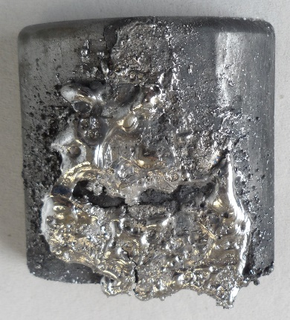
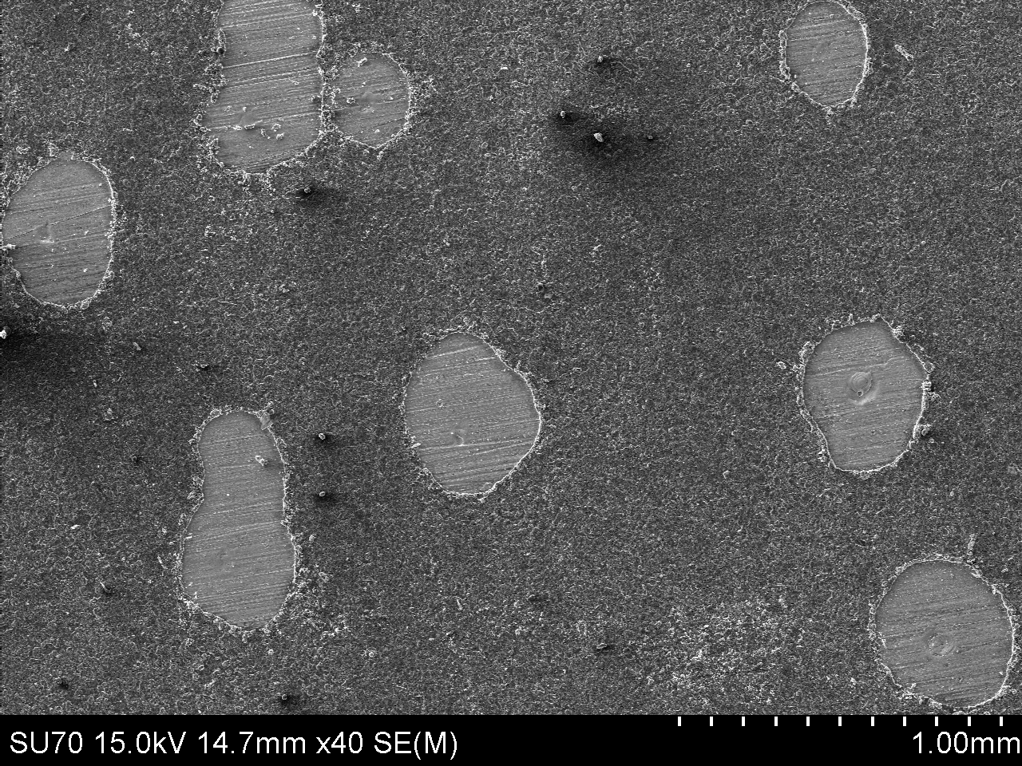
PFC damage: surface vs volumetric loading
Surface heat loads
ELMs, VDE, disruptions
Volumetric heat loads
Disruptions
  Plasma particles with energies < few keV
  → Depth range ~ 10(’s) nm (W)
  Runaway electrons with energies 1-50 MeV
  → Depth range 0.4-8mm (W)
TZM
COMPASS
FTU
W
AUG
K. Krieger et al 2018 NF 58
Be
M. De Angeli et al 2023 NF 63
JET
J. Mlynar et al 2019 PPCF 61
I. Jepu et al
2019 NF 59

Slide 4
PFC damage under surface heat loads
ELMs, VDEs, disruptions

Slide 5
Towards predictive modeling of PFC damage (surface loads)
Methodology
Modelling
Comparison,validation & design
Comparison,validation & design
Experimental
evidence
Deformation profiles + experimental contrains
Experimental
evidence
Splashing, droplets, gap wetting and bridging
Large scale
MEMENTO
(SW average)
initial/boundary
conditions
Small scale
ANSYS set-ups
(3D Navier Stokes)
Boundary
conditions on
metal-plasma
Interface
PIC simulations +
Sheath theory
Predicted material damage :
deformation and melt ejection
(if yes – droplet sizes & speeds)
Validated framework for preditive studies of melt formation, dynamics & splashing

Slide 6
Validation of MEMENTO physics model : with the only heat flux variations allowed strictly within experimental uncertainties

Slide 7
First modelling of EUROfusion experiments with two materials – W and Be two loading scenarions – ELMs and disruptions (VDE CQ) two different drives – thermionic vs halo currents two geometries – leading edge vs shallow B-angle two machines – JET and AUG
Principal experimental evidence to reproduce:
--final deformation profiles (extension and position of crater and hill)
--total melt volume displaced

Slide 8
Novel experimental constrains fore more detailed validation
Simultaneous exposure of ‘floating’ vs ‘grounded’ thermionic emitter exposures in AUG
Simultaneous exposure of ‘poor’ vs ‘good’ thermionic emitter exposures in AUG (predictive modelling was carried out prior to the experiment)
High resolution IR camera detection of the onset of melting and first detectable deformation (due to melt displacement) of LE in WEST
Presence of gaps, including predictive modelling:
AUG samples with gap and step, LE geometry (2022)
WEST sample with gap (LE geometry), shifted from 2023 to 2024 [THIS FRIDAY !]
AUG sample with new gap sample (shallow angle geometry), planned 2024

Slide 9
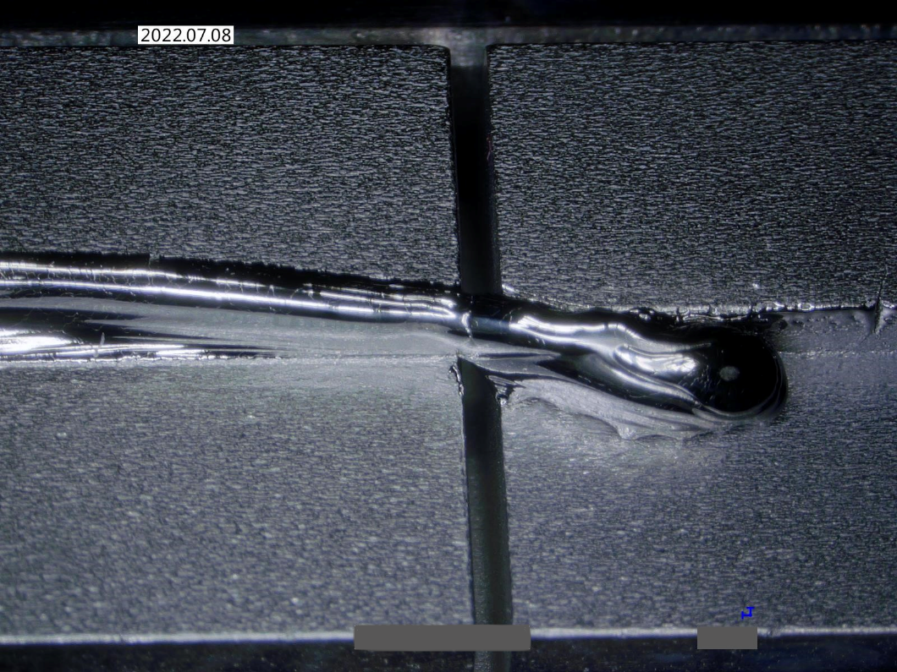
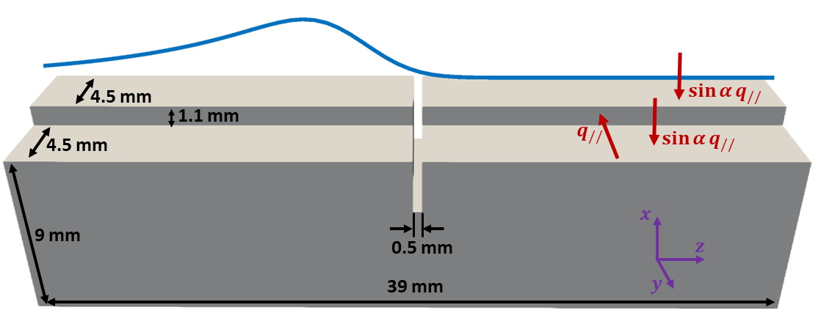
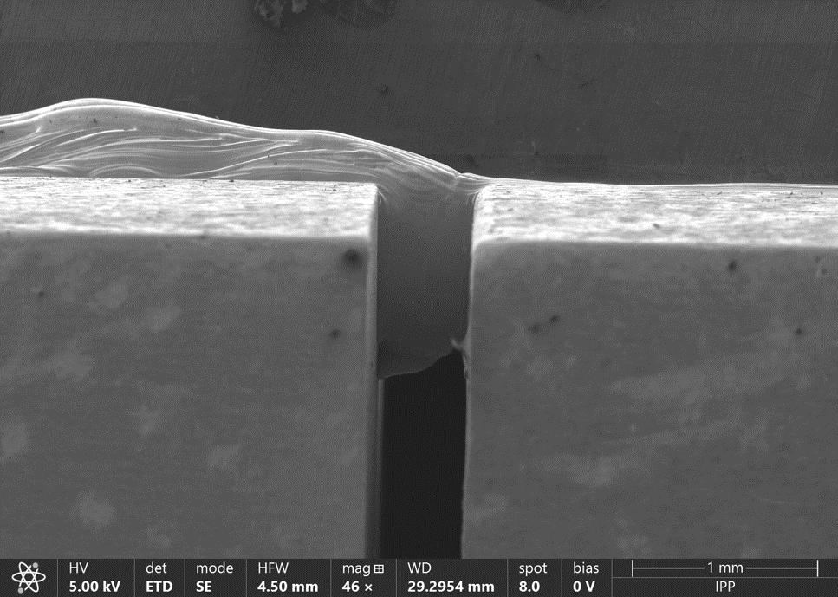
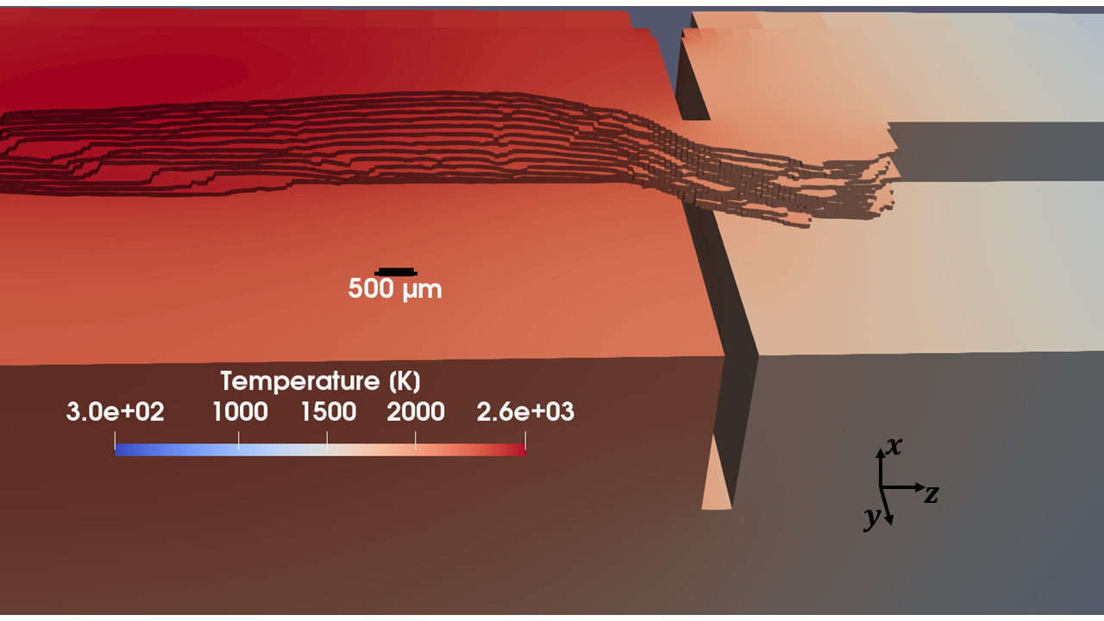
Melt edge wetting and bridging of gaps
S. Ratynskaia, K. Paschalidis, K. Krieger et al NF, 64 (2024)
Experiment
Zoom-in near the gap
MEMENTO results

Slide 10
MEMENTO (Metallic Melt Evolution in Next-step TOkamaks) physics model
$$\frac{∂h}{∂t}+∇_{t}∙\left(hU\right)=−\frac{∂b_{1}}{∂t}−{\dot{x}}_{vap}$$
$$ρ_{m}\left[\frac{∂U}{∂t}+{(U∙∇}_{t})U\right]=\left\langle J×B\right\rangle −\frac{3μ}{h^{2}}U+μ∇_{t}^{2}U+\frac{3}{2h}\left(\frac{∂σ}{∂Τ}∇_{t}T_{s}+f_{d}\right)−∇_{t}P+σ∇_{t}∇_{t}^{2}b_{2}$$
$$c_{p}ρ_{m}\left[\frac{∂T}{∂t}+{U∙∇}_{t}T\right]=∇∙\left(k∇T\right)+q_{vol}$$
$−k∇T {\left.​\right|}_{S_{e}}=q_{inc}−q_{cool}$ $−k∇T {\left.​\right|}_{S_{ne}}=−q_{cool}$
$∇∙\left[\frac{1}{ρ_{e}}∇ψ\right]=∇∙\left[\frac{1}{ρ_{e}}U×B\right]$ $J=−\frac{1}{ρ_{e}}\left[∇ψ+U×B\right]$
${\left.\frac{∂ψ}{∂n}\right|}_{b_{2}}=−ρ_{e}J_{th}+\left(U×B\right)∙\hat{n_{b_{2}}}$ ${\left.\frac{∂ψ}{∂n}\right|}_{S_{ne}}=0$ ${\left.ψ\right|}_{S_{g}}=0$
Fluid (h, U)
Heat (T)
Current (J)
$(b_{1}, b_{2}, {\dot{x}}_{vap})$ Solid-liquid interface, liquid-plasma interface and its rate of change due to vaporization
$\left(h, U\right)$ Melt column height, depth-averaged velocity
$(P, B)$ Ambient pressure, magnetic flux density
$(ρ_{m}, μ, σ, c_{p},ρ_{e})$ Mass density, dynamic viscosity, surface tension, heat capacity, electrical resistivity
$\left(T, T_{s}\right)$ Bulk and surface temperature
$(ψ, J)$ Potential, current density
S. Ratynskaia et al (2020) NF 60, E. Thorén et al (2021) PPCF 63, S. Ratynskaia et al (2021) Phys. Scr. 96, S. Ratynskaia et al (2022) NME 33
Notes:
In short these are the equations that model the relevant problem and that have to solved by the numerical tool.
The first two, in the blue box, are the SW equations, the end product of reducing the dimensionality of NS equations by 1.
The first equation desrcibes the conservation of mass, expressed as a continuity of the column height property –
flux of height relates to local temporal changes and sourses due to melting and vaporization.
The second equation describes the conservation of momentum. Here some term might seem a bit foreign compared to the typical NS equations. This is because the reduction in dimensionallity involves performing depth
integration, so terms that normally are only a BC now appear explicitly as source terms. For example, the friction term and the Marangoni flow term.
Next equation is the heat equation for the conservation of energy with its BC
Lastly are the equations for the current solver – Resulting from Faraday, Amperes and Ohm’s law under the
magnetostatics and uniform material assumption
Note that the terms underlined are terms recently added. One is surface tension, one is a volumetric source term, and the last one the dynamo term.

Slide 11
MEMENTO updates and plans
MEMENTO numerical implementations updates completed
Detailed description of the code structure and implementations in
"The MEMENTO code for modelling of macroscopic melt motion in fusion devices“
K. Paschalidis, F. Lucco Castello, S. Ratynskaia, P. Tolias
out of scope for Intern.J. Numer. Methods in Fluids (2023), to be resubmit. to Fusion Eng. Design 2024
Electrostatic problem with new current propagation solver → investigate dynamo term effects
Test possibility to include vapor shielding through simplified analytical model (feedback on incoming flux through released vapor calculations) similar to [D. I. Skovorodin et al., POP 23, (2016)].
MEMENTO + GEANT4 for RE-induced damage, see below

Slide 12
RE-induced damage

Slide 13
Towards predictive modeling of RE-induced damage
RE modelling
(DREAM, JOREK)
Tokamak evidence
FTU, COMPASS, JET
RE & wetting
characteristics
Controlled experiments
comparison &
validation
Modelling of volumetric
energy deposition GEANT4
’smart’
tiles
-- Lab HV impacts with
2SLGGs (damage laws)
-- SPH modelling
comparison & validation
Modelling of thermomechanical response
MEMENTO → LS-DYNA & COMSOL
comparison & validation
Predicted material damage
and debris characteristics
Validated framework for preditive studies of RE-induced PFC damage in reactors

Slide 14
Satellite meeting ‘Runaway electron-induced PFC damage’
Saturday July 13 (EPS main program finishes on Friday 12th)
The main idea is to bring together experimentalists and modelers from both the RE community and the PFC damage community in order to define the state-of-art and delineate a path towards future controlled RE-induced damage experiments that can serve as rigorous benchmarking exercises for the multiple simulation tools that are necessarily involved in such modelling.
The talks shall cover
(i) a survey of accidental or controlled RE-induced damage observed in contemporary devices;
(ii) the modelling of REs and their incidence on PFCs (wall footprints & impact velocity distributions);
(iii) the modelling of PFC damage due to volumetric heating by REs.

Slide 15
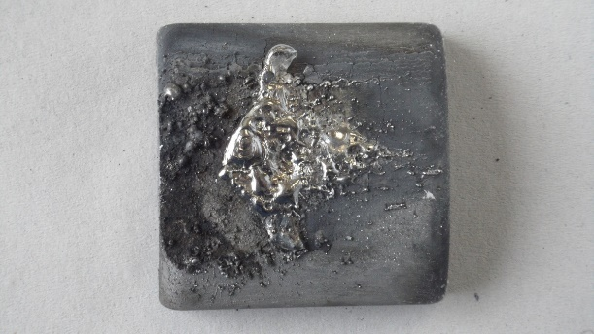
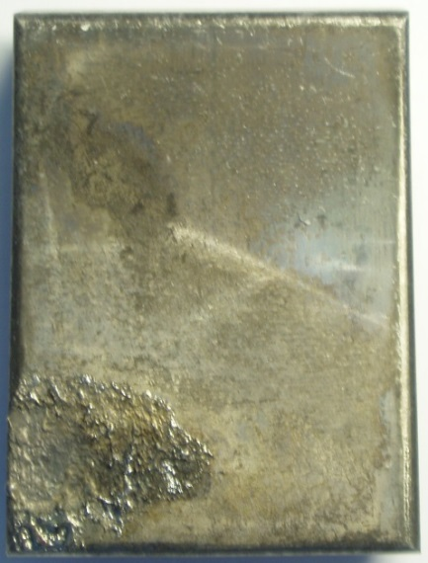
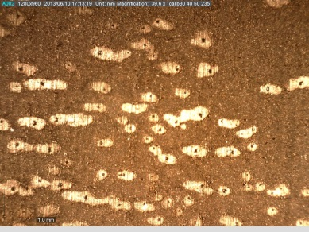
RE-induced PFC damage in FTU
toroidal
limiter
M. De Angeli, P. Tolias, S. Ratynskaia et al Nucl. Fusion 63 2023
RE beam
Fast solid dust ejected from poloidal limiter, v>800 m/s
poloidal limiter
Primary damage: explosion of poloidal limiter
Secondary damage: dust impacts on toroidal limiter
non monotonic profile → max temperature beneath the surface → internal stress buildup due to uneven thermal expansion & internal boiling → thermal shock, explosion and material detachment
B_{T}
Craters reproduced with a two-stage light gas gun with impact speeds consistent with camera observations

Slide 16
Modelling of materials with no liquid phase: C and BN

Slide 17
Modelling of materials with no liquid phase: C and BN
Currently developing with newly initiated collaboration with KTH mechanics colleagues :
GEANT4 volumetric maps are input to COMSOL set-ups where the heat transfer is coupled with the solid mechanics through thermo-elasticity → allows prediction of material failure and comparison with observed damage as well as timing
‘Simulation of graphite sample explosion due to RE impact: DIII-D experiment’,
T. Rizzi, S. Ratynskaia, P. Tolias et al Tervaniemi working session, Feb 2024, Finland
T. Rizzi, S. Ratynskaia, P. Tolias et al , ITPA, divSOL, Feb 2024
Next step:
LS-DYNA to also model fragmentation and debris (to compare with camera observations)
‘Easier’ modelling allowing faster progress towards predictions of actual damage and secondary products → the physics models are not of direct use to W but
this allows for validation of the INPUT on RE characteristics

Slide 18
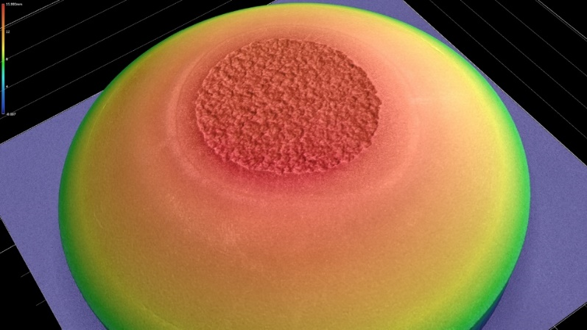
DIII-D experiment modelling: Problem implementation
Energy deposition
Loading is based on KORC (Kinetic Orbit Runaway Electrons code) data (M. Beidler)
Volumetric heat maps are simulated with GEANT4 code (Monte Carlo modelling of electron transport inside matter)
Main simulation features:
Reconstruction of the sample and B field geometry & non-uniform loading as in the experiment
Choice of list of physical processes to describe particle-matter interaction for both primary RE & secondary particles
Magnetic field is included both inside and outside the sample
Thermo-mechanical response
COMSOL: linear thermo-elastic one way coupled model
Failure criteria: comparison of principal stresses with ultimate tensile strength (UTS) & ultimate compressive strength (UCS)
Results from axisymmetric 2D (shown here) have been confirmed in full 3D geometry of the sample
Experimental constrains
Energy loaded (known through TC measurements) and material losses
Timing of release of debris is known
Material damage topology and blown-off volume are known
DIII-D sample
Confocal imaging of
sample after impact

Slide 19
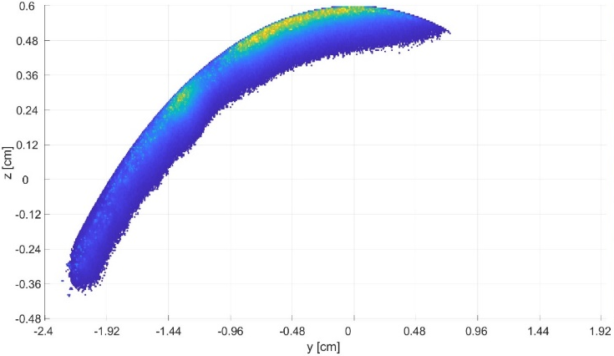
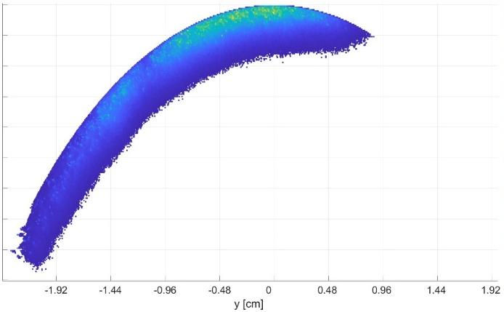
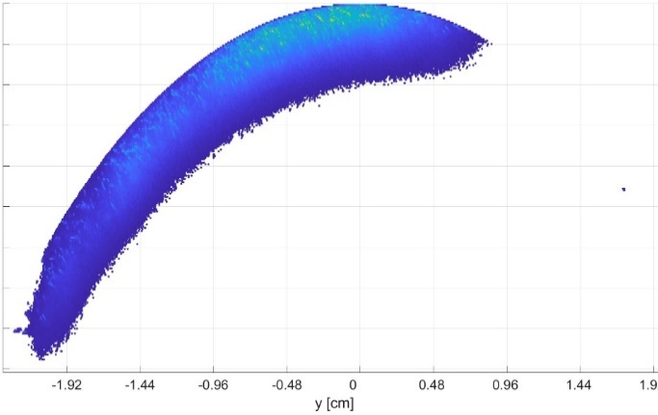

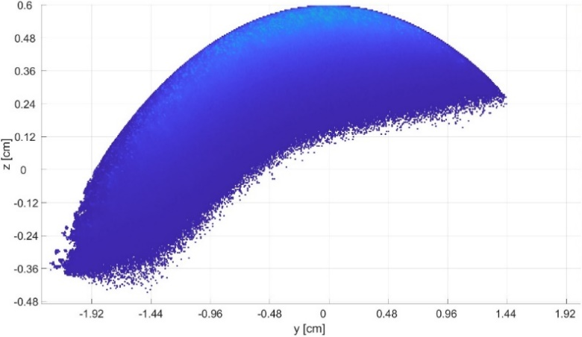
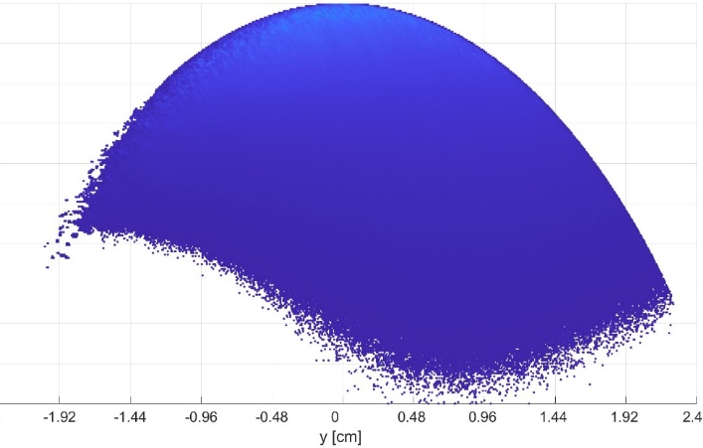
GEANT4 results : volumetric heat maps
1 MeV 10 deg
1 MeV 25 deg
1 MeV 40 deg
3 MeV 25 deg
10 MeV 10 deg

Slide 20
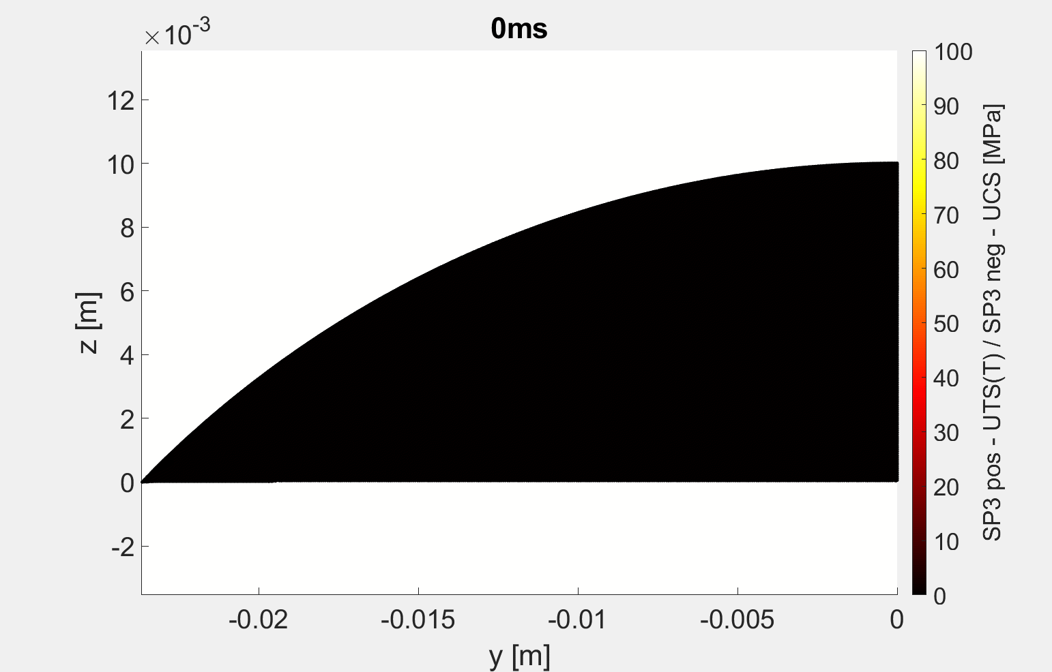
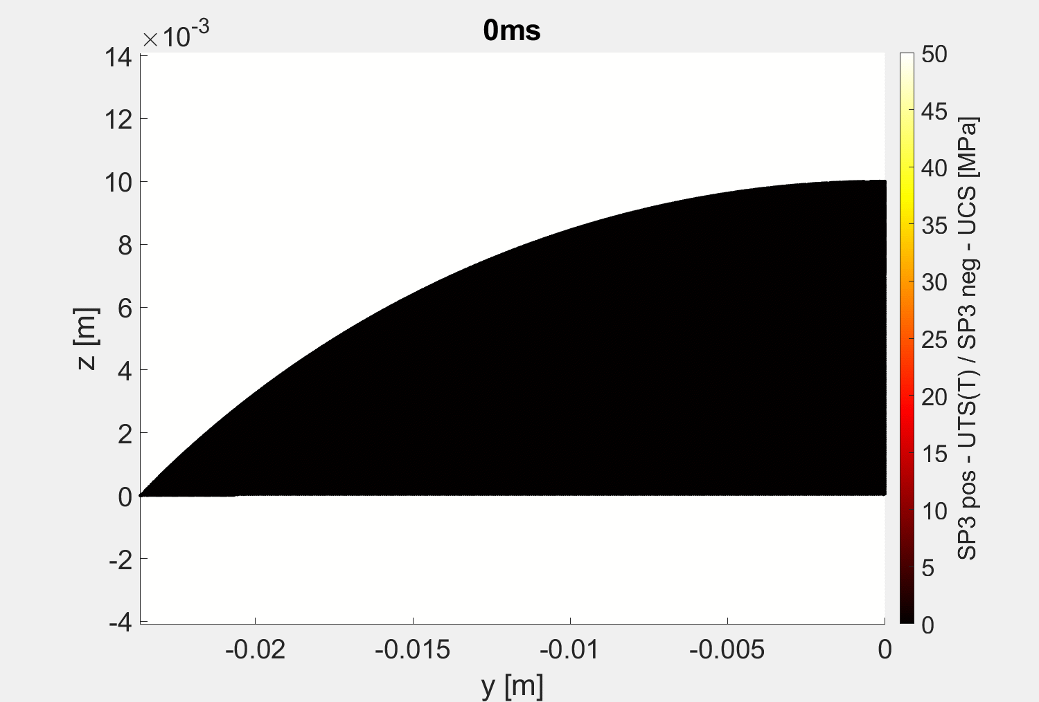
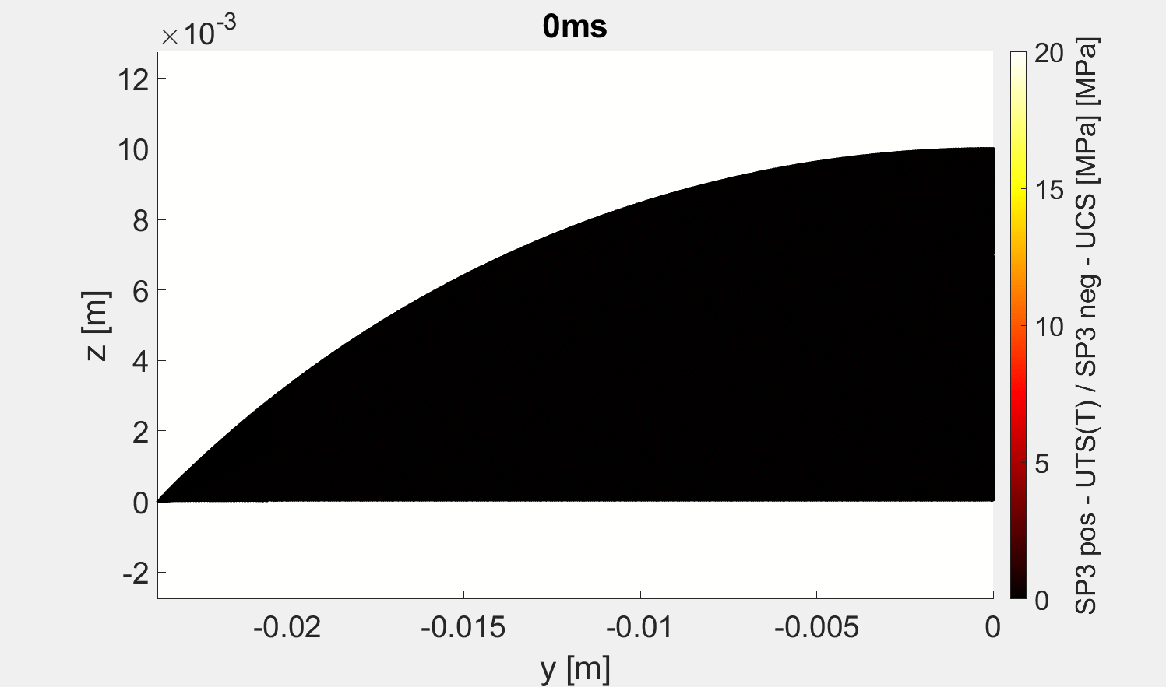


Failure criterion for different KORC input
Consistent timing and position
1 MeV 10 deg
1 MeV 25 deg
1 MeV 40 deg
No failure
3 MeV 25 deg
10 MeV 10 deg

Slide 21
Modelling of materials with no liquid phase : C and BN
2024 plans:
Continue with ITPA experiment in DIII-D (C sample) – modelling of fragmentation
With KTH Mechanics Department we opened one-year position, job announcement at
https://www.kth.se/lediga-jobb/708177?l=en
Start modelling of WEST evidence of destroyed BN tiles → significant investmentment to introduce BN properties (in connection with WP TE)
New JET data: REs impacted W coated graphite tiles, debris were observed → check whether significant deposition was in C or W (depends on RE impact angles and energies), test the current models for the coated tile

Slide 22
Modelling of W damage

Slide 23
Modelling of W damage
To realistically model RE-induced PFC damage, we need to go beyond heat transfer
  Use of LS-DYNA and COMSOL Multiphysics to include
  thermal expansion
  internal phase transitions
  explosive boiling
  shockwave propagation
  material fragmentation
Currently working with MEMENTO + GEANT4 workflow
GEANT4 benchmarking activities for energy deposition in W initiated
‘GEANT4 modelling of runaway electron transport into bulk tungsten’, T. Rizzi, P. Tolias, S. Ratynskaia, PSI May 2024
Implemented tracking of secondary particle production.
Energy losses due to photon escape as well as electron backscattering and transmission are also accounted for.
LONG - TERM GOAL

Slide 24
Modelling of W damage
GEANT4 benchmarking activities for energy deposition in W initiated
‘GEANT4 modelling of runaway electron transport into bulk tungsten’, T. Rizzi, P. Tolias, S. Ratynskaia, PSI 2024
Model benchmarking
Electron backscattering – comparison to experiments from bulk materials, including W
Calorimetry – comparison to experiments in bulk materials, also high Z
Transmission – comparison to experiments in thin foils, Gold (Z=79)
Inclusion of nuclear processes
Photo-neutron generation, elastic/inelastic neutron transport including transmutation - to check activation paths in controlled experiments (diagnostics) and ITER relevant activation of the material before the nuclear phase
Single vs multiple scattering
Realistic scenarios (RE energy and angular distributions, B field, non-uniform loading, large wetted areas) are not computationally feasible with single scattering & sufficient statistics
Multiple scattering is very fast to run but not accurate for lower energies
Needs for a mixed scheme with appropriate cut of angle (angle separating small from large scattering)

Slide 25
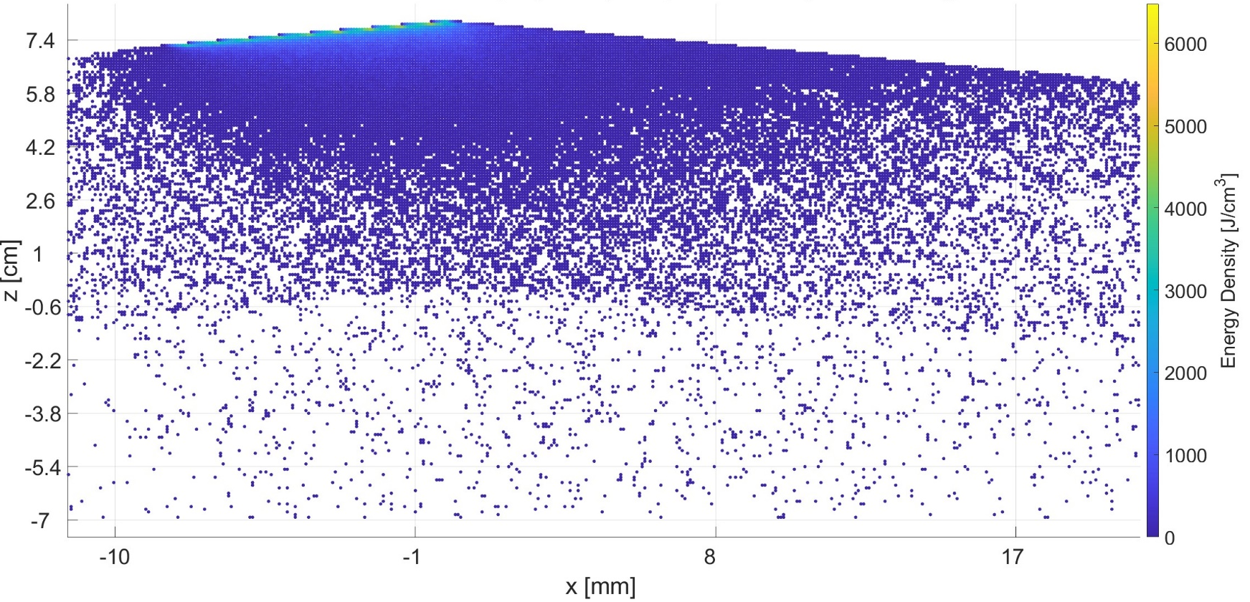
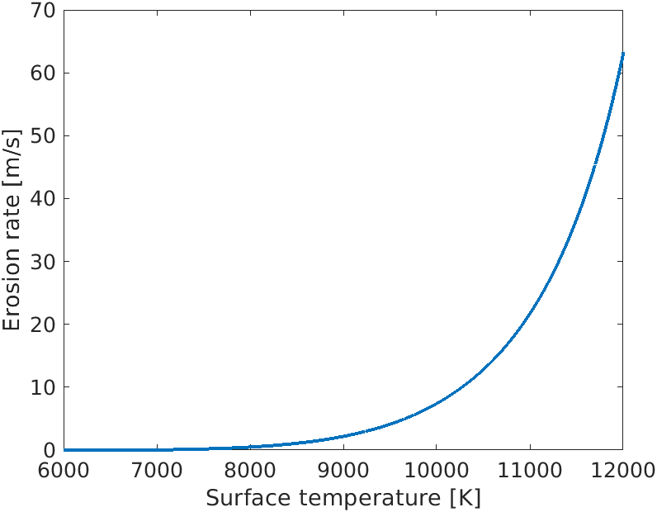
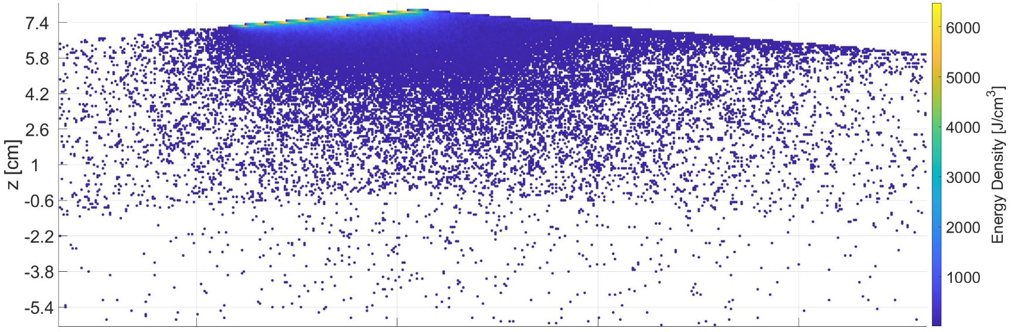
Single vs multiple scattering
MULTIPLE SCATTERING
ITER-relevant case:
Exponential RE energy distribution, mean 15 MeV, cut 1-50 MeV
B field 7 T, at 5° wrt the surface
Impacts at 5° wrt the surface
In this example: Single scattering max energy density is 30 % higher compare to the multiple scattering
Exp. scaling of vaporization with surface T
SINGLE SCATTERING
9000 K → 2.2 mm/ms

Slide 26
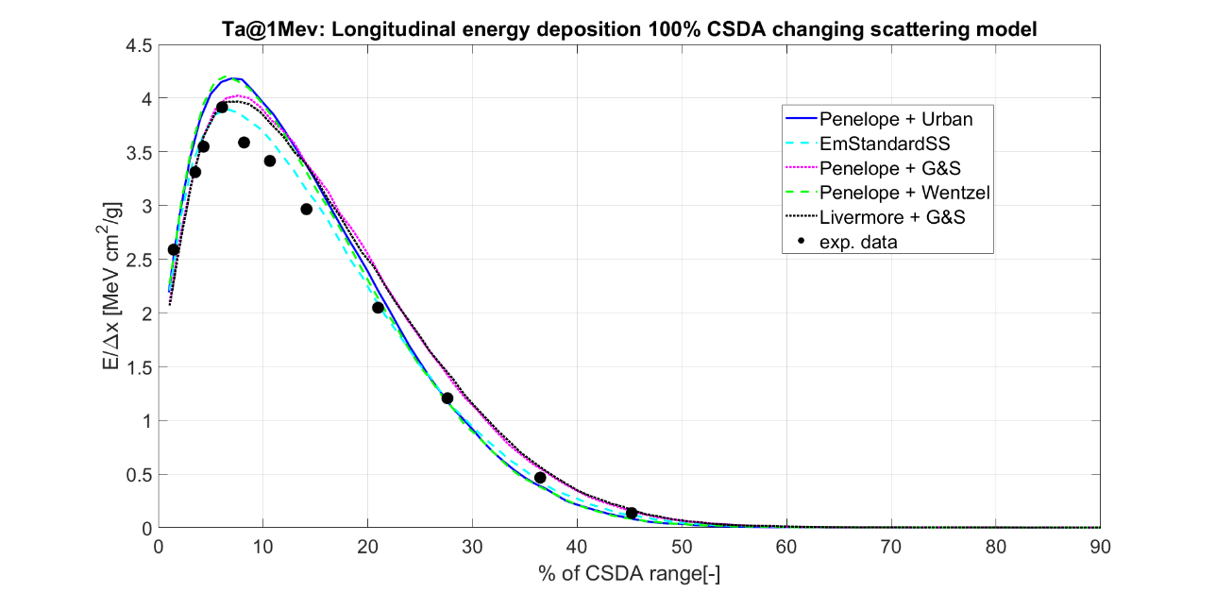
High Z model benchmarking: calorimetry
An example for Ta (Z=73)
GEANT4 physics model benchmarking against experimental data for energy deposition by 1 MeV electrons normally impacting bulk Tantalum.
The experimental energy deposition profile profile can be reproduced over the entire CSDA range only by the model which employs single scattering (light dashed blue line)
Other models available in the GEANT4 physics lists are ‘missing out’ either on the vicinity of the maximum of the experimental energy deposition or at the tail of the profile

Slide 27
Modelling of tungsten
2024 plans:
Big investment in scattering schemes but will pay off in modelling of experiments and ITER-relevant scenarios, in particular of realistic, large & complex geometry PFCs
Investigation of ITER-relevant grazing angle RE-impacts
Testing regimes of strong vaporization due to ultra-shallow energy deposition
Challenges for both GEANT4 and MEMENTO – high resolution, rapid loss of cells, non-uniform loading due to presence of B field, …

