Slide 1

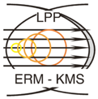



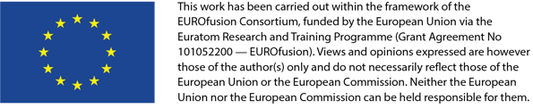
Status and prospects of TOMAS project in 2024
Andrei Goriaev and the TOMAS team

Slide 2
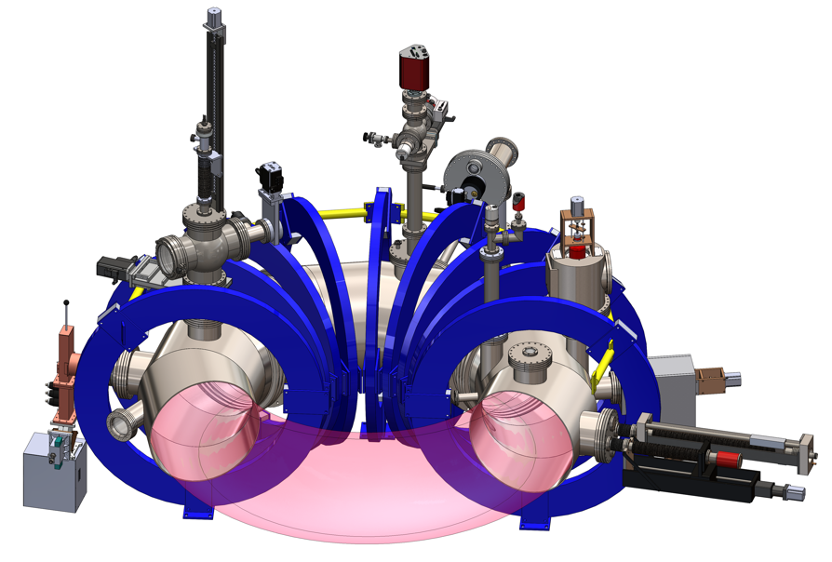
Status
The TOMAS project status
  Technical
    Langmuir probes
    ICRH system
    Microwave interferometer
  Scientific achievements
    Glow discharge characterization
    EC plasma characterization
    RF plasma characterization

Slide 3
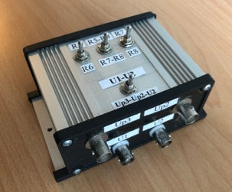
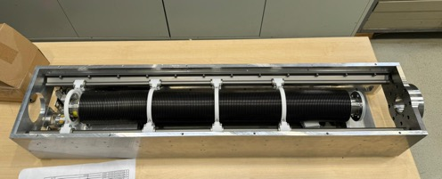
Langmuir probes
Triple Langmuir probe improvement
  Installation and test of new measuring module
  Implementation of "floating" and "ground” schemes allowing for “simultaneous” measurements of density, temperature and floating potential
New Langmuir probes
  All planned components are manufactured and purchased
  The LP assembly has been started
  Some design issues should be fixed
  Need for different material of vacuum below supports
Model of new Langmuir probe system
Assembly of new Langmuir vacuum manipulator
New electronics box and circuit scheme

Slide 4
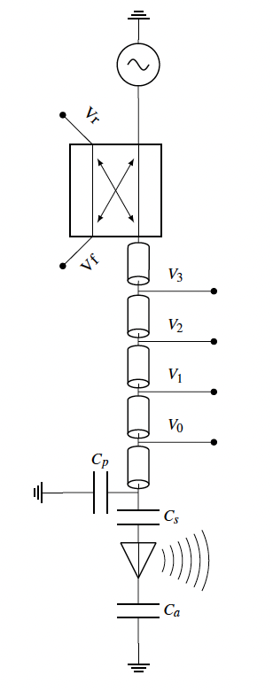
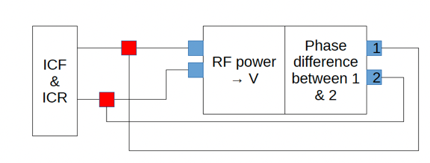
ICRH system
New automatic matching algorithm is implemented
  proposed algorithm outperforms the TEXTOR[1] one
  lower number of steps to match
  significantly larger matchable domain
New power calibration is implemented
  New electrical circuit for power measurements
  New calibration scheme using phase measurements
RF amplifier is repaired & new power feedthroughs
  Operation at full power (6 kW)
  Extended pulse operation
TEXTOR matching algorithm
Scheme of ICRH system
New matching algorithm
New forward and reflected RF power calibration scheme
[1] F. Durodié and M. Vervier 1991 Elsevier 1186–1190

Slide 5
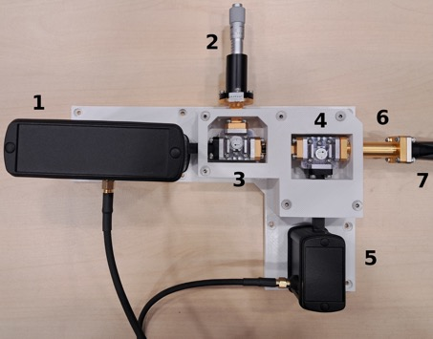
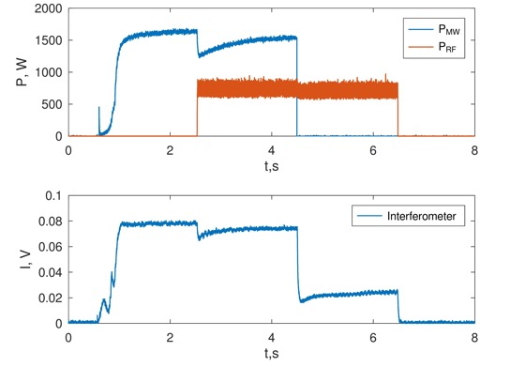
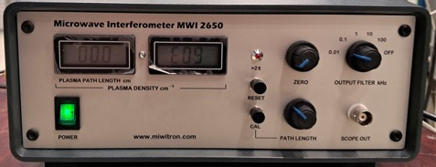
Microwave interferometer
Installation of MW interferometer MWI 2650 (26.5 GHz) with one emitting/receiving antenna
Commissioning
  Tests in EC, IC, EC+IC and GD plasmas
  Calibration using triple Langmuir probe
Principle scheme Microwave Interferometer. Transmitter (1), adjustable short (2), circulator (3, 4), receiver (5), Waveguide (6) Flexible Waveguide (7).
Control unit
Mixed EC + IC discharge power and raw interferometer data

Slide 6
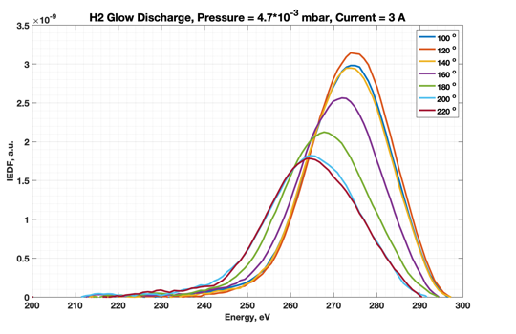
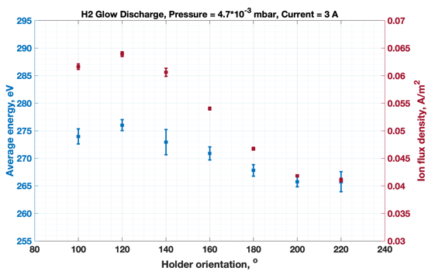
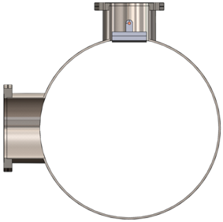
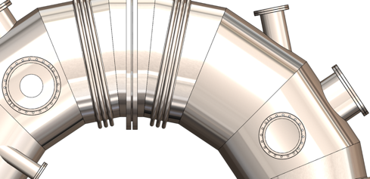
Glow discharge characterization
Characterization of local glow discharge ion energy distribution [1]
  In hydrogen, helium and argon
  At different neutral pressures and anode currents
Studies of glow discharge homogeneity with RFEA*
  Mimicking different distance from GD anode by changing detector orientation and its in-plasma depth
  Input for ITER GD model validation ?
Local ion energy distributions
* RFEA details -> see talk of L. Dittrich
115 mm
RFEA button probe
100º
GD anode
[1] K. Crombé et al., IAEA FEC 2023, London, 2023.

Slide 7
MW plasma characterization
Studies of electron cyclotron power deposition in helium [1]
  Characterization of ECRH power source
  Influence of input power, magnetic field and gas pressure on on the absorption mechanisms
  Influence of the Langmuir probe position and wave polarization on reflected power fraction
Determination of suitable scenarios for plasma start-up and pre-ionization.
Tunneling and conversion fraction for various levels of the injected power PEC and the magnetic field B₀
X-wave deposition mechanisms for increasing density (a→d)
[1] J. Buermans et. al., submitted to Physica Scripta

Slide 8
RF plasma characterization
Implementation of a new RF module (ANTITER IV [1]) to TOMATOR-1D code [2] for TOMAS RF plasma modelling
  Studies energy transfer mechanisms
  Characterization of RF waves absorption and propagation
  Generation of charge-exchanged neutrals based on plasma parameters
Characterization of RF plasma
  exploring ion and neutral particle energy distribution using using probes, ToF NPA and RFEA
  TOMATOR-1D model validation
First modelling attempt to reproduce electron temperature oscillations in radial scan
[1] A. Messiaen et al., Plasma Phys. Control. Fus. 63, 045021 (2021)
[2] T. Wauters et al., Plasma Phys. Control. Fus. 62, 105010 (2020)

Slide 9
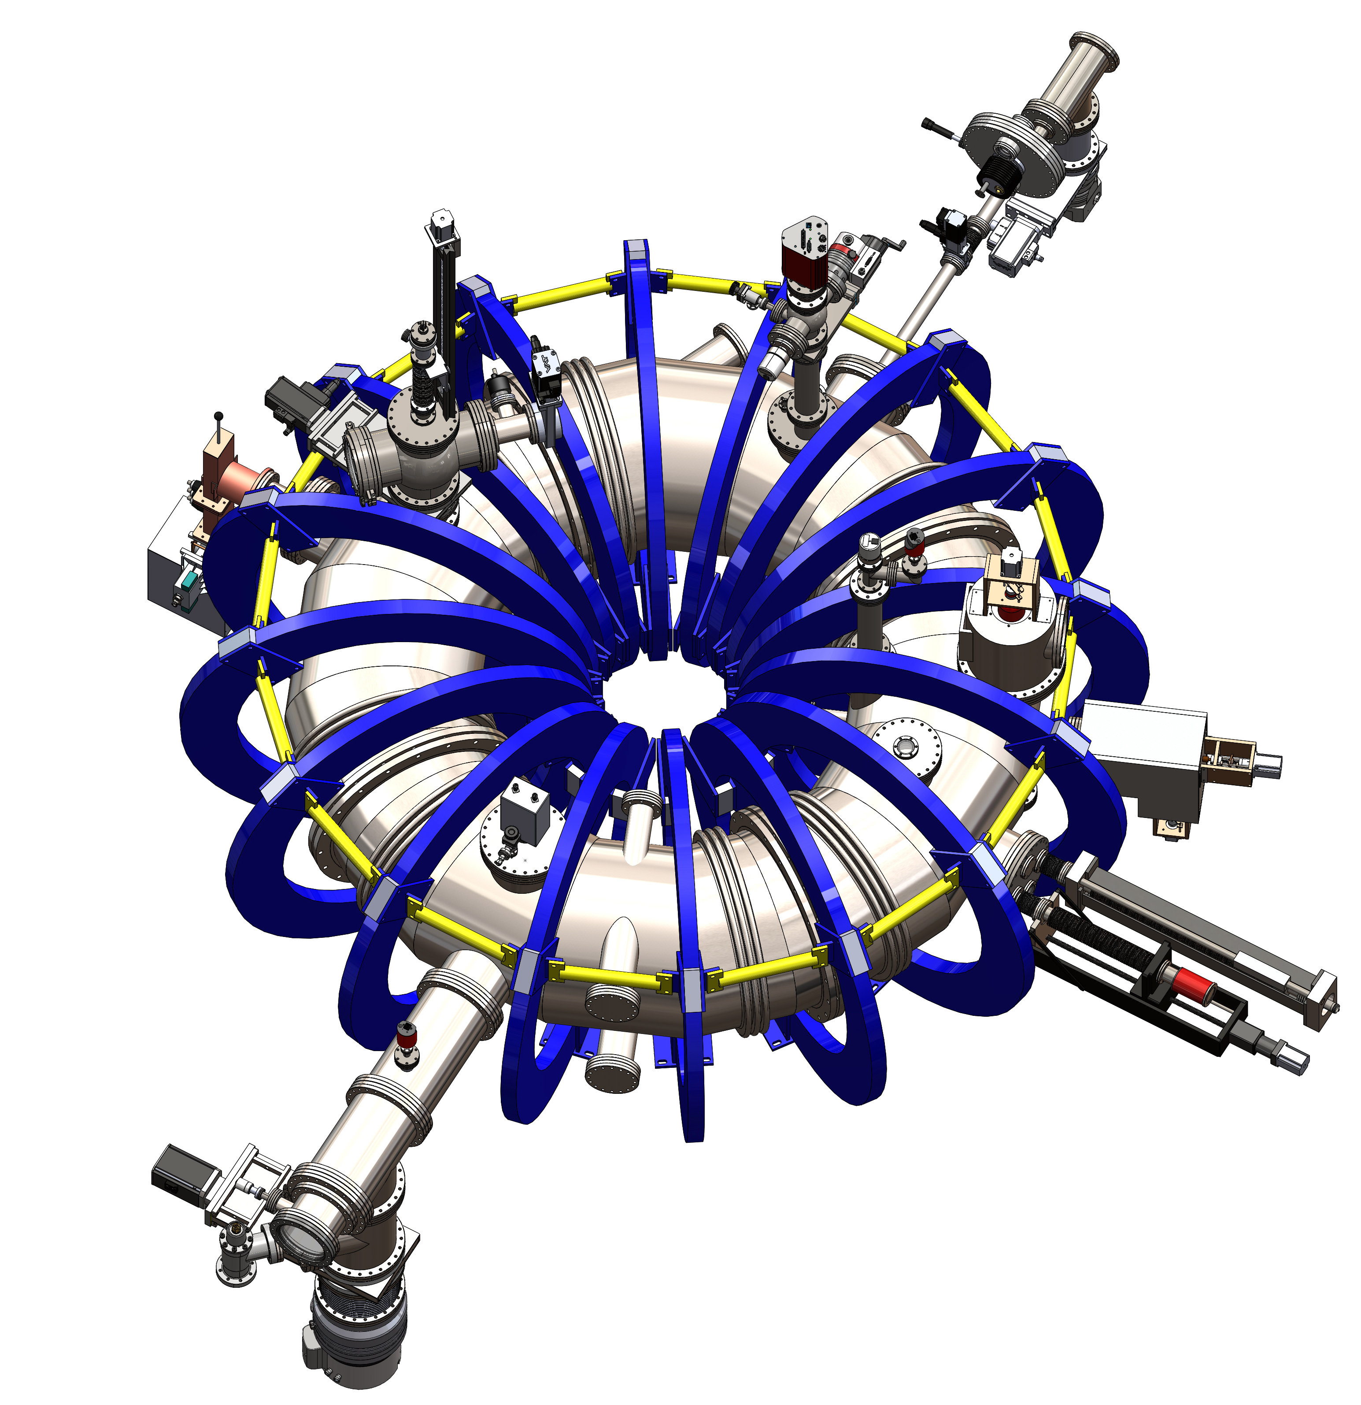
Prospects in 2024
Technical
  Extension to deuterium operation
  Plasma heating system upgrades
  In-situ material sample analysis
  Safety and control
Scientific
  Plasma characterization
  Material sample exposure

Slide 10
Extension to deuterium operation
Redesign and extension of gas injection system
  Fulfilling safety requirements for explosive gases exploitation
  Adding mass flow controller for deuterium (Bronkhorst EL-FLOW F-201CV is purchased)
  Extension to fast pulsed gas injection (system equipment with fast piezo valve)
  Additional conditions to be determined
Automatization of gas injection system
  Replacement of all manual valve by electro pneumatic ones
  Better pressure control in system lines
  Full integration to control system
Current scheme of gas injection system
Mass flow controller

Slide 11
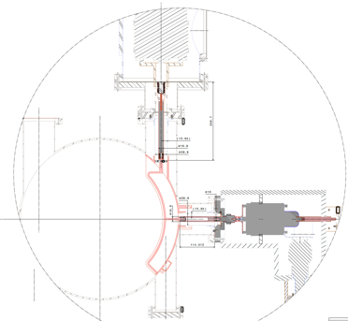
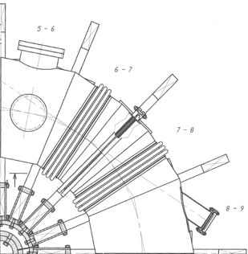
Plasma heating system upgrades
Power vacuum feedthroughs
ICRH system
  New actively cooled RF power vacuum feedthroughs
  Temperature control of feeding line components
  Extension to quasi-continuous operation
ECRH system
  Integration of additional 2 kW magnetron (increase of total power to 8 kW)
  Tangential wave launcher
  Possible launching automatization
ICRH system scheme
Current ECRH launching port
Port for tangential launching
TOMAS vessel drawing

Slide 12
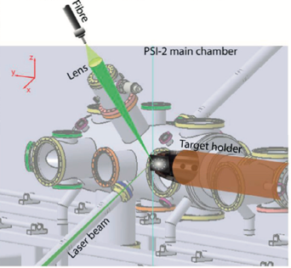
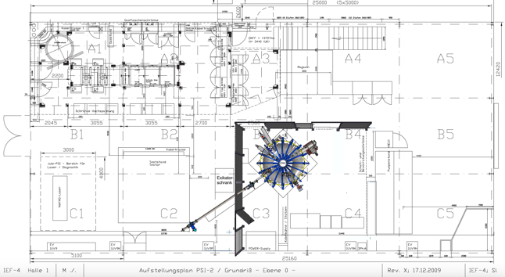
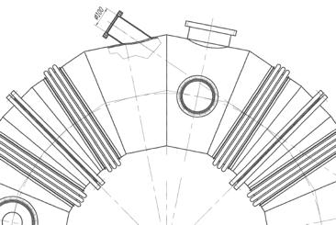
In-situ sample analysis
Preparation to LIBS [1] and LID QMS [2] installation
  Consultation with experts
  Adaptation of laser-detector geometry
  Design and assembly of support structures for fiber optics
  Selection of optical elements
Experimental setup of LIBS on PSI-2 [1].
PSI-2
Potential ports for LIBS
Sample manipulator
TOMAS vessel drawing
[1] X. Jiang et al., Fusion Engineering and Design 146 (2019) 96–99
[2] M. Zlobinski, et al. Fusion Engineering and Design 146 (2019) 1176–1180

Slide 13
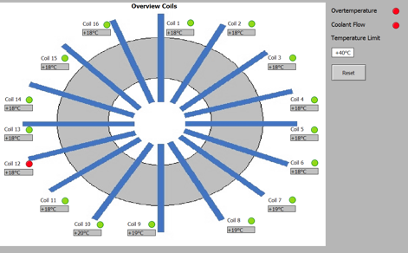
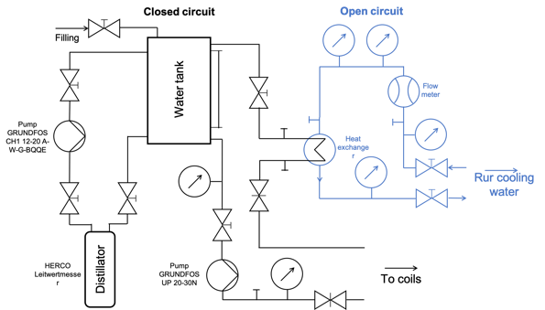
Safety and control
Moving towards facility for boronization studies
New elements integration into Control System
  Magnetic field system
  ECRH system
  Sample load-lock system + implementation control sample exposure temperature control
  Gas injection system
Safety improvement
  Safety fence and maintenance stage
  Explosive gas exhaust control
  Stray radiation protection
Reduction of cooling water consumption and electricity
Coils’ temperatures and indication of cooling water flows in control system
Current scheme of magnetic field cooling system

Slide 14
Plasma characterization
RF Plasma characterization at maximum available power -> extension of plasma parameter ranges
Continuation of IC plasma modelling and model validation
Influence of tangential launching on wave absorption and propagation in EC plasmas
Deuterium plasma (GD, EC, IC, EC+IC) characterization using probes, ToF NPA, RFEA, spectroscopy
Input from ITER ?
  Characterization of IC and GDC wall conditioning plasmas for studies of deuterium removal from boron-coated tungsten samples
  More advanced Glow Discharge homogeneity studies to contribute to improvement of Glow Discharge Cleaning system (e.g. amount and locations of glow discharge anodes) and ITER boronization procedure (determination of deposition distribution and layer thickness growth rates)

Slide 15
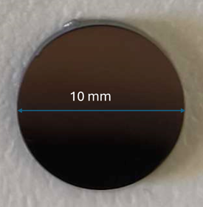
Sample exposure
Collaboration with Australia National University
Tungsten alloy sample exposure to EC and IC plasmas
  Sample material properties changes and He retention at oblique magnetic field and high material temperatures (up to 600 ºC)
  Studies of plasma species retention, oxidation resistance and subsurface structures formation
Suggested sample post-mortem analysis
Desorption and retention studies:
  Elastic Recoil Detection with Oxygen beam
  Thermal desorption spectroscopy
Nanobubble structure and form:
  Grazing-incidence small-angle X-ray Scattering(GISAXS) @ Melbourne Synchrotron
  Transmission Electron Microscopy (TEM)
  In-situ annealing in TEM
Example of material sample
“Starting” material
Polycrystalline W
Magnetron sputtered W on polycrystalline W substrate
Magnetron sputtered W - 5%(wt)Ta
Magnetron sputtered W - 3%(wt)Cr
Magnetron sputtered W 4%(wt)Ta-3%(wt)Cr
The rest of sample exposure activities and corresponding upgrades -> See talk of L. Dittrich

