Slide 1
Sample handling and exposure of boronized samples to GDC and ICWC plasmas at TOMAS
WP PWIE Midterm Meeting 2024
Laura Dittrich
KTH – Royal Institute of Technology (VR)
A. Goriaev, P. Petersson, D. López-Rodríguez, K. Crombé, Y. Kovtun, S. Möller, J. Buermans, E. Pitthan, M. Verstraeten, A. Adriaens, S. Brezinsek, M. Rubel, T. Wauters

Slide 2
Outline
Part I: Sample load lock system
Sample handling at TOMAS
Retarding Field Energy Analyzer (RFEA)
Planned upgrades to the sample handling system
Part II: Exposure of boronized samples
Exposure proceedings
Tokamak co-deposit samples from TEXTOR tiles
Sputter deposited B samples
Comparison of RFEA data with sample erosion
Summary and future plans

Slide 3
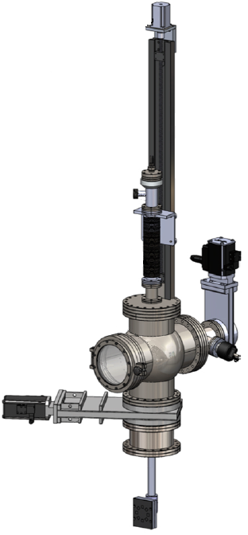
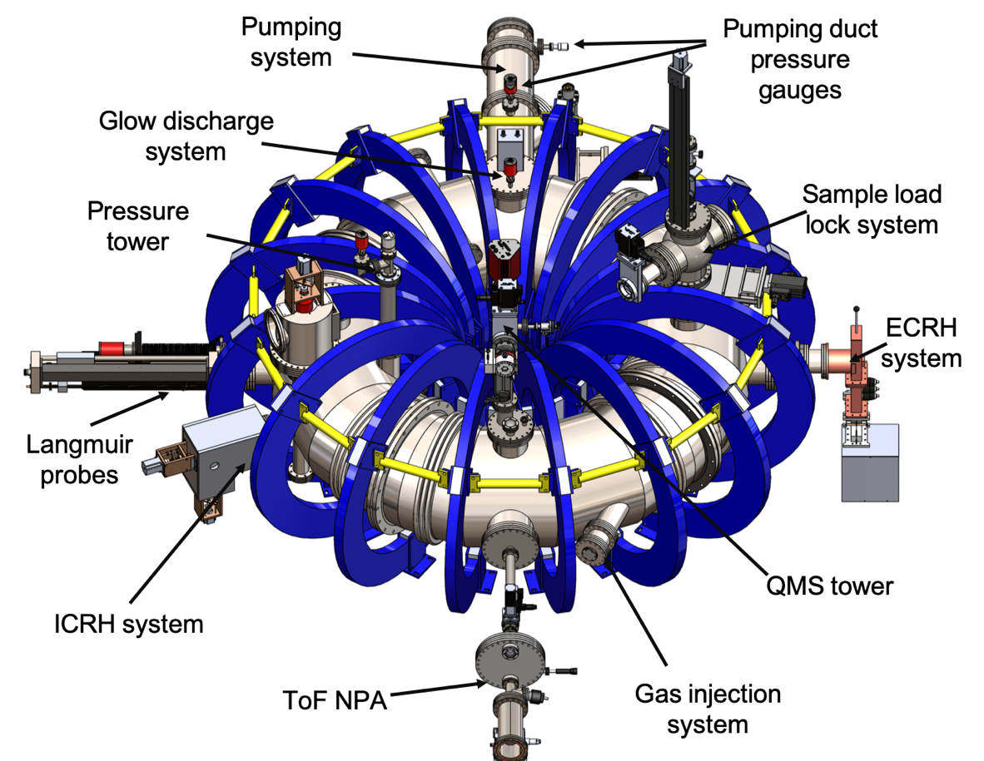
Sample handling at Toroidal Magnetized System (TOMAS)
TOMAS dedicated to:
Wall conditioning
Plasma production
Plasma-Surface Interaction studies
TOMAS dedicated to:
Wall conditioning
Plasma production
Plasma-Surface Interaction studies
Load-lock system with vertical manipulator:
Quick sample exchange
Separate pumping system
Manipulator with 1190 mm range
Heating of samples up to 600°C
Retarding Field Energy Analyzer (RFEA)
Figures: A. Goriaev et al. RSI 2021

Slide 4
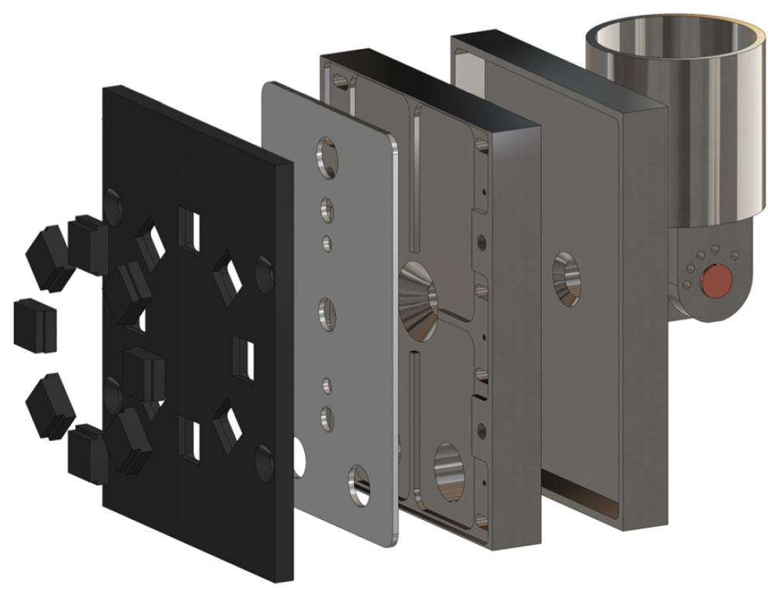
Sample holder at TOMAS
Manipulator
adapter
Manipulator adapter:
Size 100 mm × 80 mm
Tiltable to 5 possible positions
Sample holder base:
Similar to the PSI-2 design
Hollow to reduce heat transfer
Houses thermocouple and wires
Active heating element:
Allows heating up to 600°C
Sample mask:
Eight samples circularly arranged
Stainless steel, Mo, W or graphite mask
Sample holder
base
Active heating
element
Sample
mask
Figures: A. Goriaev et al. RSI 2021
Notes:
at 0°, 30°, 45°, 60°, 90°

Slide 5
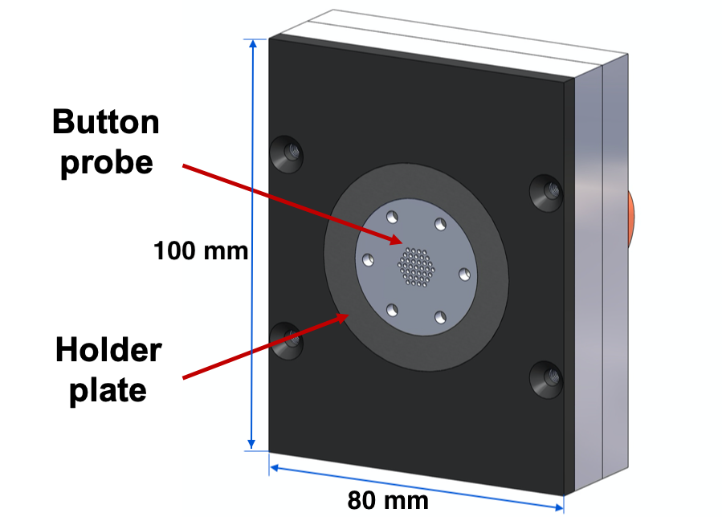
Retarding Field Energy Analyzer (RFEA)
Measurement of ion energies and ion density fluxes
Button probe on holder plate on sample holder
Four grids G₀, G₁, G₂, G₃ and collector plate C
Varying G₂ voltage gives current-voltage curve
Ion Energy Distribution Function (IEDF) measured
Parameter | Values
Ion flux range | 0.01 – 50 A/m²
Ion energy range | 0 – 2000 eV
Ion density range | 10¹² – 10²⁰ m⁻³
Operation pressure range | < 0.4 mbar
Ion energy resolution | ± 1 eV
Operation temperatures | 0 - 150 °C
Figure: K. Crombé et al. IAEA 2023

Slide 6
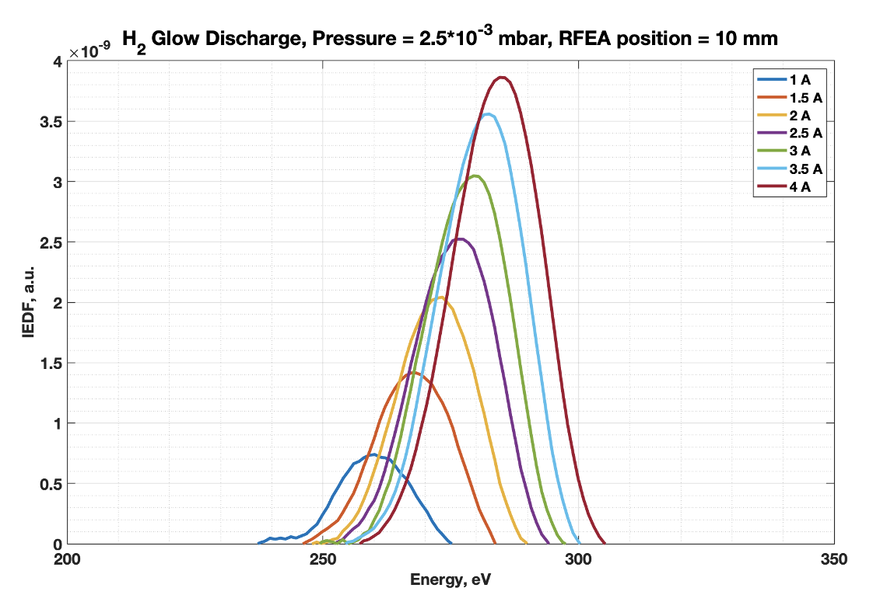
Retarding Field Energy Analyzer (RFEA)
Ion flux density: $J_{i}=\frac{1}{AT}\int_{E_{min}}^{E_{max}}{F_{IED}dE}$
$A$total ion collection area
$T$ combined transmission of the grids
$E_{min}$ and $E_{max}$ determined by variation in G₂
$F_{IED}$ experimentally obtained ion energy distribution function
Sputtering erosion rates: $S_{r}=\frac{Y\left(E_{i}\right)J_{i}}{q⋅N_{target}}$
$Y\left(E_{i}\right)$ sputter yield dependent on ion energy
$q$ electron charge
$N_{target}$atomic number density of the target
Sputter yields: Y. Yamamura, H. Tawara (1996) & R. Behrisch, W. Eckstein (2007)
As first approximation: Energies of the center of the distribution
The rates obtained are in the order of 0.05 - 1.5 nm/hour
→ To be compared with sample exposures
Credit: K. Crombé et al. IAEA 2023

Slide 7
Planned upgrades of the sample handling at TOMAS
Temperature control of the samples
Install active water cooling
Update of the temperature sensor
In combination with heating capabilities
Easily exchangeable sample holder heads
For sample mask:
Allow simple ex-situ exchange of samples
For RFEA button probe:
Fast change from RFEA operation to sample exposure
Remote inclination of the sample holder
Add a gear system for inclination movement
Inclination without breaking vacuum
Changes in the vacuum manipulator and the sample holder

Slide 8
Exposure of boronized samples
Exposure of boronized samples

Slide 9
Exposure of boronized samples - Overview
Exposure proceedings
Tokamak co-deposit samples from TEXTOR tiles
Deuterium removal by ICWC plasmas
Surface modifications by ICWC plasmas
Sputter deposited B samples
Boron layer erosion by ICWC plasmas
Boron layer erosion by GDC plasmas
Comparison of RFEA data with sample erosion
Summary and future plans

Slide 10
Exposure proceedings
Over 170 samples have been exposed 2021 – 2024 at TOMAS facility.
Ion Beam Analysis on each sample,
before and after exposure
(except clean graphite monitors):
Elastic Recoil Detection Analysis (ERDA)
Detection of elements from hydrogen to uranium
Depth profiling < 1µm, lower for resolution of ¹¹B, ¹²C
Nuclear Reaction Analysis (NRA)
Deuterium content with D(³He,p)⁴He reaction
Analysis depth roughly 10 µm
Particle-Induced Gamma-ray Emission (PIGE)
Using a 3 MeV proton beam
Boron detection with analysis depth of tens of µm

Slide 11
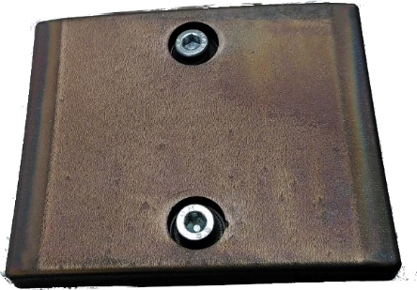
Exposure of tokamak co-deposits
Aim: Be as-close-as-possible to actual wall materials
Samples made from TEXTOR tiles for exposure to wall conditioning plasmas
Two tiles from inner bumper limiter (Tiles 384 and 079)
Operated between 2004 and 2013
Thick co-deposits: ≥ 10 µm
Thin co-deposits: 0.9 - 4.3 µm
Surfaces composition:
H, D, B, C, O, N, F, Inconel (Ni, Cr, Fe), Mo
Total of 16 exposures in TOMAS:
9 Ion Cyclotron Wall Conditioning (ICWC) exposures in He and H₂ plasmas
7 Glow Discharge Cleaning (GDC) exposures in He plasmas
10 mm
10 mm
10 mm
Notes:
Tile 384: 10-20 cm above the equatorial plane (thick) & Tile 079: 10-20 cm above the bottom of the machine (thin)

Slide 12
Deuterium removal by ICWC plasmas
Aim: Investigate the removal of D by ICWC plasmas
5 exposures in He ICWC plasmas:
At 10% duty cycle at 25 MHz, average pressure 4.6×10⁻² Pa.
Pre- and post-analysis with NRA.
No clear effect until 4 kW input power!
Follow up experiments at high power.
 | Changes in D content |  | Exposure conditions
Exposure | Sample I | Sample II | Duration [min] | Power [kW] | Position
1st ICWC | +9 % | -40 % | 24 | 2 | 1 cm in
2nd ICWC | -4 % | +50 % | 24 | 2 | vertical
4th ICWC | -15 % | +168 % | 48 | 2 | 1 cm in
5th ICWC | -68 % | -33 % | 24 | 4 | 1 cm in
6th ICWC | -26 % | +10 % | 24 | 2 | 1 cm in

Slide 13
Deuterium removal by ICWC plasmas (2)
Further exposures in He ICWC plasmas at high powers:
Confirm removal of D at high powers
Optimize D removal
→ Negative biasing of the sample holder to improve performance.
→ 4 kW plasmas remove consistently D, but negative biasing reduces effect.
→ Probable sheathing effects reduce ion flux.
 | Changes in D content |  | Exposure conditions
Exposure | Sample I | Sample II | Duration [min] | Power [kW] | Electrical connection
5th ICWC | -68 % | -33 % | 24 | 4 | Vessel
7th ICWC | -16 % | -36 % | 24 | 4 | Biased -50V
8th ICWC | -3 % | -13 % | 22.7 | 4 | Biased -100V

Slide 14
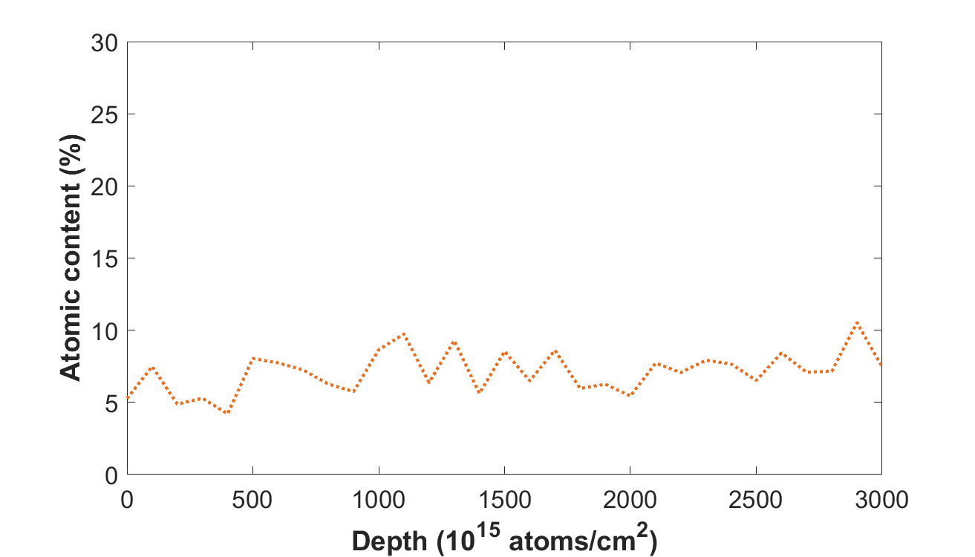
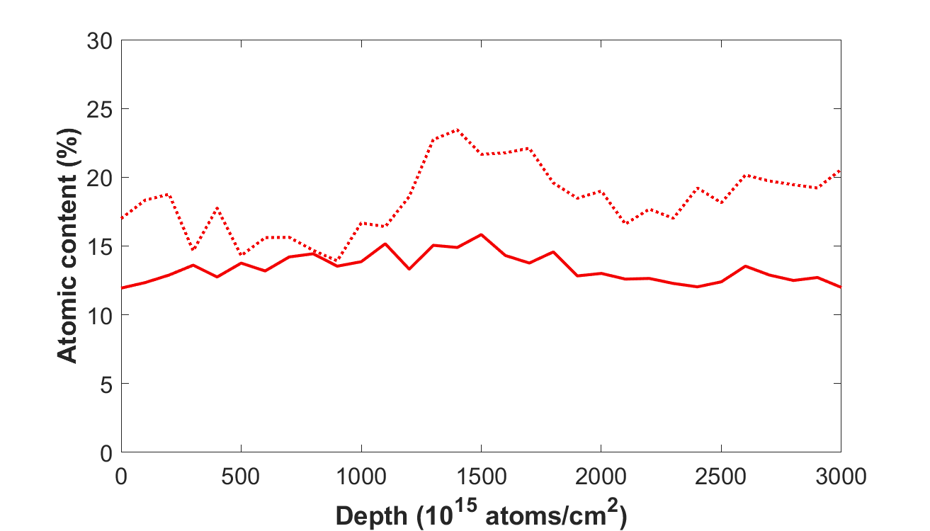
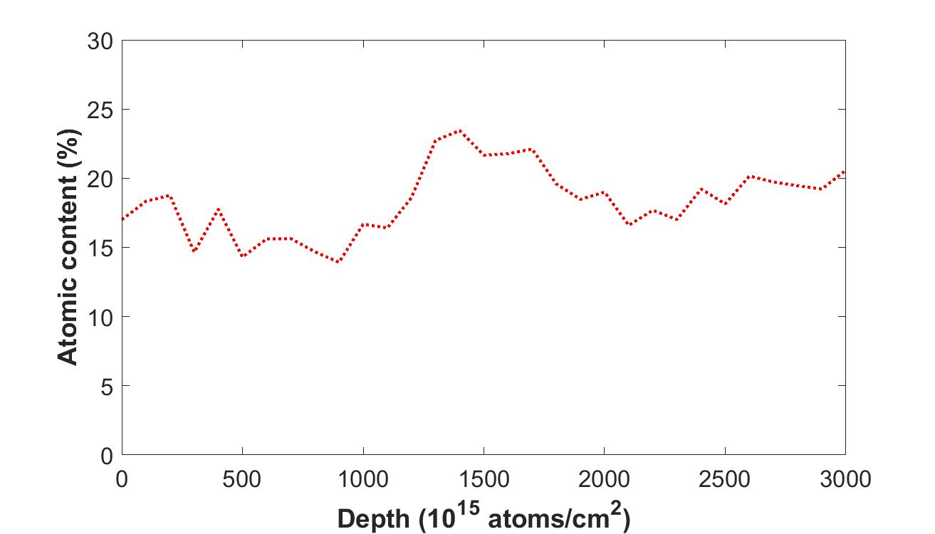
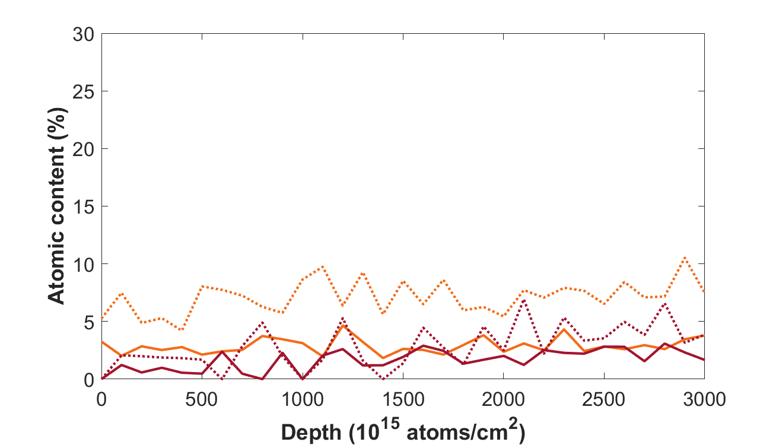
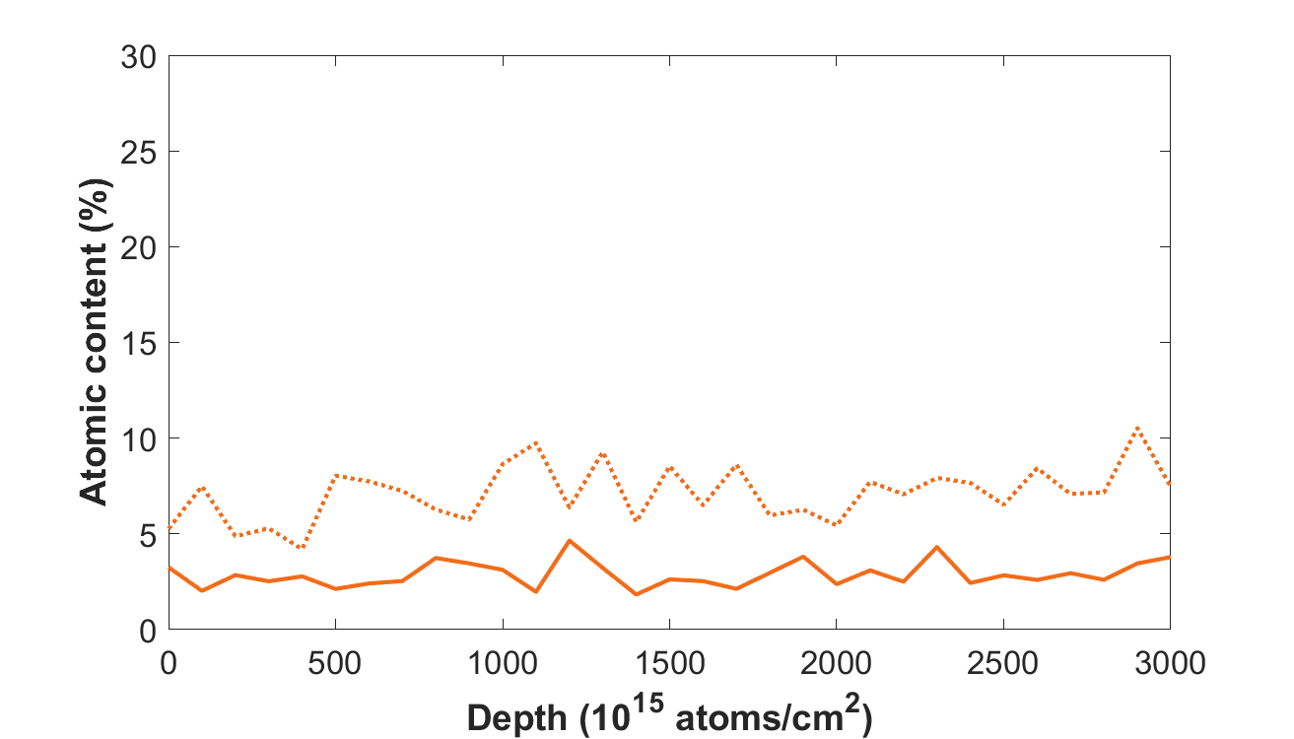
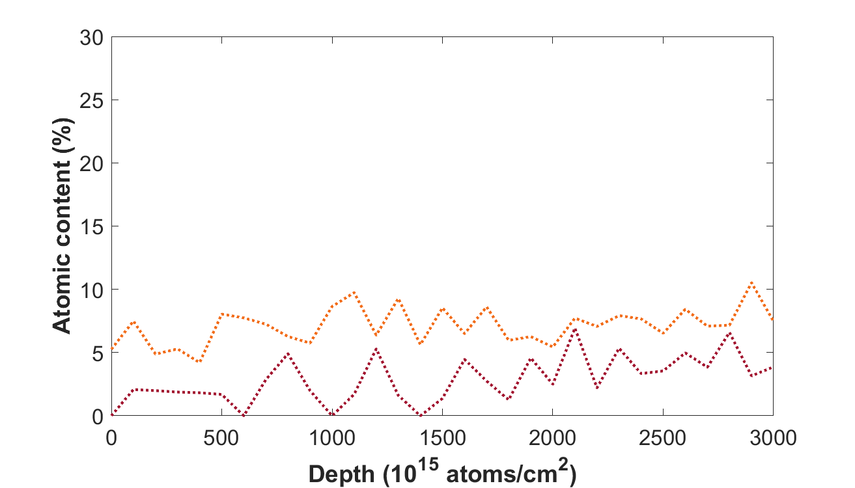
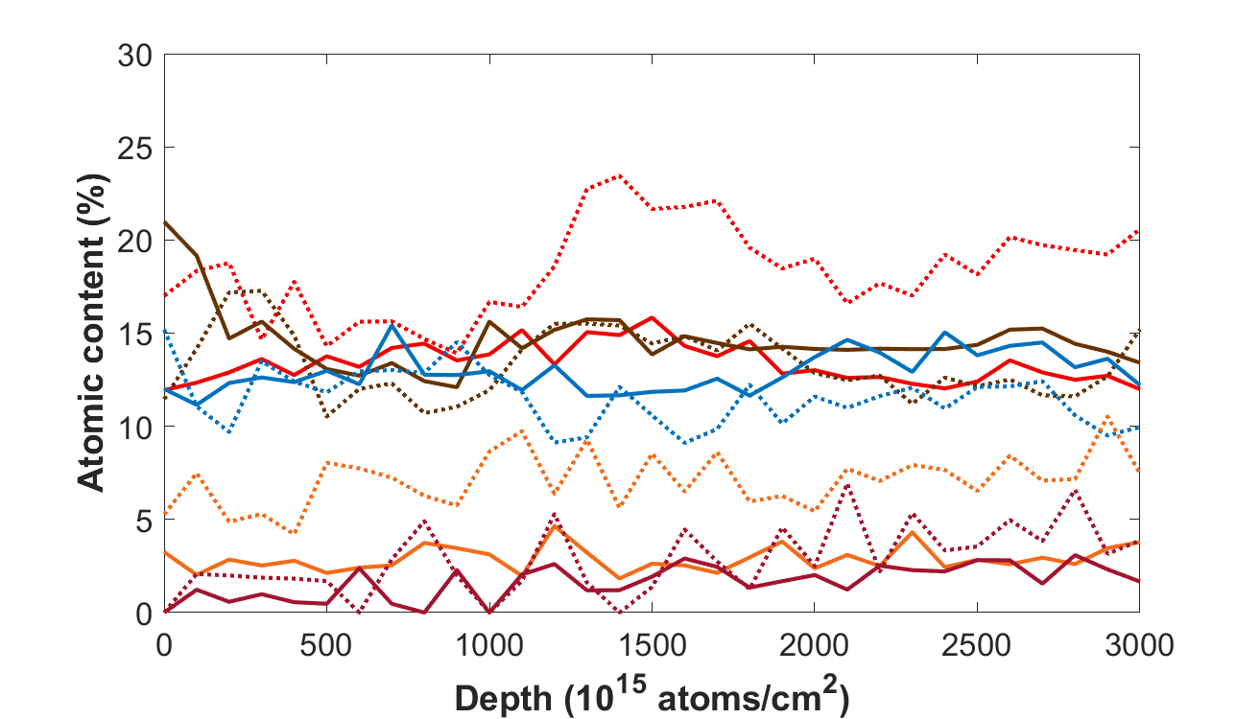
Surface modifications by ICWC plasmas
Aim: Investigation of the near-surface composition
ERDA results show, after 4 kW He ICWC plasmas H and D remove from sample surface.
5th ICWC exposure, He 4 kW:
Efficient O and H removal
on the surface.
Removal of D observed.
¹⁰B increase relative to other elements.
He plasma: More H removed than D
ERDA results for ICWC H₂ plasma:
Efficient O removal and C removal.
No clear isotope exchange effects at 1.5 kW.
C erosion supported by expected chemical sputtering.
before exposure
after exposure
C
O
¹⁰B
H
D

Slide 15
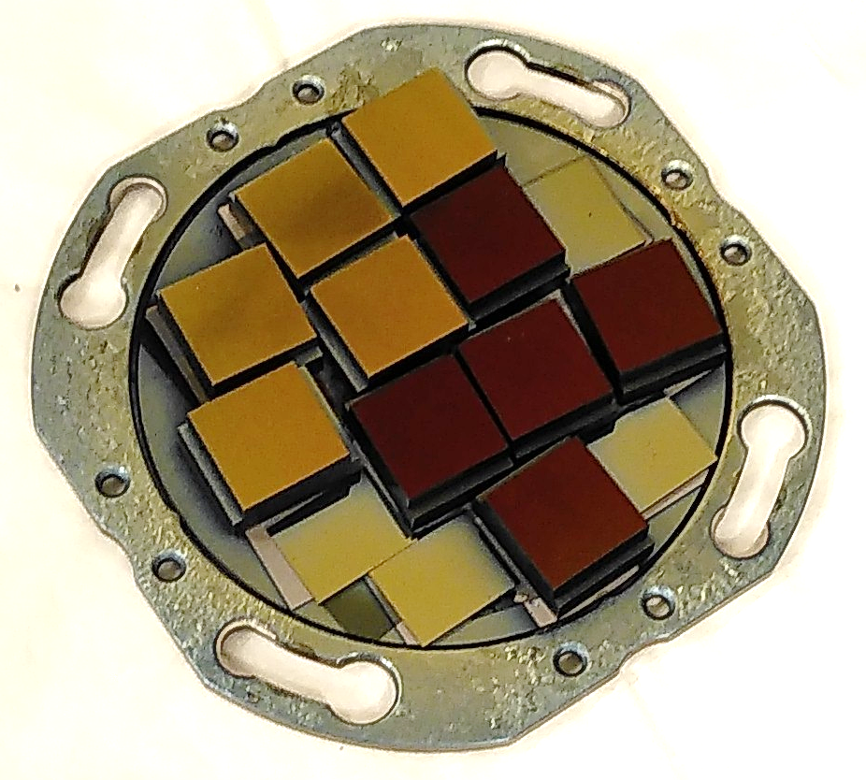
Sputter deposited B samples
Observation of e.g. unphysical increase in D content after exposure on TEXTOR samples.
Investigation of uniformity of TEXTOR tiles in toroidal direction.
Layer thickness analysis before and after exposure.
Inhomogeneities on TEXTOR samples.
Production of homogeneous sputter deposited samples:
Sputter deposition of B at Forschungszentrum Jülich
Sputter deposition of B and mixed layers at Uppsala University
Produced samples on graphite substrates:
B layers: 70 – 670 nm
B+W mixed layer: approx. 75 nm
B+D mixed layer: approx. 100 nm
B+W+D mixed layer: approx. 75 nm
W or EUROFER interlayers: 150 – 200 nm
Results of mixed layer samples will be presented at PSI conference.

Slide 16
Boron layer erosion by wall conditioning plasmas
Aim: Study B erosion by wall-conditioning plasmas.
Graphite samples with B coating exposed to ICWC plasmas:
→ Extremely high erosion rates, not been reproduced nor observed on the TEXTOR samples.
Exposure to He GDC plasmas:
(average of 4)
→ Highest erosion rates at GDC plasmas with current of 3 A.
 | B layer thickness [nm] |  | Erosion rate | Exposure conditions
Exposure | Sample I | Sample II | [nm/min] | Gas | Power [kW] | Duration [min] | Position
1st ICWC | -87 % | -86 % | 23.9 | He | 2 | 24 | 1 cm in
2nd ICWC | -54 % | -82 % | 9.9 | He | 2 | 24 | vertical
3rd ICWC | -83 % | -79 % | 10.1 | H₂ | 1.5 | 36 | 1 cm in
Presented at SOFE 2023 by A. Goriaev et al.
Exposure | Erosion rate [nm/min] | Duration [min]
GDC at 5 A | 0.12 | 421
GDC at 1 A | 0.10 | 420
GDC at 3 A | 0.15 | 293
Credit: A. Adriens, A. Goriaev, S. Möller

Slide 17
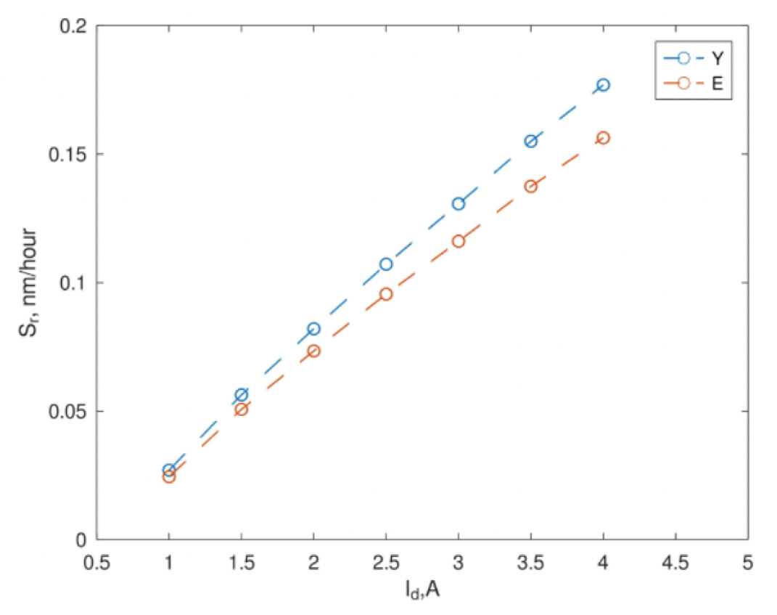
Comparison of RFEA data with sample erosion
H₂ GDC plasma
RFEA measurements:
Experimental erosion data on B+D layers:
Exposure duration 3 h
First results, data collected in March
→ Erosion rates roughly 40 times higher
GDC at 3A | Erosion rate [nm/h]
Sample I | 5
Sample II | 5
Credit: A. Bäckman
K. Crombé et al., IAEA FEC (2023)
Obtained sputtering erosion rates at 3 A: 0.12 – 0.13 nm/h
Possibly due to impurities in plasma
Notes:
Y. Yamamura, H. Tawara, “Atomic Data and Nucl. Data Tables” 62, 149–253 (1996)
R. Behrisch, W. Eckstein Springer-Verlag Berlin, Heidelberg (2007)

Slide 18
Summary and outlook
Summary:
Exposure of TEXTOR tiles:
D removal from 4 kW ICWC input power.
Inhomogeneous samples prove experiments with tokamak co-deposits difficult.
Exposure of sputter deposited B samples:
GDC erodes B at 0.15 nm/min in He plasmas.
More results in progress (PSI-26)
Sample erosion higher than expected from RFEA data
Outlook:
Different materials:
Metallic substrates: Mo and W
Isotope exchange studies in W samples
More complex sputter deposited samples
ECWC exposures
Exposures at high sample temperatures
Possible contribution to ITER

Slide 19
Thank you for your attention!
And great thanks to my colleagues:
A. Goriaev, P. Petersson, D. López-Rodríguez, K. Crombé, Y. Kovtun, S. Möller, J. Buermans, E. Pitthan, M. Verstraeten, A. Adriaens, S. Brezinsek, T. Wauters, M. Rubel

Slide 20
TOMAS results presented and published:
A. Goriaev et al., “The upgraded TOMAS device: A toroidal plasma facility for wall conditioning, plasma production, and plasma–surface interaction studies” , Rev. Sci. Instrum. 92, 023506 (2021)
S. Moon et al., “Characterization of neutral particle fluxes from ICWC and ECWC plasmas in the TOMAS facility”, Phys. Scr. 96 124025 (2021)
L. Dittrich et al., “Assessment of erosion efficiency and isotope exchange in tokamak co-deposits exposed to wall conditioning plasmas in TOMAS facility”, presented at 25th International Conference on Plasma Surface Interaction in Controlled Fusion Devices (PSI-25), Online Meeting, June 2022
Y. Kovtun et al., “Overview of TOMAS plasma diagnostics”, 6th International Conference Frontiers in Diagnostics Technologies, ENEA Frascati Research Centre, Frascati, Italy 19–21 October 2022, 2023 JINST 18 C02034
A. Goriaev et al., “First studies of local ion fluxes in radio frequency plasmas for ion cyclotron wall conditioning applications in the TOMAS device”, AIP Conf. Proc. 2984, 040007 (2023)
K. Crombé et al., “Radio frequency plasma production on the TOMAS device”, AIP Conf. Proc. 2984, 040005 (2023)
Y. Kovtun et al., “Measurement of hydrogen plasma parameters of the combined ECR+RF discharge in the TOMAS facility”, AIP Conf. Proc. 2984, 110001 (2023)
J. Buermans et al., “X-Mode Electron Cyclotron Heating Scenarios Beyond the Cut-off Density”, AIP Conf. Proc. 2984, 110003 (2023)
D. López-Rodríguez et al., “Characterisation of radio frequency plasmas in the upgraded TOMAS device”, AIP Conf. Proc. 2984, 040006 (2023)
A. Goriaev et al., “Studies of boronization layer erosion by Ion Cyclotron Wall Conditioning plasmas in W7-X - like conditions at TOMAS”, Poster presentation at SOFE, 30th IEEE Symposium on Fusion Engineering, July (2023)
K. Crombé et al., “PLASMA CHARACTERISATION AND WALL CONDITIONING STUDIES ON THE TOMAS DEVICE”, IAEA-CN-316-1890 (2023)
P. Petersson et al., “The influence of plasma parameters and electrical connection on the efficiency of wall conditioning plasmas in TOMAS facility”, presented at 19th International Conference on Plasma-Facing Materials and Components for Fusion Applications, Bonn, 22 – 26 May 2023
K. Crombé et al., “Plasma Characterisation and Wall Conditioning Studies on the TOMAS Device”, IAEA-CN-316-1890 (2023)
J. Buermans et al.,” Study of the Electron Cyclotron Power Deposition in TOMAS”, 29 December 2023 submitted

Slide 21
Extra slides
Extra slides

Slide 22
Inhomogeneity of TEXTOR samples
Investigation of uniformity of TEXTOR tiles in toroidal direction, approx. 1 cm steps.
Decrease of layer thickness in same direction
Outliers in 17 % of measurement points
Supported by layer thickness analysis before and after exposure:
 | D layer thickness in 10¹⁸atoms cm⁻²
 | Sample I |  | Sample II
 | Before | After | Before | After
1st ICWC | 52 | 14 | 32 | 19
2nd ICWC | 40 | 46 | 38 | 45
4th ICWC | 44 | 26 | 24 | 26
5th ICWC | 40 | 44 | 34 | 29
6th ICWC | 51 | 45 | 34 | 28

