Slide 1

Dust ‘survey’
S. Ratynskaia KTH, Stockholm, Sweden
P. Tolias, L. Vignitchouk, L. Boccaccia, L. Pennati, KTH, Stockholm, Sweden
G.L. Delzanno, Los Alamos National Laboratory, USA
M. De Angeli, IPP CNR, Milano, Italy
Experiments under EUROfusion FP8 and FP9

Slide 2
Outline
Dust inventory evolution in fusion devices
Main theoretical results from impact mechanics, contact mechanics and surface physics
Do they work in fusion relevant scenarios ?
Complications in fusion applications:
  Heating effects
  Sheath-within-a-sheath
  Non-spherical dust
Dust survival – new results on current collection
Boron dust – what to expect?
Summary

Slide 3
Dust inventory evolution
Release
mechanisms
Melt splashing | Solid dust remobilization | Solid dust production
Initial conditions
Dust-plasma interaction Charging Heating Dynamics (forces) Spinning (torques) Mass ablation | Dust-wall collisions Bouncing Sticking Spreading Splashing Impact bonding Disintegration
Dust transport
simulations
Raw output
End states for
a single particle
Full vaporization | Splashing as droplet | Disintegration | Sticking as solid
Statistical
Post-treatment
Reactor-relevant
predictions
Impurity source maps | Dust inventory evolution | Accumulation sites
Fluid dynamics problems
Contact mechanics problems
Solid mechanics problems
Plasma-body interaction problems

Slide 4
Main theoretical results from
impact mechanics, contact mechanics
and surface physics

Slide 5
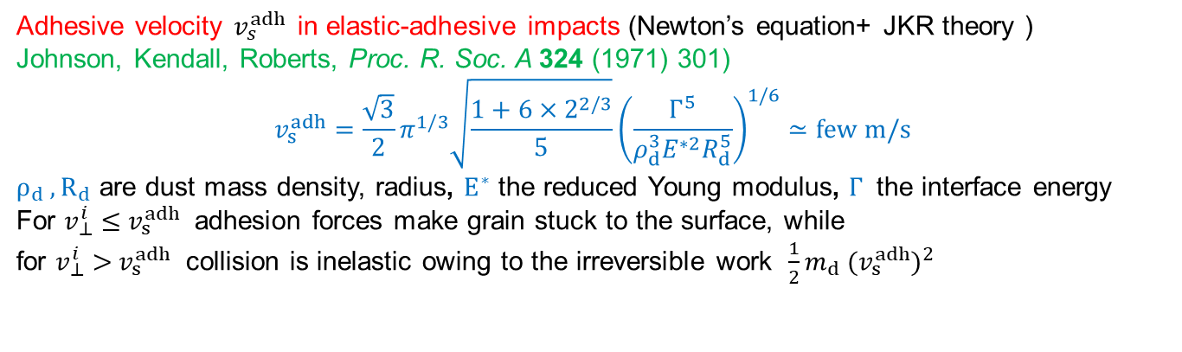
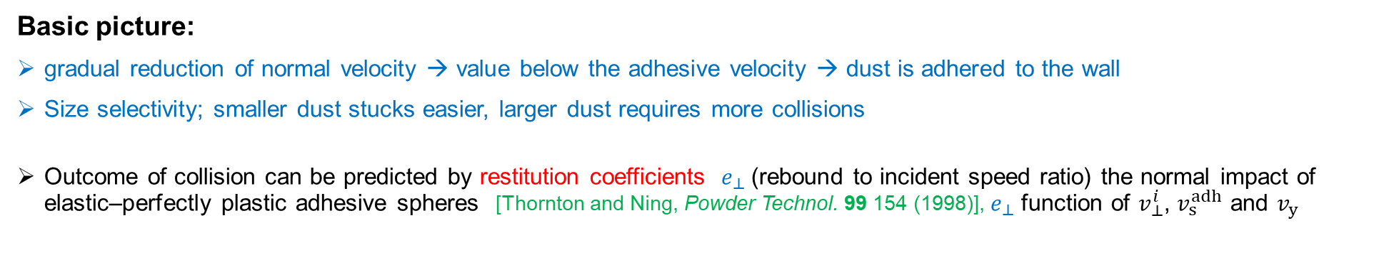
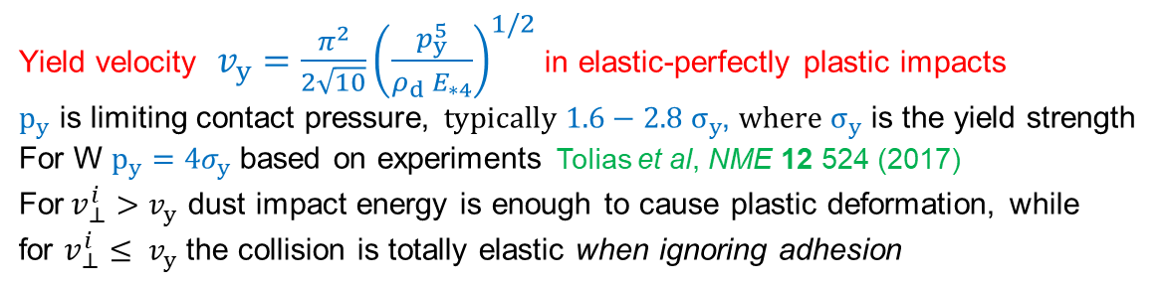
Main quantities of interest : normal impacts
Adhesive velocity $v_{s}^{adh}$in elastic-adhesive impacts (Newton’s equation+ JKR theory )
Johnson, Kendall, Roberts, Proc. R. Soc. A 324 (1971) 301)
$$v_{s}^{adh}=\frac{\sqrt{3}}{2}π^{1/3}\sqrt{\frac{1+6×2^{2/3}}{5}}{\left(\frac{Γ^{5}}{ρ_{d}^{3}E^{∗2}R_{d}^{5}}\right)}^{1/6}≃few m/s$$
$ρ_{d} ,R_{d}$ are dust mass density, radius, $E^{∗}$ the reduced Young modulus, $Γ$ the interface energy
For $v_{⊥}^{i}$ $≤{ v}_{s}^{adh}$ adhesion forces make grain stuck to the surface, while
for $v_{⊥}^{i}$ $>{ v}_{s}^{adh}$ collision is inelastic owing to the irreversible work ${\frac{1}{2}m_{d} (v}_{s}^{adh})^{2}$
Yield velocity $v_{y}=\frac{π^{2}}{2\sqrt{10}}{\left(\frac{p_{y}^{5}}{ρ_{d}{ E}_{∗4}}\right)}^{1/2}$ in elastic-perfectly plastic impacts
$p_{y}$ is limiting contact pressure, ${typically 1.6−2.8 σ}_{y}$, ${where σ}_{y}$ is the yield strength
For W $p_{y}=4σ_{y}$ based on experiments Tolias et al, NME 12 524 (2017)
For$v_{⊥}^{i}>v_{y}$ dust impact energy is enough to cause plastic deformation, while
for $v_{⊥}^{i}≤ v_{y}$ the collision is totally elastic when ignoring adhesion
Basic picture:
gradual reduction of normal velocity → value below the adhesive velocity → dust is adhered to the wall
Size selectivity; smaller dust stucks easier, larger dust requires more collisions
Outcome of collision can be predicted by restitution coefficients $e_{⊥}$(rebound to incident speed ratio) the normal impact of elastic–perfectly plastic adhesive spheres [Thornton and Ning, Powder Technol. 99 154 (1998)], $e_{⊥}$ function of $v_{⊥}^{i}$, $v_{s}^{adh}$ and $v_{y}$

Slide 6
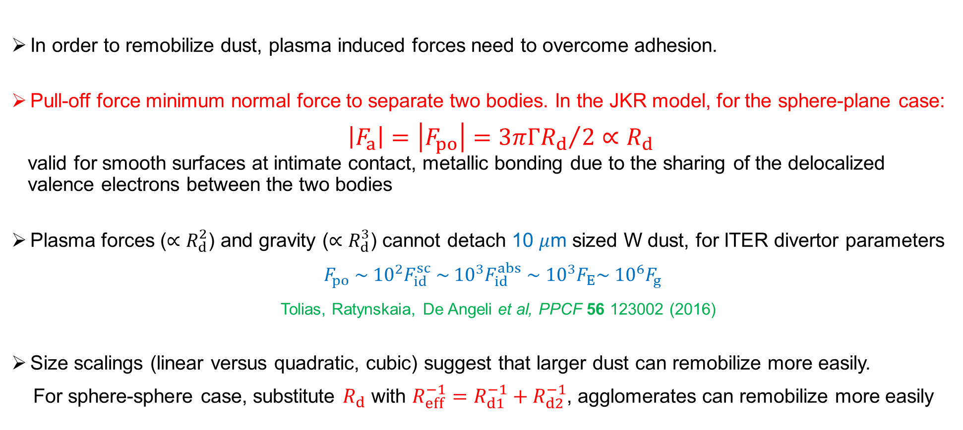
Adhesion: contact mechanics picture
In order to remobilize dust, plasma induced forces need to overcome adhesion.
Pull-off force minimum normal force to separate two bodies. In the JKR model, for the sphere-plane case:
$\left|F_{a}\right|=\left|F_{po}\right|={3πΓR_{d}}/2∝R_{d}$
valid for smooth surfaces at intimate contact, metallic bonding due to the sharing of the delocalized
valence electrons between the two bodies
Plasma forces ($∝R_{d}^{2}$) and gravity ($∝R_{d}^{3}$) cannot detach 10 $μ$m sized W dust, for ITER divertor parameters
$F_{po} \sim {10}^{2}F_{id}^{sc} \sim {10}^{3}F_{id}^{abs}$ $\sim { 10}^{3}F_{E}\sim { 10}^{6}F_{g}$
Tolias, Ratynskaia, De Angeli et al, PPCF 56 123002 (2016)
Size scalings (linear versus quadratic, cubic) suggest that larger dust can remobilize more easily.
For sphere-sphere case, substitute $R_{d}$ with $R_{eff}^{−1}=R_{d1}^{−1}+R_{d2}^{−1}$, agglomerates can remobilize more easily

Slide 7
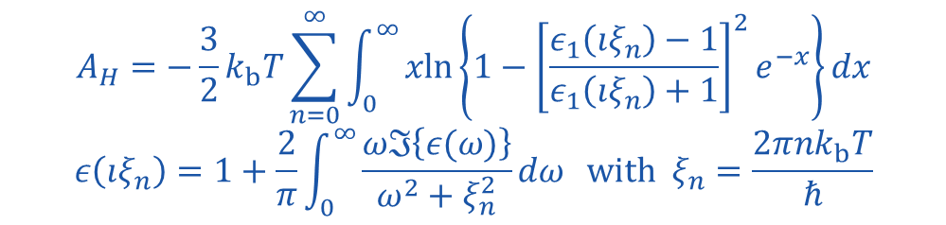
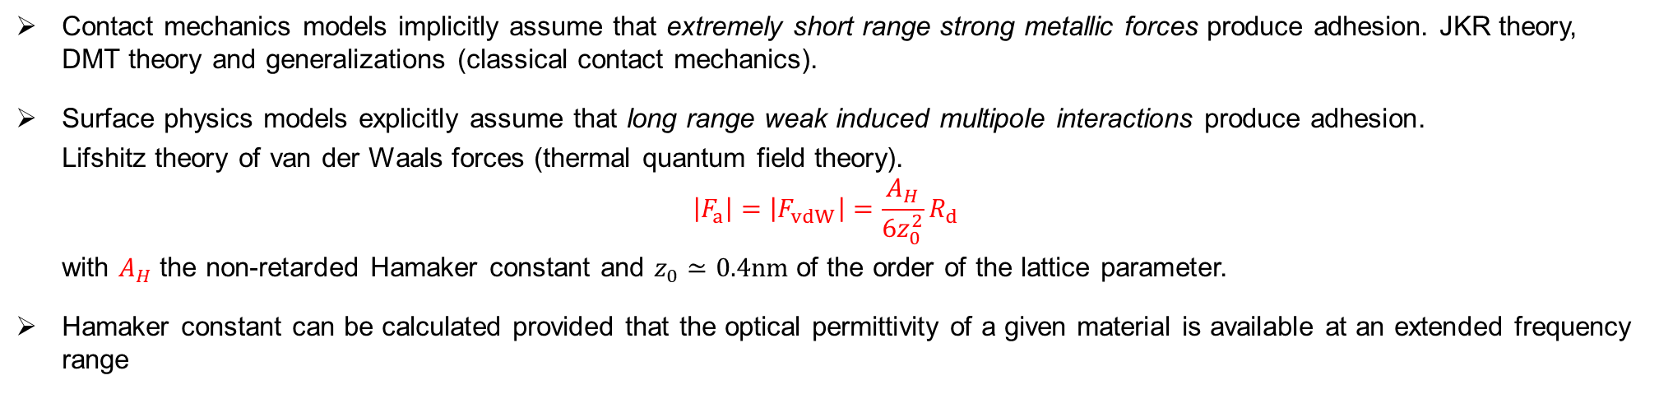
Adhesion: surface physics picture
Contact mechanics models implicitly assume that extremely short range strong metallic forces produce adhesion. JKR theory, DMT theory and generalizations (classical contact mechanics).
Surface physics models explicitly assume that long range weak induced multipole interactions produce adhesion.
Lifshitz theory of van der Waals forces (thermal quantum field theory).
$$\left|F_{a}\right|=\left|F_{vdW}\right|=\frac{A_{H}}{6z_{0}^{2}}R_{d}$$
with $A_{H}$ the non-retarded Hamaker constant and $z_{0}≃0.4nm$ of the order of the lattice parameter.
Hamaker constant can be calculated provided that the optical permittivity of a given material is available at an extended frequency range
$$A_{H}=−\frac{3}{2}k_{b}T\sum_{n=0}^{∞}{\int_{0}^{∞}{xln\left\{1−{\left[\frac{ε_{1}\left(ıξ_{n}\right)−1}{ε_{1}\left(ıξ_{n}\right)+1}\right]}^{2}e^{−x}\right\}}}dx$$
$$ε\left(ıξ_{n}\right)=1+\frac{2}{π}\int_{0}^{∞}{\frac{ωℑ\left\{ε(ω)\right\}}{ω^{2}+ξ_{n}^{2}}dω} with ξ_{n}=\frac{2πnk_{b}T}{ℏ}$$
  non-retarded calculations [P. Tolias, Fus. Eng. Des. 133, 110 (2018); P. Tolias, Surf. Sci. 700, 121652 (2020)] and even fully relativistic retarded calculations possible [P. Tolias, Surf. Sci. 723, 122123 (2022)].

Slide 8
Do they work for fusion applications?

Slide 9
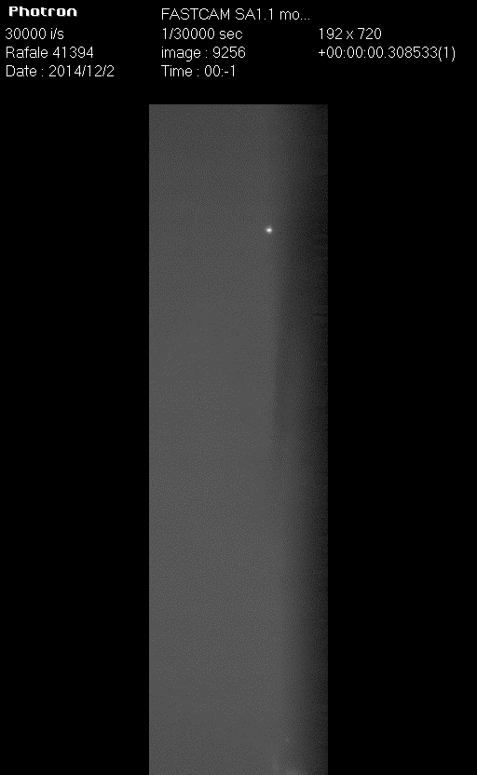

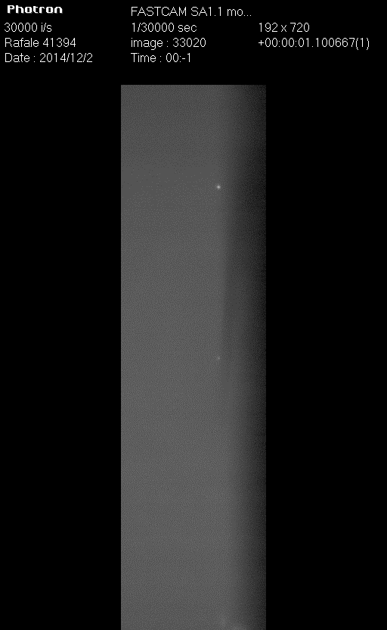

Dust impact validation in plasma environments (Pilot-PSI)
Ratynskaia et al, JNM 463 877 (2015)
Shalpegin et al, NF 55 112001 (2015)
Tolias et al, NME 12 524 (2017)

Slide 10
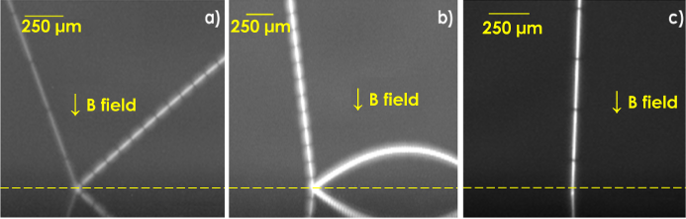
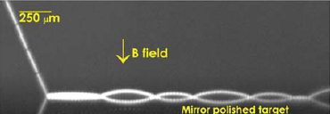
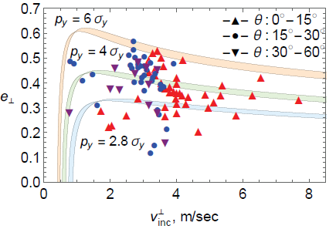
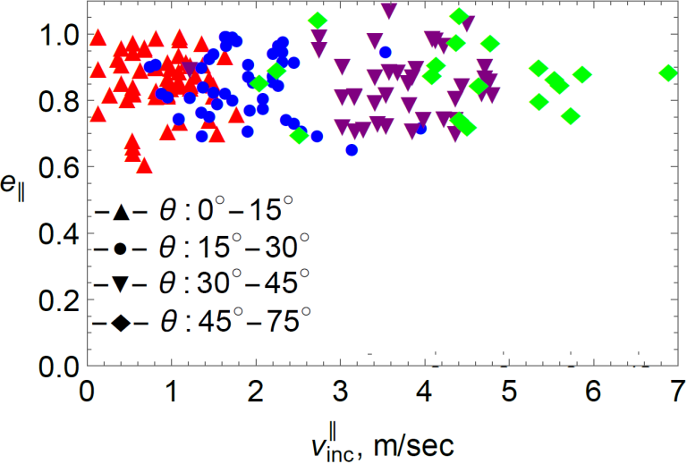
Dust impact validation in plasma environments (Pilot-PSI)
Spatial resolution down to 6.5 μm/pixel achieved in Pilot-PSI (spherical 5-25μm W dust) Shalpegin et al NF 55 (2015) 112001
(a) small loss of normal velocity, $e_{⊥}$= 0.7, $e_{||}$= 0.95; (b) substantial loss, $e_{⊥}$= 0.2, $e_{||}$= 1; (c) sticking ; (d) multi-bouncing
Plasma not relevant for instantaneous impacts
Dissipation of $v_{⊥}$ due to adhesive and plastic losses & nearly preserved$v_{||}$ (near frictionless contact)
No rebound when (i) normal velocity < sticking value (ii) High temperature
Thornton and Ning approach, elastic-perfectly plastic adhesive spheres Powder Technol. 99 (1998)

Slide 11
Dust remobilization in plasma environments (linear devices)
Tolias et al, PPCF 56, 025009 (2016); Ratynskaia et al, NME 12, 569 (2017); De Angeli et al, NME 12, 536 (2017);
Ratynskaia et al, NME 17, 222 (2018)
Seven experimental campaigns carried out in Pilot/Magnum PSI between 2014-2018 under the auspices of ENR (2014) and WP-PFC (2015-2018).
Linear plasma device | Experimental focus | Main conclusions
1st Pilot-PSI campaign | Stationary plasma exposures, W polydisperse dust, normal and oblique B-field | Clusters, large dust remobilizes Less activity at oblique incidence Not much remobilization overall
2nd Pilot-PSI campaign | Stationary plasma exposures, re-exposures of samples, W polydisperse dust, emphasis on oblique B-field | Confirmation of above conclusions No hysteresis
3rd Pilot-PSI campaign | Transient plasma exposures, first W monodisperse dust, first single ELMs | Wetting induced coagulation No isolated melting
4th Pilot-PSI campaign | Transient plasma exposures, single ELMs with normal and oblique B-field, W dust, first castellated samples | Confirmation of above conclusions No enhanced activity during ELMs (3) Dust does not move towards gaps
5th Pilot-PSI campaign | Transient plasma exposures, castellated samples, first multiple ELMs, W dust and first Be proxies | Gaps efficiently trap existing dust Dust unlikely to reside into gaps (3) No enhanced activity during multiple ELMs
1st Magnum-PSI campaign | Transient plasma exposures, Multiple ELMs, W dust and Be proxies (Cu, Cr, Al) | Growth of very large dust Chemical effects + mixed materials
2nd Magnum-PSI campaign | Transient plasma exposures, Be proxies | Source and liquid metal contamination -> no conclusions

Slide 12
Dust remobilization in plasma environments (fusion devices)
Tolias et al, PPCF 56, 025009 (2016); Ratynskaia et al, NF 56 066010 (2016); Weinzettl et al, FED 124 446 (2017);
Bykov et al, NME 12, 379 (2017); Ratynskaia et al, NF 58, 106023 (2018); De Angeli et al, NF 59, 106033 (2019).
Many experimental campaigns carried out in fusion devices under the auspices of WPTE (ASDEX-Upgrade) and by our own initiative (TEXTOR, EXTRAP-T2R, DIII-D, COMPASS, FTU).
Fusion device | Experimental focus | Main conclusions
TEXTOR campaign (2013) | Stationary plasma exposures, first L-mode experiments with Mo & Ti dust | Proof of principle of the ability to prepare samples with pre-adhered dust in a controlled manner
EXTRAP-T2R campaign (2013) | Stationary plasma exposures, first experiments with polydisperse W dust | Not much remobilization overall
DIII-D campaigns (2015-2016) | Transient plasma exposures, first ELMy H-mode experiments with W dust, also C and Al dust | Confirmation of wetting induced coagulation
COMPASS campaigns (2015-2016) | Transient plasma exposures, ELMy H-mode experiments with W and Be proxy dust | Localized remobilization due to arcing
ASDEX Upgrade campaign (2016) | Transient plasma exposures, ELMy H-mode experiments with W and Be proxy dust, castellated samples | Confirmation of most of our Pilot-/Magnum PSI observations
FTU campaign (2017) | Pure magnetic discharges, W and Fe dust exposed to pure magnetic discharges (no plasma) | Remobilization of ferromagnetic dust by magnetic moment force

Slide 13
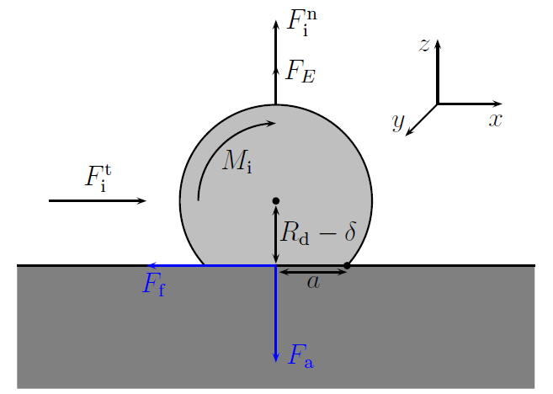
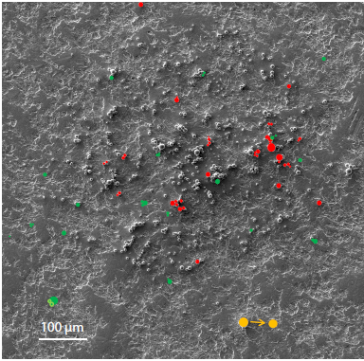
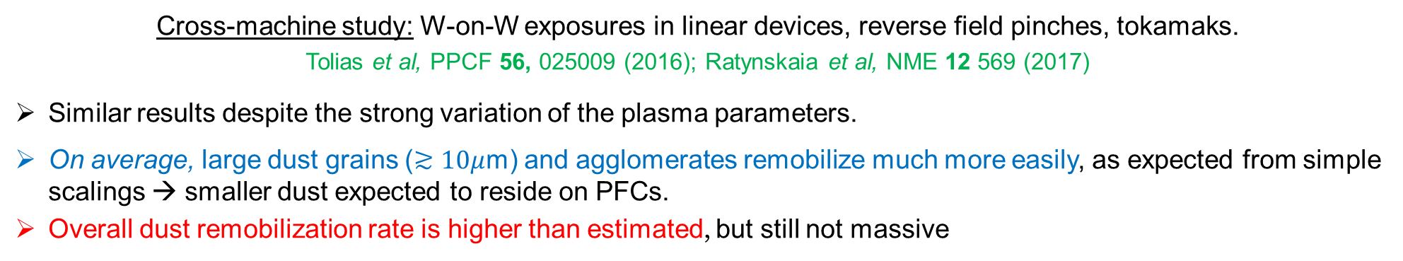

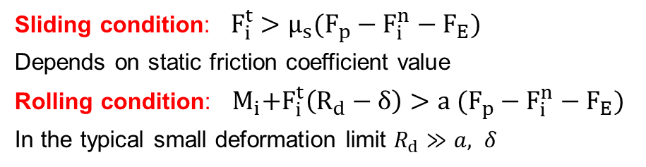
Dust remobilization in plasma environments (cross-machine)
Cross-machine study: W-on-W exposures in linear devices, reverse field pinches, tokamaks.
Tolias et al, PPCF 56, 025009 (2016); Ratynskaia et al, NME 12 569 (2017)
Similar results despite the strong variation of the plasma parameters.
On average, large dust grains ($≳10μ$m) and agglomerates remobilize much more easily, as expected from simple scalings → smaller dust expected to reside on PFCs.
Overall dust remobilization rate is higher than estimated, but still not massive
Overlaid SEM prior – post exposure to Pilot-PSI
left or strongly displaced.
Direct lift-up condition: $F_{i}^{n}+F_{E}>F_{p}$
JKR or van der Waals models?
Do we estimate plasma forces correctly?
Sliding condition: ${ F}_{i}^{t} >μ_{s}(F_{p}−F_{i}^{n}−F_{E})$
Depends on static friction coefficient value
Rolling condition: ${ M}_{i}+F_{i}^{t}\left(R_{d}−δ\right)>a (F_{p}−F_{i}^{n}−F_{E})$
In the typical small deformation limit $R_{d}≫a, δ$
G. M. Burdick, et al., J. Nanopart. Res. 3 (2001) 455
M. A. Hubbe Colloids Surf. 12 (1984)

Slide 14
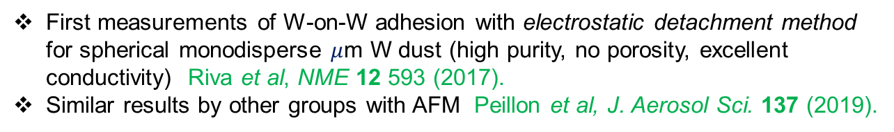
W-on-W adhesion: measurements
First measurements of W-on-W adhesion with electrostatic detachment method for spherical monodisperse $μ$m W dust (high purity, no porosity, excellent conductivity) Riva et al, NME 12 593 (2017).
Similar results by other groups with AFM Peillon et al, J. Aerosol Sci. 137 (2019).
Contact mechanics models (JKR, DMT) overestimate the adhesion force by ~ 2 orders of magnitude. The standard van der Waals expression agrees well with experiments.
Surface roughness ~ of few nm suffices to switch the dominant contact force from metallic bonding to van der Waals attraction → equivalent to dramatic decrease of surface energy
Measurements have quantified the effect of the dust deposition technique, beryllium coating thickness, atmospheric contaminants, thin oxide layers, surface roughness and prolonged heat treatment on W-on-W adhesion.
Riva et al, NME 12 593 (2017); Peillon et al, J. Electrostat. 88, 111 (2017)
Tolias et al, NME 15, 55 (2018); Tolias et al, NME 18, 18 (2019);
Peillon et al., J. Aer.Sci. 137 (2019); Tolias et al., NME 24, 100765 (2020)
Adhesive force distributions are also available beyond the mean value character of the pull-off force [Tolias et al, NME 15, 55 (2018)]. The added probabilistic component is due to the omnipresent nano-roughness statistical variations.

Slide 15
Complications in fusion applications:
Heating effects
Sheath-within-a-sheath
Non-sphericity

Slide 16
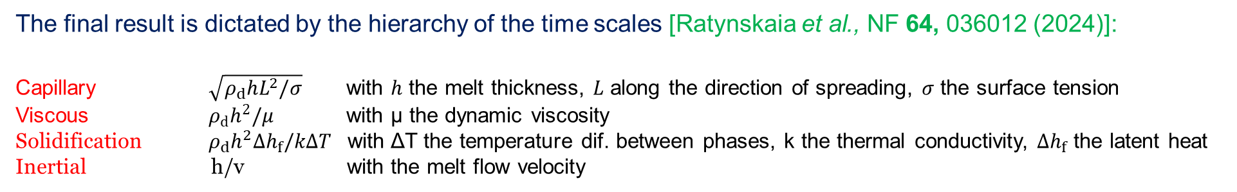
Heating effects: molten dust / droplets
In isothermal conditions, wetting dynamics result from the balance between capillary forces, which promote liquid spreading towards a small equilibrium contact angle in case of metals, and inertial/viscous effects which tend to resist fluid motion
Re-solidification also hinders spreading (transient heat loads and/or for substantial temperature difference between the liquid and the solid substrate)
In terms of characteristics the outcome depends on
melt speed
melt depth (droplet size)
melt and PFC temperatures
heat loads and exposure time
The final result is dictated by the hierarchy of the time scales [Ratynskaia et al., NF 64, 036012 (2024)]:
Capillary $\sqrt{ρ_{d}hL^{2}/σ}$ with $h$ the melt thickness, $L$ along the direction of spreading, $σ$ the surface tension
Viscous $ρ_{d}h^{2}/μ$ with μ the dynamic viscosity
Solidification $ρ_{d}h^{2}Δh_{f}/kΔT$ with ΔT the temperature dif. between phases, k the thermal conductivity, $Δh_{f}$ the latent heat Inertial h/v with the melt flow velocity

Slide 17
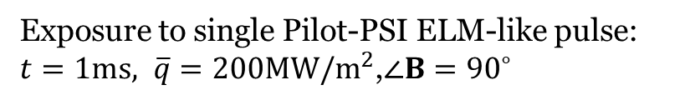
Remobilization under ELM-like heat loads: Wetting induced coagulation
No observation of melting of isolated dust grains: despite large statistics
Recurring evidence of top-bottom wetting: especially for monodisperse dust
Strong interplay between wetting and resolidification (short ELM duration): Spreading dynamics do not fully evolve, signature capillary waves frozen by resolidification
Exposure to single Pilot-PSI ELM-like pulse:
$t=1ms, \overline{q}=200MW/m^{2}$,$∠B={90}^{∘}$
Ratynskaia et al, NF 56 (2016) 066010

Slide 18
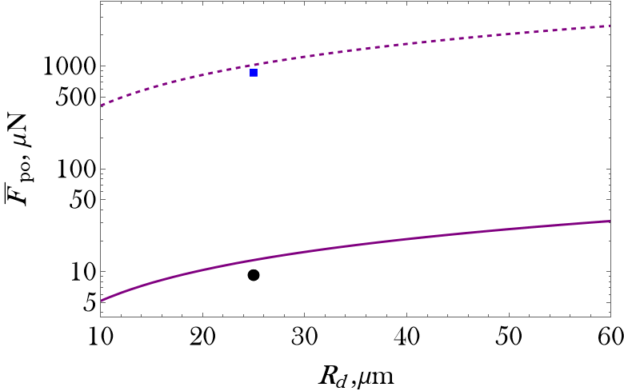
Adhered dust on hot surfaces
Prolonged heat treatments in vacuum furnaces at temperatures below the W recrystallization range lead to increase of the W-on-W adhesion force up to two orders of magnitude irrespective of the dust size [Tolias et al, NME 24 100765 (2020)]
Atomic diffusion at the contact area slowly eliminates the omnipresent nanometer-scale surface roughness, switching the dominant interaction from long-range van der Waals-like to short-range metallic bonding-like.
Confirmed also in the fusion relevant but less controlled environment of the GyM linear device.
Transition from van der Waals models to JKR models. In temperature space (for long exposure times), the adhesion force is a sigmoidal function of the temperature [Tolias et al, manuscript in preparation (2024)]
${1000}^{∘}C$ vs Johnson-Kendall-Roberts model
RT vs van der Waals model

Slide 19
Complications for fusion applications:
Heating effects
Sheath-within-a-sheath
Non-sphericity

Slide 20
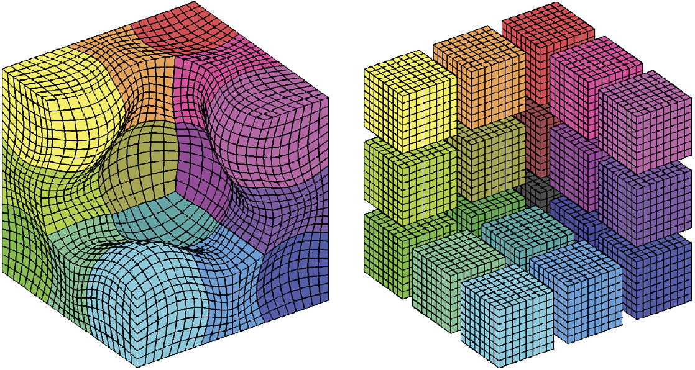
CPIC: dust-plasma interactions in arbitrary geometry
CPIC
electrostatic code designed for plasma-object interaction studies
body-fitted curvilinear mesh mapped to a logical uniform Cartesian mesh
C S Meierbachtol et al 2017 Journal of Computational Physics 350 796–823

Slide 21
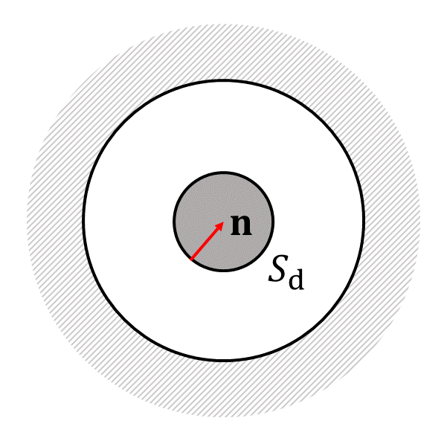
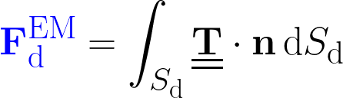
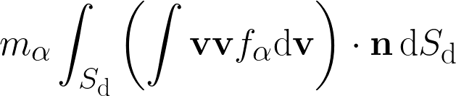
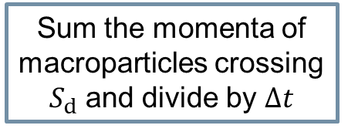
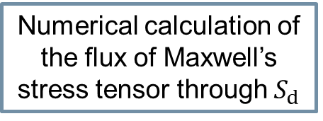
CPIC: evaluation of plasma induced forces
Collisionless kinetic momentum balance equation for the plasma
Similar evaluation of the torques
Multiple successful validation tests
  ion drag force on a sphere in a homogeneous flowing plasma
  electrostatic force on conducting sphere on a plate in presence of homogeneous electric field
  forces / torques exerted a planar wall inside a plasma
  vanishing torques in symmetric scenarios
Particle absorption force
EM field force
plasma
dust
CPIC calculation
CPIC calculation
Numerical calculation of the flux of Maxwell’s stress tensor through $S_{d}$
Sum the momenta of macroparticles crossing $S_{d}$ and divide by $Δt$

Slide 22
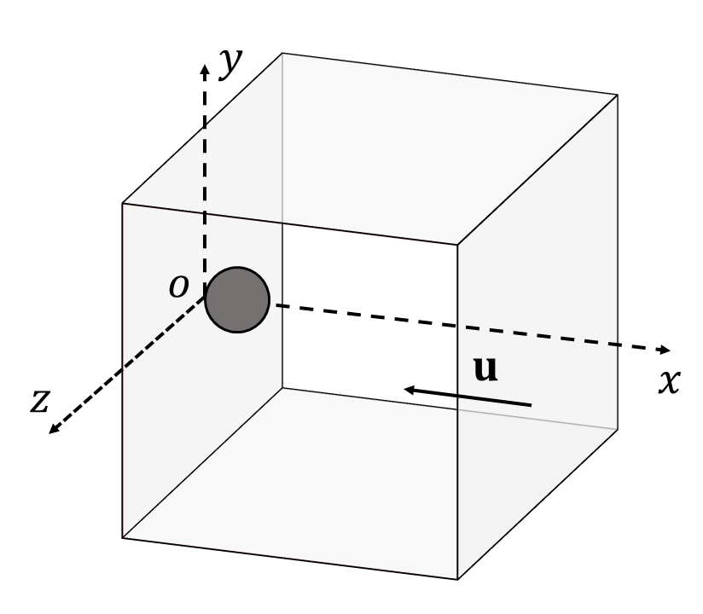
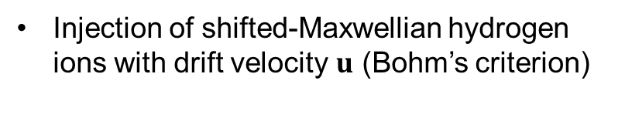
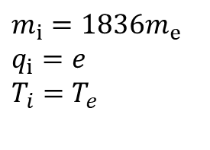



CPIC: sheath-within-a-sheath simulations
Perfectly spherical and conducting grain on a perfectly planar and conducting wall
Assumptions
unmagnetized plasma
perfectly absorbing boundaries
perfectly smooth boundaries
non-emissive dust
$$r_{d}=10λ_{De}$$
Three representative dust sizes
$$r_{d}=0.1λ_{De}$$
$$r_{d}=λ_{De}$$
$$m_{i}=1836m_{e}$$
$$q_{i}=e$$
$$T_{i}=T_{e}$$
Injection of Maxwellian electrons
Injection of shifted-Maxwellian hydrogen ions with drift velocity $u$ (Bohm’s criterion)

Slide 23


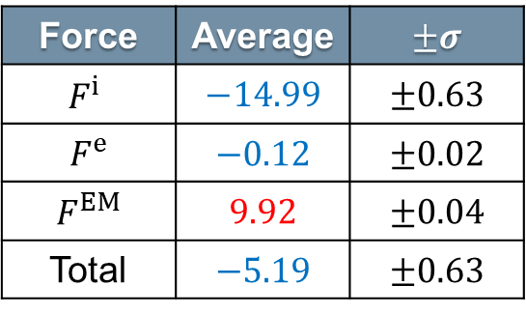
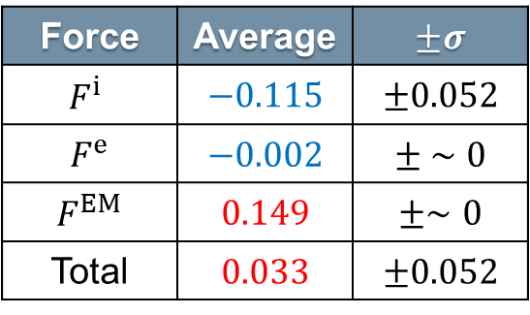

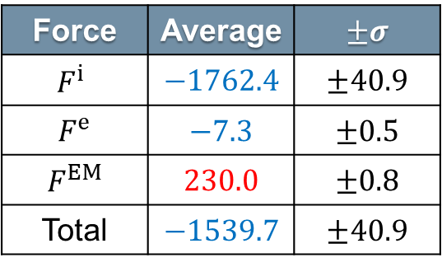
CPIC: sheath-within-a-sheath simulations
$$r_{d}=λ_{De}$$
$$r_{d}=10λ_{De}$$
Force | Average | $$±σ$$
$$F^{i}$$ | $$−14.99$$ | $$±0.63$$
$$F^{e}$$ | $$−0.12$$ | $$±0.02$$
$$F^{EM}$$ | $$9.92$$ | $$±0.04$$
Total | $$−5.19$$ | $$±0.63$$
Force | Average | $$±σ$$
$$F^{i}$$ | $$−1762.4$$ | $$±40.9$$
$$F^{e}$$ | $$−7.3$$ | $$±0.5$$
$$F^{EM}$$ | $$230.0$$ | $$±0.8$$
Total | $$−1539.7$$ | $$±40.9$$
Future work will aim to progressively remove the simplifying assumptions employed in the simulations of spherical dust adhered on a planar wall
magnetized plasma
Result: the total plasma-induced force is compressive
ion backscattering as neutrals
thermionic emission from dust
$$r_{d}=0.1λ_{De}$$
surface roughness
Force | Average | $$±σ$$
$$F^{i}$$ | $$−0.115$$ | $$±0.052$$
$$F^{e}$$ | $$−0.002$$ | $$± ∼0$$
$$F^{EM}$$ | $$0.149$$ | $$±∼0$$
Total | $$0.033$$ | $$±0.052$$
Result: the total plasma-induced force tends to pull the grain off the wall
Removal of the first two assumptions is expected to yield realistic results and allow direct comparison with the experiments

Slide 24
Evolution of dust inventory:
survival of dust and droplets

Slide 25
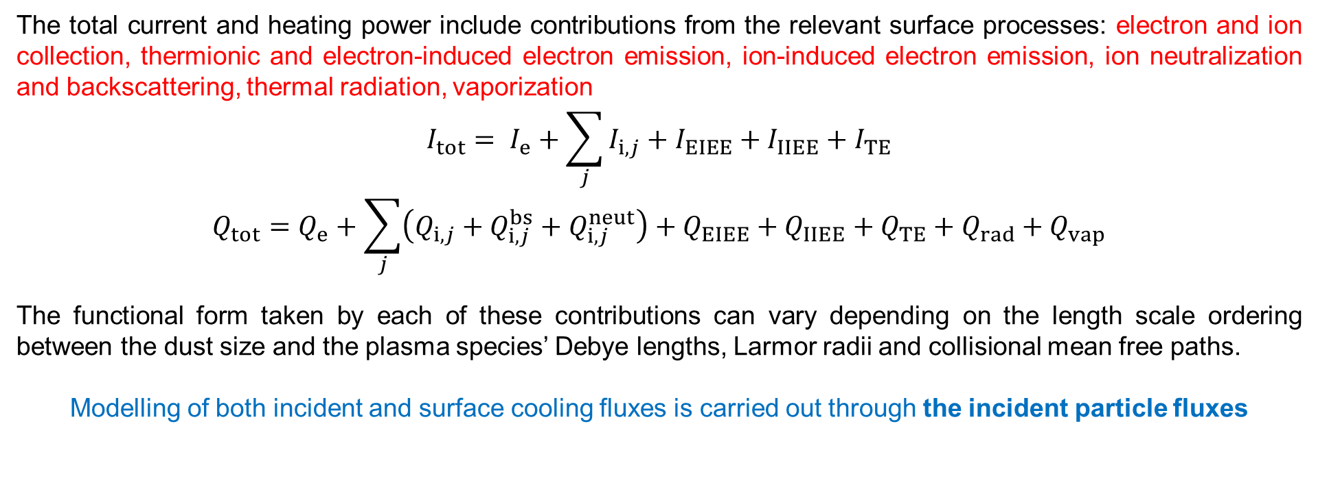
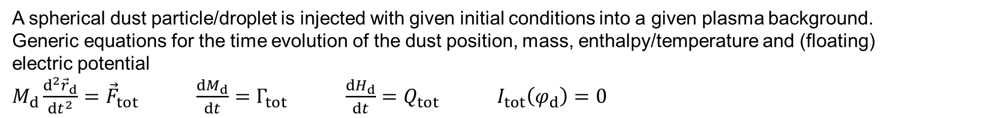
Dust transport studies
A spherical dust particle/droplet is injected with given initial conditions into a given plasma background.
Generic equations for the time evolution of the dust position, mass, enthalpy/temperature and (floating)
electric potential
$M_{d}\frac{d^{2}{\vec{r}}_{d}}{dt^{2}}={\vec{F}}_{tot}$ $\frac{dM_{d}}{dt}=Γ_{tot}$ $\frac{dH_{d}}{dt}=Q_{tot}$ $I_{tot}\left(φ_{d}\right)=0$
The total current and heating power include contributions from the relevant surface processes: electron and ion collection, thermionic and electron-induced electron emission, ion-induced electron emission, ion neutralization and backscattering, thermal radiation, vaporization
$$I_{tot}= I_{e}+\sum_{j}{I_{i,j}}+I_{EIEE}+I_{IIEE}+I_{TE}$$
$$Q_{tot}=Q_{e}+\sum_{j}{\left(Q_{i,j}+Q_{i,j}^{bs}+Q_{i,j}^{neut}\right)}+Q_{EIEE}+Q_{IIEE}+Q_{TE}+Q_{rad}+Q_{vap}$$
The functional form taken by each of these contributions can vary depending on the length scale ordering between the dust size and the plasma species’ Debye lengths, Larmor radii and collisional mean free paths.
Modelling of both incident and surface cooling fluxes is carried out through the incident particle fluxes

Slide 26
Dust in magnetized plasmas
MIGRAINe is the only dust dynamics code developed for applications to fusion relevant scenarios where,
with exception of μm dust, it holds that Rd > or >> RLe
Left figure:
OML vs magnetized electron currents
Right figure:
Comparison of lifetime predictions based on OML (dashed) and magnetized (full) model
L. Vignitchouk, S. Ratynskaia, P. Tolias, PPCF 59 (2017)
Main models: Bohm 1949 and Cohen 1968 (fluid), Sanmartin 1970 (kinetic) and Stangeby (1982) & Rozhanskii 1998 (fluid)
Vastly streched collection area → diffusive transport
Supression of electron current due to inhibited electron transport across B-field
Non-monotonic potential
Potential ’overshoot’

Slide 27
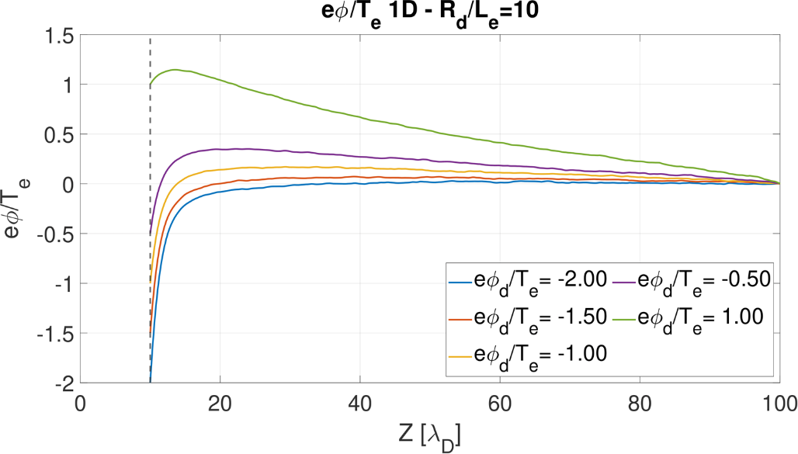
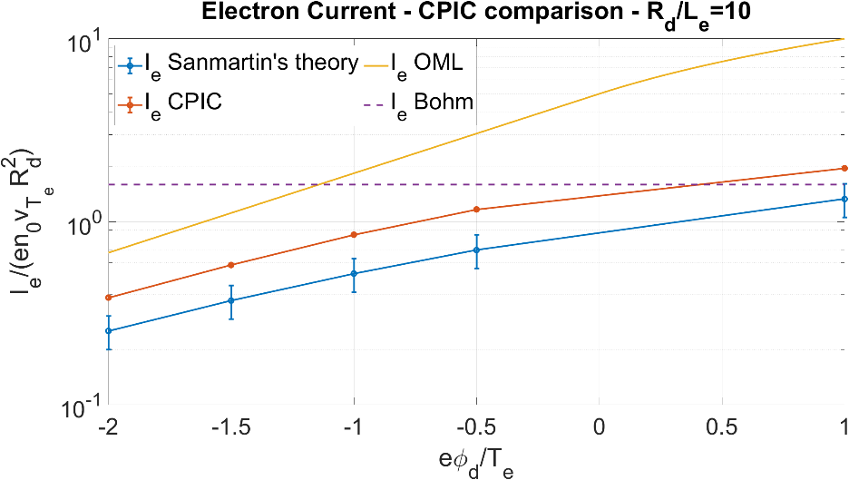
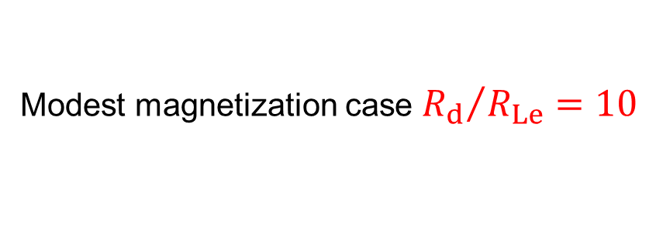

First CPIC results (run on LANL facilities)
Modest magnetization case ${R_{d}}/{R_{Le}=10}$
2D profiles at ${e φ}_{d}$/ $T_{e}$ = −0.5
Potential profile Electron density profile
All main predictions of analytical models confirmed
Depletion reaches the domain edge – still larger domain needed,
expecting even better fit from new runs (in progress)

Slide 28
Boron dust

Slide 29
Surface processes at a glance
Boron has not been studied as much as W & Be, as far as ion / electron surface interactions are concerned
secondary electron emission: experimental normal incidence data available, angle of incidence dependence can be extrapolated
from other well-studied low-Z elements (Be, C).
electron backscattering: no reliable experimental data available, MC simulations of electron transport (e.g. GEANT4) can yield accurate results for the incident energy and incident angle dependence.
low energy reflection: no reliable experimental data available, extrapolations from Si might be accurate, theoretical calculations
based on the invariant embedding principle are possible but are demanding.
ion-induced kinetic emission: few experimental data available, enough to construct an empirical dependence.
ion-induced potential emission: no reliable experimental data available, the empirical Baragiola and Kishinevsky formulas should be applicable for singly charged ions, the empirical Winter formula should be applicable for multiply charged ions but requires extrapolations.
thermionic emission: the Richardson-Dushman formula is applicable provided that the band gap is added to the work function.
ion backscattering: MC data are available for particle and energy yields (TRIM) and have been fitted to the empirical Eckstein formulas for the incident energy and incident angle dependence, this concerns the H, D, T, He, B ions for the energy dependence and only the D ions for the incident angle dependence.
physical sputtering: MC data are available for the sputtering yields (TRIM) and have been fitted to the empirical Eckstein-Preuss formulas for the incident energy and incident angle dependence, this concerns the H, D, T, He, Ne, O, B ions for the energy dependence and only the D,B ions for the incident angle dependence.

Slide 30
Material properties at a glance
Boron has not been studied as much as W & Be, as far as high temperature properties are concerned
thermophysical (mass density, latent heats, thermal conductivity, specific isobaric heat capacity)
mechanical (Young’s modulus, Poisson ratio, yield strength, yield strength size-scaling parameter, limiting pressure)
thermal (hemispherical emissivity, work function, effective Richardson constant)
fluid (dynamic viscosity, surface tension, vapor pressure)
other (surface energy, frequency dependent optical constant)
The situation depends on the property, but few experimental results are generally available at high temperatures. The situation is worse in the liquid phase, for which measurements are even sparser.
Experimental results might have to be combined with first principles results (DFT-MD modelling, with B interaction potential that is uniformly accurate from room temperature through the normal boiling point), if available.
Relatively extensive-in-frequency optical data are available from measurements of the boron dielectric permittivity, which constitute the input that is necessary for the calculation of the adhesive force from the Lifshitz theory of van der Waals forces and for the calculation of the hemispherical emissivity,

Slide 31
Irregular dust
All W dust remobilization, adhesion, impact and injection experiments conducted with spherical W dust (spheroidized by passing through a plasma torch)
necessary for reproducibility of the experiment
necessary for comparison with the theory / modelling
relevant for tokamaks (W dust generated mainly by droplet splashing, with surface tension leading to spherical shapes)
spheroidization leads to low porosity (thus material properties of bulk samples can be used)
Irregular shape should
affect dynamics by altering collection
introduce spinning, rotation now possible also under symmetric plasma conditions
drastically alter adhesion, local radius of curvature at contact should substitute radius
drastically affect remobilization (multiple contact points, rolling possibilities etc)
Boron dust
is more likely to be irregular in tokamaks (through delamination of co-deposits)
could be treated as spherical in dust dynamics codes (provided that it promptly melts, see surface tension)
should be treated as irregular in remobilization problems

Slide 32
Are experiments necessary?
Plasma-surface and plasma-wall interaction models are valid for any homogeneous dust composition, but contain numerous material constants that are adopted from experiments, theory or simulations. Some material constants will have to be approximated by best guesses → Dust injection experiments should be helpful.
It is difficult to make projections for the behavior of B dust based on the experience with W dust because of the many competing effects. For instance, because boron is essentially a semi-conductor, thermionic emission will be low but secondary electron emission will be high (even for SOL electron temperatures). However, again, the strength of the competing affects depends on material constants that can be very uncertain → Dust injection experiments should be helpful.
Many positive effects of boron powder injection have been observed in recent experiments (possibility of real time wall conditioning, pedestal control, heat exhaust and energy confinement improvement). Dust modelling can assist in the understanding of these benefits and optimization of the technique. Conversely, B powder droppers are already installed in devices and can be used for controlled (low density) powder injection experiments.
Given the strong effect of irregular shape on adhesion / remobilization, it would be wise to repeat some of the controlled remobilization experiments. Note that only irregular B dust is commercially available.

Slide 33
Summary

Slide 34
Summary
Droplet survival and dust inventory predictions require realistic input of dust release (size, speed) and dust termination conditions. These are problems that involve more contact mechanics, solid mechanics and fluid dynamics than plasma-surface interactions.
Impact mechanics analytical model for dust-vessel collisions works well as plasma is not relevant for instantaneous impacts.
The contact side of dust remobilization modelling can be based on surface physics models but fusion relevant peculiarities lead to extra complications (surface roughness, surface contamination, prolonged heating).
The plasma side of dust remobilization modelling is an archetypal sheath-within-a-sheath problem that can be reliably modelled with PIC simulations.
The main complexities of boron dust are related with the (i) material properties, (ii) irregular shape.
Boron dust injection and boron dust remobilization experiments are rather essential.

