Slide 1
Update and plans SP X
Hennie van der Meiden

Slide 2
PWIE 2024: SP X
In 2024 SP X consists of 2 parts:
SP X.1: Atomic and molecular processes in attached/detached plasmas
SP X.2: Optimization of laser-based surface analysis diagnostics

Slide 3
SP X.1: Atomic and molecular processes in attached/detached plasmas
Notes:
Facilties: JUST GIVE the integral numbers for the groups
PD: Plasma devices (MAGNUM, PSI-2, UPP, TOMAS, GyM)
HHF: JUDITH, GLADIS, QSPA, OLMAT
Analysis station: Ion beam
If Facilties, Modelling, Link not applicable, remove the lines. I assume that it is EITHER EXPERIMENT or MODELLING, thus 1 more line for TASKS or Deliveables.

Slide 4
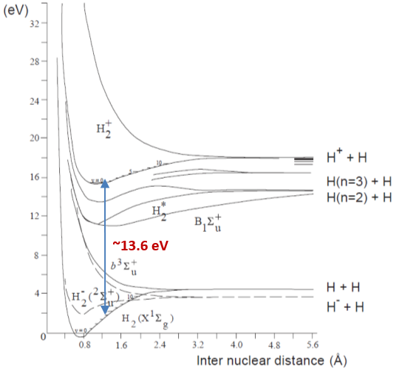
SP X.1: Atomic and molecular processes in attached/detached plasmas ➔
Motivation
Without precautions divertor components are subject to unacceptable high particle fluxes
Neutral particles are beneficial for mitigating these plasma fluxes, by removing momentum and energy
MAR is thought to be important for power mitigation, but MAR rates vary orders of magn. with ro-vibrational levels (v,j)!! ➔ (1e step MAR) H₂(v,j) + H⁺ ➔ H₂⁺ + H(1s)
This lack of ro-vibrational data can lead to major deviations in predicting plasma performance
To obtain this missing ro-vibrational distribution P(v,j) of ground state hydrogen and isotopes, the focus will be on molecular spectroscopy in linear devices
Notes:
Facilties: JUST GIVE the integral numbers for the groups
PD: Plasma devices (MAGNUM, PSI-2, UPP, TOMAS, GyM)
HHF: JUDITH, GLADIS, QSPA, OLMAT
Analysis station: Ion beam
If Facilties, Modelling, Link not applicable, remove the lines. I assume that it is EITHER EXPERIMENT or MODELLING, thus 1 more line for TASKS or Deliveables.

Slide 5
Plan 2024: active and/or passive spectroscopy on linear plasma generators: PSI-2, Magnum-PSI, UPP, JULE-PSI
Atomic density (TALIF) measured in MAGNUM-PSI and CARS installed in MAGNUM-PSI or UPP. VUV OES results H/H2 and ne/Te measurements in UPP and/or Magnum-PSI (DIFFER)
VUV OES hydrogen atom and molecule analysis of MAGNUM-PSI/UPP results H/H2 (CU)
Interpretation spectroscopy results (Magnum) using spectra simulation and (CR) modelling with YACORA (MPG)
OES results H/H₂, ne, Te and 2D distribution in JULE-PSI. VIS molecular and atomic spectroscopy in PSI-2 under ionising and recombining plasmas (FZJ)
Deliverable owners: D001 (Differ), D002 (FZJ), D003 (CU) and D004 (MPG)
Notes:
Facilties: JUST GIVE the integral numbers for the groups
PD: Plasma devices (MAGNUM, PSI-2, UPP, TOMAS, GyM)
HHF: JUDITH, GLADIS, QSPA, OLMAT
Analysis station: Ion beam
If Facilties, Modelling, Link not applicable, remove the lines. I assume that it is EITHER EXPERIMENT or MODELLING, thus 1 more line for TASKS or Deliveables.

Slide 6
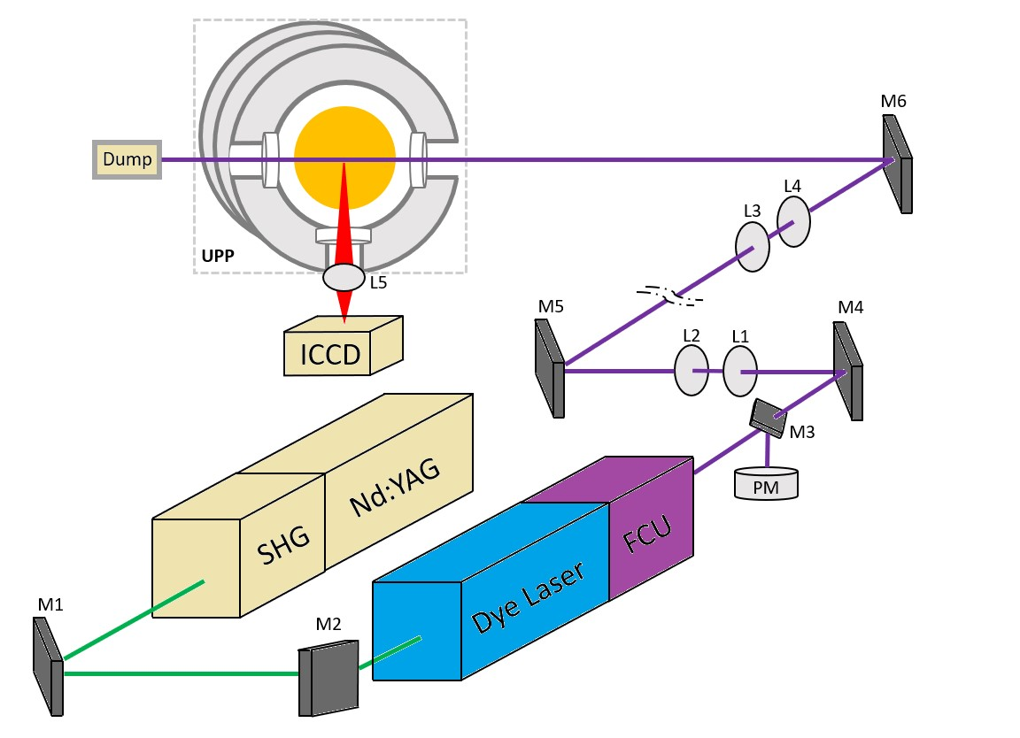
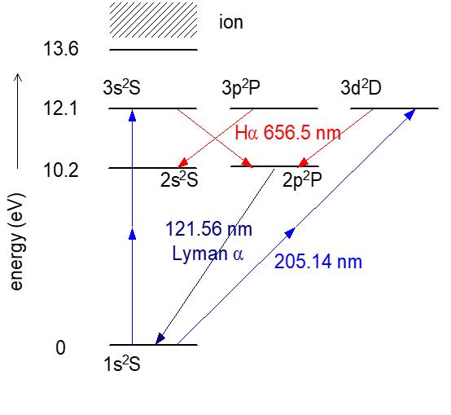
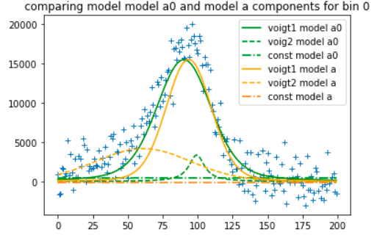
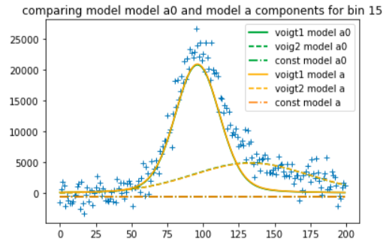
SPX.1: Atomic density (TALIF) measured in Magnum-PSI and/or UPP DIFFER
First TALIF results (atomic neutral densities) obtained in UPP (2023)
2023 data
Plans TALIF 2024
In March TALIF was performed again in UPP at lower P_{laser} to avoid ionization effects and improving statistics ➔ To be published Kaden Jay Loring et al.
TALIF will be done in Magnum-PSI, using a lens based relay system (ray tracing done) (May)
TALIF stands for: Two photon Absorption Laser Induced Fluorescence

Slide 7
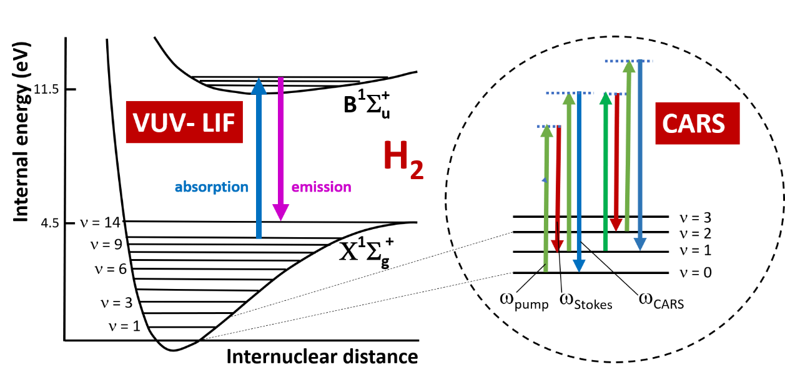
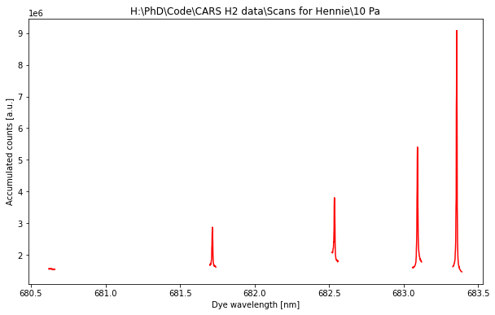
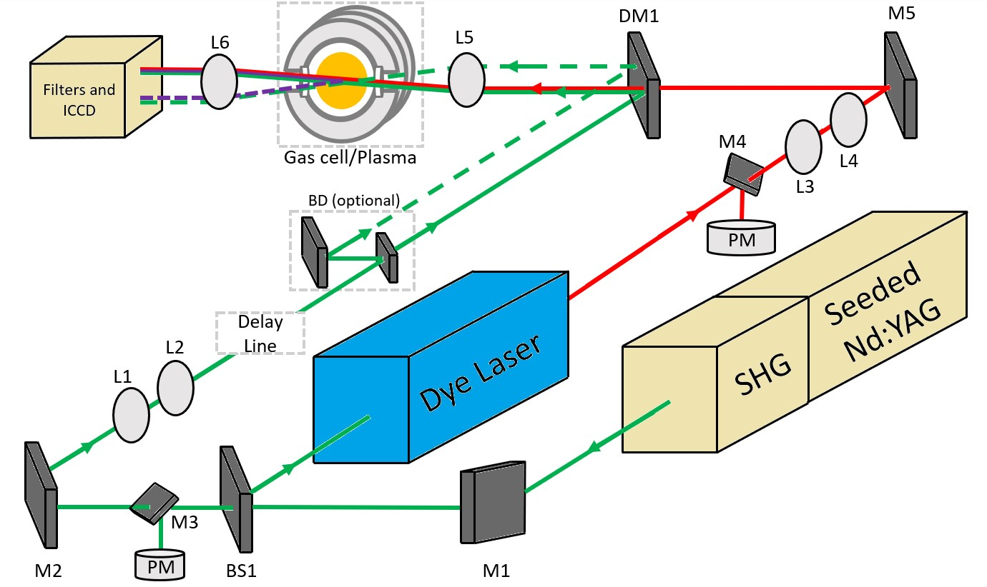
SPX.1: CARS: probing first ro-vibrational states of H₂ DIFFER
CARS spectrum measured in vessel filled with H₂ gas (short scans around transitions) Kay Schutjes et al.
v=0,j=0,1,2,3,4
First CARS signals in detached hydrogen plasma measured in UPP with few mm spatial resolution!
Plans 2024:
Redo CARS with improved performance (reduction non-resonant CARS by filters) in UPP
CARS system installed in Magnum-PSI, measurements expected this year
Installation VUV passive OES at UPP and measurements October 2024 (with CU)
CARS stands for Coherent anti-Stokes Raman spectroscopy

Slide 8
Simulation and (CR-YACORA) modelling/interpret. results Magnum-PSI MPG
Experiment
Yacora
Plans 2024➔ Analyzing Magnum PSI data and participating in the measurements.

Slide 9
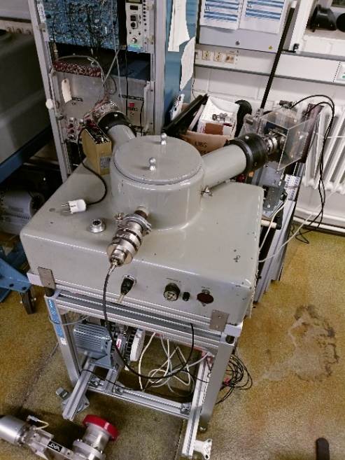
Results VUV passive spectroscopy atom/ro-vibrational data H/H₂ and isotopes in PSI-2
Good Progress: First VUV results PSI-2 feasible!
Plans 2024
Seya-Namioka Vacuum Monochromator with 500 mm spectrometer being calibrated
Installation of VUV Spectrometer at PSI-2
Results H/H2 and isotopes

Slide 10
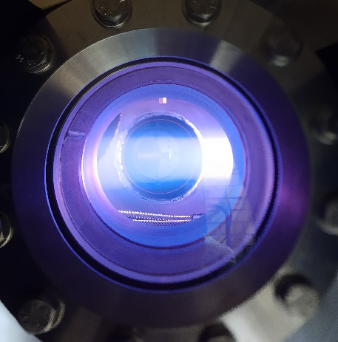
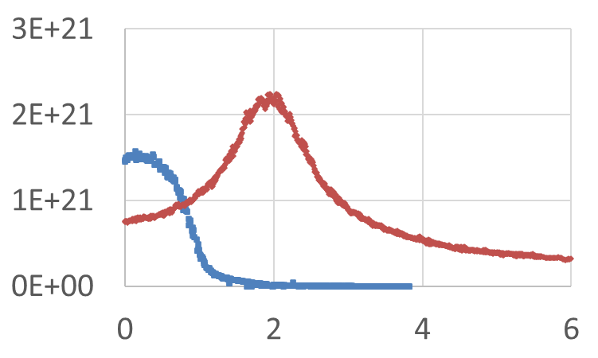
OES results H/H₂, ne, Te and 2D distribution in PSI2/JULE-PSI
Plans 2024
JULE-PSI: Acquiring permission hydrogen operation
➔ H/H2 OES results: only after permission
PSI-2: 2D VIS molecular/atomic spectroscopy in PSI2 (radial resolution) (370-1200 nm range).
JULE-PSI
JULE-PSI
PSI-2
Ion flux [m⁻²s⁻¹] vs plasma
radius [cm]

Slide 11
SP X.2: Optimization of laser-based surface analysis diagnostics
Notes:
Facilties: JUST GIVE the integral numbers for the groups
PD: Plasma devices (MAGNUM, PSI-2, UPP, TOMAS, GyM)
HHF: JUDITH, GLADIS, QSPA, OLMAT
Analysis station: Ion beam
If Facilties, Modelling, Link not applicable, remove the lines. I assume that it is EITHER EXPERIMENT or MODELLING, thus 1 more line for TASKS or Deliveables.

Slide 12
SP X.2: Optimization of laser-based surface analysis diagnostics
According to the new ITER baseline the first wall will be regularly coated with a ~50 nm layer of boron (B) by glow-discharge boronization. This boron will be eroded and co-deposited forming multiple layers that contain D and T. ➔ for more information I refer to talk Sebastijan
LIBS has to be optimized as a research tool for exploring thin layers ➔ bullet points for 2024:
Ablation rate, how to obtain a depth resolution in the 10-20 nm range?
Line distinguishability for fuel detection at elevated Ar pressures (now with boron lines in!)
Machine Learning
In addition in support of RH LIBS at JET:
Be campaign at VTT
Required samples to be determined in separate meeting
Notes:
Facilties: JUST GIVE the integral numbers for the groups
PD: Plasma devices (MAGNUM, PSI-2, UPP, TOMAS, GyM)
HHF: JUDITH, GLADIS, QSPA, OLMAT
Analysis station: Ion beam
If Facilties, Modelling, Link not applicable, remove the lines. I assume that it is EITHER EXPERIMENT or MODELLING, thus 1 more line for TASKS or Deliveables.

Slide 13
SP X.2: Optimization of laser-based surface analysis diagnostics
Deliverable ID | Deliverable Title
D001 | Comparison of ps vs. ns LIBS: absolute content and composition / Comparison SP vs. DP LIBS, or alternative LIBS signal enhancement methods: absolute fuel content in W samples and composition (CEA)
D002 | Reference measurements of outgassing, recycling, and retention after D plasma loading: absolute content and composition in W and reference samples (DIFFER)
D003 | Comparison SP vs. DP LIBS, or alternative LIBS signal enhancement methods: absolute fuel content in W samples and composition / (CF)-LIBS results He loaded samples and surface modifications (ENEA)
D004 | Comparison of ps vs. ns LIBS: absolute content and composition / Comparison SP vs. DP LIBS, or alternative LIBS signal enhancement methods: absolute fuel content in W samples and composition / Reference measurements of outgassing, recycling, and retention after D plasma loading: absolute content and composition in damaged and undamaged Wsamples / LAMIS measurements and identification of C and N containing molecules /Explore TALIF and LIBS for W isotope identification (FZJ)
D005 | Report on LIBS analysis by application of machine learning algorithm (IPPLM)
D006 | Comparison of ps vs. ns LIBS: absolute content and composition / (CF)-LIBS results He loaded samples and surface modifications. (CF-)LIBS on Be containing coatings with different type of fuel content (CU)
D007 | Analysis of B containing coatings and/or W coatings with (CF)-LIBS: absolute content and composition / (CF)-LIBS results He loaded samples and surface modifications / Reference measurements of outgassing, recycling, and retention after D plasma loading: absolute content and composition in W and reference samples. (CF-)LIBS on Be containing coatings with different type of fuel content (UT)
D008 | Comparison of ps vs. ns LIBS: absolute content and composition (ISSP-UL)
D009 | (CF-)LIBS on Be containing coatings with different type of fuel content (VTT)
Main tasks for this year 2023:
Comparizon performance different LIBS systems (ablation rate)
Sensitivity LIBS
LIBS on Be coatings (in support of JET campaign) and B coatings
D retention and outgassing
Maschine learning for LIBS analysis
Notes:
Facilties: JUST GIVE the integral numbers for the groups
PD: Plasma devices (MAGNUM, PSI-2, UPP, TOMAS, GyM)
HHF: JUDITH, GLADIS, QSPA, OLMAT
Analysis station: Ion beam
If Facilties, Modelling, Link not applicable, remove the lines. I assume that it is EITHER EXPERIMENT or MODELLING, thus 1 more line for TASKS or Deliveables.

Slide 14
Comparizon performance different LIBS configurations
Comparison SP vs. DP LIBS, or alternative LIBS signal enhancement methods: absolute fuel content in W samples and composition (CEA, D001), (ENEA, D003), (FZJ, D004)
Comparison of ps vs. ns LIBS: absolute content and composition (CEA, D001), (FZJ, D004), (CU, D006) and (ISSP-UL, D008)
CORIA/CEA will compare ns-LIBS/ps-LIBS, but also SP-DP/ps-LIBS (incl. ablation rate)
Some work is already done in Al samples, using very localized D content in the material
Plans 2024
Continuation comparison different LIBS configurations
With He3 beam known implantation profiles will be realized inside different materials and will be used as depth profile reference for LIBS. The same will be done for D in W and Al.
In addition: self-developed Merlin software (including comprehensive database for CF-LIBS) will be applied in deep learning for enabling real time analysis
Notes:
Facilties: JUST GIVE the integral numbers for the groups
PD: Plasma devices (MAGNUM, PSI-2, UPP, TOMAS, GyM)
HHF: JUDITH, GLADIS, QSPA, OLMAT
Analysis station: Ion beam
If Facilties, Modelling, Link not applicable, remove the lines. I assume that it is EITHER EXPERIMENT or MODELLING, thus 1 more line for TASKS or Deliveables.

Slide 15
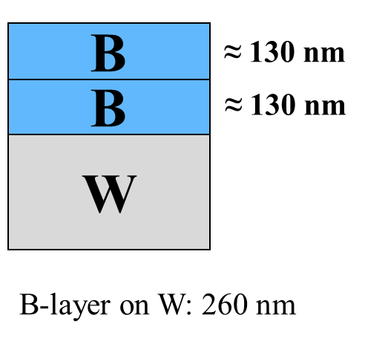
Comparizon performance different LIBS configurations
FZJ compared ns-LIBS and ps-LIBS: absolute content
Measurement boron film on W by ps-LIBS (λ=355nm, 35 ps) at vacuum pressure 3 10⁻⁵ Pa
Depth resolution in B for ps-LIBS (67 nm/pulse) better than ns-LIBS
Plans 2024
Continuation comparison of ps vs. ns LIBS: absolute content and composition
Comparison SP vs. DP LIBS, or alternative LIBS signal enhancement methods
Notes:
Facilties: JUST GIVE the integral numbers for the groups
PD: Plasma devices (MAGNUM, PSI-2, UPP, TOMAS, GyM)
HHF: JUDITH, GLADIS, QSPA, OLMAT
Analysis station: Ion beam
If Facilties, Modelling, Link not applicable, remove the lines. I assume that it is EITHER EXPERIMENT or MODELLING, thus 1 more line for TASKS or Deliveables.

Slide 16
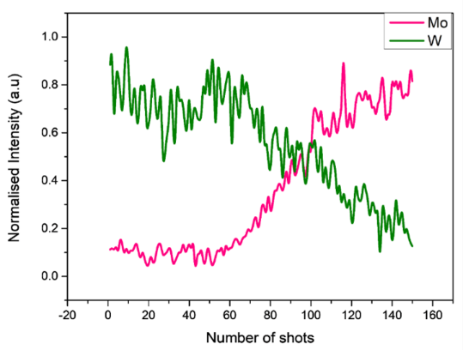
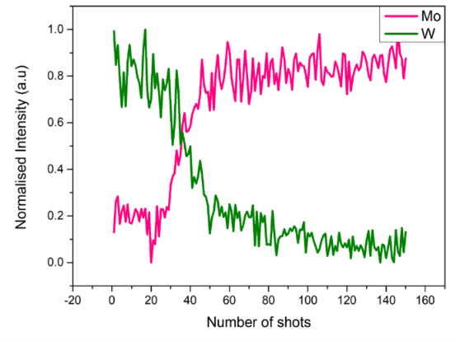
Comparizon performance different LIBS configurations
CU comparizon ps-ns LIBS and methods to reduce ablation rates resonant-LIBS
3 ns OPO laser
W/Ta-Mo samples
R-LIBS @ 255.135 nm (W I)
2 mJ/pulse, air 1 bar ➔ Ablation rate- 90 nm/pulse
Layer thickness- 7.7 μm
NR- LIBS @ 222.75 nm (out of W I-II, Ta I-II)
2 mJ/pulse, air 1 bar ➔ Ablation rate- 250 nm/pulse
Layer thickness- 6.2 μm
Plans 2024
Continuation exploration R-LIBS
Modification laser beam to top flat beam profile for homogeneous ablation, combined with confocal microscopy for evaluation of ablation rate
Comparizon ps/ns LIBS
Notes:
Facilties: JUST GIVE the integral numbers for the groups
PD: Plasma devices (MAGNUM, PSI-2, UPP, TOMAS, GyM)
HHF: JUDITH, GLADIS, QSPA, OLMAT
Analysis station: Ion beam
If Facilties, Modelling, Link not applicable, remove the lines. I assume that it is EITHER EXPERIMENT or MODELLING, thus 1 more line for TASKS or Deliveables.

Slide 17
Comparizon performance different LIBS configurations
ENEA comparizon ps-ns LIBS and SP/DP-LIBS
Plans 2024
Comparizon ps-ns LIBS: new efforts for optimization of depth resolution ns-LIBS
Newly purchased optical profiler will allow to measure LIBS spots with high axial resolution:
Depth profiling → ablation rate (for both ps and ns laser)
Layer thickness (Boron or other)
Mass removal will be determined also
Line distinguishability at Ar atmospheric pressure:
LIBS experiments under Ar flow and are being carried out, with focus on line distinguishability by acting on:
Gate delay, integration time and energy laser pulse
Comparison of single and double pulse LIBS
Notes:
Facilties: JUST GIVE the integral numbers for the groups
PD: Plasma devices (MAGNUM, PSI-2, UPP, TOMAS, GyM)
HHF: JUDITH, GLADIS, QSPA, OLMAT
Analysis station: Ion beam
If Facilties, Modelling, Link not applicable, remove the lines. I assume that it is EITHER EXPERIMENT or MODELLING, thus 1 more line for TASKS or Deliveables.

Slide 18
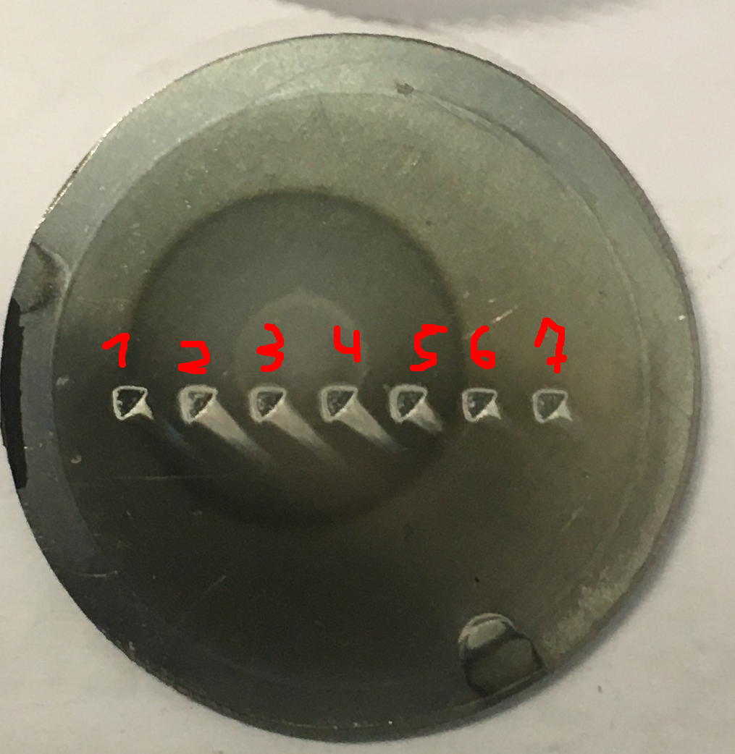
Sensitivity LIBS
LIBS results He loaded samples and surface modifications (DIFFER,D002),(ENEA, D003), (CU, D006) and (UT, D007)
UT (DIFFER) CF)-LIBS results He loaded samples and surface modifications
1 μm c-W
LIBS
ToF-ERDA
Edge 16·10¹⁵ at/cm²
Center 250·10¹⁵ at/cm²
Plans 2024
Analysis of He in Magnum-PSI loaded samples and deposited coatings with He.
(publication of VTT and DIFFER campaign results)
He loading in Magnum
Notes:
Facilties: JUST GIVE the integral numbers for the groups
PD: Plasma devices (MAGNUM, PSI-2, UPP, TOMAS, GyM)
HHF: JUDITH, GLADIS, QSPA, OLMAT
Analysis station: Ion beam
If Facilties, Modelling, Link not applicable, remove the lines. I assume that it is EITHER EXPERIMENT or MODELLING, thus 1 more line for TASKS or Deliveables.

Slide 19
Be coatings (in support of JET campaign) and B containing coatings
(CF-)LIBS on Be containing coatings with different type of fuel content (CU, D006), (UT, D007), (VTT,009)
(CF-) LIBS on B containing coatings and/or W coatings (UT, D007)
Plans 2024
VTT, CU, UT and ENEA in support of JET RH LIBS campaign a joined campaign at VTT was performed for LIBS on Be (at elevated pressure) (done: some things to be checked)
ENEA contribution regarding Be/B: See presentation Salvatore!
UT will analyze Boron containing WEST samples with (CF)-LIBS
Notes:
Facilties: JUST GIVE the integral numbers for the groups
PD: Plasma devices (MAGNUM, PSI-2, UPP, TOMAS, GyM)
HHF: JUDITH, GLADIS, QSPA, OLMAT
Analysis station: Ion beam
If Facilties, Modelling, Link not applicable, remove the lines. I assume that it is EITHER EXPERIMENT or MODELLING, thus 1 more line for TASKS or Deliveables.

Slide 20
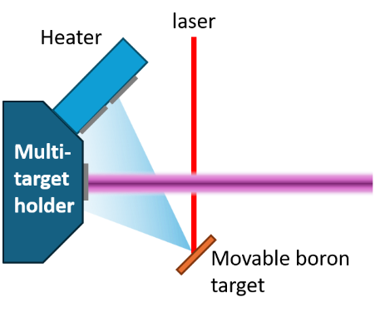
D retention and outgassing
Reference measurements outgassing, recycling, and retention after D plasma loading: absolute content and composition in W and reference samples (DIFFER, 002), (FZJ, 004), (UT, D007).
Plans 2024
FZJ absolute content and composition in damaged and undamaged Wsamples
LAMIS (Laser Ablation Molecular Isotopic Spectrometry) measurements and identification of C and N containing molecules
Explore TALIF and LIBS for H isotope identification
UT (CU, DIFFER) D loading, outgassing and retention (tbd)
Possibly Boron related PLD tests in Magnum(?), not sure yet if LIBS on (PLD) B can be done this year
Layer thickness monitored by QMS and or ion beam
First ideas fore more realistic:
Explore LIBS depth resolution (inside crater) with NRA (Indrek)
Expose Boron containing samples (Bobby, Matti, David)
Collaboration with Matteo, David and Bobby desired
Notes:
Facilties: JUST GIVE the integral numbers for the groups
PD: Plasma devices (MAGNUM, PSI-2, UPP, TOMAS, GyM)
HHF: JUDITH, GLADIS, QSPA, OLMAT
Analysis station: Ion beam
If Facilties, Modelling, Link not applicable, remove the lines. I assume that it is EITHER EXPERIMENT or MODELLING, thus 1 more line for TASKS or Deliveables.

Slide 21
Maschine learning and additional analysis tools for LIBS
LIBS analysis by application of machine learning algorithm (IPPLM, D005)
IPPLM
Machine learning models based on deep artificial neural networks (DNN) successfully operated on quasi-experimental data, i.e. model for estimation of chemical composition was trained on dimensionally reduced synthetic data, then dimensionally reduced quasi experimental spectra were converted by another DNN model for conversion and applied for validation on the model for estimation of chemical composition. The validation brought correct results which confirmed its feasibility.
Plans 2024
Models will be under further development to obtain compatibility with boron and residual gasses/contaminations. Besides of synthetic data, spectra from ongoing experiments will be employed for validation and training.
Notes:
Facilties: JUST GIVE the integral numbers for the groups
PD: Plasma devices (MAGNUM, PSI-2, UPP, TOMAS, GyM)
HHF: JUDITH, GLADIS, QSPA, OLMAT
Analysis station: Ion beam
If Facilties, Modelling, Link not applicable, remove the lines. I assume that it is EITHER EXPERIMENT or MODELLING, thus 1 more line for TASKS or Deliveables.

Slide 22
Question: according to Fredric Grandberg (referring to Mason): more D retention in W, means lower binding energy for W.
For LIBS we see: more retention means higher ablation rate.
Is there a relation between these results, or is first statement more a superficial effect?
SPARE
Notes:
Facilties: JUST GIVE the integral numbers for the groups
PD: Plasma devices (MAGNUM, PSI-2, UPP, TOMAS, GyM)
HHF: JUDITH, GLADIS, QSPA, OLMAT
Analysis station: Ion beam
If Facilties, Modelling, Link not applicable, remove the lines. I assume that it is EITHER EXPERIMENT or MODELLING, thus 1 more line for TASKS or Deliveables.

Slide 23
Thesis Willem-Jan Harskamp 2012 TU/e
Mutual neutralization processes
Notes:
Facilties: JUST GIVE the integral numbers for the groups
PD: Plasma devices (MAGNUM, PSI-2, UPP, TOMAS, GyM)
HHF: JUDITH, GLADIS, QSPA, OLMAT
Analysis station: Ion beam
If Facilties, Modelling, Link not applicable, remove the lines. I assume that it is EITHER EXPERIMENT or MODELLING, thus 1 more line for TASKS or Deliveables.

Slide 24
Notes:
Facilties: JUST GIVE the integral numbers for the groups
PD: Plasma devices (MAGNUM, PSI-2, UPP, TOMAS, GyM)
HHF: JUDITH, GLADIS, QSPA, OLMAT
Analysis station: Ion beam
If Facilties, Modelling, Link not applicable, remove the lines. I assume that it is EITHER EXPERIMENT or MODELLING, thus 1 more line for TASKS or Deliveables.

