Slide 1
Post DTE3 Tritium Inventory
Upper limit estimation of fuel retention based on:-
maximum allowable 11 g T on cryopumps, limiting maximum injection per day
0.24% retention as a fraction of injected fuel in DD from ILW1 tile analysis
9.9 g/19.9×10²³ T injected per day into main chamber
Maximum 11g T/day on cryopanels
90% (9.9g) in main chamber (1.1 g injected to neutral beams and does not have major influence on main chamber) [2]
39.6 g/79.5×10²³ T injected per week into main chamber
4 days per week DTE3 – G. Sips 2024 neutron activation schedule Nov 2019 [3]
614 g/1.232×10²⁶ T injected during DTE3
62 days DTE3 – G. Sips 2024 neutron activation schedule Nov 2019 [3]

Slide 2
DTE3
 | Mass tritium (g) | Tritium atoms | Retained Tritium atoms in JET @ 0.24% injected fuel [4] | Tritium in HFGC and Tile 1 @ 0.08% of injected fuel [4] | Retained Tritium in one HFGC tile (assumes 96 HFGCs, 55% of HFGC+Tile 1 data from [1]) | Tritium areal density (atoms/cm2) from data analysis for [4]
11 g T inventory limit on cryo-panel | 11 | 2.2E+24 | 5.3E+21 | 1.8E+21 | 1.0E+19 | 5.6E+16
4 days per week | 44 | 8.8E+24 | 2.1E+22 | 7.1E+21 | 4.0E+19 | 2.3E+17
62 days in DTE3 | 682 | 1.4E+26 | 3.3E+23 | 1.1E+23 | 6.2E+20 | 3.5E+18
9.9 g T in main chamber per day | 9.9 | 2.0E+24 | 4.8E+21 | 1.6E+21 | 9.0E+18 | 5.1E+16
4 days per week | 39.6 | 7.9E+24 | 1.9E+22 | 6.4E+21 | 3.6E+19 | 2.0E+17
62 days in DTE3 | 614 | 1.2E+26 | 3.0E+23 | 9.9E+22 | 5.6E+20 | 3.1E+18

Slide 3
Raster areas
 | Tritium areal density (atoms/cm2) from data analysis for [4] | Raster area to achieve 1e16 atoms released (cm2) | Raster area to achieve 1e17 atoms released (cm2) | Raster area to achieve 1e18 atoms released (cm2) (Current proven detection level – Mar 2020)
11 g T inventory limit on cryo-panel | 5.6E+16 | 0.2 | 1.8 | 17.8
4 days per week | 2.3E+17 | 0.04 | 0.4 | 4.4
62 days in DTE3 | 3.5E+18 | 0.003 | 0.03 | 0.3
9.9 g T in main chamber per day | 5.1E+16 | 0.2 | 2.0 | 19.7
4 days per week | 2.0E+17 | 0.05 | 0.5 | 4.9
62 days in DTE3 | 3.1E+18 | 0.003 | 0.03 | 0.3

Slide 4
Laser info
 | Tritium areal density (atoms/cm2) from data analysis for [4] | Raster area to achieve 1e16 atoms released (cm2) | Number of 3 mm diameter (0.071 cm2) spots to meet target area for 1e16 | Raster area to achieve 1e17 atoms released (cm2) | Number of 3 mm diameter (0.071 cm2) spots to meet target area for 1e17 | Raster area to achieve 1e18 atoms released (cm2) (Current proven detection level – Mar 2020) | Number of 3 mm diameter (0.071 cm2) spots to meet target area for 1e18
11 g T inventory limit on cryo-panel | 5.6E+16 | 0.2 | 2.5 | 1.8 | 25.2 | 17.8 | 251.5
4 days per week | 2.3E+17 | 0.04 | 0.6 | 0.4 | 6.3 | 4.4 | 62.9
62 days in DTE3 | 3.5E+18 | 0.003 | 0.04 | 0.03 | 0.4 | 0.3 | 4.1
9.9 g T in main chamber per day | 5.1E+16 | 0.2 | 2.8 | 2.0 | 27.9 | 19.7 | 279.5
4 days per week | 2.0E+17 | 0.05 | 0.7 | 0.5 | 7.0 | 4.9 | 69.9
62 days in DTE3 | 3.1E+18 | 0.003 | 0.05 | 0.03 | 0.5 | 0.3 | 4.5

Slide 5
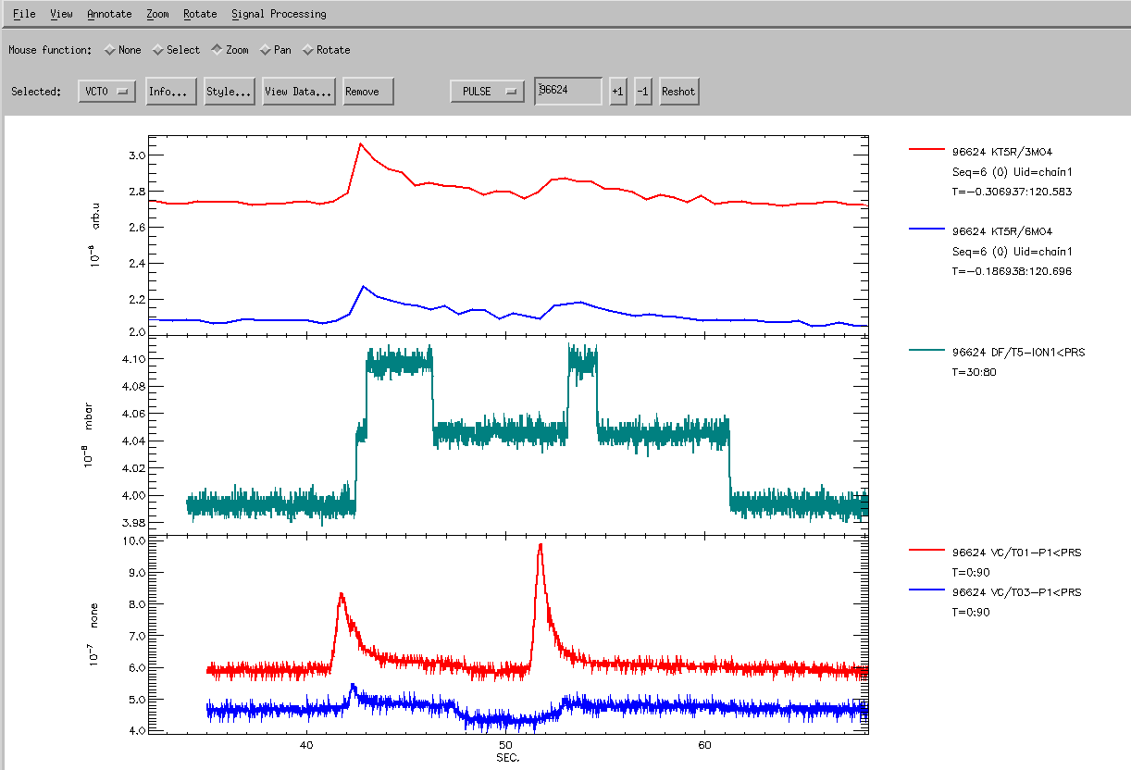
From I. Jepu 30 March
Dry run #96624
t_{r}
t_{1/2}
*Li He in the cryo panels
Between JET pulses
0.5 s injection time
10¹⁸ atoms D
Response/rise time t_{r} = ~ 1 s
t_{1/2} = ~2 s
Added comment during discussion: Can also evaluate pumping regimes work best during the operation of the diagnostic

Slide 6
Laser info
 |  | 1e16 atoms T released |  |  | 1e17 atoms T released |  |  | 1e18 atoms T released
 | T areal density (atoms/cm²) [4] | Raster area (cm2) | Number of 3 mm diameter (0.071 cm²) spots | Laser frequency for “injection” in 0.5 s | Raster area (cm²) | Number of 3 mm diameter (0.071 cm²) spots | Laser frequency for “injection” in 0.5 s | Raster area (cm²) | Number of 3 mm diameter (0.071 cm²) spots | Laser frequency for “injection” in 0.5 s
11 g T inventory limit on cryo-panel | 5.6E+16 | 0.2 | 2.5 | 5.0 | 1.8 | 25.2 | 50.3 | 17.8 | 251.5 | 503.1
4 days per week | 2.3E+17 | 0.04 | 0.6 | 1.3 | 0.4 | 6.3 | 12.6 | 4.4 | 62.9 | 125.8
62 days in DTE3 | 3.5E+18 | 0.003 | 0.04 | 0.08 | 0.03 | 0.4 | 0.8 | 0.3 | 4.1 | 8.1
9.9 g T in main chamber per day | 5.1E+16 | 0.2 | 2.8 | 5.6 | 2.0 | 27.9 | 55.9 | 19.7 | 279.5 | 559.0
4 days per week | 2.0E+17 | 0.05 | 0.7 | 1.4 | 0.5 | 7.0 | 14.0 | 4.9 | 69.9 | 139.7
62 days in DTE3 | 3.1E+18 | 0.003 | 0.05 | 0.09 | 0.03 | 0.5 | 0.9 | 0.3 | 4.5 | 9.0

Slide 7
Uniformity of deposits: HFGC exposed 2011-12 Ion Beam Analysis
tile 1
16 measurement points for IBA
(NRA, RBS)
two clearly distinguishable regions:
  shadowed region
  plasma-wetted region
Uniformity in poloidal direction
wetted
NRA results: D and Be concentrations along HFGC
shadow
IWGL
cross sections for E_{3He}=2.2 MeV and Θ=135° : deuterium 10.36 mb/sr
beryllium 1.16 mb/sr, interpolated from experimental
results of Θ=90° and Θ=150°

Slide 8
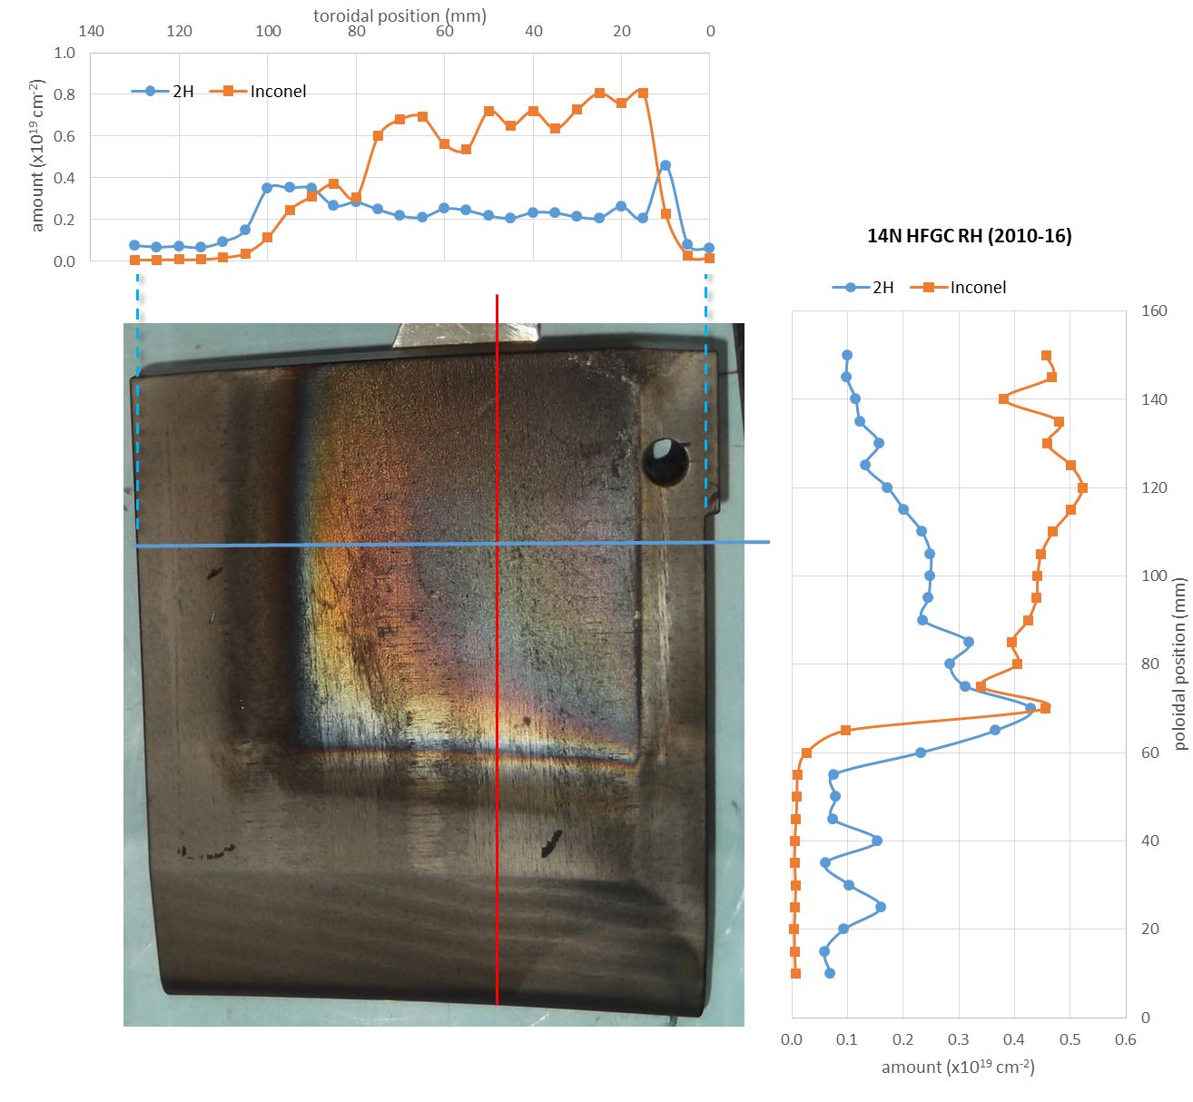
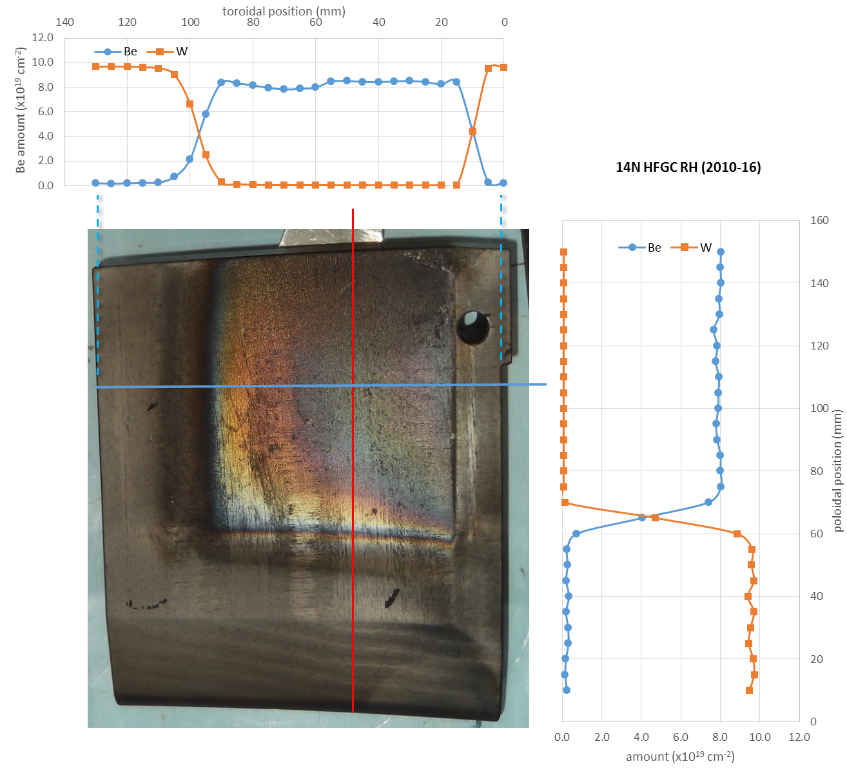
Uniformity of deposits: HFGC exposed 2011-16 Ion Beam Analysis
14NRH 2011-16

Slide 9
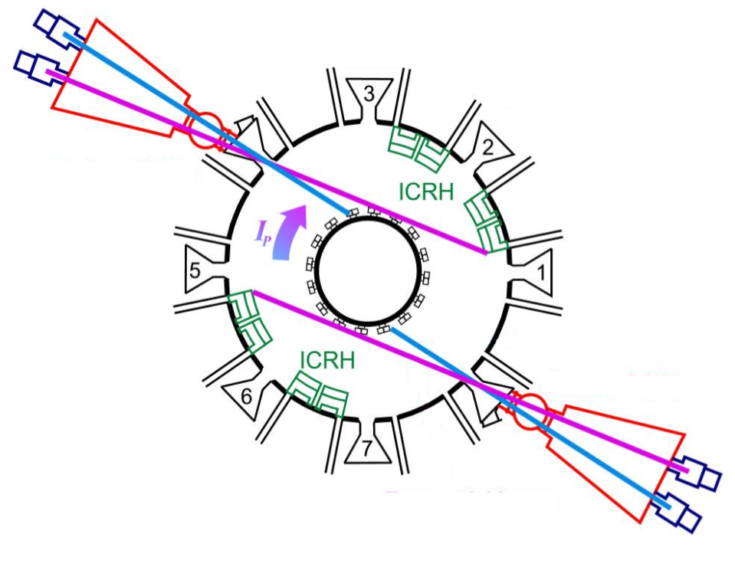
Location of Target tile wrt RGA Oct 8
Diagram from M Maslov presentation 30 March
Observing T01 and T03 responses to GIM4 gas puffs gives complementary information
GIM4 located in Oct 1 pumping chamber, next to T01/T02
T03, T04
GIM4
T01, T02
RGA/QMS location
Module 14 HFGC target tile

Slide 10
Thoughts/open questions
Calculation gives an upper limit for fuel retention based analysis of tiles removed from JET
  11 g limit T per day seems high when compared to current DD operations
    2011-12 (DD) total = 1.67e23 D Calculated 2023-24 (DT) total = 1.23e23 D &1.23e23 T
  In vessel retention between pulses from gas balance – order of magnitude higher? [5]
  Fuelling rates for baseline or hybrid scenario pulses during DT and number of pulses per day – does this increase or decrease the amount of fuel injected?
Still need to confirm QMS sensitivity in dry run after weekend regeneration with cryo-warm [N] (& cryo-cold [He]?)
Sensitivity has an impact on area for rastering. Results suggest 1e17 sensitivity required for <1 cm² sampling area for weekly operations of LID. Otherwise will “use up” target area/need to cross castellation cuts.
What are the technical difficulties of moving mirrors for rastering? Do these also limit the laser repetition rate?
Need to understand surface temperature evolution with rastering.
Other comments…?

Slide 11
DTE3 pulse schedule Oct 2023 – Jan 2024
 |  |  |  |  | 2019 |  |  |  |  |  |  |  |  |  |  |  | 2020 |  |  |  |  |  |  |  |  |  |  |  | 2021 |  |  |  |  |  |  |  |  |  |  |  | 2022 |  |  |  |  |  |  |  |  |  |  |  | 2023 |  |  |  |  |  |  |  |  |  |  |  | 2024
 | j | f | m | a | m | j | j | a | s | o | n | d | j | f | m | a | m | j | j | a | s | o | n | d | j | f | m | a | m | j | j | a | s | o | n | d | j | f | m | a | m | j | j | a | s | o | n | d | j | f | m | a | m | j | j | a | s | o | n | d | j | f | m | a | m | j | j | a | s | o | n | d
 |  |  |  |  |  | C38 |  |  |  |  |  |  | SD/R |  | C38 |  | T-expand | C39 |  | C40 |  |  | DTE2 |  | Cont. | T removal |  | He |  |  | 2021 Shutdown 6 months |  |  |  |  |  |  |  |  |  | cont. |  |  | SPI 2, Seeding & contingency |  |  |  |  |  |  |  |  |  |  |  | cryo |  | DTE3 |  |  | Cont. | T removal |  |  | Take samples & Put JET in safe state
 | Restart |  |  |  |  | D |  |  |  |  |  |  | R |  | D |  | R | H |  | 100% T |  |  | DT |  |  | D |  | He |  |  | SD |  |  |  |  |  | Restart |  |  |  | D |  |  |  |  |  |  |  |  |  |  |  |  |  |  | S |  | DT |  |  |  | D |  |  | RH
One campaign day: 2.25e17 DD-neutrons, 2.25e19 DT-neutrons, 4.5e17 TT-neutrons
2.2e19 T atoms [DT] + 4.5e17 T atoms [TT] = 1.7e19 T atoms reacted
19.9e23 T atoms injected into vessel each day

Slide 12
References
[1] Heinola K, Widdowson A, Likonen J, Alves E, Baron-Wiechec A, Barradas N P, Brezinsek S, Catarino N, Coad J P, Koivuranta S, Krat S, Matthews G F, Mayer M, Petersson P and JET Contributors 2016 Phys. Scr. T167 014075 10.1088/0031-8949/T167/1/014075
[2] Widdowson A, Baron-Wiechec A, Batistoni P, Belonohy E, Coad J P, Dinca P, Flammini D, Fox F, Heinola K, Jepu I, Likonen J, Lilley S, Lungu C P, Matthews G F, Naish J, Pompilian O, Porosnicu C, Rubel M and Villari R 2016 Phys. Scr. 2016 014057 10.1088/0031-8949/T167/1/014057
[3] Sips G Nov 2019 Private communication 2024 neutron activation schedule
[4] Heinola K, Widdowson A, Likonen J, Alves E, Baron-Wiechec A, Barradas N, Brezinsek S, Catarino N, Coad P, Koivuranta S, Matthews G F, Mayer M, Petersson P and JET-EFDA contributors 2015 J. Nucl. Mater. 463 961–5
[5] Philipps V, Loarer T, Esser H G, Vartanian S, Kruezi U, Brezinsek S and Matthews G 2013 J. Nucl. Mater. 438 S1067–71

Slide 13
Heinola data for [1] & [4]
location | Heinola [17] | Heinola [8]
INJECTED | 1.67E+26 | 1.67E+26
UDP | 2.10E+22 | 2.10E+22
OPL | 5.72E+22 | 5.20E+22
outer wall |  | 8.80E+21
IWGL | 2.75E+22 | 1.40E+22
recessed inner limiters |  | 1.10E+22
recessed IWC |  | 1.70E+22
divertor | 2.40E+23 | 2.10E+23
remote areas | 4.20E+22 | 4.20E+22
tile 0&1 | 1.30E+23 | 1.20E+23
tile0&1 % of retained | 3.35E+01 | 3.19E+01
tile0&1 % of injected fuel | 7.78E-02 | 7.19E-02
sum | 3.88E+23 | 3.76E+23
total retention of injected fuel (%) | 2.32E-01 | 2.25E-01
Used ref [4] for calculations. Ref [1] revises down retention in Tile 1 and HFGC from 0.08% to 0.07%.
2011-12 fuelling (150 ?? Days) = 1.67e23 D atoms
2023-24 Calculated injection based on 11 g limit/day, with 9.9g into main chamber (62 days) = 1.23e26 T atoms + 1.23e26 D atoms = 2.46e26 fuel atoms total
Look at fuelling of individual pulses
ROUGH CALCULATION
Philipps [5] Long term fuel retention from gas balance
Of injected fuel, typically 80% pumped by cryopump and 20% pumped dynamically by walls at end of shot
2x10²² D retained in walls at end of shot
⇒ 1x10²³ D injected
2-3x10²¹ D retention in vessel “long term” retention
in vessel “long term” retention 2% of injected fuel
Potentially higher surface fuel retention during operations
This would be more encouraging for LID-QMS

Slide 14
Laser info (using ref [1] retention 0.07% on Tile 1 and HFGC – don’t need to show)
 |  | 1e16 atoms T released |  |  | 1e17 atoms T released |  |  | 1e18 atoms T released
 | T areal density (atoms/cm²) [1] | Raster area (cm2) | Number of 3 mm diameter (0.071 cm²) spots | Laser frequency for “injection” in 0.5 s | Raster area (cm²) | Number of 3 mm diameter (0.071 cm²) spots | Laser frequency for “injection” in 0.5 s | Raster area (cm²) | Number of 3 mm diameter (0.071 cm²) spots | Laser frequency for “injection” in 0.5 s
11 g T inventory limit on cryo-panel | 4.9E+16 | 0.2 | 2.9 | 5.7 | 2.0 | 28.7 | 57.5 | 20.3 | 287.5 | 574.9
4 days per week | 2.0E+17 | 0.051 | 0.7 | 1.4 | 0.5 | 7.2 | 14.4 | 5.1 | 71.9 | 143.7
62 days in DTE3 | 3.1E+18 | 0.003 | 0.05 | 0.09 | 0.03 | 0.5 | 0.9 | 0.3 | 4.6 | 9.3
9.9 g T in main chamber per day | 4.4E+16 | 0.2 | 3.2 | 6.4 | 2.3 | 31.9 | 63.9 | 22.6 | 319.4 | 638.8
4 days per week | 1.8E+17 | 0.06 | 0.8 | 1.6 | 0.6 | 8.0 | 16.0 | 5.6 | 79.9 | 159.7
62 days in DTE3 | 2.7E+18 | 0.004 | 0.05 | 0.10 | 0.04 | 0.5 | 1.0 | 0.4 | 5.2 | 10.3

