Slide 1
Edge LIDAR laser portion for LIBS
LH13N
RH13N
RH14N
LH15W
RH15W
LH15N
RH15N
LH14W
RH14W
LH14N
13ING1C
13ING1D
14IWG1A
14IWG1B
15ING1C
15ING1D
14ING1C
14ING1D
15IWG1A
15IWG1B
15NG3B
13ING3B
14IWG3A
14ING3B
15IWG3A

Slide 2
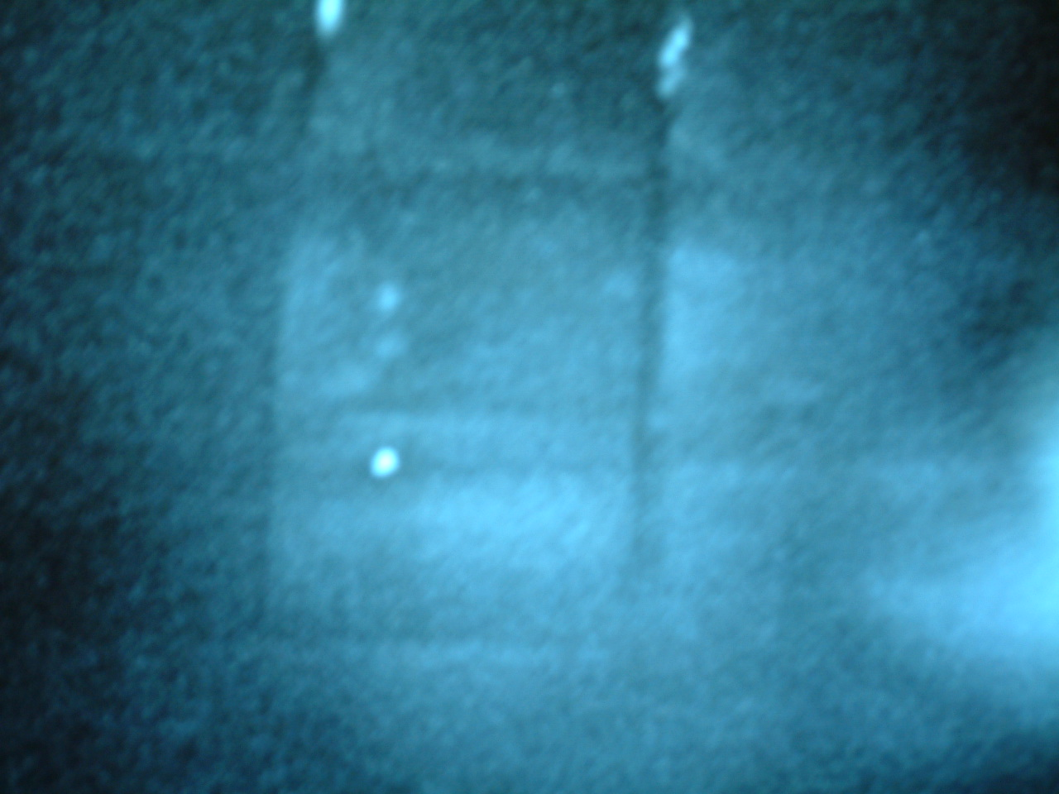
Laser spot on tile 1 2007 Note mirrored image from IVIS
Apron/HFGC
14ING1C
14IWG1B
Location of LIDAR laser spot (HeNe alignment laser shown)
IVIS image is mirrored in vertical axis (confirmed with S. Cramp)
Need DO line of sight for final check.

Slide 3
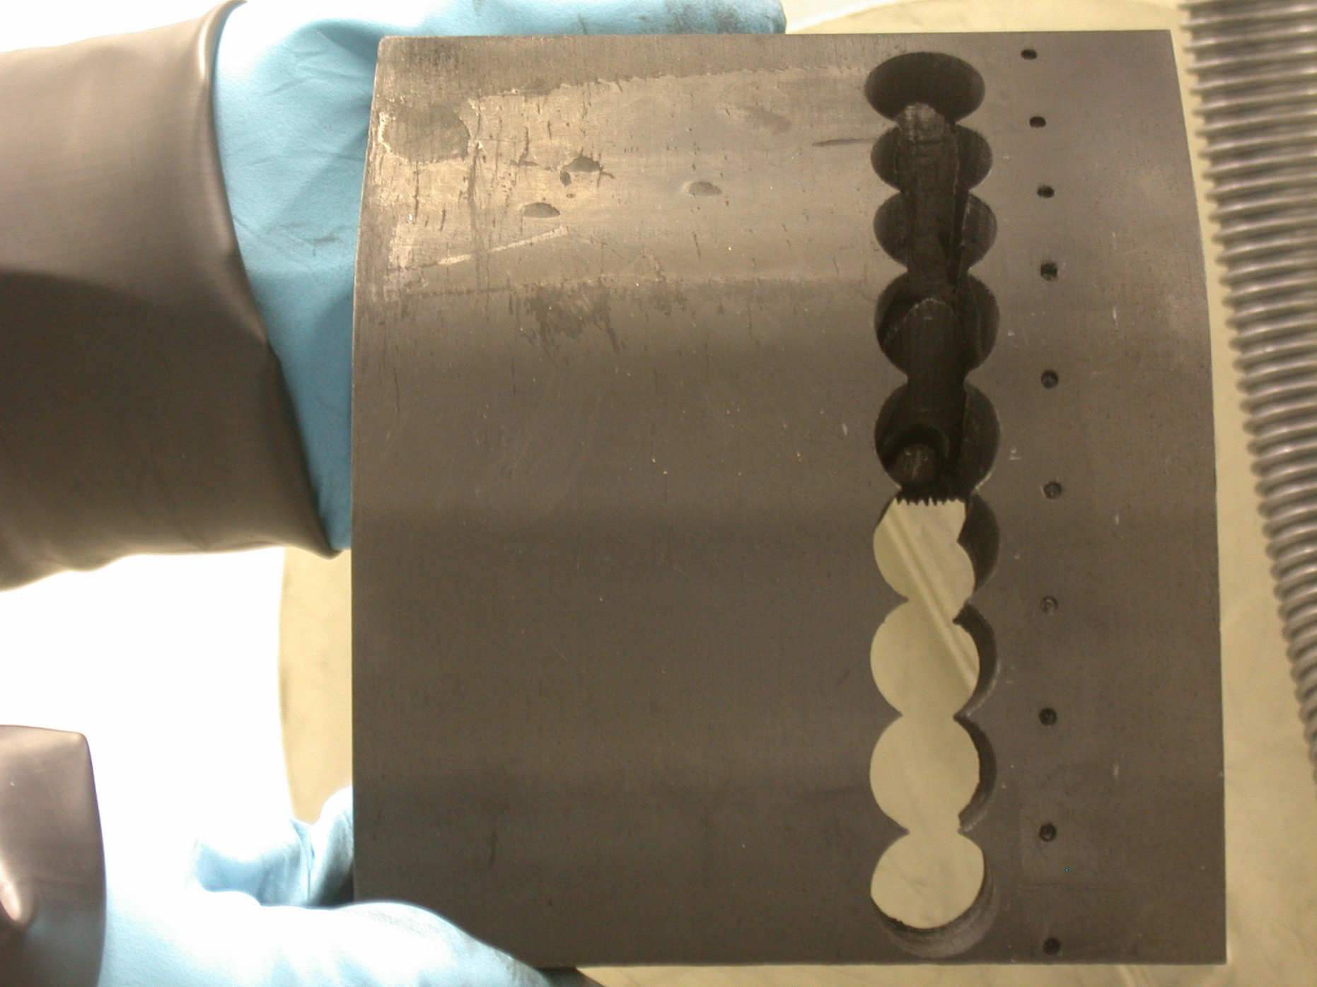
14IN G1C (2005-2009)
9
8
7
6
5
4
3
2
1

Slide 4
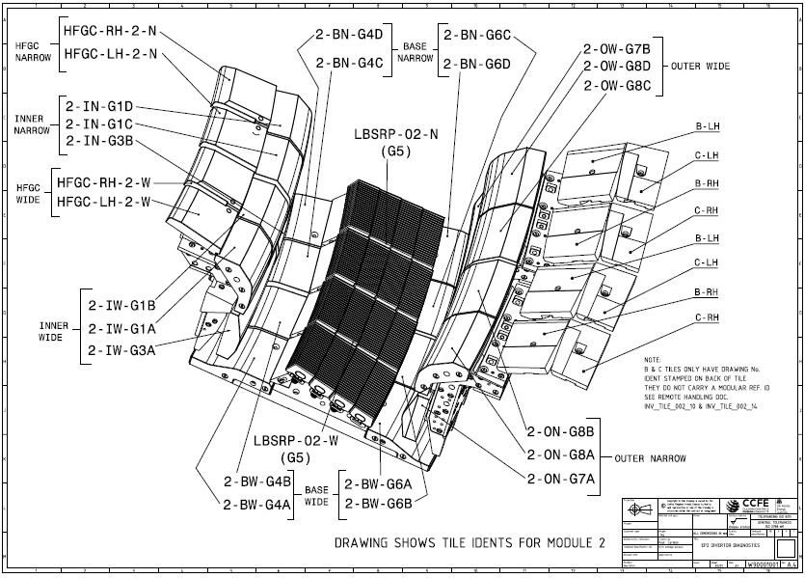
Numbered in LH&RH pairs from 1-ON

Slide 5
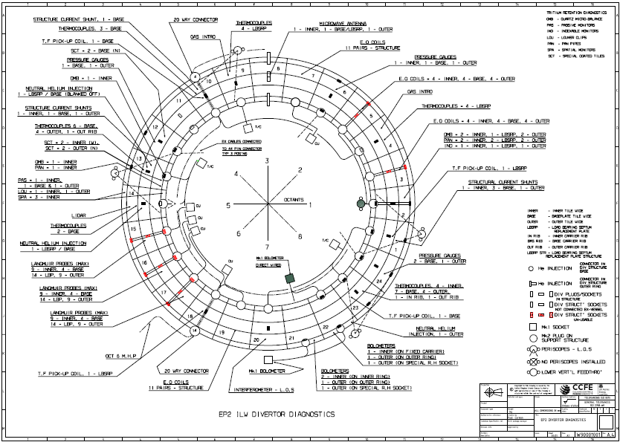
14ING1C &
HFGC RH14N

Slide 6
Initial conclusion: No in-vessel wiring at this location.
Other locations may be possible.

Slide 7
Tile spares
Tile 1 type | Drawing number | Location | Comments/location checked
Type 1A | W62051101 | JBON/Shelf 01/01 | ID = G1A-R1
Type 1B | W62051201 | JBON/Shelf 01/01 | ID = 1 (Also 2)
Type 1C | W62051301 | ---- | No clean spares. No exposed spares – all G1C tiles removed have been cut up for analysis.
Type 1 D | W62051401 | JBON/Shelf 01/01 | ID = 5 (Also G1D-R1, G1D-R2, 1, 4)
HFGC RH | F63000001 | JBON/Shelf 01/nn | ID = RH25N Double check: Fits all RH locations (W & N)
HFGC LH | F63000002 | ---- | No clean spares.
LH13N
RH13N
RH14N
LH15W
RH15W
LH15N
RH15N
LH14W
RH14W
LH14N
13ING1C
13ING1D
14IWG1A
14IWG1B
15ING1C
15ING1D
14ING1C
14ING1D
15IWG1A
15IWG1B
15NG3B
13ING3B
14IWG3A
14ING3B
15IWG3A

Slide 8
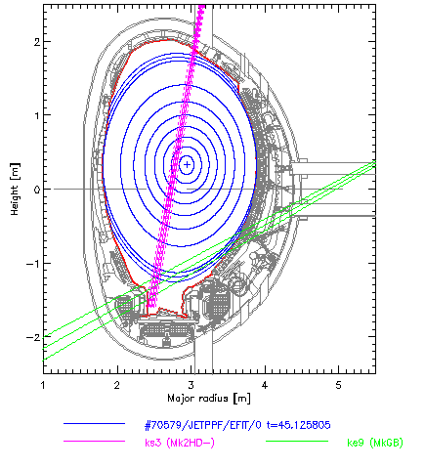
Geometry
Is HFGC a suitable replacement?
Line of sight on HFGC needs to be reviewed.
HFGC
Tile1

