Slide 1
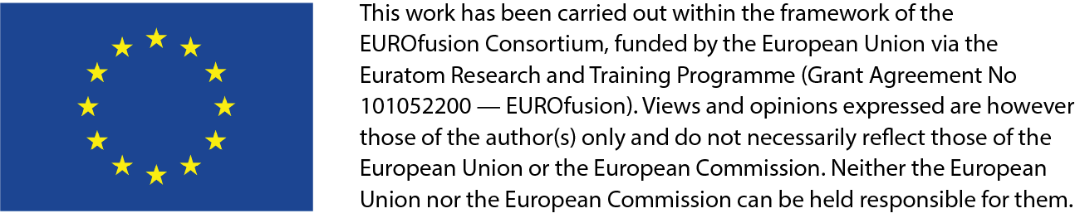
Current activities by WP DIV for JT-60SA
M. Richou
EUROfusion Science Coordination Meeting on the transition of JT-60SA to W
| 26/03/2024

Slide 2
EUROfusion WPDIV program
JT-60SA water-cooled divertor
  2.1 Carbon-Actively Cooled Divertor (C-ACD)
  2.2 Tungsten-Actively Cooled Divertor (W-ACD)
  Requirements
  Concepts
    Challenges
Richou | Science Coordination Meeting on the transition of JT-60SA to W | Remote | 26th of March 2024 | Page 2
Notes:
Stellarator and tokamak are included as pilars for the definition of the technologie for fusion power plant

Slide 3
1. WPDIV – General – 2021->2025
WPDIV
R. Neu
J-H. You
M. Richou
M. Richou
R. Neu
Eu-DEMO
W7X
JT60SA
IDTT
Eu-DEMO: Conceptual design
Deliver holistic design concept of divertor (target, cassette) and limiter for DEMO
Prepare the transition from conceptual design phase to engineering design phase
IDTT: Support the design, qualification R&D, fabrication, assembly and installation of the divertor
(PFC+cassette body) and the subsystems which have an interface with the divertor.
W7X and JT60-SA: Develop and demonstrate feasibility of actively cooled W divertor PFCs
Richou | Science Coordination Meeting on the transition of JT-60SA to W | Remote | 26th of March 2024 | Page 3

Slide 4
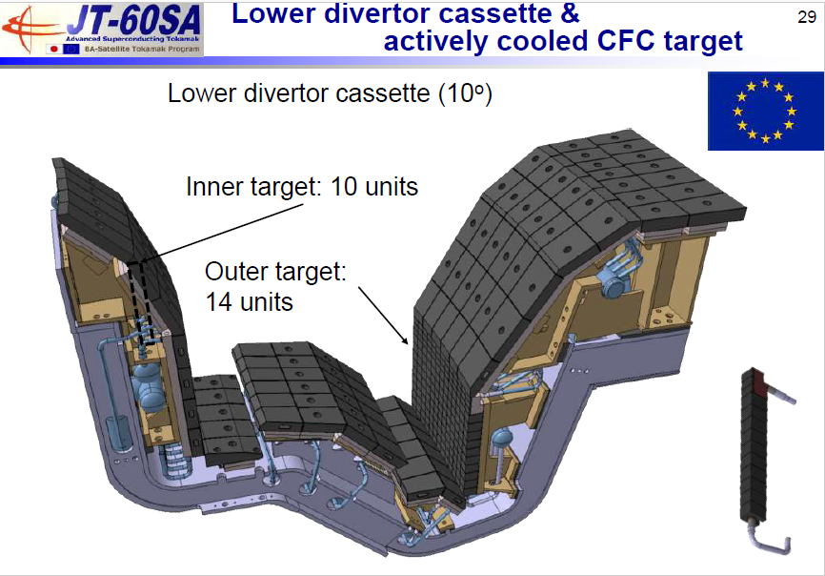
1-WPDIV -JT60SA (Main objectives)
For the carbon-Actively Cooled Divertor (C-ACD), the objective of WPDIV- JT60SA subproject consists in providing support to F4E to run the C-ACD series manufacturing (thermo-mechanical analysis, Electromagnetic loads analysis, mechanical testing, non-destructive testing, high heat flux tests)
For the tungsten-Actively Cooled Divertor (W-ACD), WPDIV-JT60SA subproject has the responsibility to design and develop the W-ACD by full scale prototype manufacturing and high-heat-flux testing.
Richou | Science Coordination Meeting on the transition of JT-60SA to W | Remote | 26th of March 2024 | Page 4

Slide 5
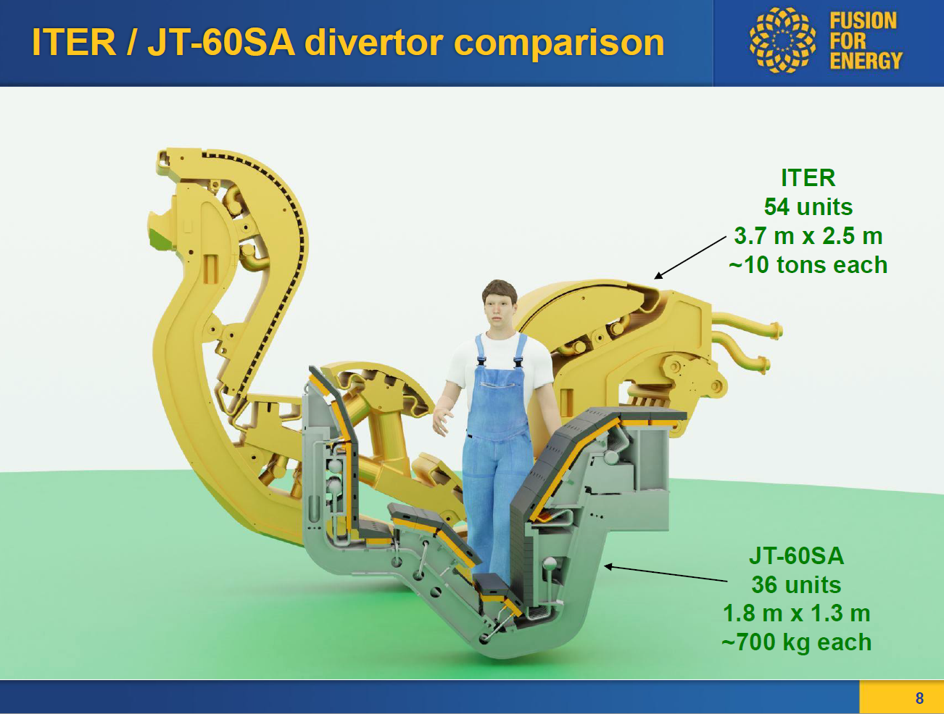
2. JT-60SA water cooled divertor
2.1 Carbon-Actively Cooled Divertor (C-ACD)
Richou | Science Coordination Meeting on the transition of JT-60SA to W | Remote | 26th of March 2024 | Page 5

Slide 6
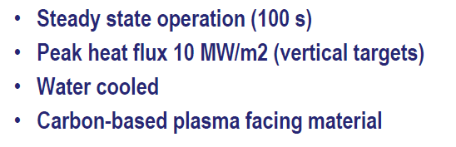
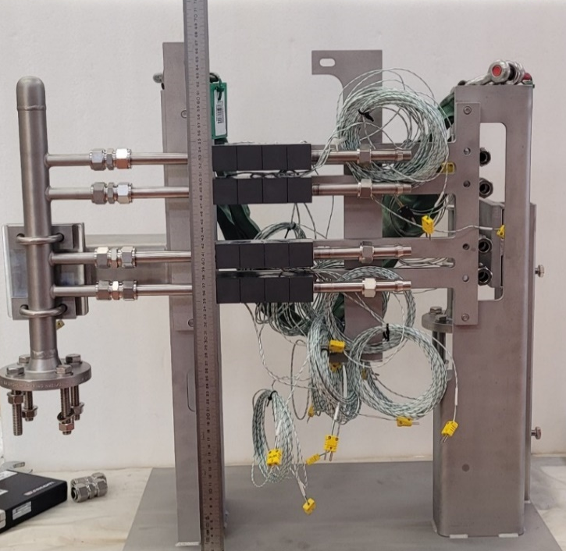
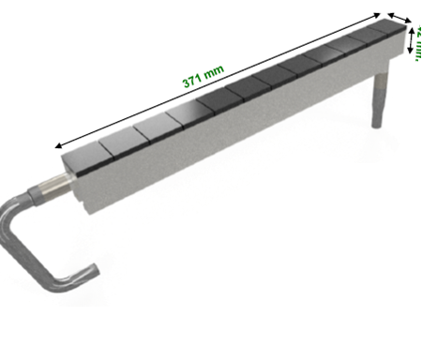
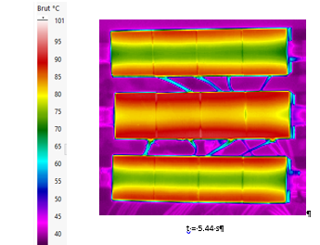
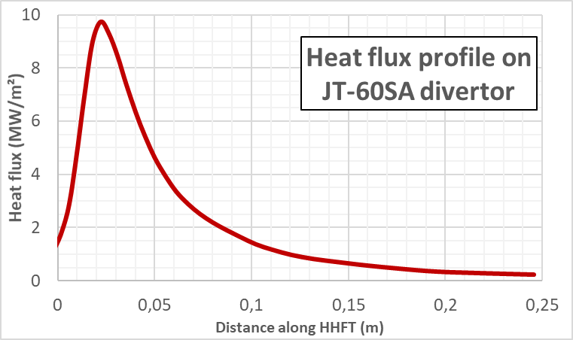
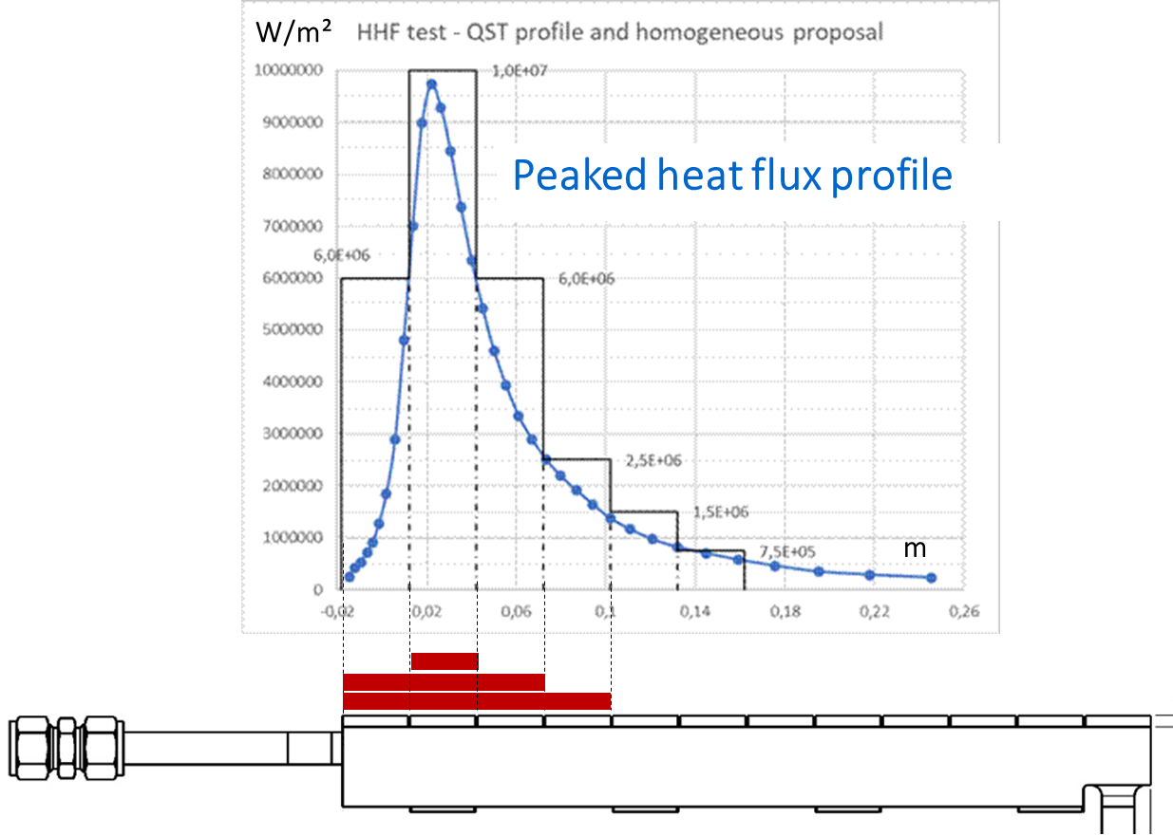
2. 1 Carbon-Actively Cooled Divertor (C-ACD)
Target element :
Conventional flat tile concept
32 mm
Steady state heat loads
Graphite
TZM
Divertor cassette
and plasma facing components
Cooling conditions :
20 bar, 7m/s, 40°C, swirl
Support of EUROfusion to F4E
(Infrared thermography, HHF tests)
Richou | Science Coordination Meeting on the transition of JT-60SA to W | Remote | 26th of March 2024 | Page 6
Notes:
In the frame work of the BA
Inlet diameter 12 mm
2025 : fin fabrication target
2025 : début d’intégration sur la cassette

Slide 7
2.2 Tungsten-Actively Cooled Divertor (W-ACD)
Richou | Science Coordination Meeting on the transition of JT-60SA to W | Remote | 26th of March 2024 | Page 7

Slide 8
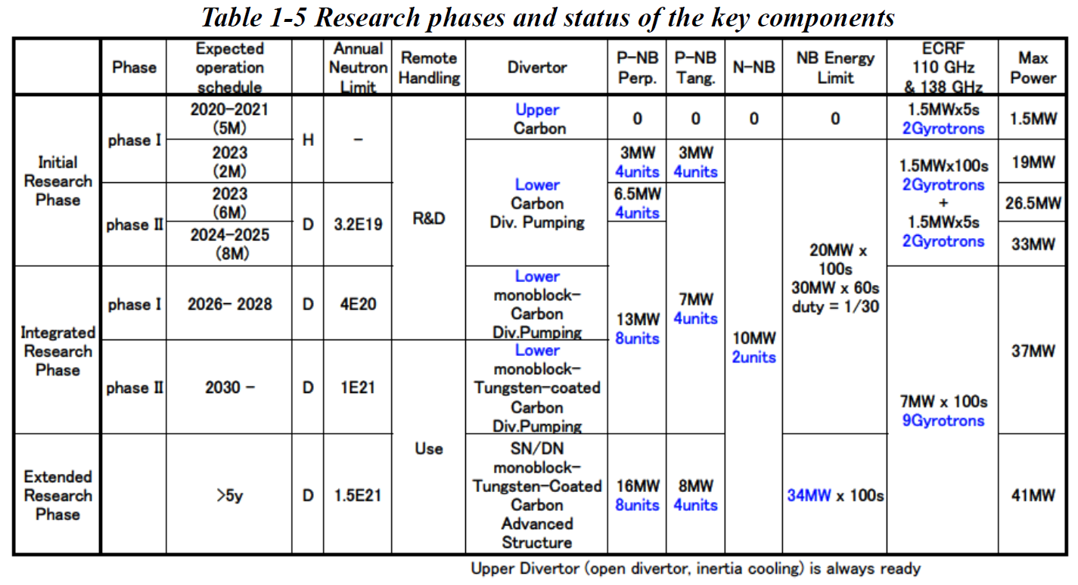
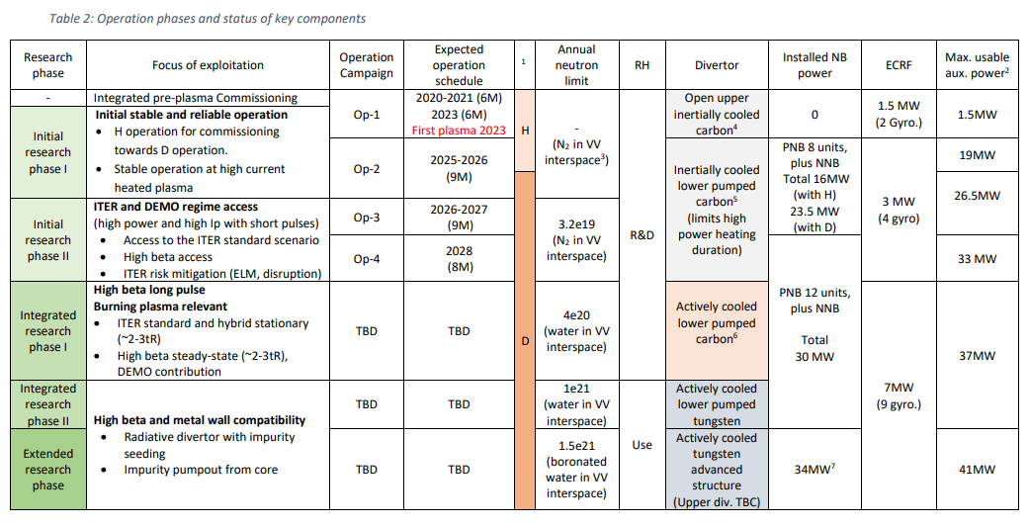
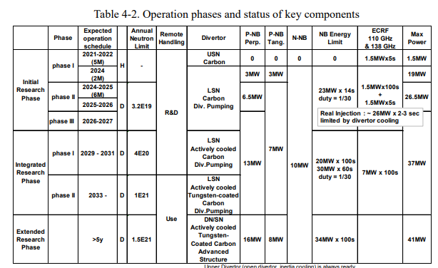
2.2 Tungsten-Actively Cooled Divertor (W-ACD)-> Schedule
Used To build the WPDIV-JT60SA project in 2020
2023: BA_SC_31-9.4-1
End of 2021: BA SC 27-7.4 – Basis for the curent EUROfusion Project Execution Plan
Richou | Science Coordination Meeting on the transition of JT-60SA to W | Remote | 26th of March 2024 | Page 8
Notes:
Activity started in 2021 (based on CFC divertor geometry)
(PID Plant Integration Document )
PSOL (MAX) : 35 MW (p175 PID V4.3)
Feedback from the assembly of the activelly cooled divertor (
WèX
A metallic wall in W7-X will help to understand the impurity ingress of and radiation losses by high Z materials and their effect on plasma performance (stellarator configuration)
JT60SA
10 MW/m² 100s, 10000 cycles
15 MW/m² 100s 3000 cycles
Based on simulations of the divertor heat load and pumping flux for an ITER-shape LSN plasma with Ip~3MA and Bt =2.45 T, for the vertical target divertor with a V-shaped corner, a significant reduction in the peak heat flux is expected, with plasma detachment foreseen for the maximum level of heating power of 41 MW, provided that radiation fraction is relatively large, i.e. Prad/Pout >~ 50%. It is also foreseen that control of the divertor detachment and reduction in the plasma density could be established by an X-point shift as well by reducing the gas puff rate. Based on scaling of particle confinement time for the ELMy H-mode plasmas in JT-60U, pellet fuelling from the high-field-side with a fuelling rate of ~1x1022 s -1 will be required to increase the density up to the Greenwald density (1.3x1020 m-3 ) in a 5.5 MA plasma. This fuelling rate shall be achieved at an injection frequency of ~12 Hz using 2.5 mm cube pellets, or ~20 Hz with 2.1 mm cube pellets

Slide 9
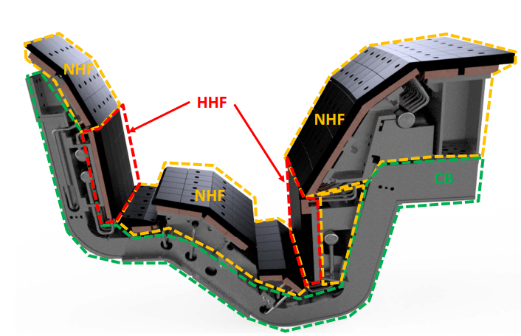
2.2 Tungsten-Actively Cooled Divertor (W-ACD)-> Requirements
  Use of W armor material, to be relevant with fusion power plant plasma facing material
  WPDIV assumptions for the development of the HHF target (in line with F4E to save cost)
    Minimize the interfaces changes (same cassette body ideally)
    Keep the same envelope geometry as for the C-ACD
     Keep the present cooling capability
     Minimize the weight increase
    Heat loads (higher than JT-60SA C-target)
        15 MW/m² (Steady state, for C-Target considered for transient loading)
        Transient : 10 MJ/m² - 0.2 ms
      Existing feedback from industrial fabrication (materials, joining solutions, swirl shape…)
Richou | Science Coordination Meeting on the transition of JT-60SA to W | Remote | 26th of March 2024 | Page 9
Notes:
For already improved technology (no qualification of new joining technology such as W flat tile (W on CuCrZr) or W monoblock)
Based on WEST series manufacturing (2 years 450 PFUs 500 mm long – For 1000 components 4 years)
Same trend for the series manufacturing performed for W7X C ACD – IDTT
WEST Assemblage 6 mois pour 12 secteurs de 38 composants
JT60SA 36 units de 24 PFC -

Slide 10
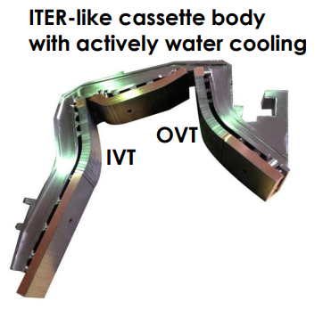
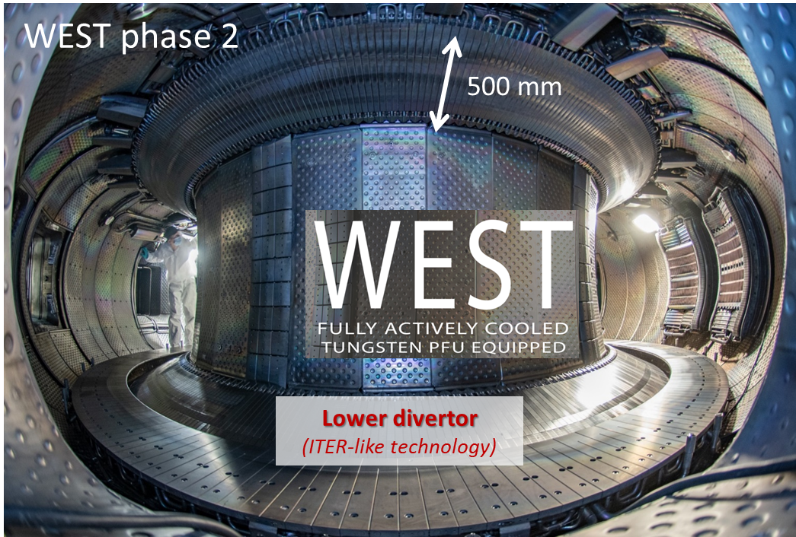
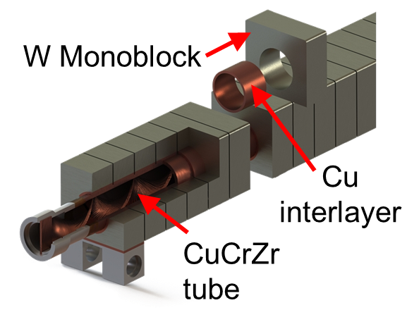
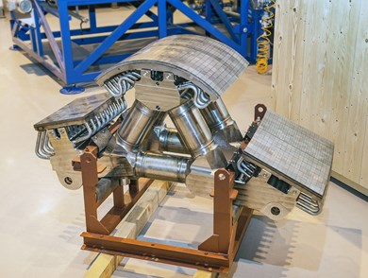
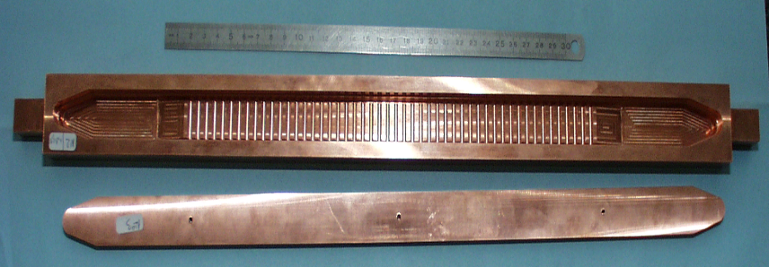


2.2 W-ACD-> Assessed concepts
Conventional flat tile
Monoblock
EAST
10-15 MW/m²
20 MW/m²
32mm
W – 3 mm
Interlayer
Water cooled
- Should handle ~100MW
10MW.m⁻² steady state
20MW.m⁻² transient
Heat sink ( TZM, CuCrZr…)
$$φ 12 mm$$
Massive tungsten
32 mm
ITER Dome
Enhanced flat tile
Schematic cut view
Example of Hypervapotron mock-up
10-25 MW/m²
CuCrZr
6
6
6
491 mm
CuCrZr
Richou | Science Coordination Meeting on the transition of JT-60SA to W | Remote | 26th of March 2024 | Page 10

Slide 11
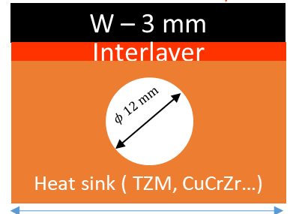
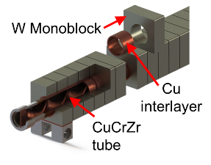


2.2 W-ACD -> Schedule and analysis (1/2)
 | Thermal analysis | Thermo-mechanical analysis (assuming same interfaces to the CB as the carbon target ones) | Electromagnetic analysis | Manufacturing feasibility
Conventional flat tile Massive tungsten | 2023 | 2023 | 2023 | 2023 (feedback from fusion devices series manufacturing)
Monoblock Massive tungsten | 2024 | 2024 | 2024 | 2022 (feedback from fusion devices series manufacturing)
Enhanced flat tile Massive tungsten | 2024 | 2024 | 2024 | 2024
6
6
6
Richou | Science Coordination Meeting on the transition of JT-60SA to W | Remote | 26th of March 2024 | Page 11

Slide 12
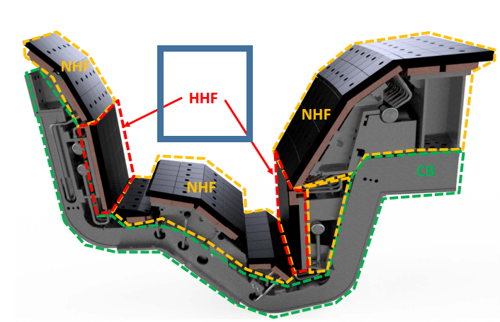
2.2 W-ACD -> Schedule (2/2)
WPDIV JT-60SA PEP
4 years for series manufacturing
Assessment by modeling
of « Conventional flat tile »
Prototype manufactured and tested
“Enhanced flat tile” and “monoblock” concepts
Richou | Science Coordination Meeting on the transition of JT-60SA to W | Remote | 26th of March 2024 | Page 12

Slide 13
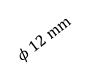
2.2 W-ACD-> Conventional flat tile concept (1/2)
JT-60SA
W or W alloy…
  Material choice:
    W/W alloy like NiFe(3% mass NiFe)…:
    ductility at RT (alloy), transient resistance
    CuCrZr (“ITER grade”) : good thermomechanical properties, existing feedback from joining feasibility (used for series manufacturing)
    TZM (JT60SA): good thermomechanical properties, material used for series manufacturing but not reactor relevant (activation)
  Rationales for the material geometry and thickness choices:
    Equivalent envelope as the C-ACD
    W: erosion (> 2 mm), recrystallization
    CuCrZr, TZM: structural resistance
    Interlayer: joining feasibility feedback
CuCrZr or TZM
10-15 MW/m²
Target cross view
W or W alloy – 3 mm
Interlayer – 1 mm
Heat sink ( TZM, CuCrZr…)
3 mm
27 mm
$$φ 12 mm$$
32 mm
Richou | Science Coordination Meeting on the transition of JT-60SA to W | Remote | 26th of March 2024 | Page 13

Slide 14
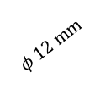
2.2 W-ACD-> Conventional flat tile concept (2/2)
10-15 MW/m²
W – 3 mm
Interlayer – 1 mm
3 mm
Heat sink ( TZM, CuCrZr…)
  Maximum allowable temperature (loss of mechanical properties)
  CuCrZr - 450 °C
  W - 1200°C
  TZM - 1200°C
27 mm
$$φ 12 mm$$
32 mm
Proposed geometry may be able to sustain 10 MW/m² in steady state ✓
Mechanical attachment to cassette has to be improved (RCC-MRx)
Monoblock and enhanced concept are able to sustain 15 MW/m² in steady state
  Results of thermal analysis (FEM)
Heat sink | CuCrZr |  | TZM
Incident heat flux (MW/m²) | 10 | 15 | 10 | 15
Heat sink Max Temp. (C) | 452 | 603 | 963 | 1435
W Max Temp. (C) | 704 | 1015 | 1221 | 1832
Richou | Science Coordination Meeting on the transition of JT-60SA to W | Remote | 26th of March 2024 | Page 14
Notes:
Here W is 3,5 mm interlayer 2 mm Heat sink 19 mm

Slide 15
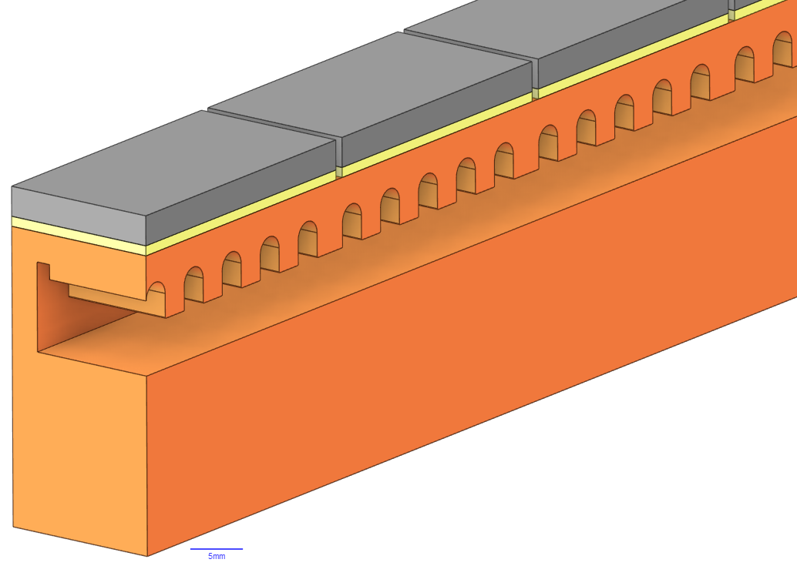
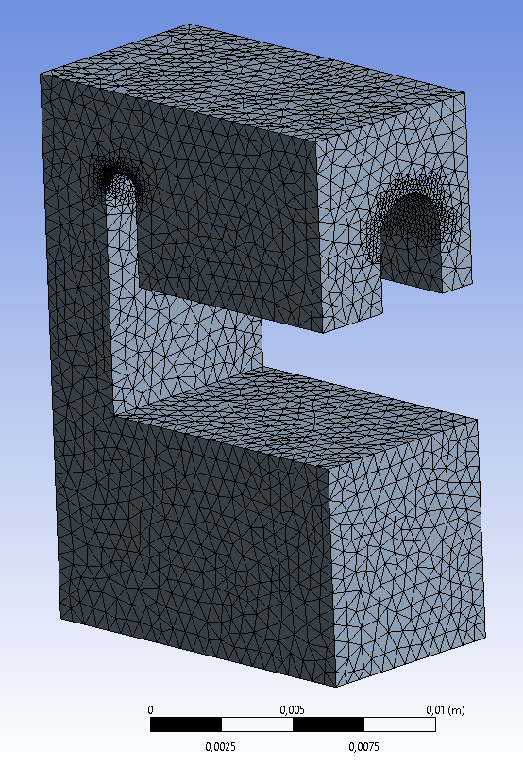
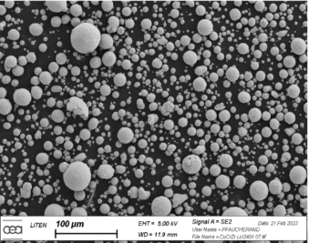
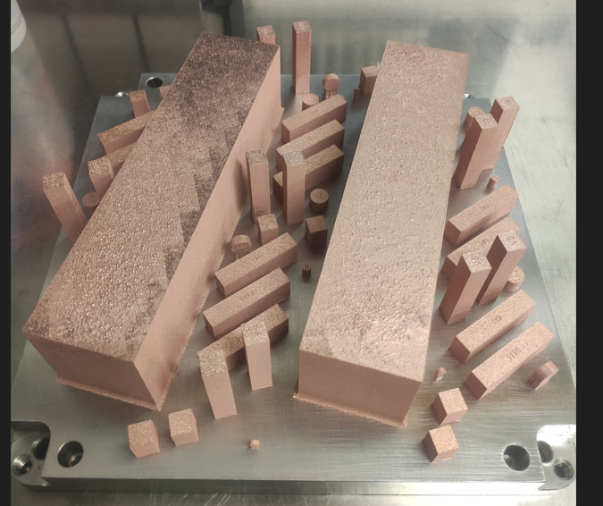
2.2 W-ACD -> Enhanced flat tile concept (1/2)
10-25 MW/m²
Proposed geometry is able to sustain 15 MW/m² in steady state ✓
The use of FEM is promising to define the most adapted W target hypervapotron geometry
W
CuCrZr
Experiment²
Thermal analysis (FEM)
275 mm
2: F. Escourbiac et al, Fus. Eng. and Des., 2003
3. Salvan, 2021
Richou | Science Coordination Meeting on the transition of JT-60SA to W | Remote | 26th of March 2024 | Page 15
Notes:
W-Target : W= 32 mm, 3 mm heat sink
For a tested geometry similar to the one needed for the W JT60SA target
Equivalent stress strain curve as for forged CuCrZr
The existing correlations for convected coefficient may be used if final geometry is the same as the one already tested

Slide 16
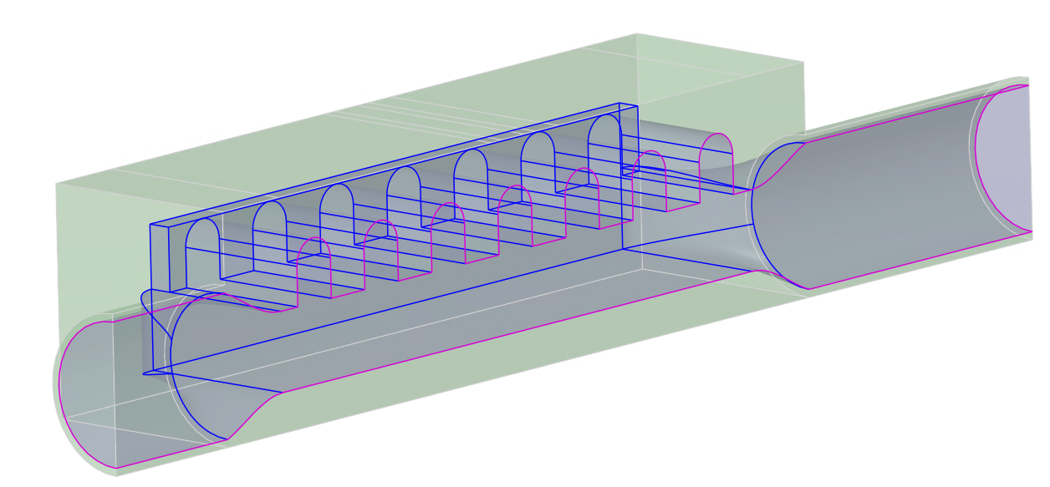
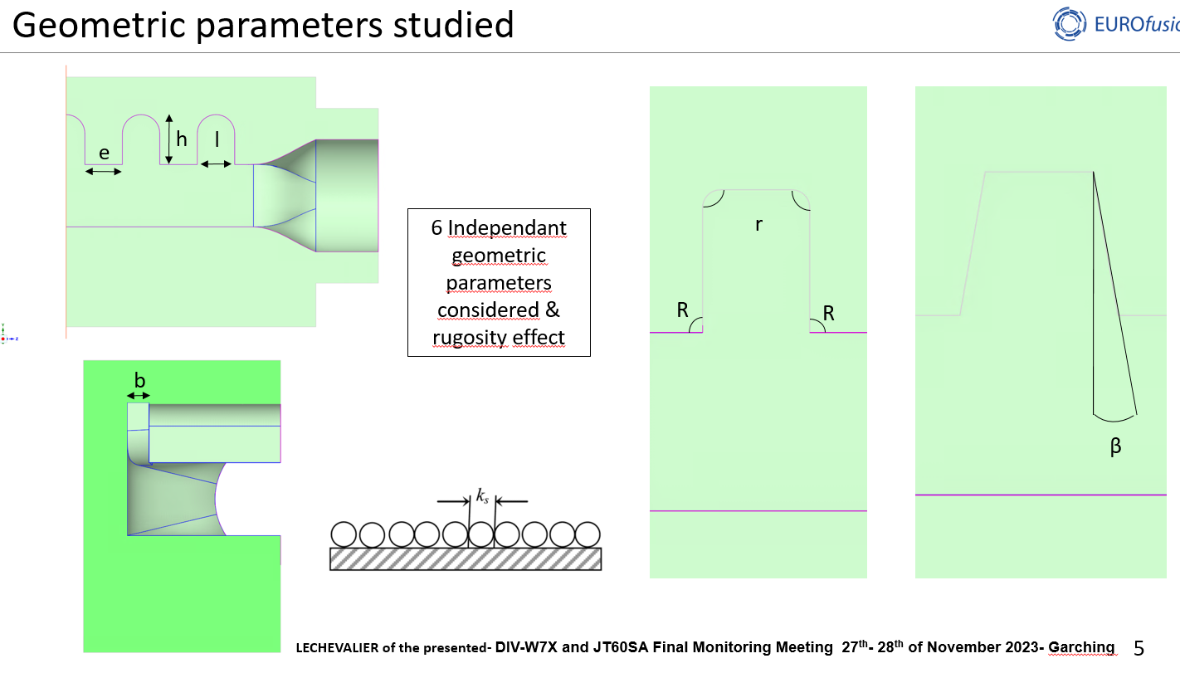
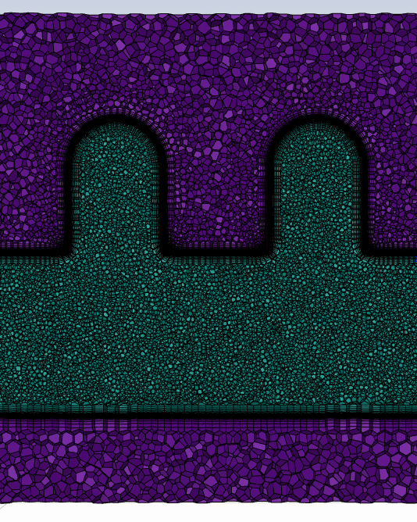
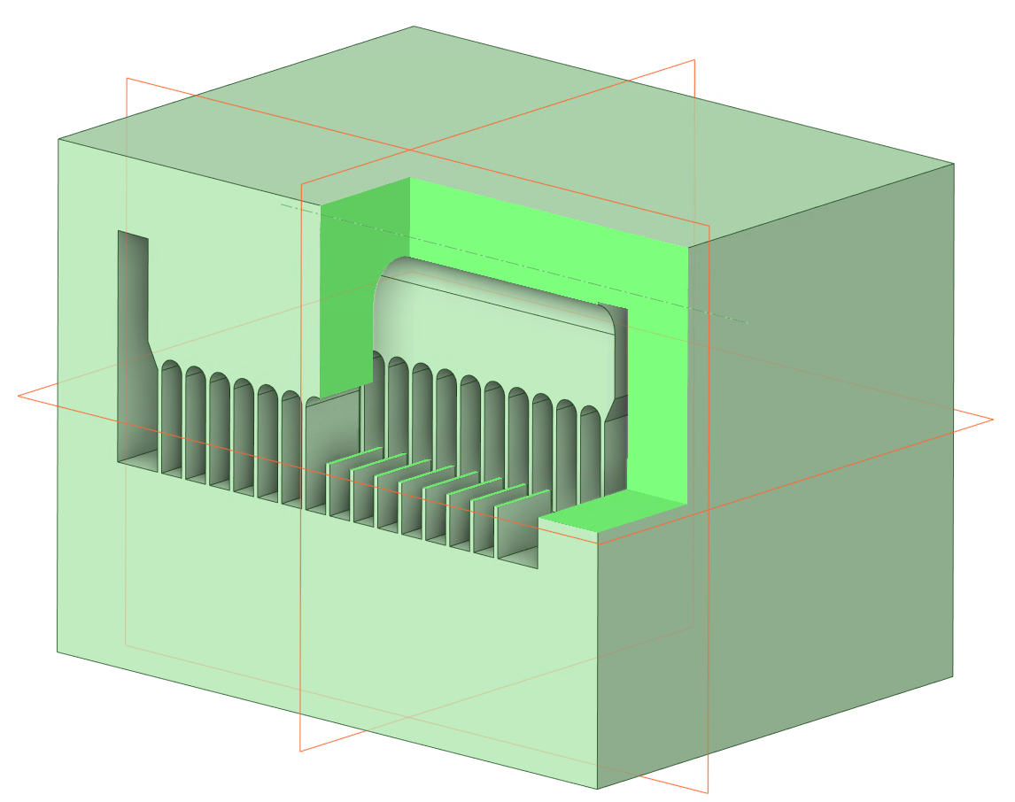
2.2 W-ACD -> Enhanced flat tile concept (2/2)
52 mm
No important room for hypervapotron geometry optimisation
Inlet:
Water
4 m/s
40°C
CFD Settings (ANSYS Fluent 2023 R2) :
Polyhedral mesh such as y+ ~ 1
k-w SST turbulence model used
Energy equation solved in monophasic situation (Phase I)
Geometries cut in two by symmetry of the situation
27 mm
Definition of a geometry compatible with additive manufacturing
-> Mock-up available in September
Richou | Science Coordination Meeting on the transition of JT-60SA to W | Remote | 26th of March 2024 | Page 16

Slide 17
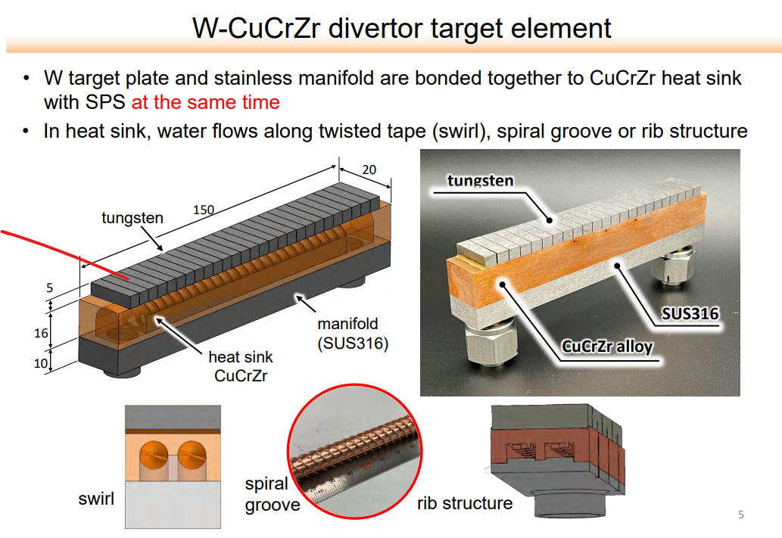
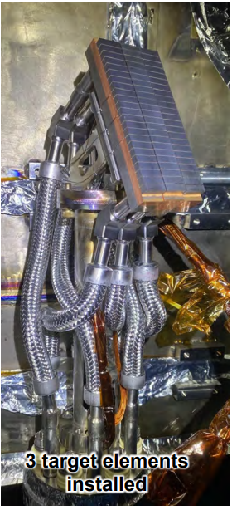
2.2 W-ACD -> Development in NIFS Tomohiro Morisaki (outside WPDIV)
  Use of SPS in H₂ process for joining
  After HHF tests: 20 MW/m² during 10 min,
  “no serious damage observed”
  Mass production for 450 mm feasible
Richou | Science Coordination Meeting on the transition of JT-60SA to W | Remote | 26th of March 2024 | Page 17

Slide 18
2.2 W-ACD-> Challenges for the development of the HHF W target
Technological concern (materials)
  What plasma facing materials ? Alloyed W (compatibility with plasma operation ? WPDIV W7X and WPW7X)
  TZM or CuCrZr
    Activation calculation planned to be performed by F4E
    Does additive manufacturing applicable for a PFC series manufacturing production ? (Answer in 2024)
Technological concern for joining materials (Bonding)
  Qualify the bonding of plasma facing material to CuCrZr manufactured by additive manufacturing (Answer in 2024)
  W/TZM (F4E ?, QST with Spark Plasma Sintering Process ? see T. Morisaki San talk )
Technological concern for heat exhaust (Concept)
  Enhanced flat tile : Does this concept bring an added value (performance vs cost) ? (Answer in 2024)
  Conventional flat tile : If this concept is the privileged option: there is a need to adapt the attachment to the cassette (Shown during this project) (F4E)
Modeling concern-> Heat transfer coefficient need to be assessed for the definition of the maximum allowable heat flux (Answer in 2025)
Above the HHF target: Assess the needed upgrades of the whole divertor, whole tokamak (diagnostics, wall, operation…)
Richou | Science Coordination Meeting on the transition of JT-60SA to W | Remote | 26th of March 2024 | Page 18

Slide 19
Conclusions
Divertor water cooled target with W armor material for JT-60SA
  In the project the development are run so that it could be operated in 2033
  Steady state heat loads requirement : 15 MW/m²
  Lower loads (heat, neutrons…) compared to the ITER and DEMO divertor targets
  Monoblock, conventional and enhanced flat tile concepts are studied
    No need for dedicated conventional flat tile (W/CuCrZr) and monoblock fabrication development (Feedback from other fusion devices)
    Assessment of the conventional flat tile concept – CDR Done (modeling and recommendations for possible needed manufacturing dev. ex : W/TZM)
    Assessment of the enhanced (Fab. + modeling) and monoblock concept (modeling) – 2024
  Solution of a divertor without leading edge is studied (not presented here)
  Prototype manufacturing and qualification is planned in 2025
Richou | Science Coordination Meeting on the transition of JT-60SA to W | Remote | 26th of March 2024 | Page 19
Notes:
More neutrals into the pumping gap
W target is a opportunity to improve power exhaust
Change the angle of the PFC
Improve the edge tile technology to handle higher heat flux.
In these fusion devices, divertor target are tools to serve the physics

Slide 20
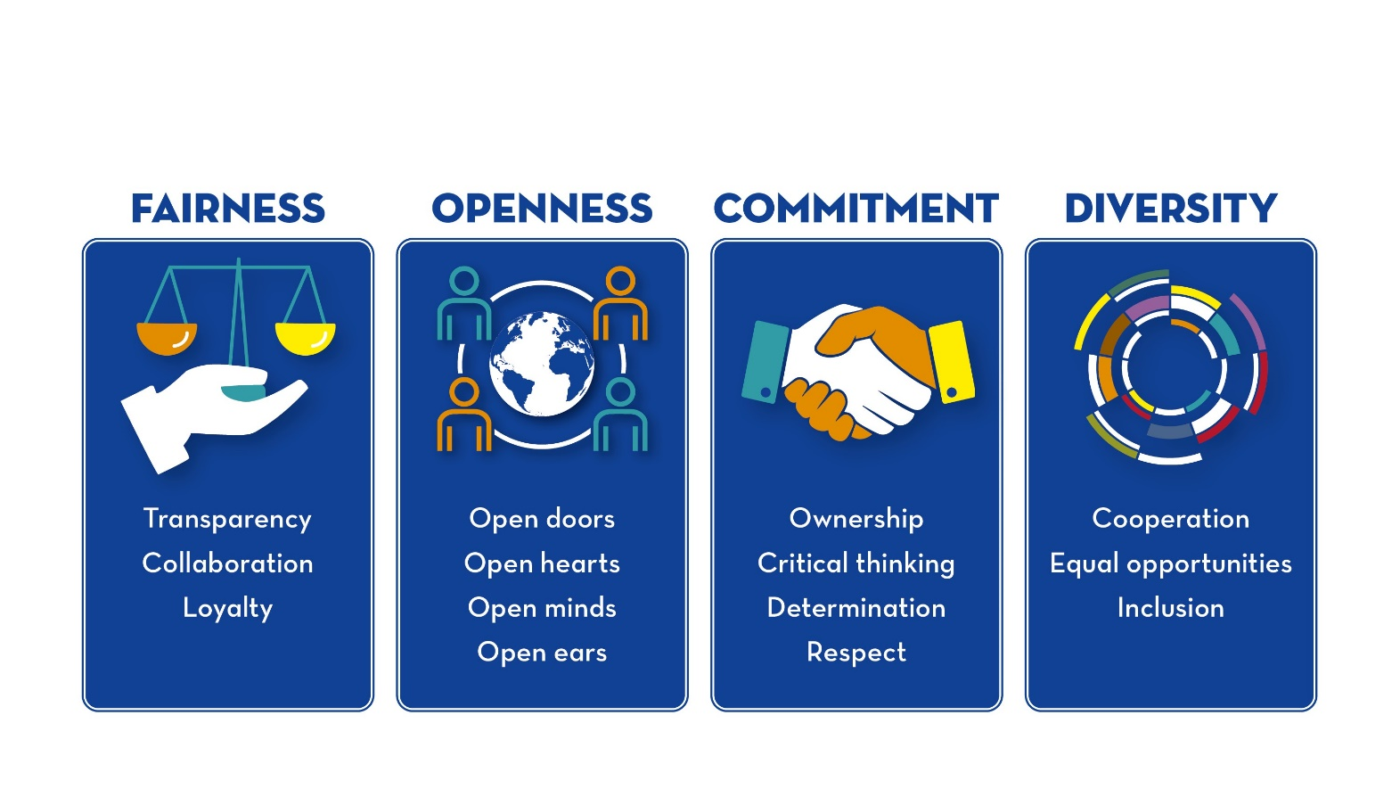
Richou | Science Coordination Meeting on the transition of JT-60SA to W | Remote | 26th of March 2024 | Page 20

