Slide 1
3rd joined TSVV10-TSVV11 meeting high beta, low s modelling challenge (even in absence of Energetic Particles)
C. Bourdelle
11/04/2024

Slide 2
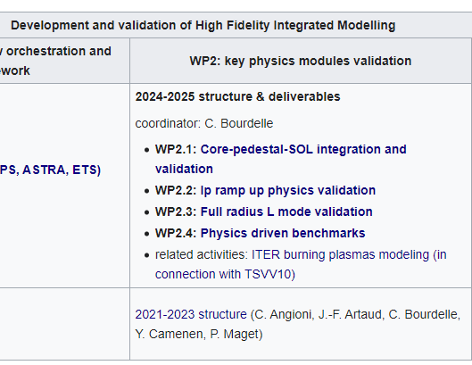
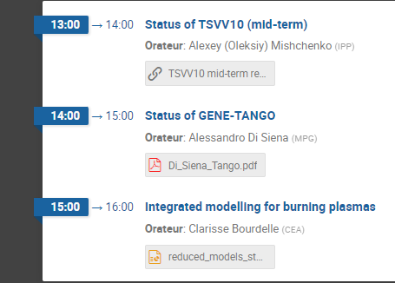
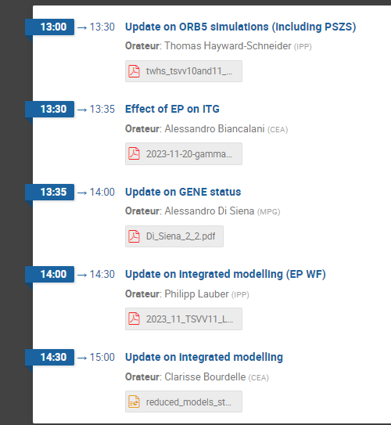
3rd joined TSVV10-TSVV11 meeting
You can find the previous meeting slides here
https://wiki.euro-fusion.org/wiki/TSVV-11
Sept 2023
Nov 2023

Slide 3
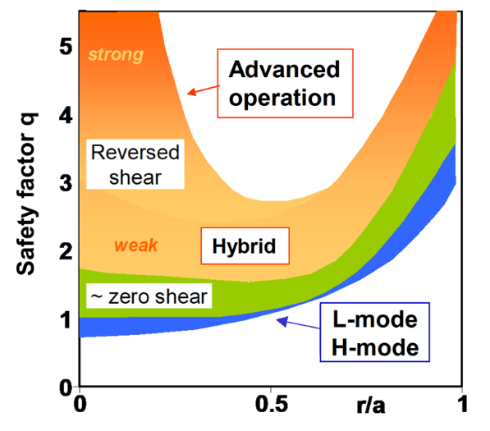
DEMO hybrid scenario assumed: low s and high beta, prone to KBM
 | EU-DEMO 2018 (PROCESS)
$R$ [m] $A$ | 9.00 3.1
$B_{0}$ [T] | 5.86
$q_{95}$ $δ_{95}$ $κ_{95}$ | 3.89 0.33 1.65
$I_{p}$ [MA] | 17.75
$P_{fus}$ [MW] | 2000
$P_{sep}$ [MW] | 170.4
$P_{LH}$ [MW] | 120.8
$H_{98}$ | 0.98
$β_{N}$ [% mT/MA] $Fusion Gain Q$ | 2.5 >40
$${P_{sep}B}/{q_{95}AR }$$ [MW T /m] | 9.2
Pulse length [sec] | 7200
H. Zohm EUROfusion Science Meeting, 8/3/2023, AAPS 2022
If KBM capable model, do expect strong KBM with such parameters

Slide 4
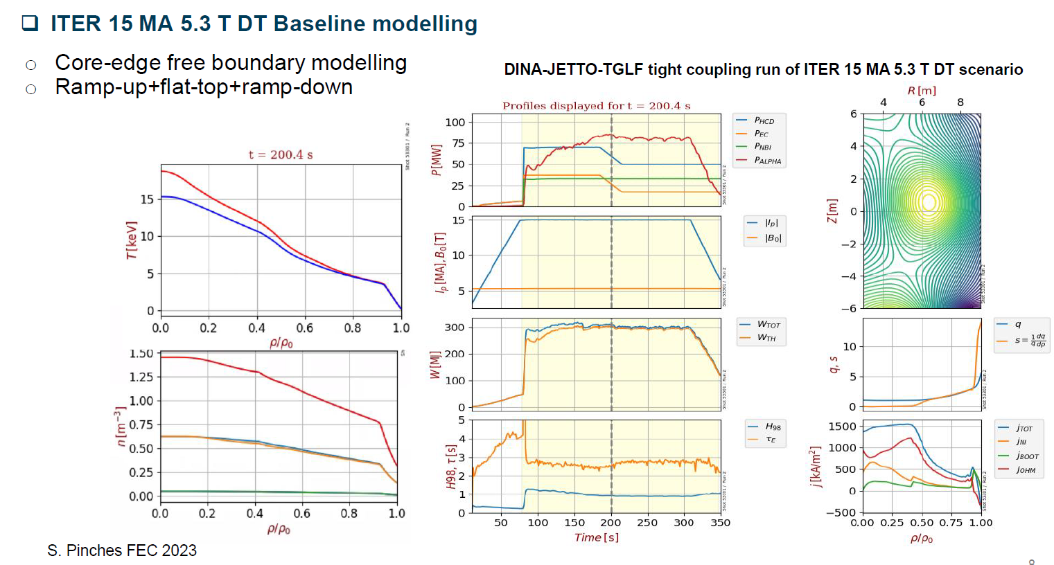
ITER Q=10 case
Often modelled with flat q, although it is a sawtoothing plasma, with very large ST period
If KBM capable model, do expect strong KBM with such parameters

Slide 5
Today: on high beta, low s modelling challenge (even in absence of Energetic Particles)
Towards burning plasma modelling, ITER Q=10, DEMO …
Need to explore the ability of electromagnetic reduced models such as TGLF to capture ITG-TEM and KBM
1st part, context:
DEMO/ITER scenario: DEMO hybrid hence low s and high beta, ITER Q=10 after ST relaxation also low s and high beta. Vicinity of KBM onset, is it a challenge for model as TGLF? (Clarisse Bourdelle 5 min)
ITER Q=10, GENE-TANGO, KBM on-set challenge (Alessandro Di Siena 5 min)
2nd part, way forward:
non-linear vs quasilinear gyrokinetic GKW modelling of high beta, low s cases (Yann Camenen 10 min)
TGLFsat2 vs GKW non-linear for high beta, low s (Anass Najlaoui 10 min)
nonlinear saturation in high beta low s cases (Fulvio Zonca 10 min)
ORB5 results overview of KBM cases (Alexey Mischenko 10 min)

