Slide 1
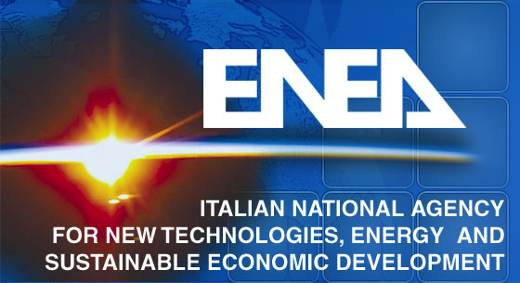
3rd joined TSVV10-TSVV11 meeting
March 20th, 2024
Nonlinear saturation of
KBM instabilities
Fulvio Zonca1,2, Liu Chen2,3,1, Matteo V. Falessi1 and Zhiyong Qiu2,1
1Center for Nonlinear Plasma Science and ENEA C.R. Frascati, 00044 Frascati, Italy
2IFTS and Dept. Physics, Zhejiang University, Hangzhou, 310027 P.R. China
3Dept. Physics and Astronomy, University of California Irvine, Irvine, CA, USA
Support from: EUROfusion projects ATEP and TSVV#10
Frascati - April 11th, 2024

Slide 2
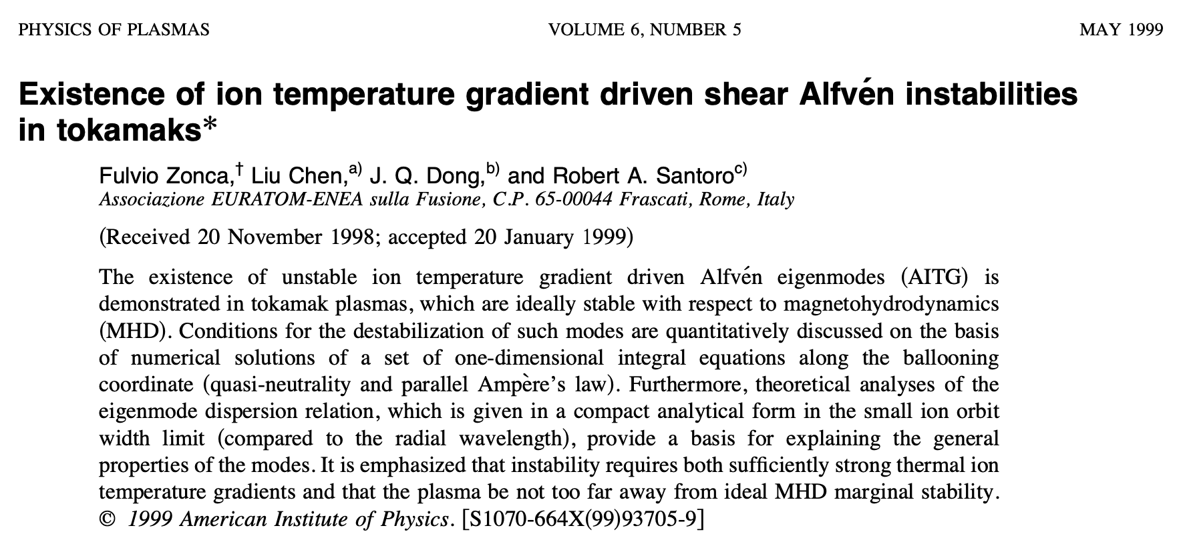
Background-I
Kinetic Ballooning modes and Alfvén ITG
Frascati - April 11th, 2024

Slide 3
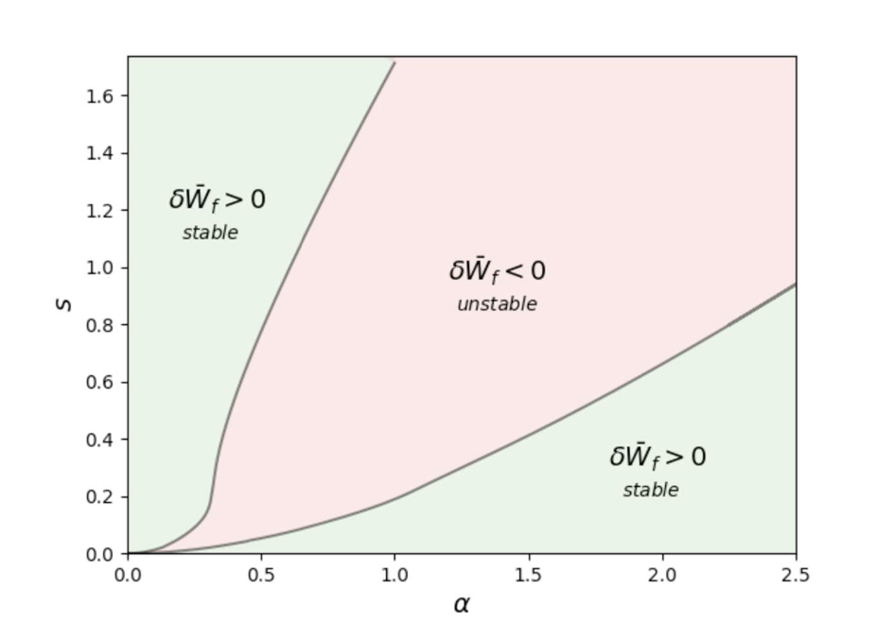
Background-II
Kinetic Ballooning modes and Alfvén ITG
Interesting new physics
emerge when BAE and
KBM are nearly degenerate
Dissipative and reactive
Instabilities
[R.R. Ma et al 2023]
KBM: diamagnetic
stabilization
Frascati - April 11th, 2024

Slide 4
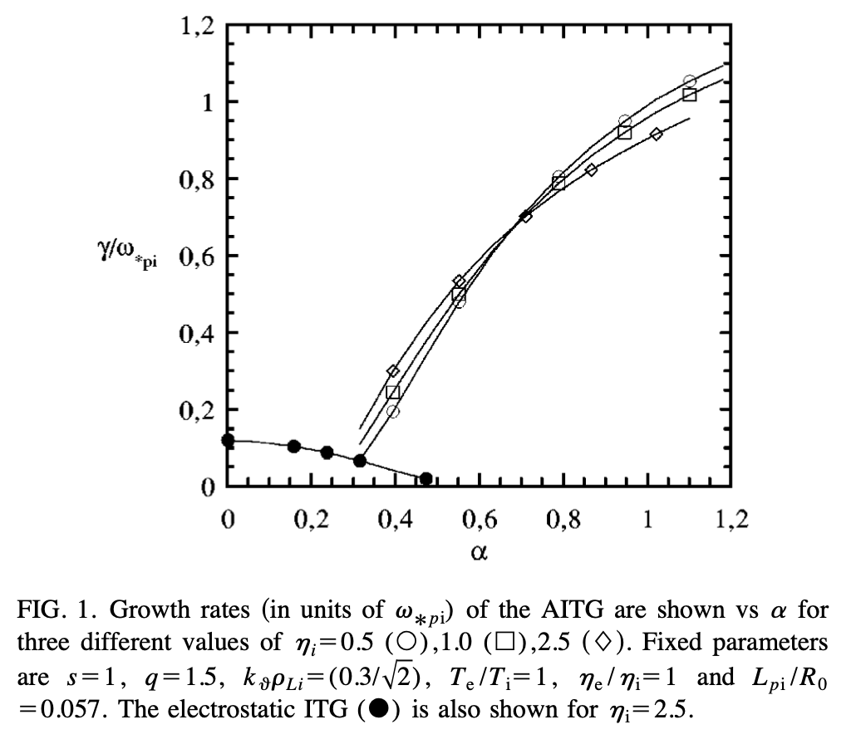
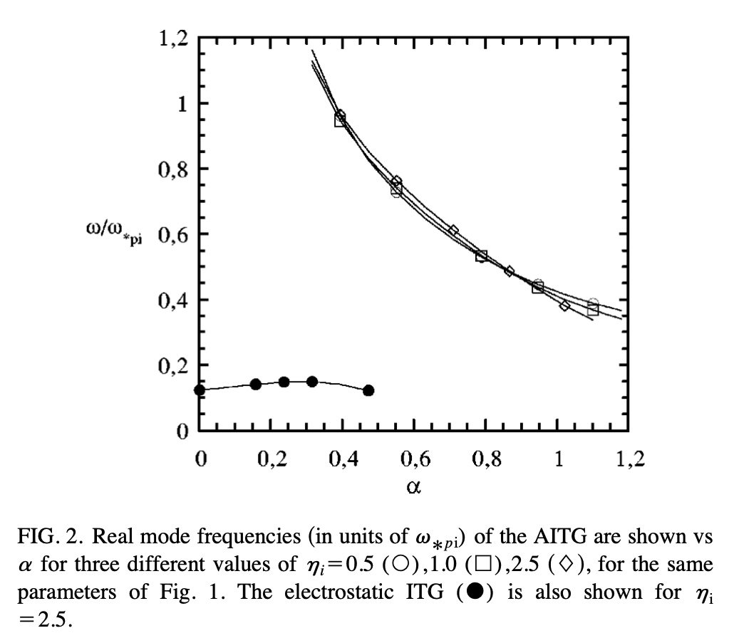
Background-III
Kinetic Ballooning modes and Alfvén ITG
➔Kinetic thermal ion (KTI) gap (Chen&Zonca NF 2007)
➔Crucial kinetic compression effect to break the
Alfvénic state
Frascati - April 11th, 2024

Slide 5
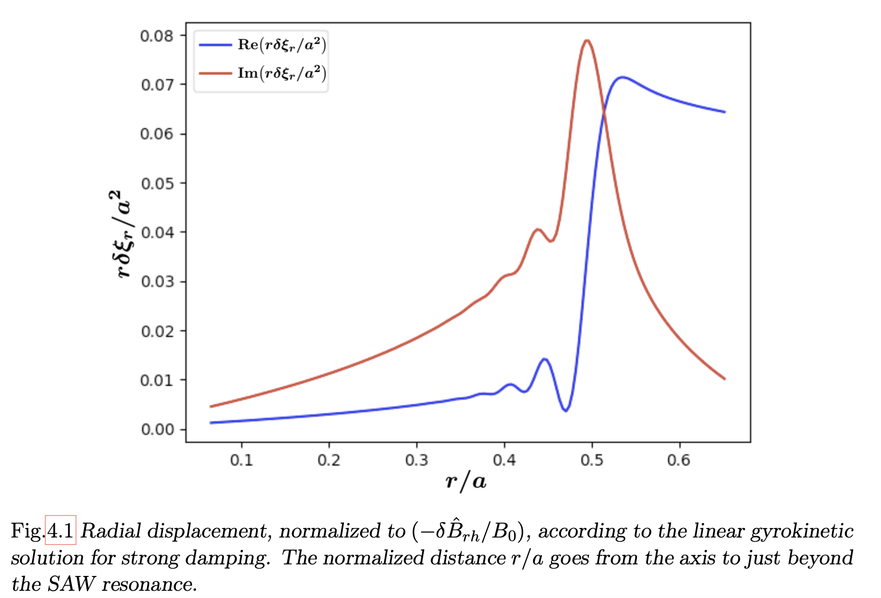
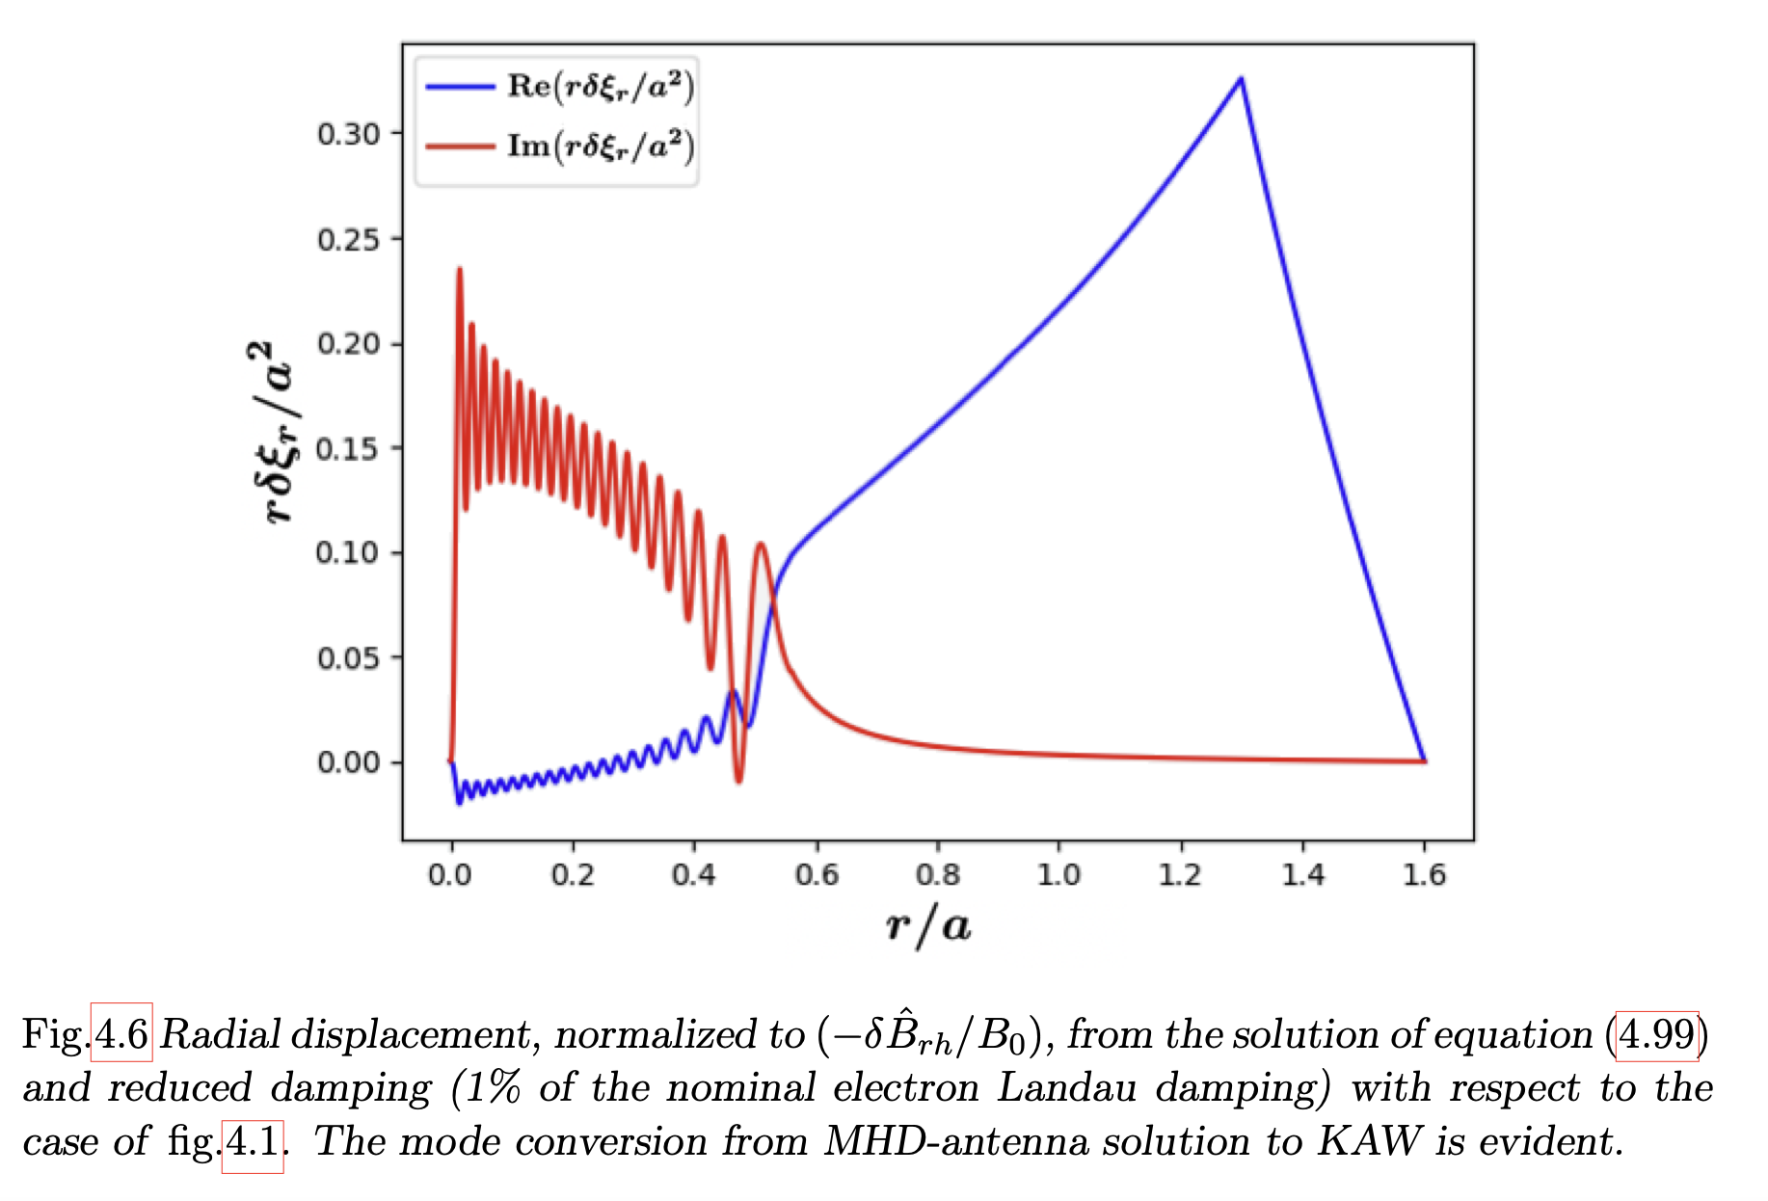
Background-IV
Nonlocal phenomena (mode width vs profile length)
➔ naturally connected with steep gradient/low shear
➔ focus of this meeting
Nonlinear physics and Alfvén waves
➔Natural cross scale coupling due to continuous
spectrum and mode conversion to KAW
➔Crucial kinetic compression effect to break the
Alfvénic state (cf. later)
Frascati - April 11th, 2024

Slide 6
Nonlinear wave-wave interactions
Route to NL physics: typically 3- or 4-wave interactions
reflecting existence of Alfvénic State [Alfvén42, Walén44]:
SAW can exist in uniform, incompressible MHD plasmas
independently of their amplitude
Fundamental processes (of comparable strength [Z.Qiu 19]):
➔ parametric decay (3-wave) [Sagdeev&Galeev69]
➔ NL SAW continuum mod. (3-wave) [3D Biancalani 10 ]
➔ modulational instability (4-wave; zonal flows/fields)
[L. Chen et al. 00 – PoP 2024] (spontaneous/forced)
➔ cross-scale couplings by direct wave-wave interaction
(4-wave scattering) [L. Chen et al NF 22 - 23]
Importance of equilibrium geometry, non-uniformity, kinetic analyses ➔ Global NL e.m. GK approach is necessary
Frascati - April 11th, 2024

Slide 7
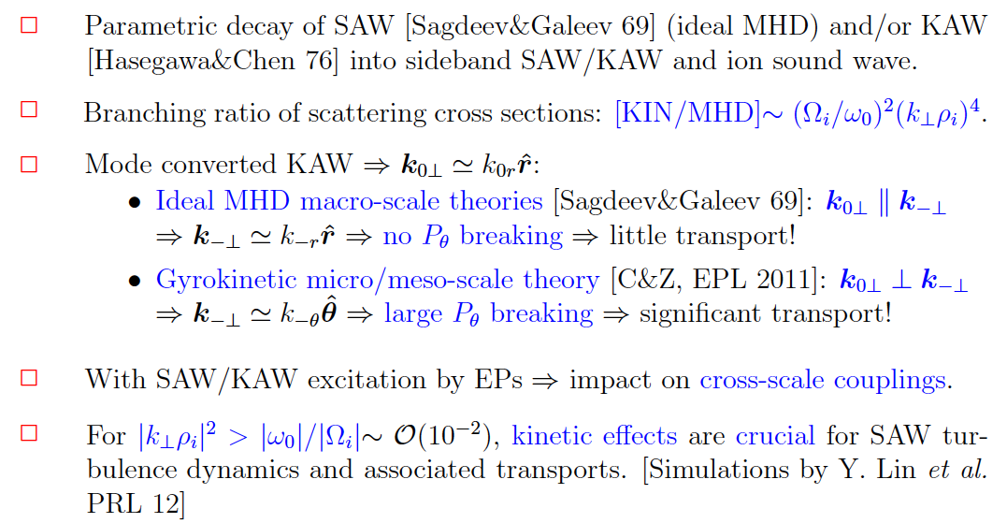
Parametric decay
[Qiu et al PRL18, extension to GAM]
[Chen et al POP22]: importance of nonuniformity; parity breaking
momentum transport
Frascati - April 11th, 2024

Slide 8
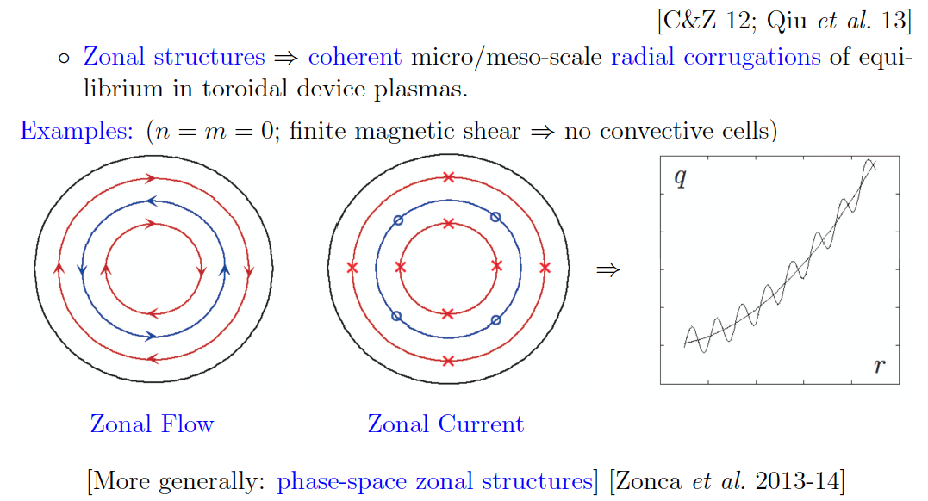
Modulational instability - I
Zonal Structures by Toroidal Alfvén Eigenmodes
May 18th 2022

Slide 9
Modulational instability - II
[Qiu et al PRL18, PST18, NF19a,b, PPCF20]
[Qiu et al POP16, NF17]: micro-scale (fine) TAE structures enhance NL
coupling and reduce TAE saturation level;
➔ thermal plasma vs EP have different roles in spontaneous vs
beat driven generation of zonal structures consistent with
[Todo et al 10; Wang et al 17] [Chen, Qiu, Zonca, PoP 24]
Frascati - April 11th, 2024

Slide 10
TAE scattering by ambient DW
[L. Chen et al NF 22]
➔ For typical reactor parameters
DW scattering can significantly reduce or even suppress TAE/AE
Effect of Ω_{+/-} of KAW sidebands leads to significant anomalous
e-heating comparable to collisional e-heating
Frascati - April 11th, 2024

Slide 11
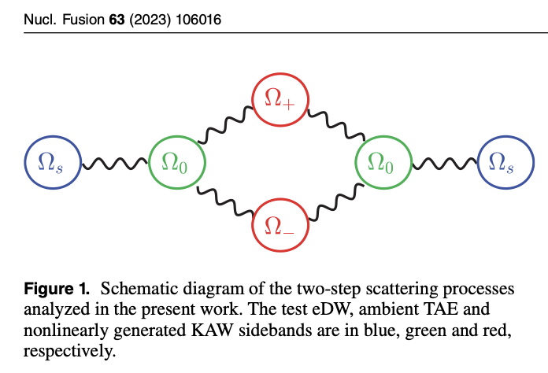
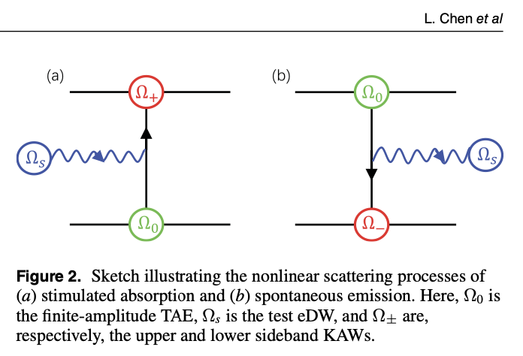
DW scattering by TAE
[L. Chen et al NF 23]
TAE induced scattering is inefficient in its direct regulation of DW
This suggests indirect coupling mediated by ZFs may be dominant effect in turbulent transport regulation
Assessment of properties of the Zonal State [M. Falessi et al NJP 2023]
Frascati - April 11th, 2024

Slide 12
Paradigm for NL KBM studies
Independently test saturation mechanisms
Single n KBM saturation, switching off n=0 ZFs
Single n KBM saturation, including n=0 ZFs
Study the effect of PSZS (NL equilibrium distortion)
Explore nonlocality due to competition of characteristic fluctuation scale vs equilibrium
Study the effect of full ZS (NL equilibrium distortion)
Explore nonlocality including turbulence spreading effect and possible soliton formation [Chen et al PPCF to be published]
Multi n KBM saturation, including n=0 ZFs
Explore the effect of NL spectral transfers
Frascati - April 11th, 2024

Slide 13
Conclusions
Applications to realistic cases of practical interest (ITER, CFETR, BEST, DTT, etc.) are in progress [EUROfusion projects ATEP/TSVV#10 (Lauber/Mishchenko)]
Thank you for your attention!
Your questions are welcome
Main references are available at the CNPS site:
https://www.afs.enea.it/zonca/CNPS/
Daejeon - March 20th, 2024

