Slide 1
Measurement of High-n Rydberg-like Transitions for the Study of Heavy Impurities
Colin Swee¹, Benedikt Geiger¹, Thilo Romba², Thomas Wegner², Oliver Ford², Peter Poloskei², Martin O’Mullane³
¹ University of Wisconsin – Madison, Madison WI
² Max Planck Institute for Plasma Physics, Greifswald Germany
³University of Strathclyde, Glasgow Scotland

Slide 2
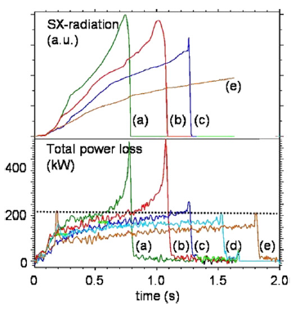
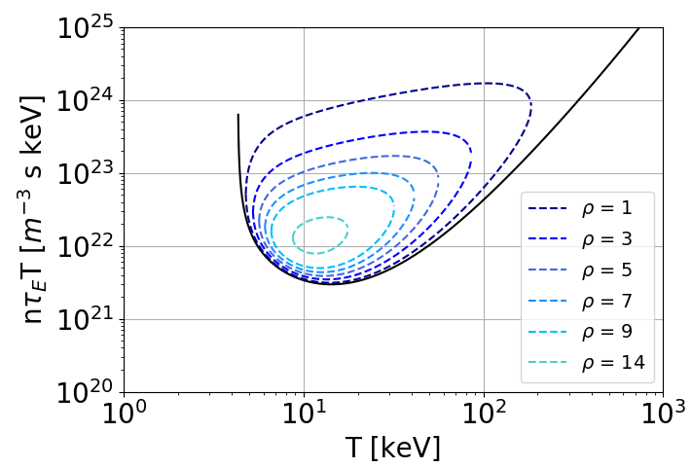
Evaluation of Impurity Transport Is Important for Designing Operational Schemes
Motivation: Accumulation of impurities must be avoided to prevent fuel dilution and radiative losses
Heavy impurities will be present in first wall materials
Previous impurity transport studies at W7X:
Laser Blow off (LBO) impurity injections:
Vacuum ultra-violet measurements (line integrated)
S.S. Impurity density profiles from Charge Exchange (CX) Measurements (C6+)
Desire to validate theoretical understanding of turbulent and neoclassical impurity fluxes
CXRS analysis paired with other standard diagnostics provides a simple yet effective method for impurity transport measurement
R. Burhenn et al 2009 Nucl. Fusion 49 065005
CX measured Carbon Density Profiles
T. Romba et al 2023 Nucl. Fusion 63 076023

Slide 3
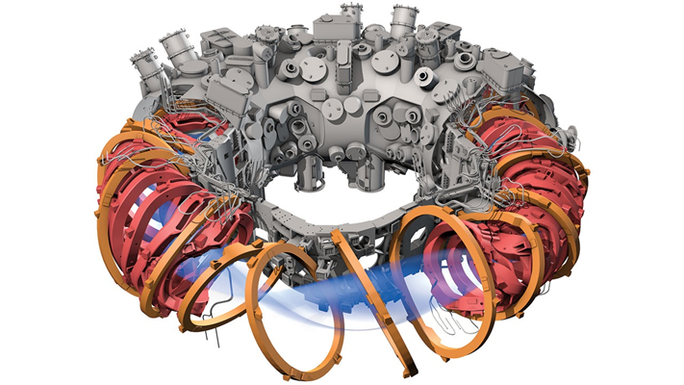
Outline
Introduction and Motivation
High speed charge exchange spectroscopy system at W7-X
High-n Rydberg transitions for measurement of impurities
Bayesian Inference of Impurity Transport
Inference uncertainty improvement by adding additional diagnostics
Conclusion
IPP, ADAPTED BY C. BICKEL/SCIENCE

Slide 4
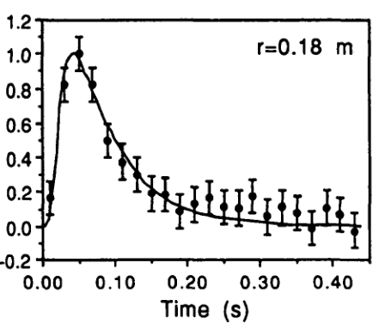
Charge Exchange Recombination Spectroscopy Can Be Used For Impurity Studies
Need good spatial resolution & high time resolution
W7-X has diagnostics for measuring impurities:
High Efficiency X-ray Overview Spectrometer (HEXOS): high time resolution, low spatial resolution
ITER-like Spectrometer (ILS) CX system: low time resolution, high spatial resolution
A new CXRS system has been installed to provide both high time and spatial resolution measurements
High speed -> need high light throughput
Previous study on CX emission of highly ionized Fe used visible emissions Fe 23+ charge state (Stratton 1991)
Charge exchange with beam neutral
B.C. Stratton et al 1991 Nucl. Fusion 31 171
$$γ$$
-
$$n∼q^{\frac{3}{4}}$$
H⁰⁺
-
-
Active Fe XXIV Emission at 500.1 nm
Fe²³⁺
Fe²⁴⁺
Fe²³⁺
H¹⁺

Slide 5
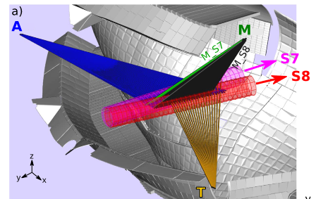
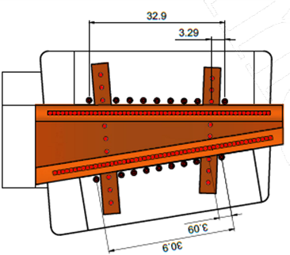
Optical Head and Beam Viewing Geometry at W7-X
Optical port views two neutral beams injection paths
Fine coverage of length of beam by $400 μm$ optical fibers
New $600 μm$ diameter fibers installed for high photon throughput
$$600 μm$$
Diameter
$$400 μm$$
Diameter
Ford, Rev. Sci. Instrum. 91, 023507 (2020)

Slide 6
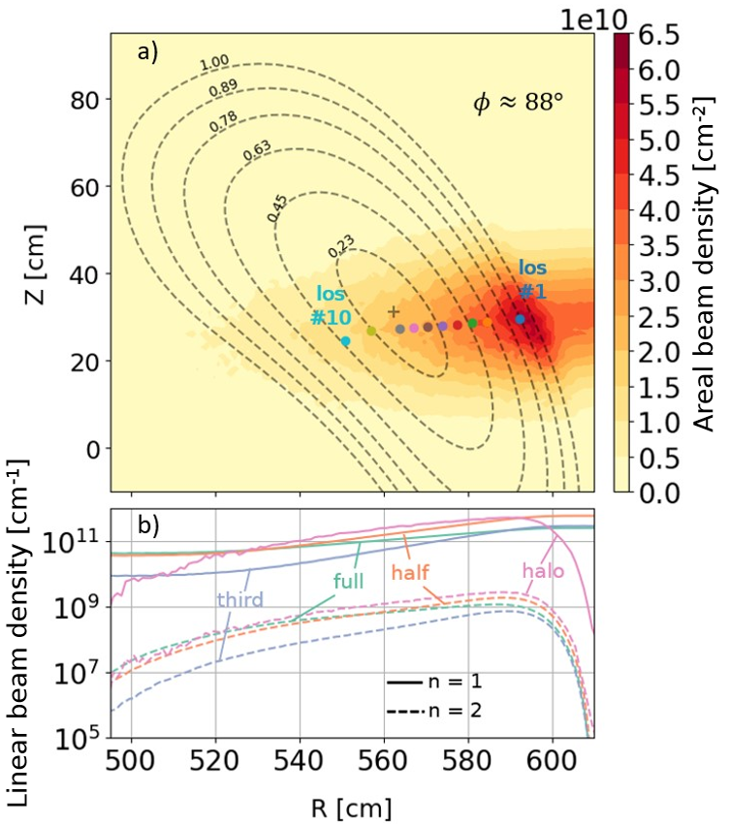
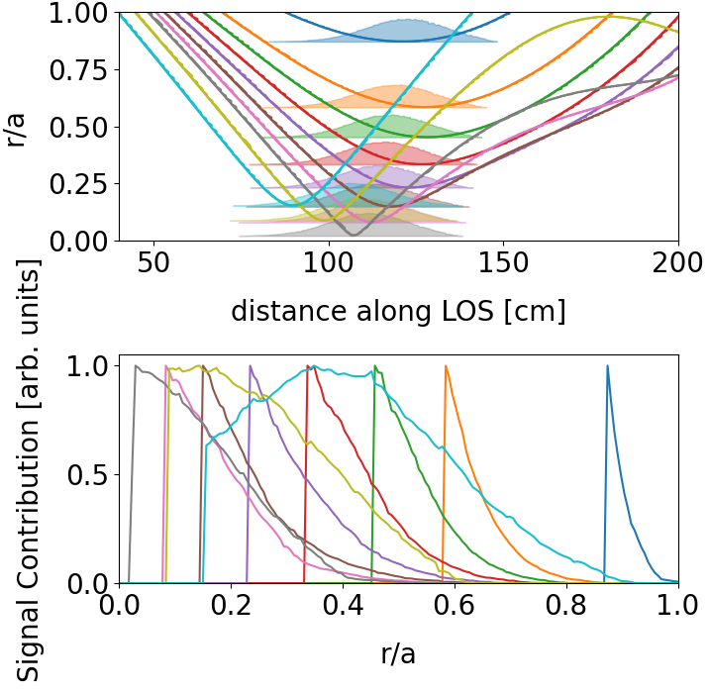
Spatial resolution and LOS geometry
10 channels span radial extent of device
Better spatial localization for outer channels
Easy reassignment of spectrometer lines of sight via patch panel outside of torus hall
High-mirror configuration
8
9
10
LOS #1
7
6
2
4
5
3

Slide 7
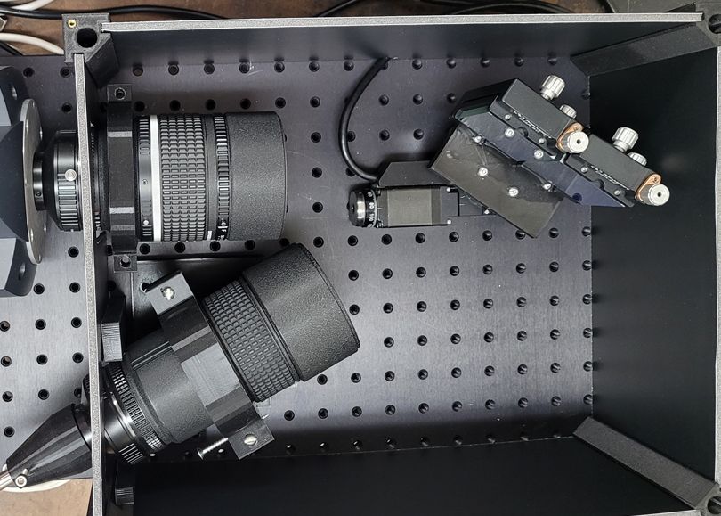
A New Fast CXRS Diagnostic Has Been Developed
New custom made visible spectrometers have been designed, constructed, and installed at W7-X for impurity transport studies
Czerny Turner layout
3D printed, form fitting lens holders
Designed with high photon throughput in mind to operate at > 1 kHz
f/2.8 collection lens (“off the shelf” components) (Nikkor 180mm, adjustable aperture, focus…)

Slide 8
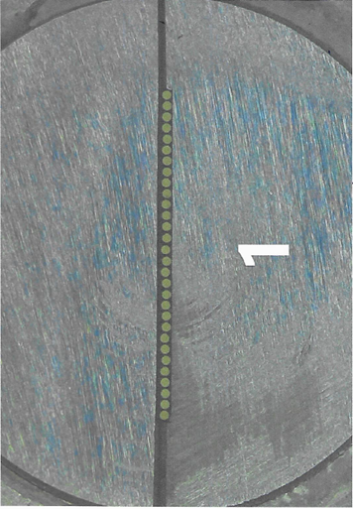
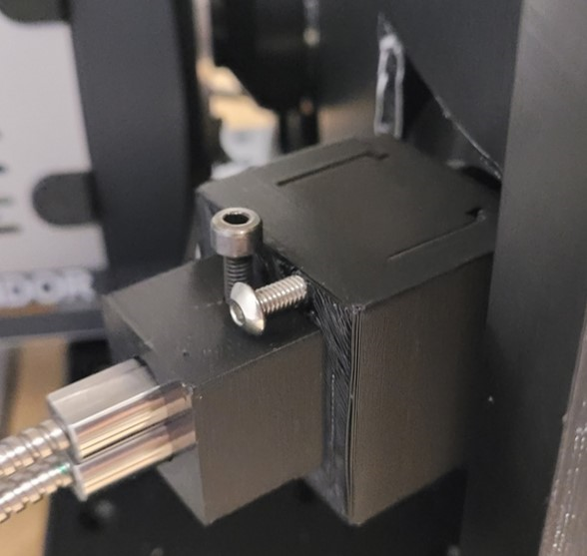
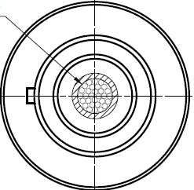
Entrance slit design
Custom round-to-linear fiber bundle assemblies have been used to maximize collected light
Fiber cores fused together at round end to prevent packing losses
Individual fibers unwound into linear arrangement in place of an entrance slit
Cladding machined to allow for stacking of fibers at spectrometer entrance (dual channel)
$600$ $μm$
100 $μm$

Slide 9
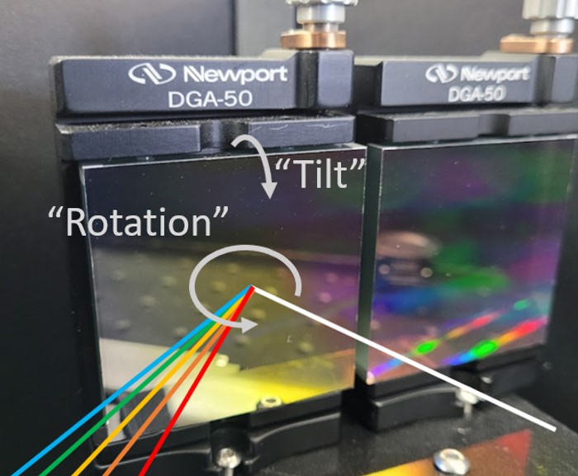
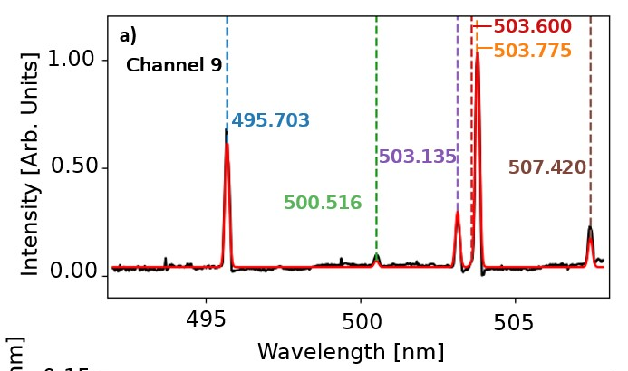
Two 50mm Gratings Used in Place of 100 mm grating
Two “off the shelf”, low cost, gratings utilized to maximize light footprint
Unique procedure for coplanar alignment of independent gratings: 1) Using calibration lamp, record vertical position on CCD of several line emissions
2) Least squares optimizer used to infer grating orientation
3) Adjust grating to be perpendicular to optical axis
4) Repeat for second grating
5) Horizontally align images from gratings
CCD
$$y_{1}$$
grating
$$λ_{1}$$
CCD
$$y_{2}$$
grating
$$λ_{2}$$

Slide 10
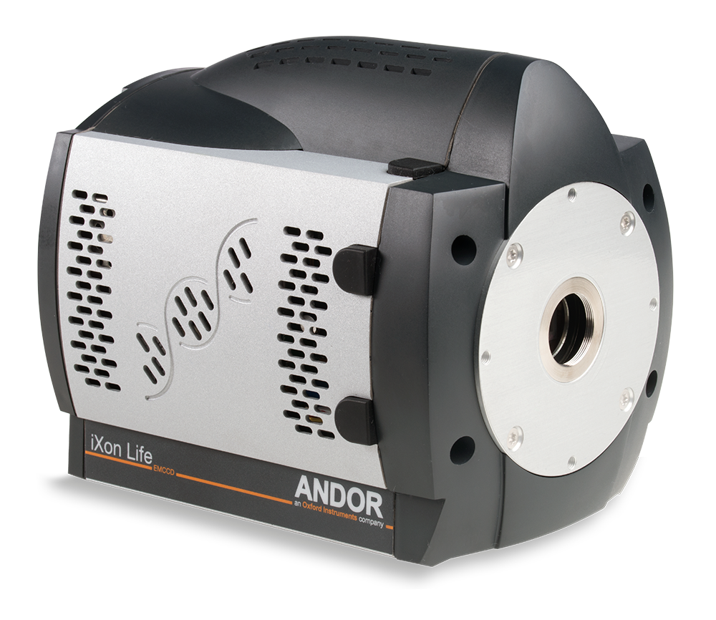
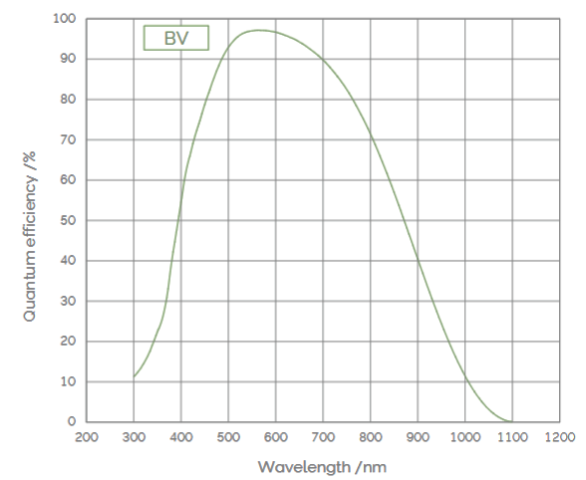
EMCCD Detector provides excellent photon sensitivity
Detector: Andor iXON 897 EMCCD
Excellent QE in the visible range
Customizable exposure times
Frame rates can be additionally boosted by defining regions of interest & performing vertical binning
Continuous operation at $∼1$ kHz
$∼$66% duty cycle operation available at $∼10$ kHz by using “fast kinetics” mode
andor.oxinst.com

Slide 11
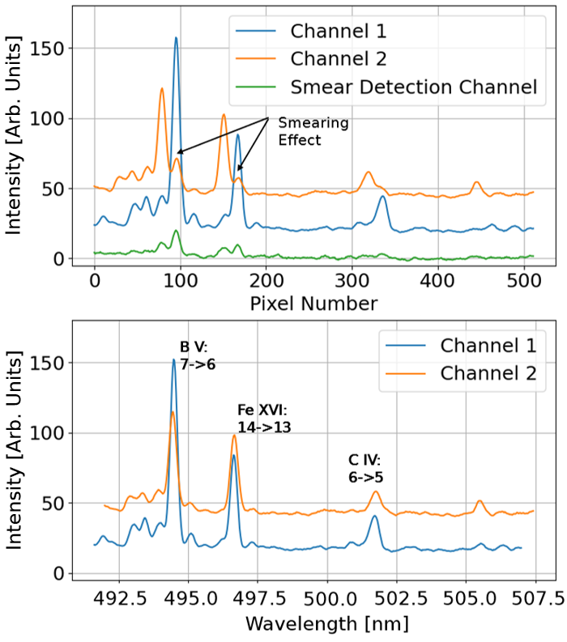
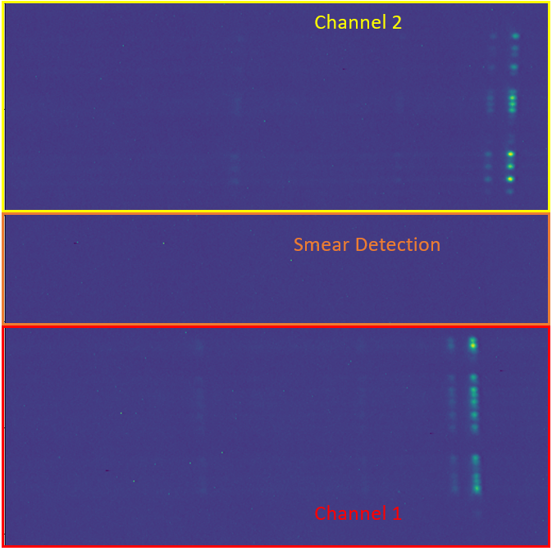
Stacked Fiber Bundles Allow for Dual Channel Operation
EMCCD area split into 3 vertically binned regions of interest:
2 channels for signal readout
3rd central channel for smear detection and correction
“Smearing” effects can occur when the frame rate is comparable to the vertical pixel shift rate in between frames
Unique smear correction algorithm developed:
$$I_{1}$$
$$S_{2,corrected}=S_{2}−n_{2}S_{1}\left(\frac{I_{sm}}{n_{sm}}\right){\left(\frac{I_{1}}{n_{1}}\right)}^{−1}$$
$$S_{2}$$
$$I_{sm}$$
$$S_{1}$$
Bonus slide available

Slide 12
Outline
Introduction and Motivation
High speed charge exchange spectroscopy system at W7-X
High-n Rydberg transitions for measurement of impurities
Bayesian Inference of Impurity Transport
Inference uncertainty improvement by adding additional diagnostics
Conclusion
IPP, ADAPTED BY C. BICKEL/SCIENCE

Slide 13
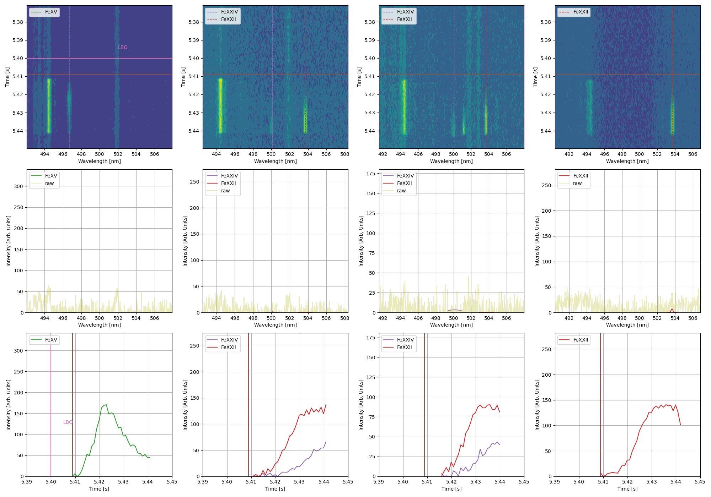
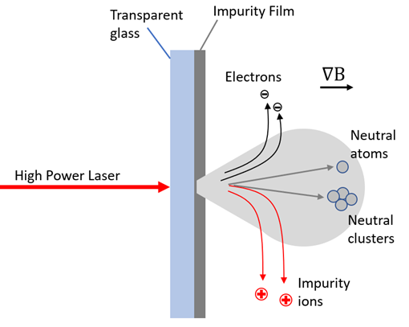
Iron CX Emission Can Be Seen Following LBO
Laser Blow-off injections were performed to introduce iron impurities
First set of data successfully measured Fe XXIV line at 500.1 nm following LBO injection!
Additional lines are seen as well…

Slide 14
Line Transitions Identified as Rydberg-Like
Three of the observed line emissions can be attributed to Rydberg-like transitions between high-n levels
Emission wavelengths can be observed using relativistic Rydberg equation [Haug, E.G. (2020) J. of Modern Phys., 11, 528-534.]:
$q=14, n_{1}=13, n_{2}=14 →λ=496.68$ nm
$q=21, n_{1}=17, n_{2}=18 →λ=503.5$ nm
$q=23, n_{1}=18, n_{2}=17 →λ=499.91$ nm
$$\frac{1}{n_{air}λ_{air}}= \frac{m_{e}c}{h}\left(\frac{1}{\sqrt{1−{\left(q+1\right)}^{2}{α^{2}}/{n_{2}^{2}}}} −\frac{1}{\sqrt{1−{\left(q+1\right)}^{2}{α^{2}}/{n_{1}^{2}}}}\right)$$

Slide 15
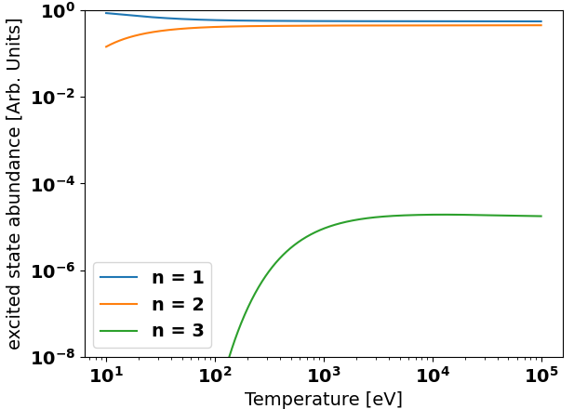
Rydberg-Like Transitions Occur Only After CX
Only CX reactions are capable to appreciably populating high energy levels
Impact excitation is excessively unlikely to excite impurity ions beyond 2-3 energy levels above ground
LBO injections into NBI modulated plasmas confirm lack of passive signal
$q=21, n_{1}=17, n_{2}=18 →λ=503.5$ nm
$q=23, n_{1}=18, n_{2}=17 →λ=499.91$ nm
Experimental program: 20221201.38
ColRadPy Simulation of S.S. Energy Level Balance
Fe²³⁺

Slide 16
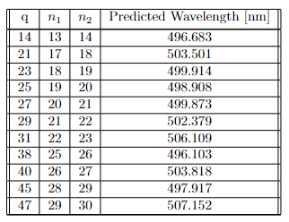
Observation of Impurity Lines for Other Species
Rydberg-like emissions depend only on the effective charge of the nucleus
Wavelength prediction valid for wide range of heavy impurities
Useful tool for studies on a wide range of impurity species

Slide 17
Outline
Introduction and Motivation
High speed charge exchange spectroscopy system at W7-X
High-n Rydberg transitions for measurement of impurities
Bayesian Inference of Impurity Transport
Inference uncertainty improvement by adding additional diagnostics
Conclusion
IPP, ADAPTED BY C. BICKEL/SCIENCE

Slide 18
pySTRAHL Can Simulate Impurity Densities Following LBO
pySTRAHL is a code that calculates the evolution of impurity densities by solving the impurity transport equation:
Transport of impurity $I$ (charge state Z)
Sources/sinks (ionization, recombination)
LBO
Inputs: Ionization/recombination rates (from kinetic profiles), impurity sourcing function, diffusion & convection profiles
Outputs: Density of impurities as a function of time, position, charge state

Slide 19
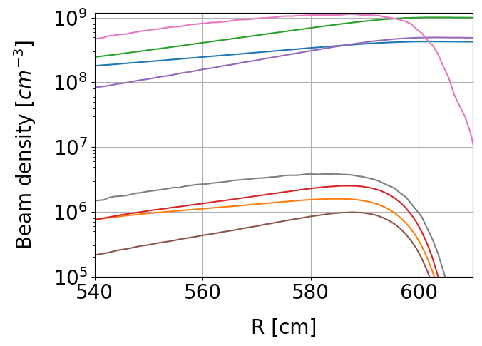
pyFIDASIM Simulates the Neutral Beam Injection
Monte Carlo code which simulates beam neutrals in background plasma
Uses a collisional-radiative model to calculate beam attenuation and population of neutral excited states
Inputs: Kinetic profiles, beam parameters, excitation & deexcitation rates, flux surface geometry
Outputs: Beam density vs. position, energy component, & excitation level, translation between 3D sightline geometry and 1D grid used in pySTRAHL
Halo – n=1
Half – n=1
Full – n=1
Third – n=1
Halo – n=2
Half – n=2
Full – n=2
Third – n=2

Slide 20
Charge Exchange Measurements Can Be Forward Modeled
Using outputs from pySTRAHL and pyFIDASIM, CX measurements can be simulated:
$$ε_{LOS}=\int{n_{Z}\sum_{n}{\left(n_{0,n,full}\left\langle σ_{n,full}ν\right\rangle +n_{0,n,half}\left\langle σ_{n,half}ν\right\rangle +n_{0,n,third}\left\langle σ_{n,third}ν\right\rangle +n_{0,n,halo}\left\langle σ_{n,halo}ν\right\rangle \right)dl}}$$
Assumption: First excited state from full and half energy components dominate signal
$$ε_{LOS}≈\int{n_{z}}\left(n_{0,n=1,full}\left\langle σ_{n=1,full}ν\right\rangle +n_{0,n=1,half}\left\langle σ_{n=1,half}ν\right\rangle \right)dl$$
From pySTRAHL
$v_{beam}≫v_{th}→ \left\langle σv\right\rangle ≈σv=$ const.
From pyFIDASIM
$$ε_{LOS}∝\int{n_{z}}\left(n_{0,n=1,full}+αn_{0,n=1,half}\right)dl$$

Slide 21
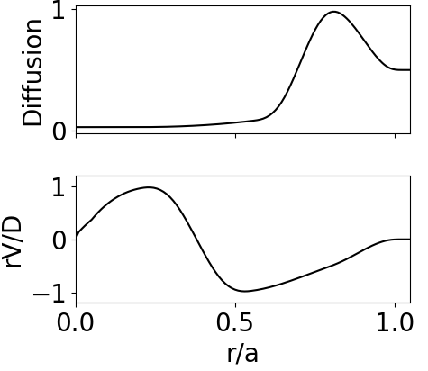
Modeling of Impurity Transport Using pySTRAHL
Forward model from pySTRAHL + pyFIDASIM
Diffusion, rV/D parametrized by 3 movable spline knots
-> 12 free parameters
Priors
1) Impurities should not be significantly peaked or hollow (constrains |𝑟𝑉/𝐷|to be of order 1)
2) Diffusion bound between classical & Bohm diffusion models
3) Additional priors enforce knot point minimum distance, monotonicity
Likelihood: Standard Gaussian likelihood, $σ$ set by measurement uncertainty

Slide 22
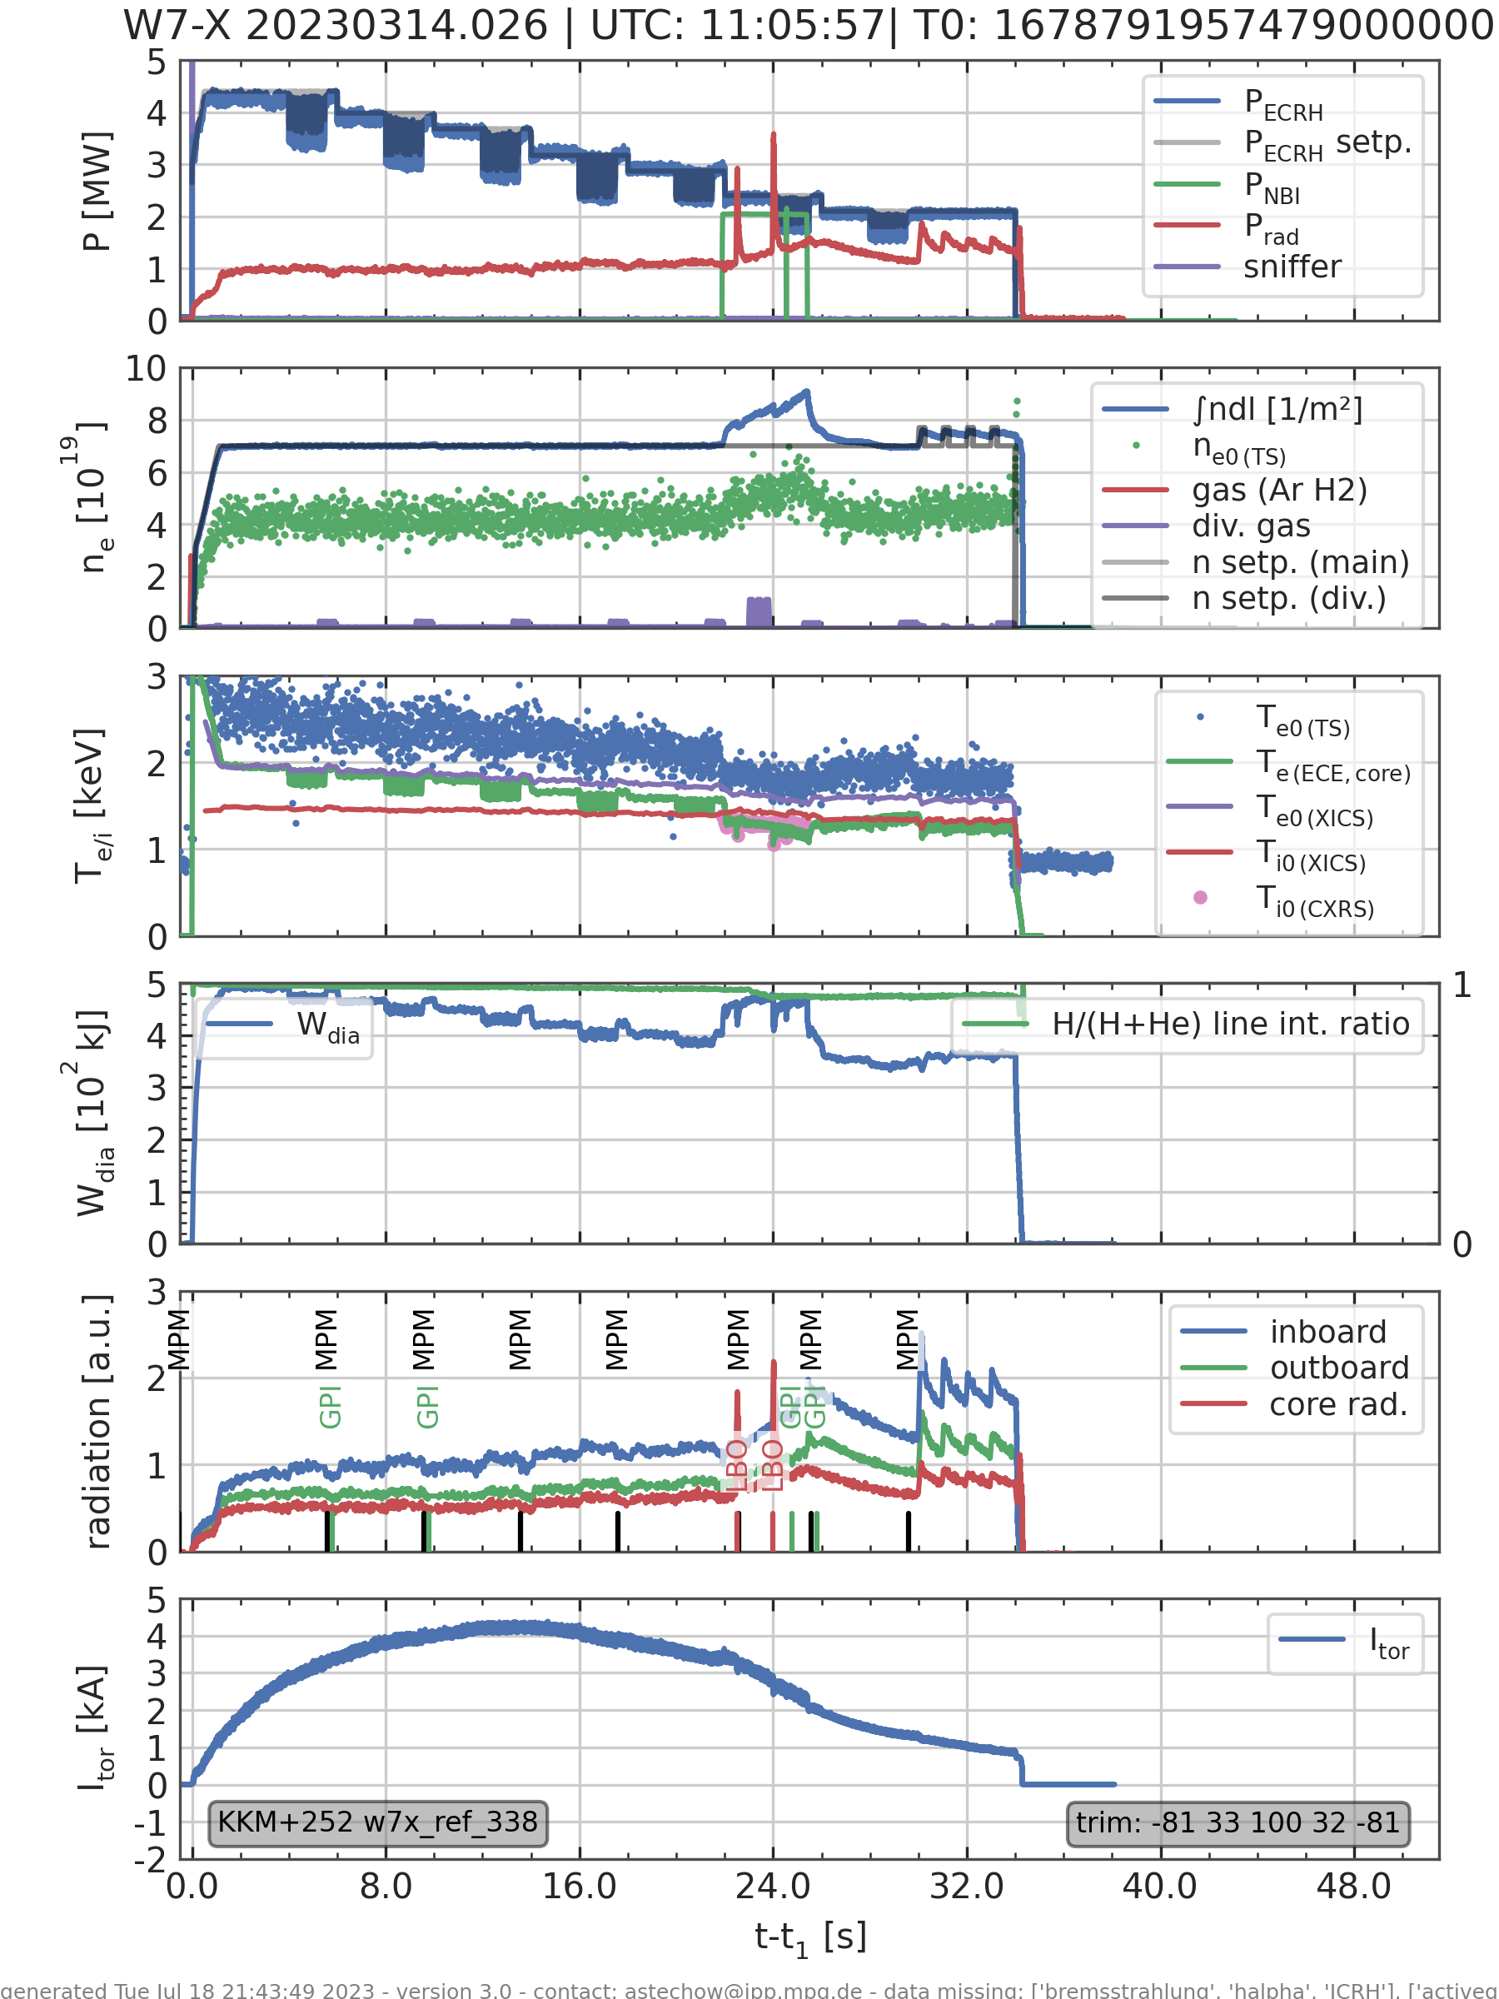
Impurity Injection Experiments Where Carried Out at W7-X
Impurity injection experiment carried out on 3/14/2023
“High-mirror” configuration
~2.5 MW ECRH, 2MW NBI heating
LBO injection at 22.5 seconds
Kinetic profiles obtained via Thomson scattering & CXRS on C⁶⁺

Slide 23
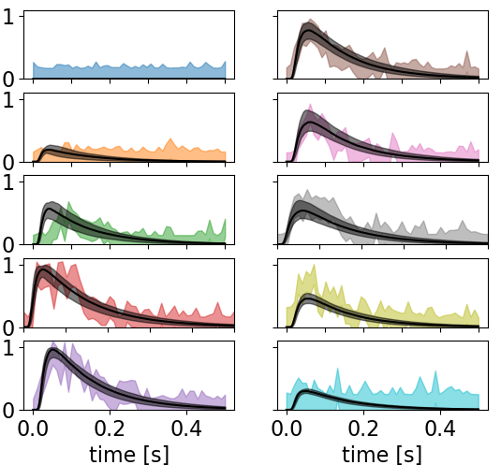
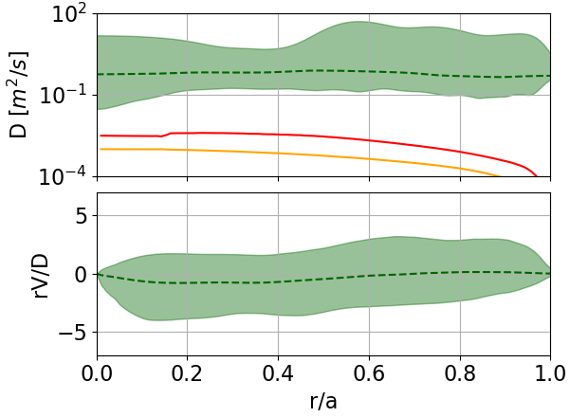
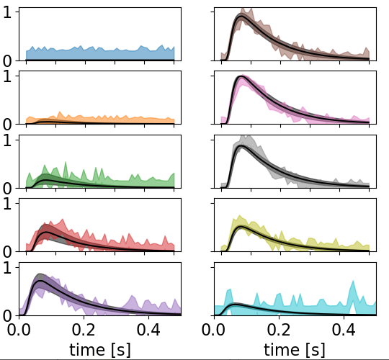
Analysis Using Relatively Calibrated CXRS Can Rule Out Neoclassical Transport
Model can reproduce measured CXRS signals well
Some disagreement remains at edge localized signals, inboard signals
Edge localized: more susceptible to local temperature variations
Inboard signals: known benchmarking issues with pyFIDASIM calculated attenuation on inboard side
Analysis of CXRS signals alone enough to reproduce result of anomalous diffusion
Fe XXII
LOS #1
LOS #6
LOS #2
LOS #7
LOS #3
LOS #8
LOS #4
LOS #9
LOS #5
LOS #10
$$+2σ$$
Median sample
$$-2σ$$
Fe XXIV
$$D_{neo} −Fe^{10+}$$
LOS #1
LOS #6
$$D_{neo} −Fe^{25+}$$
LOS #2
LOS #7
$$+2σ$$
LOS #3
LOS #8
Median sample
$$-2σ$$
LOS #4
LOS #9
LOS #5
LOS #10

Slide 24
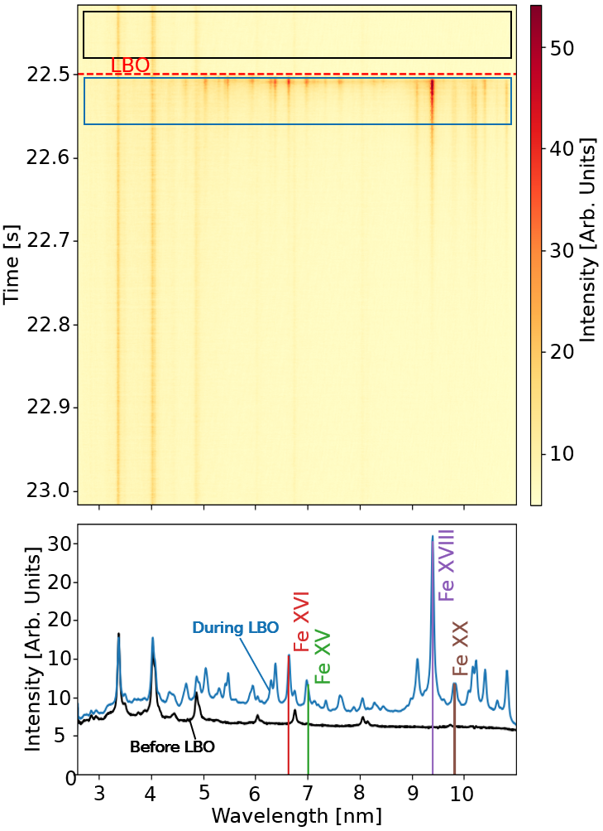
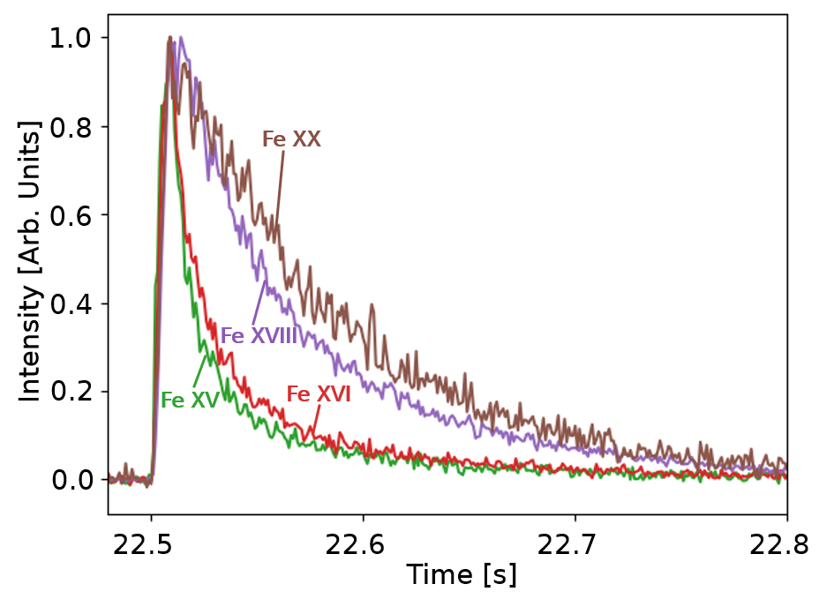
The High Efficiency X-ray Overview Spectrometer (HEXOS)
X-Ray Emissions can be observed using the High Efficiency X-ray Overview Spectrometer (HEXOS) [Biel, Rev. Sci. Instrum. 77, 10F305 (2006)]
Signals can be forward modeled using the pySTRAHL framework:
$$ε_{Z,λ}\left(t\right)= \int{n_{z}\left(\frac{r}{a}, t\right)n_{e}\left(\frac{r}{a}\right)PEC\left(\frac{r}{a}\right) dl }$$

Slide 25
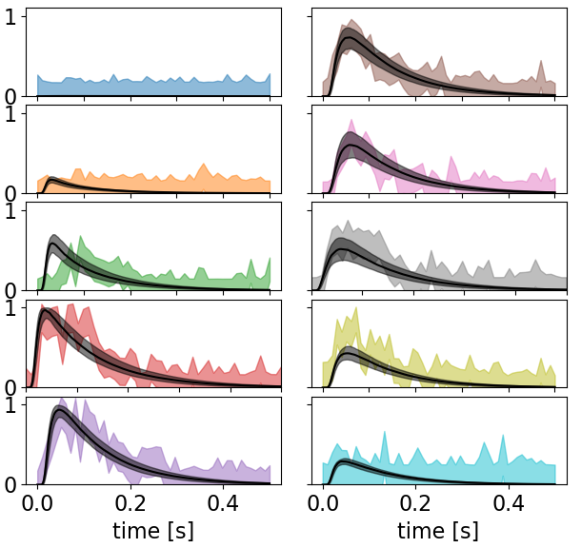
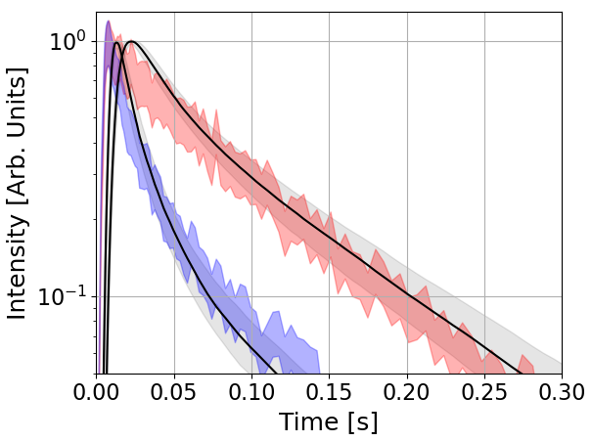
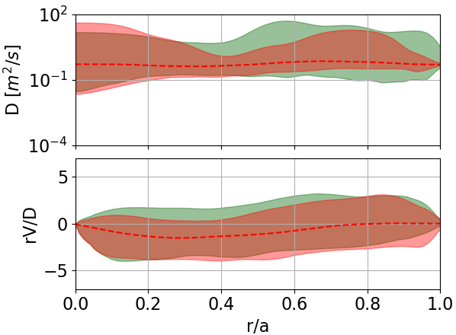
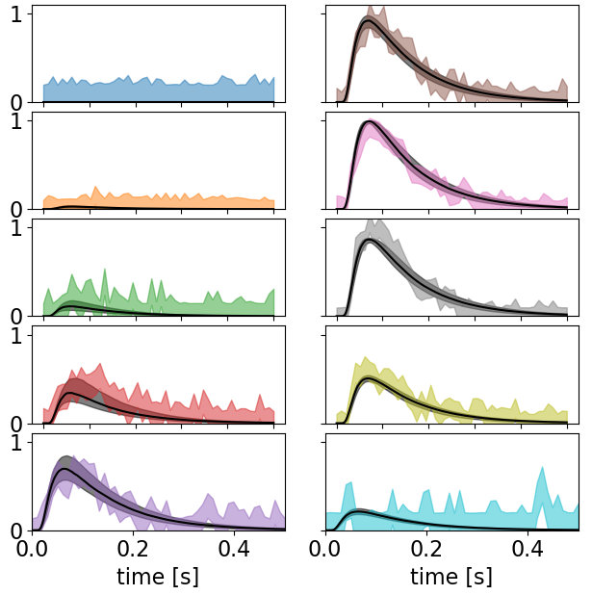
Addition of HEXOS Diagnostic Into Framework Provides Marginal Improvement of Uncertainty
Addition of HEXOS to inference framework marginally improves fitting uncertainty
Constraints on lower charge states improve certainty near the edge
Fe XXII
Fe XVIII
Fe XVI
CXRS
CXRS+ HEXOS
Fe XXIV

Slide 26
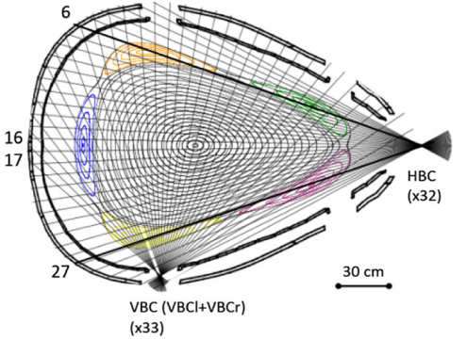
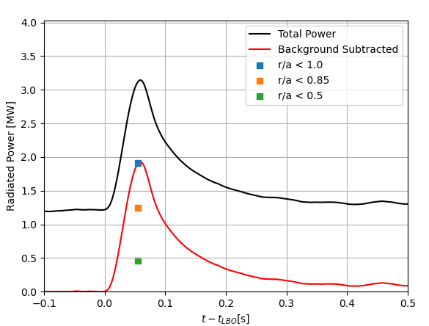
Bolometer Measurements
Metal-resistive bolometer array measures radiated power [D. Zhang et al 2021 Nucl. Fusion 61 116043]
Total radiated power measurements (~600 Hz), radiation fraction measurements (~15 Hz)
Radiated power forward modeled by using cooling rate coefficients:
Figure credit: D. Zhang et al 2021 Nucl. Fusion 61 116043
$$P\left(t\right)=\iiint{\sum_{z}{n_{Z}\left(\frac{r}{a},t\right)\left(n_{e}\left(\frac{r}{a}\right)\left(PLT+PRB\right)+ \left\langle n_{0}\right\rangle \left(\frac{r}{a}\right)PRC\right)}dV}$$
$PLT −$ Impact Excitation
$PRB −$ Recombination
$PRC −$ Charge Exchange

Slide 27
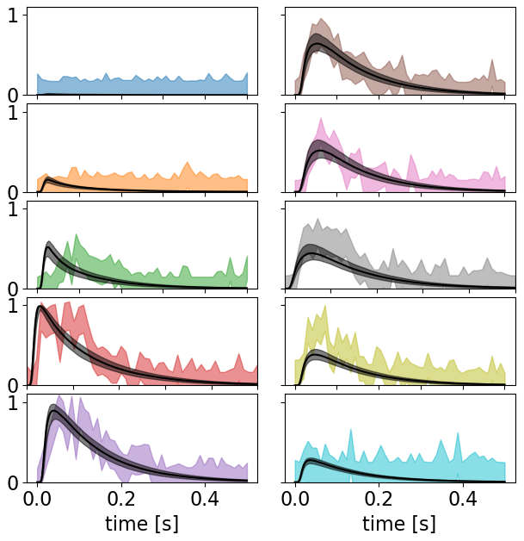
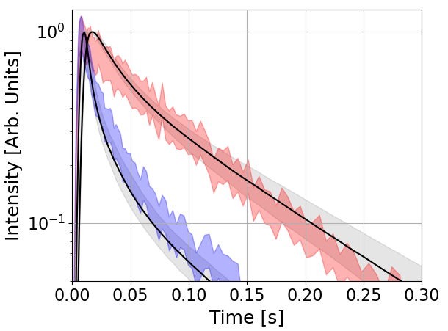
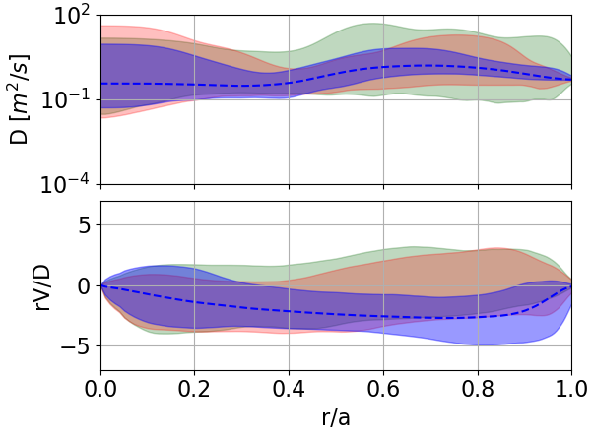
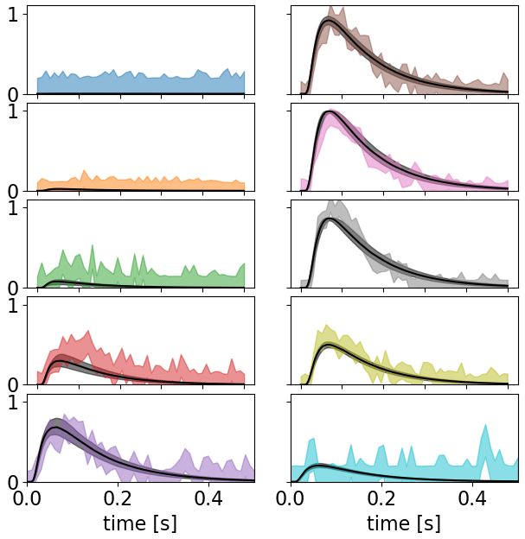
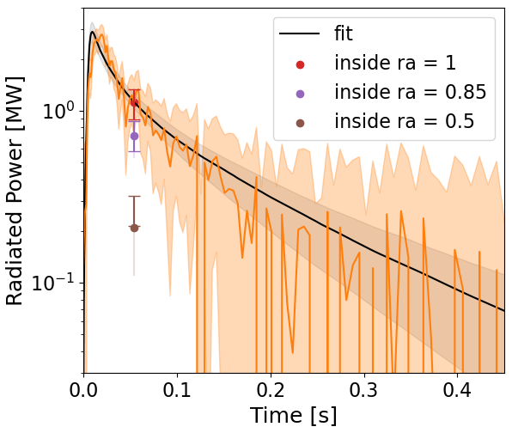
Inclusion of Absolutely Calibrated Bolometer Measurements Provides Strongest Constraints
LOS #1
LOS #6
Significant improvement in fitting uncertainty by inclusion of bolometer signal
Provides constraint on total impurity content
Beginning to resolve inward convection velocity
Consistent with expectation for ITG turbulence
LOS #2
LOS #7
Fe XXII
LOS #3
LOS #8
Fe XVIII
LOS #4
LOS #9
Fe XVI
LOS #5
LOS #10
LOS #1
LOS #6
CXRS
LOS #2
CXRS+ HEXOS
LOS #7
CXRS+ HEXOS + Bolo.
Fe XXIV
LOS #3
LOS #8
LOS #4
LOS #9
LOS #5
LOS #10

Slide 28
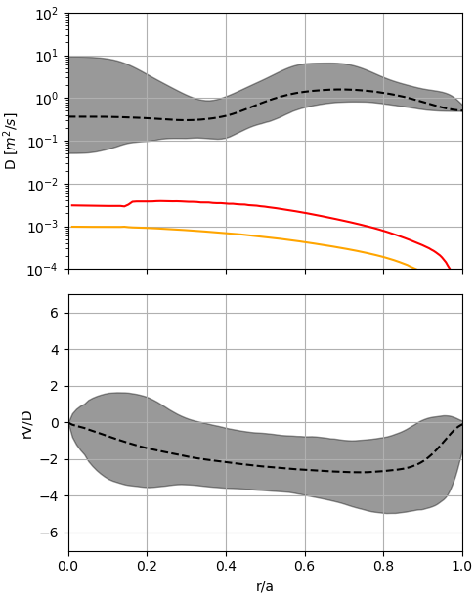
Summary/Conclusion
Bayesian analysis of only relatively calibrated CXRS measurements enough to reproduce previous results
Inclusion of multiple diagnostics in framework improved fitting uncertainty
Consistent with theory expectation for ITG turbulence
Could infer “effective emission coefficients”
Plan to apply framework to new data from upcoming campaign
$$+2σ$$
median sample
$$-2σ$$
$$D_{neo} −Fe^{10+}$$
$$D_{neo} −Fe^{25+}$$
$$+2σ$$
median sample
$$-2σ$$

Slide 29
Bonus: Bayesian Statistical Model
Priors
1) Impurities should not be significantly peaked or hollow (constrains $\left|rV/D\right|$to be of order 1)
2) Diffusion bound between classical & Bohm diffusion models
3) Additional priors enforce knot point minimum distance, monotonicity
Prior probability functions:
$$p_{1}\left(\vec{θ} | M\right)=\text{𝒩}\text{(0,2) = }\frac{1}{\sqrt{8π}} e^{−{\frac{1}{8}\left(\frac{rV}{D}\right)}^{2}}$$
$$p_{2}\left(\vec{θ} | M\right)=\begin{matrix}0 if\log_{10}{D}>2 \text{or} \log_{10}{D}<−3 \\ 1 otherwise \end{matrix}$$
Likelihood: Standard Gaussian likelihood, $σ$ set by measurement uncertainty:
$p\left(D | M,\vec{θ}\right)=\text{𝒩}\text{(}\text{D}\text{,}σ_{D})= \frac{1}{σ_{D}\sqrt{2π}}e^{−\frac{1}{2}{\left(\frac{D −μ}{σ_{D}}\right)}^{2}}$
Bayes’ Theorem
$$p\left(\overset{⃑}{θ} | D,M\right)=\frac{p\left(\overset{⃑}{θ} | M\right)p\left(D | M,\overset{⃑}{θ}\right)}{p(D|\overset{⃑}{θ})}$$
prior
likelihood
posterior
Evidence
$\overset{⃑}{θ}=$D, V, etc.
$D=$ spectroscopy, bolometer measurements
$M=$pySTRAHL impurity transport model

Slide 30
Bonus: Stacked Fiber Bundles Allow for Dual Channel Operation
“Smearing” effect occurs at fast frame rates when…
EMCCD area split into 3 vertically binned regions of interest:
2 channels for signal readout
3rd central channel for smear detection and correction
Unique smear correction algorithm developed:
$$I_{1}$$
Identify smear contribution per pixel, $\frac{I_{sm}}{n_{sm}}$
Identify channel 1 intensity per pixel, $\frac{I_{1}}{n_{1}}$
Calculate how much of channel 1’s signal contributes to smearing: $\left(\frac{I_{sm}}{n_{sm}}\right){\left(\frac{I_{1}}{n_{1}}\right)}^{−1 }$
Scale spectrum 1 by smearing factor and subtract from spectrum 2:
$$S_{2,corrected}=S_{2}−n_{2}S_{1}\left(\frac{I_{sm}}{n_{sm}}\right){\left(\frac{I_{1}}{n_{1}}\right)}^{−1}$$
$$S_{2}$$
$$I_{sm}$$
$$S_{1}$$

