Slide 1
A scintillator-based fast ion loss detector for steady-state operation in Wendelstein 7-X
Alexandra LeViness, S. A. Lazerson, A. Jansen van Vuuren, J. Rueda-Rueda, J. Ayllon-Guerola, S. Bozhenkov, D. Corl, R. Ellis, J. Galdon-Quiroga, J. Garcia-Dominguez, M. Garcia-Munoz, J. Hidalgo-Salaverri, C. Killer, K. Ogawa, N. Pablant, J. Segado-Fernandez, and the W7-X team

Slide 2
Background
Stellarators do not inherently confine trapped particle orbits as tokamaks do, given the lack of symmetry, so optimization is necessary
Fast ion confinement is an important optimization target of W7-X
Measurement of lost fast ions helps to determine the success of optimization
Main types of fast ion loss detectors (FILDs) are:
Faraday Cup: measures flux of lost fast ions directly as a current
Scintillating: measures light released when fast ions strike a phosphorescent material with a video camera or array of photomultiplier tubes
FILDs often make use of a pinhole and collimating structure to spread out arrival position of ions by energy and pitch angle, allowing these quantities to be resolved
Simulation of FILDs can be difficult due to the scale difference between the pinhole and the last closed flux surface (LCFS) of the plasma

Slide 3
FILDs on Wendelstein 7-X: Present and Future
NIFS-FILD
Developed by National Institute for Fusion Science (NIFS) in Japan and Max Planck Institute for Plasma Physics (IPP)
Faraday Cup FILD, 8 channels
Uses a collimating pinhole and slit to resolve losses in energy and pitch angle
Utilized in experimental campaigns OP1.2b (2018) and OP2.1 (2023)
FC-FILD
Developed by IPP & PPPL
Faraday Cup FILD, 5 channels
Uses insulating layers of increasing thickness to resolve losses in energy
Mimics a W7X wall tile to test the feasibility of in-wall FILD array
Utilized in experimental campaign OP2.1 (2022 - 2023)
Aperture being updated for OP2.2 (2024)
S-FILD
Developed by PPPL, IPP, and the University of Seville in Spain
Scintillating FILD imaged by fast video camera
Uses collimating pinholes and slits to resolve losses in energy and pitch angle
2 layer Faraday Cup beneath scintillating material to measure absolute ion flux
In development, planned for an upcoming experimental campaign

Slide 4
FILDs on Wendelstein 7-X: Present and Future
NIFS-FILD
Developed by National Institute for Fusion Science (NIFS) in Japan and Max Planck Institute for Plasma Physics (IPP)
Faraday Cup FILD, 8 channels
Uses a collimating pinhole and slit to resolve losses in energy and pitch angle
Utilized in experimental campaigns OP1.2b (2018) and OP2.1 (2023)
FC-FILD
Developed by IPP & PPPL
Faraday Cup FILD, 5 channels
Uses insulating layers of increasing thickness to resolve losses in energy
Mimics a W7X wall tile to test the feasibility of in-wall FILD array
Utilized in experimental campaign OP2.1 (2022 - 2023)
Aperture being updated for OP2.2 (2024)
S-FILD
Developed by PPPL, IPP, and the University of Seville in Spain
Scintillating FILD imaged by fast video camera
Uses collimating pinholes and slits to resolve losses in energy and pitch angle
2 layer Faraday Cup beneath scintillating material to measure absolute ion flux
In development, planned for an upcoming experimental campaign

Slide 5
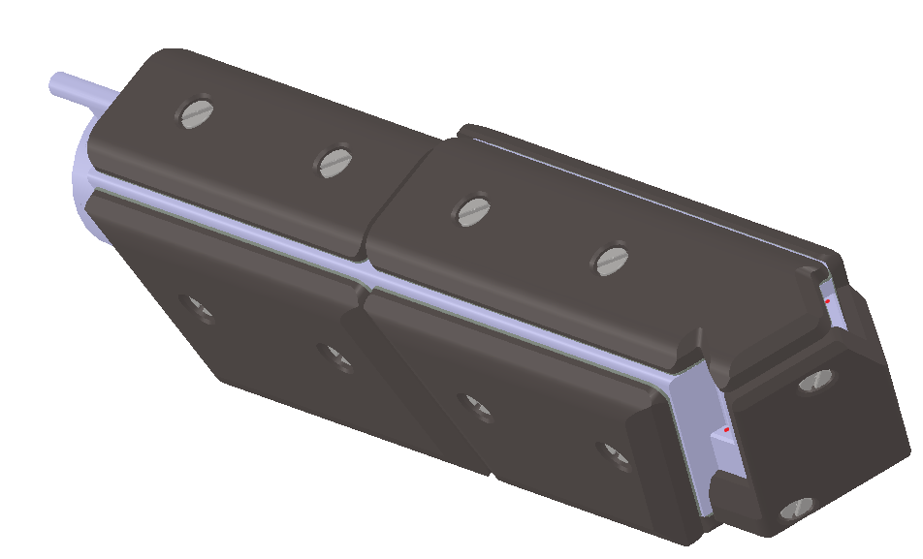
Design of the S-FILD probe head
Two pinholes: one to measure co-going fast ions, the second to measure counter-going
3D-printed, stainless steel probe head with water cooling channels covered in graphite tiles for heat protection
Designed to measure fast ions produced by the W7-X NBI system (energies $≤$55 keV)
Will also be able to measure higher-energy fast ions produced by combined NBI-ICRH in future
Counter-going pinhole
Co-going pinhole

Slide 6
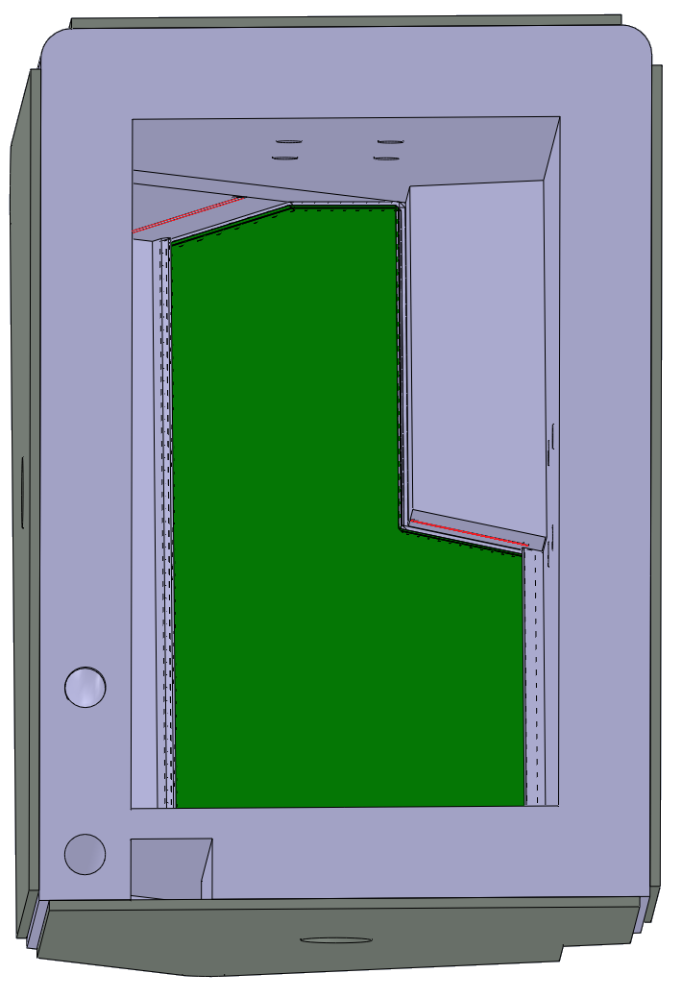
Combined scintillator plate/Faraday Cup for measurement
Inside of probe head: stainless steel plate covered by SrGa₂S₄:Eu²⁺ (aka TG-Green), phosphorescent material
When fast ions hit the plate, light is released, passes through array of lenses and mirrors to reach camera
Ions then captured by the steel plate beneath and measured as a current
Collimating slits are used to spread strikes out spatially based on energy and pitch
Counter-going slit
Co-going slit

Slide 7
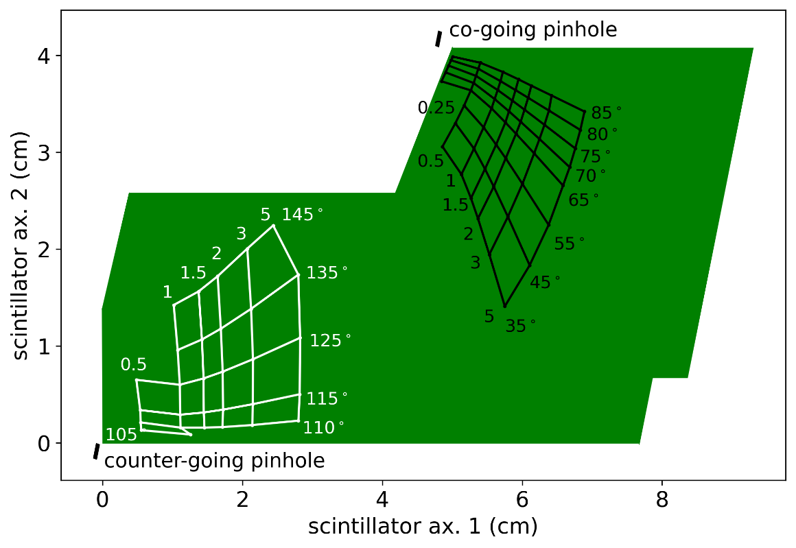
Strike pattern on scintillator reveals information about ions
Average strike position by pitch angle and “gyroscalar” (a gyroradius-like quantity) shown
Actual position also depends on gyrophase, starting location in pinhole
Light released measured by CMOS video camera (C-Blue One 1.7MP, full frame rate 481 fps at 12-bit depth)
Gyroscalar = (v/vꓕ) * gyroradius, given in units of cm

Slide 8
Engineering design of the S-FILD
W7-X was designed for steady-state operation
Most recent campaign: 8 minute plasma with over 1 GJ injected energy
S-FILD must be capable of withstanding 120 kW/m² of steady-state heat flux from ECRH stray radiation and heat radiated from the plasma, plus 100 kW/m² of transient fast ion heat loads from NBI for up to 20 s
TG-Green material operates best at temperatures under 200° C, minimal photon yield above 400° C
S-FILD designed with active water cooling, reciprocating manipulator arm controlled by pneumatic drive for insertion up to 26 cm into the vacuum vessel
Full thermomechanical and vibrational analysis has been performed; temperature rise and mechanical stress found to be within acceptable limits

Slide 9
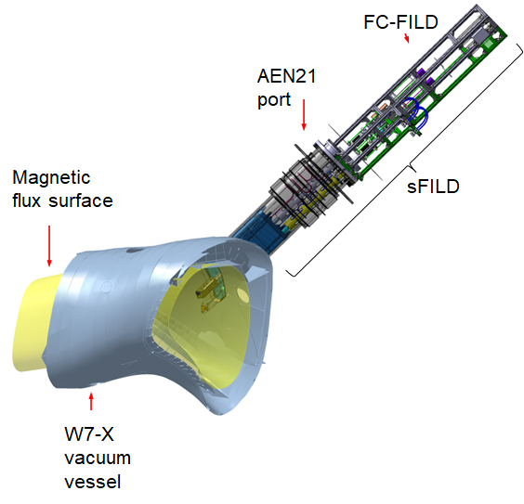
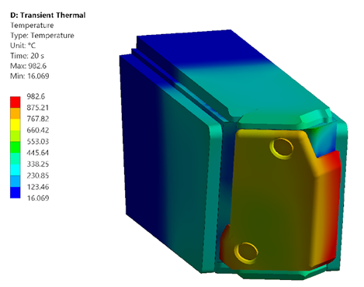
S-FILD engineering design has been completed and reviewed and the first components have been purchased
S-FILD directly next to FC-FILD, allowing complementary measurements
Temperature rise after 20 s of 220 kW/m² remains within acceptable limits
Interior temperature (not shown) $≤$ 250° C
A. Jansen van Vuuren et al., “Development of a scintillator based fast-ion loss detector for the Wendelstein 7-X stellarator,” 15th International Symposium on Fusion Nuclear Technology (ISFNT-15).

Slide 10
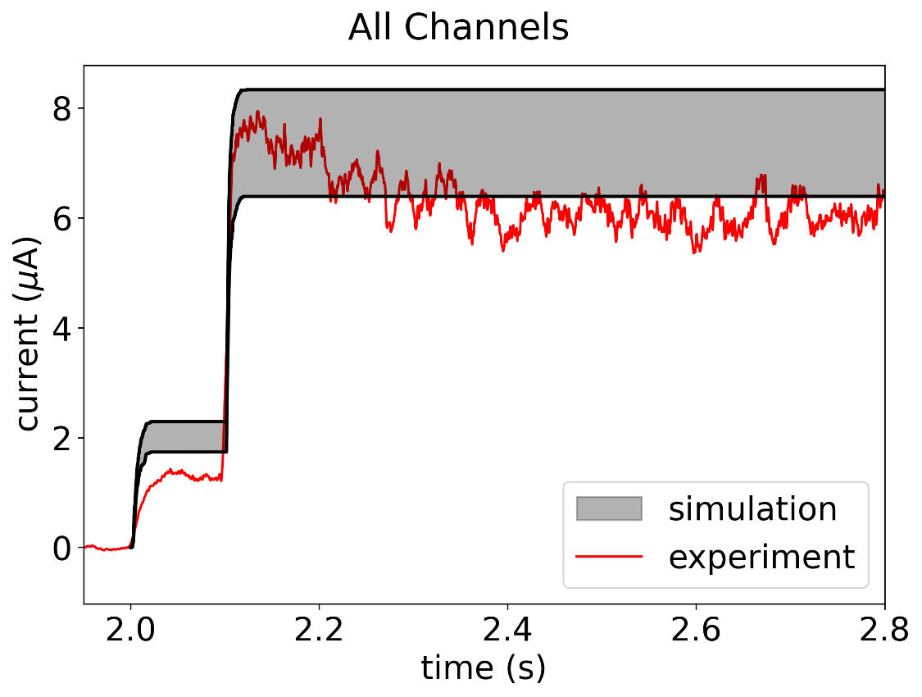
Detailed simulation method developed for FILD signals
Making use of gyro-orbit expansions and virtual detection planes, a method was developed for simulation of signals to FILDS
Method was first developed for the NIFS-FILD on W7-X, which has been used in two campaigns, and used to find the first quantitative agreement between simulated and measured fast ion losses on W7-X
Now this method is expanded to be applicable to a scintillating FILD for the first time and used to predict signals to the S-FILD
Above: simulated and measured current to all channels of the NIFS-FILD for W7-X shot 20230216.028

Slide 11
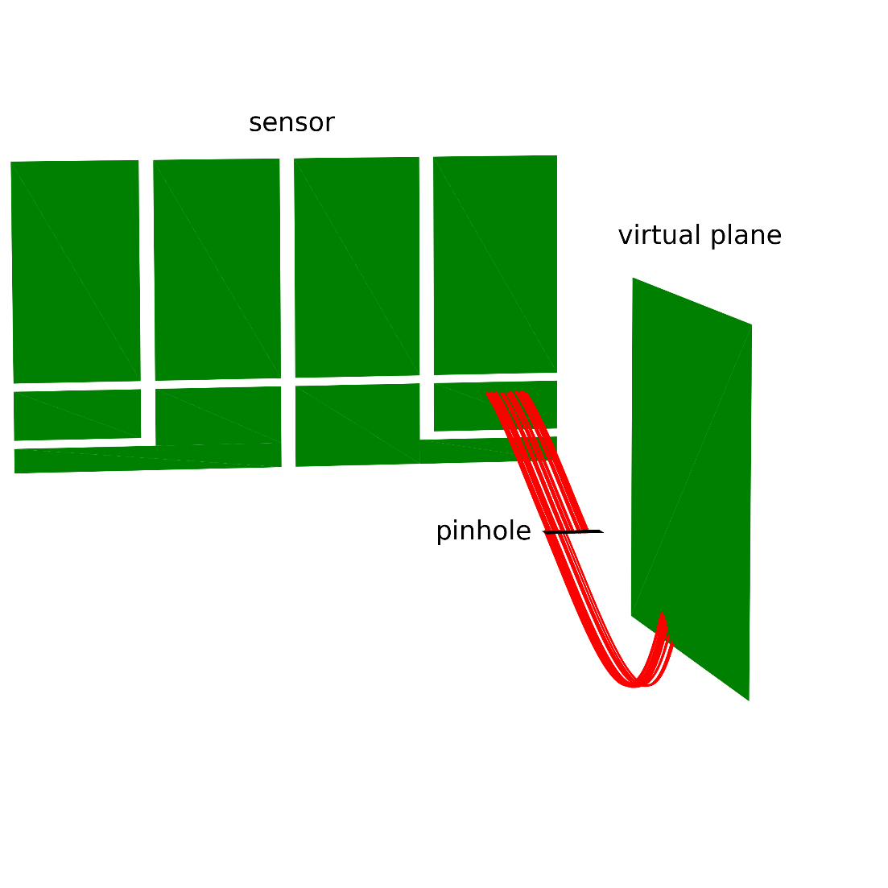
Virtual detection plane placed outside of the probe head as a target for simulation
A. LeViness et al., “Validation of a synthetic fast ion loss detector model for Wendelstein 7-X,” Nucl. Fusion (submitted).
Illustrated here on the NIFS-FILD, we see the sensors of the detector, the pinhole, and the virtual plane
It is positioned along the magnetic field vector from the pinhole(s) so that every fast ion reaching the pinhole(s) must pass through it first
Fast ions created by NBI are traced from injection to LCFS by Monte Carlo code BEAMS3D*, then from LCFS to wall by ASCOT5, while being saved each time they pass through the transparent virtual plane
Plane set at constant toroidal angle ϕ
Image created with FILDSIM: Galdon-Quiroga J. et al. “Velocity-space sensitivity and tomography of scintillator-based fast-ion loss detectors.” Plasma Phys. Control. Fusion 60 (2018), 105005. 10.1088/1361-6587/aad76e.
*McMillan M. and Lazerson S. A. “BEAMS3D Neutral Beam Injection Model.” Plasma Phys. Control. Fusion 56 (2014), 095019. 10.1088/0741-3335/56/ 9/095019.

Slide 12
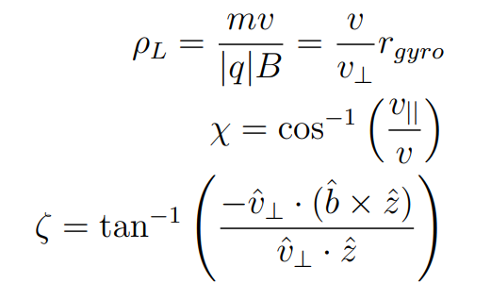
Virtual detection plane placed outside of the probe head as a target for simulation
A. LeViness et al., “Validation of a synthetic fast ion loss detector model for Wendelstein 7-X,” Nucl. Fusion (submitted).
Separate simulations performed in ASCOT5 to find mapping between virtual plane and FILD sensor
To do so, “markers” representing fast ions are traced forward and backward from the pinhole
Mapping is based on:
Position on the plane in R and Z
Gyroscalar, pitch angle, & gyrophase
Image created with FILDSIM: Galdon-Quiroga J. et al. “Velocity-space sensitivity and tomography of scintillator-based fast-ion loss detectors.” Plasma Phys. Control. Fusion 60 (2018), 105005. 10.1088/1361-6587/aad76e.

Slide 13
Markers traced backwards from pinhole to plane
Markers launched from the edges of the pinhole with a single set of (χ,ρL,ζ) values are tracked until they hit the virtual plane (divided into a grid in R and Z)
ζ’, gyrophase at the virtual plane, is calculated
A set of two markers are found which have desired value of ζ’ at the plane; say that ζ = ζ1 at the pinhole

Slide 14
Second set of markers are followed to find an area on the plane
This process is repeated for a second set with (χ,ρL,ζ2) at the pinhole
The two lines form an area at the plane within which markers with (χ,ρL,ζ’) will reach the pinhole with gyrophase in the range (ζ1-ζ2)
This is used to map the (R,Z) grid of the virtual plane into the pinhole to see where markers in each (R,Z) box will end up

Slide 15
Markers followed forwards in a grid to find mapping to the scintillator plate
Markers with (χ,ρL,ζ1) and (χ,ρL,ζ2) at the pinhole are launched in a grid and followed forward to the scintillator; those which are collimated (hit the inside of the slit) are removed
By overlaying the (R,Z) mapping from the previous step onto this grid, we find a mapping between the (R,Z) plane and the scintillator plate

Slide 16
Include all values of ζ at the pinhole to find the full mapping
We can now, for a single value of (χ,ρL,ζ’) at the virtual plane, find a mapping between any marker’s original location on the plane, its intermediate position in the pinhole, and its final position on the scintillator plate
The green shaded area is a single (R,Z) grid box which is mapped from the plane to the scintillator

Slide 17
Finding the probability of transmission
For this (R,Z) box, because it falls entirely within the green-outlined area, the probability of transmission is 100%: all markers inside of this box with our chosen velocity vector will reach the scintillator
P(R,Z,χ,ρL,ζ’) = 1

Slide 18
Finding the probability of transmission
For this new (R,Z) box, only the area which lies within the green outline will reach the scintillator
P(R,Z,χ,ρL,ζ’) = (green shaded area) / (area of bold-outlined (R,Z) box)
Can average P together for different (χ,ρL,ζ’) values to get bins

Slide 19
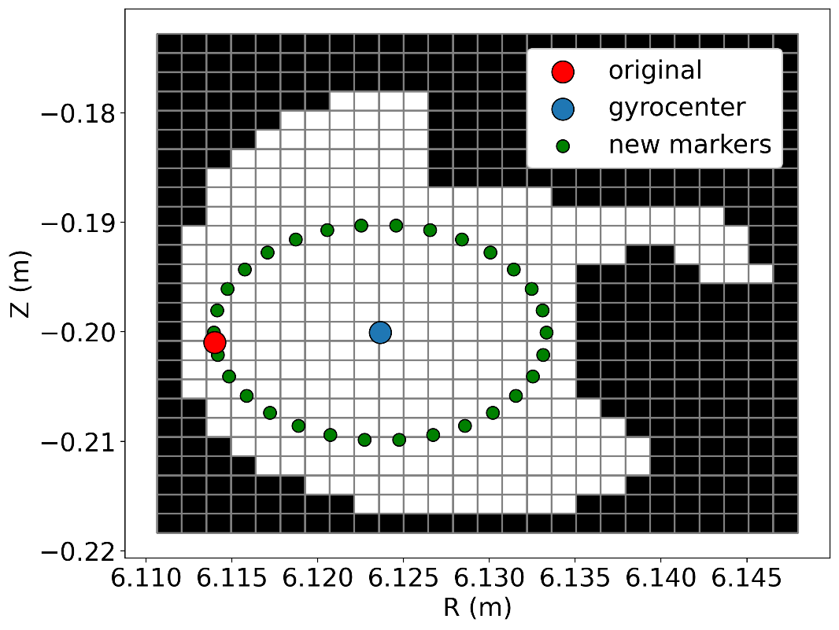
Calculating the signal
Markers which passed through the virtual plane on their way from the LCFS to the wall are considered
Markers are expanded around the guiding-center, making 1000 new markers
(Illustrated on right for the NIFS-FILD virtual plane)
New markers are traced backwards 10 orbits; those which hit anything are removed and their weight redistributed
To find total fast ion flux to the plate: multiply the weight of each marker by P(R,Z,χ,ρL,ζ’) based on its spatial location and velocity
Perform a boxcar sum over marker arrival time and NBI duration to get signal over time

Slide 20
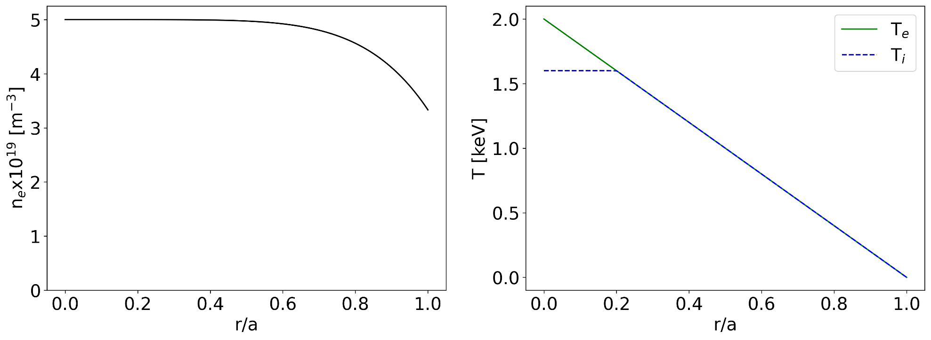
Signal simulated for W7-X standard configuration EIM
For simulation, used standard magnetic field configuration; density and temperature profiles chosen to match typical operating parameters
70 ms injection, 1.8 MW from all four commissioned NBI sources simulated
The S-FILD was at full insertion (26 cm from the parked position level with the wall) for the simulation

Slide 21
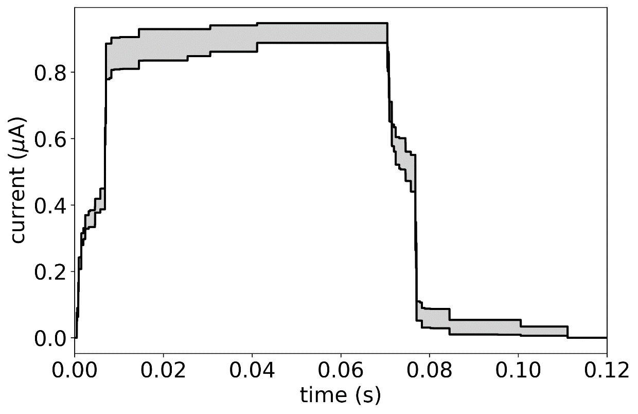
Total fast ion flux to scintillator plate over time
Current reaches steady-state value after <50 ms
May not be the exact current measured by the Faraday Cup: uncertain if all ions will pass through the TG-Green material and be collected
Uncertainty from choice of probability bin size represented as band
Current on par with that measured by NIFS-FILD thus far (~μA)

Slide 22
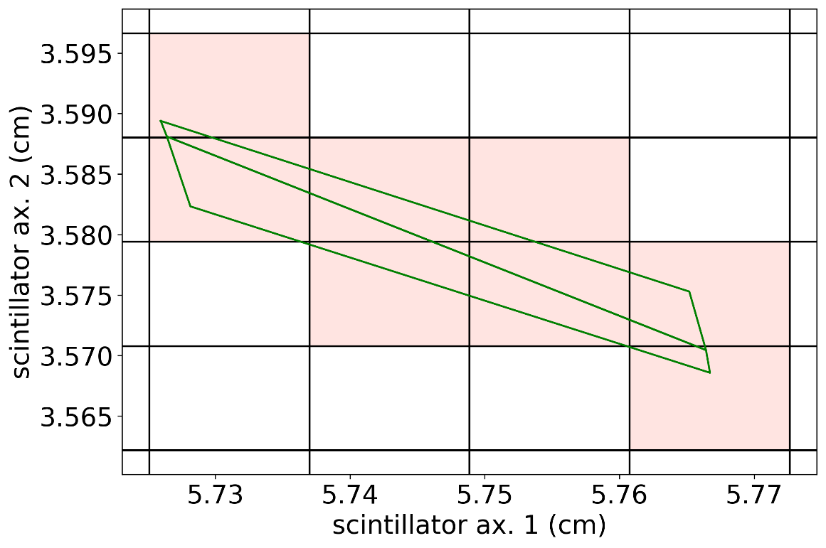
Finding spatial distribution on the scintillator plate
Scintillator plate is separated into a grid, as the virtual plane was
For each (R,Z) bin mapped onto the grid, the boxes which it overlaps are found
To save computational time, the signal is divided evenly between these boxes, rather than calculating the exact % of the area which falls into each grid box
For a grid box (j,k), the probability becomes:
Pj,k(R,Z,χ,ρL,ζ’) = P(R,Z,χ,ρL,ζ’) / Nboxes
for the shaded boxes and 0 otherwise
For example, here Nboxes = 8

Slide 23
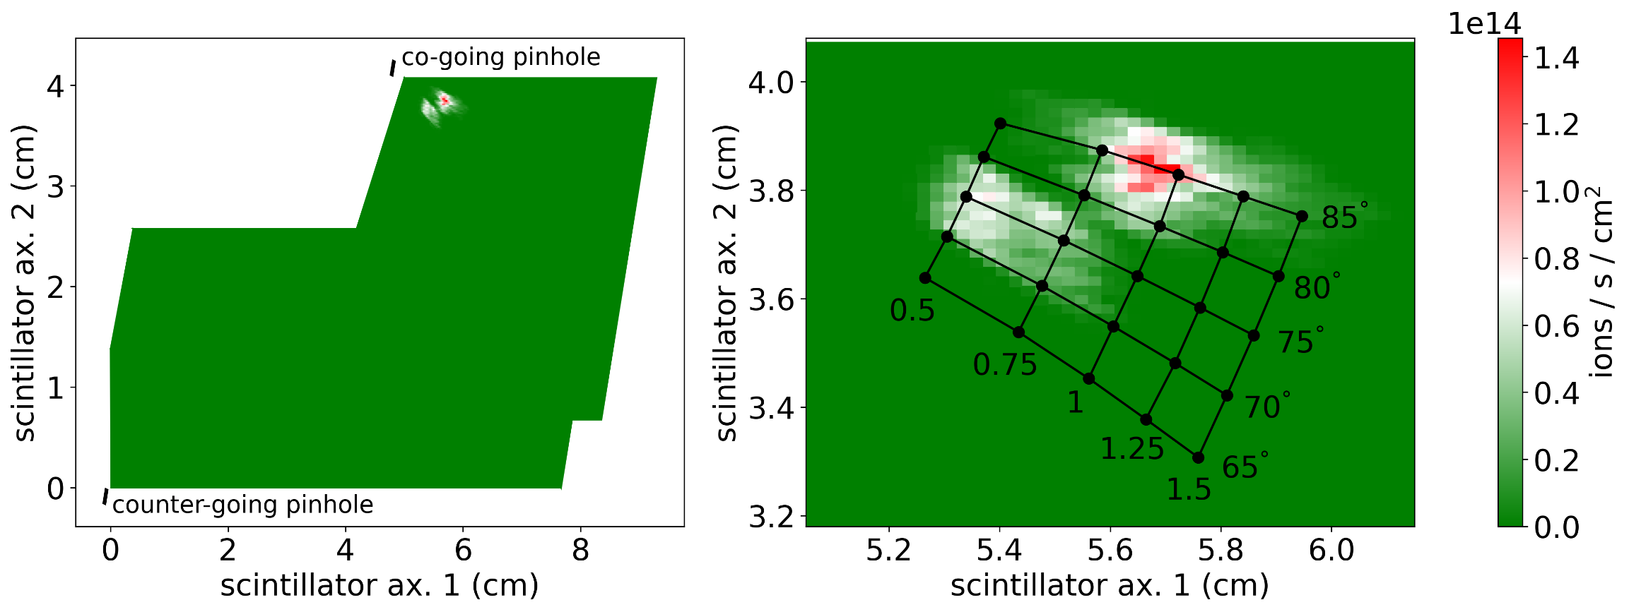
Total spatial flux of fast ions to scintillator
This is not the same as the camera signal: need to take into account position and tilt of the scintillator plate, photon yield of TG-Green, and transmission efficiency of optical system
Only measure co-going ions for this configuration and set of profiles!

Slide 24
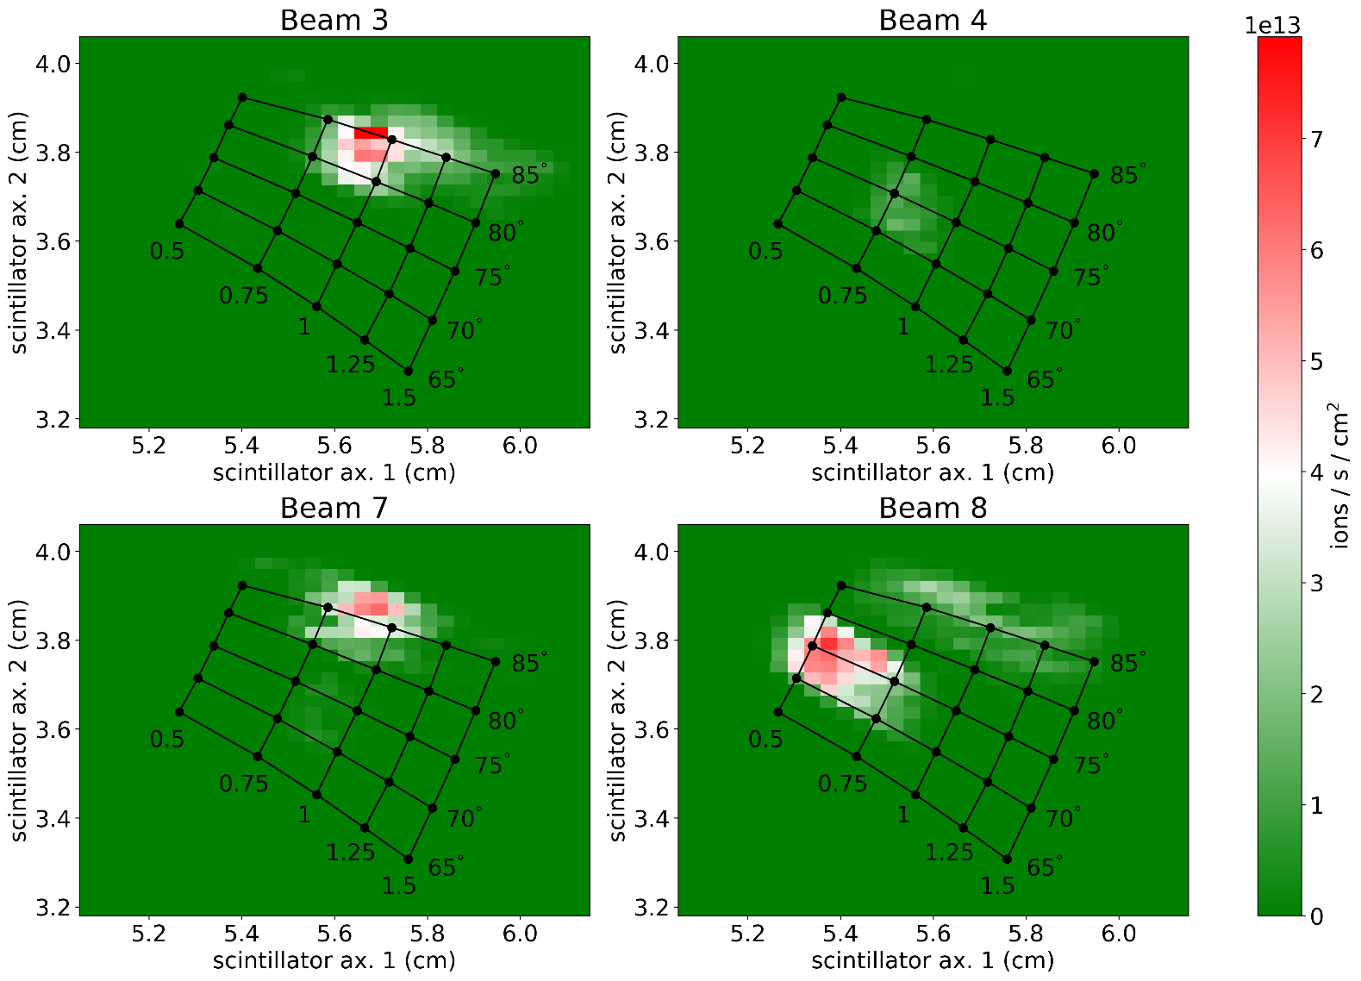
Can divide up the flux from each of the 4 neutral beams
Beams 3 and 7, which inject more radially, show higher pitch angles at the scintillator
Minimal signal seen from Beam 4
Total flux reaching the scintillator does not correspond to overall energy losses from the plasma

Slide 25
Conclusions
The S-FILD, a new scintillating fast ion loss detector, has been designed for W7-X, and analysis confirms that it can withstand the high heat loads produced during steady-state operation, including even higher transient loads during NBI operation
A detailed method for simulating FILDs, which has already been used to reproduce experimental measurements by the NIFS-FILD used in previous experimental campaigns, was applied to the S-FILD to predict what this diagnostic will measure
Total flux values matched those already seen by the NIFS-FILD
Only co-going fast ions were seen in the simulation of W7-X standard configuration; this is because none of the markers reaching the virtual plane had a pitch angle over 105°
If future simulations show that no signal is seen by the counter-going pinhole, it may be necessary to change the design of the probe head

