Slide 1
Ion temperature imaging in the divertor of the W7-X stellarator using coherence imaging spectroscopy
Matt Kriete¹
V. Perseo², D. Gradic², D.A. Ennis¹, R. König², D.A. Maurer¹, and the W7-X Team²
¹Auburn University
²Max Planck Institute for Plasma Physics
High Temperature Plasma Diagnostics Conference
April 22, 2024
Funded by DoE grant DE-SC0014529 and EUROfusion grant 101052200

Slide 2
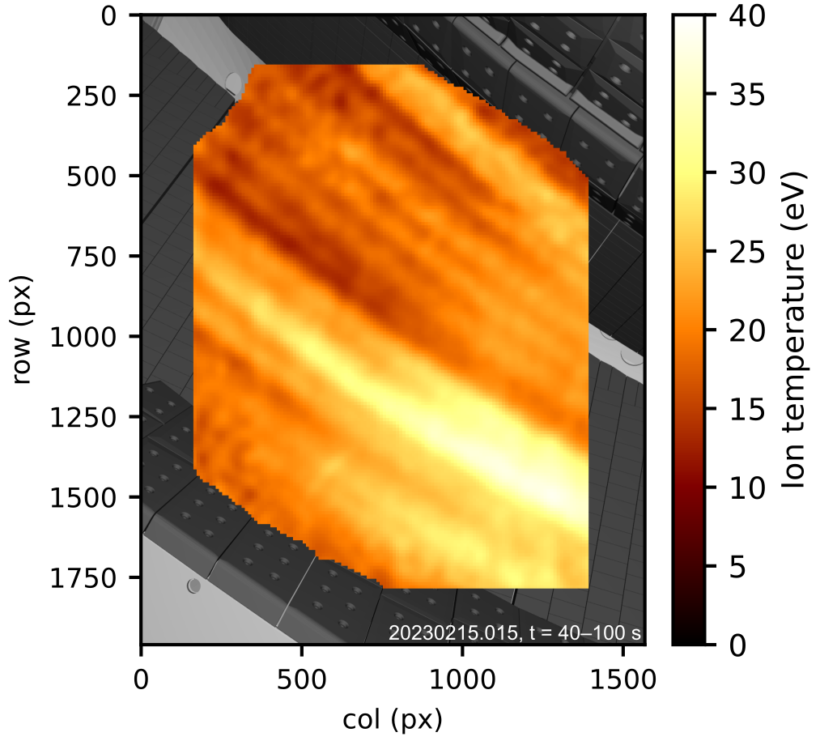
The coherence imaging spectroscopy technique has been advanced to enable imaging of the divertor ion temperature distribution
C²⁺ temperature distribution near lower divertor in W7-X
Coherence imaging spectroscopy (CIS) provides 2D images of plasma parameters in the core and scrape-off layer
Flow velocity measurements now routinely available with CIS
New: we have advanced the CIS technique to reliably measure ion temperatures
  This talk: impurity $$T_{i}$$ in scrape-off layer
  Wednesday talk by R. Lopez Cansino [3.1.2]: main ion $$T_{i}$$ in core

Slide 3
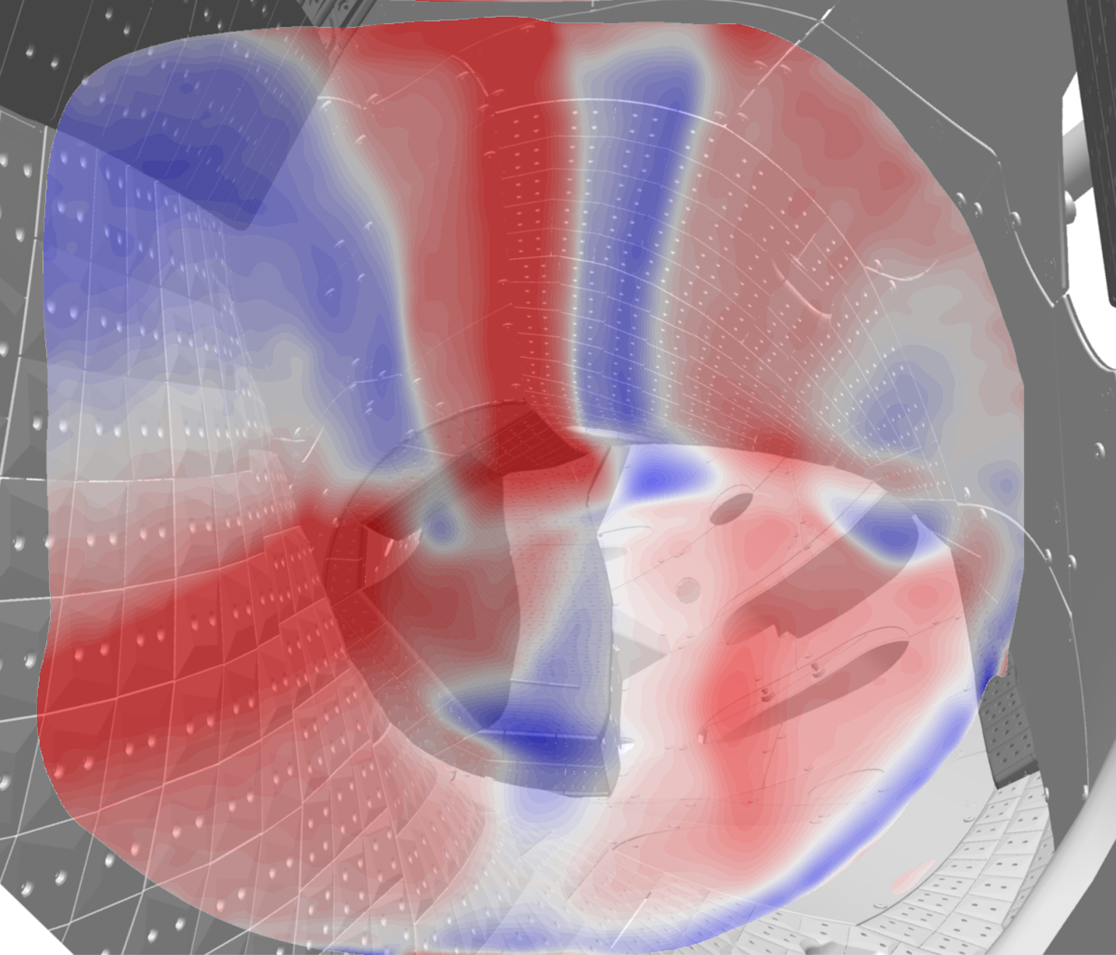
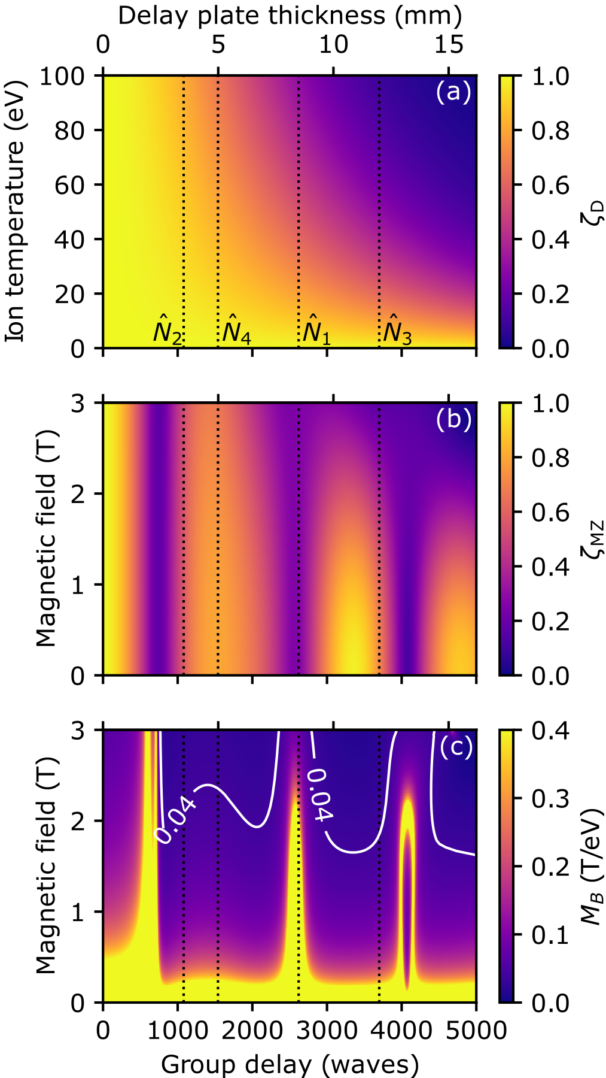
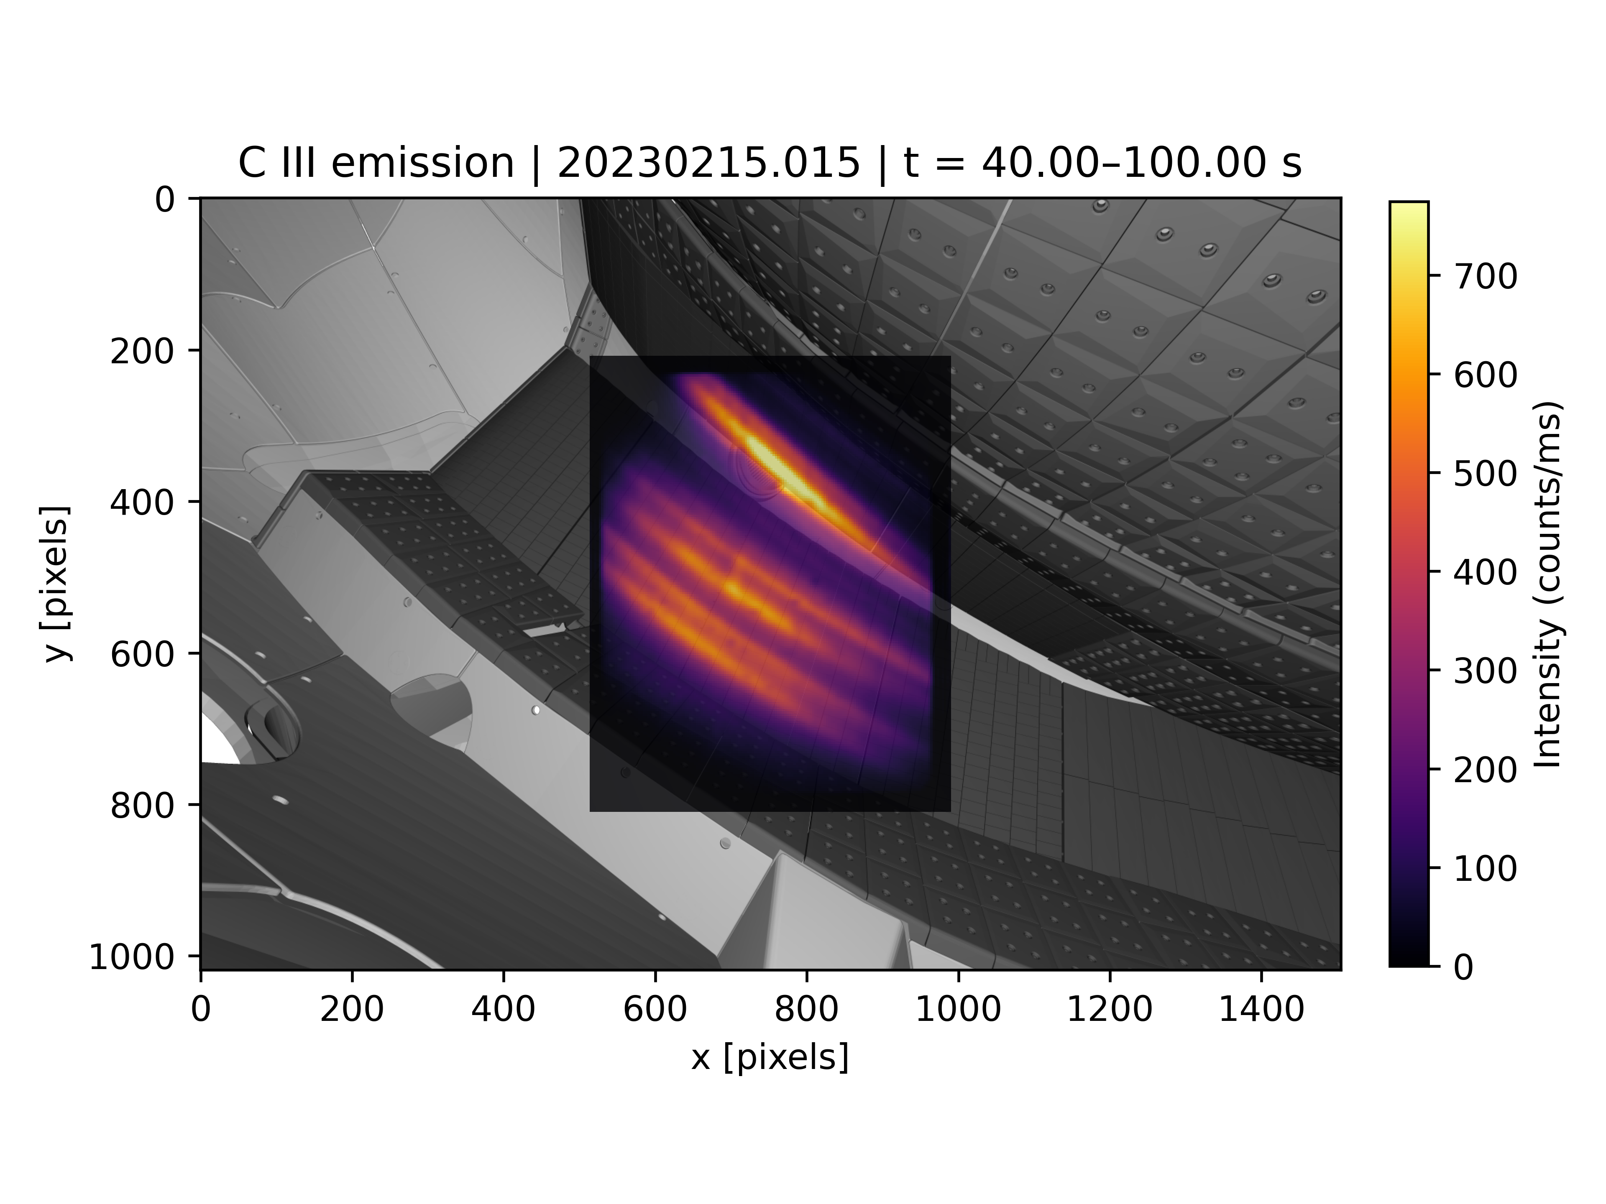
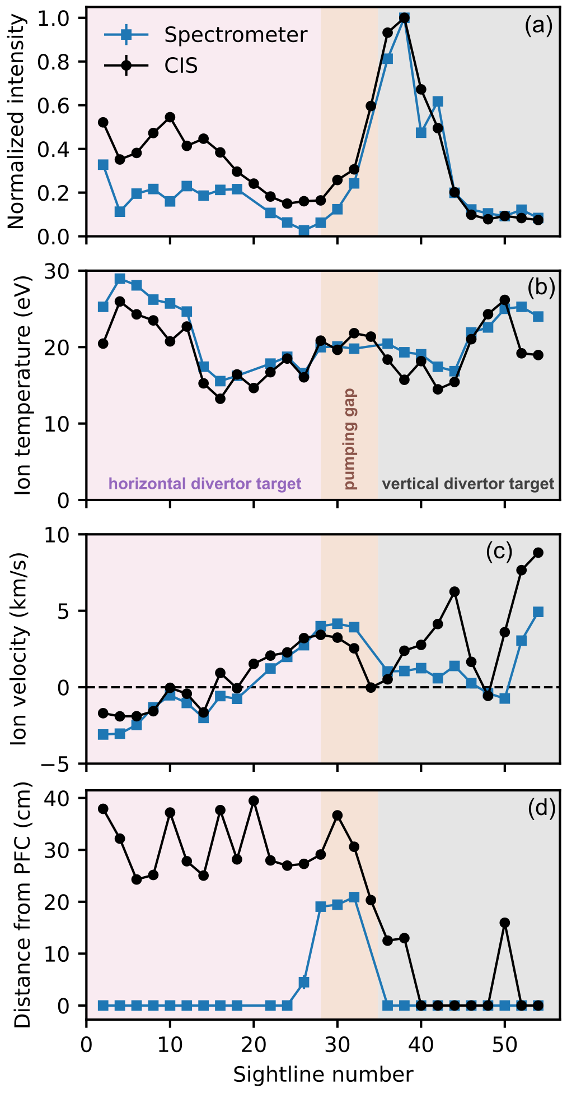
Outline
Motivation and overview of coherence imaging spectroscopy
CIS design principles for edge $$T_{i}$$ measurements
Inference of $$T_{i}$$ from CIS data
Validation of CIS $$T_{i}$$ measurements on W7-X

Slide 4
Outline
Motivation and overview of coherence imaging spectroscopy
CIS design principles for edge $$T_{i}$$ measurements
Inference of $$T_{i}$$ from CIS data
Validation of CIS $$T_{i}$$ measurements on W7-X

Slide 5
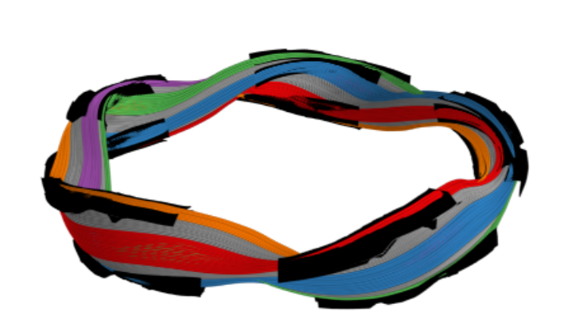
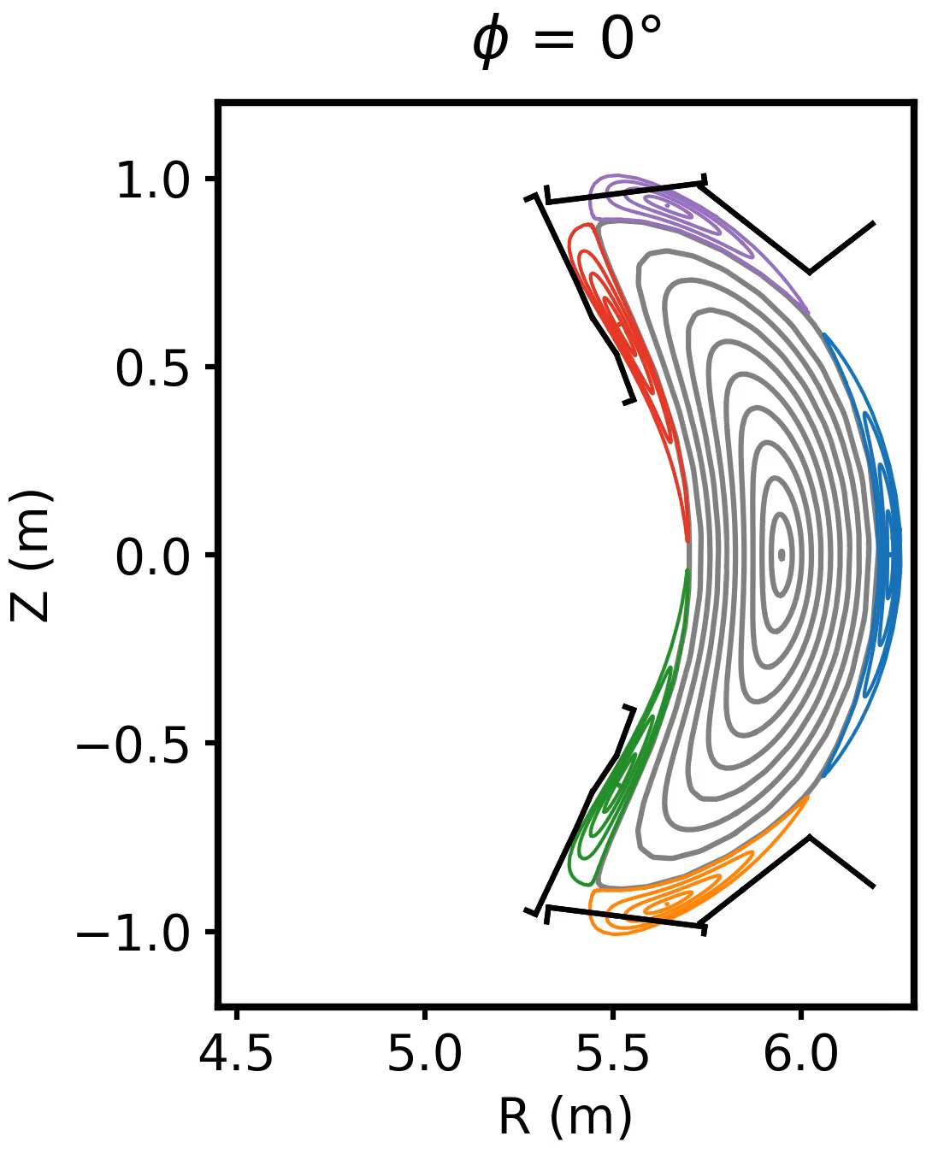
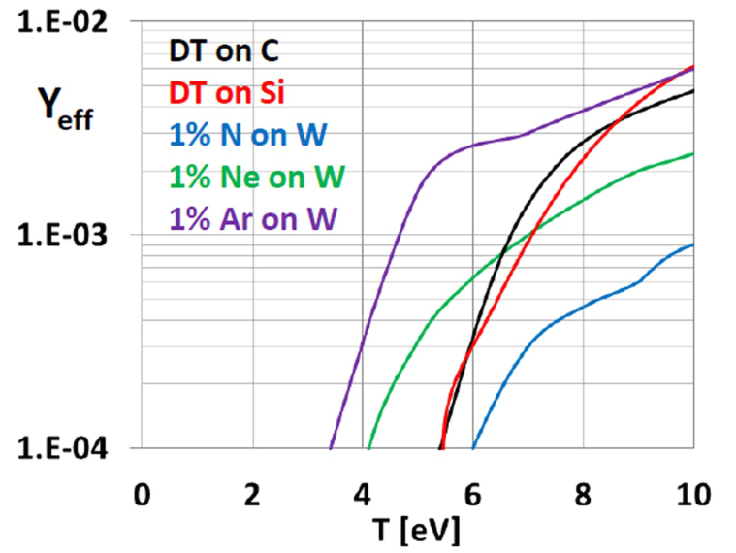
Images of edge ion temperature provide crucial information for understanding stellarator divertor physics
Many key scrape-off layer (SOL) plasma parameters depend on $$T_{i}$$
  $$T_{i}$$ information is sparser than other parameters ($$T_{e}$$, $$n_{e}$$, $$v_{i}$$)
Stellarators SOLs are fully 3D → diagnostics with high spatial information are needed to fully characterize edge plasma
W7-X SOL consists of magnetic islands intersected by divertor targets
Physical sputtering yield strongly depends on divertor ion temperature
0°
72°
P.C. Stangeby, PPFC 60 044022 (2018)
Notes:
Can mention a few edge plasma parameters that depend on Ti: divertor erosion rates, ion sound speed, sheath heat transmission factor

Slide 6
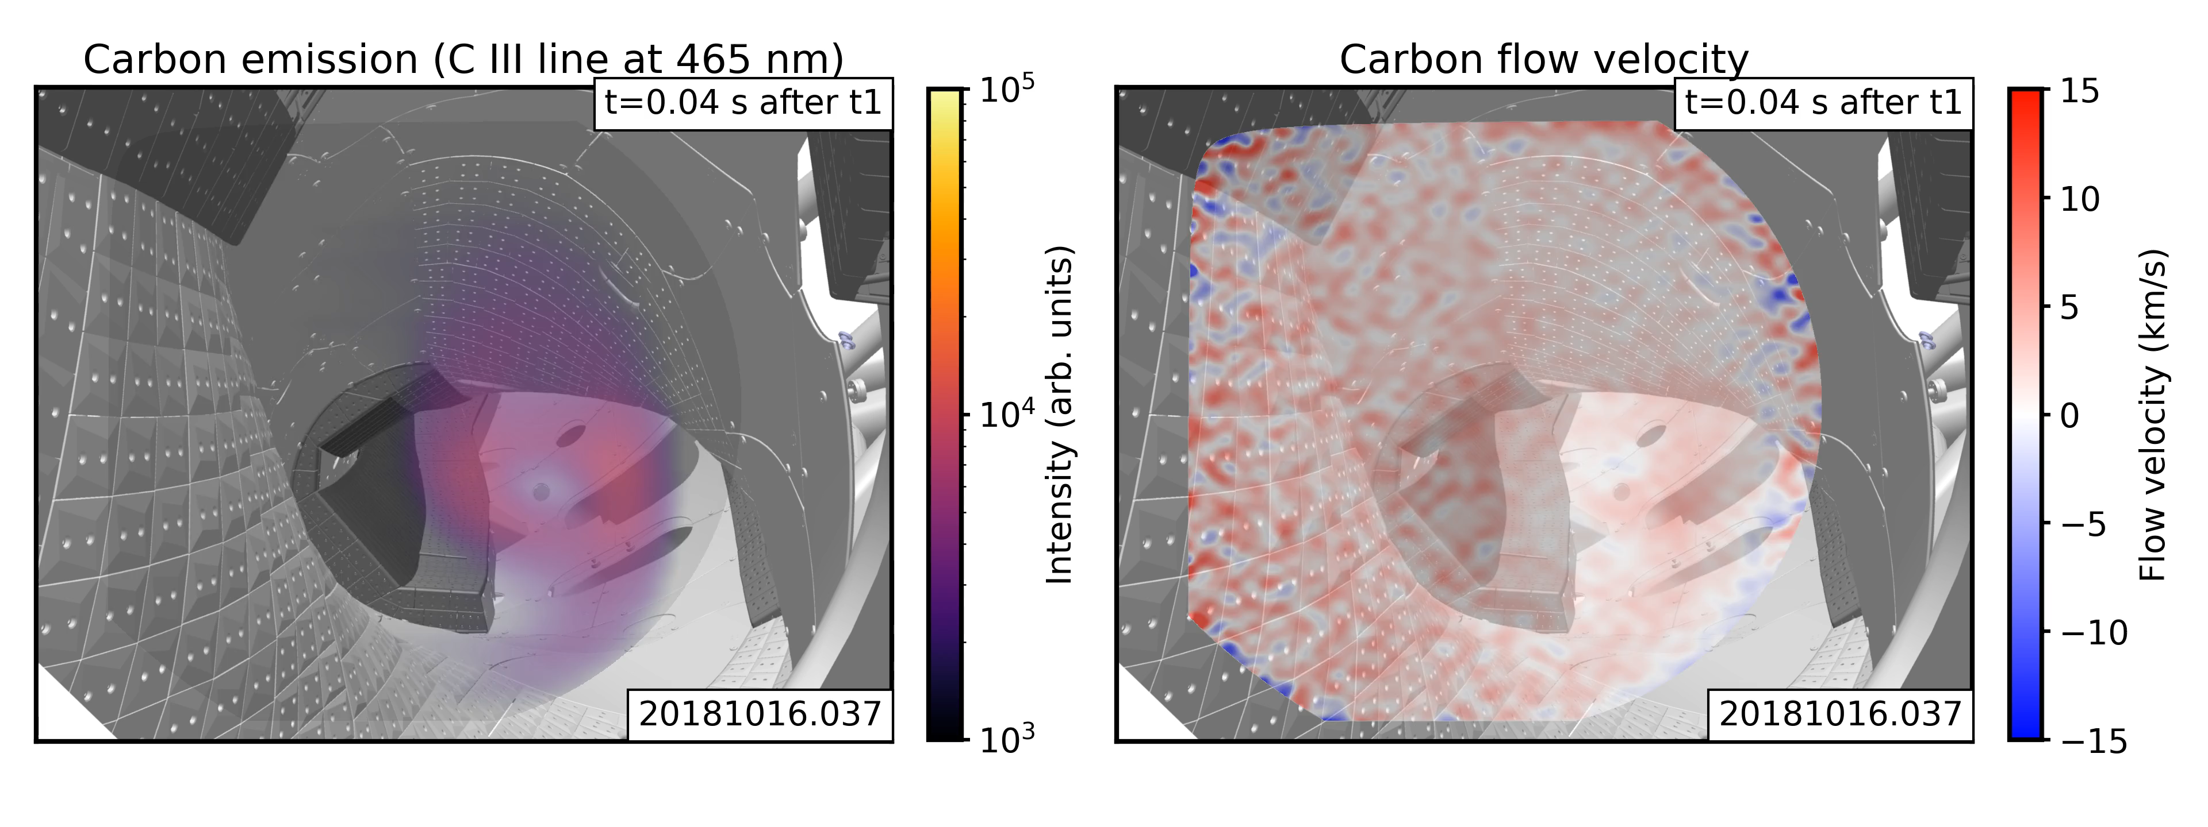
Coherence imaging spectroscopy is an established diagnostic for impurity emission and velocity measurements
Coherence imaging spectrometer (CIS) compared to dispersive spectrometer:
  CIS obtains substantially more spatial information
  CIS has ~100x higher optical throughput (no slit required)
  CIS collects substantially less spectral information → requires isolated spectral line

Slide 7
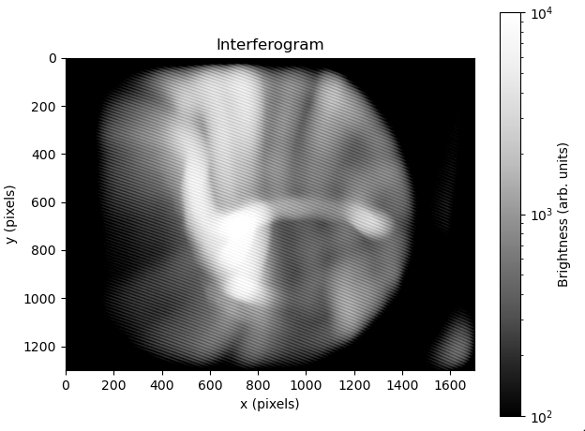
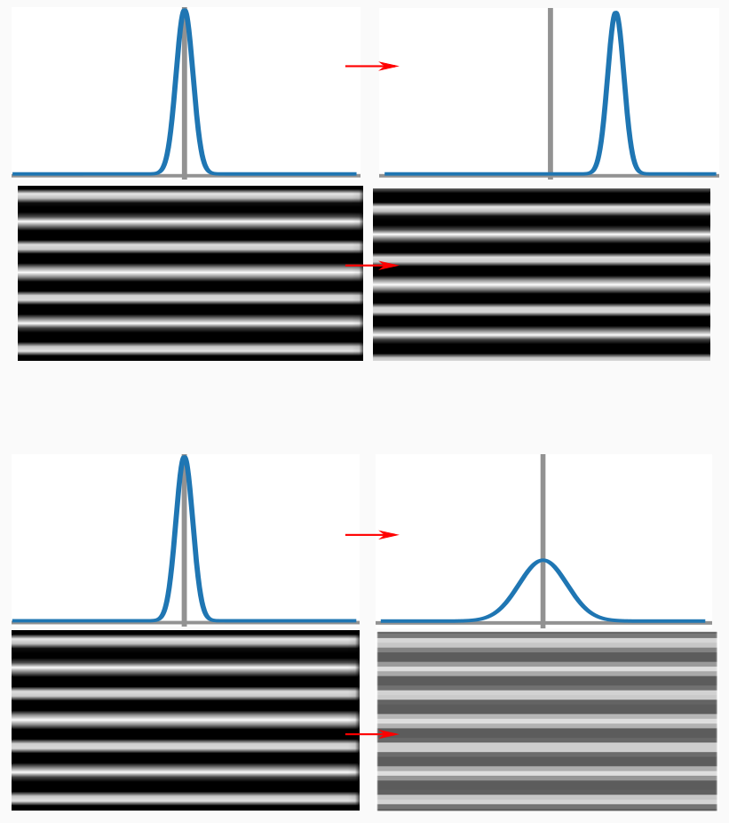

CIS encodes Doppler information from spectral emission lines into a spatial interference pattern
Interferogram (raw data)
Doppler shift
Ion velocity shifts wavelength of the emission line, resulting in a shift of the interference pattern
$$\frac{∆λ}{λ_{0}}=\frac{v_{i}}{c}$$
$$Δλ$$
$$λ_{0}$$
demodulation + calibration
Ion velocity (processed data)
Doppler broadening
Ion temperature broadens the emission spectrum, resulting in reduced contrast
$$σ=\frac{k_{B}T_{i}}{m_{i}}$$
$$2σ$$
[Figure courtesy N. Allen]

Slide 8
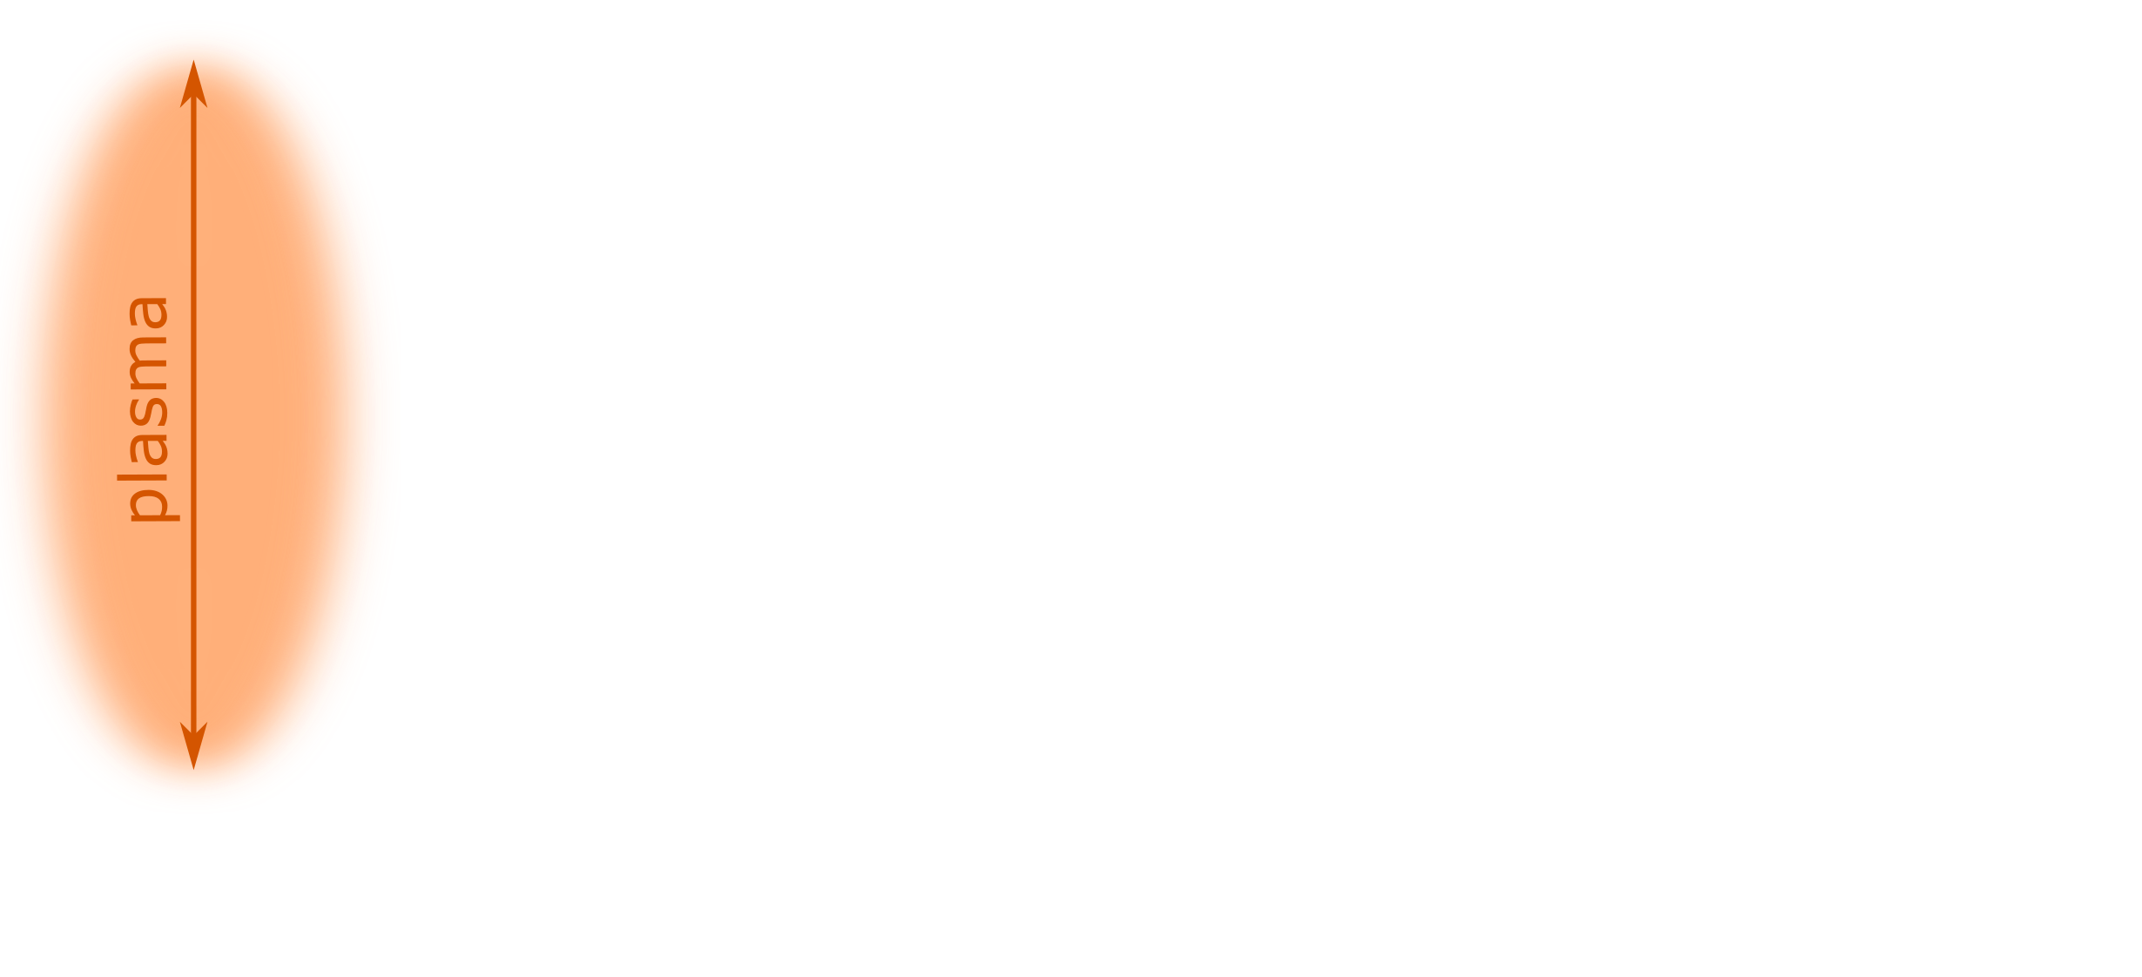
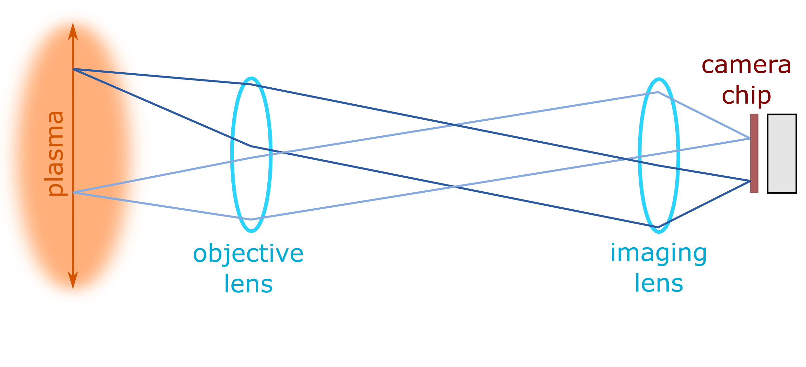
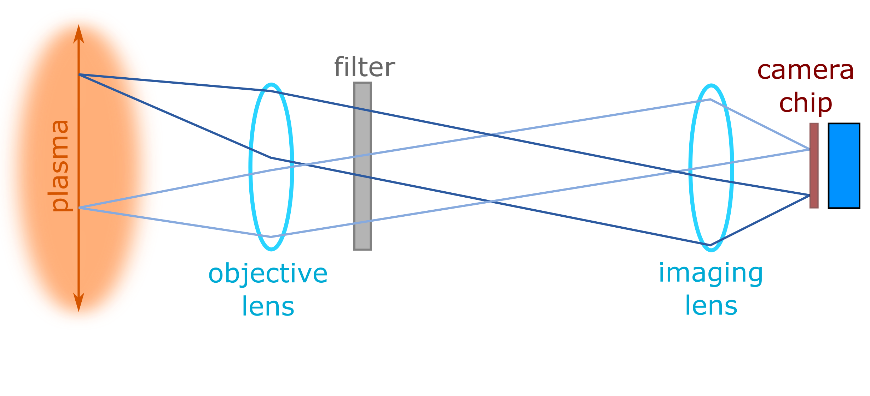
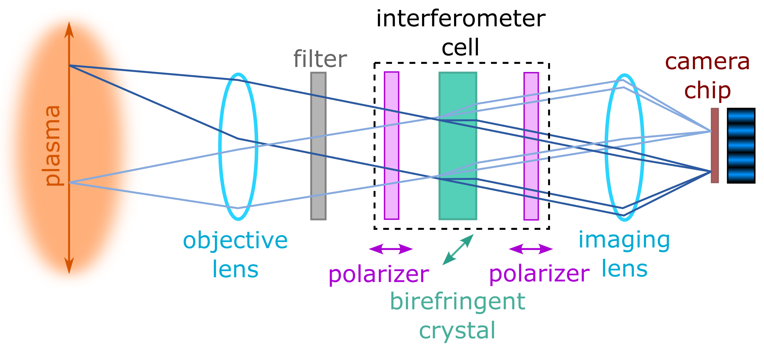
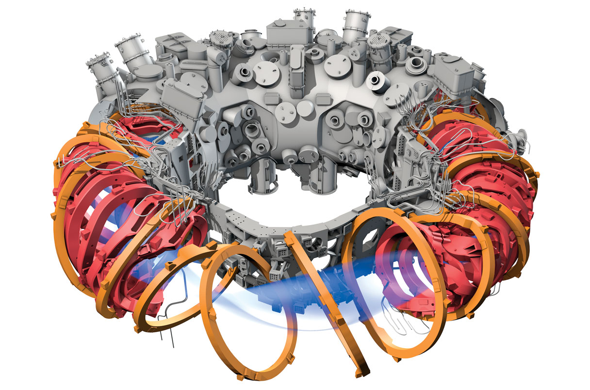
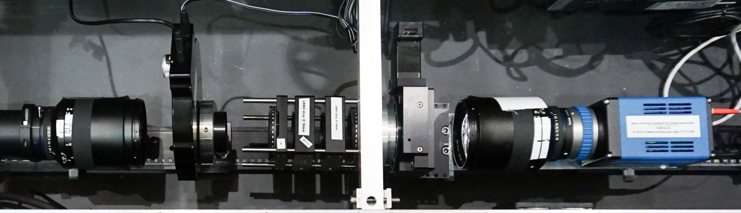
Interference pattern formed by imaging plasma light through a polarization interferometer
Polarizers + birefringent crystal split light into two orthogonally polarized beams and introduce phase delay $$Φ$$ between them
$$I$$: intensity
$$Φ$$: phase
$$ζ$$: contrast
$$S=\frac{I}{4}\left(1+ζ\cos{Φ}\right)$$
$$Iζe^{iΦ}=\int{I\left(λ\right)\text{exp}\left[−2πi\hat{N}{\left(λ−λ_{0}\right)}/{λ_{0}}\right]}dλ$$
Instrument sensitivity given by group delay:
$$\hat{N}=−\frac{λ}{2π}\frac{dΦ}{dλ}$$
imaging fiber bundle
V. Perseo et al, RSI 91 013501 (2020)
Notes:
Rework this to use animations to break this up (and include pictures of actual hardware is shown in addition to schematics + maybe polarization state of light at each stage?)

Slide 9
Outline
Motivation and overview of coherence imaging spectroscopy
CIS design principles for edge $$T_{i}$$ measurements
Inference of $$T_{i}$$ from CIS data
Validation of CIS $$T_{i}$$ measurements on W7-X

Slide 10
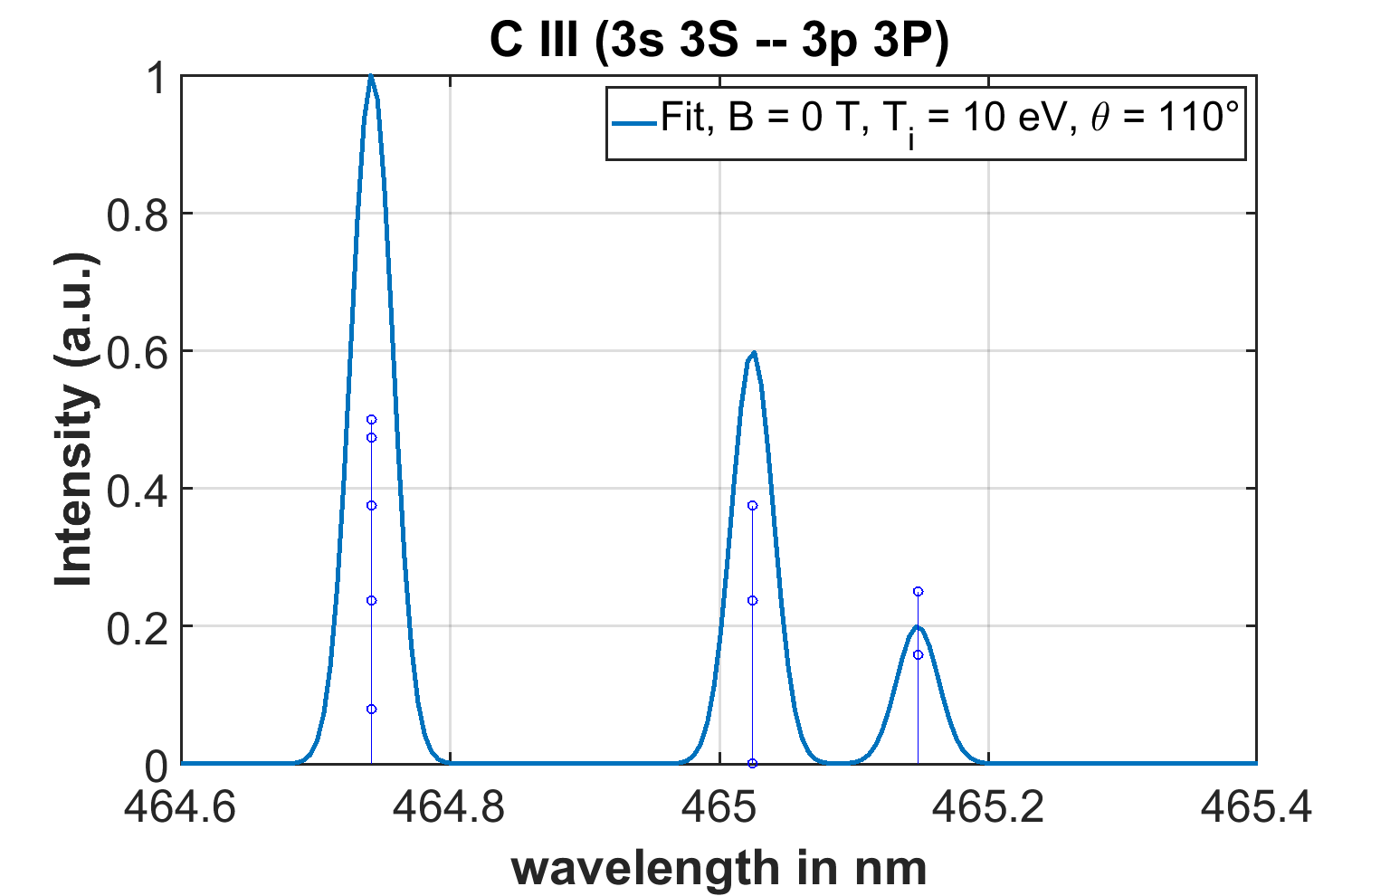
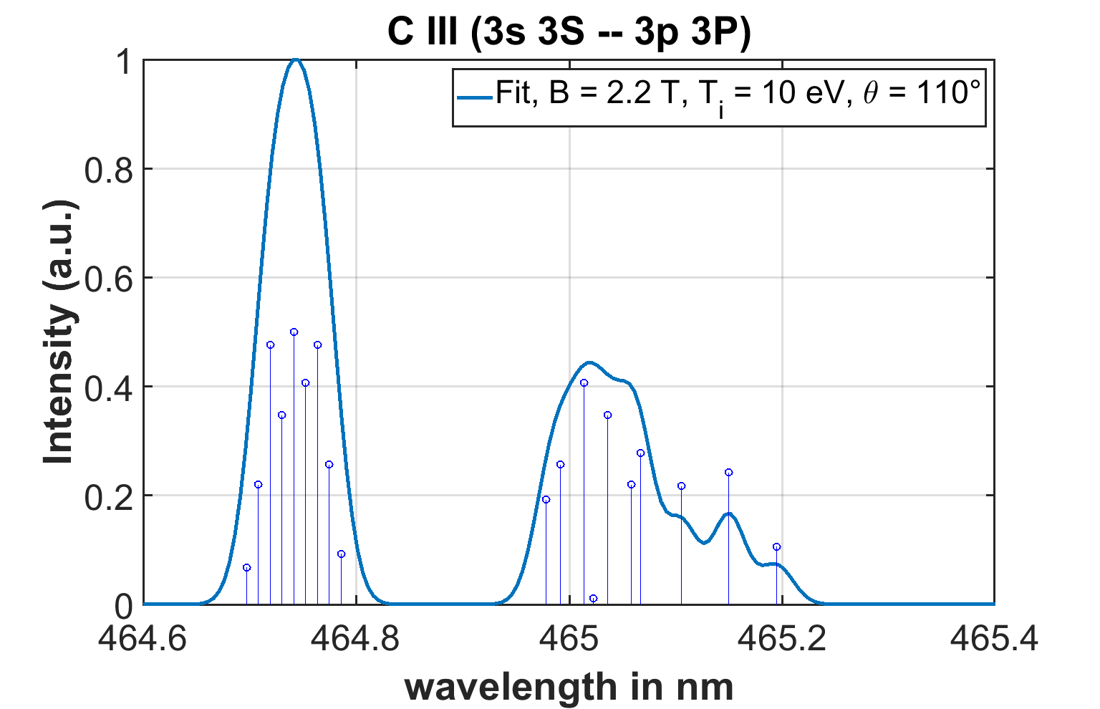
Main challenge measuring edge $$T_{i}$$ with CIS is distinguishing between Doppler broadening and Zeeman splitting
Several mechanisms can contribute to the CIS contrast
  Doppler broadening $$ζ_{D}=\text{exp}\left[−T_{i}{\hat{N}}^{2}{2π^{2}}/{m_{i}c^{2}}\right]$$
  Zeeman splitting $$ζ_{Z}$$: depends on magnetic field $$B$$ and observation angle $$θ$$
  Stark broadening $$ζ_{S}\left(n_{e}\right)$$
  Background emission (e.g. bremsstrahlung) $$ζ_{B}\left(n_{e,core},Z_{eff}\right)$$
  Instrument contrast $$ζ_{I}$$: calibration factor
Choice of C III 465 nm spectral line greatly simplifies analysis
  C III intensity >> background
  Well-separated from other strong impurity lines
  Inferred $$T_{C^{2+}}$$ is decent proxy for main ion $$T_{i}$$ up to ~30 eV
$$ζ_{D}$$and $$ζ_{Z}$$ are comparable in the SOL plasma of magnetic confinement fusion experiments
C III 465 nm line shape
$$ζ=ζ_{D}ζ_{Z}{ζ_{S}ζ}_{B}ζ_{I}$$
B = 0 T
T_{i} = 10 eV
B = 2.2 T
T_{i} = 10 eV
$$ζ≈ζ_{D}ζ_{Z}ζ_{I}$$
D. Gradic et al, NF 61 106041 (2021)

Slide 11
CIS birefringent crystals are optimized to minimize sensitivity to Zeeman splitting of C III 465 nm line
Response to Doppler broadening ($$T_{i}$$)
Response to Zeeman splitting ($$B$$ & field-sightline angle)
Relative sensitivity to Doppler vs Zeeman
$$S_{T_{i}}=\frac{1}{ζ_{D}}\frac{\text{d}ζ_{D}}{\text{d}T_{i}}$$
$$S_{B}=\frac{1}{ζ_{MZ}}\frac{\text{d}ζ_{MZ}}{\text{d}B}$$
$$M_{B}={S_{T_{i}}}/{S_{B}}$$
Sensitivity to multiplet + Zeeman splitting has non-monotonic group delay dependence → certain group delays give low Zeeman splitting sensitivity
Specific group delays give higher sensitivity to $$T_{i}$$ than $$B$$ in the relevant 2–3 T range
Sensitivity to Doppler broadening increases monotonically with increasing group delay
2620 waves chosen

Slide 12
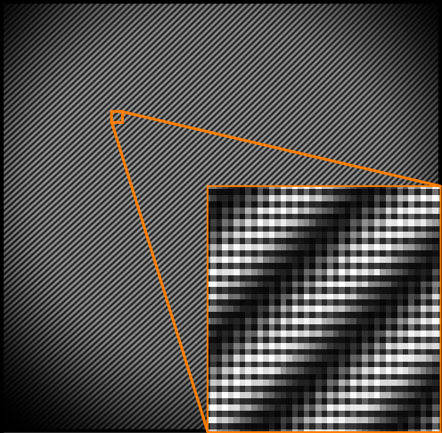
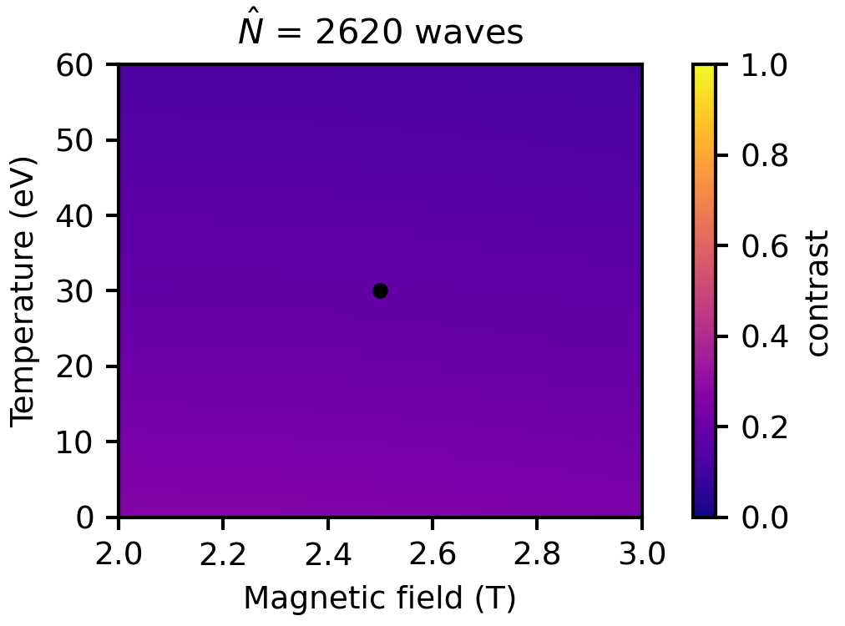
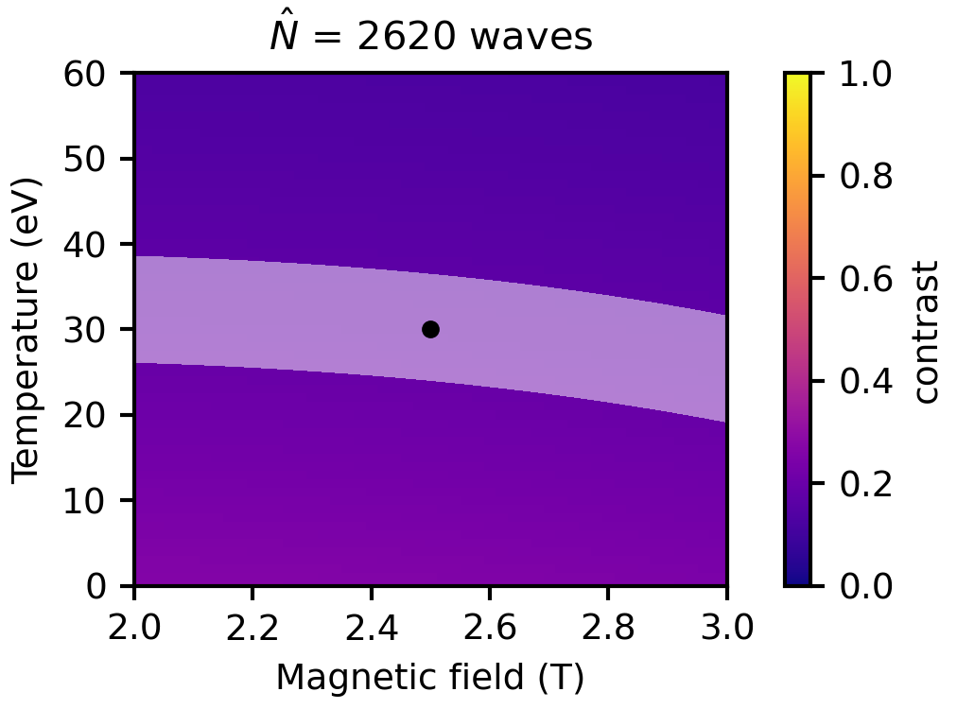
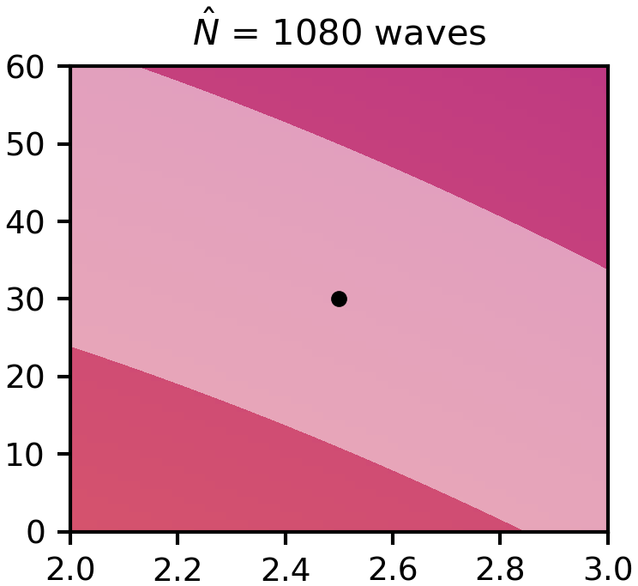
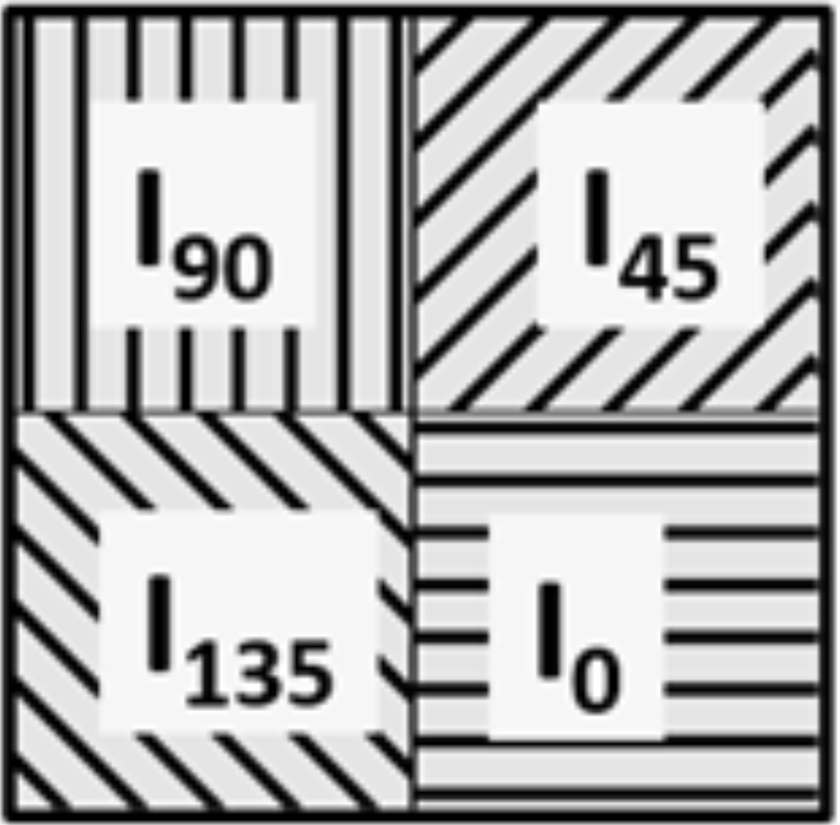
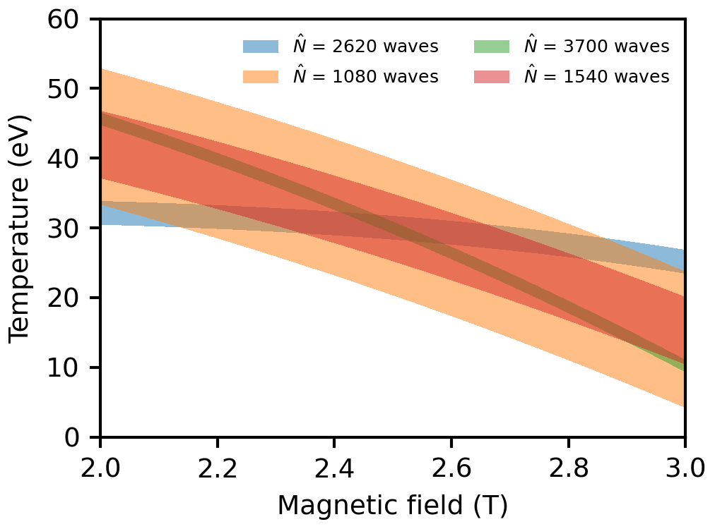
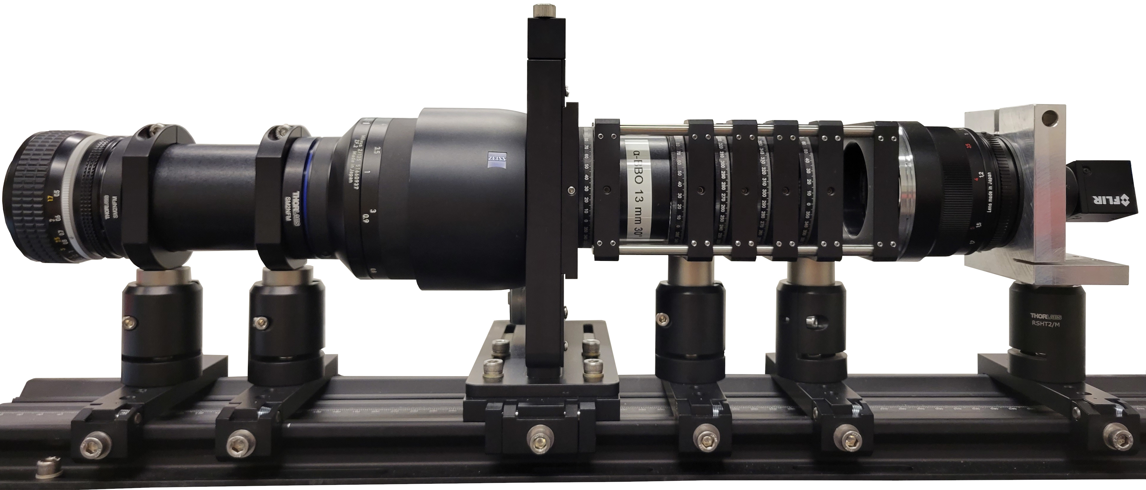

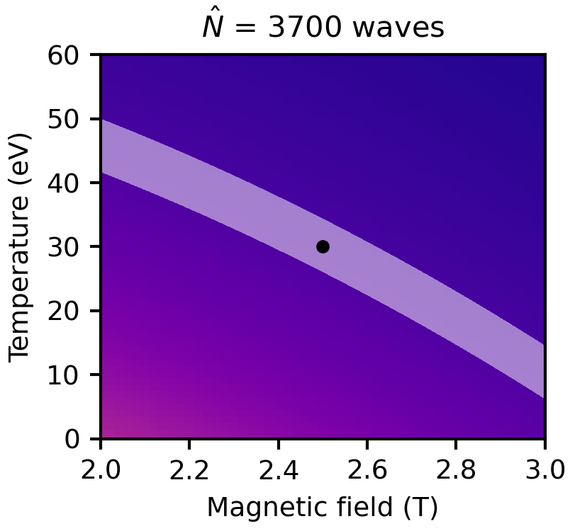
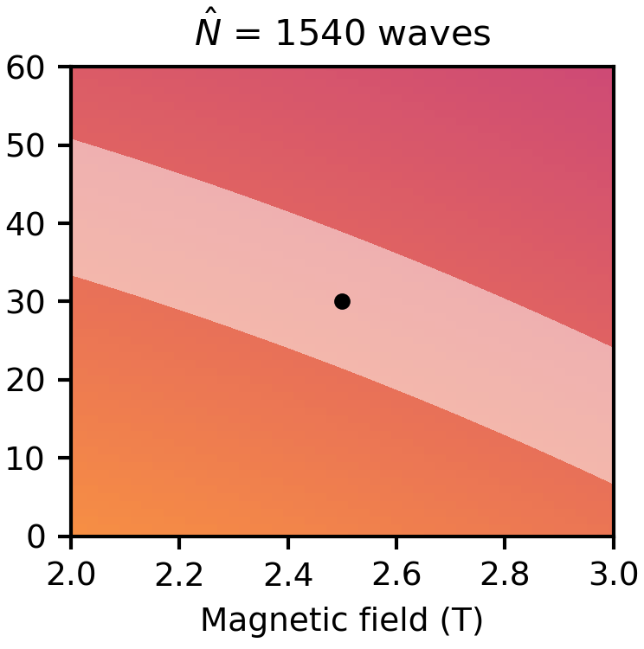
Multi-delay CIS approach increases the available spectral information, improving $$T_{i}$$ measurement accuracy
Possible solutions for $$T_{i}=30 \text{eV}$$ and $$B=2.5 \text{T}$$ (1% uncertainty in contrast measurement)
Multi-delay CIS approach¹ obtains four times amount of spectral information as conventional CIS
Multi-delay fringe pattern
Micropolarizer grid
Filter wheel
Polarizer #1
Polarizer #2
Camera with micropolarizer sensor
Crystal #1 (displacer)
Crystal #2 (delay)
Collimating lens
Quarter-wave plate
Camera lens
Combination of linear carrier (crystal #1) and pixelated carrier (crystal #2) interferometry
Polarizers plus crystal #1 encode spectra into linear fringes at $${\hat{N}}_{1}$$
Crystal #2, QWP, and polarization camera encode spectra into pixelated fringes at $${\hat{N}}_{2}$$
Fringes multiplied together → information also encoded at $${\hat{N}}_{1}+{\hat{N}}_{2}$$ and $${\hat{N}}_{2}−{\hat{N}}_{1}$$
solution space using information from all four group delays
¹J.S. Allcock et al., RSI 92 073506 (2021)

Slide 13
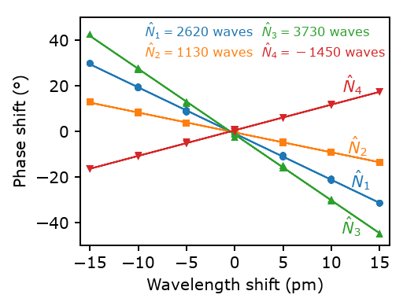
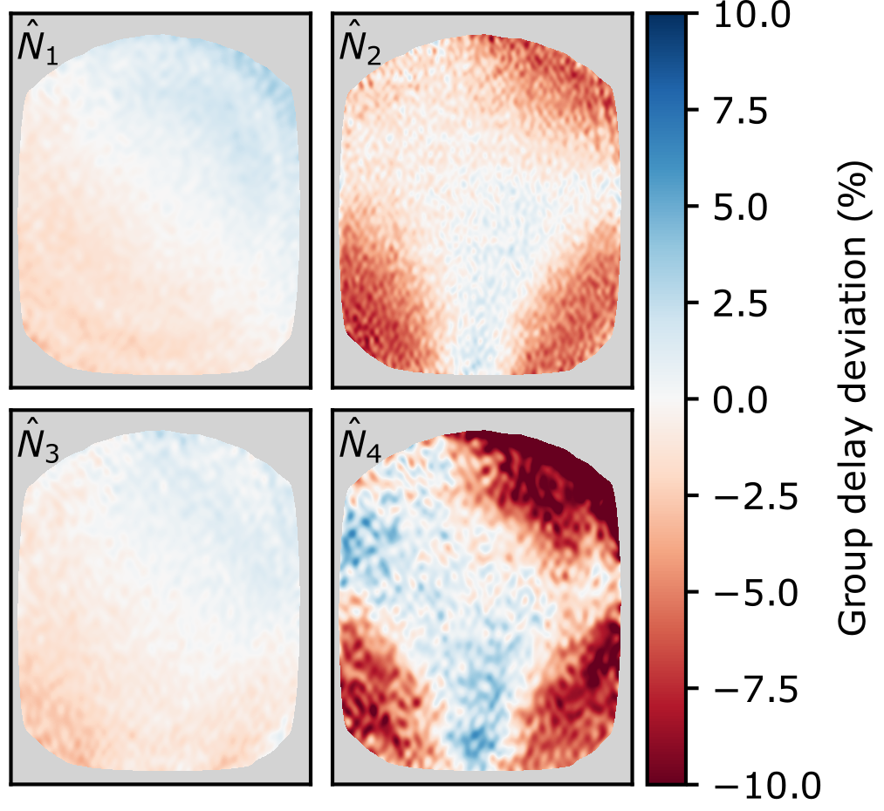
Multi-delay CIS instrument characterized and calibrated using precision tunable laser
Group delay measured using fine wavelength scans of precision tunable C-WAVE laser^{1,2}
Variation of group delay across image measured to eliminate errors caused by common assumption of constant $$\hat{N}$$
All group delays within 5% of design value
For more details on laser scans, see posters by V. Perseo [1.2.30] and S. Ahkundzada [1.4.26]
¹D. Gradic et al., FED 146 995 (2019)
²V. Perseo et al., RSI 91 013501 (2020)
Notes:
Sapida Ahkundzada

Slide 14
Outline
Motivation and overview of coherence imaging spectroscopy
CIS design principles for edge $$T_{i}$$ measurements
Inference of $$T_{i}$$ from CIS data
Validation of CIS $$T_{i}$$ measurements on W7-X

Slide 15
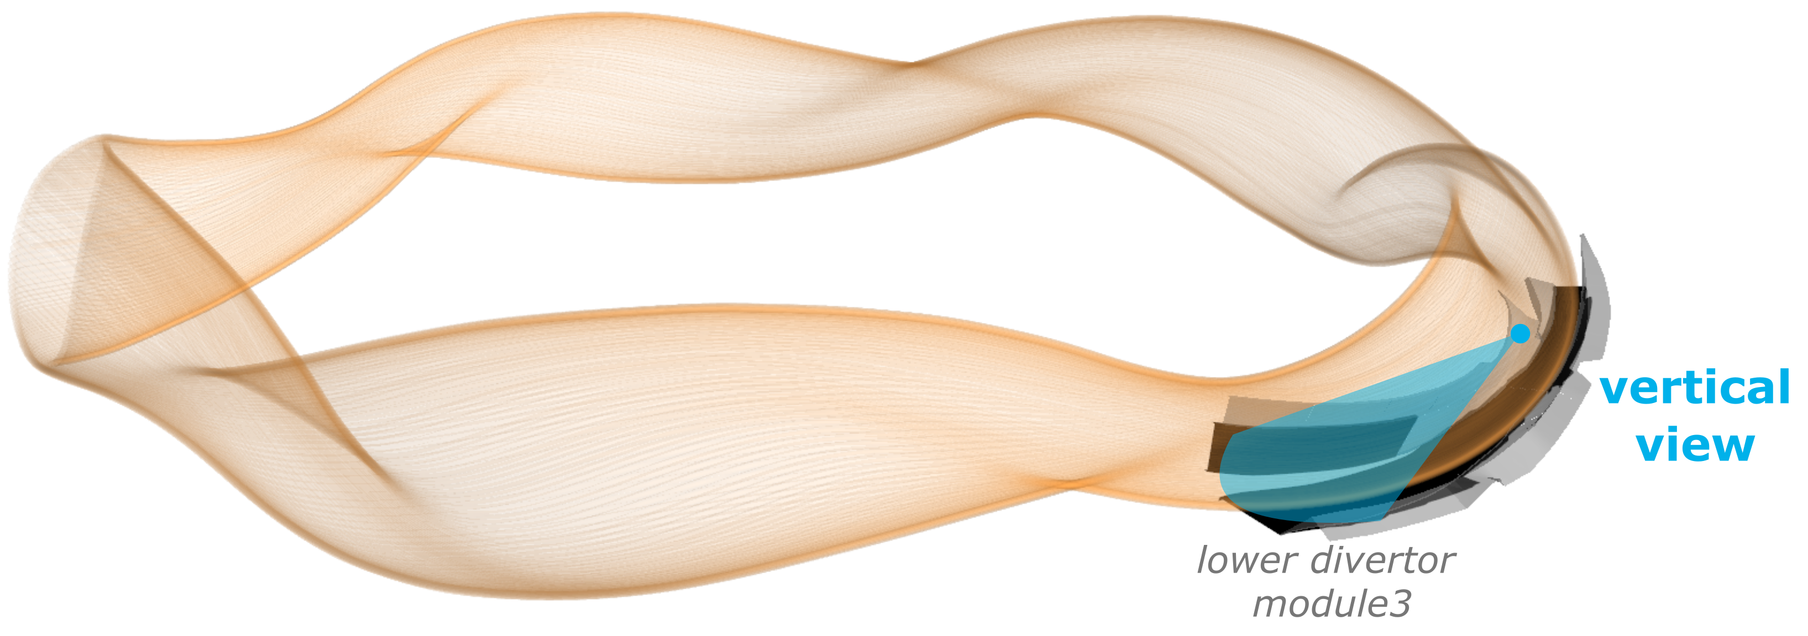
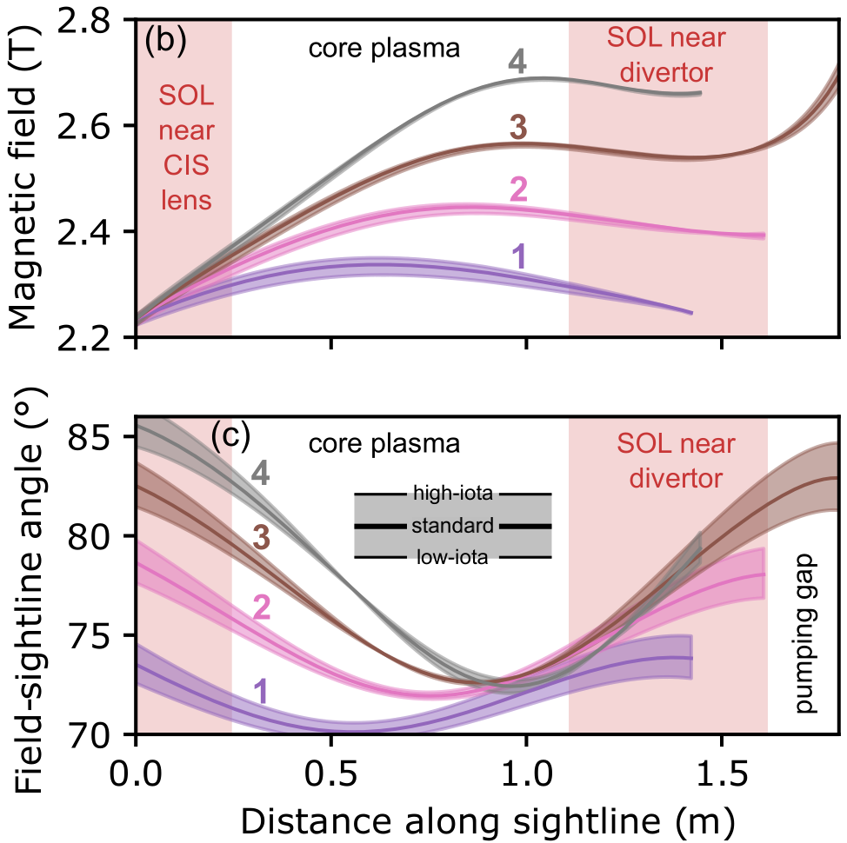
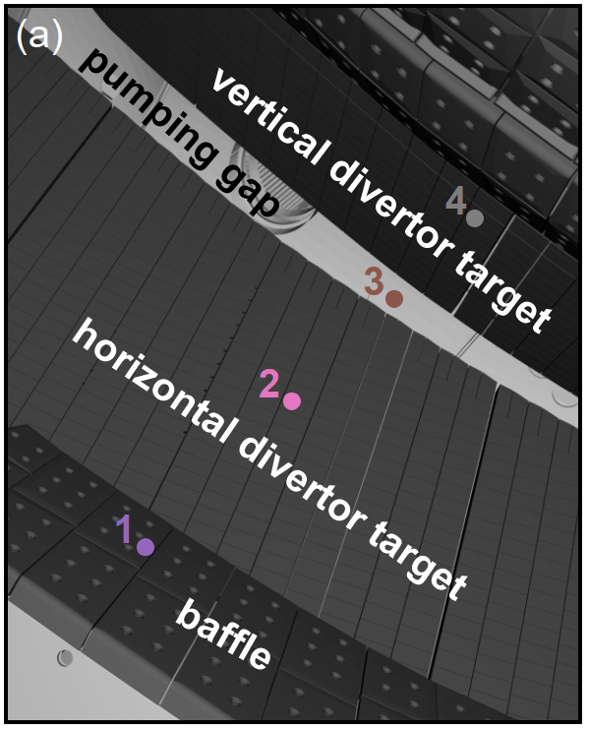
Magnetic field geometry is precisely known along CIS sightlines
W7-X stellarator optimized for low plasma current
→ magnetic field generated largely be external coils and easy to calculate along CIS sightlines
toroidal direction

Slide 16
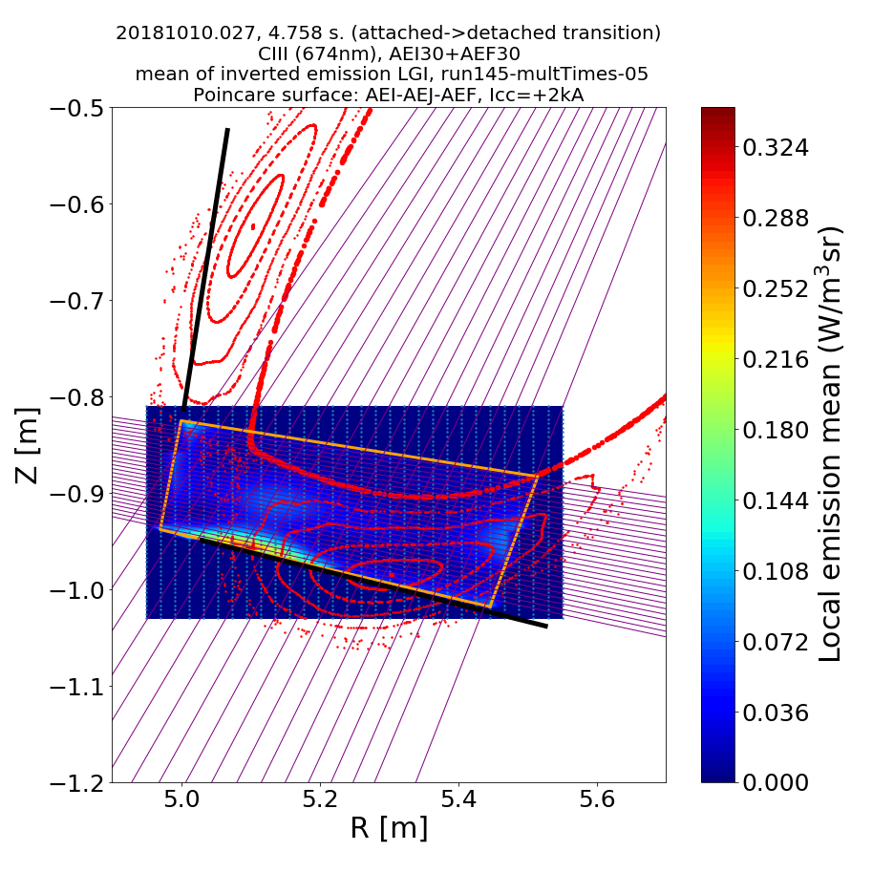
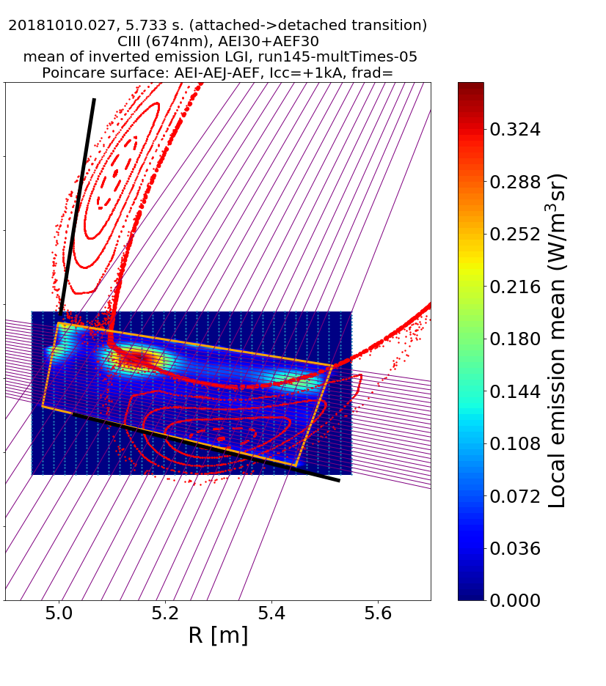
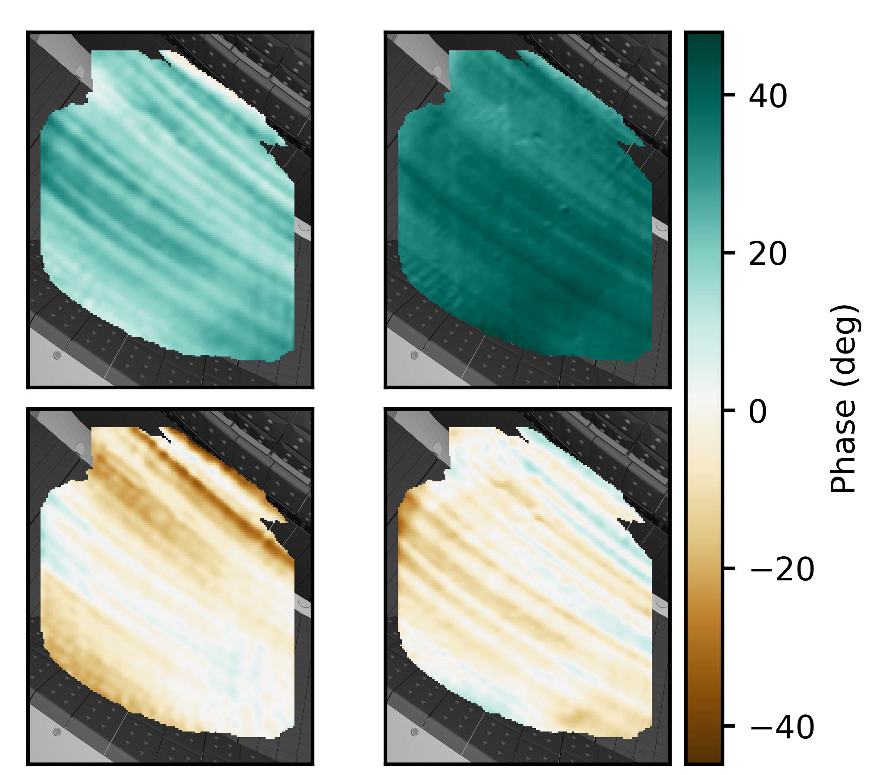
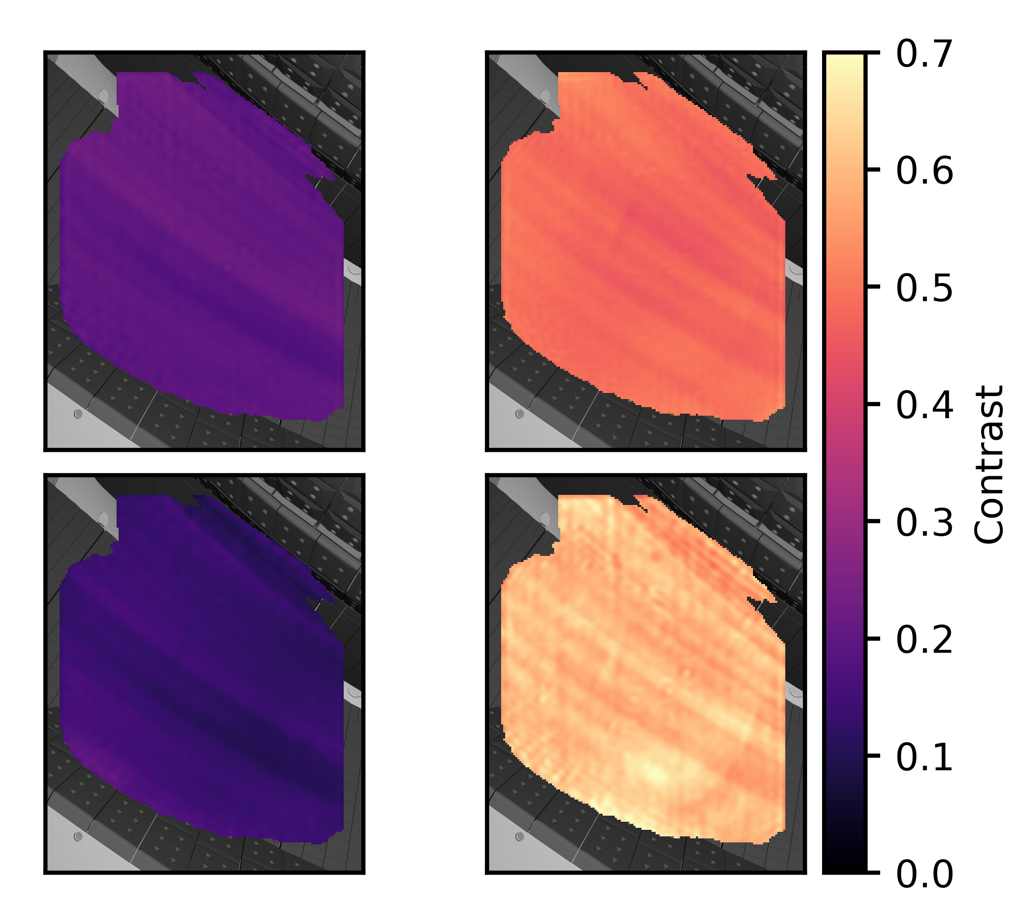
Temperature is inferred by fitting a model of the C III line shape to data, using variation of magnetic field along sightlines
Data: phase and contrast images for each of
the four group delays
Fitting model: C III 465 nm triplet with Doppler
shift/broadening and Zeeman splitting
C III emission localized to a single 1-5 cm long
region in SOL near divertor^{1,2} → $$B$$ and $$θ$$ are
not independent fit parameters
Fit parameters:
C²⁺ velocity $$v_{i}$$
C²⁺ temperature $$T_{i}$$
Distance of emission location along sightline $$d_{sightline}$$
Magnetic field known along sightlines
→ $$B=B\left(d_{sightline}\right)$$, $$θ=θ\left(d_{sightline}\right)$$
$$B$$ and $$θ$$ for example sightlines
Tomographic reconstructions of C III radiation distribution²
Phase $$Φ$$
Contrast $$ζ$$
$${\hat{N}}_{1}$$
$${\hat{N}}_{2}$$
$${\hat{N}}_{1}$$
$${\hat{N}}_{2}$$
$$Φ−Φ_{cal}=Φ_{D}\left(v_{i}\right)+Φ_{MZ}\left(B,θ\right)$$
$$ζ/{ζ_{I}}=ζ_{D}\left(T_{i}\right)ζ_{MZ}\left(B,θ\right)$$
$${\hat{N}}_{3}$$
$${\hat{N}}_{4}$$
$${\hat{N}}_{3}$$
$${\hat{N}}_{4}$$
¹D. Gradic et al., PPCF 64 075010 (2022)
²M. Krychowiak et al., EPS 2021 P1.1026

Slide 17
Outline
Motivation and overview of coherence imaging spectroscopy
CIS design principles for edge $$T_{i}$$ measurements
Inference of $$T_{i}$$ from CIS data
Validation of CIS $$T_{i}$$ measurements on W7-X

Slide 18
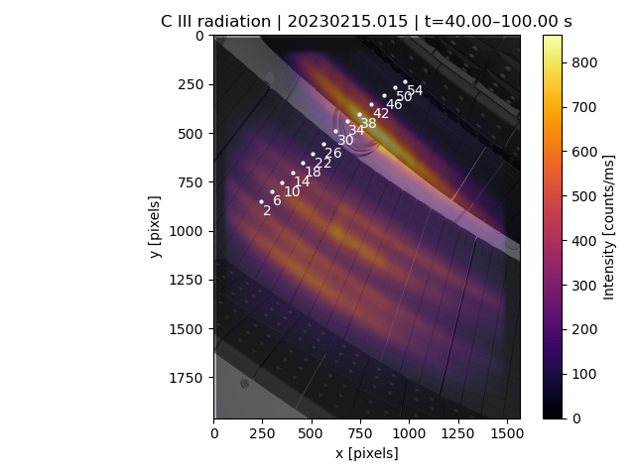
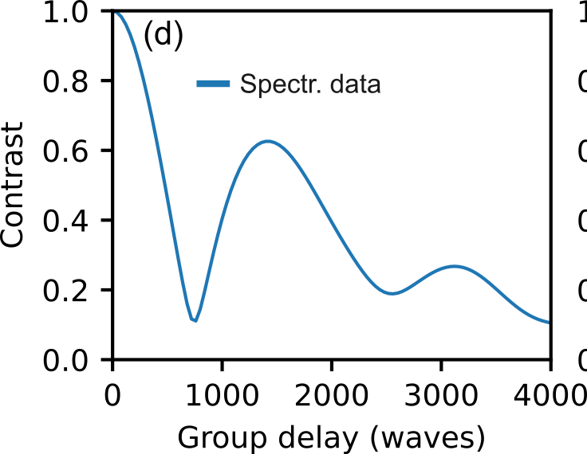
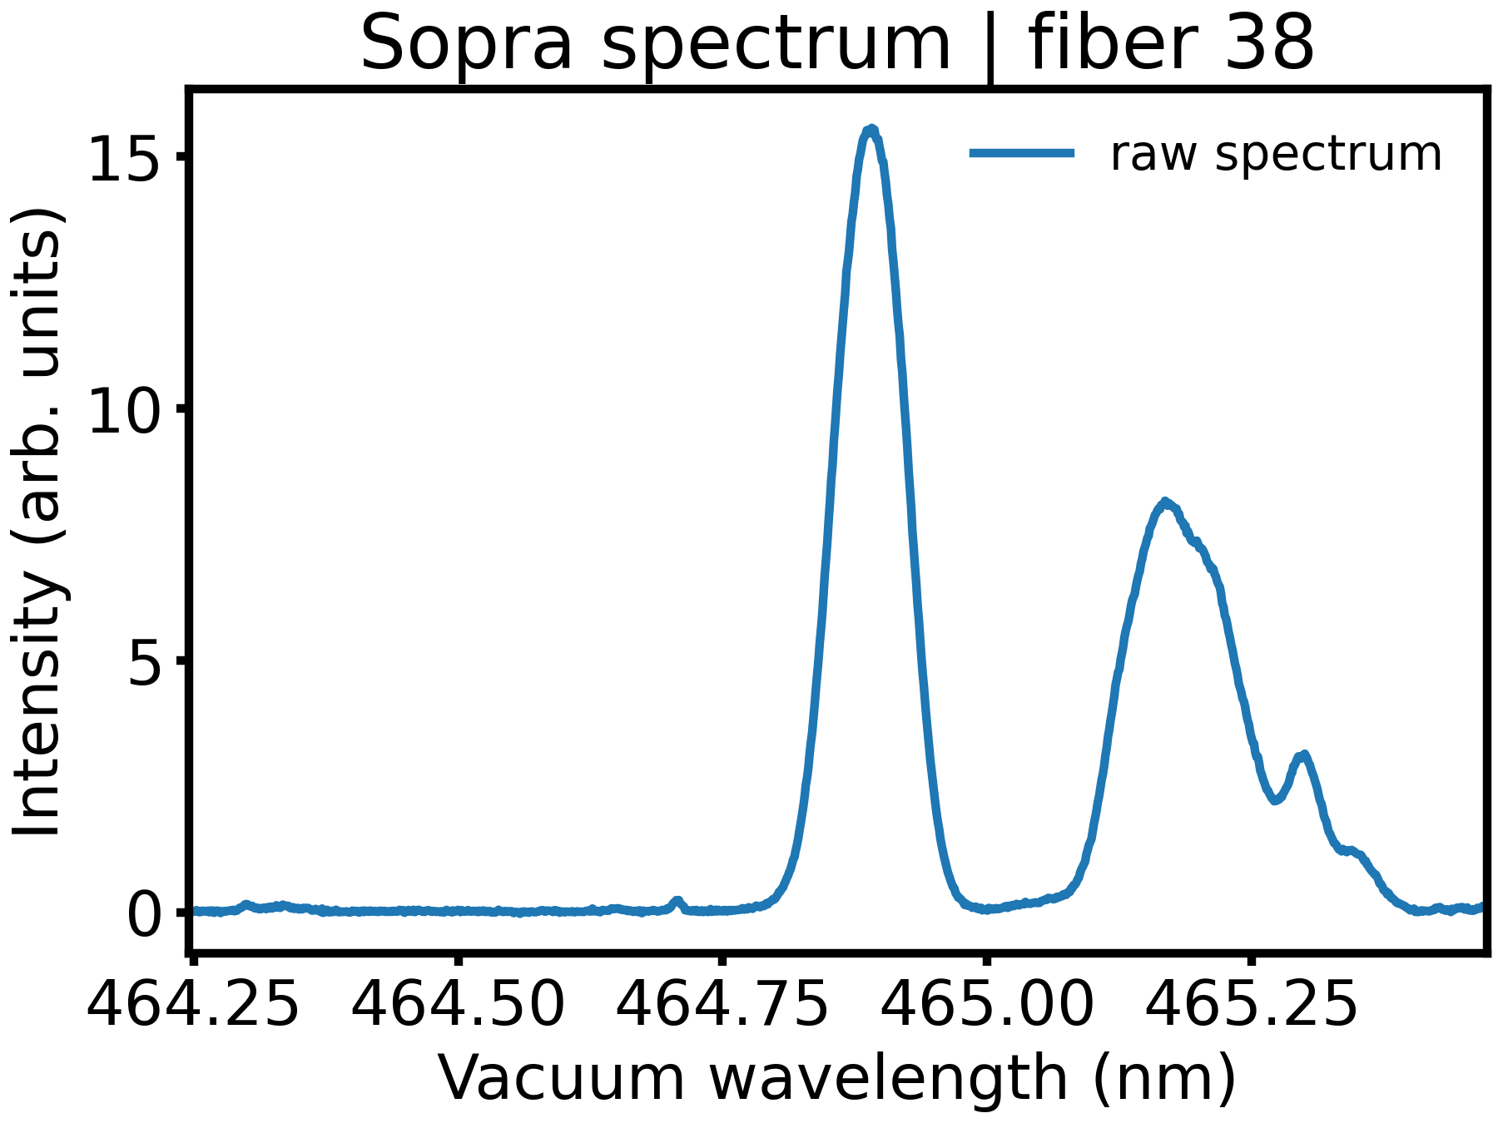
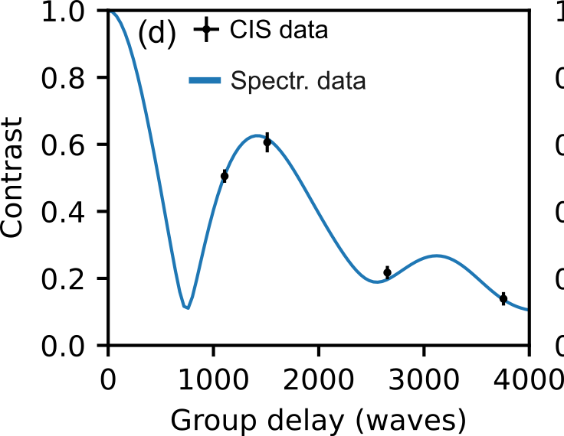
$$T_{i}$$-optimized CIS diagnostic is validated by cross-comparison with a high-resolution dispersive spectrometer
CIS C III intensity image in long-pulse W7-X plasma
CIS & spectrometer data averaged over long stationary time window in a 100 s plasma → high signal-to-noise ratio
Direct comparison of CIS and spectrometer data requires Fourier transformation of spectrometer wavelength spectra into coherence spectra: $$I\left(λ\right)→γ\left(\hat{N}\right)$$
spectrometer fiber locations
spectrometer fiber locations
Spectrometer sightline 38
Spectrometer sightline 38
Fourier transform
$$γ=\frac{1}{I}\int{I\left(λ\right)}\exp\left[−2πi\hat{N}λ/{λ_{0}}\right]\text{d}λ$$
Contrast = $$\left|γ\right|$$
$$γ$$: coherence
$$\hat{N}$$: interferometer group delay
$$λ_{0}$$: center wavelength of line
$$I\left(λ\right)$$: intensity per unit wavelength
$$I$$: integrated line intensity
EJM007+2520

Slide 19
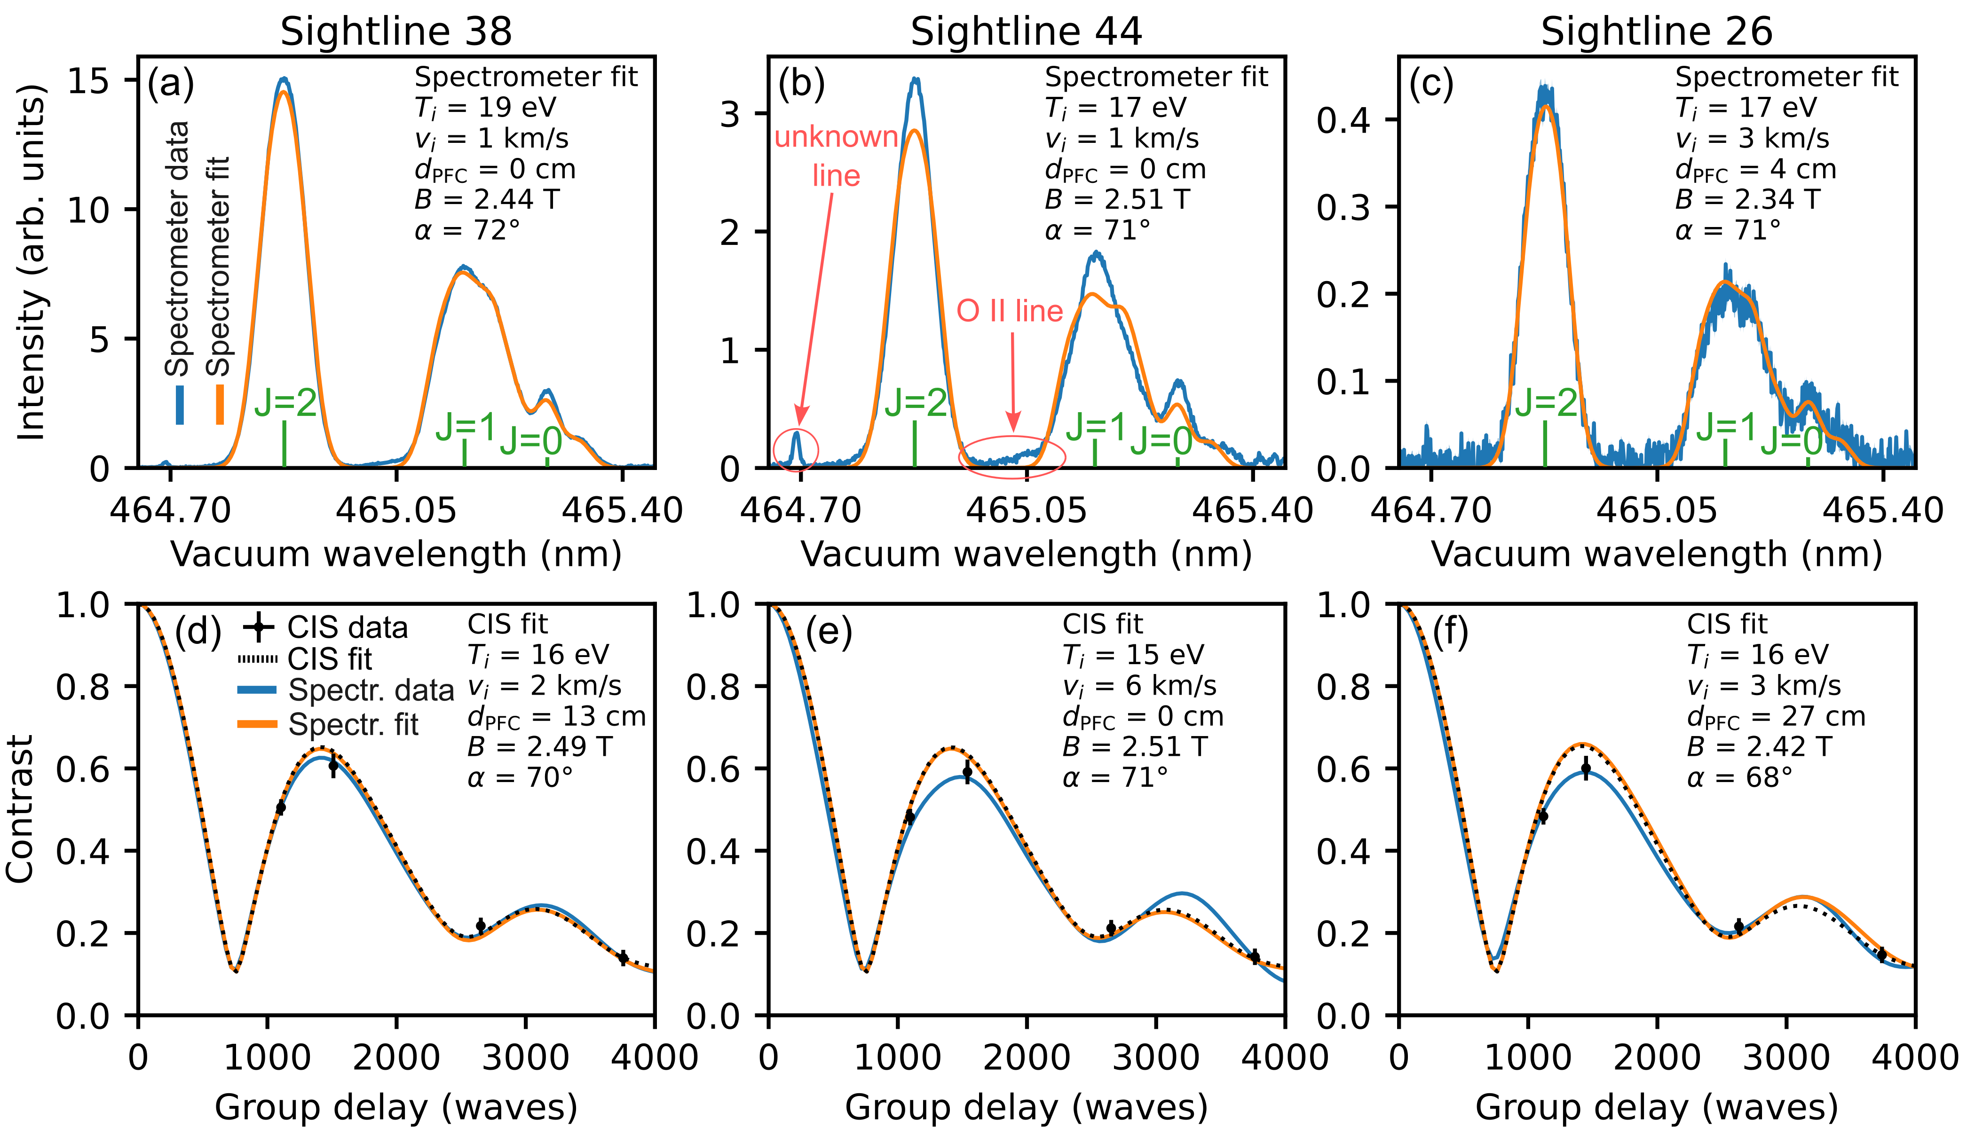
CIS and spectrometer measure same spectral information and fits are in good agreement for most sightlines
Highest signal
Most spectral contamination
Lowest spectrometer signal
spectrometer fiber locations
$$J=0,1$$ triplet components weighted 15% higher than statistical values due to strong electron impact excitation
[J.D. Hey et al., J. Phys. B 35 1525 (2002)]

Slide 20
Comparison between CIS and Sopra $$T_{i}$$ shows excellent agreement of C²⁺ temperatures
Do CIS and the spectrometer infer the same plasma parameters?
spectrometer fiber locations
CIS & Sopra C²⁺ $$T_{i}$$ show excellent agreement:
Well-matched profile shape
~10% difference on average
25% difference in worst case (ends of array)
Similar C III intensity profiles (difference in vignetting by plasma facing lens)
vertical divertor target
pumping gap
horizontal divertor target

Slide 21
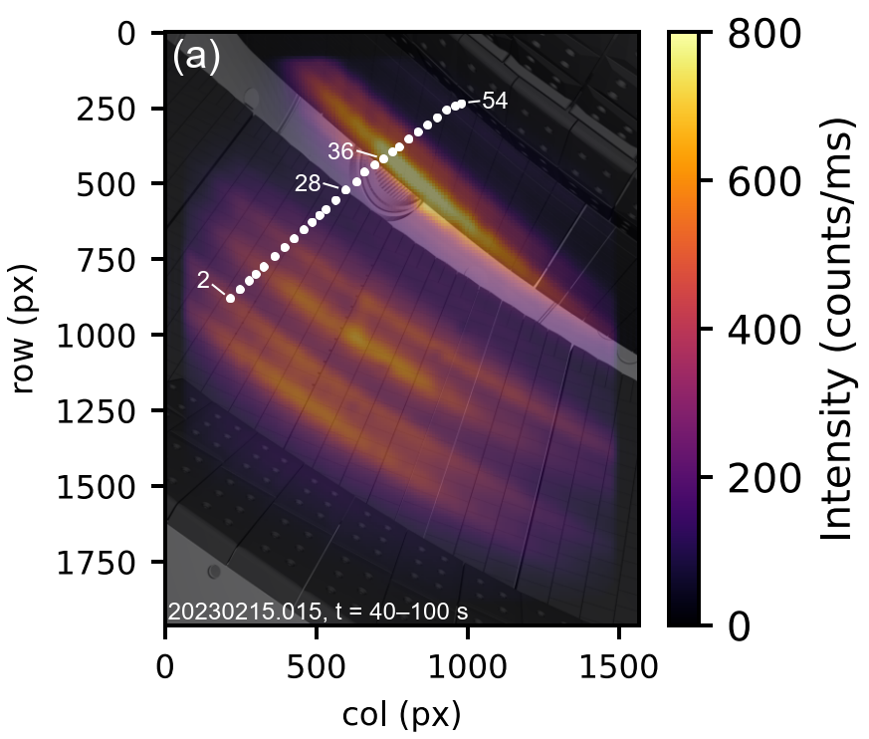
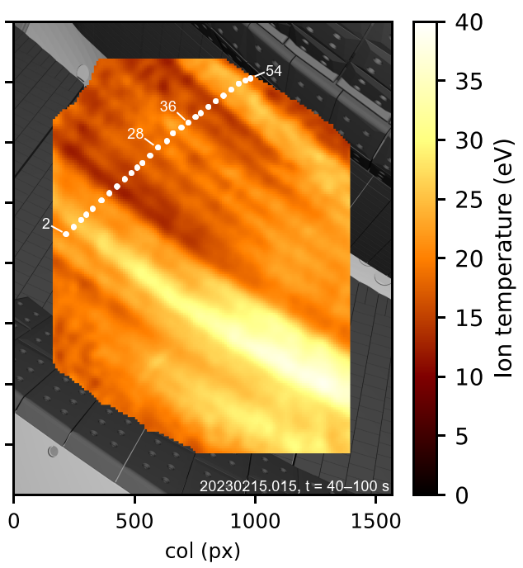
Divertor ion temperature image shows toroidally elongated structures and inverse correlation between $$T_{i}$$ and C III radiation
C III intensity
C²⁺ ion temperature image
$$T_{i}=10−40 \text{eV}$$ over divertor
Regions of high C III emission have lower $$T_{i}$$ and vice-versa
Band with particular high $$T_{i}$$ (up to 40 eV)

Slide 22
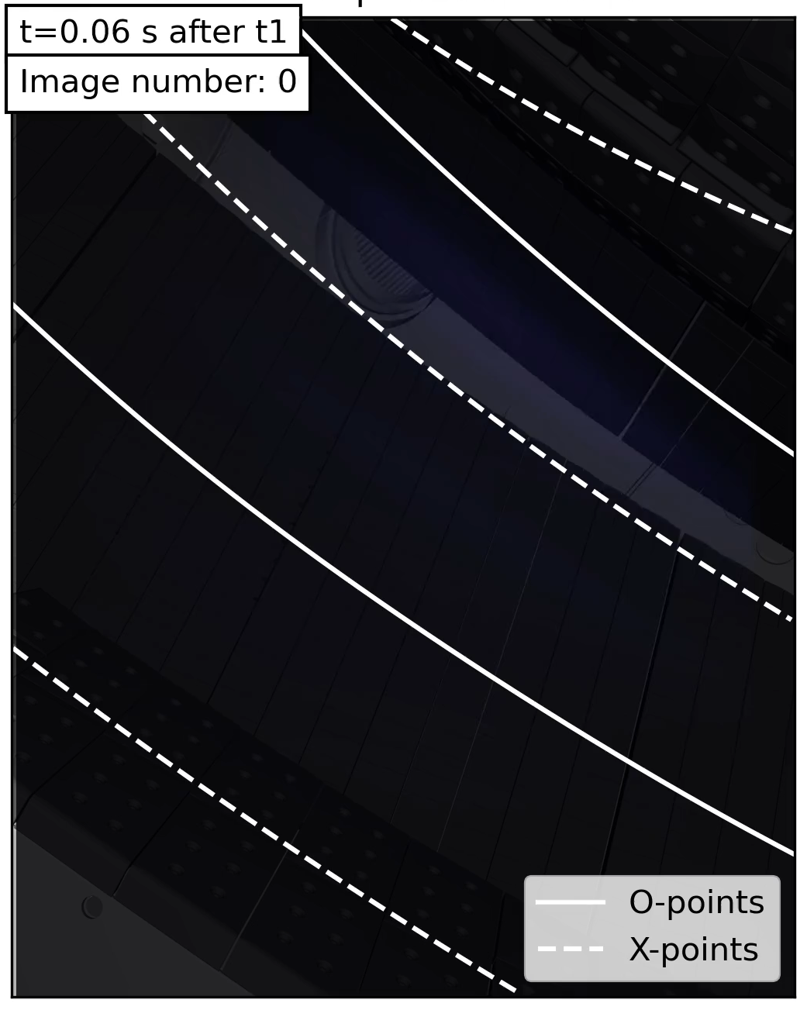
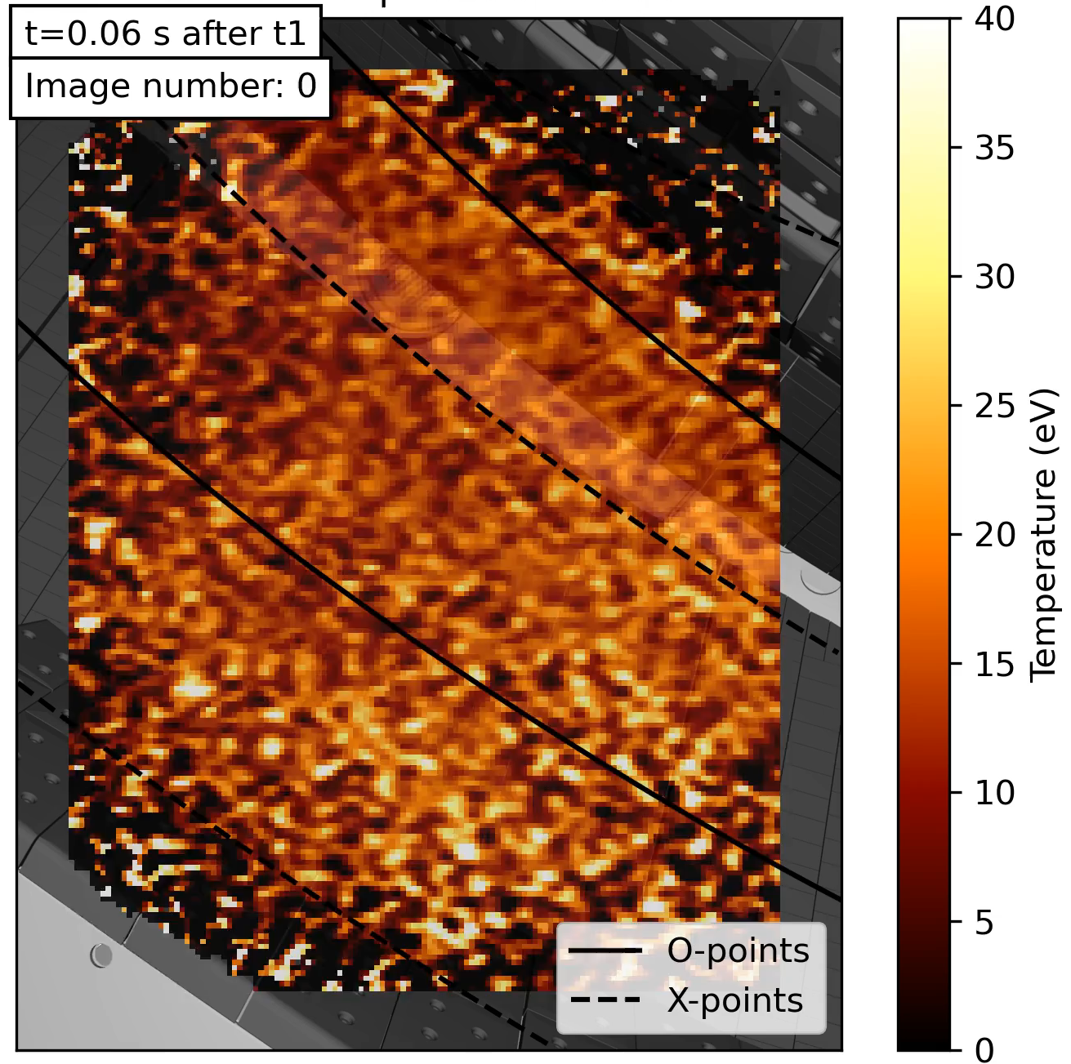

Summary and outlook
CIS diagnostic technique has been advanced to image C²⁺ ion temperatures without requiring cross-calibration by a separate dispersive spectrometer
Temperature measurements enabled by multi-delay configuration and novel approach to designing CIS birefringent crystals that minimizes instrument sensitivity to Zeeman splitting
CIS C²⁺ $$T_{i}$$ measurements validated by comparison against high-resolution spectroscopy in W7-X
New measurement capability is being used to characterize SOL $$T_{i}$$ distribution across W7-X parameter space (example: density ramp to detachment)
Density ramp to detachment
C III intensity
C²⁺ temperature
20230214.042
Funded by DoE grant DE-SC0014529 and EUROfusion grant 101052200

Slide 23
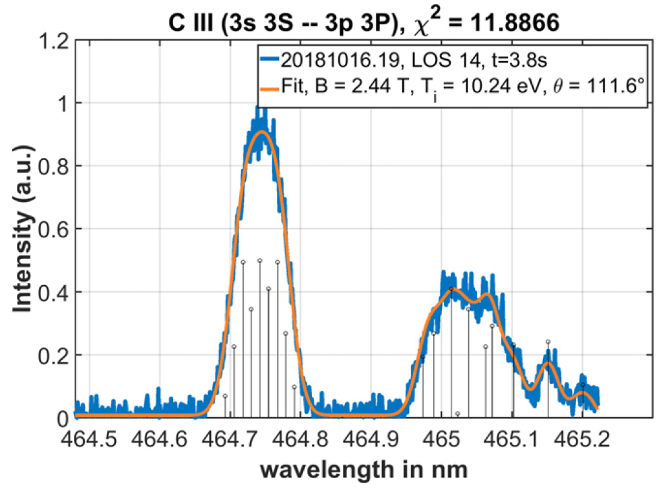
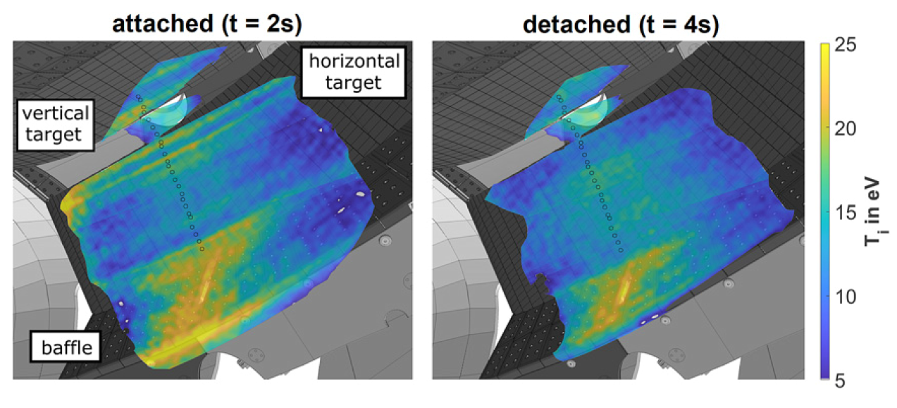
Overview of W7-X SOL $$T_{i}$$ measurements
Sopra spectrometer + fit to C III 465 nm line
Upstream $$T_{i}$$ measured with MPM using RFA or bell pen probe tip
High-resolution spectroscopy used to measure impurity $$T_{i}$$ in divertor
  Main challenge: Doppler broadening (which gives $$T_{i}$$) is comparable to Zeeman splitting
  Drawback of high-resolution spectroscopy: low time resolution (0.2–2 s) and limited number of sightlines
Goal: use coherence imaging spectroscopy (CIS) to image the $$T_{i}$$ distribution above the divertor
  CIS obtains limited spectral information → difficult to separate Doppler and Zeeman effects
  CIS $$T_{i}$$ image previously made by using spectrometer to determine Zeeman contribution and „calibrate“ it from CIS
$$T_{i}$$ from CIS using Sopra to calibrate
D. Gradic et al., NF 61 106041 (2021)

Slide 24
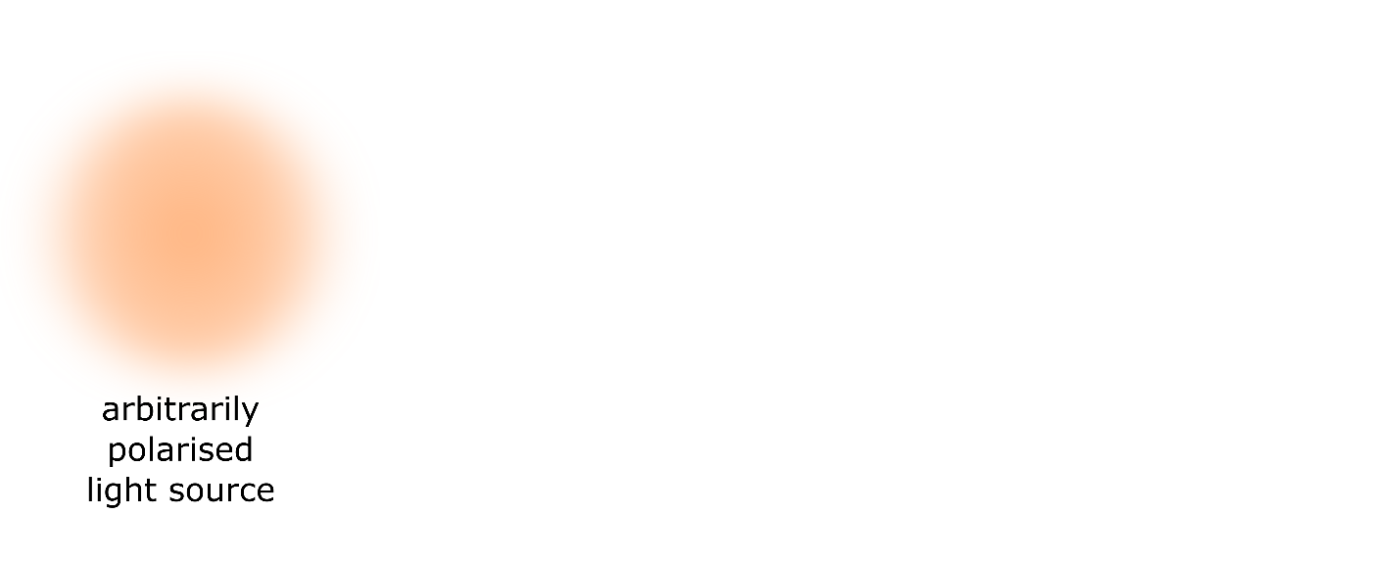
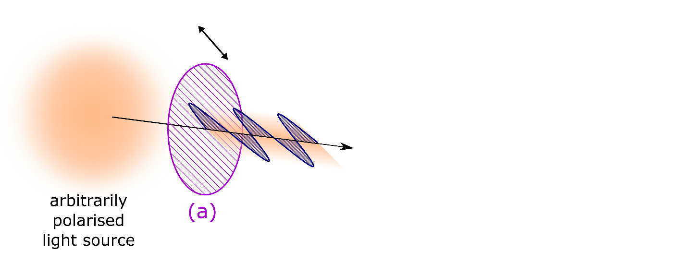



CIS uses polarizers and birefringent crystals to form an imaging polarization interferometer
$$y$$
$$x$$
Polarizer (a):
Polarizes incoming light at 45°
→ two equal-amplitude beams, one horizontally polarized and other vertically polarized, with 0° phase difference between them
Birefringent crystal:
Creates phase shift $$Φ$$ between two beams
$$Φ \sim λ$$
$$Φ$$ depends on angle of light through crystal
Polarizer (b):
Acts as an analyzer
Phase shift converted to an intensity modulation: $$I=\frac{1}{2}\left(1+\cos{Φ}\right)$$
Angle dependence of $$Φ$$ leads to a linear variation of $$I$$ across the image (straight fringes)
Notes:
Crucial for efficient interferometer cell → polarizers’ optical axes at 45° to crystals’ optical axes

Slide 25





CIS is calibrated before and after every plasma using a tunable laser
Laser scan
Unphysical results when calibrating 3 nm away from line wavelength
Primary challenge with CIS: calibrating the zero-flow reference point
  Spectral lamps typically not available at wavelength of spectral line being measured
  Highly sensitive to ambient temperature variations → need calibration near time of measurement
Solution: precision tunable laser calibrates CIS at $$λ_{line}$$ before and after every plasma discharge
  <0.1 pm precision, tunable 450–525 & 540–650 nm
Laser scans allow birefringent crystal parameters to be precisely characterized
  Future: characterize an interferometer cell one time, then calibrate with spectral lamps + extrapolation
1°C temperature drift leads to a 20 km/s velocity offset
$$λ_{cal}=λ_{Zn}$$

Slide 26





CIS data is analyzed by demodulating interferograms to obtain intensity and fringe phase
Fourier transform demodulation algorithm
2D inverse Fourier transform
Fringe phase
Filtered fringe box
2D Fourier transform
Amplitude spectrum
Interferogram (raw data)
Hilbert transform
Filtered center box
Intensity
$$v=\frac{c}{λ_{0}}\frac{Φ_{p}−Φ_{0}}{{ΔΦ}/{Δλ}}$$
$$Φ_{p}$$: fringe phase of plasma image
$$Φ_{0}$$: fringe phase of calibration image at $$λ_{0}$$ (rest-frame wavelength of spectral line)
$${ΔΦ}/{Δλ}$$: measured group delay of interferometer
2D inverse Fourier transform

Slide 27

Multi-delay fringe patterns are demodulated using the synchronous Fourier transform method
Frequency spectrum of calibration image × pixelated carrier phase
Frequency spectrum of calibration image
Calibration image
Compute frequency spectrum of image, use bandpass filters to isolate peaks 0 and 1, inverse Fourier transform to get intensity (from peak 0) and phase/contrast of linear fringes (from peak 1)
Multiply image by the pixelated carrier phase, $$\exp\left[i2θ_{p}\right]$$ ($$θ_{p}$$ is micropolarizer angle on camera), then repeat step 1. Peak 2 gives phase/contrast of pixelated fringes, and peaks 3 & 4 give phase/contrast of mixed linear & pixelated fringes.

Slide 28


Impurity ion temperatures can have a complex relationship with main ion temperatures in the scrape-off layer
Temperature of any carbon charge state governed by two processes:
  Collisional heating by main ions
  Ionization to next charge state (terminates heating)
Carbon sputtered as a neutral with some initial temperature¹:
1.5 eV for chemical erosion
~13.5 for physical sputtering
CIS
¹J.D. Hey et al., J. Phys. B 35 1525 (2002)
incoming plasma ion
sputtered neutral impurity atom
material surface
B.D. Wirth et al., MRS Bulletin 36 (2011)
[Calculated with ColRadPy: C.A. Johnson et al., NME 20 100579 (2019) ]

Slide 29


Time-evolution of carbon charge state temperatures calculated using collisional-radiative modelling
Approach: use collisional-radiative equations + collisional energy transfer with main ions to evolve the total population and total energy in each charge state¹
Ionization balance:
$$\frac{d}{dt}N_{z}=N_{z−1}S_{z−1}−N_{z}S_{z}+N_{z+1}R_{z+1}−N_{z}R_{z}$$
Energy balance:
$$\frac{d}{dt}\left(N_{z}T_{z}\right)=$$$$ν_{E}^{iz}N_{z}\left(T_{i}−T_{z}\right)$$$$+N_{z−1}T_{z−1}S_{z−1}−N_{z}T_{z}S_{z}$$$$+N_{z+1}T_{z+1}R_{z+1}−N_{z}T_{z}R_{z}$$
Measured C²⁺ temperature ≈ emissivity-weighted average of $$T_{z}\left(t\right)$$
$$N_{z}$$: population of charge state $$z$$
$$T_{z}$$: temperature of charge state $$z$$
$$S_{z−1}$$: ionization from below charge state ($$z−1$$ → $$z$$)
$$S_{z}$$: ionization to above charge state ($$z$$ → $$z+1$$)
$$R_{z}$$: recombination to below charge state ($$z$$ → $$z−1$$)
$$R_{z+1}$$: recombination from above charge state ($$z+1$$ → $$z$$)
$$ν_{E}^{iz}$$: energy transfer rate from collisions with main ions ($$ν_{E}^{iz} \sim { n}_{i}T_{i}^{−3/2}$$)
¹J.D. Hey et al., J. Phys. B 35 1525 (2002)

Slide 30




C²⁺ temperature matches main ion temperature $$T_{i}$$ for $$T_{i}≲30 \text{eV}$$
Measured C²⁺ temperature depends on main ion temperature, electron temperature, and density
Measured C²⁺ temperature as fraction of main ion (protium) temperature
Measured C²⁺ temperature as fraction of main ion (protium) temperature
Measured C²⁺ temperature assuming $$T_{i}=1.5{×T}_{e}$$
Measured C²⁺ temperature assuming $$T_{i}=T_{e}$$
$$n_{e}={10}^{19} {\text{m}}^{−3}$$
$$n_{e}={10}^{20} {\text{m}}^{−3}$$

Slide 31


CIS measurements are compared with those from a high-resolution dispersive spectrometer in a long-pulse W7-X plasma
CIS C III intensity image
CIS & spectrometer data averaged over long stationary time window in a 100 s plasma → high signal-to-noise ratio
Plasma in a limiter-like configuration (islands just inside last closed flux surface)
spectrometer fiber locations
Spectrometer sightlines¹
Time traces for long-pulse plasma
EJM007+2520
Time-average window
¹D. Gradic et al., PPCF 64 075010 (2022)
[Courtesy A. von Stechow]

Slide 32

Comparison between CIS contrast and equivalent spectrometer contrast verifies that both diagnostics observe same spectra
Highest signal
Most spectral contamination
Lowest spectrometer signal
spectrometer fiber locations

Slide 33
CIS accurately infers C²⁺ velocities except near vertical target, where C III line shape model deviates from expectations
Deviation of C III line shape model from data near $$J=1$$ component → CIS fit gives inaccurate $$v_{i}$$, spectrometer $$v_{i}$$ still accurate
Good agreement of C²⁺ $$v_{i}$$ except over vertical target
horizontal divertor target
pumping gap
vertical divertor target

Slide 34
CIS is unable to accurately determine the C III emission location
Spectrometer infers C III emission at target → expected for this attached plasma with $$f_{rad}≈20\%$$
CIS-inferred C III emission location oscillates and is inside confined plasma → unphysical for attached conditions
Emission localization depends on instrument sensitivity to Zeeman splitting → crystal $$T_{i}$$ optimization prevents accurate localization
Spectrometer infers C III emission is at pumping gap entrance
pumping gap
vertical divertor target
horizontal divertor target

