Slide 1
Divertor Tokamak Test facility Project:
Status of Design and Implementation
Enrico Di Pietro – DTT General Project Manager
EUROfusion Science Meeting - 12 June 2024

Slide 2
DTT project mission
"European Research Roadmap to the Realization of Fusion Energy" → the heat exhaust is one of the main challenges towards the construction of a fusion power plant.
A dedicated Divertor Tokamak Test (DTT) facility was considered necessary →a high-field, compact tokamak design was proposed capable of producing plasma conditions similar to those in ITER and DEMO in steady–state conditions
Substantial amount of external heating power to reproduce the level of divertor heat loads foreseen in ITER and DEMO.
Machine is expected to explore a variety of different magnetic configurations and in extreme conditions

Slide 3
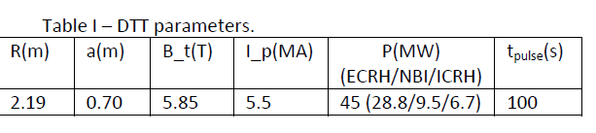
Scientific objectives & main parameters
Four main lines of investigation:
  magnetic configurations with large divertor wetted areas and detached plasma conditions;
  advanced plasma facing components technology;
  impurity seeding to increase core radiation; and
  liquid metals as plasma facing component.
DTT breakeven-class device with full tungsten actively cooled components before ITER.

Slide 4
Technical challenges
High toroidal magnetic field,
Wide range of plasma shaping,
Central solenoid flux swing for 5.5MA/100 s pulses,
Exhaust heat fluxes in excess of 20 MW/m2,
Up to 45 MW of additional heating power

Slide 5
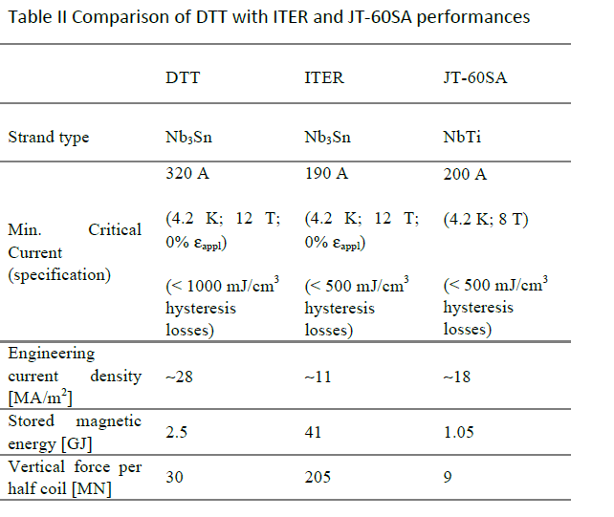
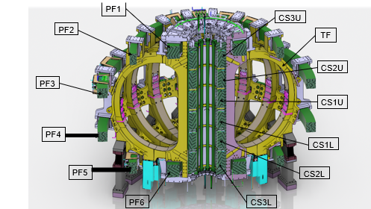
Superconducting magnet system
  Toroidal Field Coils System.
  Poloidal Field Coil System
  Central Solenoid System.

Slide 6





Superconducting Strands
0.82 mm wires | Min. Critical Current (requested by DTT) | Min. Critical Current (guaranteed by the awarded supplier) | Awarded Supplier | Delivered amount (tons)
DTT TF (Nb₃Sn) | 285 A (4.2 K; 12 T; 0% strain) | 320 A (4.2 K; 12 T; 0% strain) |  | 55 completed
DTT CS & PF1/6 (Nb₃Sn) | 270 A (4.2 K; 12 T; 0% strain) | TBD | TBD | new tender to be launched in coming weeks
DTT PF2-5 (NbTi) | 500 A (4.2 K; 5 T) | confirmed |  | 27.5 completed
Cr coated (31/31 tons delivered) and Ni coated Cu (23/23 tons delivered) wires are also supplied by Luvata Waterbury.

Slide 7

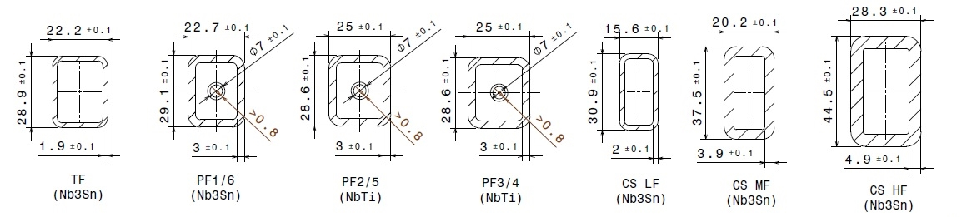

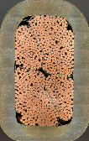




Conductors
7 different CICC layouts are foreseen for the 3 sets of magnets
with Unit Lengths going from 195m up to 780m
Copper dummies have been manufactured for all the 7 conductors
Super-dummies and SULTAN samples have been prepared for the TF, PF2 to PF5 ones

Slide 8
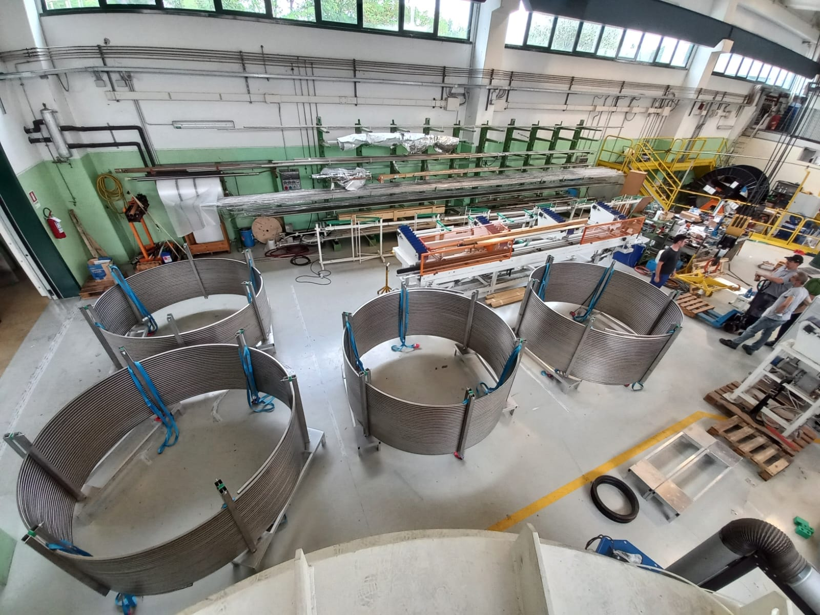
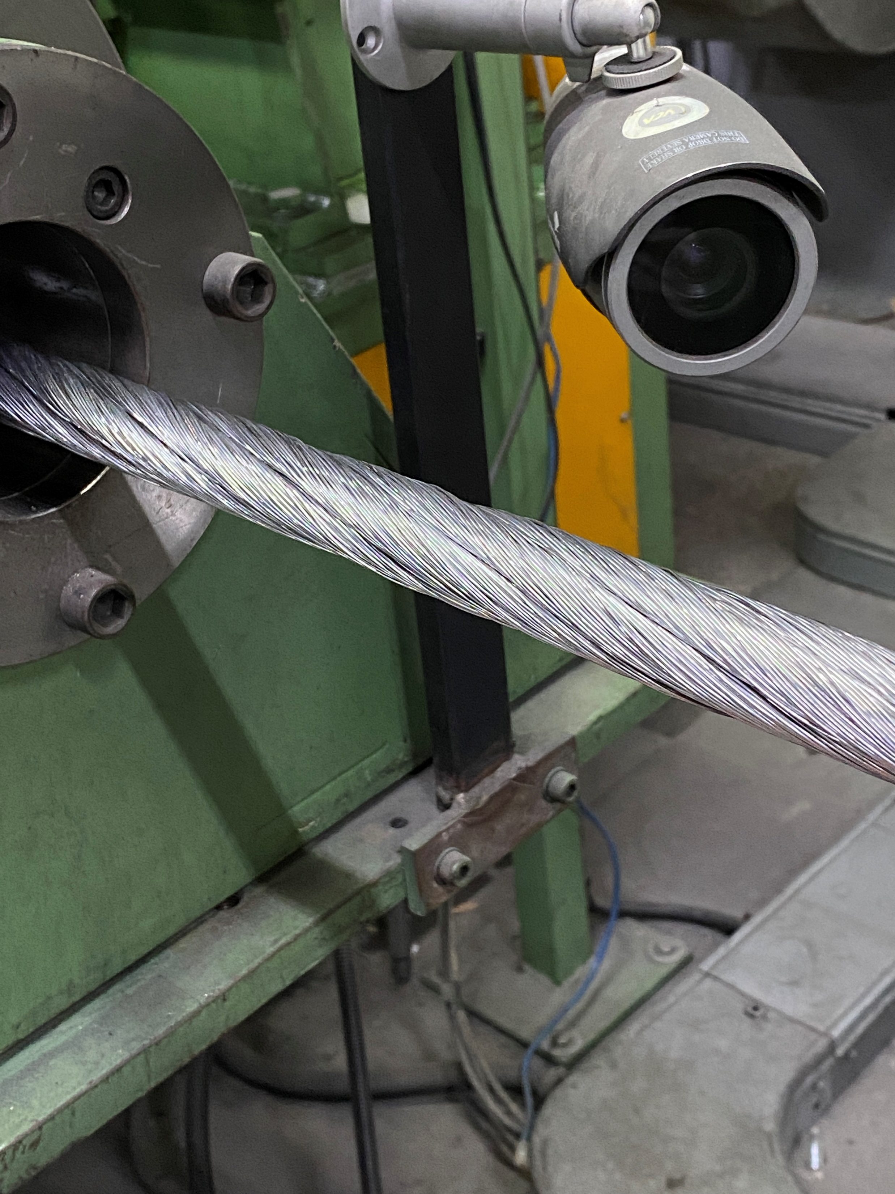
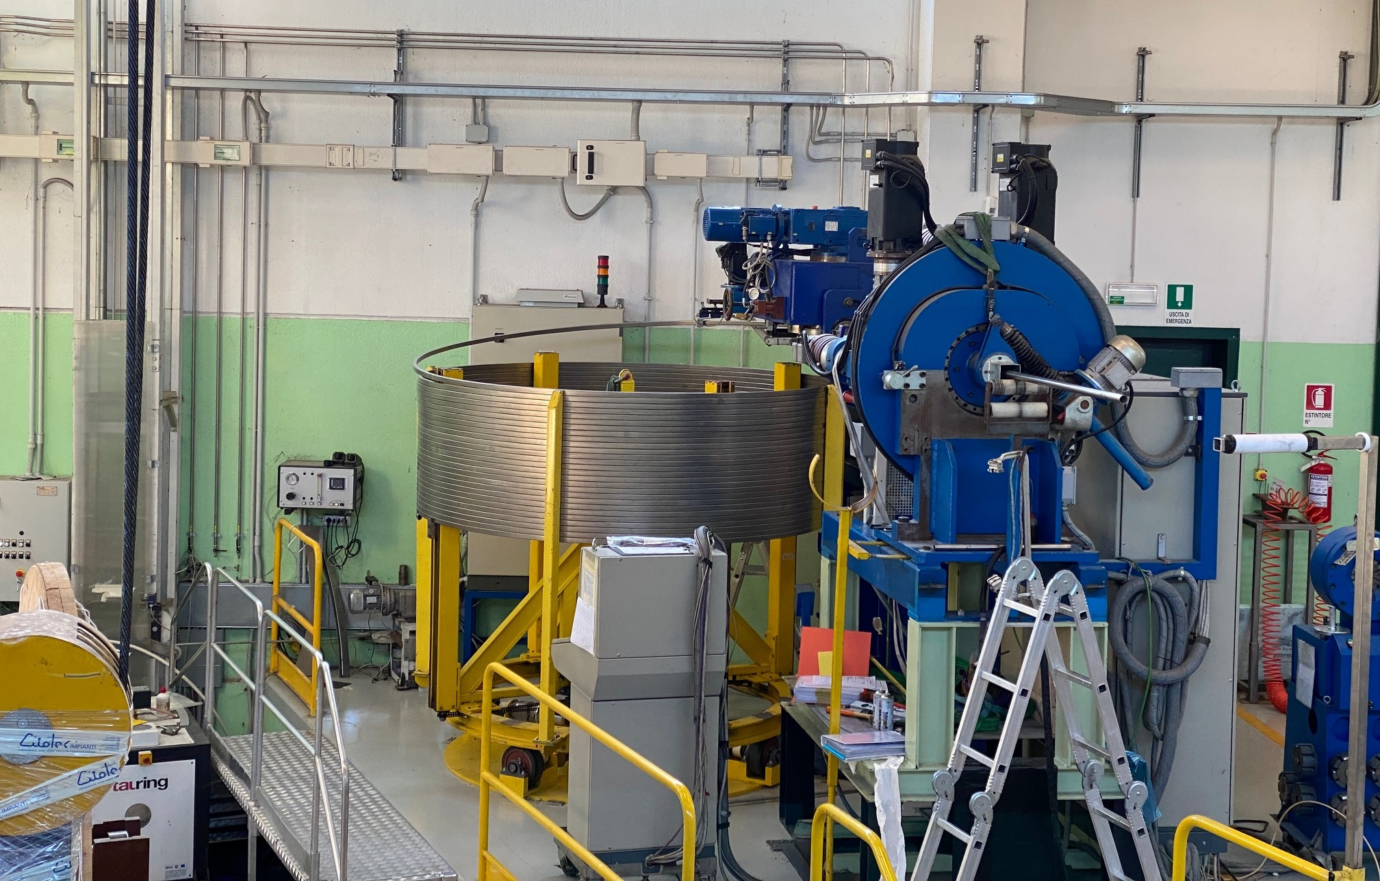
Conductors
The first 45 Conductor Unit Lengths for TF have been delivered to coil manufacturer ASG

Slide 9
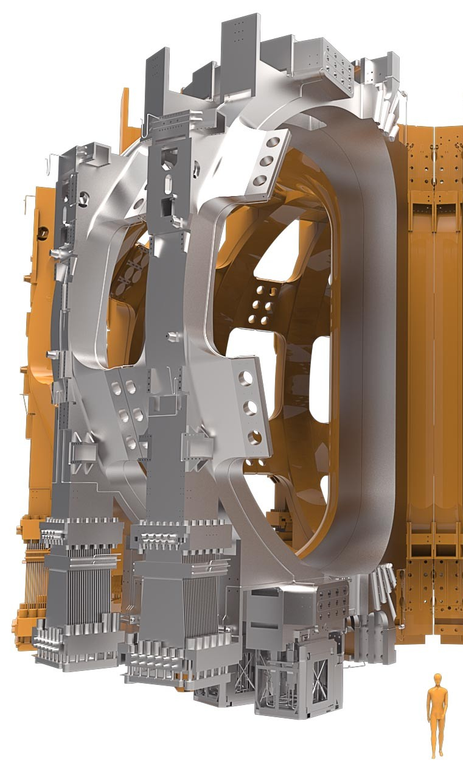
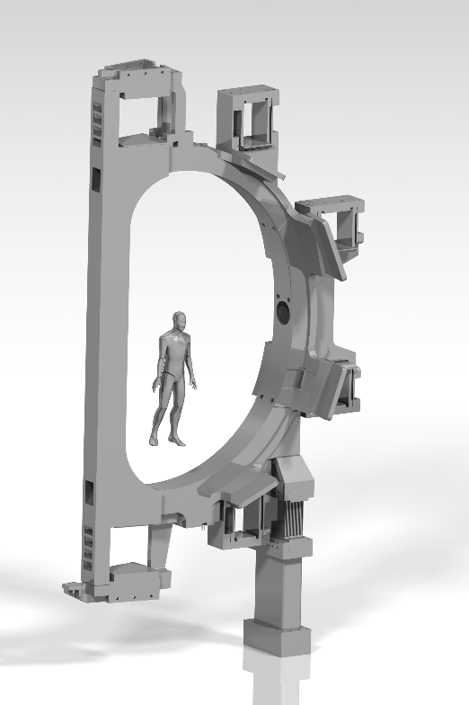
DTT vs ITER TFC
16.5 m
All the contract for the manufacturing of the DTT TF system (including Power Supply System) have been placed
First components (PS-TF) delivered May 2024 (see PS section)
9 m
6.4 m
DTT TFC:
Nb3Sn coils
B_{max} = 11.9T
I_{turn}= 42.5 kA
Turns= 84
Radius = 2.19 m
Bplasma= 6 T
ITER TFC:
Nb3Sn coils
B_{max} = 11.8T
I_{turn}= 68 kA
Turns= 134
Radius= 6.2 m
Bplasma= 5.3 T
3.7 m
Courtesy of ITER Organization

Slide 10

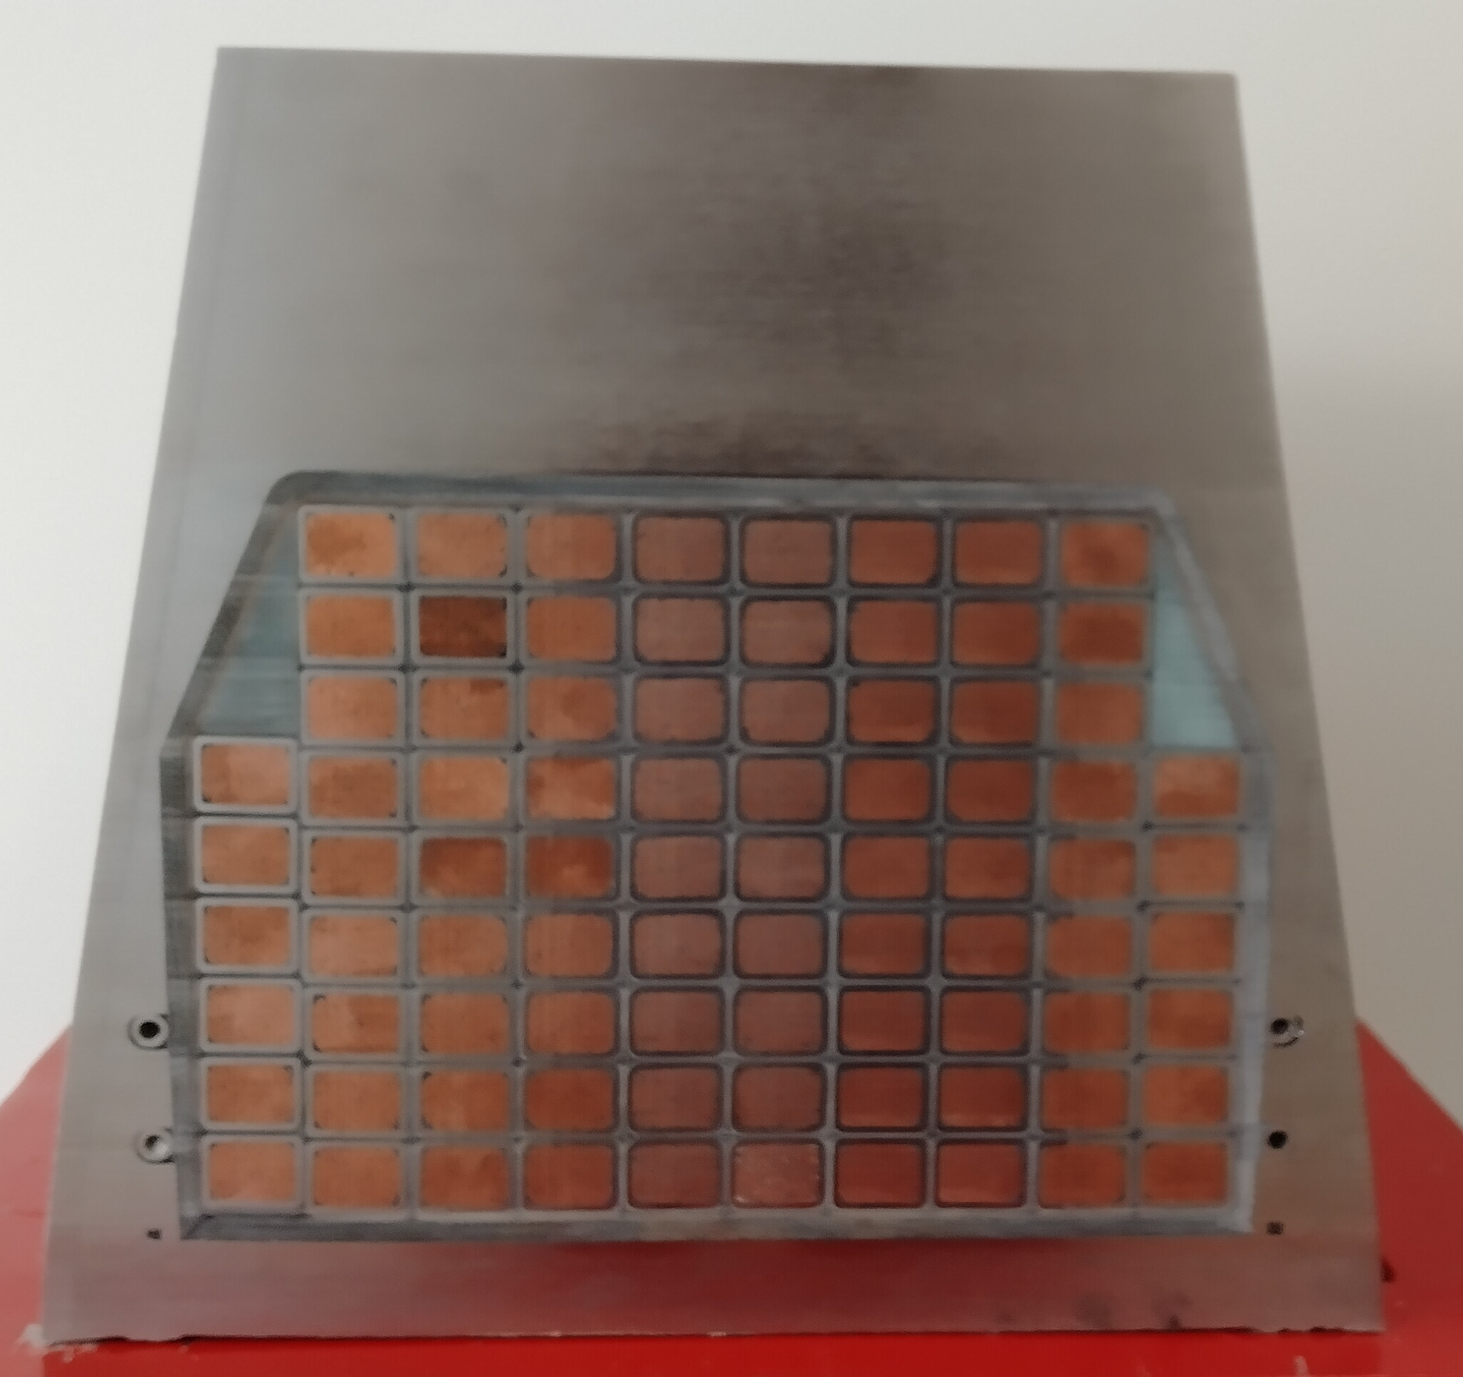
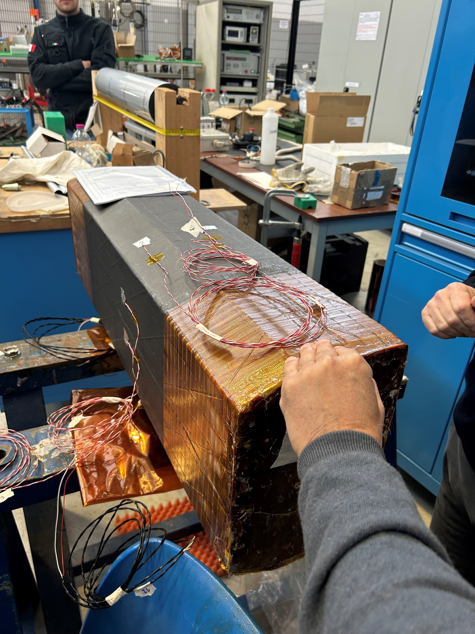
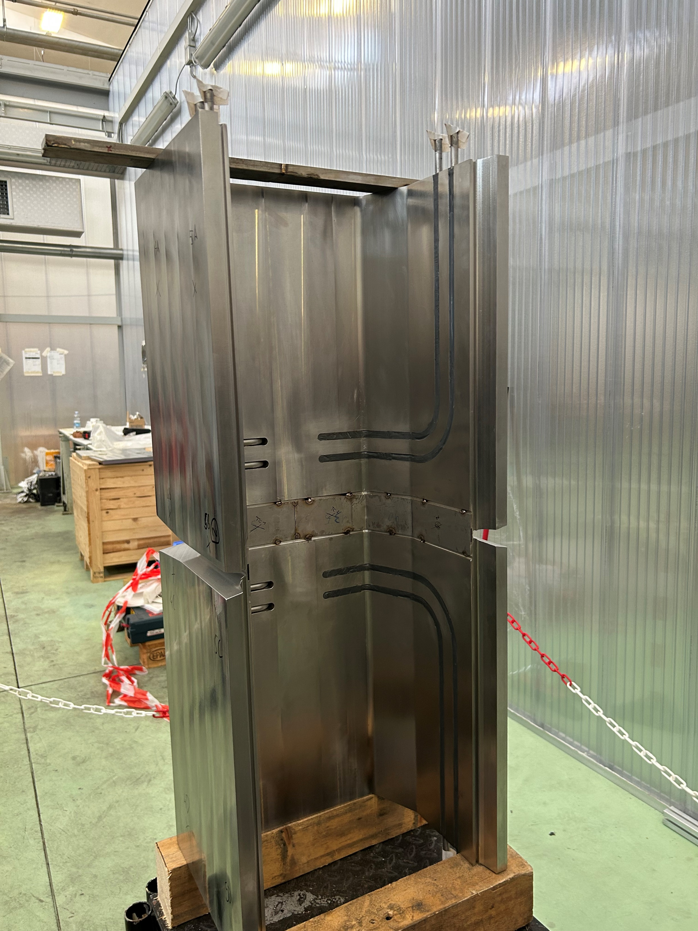
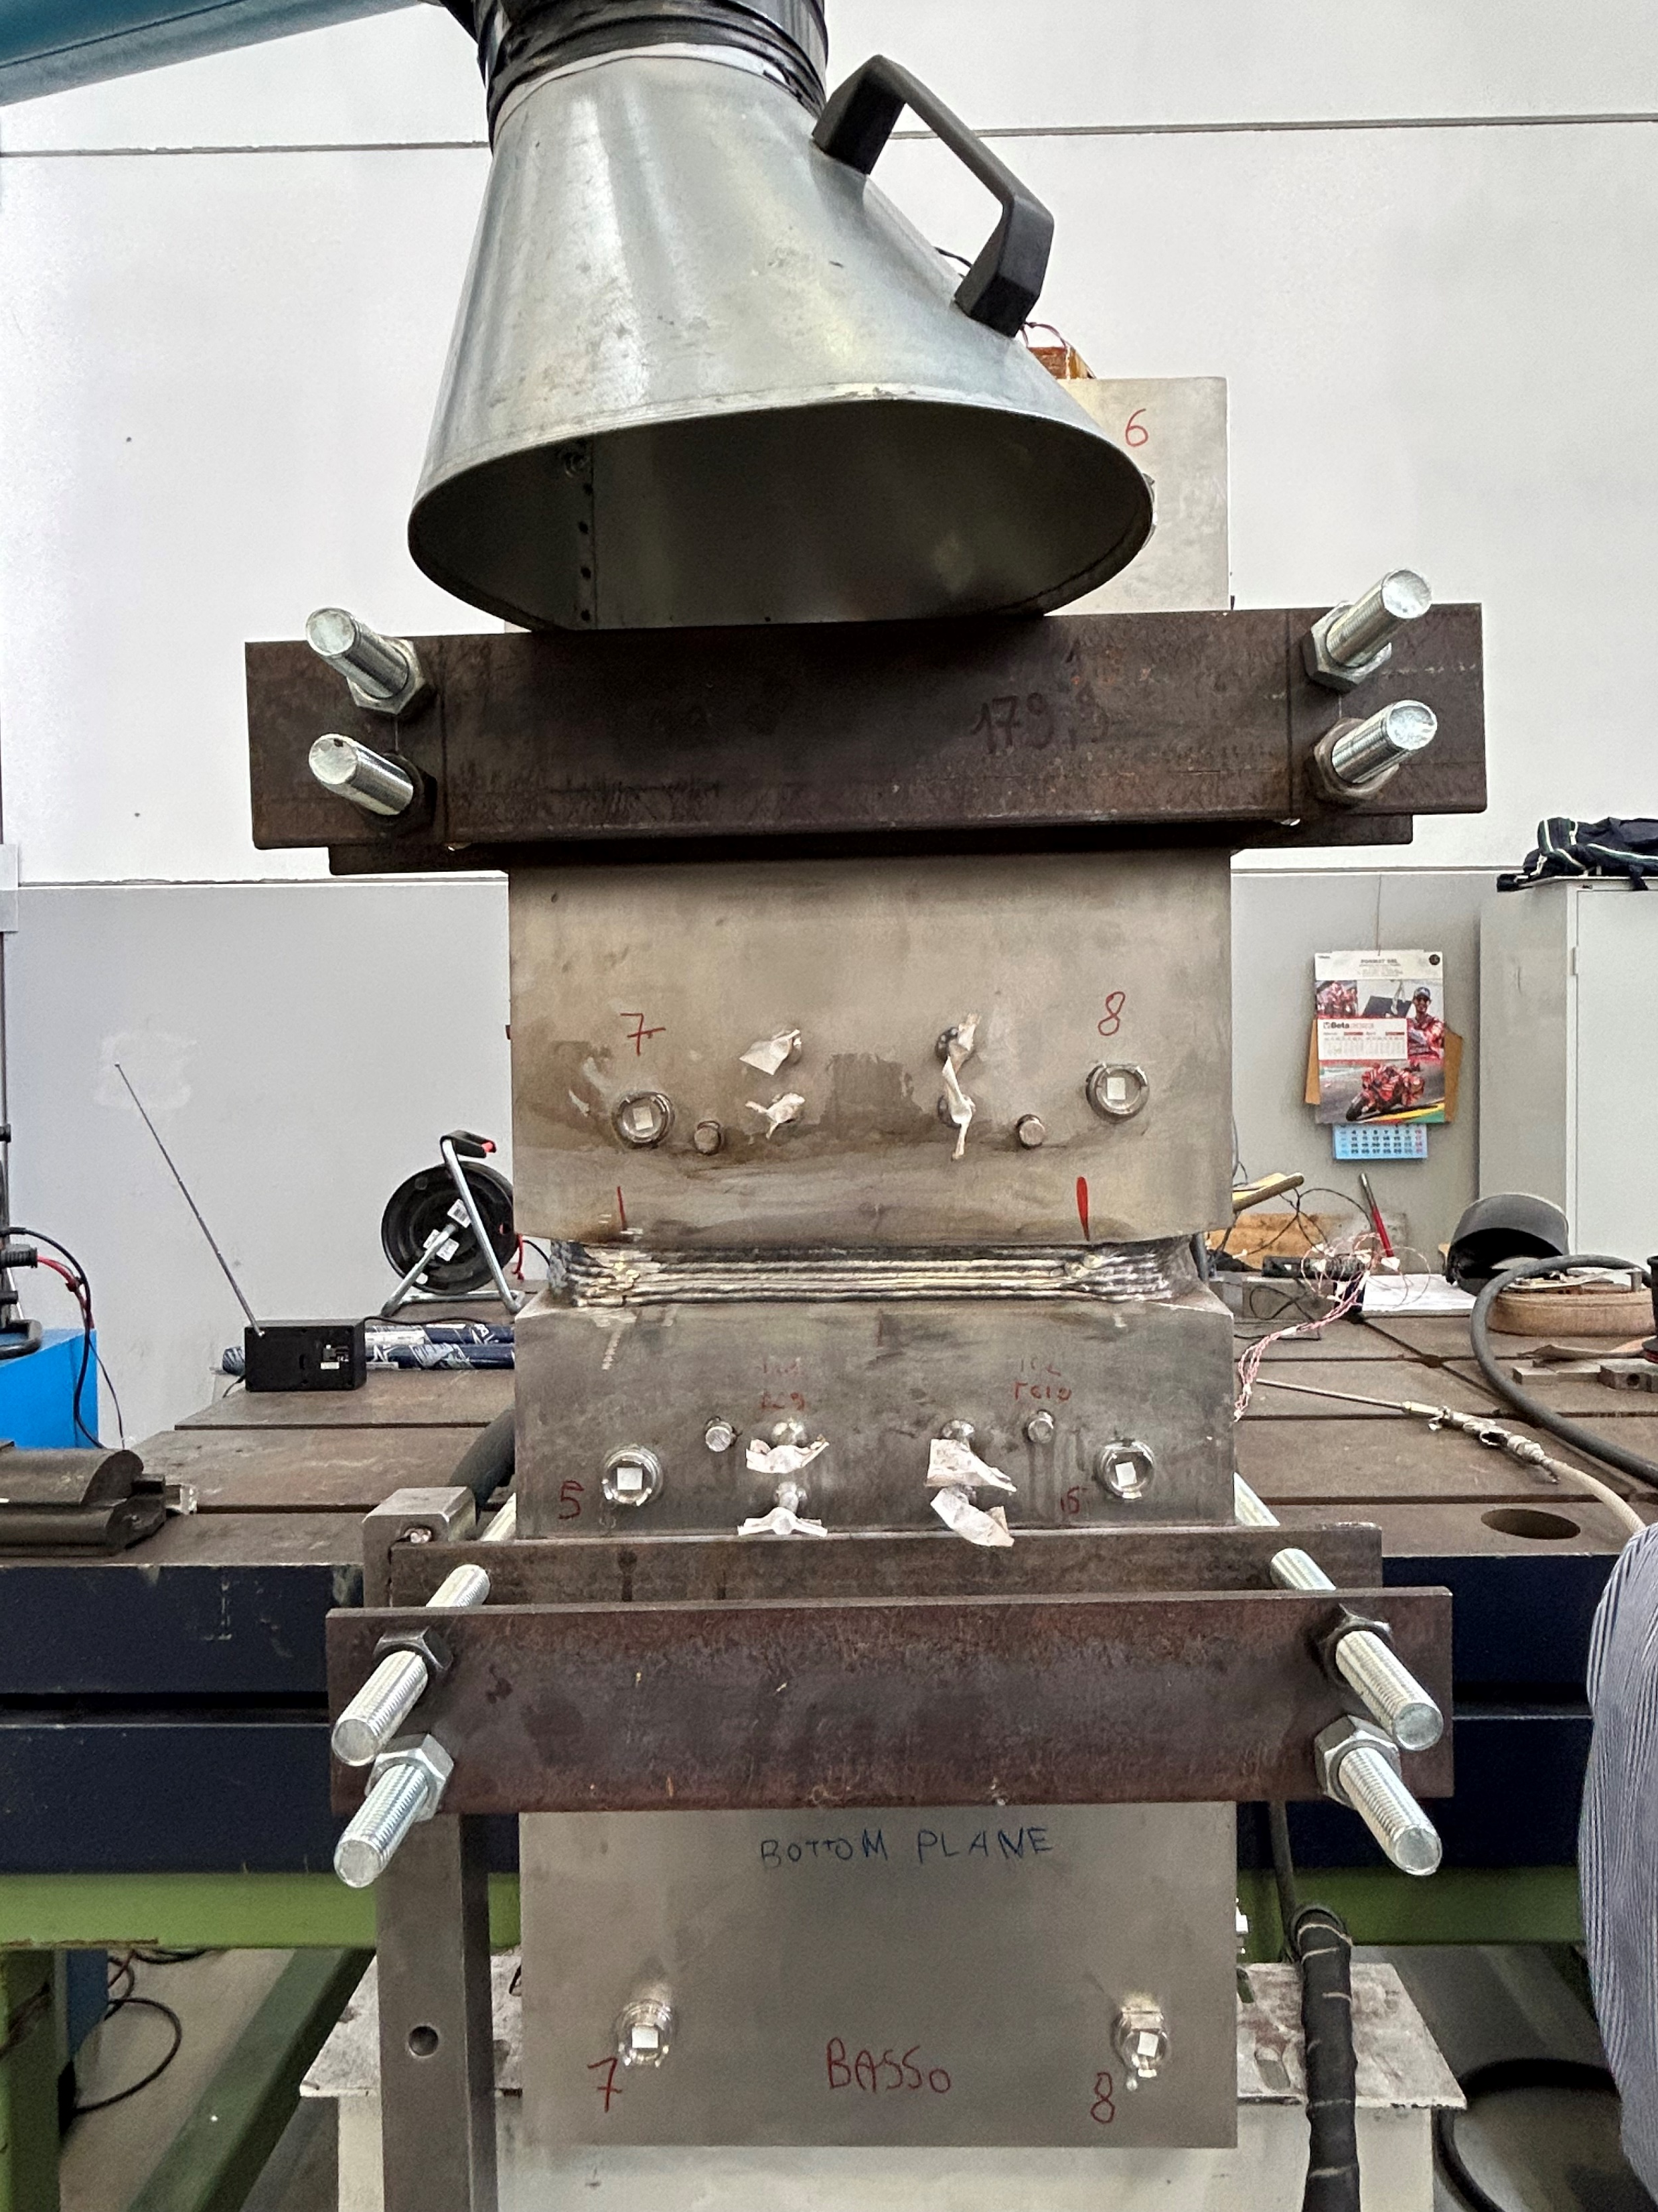
TF Winding & Integration
Winding line is ready for the winding of first dummy rDP
Detailed design, trials and mock-up manufacturing completed

Slide 11
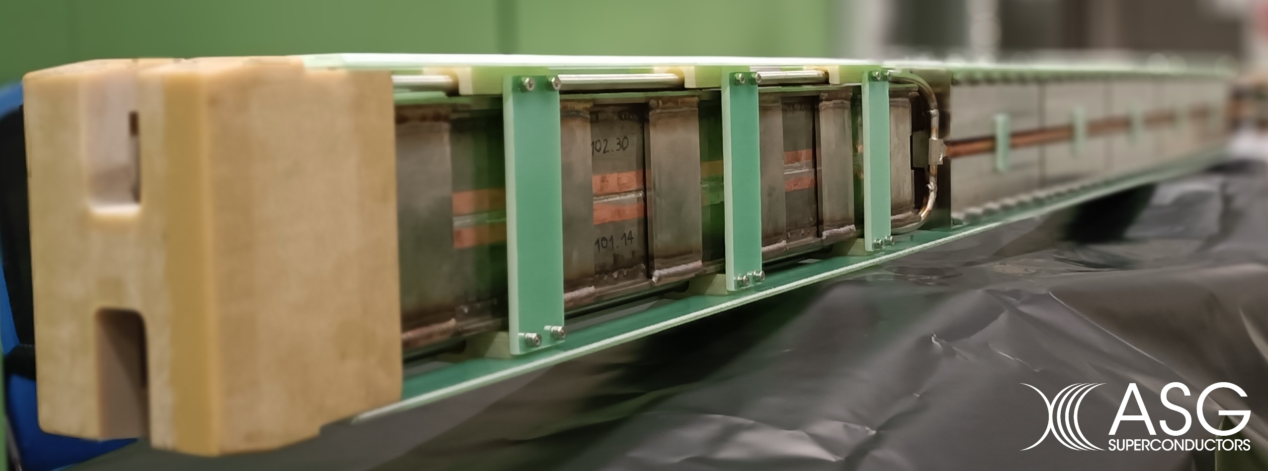
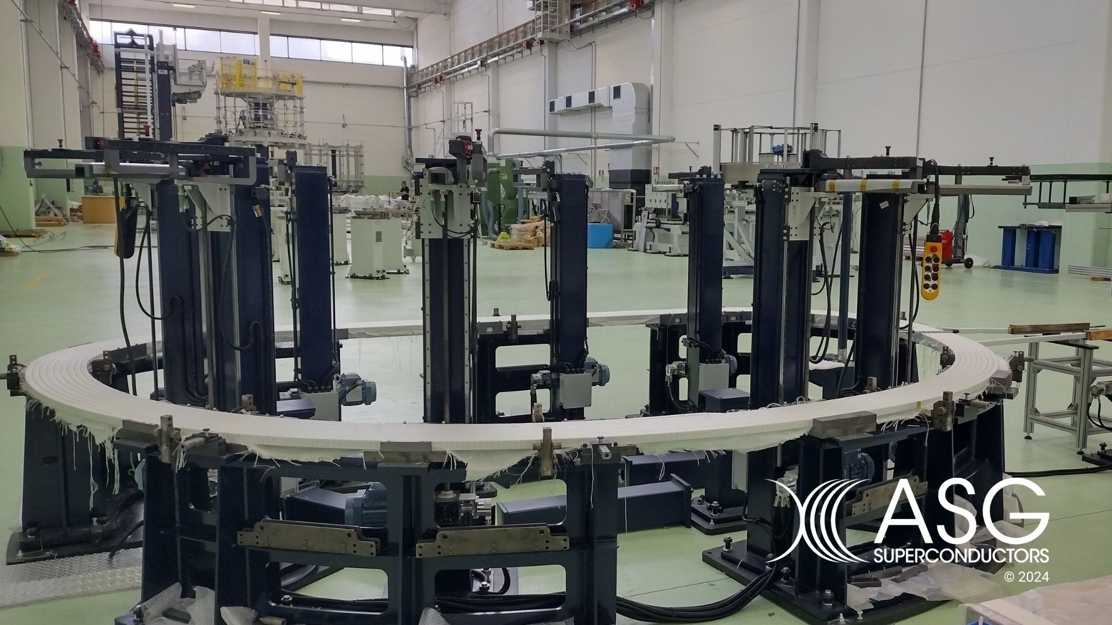
TF Winding & Integration
Full size joint tested in SULTAN
First rDP completed (winding, heat treated, insulated)

Slide 12
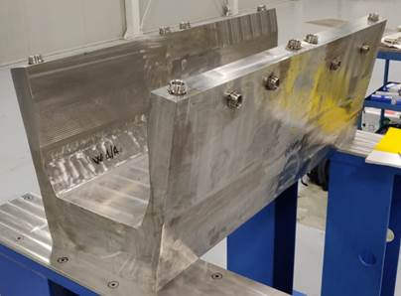
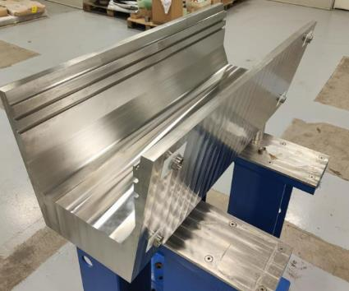
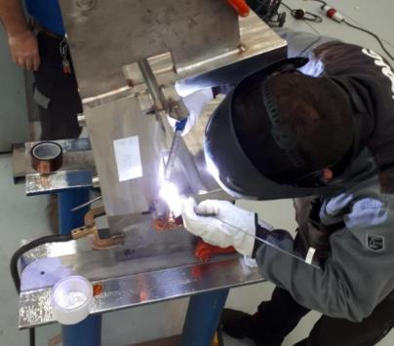
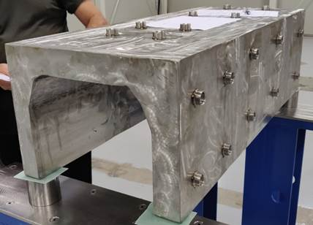
TF Casing
During a first contract the Constructive design, trials and mock-up manufacturing were made. New tender is ongoing
1 m inboard leg mock-up
2 x 0.5 m outboard leg mock-ups

Slide 13
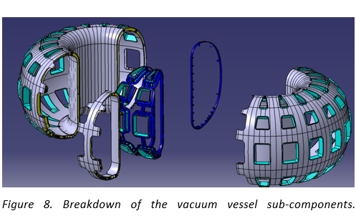
Vessel
D-shaped Vacuum Vessel
Double wall structure to provide high rigidity against operational load and high toroidal one-turn resistance
The VV overall mass about 174 ton plus 14 ton of coolant. The assembly is about 9.5 m high with about 11.5 m diameter.
gravity support pack of spring plates to accommodate free thermal expansions along the radial direction produced, in particular, by vacuum, VV baking, and possible earthquakes.

Slide 14
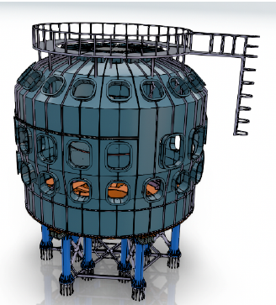
Thermal Shield & Cryostat
Thermal shield cooled by He flowing at 80 K single silver coated 3 mm thick stainless steel (inspired by KSTAR design)
Cryostat :Conceptual modular design, inspired by that of JT-60SA
Support base is made of 12 columns incorporating anti-seismic dumping system
access to the bottom area for the feeding of the He circuit and of the superconducting coils.

Slide 15
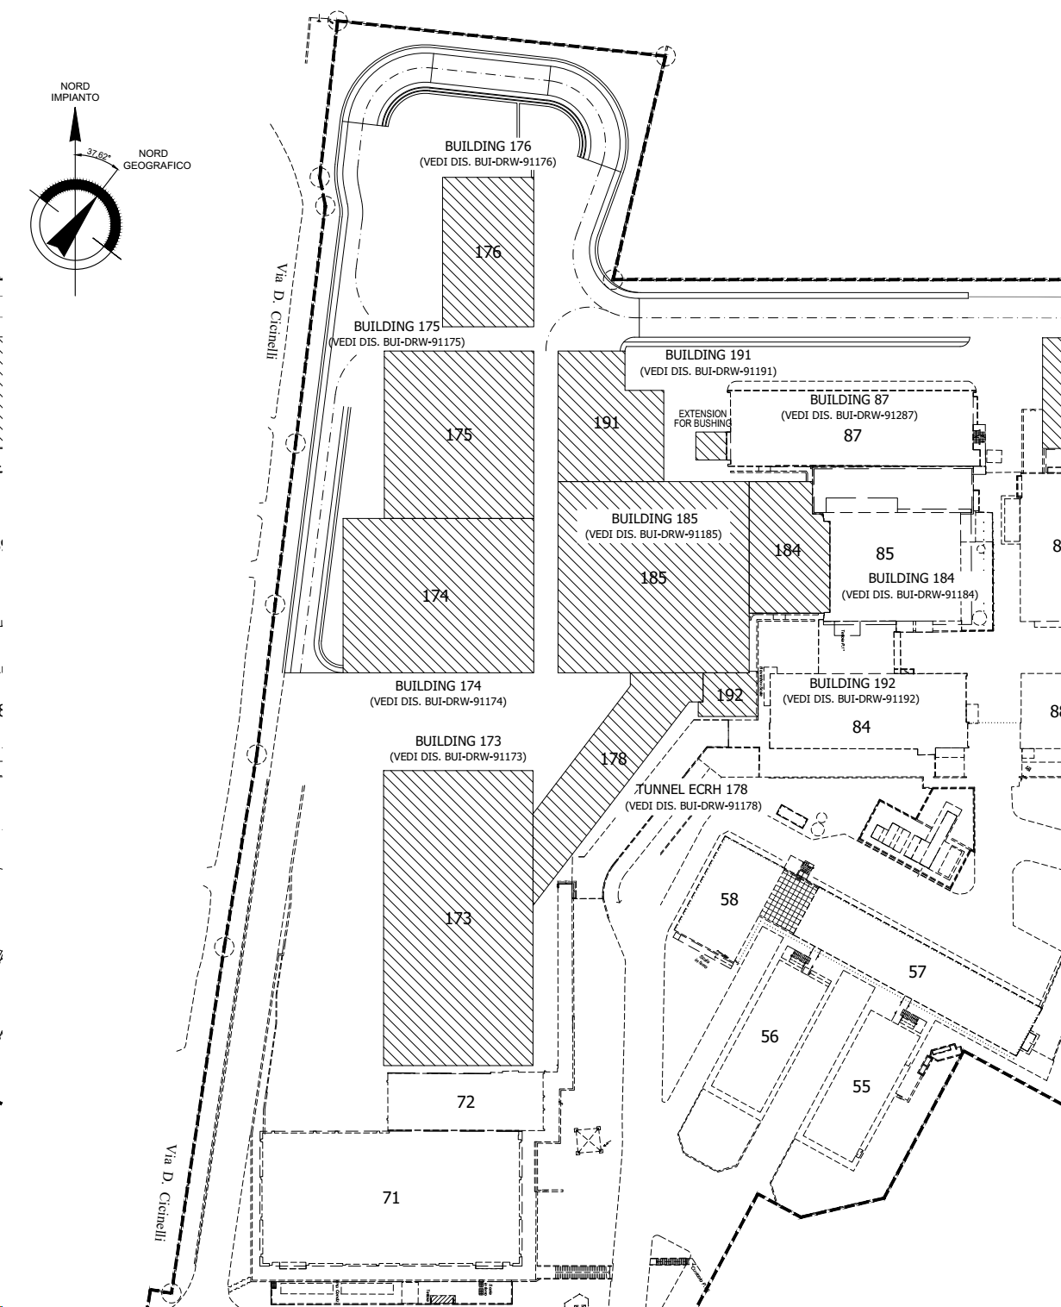
Assembly procedure
Assembly contract will have the following steps:
Engineering phase (procedure, design of tooling, material);
Tooling fabrication;
Pre-assembly;
Assembly
3 buildings have been reserved for the assembly activities: F87, F71, F185
F87 preassembly hall
F185 assembly hall
F71 CS pre-assembly

Slide 16
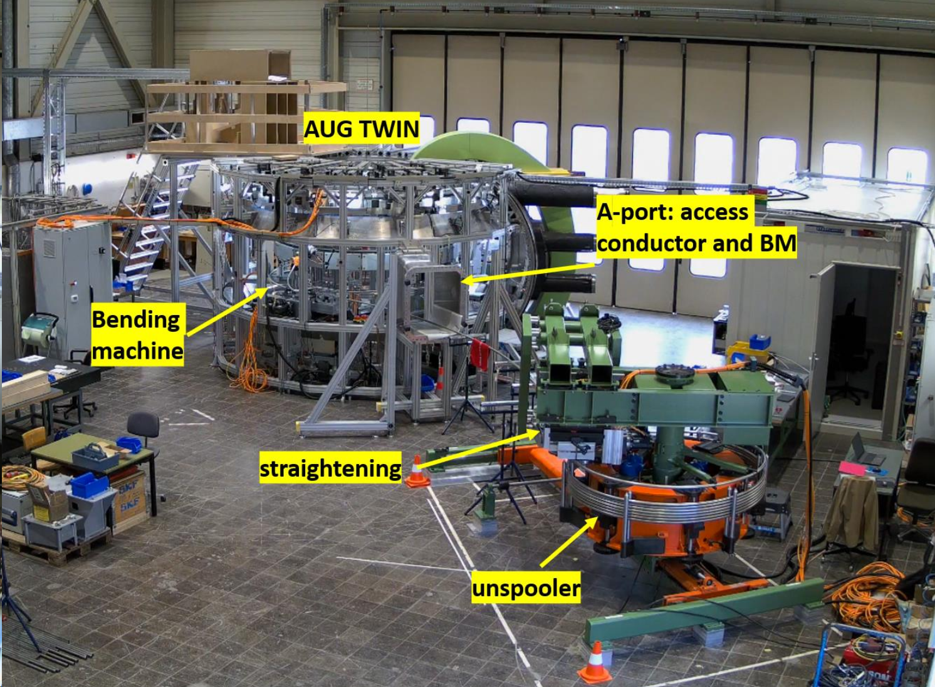
Assembly procedure - Training
F87 will be devoted to:
Qualification activities with full scale mockup;
Storage of components
Pre-assembly activities
F87 preassembly
Courtesy of I. Zammuto, AUG mechanical twin and winding line

Slide 17
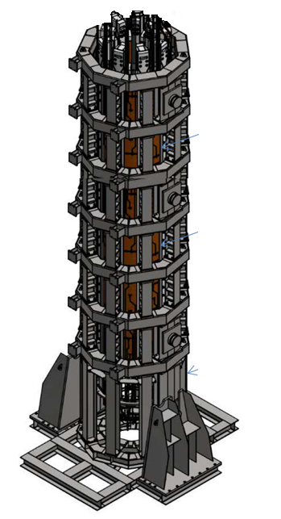
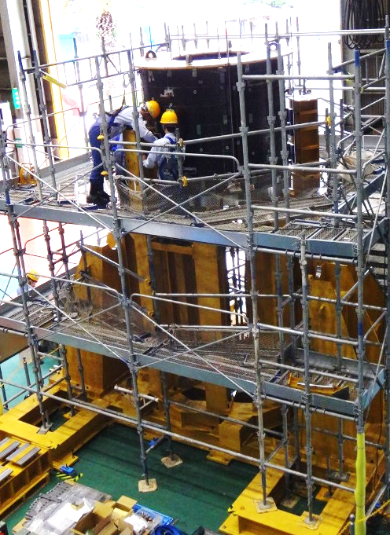
Assembly procedure
F71 will be devoted to:
CS Pre-assembly
Storage of components
F71 CS pre-assembly
Courtesy of JT-60SA, CS pre-assembly

Slide 18
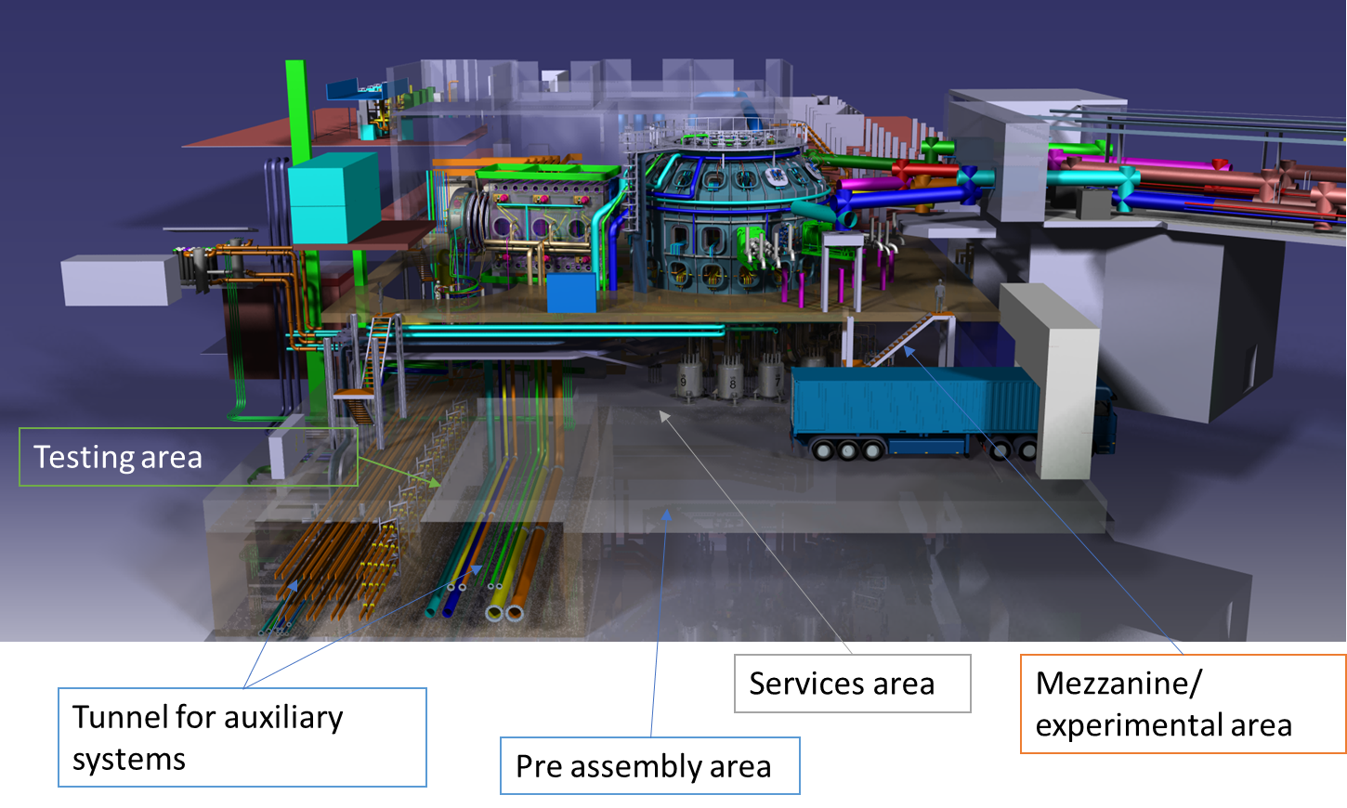
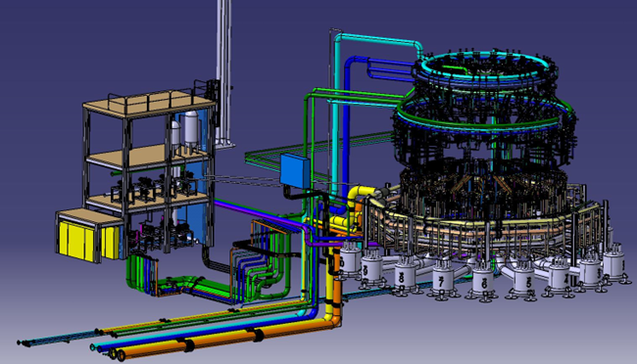
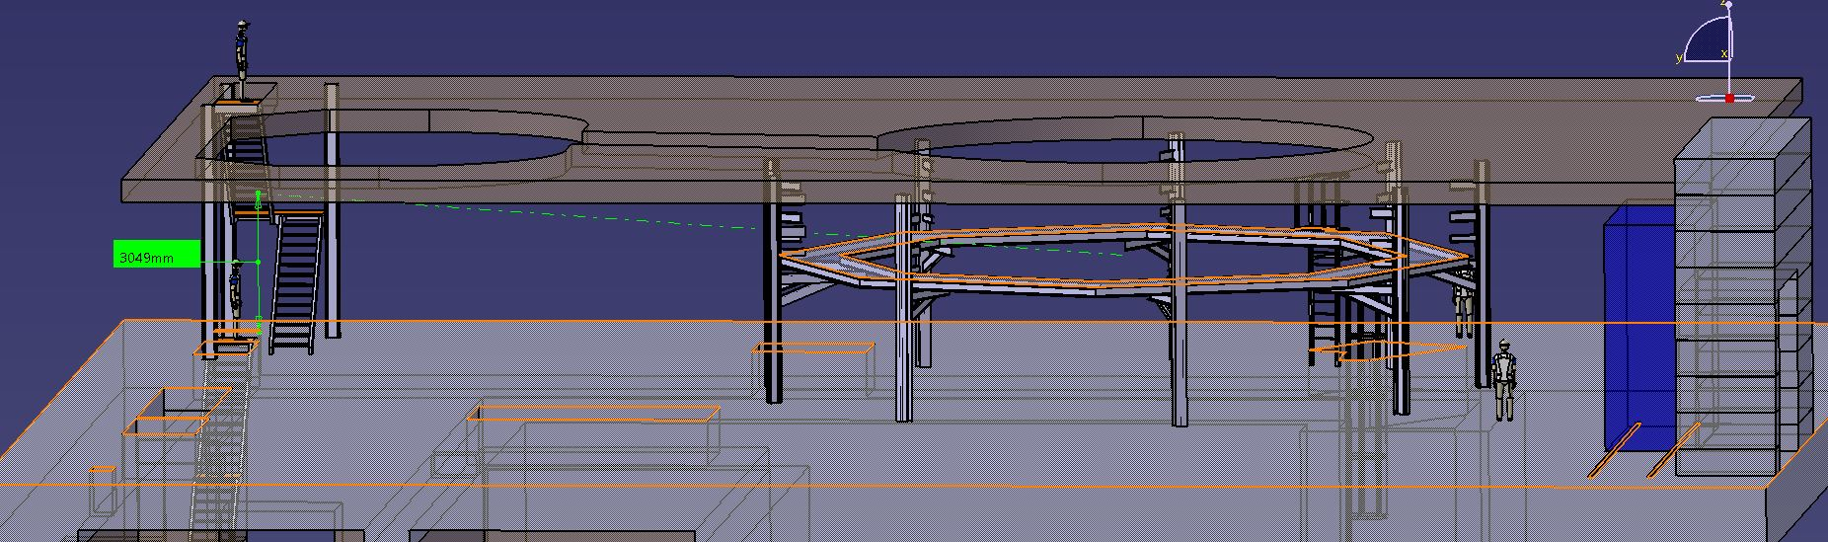
Assembly procedure: Tokamak Hall
F185 will be devoted to:
Pre-assembly
Assembly
Storage of components
Included in assembly:
WCS
mezzanine
F185 assembly hall

Slide 19
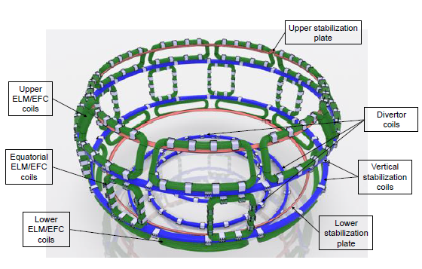
Power supply system
Superconducting magnet system is the power supply system. It includes the power supply for the superconducting magnets, with the protection and busbar,
Additional (in-vessel) coils:
  Five for axisymmetric coils: two devoted to stabilize plasma, the other three, located under the divertor, to the fine control of the X-point.
  In addition, a set of 27 non-axisymmetric coils, devoted to control ELM events and to the error field correction (EFC), is also foreseen.
Several different innovative solutions

Slide 20
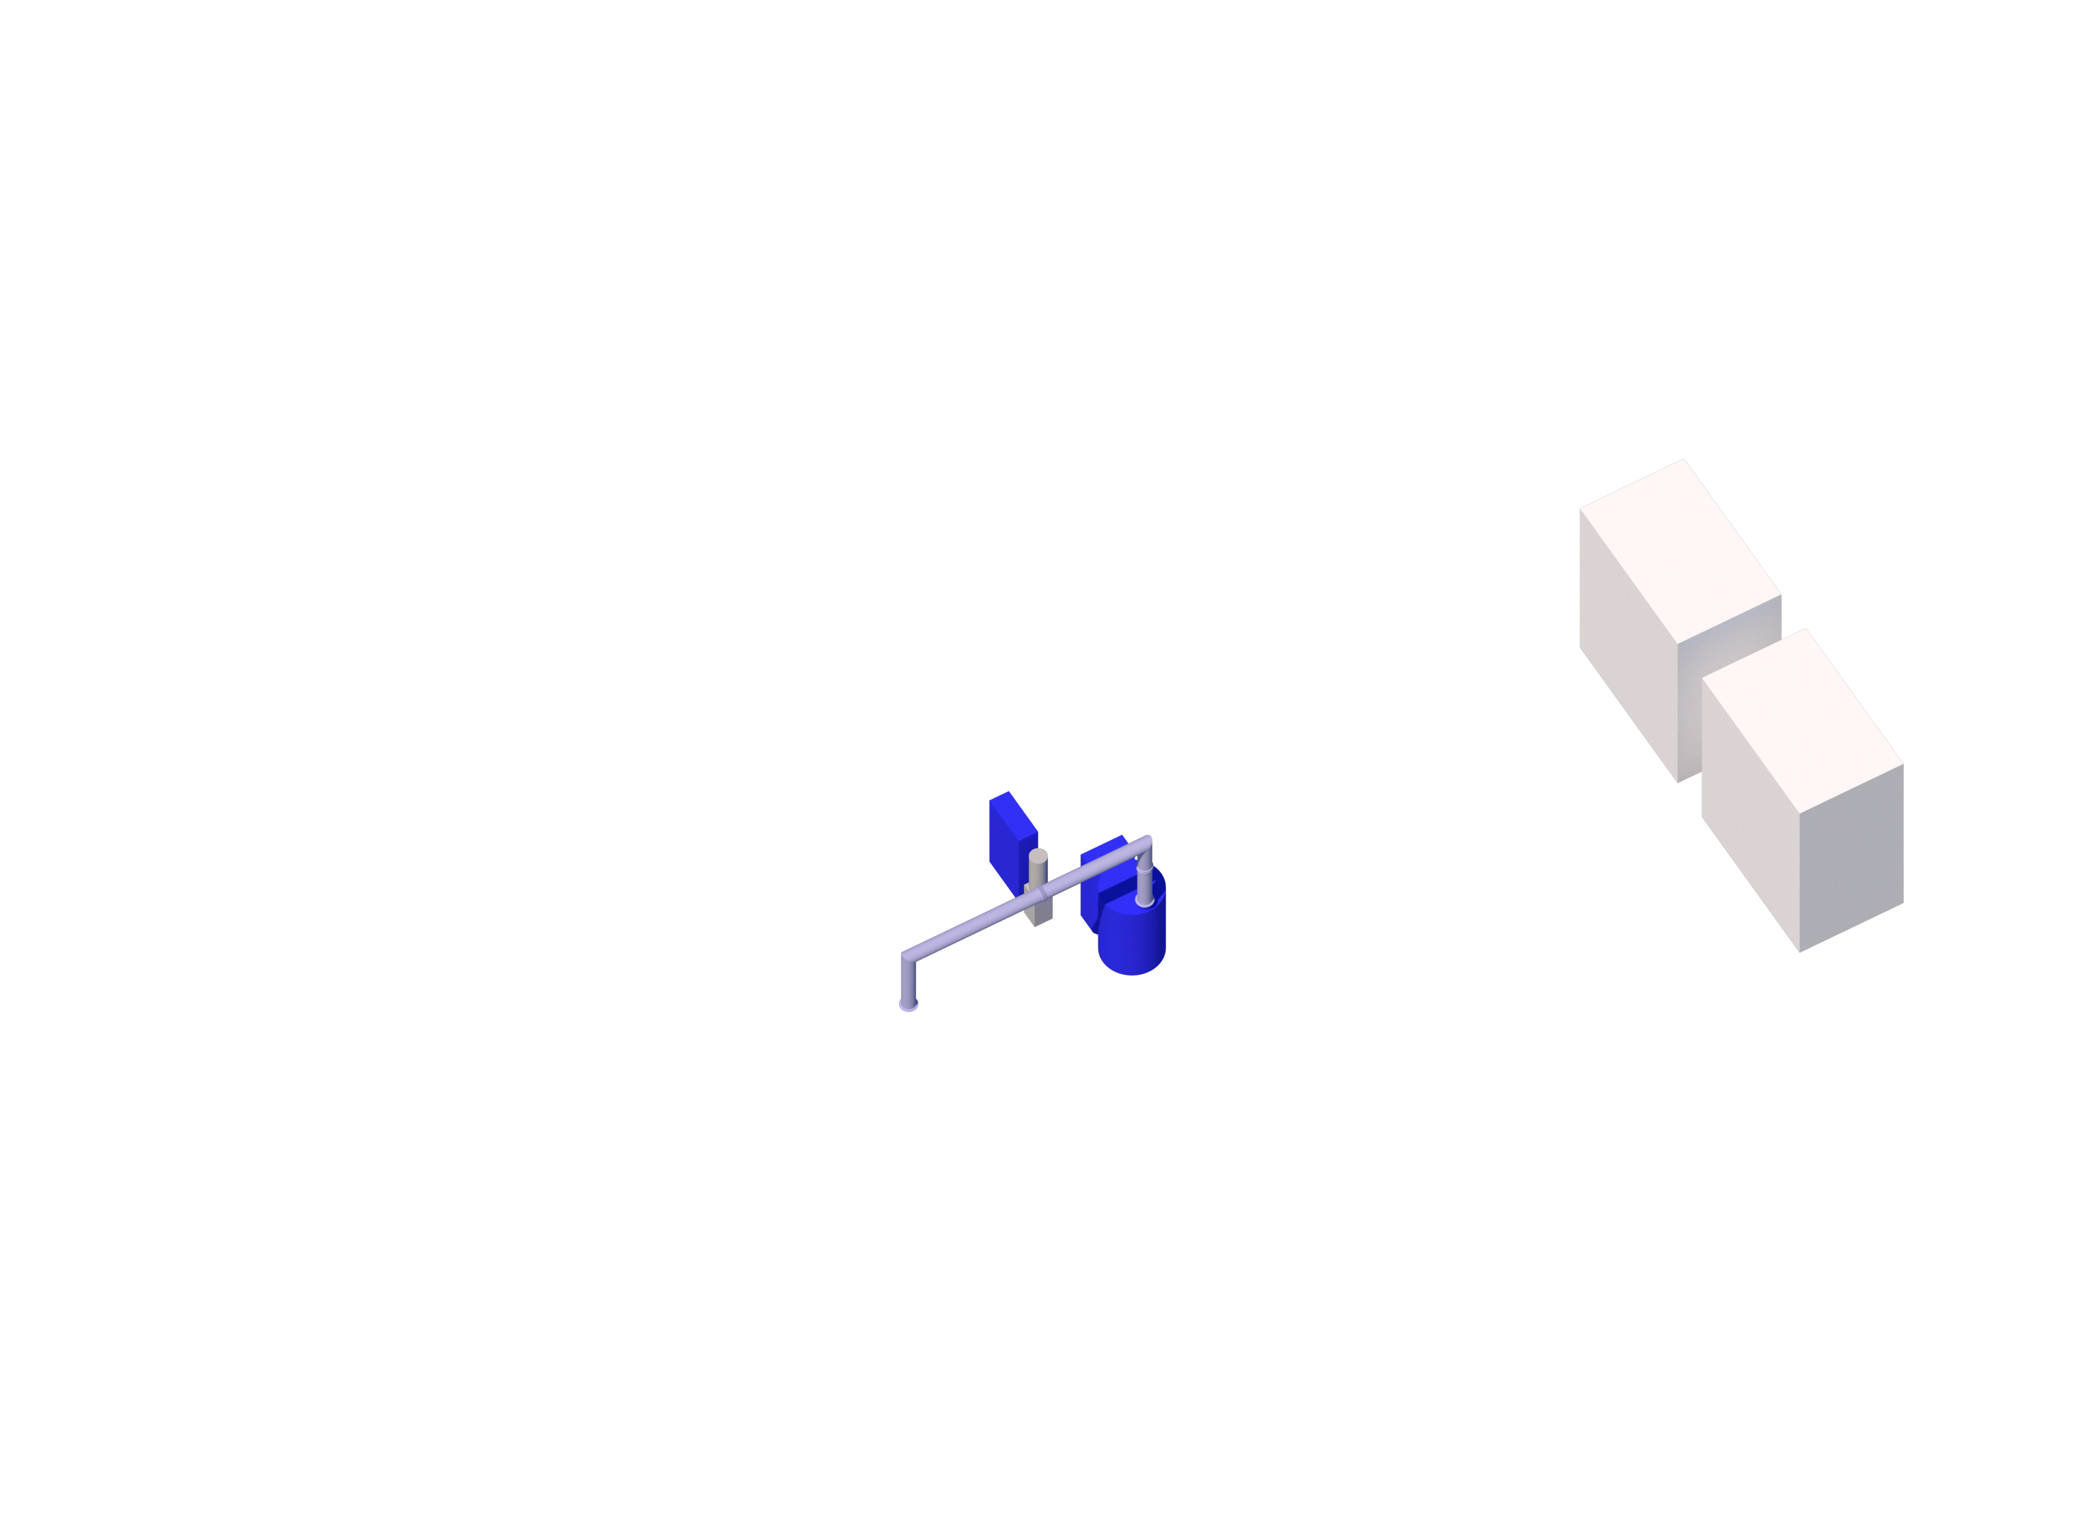
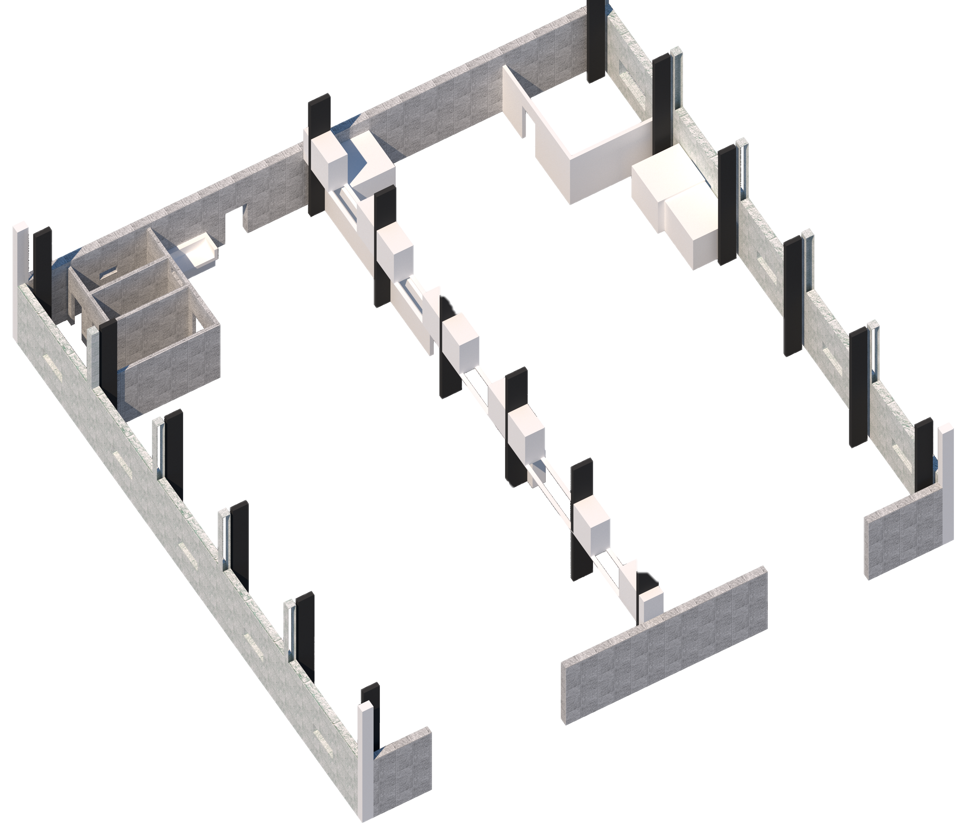
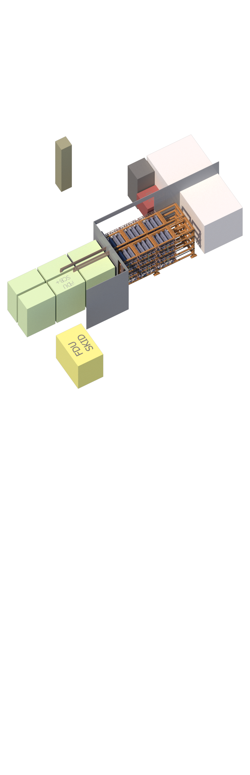



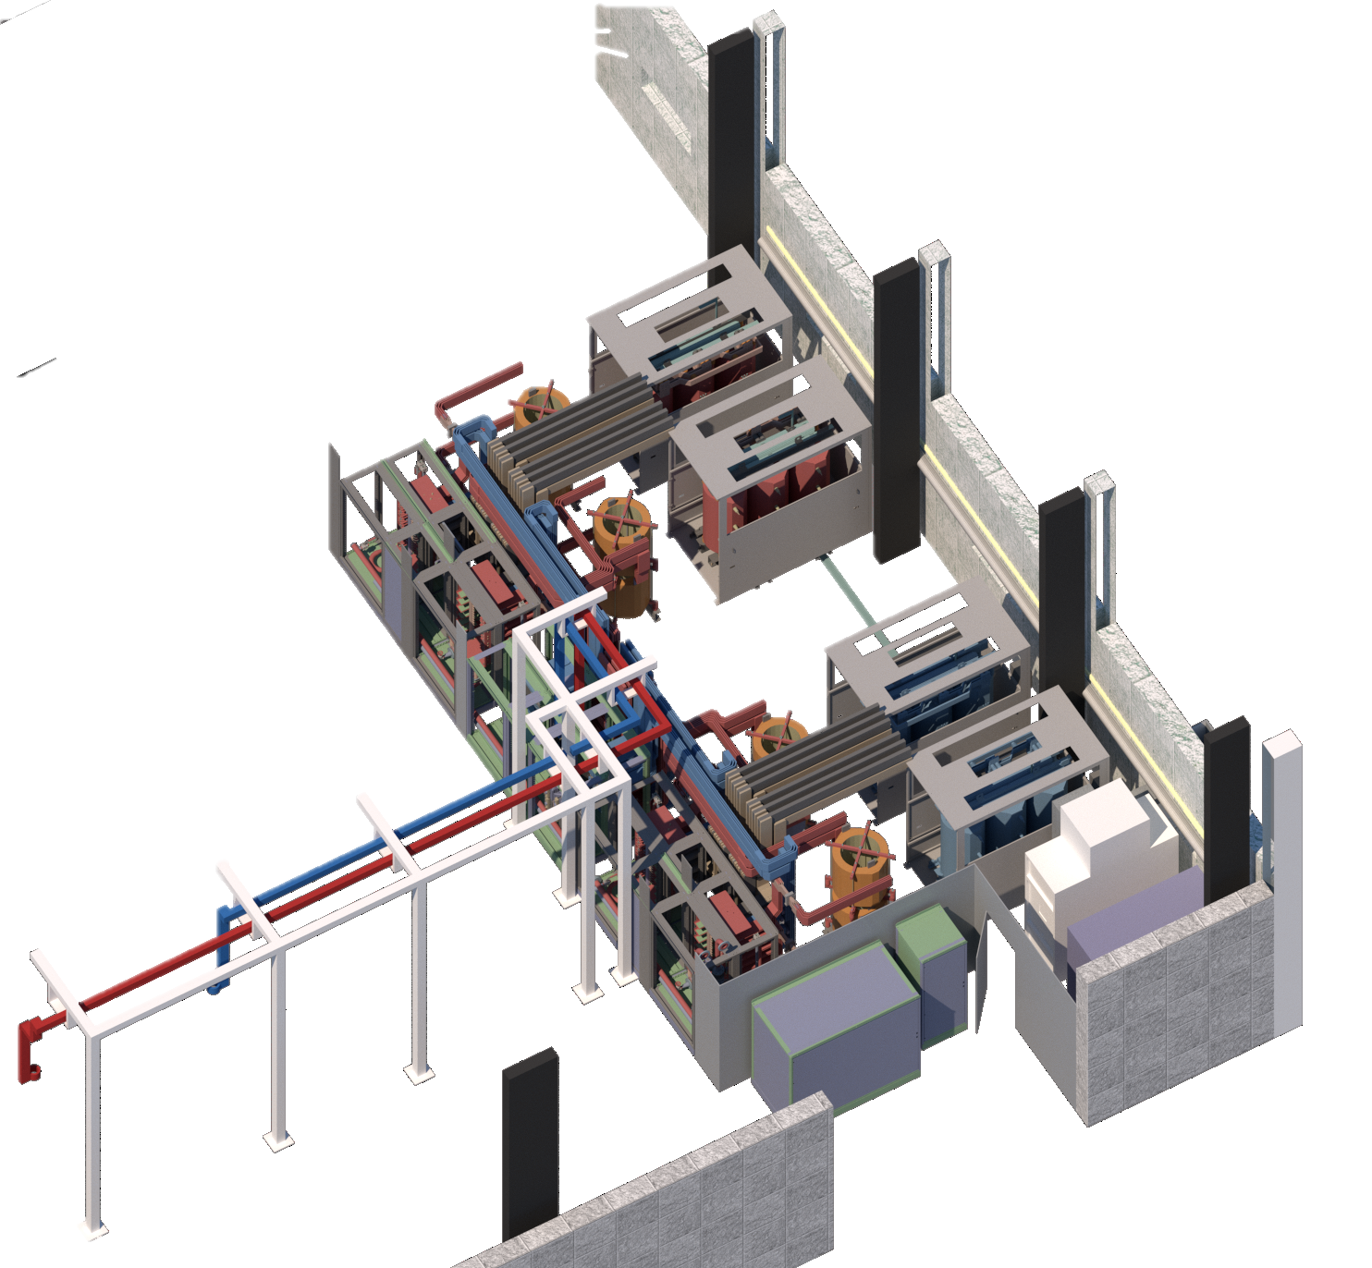

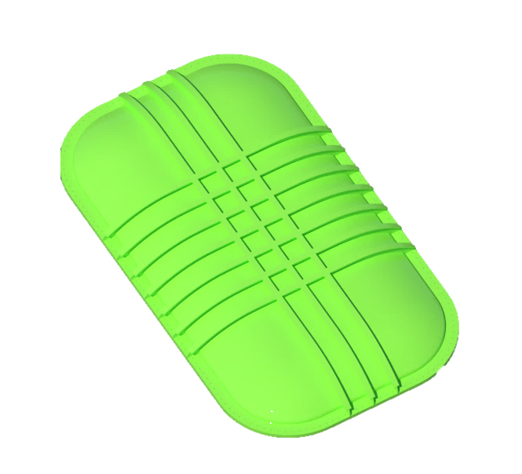
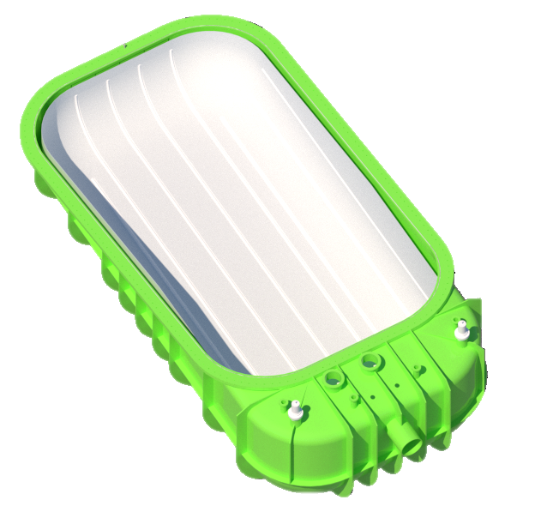
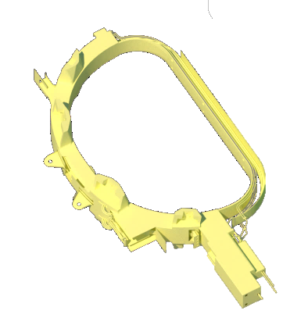
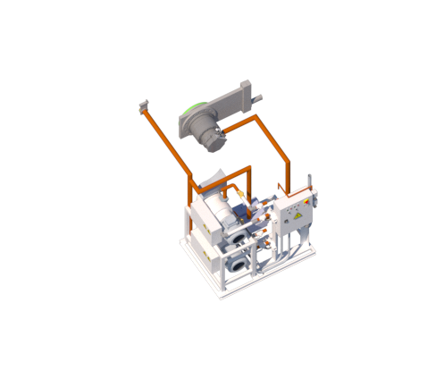
FCCTF Layout
650 m² lab Area
Control room
100 m³ large cryostat
He gas
Pumping system
10⁻⁵ mbar
FDU
Cryogenic system
(LINDE Refrigerator + LN2)
Chiller
Power Supply
Power supply
  43 kA
Cryostat
Refrigerator
FDU system
Quench detection
Control room
Liquid N
Vacuum pump

Slide 21
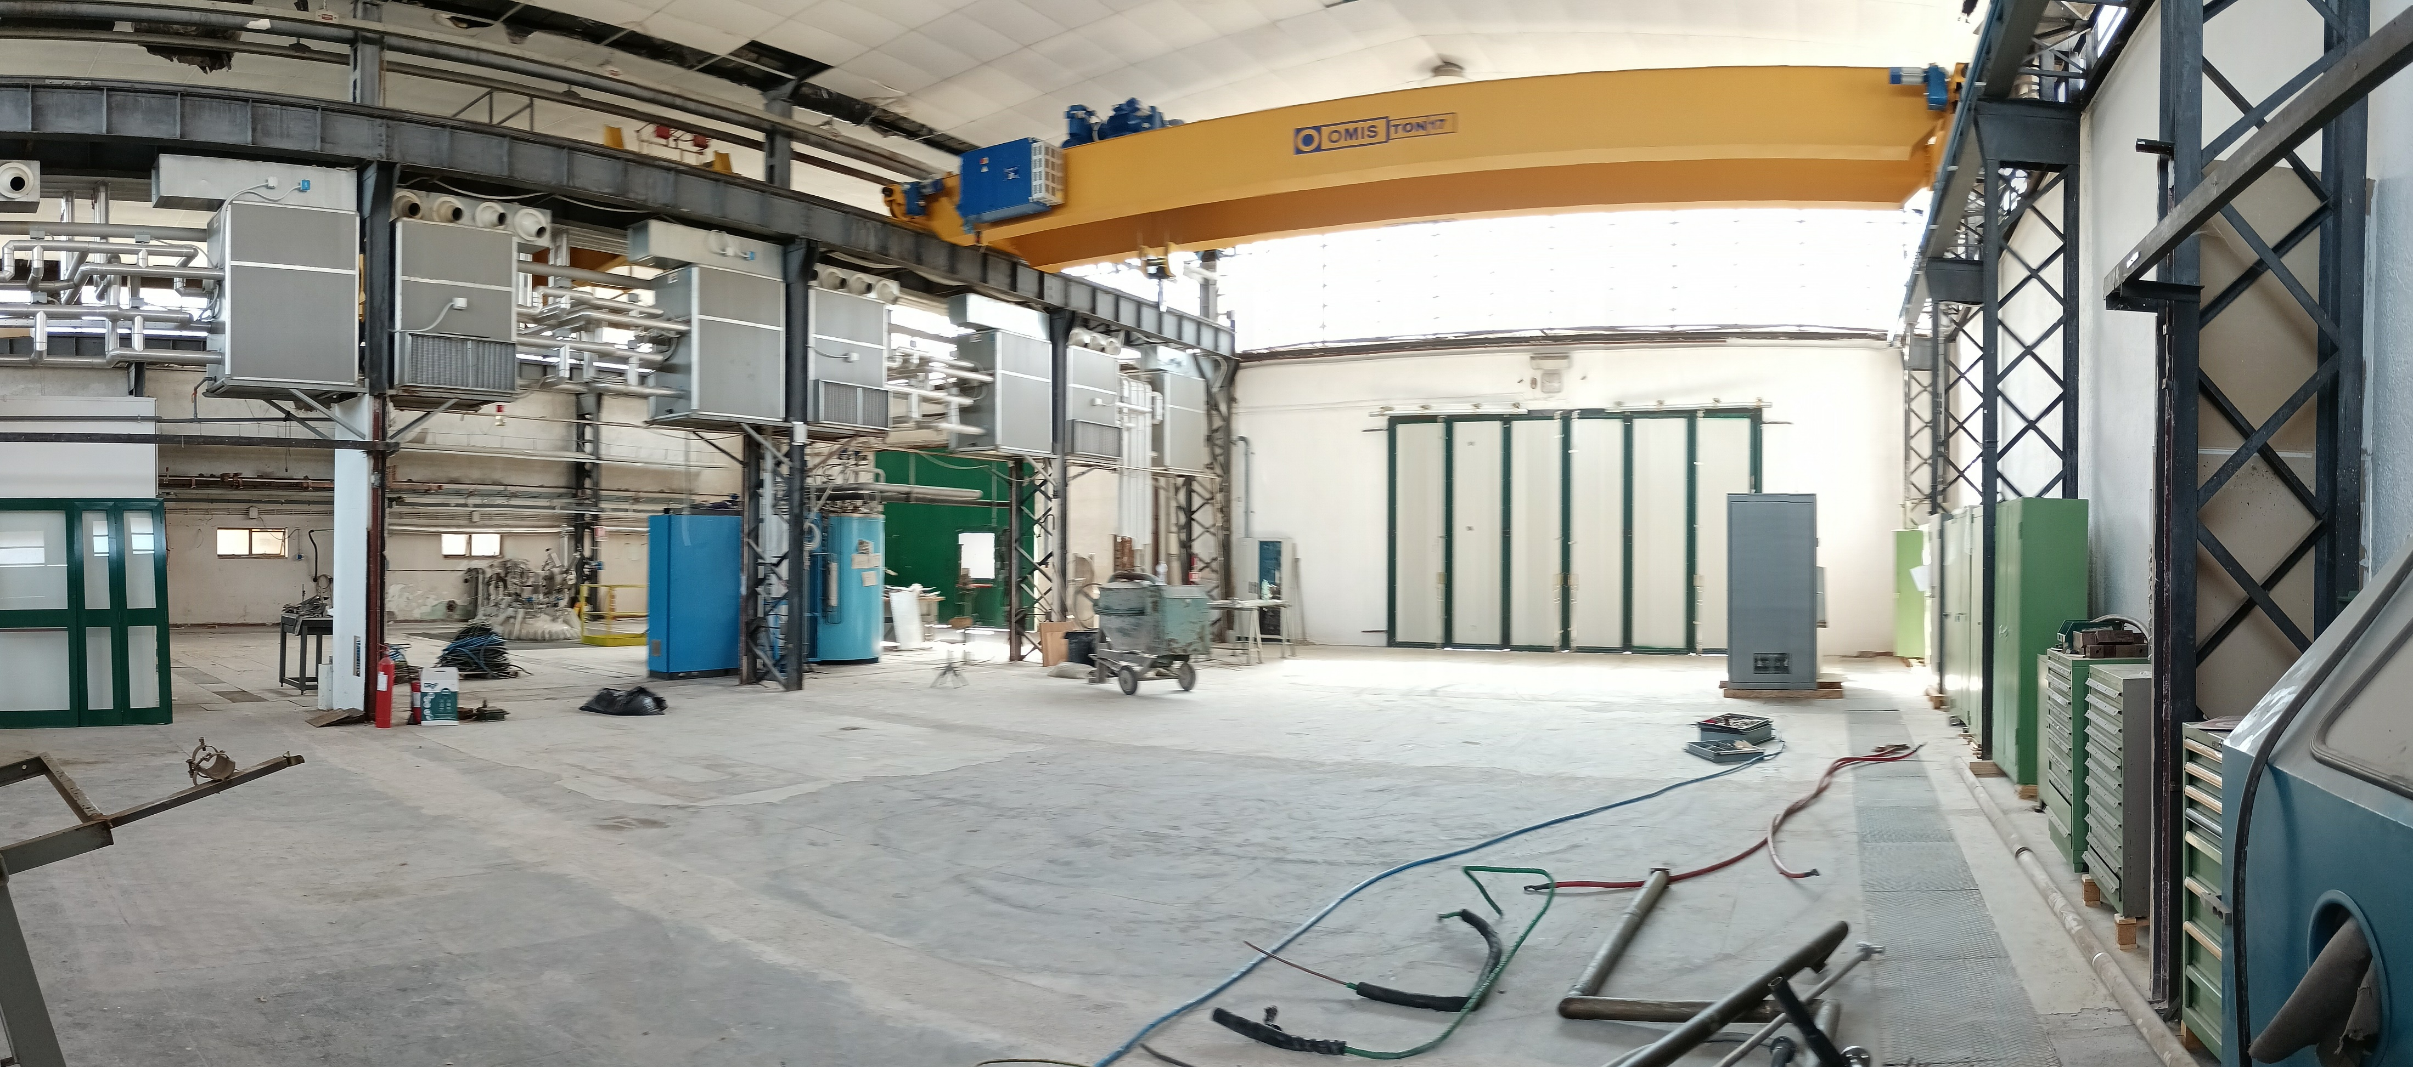
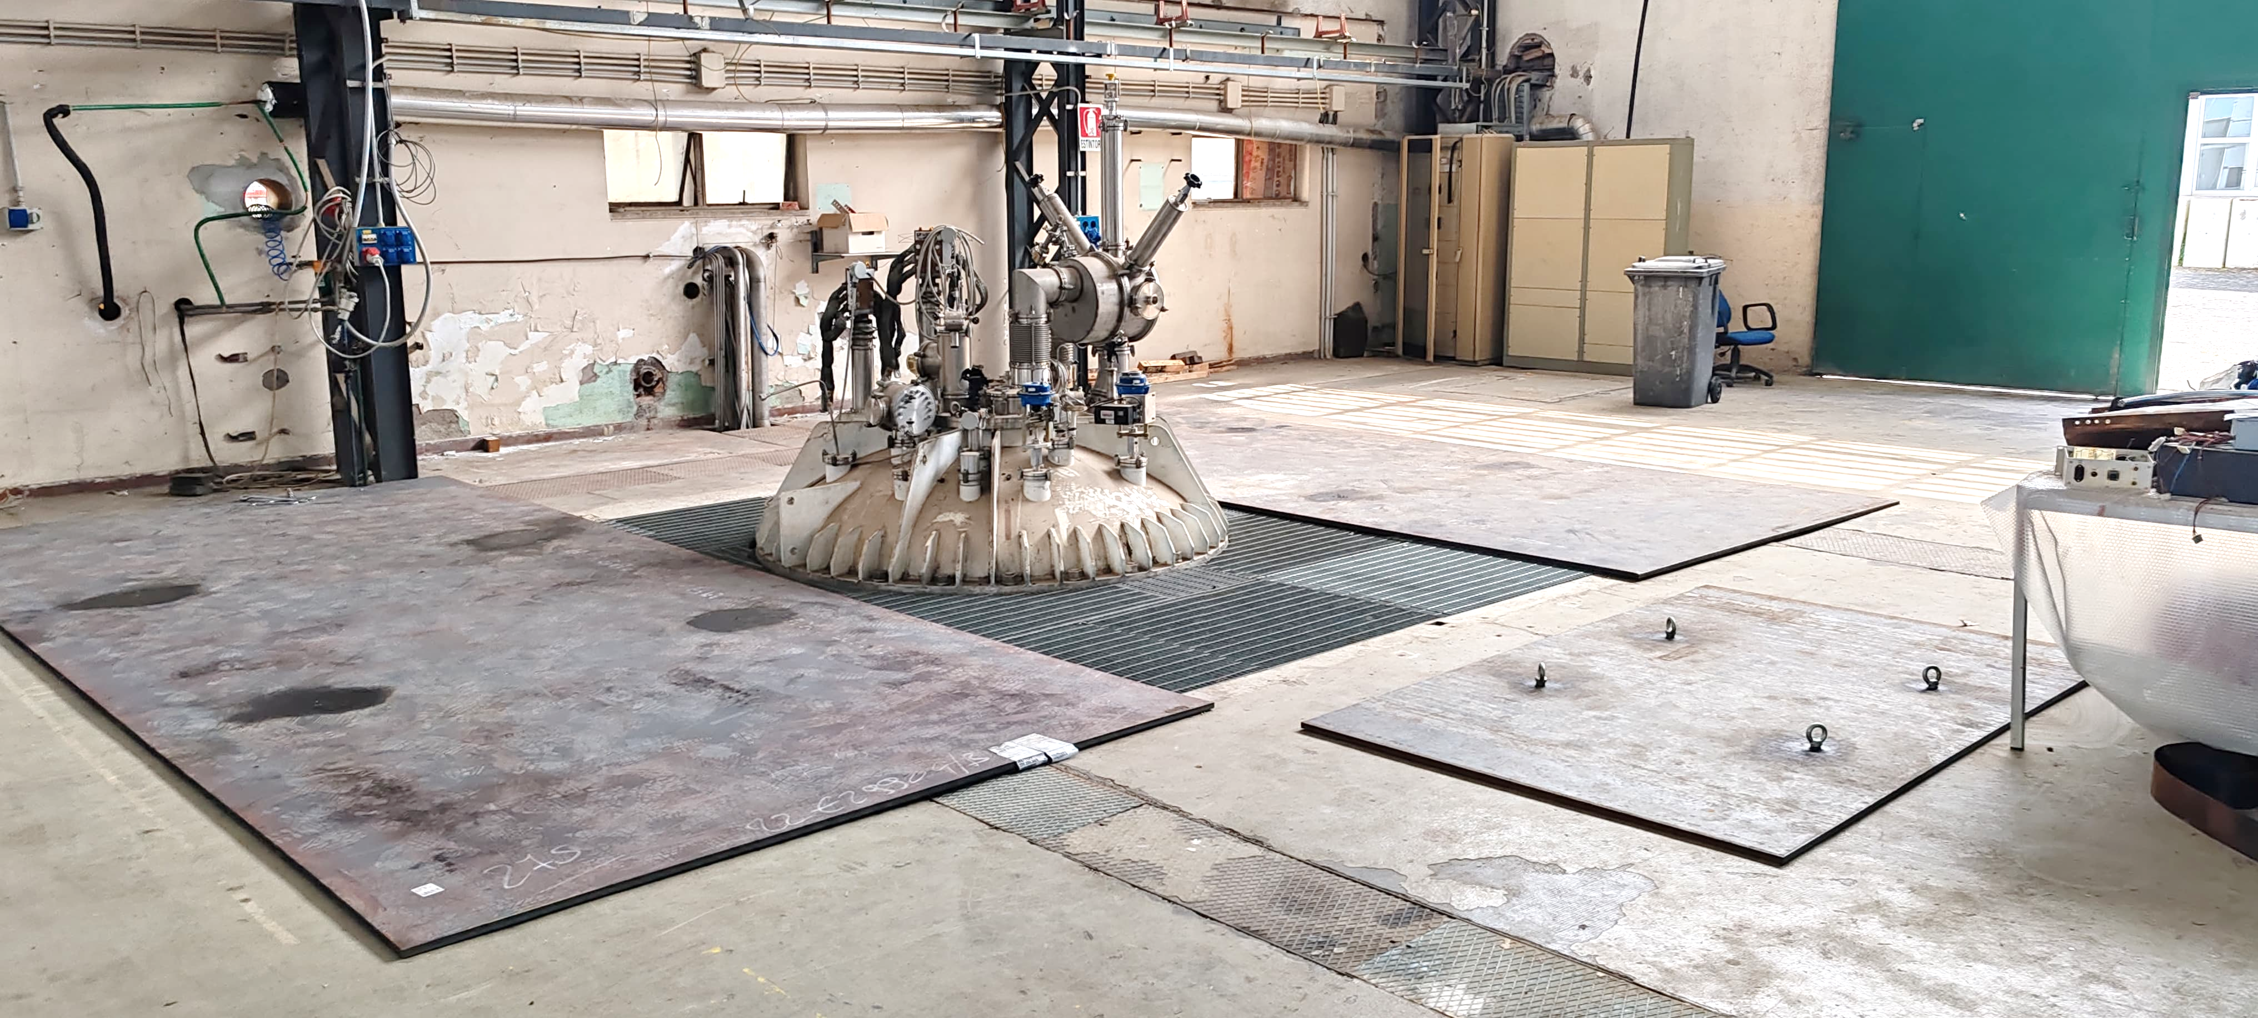
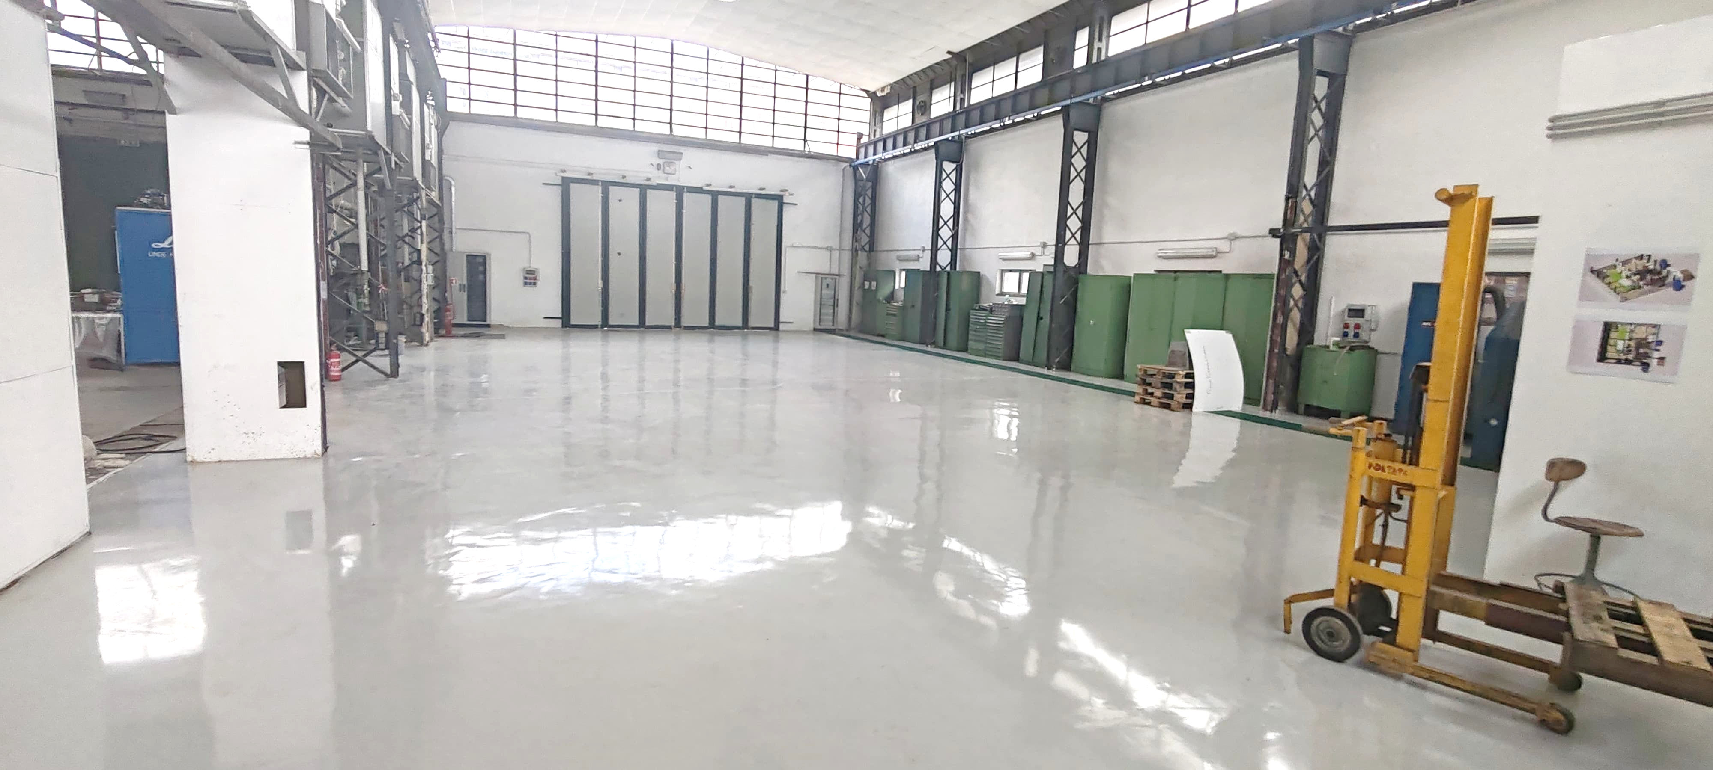
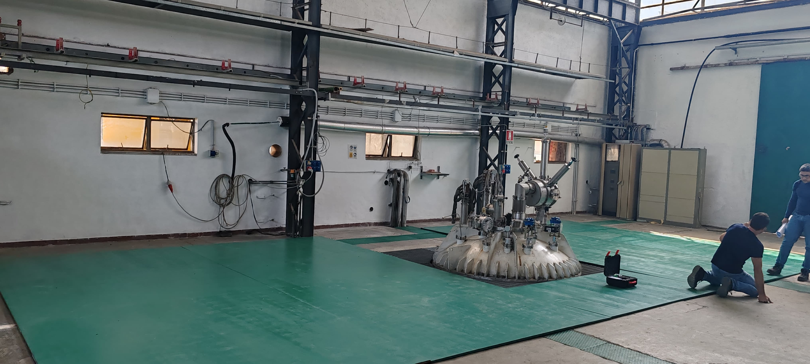
Frascati Coil Cold Test Facility updates
The preparation works for FCCTF are undergoing

Slide 22
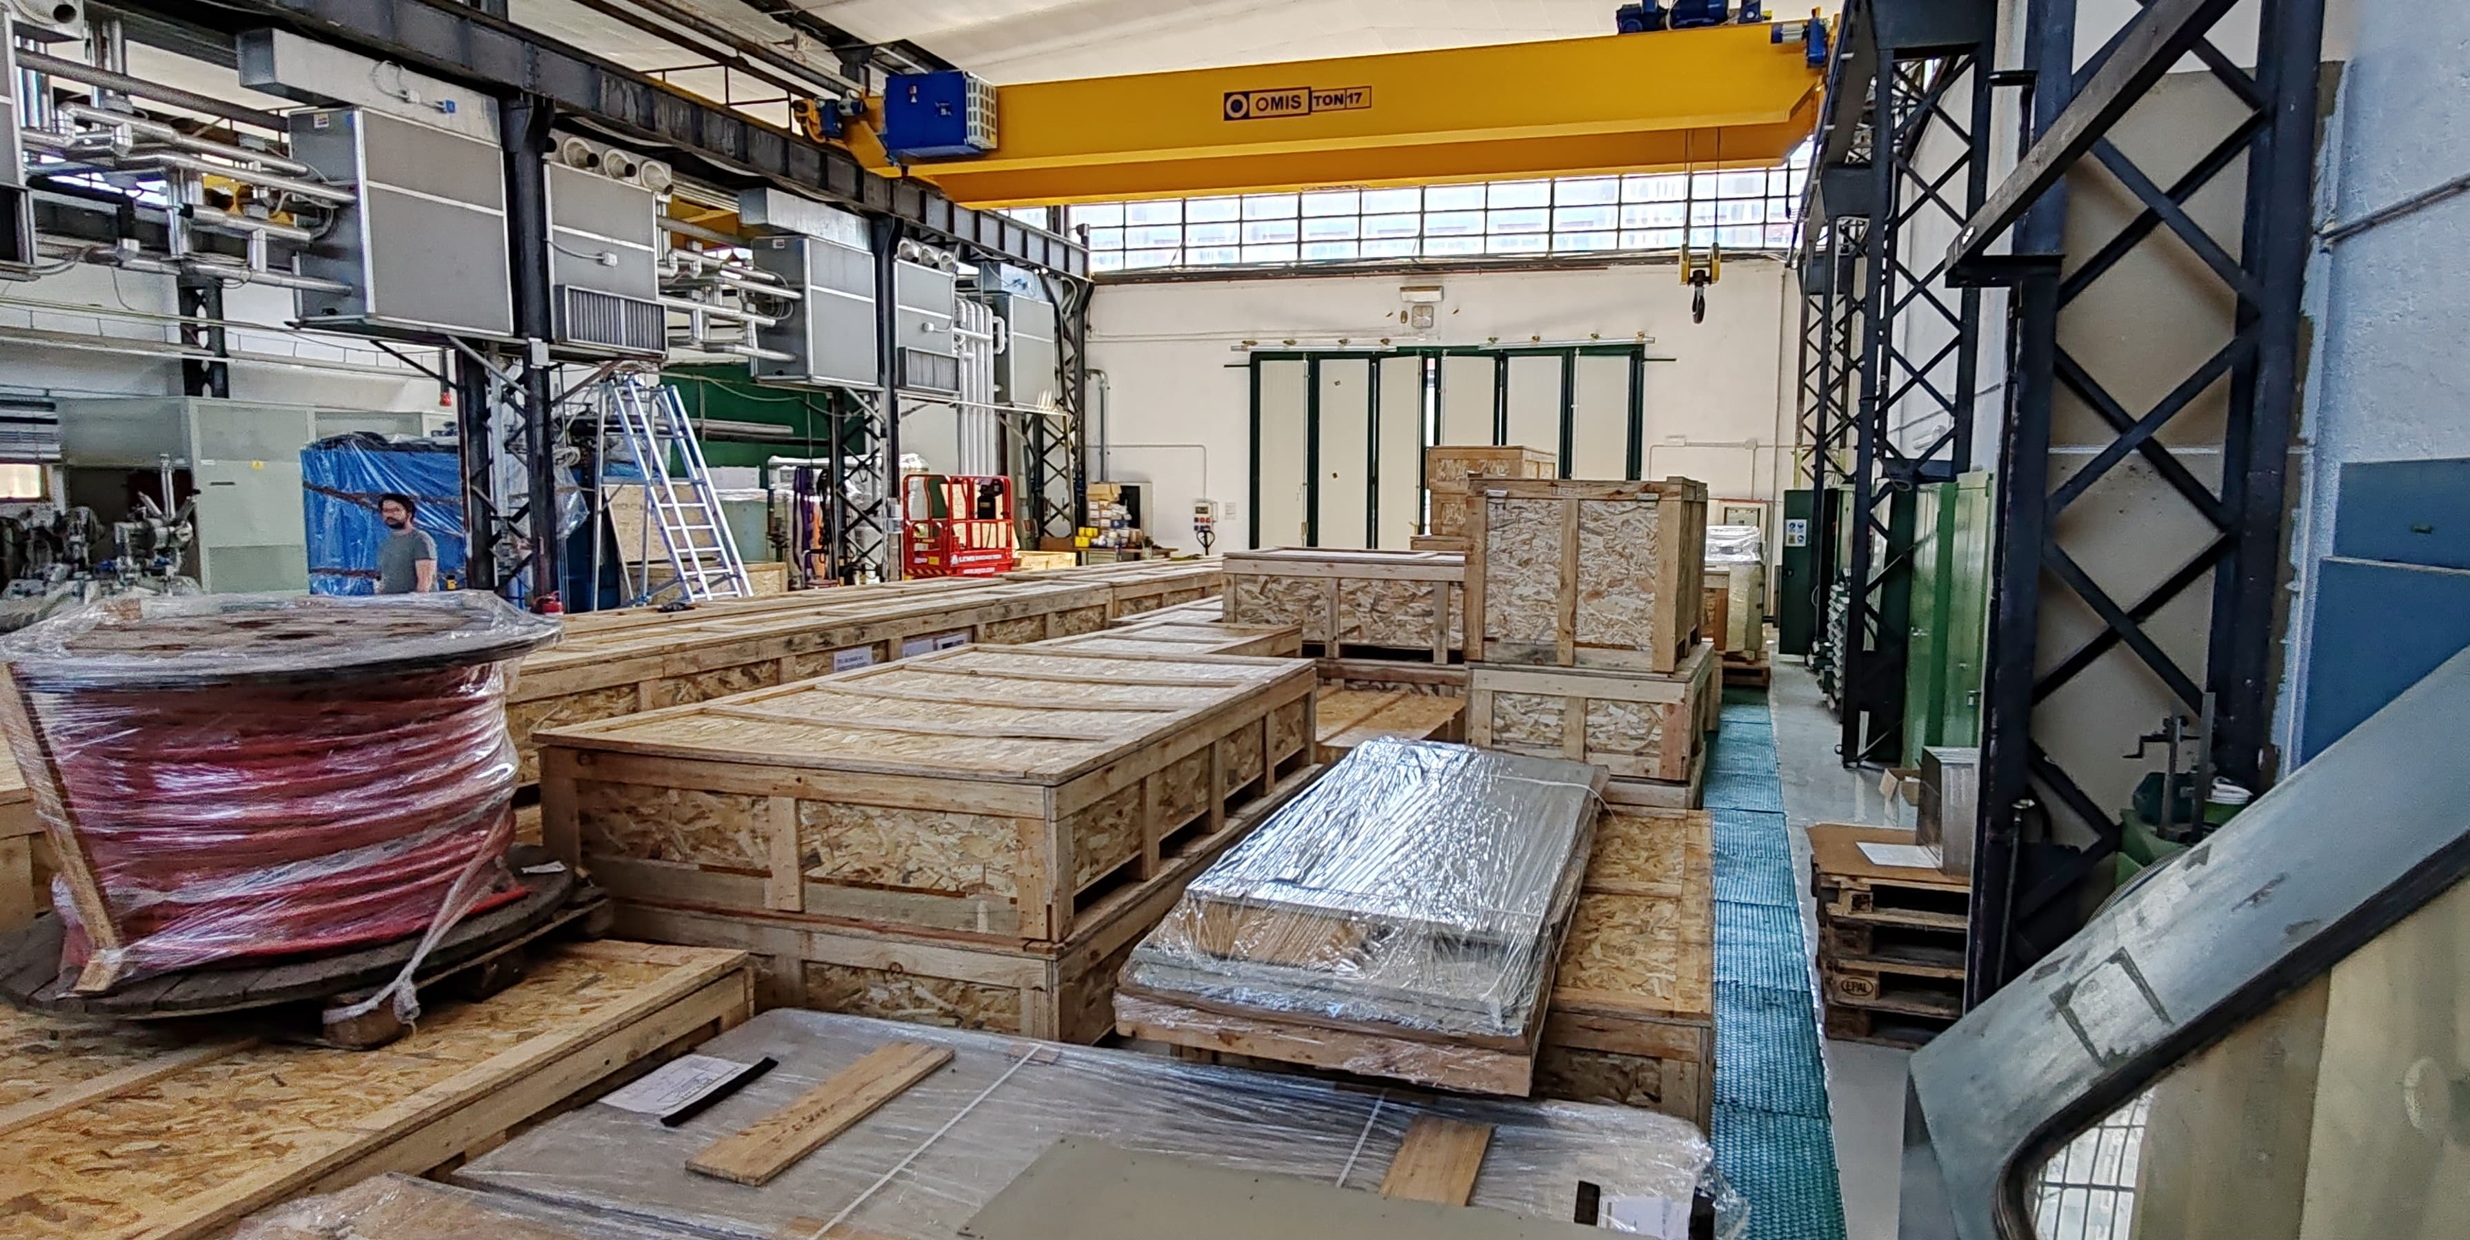
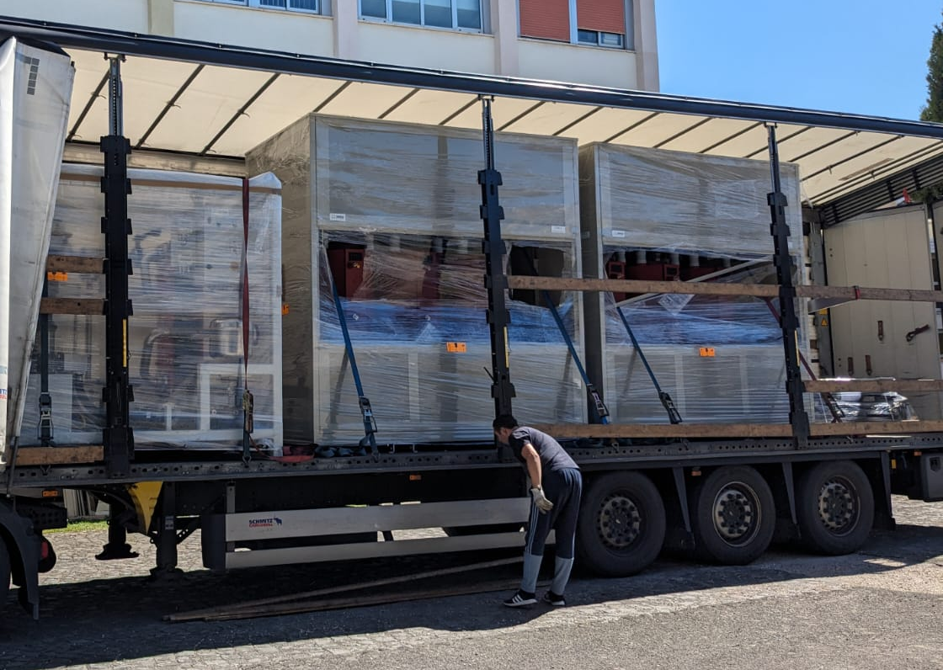
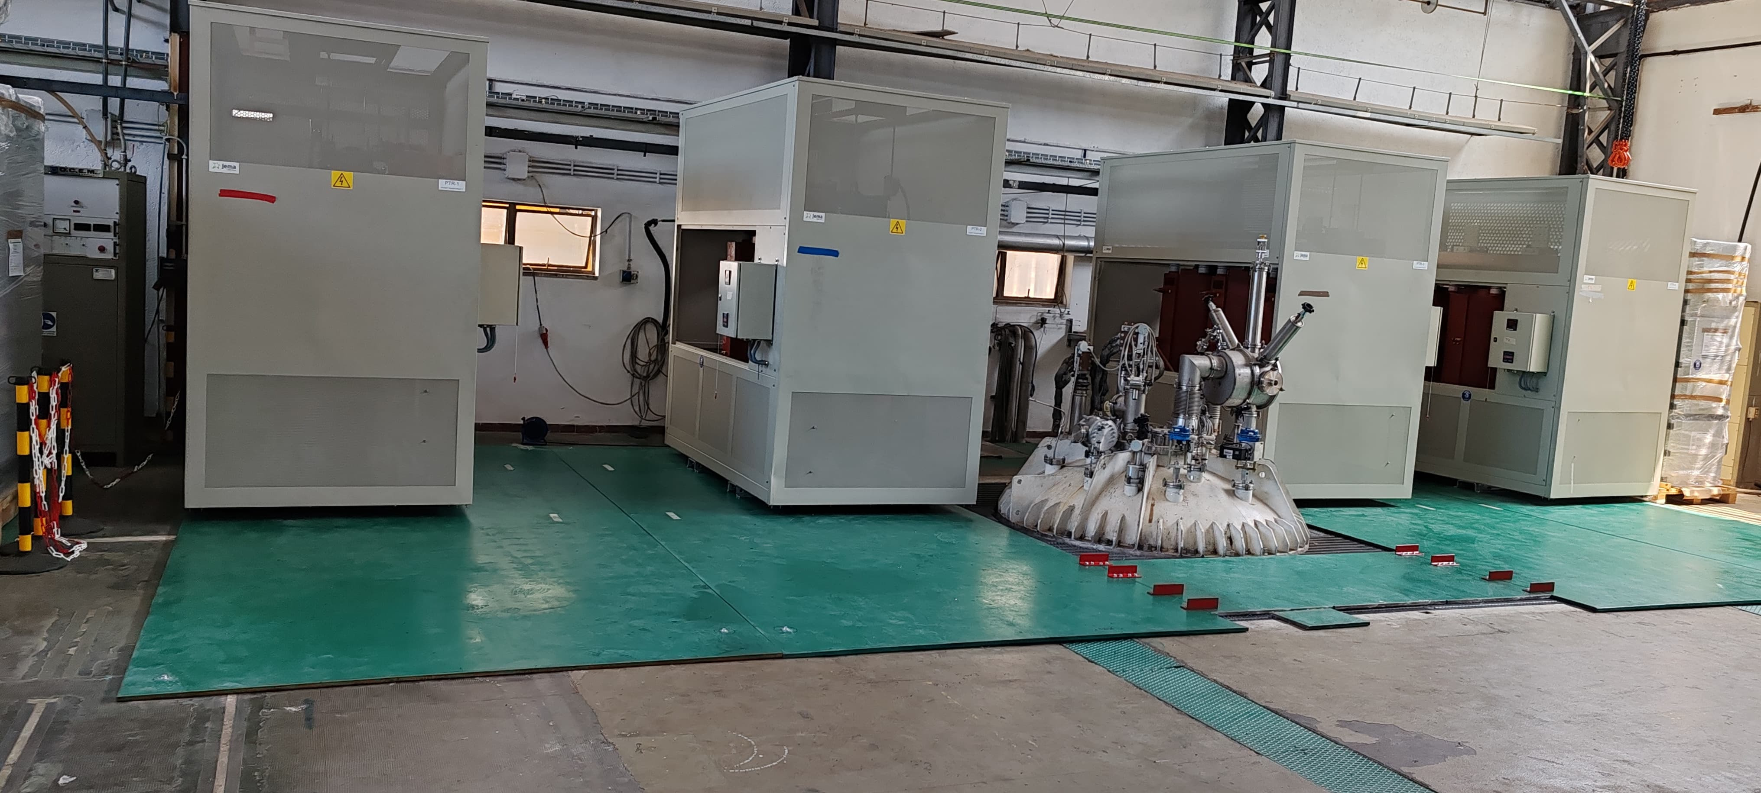
Frascati Coil Cold Test Facility updates
These days, the power supply is being installed in FCCTF
SAT of power supply are scheduled for July-September 2024
FDU will be ready by the end of 2024
Cryostat and quench detection system will be ready at the end of 2025

Slide 23
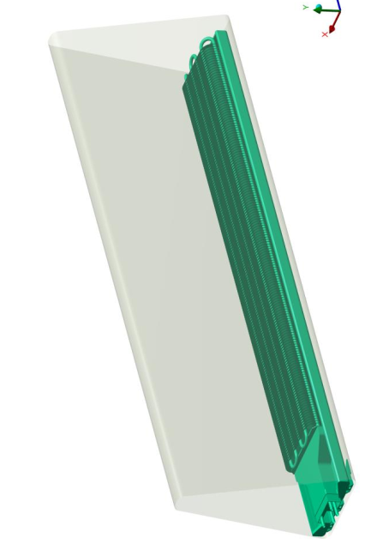
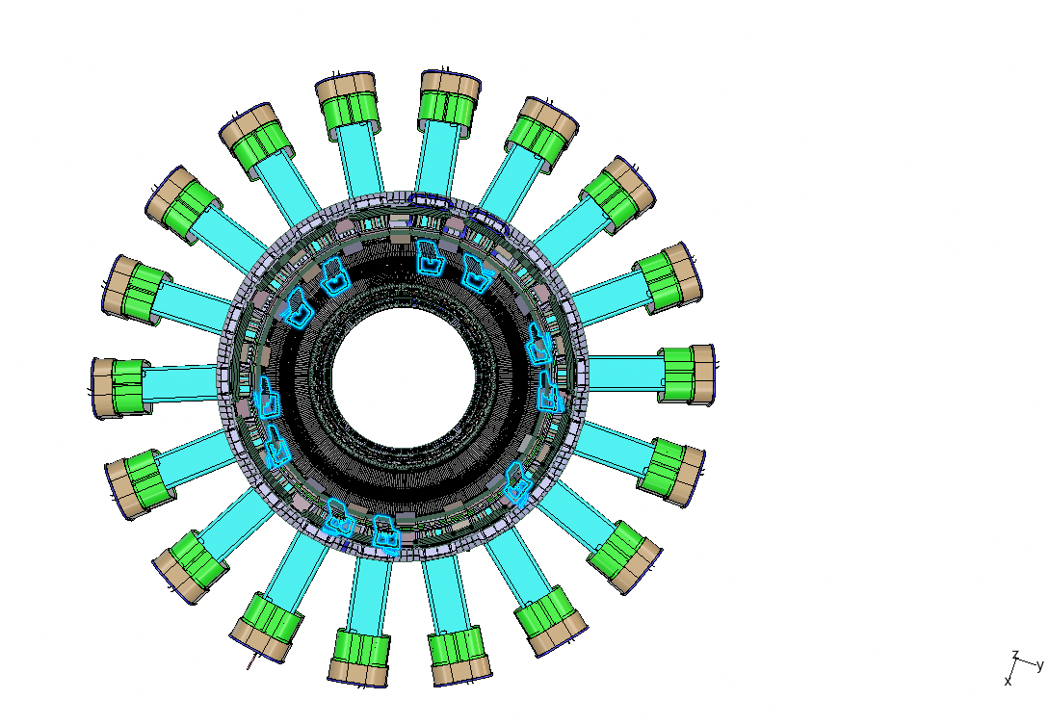
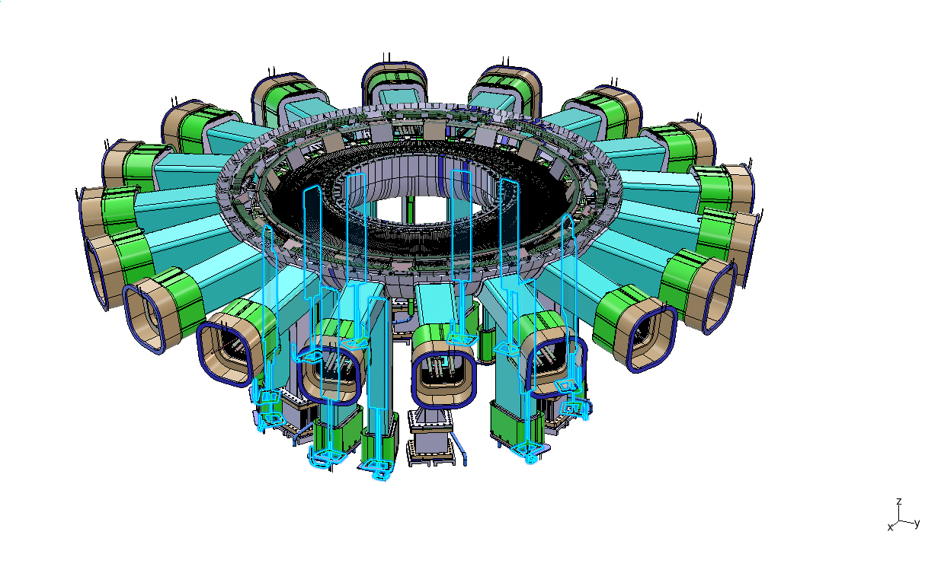
Divertor pumping system
KIT –DTT joint development
Cryogenic pumps at 4.5 K.
Throughput 103 Pa m³/s
Working Pressure 0.1 Pa and 1 Pa
Modularity (3-6-9) for optimal pumping at every scenario
For further detail please refer to Romano’s talk in this conference
Courtesy of C.Day and P.Innocente & VAU team
Notes:
Divertor pumping system has been developed jointly with KIT.
Based on cryogenic pumps operated at 4.5 K.
9 pumps will provide target deuterium throughput equals to 103 Pa m³/s
Working pressure between 0.1 Pa and 1 Pa
Modularity requirement (3-6-9 different pumps operations) for optimal pumping at every scenario

Slide 24
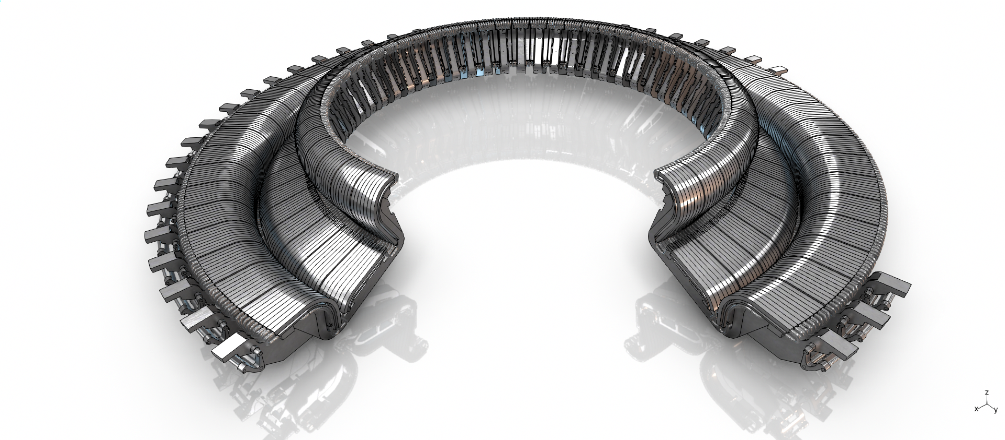
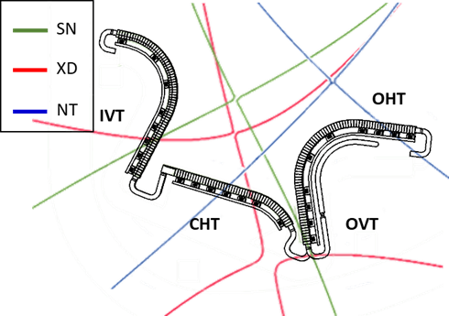





Divertor system
Final design of completed in 2024 jointly with EUROFusion in WPDIV-IDTT
4 test modules (with separate WCS and specific diagnostics)
54 actively cooled modules
SN
5.5MA
XD
4.5MA
NT
4MA
A1.
Reference Magnetic configurations
Courtesy of B.Riccardi , F.Giorgetti and S.Roccella & IVC team
Notes:
In DTT, 54 actively cooled divertor modules are foreseen, 3 for each 20° sector.
central modules of the four remote handling sectors can be used as test modules for the ease of their removal
The poloidal shape has been designed in order to allow a full compatibility with three families of plasma scenarios (SN, XD, and NT).
The High Heat Flux tests conducted on the DTT divertor target mock-ups, of 3 and 4 mm armour thickness respectively, highlighted an excellent overall behavior
The mechanical fatigue resistance of the armour material and of the junction with the cooling tube

Slide 25




Armor Thickness Assessment
Two mock-ups were manufactured by HRP in ENEA lab. to be tested at 20 MW/m2 per 1000 cycles in the GLADIS Facility
Applied 20 MW/m² heat flux profile
DTT-T02 mock-up with 4 mm di armour thickness
DTT-T03 mock-up with 3 mm di armour thickness
Technical capabilities of GLADIS
Power 2 x 1 MW ion source, H₂
U_{ex} 15 – 55 kV
Heat flux 3 - 45 MW/m², 150 mm FWHM ∅ 50 mm (95% q’max)
Pulse length 1 ms - 45 s
Cycle rate 80 - 100 /h
Target dim. mm size up to 60 cm (max. 2m)
  Target cooling: 20-230 °C inlet, 1-4 MPa, < 8l/s „high purity water“ fulfils ITER requirements
Capability for operation with H/He beam
Focus of the two-colour pyrometer
hydraulic conditions during the test
T_{in}=130°C;
p_{in} 40 bar; ← p_{in} 50 bar;
v= 14 m/s; ← v 11m/s
lower available pressure -> increased the flow rate to verify the margin 1.4 from the critical heat flux

Slide 26








Armor Thickness Assessment
DTT-T02 (above) of DTT-T03 (below) during the HHF test
1st pulse
500th pulse
1000th pulse
By H. Greuner and Bernd Böswirth

Slide 27
Armour Thickness Assessment
DTT-T02 (above) of DTT-T03 (below) during the HHF test
➔ No change of temperature distribution during cycling on both mock-ups. No indication of any defects or degradation.
1st pulse
500th pulse
1000th pulse
Both mockups have been tested up to 1000 cycles at 20 MW/m2 with no evidence of damage.
By H. Greuner and Bernd Böswirth

Slide 28

First Wall
Regarding the first wall, water cooled from the beginning of the operations.
Four distinct refrigeration circuits are envisaged:
  The limiter modules at the inboard side,
  the standard module at the inboard,
  the top and one for the outboard
four different designs adoped for inboard.
18 standard modules, made of CuCrZr coaxial pipes coated with W plasma spray to sustain the radiative loads
Interleaved with the limiter modules, made with W monoblocks welded on CuCrZr coaxial pipes.
top first wall will be similar to that of the inboard limiter modules

Slide 29

Remote handling system
HYRMAN
Remote handling of the in-vesselis planned to be ready from the beginning of the operation.
Two main sub-systems:
  HYRMAN (Hyper Redundant Manipulators) for outboard, top and inboard first wall modules; and
  CTM-CMM (Cassette Toroidal and Multifunctional Movers) for the removal and installation of the lower divertor
CTM-CMM

Slide 30


Remote Manipulation Systems
Contracts awarded to one single supplier
2 HYRMAN
3 CMM
CMM will be used during assembly
HYRMAN
Hyper Redundant Manipulator for FW maintenance
A1.
CMM
Cassette Multifunctional Mover for maintenance of the divertor cassettes from port 4

Slide 31


ENEA-DTT RH Training facility
Divertor test modules RH to be performed between one experimental campaign and the other.
Through a “NextGenerationEU” funding scheme a dedicated RH training facility for DTT is being constructed in Naples (2 hours from DTT by car)
Courtesy of A.Reale & RHS team

Slide 32
ENEA-DTT RH Training facility
Contract awarded and KoM launched
Mockup of divertor and FW will be useful for testing alternative concepts of connections to the vessel compatible with RHS

Slide 33

Diagnostics
id | WBS | DIagnostics
01 | DTI | Tomography and SXR imaging
02 | DIP | Interferometry and Polarimetry
03 | DSP | Active and Passive Spectroscopy
04 | DGN | Neutrons and Gammas
05 | DMA | Magnetic Sensors
07 | DWI | Embedded, IR/VIS cameras and PWI Diagnostics
08 | DEE | ECE Diagnostics
09 | DRE | Reflectometry
10 | DTS | Thomson Scattering systems
11 | DRA | Run Aways Diagnostics
12 | DFP | Fast Particles Diagnostics
Diagnostics conceptual design is under review by an external panel
Interfaces will be locked (with cooling, ports, IVC, etc)
Engineering and procurement phase to be launched after review panel

Slide 34



Heating and Current Drive (1)
DTT will be equipped with three Heating Systems
  Electron Cyclotron Heating
  Ion Cyclotron Heating and
  Negative Neutral Beam Injector
ECH System
The reference microwave source is a diode-type gyrotron, with collector voltage depression , operating at 170 GHz with efficiency > 40%, to yield 1 MW for 100 s
Two 8- gyrotrons clusters for the first stage of operation and four clusters for the final stage
The interim acceptance of the first DTT gyrotron has taken place at the end of 2023, final FAT will be in 2024
Completion of the first cluster manufacturing by THALES within 2027 (Specific Contract n.2 signed in Dec 2023)
Quasi-optical propagation of 8 Gaussian beams in a single path, realized by a set of shared focusing and plane mirrors in a confocal arrangement, is at the end of the conceptual phase.
Layout of the whole DTT ECH system
THALES property and confidential information, not to be disclosed
Reference pulse for interim FAT
RF power = 980 kW ±5 %
Installation of First DTT Gyrotron @ Falcon Test Facility
Notes:
L’impulso è un segnale RF non calibrato, il picco iniziale è dovuto a una variazione di frequenza naturale del gyrotron.

Slide 35








Heating and Current Drive (2)
ECH System
TL connection mirror between Gyrotron and RF Load under manufacturing to be tested after Gyrotron FAT
4 RF Loads procurement: contract signed in Feb. 2024
  First RF Load ready in 2025
  Completion in Jan. 2027
CURTI and LT Calcoli property and confidential information, not to be disclosed
Mirror in CuCrZr alloy Additive Manufacturing
Active cooling
Adjustable on 3 axis and 2 angles
Notes:
La connection line verrà usata per commisionign dei singoli gyrotron a DTT e testare specchi della linea di trasmisisoen a FALCON con il gyrotron pre-serie. Verrà poi utilizzato nelal fase di allestimento dei cluster a DTT

Slide 36
Heating and Current Drive (3)
ICH System
  The Ion Cyclotron Heating (ICH) system of DTT is aimed at providing radiofrequency (RF) power in the frequency range between 60 and 90 MHz to be delivered for:
    DTT experiments: around 1.5 MW per antenna for the ion heating in the reference scenario, mostly via 3He or H minority heating.
    Wall conditioning: less than 100 kW per antenna for wall cleaning and conditioning (i.e. boronization)
  The system is organized in modules, each made of
    Four transmitters, fully based on solid-state
    technology, for the first time for such an
    unprecedented combination of power,
    frequency range and pulse duration for
    such technology. The contract for the first
    two transmitters started in May 2024.
    Two antennas: they will be based on
    traditional straps and their assembling
    will require remote-handling system.
Notes:
I triangoli in figura rappresentano i trasmettitori
Il modulo arancione in figura è il primo che sarà installato, quello disponibile col primo sparo.
Il modulo blu/Azzurro è invece il secondo, previsto nella fase di DTT a piena potenza.
Qualcuno potrebbe chiedere se per gli esperimenti di DTT pensiamo di usare anche lo scenario a 3 ioni oltre ai due classici in minority heating di 3He e H. La risposta è sì, questo scenario è attualmente oggetto di studio.
ICH System
The Ion Cyclotron Heating (ICH) system of DTT is organized in modules, each made of four transmitters and
two antennas.
The system is aimed at providing radiofrequency (RF) power in the frequency range between
60 and 90 MHz [49] to be delivered for:
DTT experiments: around 1.5 MW per antenna for the ion heating in the reference scenario, mostly via 3He or H minority heating.
Wall conditioning: less than 100 kW per antenna for wall cleaning and deposition of materials with low atomic number over DTT first wall (i.e boronization)
DTT will be completely based on solid-state technology, the first ones of this kind, i.e., with such an unprecedented combination of power, frequency range and pulse duration for such technology.

Slide 37
Balance of Plant
The new buildings amount to about 150.000 m3
plus existing buildings to be adapted for the DTT systems amount to about 12.000 m2.
permissions for the construction have been granted together with the licensing for cat. A ionizing radiation source.

Slide 38

Balance of Plant
Tokamak Hall and New Building
Electrical Network System
Auxiliaries Systems
Refurbishment of Existing Building
Control Saf. Sec. Telecomm. Systems
Notes:
Sono identificati con colori diversi le varie aree I nuovi edifice, quelli da ristrutturare, la sottostazione HV, e le varie aree di cantiere all’interno del CR ENEA

Slide 39

Tokamak Hall and New Building and Refurbishment of Existing Buildings
Notes:
New Buildings: area highlighted with colours…
The new buildings amount to about 150.000 m3
185 Tokamak hall Building,
174 cooling divertor, FW and vacuum vessel Building,
176 Electrical SS,
191 PSS IVCNBI Cooling, ICRH Splitters,
192 Diagnostics Building,
184 FDU and TF PSS Building,
173 ECRH and electrical SS Building,
178 Tunnel ECHR,
190 ICHR Building,
187 pipe rack,
175 PSS CS and PF Building.
Building to be refurbished: area highlighted in light green 12.000 m2
Tokamak Hall and New Building – Status and way forward
Status:
Engineering completed
Third party Verification ongoing (mandatory by Italy public procurement Law)
Bid Package under completion
Way forward:
ITT to be issued by the end of July 2024
Contract Award expected in Q1 2025 (Engineering and construction integrated contract)
Demolition activities to be completed (next slide)
Refurbishment of Existing Buildings – Status and way forward
Status:
Technical and historical assessment completed
Engineering Scope of Work completed (including energy efficiency improvement)
Way forward:
Engineering contract to be awarded in Q3 2024

Slide 40

Demolitions Activities
Status:
  Phase 1 Engineering (building 90) completed
  Phase 2 Engineering (Building 73) ongoing
  Bid Packages under Preparation
Way forward:
  Phase 1 third party Verification to be completed by mid-July and ITT by end of August
  Phase 2 third party Verification contract to be launched and award expected by end of September and ITT in October 2024
  Phase 1 execution: 4 months
  Phase 2 Execution 8 months
Notes:
Demolition phase 1 highlighted in yellow and phase 2 highlighted in blu
Building 90 simple demolition
Building 73: deconstruction (more advanced project and structural verification needed)

Slide 41

Electrical Network System
Notes:
Evidenziare SS Terna, SS HV e Cabine come da layout Generale.
Electrical Network System– Status and way forward
Status:
Engineering under completion
Third party Verification contract awarded
Bid Package under preparation
Way forward:
Land use permit to be obtained by August 2024
Third Party Verification to be completed by end of August 2024
ITT to be issued by the end of September
Contract Award expected in Q2 2025 (Engineering and construction integrated contract)

Slide 42
Some final remarks
DTT is in the construction phase with about one third of the construction budget already committed in industrial contracts while other critical contracts are presently being launched.
The actual final date for completion is still under revision considering a number of acceleration actions that are planned at design and construction level
The design of the new buildings has been completed and that of the electrical distribution system (including the new 150kV/20kV switchyard) is being completed and in 2024 the call for tender for both will be launched. The construction of the 150kV line has been approved and it is in progress.
The characteristics of the first divertor have been agreed with EUROfusion and the engineering activity is progressing. The preparation of the Research Plan has started in collaboration with all the EUROfusion laboratories.

Slide 43
Frascati Coil Cold Test Facility (FCCTF)
Goal: Testing the Superconducting magnets of the DTT (Divertor Tokamak Test facility) experimental reactor in cold conditions (4.5 K inlet temperature).
Cold tests will minimize the risk associated to SC coils manufacturing.
Side beneficial effect, practising with cryogenic aspects, magnets operations and data acquisition systems.
FCCTF allows a safe investigation of the coil behavior in close-to-operative conditions.
FCCTF cryostat can host magnets as long as 7 m and as large as 3 m, having a maximum weight of 17 tons
FCCTF Power supply can deliver the high current up to 43 kA with the desired ramps.

Slide 44

Tests program of Frascati Coil Cold Test Facility
All DTT Nb₃Sn coils (18 TF, 6 CS and PF1/6) will be tested at their maximum currents
The DTT TF (and PF/CS, if possible) power supplies will be commissioned in FCCTF
The DTT FDU (Fast Discharge Unit) systems for quench protection
A CODAS (COntrol and Data Acquisition System) will be tested in a lighter version wrt to the tokamak’s one, including the quench detection system
Coils will be checked for:
Electrical integrity of coils at cryogenic temperature
SC performances (even if at lower conditions)
Thermo-hydraulic characterization
Joints/terminations behaviour and resistance values

