Slide 1
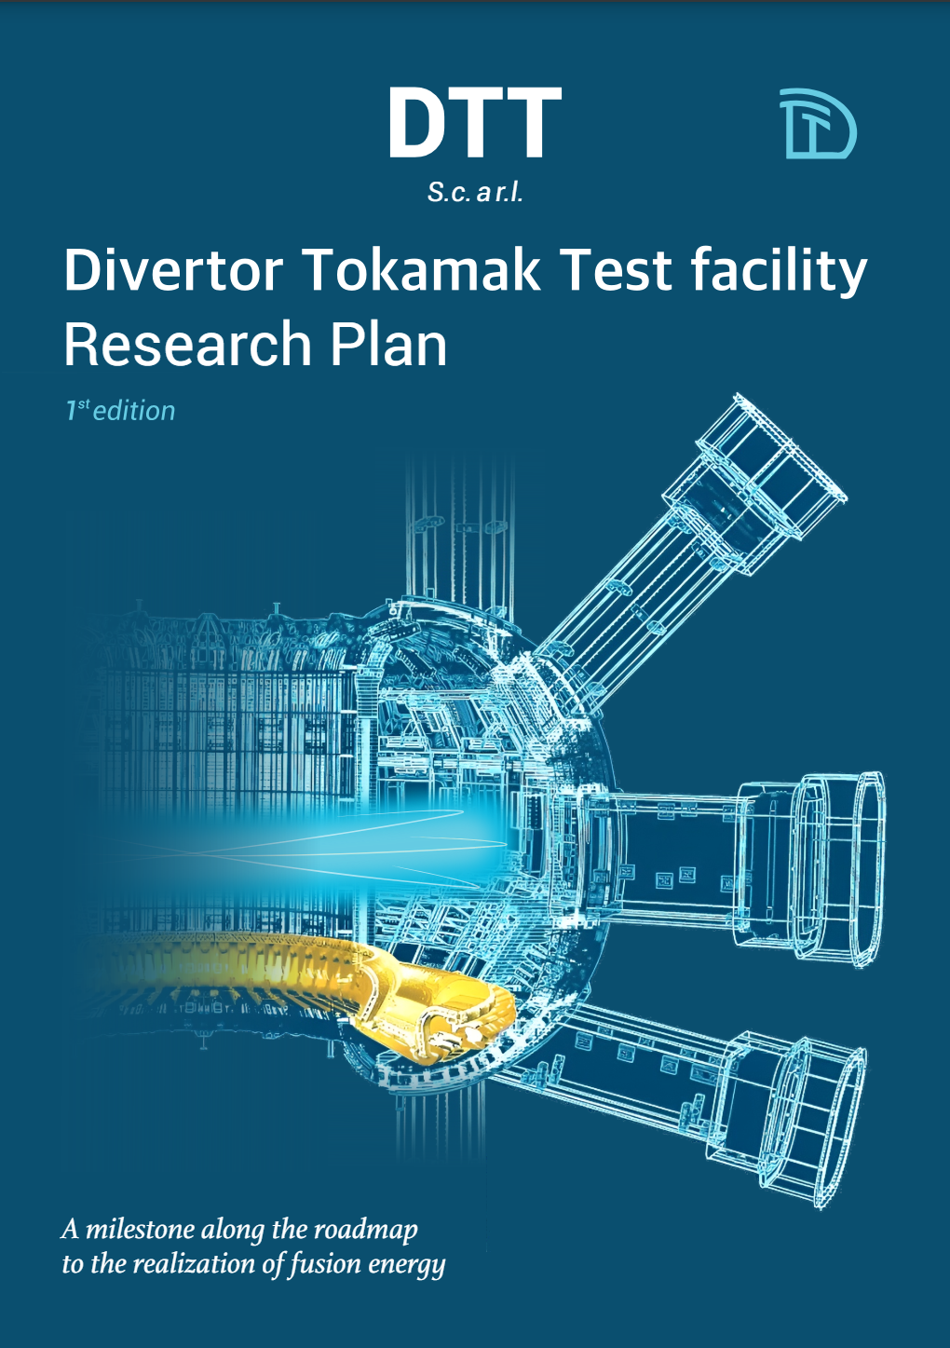
DTT Research Plan
F. Crisanti - DTT S.C.a.r.l. & University of Tuscia (Italy)
G. Giruzzi - CEA, IRFM (France)
P. Martin - DTT S.C.a.r.l., RFX & University of Padova (Italy)
EUROfusion Science Meeting
12th June 2024

Slide 2

















DTT Research Plan – Version 1.0 (May 2024)
Public issue available at: https://www.dtt-project.it/index.php/about/dtt-research-plan.html
Voluntary participation by:
100 authors and contributors
20 Research Institutes
10 countries
9 Chapters
9 Appendices
195 pages

Slide 3
DTT Research Plan activity (2022-2024)
DTT Research Plan workshop July 2022
Call for voluntary participation → European Research Institutes July-Sept. 2022
Selection of DTT-RP participants (~90) and ROs of the 6 Expert groups: Sept. 2022
EG-1: DTT scientific exploitation strategy - EG-4: Heating, current drive and fuelling
EG-2: Divertor and SOL physics - EG-5: MHD and fast particles, theory
EG-3: Plasma scenarios and associated modelling - EG-6: Fusion technology developments
1st meeting (Kick-off) of the DTT-RP Team (in person, at ENEA/Frascati) 16-17 Nov. 2022
2nd meeting of the DTT-RP Team (in person, at ENEA/Frascati) 26-28 Apr. 2023
DTT-RP Team contribution to the EU facilities review June 2023
3rd meeting of the DTT-RP Team (in person, at Padova University) 13-15 Dec. 2023
First draft of the DTT-RP completed Sent for final reading by Expert Groups end March 2024
4th meeting of the DTT-RP Team (in person, at ENEA/Frascati) 6-8 May 2024
Draft sent to CTS (DTT scientific & technical committee) for comments May 2024
DTT-RP version 1 issued end May 2024

Slide 4
Chapters and leading authors (DTT-RP Team)
Chapter 1: DTT power exhaust strategy | F Crisanti G Giruzzi P Martin | DTT S.C.a.r.l. & University of Tuscia, Italy CEA, IRFM, France DTT S.C.a.r.l., RFX & University of Padova, Italy
Chapter 2: Plasma scenarios | P Mantica C Angioni | CNR – ISTP, Italy Max Planck IPP, Germany
Chapter 3: Divertor and SOL physics, plasma-wall interactions | P Innocente E Tsitrone M Wischmeier | Consorzio RFX, Italy CEA, IRFM, France Max Planck IPP, Germany
Chapter 4: Transport physics and integrated modelling | C Angioni P Mantica | Max Planck IPP, Germany CNR – ISTP, Italy
Chapter 5: MHD, disruptions and control | E Nardon G Vlad M Falessi | CEA, IRFM, France ENEA, Italy ENEA, Italy
Chapter 6: Physics of heating, current drive and fuelling | C Sozzi D Van Eester P Vincenzi D Terranova | CNR – ISTP, Italy LPP-ERM/KMS, Belgium Consorzio RFX, Italy Consorzio RFX, Italy
Chapter 7: Energetic particle physics | G Vlad M Falessi E Nardon | ENEA, Italy ENEA, Italy CEA, IRFM, France
Chapter 8: Theory and simulation | M Falessi G Vlad E Nardon | ENEA, Italy ENEA, Italy CEA, IRFM, France
Chapter 9: Fusion technology developments | S Brezinsek C Day G Dose | FZJ, Germany KIT, Germany ENEA, Italy
Coordinators
F. Crisanti, G. Giruzzi, P. Martin
Appendices
A: DTT parameters
B: DTT tokamak description
C: ASTRA scenario simulations
D: Plasma facing components
E: Heating &CD systems
F: Diagnostic systems
G: Gas injection & pumping
H: Numerical codes
I: Programme headlines table

Slide 5
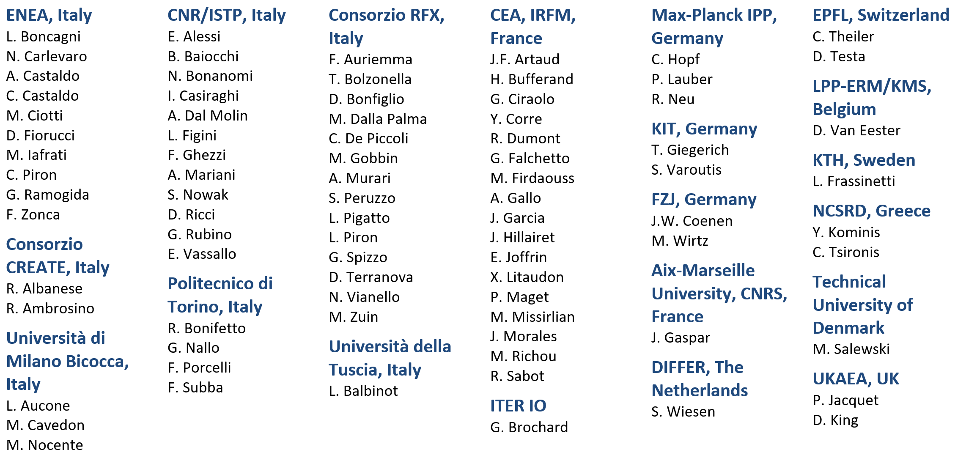
Participating Institutes and contributors

Slide 6
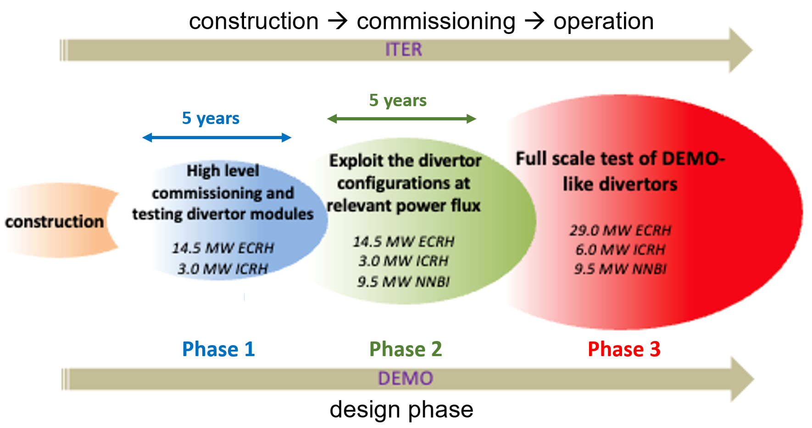
DTT Research Plan : characteristics and objectives
living document, to be regularly updated
basis for the DTT scientific programme
basis for subsequent device upgrades
describing the objectives and research strategy of DTT scientific exploitation
describing programmatic headlines in the main research phases
guide and catalyse DTT research activities in preparation of exploitation

Slide 7
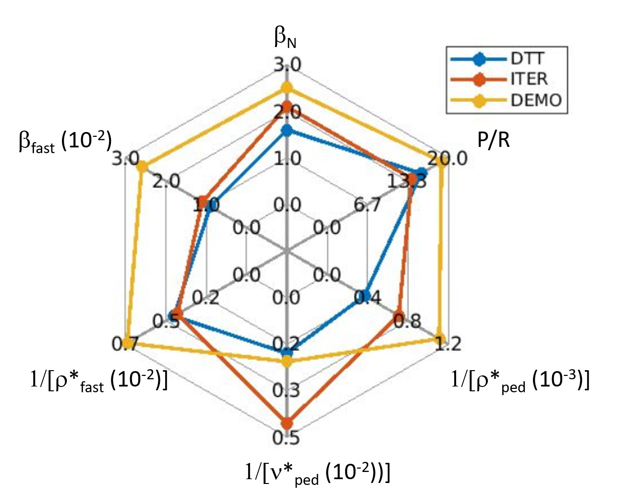
DTT Research Plan: guidelines
1) DTT unique combination of characteristics:
High field, high current, high density and low collisionality, full W, long pulse, dominant electron heating, low torque
2) DTT main missions:
Validation of optimum power exhaust strategy for DEMO and related plasma scenarios, with full core-edge integration at high performance
Support to the various phases of ITER exploitation
3) DTT phases:
Commissioning (including actively cooled W PFCs)
Short term: a) reduced field and current; b) reduced power
Long term: a) nominal heating power level; b) different divertors

Slide 8
Top-level headlines of the DTT Research Programme (Chap. 1)
Development and assessment of baseline and advanced scenarios for various divertor configurations
Development of scenarios at half field and current → high β (research complementary to JT-60SA)
Disruption and runaway electrons studies, including mitigation by SPI, in support of ITER
Detached regimes optimization and control by impurity seeding in various scenarios
Assessment of edge transport at high current and comparison with λ_{q} scalings & theory
Development of small/no ELMs scenarios and their control
Wall erosion, W migration, D retention & removal studies and assessment for DEMO
Use the 4 Divertor Test Modules for testing new first wall and divertor materials
Transport, MHD, Energetic Particle physics studies with reactor relevant dimensionless parameters

Slide 9
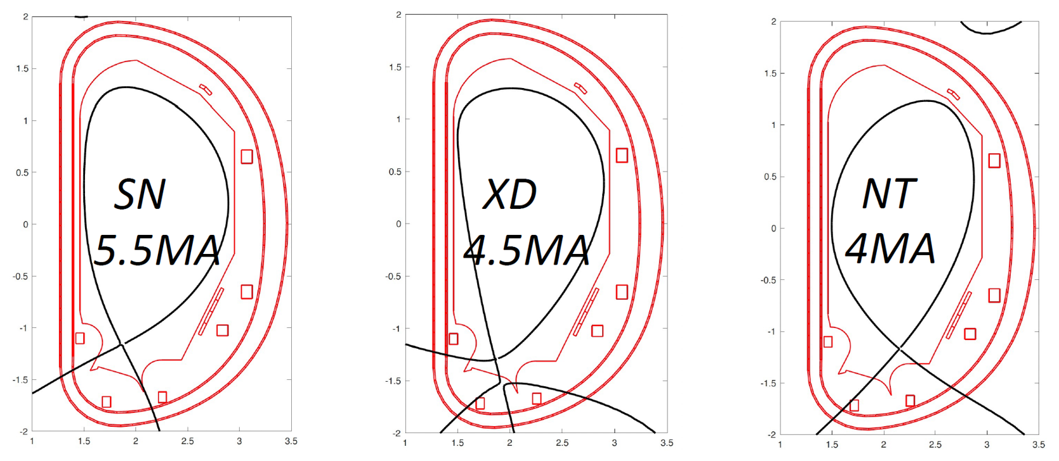
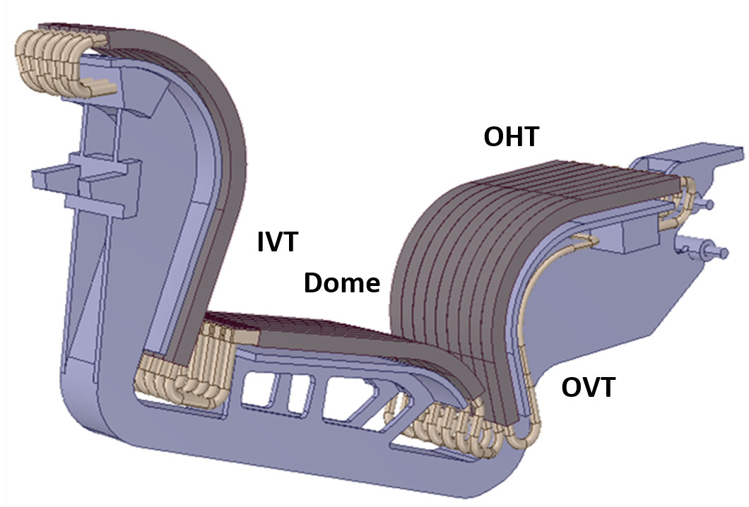
DTT-RP content in a nutshell (Chapters 1-3)
Chapter 1: DTT power exhaust strategy
Short description of the DTT tokamak
Role, objectives and priorities
Research Phases and evolutions
Chapter 2: Plasma scenarios
DTT heating phases (8 → 50 MW installed power)
Magnetic configurations & discharge evolution (breakdown→start-up→flat-top→ramp-down)
Baseline and alternative scenarios descriptions and simulations → talk by P. Mantica
Chapter 3: Divertor and SOL physics, PWI
PFC and diagnostics relevant for divertor & SOL physics
Research programme on divertor & edge physics studies
Far SOL physics and first wall loads
PWI in full tungsten environment → talk by P. Innocente

Slide 10
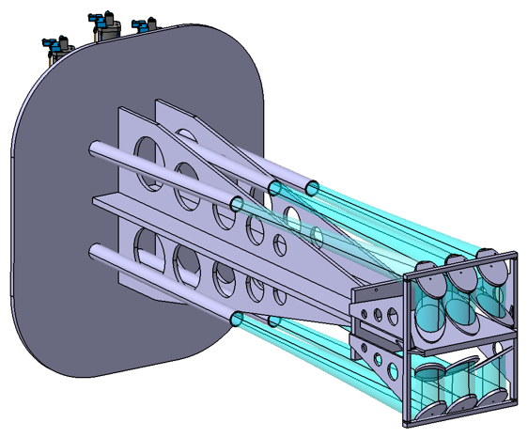
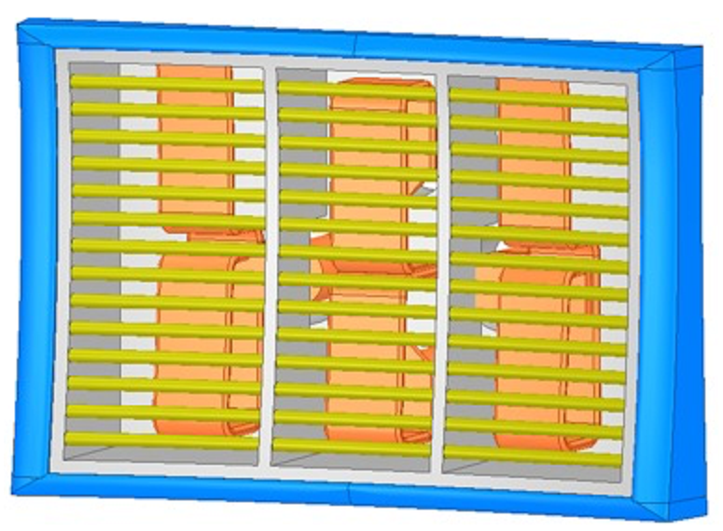
DTT-RP content in a nutshell (Chapters 4-6)
Chapter 4: Transport physics and integrated modelling
DTT characteristics, missions and research areas on transport & confinement
Predictions of plasma profiles during current flat-top phases
Diagnostic requirements for transport studies
Chapter 5: MHD, disruptions and control
MHD stability and control for DTT scenarios
Disruptions and runaways
Relevant diagnostics for MHD, disruptions and runaways
Chapter 6: Physics of heating, current drive and fuelling
ECRH system: tasks, commissioning, required diagnostics and modelling
ICRH system: tasks, commissioning, required diagnostics and modelling
NBI system: tasks, commissioning, required diagnostics and modelling
Plasma fuelling system: tasks, commissioning, required diagnostics and modelling

Slide 11
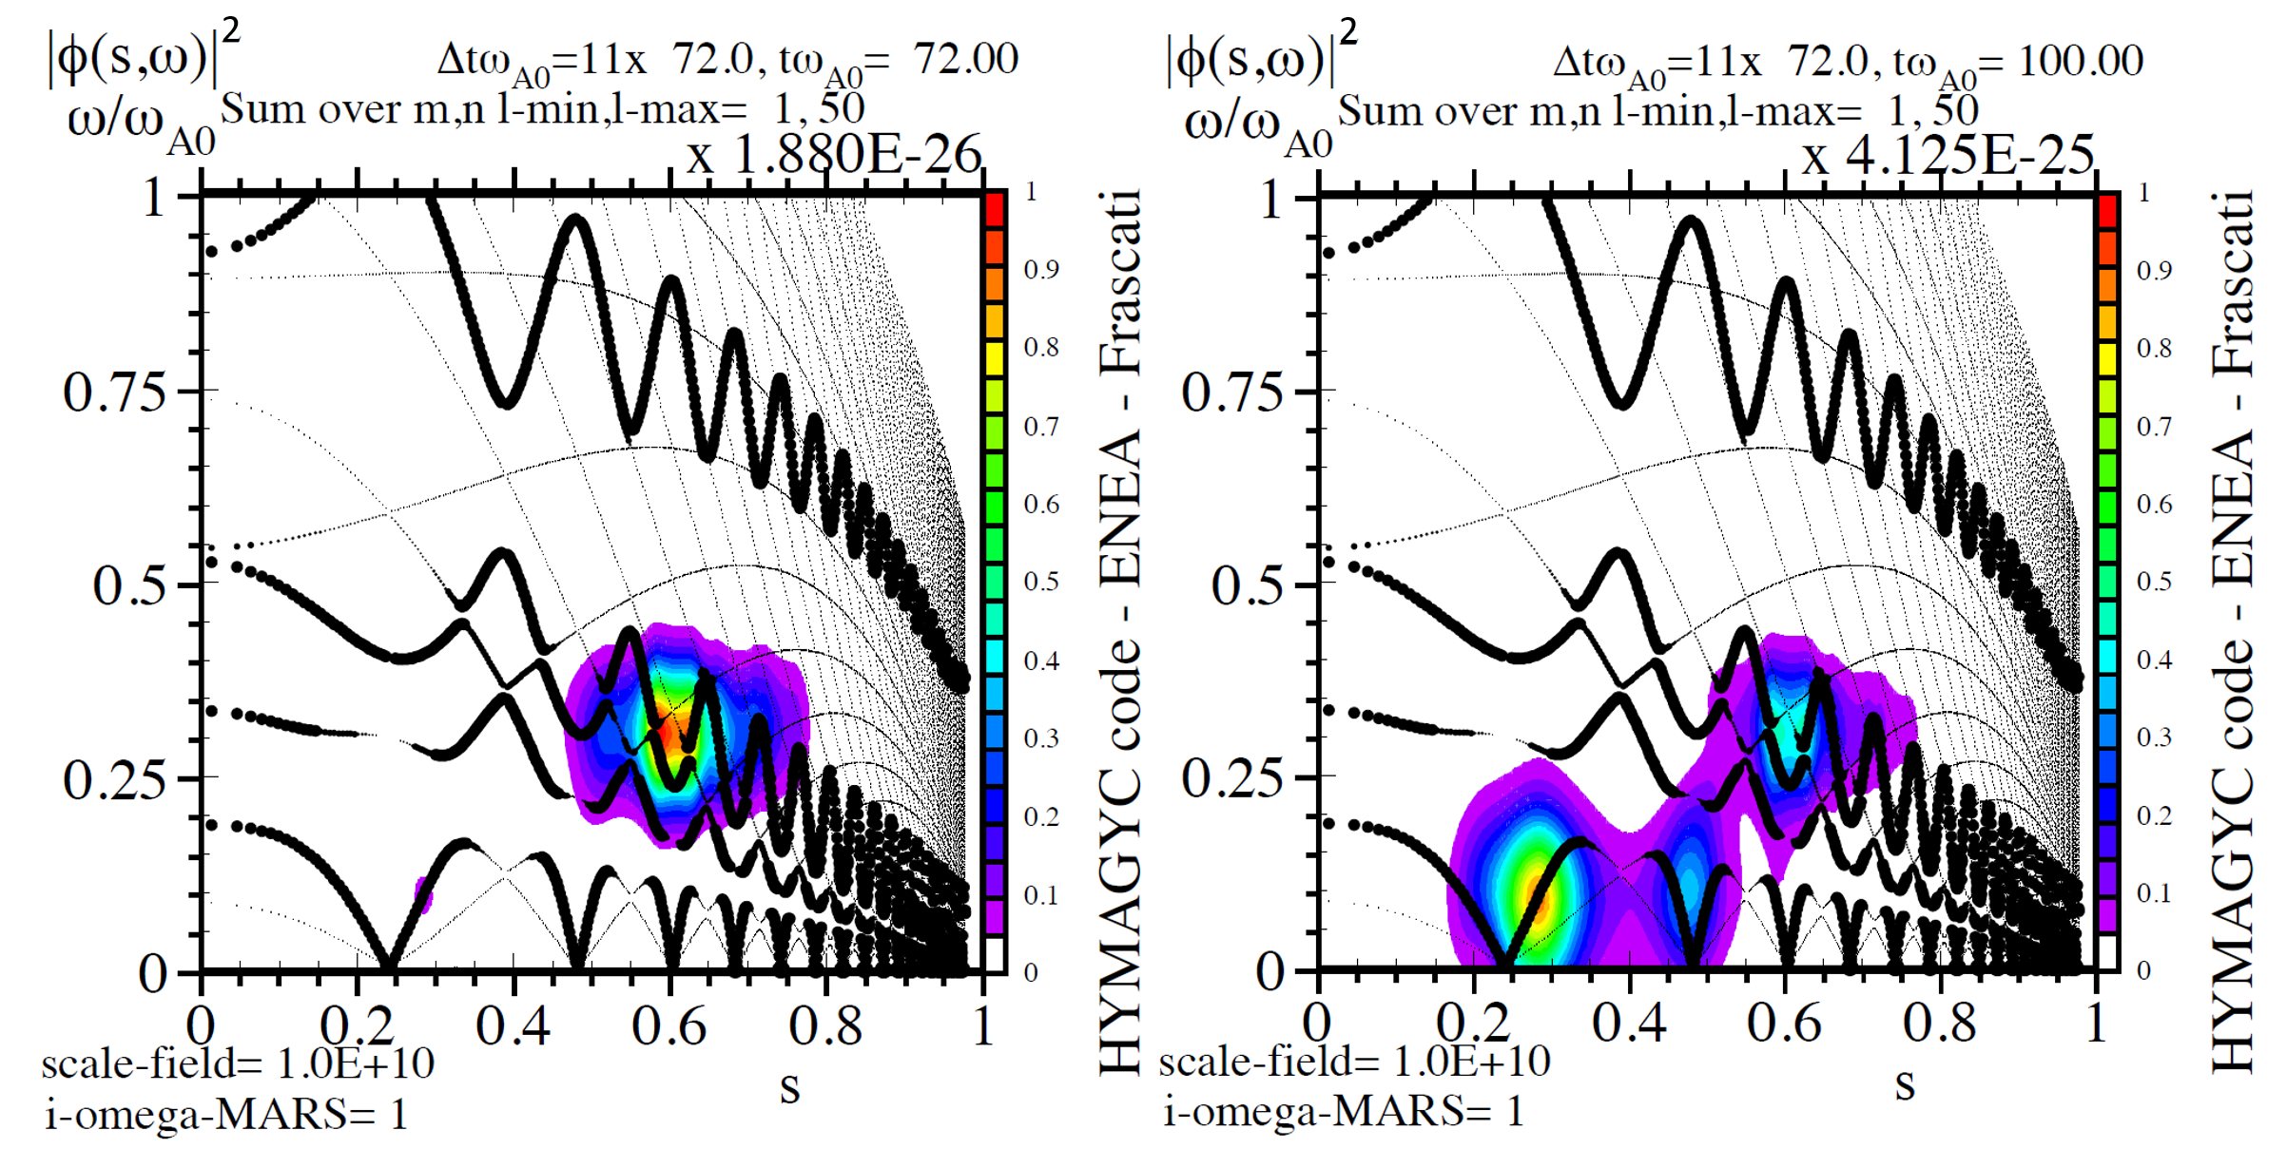
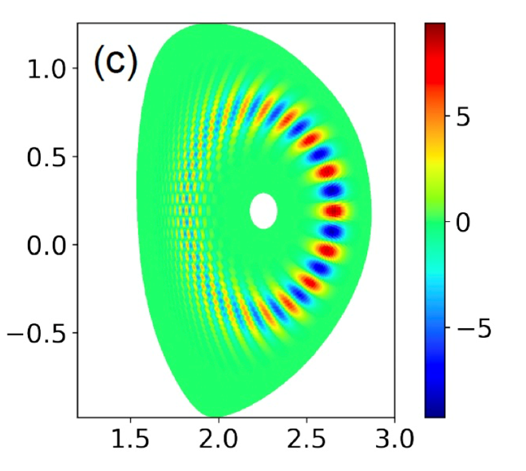
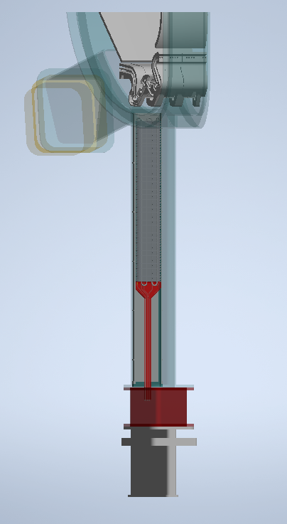
DTT-RP content in a nutshell (Chapters 7-9)
Chapter 7: Energetic particle physics
Simulation activity for EP physics. Test particle transport
DTT as a test-bed for reactor-relevant EP diagnostics
Diagnostics for Fast Ions vs instabilities & turbulence
Chapter 8: Theory and simulation
Weak similarity scaling & DTT
Plasma nonlinear equilibria and self-organization
Gyrokinetic transport theory: general approach
Integration of theory, simulation and experiments
Chapter 9: Fusion technology developments
Plasma Facing Materials and Components
Use of DTM (Divertor Test Modules)
Matter control: advances for pumping and fuelling

Slide 12
DTT Research Plan activities: ideas for next steps
Objectives (as proposed by the present DTT-RP Team):
Revisit the DTT-RP by considering evolution of knowledge (theory and experiments)
Identify and propose experiments to be performed on worldwide operating tokamaks
Identify and propose simulations to be done using the present codes & code upgrades
Identify and propose tests on new materials for the DTT divertor, first wall and DTM
Follow the evolution of diagnostics and propose their possible integration on DTT
Next steps (proposal)
Workshop to present and discuss the DTT Research Plan to the fusion community autumn 2024
Call for new DTT-RP Team (to elaborate version 2.0)
  supported by EUROfusion (highly desirable)
  extended to non-EU participants
1st meeting of the new DTT-RP Team
DTT-RP 2nd version issued autumn 2026

