Slide 1












DTT plasma scenarios, MHD stability and energetic particle physics
P. Mantica⁽¹⁾, M.V. Falessi ⁽²⁾, G.Vlad⁽²⁾
on behalf of DTT Plasma Scenarios, MHD stability and Theory groups
⁽¹⁾ CNR-ISTP Milano ⁽²⁾ ENEA C.R. Frascati
EUROfusion Science Meeting
12th June 2024
DTT Consortium (DTT S.C.a r.l. Via E. Fermi 45 I-00044 Frascati (Roma) Italy)

Slide 2
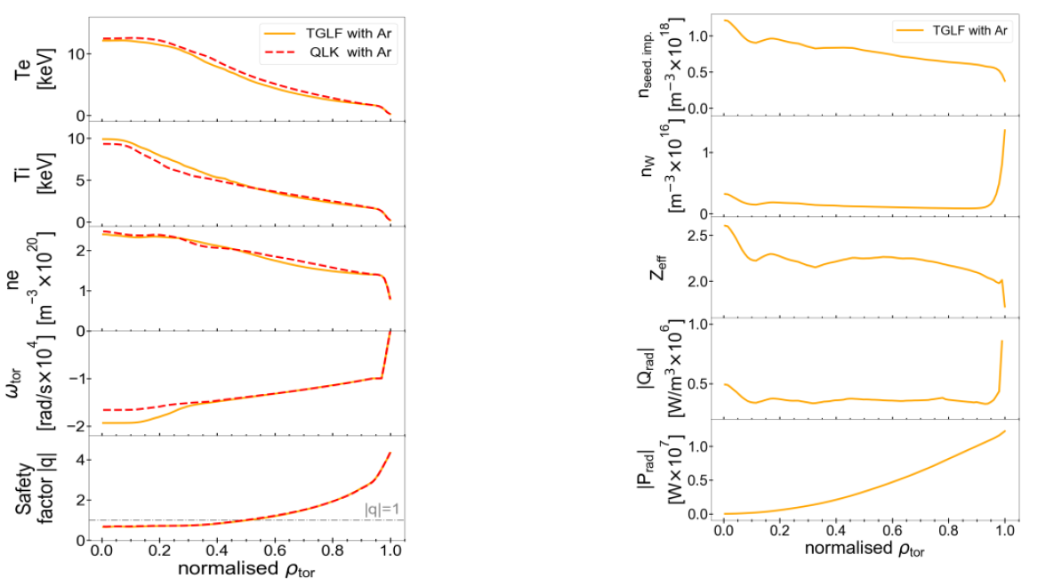
DTT at full power, field and current
Standard baseline H-mode
High density but low collisionality
Mainly external electron heating but large collisional coupling
Issue:q=1 ~mid radius
Integrated modelling performed with both ASTRA and JINTRAC with TGLF or QLK transport models, solving for Te, Ti, ne, J, rotation and 2 impurities, heating and equilibrium self-consistent. See I.Casiraghi et al, PPCF 2023, N.Bonanomi et al, EPS 2023 to be submitted.

Slide 3
DTT at full power, field and current
 | DTT | ITER | EU DEMO
R [m] / a [m] | 2.19/0.70 = 3.1 | 6.2/2.0 = 3.1 | 9.07/2.92=3.1
Ipl [MA] / Btor [T] /q₉₅ | 5.5/5.85/3 | 15/5.3/3.2 | 17.75/5.86/3.9
Psep/R [MW/m] | 15 | 14 | 19
Ptot [MW] | 45 | 150 | 450
Pulse length [s] | 95 | 400 | 7200
βN [%] | 1.6 | 2.1 | 2.5
𝜏E [s] | 0.42 | 2.9 | 6.9
ρ*at r/a=0.5 [10^{–3}] | 3.8 | 2.0 | 1.5
𝜈* at r/a=0.5 [10^{–2}] | 1.2 | 1.4 | 0.8
ρ*_{ped} [10^{–3}] | 2.7 | 0.3 | 0.3
𝜈*_{ped} [10⁻²] | 5 | 2.2 | 8
n_{GW} [E20 m⁻³] | 3.6 | 1.2 | 0.66

Slide 4
Unique DTT characteristics within EU devices
(indicated as indispensable in Facility Review)
High B_{T} and I_{p} and high power wrt plasma size
High n_{e}^{GW}--> high n_{e} : reactor relevant ν*_{ped} and ρ*_{ped} and within local approximation, but high ν*_{sep} for divertor studies➔Integration of edge/core reactor relevant parameters, in presence of W wall
Low edge neutral penetration: reactor relevant fuelling studies
Transport studies of intrinsic (W) and seeded impurities in reactor relevant conditions
ELM mitigation studies with reactor relevant parameters
Strong variation of I_{p}, B_{T}, q₉₅ : test of scaling laws and integrated modelling
Wide spectrum of accessible scenarios, operation with both favourable and unfavourable gradB drift (for L-mode, I-mode, negative triangularity), strong shaping for ELM-free scenarios (EDA, QCE, XPR)
NBI/ICRH fast ions allow studies of energetic particles as mediators of cross-scale couplings in reactor relevant plasmas

Slide 5
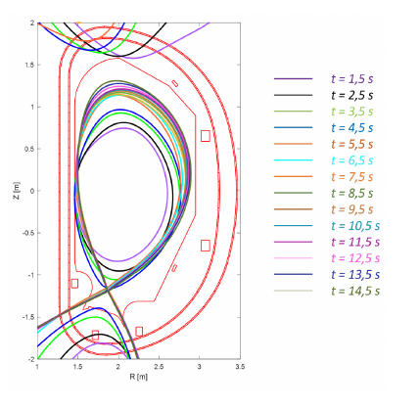
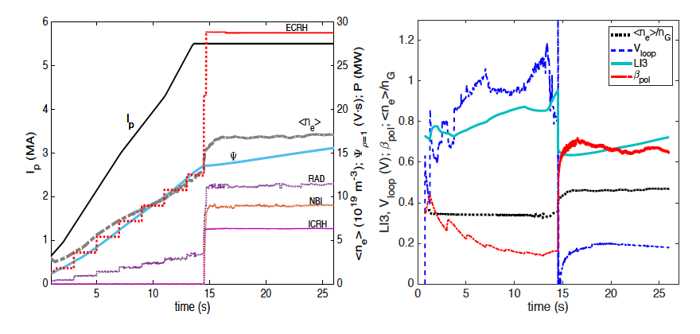
Time dependent simulations
Using ASTRA/IMEP/TGLF
Flux consumption at the end of ramp-up allows discharge duration ~30-40 sec at full performance.

Slide 6
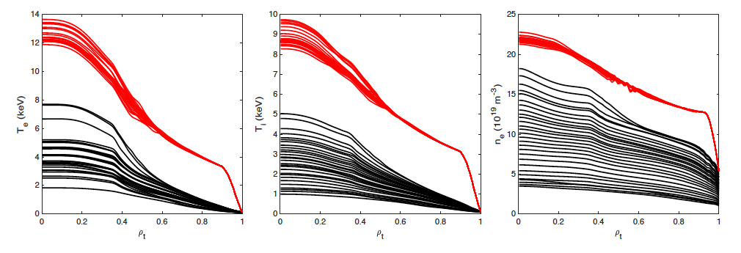
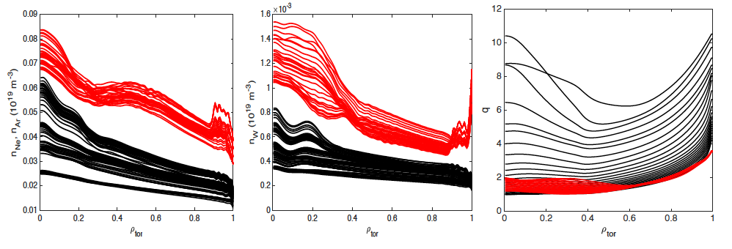
Time dependent simulations

Slide 7
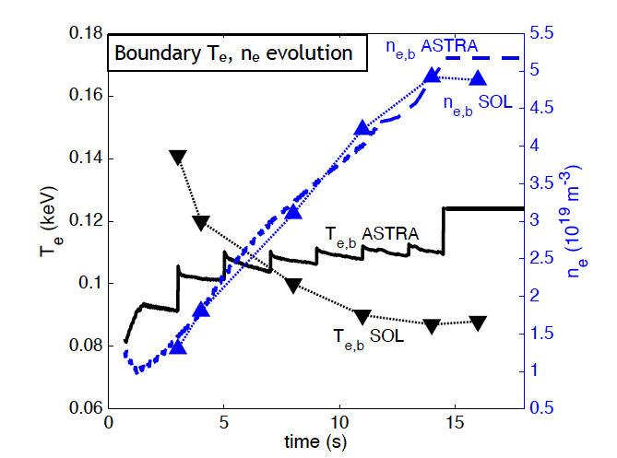
Weak coupling
Weak coupling with CREATE-NL to check consistency of scenarios with magnetic controls
Weak coupling with the edge code SOLEDGE2D-Eirene
Particle and power fluxes derived from core modelling are input to SOLEDGE2D-Eirene
Separatrix density, temperatures and impurity concentration for sustainable power exhaust at the divertor targets and the neutral penetration are input to core modelling

Slide 8
Scenarios accessible in DTT during the various phases
Phase 2
Half RF+NBI
Phase 1
Half RF
L-mode
Baseline H-mode
High β_{N}
Negative δ
Hybrid
EDA/QCE
XPR-CRD
I-mode
WPQH
Phase 3
Full RF+NBI

Slide 9
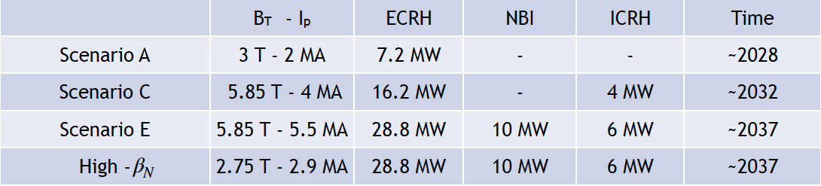
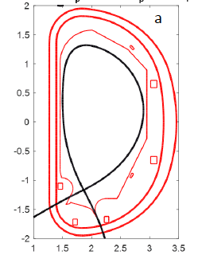
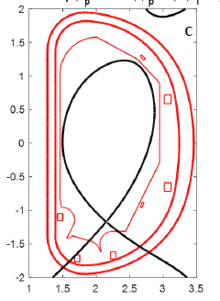
DTT single null baseline scenarios in various phases
DTT negative triangularity scenarios
Scenarios can be performed also in Negative Triangularity configuration, since the early phase
PT
PT
PT
NT
NT
NT
Full power NT
Full power NT vs PT

Slide 10
MHD stability
linear stability code [A. Bondeson, G. Vlad, and H. Lütjens, 92]
it solves full MHD linear, resistive equations [ A. Bondeson, G. Vlad, and H. Lütjens [4]].
It considers an axisymmetric general toroidal equilibrium.
MARS
nonlinear gyrokinetic hybrid code [G. Vlad et al., 2009, G. Fogaccia, et al., 2013]
two modules:
the fluid module describes the bulk plasma solving the full MHD linear resistive equations (evolutive MARS)
the kinetic module solves the Vlasov equations with a PIC (particle in cell) tecnique
The two modules are coupled by means of the pressure tensor of the energetic particles added to the fluid momentum equation.
HYMAGYC

Slide 11
Linear stability analysis with MARS for Full Power Scenario SN from low to intermediate n
Input data and profiles for Full Power at flat-top from JINTRAC integrated modelling [I. Casiraghi et al, Nucl. Fusion 61, 2021, 116068]. No sawtooth model included.
Unstable internal kink (q₀ <1) . The q=1 surface is located around s=ρ_{pol}≈0.64.
the infernal modes are observed where q rational surfaces lie in the zone of low shear and high-pressure gradient
Sensitivity studies have been carried out showing that the appearance of external modes occurs for parameters far from the nominal scenario [V. Fusco et al. 2022, 48th EPS Conference on Plasma Physics]
Internal kink n=1
Infernal mode (n≤10): pressure driven modes excited in a region of low shear and high-pressure gradient.
v^{s}_{m,n}
n=7
𝛄τ_{A0}
q
s
n
s

Slide 12
Linear stability analysis with MARS for scenario A (day0) SN from low to intermediate n
Input data and profiles for Full Power at flat-top from JINTRAC integrated modelling [I. Casiraghi et al, Nucl. Fusion 61, 2021, 116068]. No sawtooth model included.
Unstable internal kink (q₀ <1) . The q=1 surface is located around s≈0.54.
Infernal modes are stable indeed pressure has a low gradient in the flat q region
Internal kink n=1
p/B₀²/μ₀
q
v^{s}_{m,n}
Full Power
q
Day0
s
s

Slide 13
Prediction of 2/1 (N)TM control
EC power requirements for the control and suppression of (Neoclassical)Tearing Modes, (N)TM
in the DTT full power scenario at 5.5 MA, 5.85T with sawteeth the 2/1 mode is located at very off-axis positions ρ_{τor}^{2/1}=0.82
EC power up to 7.2 MW can be injected in continuous (CW) and modulated 50% duty cycle (mod) from the upper launcher
mode width = 0.023 m: ECH-ON stabilizes with 4 MW modulated for TM and 1.5 MW CW or modulated for NTM
mode width=0.04 m: ECH-ON stabilizes with 6 MW CW or modulated for TM

Slide 14
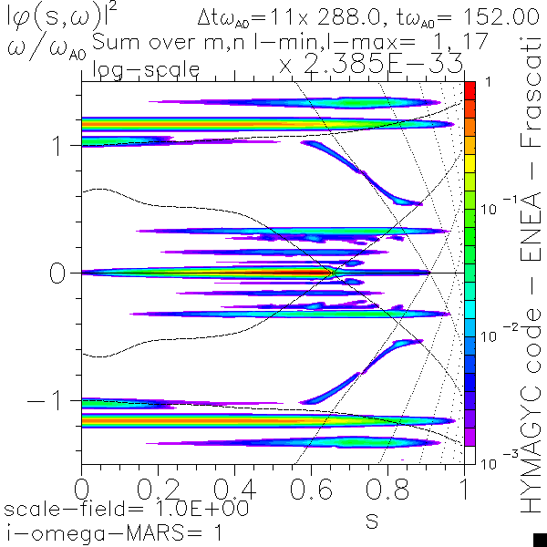
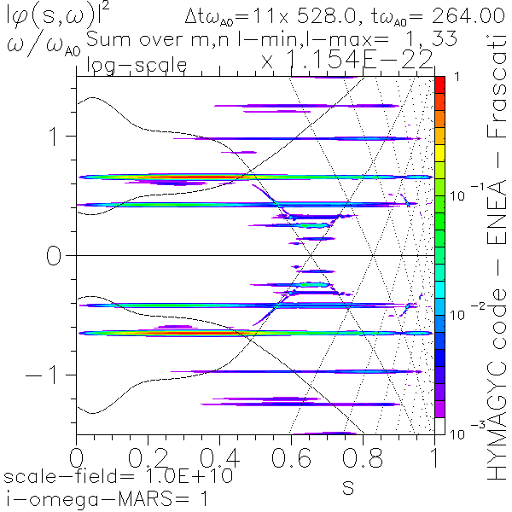
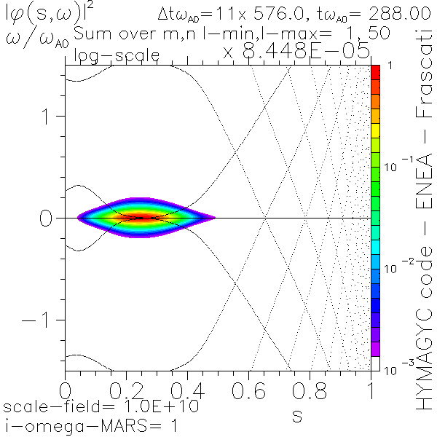
Linear MHD stability and Alfvénic modes with HYMAGYC (no EPs): Negative vs Positive triangularity
MHD stability for Negative Triangularity (”flipped”) equilibria is considered for two different cases:
“Flipped” boundary and fixed p’, I* profiles, or
“Flipped” boundary and p’, q profiles.
Internal kink stability of NT equilibria is always worst, Infernal modes are always less unstable for NT with fixed p’, q profiles.
n=1, Internal kink and Global Alfvénic modes
n=2, Global Alfvénic modes
n=3, Infernal mode
(q(s)=2/3)
s
|𝜙(s, 𝜔)|²
|𝜙(s, 𝜔)|²
|𝜙(s, 𝜔)|²
𝜔/𝜔_{A0}
𝜔/𝜔_{A0}
𝜔/𝜔_{A0}
s
s
s
Frequency spectra of the perturbed electrostatic potential

Slide 15
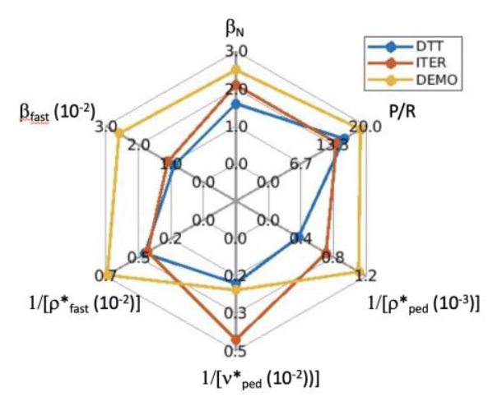

EP studies on DTT
DTT has been designed with reactor-relevant dimensionless parameters;
In particular, EPs dimensionless parameters preserve cross-scale couplings: $ρ_{EP}^{∗}$/$ρ^{∗}$;
Integrated simulations are required to address plasma as a complex self-organized system;

Slide 16
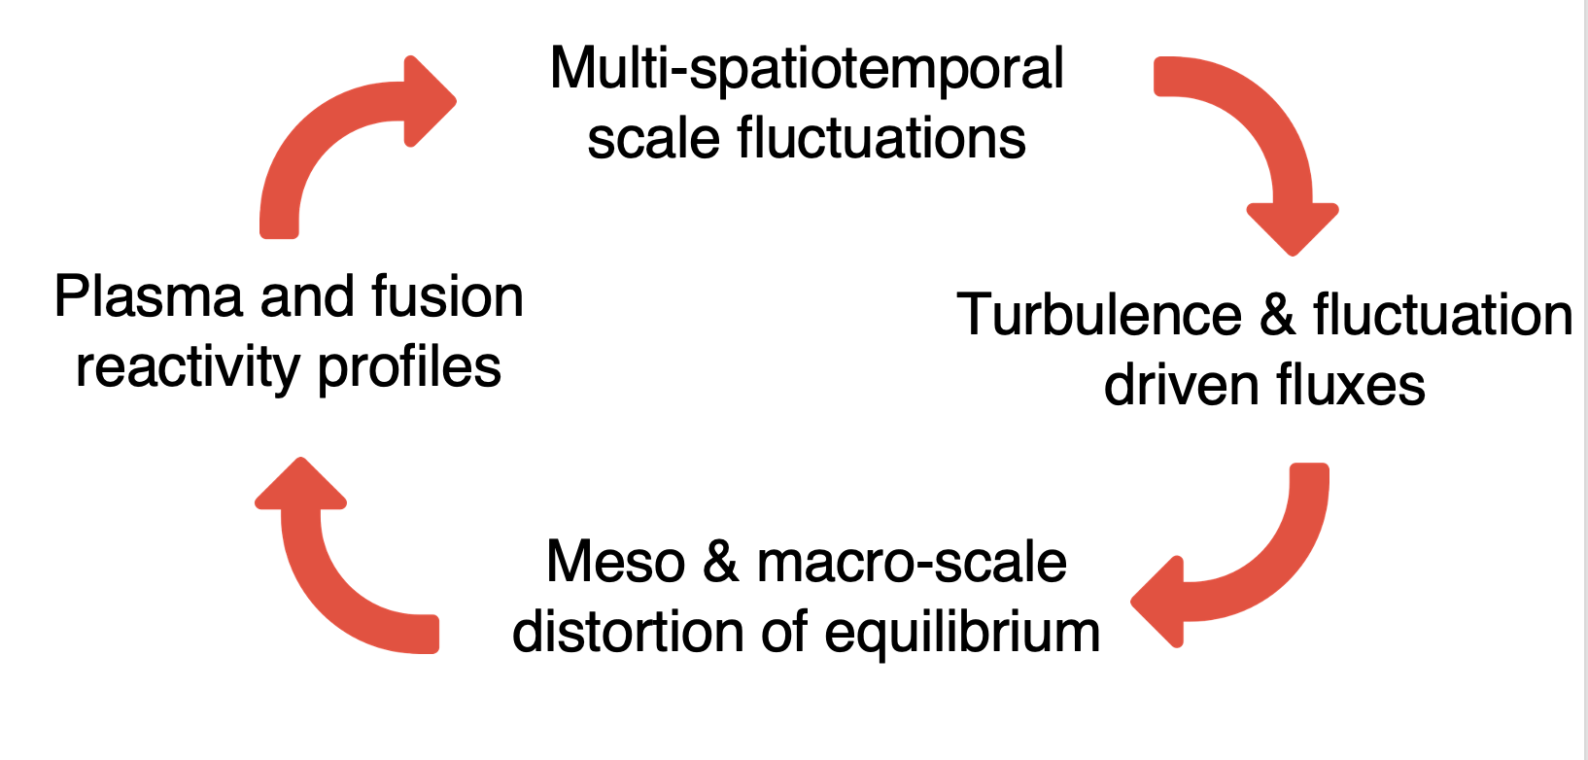
Self-organization

Slide 17




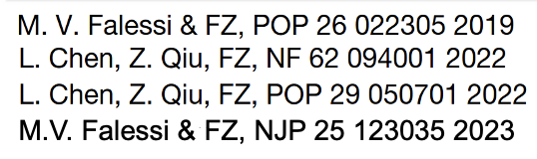
Self-organization
NL wave-particle
NL wave-wave
Importance of EPs as mediators of cross-scale couplings;
A description of transport processes in the phase space is crucial because of non Maxwellian features of EPs

Slide 18
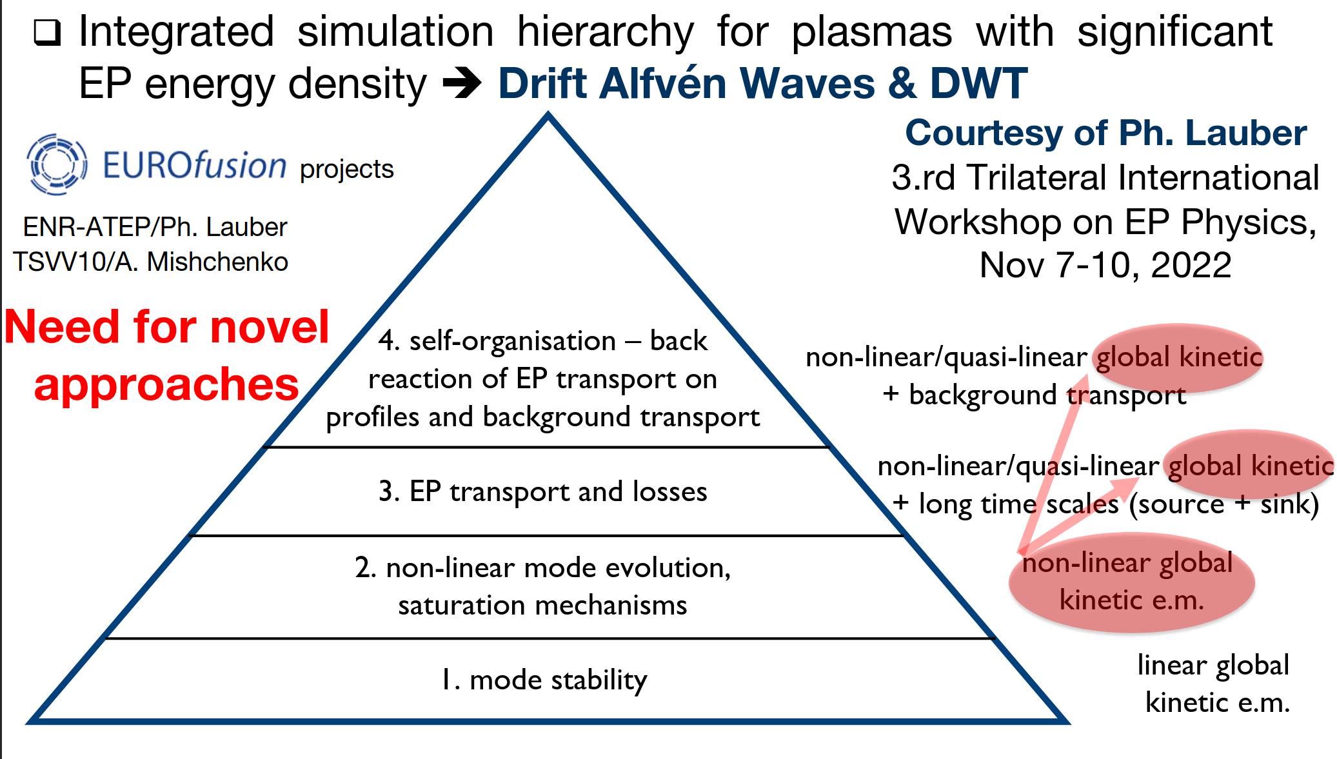
Hierarchy of reduced transport models

Slide 19
Alfvénic modes driven by EPs: linear dinamics using HYMAGYC
Alfvénic modes driven by EPs using a model DTT equilibrium:
Mawellian distribution function of EPs, ITER-like EP density profile
t𝜔_{A0}=72
t𝜔_{A0}=100
purely MHD (infernal modes)
Infernal modes modified by EPs
Purely EP driven modes

Slide 20
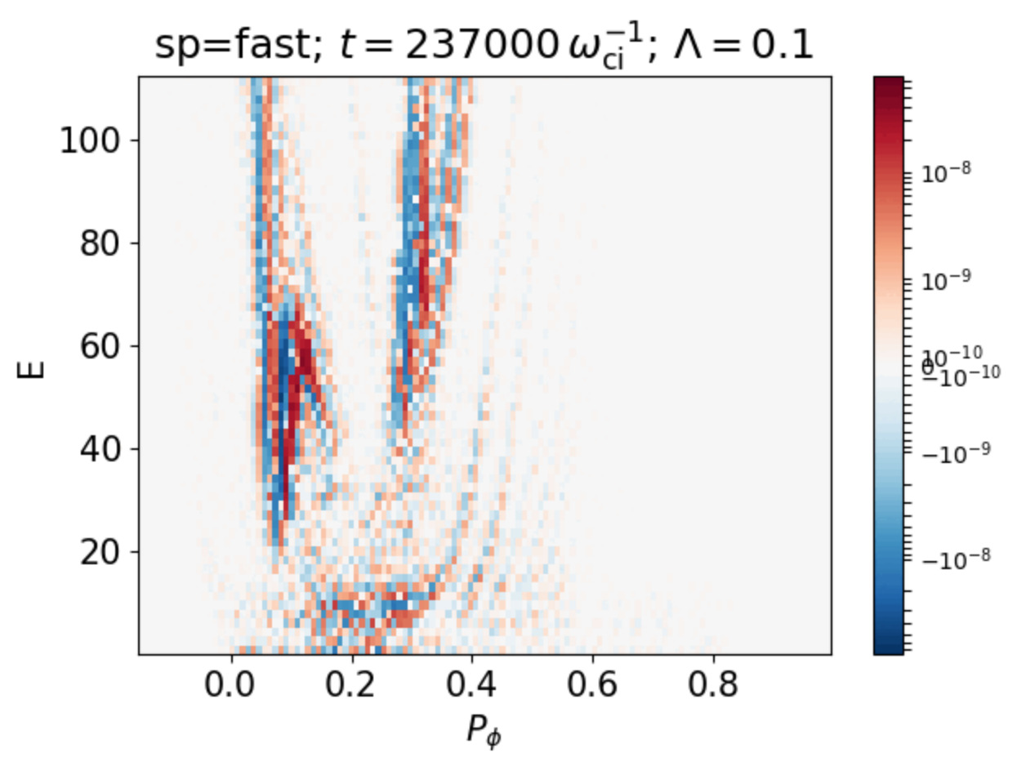
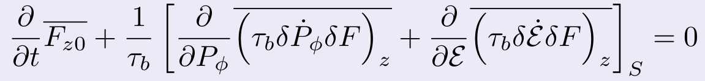

Phase Space Zonal Structures
$$\overline{δF_{z0}}$$
EP transport can be calculated in ORB5 global non-linear EM simulations
Constant of motion space : Pφ, E, μ
Resonant transport induces small scale phase space zonal structures in the distribution function (PSZS)
This distribution function can be evolved in phase space according to:
M.V. Falessi & FZ, NJP 25 123035 2023
➔ Can be used in building reduced models for transport in presence of EPs
  ORB5 simulation Courtesy of Thomas Hayward-Schneider

Slide 21
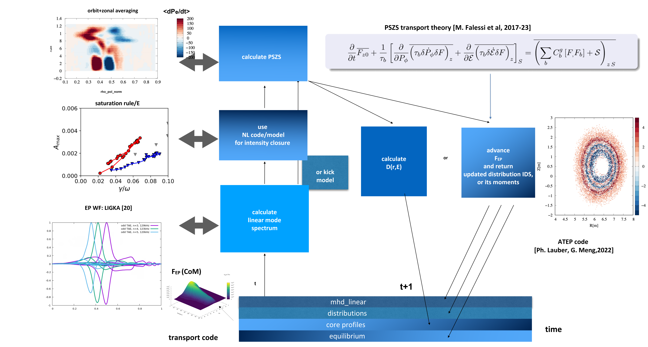
Advanced transport models for EPs (ATEP)

Slide 22
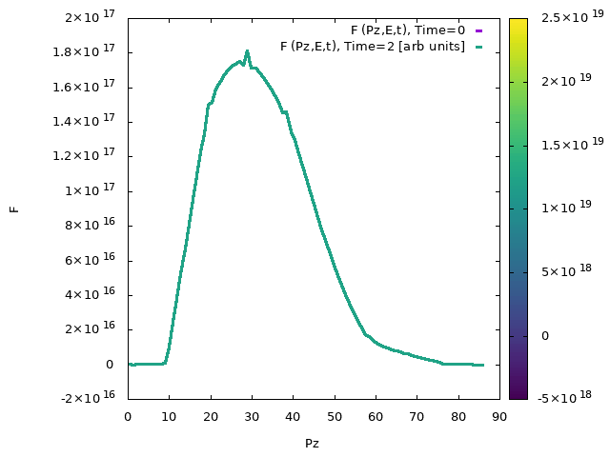
Advanced transport models (ATEP)
F
P_{Φ}

