Slide 1
Machine learning accelerated SOL simulations: SOLPS-NN
FSD Science Coordination Meeting / KoM AI&ML projects
May 21st 2024
S. Wiesen et al
DIFFER

Slide 2
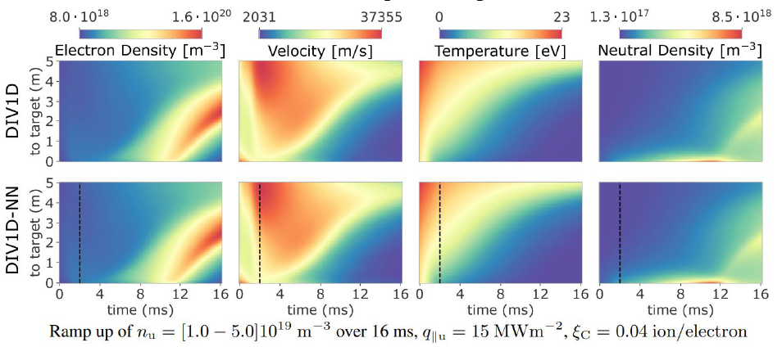
Objectives
Previous ML work (ENR-MOD.01.FZJ) developed proof-of-principle surrogate models for these components
SOLPS-NN
[Dasbach NME 2023]
Fast 1D/2D prediction, steady
Input: engineering params & anomalous transport assumptions
Cross-validated optimised NN model
Transfer learning: e.g. for transport uncertainty in ITER
DIV1D-NN
[Poels NF 2023]
Neural PDE surrogate of DIV1D
Various encode/decode processes tested and optmised
Can be faster then real-time in predictions for unseen params
Captures dynamic features and hysteresis (detachment control)

Slide 3
Objectives
This ML/AI project is to extend the capabilities of SOLPS-NN and DIV1D-NN by investigating methods to increase the physics fidelity (hierarchy of neutral models, drifts), as well as investigate approaches to combine dynamical (1D) and spatial (2D) information for hybrid models informed by both.
The worked out and improved (dynamical) SOLPS-NN model could be tested against AUG data. Additional transfer learned data from previous SOLPS modelling (e.g. from the AUG MDSplus DB) → coupling to a core-code, e.g. IMEP [Luda NF 2021] or TSVV-11’s HFPS JINTRAC (e.g. providing separatrix density as function of time) → potentially better than a regression method [Polevoi NF 2017] to prescribe n_{e,sep} dependence on divertor conditions
Attempt to link AUG-JET-ITER: remove scarcity of data (SOLPS). Employ the SOLPS-NN model to interpolate between AUG and ITER, and infer JET information as a test.
The proposed work directly supports various WPs in EUROfusion and especially responds to the needs of WP PrIO / TSVV11 and WPTE.

Slide 4
Scientific Tasks and Deliverables
T1 Neutrals fidelity increase of the SOLPS-ITER surrogate (SOLPS-NN) D1 SOLPS-ITER surrogate extended with higher fidelity neutral physics → hierarchy of neutral models (standard fluid model → AFN → EIRENE kinetics); attempt active learning techniques (DL/AL)
T2 SOLPS-NN fidelity increase with cross-field drifts D3 Extended SOLPS-ITER surrogate with drift physics → increase fidelity by adding (subset) of drift simulations (fluid neutrals); refine training DB on scarce data with DL/AL as similar as in T1
T3 Develop ML models for mapping between DIV1D and SOLPS-ITER solution D2 ML based mapping between DIV1D and SOLPS-ITER → representation learning (RL) to map flux tubes between SOLPS and DIV1D → fidelity increase in DIV1D (e.g. anomalous transp)
T4 Develop ML algorithms to correct SOLPS-NN dynamics with DIV1D D4 Demonstrate capability for ML algorithms to learn dynamical corrections for steady-state SOLPS-ITER based on DIV1D simulations → By leveraging the projection algorithms developed in T3, a model is developed that corrects the 2D SOLPS-ITER surrogate solution based on dynamics information from DIV1D surrogate; ranging from slow to fast processes/transients → focus on dynamics of detachment front movement: establish a latent representation based on DIV1D simulations and mappings for the individual flux tubes from 2D SOLPS-ITER surrogate simulations with the relevant dynamical parameters through the model (c.f. T3) → also try feature generation image synthesis [Aniruth 2020 / Tyagi 2022]
T5 Application of transfer learned SOLPS-NN model to ASDEX-Upgrade and ITER predictions D5 Re-calibrate (dynamic) SOLPS-NN by additional SOLPS data from AUG SOLPS MDSplus database and make improved predictions for separatrix conditions; coupling to IMEP and/or JINTRAC (TSVV-11)
D6 Assess interpolatabilty for JET (between AUG and ITER in terms of system size)

Slide 5
Timeline & resources
plus established collabs in EF (ENR) and TU/e
HPC facilities The primary facility requirement for this project is to have sufficient access to HPC resource for the database generations as well as for training the ML models. The project will apply as much as possible the EUROfusion HPC resources but may also make use of other HPC resources available to the proponents in kind.
Data handling and dissemination Data produced as part of the project will be handled by means of the FAIR4FUSION Open Data Framework and made available and disseminated towards the EUROfusion community through WPs and TSVVs. IMAS will be used wherever possible for data storage and transfer, or, if performance requires, through open source alternatives (e.g. Xarray, Pandas, etc).

