Slide 1
JET Task Force Meeting
Proposal for the QMB measurements in H ohmic plasmas during C39 campaign
G. Sergienko and A.Kirschner

Slide 2
QMB measurement and ERO modelling
Original proposal
Rationale: Retention in JET-ILW is still dominated by co-deposition, in particular at remote areas. Therefore, pulse-resolved measurement of the deposition rate at such areas is important to make predictions for ITER. The impact of fuel isotope composition on the deposition rate has to be investigated.
Summary of Proposal: Remote pulse-resolved deposition will be measured with the upgraded QMB diagnostics located at the divertor corners close to the pump ducts and below tile 5. The influence of magnetic configuration (strike point position) and plasma (ohmic, L-Mode and H-Mode) conditions. To examine the isotope effect, experiments will be done in D, T and H plasmas under comparable conditions.
Scientific Deliverables: The experimental results (remote deposition rates for H, D, T plasmas under ohmic, L-Mode and H-Mode conditions) will be used as input for impurity transport codes (ERO, WallDYN, …) to benchmark the JET results and improve predictive modelling for ITER.

Slide 3
Location of QMBs in JET
Toroidal position
QMB1 Oct5
QMB2 Oct1
QMB3 Oct1
QMB4 Oct1
QMB5 Oct1
out of order
QMB4

Slide 4
M18-41 Divertor geometry effect on detachment and SOL:
QMB measurements
QMB study was incorporated in M18-41 experiment
Required plasmas: C-C and V-V divertor configurations
B_{t}= 2.2 T , I_{p}= 2.0 MA , L-mode NBI = 2 MW, line-integrated electron density 10²⁰ 1/m²
B_{t}= 2.2 T , I_{p}= 2.0 MA , H-mode NBI = 10 MW, line-integrated electron density 10²⁰ 1/m²
B_{t}= 2.2 T , I_{p}= 2.0 MA , ohmic plasma, line-integrated electron density 5·10¹⁹ 1/m²
Performed QMB pulses :
31/07/2019 (Early) #94560 no QMB data; shutter power supply out of order
19/08/2019 (Early) #94834 no QMB data ; shutter power supply out of order
05/09/2019 (Early) #95018-95031 14 good pulses (ohmic plasma,C-C and V-V);
02/10/2019 (Early) #95499 H-mode plasma, C-C; LIDAR stops at 42.3s; no HRTS;
15/10/2019 (Early) no pulses
21/11/2019 (Early) no pulses
20/12/2019 (Early) no pulses
QMB measurements mainly performed in ohmic plasma

Slide 5
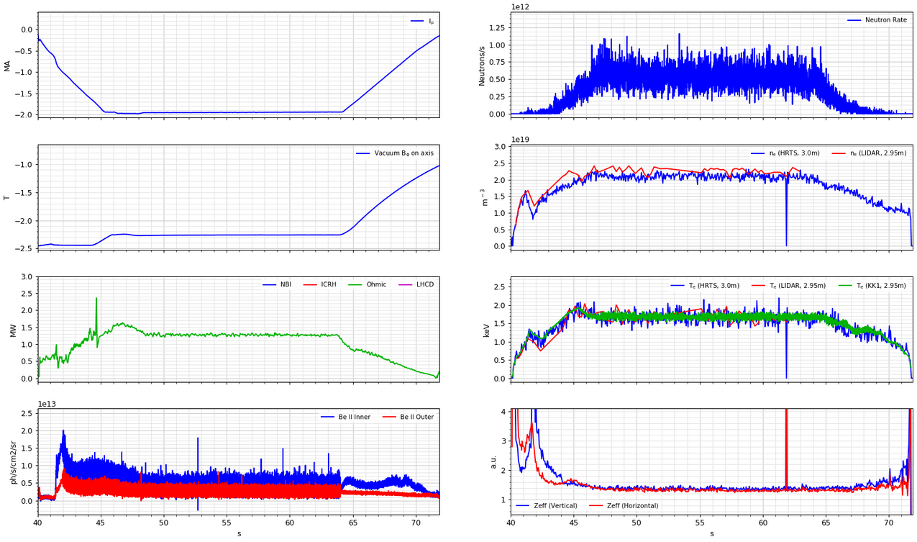
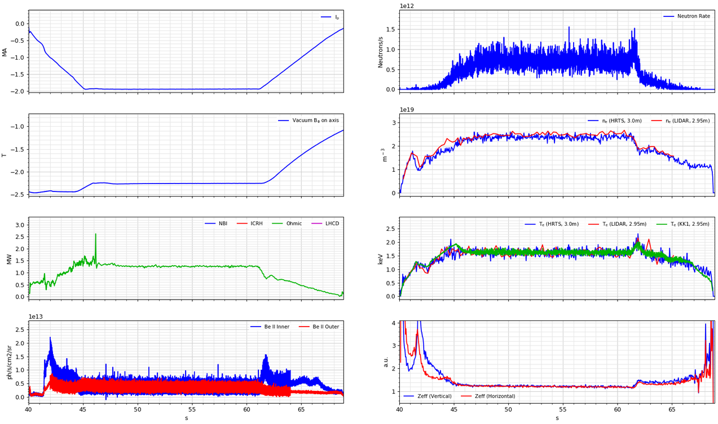
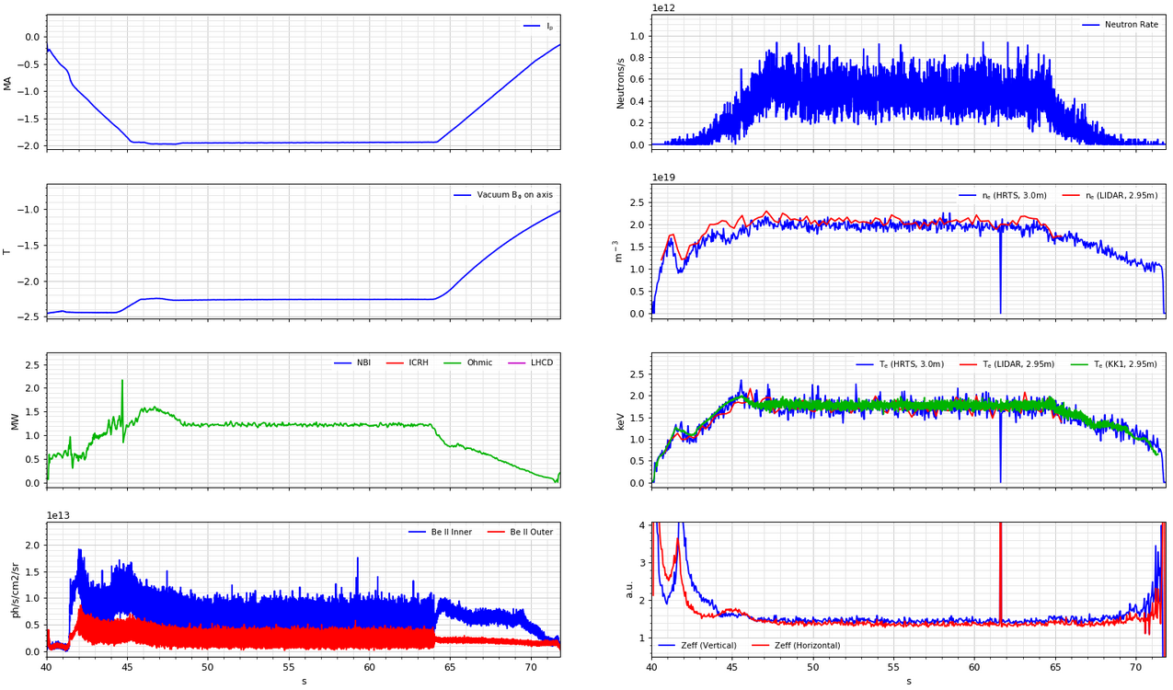
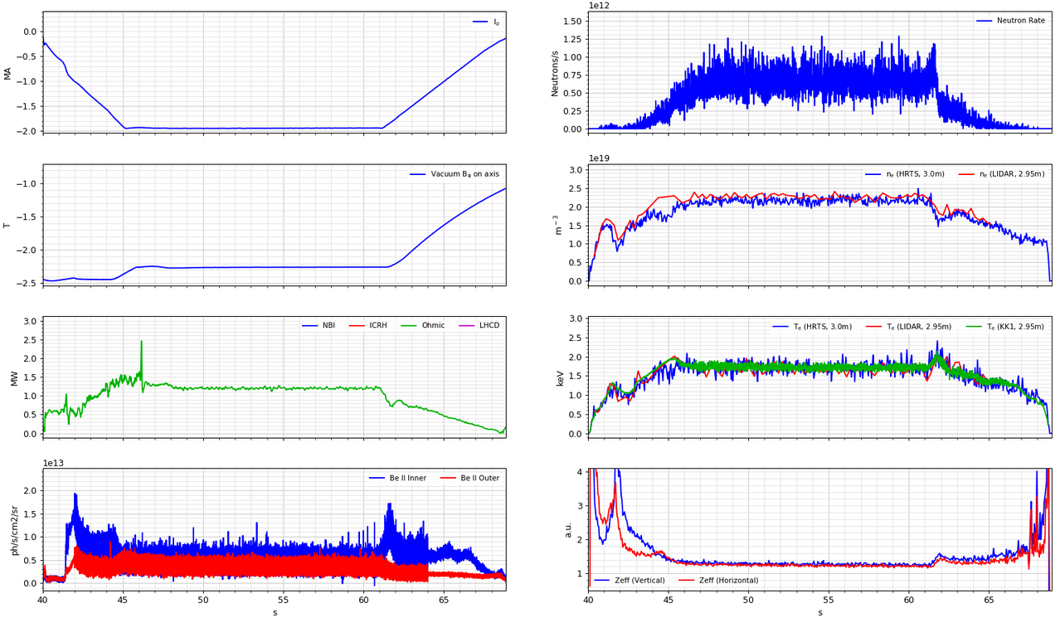
QMB measurement: plasma parameters
D1Z_C_ILW_LT
D1Z_V_SFE_LT
#95021
#95025
#95029
#95032

Slide 6
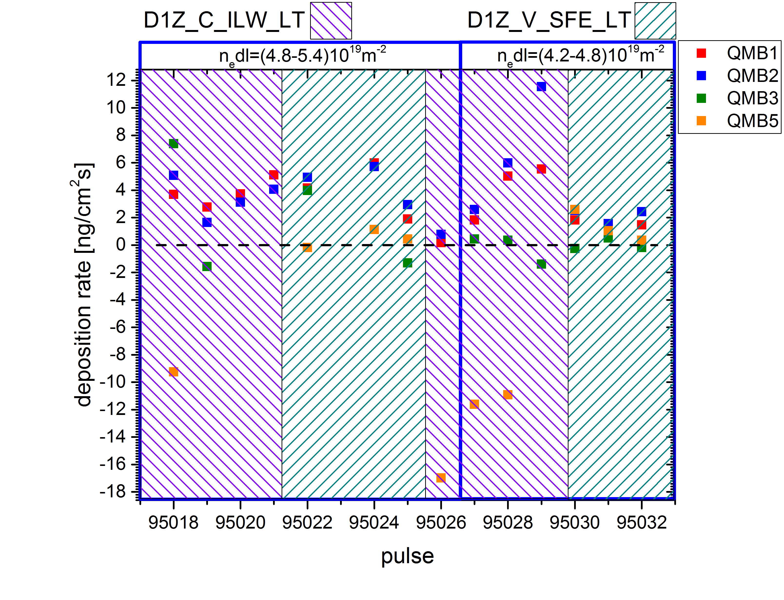
QMB measurement: results
QMB shutters were open for 6 sec during plasma flap top
Deposition rates decrease in C-C configuration and increase in V-V with plasma density grow
Deposition rates in C-C configuration were similar to V-V in fully detached plasma
Deposition rates in C-C configuration were higher in comparison with V-V in semi-detached plasma
3-4 pulses are not sufficient to reach steady state deposition in ohmic plasma pulses

Slide 7
Proposed pulse plan for C39
Plasmas: B_{t}= 2.5 T , I_{p}= 2 MA
line-integrated electron density 4.5E18 1/m²
1 pulse: cleaning
2 pulse: strike points sweep in L-mode conditions following by fixed strike points at corner tiles 4/6 (D1Z_H_ILW_LT, reference #95018) after sweep until end of the discharge, QMBs open when strike points fixed
3-8 pulses: L-mode with fixed strike points at corner tiles 4/6 (D1Z_C_ILW_LT, reference #95029 ), QMBs open during flat top
9-14 pulses: L-mode with fixed strike points at lower vertical tiles 3/7 (D1Z_V_SFE_LT, reference #95032), QMBs open during flat top
Perform all measurements in morning shift only with increased inter pulse time interval to keep the QMB crystal temperature below 100°C

Slide 8
Diagnostics
Essential diagnostics: QMBs (KV6)
Desirable diagnostics: Langmuir probes (KY4D), spectroscopy (KT3, KS3, KSRD, KT1(VIS),KT1(VUV), KT7), optical tomography (KL11), infrared cameras (KL9,KL7,KL3), lithium beam (KY6), reflectometer (KG10), Thomson scattering (HRTS), ECE electron temperature (KK3), thermocouples (KD1D), divertor gas analysis and RGA (KT5P, PT5P)

Slide 9
Spectroscopy settings
KT3 setting 1: 4000/300lmm, 4500/300lm, 8900/300l/mm
3710-4290 BeI(3813) WI(4009) CII(4267) ,
4205-4786 CII(4267) WI(4295) WI(4302) Dg(4339) BeII(4361) BeI(4573) BeII(4673)
8160-9630 CI(9095) BeI(8254)
KT3 setting 2 : 4000/300lmm, 5090/1200lm, 9090/1200l/mm
3710-4290 BeI(381)3 WI(4009) CII(4267)
5023-5157 BeD (5065-5023) CII(5133,5145)
8920-9264 CI(9095) BeI(8254) DI (9226)
KT3 setting 3 : 4000/300lmm, 5040/600lm, 9090/1200l/mm
3710-4290 BeI(3813) WI(4009) CI( 4267)
4906-5174 BeD(4955) CII(5133,5145)
8920-9264 CI(9095) BeI(8254) DI(9226)

Slide 10
Spectroscopy settings
KSRD setting 1: 400.8 nm (WI)
KSRD setting 2: 465.0 nm (CIII)
KSRD setting 3: 527.0 nm (BeII)
KL11 setting 1:
KL11-E1DC Dα
KL11-E1DD not operational
KL11-E1DE W I (400.96 nm)
KL11-E1DF W I (400.8 nm)
KL11 setting 2:
KL11-E1DC Dα
KL11-E1DD not operational
KL11-E1DE Be I (457.3 nm)
KL11-E1DF Be II (436.3 nm)

