Slide 1
Work-Package PrIO Preparation of ITER Operation
FSD planning meeting: 2025 objectives
10-12 June 2004 Garching
Xavier LITAUDON* (Project Leader), Gloria FALCHETTO (Project Support Officer),
João FIGUEIREDO (Coordinator Officer @ Programme Management Unit)
CEA lead lab. for WP-PrIO
*xavier.litaudon@cea.fr

Slide 2
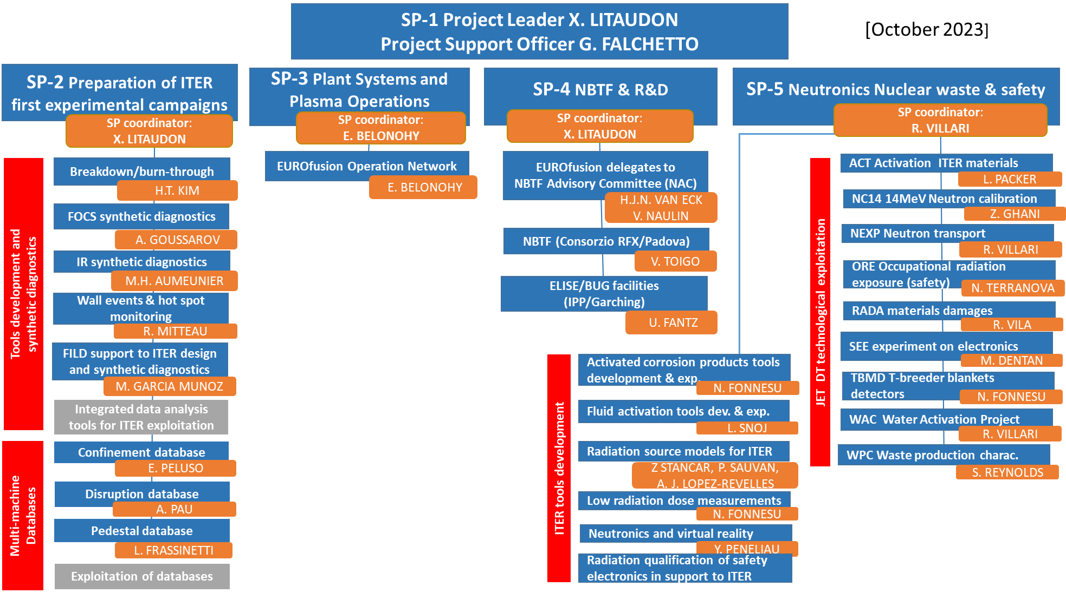
New
+ support to ITER ECRH (call)
+ SL courses (call)
+ Integrated Data analysis (IDAV)
+ IR images multi-machine database
+ AI/ML projects
+ Extra support in 2025 for FNG and KATANA neutronic experiments ?

Slide 3
New activities in 2024 that should continue in 2025
Preparation of special issue in Plasma Physics & Controlled Fusion on JET D-T neutronic
Set-up a multi-machine Infra-Red image database (experiments & simulations)
  Pending resources in 2025
Integrated multi-diagnostics data analysis tool in view of ITER (density & temperature)
  Pending resources in 2025
New Artificial Intelligence (with TE/SA/PWIE) projects related to operation and/or use of multi-machine databases
  Tokamak operation Conversational AI Interface Using Multimodal Large Language Models
  AI-assisted Plasma State Monitoring for Control and Disruption-free Operations
  Identification and confinement scaling of hybrid scenarios across multiple devices
  Applying AI/ML for NBI ionization and slowing-down simulations using ASCOT/BBNBI
  Machine learning accelerated pedestal MHD stability simulations
  Machine learning accelerated SOL simulations: SOLPS-NN

Slide 4
Key issues for 2025
SP-2
  No resource in 2025 for FILD
  No resource in 2025 on ”Integrated multi-diagnostics data analysis tool in view of ITER application”
  ENEA-Coordinator on Transport Database resigned in 2024
    New call or stand-by ?
SP-4
  Address ITER STAC assessment on NBI and consequences for 2025 activity
  In 2025 conjunction of the end of the EUROfusion grant and the end of the EUROfusion-NBTF collaboration agreement : Extension ?
    20 experts in 2021 down to 18 in 2022/2023 and 15 in 2025
  IPP-ELISE : 2 EUROfusion experts will leave at the end of 2024
    6 in 2021 then 5 in 2023 and down to 3 in 2025
  At the NBTF down to 12 in 2025
    14 in 2021 then 13 in 2023 and 12 in 2024/2025
  Impossible to open a call without clarity beyond 2025 and extension of the agreements
  Possible de transfer PM in procurements of solid state generators at ELISE for Long pulse operation ?
SP-5
  Some delay in the analysis of the JET neutronic activity is expected since delay in the detailed splits between DT vs DD neutron
  Activity at KATANA water loop (neutron induced water activation) and FNG (test of electronics) should be expanded
  New activities in support of the revised ITER baseline

Slide 5
High priority PrIO PL & «significant» Project Change Requests (2025)
SP-2
  STAC comments on AWP-2024 : “Resourcing for activity PrIO SP-2 should be increased as it may be not commensurate to the needs and thus not aligned with the EU's strategy of providing a large fraction of diagnostics to ITER”
  Support on ITER synthetic diagnostics (new call)
  Integrated Data Analysis & Validation tools (expand on 2024 activity)
  FILD synthetic diagnostics in support to ITER (no resource foreseen in 2025)
SP-3
  IO DDG at EFPW 2024 " ITER needs the strong support from the fusion community, labs and industries, in addressing and mitigating the remaining/new risks in a pro-active manner. ECRH technology: ensure enough experienced people available to support the IO and gyrotron suppliers in the commissioning phases".
  Training on ECRH operation including commissioning of gyrotrons and plant system in support of the revised ITER Heating & Current Drive mix. (new call)
  Knowledge management & Session leader courses
SP-4
  Procurement of new 2 new solid state generators (300k€/each) to replace the tetrodes for ELISE Long pulse operation
SP-5 “Adressing key neutronic/safety issues for ITER“ IO DG at FEC 2023
  calculations and experiments in the context of the ITER new baseline and safety issues
  W material activation due to runaway electrons : experiments & simulation for ITER
  Neutronics code and radiation source: validation and development
  Focus & expand on the water activation (JSI-Fission Reactor) and ACP experiments (FNG) in support of ITER
  Test of electronics/components at FNG for DTT & ITER

Slide 6
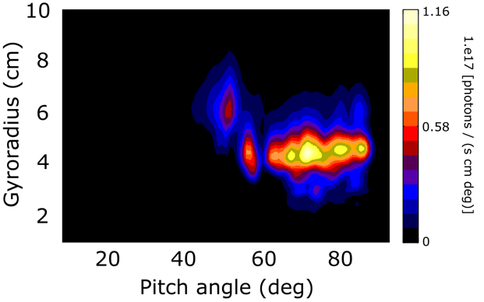
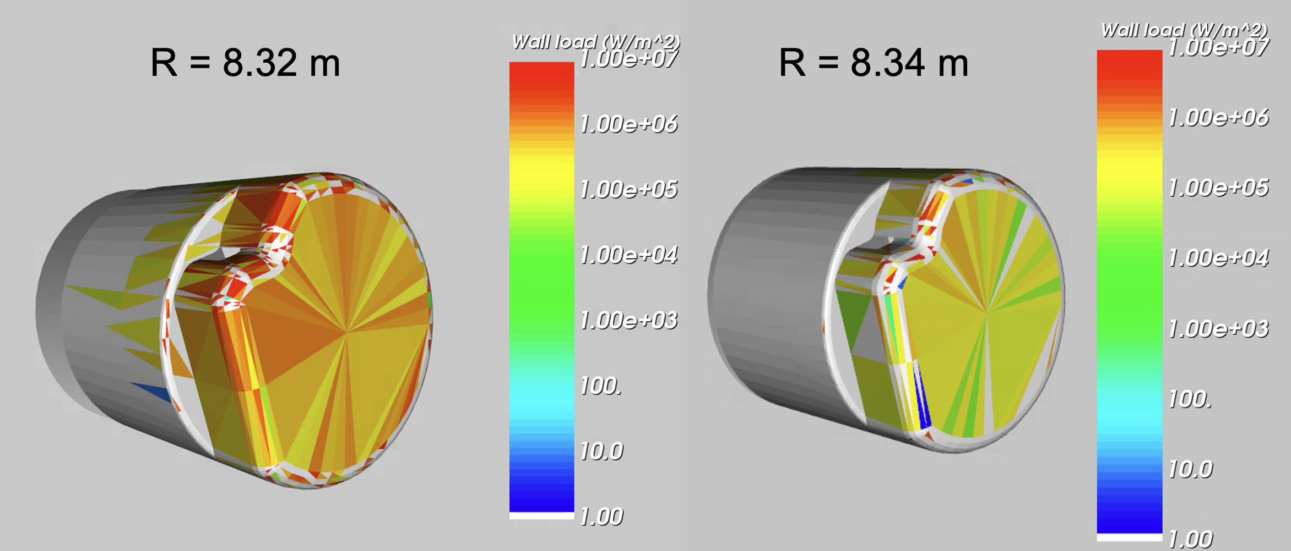
SP-2: ITER fast ion loss detector diagnostic design and synthetic diagnostic
with WPSA-TE
Simulated FILD measurements of the velocity-space distribution (as a function of gyroradius and pitch angle) of the escaping ions for ITER baseline scenario
  synthetic diagnostic FILDSIM + ASCOT simulation for calculating the fast ion losses at diagnostic location.
2025:
Assess the consequences of the new magnetic configuration (with the full W wall) on the radial profile of fast ion losses.
Hybrid kinetic-MHD MEGA simulations to self consistently obtain the AE amplitude and spatial structure. Use that information in ASCOT to estimate the AE-induced fast-ion flux on the FILD head.
Apply FILDSIM to estimate the signals induced on the camera and PMTs by a combination of AEs, NTMs and RMPs.
α-particles
Beam ions

Slide 7
SP-4: 2025 strong effort on Beam divergence studies
A low beamlet divergence (7 mrad) is crucial for the efficiency of the ITER-NBI systems, since it affects beamline transmission and delivered power
SPIDER, ELISE and BATMAN Upgrade:
  beam divergence of typically 12-15 mrad
  Experiments at low beam energy
beam divergence systematically higher in RF driven sources compared to arc-based sources
  International collaboration with Japan
  IO Task Force
  Unify data analysis, diagnostics and methodology
  strong dependence of the beam divergence on the filling pressure
Simulation: favourable beam divergence reduction with energy
  divergence below 7 mrad achievable at 1 MeV
  What about the Diagnostic beam ?
[ DEN HARDER FEC 2023 , Fantz FEC 2023 ]

Slide 8
SP-4 Ongoing Activity to reply to the ITER STAC Assessment
Main points of STAC related to NBTF : i) to accelerate the NBTF schedule, in particular the achievement of high performances before the release of last input of the HNB design (2031) and ii) Explore and report (by 2025) on the divergence achievable for the DNB.
  The STAC notes that the DNB is foreseen only in DT-1. It can only be available for SRO if the period after completion of the VV and the start of SRO is extended by one year (and if the IN DA would be able to accelerate the delivery of the later components). This is due to captive components in the port plugs (beam liner, already under manufacturing) which are dimensioned such that the NB installation has to start with them, i.e. it is dimensionally impossible to mount them through other ports.
  The STAC recommends accelerating the full hydrogen beam demonstration at 870kV (milestone 4) in MITICA, prior to start of manufacture of the beam source, by increasing the operational phases and minimizing the maintenance phases. The STAC considers the planned date of 2029 when the design of all components, except the beam source (design due 2030), is completed, is too late. The STAC recommends that up to that point, work in MITICA should focus only on hydrogen.
  The STAC recommends taking a decision on the third HNB not later than 2030. Technically this decision should depend on the MITICA results achieved by then. If a decision is taken not to install the beam, the captive components should not be installed. This would allow an alternative usage of that port.
  The STAC recommends including a milestone for voltage insulation tests with 1 MV in vacuum in 2025.
Some NAC members recommended to address these points preparing a new NBTF plan, with more clear targets (project oriented), more aggressive, and including risks.

Slide 9
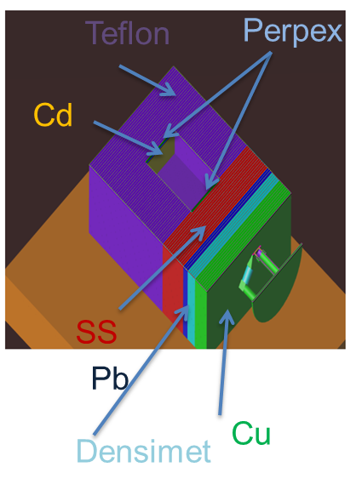
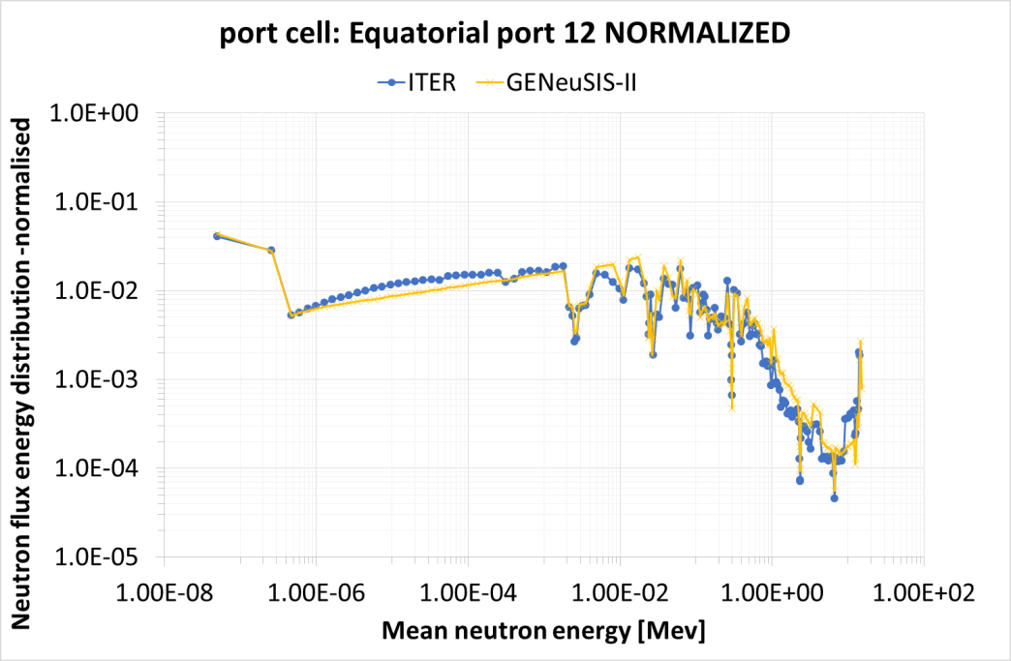
SP-5 Replicate ITER neutron energy spectra shape at FNG
General Experimental Neutron Systems Irradiation Station: Novel neutron test bed facility for testing diagnostics, electronics and critical ITER components
Support from ITPA, IO
Materials assembly as moderator in front of 14MeV neutron flux to replicate the required neutron energy spectra distribution.
Neutron energy spectra as in ITER Port Cell: unique facility for testing Single Event Effects (SEE) on electronics with ITER-like neutron spectrum
FNG target
GENeuSIS design extra resource
MCNP calculations to optimise the material assembly
Final design
Database for AI training to reproduce any neutron spectra
Tests of SEE on electronics with GENeuSIS in ITER conditions
Procurement and installation of GENeuSIS at FNG
Perform experimental characterization of the test-cavity
Experimental tests on selected electronic components
Study the impact of thermal neutron shield on SEE

Slide 10
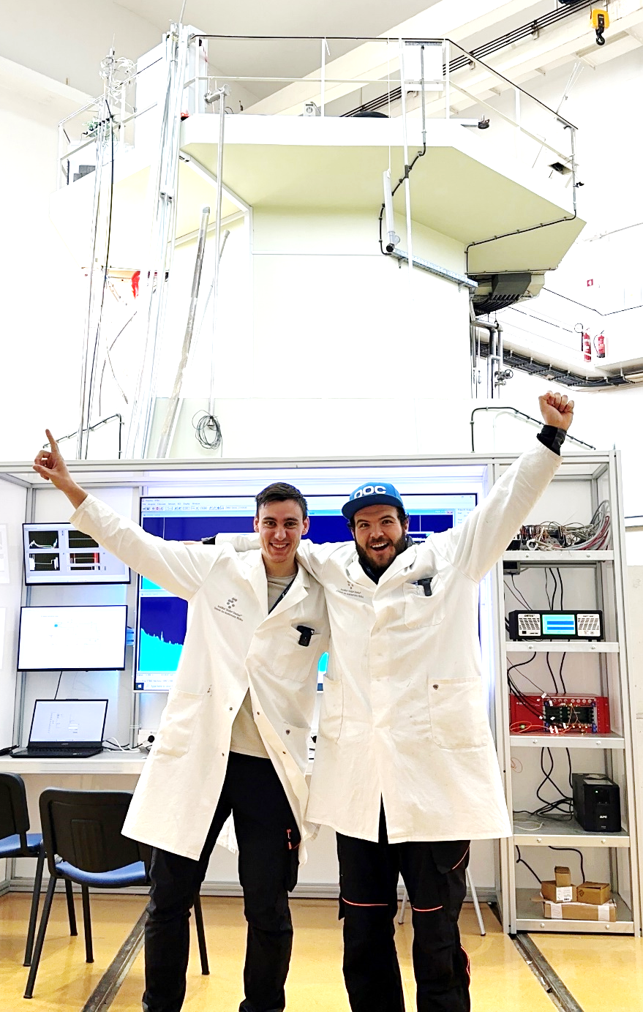
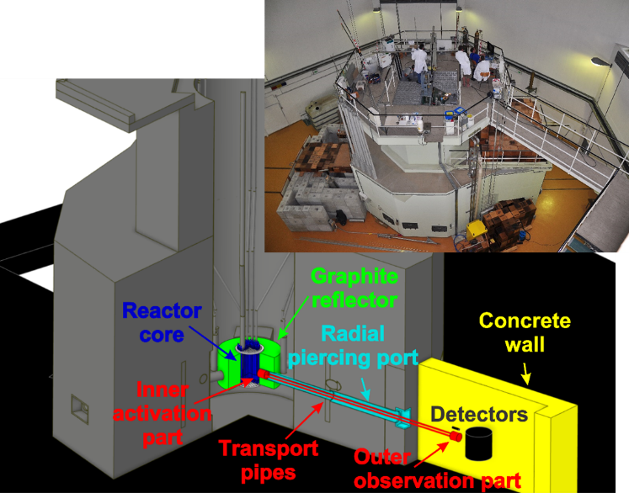

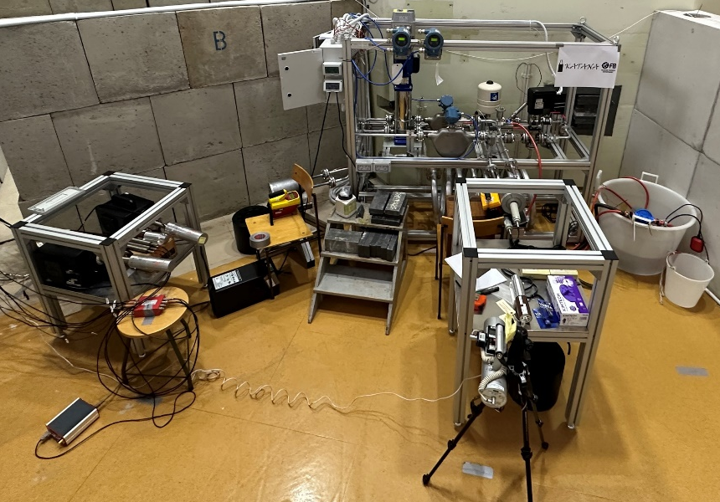
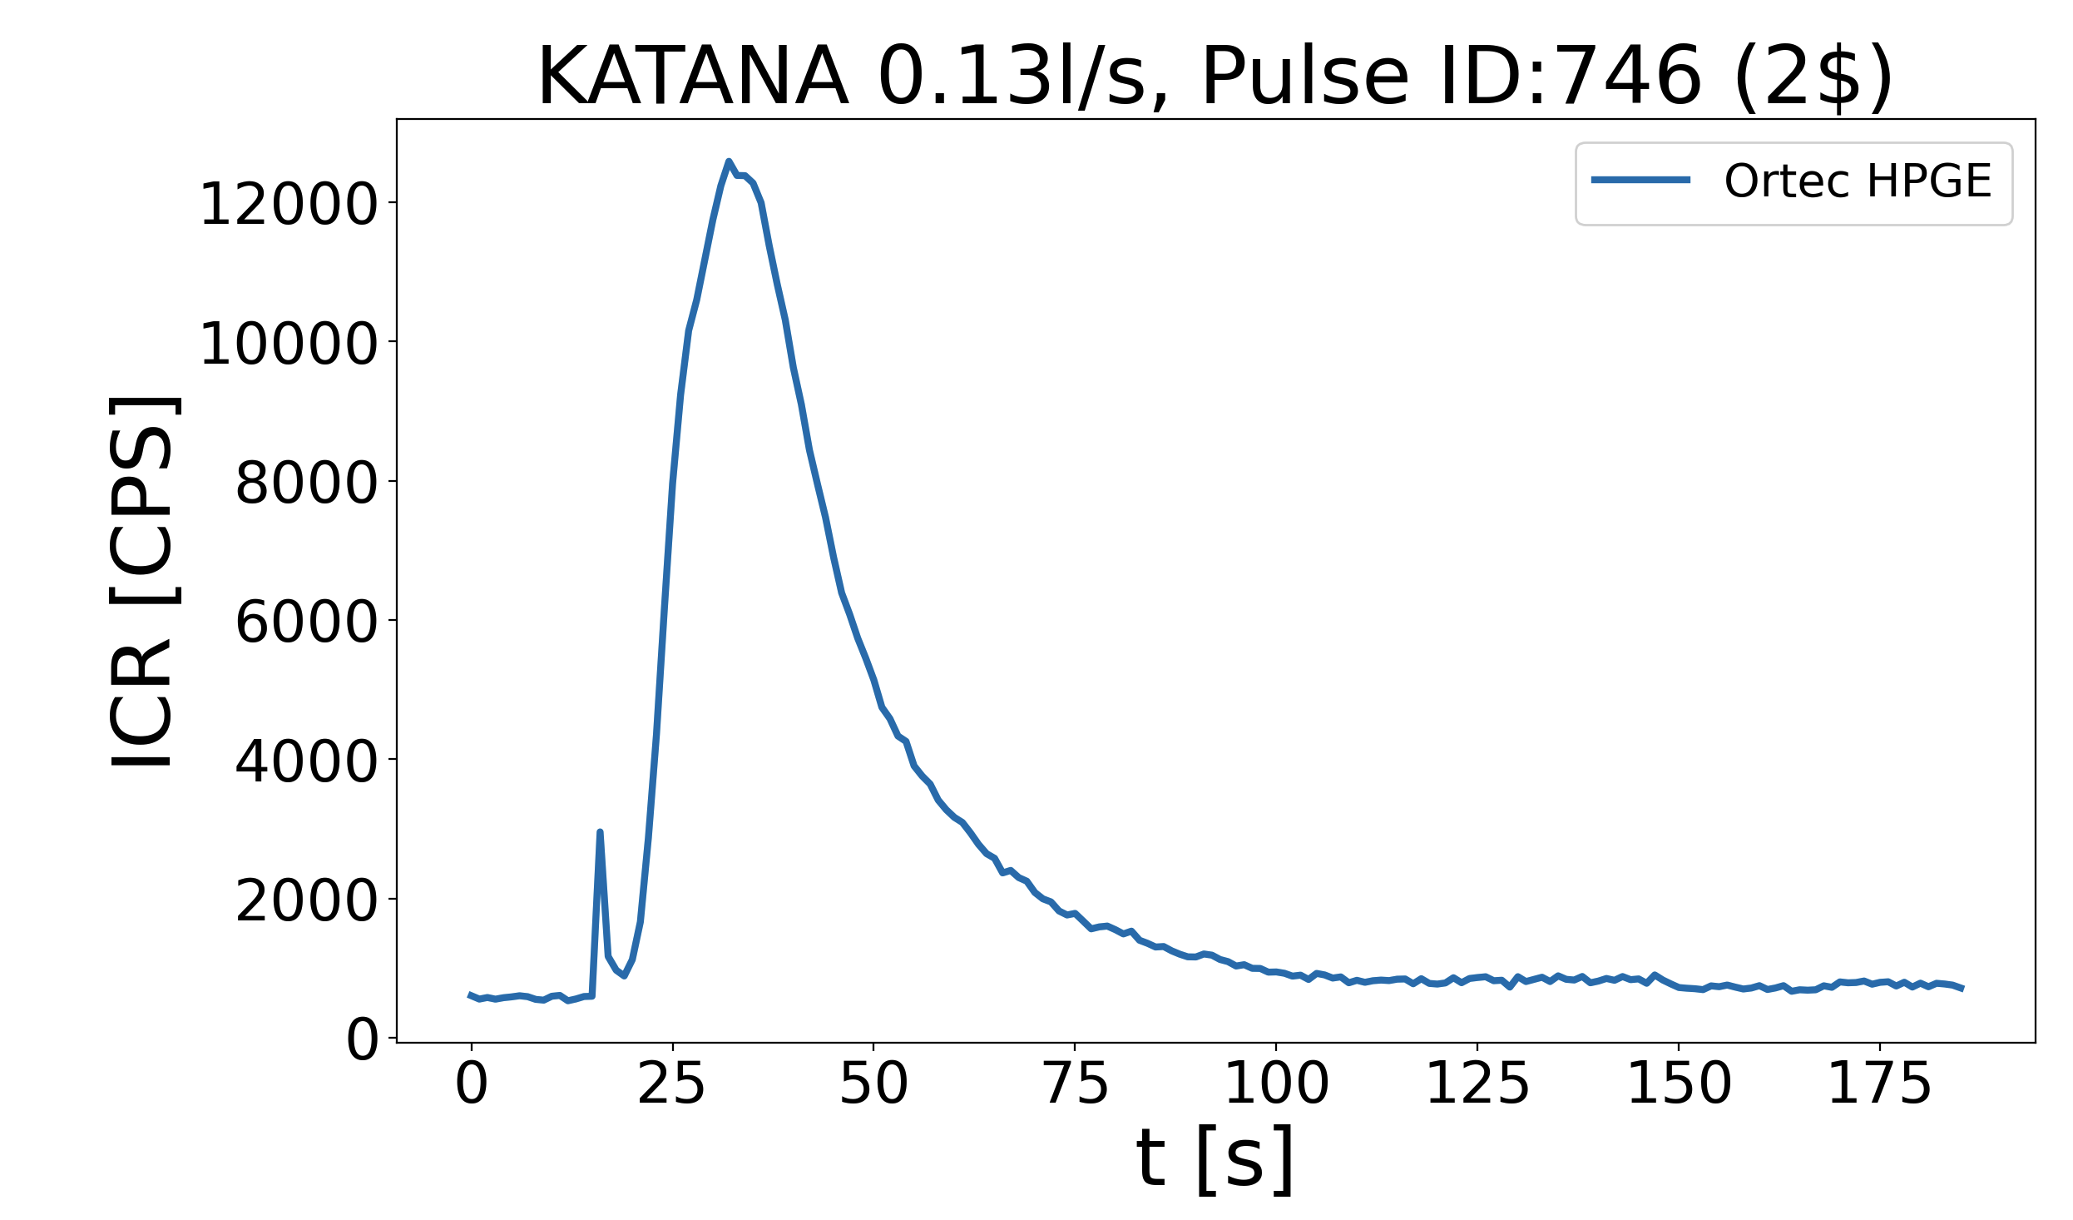
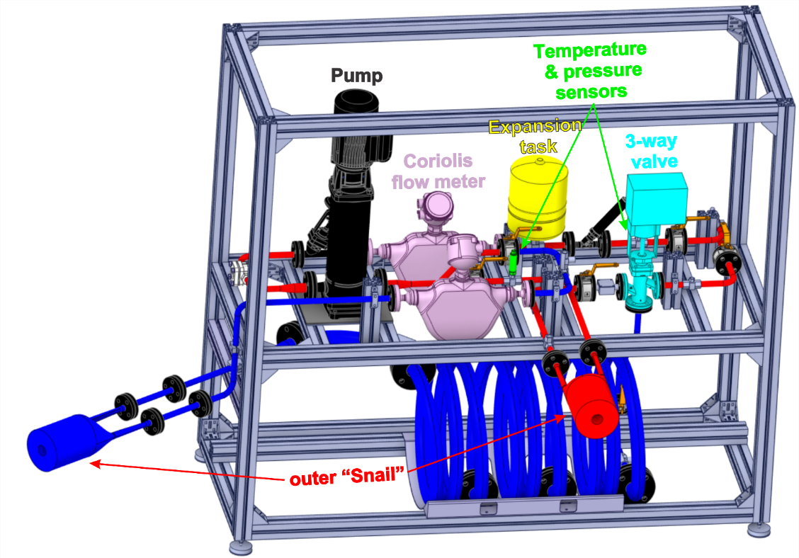
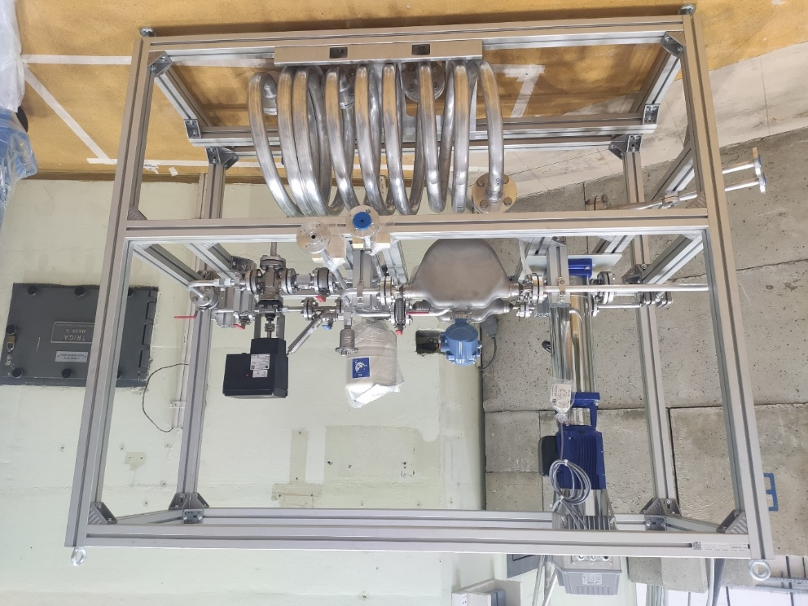
SP-5 KATANA, new closed-water activation loop at JSI TRIGA fission reactor to validate water activation codes for ITER
Design, construction and first experiments 20th Dec. 2023
Connecting fusion with fission
Gamma count rate after TRIGA pulse
(water activation)
Gamma count rate during TRIGA PULSE 746
  2025: KATANA loop design & manufacturing with new ITER relevant head 20 k€ (extra resource)
[Snoj, Kotnik, Peric, Lengar, Radulović et al. ]

Slide 11




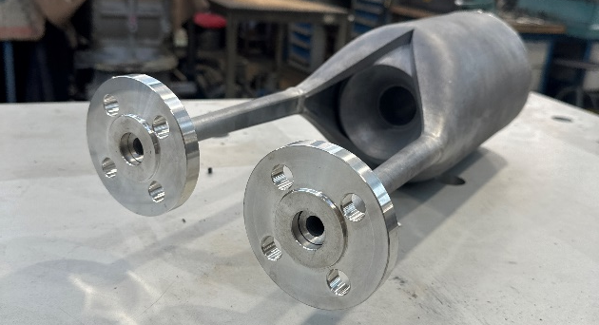
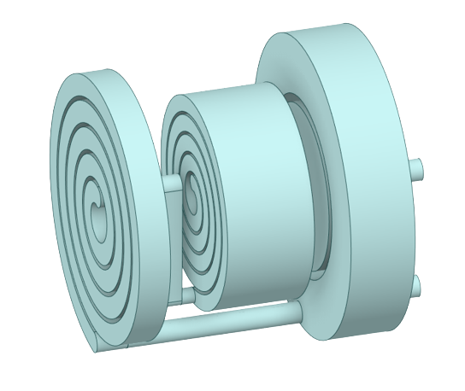
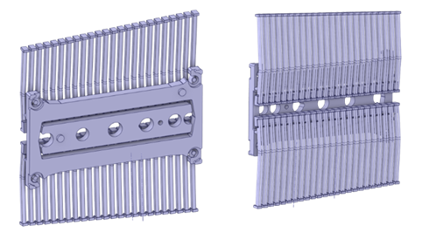
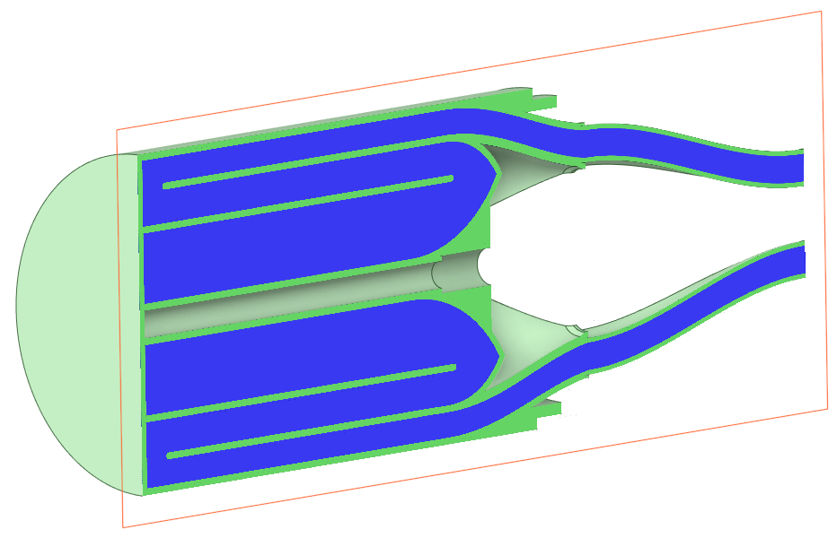
SP-5 KATANA, Expands activity with different cooling loop
Replacing Snail head with ITER relevant FW head (~2025)
neutronic & hydraulic simulations in 2024
Conceptual design is to preserve:
  Hydraulic features: pipework, water boxes, fingers
  Residence time: adjusted flow rate (same regime, i.e. Reynolds #)
  Orientation of neutron flux gradients
Snail head to be replaced by
ITER-relevant head
ITER FW cooling channel
Challenging Computational Fluid Dynamics effects: vortexes, stagnation points, etc.
[SNOJ ]

Slide 12
Dec. 2025 Grant Deliverables (Green OK – Red issues)
SP-2
  PRIO.D.06 Report on full-pulse predictive modelling of current, heat, particle, momentum for ITER relevant heating (ICRH, ECRH, NBI) and fuelling (gas puff, pellets) schemes from breakdown to termination (L or H-mode phases) demonstrated on three different tokamaks, together with operational limit predictions (Responsibility of TSVV11)
  PRIO.D.07 Report on the simulations of the first ITER operational phase (simulation of dynamic phases at 1/3 and 1/2 magnetic field in H and He plasmas) (Responsibility of TSVV11)
  PRIO.D.08 Report on the synthetic diagnostics development for ITER focusing on thermal imaging and diagnostics for monitoring and protection of ITER first wall.
SP-3
  PRIO.D.17 Report on EUROfusion participation in ITER NBTF, ELISE and BUG activities
  PRIO.D.18 Report on long pulse ELISE / BATMAN Upgrade operation scenarios and consequences for the NBTF and reliable NBI operation on ITER
  PRIO.D.19 Report on the studies and modelling developed for the Caesium operation in the negative ion sources with data provided by ELISE, BUG and SPIDER
  PRIO.D.20 Report on the RF studies and modelling developed for the inductively coupled plasma (ICP) ion sources for the NB for ITER
  PRIO.D.21 Final report on the beam physics studies and modelling in support of the injector operation for ITER
SP-5
  PRIO.D.28 Report of neutronics and safety activities in support of the preparation of ITER nuclear phase (pending extra resources available)

Slide 13
International collaborations within PrIO
US: Collaboration to Benchmark Neutronics Simulation Computer Codes under the EURATOM-U.S. DOE Agreement in the Field of Fusion Energy Research and Development
  Technical annex finalized and Official letter sent to DOE
  Advanced courses on neutronics code ADVANTAG with Oak-Ridge National Laboratory developers in 2023 (FEC 2023)
Korea:
  Breakdown simulation, collaboration for DYON upgrade and validation (FEC 2023)
Japan (QST & NIFS):
  Participation in QST test facilities of Negative Neutral Beam; Comparison of between RF and filament source
CERN
  Test of electronic under neutron flux
IAEA:
  Coordinated Research Project (CRP) on Artificial Intelligence for Accelerating Fusion R&D (Disruption database) (adhering to FAIR/Open Science principles).
  Contribution to the IAEA nuclear database
IEA TCP agreement:
  leader of subtask on Neutronics within IEA TCP Nuclear Technology of Fusion Reactors
  Chair of Coordination of International Challenges on Long duration Operation, CICLOP group (IEA-IAEA)

Slide 14
Conclusion
PrIO project set-up in 2021 is on track with significant contributions
In the context of the ITER revised baseline with the aim of achieving Q=10 as soon as possible once the machine construction is complete, it is timely to strengthen our collective effort:
  Impact of ITER new baseline on PrIO activities is under assessment
  New opportunities to increase the support to ITER using EUROfusion facilities/know-how
This involves ensuring that operational tools, broadly defined to include methods, codes, and sub-systems, are fully tested, validated, and reliable before being transferred to ITER for future application

Slide 16
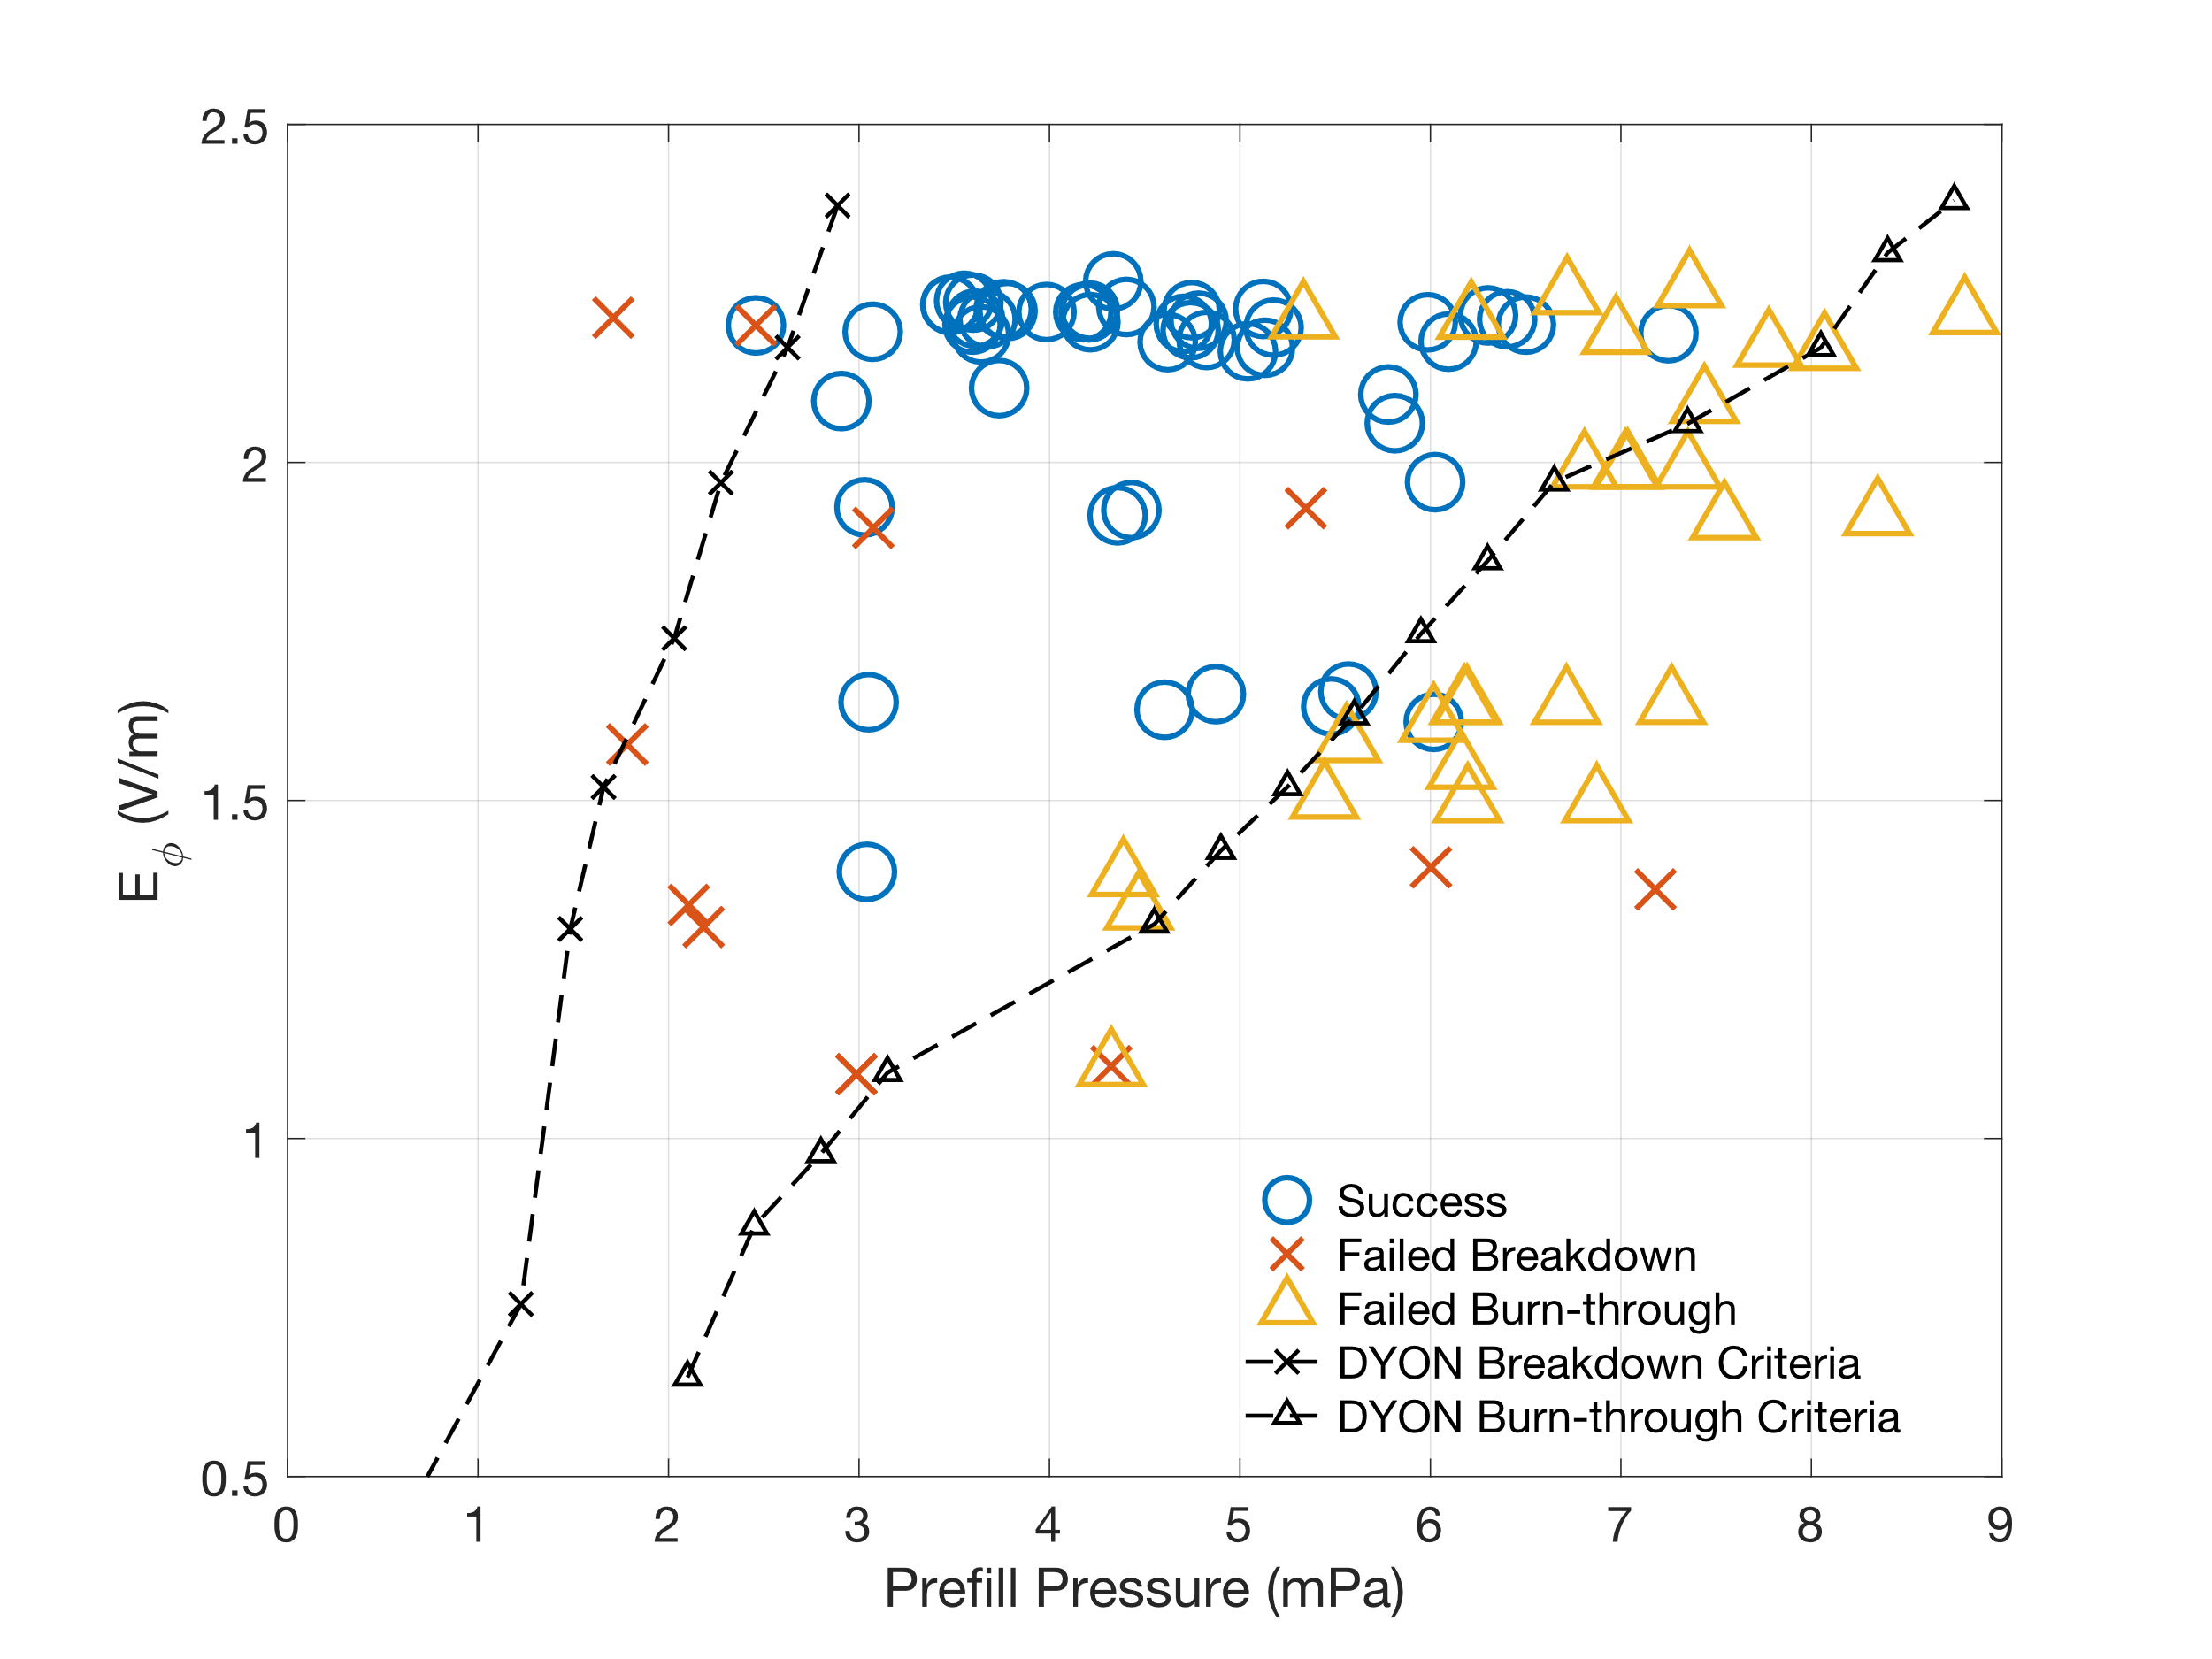
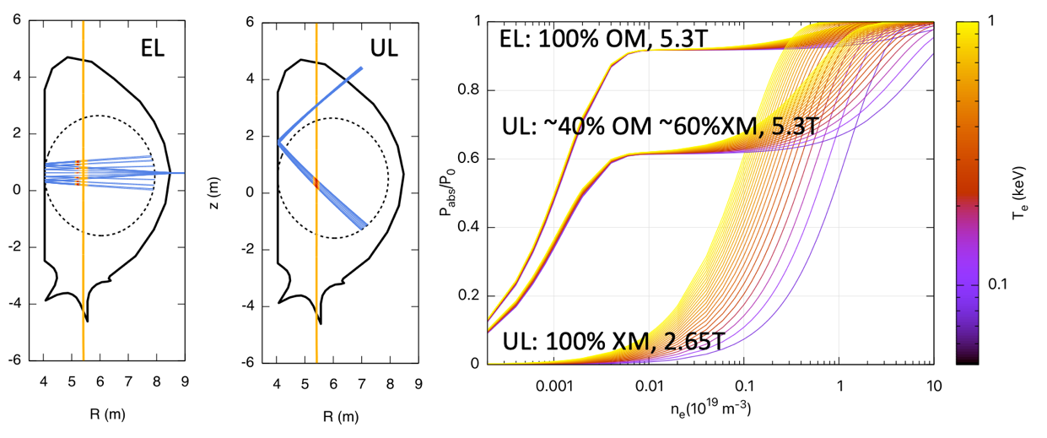
SP-2: Validated Breakdown/Burn-through tools for ITER first operation
with WPSA/TE
DYON Full electromagnetic burn-through model further validated on VEST (Univ. Seoul- Int. coll.)
Absorption of EC waves in ITER first plasma start-up conditions in the GRAY-BKD0-CREATEBD framework
Operation space prediction and validation
EC power absorption in ITER: Upper Launcher (UL) and Equatorial Launcher (EL) for different frequencies and Toroidal Fields
2024 : IMAS interface and ITER application
Wall reflection allows to optimize ECRH absorption at low density via conversion of the residual power from OM to XM
[Yun FEC 2023, Kim 2022 NF ]
[Mattei FEC 2023]

Slide 17
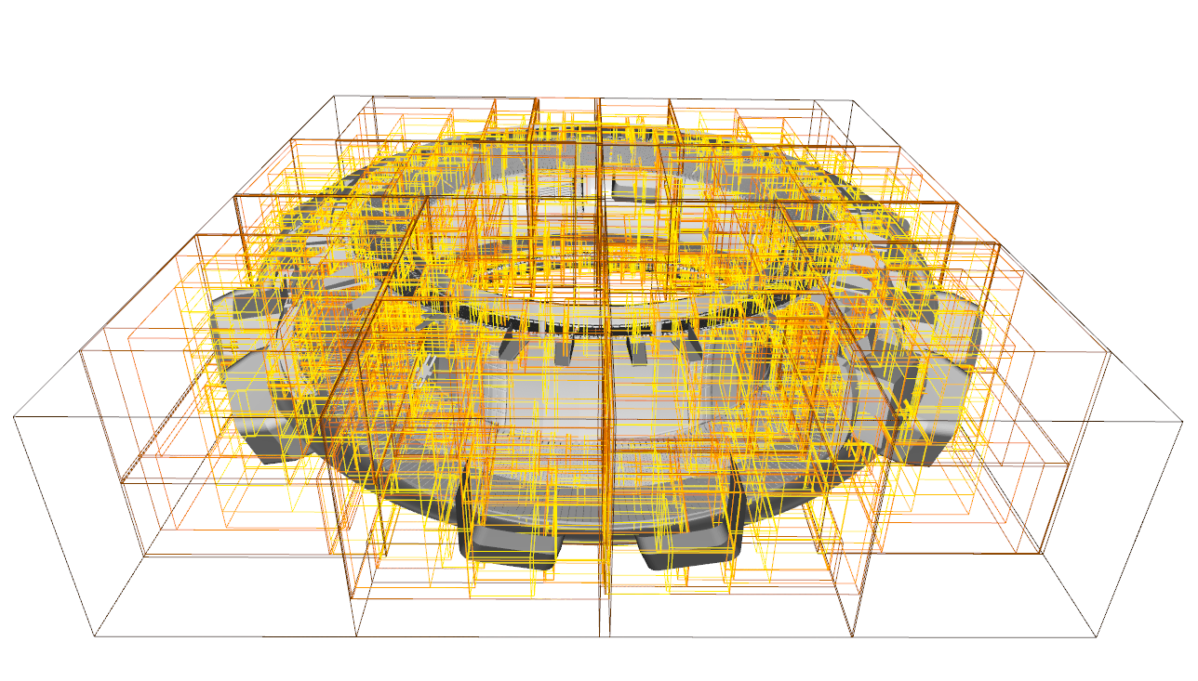
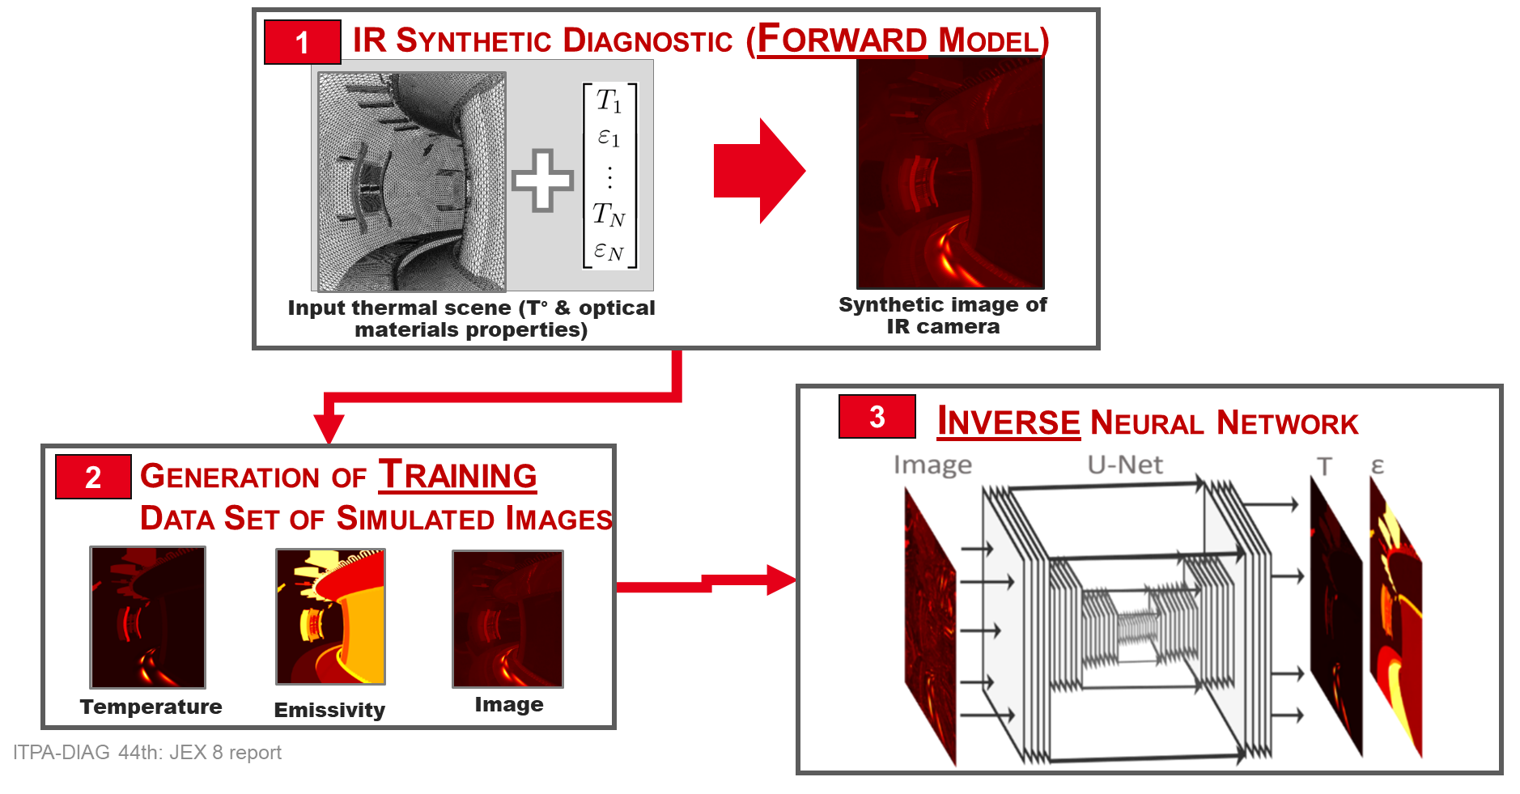
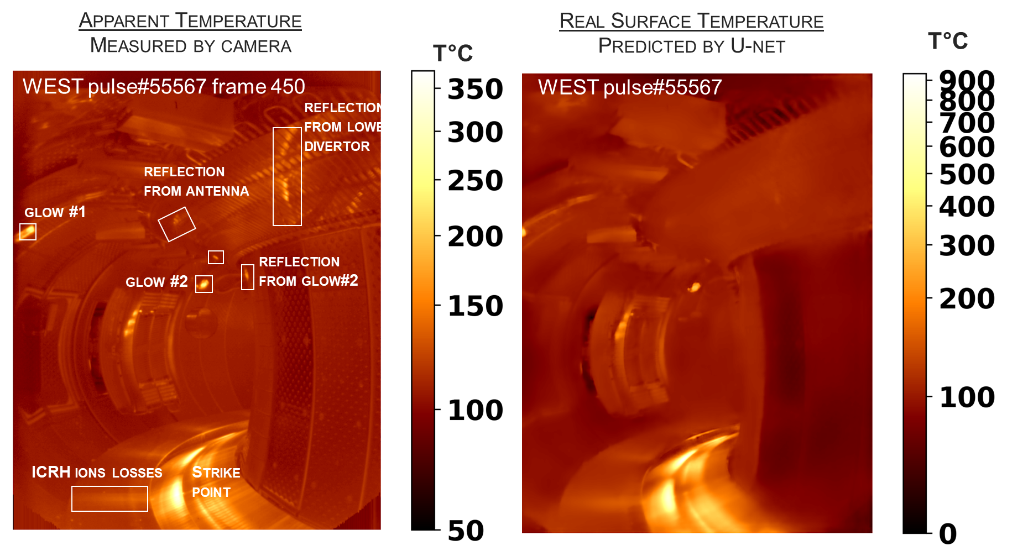
SP-2: IR synthetic diagnostic & wall monitoring for real time protection
with WPW7X
IR Synthetic diagnostic:
Interpretation of IR images and evaluation of the impact of various disturbances in the IR measurement
Machine protection and inverse processing to obtain reliable surface temperature or emissivity from IR image
[Aumeunier FEC 2023]
A new accelerated ray tracing code for generating sequences of images & database for IA
First application of inverse IR radiative neural network on experimental images of WEST

Slide 18
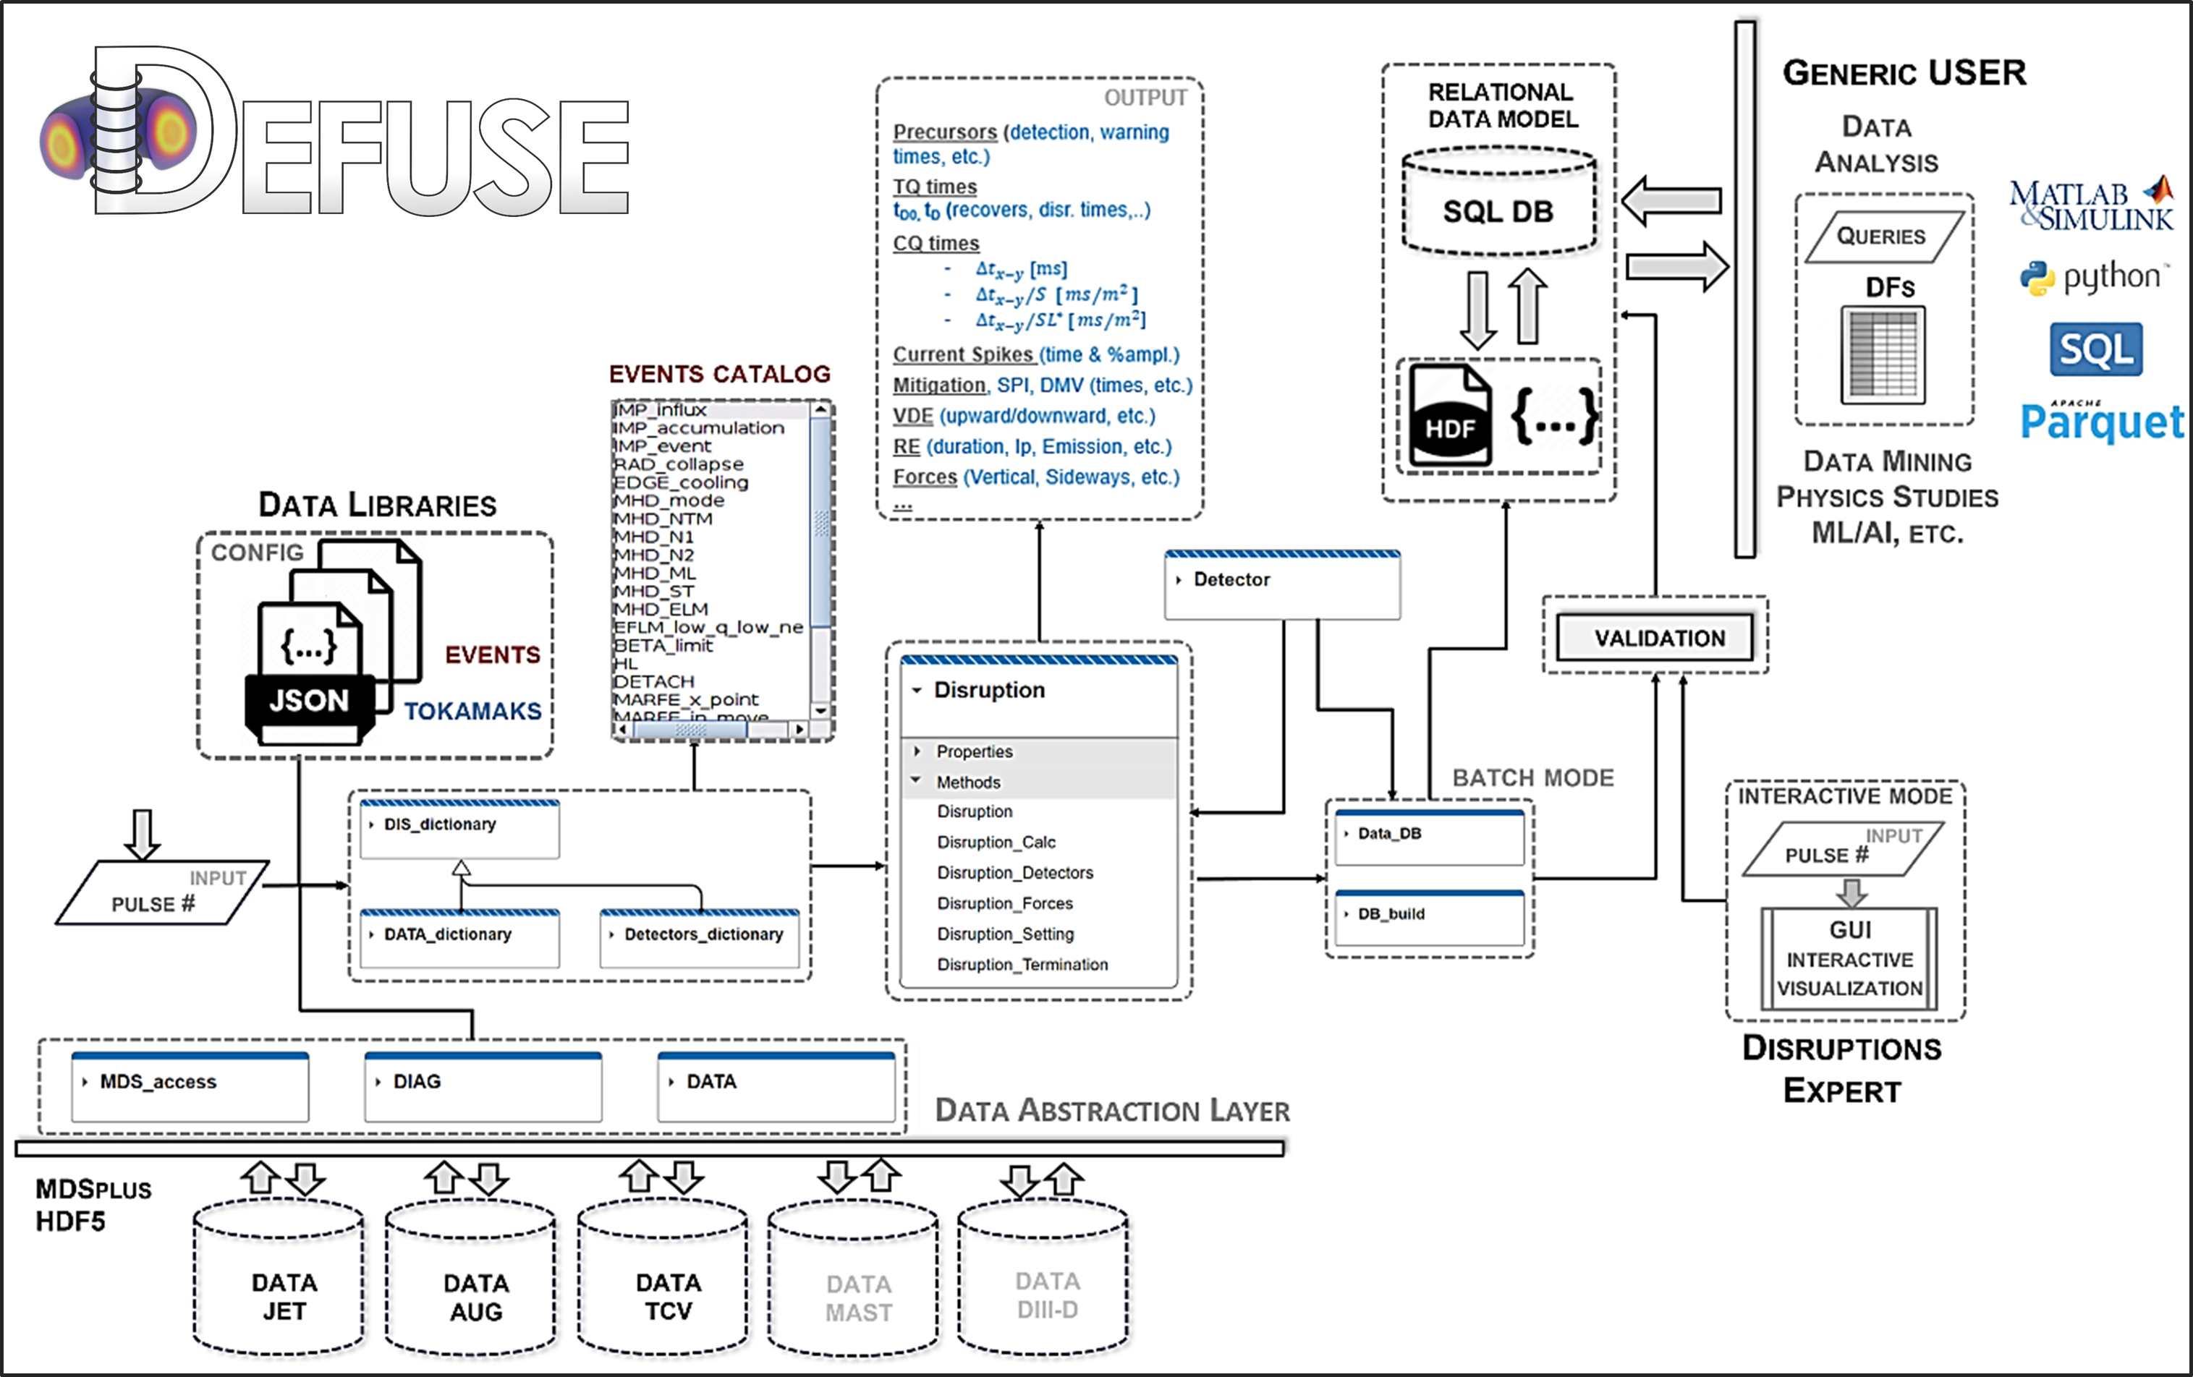
SP-2: Progress on the multi-machine disruption database
with WPTE-AC
Status
  JET: ~4000 validated entries (from the start of ILW until 2022)
  TCV: ~4500 entries under validation
  AUG: ~1500 entries under validation
  MAST(-U): integration of data libraries & dictionaries
  WEST: Preliminary discussion on the integration
Validate a new first-principles density limit scaling law with the disruption database (AUG, JET, and TCV)
  Implication for ITER: new limit is twice Greewald limit (Psol dependence)!
development of physics based disruption predictions for baseline scenarios
Disruption database framework DEFUSE (Disruption and Event analysis framework for FUSion Experiments)
  open source, Aligns with OPEN and FAIR principles
[GIACOMIN, M., Pau, A., RICCI, P., SAUTER, O., EICH, T., PRL 128, (2022) 185003]
[PAU A., et al., FEC 2023]
PrIO Grant Deliverable PRIO.D.03

Slide 19
SP-2: ITER fast ion loss detector diagnostic design and synthetic diagnostic
with WPSA-TE
Simulated FILD measurements of the velocity-space distribution (as a function of gyroradius and pitch angle) of the escaping ions for ITER baseline scenario
  synthetic diagnostic FILDSIM + ASCOT simulation for calculating the fast ion losses at diagnostic location.
Fast-ion heat flux on the FILD probe head for two different insertions
α-particles
2024 :
tool validation on JET DT (new activity)
new ITER scenarios + Wall conf.
Beam ions

Slide 20
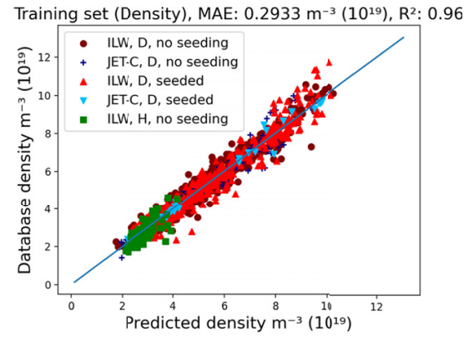
SP-2: Progress on the multi-machine pedestal database
with WPTE-AC
Application: deep learning techniques to predict pedestal density (free parameter in E-PED)
  Application for integrated modelling
Status
  JET: 4018 pulses stored in IMAS on the Gateway (all JET-C and JET-ILW pulses till end of DTE2)
  TCV:209 pulses stored in IMAS on the Gateway [Labit IAEA 2021]
  AUG: All the pulses provided by M. Dunne
A web interface to download the Pedestal Database should be available in 2024
  The web interface for the pedestal DB can be used for the other DBs (same IMAS format).
2024-2025 strengthen AI application:
  training sets for pedestal structure/stability predictions (extra resources)
PrIO Grant Deliverable PRIO.D.03
[Frassinetti et al., Nucl. Fusion 2021]
[Gillgren et al., 2022 NF 62 096006 ; A. Kit et al, PPCF 65 (2023) 045003]

Slide 21
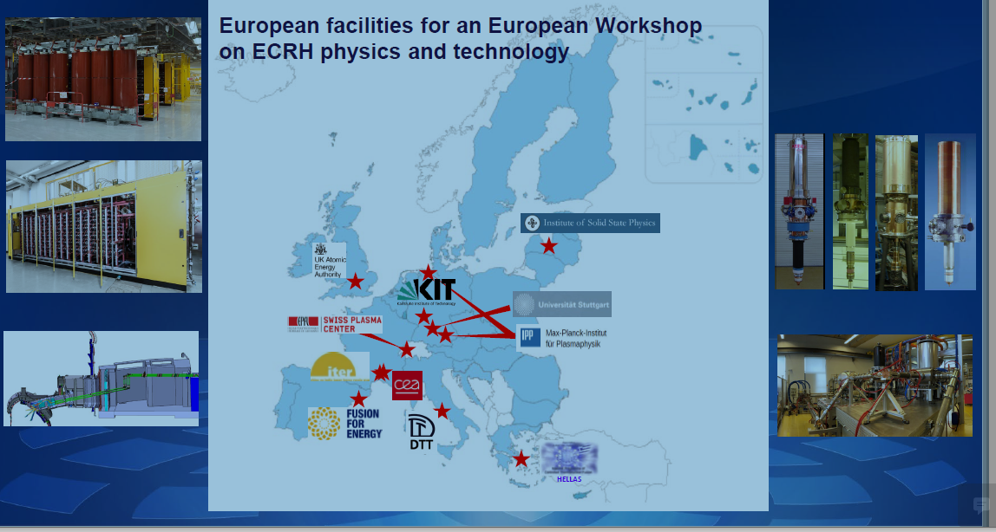
SP-3: EUROfusion Operations Network (EON) – Voluntary contribution-
with WPTRED
2024 Develop Session Leader courses
2024 EU-ECRH network (like the NBI network) together with F4E
2024 increase ECRH EUROfusion effort in support to ITER revised baseline
  ITER Significant transition from 24 Gyrotron procurements to 80 in the revised baseline
  commissioning on test beds will be on the critical path of the timeline
18 experts across 9 associations (tokamak and stellarator)
  facilitate stronger connection between the operational groups of EUROfusion facilities
  to share operational experience
NBI network activities continued in 2023 under the EUROfusion Operations Network
  6 seminars organised in the first half of 2023
June 2024 Grant Agreement Deliverable PRIO.D.10
  “Report on the EUROfusion plan/programme for the involvement and contribution to ITER operation”
  Postoned in Dec. 2025 Waiting for formal approval of the ITER revised baseline + inputs from the high-level (EUROfusion-F4E) Working Group
[Belohony]
PrIO Grant Deliverable PRIO.D.09

Slide 22
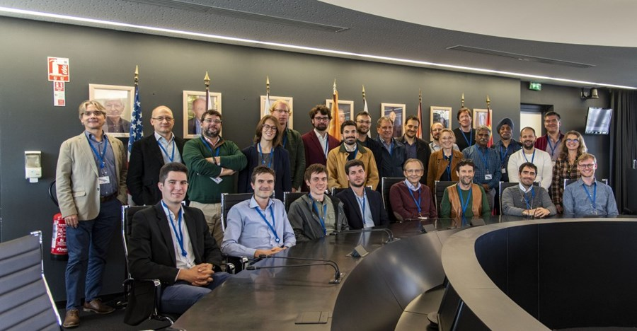
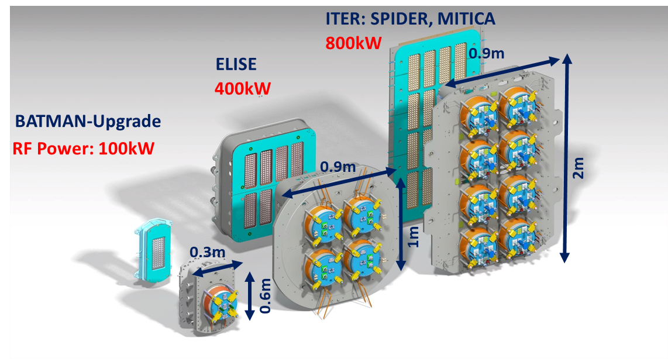
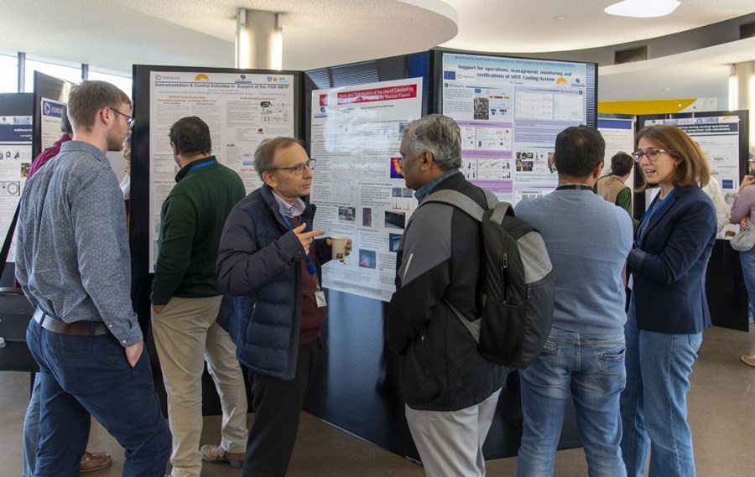
SP-4: ITER Neutral Beam test Facility and R&D for the ITER Neutral Beam
Develop one-team approach:
  experts on neutral beam injection for a few days at ITER (oct. 2023)
  https://www.iter.org/newsline/-/3953
Participation in the exploitation of ELISE and BATMAN Upgrade for long pulse op.
  Provide inputs for SPIDER in a step-ladder approach
Training of engineers with hands-on activities
Participation in the ITER Neutral Beam Test Facility:
  Vanni Toigo has been replaced as NBTF PM by Diego Marcuzzi
  SPIDER Assembly and commissioning activities
  MITICA high voltage and protection systems tests and installation
  Hardware Design and Procurement
  Analysis, Diagnostics , simulations
  Software & control (including remote participation tools)
2 PrIO 2023 Grant Deliverables PRIO.D.14 , PRIO.D.15
[Fantz FEC 2023, Toigo FEC 2023, Den Harder FEC 2023 ]

Slide 23
SP-4: 2025 Objectives NBTF
SPIDER:
  In the first part of 2025, the shutdown started in the second half of 2024 will be completed with the integration of the RF solid state amplifiers and the Vacuum Enhancement system
  The experimental phase will restart around mid-2025 in full configuration
    Investigation of the source refurbishment (as a consequence of 2024 experimental campaign and following findings at the short shutdown, replacement of GG1 and GG2 segments; revised driver configuration as result from SPIDER campaign)
    First test of plasma and beam operation with new RF solid state generators
    First test of new vacuum enhancement system
MITICA
  In the first part of 2025, the onsite installation phase of the additional protections together with the new components to replace the damaged ones will be completed and final integrated PS tests will be carried out
  Trial for temporary in-vessel installation of the cryopumps and integration with cryoplant will be carried out in parallel to new PS components installation phase mentioned here above
  Final installation of all in-vessel components will be carried out after positive completion of PS tests

Slide 24
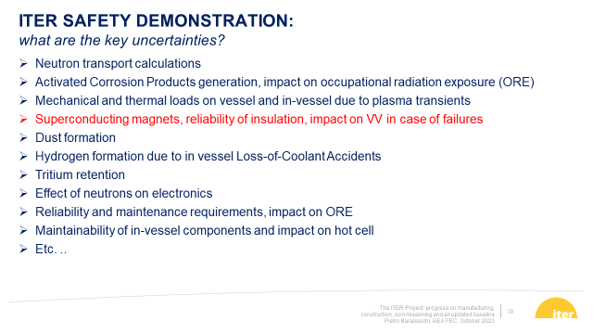
SP-5 Adressing key neutronic/safety issues for ITER (IO DG at FEC 2023)
Neutron transport calculations
Water activation & Activated Corrosion Products generation & impact on occupational radiation exposure
  PrIO activities are part of the ITER ACP roadmap
Effect of neutrons on electronics
Material activation
Significant connection and link with IO & F4E have been developed , e.g.
F4E voluntary contribution to KATANA water loop, Water activation & ACP experiments
PrIO participation in the IO 15th ITER Neutronics meeting
PrIO participation IO ACPs workshop for fusion applications

Slide 25
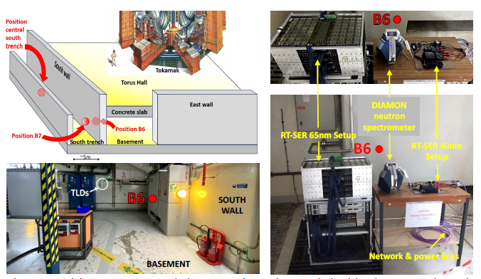




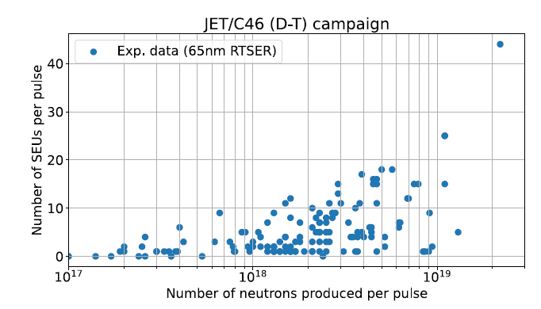
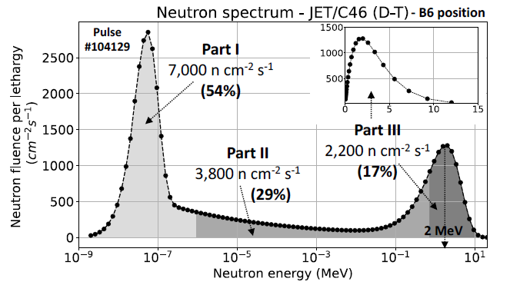
SP-5 DTE3-neutron effect on electronics at JET (collaboration with CERN)
Number of single-event upset during D-T
Neutron energy spectrum measured by DIAMON during DT
[Dentan et al. ]

Slide 26
SP-5 Exploitation of JET DT campaign
DT operations at JET offer a unique opportunity to study in real tokamak environment:
Calibration of neutron detectors
Activation and damage of materials & electronics
Tritium breeding & detectors
Validate nuclear codes
Develop advanced techniques
Collect & process nuclear safety data
  Projects
  14 MeV Neutron calibration
  Activation of ITER materials
  Radiation damage studies
  Streaming benchmark exp
  Shutdown dose rate benchmark exp
  Test Blanket Module detectors - TBR
  Water activation exp
  Single Event Effects on electronics
  Occupational Radiation Exposure
  Waste
DD,TT
DTE2+
DTE3
DTE3
relevance to ITER & DEMO
[Villari 2023 ]
26

Slide 27
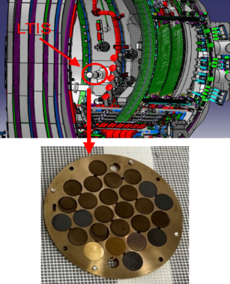
SP-5: DTE2 Activity predictions for ITER materials vs Experiment (C/E) following recent & comprehensive analysis (Summer 2023)
gamma spectrometry techniques at several lab.* to identify and quantify activities (neutron activation)
In general, C/E close to 1 within 25%
CuCrZr and W monoblock samples showed more deviations !
  New experiments proposed last week of DTE3 or during T cleaning !
*NCSRD; CCFE; IFJ-PAN; ENEA and IPPLM
[PACKER V. et al., FEC 2023]

Slide 28
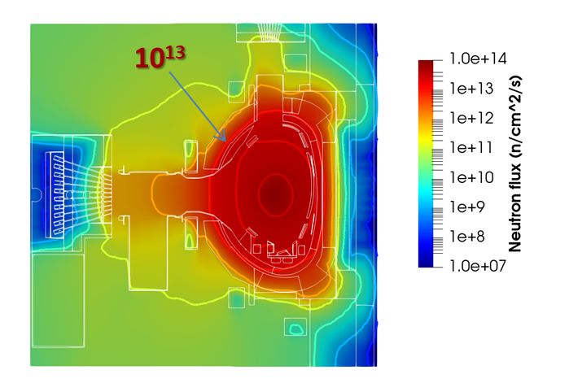
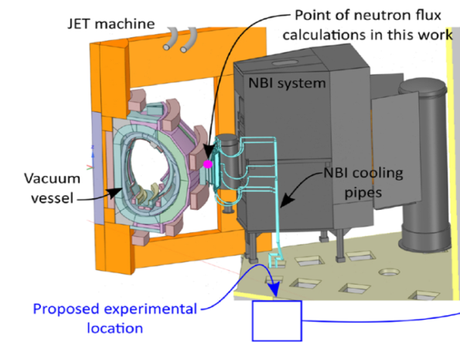
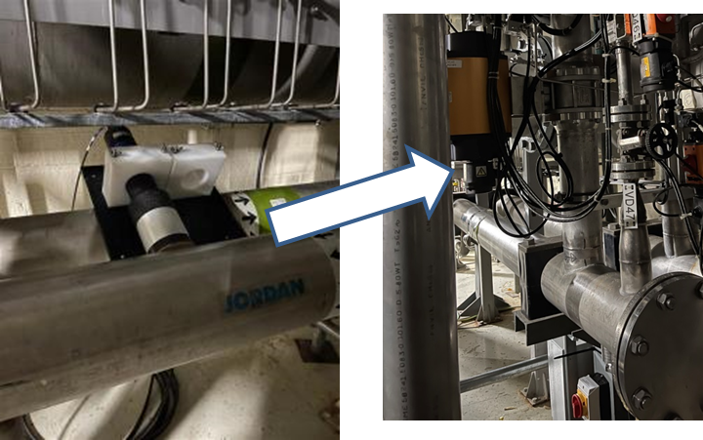
SP-5: Neutronics following successful DTE2 & “three world premieres”
[Villari Plenary SOFT 2022 & ISFNT 2023]
Neutronic code validation (streaming and shutdown dose rate) & analysis of irradiated ITER materials/functionals materials @ 8.5x 10²⁰ DT neutrons
First observation of delayed Be photo-neutrons due to the decay gamma following JET in-vessel 14MeV activation ⇒ photo-neutrons from ⁹Be (γ,n) ⁸Be
First quantitative test of electronic component under 14 MeV neutrons
First observation of water activation
  high energy γ (¹⁶N16 decay ¹⁶O(n,p)¹⁶N) in proof of principle experiment (summer 2022 D-NBI & 1% T cleaning campaign)
JET neutron flux #99971
10¹³ n/cm²/s neutron flux as in rear ITER blanket diagnostic first wall
Same level of shutdown dose rate as in ITER port interspaces and port cells

Slide 29
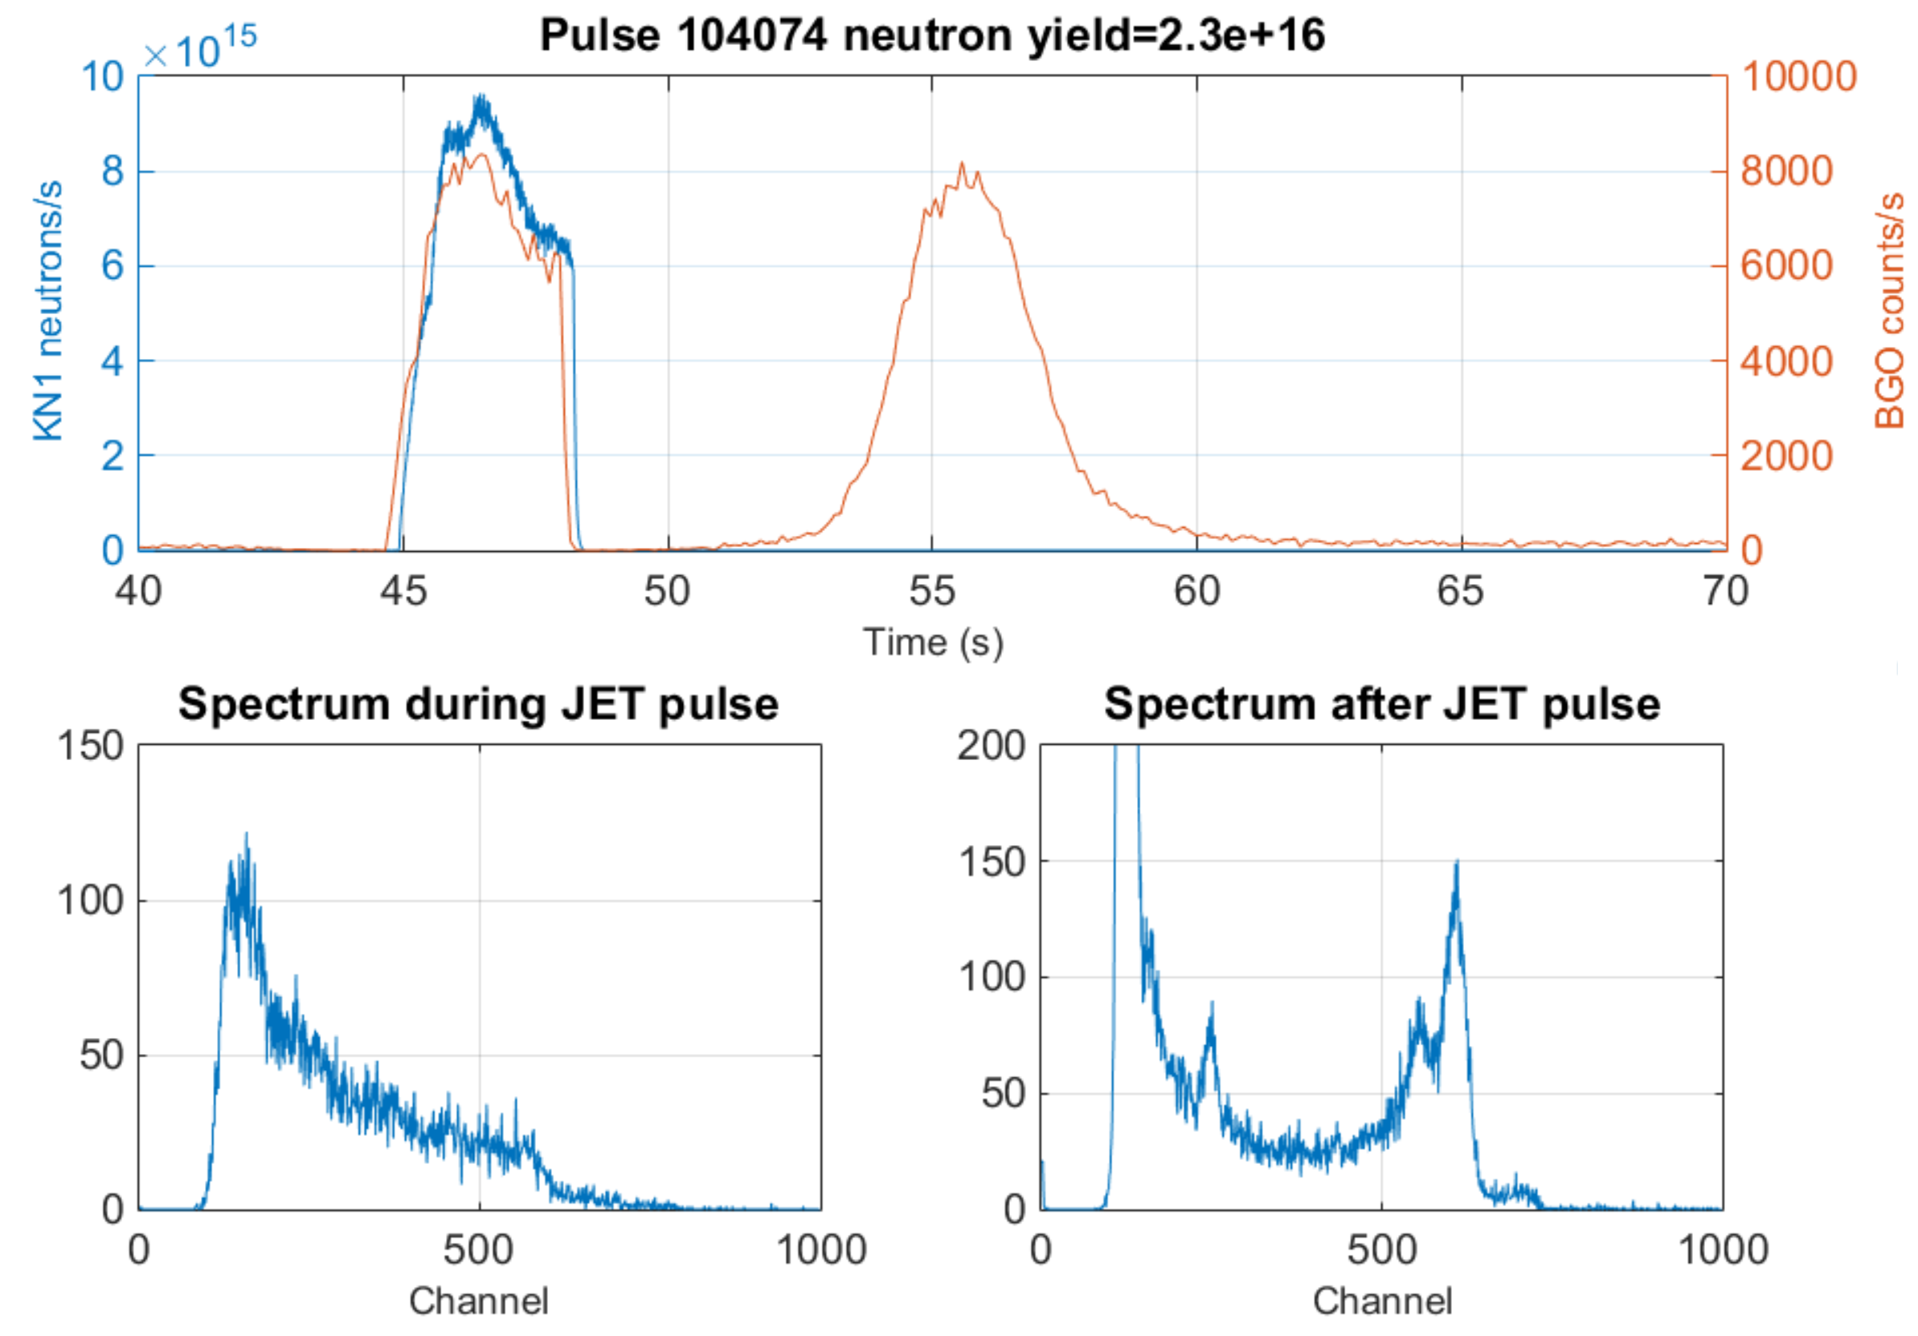
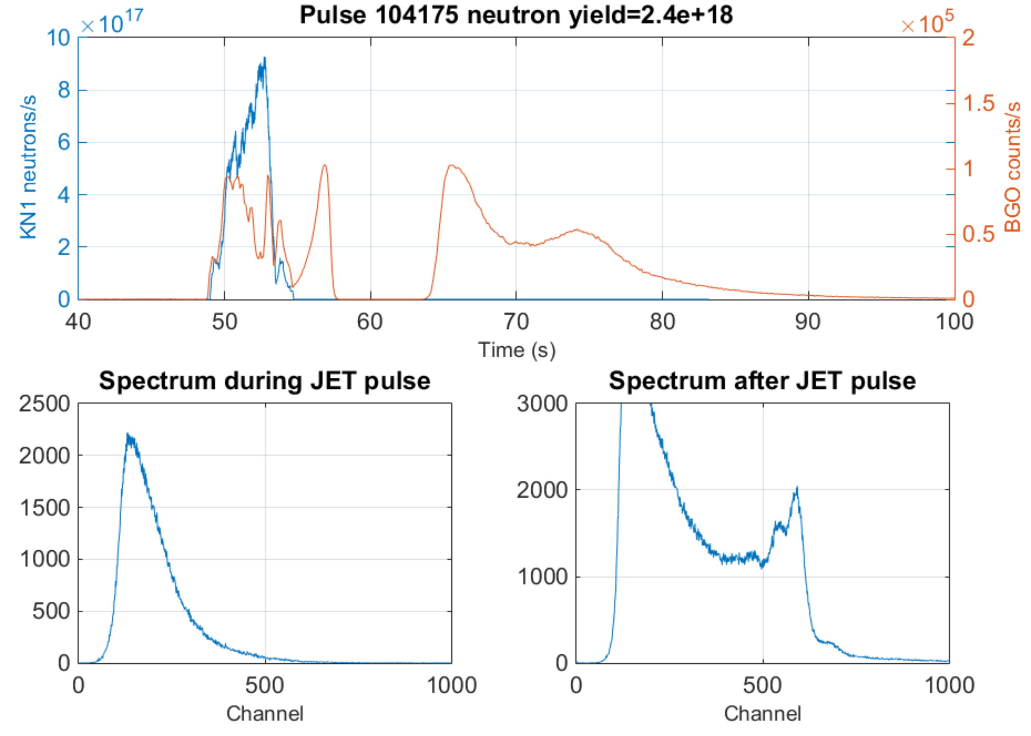


SP-5 JET water activation experiment- first measurements in tokamak !!
C45 DD campaign
DTE3 campaign
DT neutrons from T burn-up ~1% total N yield
Delayed signal due to activated water
Water activation 6&7 MeV peaks!!
Calibration to be carried out in 2024
Post-analysis with Actiflow/Gammaflow, RSTM (F4E), FLUNED & DEMO tool in 2024 in collaboration with F4E
29

Slide 30
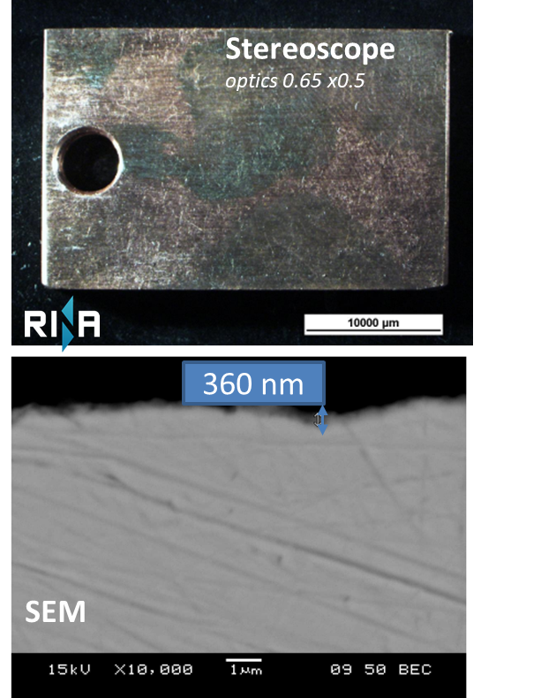
SP-5: Erosion and corrosion processes for ITER materials (CuCrZr) in baking conditions at CSM-RINA facility (in collaboration with IO & F4E)
CuCrZr samples provided by F4E exposed in typical water conditions during ITER baking, i.e. T=240°C, p=45 bar and reduced oxidation environment (O₂ content<10 ppb)
Tests in collaboration with IO as part of the ITER ACP roadmap: ORE from ACP
PrIO call in 2023 and initial experiments to be extanded up to 2000h in 2024 (extra resources)
Metallography analysis after 500 h, using a stereoscope and SEM (Scanning Electro Microscope): difficult to measure extremely thin copper oxide layers (low oxygen concentration)
Extra TEM (Transmission Electroscope Microscopy) required for thinner layers < 1μm
Extra activity (3 PM @ 100% in 2024)
  TEM analysis
  Extend exposure up to 2000h to obtain measurable oxide layers for deriving a new corrosion law & code validation (OSCAR-Fusion)
ITER sample #3 @500h

Slide 31
Deviations from the approved WP 2023
SP-2 Delay
  Upgrade SMITER with a new field line code (integrating 3D magnetic field and accelerated calculations algorithm) for the IR temperature synthetic diagnostic with benchmark
  Delay in producing a reference paper for the confinement database
SP-4 Extra task
  A new small facility to test one RF driver (MINION) at NBTF to optimize the RF source prior the installation on SPIDER has been designed, set-up and experiments in 2023. SPIDER will restart spring 2024 with optimized source.
SP-5 Delay
  JET : delay in completion of validation of 14 MeV neutron calibration + delay in collection of data on work-efforts for ORE and waste.
  Delay in procurement and commissioning of the water loop for Activated Corrosion Product experiment at FNG
SP-5 Extra task
  Preparation and execution of experiments by exposing electronic components to the neutron flux during JET DTE3 (collaboration with CERN)
  Experiments (CSM RINA – ENEA) to investigate erosion and corrosion processes for ITER materials (CuCrZr) in baking conditions (call in 2023)

Slide 32
SP-2 new-activities in 2024 within the approved IMS 2024 budget (green): call analysis of CfP-FSD-AWP24-PrIO-12
Topic 1 multi-machine IR database
  CEA (1PM) proposal for a coordinator for a multi-machine database of IR images
Topic 2 Database contact person
  CEA (2PM): WEST data to the EUROfusion databases
  EPFL (1PM): TCV Contact Person at TCV for the EF pedestal database
  No reply from MPG as contact person for AUG
Topic 3: Integrated multi-diagnostics data analysis tool in view of ITER application
  MPG (6PM) + CEA (1.4 PM) : In 2024 at WEST the existing ECE and interferometer data will jointly be analysed for estimating the electron density and temperature profiles. Reflectometry data will be added in a second step.
  LPP-ERM-KMS (9 PM requested): Integrated data analysis for the magnetic equilibrium, kinetic profiles and impurity profiles in ITER pending extra resource resources
  UKAEA (3PM requested) Development of MIDAS (Multi-Instrument Data Analysis System in view of ITER application) pending extra UKAEA resources

Slide 33

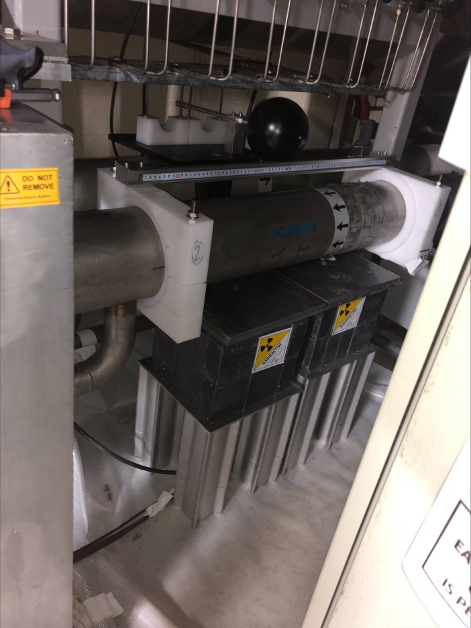
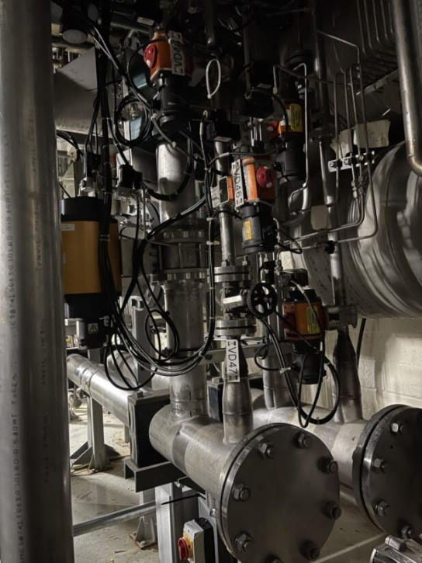
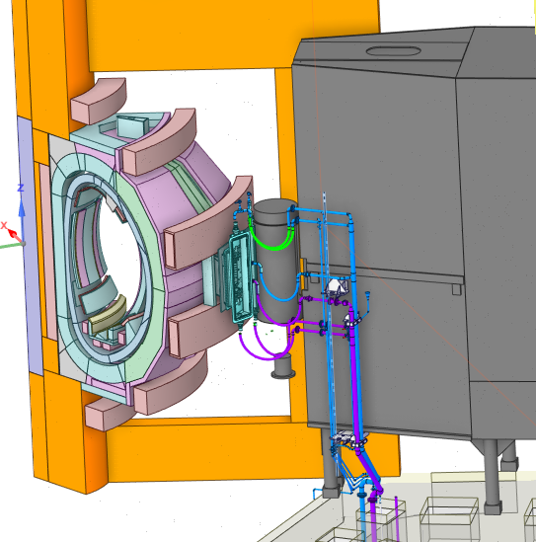
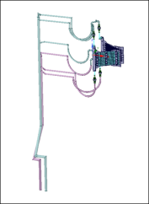
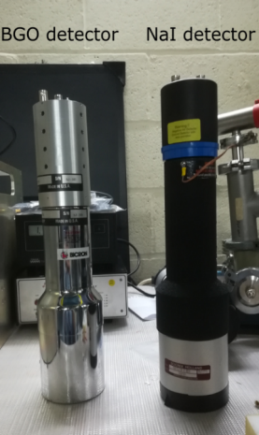
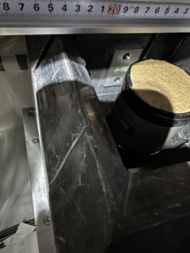
SP-5: JET water activation experiment during DTE3
Unique experiment in real tokamak water cooling loop under DT for the validation of water activation predictions in ITER
Location of WACT system
Outlet horizontal pipe
NBI duct scraper cooling loop Oct 4
Ionization Chamber
Oct 4 Basement
Pipe forest
NaI
BgO
  Detectors
  Gamma spectrometers: NaI & BGO
  Dose rate: Ionization chamber
Basement of octant 4
Measurements of γ from ¹⁶N decay
Online acquisition-CODAS
33

Slide 34
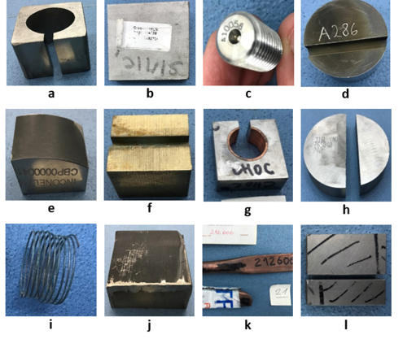
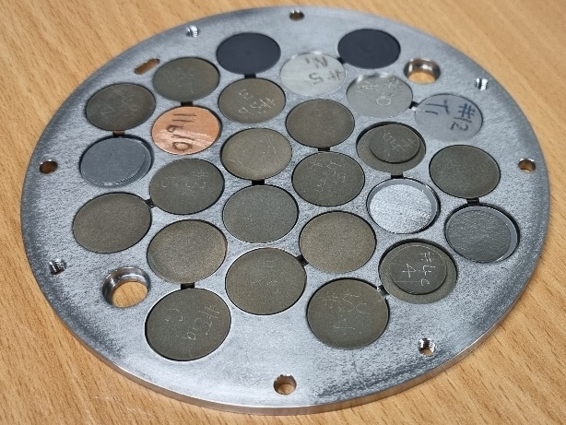
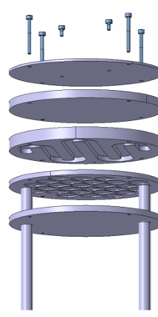
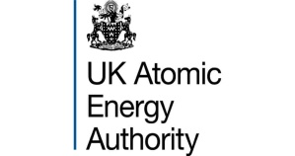



SP-5 Activation of real ITER materials
Unique irradiation in tokamak under 14 MeV neutrons of REAL ITER materials used in the manufacturing of the main in-vessel components
  Activation measurements of irradiated ITER material samples and dosimetry foils in DT
  Characterization and data validation for the predictions of ITER materials activation
Long-term
irradiation station assembly (LTIS)
715 days of irradiation
DT N flux
up to 2x10¹³ n/cm²/s
One order of magnitude less than ITER FW@500 MW
DT N fluence
5x10¹⁵ n/cm²
27 ITER samples
Assembly location
JET plasma
  Nb3Sn, SS316L steels from various manufacturers, SS304B, Alloy 660, Be, W, CuCrZr, OF-Cu, XM-19, Al bronze, Nb3Sn, NbTi and EUROFER
L. Packer Nuclear Fusion (2021) 61 116057

Slide 35
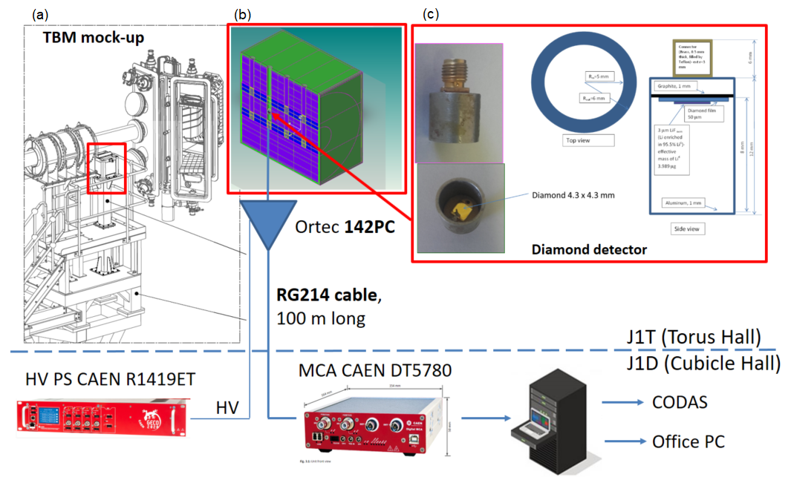
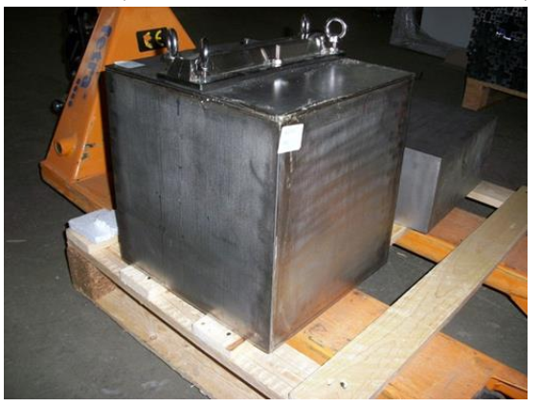
SP-5: Test of n/T detectors in JET DT for breeder blanket [1/2]
The Helium Cooled Pebble Bed Test Blanket Module mock-up (HCPB TBM) located on a dedicated holder near the JET octant 8 (under JET-3/FP-8)
  welded box of stainless steel, filled with beryllium and it contains two steel double cassettes filled with Li₂CO₃ powder simulating the Li₄SiO₄ breeder ceramics of the TBM.
[N. Fonnesu et al, P. Batistoni et al ]

Slide 36
SP-5: Measurement & simulation of the T production for breeder blanket during DTE2 [2/2]
“test of n/T detectors in JET DT for breeder blanket”
The tritium production: 1.40x10⁻¹² tritons per neutron (measured by the diamond detector)
The ratio Monte Carlo N-Particle® simulation vs. measured tritium production is 0.77
Improvement of the measuring chain to get data above 10¹⁵ n/s for DTE3
[N. Fonnesu et al, S. Villari et al ]

Slide 37
SP-2: ITER simulation of transient ELMs in the IR synthetic diagnostic
First demonstration (proof of principle) of ITER IR simulated images during ELMs
Non-linear MHD code JOREK to simulate density distribution (Fig. 2a) and heat loads on PFCs during ELMs (Fig. 2b)
thermal analysis to convert the power deposition on PFCs into surface temperature
3D temperature as input of ray tracing code to take into account materials optical properties i.e. emissivity and reflectance
Extension of the methodology to disruption
[Aumeunier & Pamela 2023, Aumenier et al. FEC 20023]

Slide 38
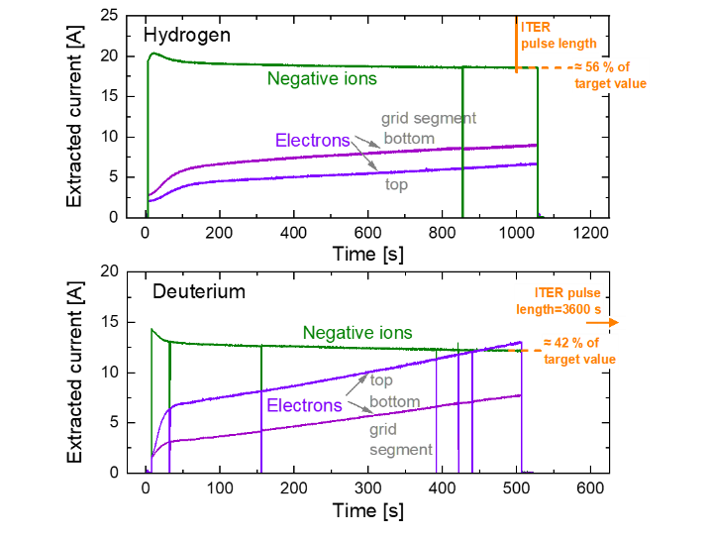

SP-4: BUG/ELISE (IPP), SPIDER/MITICA (RFX) in a step ladder approach for ITER
EUROfusion participation (14ppy/y) integrated in the NBTF team as one team approach. EUROfusion member of NAC
SPIDER: first Cs operation in 2021, shutdown for improvement and restart in 2023.
ELISE Long Pulse Operation (>1000s) in H with CW power supply and Calorimeter (summer 2022)
ITER target 386A/m²
  ITER target for extracted negative ion density: 60% reached for H2 and 40% in D2
Target electron-to ion ration reached
[Fantz et al. FEC 2023]
[Toigo et al FEC 2023]

Slide 39


2023-SP4: Lessons learnt and significant contributions to ITER NBI design
[FANTZ U. et al. FEC 2023 , DEN HARDER N. et al., FEC 2023]
BUG/ELISE : Recent contributions to ITER NBI and NBTF, e.g.
RF solid state
generators
Separation of
EG segments
Bias plate potential
Mo coating techniques
Steady exchange of expertise and experience between the two teams at IPP & RFX in support to ITER
Improved RF coupling
Vertical resolution of
co-extracted electrons
Electron suppression
and symmetrisation
Qualification for SPIDER
MITICA HV tests (breakdowns produced faults that damaged a 200kV diode rectifier and 1MV insulating transformer): similar additional protection systems implemented in ITER NB reference design
MITICA HVH preliminary layout with LCR Transformer protection
[TOIGO V.. et al., FEC 2023]

Slide 40







Neutron Streaming and Shutdown Dose Rate benchmark experiment
  Unique experiment for the validation of ITER-relevant neutronics code in tokamak under DT
Neutron fluence & dose measurements
  Thermoluminescent dosimeters (TLD)
  Activation foils (AF)
Accurate calibration in DD & DT
  Several positions inside the torus hall & labyrinths
  22 TLDs & 6 AF
Calculations
  MCNP5&6 +ADVANTG
  TRIPOLI-4©
Accurate measurements for quantitative comparison to simulations → Validation
  >40 m from the plasma
  8 orders of magnitude variation
  10⁵ to 10¹³ n/cm²
  N fluence range in
  DTE2
DTE3: installation of new assemblies
[Batistoni, NF, 55, 053028 (2015)- Villari, FED,107,171 (2017)- Kos, FED, 147, 111252 (2019)- Naish, FED, 170, 112538 (2021)]
40

Slide 41
Neutron-induced water activation: code development & validation [1/2]
¹⁶O(n,p)¹⁶N and ¹⁷O (n,p)¹⁷N: induce nuclear responses in superconducting magnets, polymer sealants, electronics
Accurate quantification for ITER:
  safety of public, workers & compatibility with operation of radiation-sensitive systems
Novel open-source code FLUNED, calculates activation of irradiated fluid through the coupling of computational fluid dynamics with neutronics calculations: validation with 2019 data from the 14MeV Frascati Neutron Generator
FNG Experimental loop
Simulation: Water velocity &¹⁶N in the ITER First Wall mock-up
Simulation: neutron radiation source of the activated water in the neutron-detector water tank
[M. De Pietri et al FEC 2023 & Nuc. Fusion, sub. 2023]

Slide 42


SP-5: Neutron-induced water activation: code validation at 14MeV FNG [2/2]
Calculated and exp. Counts rates per second in gamma photon detector & ratio of calculated to experimental data, C/E, vs flow rate of actived water: neutron source at 2 or 5cm from irradiated water loop.
[M. De Pietri et al FEC 2023 & Nuc. Fusion, sub. 2023]

Slide 43


SP-5: Specific ITER activities on neutronics initiated in 2022
Activated corrosion products tools development and experiments
  Develop methodology for assessment of dose contribution due to ACP
  Design, carry-out and analyse experiments at FNG to validate OSCAR-Fusion for ITER
Fluid activation tools development and experiments
  Develop of simulation tools for the determination of water activation considering complex flow pattern
  Design and perform water activation experiments at JSI TRIGA fission reactor to validate ITER prediction
Radiation source model development and simulation of the radiation field
  Develop neutron and gamma sources for neutronics calculations of the radiation fields in early ITER phase
  Develop source of photo-neutrons from Be and perform Shutdown Dose rate assessment in ITER
  Develop neutron sources in ITER NB cell
Techniques for low radiation dose level measurements
  Develop methodology for low dose measurements during ITER operation and shutdown
Neutronics and virtual reality coupling for maintenance operations
  Develop of Virtual Reality (VR) tool coupled with on-line dose rate calculation for ALARA optimization
[ N. Terranova, G Mariano SOFT 2022]
[ D. Kotnik SOFT 2022]
[ R. Villari SOFT 2022]

